Slide 1
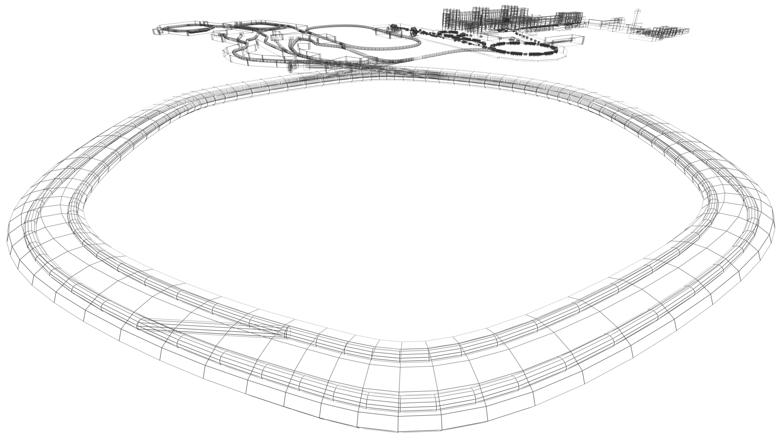

Physics with Exotic Nuclei
Hans-Jürgen Wollersheim
NUclear STructure, Astrophysics and Reaction

Slide 2
Outline
Projectile Fragmentation – A Route to Exotic Nuclei
Fragmentation Cross Sections
Nuclear Reaction Rates
In-Flight Separation of Radioactive Ion Beams
FRagment Separator at GSI
Comparison FRS – Super-FRS
Identification of RIBs
Excited Fragments – Gateway to Nuclear Structure
Scattering Experiments with RIBs
projectile
projectile fragment
target nucleus
abrasion
ablation

Slide 3
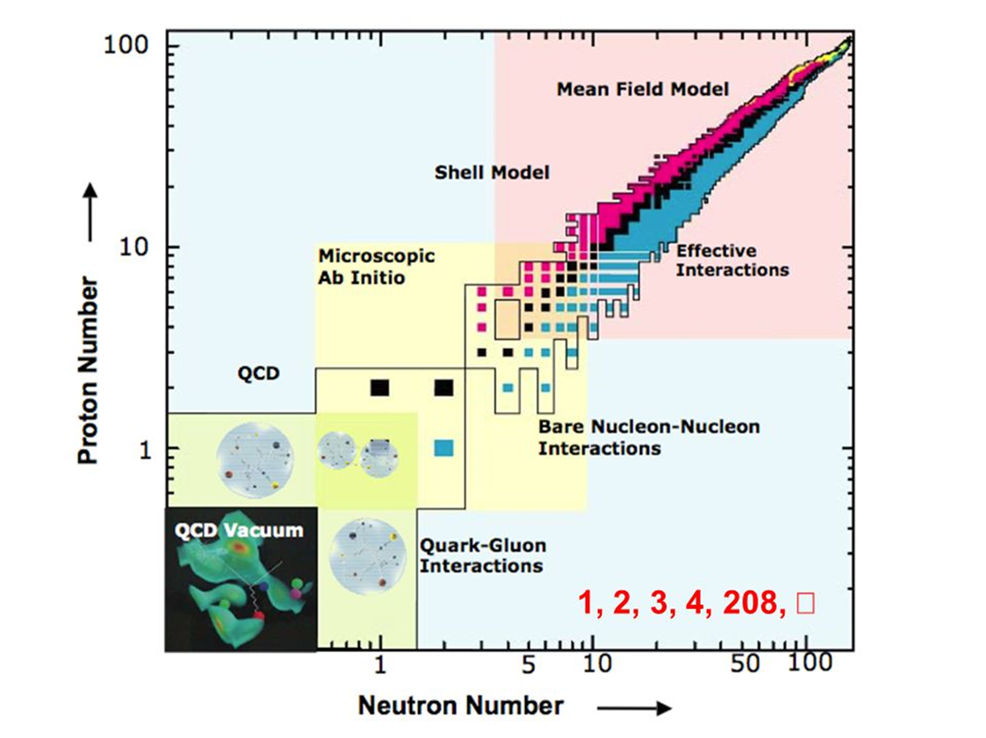

The Why and How of Radioactive-Beam Research

Slide 4
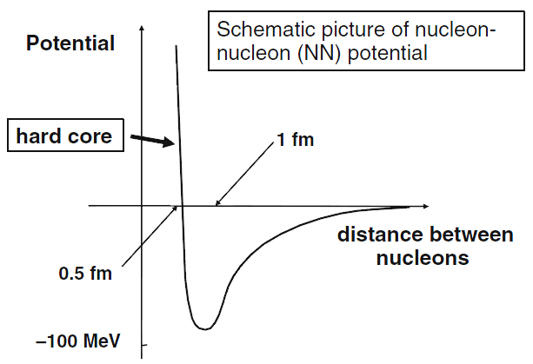
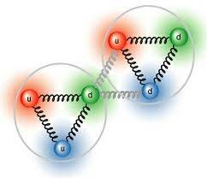
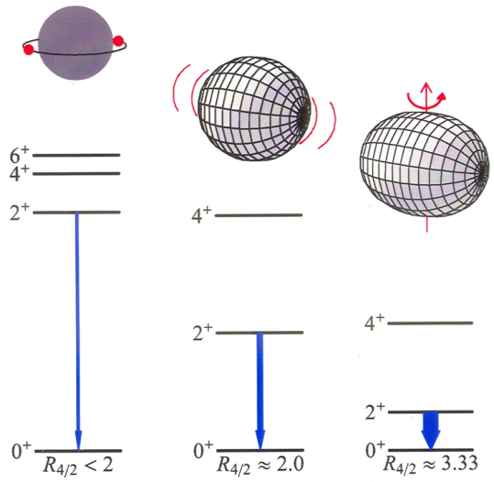
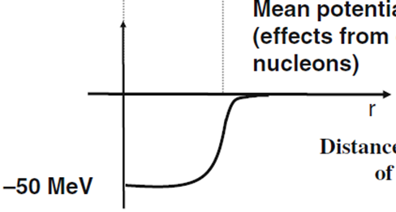
The Why and How of Radioactive-Beam Research
Atomic nuclei are quantum systems with a finite number of strongly interacting fermions: protons and neutrons.
Light nuclei up to A=12 are described by
bare nucleon-nucleon interaction.
In heavier nuclei the interactions between
the nucleons are modified by the medium
→ effective interactions are needed.
range of nuclear force
from
Due to constant density,
potential energy felt by
is also constant
Mean potential
(effect from other nucleons)
distance from the center
of the nucleus
How can collective phenomena be explained from individual motion?

Slide 5
The Nuclear Chart
Our Road Map from Stable to Exotic Nuclei
126
doubly magic nuclei:
⁴He, ¹⁶O, ⁴⁰Ca, ⁴⁸Ca, ²⁰⁸Pb
82
50
protons
82
28
20
50
instable: ⁴⁸Ni, ⁵⁶Ni, ⁷⁸Ni, ¹⁰⁰Sn, ¹³²Sn
8
28
no ²⁸O !
2
20
neutrons
2
8

Slide 6
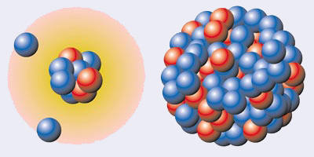
Nuclear radii
textbooks says: R=1.2· A^{1/3}
¹¹Li
²⁰⁸Pb
Prog. Part. Nucl. Phys. 59 (2007), 432

Slide 7
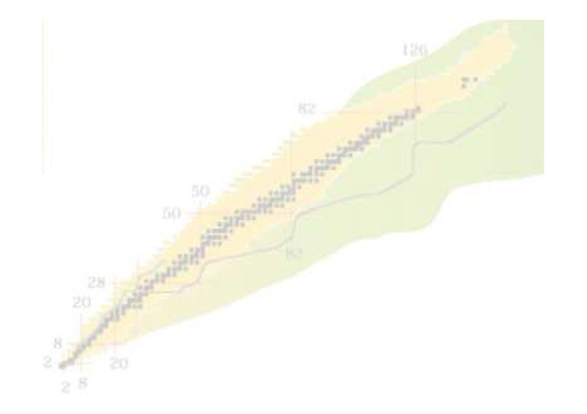
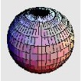

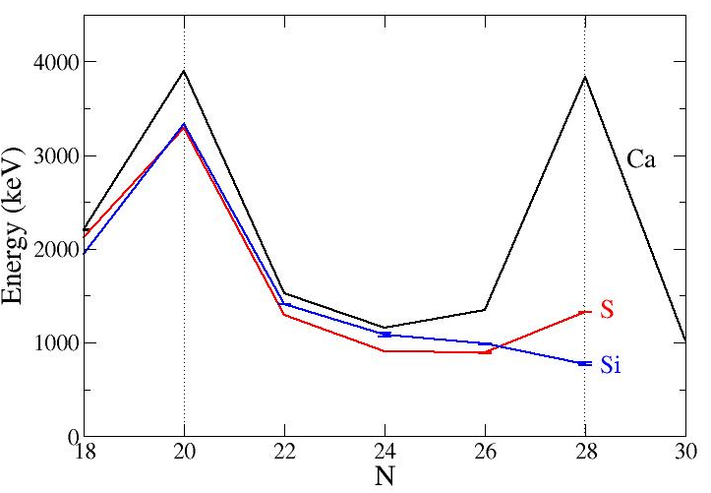
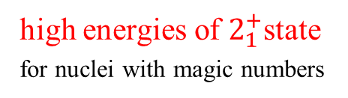
Nuclear shell structure
Experimental evidence of magic numbers
N=20
N=28
Z=20
⁴⁰Ca
⁴²Ca
⁴⁴Ca
⁴⁶Ca
⁴⁸Ca
spherical
Z=18
³⁸Ar
⁴⁶Ar
Ca
Z=16
³⁶S
⁴⁴S
S
Z=14
³⁴Si
⁴²Si
Si
deformed
Z=12
³²Mg
⁴⁰Mg
Z=10
³⁰Ne
³⁸Ne
Indicators for nuclear shell model:
high energies of $2_{1}^{+}$state
for nuclei with magic numbers

Slide 8
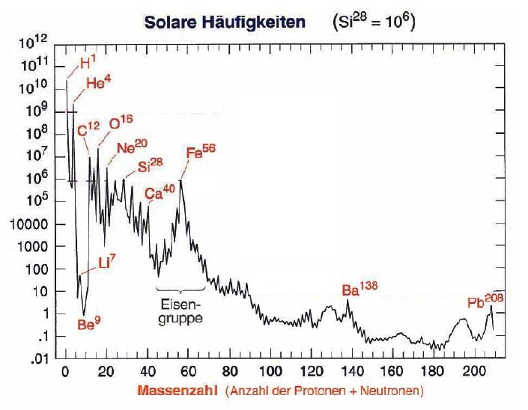
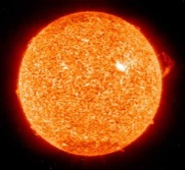
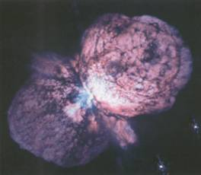
Solar abundances of elements
Solar abundance (Si²⁸ = 10⁶)
Big Bang
fusion reactions
neutron reactions
open questions:
Why is Fe more common
than Au ?
Why do the heavy elements
exist and how are they
produced?
Can we explain the solar
abundances of the elements?
Mass number

Slide 9
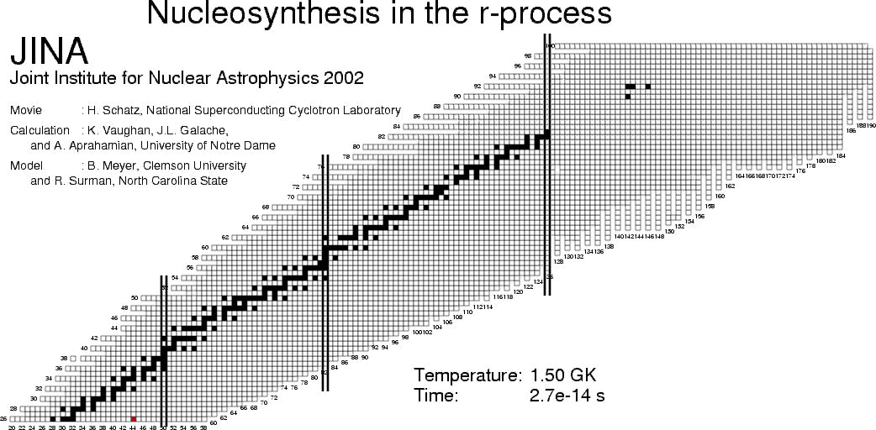
The chart of nuclides

Slide 10
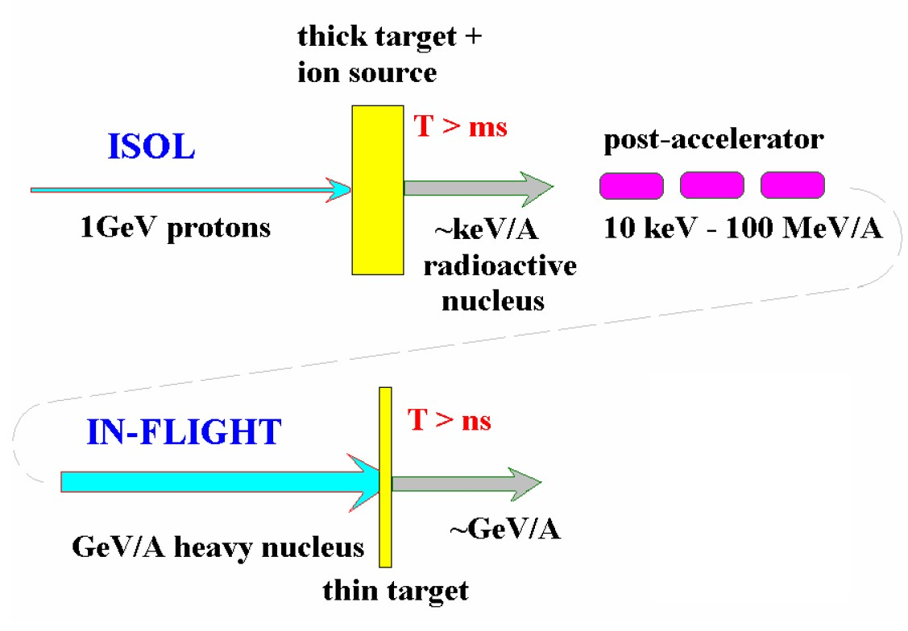
Spallation & Projectile Fragmentation Reactions
A Route to Exotic Nuclei
Spallation
Fragmentation
ISOL = Isotope Separator On Line

Slide 11
High-energy proton-induced nuclear reactions
Some early high-energy proton accelerators:
Facility | Energy | from year
Bevatron (Berkeley) | 6 GeV | 1954.....
AGS (Brookhaven) | 11 GeV | 1960.....
Fermilab (Chicago) | >300 GeV | 1967.....
They were also used to bombard various stable target materials.
These targets were analyzed with radiochemical methods,
i.e. γ-spectroscopy with or without chemical separators
Production cross sections and (some) kinematics for suitable radioactive isotopes

Slide 12
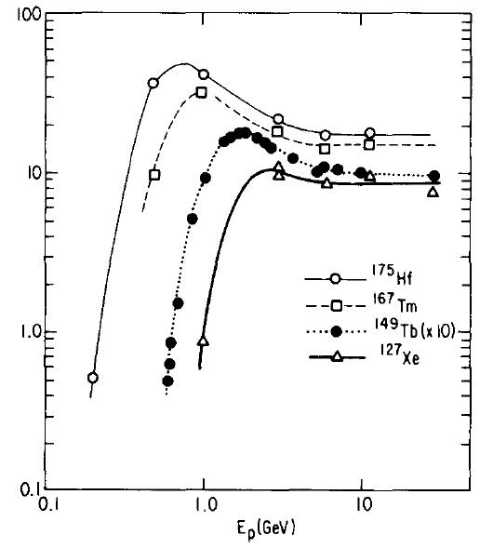
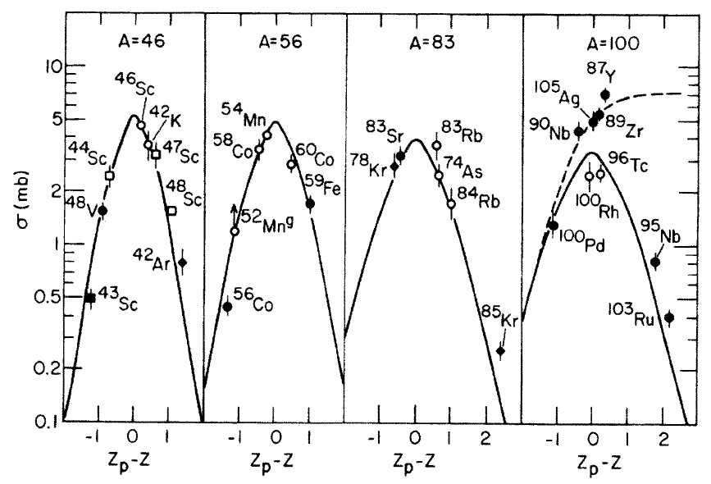
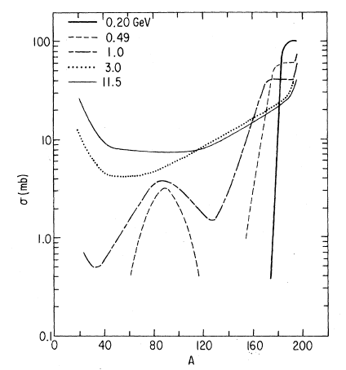
High-energy proton-induced nuclear reactions
Important findings:
Energy-independence of cross sections
Bell-shaped Z-distribution for constant A
E_{p} [GeV]
σ [mb]
σ [mb]
p+Au
Mass yields: exponential slope
A

Slide 13
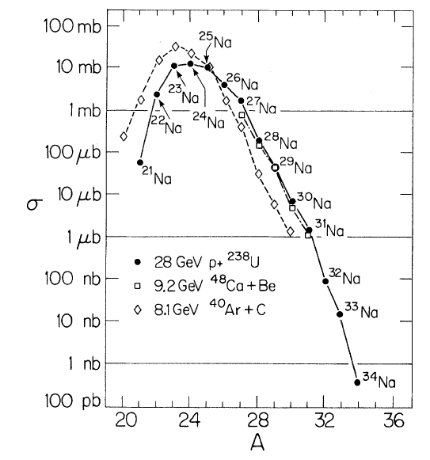
Proton- versus heavy-ion induced reactions
Proton- and heavy-ion induced reactions give very similar isotope distribution:
Na
8 GeV ⁴⁸Ca+Be
Target fragmentation: GeV p + A_{target} → A
Projectile fragmentation: GeV/u A_{proj} + p → A
are equivalent
28 GeV p + ²³⁸U

Slide 14
Projectile fragmentation reactions
projectile
projectile fragment
target nucleus
abrasion
ablation
At GeV energies nucleons can be regarded as a classical particles
Nucleon-nucleon collisions can be treated classically using measured free nucleon-nucleon cross sections (intra-nuclear cascade).
In these collisions very little transfer momentum is exchanged.
After the cascade the residual nucleus is highly excited.
Heavy-ion projectiles can be treated as a bag of individual nucleons.
Physical models: Two-step approach
Step 1: Intranuclear-cascade models or Abrasion models
Step 2: Evaporation calculation

Slide 15
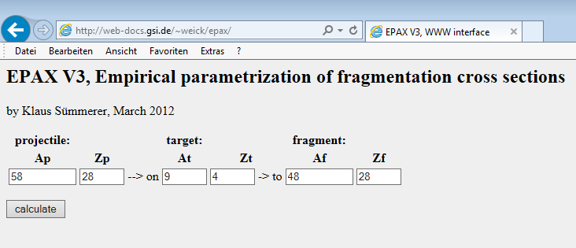
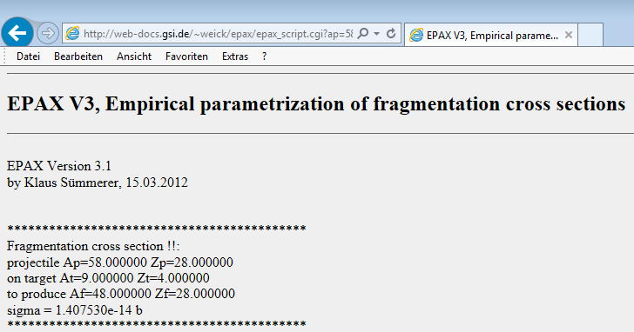
Projectile fragmentation reactions
projectile
projectile fragment
target nucleus
abrasion
ablation
Empirical parameterization of fragmentation cross section:
EPAX v.3 K. Sümmerer, Phys. Rev. C86 (2012) 014601
http://web-docs.gsi.de/~weick/epax/

Slide 16
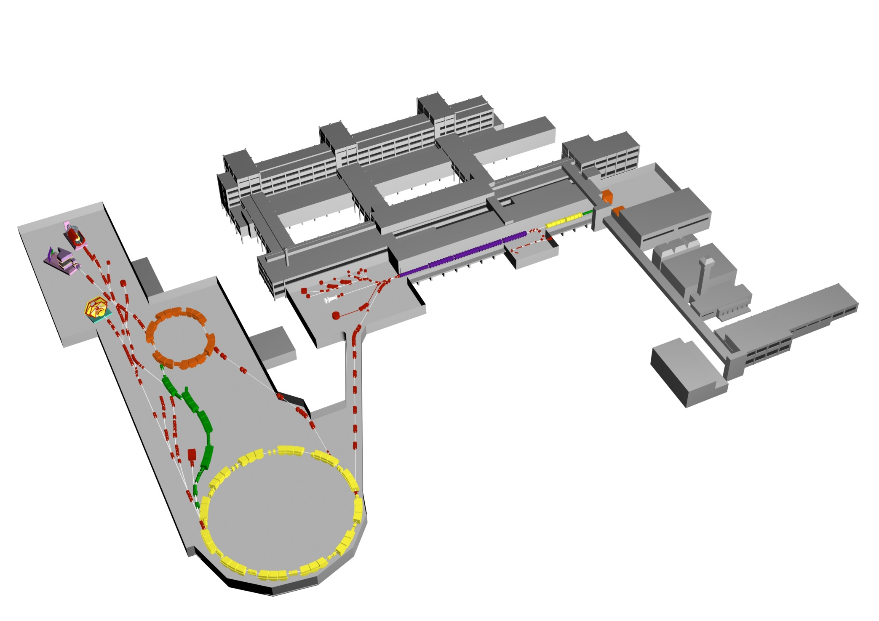

The Accelerator Facility at GSI
Experimental Areas
Ion Sources
all elements: p…U
UNILAC
ESR
Linear-Accelerator
20% speed of light
(20 AMeV)
Fragment
Separator
FRS
N
Synchrotron SIS-18
SIS
90% speed of light
(2 AGeV)

Slide 17
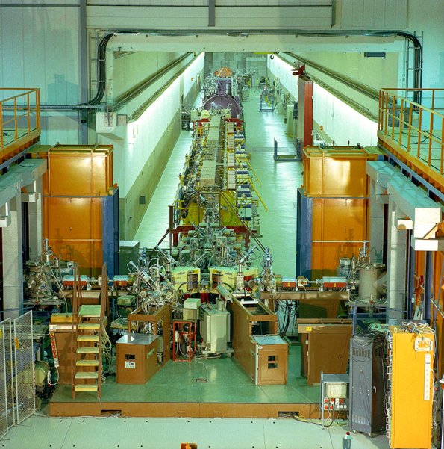
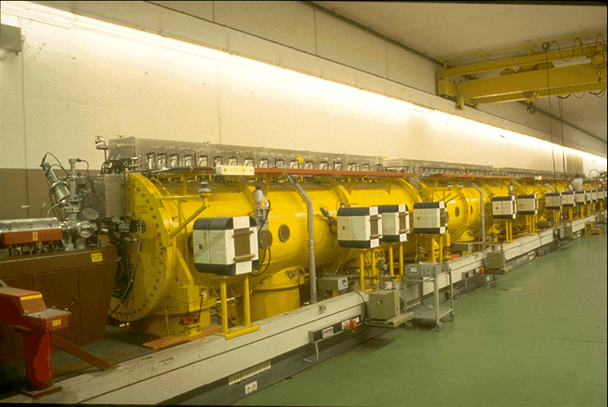
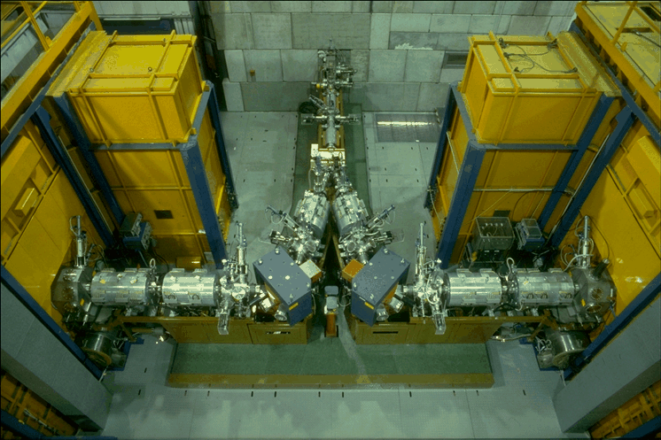
UNILAC Accelerator

Slide 18
The Accelerator Facility at GSI
Experimental Areas
Ion Sources
all elements: p…U
UNILAC
ESR
Linear-Accelerator
20% speed of light
(20 AMeV)
Fragment
Separator
FRS
N
Synchrotron SIS-18
SIS
90% speed of light
(2 AGeV)

Slide 19
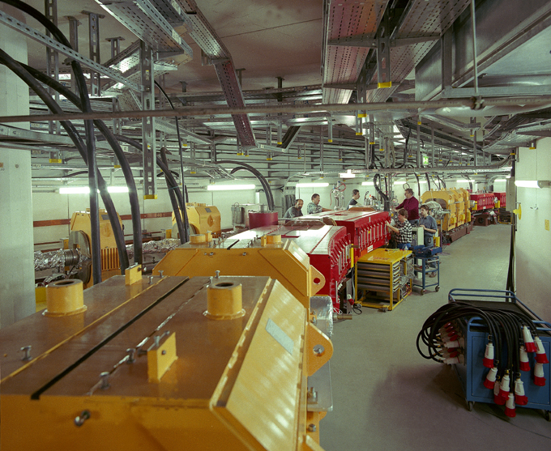

Slide 20
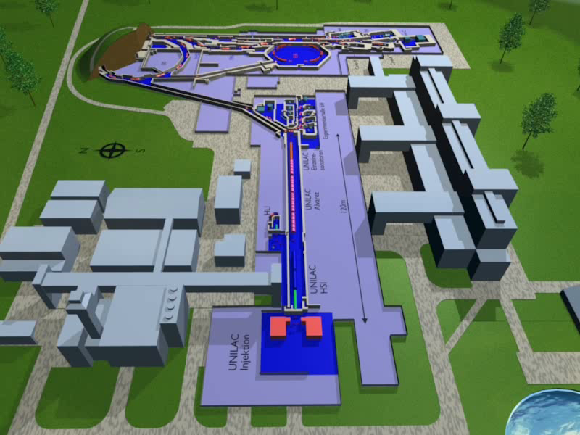
Where do we do the experiments?

Slide 21
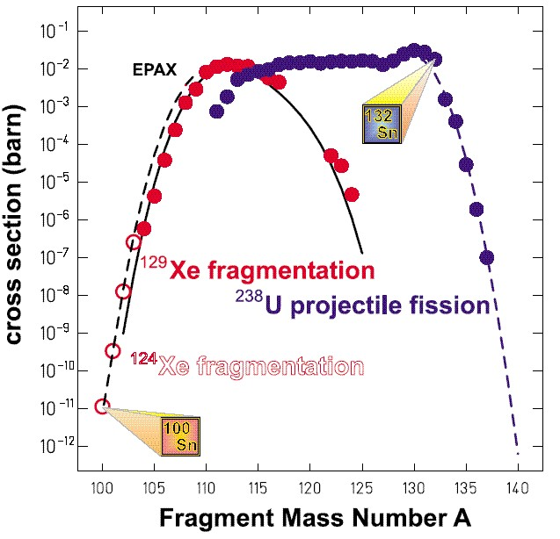
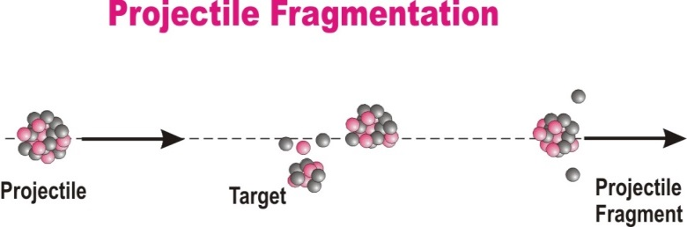
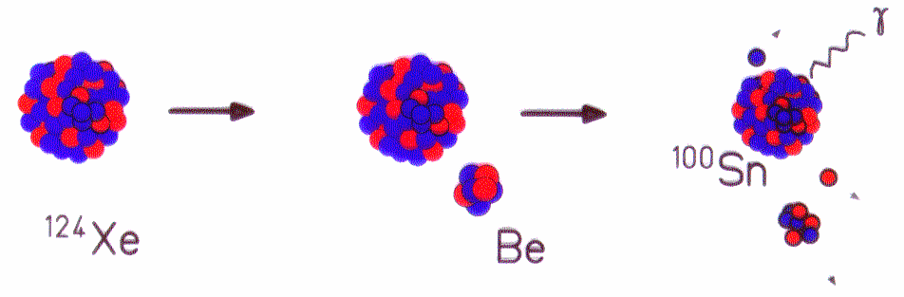
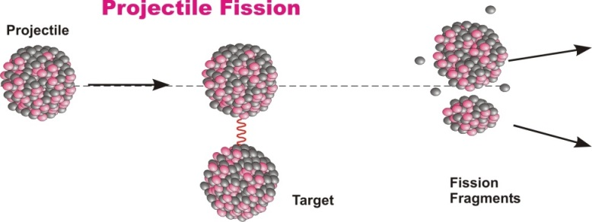
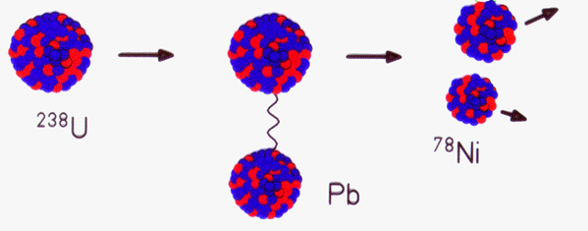
Projectile fragmentation reactions
Projectile Fragmentation
Projectile
Target
Projectile
Fragment
Projectile Fission
Projectile
Projectile
Fragments
Target

Slide 22
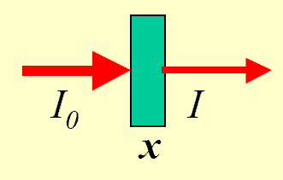
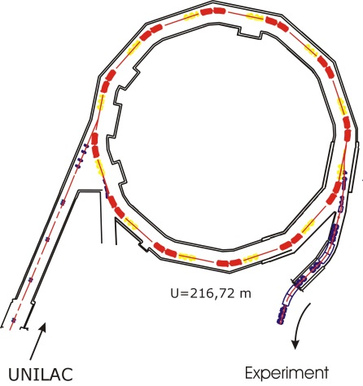

Nuclear Reaction Rate
nuclear reaction rate [s⁻¹] = luminosity [atoms cm⁻² s⁻¹] * σ_{f} [cm²]
abrasion
ablation
σ_{f} [cm²] for projectile fragmentation + fission
luminosity [atoms cm⁻² s⁻¹] = projectiles [s⁻¹] * target nuclei [cm⁻²]
Ion | SIS-18 (2008) | SIS-100 (expected)
²⁰Ne¹⁰⁺ | 2·10¹¹ | ²⁰Ne⁷⁺ | 1.6·10¹²
⁴⁰Ar¹⁸⁺ | 1·10¹¹ | ⁴⁰Ar¹⁰⁺ | 1.4·10¹²
⁵⁸Ni²⁶⁺ | 9·10¹⁰ | ⁵⁸Ni¹⁴⁺ | 1.3·10¹²
⁸⁴Kr³⁴⁺ | 8·10¹⁰ | ⁸⁴Kr¹⁷⁺ | 1.2·10¹²
¹³²Xe⁴⁸⁺ | 7·10¹⁰ | ¹³²Xe²²⁺ | 1.3·10¹²
¹⁹⁷Au⁶⁵⁺ | 5·10¹⁰ | ¹⁹⁷Au²⁵⁺ | 1.2·10¹²
²³⁸U⁷³⁺ | 1.6·10¹⁰ | ²³⁸U⁹²⁺ | 1.4·10¹⁰
²³⁸U²⁸⁺ | 1.4·10¹⁰ | ²³⁸U²⁸⁺ | 5.0·10¹¹
$$extraction$$
$$≥70\%$$
experiment

Slide 23
Nuclear Reaction Rate
Primary reaction rate:
(thin target)
density ρ
Example: ²³⁸U (10⁹s⁻¹) on ²⁰⁸Pb (x=1g/cm²) → ¹³²Sn (σ_{f}=15.4mb) reaction rate: 44571 [s⁻¹]
Example: ¹²⁴Xe (10⁹s⁻¹) on ⁹Be (x=1g/cm²) → ¹⁰⁴Sn (σ_{f}=5.6μb) reaction rate: 375 [s⁻¹]
The optimum thickness of the production target is limited by the loss of fragments due to secondary reactions
Primary + secondary reaction rate:
Example:
max
$$φ_{f}\left[s^{−1}\right]=φ_{p}\left[s^{−1}\right]−φ\left[s^{−1}\right]=φ_{p}\left[s^{−1}\right]∙\left\{1−e^{−N_{t}\left[{cm}^{−2}\right]∙σ_{f}\left[{cm}^{2}\right]}\right\}$$
(thick target)
x [g/cm²]

Slide 24
Nuclear reaction rate
Reaction rate (thick target):
Reaction rate (thin target):
Example:
Reaction rate: 57941[s⁻¹] transmission (SIS/FRS)=70%, transmission (FRS) 1.9%

Slide 25
Optimization of the target thickness
Primary reaction rate:
Primary + secondary reaction rate:
1 | 0.79
2 | 1.25
3 | 1.48
4 | 1.56
5 | 1.54
6 | 1.46
Example:

Slide 26
Reaction Parameters for Heavy-Ion Collisions
The relevant formulae are calculated if A₁, Z₁ and A₂, Z₂ are the mass (in amu) and charge number of the projectile and target nucleus, respectively.
Nuclear radius for homogeneous (sharp) mass distribution:
Nuclear radius for diffuse (Fermi) mass distribution:
Nuclear interaction radius:
Nuclear reaction cross section at relativistic energies:

Slide 27

In-Flight Separation of Radioactive Ion Beams
Primary (production) target
Peripheral nuclear reactions
Forward focused products
Secondary (reaction) target
Experimental area
Electromagnetic separator
Stable HI projectile source
E ~ 1000 AMeV
Selected radioactive beam
E >> 20 AMeV

Slide 28
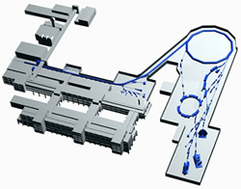
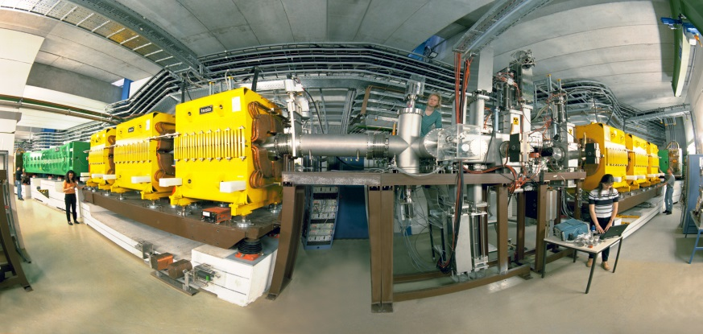
Fragmentation at Relativistic Energies
projectile
projectile fragment
target nucleus
abrasion
ablation
FRS
FRS
FRagment Separator

Slide 29
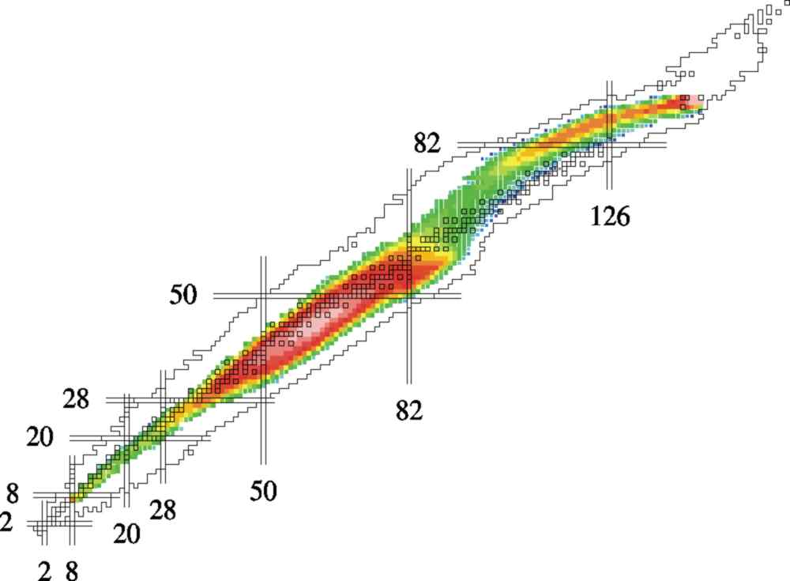
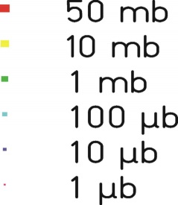
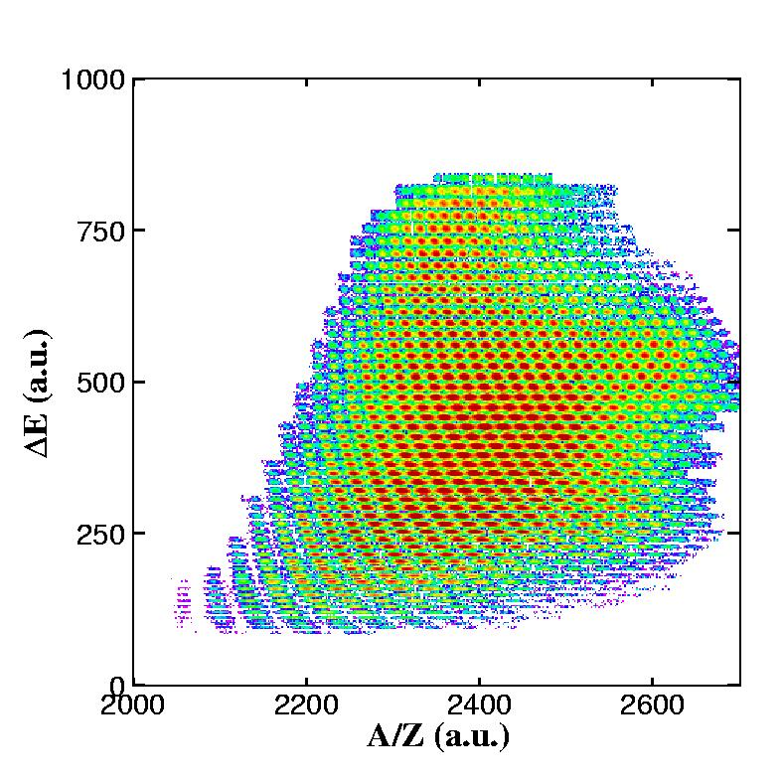
Radioactive Ion Beams at GSI
1GeV/u U + H
About 1000 nuclear residues identified
A/Z-resolution ~10⁻³

Slide 30

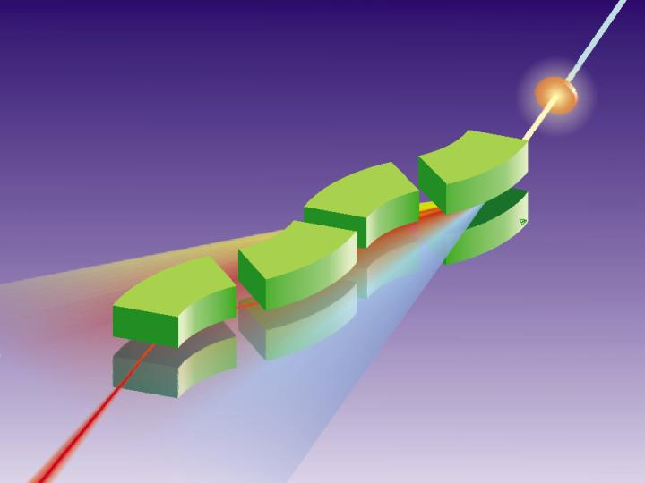
FRagment Separator at GSI
¹³¹Sn
¹³²Sn
in-flight A and Z selection
energy resolution: ~ 1 GeV

Slide 31
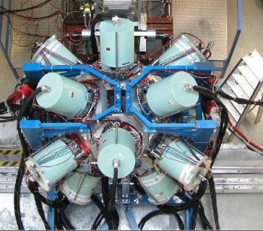

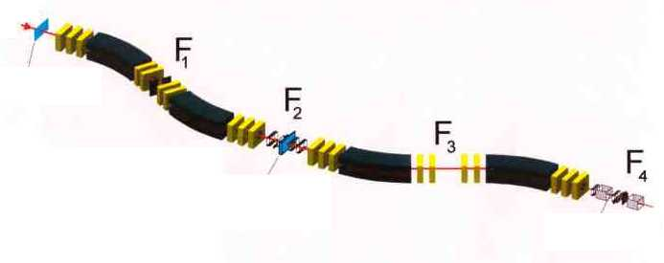
Rare Isotope Selection at FRS: Bρ-ΔE-Bρ Selection
fully striped fragments
primary beam
⁸⁶Kr ~700 AMeV
20m
secondary beam
⁷⁸Ni ~ 100 AMeV
production target
⁹Be

Slide 32
Rare Isotope Selection at FRS: Bρ-ΔE-Bρ Selection
Transmission :
20-70 % for fragmentation
< 2 % for fission
primary beam
⁸⁶Kr ~700 AMeV
20m
secondary beam
⁷⁸Ni ~ 100 AMeV
production target
⁹Be
magnetic dipoles
degrader
magnetic dipoles
Βρ ∝ βγ Α/Ζ
ΔΕ ∝ Ζ²f(β)
Βρ ∝ βγ Α/Ζ

Slide 33
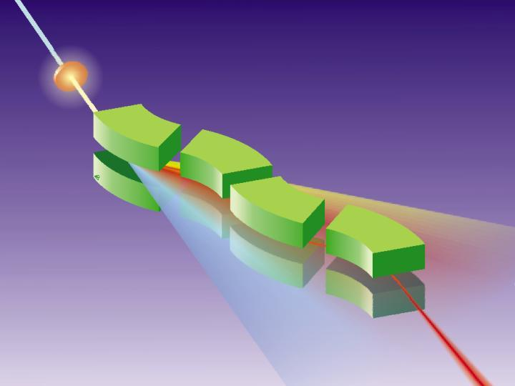
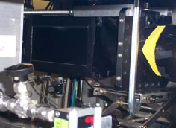
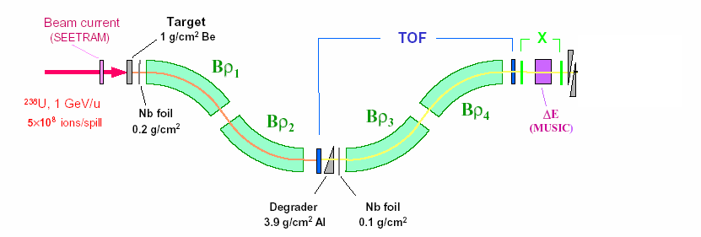
Production, Separation, Identification
UNILAC
SIS
fragment
FRS
abrasion
ablation
FRagment Separator
⁵⁶Cr, 100MeV/u
⁸⁶Kr, 480MeV/u
Standard FRS detectors
TPC-x,y position @ S2,S4
Plastic scintillator (TOF)
@ S4
MUSIC (ΔE)
@ S4

Slide 34
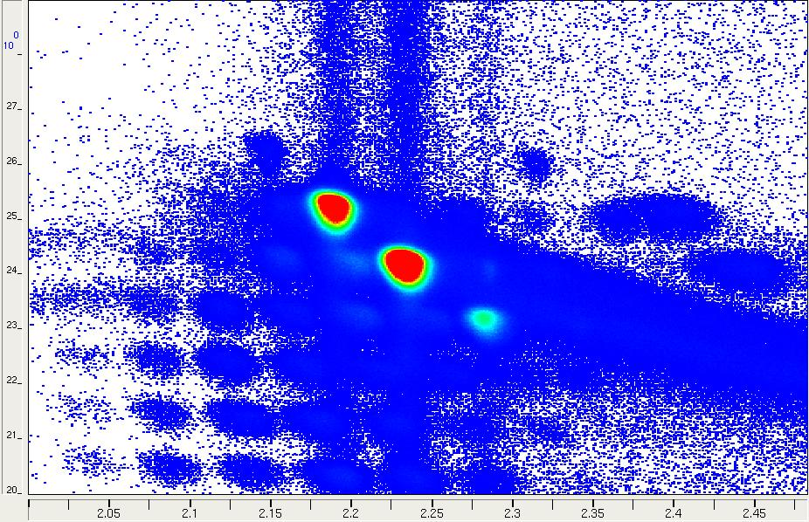
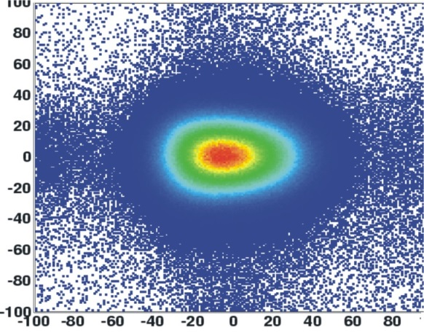
Production, Separation, Identification
multiwire chamber;
beam position
MUSIC
ionization chamber;
Z
scintillator
scintillator
β
Z
Y
X
A/Q

Slide 35
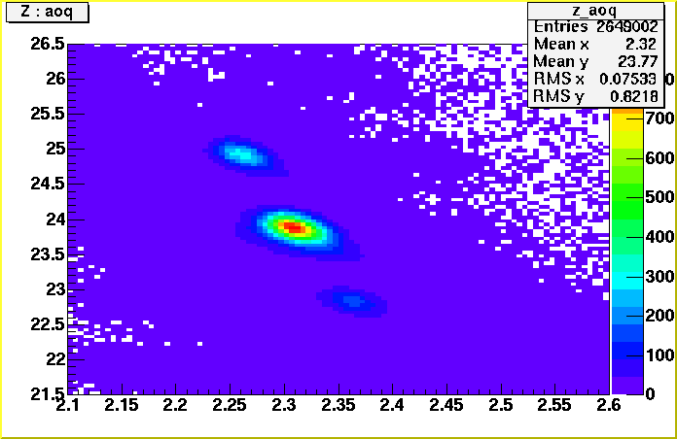
Production, Separation, Identification
multiwire chamber or TPC;
beam position
⁵⁶Cr, 100MeV/u
⁸⁶Kr, 480MeV/u
MUSIC
ionization chamber;
Z
scintillator
scintillator
β
⁵⁶Cr
Y
Z
X
A/Q

Slide 36
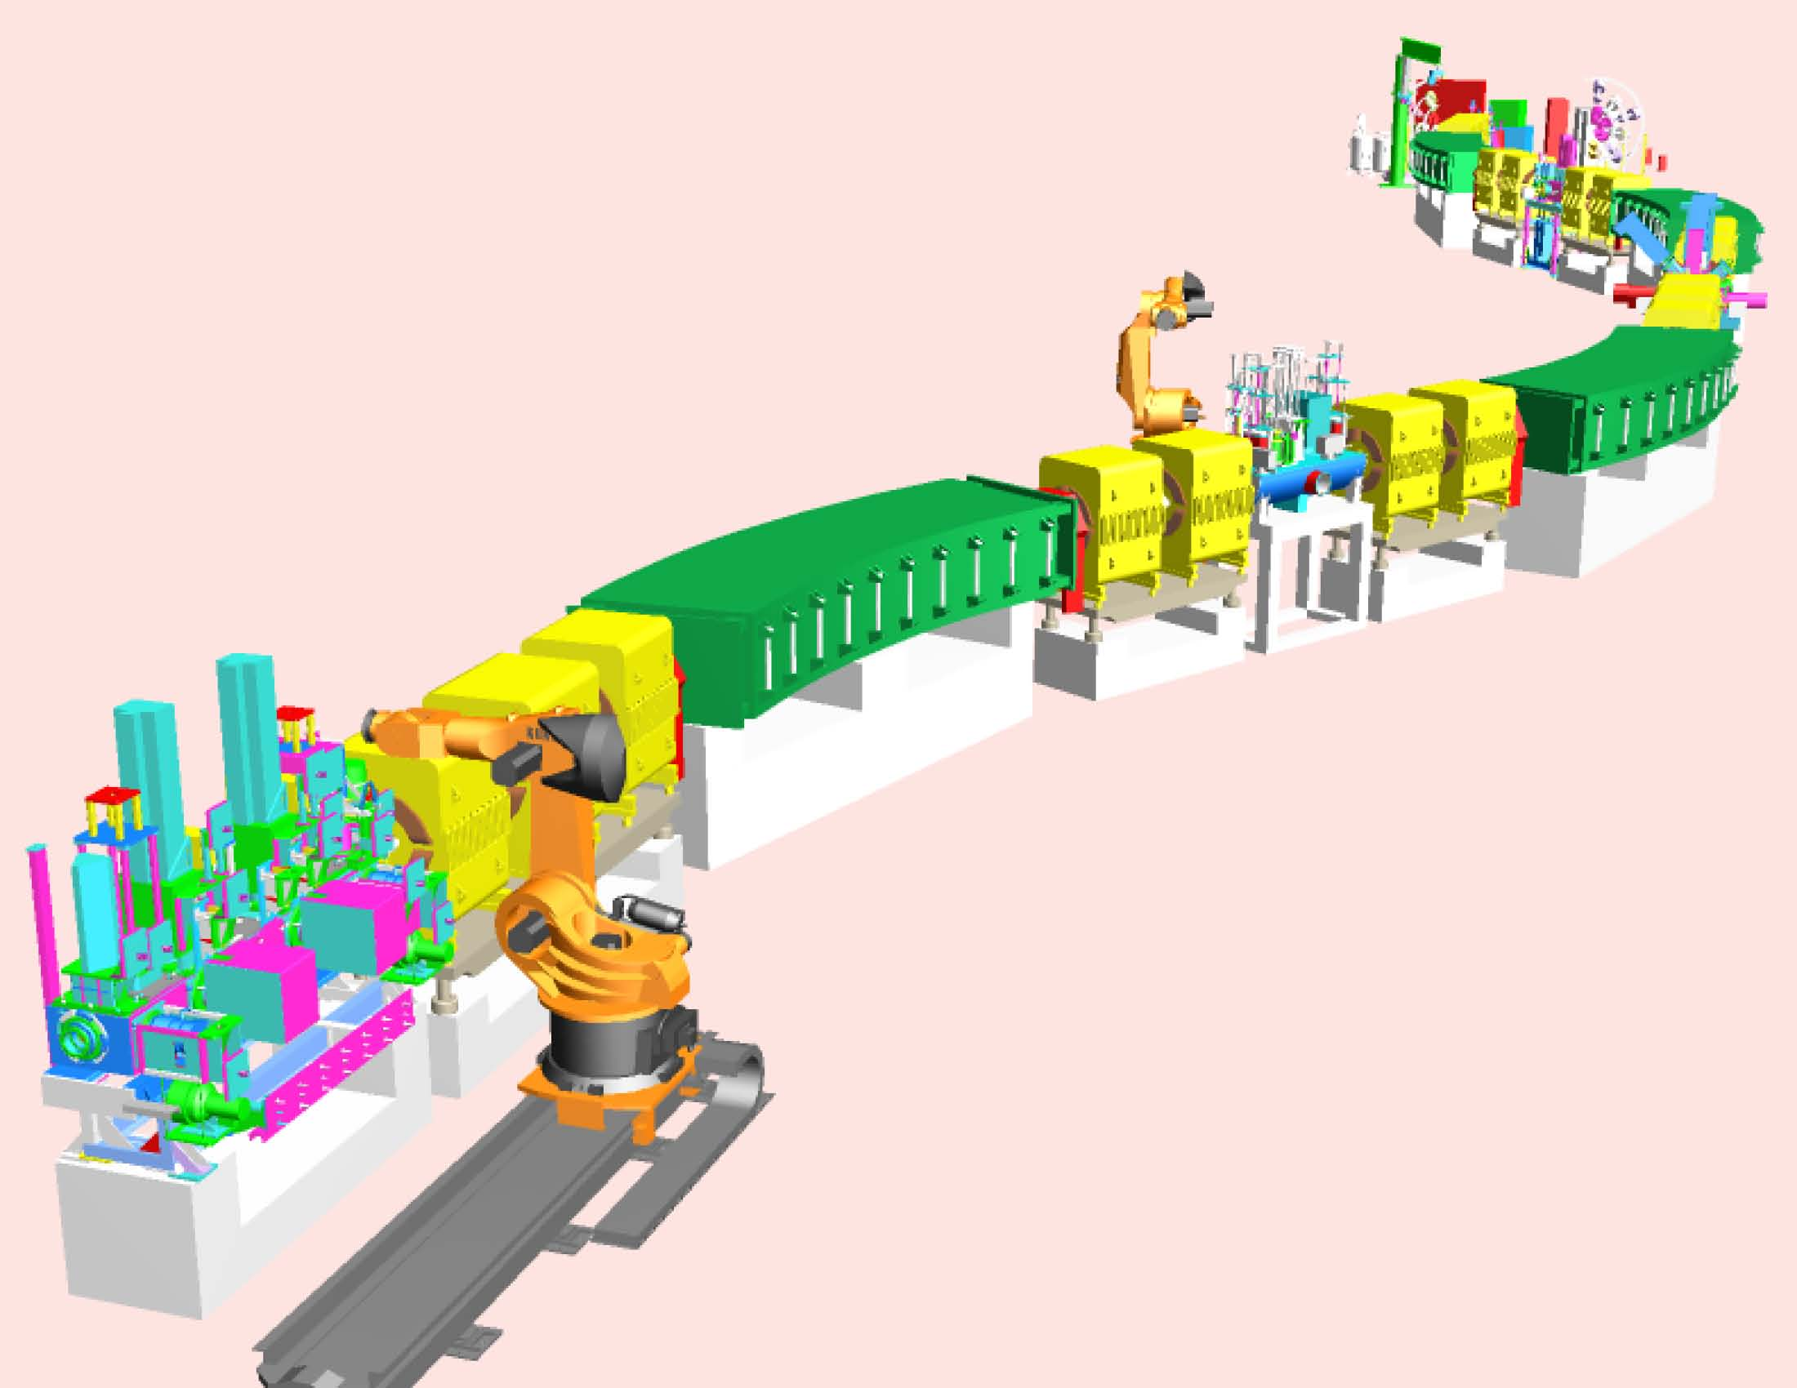

Production, Separation, Identification
UNILAC
SIS
fragment
FRS
abrasion
ablation
FRagment Separator

Slide 37





Comparison of FRS with Super-FRS
FRS
Super-FRS
150m

Slide 38

Layout and Separation Properties

Slide 39

²³⁸U → ¹⁸⁶Po
²⁰⁸Pb → ¹⁵⁵Ta
¹⁷⁰Dy → ¹³⁰Eu
¹²⁴Xe → ⁹⁰Rh
⁵⁸Ni → ⁴⁵Fe
⁴⁸Ca → ²⁴O
¹⁸O → ¹¹Li

Slide 40


FRagment Separator
Beam & All
Fragmentation
Products
Primary
Beam
Spacial
Dispersion
Secondary
Beam
Momentum
Selection
Isotope
Selection
Wedge-shaped
Degrader
¹⁹Ne at 600AMeV:
Phase-space imaging of differently shaped degraders within the achromatic ion-optical system. The results for a homogeneous, an achromatic, and a monoenergetic degrader are given. All degraders have the same thickness on the optical axis (d/r=0.5)

Slide 41




Fragment Separation
⁴⁰Ar 50MeV/u + Ta (100μm), wedge shaped Al (200μm) degrader
0.39 mrad
1.66 mrad

Slide 42


Chromatic Aberration
When different colors of light propagate at different speeds in a medium, the refractive index is wavelength dependent. This phenomenon is known as dispersion.
Longitudinal (axial) chromatic aberration: Transverse (lateral) chromatic aberration:
The focal planes of the various colors do The size of the image varies from one
not coincide. color to the next.

