Slide 1
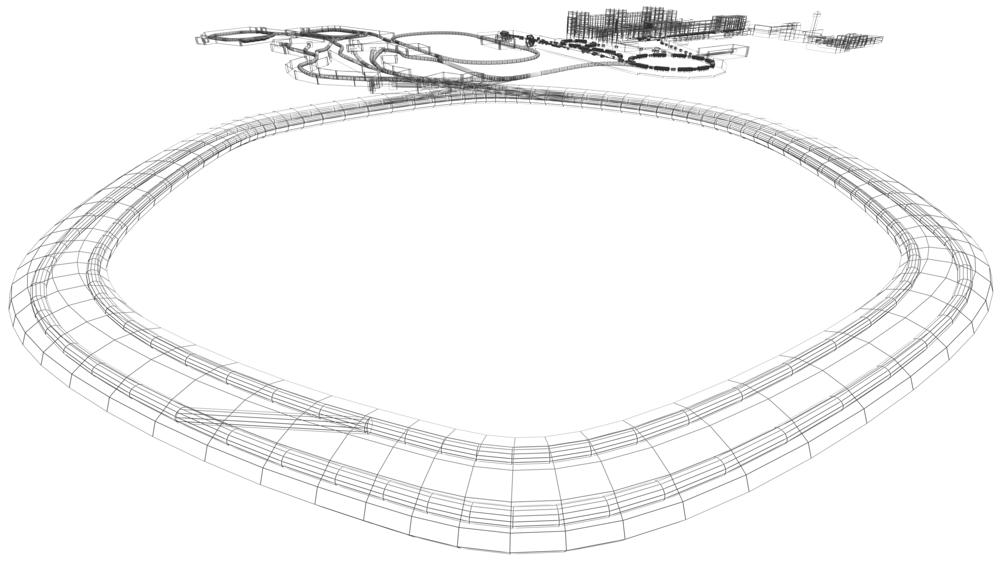

Physics with Exotic Nuclei
Hans-Jürgen Wollersheim

Slide 2
Outline
Scattering Experiments with RIBs – Nuclear Structure Results
Experimental evidence for closed-shell nuclei
Scattering experiments at relativistic energies
Projectile-like identification (Z, A) and scattering angle θ
Doppler-shift correction of the emitted γ-rays

Slide 3
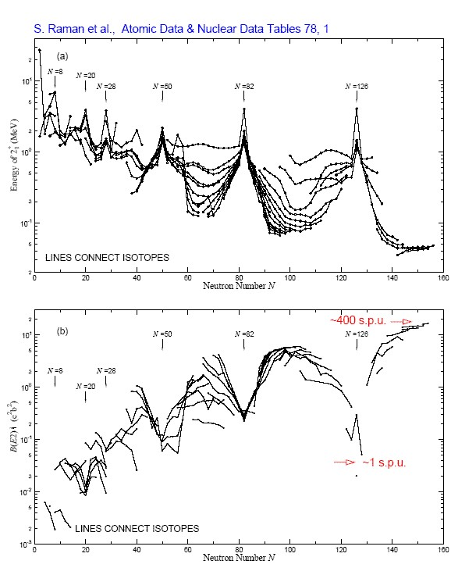
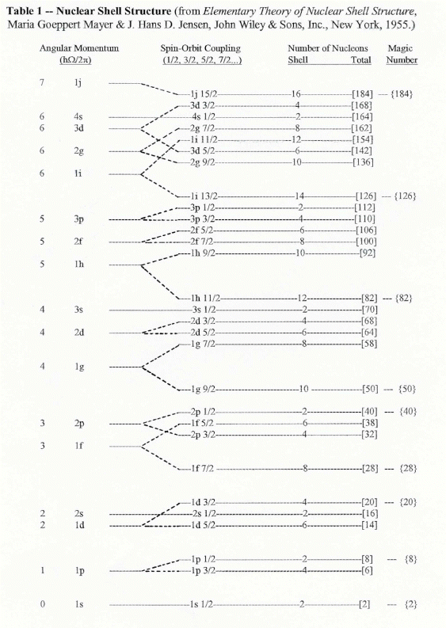

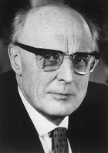
Physics with Exotic Nuclei
Experimental evidence for magic numbers close to stability
Maria Goeppert-Mayer & J. Hans D. Jensen

Slide 4
Physics with Exotic Nuclei
Experimental evidence for magic numbers close to stability
Nuclei with magic numbers
of neutrons/protons
high energy of 2₁⁺ state
low B(E2; 2₁⁺→0⁺) values
transition probability measured in
single particle units (spu)
If we move away from stability?

Slide 5
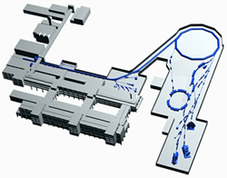
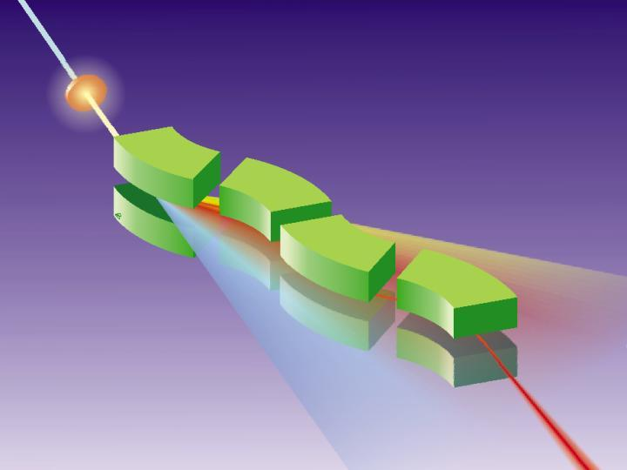
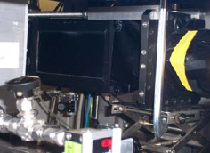
Production, Separation, Identification
UNILAC
SIS
projectile
projectile fragment
FRS
target nucleus
abrasion
ablation
FRagment
Separator
Standard FRS detectors
TPC-x,y position @ S2,S4
Plastic scintillator (TOF)
@ S4
MUSIC (ΔE)
@ S4

Slide 6
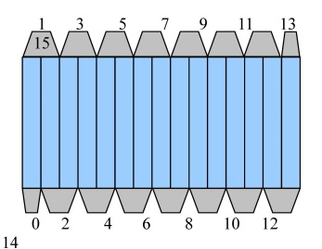
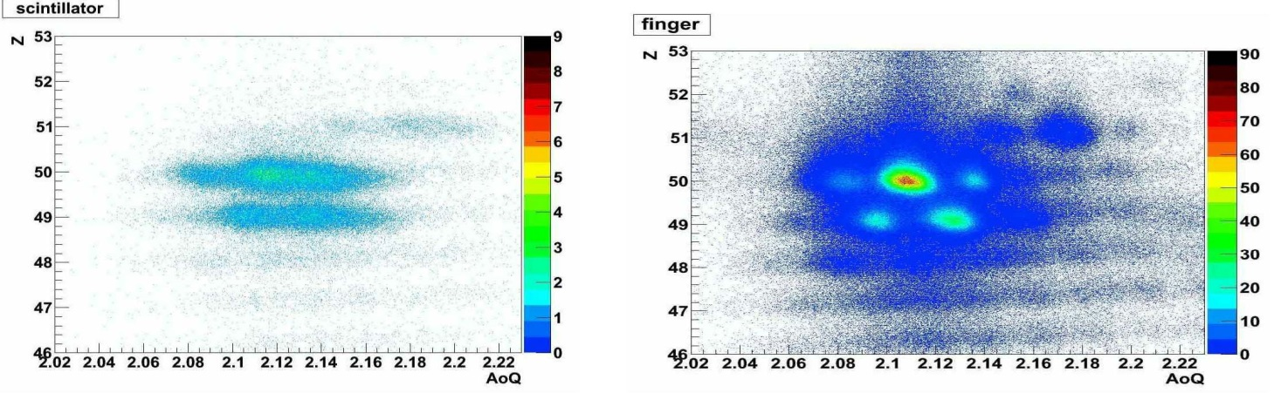
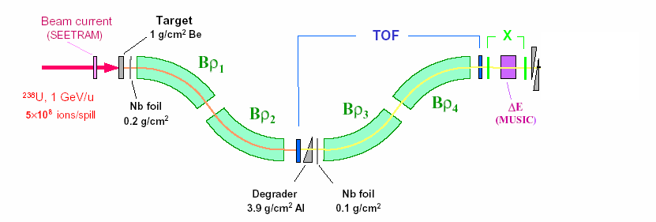
Scattering Experiment at Relativistic Energies
¹⁰⁴Sn, 100 MeV/u
¹²⁴Xe, 793MeV/u
new digital readout
standard scintillator (SC21)
finger segmented detector
¹⁰⁴Sn fragments
using ¹²⁴Xe at 793 MeV/u
high rate at S2 ~10⁶ s⁻¹
~2400 % more tracking efficiency
good A/Q resolving power
Frederic Ameil

Slide 7
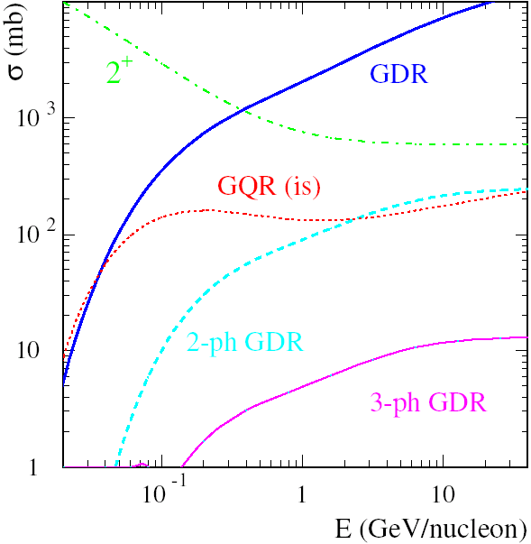
Scattering Experiment at Relativistic Energies
fragment
impact parameter: b
D_{min}
2⁺
GDR
Au
Rutherford scattering only if distance of closest approach D_{min}
is large compared to nuclear radii + surfaces:
C_{P}, C_{T} half-density radii

Slide 8
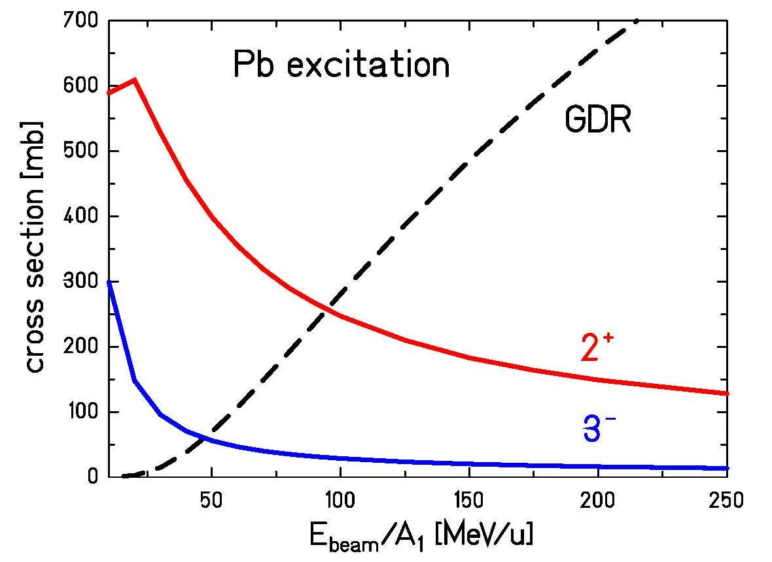
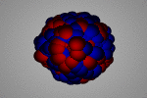
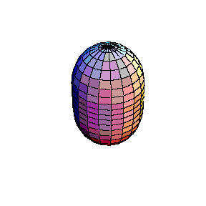
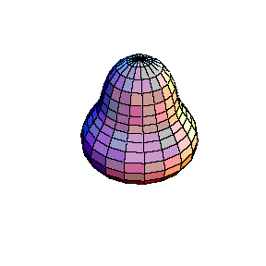
Scattering Experiment at Relativistic Energies
fragment
impact parameter: b
D_{min}
Au
Rutherford scattering only if distance of closest approach D_{min}
is large compared to nuclear radii + surfaces:
C_{P}, C_{T} half-density radii
Notes:
the lower multipolarities are dominant

Slide 9
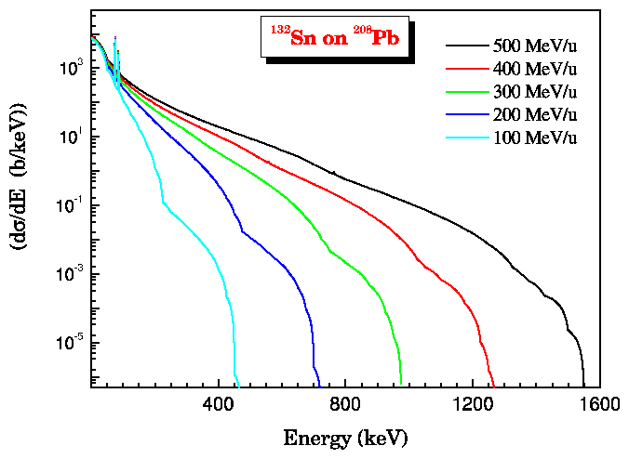
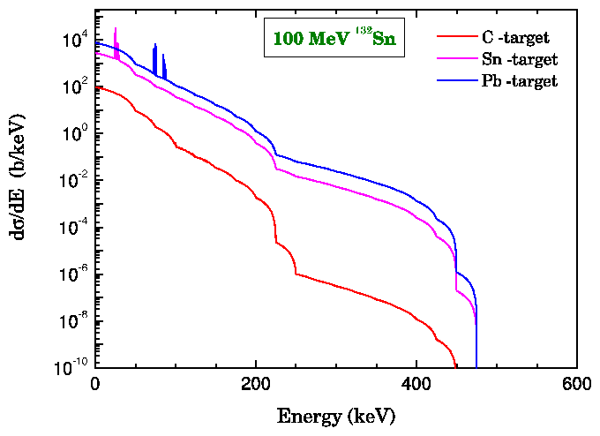
Atomic Background Radiation
Radiative electron capture (REC) capture of target electrons into bound states of the projectile:
Primary Bremsstrahlung (PB)
capture of target electrons into continuum states of the projectile:
Secondary Bremsstrahlung (SB)
Stopping of high energy electrons in the target:
Bremsstrahlung: slowing down of a moving point-charge

Slide 10


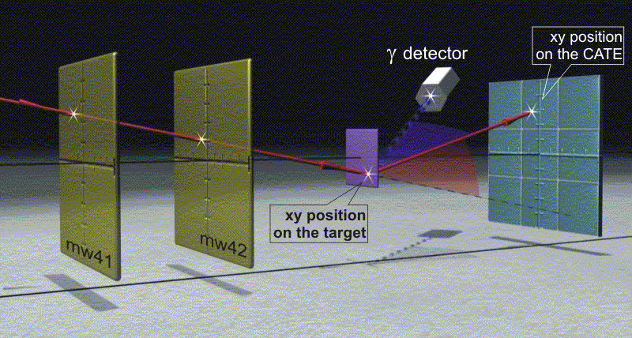

Scattering Experiment at Relativistic Energies
¹⁰⁴Sn
¹⁹⁷Au-target
¹²⁴Xe, 793MeV/u
relativistic Coulomb excitation
xy position
from LYCCA

Slide 11



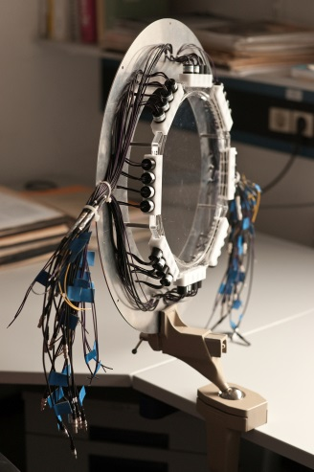
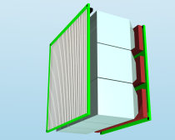
Scattering Experiment at Relativistic Energies
¹⁰⁴Sn
¹²⁴Xe, 793MeV/u
Lund-York-Cologne CAlorimeter
secondary
¹⁹⁷Au target
DSSSD
diamond/plastic
DSSSD
exp. observables:
Z, A, θ
(x,y,ΔE)
(x,y,ΔE)
RIB from FRS
CsI
CsI
time-of-flight

Slide 12
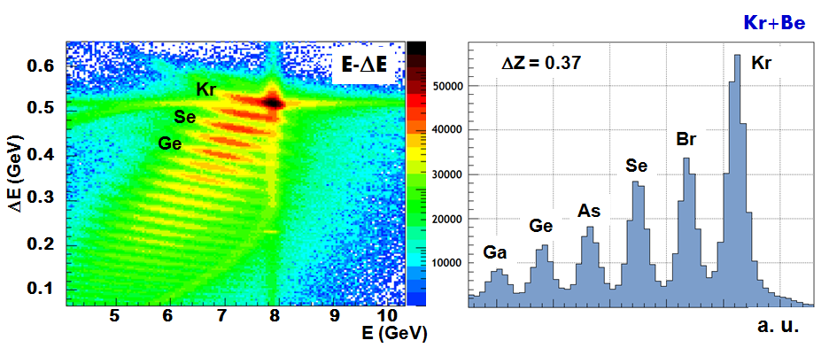
Scattering Experiment at Relativistic Energies
secondary
⁹Be target
DSSSD
diamond/plastic
DSSSD
exp. observables:
Z, A, θ
(x,y,ΔE)
(x,y,ΔE)
RIB from FRS
CsI
CsI
time-of-flight

Slide 13
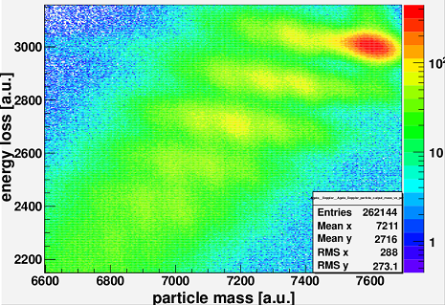
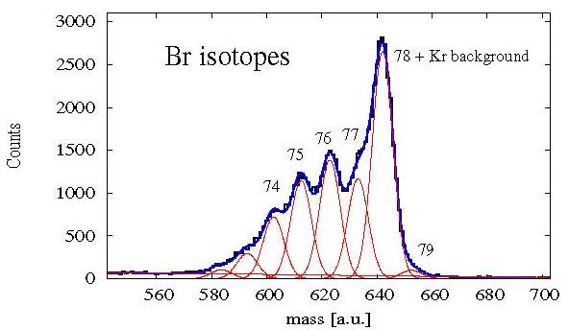
Scattering Experiment at Relativistic Energies
with
and
with v from LYCCA-ToF
secondary
⁹Be target
DSSSD
diamond/plastic
DSSSD
exp. observables:
Z, A, θ
(x,y,ΔE)
(x,y,ΔE)
RIB from FRS
CsI
CsI
time-of-flight

Slide 14
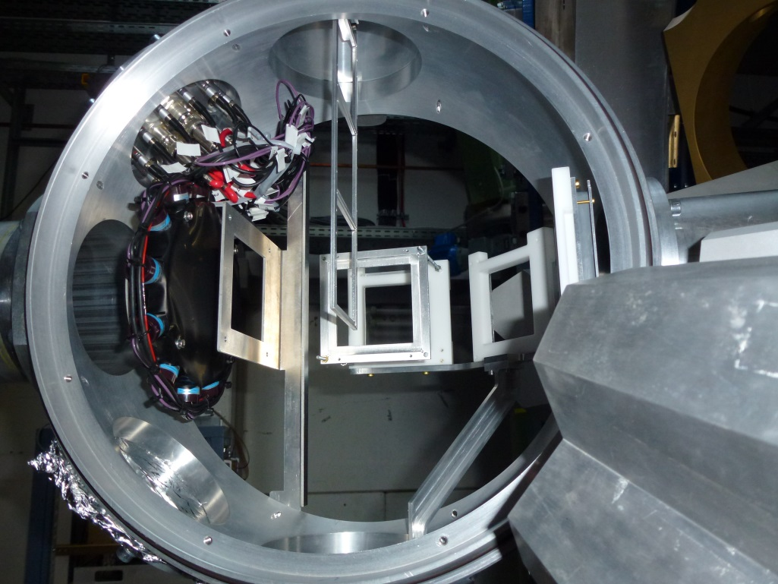
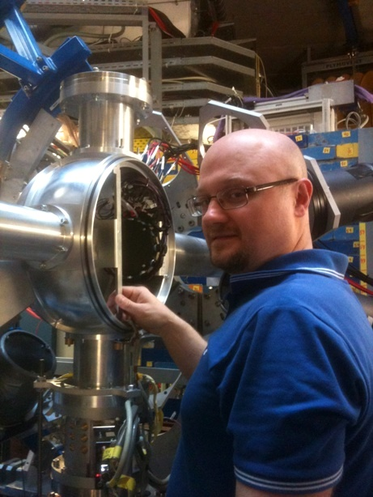
Lund-York-Cologne CAlorimeter
DSSSD
start ToF
Au target
PreSPEC target chamber
variable target position (13cm, 23cm)
Pavel Golubev

Slide 15
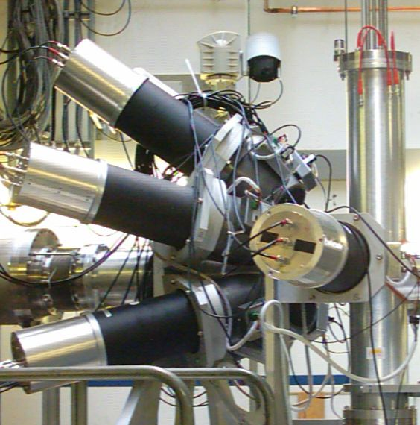
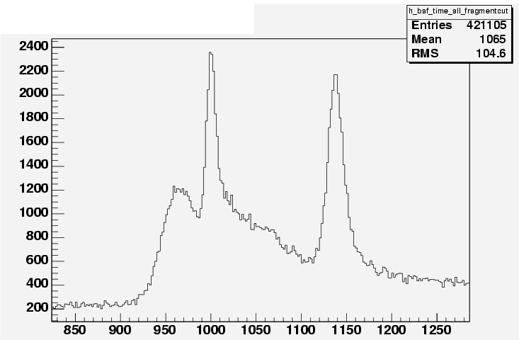
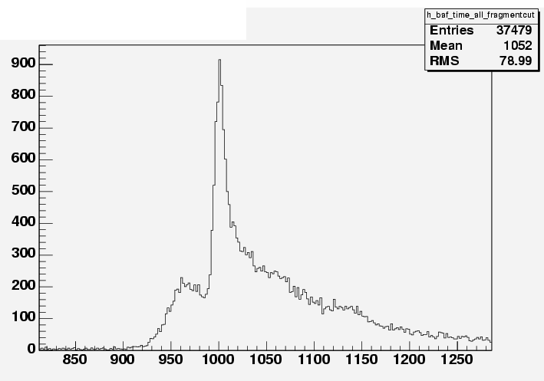
Additional γ-Ray Background Radiation
Coulomb excitation:
A/Q - ³⁷Ca
all Ca detected in ΔE-E
prompt
ΔE-E
1‰ interaction target
most γ-rays from CATE
HECTOR BaF₂
³⁷Ca beam
at 196 MeV/u
time spectrum
Fragmentation:
A/Q - ³⁷Ca
K detected (mainly ³⁶K)
prompt

Slide 16
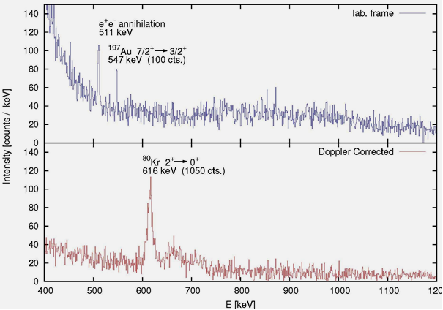

Scattering Experiment at Relativistic Energies
⁸⁰Kr → ¹⁹⁷Au, 150 AMeV
Doppler effect

Slide 17
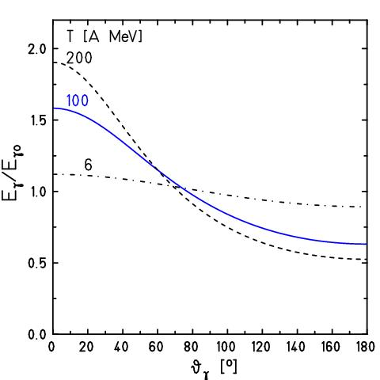
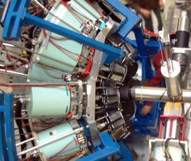
Scattering Experiment at Relativistic Energies
Doppler effect:
for
Lorentz boost:
beam

Slide 18
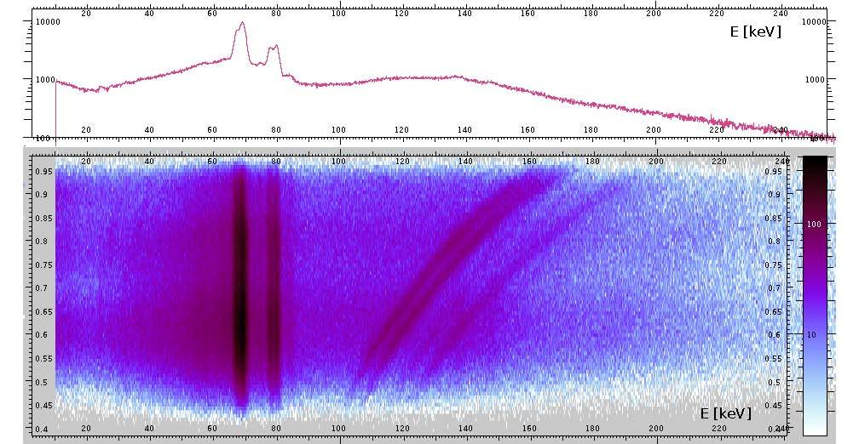
Doppler-Shift Correction
²³⁸U on ¹⁹⁷Au (386 mg/cm²) at 183 AMeV
cos θ_{γ}
66.372 | 79 Au | K_{α3} | 0.033
66.991 | 79 Au | K_{α2} | 27.5
68.806 | 79 Au | K_{α1} | 46.4
77.577 | 79 Au | K_{β3} | 5.57
77.982 | 79 Au | K_{β1} | 10.70
80.130 | 79 Au | K_{β2} | 3.84
http://ie.lbl.gov/atomic/x2.pdf
Michael Reese

Slide 19
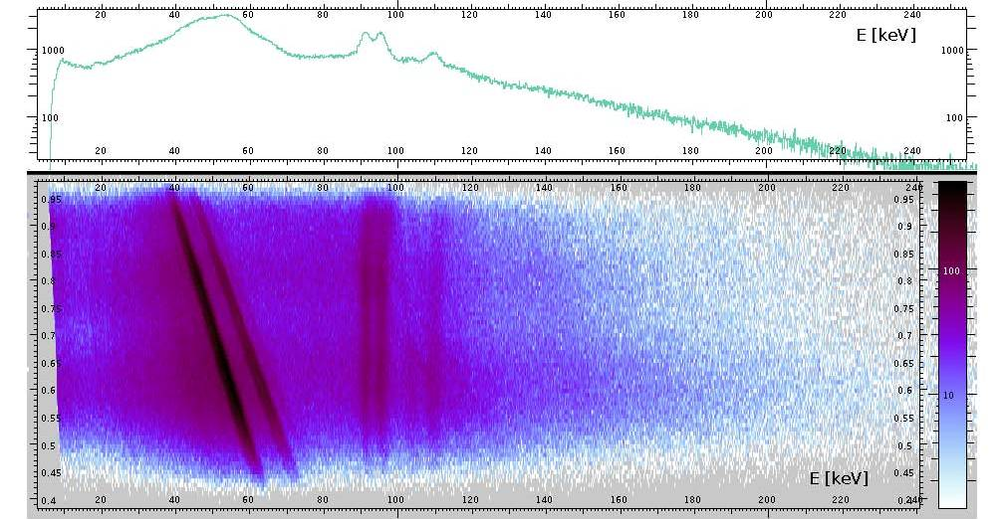
Doppler-Shift Correction
²³⁸U on ¹⁹⁷Au (386 mg/cm²) at 183 AMeV
cos θ_{γ}
93.844 | 92 U | K_{α3} | 0.099
94.654 | 92 U | K_{α2} | 28.2
98.434 | 92 U | K_{α1} | 45.1
110.421 | 92 U | K_{β3} | 5.65
111.298 | 92 U | K_{β1} | 10.70
114.445 | 92 U | K_{β2} | 4.15
http://ie.lbl.gov/atomic/x2.pdf
Michael Reese

Slide 20
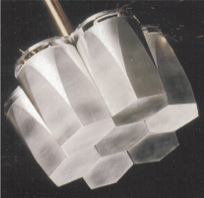
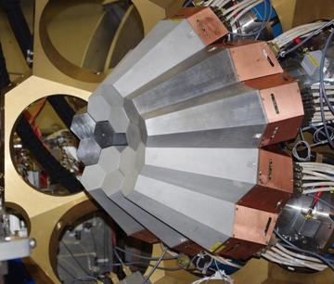
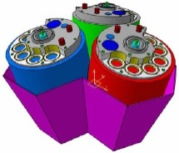
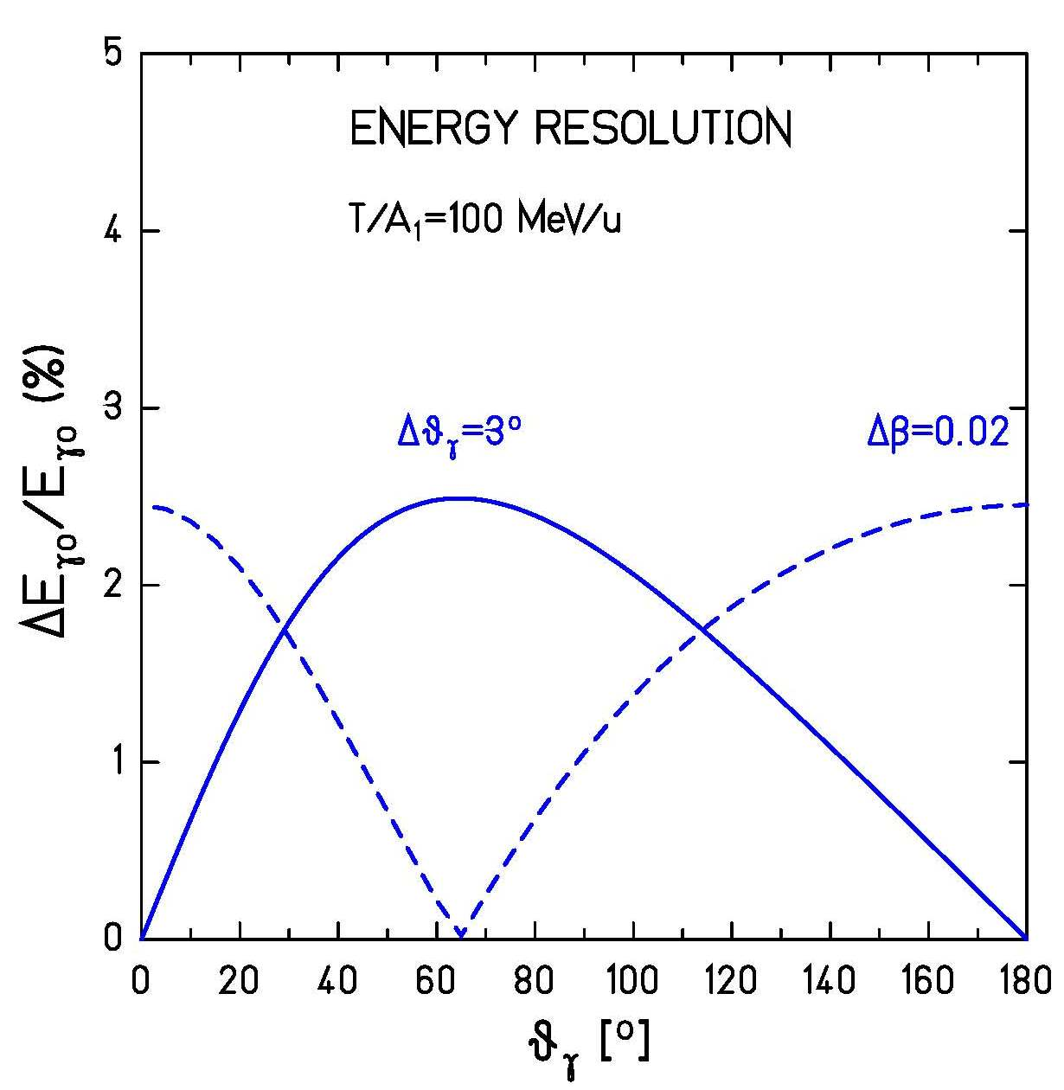
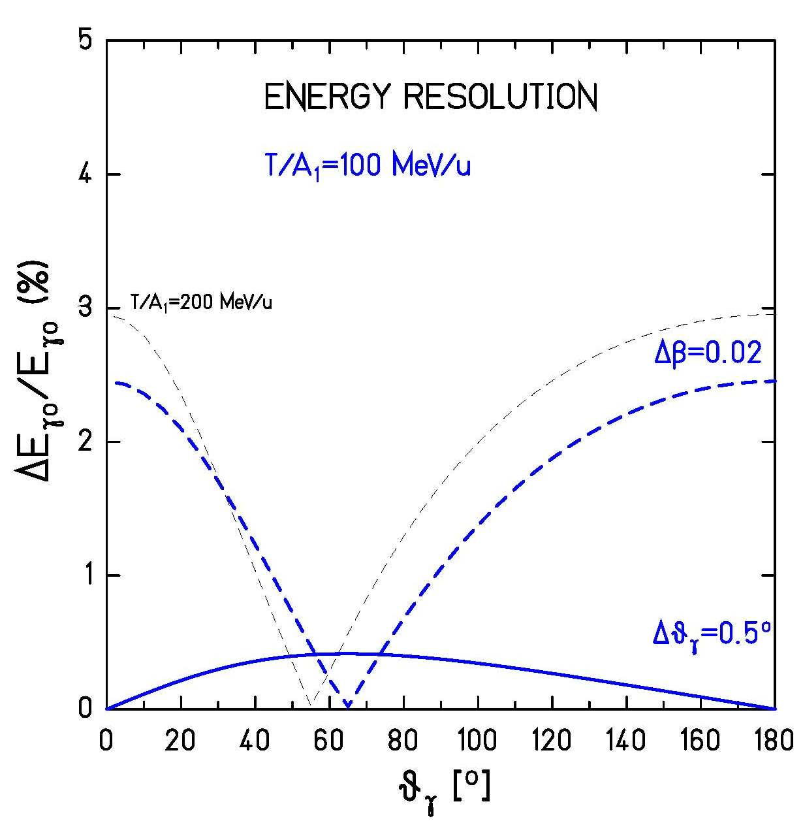



Doppler Broadening
opening angle: slowing down in target:

Slide 21
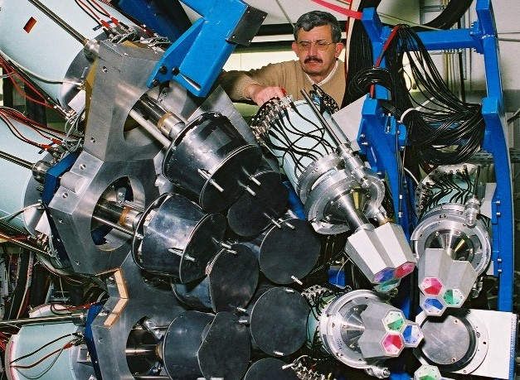



γ-ray set-up with higher efficiency
70cm
target
beam
20cm
Ivan Kojouharov

Slide 22

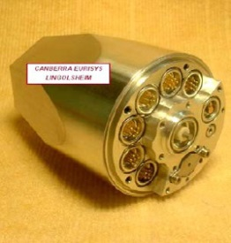
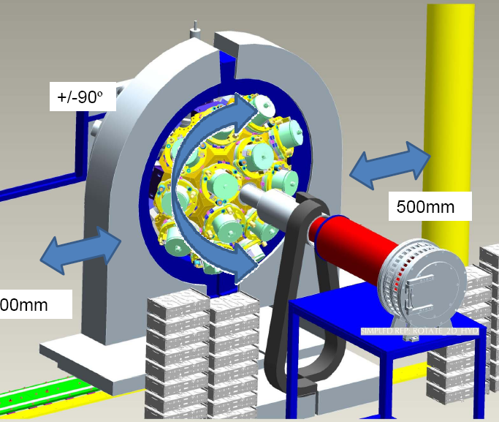
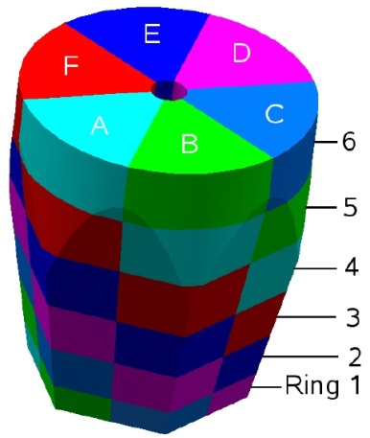

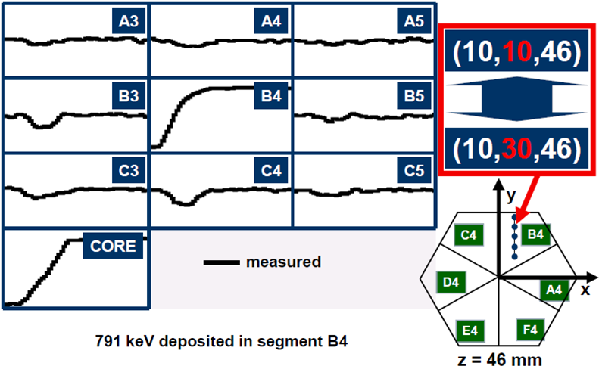
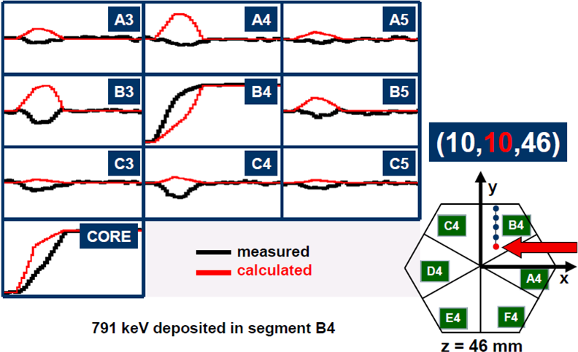

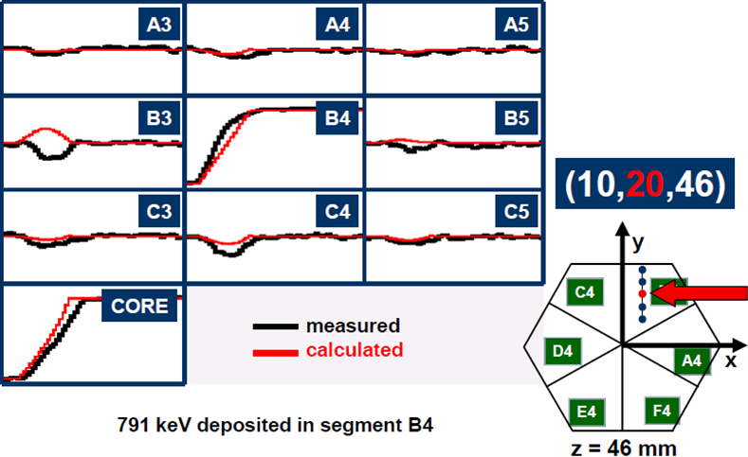

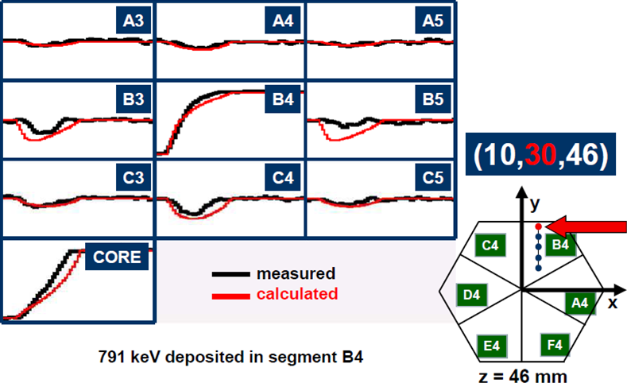
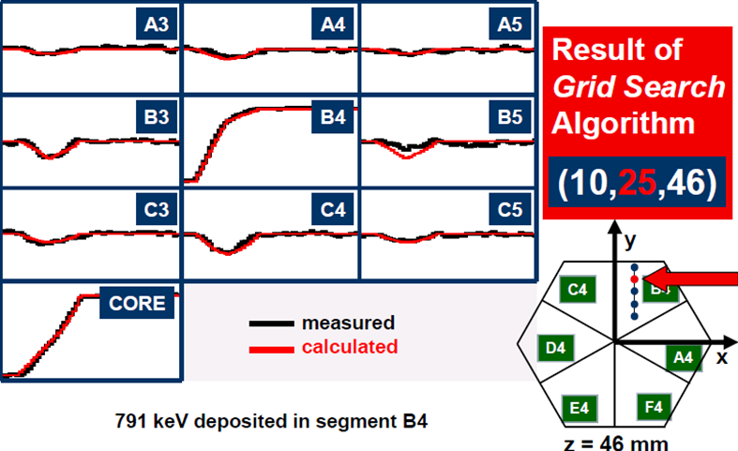
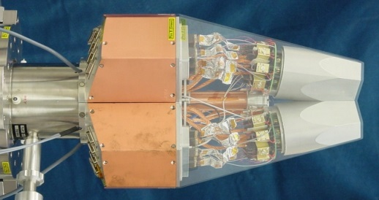

Advanced GAmma Tracking Array
Encapsulation
Signals from 36 segments + core
are measured as a function of time
(γ-ray interaction point)
John Strachan

Slide 23
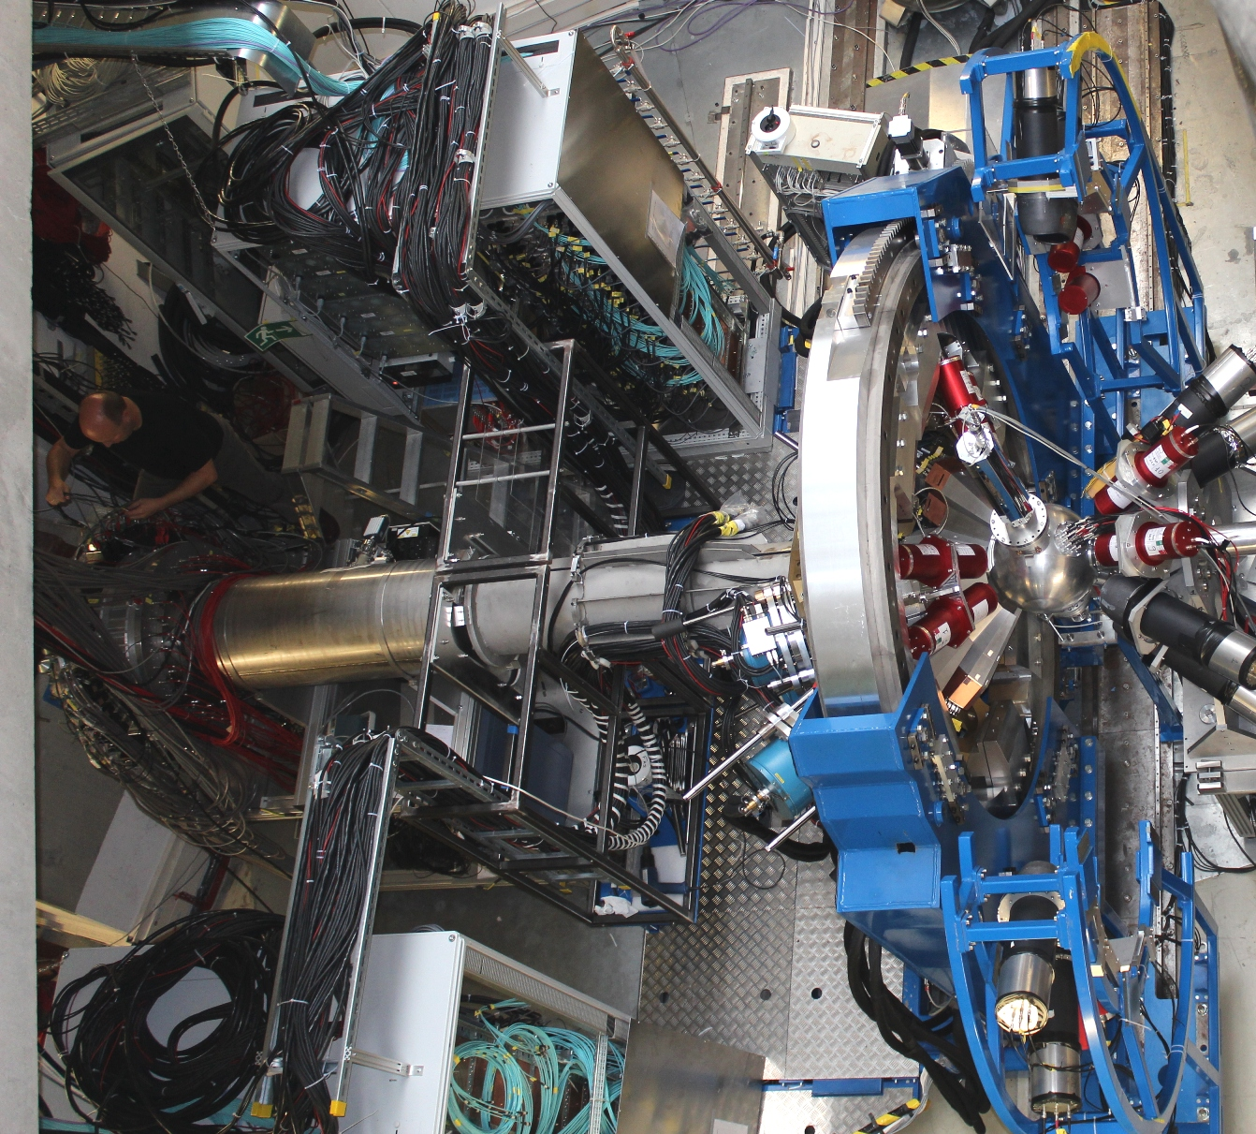


Au, Be target
LYCCA
AGATA Cluster array
HECTOR BaF₂ array

Slide 24
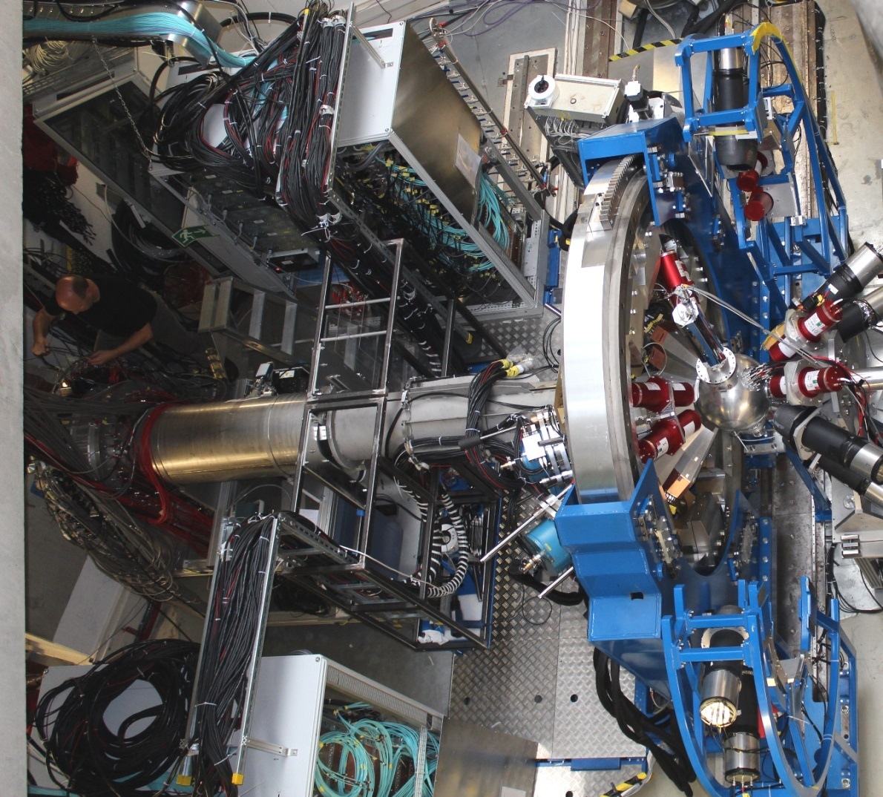



HECTOR team

Slide 25





AGATA at PreSPEC
preprocessor
computer farm
AGATA
digitiser
Damian Ralet,
Stephane Pietri

Slide 26


High-energy Coulomb excitation
triaxiality in even-even nuclei (N=76)
2₁⁺→0⁺
2₂⁺→2₁⁺
2₂⁺→0⁺
2₂⁺→2₁⁺
2₂⁺→0⁺
First observation of a second excited 2⁺ state populated in a Coulomb experiment at 100 AMeV using EUROBALL and MINIBALL Ge-detectors.
shape symmetry
collective strength
T.R. Saito et al. Phys.Lett. B669 (2008), 19

Slide 27

Ivan Kojouharov, Michael Reese, Namita Goel, Liliana Cortes, Frederic Ameil, Bogdan Szczepanczyk
H.-J. W., Damian Ralet, Pushpendra Singh, Stephane Pietri, Tobias Habermann, Edana Merchan, Giulia Guastalla, Plamen Boutachkov, Adolf Brünle,
Ian Burrows, Jonathan Strachan, (Paul Morral), Jürgen Gerl, (Henning Schaffner, Magda Gorska)

Slide 28



Slowed down beams – new experimental perspectives
collective strength
nuclear shape
angular momentum transfer:
V_{C}

Slide 29






Slowed down beams – new experimental perspectives
10⁹ pps 10⁷ pps 3∙10⁶ pps 10⁵ pps
⁶²Co 250 AMeV
⁶⁴Ni
700 AMeV
⁶²Co
~ 13 AMeV
V_{C}

Slide 30

Slowed down beams – beam characteristics
10⁹ pps 10⁷ pps 3∙10⁶ pps 10⁵ pps
⁶⁴Ni
700 AMeV
⁶²Co
~ 13 AMeV
ΔEnergy
5.2 AMeV
Δθ
35 mrad

Slide 31

Slowed down beams – beam characteristics
⁶²Co
~ 13 AMeV
⁶²Co
250 AMeV
ΔEnergy
5.2 AMeV
Δθ
35 mrad

Slide 32


Slowed down beams – experimental set-up
degrader
target
TPC-1 TPC-2 SC41
(x₁ y₁ t₁) (x₂ y₂ t₂)
(x₃ y₃ t₃)
experimental results:
velocity β
beam energy E/A₁
scattering angle θ_{cm}
electrostatic mirror + MCP detector
position resolution ~ 1 mm
time resolution ~ 100 ps

Slide 33


Slowed down beams – experimental set-up
degrader
target
TPC-1 TPC-2 SC41
(x₁ y₁ t₁) (x₂ y₂ t₂)
(x₃ y₃ t₃)
TOF between MCP and DSSSD
MCP DSSSD
Time resolution 200 ps for one of the 256 detector pixels
Akhil Jhingan (IUAC)

Slide 34


Reactions with Relativistic Radioactive Beams – R³B
Excitation energy E* from kinematically complete measurement of all outgoing particles
$$E^{∗}=\left(\sqrt{\sum_{i}{{m_{i}}^{2}}+\sum_{i≠j}{m_{i}m_{j}γ_{i}γ_{j}\left(1−β_{i}β_{j}cosθ_{ij}\right)}}−m_{proj}\right)c^{2}+E_{γ,sum}$$
Notes:
invariant-mass technique, Rossi

Slide 35










Invariant mass analysis
$$M_{proj}^{inv}=m_{proj}+E^{∗}$$
$$M_{proj}^{inv}=\sqrt{{\left\{\begin{matrix}\sum_{i}{E_{i}} \\ \sum_{i}{\overset{→}{p_{i}}}\end{matrix}\right\}}^{2}}$$
$${\left(\sum_{i}{E_{i}}\right)}^{2}=\sum_{i}{{\left(γ_{i}m_{i}\right)}^{2}}+\sum_{i≠j}{γ_{i}γ_{j}m_{i}m_{j}}$$
$${\left(\sum_{i}{\overset{→}{p_{i}}}\right)}^{2}=\sum_{i}{{\left(γ_{i}β_{i}m_{i}\right)}^{2}}+\sum_{i≠j}{γ_{i}γ_{j}β_{i}β_{j}m_{i}m_{j}cosθ_{ij}}$$
$$M_{proj}^{inv}=\sqrt{\sum_{i}{{m_{i}}^{2}}+\sum_{i≠j}{m_{i}m_{j}γ_{i}γ_{j}\left(1−β_{i}β_{j}cosθ_{ij}\right)}}+E_{γ}$$
Momentum reconstruction: (ħ=c=1)
four-momenta:
$$\hat{P}=\left(E,\vec{p}\right)$$
$$E^{∗}=\sqrt{\sum_{i}{{m_{i}}^{2}}+\sum_{i≠j}{m_{i}m_{j}γ_{i}γ_{j}\left(1−β_{i}β_{j}cosθ_{ij}\right)}}−m_{proj}+E_{γ}$$
$$\left\{\begin{matrix}p_{x}=p_{0}sinθcosφ \\ p_{y}=p_{0}sinθsinφ \\ p_{z}=p_{0}cosθ \end{matrix}\right\}$$
$$p_{0}=m_{0}βγ$$
$$γ^{2}\left(1−β^{2}\right)=1$$

Slide 36





Dipole strength distribution of ⁶⁸Ni
mean field calculation
Pygmy resonance
neutron decay data
direct γ-decay
branching ratio:
Γ₀/Γ = 7(2)%
E.Litvinova et al.; PRC 79, (2009) 054312
γ-ray decay data
O. Wieland et al.; Phys. Rev. Lett 102, 092502 (2009)
D. Rossi et al.; Phys. Rev. Lett 111, 242503 (2013)

