Slide 1
Coulomb excitation
Hans-Jürgen Wollersheim
HPGe
γ
θ
Target
target excited
Beam
projectile

Slide 2
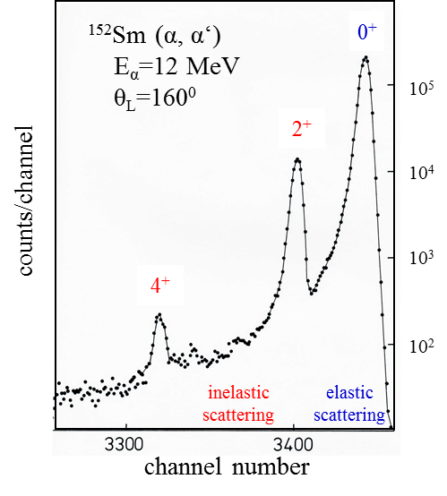




Coulomb excitation
particle detection
Nuclear excitation by electromagnetic field acting between nuclei.
observables:
1. scattering angle
2. intensity
+
$$θ_{lab}⟹θ_{cm}$$
$$a∙cot\frac{θ_{cm}}{2}=$$
b
+
+
$$\frac{dσ_{Ruth}}{dΩ_{cm}}=\frac{a^{2}}{4}∙\sin^{−4}\frac{θ_{cm}}{2}$$
+
target
~10⁻²²s
$$\frac{dσ_{inel}}{dΩ_{cm}}={\left|a_{i⟶f}\right|}^{2}∙\frac{dσ_{Ruth}}{dΩ_{cm}}$$
projectile
α-particle spectroscopy
¹⁵²Sm target
α-particles
ϑ_{lab}
Si-detector
inelastic scattering: kinetic energy is transferred into nuclear excitation energy
Possible:
depletion depth ~ 300μm
dead layer d_{d} ≤ 1μ
V ~ 0.5 V/μ
Over-bias reduces d_{d}
H.J. Wollersheim et al., Phys. Lett 48B (1974) 323

Slide 3

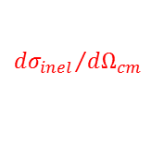


Coulomb excitation
particle detection
Nuclear excitation by electromagnetic field acting between nuclei.
observables:
1. scattering angle
2. intensity
+
$$θ_{lab}⟹θ_{cm}$$
$$a∙cot\frac{θ_{cm}}{2}=$$
b
+
+
$$\frac{dσ_{Ruth}}{dΩ_{cm}}=\frac{a^{2}}{4}∙\sin^{−4}\frac{θ_{cm}}{2}$$
+
target
~10⁻²²s
$$\frac{dσ_{inel}}{dΩ_{cm}}={\left|a_{i⟶f}\right|}^{2}∙\frac{dσ_{Ruth}}{dΩ_{cm}}$$
projectile
α-particle spectroscopy
lifetime
I_{f}
τ
~10⁻¹²-10⁻⁹s
$$\frac{1}{τ}≅1.23∙{10}^{13}∙B\left(E2;I_{f}→I_{i}\right)∙E_{γ}^{5} \left[s^{−1}\right]$$
I_{i}
1st order:
$$B\left(E2;I_{i}→I_{f}\right)=\frac{1}{2I_{i}+1}{\left\langle I_{f}\left\|M\left(E2\right)\right\|I_{i}\right\rangle }^{2}$$
The inelastic cross section
is a direct measure of the E2 matrix elements
$${dσ_{inel}}/{dΩ_{cm}}$$
H.J. Wollersheim et al., Phys. Lett 48B (1974) 323

Slide 4
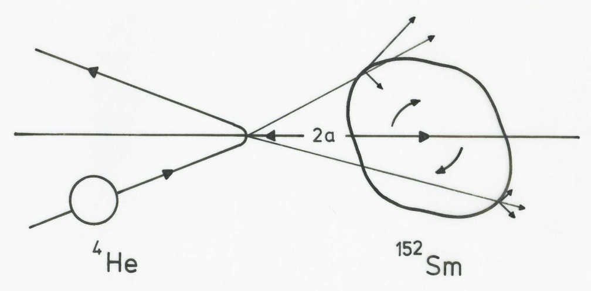
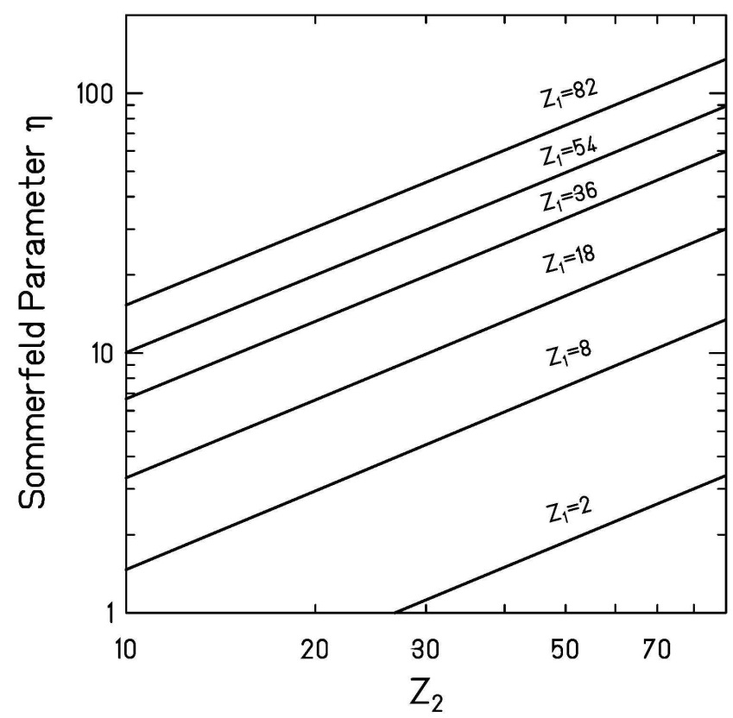

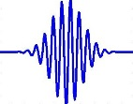
Coulomb excitation
particle
Sommerfeld parameter:
>> 1 requirement for a (semi-) classical treatment
of equations of motion (hyperbolic trajectories )
wave
⁴He (Z=2) projectiles behave like waves
quantummechanical analysis is needed

Slide 5
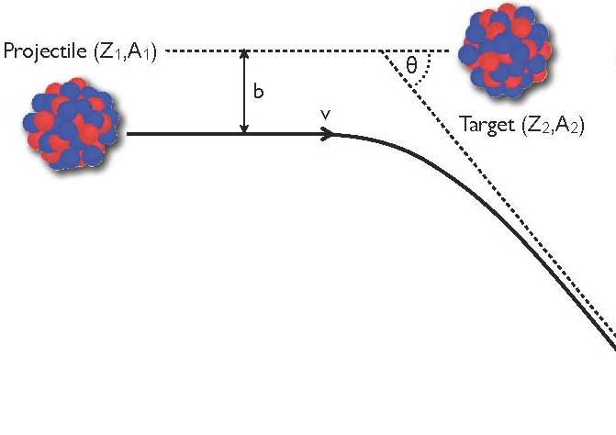




Classical Coulomb trajectories
impact parameter
scattering angle
Hyperbolic trajectory:
ε = sin⁻¹(θ_{cm}/2) eccentricity of orbit
$$t=\frac{a}{v_{∞}}\left[ε∙sinhω+ω\right]$$
distance of closest approach:
impact parameter:
angular momentum :
$$D=a∙\left[\sin^{−1}\frac{θ_{cm}}{2}+1\right]$$
$$b=a∙cot\frac{θ_{cm}}{2}$$
$$ℓ=k_{∞}∙b=η∙cot\frac{θ_{cm}}{2}$$

Slide 6
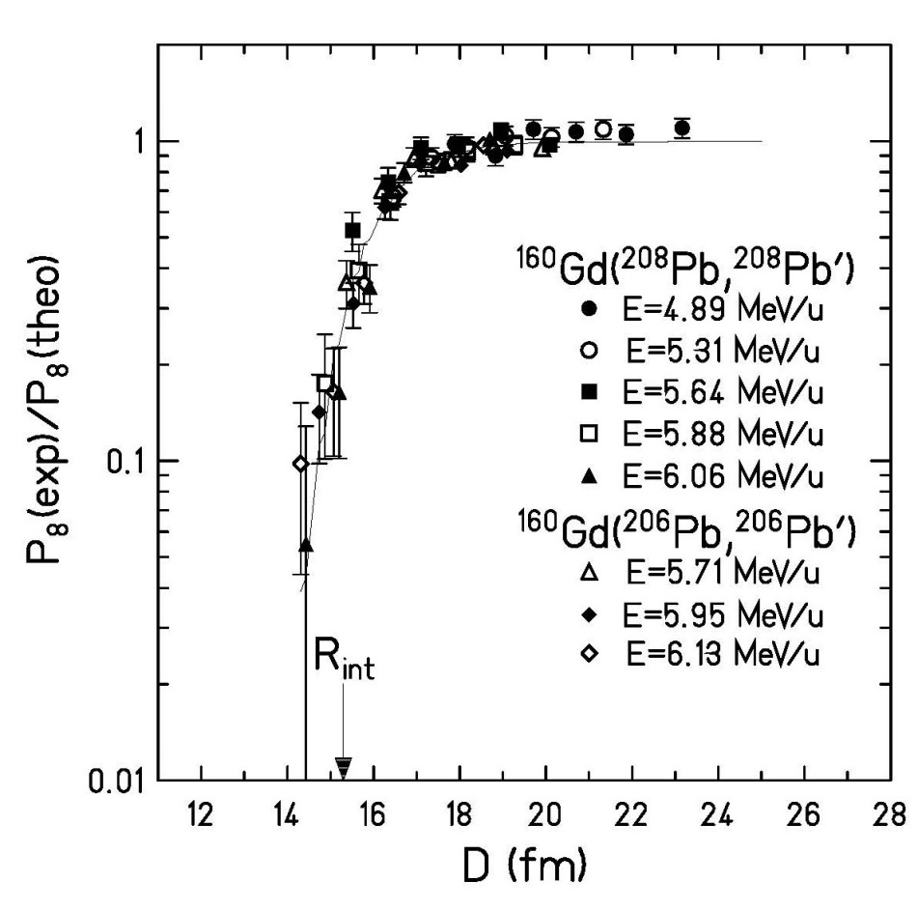
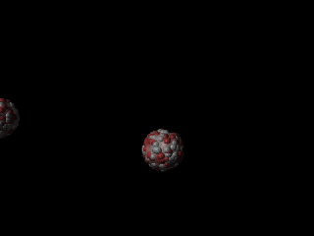


Safe bombarding energy
pure electromagnetic interaction
Nuclear interaction radius:
C_{P}, C_{T} half-density radii
Pure Coulomb excitation requires a much larger distance between the nuclei
➔ ”safe bombarding energy” requirement
$$R_{int}≅C_{p}+C_{t}+3fm$$
$$R_{int}=C_{p}+C_{t}+4.49−\frac{C_{p}+C_{t}}{6.35}$$

Slide 7
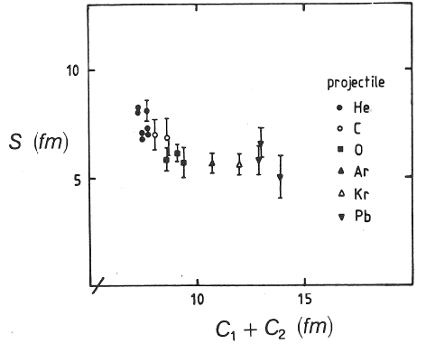
Safe bombarding energy
pure electromagnetic interaction
< 1% deviation from Coulomb excitation
D_{min}
Rutherford scattering only if D_{min} is large
compared to nuclear radii + surfaces:
D_{min} > C_{p} + C_{t} + 5 fm
C_{P}, C_{T} half-density radii
choose adequate beam energy E_{lab}
(D > D_{min} for all θ_{cm})

Slide 8


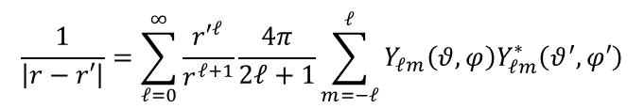
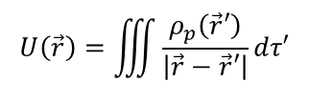
Electric fields of multipoles
In general the electric potential due to
an arbitrary charge distribution is
$$U\left(\vec{r}\right)=\iiint{\frac{ρ_{p}\left(\vec{r}′\right)}{\left|\vec{r}−\vec{r}′\right|}}dτ′$$
expansion
$$\frac{1}{\left|r−r′\right|}=\sum_{ℓ=0}^{∞}{\frac{{r′}^{ℓ}}{r^{ℓ+1}}\frac{4π}{2ℓ+1}}\sum_{m=−ℓ}^{ℓ}{Y_{ℓm}\left(θ,φ\right)Y_{ℓm}^{∗}\left(θ^{′},φ′\right)}$$
special case: electric monopole
$$ℓ=m=0 Y_{00}\left(θ,φ\right)=Y_{00}\left(θ^{′},φ′\right)=\frac{1}{\sqrt{4π}}$$
$$→ \frac{1}{\left|r−r′\right|}=\frac{1}{r}$$

Slide 9
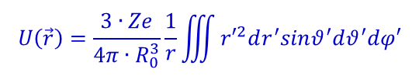

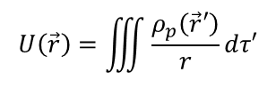


Electric fields of multipoles
In general the electric potential due to
an arbitrary charge distribution is
$$U\left(\vec{r}\right)=\iiint{\frac{ρ_{p}\left(\vec{r}′\right)}{r}}dτ′$$
homogenous charge distribution
$$ρ_{p}\left(\vec{r′}\right)=\frac{3∙Ze}{4π∙R_{0}^{3}}$$
$$U\left(\vec{r}\right)=\frac{3∙Ze}{4π∙R_{0}^{3}}\frac{1}{r}\iiint{{r′}^{2}dr^{′}sinθ^{′}dθ^{′}dφ′}$$
special case: electric monopole
$$U\left(\vec{r}\right)=\frac{3∙Ze}{4π∙R_{0}^{3}}∙\frac{1}{r}∙\frac{R_{0}^{3}}{3}∙4π$$
$$=\frac{Ze}{r}$$

Slide 10
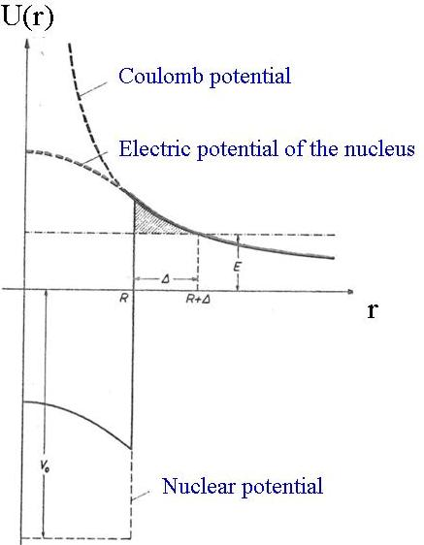
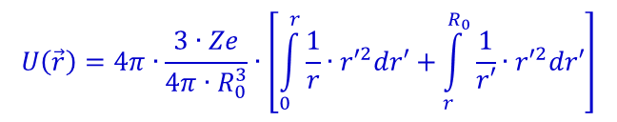
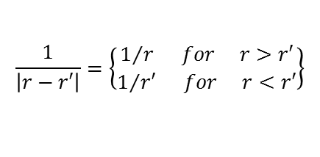
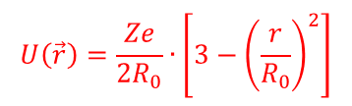

Electric fields of multipoles
In general the electric potential due to
an arbitrary charge distribution is
$$U\left(\vec{r}\right)=\iiint{\frac{ρ_{p}\left(\vec{r}′\right)}{\left|\vec{r}−\vec{r}′\right|}}dτ′$$
$$\frac{1}{\left|r−r′\right|}=\left\{\begin{matrix}1/r for r>r′ \\ 1/{r′} for r<r′\end{matrix}\right\}$$
$$U\left(\vec{r}\right)=4π∙\frac{3∙Ze}{4π∙R_{0}^{3}}∙\left[\int_{0}^{r}{\frac{1}{r}∙{r′}^{2}dr′}+\int_{r}^{R_{0}}{\frac{1}{r′}∙{r′}^{2}dr′}\right]$$
$$U\left(\vec{r}\right)=\frac{3∙Ze}{R_{0}^{3}}∙\left[\frac{r^{2}}{3}+\frac{R_{0}^{2}}{2}−\frac{r^{2}}{2}\right]$$
special case: electric monopole
$$U\left(\vec{r}\right)=\frac{Ze}{2R_{0}}∙\left[3−{\left(\frac{r}{R_{0}}\right)}^{2}\right]$$

Slide 11

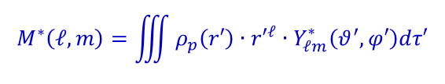
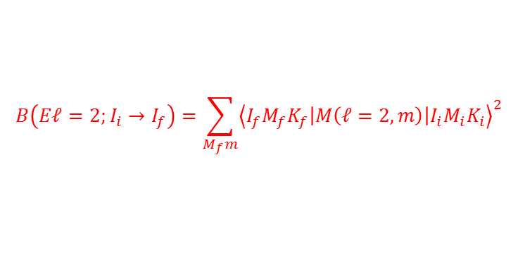
Electric fields of multipoles
In general the electric potential due to
an arbitrary charge distribution is
$$U\left(\vec{r}\right)=\iiint{\frac{ρ_{p}\left(\vec{r}′\right)}{\left|\vec{r}−\vec{r}′\right|}}dτ′$$
expansion
$$\frac{1}{\left|r−r′\right|}=\sum_{ℓ=0}^{∞}{\frac{{r′}^{ℓ}}{r^{ℓ+1}}\frac{4π}{2ℓ+1}}\sum_{m=−ℓ}^{ℓ}{Y_{ℓm}\left(θ,φ\right)Y_{ℓm}^{∗}\left(θ^{′},φ′\right)}$$
multipole moments
$$M^{∗}\left(ℓ,m\right)=\iiint{ρ_{p}\left(r′\right)∙{r′}^{ℓ}∙Y_{ℓm}^{∗}\left(θ^{′},φ′\right)dτ′}$$
special case: electric quadrupole matrix element
$$M^{∗}\left(ℓ=2,m\right)=\frac{3∙Ze∙R_{0}^{2}}{4π}∙β_{2}$$
$$B\left(Eℓ=2;I_{i}→I_{f}\right)=\sum_{M_{f}m}{{\left\langle I_{f}M_{f}K_{f}\left|M\left(ℓ=2,m\right)\right|I_{i}M_{i}K_{i}\right\rangle }^{2}}$$
B(E2)-value:

Slide 12



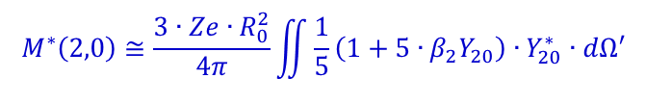
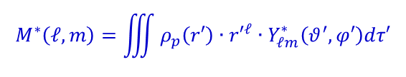
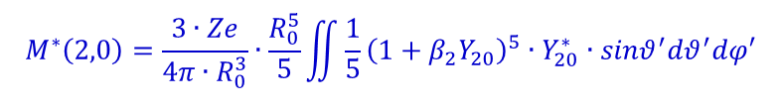
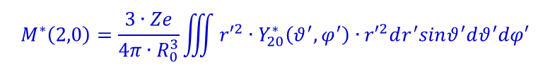
Electric fields of multipoles
multipole moments
$$M^{∗}\left(ℓ,m\right)=\iiint{ρ_{p}\left(r′\right)∙{r′}^{ℓ}∙Y_{ℓm}^{∗}\left(θ^{′},φ′\right)dτ′}$$
special case: electric quadrupole matrix element (ℓ = 2, m = 0)
$$ρ_{p}\left(\vec{r′}\right)=\frac{3∙Ze}{4π∙R_{0}^{3}}$$
$$M^{∗}\left(2,0\right)=\frac{3∙Ze}{4π∙R_{0}^{3}}\iiint{{r′}^{2}∙Y_{20}^{∗}\left(θ^{′},φ^{′}\right)∙{r′}^{2}dr^{′}sinθ^{′}dθ^{′}dφ′}$$
$$R\left(θ^{′},φ′\right)=R_{0}∙\left\{1+β_{2}Y_{20}\left(θ^{′},φ′\right)\right\}$$
$$M^{∗}\left(2,0\right)=\frac{3∙Ze}{4π∙R_{0}^{3}}∙\frac{R_{0}^{5}}{5}\iint{\frac{1}{5}{\left(1+β_{2}Y_{20}\right)}^{5}∙Y_{20}^{∗}∙sinθ^{′}dθ^{′}dφ′}$$
$$M^{∗}\left(2,0\right)≅\frac{3∙Ze∙R_{0}^{2}}{4π}\iint{\frac{1}{5}\left(1+5∙β_{2}Y_{20}\right)∙Y_{20}^{∗}∙dΩ′}$$
$$M^{∗}\left(2,0\right)≅\frac{3∙Ze∙R_{0}^{2}}{4π}∙β_{2}$$

Slide 13
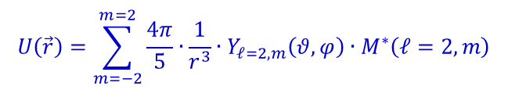
Electric fields of multipoles
In general the electric potential due to
an arbitrary charge distribution is
$$U\left(\vec{r}\right)=\iiint{\frac{ρ_{p}\left(\vec{r}′\right)}{\left|\vec{r}−\vec{r}′\right|}}dτ′$$
expansion
$$\frac{1}{\left|r−r′\right|}=\sum_{ℓ=0}^{∞}{\frac{{r′}^{ℓ}}{r^{ℓ+1}}\frac{4π}{2ℓ+1}}\sum_{m=−ℓ}^{ℓ}{Y_{ℓm}\left(θ,φ\right)Y_{ℓm}^{∗}\left(θ^{′},φ′\right)}$$
multipole moments
$$M^{∗}\left(ℓ,m\right)=\iiint{ρ_{p}\left(r′\right)∙{r′}^{ℓ}∙Y_{ℓm}^{∗}\left(θ^{′},φ′\right)dτ′}$$
$$U\left(\vec{r}\right)=\sum_{m=−2}^{m=2}{\frac{4π}{5}∙\frac{1}{r^{3}}∙Y_{ℓ=2,m}\left(θ,φ\right)∙M^{∗}\left(ℓ=2,m\right)}$$
special case: electric quadrupole potential

Slide 14
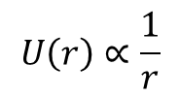
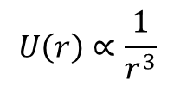
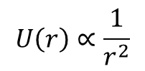
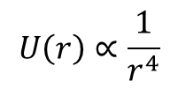
Monopole, dipole, quadrupole, ...
Monopole
dipole
quadrupole
octopole
$$U\left(r\right)∝\frac{1}{r}$$
$$U\left(r\right)∝\frac{1}{r^{2}}$$
$$U\left(r\right)∝\frac{1}{r^{3}}$$
$$U\left(r\right)∝\frac{1}{r^{4}}$$

Slide 15
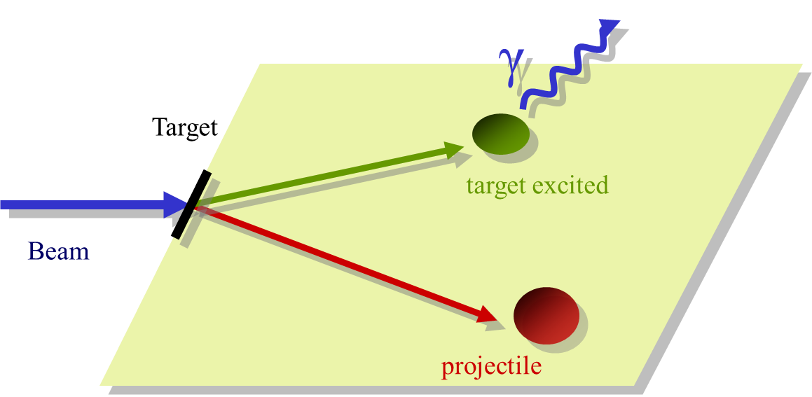
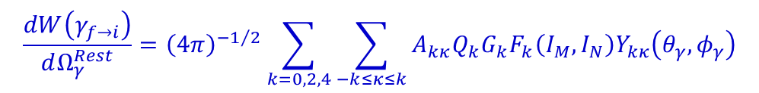
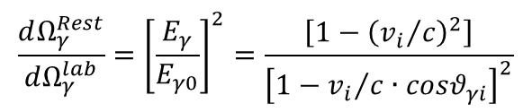
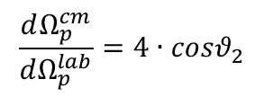
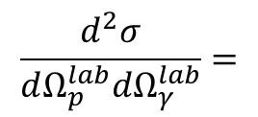
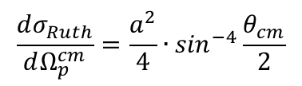
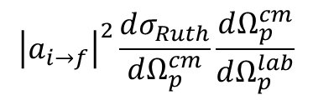
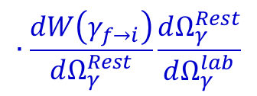

Coulomb excitation
particle – γ-ray coincidence measurement
~10⁻¹²-10⁻⁹s
$$\frac{d^{2}σ}{dΩ_{p}^{lab}dΩ_{γ}^{lab}}=$$
$${\left|a_{i→f}\right|}^{2}\frac{dσ_{Ruth}}{dΩ_{p}^{cm}}\frac{dΩ_{p}^{cm}}{dΩ_{p}^{lab}}$$
$$∙\frac{dW\left(γ_{f→i}\right)}{dΩ_{γ}^{Rest}}\frac{dΩ_{γ}^{Rest}}{dΩ_{γ}^{lab}}$$
~10⁻²²s
$≡P_{I}$ (excitation probability)
$$\frac{dσ_{Ruth}}{dΩ_{p}^{cm}}=\frac{a^{2}}{4}∙\sin^{−4}\frac{θ_{cm}}{2}$$
$$\frac{dΩ_{p}^{cm}}{dΩ_{p}^{lab}}=4∙cosθ_{2}$$
$$\frac{dW\left(γ_{f→i}\right)}{dΩ_{γ}^{Rest}}={\left(4π\right)}^{−1/2}\sum_{k=0,2,4}{\sum_{−k≤κ≤k}{A_{kκ}Q_{k}G_{k}F_{k}\left(I_{M},I_{N}\right)Y_{kκ}\left(θ_{γ},φ_{γ}\right)}}$$
$$\frac{dΩ_{γ}^{Rest}}{dΩ_{γ}^{lab}}={\left[\frac{E_{γ}}{E_{γ0}}\right]}^{2}=\frac{\left[1−{\left({v_{i}}/c\right)}^{2}\right]}{{\left[1−{v_{i}}/c∙cosθ_{γi}\right]}^{2}}$$

Slide 16
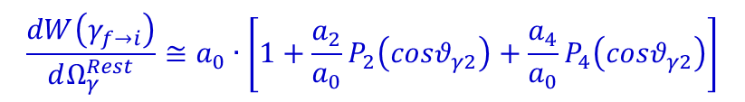
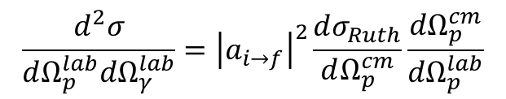
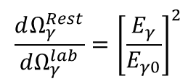



Coulomb excitation
particle – γ-ray coincidence measurement
$$\frac{d^{2}σ}{dΩ_{p}^{lab}dΩ_{γ}^{lab}}={\left|a_{i→f}\right|}^{2}\frac{dσ_{Ruth}}{dΩ_{p}^{cm}}\frac{dΩ_{p}^{cm}}{dΩ_{p}^{lab}}$$
$$∙\frac{dW\left(γ_{f→i}\right)}{dΩ_{γ}^{Rest}}\frac{dΩ_{γ}^{Rest}}{dΩ_{γ}^{lab}}$$
$$\frac{dσ_{Ruth}}{dΩ_{p}^{cm}}=\frac{a^{2}}{4}∙\sin^{−4}\frac{θ_{cm}}{2}$$
$$\frac{dΩ_{p}^{cm}}{dΩ_{p}^{lab}}=4∙cosθ_{2}$$
$$a_{0}=\frac{1}{1+α_{T}\left(I→I−2\right)}\frac{1}{4π}$$
$$\frac{dW\left(γ_{f→i}\right)}{dΩ_{γ}^{Rest}}≅a_{0}∙\left[1+\frac{a_{2}}{a_{0}}P_{2}\left(cosθ_{γ2}\right)+\frac{a_{4}}{a_{0}}P_{4}\left(cosθ_{γ2}\right)\right]$$
$$\frac{a_{2}}{a_{0}}=\frac{5}{7}\frac{I+1}{2I−1}$$
$$\frac{a_{4}}{a_{0}}=−\frac{3}{7}\frac{\left(I+1\right)∙\left(I+2\right)}{\left(2I−3\right)∙\left(2I−1\right)}$$
$$\frac{dΩ_{γ}^{Rest}}{dΩ_{γ}^{lab}}={\left[\frac{E_{γ}}{E_{γ0}}\right]}^{2}$$
$$cosθ_{γ2}=cosθ_{γ}∙cosθ_{2}+sinθ_{γ}∙sinθ_{2}∙cos\left(φ_{γ}−φ_{2}\right)$$

Slide 17
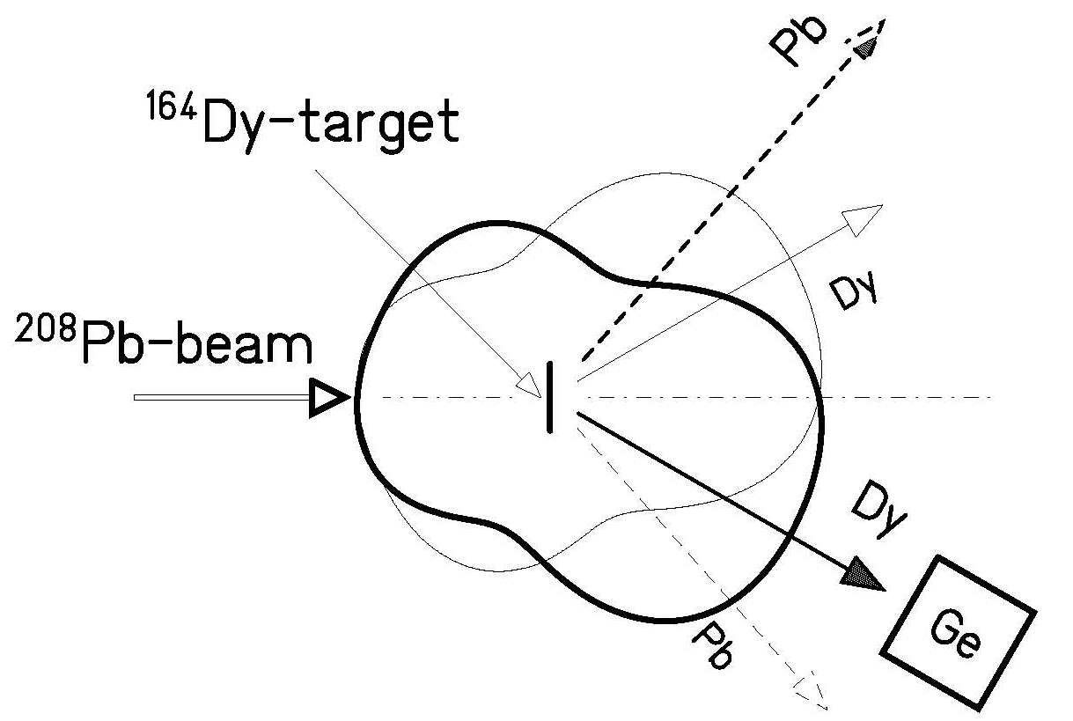
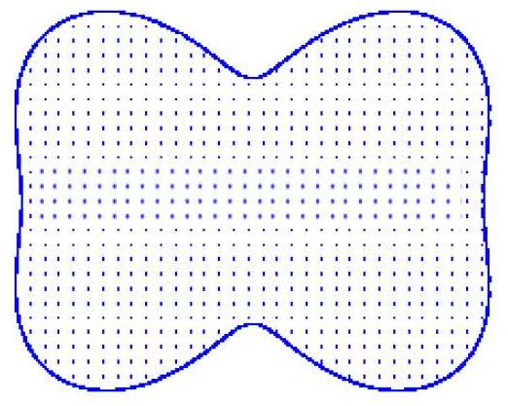
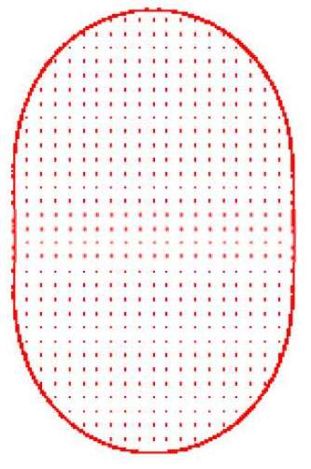


Coulomb excitation
particle – γ-ray coincidence measurement
Dy
$$4^{+}→2^{+}$$
Pb
$${12}^{+}→{11}^{−}$$

Slide 18
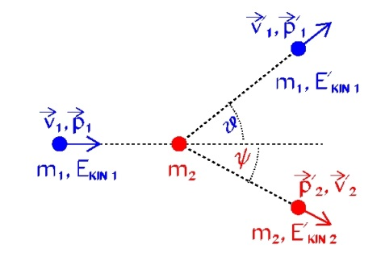
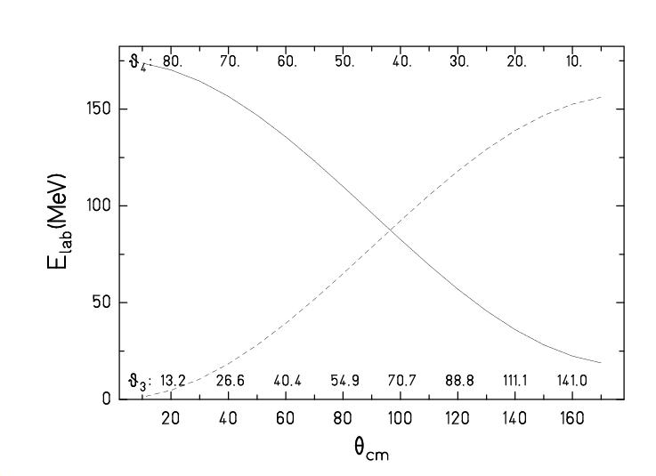
Kinematics
⁵⁸Ni → ¹¹²Sn @ 175 MeV
Ψ:
ϑ:

Slide 19
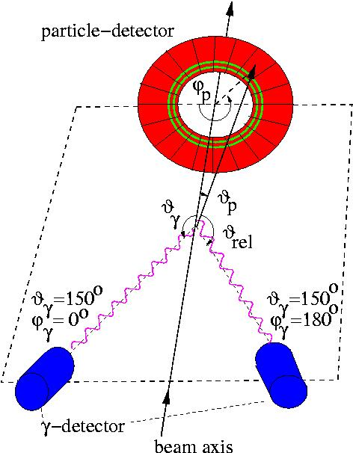
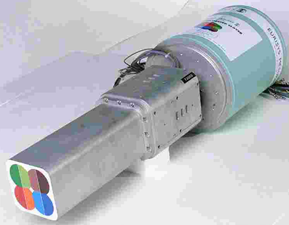
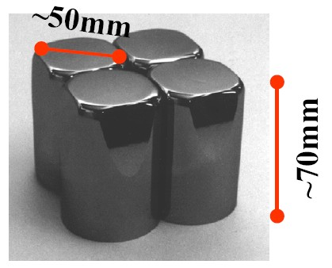
Coulomb excitation at IUAC
⁵⁸Ni → ¹²²Sn at 175 MeV
E_{safe} = 202 MeV
beam intensity = 0.5 pnA
target thickness = 0.5 mg/cm²
→ luminosity = 8·10²⁷ s⁻¹cm⁻²
cross section ~ 70 mb
event rate = 560 s⁻¹
γ-efficiency = 0.005
pγ-rate (Sn) = 3/s
¹¹²Sn target
⁵⁸Ni beam
Clover Ge detector
R. Kumar et al., Phys. Rev. C81, 024306 (2010)
M. Saxena et al., Phys. Rev. C90, 024316 (2014)

Slide 20
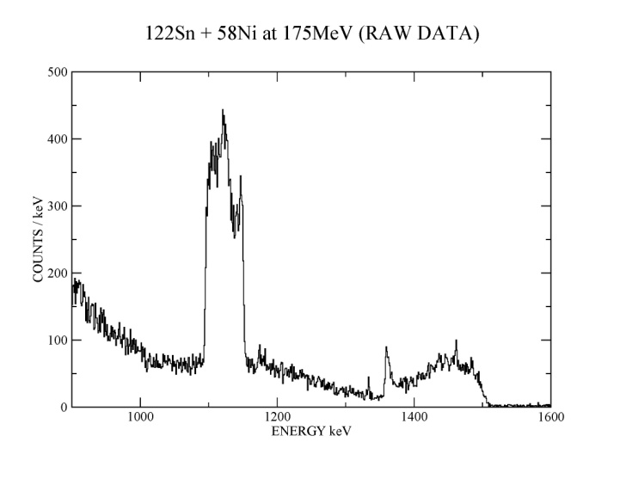
Coulomb excitation at IUAC
⁵⁸Ni → ¹²²Sn at 175 MeV
¹²²Sn: 2⁺ 1140 keV
⁵⁸Ni: 2⁺ 1454 keV
¹²²Sn target
⁵⁸Ni beam
Clover Ge detector
R. Kumar et al., Phys. Rev. C81, 024306 (2010)
M. Saxena et al., Phys. Rev. C90, 024316 (2014)

Slide 21
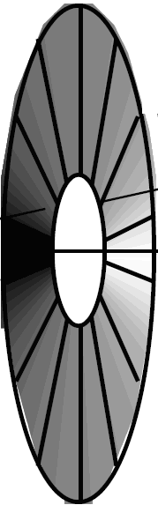
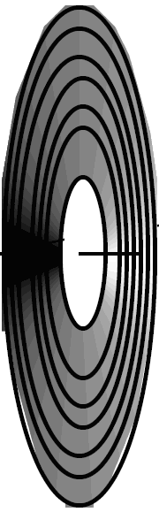





Annular gas-filled parallel-plate avalanche counter (PPAC)
V₀ ~ 500 V
p = 5-10 Torr
gap ~ 3 mm (anode-cathode)
¹²²Sn
⁵⁸Ni beam
Δt ~ tanϑ
o
i
i
i
delay line
Δtime →
A. Jhingan detector laboratory at IUAC

Slide 22






Doppler shift correction
⁵⁸Ni + ¹²²Sn at 175 MeV
delay line: inner – outer contact ≈ tanϑ
φ-segmentation : 36⁰, 72⁰, 108⁰, etc
$$tanθ=\frac{tan{45}^{0}−tan{15}^{0}}{{ch}_{2}−{ch}_{1}}∙\left(ch−{ch}_{1}\right)+tan{15}^{0}$$
⁵⁸Ni projectile measured with PPAC (¹²²Sn target excitation)
index 1 ≡ projectile (⁵⁸Ni) index 2 ≡ target nucleus (¹²²Sn)
¹²²Sn target
$$v_{cm}=0.04634∙{\left(1+{A_{2}}/{A_{1}}\right)}^{−1}\sqrt{{E_{lab}}/{A_{1}}}$$
( = 0.02594)
$$θ_{cm}=θ_{1}+arcsin\left(\frac{A_{1}}{A_{2}}sinθ_{1}\right)$$
$$θ_{2}=0.5∙\left({180}^{0}−θ_{cm}\right)$$
$$v_{2}=2∙v_{cm}∙cosθ_{2}$$
$$cosθ_{γ2}=cosθ_{γ}∙cosθ_{2}−sinθ_{γ}∙sinθ_{2}∙cos\left(φ_{γ}−φ_{1}\right)$$
$$cos\left(φ_{γ}−φ_{1}\right)=cosφ_{γ}∙cosφ_{1}+sinφ_{γ}∙sinφ_{1}$$
$$\frac{E_{γ0}}{E_{γ}}=\frac{1−v_{2}∙cosθ_{γ2}}{\sqrt{1−v_{2}^{2}}}$$
⁵⁸Ni beam
D. Schwalm et al. Nucl.Phys. A192 (1972), 449

Slide 23


Doppler shift correction
⁵⁸Ni + ¹²²Sn at 175 MeV
¹²²Sn: 2⁺ 1140 keV
⁵⁸Ni: 2⁺ 1454 keV
¹²²Sn target
2⁺ ¹²²Sn
2⁺ ⁵⁸Ni
⁵⁸Ni beam
R. Kumar, A. Jhingan @ IUAC

Slide 24



Doppler shift correction
²⁰⁸Pb + ¹⁶⁴Dy at 978 MeV

Slide 25



Experimental set-up
TARGET
CLOVER DETECTORS
@ backward angles
PPAC @ forward angle

Slide 26


Particle-gamma coincidence spectroscopy
+
b
+
+
+
target
~10⁻²²s
projectile
lifetime
2⁺
τ
~10⁻¹²-10⁻⁹s
Coulomb excitation:
$$σ_{E2}\left(2^{+}\right)\left[b\right]=4.819∙{\left(1+{A_{1}}/{A_{2}}\right)}^{−2}∙\frac{A_{1}}{Z_{2}^{2}}∙\left(E_{MeV}−∆{E′}_{MeV}\right)∙{B\left(E2,0^{+}→2^{+}\right)}_{e^{2}b^{2}}∙f_{E2}\left(ξ\right)$$
0⁺
1st order:
$$ξ=\frac{Z_{1}{∙Z}_{2}∙A_{1}^{1/2}∙∆{E′}_{MeV}}{12.65∙{\left(E_{MeV}−0.5∙∆{E′}_{MeV}\right)}^{3/2}}∙\left(1+\frac{5}{32}{\left(\frac{∆E′}{E}\right)}^{2}+…\right)$$

Slide 27

Particle-gamma coincidence spectroscopy
Coulomb excitation:
$$σ_{E2}\left(2^{+}\right)\left[b\right]=4.819∙{\left(1+{A_{1}}/{A_{2}}\right)}^{−2}∙\frac{A_{1}}{Z_{2}^{2}}∙\left(E_{MeV}−∆{E′}_{MeV}\right)∙{B\left(E2,0^{+}→2^{+}\right)}_{e^{2}b^{2}}∙f_{E2}\left(ξ\right)$$
$$ξ=\frac{Z_{1}{∙Z}_{2}∙A_{1}^{1/2}∙∆{E′}_{MeV}}{12.65∙{\left(E_{MeV}−0.5∙∆{E′}_{MeV}\right)}^{3/2}}∙\left(1+\frac{5}{32}{\left(\frac{∆E′}{E}\right)}^{2}+…\right)$$
K. Alder et al., RMP 28 (56) 432

Slide 28
Particle-gamma coincidence spectroscopy
+
b
+
+
+
target
~10⁻²²s
projectile
lifetime
2⁺
τ
~10⁻¹²-10⁻⁹s
Coulomb excitation:
$$σ_{E2}\left(2^{+}\right)\left[b\right]=4.819∙{\left(1+{A_{1}}/{A_{2}}\right)}^{−2}∙\frac{A_{1}}{Z_{2}^{2}}∙\left(E_{MeV}−∆{E′}_{MeV}\right)∙{B\left(E2,0^{+}→2^{+}\right)}_{e^{2}b^{2}}∙f_{E2}\left(ξ\right)$$
0⁺
1st order:
Particle-γ coincidence spectroscopy: Y_{γ}(I_{i}→I_{f}) → σ_{E2}(I_{i})
(indirect measurement)
need to take into account branching ratios, particle-γ angular correlations, electron conversion

Slide 29

Particle-gamma angular correlation
¹¹²Sn
⁵⁸Ni beam

Slide 30

Conversion electrons
Energetics of CE-decay (i=K, L, M,….)
E_{i} = E_{f} + E_{ce,i} + E_{BE,i}
γ- and CE-decays are independent; transition probability (λ ~ Intensity)
  λ_{T} = λ_{γ} + λ_{CE} = λ_{γ} + λ_{K} + λ_{L} + λ_{M}……
Conversion coefficient
  a_{i} = λ_{CE,i} / λ_{γ}

Slide 31








Coulomb excitation results of semi-magic Sn isotopes
Z = 50
g_{7/2}
d_{5/2}
s_{1/2}
d_{3/2}
h_{11/2}
single-particle transition:
(Weisskopf estimate)
$$B\left(E2;I_{i}→I_{gs}\right)=5.94 {10}^{−6}∙A^{4/3} \left[e^{2}b^{2}\right]$$
$B\left(E2;2^{+}→0^{+}\right)=14 \left[spu\right]$ for ¹¹⁴Sn
$B\left(E2;0^{+}→2^{+}\right)=0.232 \left[e^{2}b^{2}\right]$ for ¹¹⁴Sn
$$B\left(E2;I_{i}→I_{f}\right)=\frac{2I_{f}+1}{2I_{i}+1}∙B\left(E2;I_{f}→I_{i}\right)$$
N = 50
N = 82

Slide 32



Coulomb excitation results of semi-magic Sn isotopes
Z = 50
g_{7/2}
d_{5/2}
s_{1/2}
d_{3/2}
h_{11/2}
seniority scheme

Slide 33




Coulomb excitation team
Vivek Mishra, Pieter Doornenbal, Mansi Saxena, Chhavi Joshi, Sunil Prajapati, Rakesh Kumar, Paer-Anders Soederstroem, Mohit Kumar, Sunil Dutt, Akhil Jhingan, Aakashrup Banerjee, Hans Jürgen Wollersheim.

Slide 34

Multiple (multi-step) Coulomb excitation

Slide 35

γ-ray decay after multiple Coulomb excitation

Slide 36




The reorientation effect
The excitation cross section is a
direct measure of the Eλ matrix elements.
M_{f}
I_{f}
τ
I_{f}
I_{i}
I_{i}
1st order:
reorientation effect:
$$P_{0→2}^{(2)}\left(θ,ξ\right){=P}_{0→2}^{(1)}\left(θ,ξ\right)∙\left[1+\sqrt{\frac{7}{2π}}\frac{5}{4}∙\frac{A_{p}}{Z_{p}}∙\frac{∆E}{1+{A_{p}}/{A_{t}}}∙Q_{2}∙K\left(θ,ξ\right)\right]$$
$$Q\left(2^{+}\right)=−\sqrt{\frac{2π}{7}}\frac{4}{5}∙\left\langle 2\left\|M\left(E2\right)\right\|2\right\rangle$$

Slide 37


Shape coexistence in ⁷⁴Kr

Slide 38










Deformed nuclei
collective rotation
z
$$R\left(θ,φ\right)=R_{0}∙\left[1+β∙Y_{20}\left(θ,φ\right)\right]$$
$$β=\frac{4}{3}\sqrt{\frac{π}{5}}\frac{ΔR}{\overline{R}}$$
$$ΔR=a−b$$
$$\overline{R}=\frac{a+b}{2}$$
b
a
$$E_{γ}=E_{I}−E_{I−2}=\frac{ℏ^{2}}{2ℑ}\left(4I−2\right)$$
$$B\left(E2;I→I−2\right)=\frac{15}{32π}\frac{I\left(I+1\right)}{\left(2I−1\right)\left(2I+1\right)}∙Q_{2}$$
$$E_{I}=\frac{ℏ^{2}}{2ℑ}I\left(I+1\right)$$
$$Q_{2}=\frac{3ZR_{0}^{2}}{\sqrt{5π}}∙β$$
$$ℑ=\frac{2}{5}A∙M∙R_{0}^{2}∙β^{2}$$
analysis with GOSIA code
W. Spreng et al., Phys. Rev. Lett. 51 (1983), 1522

Slide 39






Coulomb excitation
angular momentum transfer
4⁺→2⁺
6⁺→4⁺
¹⁶⁴Dy(²⁰⁸Pb, ²⁰⁸Pb´)
E_{Pb} = 4.7 MeV/A
8⁺→6⁺
10⁺→8⁺
12⁺→10⁺
θ_{cm}= 66.5⁰-70.9⁰
θ_{cm}= 88.0⁰-94.2⁰
4⁺→2⁺
6⁺→4⁺
8⁺→6⁺
$$∆L_{max}=\frac{3}{2}∙J_{20}\left(θ_{cm}\right)∙q$$
10⁺→8⁺
12⁺→10⁺
θ_{cm}= 128.5⁰-148.5⁰
14⁺→12⁺
$$q=\frac{Z_{p}∙e^{2}∙Q_{0}}{4∙ℏ∙v∙a^{2}}$$
16⁺→14⁺
18⁺→16⁺
$$J_{20}\left(θ_{cm}\right)=\sin^{2}\frac{θ_{cm}}{2}+\tan^{2}\frac{θ_{cm}}{2}\left[1−\frac{π−θ_{cm}}{2}tan\frac{θ_{cm}}{2}\right]$$
$$J_{20}\left(θ_{cm}\right)≅\frac{2}{3}\left(1−cosθ_{cm}\right)$$

Slide 40




Coulomb excitation
energy transfer
$$ξ=1$$
ξ measures suddenness of interaction
$$ξ\left(θ_{cm}\right)=\frac{∆E_{exc}}{ℏ∙c}∙\frac{D−a}{γ∙β}$$
“adiabatic limit” for (single step) excitation ξ = 1
V_{C}
$$∆E_{exc}=ℏ∙c∙\frac{β∙γ}{D−a}$$
maximum energy transfer:

Slide 41

Evolution of nuclear structure
as a function of nucleon number

