Slide 1
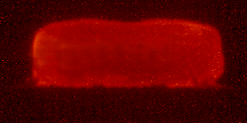
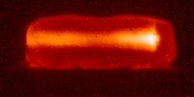
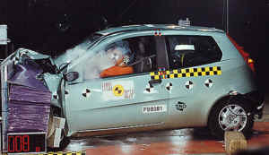
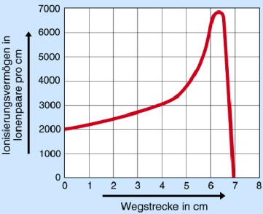
Interaction of Ions with Matter
Matter block
Intensive
heavy ion pulse
30 mm
Hadron beams slow down and stop, depositing the energy at the very end of the pass

Slide 2
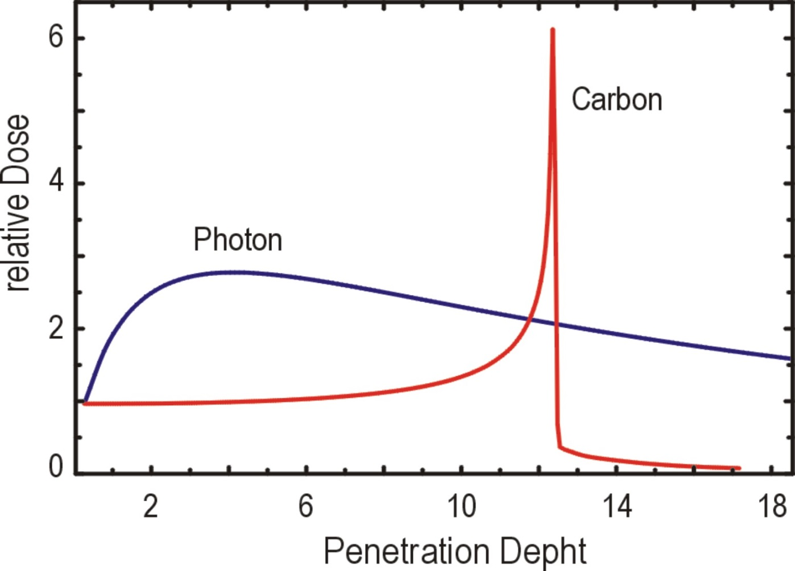
Radiation Effects
“Bragg”-peak
100 %
Ion beam
X-rays
Gamma beams
relative ionization
50 %
0 %
2
6
10
14
18
penetration depth
Hadron beams slow down and stop, depositing the energy at the very end of the pass.
γ-rays deposit the energy evenly through the tissue.

Slide 3
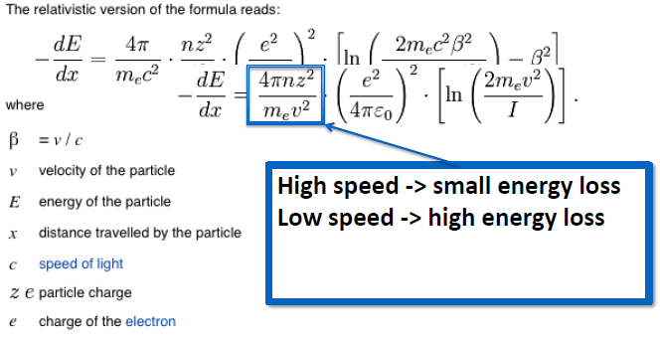
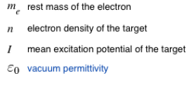
Energy loss in materials

Slide 4
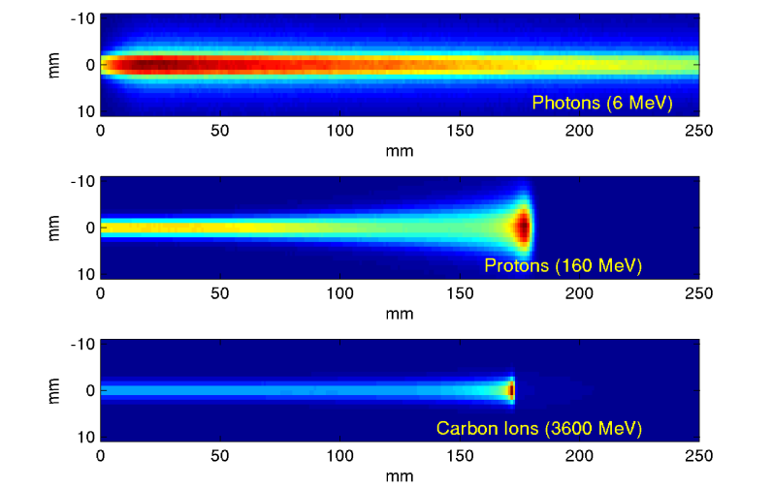
Radiation Effects

Slide 5
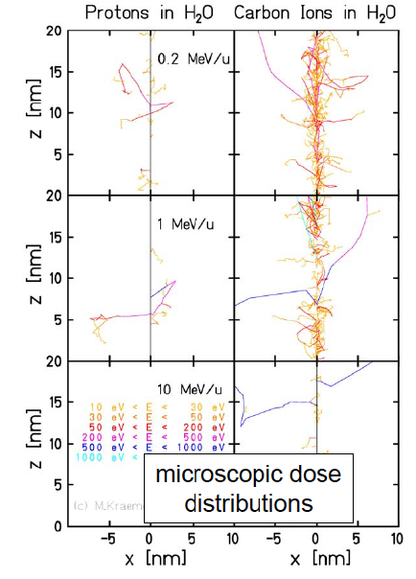
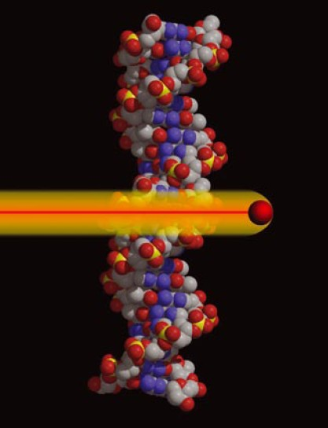
Physics and Biology of Radiation Therapy
Basic effect of radiation on cells:
Energy loss in matter leads to defects in the DNA – double strand breaks of the DNA kills the cell. Tumor cells have less repair capabilities than normal cells.

Slide 6
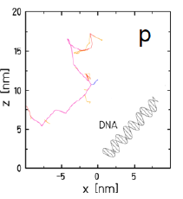
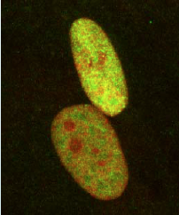
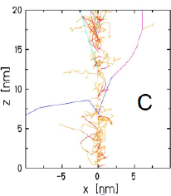
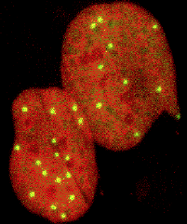
Physics and Biology of Radiation Therapy
Low LET
homogeneous deposition of dose
High LET
Local deposition of high doses
LET: linear energy transfer

Slide 7
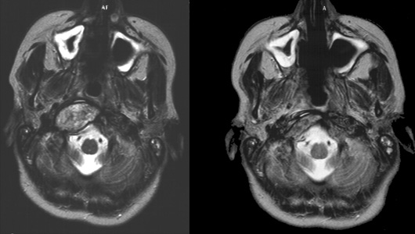
Treatment of Disease
DNA-molecule
with a passing C-ion
before treatment
after treatment with Carbon-ions

Slide 8
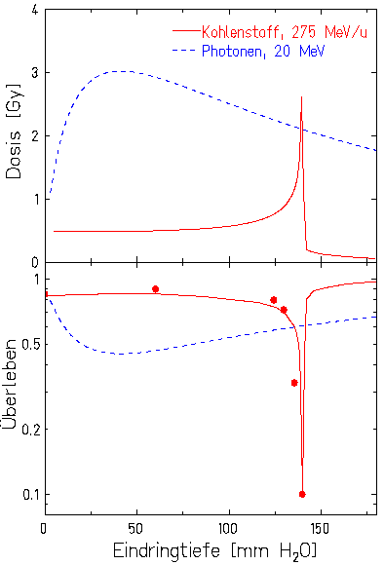
Treatment of Disease
C-ions, 275 MeV/u
photons, 20 MeV
survival rate dose [Gy]
before treatment
after treatment with Carbon-ions
after treatment with ion beam
penetration depth [mm H₂O]

Slide 9
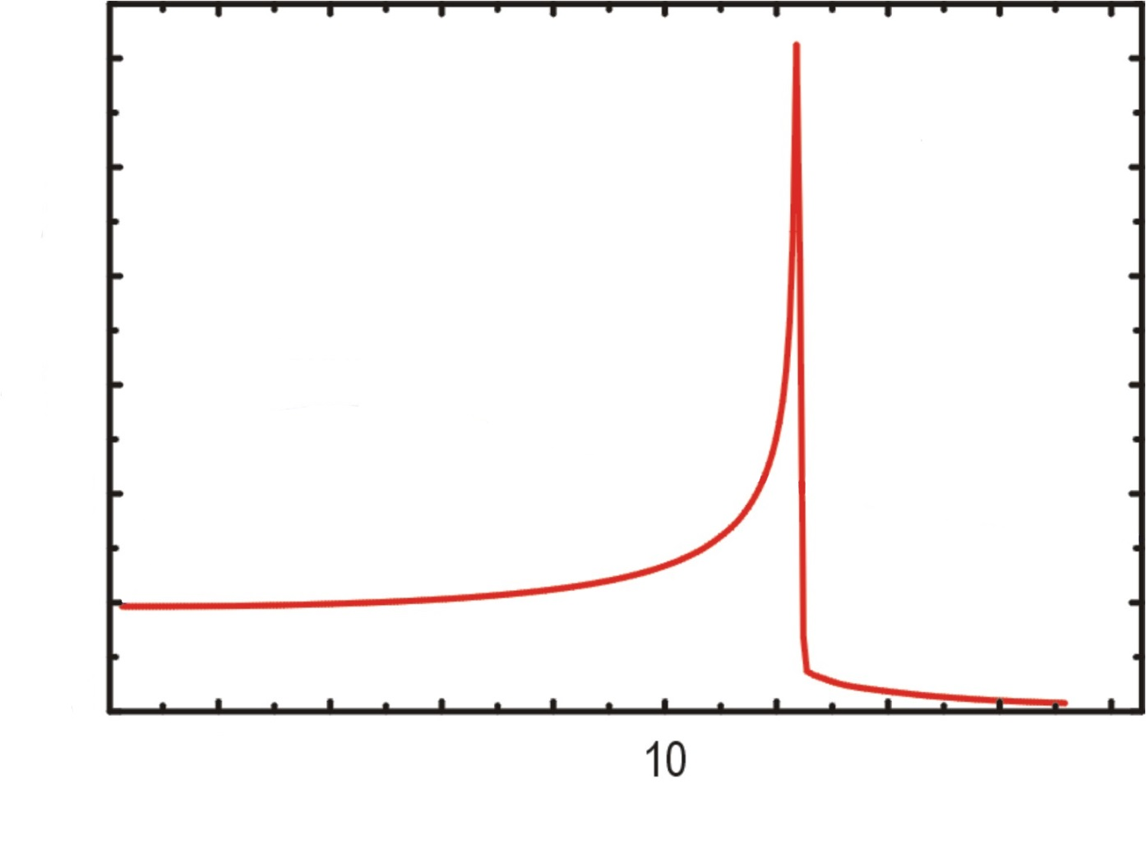
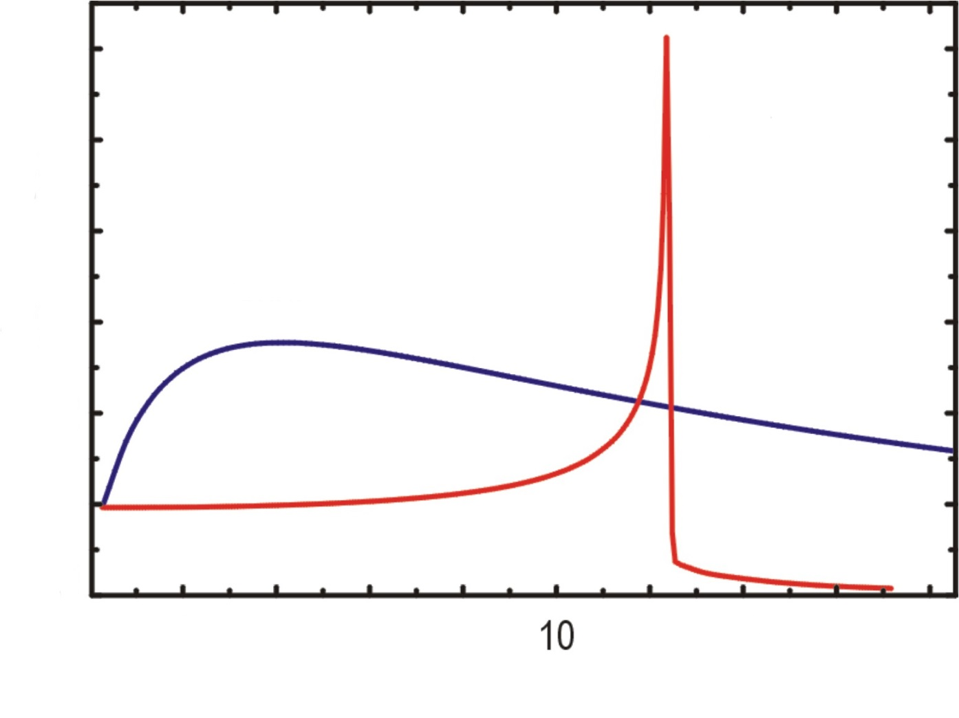
Radiation Effects
Tumor
100 %
ion beam
dose
hard X-ray radiation
50 %
0 %
2
6
10
14
18
depth in tissue [cm]
Notes:
9

Slide 10
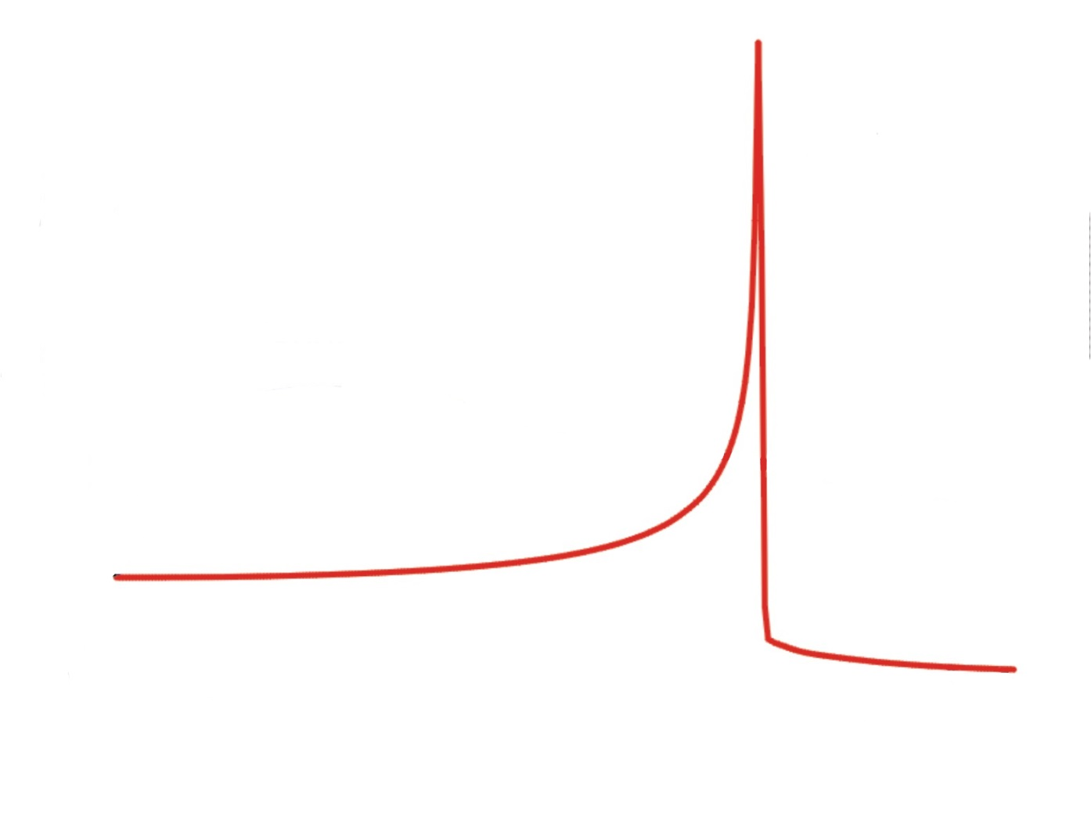
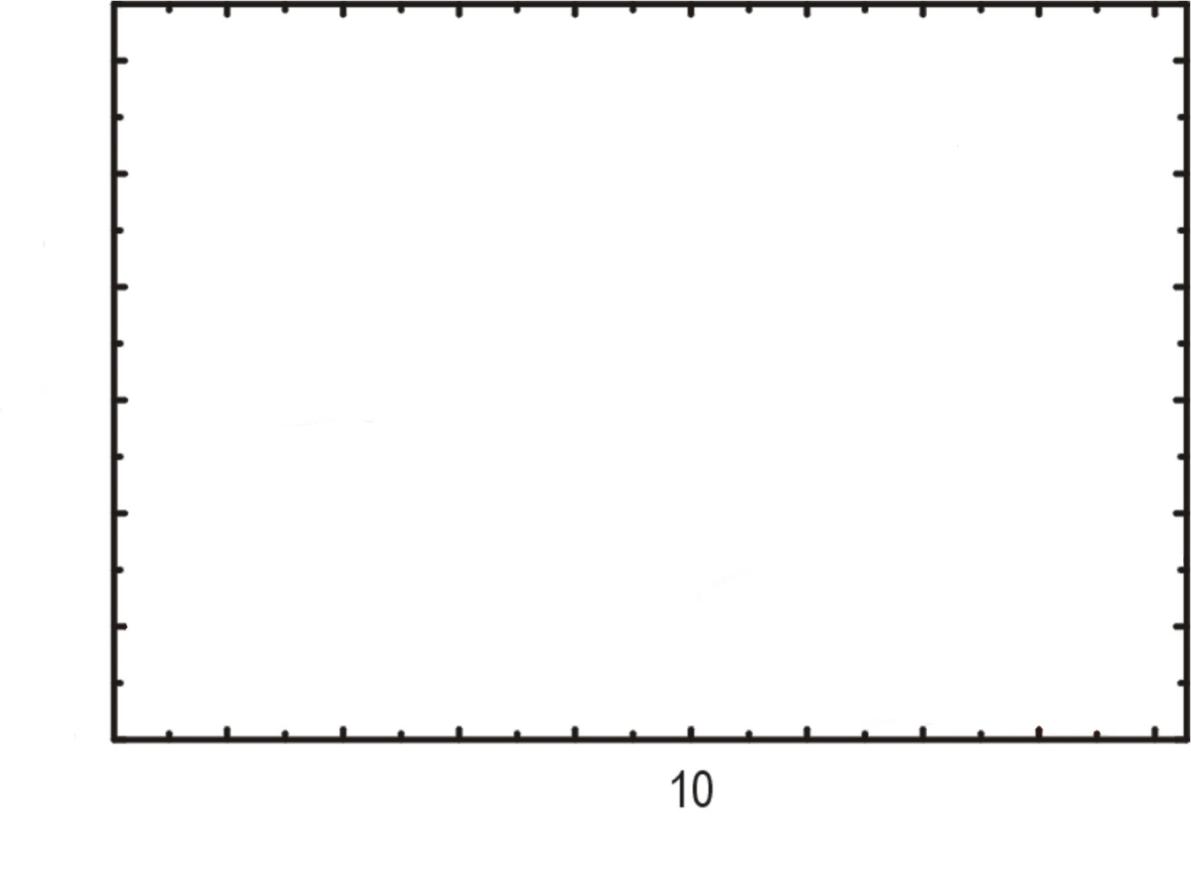
Radiation Effects
Tumor
100 %
ion beam
dose
50 %
0 %
2
6
10
14
18
depth in tissue [cm]
Notes:
10

Slide 11
Radiation Effects
Tumor
100 %
ion beam
dose
50 %
0 %
2
6
10
14
18
depth in tissue [cm]
Notes:
11

Slide 12
Radiation Effects
Tumor
100 %
ion beam
dose
50 %
0 %
2
6
10
14
18
depth in tissue [cm]
Notes:
12

Slide 13
Radiation Effects
Tumor
100 %
ion beam
dose
50 %
0 %
2
6
10
14
18
depth in tissue [cm]
Notes:
13

Slide 14
Radiation Effects
Tumor
100 %
ion beam
dose
50 %
0 %
2
6
10
14
18
depth in tissue [cm]
Notes:
14

Slide 15
Radiation Effects
Tumor
100 %
ion beam
dose
50 %
0 %
2
6
10
14
18
depth in tissue [cm]
Notes:
15

Slide 16
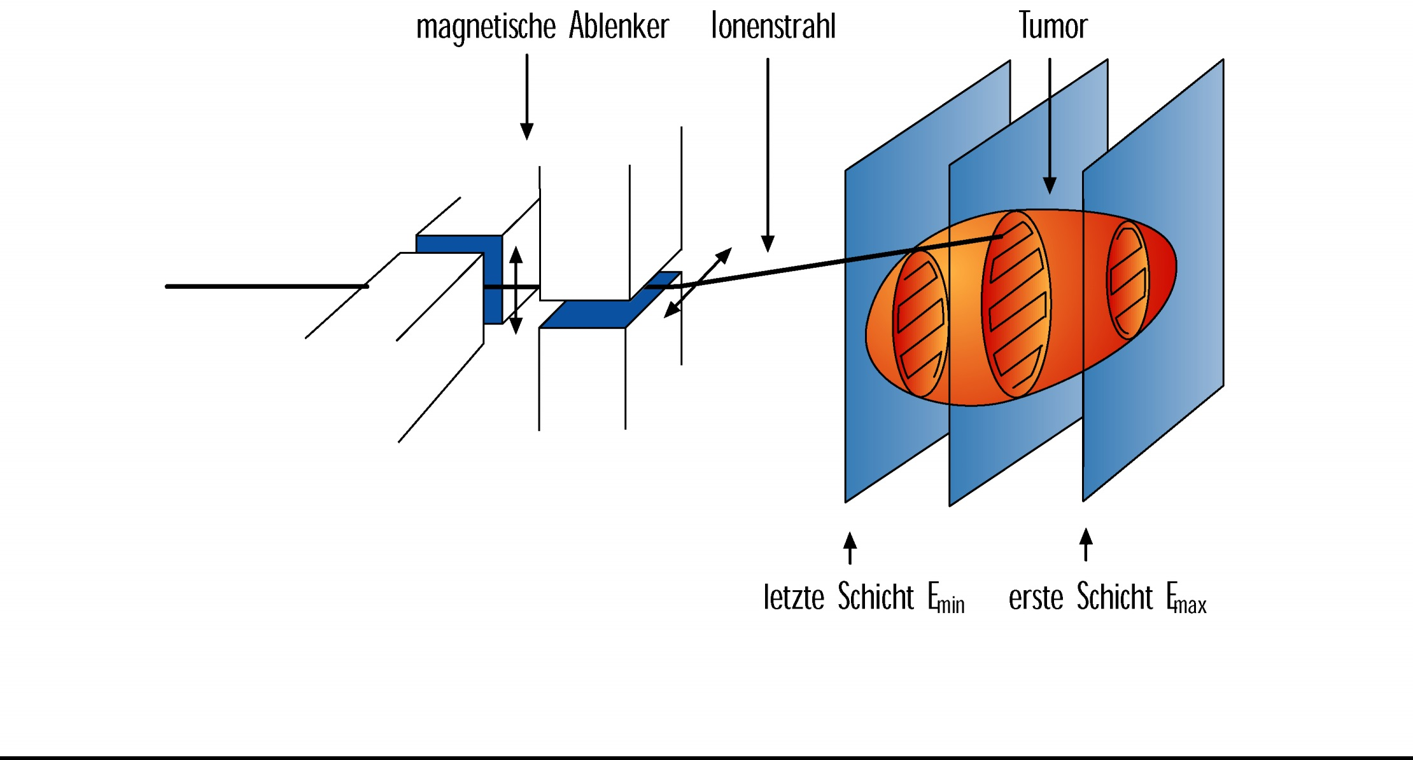
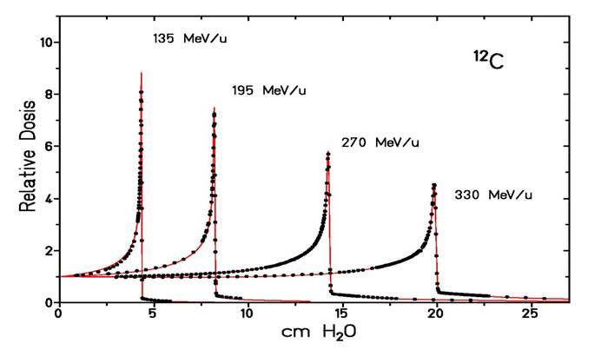
Ion Beam Therapy
magnetic deflector
ion beam
intensity controlled
raster scan procedure
last layer
first layer

Slide 17
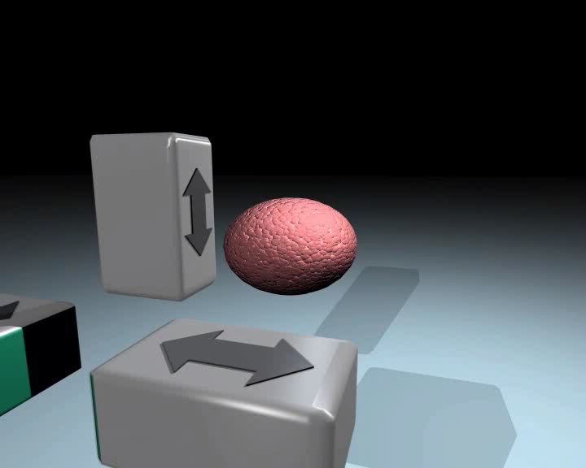
Ion Beam Therapy

Slide 18
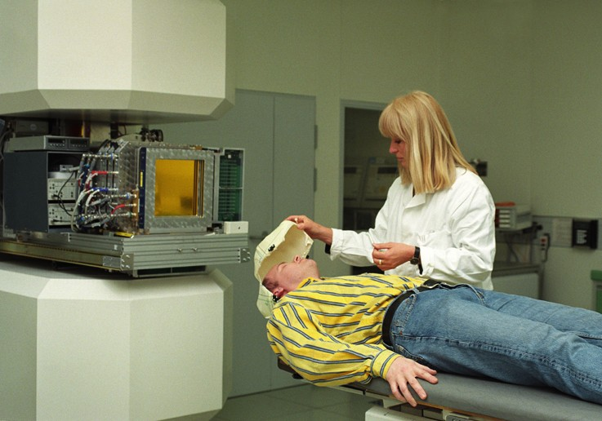
Ion Beam Therapy
448 patients were treated with carbon beams from 1997 – 2008 using raster scanning technique

Slide 19
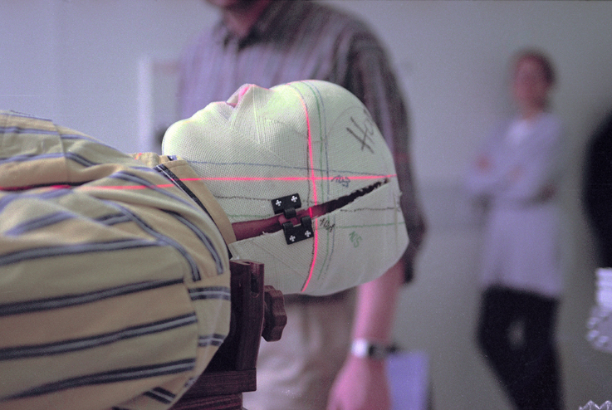
Ion Beam Therapy

Slide 20
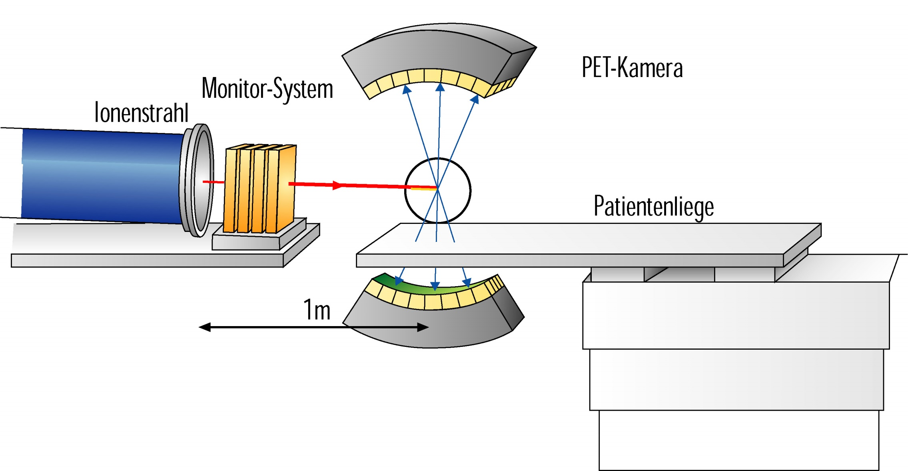
PET - Camera
PET-camera
monitor system
Ion beam
1
2
3
head
Kopf
bed for the patient
3
2
1

Slide 21
Course of Disease
before treatment
after treatment with ion beam

Slide 22


Course of Disease
before treatment
6 weeks after treatment
with Carbon ion beam

Slide 23
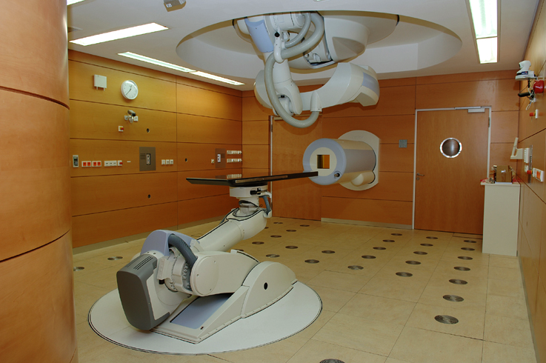
Heidelberg Ion-Beam Therapy Center (HIT)

Slide 24
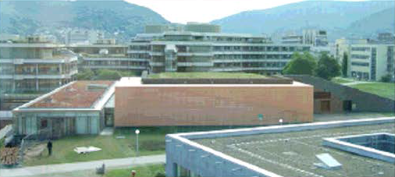
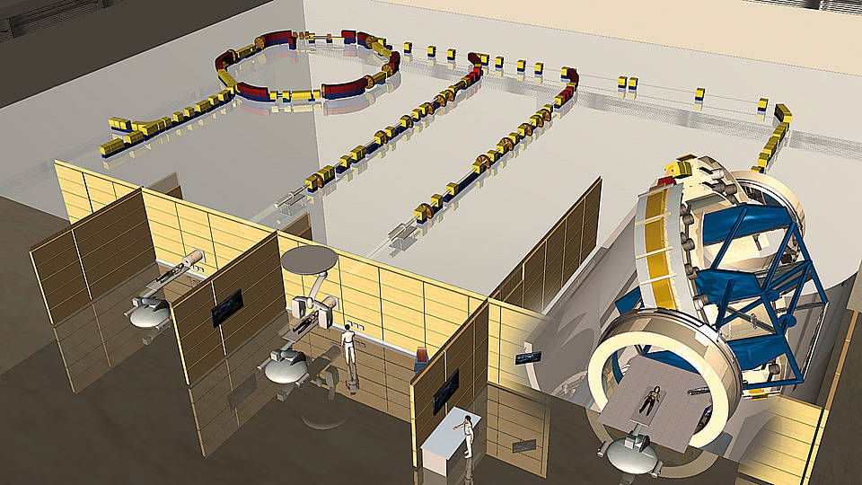
Heidelberg Ion-Beam Therapy Center (HIT)
Gantry

Slide 25
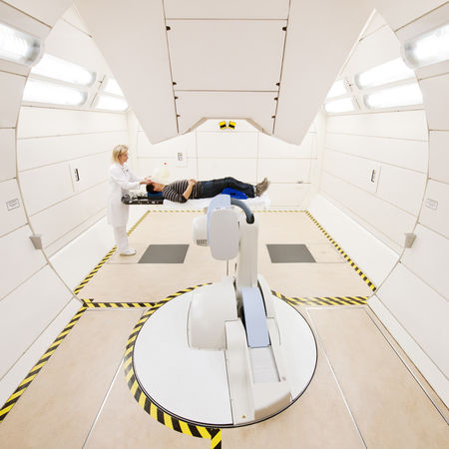
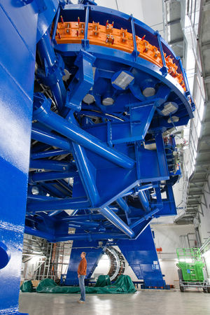
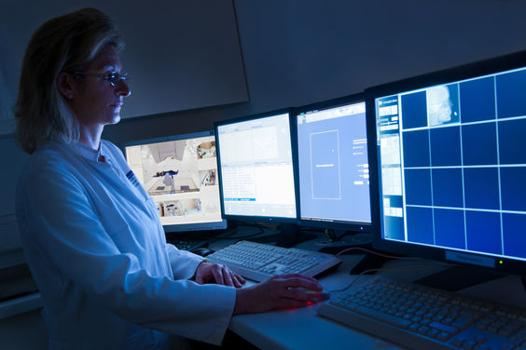
Heidelberg Ion-Beam Therapy Center (HIT)

Slide 26
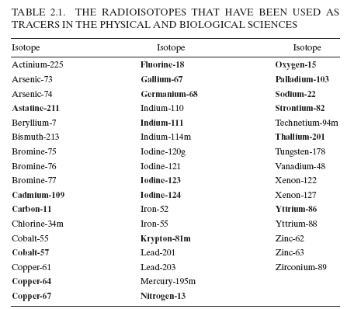
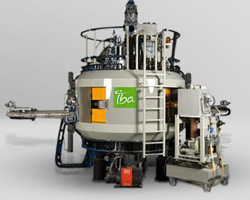
Radiopharmaceuticals
p, d, ³He, ⁴He beams
Isotopes used for PET, SPECT and Brachytherapy etc.

Slide 27
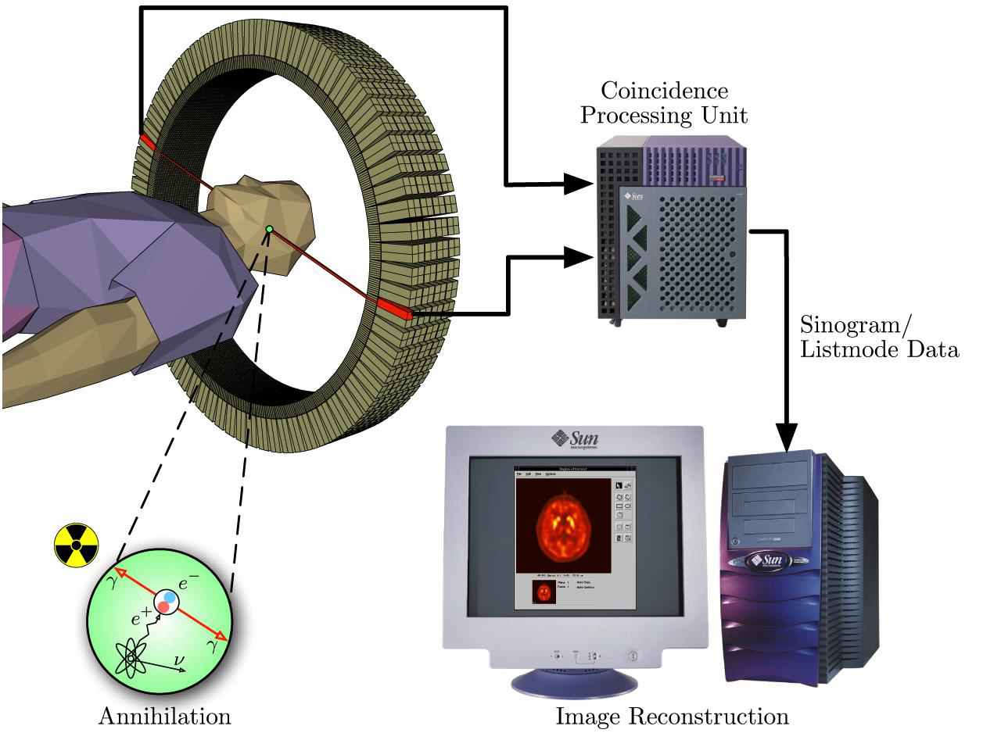
Radioisotope production
Accelerators (compact cyclotrons or linacs) are used to produce radio-isotopes for medical imaging.
7-11 MeV protons for short-lived isotopes for imaging
70-100 MeV or higher for longer lived isotopes.
Positron emission tomography (PET) uses Fluorine-18, half life of ~ 110 min

Slide 28
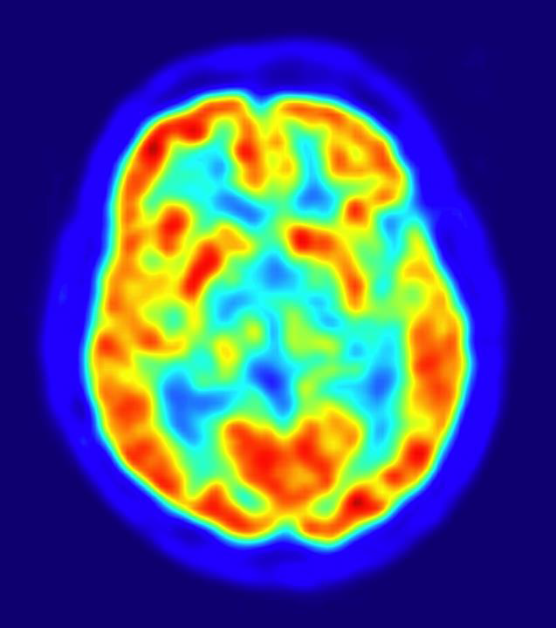
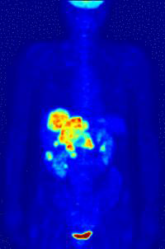
Radioisotope production
Fluorodeoxyglucose or FDG carries the 18F to areas of high metabolic activity
90% of PET scans are in clinical oncology

Slide 29
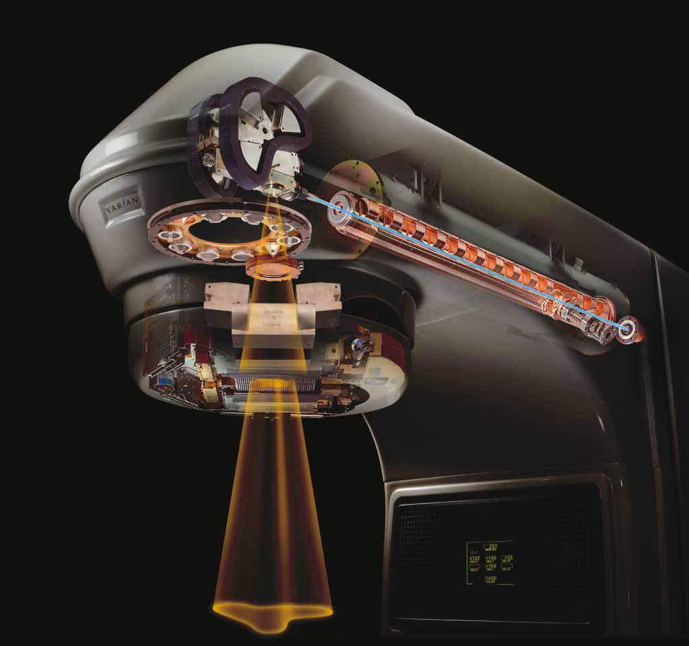
X-Ray Radiotherapy
Linac
Foil to produce X-rays
Collimation system
Varian medical system

Slide 30
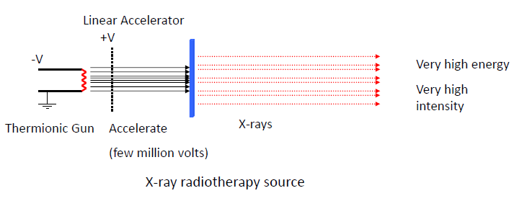
X-Ray Radiotherapy

Slide 31
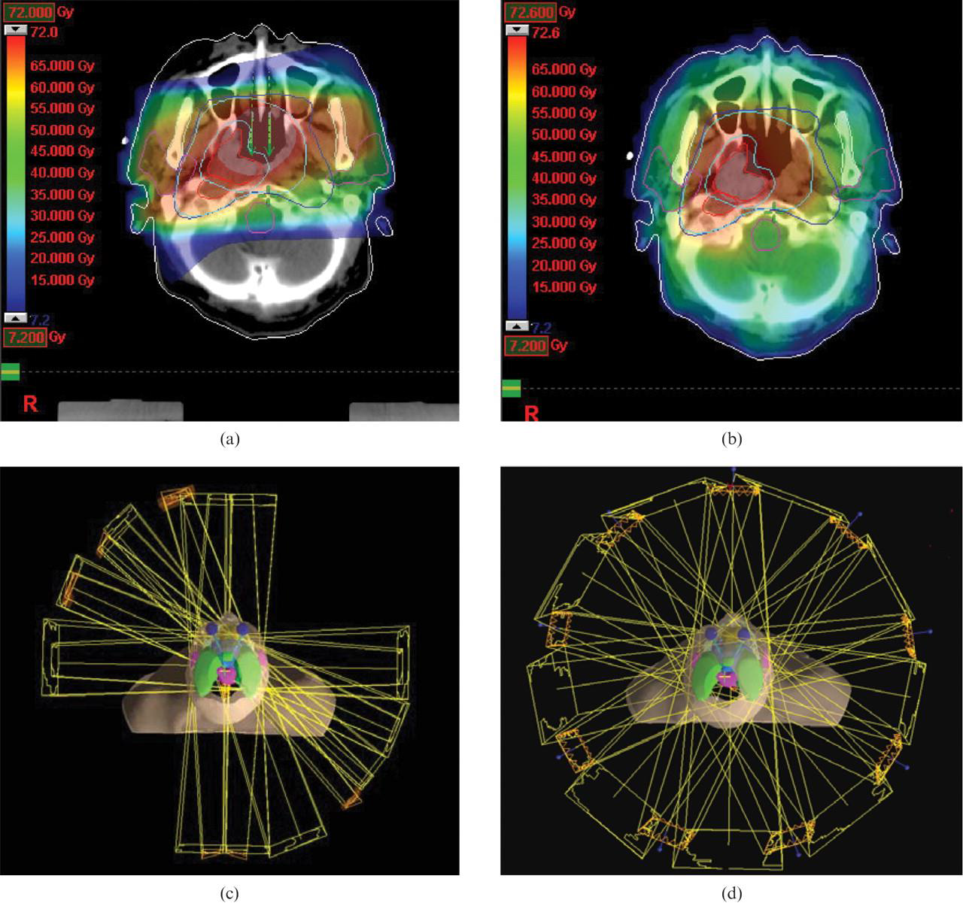
X-Ray Radiotherapy

Slide 32
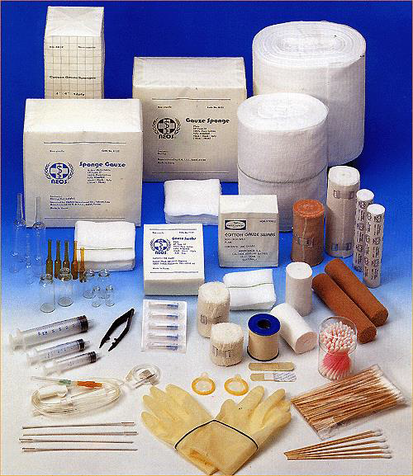
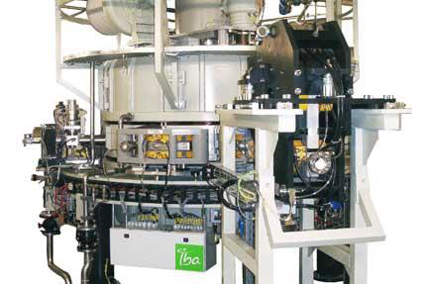
Equipment Sterilization
Manufacturers of medical disposables have to kill every germ on syringes, bandages, surgical tools and other gear, without altering the material itself.
E-beam sterilization works best on simple, low density products.
Advantages: takes only a few seconds (gamma irradiation can take hours)
Disadvantages: limited penetration depth, works best on simple, low density products (syringes)
The IBA rhodotron – a commercial accelerator used for e-beam sterilization

