Slide 1
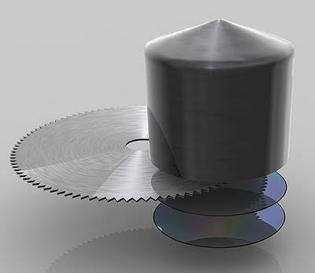
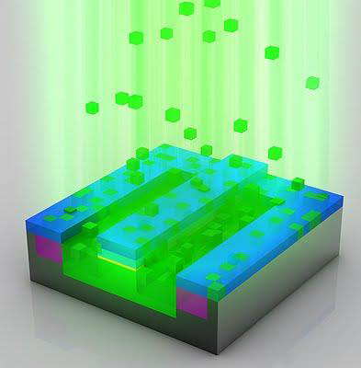
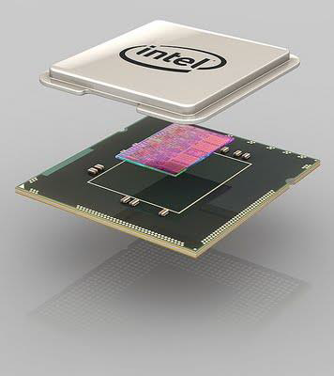
Ion Implantation
Electrostatic accelerators are used to deposit ions in semiconductors

Slide 2
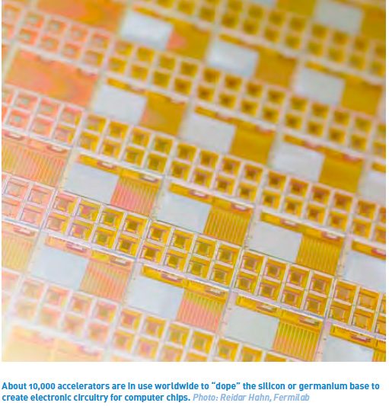
Ion Implantation
The semiconductor industry relies on the implanting of impurities in semiconductors (doping).
This is critical in integrated circuit manufacturing.
One way of doping this is to fire ions into the material from an accelerator with its penetration dependent on the energy, hence they can be placed accurately in the material.
Ion implanting is the only method to accurately control the ion position from the equipment settings.

Slide 3
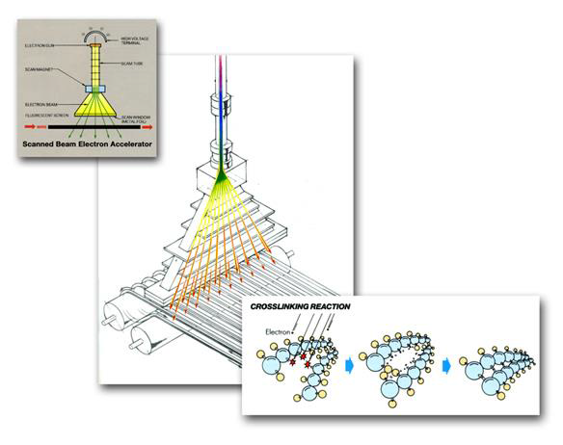
Electron Beam Processing
In the US, potential markets for industrial electron beams total $50 billion per year.
33% wire cable tubing
32% ink curing
17% shrink film
7% service
5% tires
6% others
http://rsccnuclearcable.com/capabilities.htm
When polymers are cross-linked, can become:
stable against heat,
increase tensile strength, resistance to cracking
heat shrinking properties etc.

Slide 4
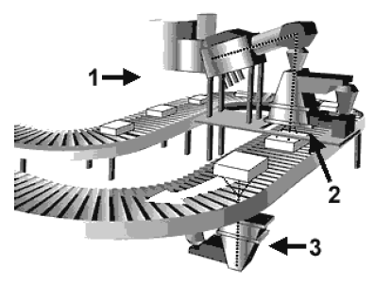
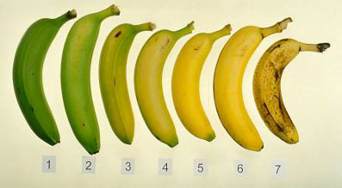
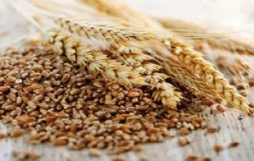
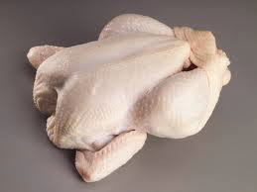
Food Irradiation
‘Cold pasteurization’ or ‘electronic pasteurization’ uses electrons (from an accelerator) or X-rays produced using an accelerator.
The word ‘irradiated’ or ‘treated with ionizing radiation’ must appear on the label packaging.
In the US all irradiated foods have this symbol
Foods authorized for irradiation in the EU:
Lower dose
Higher dose

Slide 5
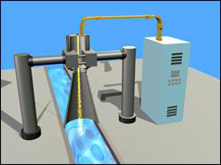
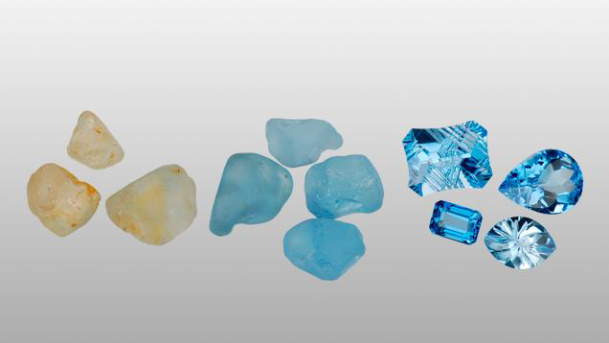
Other uses in industry
Hardening surfaces of artificial joints
Removal of NO_{x} and SO_{x} from flue gas emissions
Scratch resistant furniture
Treating waste water or sewage
Purifying drinking water
Irradiating topaz and other gems with electron beams to change color

Slide 6
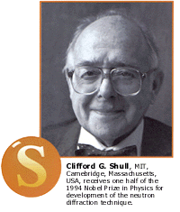
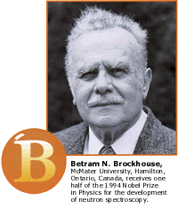
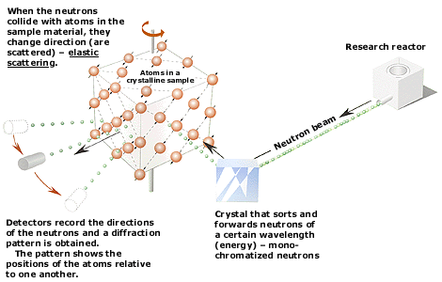
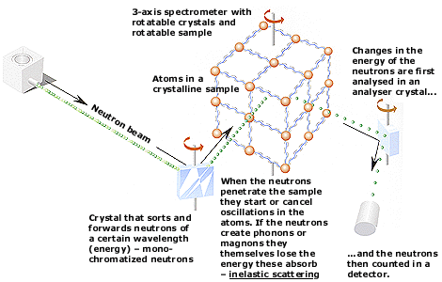
Neutrons reveal structure and dynamics
Neutrons show where atoms are
Neutrons show what atoms do

Slide 7
Neutrons reveal structure and dynamics

Slide 8
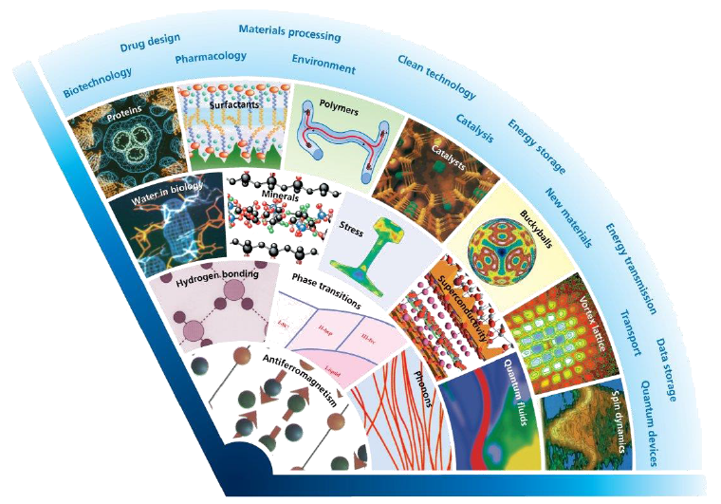
Neutrons reveal structure and dynamics

Slide 9
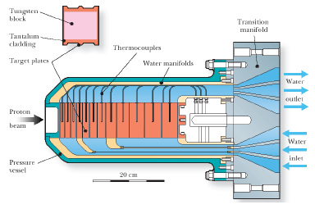
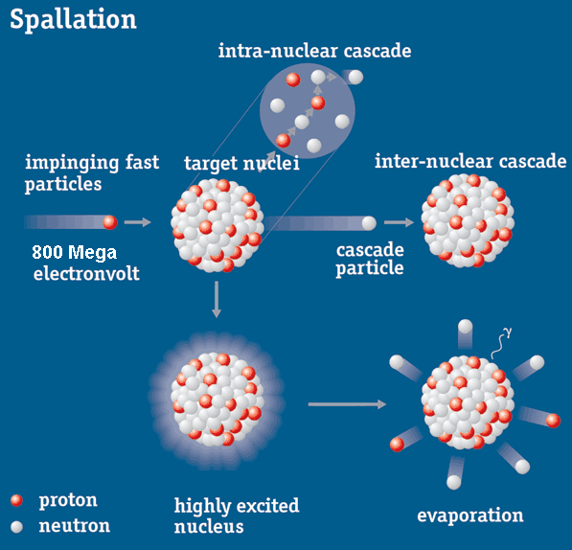
Spallation target
~ 2.3∙10¹³ (4 μC) ppp on to TS-1 tantalum coated tungsten target (40 pps)
~15-20 neutrons/proton, ~4∙10¹⁴ neutrons/pulse
primary neutrons from spallation: evaporation spectrum (E ~ 1 MeV) + high energy tail

Slide 10
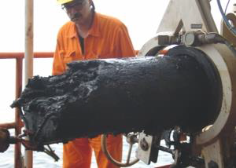
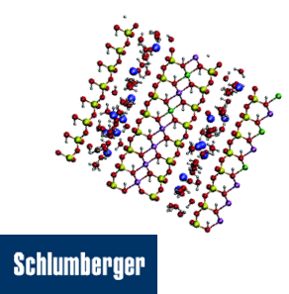
Unblocking oil pipes
Asphaltenes are a complex mixture of molecules that can sometimes block oil pipes.
Research to more easily predict and prepare for the formation of asphaltene deposits
Result in fewer blockages and big savings for the oil industry.
“ISIS allowed to understand more clearly how asphaltenes aggregate, an important observation from a flow assurance point of view and should allow more efficient extraction of hydrocarbons in the future.”
-Edo Boek, Schlumberger Cambridge Research

Slide 11
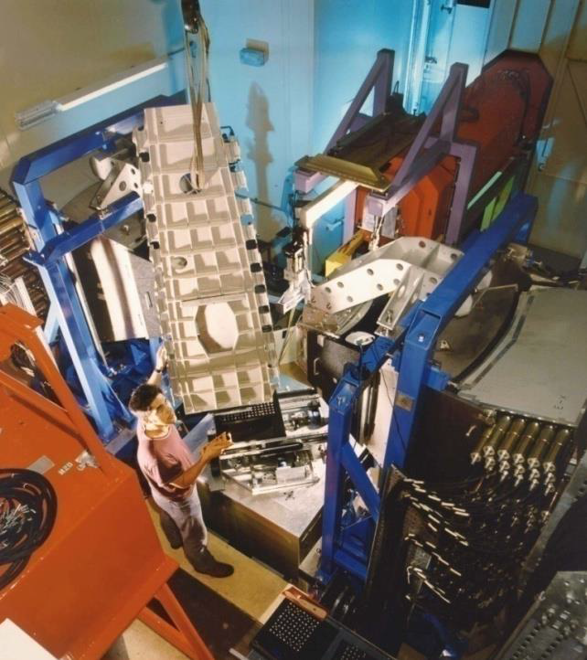
Stresses in Airbus A380 Wing
Aircraft manufacturer Airbus has used ISIS since 2006
Research into aluminum alloy weld integrity for aircraft programs
Residual stresses from welding cause weaknesses and possibility of cracks
ISIS neutrons look deep inside engineering components to measure stress fields

Slide 12
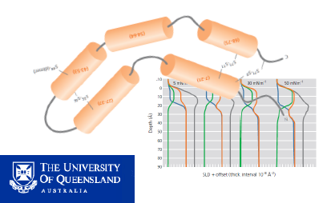
Understanding infant lung structure
Natural lung surfactant allows oxygen into bloodstream
Absence in premature babies causes breathing difficulties
ISIS mimicked change in lung capacity to discover how proteins and phospholipids act together
Helping to develop synthetic lung surfactants which can be more precisely targeted at clinical needs to help save babies’ lives

Slide 13
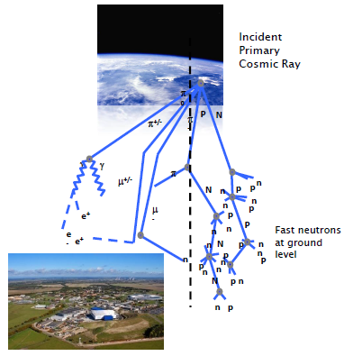
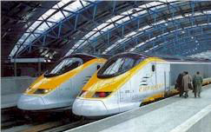
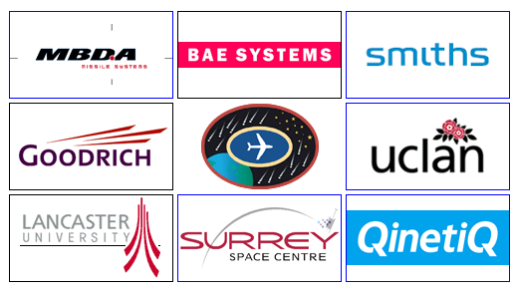
Fast neutron testing for semiconductor industry
Atmospheric neutrons collide with microchips and upset microelectronic devices every few seconds
300 times greater effect at high altitude
ISIS enables manufacturers to mitigate against the problem of cosmic radiation
Increased confidence in the quality and safety of aerospace electronic systems

Slide 14
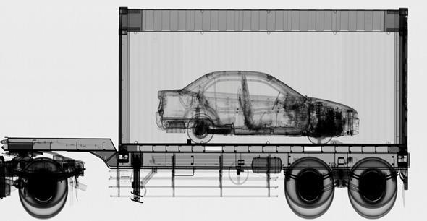
Cargo scanning
Cargo containers scanned at ports or border crossing
Accelerator-based sources of X-rays can be far more penetrating (6 MV) than Co-60 sources.
Container must be scanned in 30 s.

Slide 15
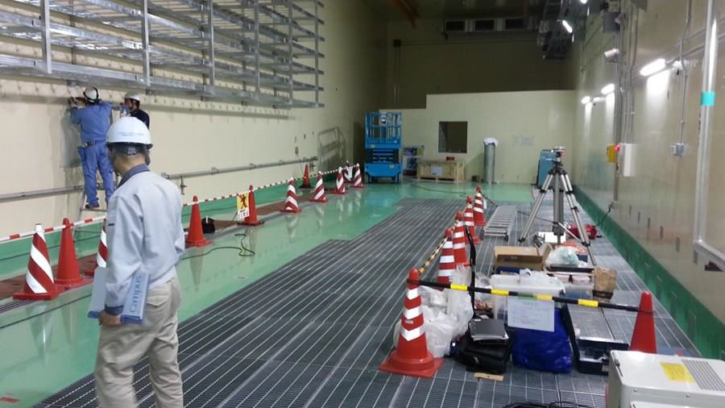
Materials testing for fusion
“deuterium-tritium nuclear fusion reactions will generate neutron fluxes in the order of 10¹⁸ m⁻²s⁻¹ with an energy of 14.1 MeV that will collide with the first wall of the reactor vessel”
International Fusion Material Irradiation Facility
40 MeV
2∙125 mA linacs
CW deuterons, 5 MW each
Beams will overlap onto a liquid Li jet to create conditions similar to in a fusion reactor
To de-risk IFMIF, first a test accelerator ‘LIPAc’ is being built
Installation of ‘LIPAc’ test accelerator has started in Japan

Slide 16
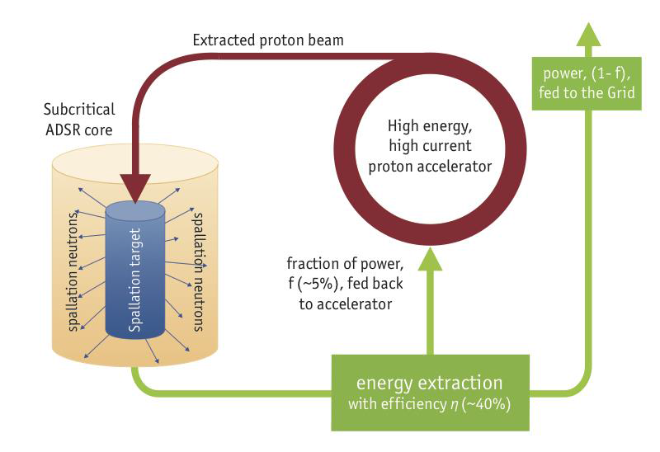
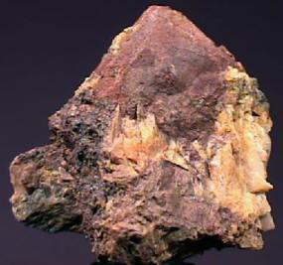
ADS systems Transmutation of nuclear waste isotopes or energy generation
Thorium
Major challenges for accelerator technology in terms of beam power (> 10 MW) and reliability

Slide 17
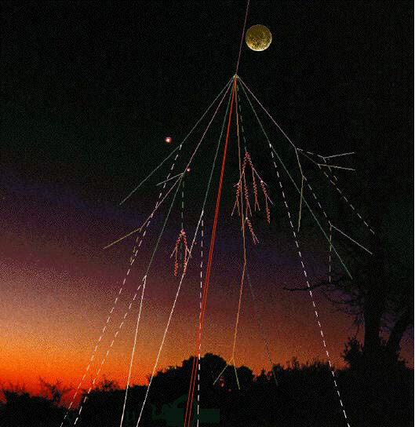
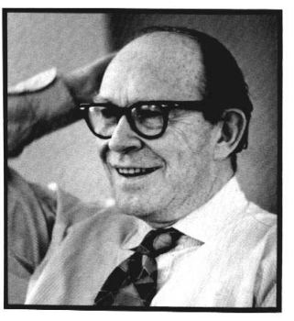
Radiocarbon (¹⁴C) formation and decay
formed by interaction of cosmic ray spallation products with stable N gas
radiocarbon subsequently decays by $β^{−}$ decay back to 14N with a half-life of 5730 y
Radiocarbon dating was first explored by W.R. Libby (1946) , who later won the Nobel Prize.
$${}_{0}^{1}n+{}_{7}^{14}N→{}_{7}^{15}N→{}_{6}^{14}C+{}_{1}^{1}H$$
$${}_{6}^{14}C→{}_{7}^{14}N+β^{−}+\overline{ν}$$
The activity of radiocarbon in the atmosphere represents a balance of its production, its decay and its uptake by the biosphere, weathering, etc.
Which of these three things might change through time and why?
Willard Frank Libby

Slide 18
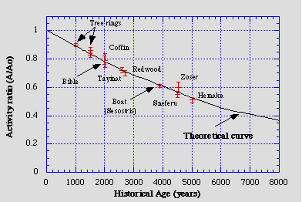
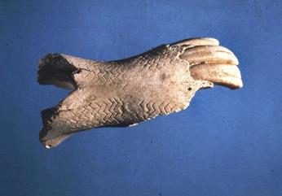
Radiocarbon Dating
As plants uptake C through photosynthesis, they take on the ¹⁴C activity of the atmosphere.
Anything that derives from this C will also have atmospheric ¹⁴C activity (including you and I).
If something stops actively exchanging C (it dies, is buried, etc.), that ¹⁴C begins to decay.
$$A=A_{0}∙e^{−λ∙t}$$
where present-day, pre-bomb, ¹⁴C activity = 13.56 dpmin/g C

Slide 19
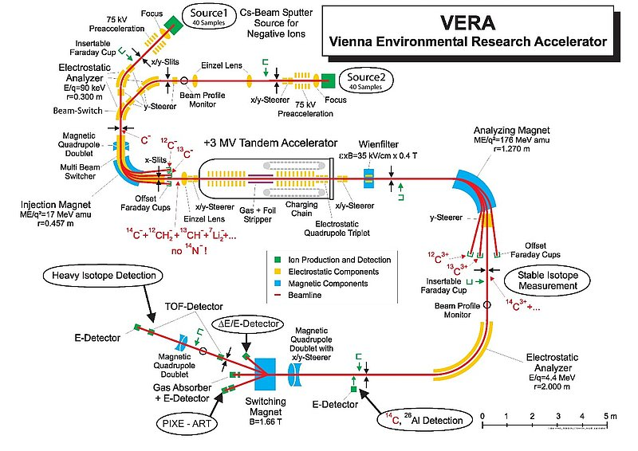
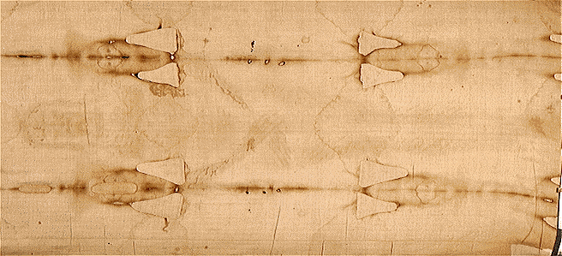
Mass Spectrometry
For more accuracy, isolated C-14 from other isotopes
“AMS” = Accelerator Mass Spectrometry

Slide 20
Finally, just one more application …
Detecting wine fraud
Use ion beam to test the bottle of “antique” wine – chemical composition of the bottle compared to a real one.
“In a recent and spectacular case, American collector William Koch sued a German wine dealer, claiming four bottles – allegedly belonging to former U.S. president Thomas Jefferson – purchased for 500,000 dollars, were fake. The case has yet to be settled”.
- http://www.cosmosmagazine.com

