Slide 1
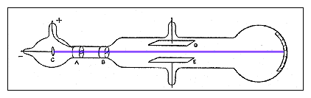
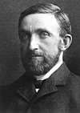
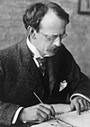
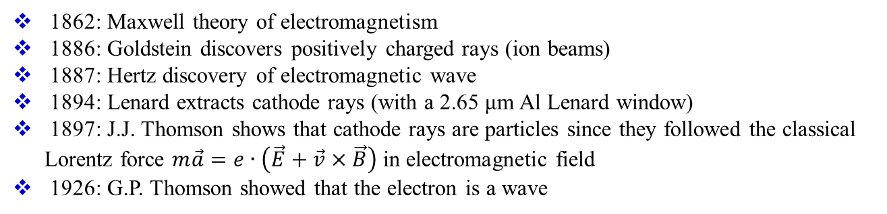
History
1862: Maxwell theory of electromagnetism
1886: Goldstein discovers positively charged rays (ion beams)
1887: Hertz discovery of electromagnetic wave
1894: Lenard extracts cathode rays (with a 2.65 μm Al Lenard window)
1897: J.J. Thomson shows that cathode rays are particles since they followed the classical Lorentz force $m\vec{a}=e∙\left(\vec{E}+\vec{v}×\vec{B}\right)$ in electromagnetic field
1926: G.P. Thomson showed that the electron is a wave
Philipp E.A. von Lenard
(1862-1947)
Joseph J. Thomson
(1856-1940)
Nobel prize 1905
Nobel prize 1906

Slide 2
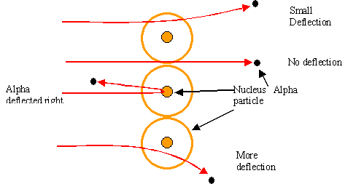
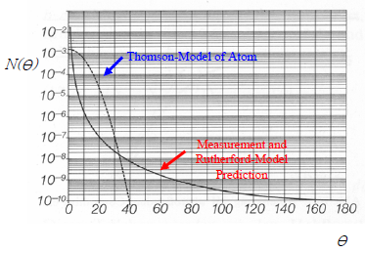
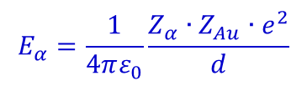
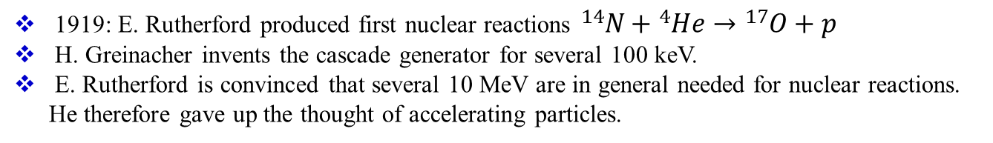
Rutherford scattering
Ernest Rutherford discovers the nucleus with 7.7 MeV ⁴He from ²¹⁴Po alpha decay measuring the elastic cross section
$$E_{α}=\frac{1}{4πε_{0}}\frac{Z_{α}∙Z_{Au}∙e^{2}}{d}$$
d = distance of closest approach for head-on collision
1919: E. Rutherford produced first nuclear reactions ${}_{}^{14}N+{}_{}^{4}{He}→{}_{}^{17}O+p$
H. Greinacher invents the cascade generator for several 100 keV.
E. Rutherford is convinced that several 10 MeV are in general needed for nuclear reactions. He therefore gave up the thought of accelerating particles.

Slide 3
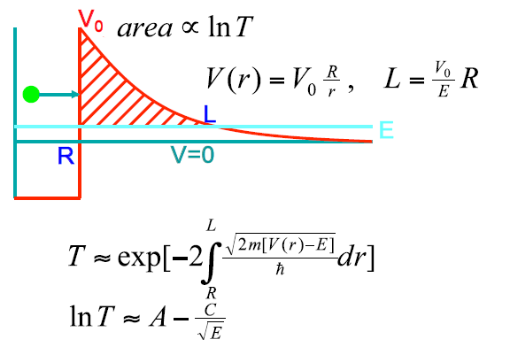
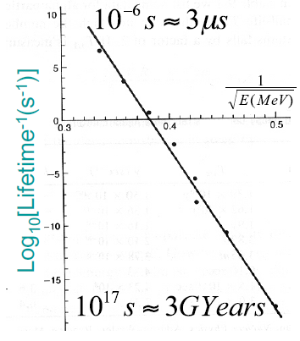
Tunneling allows low energies
1928: Explanation of alpha decay by George A. Gamov as tunneling showed that several 100 keV protons might suffice for nuclear reactions
Schrödinger equation: $\frac{∂^{2}}{{∂r}^{2}}u\left(r\right)=\frac{2m}{ℏ^{2}}\left[V\left(r\right)−E\right]u\left(r\right)$, $T={\left|\frac{u\left(L\right)}{u\left(0\right)}\right|}^{2}$
The transmission probability T for an alpha particle traveling from the inside towards the potential well that keeps the nucleus together determines the lifetime for alpha decay

Slide 4
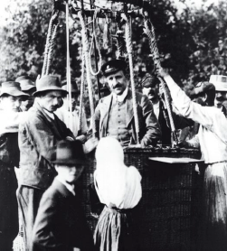
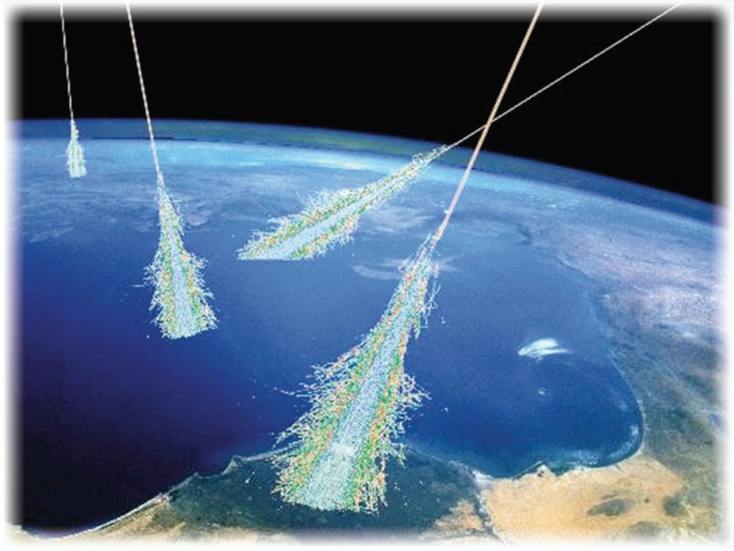
Natural Particle Acceleration
Radioactive sources produce maximum energies of a few million electron volts (MeV)
Cosmic rays are high-energy radiation, mainly originating outside the Solar System and even from distant galaxies. Upon impact with the Earth’s atmosphere, cosmic rays can produce showers of secondary particles that sometimes reach the surface.
Victor Hess (1912)
discovery of cosmic showers
Nobel Prize 1936

Slide 5
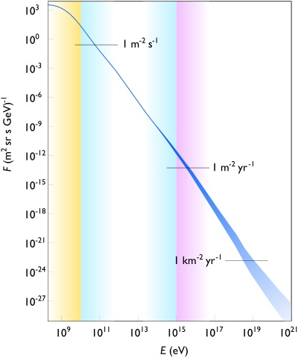
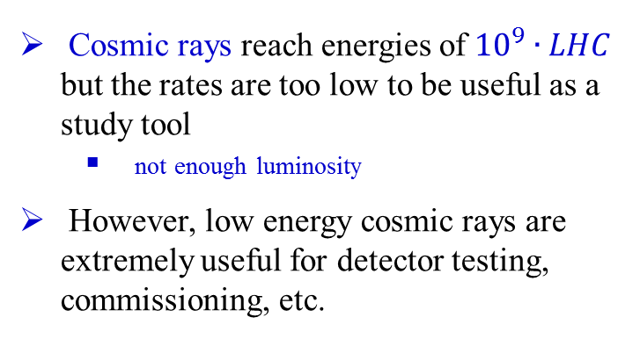
Natural Particle Acceleration
max. LHC energy
Cosmic rays reach energies of ${10}^{9}∙LHC$ but the rates are too low to be useful as a study tool
  not enough luminosity
However, low energy cosmic rays are extremely useful for detector testing, commissioning, etc.

Slide 6
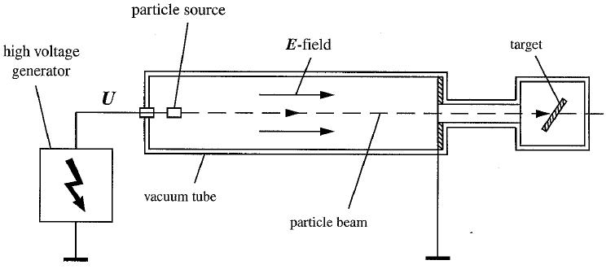
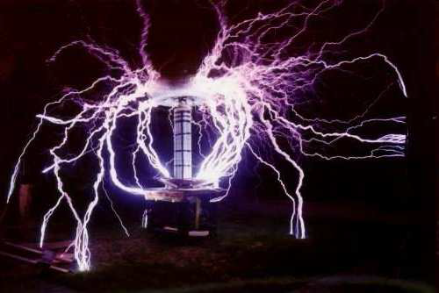
Three historical lines of accelerators
Direct Voltage/Electrostatic Accelerators
Resonant Accelerators
Transformer Accelerator
General Principle and Limitations:
Constant electric field between two electrodes
One of the electrodes contains the particle source
Voltage 1 MV
Charge Ze
Energy Z MeV
The energy limit is given by the maximum possible voltage. At the limiting voltage, electrons and ions are accelerated to such large energies that they hit the surface and produce new ions. An avalanche of charge carriers causes a large current and therefore a breakdown of the voltage.
Maximum DC voltage: a few MV are technically possible

Slide 7
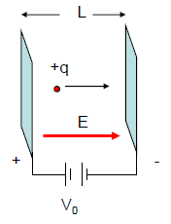
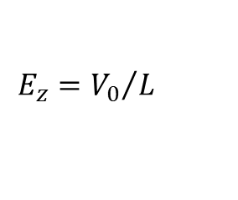
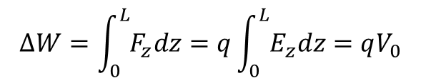
Acceleration by static electric fields
We can produce an electric field by establishing a potential difference V₀ between two parallel plate electrodes, separated by a distance L:
$$E_{z}={V_{0}}/L$$
A charged particle released from the + electrode acquires an increase in kinetic energy at the - electrode of
$$∆W=\int_{0}^{L}{F_{z}dz}=q\int_{0}^{L}{E_{z}dz}=qV_{0}$$

Slide 8
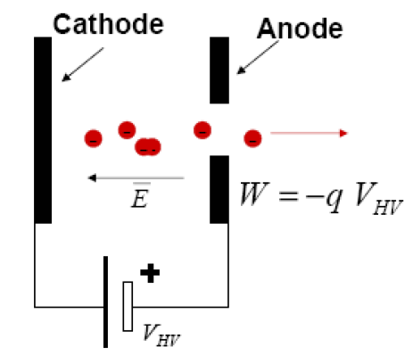
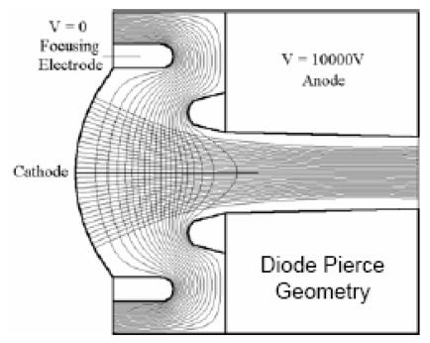
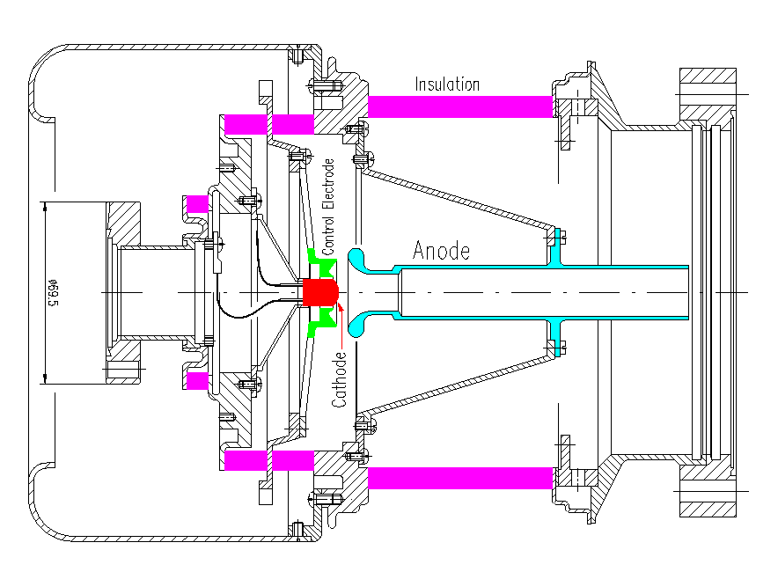
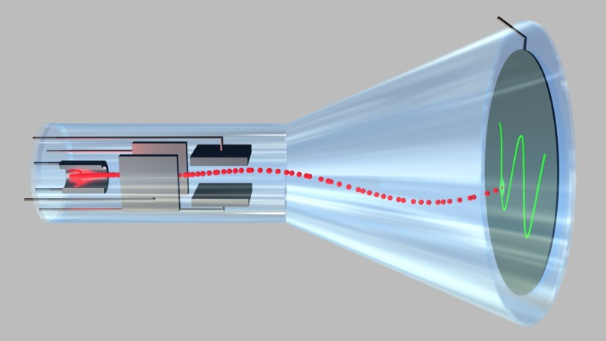
The simplest electrostatic accelerators: Electron Guns
Still one of the most used schemes for electron sources

Slide 9
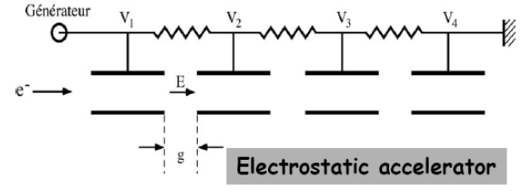
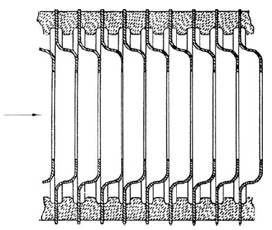
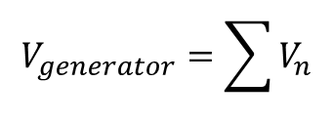

Electrostatic Accelerators
Some small accelerators, such as electron guns for TV picture tubes, used the parallel plate geometry.
Electrostatic particle accelerators generally use a slightly modified geometry in which a constant electric field is produced across an accelerating gap
Energy gain:
Limited by the generator
$$W=n∙q\sum{V_{n}}$$
Accelerating column in electrostatic accelerator
$$V_{generator}=\sum{V_{n}}$$

Slide 10
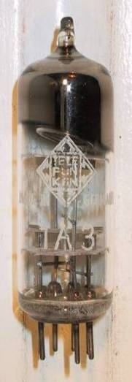
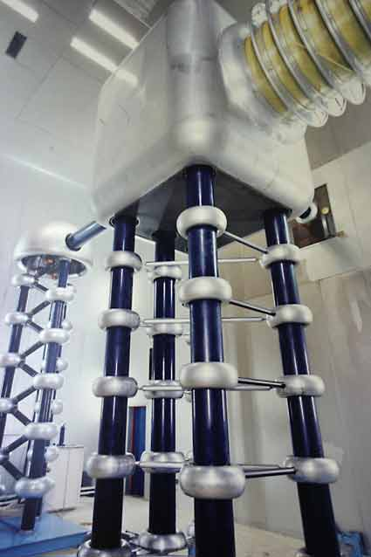

Man-made Particle Accelerators
The simplest accelerators accelerate charged particles through a static electric field.
Example: vacuum tubes (or CRT TV’s)
Cathode
Anode
$$Energy=e∙E∙d \left[eV\right]$$
limited by magnitude of electric field E
  - CRT display ~keV
  - X-ray tube ~10’s of keV
  - Van de Graaf ~MeVs
Old FNAL Cockroft-Walton = 750 kV
Solutions:
- Alternate fields to keep particles in accelerating fields
→ Radio Frequency
- Bend particles so they see the same accelerating field
over and over → cyclotron, synchrotrons

Slide 11
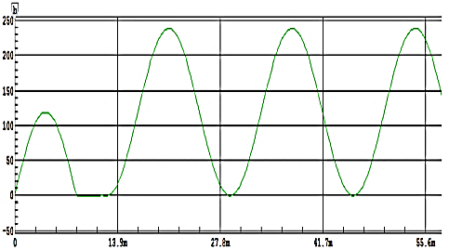
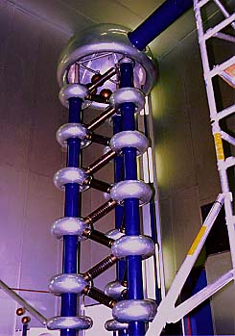
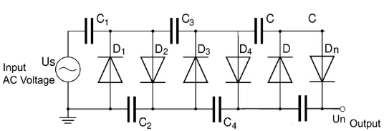
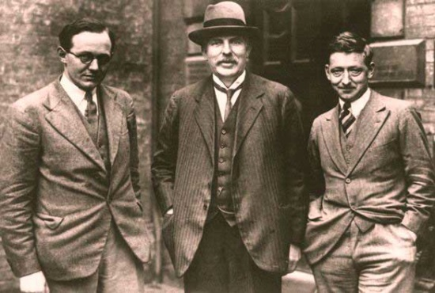
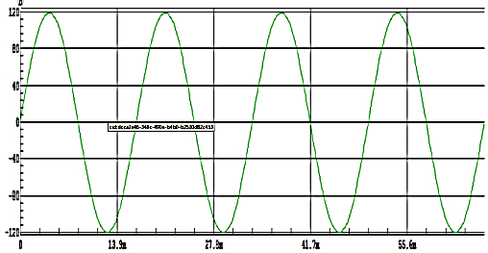
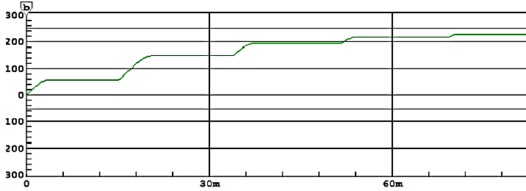
Cockroft Walton multiplier
240 V
120 V
0 V
+240V
+120V
-120V
+120V
120 V
0 V
-120 V
DC Voltage
Walton, Rutherford, Cockroft - 1932
Nobel Prize 1951

Slide 12
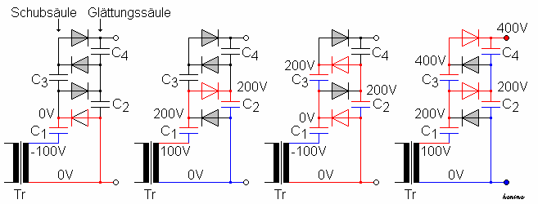
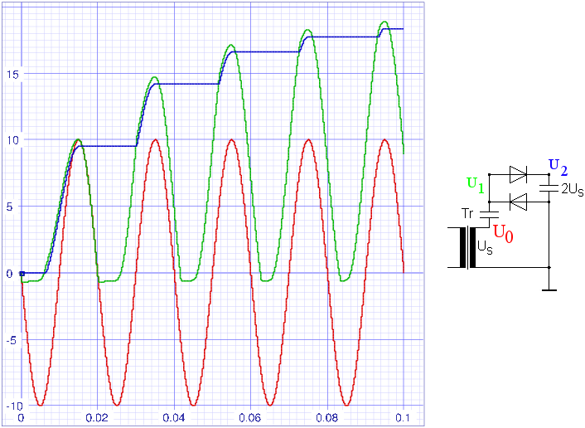
1. Die erste (negative) Halbwelle lädt C₁ auf 100V auf. Dabei ist das obere Ende von C₁
positiv gegenüber dem unteren, welches demnach auf -100V liegt.
2. In der zweiten Halbwelle polt die Ausgangsspannung des Transformators um, sein oberes
Ende hat nun 100V. Zusammen mit den 100V des Kondensators ergeben sich nun 200V am
oberen Ende von C₁, dh. die Spannung dieses Punktes wurde auf 200V hoch geschoben.
Diese 200V laden C₂ auf.
3. In der folgenden Halbwelle geht das obere Ende von C₁ wieder auf 0V, daher kann nun C₃
von C₂ auf 200V geladen werden.
4. In der nächsten Halbwelle werden die 200V von C₃ nun auf 400V hoch geschoben, damit
liegen 200V zwischen dem oberen und unteren Ende von C₄ und laden diesen auf 200V. Da
das untere Ende von C₄ bereits auf 200V liegt, erscheinen jetzt am Ausgang 400V.

Slide 13
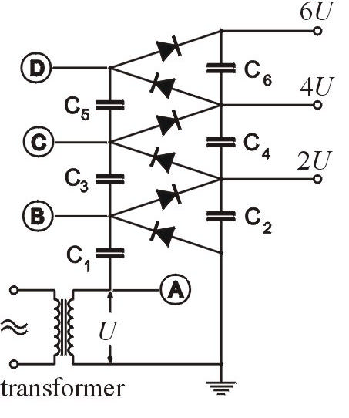



Cockroft Walton multiplier
$$U_{total}=2∙n∙U$$
$$−\frac{2∙π∙I}{ω∙C}\left(\frac{2}{3}n^{3}+\frac{1}{4}n^{2}+\frac{1}{12}n\right)$$
correction for current induced losses:
high frequency ω and large capacities C reduce the influence of the current
$$U\left(t\right)=U∙sin\left(ωt\right)$$
high voltage generator U = 400 kV
One could reach voltages of U = 4 MV and beam currents of 100 mA in pulse operation of μs range.

Slide 14
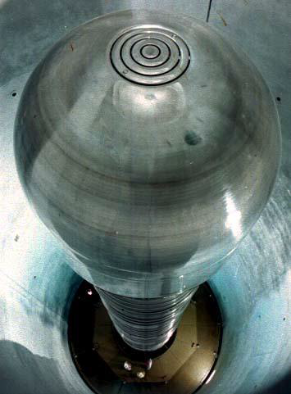
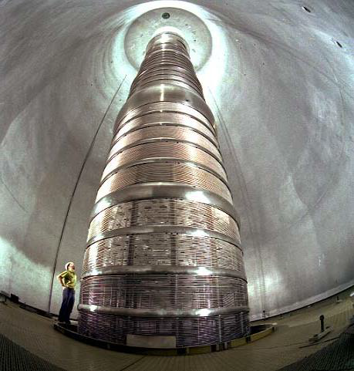
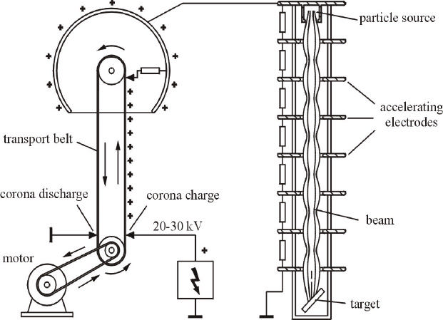
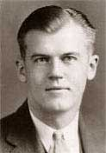
Van de Graaff accelerator
Van de Graaff - Daresbury
Robert Van de Graaff
Creating high voltage by mechanical transport of charges
The maximum achievable voltage in air at atmospheric pressure is about U_{max} = 2 MV.
The use of compressed gas increases the break down potential. For purified sulfur hexafluoride (SF₆) at a pressure of ~1 MPa the maximum voltage is increased to U_{max} = 20 MV. It is however difficult to establish and maintain a static DC field of 20 MV.

Slide 15
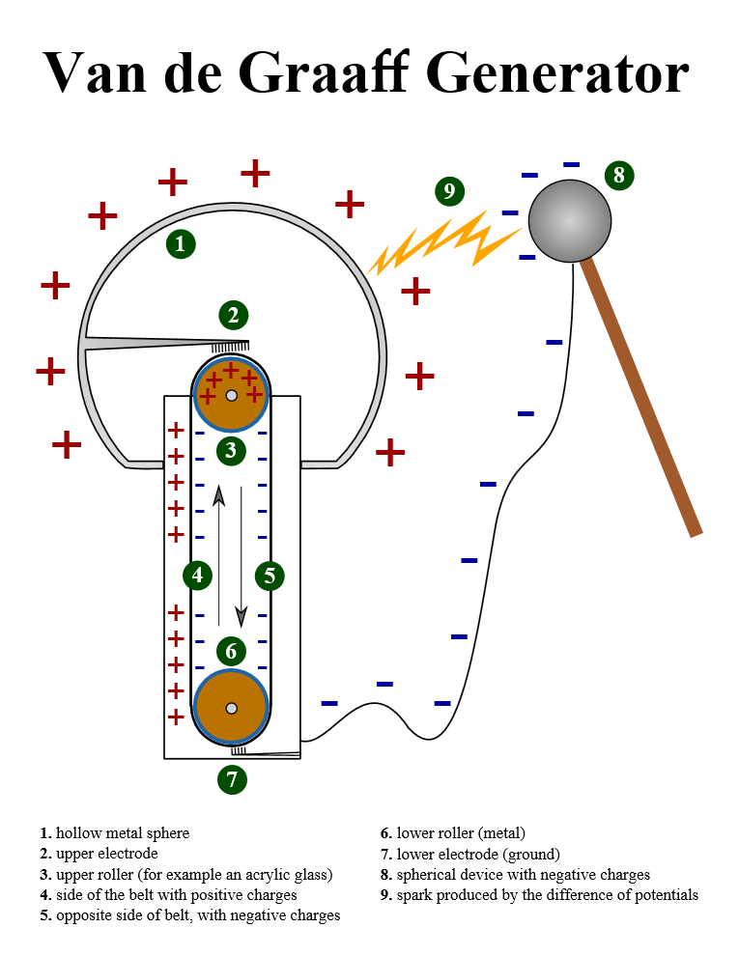
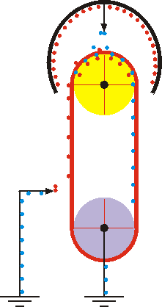
Van de Graaff accelerator

Slide 16
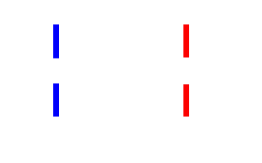
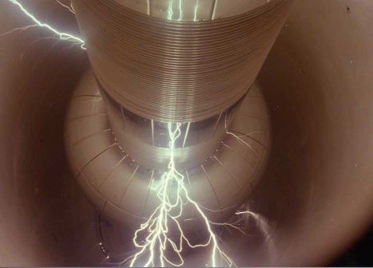
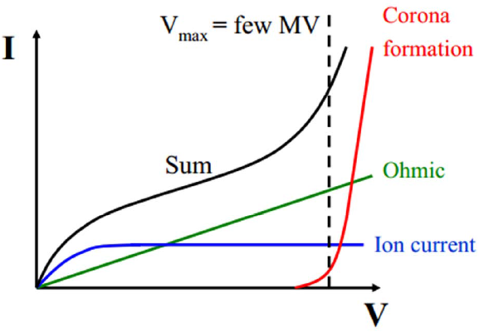
Current in electrostatic accelerator
Dependence of the current on the applied voltage in electrostatic accelerator
Since the conductivity of an insulator is never quite zero, there is always an ohmic component, which increases in proportion to the voltage.
The ions are always present in the residual gas. It very quickly reaches a constant saturation level.
The corona formation leads to the actual voltage limit. The field strength close to the electrodes grows so much that ions and electrons produced in this region are accelerated to considerable energies. They collide with gas molecules and so produce many more ions. The result is an avalanche of charge carriers causing spark discharge and the breakdown of the high voltage.

Slide 17
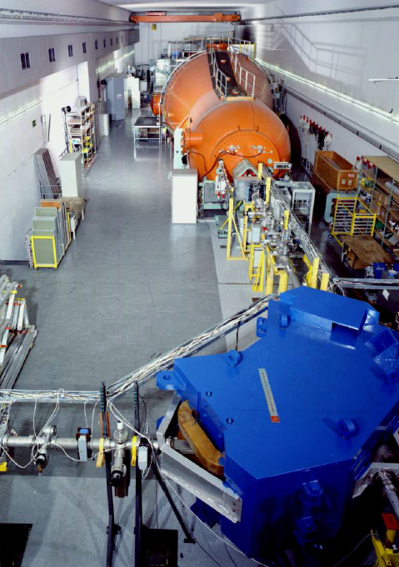
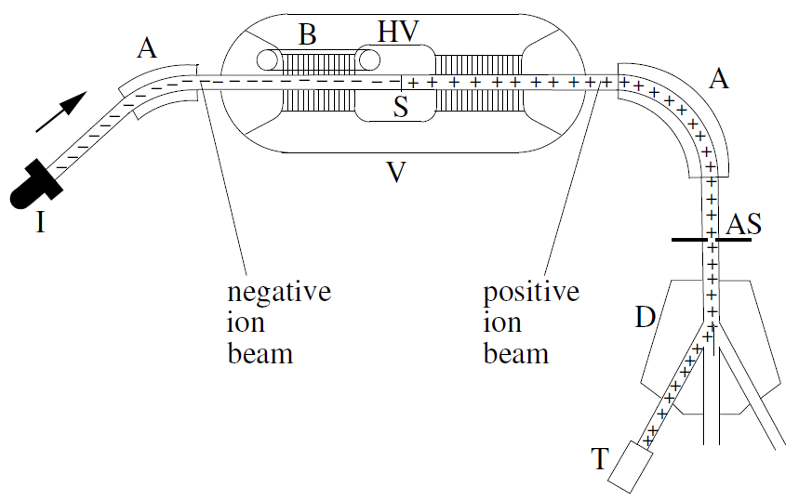
Tandem accelerator
p,d : T = 2 eU
²He²⁺, ⁴He²⁺ : T = 3 eU
³²S¹⁶⁺ : T = 17 eU
Tandem accelerator Munich
The Tandem accelerator utilizes the terminal high voltage twice. Negative ions produced by an appropriate ion source are accelerated from ground to the positively charged terminal. Inside the terminal is a stripper to remove electrons from the incoming negative ions. The now positively-charged ions experience a second boost of acceleration (‘Tandem’ accelerator).
IUAC tandem accelerator: terminal voltage 12.5 MV

