Slide 1
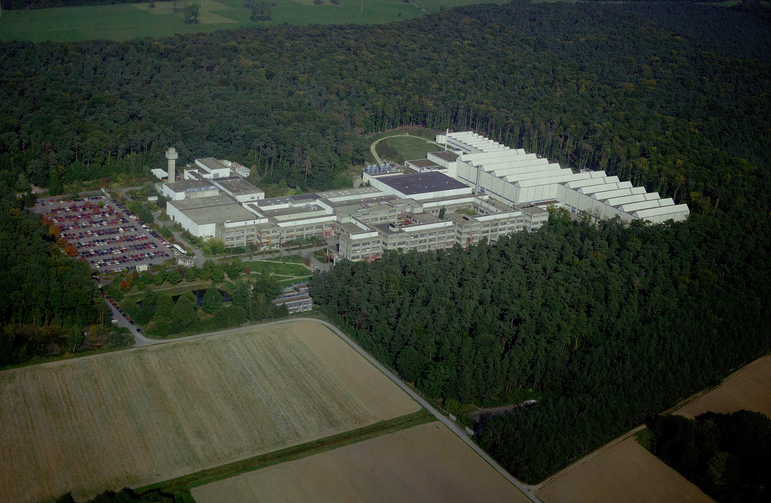
GSI Helmholtz Centre for Heavy Ion Research

Slide 2
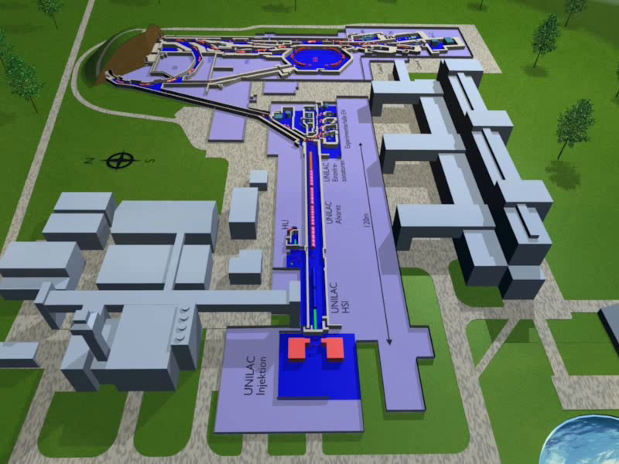
Accelerator facility

Slide 3
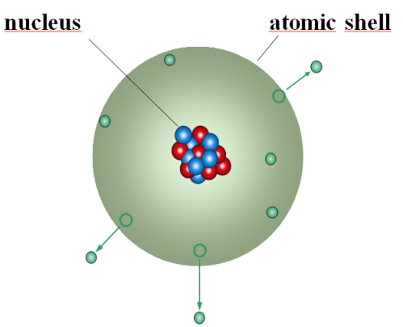
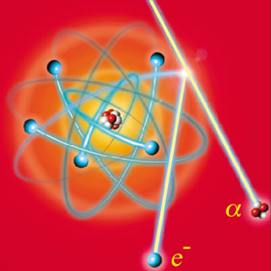
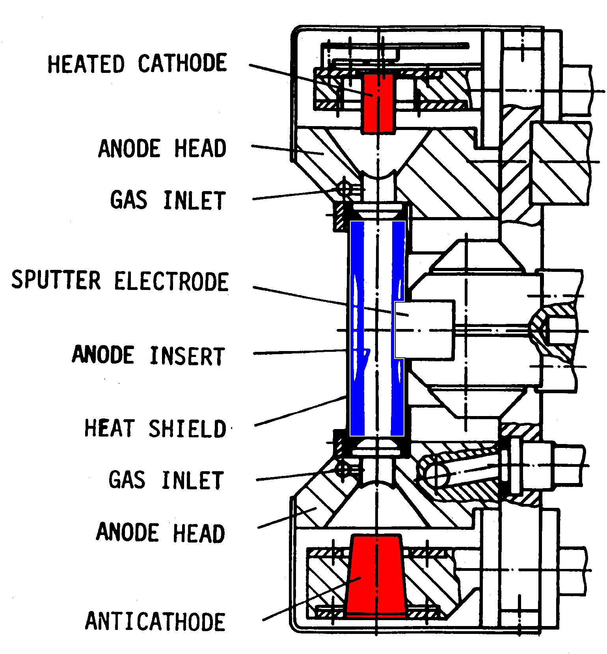
Ion source
To create ions one needs:
electrons
noble gases
element material (e.g. Fe, Sn, Pb, U)
Ionization
Discharge voltage 0.3...1.3 kV
Discharge current 5...20 A
Magnetic flux 0,2...2 T
Filament heating 0.5 kW
Power consumption up to 20 kW
T_{e} in the order of 1 eV
Current density 10 mA/cm²
Penning ion source

Slide 4
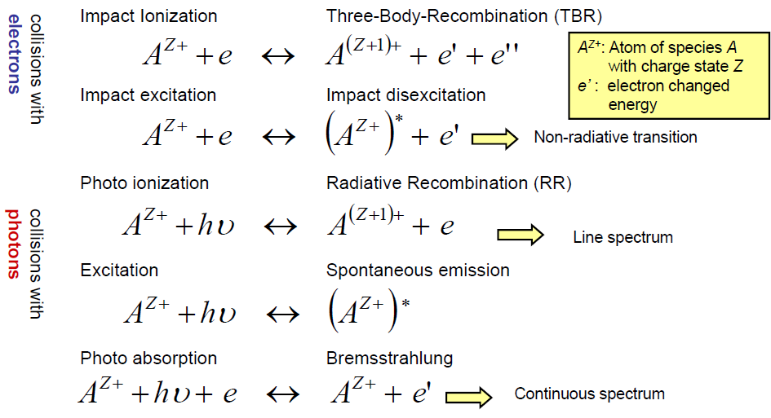
Ionization for positive ions

Slide 5
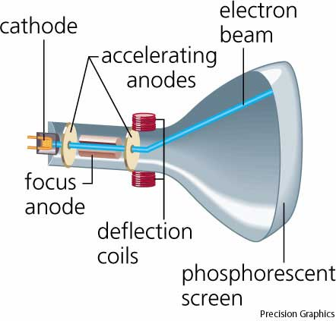
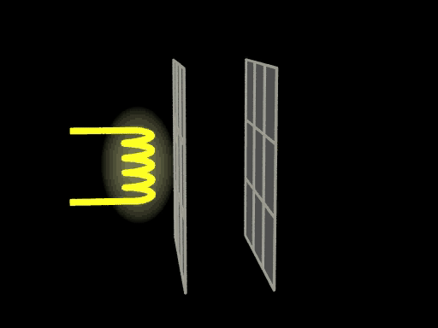
Cathode Ray Tube

Slide 6
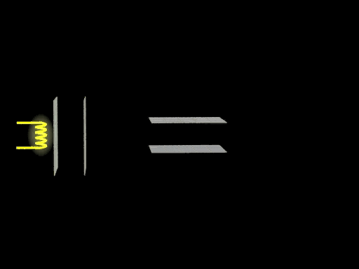
Cathode Ray Tube

Slide 7
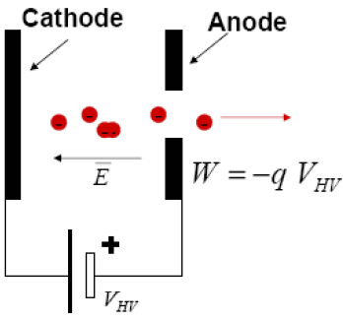
Electron Gun – simplest electrostatic accelerator

Slide 8
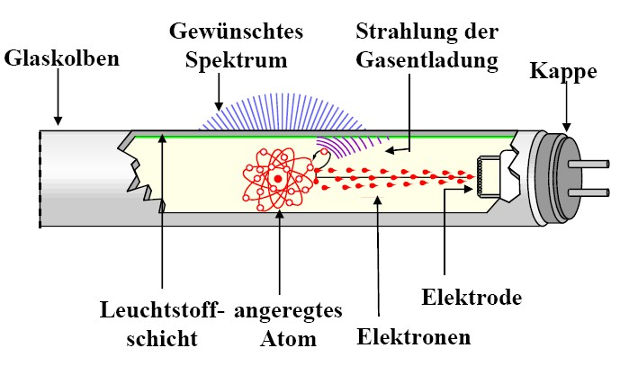
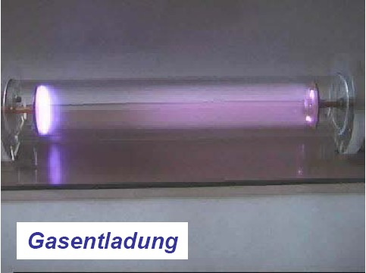
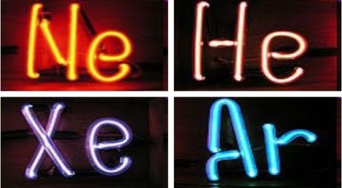
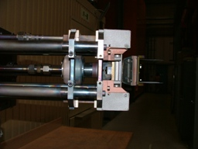
How to create ions?
desired
spectrum
radiation of
gas discharge
glass bulb
end-cap
gas discharge
luminescent
substrate
electrode
excited
atom
electrons
Discharge voltage 0.3...1.3 kV
Discharge current 5...20 A
Magnetic flux 0,2...2 T
Filament heating 0.5 kW
Power consumption up to 20 kW
T_{e} in the order of 1 eV
Current density 10 mA/cm²
To create ions one needs:
electrons
noble gases
element material (e.g. Fe, Sn, Pb, U)

Slide 9
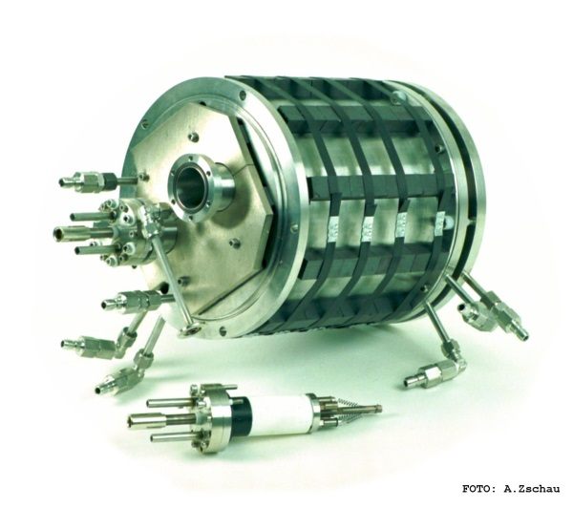
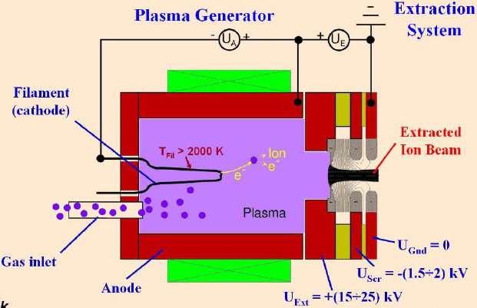
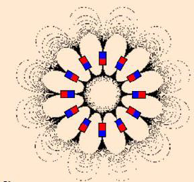
Volume ion source with filament
Multi Cusp Ion Source
with permanent magnets
Electrons generated from a filament and used for ionization within a gas volume. Magnetic field guides electrons towards the plasma chamber.

Slide 10
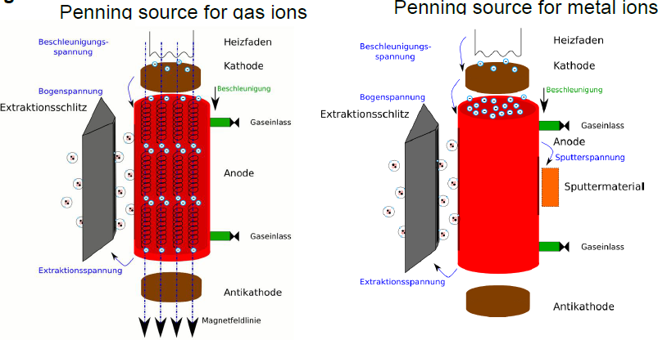
Penning ion source for gases and metals

Slide 11
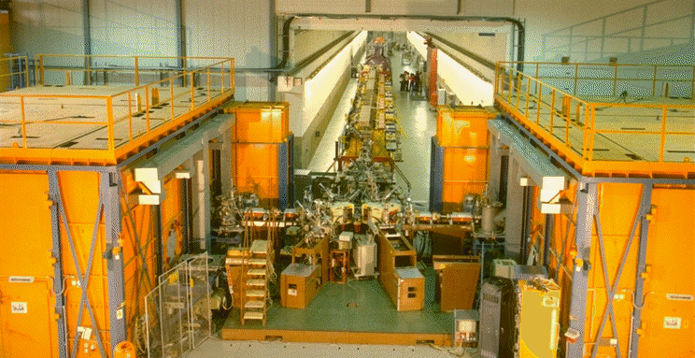

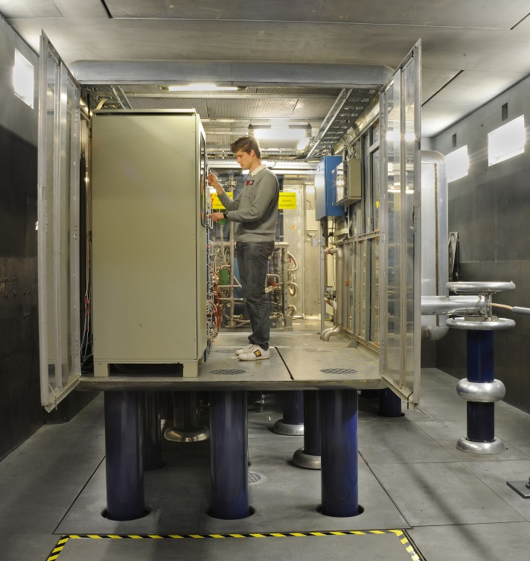
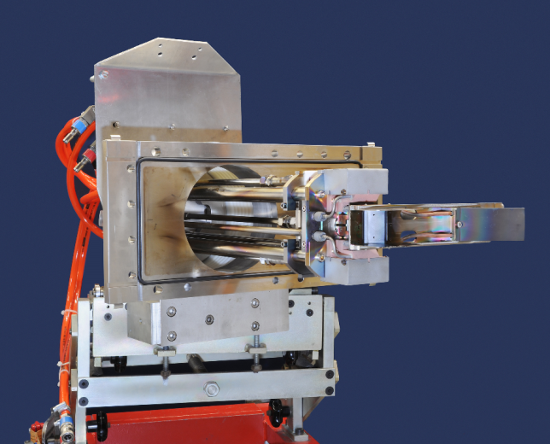
UNIversal Linear ACcelerator
From zero to 2,000,000 km/h
with a voltage of 20,000 V to 130,000 V
ions will be accelerated to v/c = 0.002

Slide 12
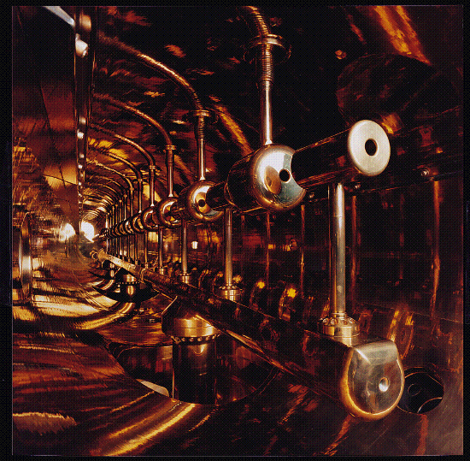
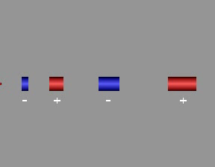
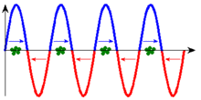
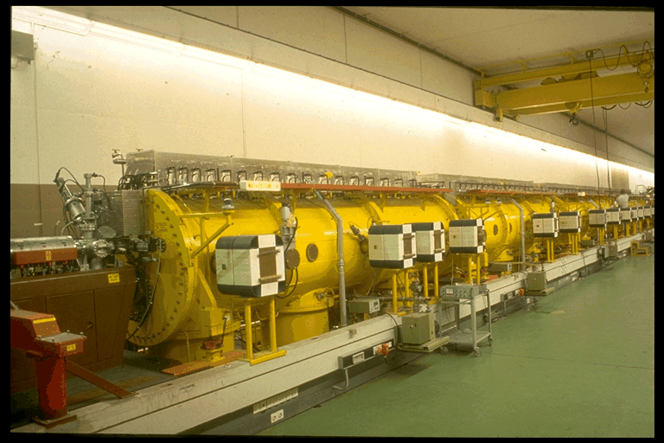
UNILAC Wideroe - Accelerator
27 MHz high frequency

Slide 13
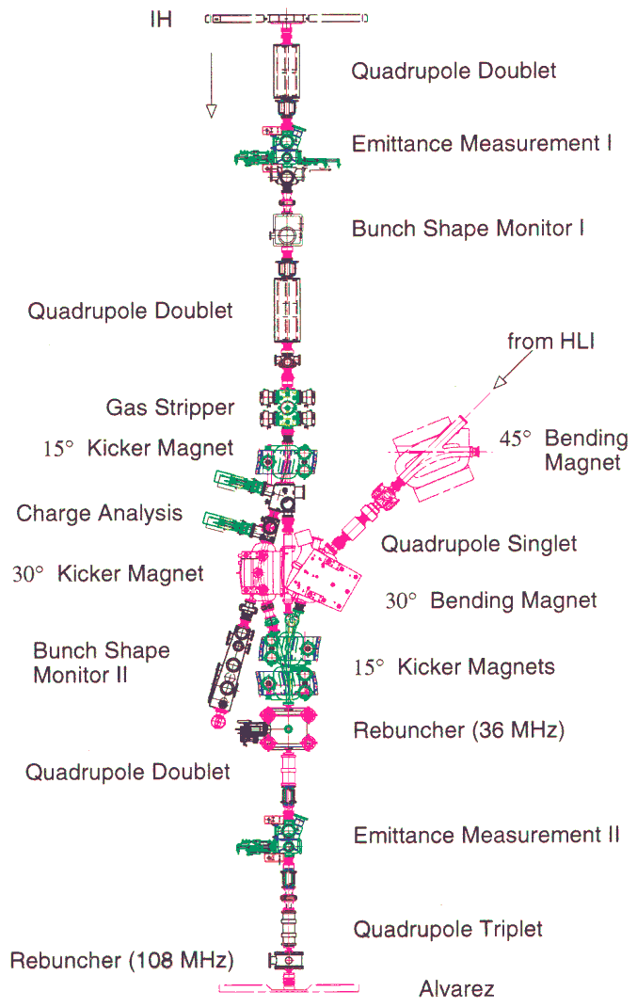
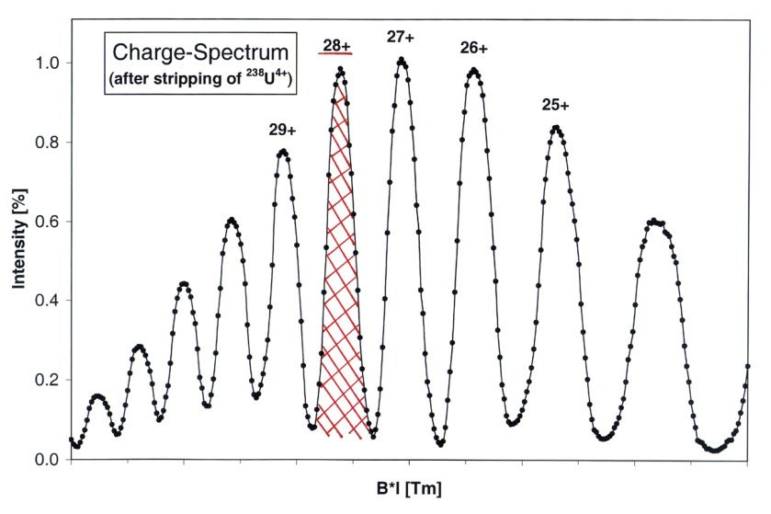
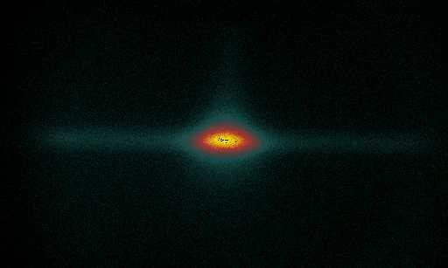
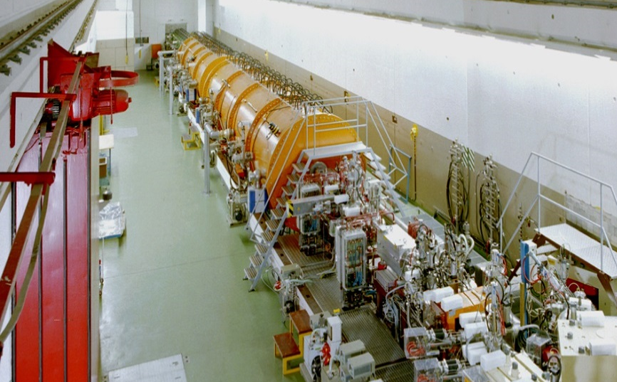
Gas-stripper to increase acceleration efficiency
N·²³⁸U⁴⁺
increase of accel. efficiency by a factor of 28/4 = 7
but ≈ 87% of ions get lost (q ≠ 28)
noble gas (Xe)
0.13·N·²³⁸U²⁸⁺
v/c = 5.4% or 1.4 MeV/u

Slide 14
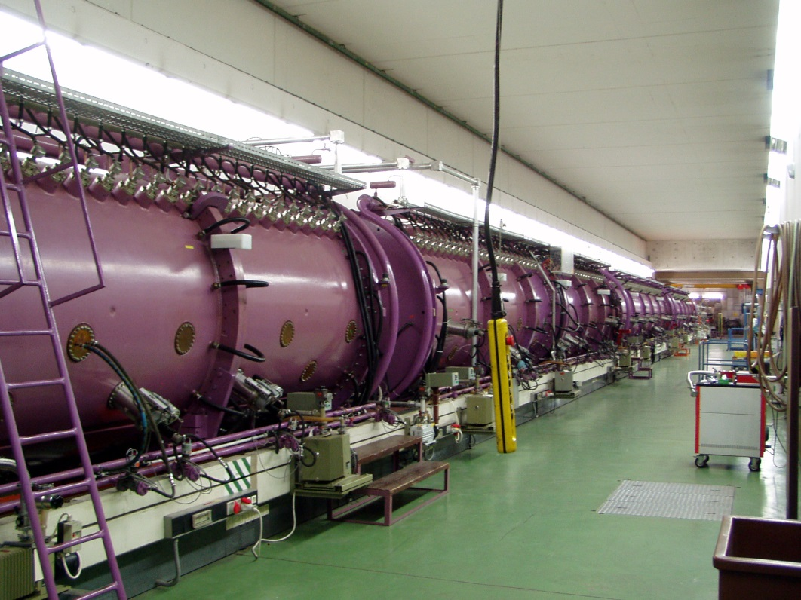
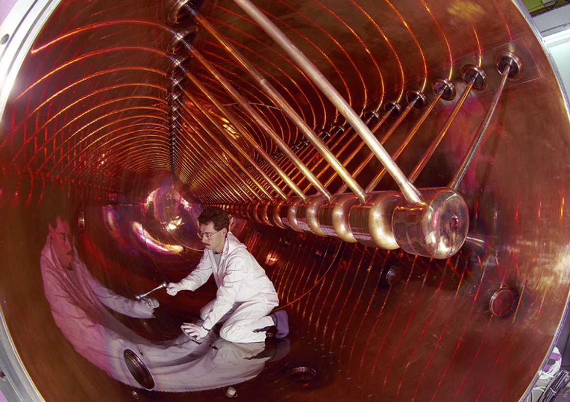
UNILAC Alvarez Accelerator
108 MHz high frequency
standing wave
v/c = 16% or 11.4 MeV/u

Slide 15
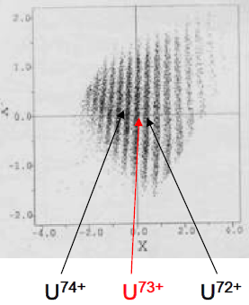
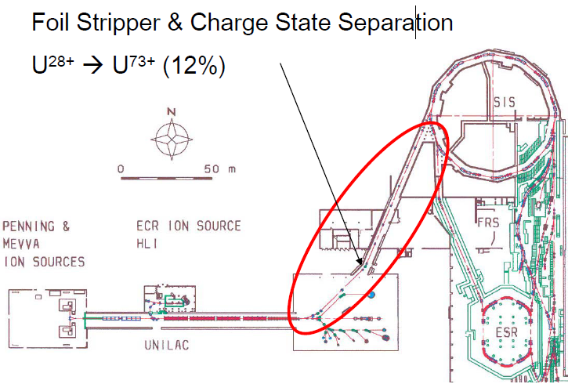
UNILAC: Beam transfer to synchrotron SIS-18
Foil Stripper and Charge State Separation

Slide 16
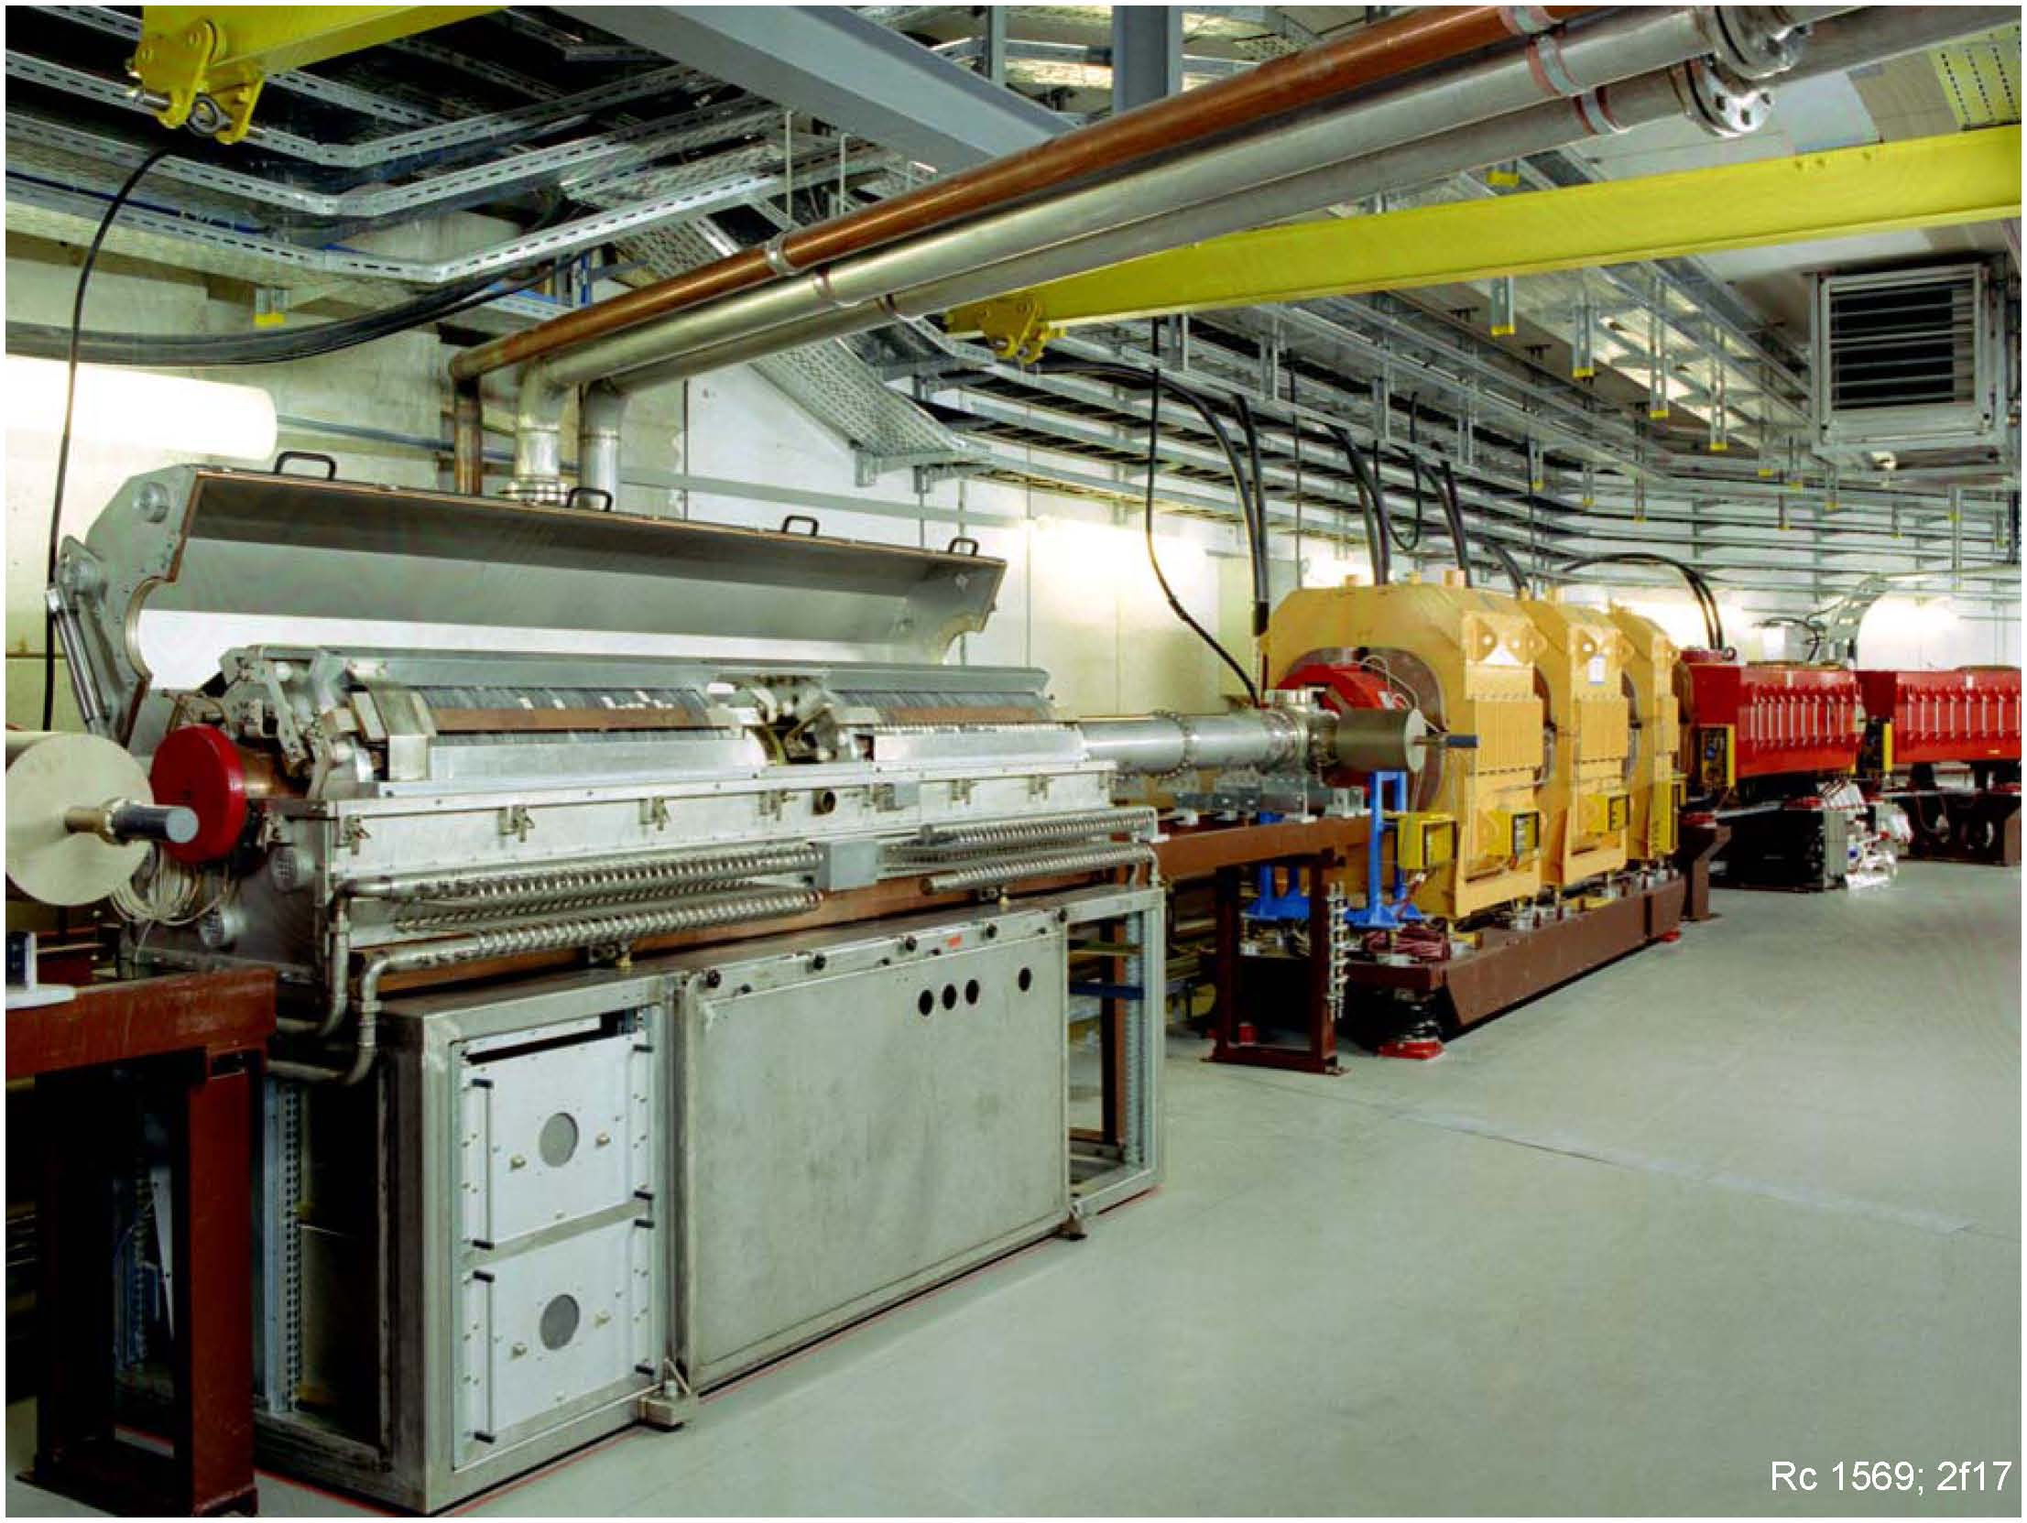
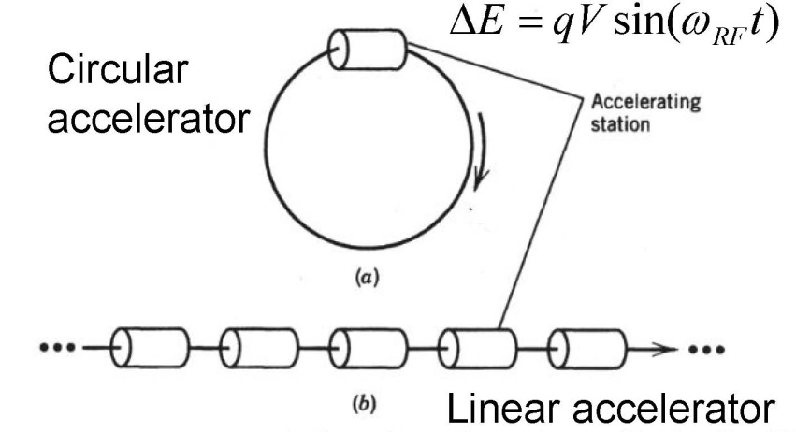
GSI Synchrotron SIS-18
As linacs are dominated by cavities, circular maschines are dominated by magnets
SIS-18 accelerating cavity

Slide 17
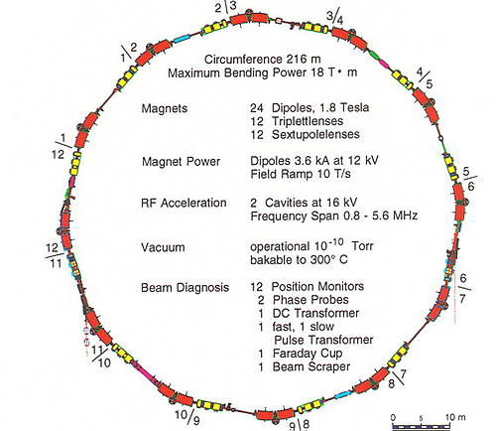
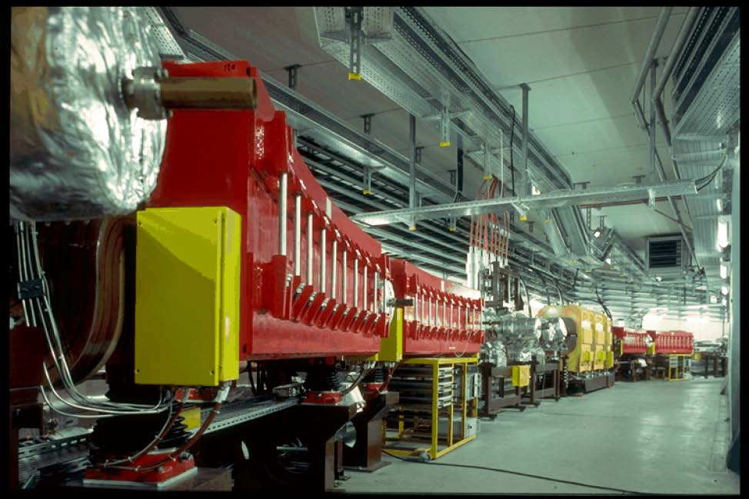
GSI Synchrotron SIS-18
SIS: Schwere Ionen Synchrotron
Heavy Ion Synchrotron
accelerates ions from p to U
energy: 4 GeV (p), 2 GeV/u (Ne), 1 GeV/u (U)
β = 0.98 (p), 0.95 (Ne), 0.88 (U)
bending radius: 10 m
max mag. field 18 T
rf frequency: 0.85 – 6 MHz

Slide 18
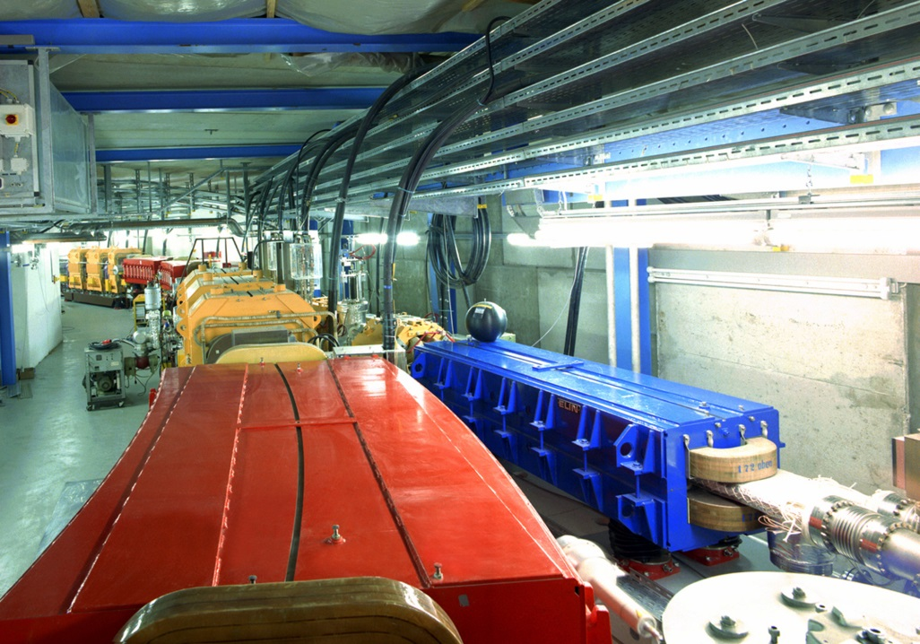
GSI Synchrotron SIS-18
SIS: Schwere Ionen Synchrotron
Heavy Ion Synchrotron
SIS 18 has a circumference of 216 m
92 elements will be accelerated from p to U
max. ion velocity up to 270 000 km/s (β = 90%)
ions are accelerated by 80 000 V in the accelerator structures during every circulation
ions are accelerated in one second cover a distance of 90 000 km, that corresponds to 416 000 cycles in the ring
32 billion medium-charged uranium ions can be accelerated at SIS 18
one billionth Pascal: an ultra-high vacuum is a prerequisite for acceleration.

Slide 19
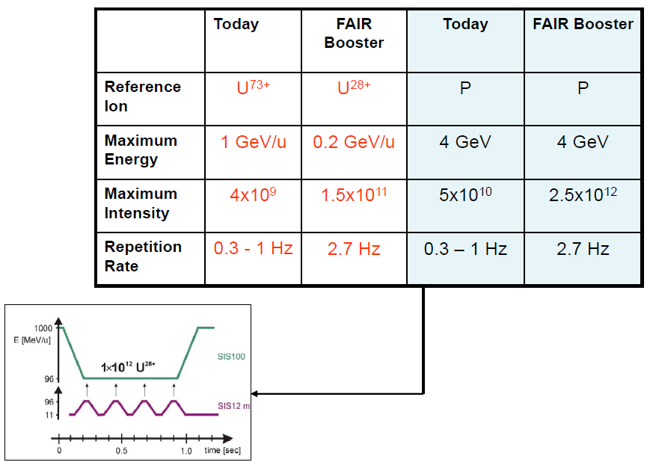
Requirements for SIS-18

Slide 20
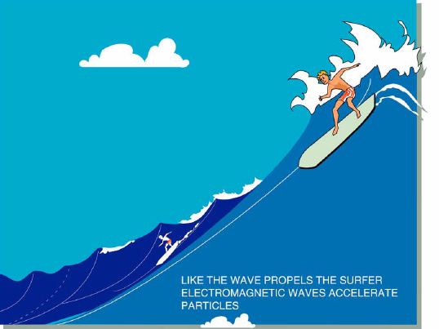
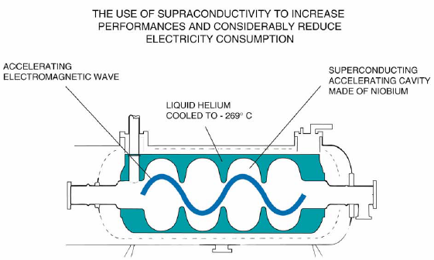

Slide 21
Nuclear reaction rate
Reaction rate (thick target):
Reaction rate (thin target):
Example:
Reaction rate: 57941[s⁻¹] transmission (SIS/FRS)=70%, transmission (FRS) 1.9%

Slide 22
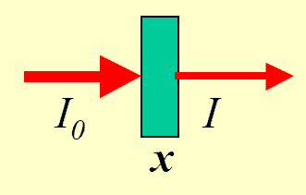
Nuclear reaction rate
Primary reaction rate:
Example: ²³⁸U (10⁹s⁻¹) on ²⁰⁸Pb (x=1g/cm²) → ¹³²Sn (σ_{f}=15.4mb) reaction rate: 44571[s⁻¹]
Example: ¹²⁴Xe (10⁹s⁻¹) on ⁹Be (x=1g/cm²) → ¹⁰⁴Sn (σ_{f}=5.6μb) reaction rate: 375[s⁻¹]
The optimum thickness of the production target is limited by the loss of fragments due to secondary reactions
Primary + secondary reaction rate:
1 | 0.79
2 | 1.25
3 | 1.47
4 | 1.55
5 | 1.53
6 | 1.45
Example:

Slide 23
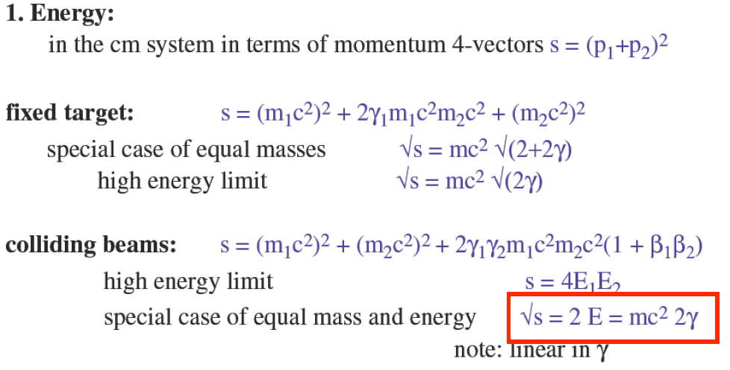

Slide 24
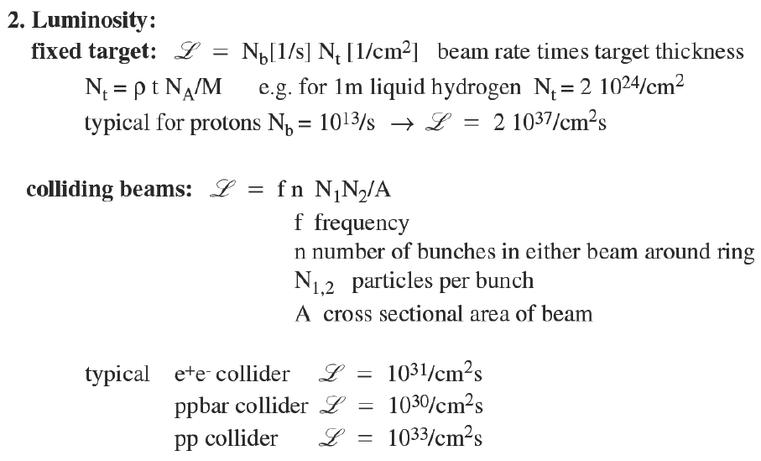
Luminosity

