Slide 1
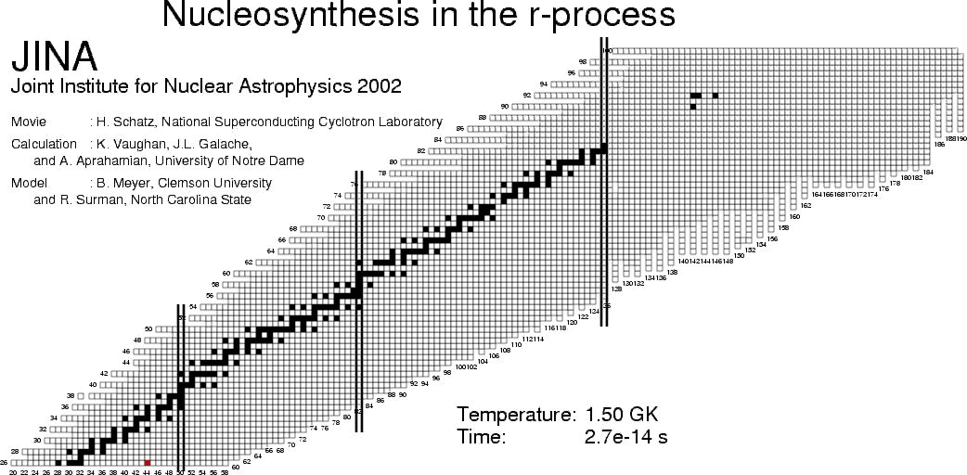
Radioactive Ion Beams

Slide 2
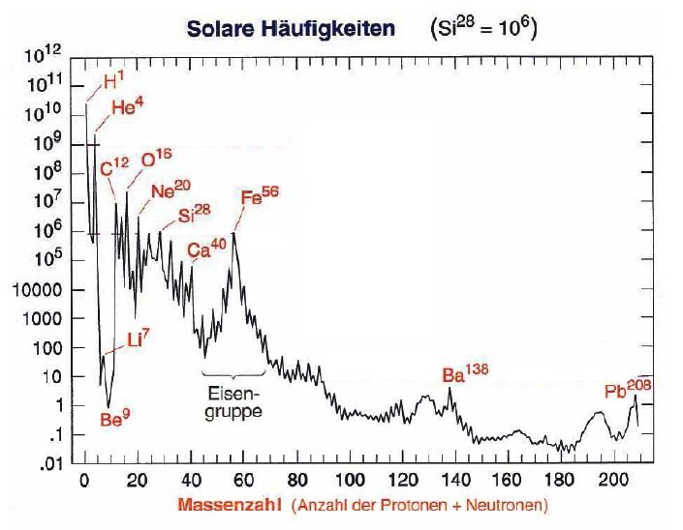
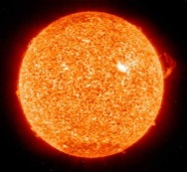
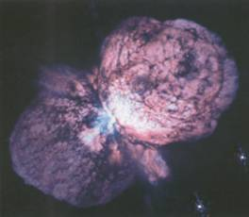
Solar abundances of elements
Solar abundance (Si²⁸ = 10⁶)
Big Bang
fusion reactions
neutron reactions
open questions:
Why is Fe more common
than Au ?
Why do the heavy elements
exist and how are they
produced?
Can we explain the solar
abundances of the elements?
Mass number

Slide 3
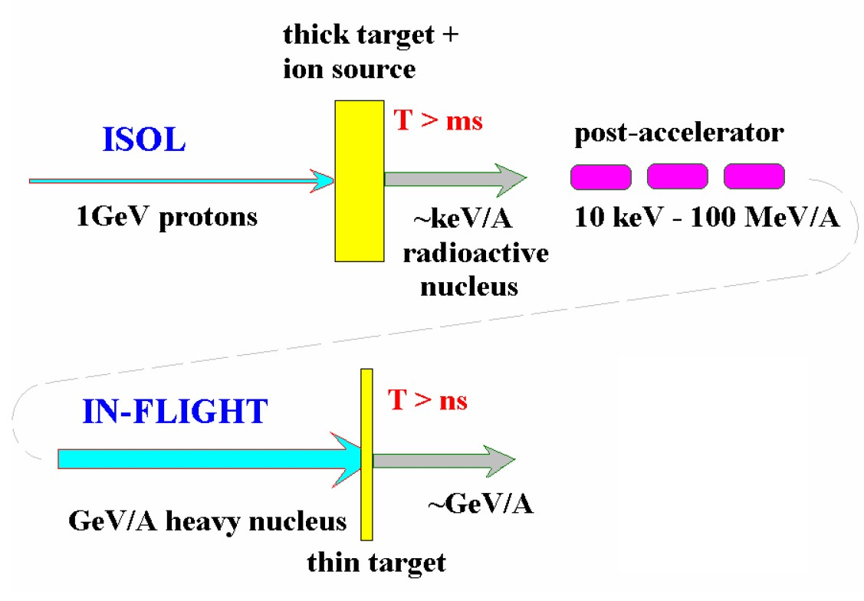
Spallation & Projectile Fragmentation Reactions
Spallation
Fragmentation

Slide 4
High-energy proton-induced nuclear reactions
Some early high-energy proton accelerators:
Facility | Energy | from year
Bevatron (Berkeley) | 6 GeV | 1954.....
AGS (Brookhaven) | 11 GeV | 1960.....
Fermilab (Chicago) | >300 GeV | 1967.....
They were also used to bombard various stable target materials.
These targets were analyzed with radiochemical methods,
i.e. γ-spectroscopy with or without chemical separators
Production cross sections and (some) kinematics for suitable radioactive isotopes

Slide 5
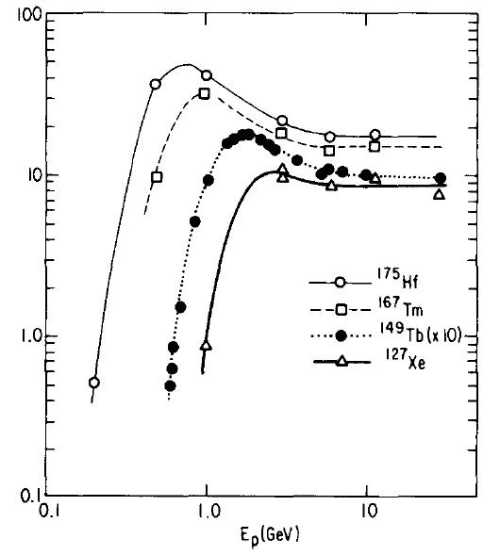
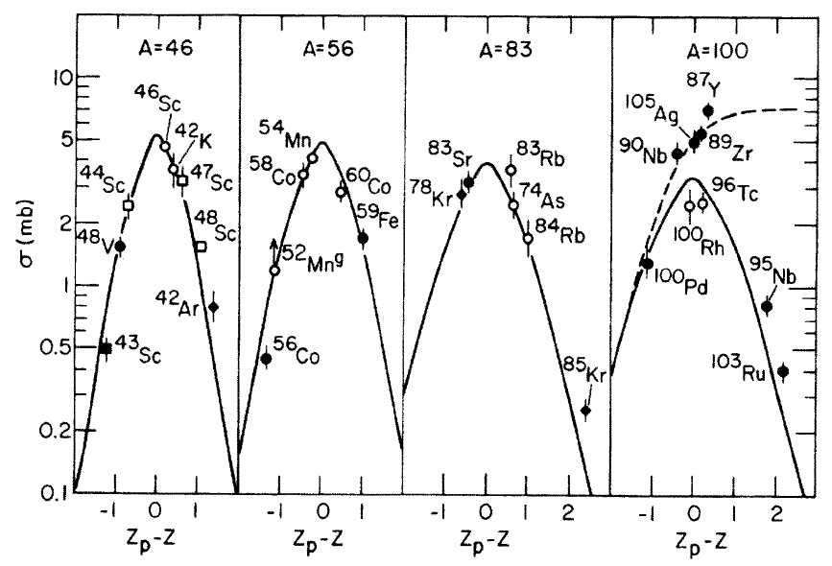
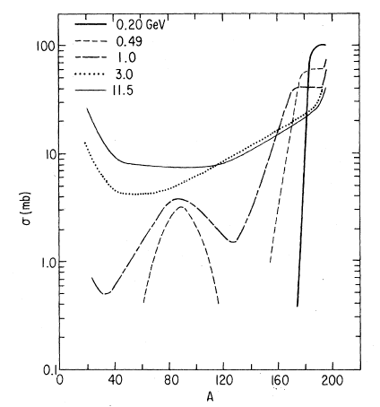
High-energy proton-induced nuclear reactions
Important findings:
Energy-independence of cross sections
Bell-shaped Z-distribution for constant A
E_{p} [GeV]
σ [mb]
σ [mb]
p+Au
Mass yields: exponential slope
A

Slide 6
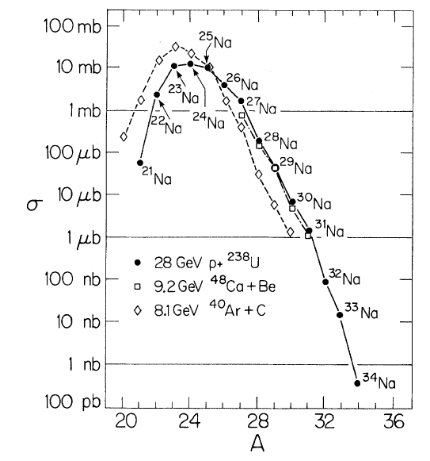
Proton- vs. heavy-ion induced reactions
Proton- and heavy-ion induced reactions give very similar isotope distribution:
Na
8 GeV ⁴⁸Ca+Be
Target fragmentation: GeV p + A_{target} → A
Projectile fragmentation: GeV/u A_{proj} + p → A
are equivalent
28 GeV p + ²³⁸U

Slide 7
Projectile fragmentation reactions
projectile
projectile fragment
target nucleus
abrasion
ablation
At GeV energies nucleons can be regarded as a classical particles
Nucleon-nucleon collisions can be treated classically using measured free nucleon-nucleon cross sections (intra-nuclear cascade).
In these collisions very little transfer momentum is exchanged.
After the cascade the residual nucleus is highly excited.
Heavy-ion projectiles can be treated as a bag of individual nucleons.
Physical models: Two-step approach
Step 1: Intranuclear-cascade models or Abrasion models
Step 2: Evaporation calculation

Slide 8
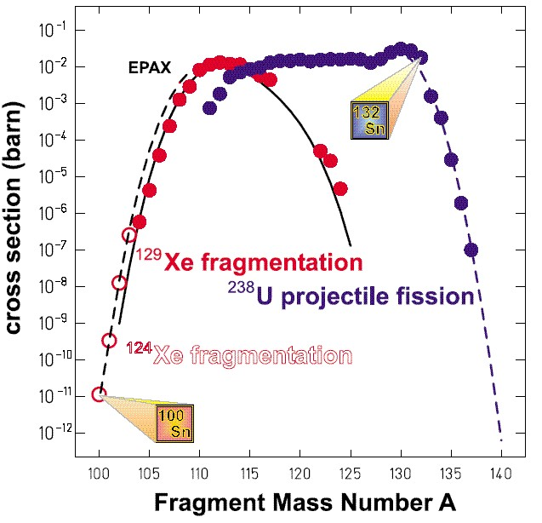
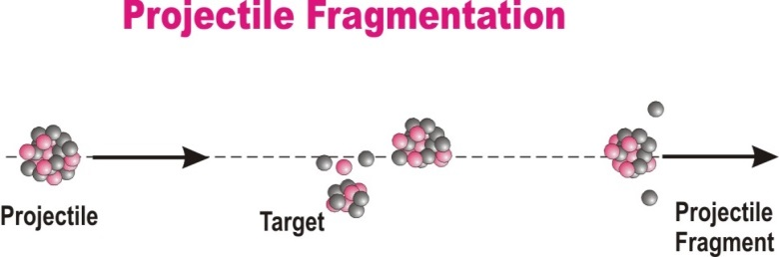
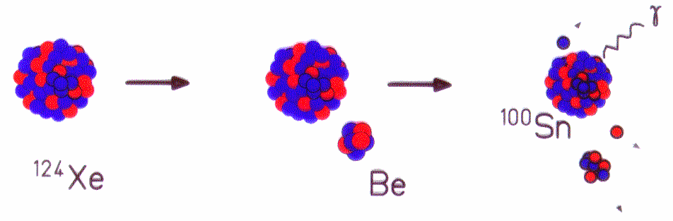
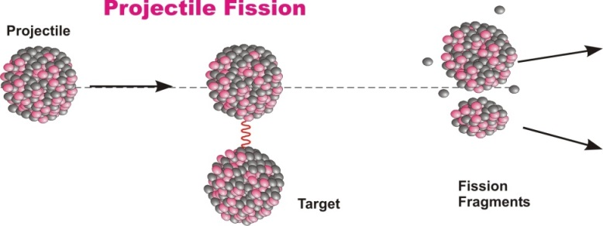
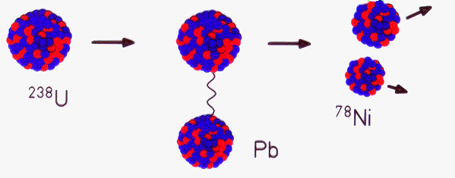
Projectile fragmentation reactions
Projectile Fragmentation
Projectile
Target
Projectile
Fragment
Projectile Fission
Projectile
Projectile
Fragments
Target

Slide 9

In-Flight Separation of Radioactive Ion Beams
Primary (production) target
Peripheral nuclear reactions
Forward focused products
Secondary (reaction) target
Experimental area
Electromagnetic separator
Stable HI projectile source
E ~ 1000 AMeV
Selected radioactive beam
E >> 20 AMeV

Slide 10
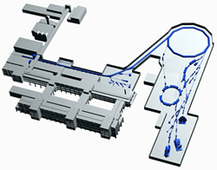
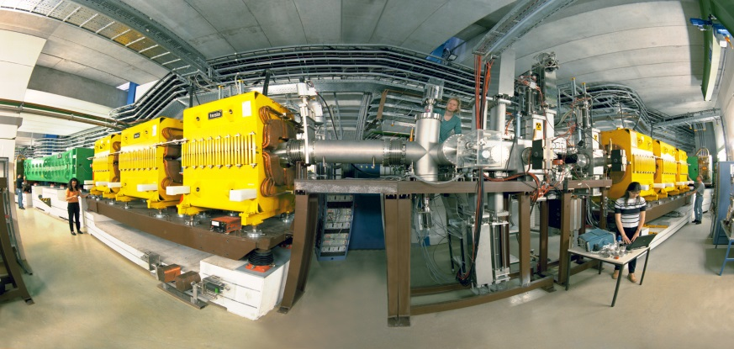
Fragmentation at Relativistic Energies
projectile
projectile fragment
target nucleus
abrasion
ablation
FRS
FRS
FRagment Separator

Slide 11
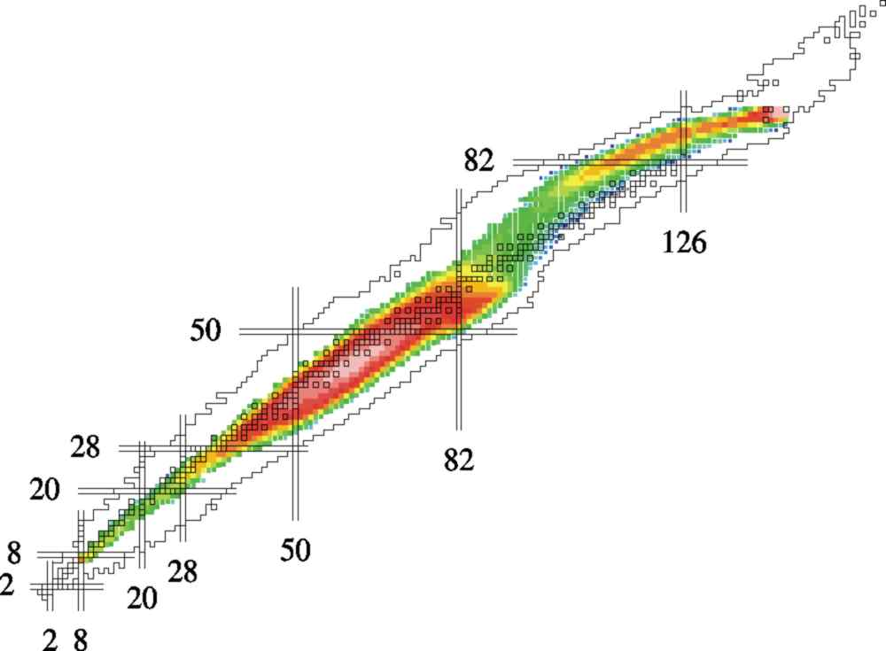
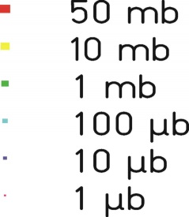
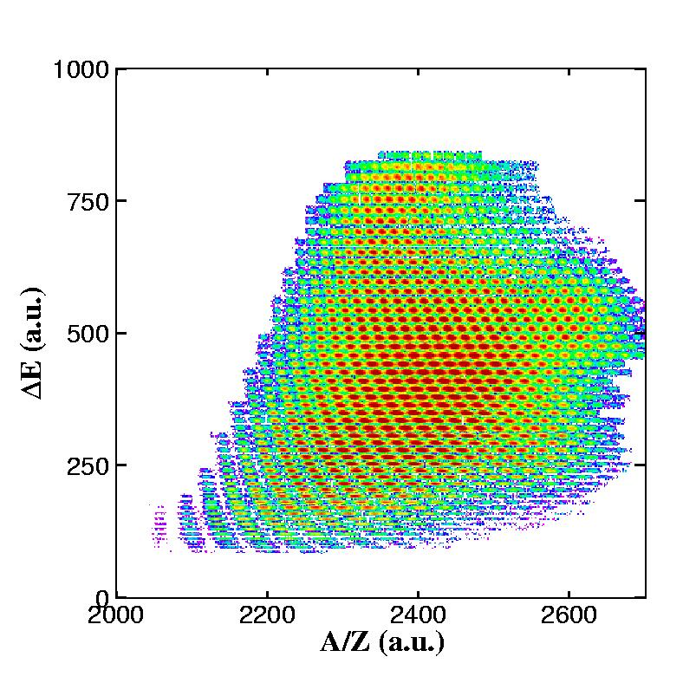
Radioactive Ion Beams at GSI
1GeV/u U + H
About 1000 nuclear residues identified
A/Z-resolution ~10⁻³

Slide 12

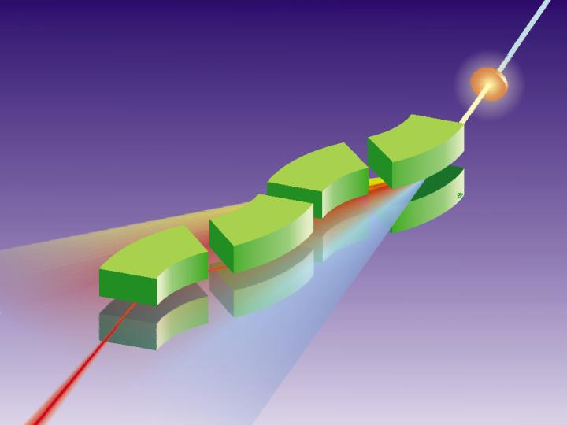
FRagment Separator at GSI
¹³¹Sn
¹³²Sn
in-flight A and Z selection
energy resolution: ~ 1 GeV

Slide 13
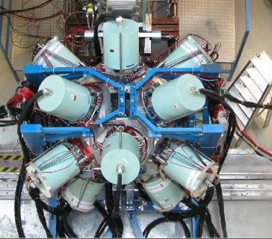

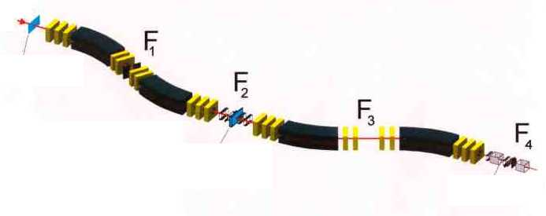
Rare Isotope Selection at FRS: Bρ-ΔE-Bρ Selection
fully striped fragments
primary beam
⁸⁶Kr ~700 AMeV
20m
secondary beam
⁷⁸Ni ~ 100 AMeV
production target
⁹Be

Slide 14
Rare Isotope Selection at FRS: Bρ-ΔE-Bρ Selection
Transmission :
20-70 % for fragmentation
< 2 % for fission
primary beam
⁸⁶Kr ~700 AMeV
20m
secondary beam
⁷⁸Ni ~ 100 AMeV
production target
⁹Be
magnetic dipoles
degrader
magnetic dipoles
Βρ ∝ βγ Α/Ζ
ΔΕ ∝ Ζ²f(β)
Βρ ∝ βγ Α/Ζ

Slide 15
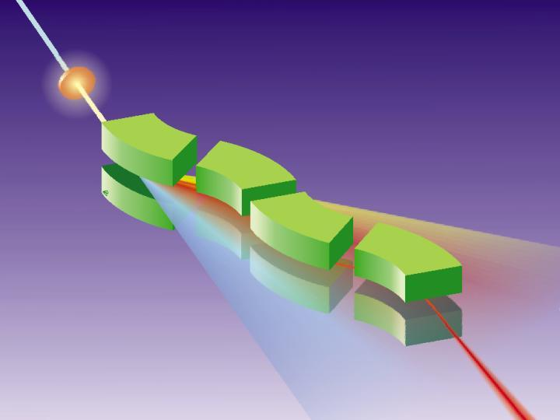
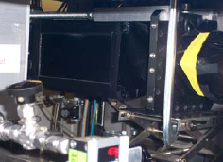
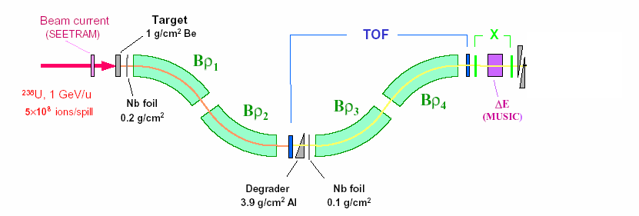
Production, Separation, Identification
UNILAC
SIS
fragment
FRS
abrasion
ablation
FRagment Separator
⁵⁶Cr, 100MeV/u
⁸⁶Kr, 480MeV/u
Standard FRS detectors
TPC-x,y position @ S2,S4
Plastic scintillator (TOF)
@ S4
MUSIC (ΔE)
@ S4

Slide 16
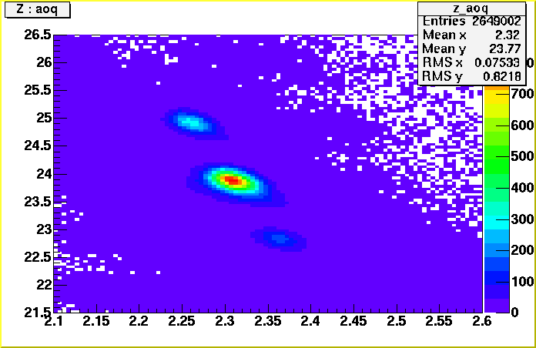
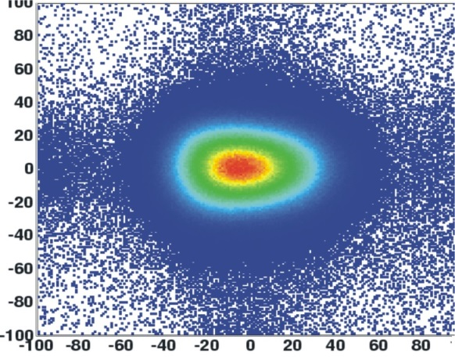
Production, Separation, Identification
multiwire chamber or TPC;
beam position
⁵⁶Cr, 100MeV/u
⁸⁶Kr, 480MeV/u
MUSIC
ionization chamber;
Z
scintillator
scintillator
β
⁵⁶Cr
Y
Z
X
A/Q

Slide 17
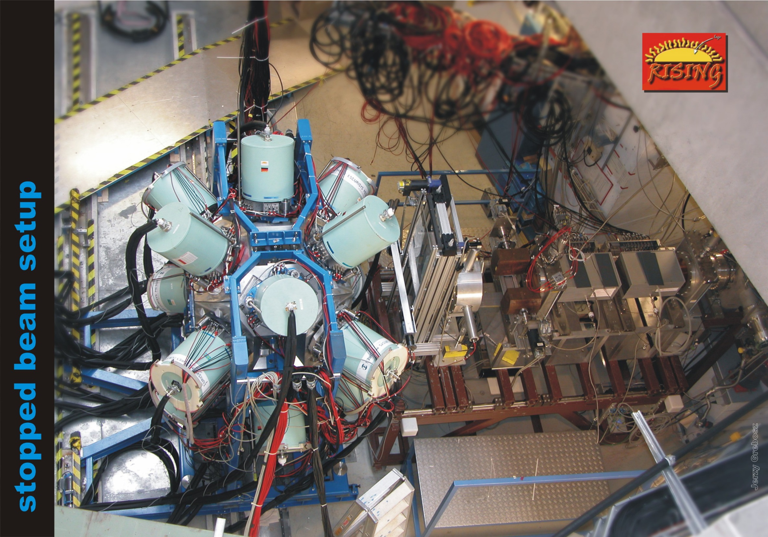
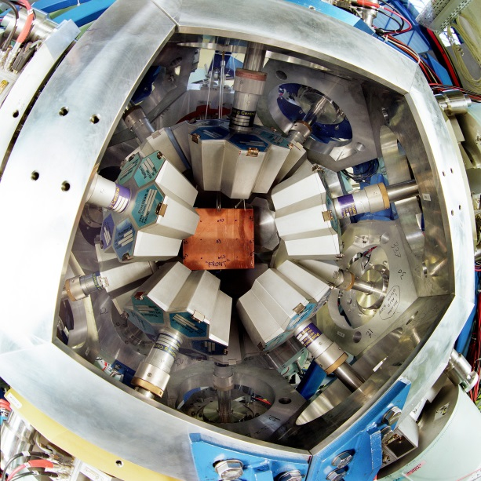
Production, Separation, Identification
ionization
chambers
(MUSIC41,42)
scintillator
(SC41)
beam
multiwire
chambers
(MW41,MW42)
degrader

Slide 18
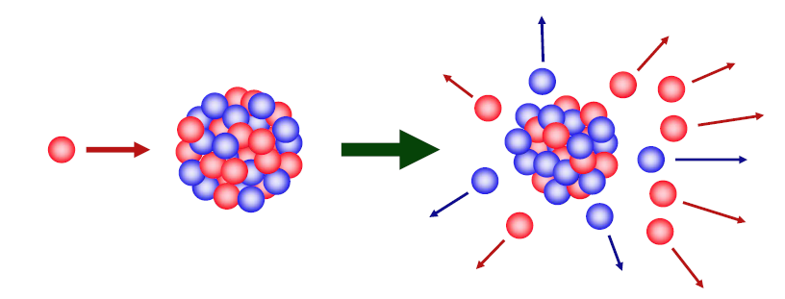
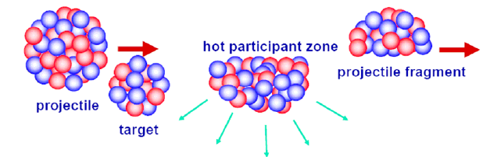
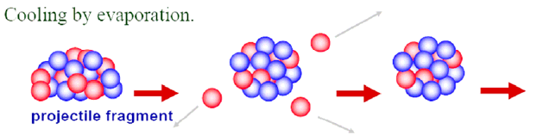
Production of radioactive ion beams
Target fragmentation
Random removal of protons and neutrons from heavy target nuclei by energetic light projectiles
Projectile fragmentation
cooling by evaporation
Random removal of protons and neutrons from heavy projectile in peripheral collisions

Slide 19
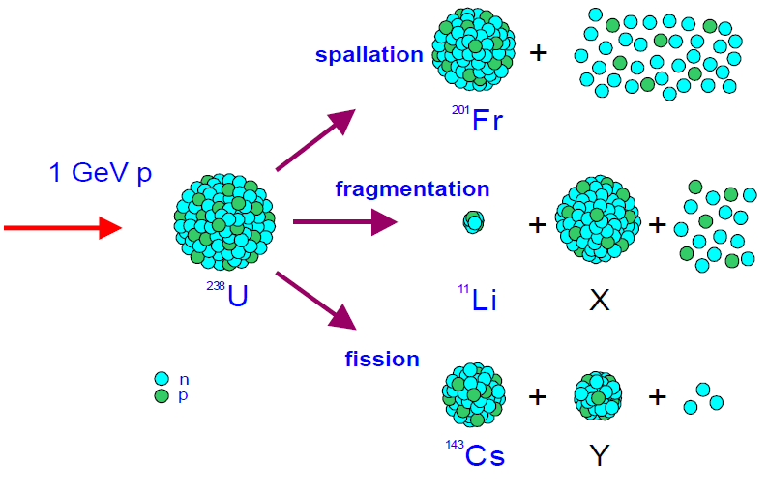
Production Channels

Slide 20
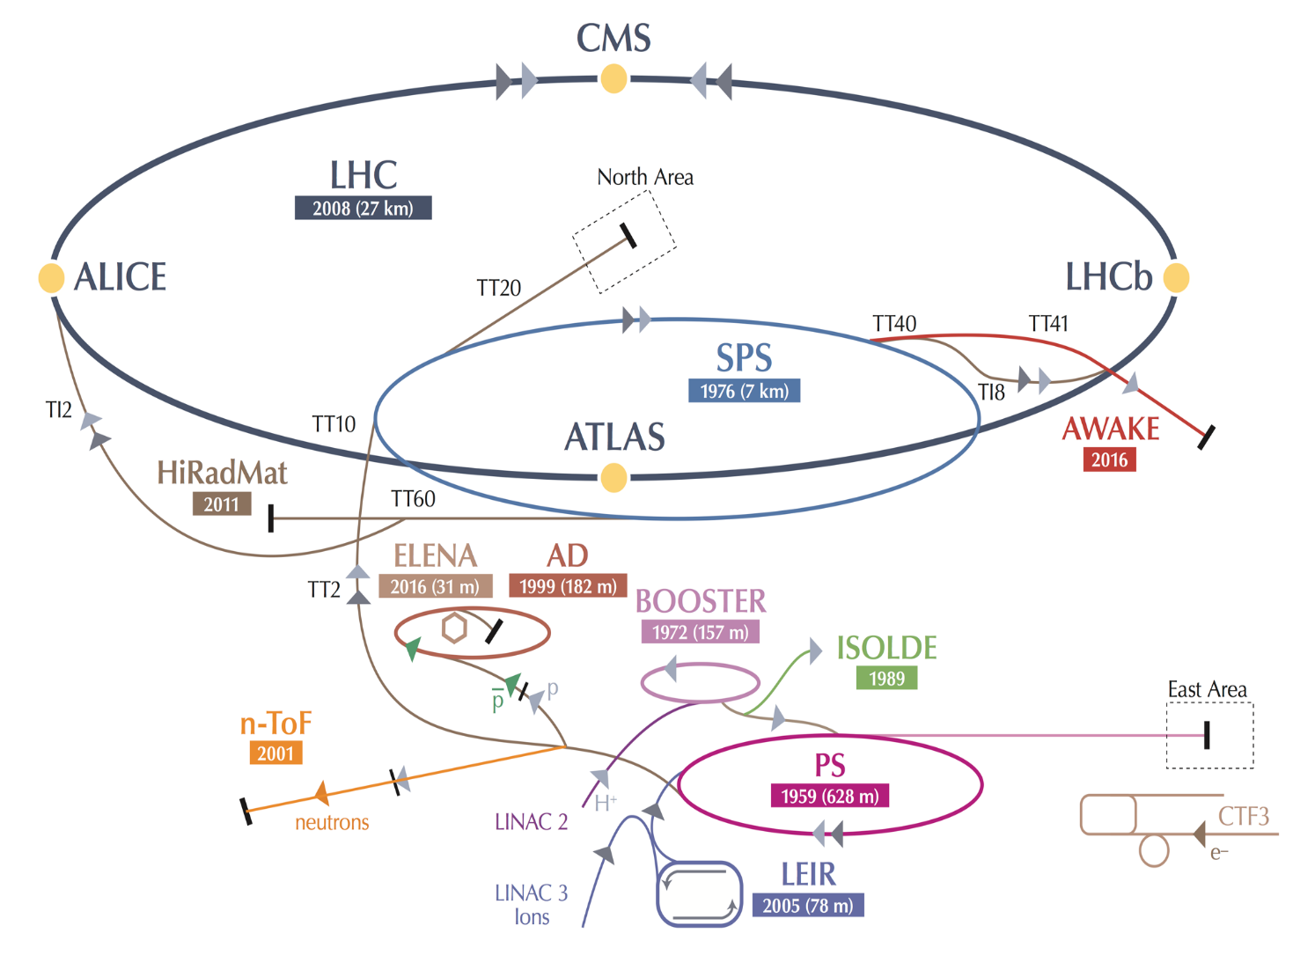

ISOLDE at CERN

Slide 21
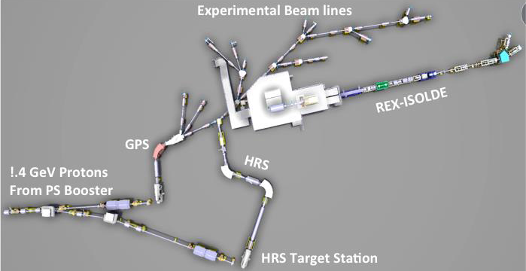
ISOLDE at CERN
RIB at 60 keV
RIB at 3 MeV/A
1.
targets

Slide 22
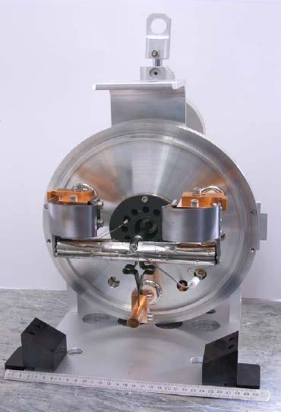
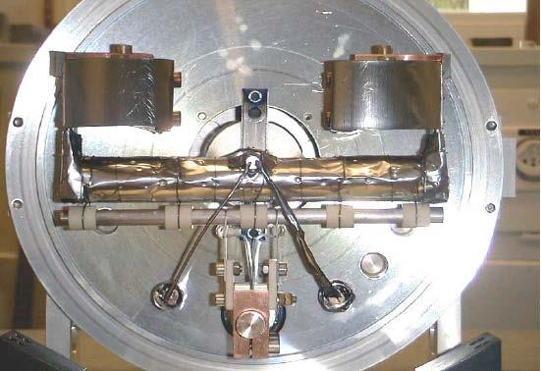
Production targets
Over 20 target materials and ionizers, depending on beam of interest
U, Ta, Zr, Y, Ti, Si, …
Target material and transfer tube heated to 1500 – 2000⁰ C
Operated by robots due to radiation
target
target
converter
converter target
standard target

Slide 23
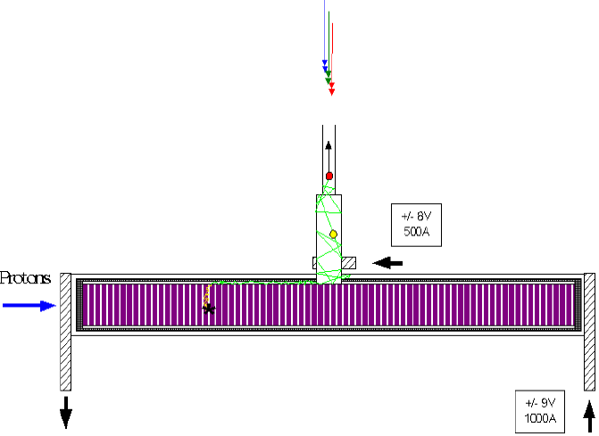
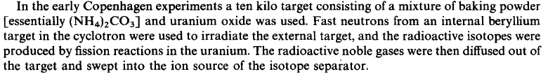
Inside a standard target

Slide 24
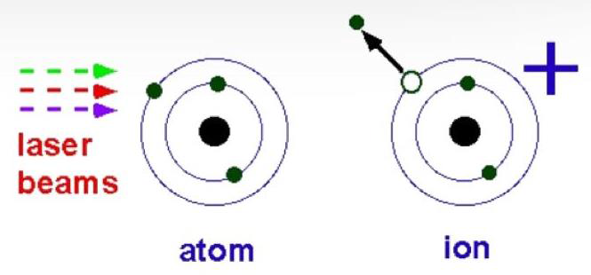
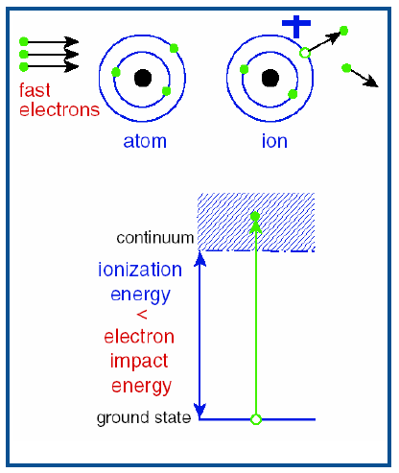
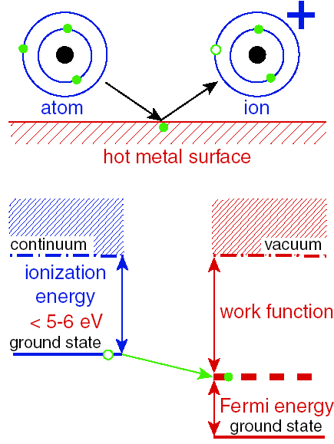
Ionization
Lasers
Plasma
Surface

Slide 25
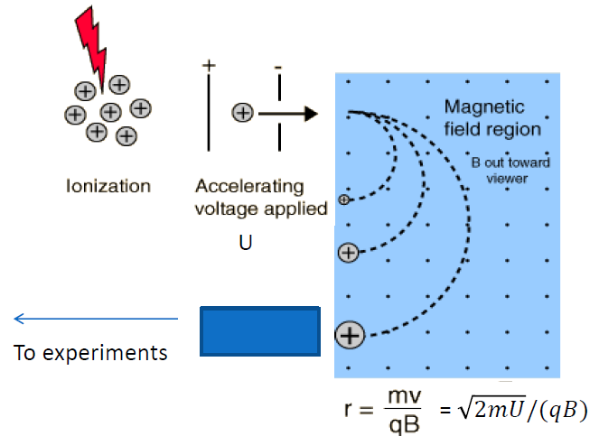
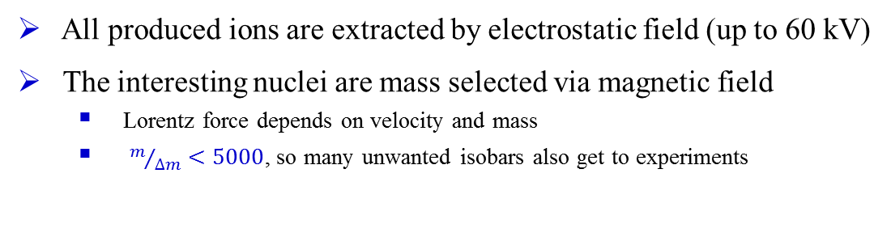
Beam extraction and separation
All produced ions are extracted by electrostatic field (up to 60 kV)
The interesting nuclei are mass selected via magnetic field
  Lorentz force depends on velocity and mass
  $m/{∆m}<5000$, so many unwanted isobars also get to experiments

Slide 26
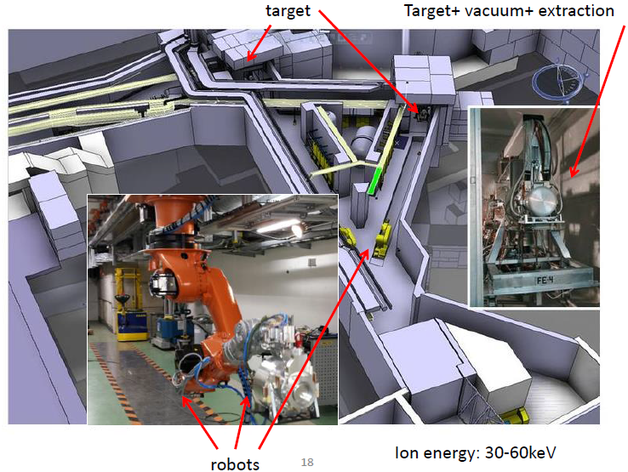
Production, ionization, extraction

Slide 27
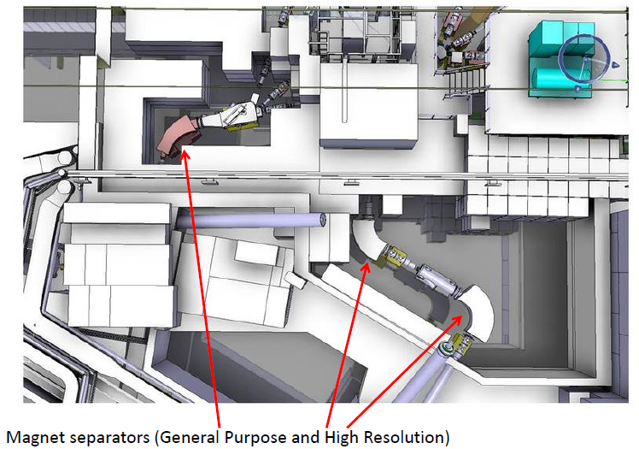
Separation

Slide 28
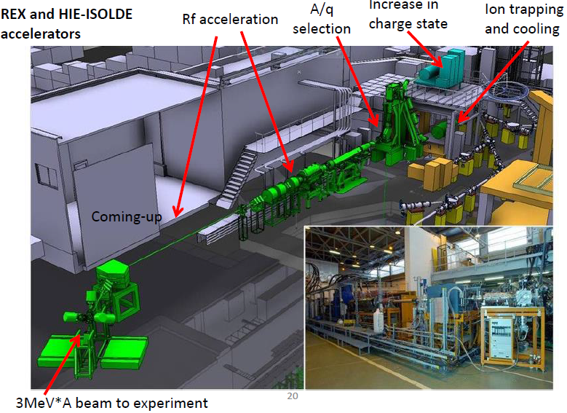
Post-acceleration

Slide 29
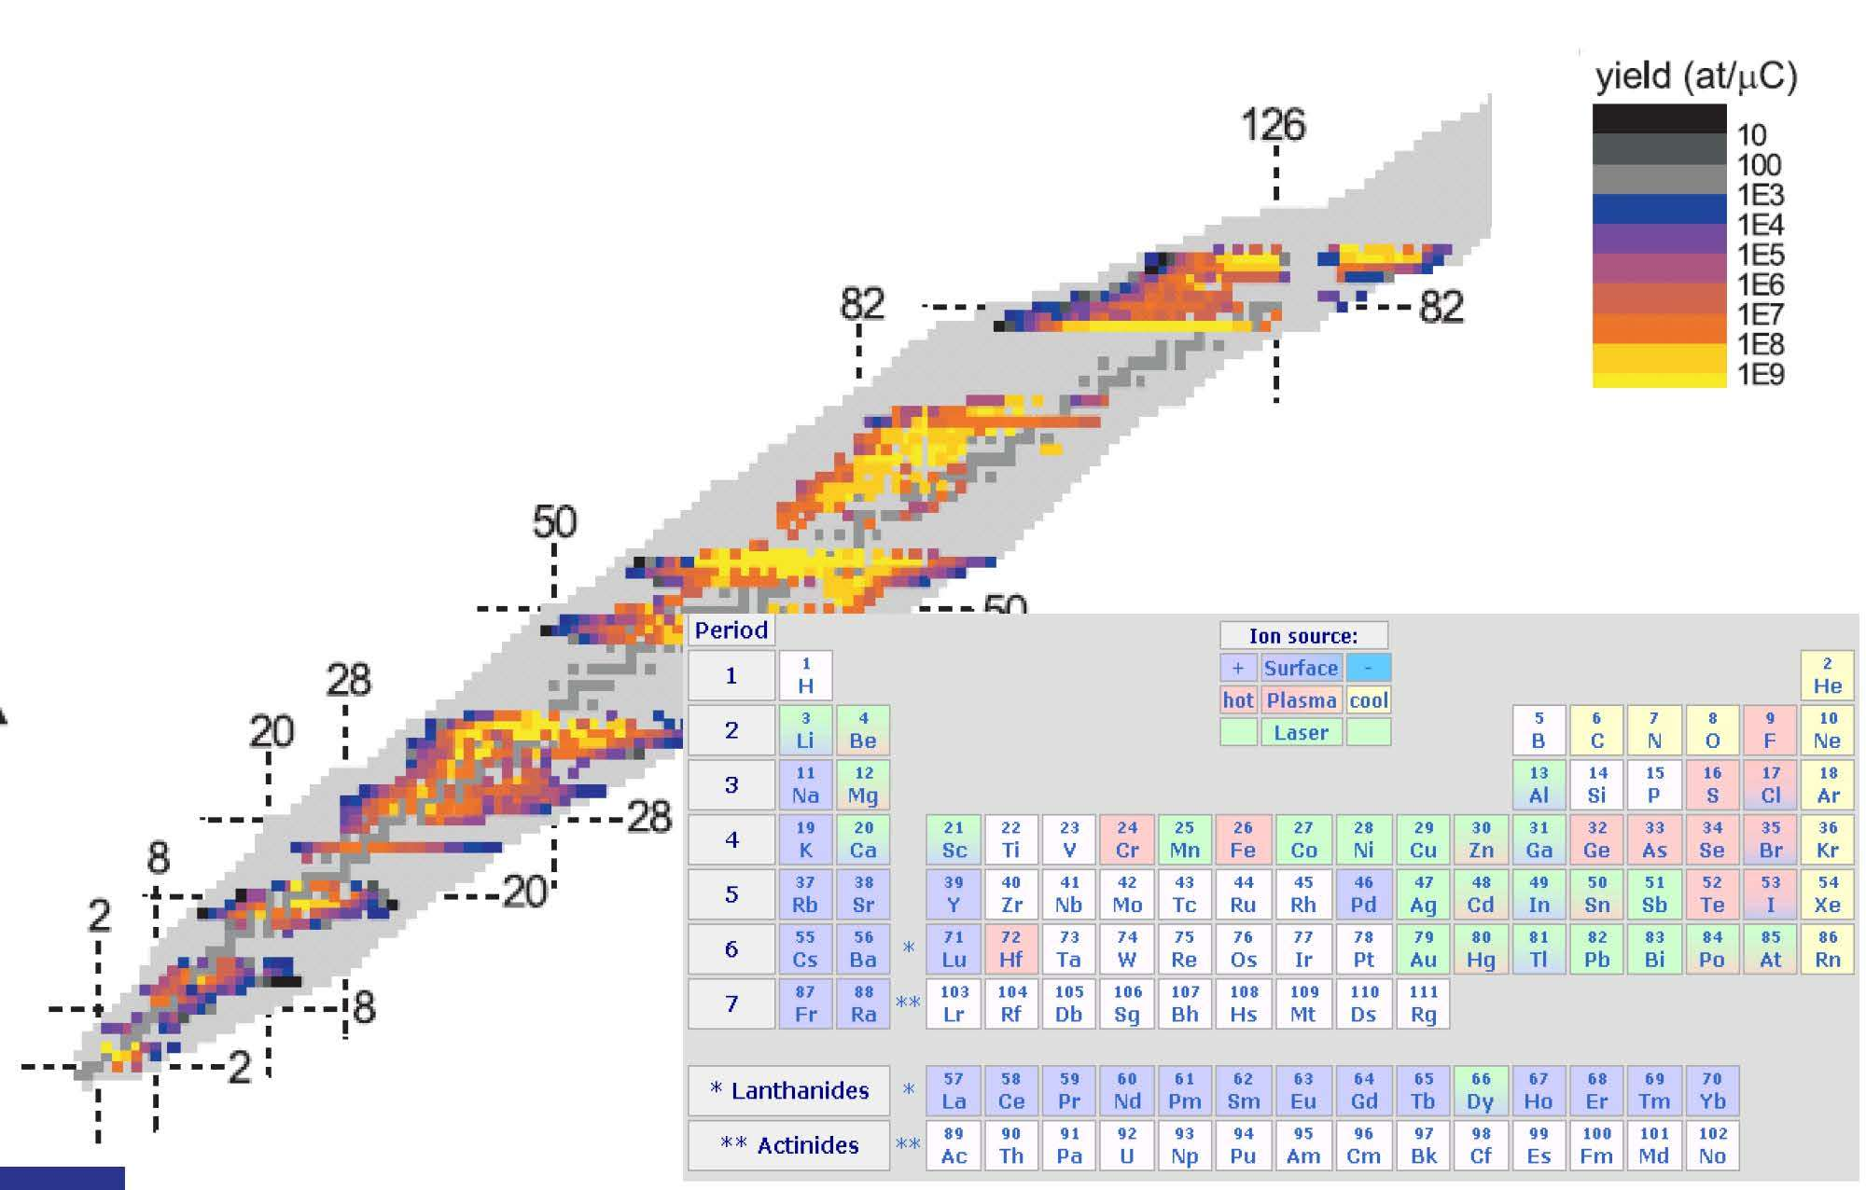
Extracted nuclides

Slide 30
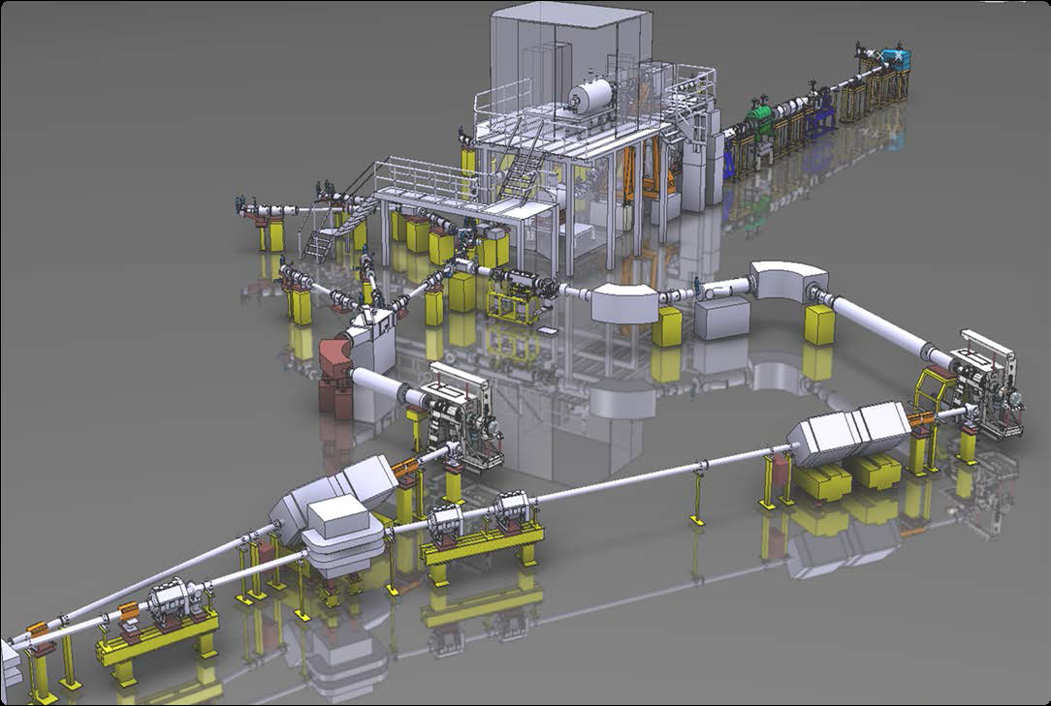
High-Intensity and Energy upgrade of Isolde (HIE-Isolde)
post accelerator
beam quality
intensity
target-ion source

Slide 31
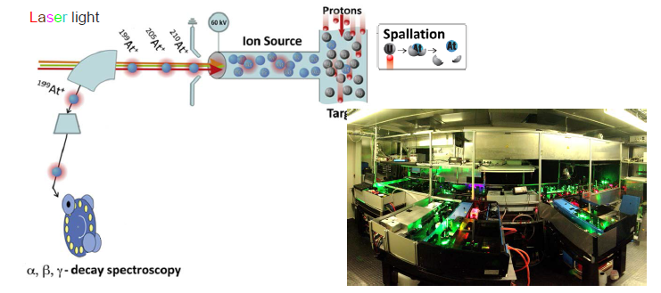

An example: Selective production of Astatine
Guinness World Records has dubbed this element the rarest on Earth, stating: “Only around 25g of the element astatine occurring naturally”
$⇒$ Ionization potential not experimentally deduced
$⇒$ Only two atomic transitions were known

Slide 32


Example: Astatine isotopes
How to produce pure beams of At isotopes (all are radioactive)?
  Use laser to ionize them
  Determine for the first time the At ionization potential
S. Rothe et al.; Nature Communications 4 (2013), 1835

Slide 33

Determination of the atomic properties of Astatine
Determination of ionizing potential
Identification of new atomic transitions
Comparison with atomic theory
Scan of ionizing laser: converging Rydberg levels allow precise determination of the IP
laser spectroscopy
Test of atomic theory and quantum chemistry
Properties of chemical homologue Z = 117
New beams / exotic decay modes: β-fission
Potential development of ²¹¹At as a medical radioisotope

Slide 34



The resonance ionization laser ion source (RILIS)

Slide 35

40 MV post-accelerator

Slide 36



40 MV post-accelerator
HIE-ISOLDE has innovated many new ideas, particularly in space-saving solutions. One way the engineers kept the system compact was to build cryomodules that each contain five cavities, not just one (Image: Maximilien Brice/ CERN)
The new linac had to fit into just 16 m of space. “We had to develop a very compact linac. That’s what makes it unique. In other facilities, every cavity has its own cryostat but if we had to do that it would be far too long, so we had to squeeze all of them into one cryomodule. We had to have the solenoids fitted too, they’re almost the same length as a cavity, so we had to do lots of design, research and development. The biggest challenge was to design in spaces with clearances of just 1 mm,” explains Yacine Kadi, project leader for HIE-ISOLDE. (Image: Maximilien Brice/CERN)

Slide 37

The Miniball Germanium Array

Slide 38





Coulomb excitation experiments at REX-Isolde

