Slide 1
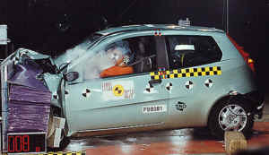
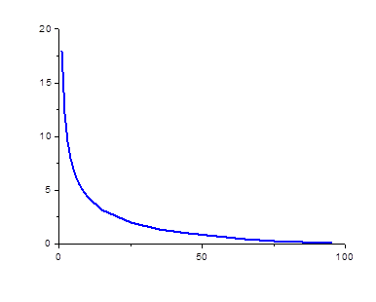

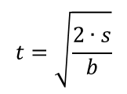



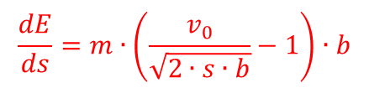



Interaction with matter
accelerated motion:
$$t=\sqrt{\frac{2∙s}{b}}$$
$$s=\frac{b}{2}t^{2}$$
$$v=v_{0}−b∙t=v_{0}−\sqrt{2∙s∙b}$$
$$\frac{energy loss}{braking distance}\left(\frac{Joule}{m}\right)$$
$$E=\frac{1}{2}mv^{2}$$
$$\frac{dE}{ds}=m∙\left(\frac{v_{0}}{\sqrt{2∙s∙b}}−1\right)∙b$$
$$v_{0}=100\frac{km}{h}=27.78\frac{m}{s}$$
$$b=3.86\frac{m}{s^{2}}$$
$$braking distance \left(m\right)$$

Slide 2
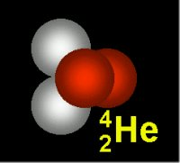
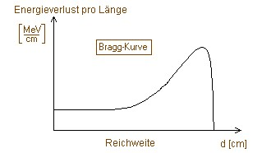
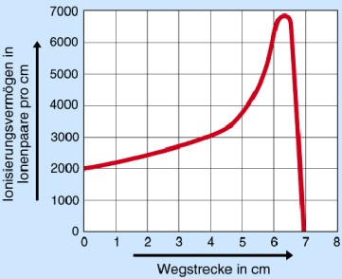
Interaction with matter
$$\frac{energy loss}{braking distance}\left(\frac{Joule}{m}\right)$$
energy loss
Bragg-curve
range
d [cm]
$$braking distance \left(m\right)$$

Slide 3


Some Nuclear Units
Nuclear energies are very high compared to atomic processes, and need larger units. The most commonly used unit is the MeV.
1 electron Volt = 1 eV = 1.6·10⁻¹⁹ Joules
1 MeV = 10⁶ eV; 1 GeV = 10⁹ eV; 1 TeV = 10¹² eV
However, the nuclear size are quite small and need smaller units:
Atomic sizes are on the order of 0.1 nm = 1 Angstrom = 10⁻¹⁰ m. Nuclear sizes are on the order of femtometers which in the nuclear context are usually called fermis:
1 fermi = 1 fm = 10⁻¹⁵ m
Atomic masses are measured in terms of atomic mass units with the carbon-12 atom defined as having a mass of exactly 12 amu. It is also common practice to quote the rest mass energy E=m₀c² as if it were the mass. The conversion to amu is:
1 u = 1.66054·10⁻²⁷ kg = 931.494 MeV/c²
electron mass = 0.511 MeV/c²; proton mass = 938.27 MeV/c²; neutron mass = 939.56 MeV/c²
Mass data: nucleardata.nuclear.lu.se/database/masses/

Slide 4
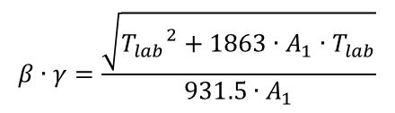



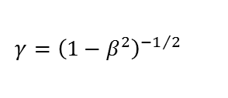
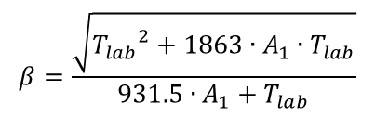
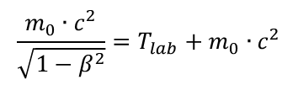
Relevant Formulae
The relevant formulae are calculated if A₁, Z₁ and A₂, Z₂ are the mass number (amu) and charge number of the projectile and target nucleus, respectively, and T_{lab} is the laboratory energy (MeV)
$$E=T_{lab}+m_{0}∙c^{2}$$
$$m∙c^{2}=T_{lab}+m_{0}∙c^{2}$$
$$\frac{m_{0}∙c^{2}}{\sqrt{1−β^{2}}}=T_{lab}+m_{0}∙c^{2}$$
$$β=\frac{\sqrt{{T_{lab}}^{2}+1863∙A_{1}∙T_{lab}}}{931.5∙A_{1}+T_{lab}}$$
beam velocity:
Lorentz contraction factor:
$$γ={\left(1−β^{2}\right)}^{{−1}/2}$$
$$γ=\frac{931.5∙A_{1}+T_{lab}}{931.5∙A_{1}}$$
$$β∙γ=\frac{\sqrt{{T_{lab}}^{2}+1863∙A_{1}∙T_{lab}}}{931.5∙A_{1}}$$

Slide 5
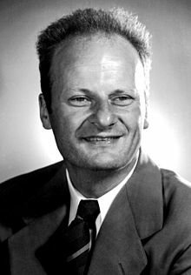
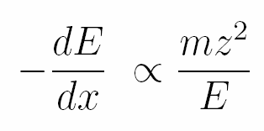
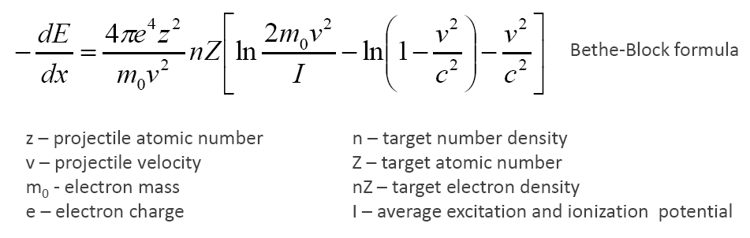
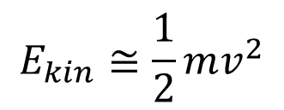
Energetic charged particles in matter
$$E_{kin}≅\frac{1}{2}mv^{2}$$
Hans Bethe
(1906-2005)
dominant in the classical limit [40 MeV/A (0.3c) - <1% deviation

Slide 6
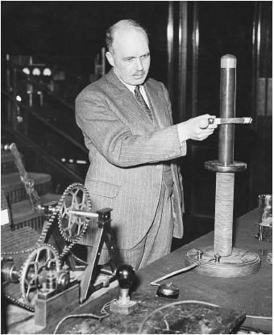
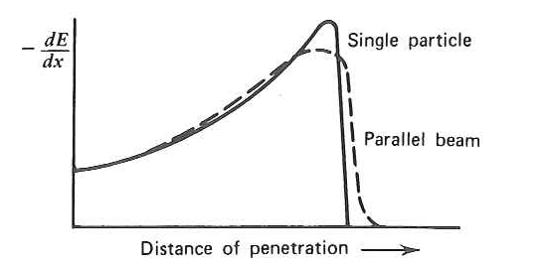
Energetic charged particles in matter
Bragg curve
William Henry Bragg
(1890-1971)

Slide 7
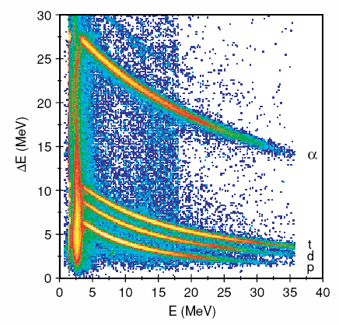
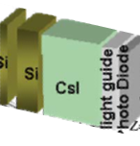
Energetic charged particles in matter
Charged particle identification with
segmented or stacked detectors
Si

Slide 8
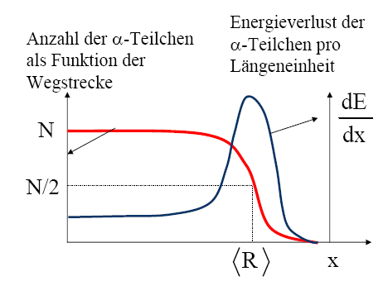
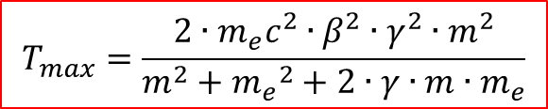

Interaction of α-particles in matter
α-particles are highly ionized and lose their energy very fast by ionization and excitation
when passing through matter.
maximum energy transfer T_{max} of a projectile with mass m
and velocity β on an electron m_{e} at rest
$$T_{max}=\frac{2∙m_{e}c^{2}∙β^{2}∙γ^{2}∙m^{2}}{m^{2}+{m_{e}}^{2}+2∙γ∙m∙m_{e}}$$
$$T_{max}=2∙m_{e}c^{2}∙β^{2}∙γ^{2}$$
number of α-particles
as a function of distance x
energy loss of
α-particles
per distant unit
for all heavy primary particles except electrons and positrons
average range <R> of α-particles with 5 MeV
2,5cm in air, 2,3cm in Al, 4,3cm in tissue

Slide 9
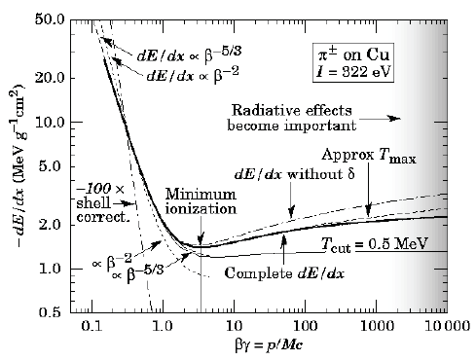

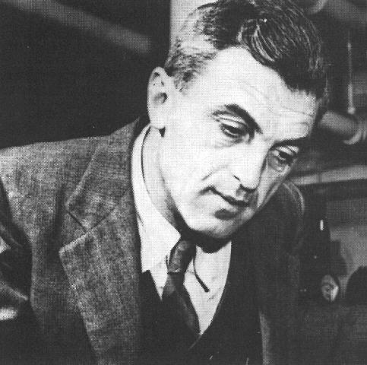

Interaction of charged particles in matter
Bethe-Bloch formula describes the energy loss of heavy particles passing through matter
N_{a} : Avogadro number 6.02·10²³ mol⁻¹
r_{e} : class. electron radius 2.81·10⁻¹³ cm
m_{e} : electron mass
ρ : density of abs. matter
Z : element number of abs. matter
A : mass of abs. matter
z : charge number of incoming particle
W_{max} : max. energy transfer in a single collision
I : average ionization potential
$$−\frac{dE}{dx}=4∙π∙{r_{e}}^{2}∙N_{a}∙m_{e}c^{2}∙ρ∙\frac{Z}{A}∙\frac{z^{2}}{β^{2}}∙\left[\frac{1}{2}ln\left(\frac{2∙m_{e}c^{2}∙γ^{2}∙β^{2}{∙T}_{max}}{I^{2}}\right)−β^{2}−δ−2∙\frac{C}{Z}\right]$$
$$≈z^{2}∙\frac{Z}{A}∙f\left(β,I\right)$$
= 0.3071 MeV g⁻¹cm²
for small β the term 1/β² is dominant
dE/dx has a minimum at βγ~3-4 (minimum ionizing particle)
for high momenta dE/dx reaches a saturation

Slide 10
Interaction of charged particles in matter
Bethe-Bloch formula describes the energy loss of heavy particles passing through matter
energy loss of a particle is
independent of its mass!
energy loss is an important
tool for particle identification
for minimum ionizing particles m.i.p.
dE/dx ~ 2 MeV g⁻¹ cm²
i.e. for a target density ρ = 1 g/cm³
dE/dx ~ 2 MeV/cm
$$−\frac{dE}{dx}=4∙π∙{r_{e}}^{2}∙N_{a}∙m_{e}c^{2}∙ρ∙\frac{Z}{A}∙\frac{z^{2}}{β^{2}}∙\left[\frac{1}{2}ln\left(\frac{2∙m_{e}c^{2}∙γ^{2}∙β^{2}{∙T}_{max}}{I^{2}}\right)−β^{2}−δ−2∙\frac{C}{Z}\right]$$
$$≈z^{2}∙\frac{Z}{A}∙f\left(β,I\right)$$
= 0.3071 MeV g⁻¹cm²
liquid-H₂
He-gas
for small β the term 1/β² is dominant
dE/dx has a minimum at βγ~3-4 (minimum ionizing particle)
for high momenta dE/dx reaches a saturation

Slide 11
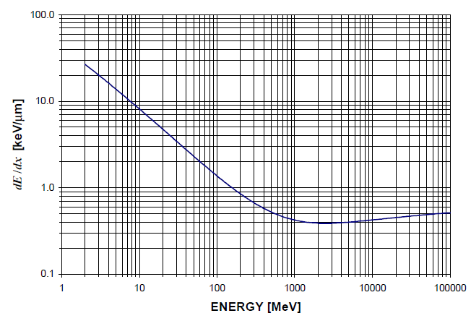

Example: Proton in Silicon
Bethe-Bloch formula describes the energy loss of heavy particles passing through matter
$$−\frac{dE}{dx}=4∙π∙{r_{e}}^{2}∙N_{a}∙m_{e}c^{2}∙ρ∙\frac{Z}{A}∙\frac{z^{2}}{β^{2}}∙\left[\frac{1}{2}ln\left(\frac{2∙m_{e}c^{2}∙γ^{2}∙β^{2}{∙T}_{max}}{I^{2}}\right)−β^{2}−δ−2∙\frac{C}{Z}\right]$$
$$≈z^{2}∙\frac{Z}{A}∙f\left(β,I\right)$$
= 0.3071 MeV g⁻¹cm²
$$T_{max}=2∙m_{e}c^{2}∙β^{2}∙γ^{2}$$
dE/dx vs. E of protons in silicon

Slide 12
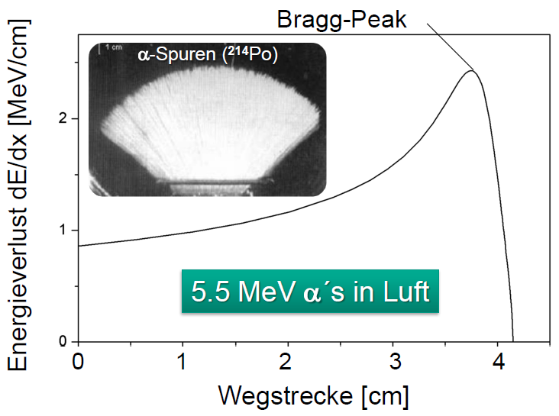
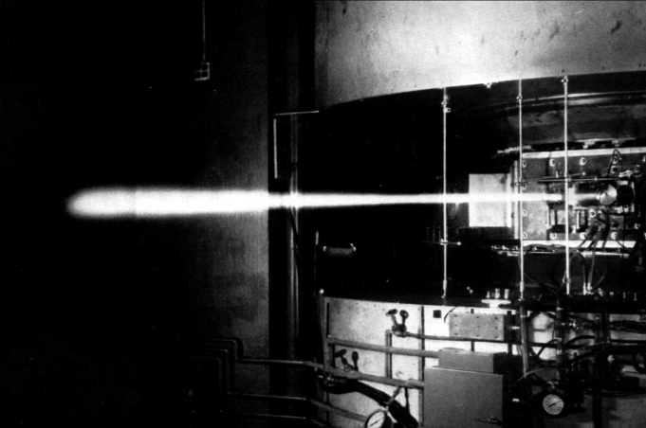



Energy loss and range of charged particles
$$−\frac{dE}{dε}=−\frac{1}{ρ}∙\frac{dE}{dx}=z^{2}∙\frac{Z}{A}∙f\left(β,I\right)$$
-dE/dε is independent of the material for equal particles
the average range for particles with kin. energy T is obtained by integration
7.7 MeV α-particles in air:
range is not exact but there is range straggling,
the number of interactions is a statistical process.
$$\overline{R}=\int_{E_{0}}^{0}{{\left(\frac{dE}{dx}\right)}^{−1}}dE$$
energy loss
5.5 MeV α´s in air
$$\overline{R}/ρ≈7cm$$
distance
deuteron beam scintillating in air

Slide 13
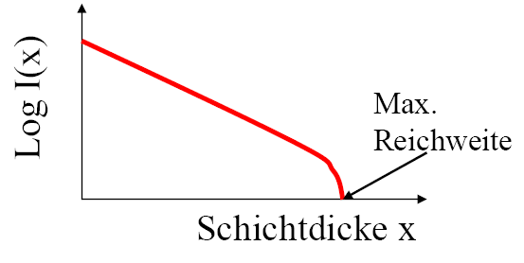
Interaction of β-particles with matter
β-particles are also ionizing, similar to α-particles. Since the mass of the electrons and positrons are very small, the energy transfer per collision is small and the range large. Similar to the X-rays there is first only an attenuation, which finally leads to a maximum range for larger layer thicknesses.
max. range
layer thickness

Slide 14
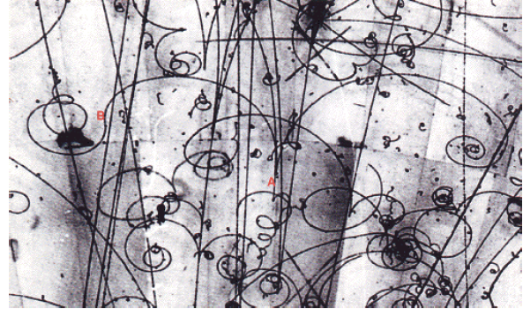
Interaction of β-particles with matter
β⁺ particles behave similarly as β⁻ particles; they are ionizing and attenuated on their way through matter.
But at the end of the their attenuation one observes a pair annihilation with an electron, which yields high energetic γ-emission. Positrons are hence more dangerous than electrons.

Slide 15
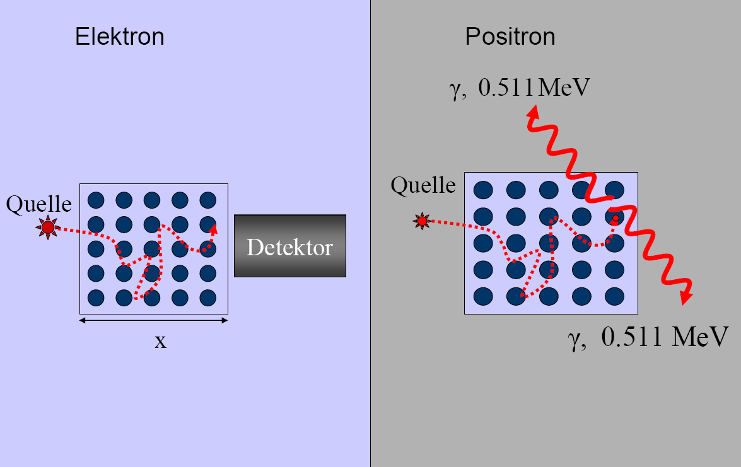
Comparison between electrons (β⁻) and positrons (β⁺) on their way through matter
electron
positron
β⁺ particles behave similarly as β- particles; they are ionizing and attenuated on their way through matter.
But at the end of the their attenuation one observes a pair annihilation with an electron, which yields high energetic γ-emission. Positrons are hence more dangerous than electrons.
source
source
detector

Slide 16
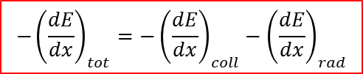
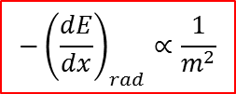
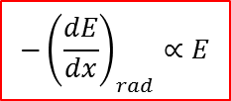
Energy loss for electrons and positrons
e± are exceptional cases due to their low mass. They will be deflected significantly in each collision.
In addition to the energy loss due to ionization, the energy loss due to Bremsstrahlung is of importance.
$$−{\left(\frac{dE}{dx}\right)}_{tot}=−{\left(\frac{dE}{dx}\right)}_{coll}−{\left(\frac{dE}{dx}\right)}_{rad}$$
For high energies the energy loss due to Bremsstrahlung is given by
$$−{\left(\frac{dE}{dx}\right)}_{rad}∝E$$
$$−{\left(\frac{dE}{dx}\right)}_{rad}∝\frac{1}{m^{2}}$$
and
Other particles like muons also radiate,
especially at higher energies.

Slide 17
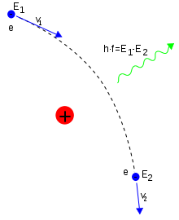
Bremsstrahlung
Bremsstrahlung (‘braking radiation’) is electromagnetic radiation produced by the deceleration of a charged particle when deflected by another charged particle, typically an electron by an atomic nucleus.
The moving particle loses kinetic energy, which is converted into a photon, thus satisfying the law of conservation of energy.
Bremsstrahlung has a continuous spectrum.

Slide 18
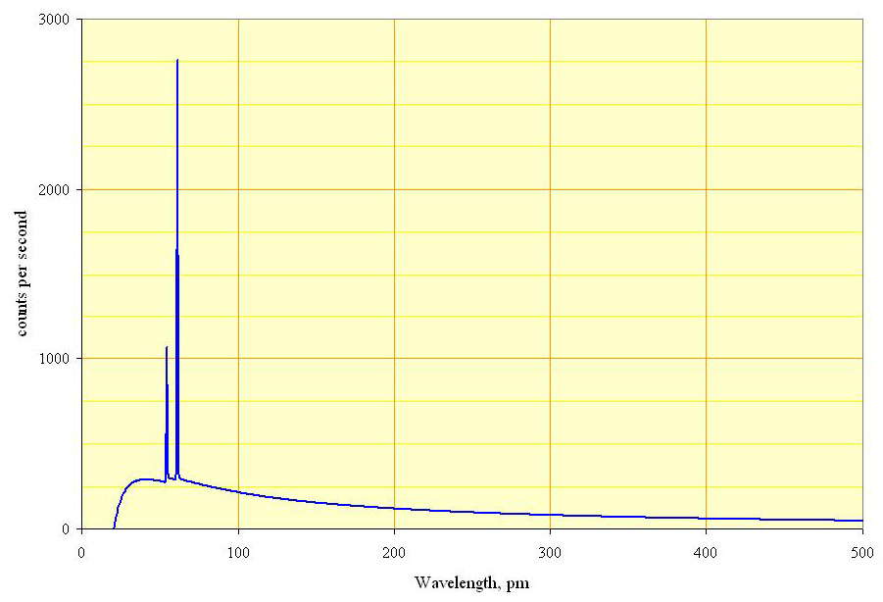
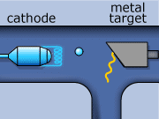




Bremsstrahlung
$$E_{photon}=h∙ν=E_{kin}=e∙U$$
$$λ_{min}=\frac{h∙c}{e∙U}$$
$$λ_{min}=\frac{1.24∙{10}^{−6}Vm}{U}$$
spectral distribution:
$$J\left(λ\right)=K∙I∙Z∙\left(\frac{λ}{λ_{min}}−1\right)∙\frac{1}{λ^{2}}$$
K = Kramer constant
I = electron current
Z = element number of material
Spectrum of the X-rays emitted by an X-ray tube with a rhodium target, operated at 60 kV. The continuous curve is due to bremsstrahlung, and the spikes are characteristic K lines for rhodium.

Slide 19

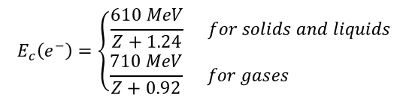
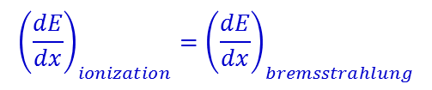
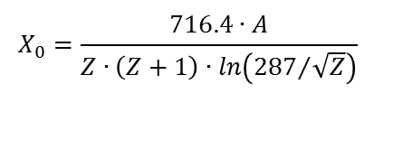
Bremsstrahlung
$$−{\left(\frac{dE}{dx}\right)}_{rad}=\frac{E}{X_{0}}$$
X₀ is the radiation length. It is the mean distance over which a high-energy electron loses all but 1/e of its energy by Bremsstrahlung
fit to data:
$$X_{0}=\frac{716.4∙A}{Z∙\left(Z+1\right)∙ln\left({287}/{\sqrt{Z}}\right)}$$
Usual definition for the critical energy E_{c} (electron)
$${\left(\frac{dE}{dx}\right)}_{ionization}={\left(\frac{dE}{dx}\right)}_{bremsstrahlung}$$
$$E_{c}^{}\left(e^{−}\right)=\left\{\begin{matrix}\frac{610 MeV}{Z+1.24} for solids and liquids \\ \frac{710 MeV}{Z+0.92} for gases \end{matrix}\right.$$
example: Pb (Z=82, ρ = 11.34 [g/cm³] → E_{c} = 7.34 MeV

Slide 20
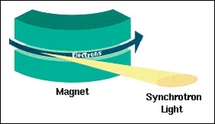

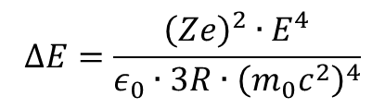
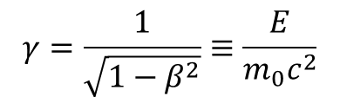
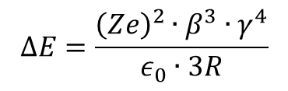
Synchrotron radiation
The electromagnetic radiation emitted when charged particles are accelerated radially (a ⊥ v) is called synchrotron radiation. It is produced, for example, in synchrotrons using bending magnets.
The energy loss of a charged particle (Z·e) due to radiation (during one cycle) is given by
with Z = element number, ε₀ = electric field constant, R = radius of the storage ring, β=v/c and the Lorentz factor
For relativistic velocities β ≈ 1
It is apparent that one uses light particles to create synchrotron radiation.
$$ΔE=\frac{{\left(Ze\right)}^{2}∙β^{3}∙γ^{4}}{ε_{0}∙3R}$$
$$γ=\frac{1}{\sqrt{1−β^{2}}}≡\frac{E}{m_{0}c^{2}}$$
$$ΔE=\frac{{\left(Ze\right)}^{2}∙E^{4}}{ε_{0}∙3R∙{\left(m_{0}c^{2}\right)}^{4}}$$

Slide 21

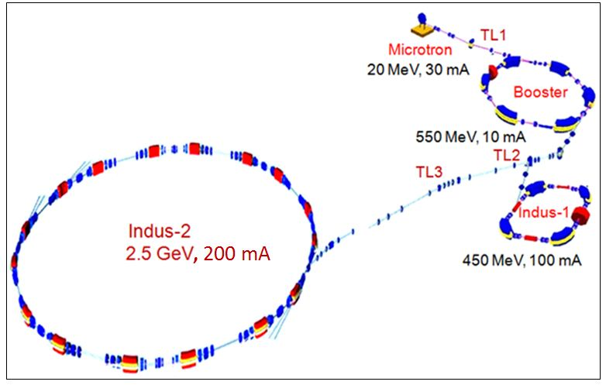
Synchrotron radiation
Raja Ramanna Centre for Advanced Technology
Indore

Slide 22

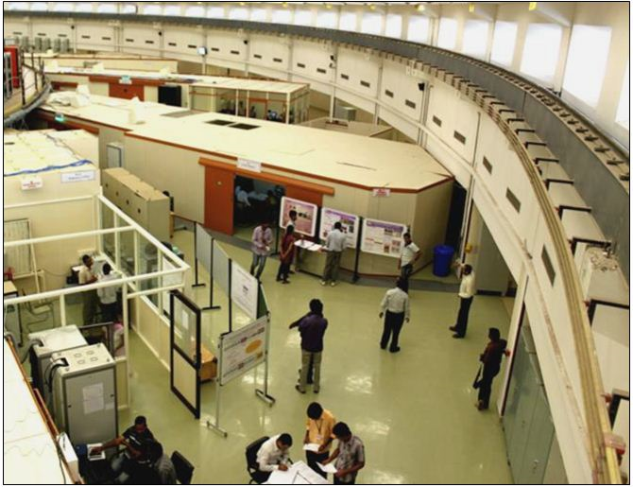
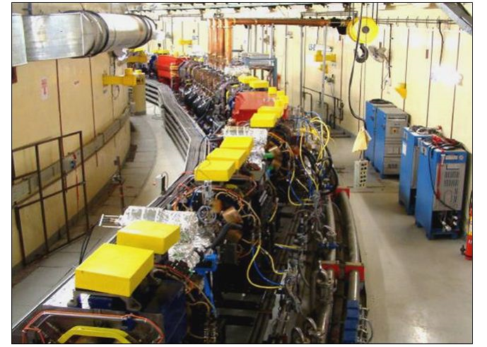
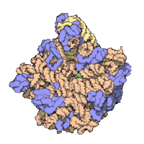
Raja Ramanna Centre for Advanced Technology - Synchrotron radiation
Applications: condensed matter physics, material science, biology and medicine.
Structure of a ribosome (components of a cell)

Slide 23
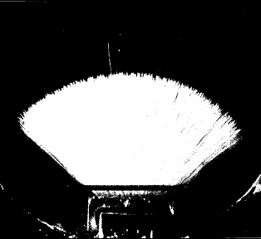
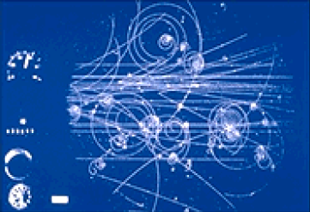
Typical range of radioactive radiation in air
range of 5.5 MeV α-particles in air is ~ 4.2 cm
range of 1 MeV β-particles in air is ~ 4 m
range of X-rays, γ-rays and neutrons is very large.
shielding or large distances (1/r² law) are the solution

