Slide 1
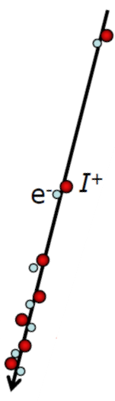
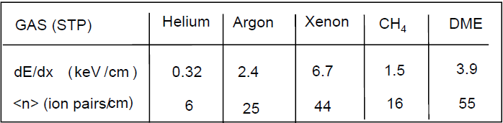
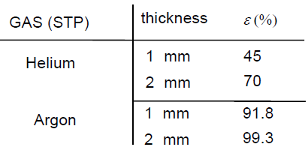



Ionization detectors
incoming particle
ionization track
ion/e⁻ pairs
Minimum-ionizing particles (Sauli. IEEE+NSS 2002)
different counting gases:
ionization process: Poisson statistics
detection efficiency ε depends on average number <n> of ion pairs
$$ε≤1−e^{−\left\langle n\right\rangle }$$
$$∆E∝\left\langle n\right\rangle$$
$$≈linear for ∆E≪E$$

Slide 2
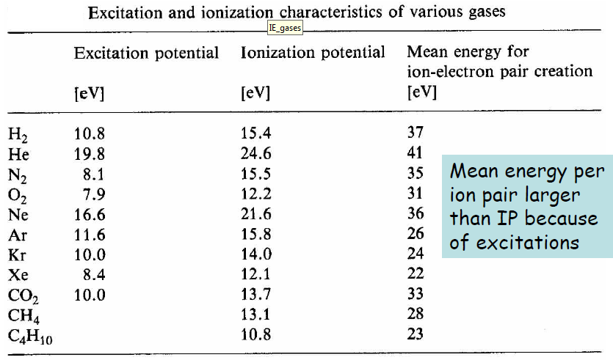
Effective ionization energies
Large organic molecules have low-lying excited rotational states
→ excitation without ionization through collisions

Slide 3
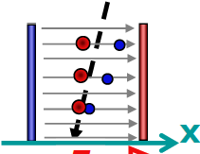
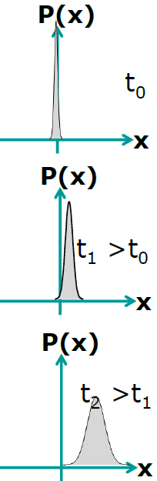


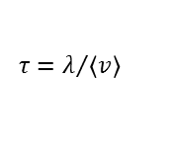
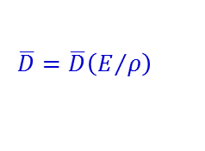

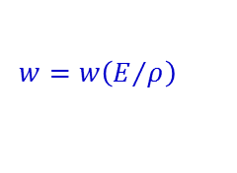
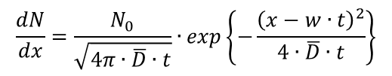

Charge transport in gas
Electric field E = ΔU / Δx separates positive and negative charges
E
charge diffusion in electric field
$$\frac{dN}{dx}=\frac{N_{0}}{\sqrt{4π∙\overline{D}∙t}}∙exp\left\{−\frac{{\left(x−w∙t\right)}^{2}}{4∙\overline{D}∙t}\right\}$$
$$w=\frac{e}{2m}∙E∙τ$$
drift velocity
$$τ=λ/{\left\langle v\right\rangle }$$
mean time between collisions
$$\overline{D}=μ∙\frac{k∙T}{e}$$
$$μ=\frac{w}{E}$$
mobility
There is a cycle of acceleration and scattering/ionization etc.
drift(w) and diffusion (D) depend on field strength E and gas pressure ρ
charge diffusion
$$w=w\left(E/ρ\right)$$
$$\overline{D}=\overline{D}\left(E/ρ\right)$$
Notes:
Gauss distribution

Slide 4
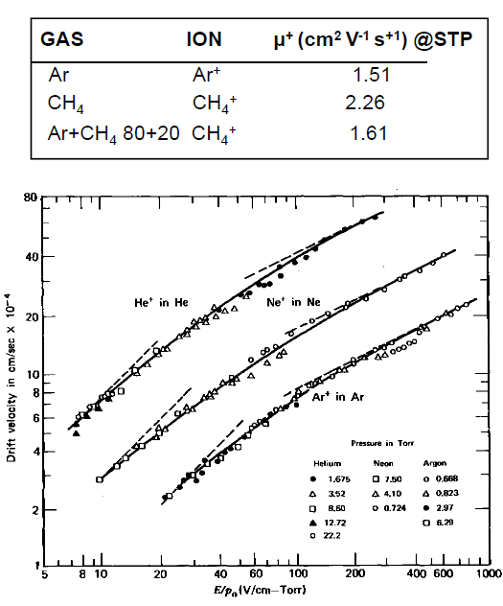
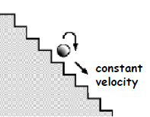
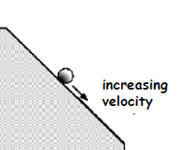
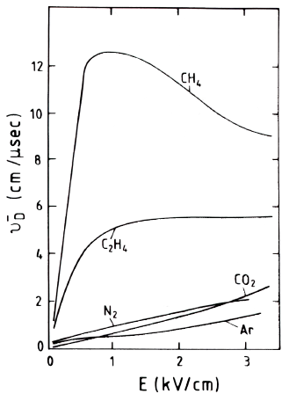
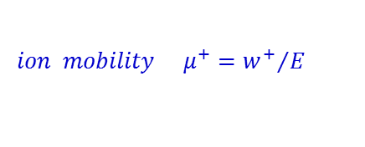
Ion mobility
$$ion mobility { μ}^{+}={w^{+}}/E$$
For ions there is an interplay between acceleration and
collisions. Ion mobility is independent of field for a given gas at ρ, T = const.
ions
electrons
He
Ne
Ar
E/ρ (V/cm/torr)
w⁺ ~ 10⁻² cm/μs
w⁻ ~ 10¹ cm/μs
E. McDaniel and E. Mason; The mobility and diffusion of ions in gases (Wiley 1973)

Slide 5
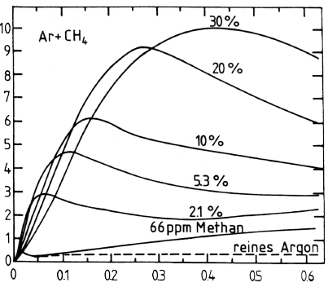
Electron mobility
In general, the mobility of electrons is not constant, but depend on on their kinetic energy and varies with the electric field strength.
drift velocities of electrons in Argon-Methan mixtures
drift velocities of electrons in different gases
pure
reduced electric field strength [V/cm mm Hg]

Slide 6
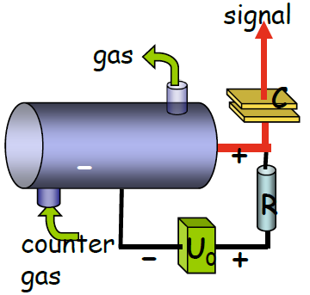
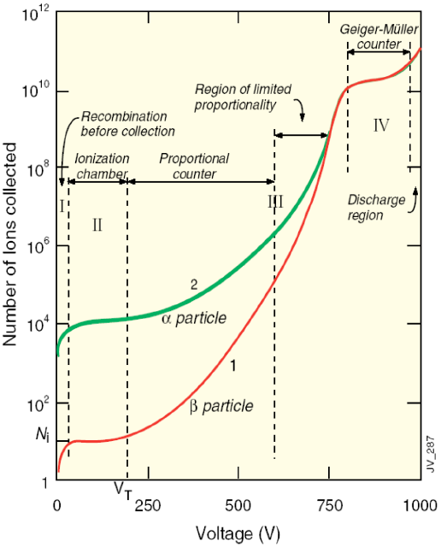
Amplification counters
single-wire gas counter
gas counters may be operated in different operation modes depending on the applied high voltage.

Slide 7
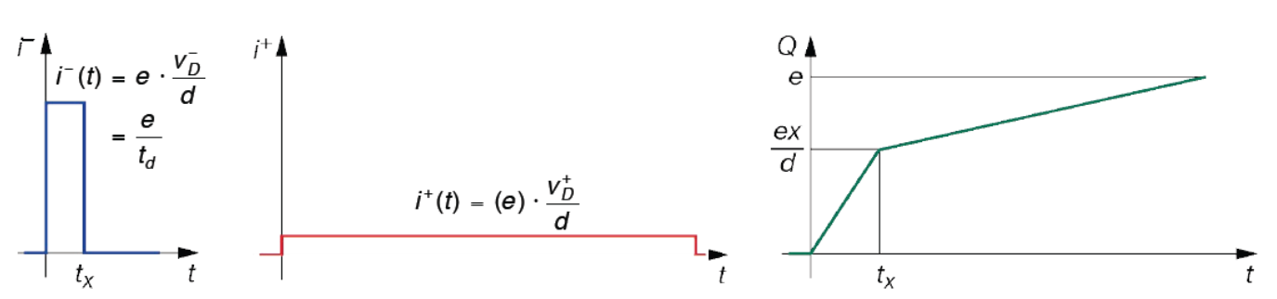
Ionization chamber
An ionization chamber is operated at a
voltage which allows full collection of
charges, however below the threshold of
secondary ionization (no amplification).
planar ionization chamber
For a typical field strength 500 V/cm and typical
drift velocities the collection time for 10 cm drift is
about 2 μs for e– and 2 ms for the ions.
Time evolution of the signals for one e⁻ ion pair:
electrons
ions
total charge

Slide 8
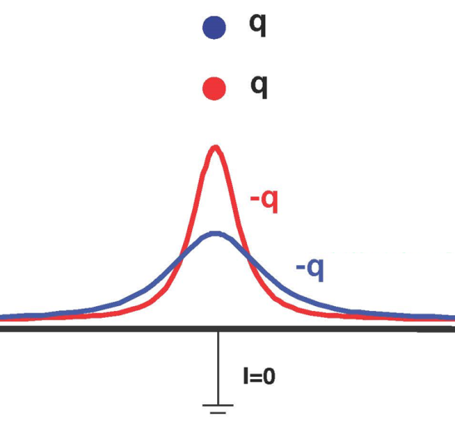
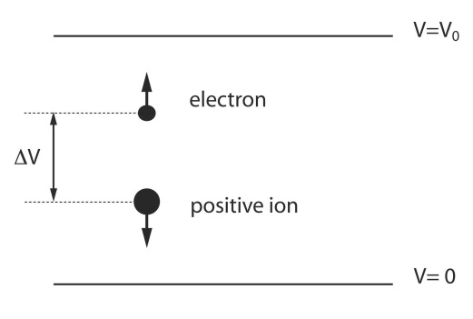
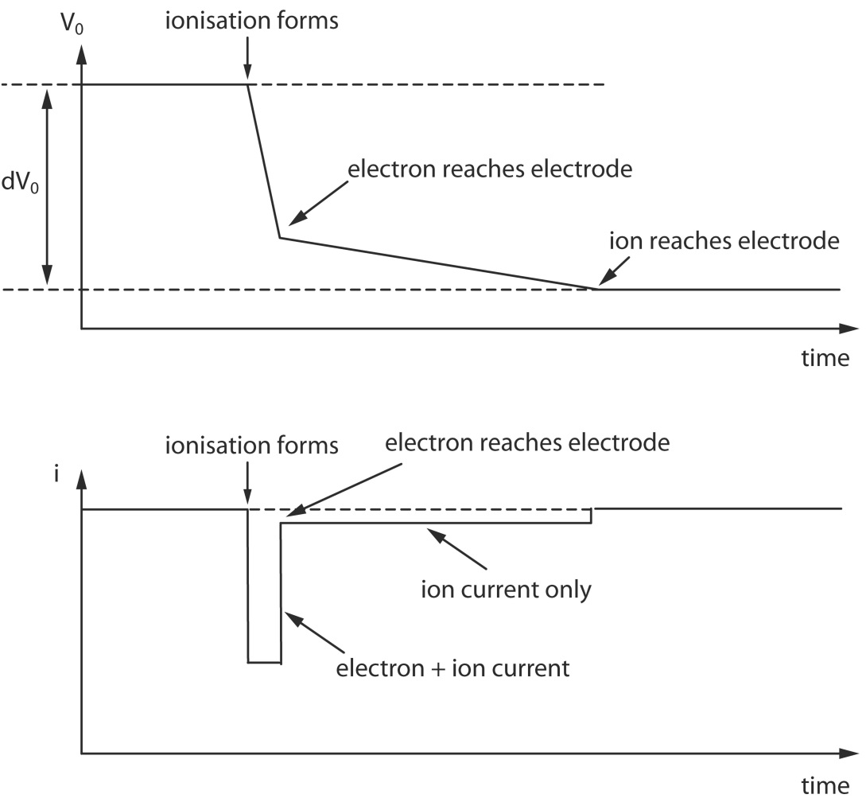

Signal collection
The motion of charges induces an apparent current in the electrodes.
Ion causes the same signal as the electron = same sign, same amplitude, but much slower
$$i=\frac{q}{V_{0}}\frac{dV}{ds}\frac{ds}{dt}$$

Slide 9
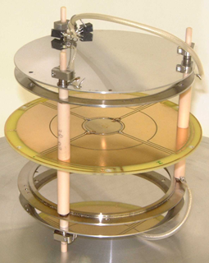
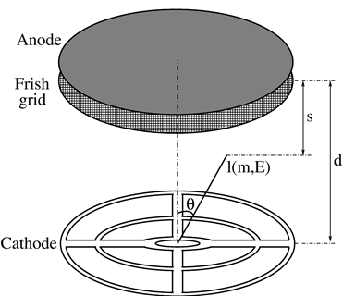
Ionization chamber
no gas gain
charges move in electric field
induced signal is generated during drift of charges
induced current ends when charges reach electrodes
²⁵²Cf source (25k f/s)
T_{1/2}=2.645 y
E_{α} = 6.118 and 6.076 MeV
binary fission/α-decay = 1/31
additional ´Frisch grid´:
electrons drift towards Frisch grid and induce a signal but not on the anode.
when electrons pass the Frisch grid, a signal is induced on anode.
the angular dependence of the electrons is removed from anode signal

Slide 10
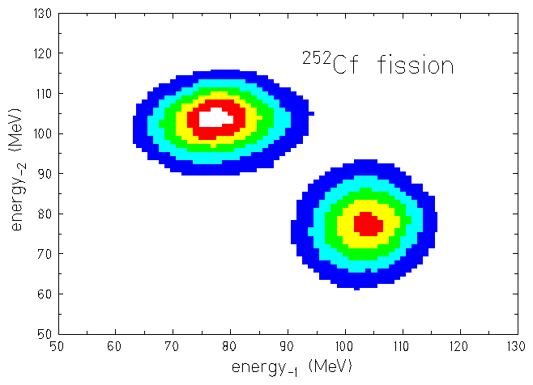
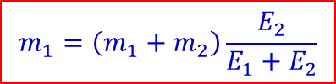
4π twin ionization chamber for fission fragments
measured quantities:
E_{H}
A_{H}
E_{L}
A_{L}
e⁻ drift time
ϑ
segmented cathode
φ
$$m_{1}v_{1}+m_{2}v_{2}=0 → m_{1}E_{1}=m_{2}E_{2}$$
$$m_{1}=\left(m_{1}+m_{2}\right)\frac{E_{2}}{E_{1}+E_{2}}$$
$$\left\langle E_{L}\right\rangle =103.5±0.5 MeV → \left\langle A_{L}\right\rangle =108.9±0.5$$
$$\left\langle E_{H}\right\rangle =78.3±0.5 MeV → \left\langle A_{H}\right\rangle =143.1±0.5$$

Slide 11
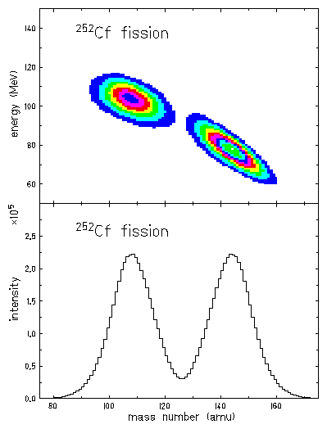
Fission fragment mass measurement
<108.9 amu>
<143.1 amu>
mass resolution σ = 3 amu
P. Adrich, diploma thesis (2000)

Slide 12
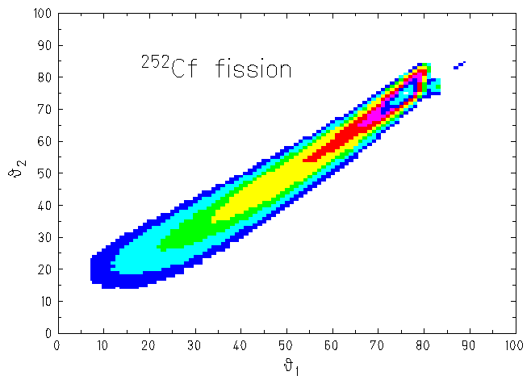

Determination of the polar angles
$$cos\left(θ\right)=\frac{d−t∙v_{drift}}{ℓ\left(E,A\right)}$$
angular resolution
ϑ | φ
30⁰ | 4.2⁰
50⁰ | 2.5⁰
70⁰ | 2.3⁰
drift velocity: v_{drift} = 10 (cm/μs)
range of fragments in methan gas: ℓ(E,A)
distance cathode-anode: d = 3.8cm
P. Adrich, diploma thesis (2000)

Slide 13
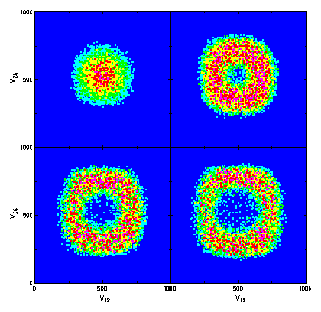
Determination of the azimuthal angles
energy ratios for different emission angles ϑ
P. Adrich, diploma thesis (2000)

Slide 14
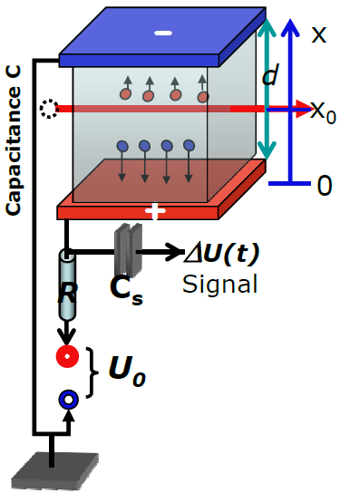



Signal generation in ionization counters
primary ionization in gases: I ≈ 20-30 eV/IP
energy loss Δε: n = n_{I} = n_{e} = Δε / I of primary ion pairs n at x₀, t₀
force: F_{e} = -eU₀/d = -F_{I}
energy content of capacity C
1)
2)
1) + 2)
$$W\left(t\right)=\frac{C}{2}\left[{U_{0}}^{2}−U^{2}\left(t\right)\right]≈C∙U_{0}∙∆U\left(t\right)$$
$$W\left(t\right)=n_{e}F_{e}\left[x_{e}\left(t\right)−x_{0}\right]+n_{I}F_{I}\left[x_{I}\left(t\right)−x_{0}\right]$$
$$=+\frac{n∙eU_{0}}{d}\left[x_{I}\left(t\right)−x_{e}\left(t\right)\right]$$
w⁺(t)∙(t-t₀)
$$∆U\left(t\right)=\frac{W\left(t\right)}{C∙U_{0}}=\frac{n∙e}{C∙d}\left[w^{+}\left(t\right)−w^{−}\left(t\right)\right]\left(t−t_{0}\right)$$
total signal: electron & ion components

Slide 15
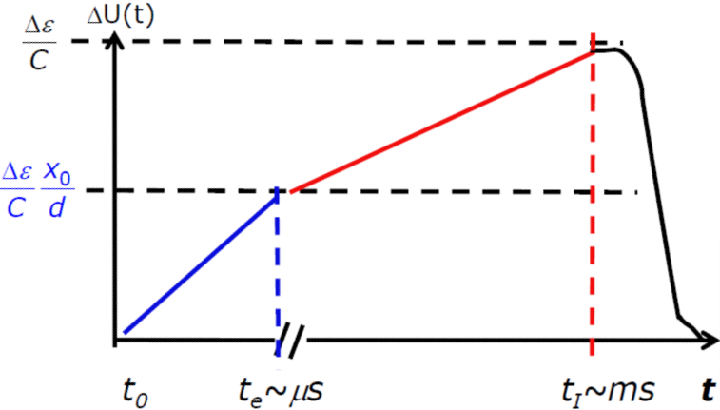


Time-dependent signal shape
total signal: electron & ion components
$$∆U\left(t\right)=\frac{∆ε}{C∙d}\left[w^{+}\left(t\right)−w^{−}\left(t\right)\right]\left(t−t_{0}\right)$$
drift velocities (w⁺ > 0, w⁻ < 0)
$$\left|w^{+}\left(t\right)\right|\sim {10}^{−3}∙\left|w^{−}\left(t\right)\right|$$
Both components measure Δε and
depend on position of primary ion pair
x₀ = w⁻∙(t_{e}-t₀)
for fast counting use only electron component!

Slide 16
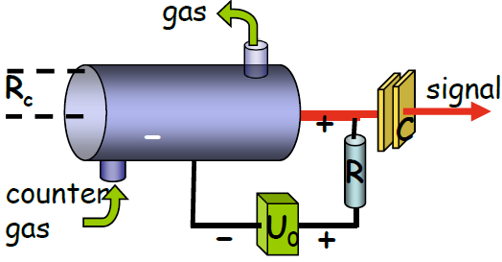
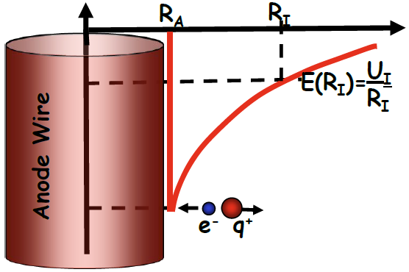
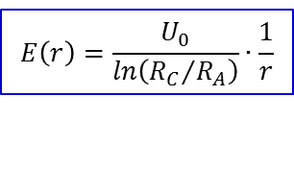
Proportional counter
gas amplification factor (typical 10⁴–10⁶) is constant
anode wire: small radius R_{A} ≈ 50 μm or less
voltage U₀ ≈ (300-500) V
field at r from the wire
$$E\left(r\right)=\frac{U_{0}}{ln\left({R_{C}}/{R_{A}}\right)}∙\frac{1}{r}$$
avalanche R_{I} → R_{A}, several mean free paths needed
pulse height mainly due to positive ions (q⁺)

Slide 17
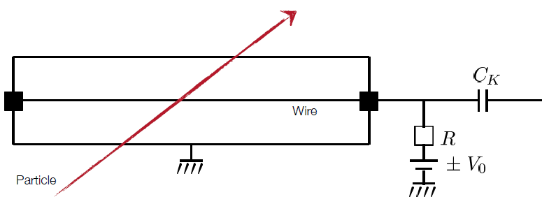
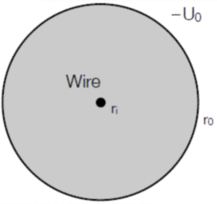
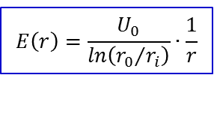
Proportional counter
gas amplification factor (typical 10⁴–10⁶) is constant
anode wire: small radius r_{i} ≈ 50 μm or less
voltage U₀ ≈ (300-500) V
-U₀
field at r from the wire
$$E\left(r\right)=\frac{U_{0}}{ln\left({r_{0}}/{r_{i}}\right)}∙\frac{1}{r}$$
r_{i}
r₀
avalanche R_{I} → R_{A}, several mean free paths needed
pulse height mainly due to positive ions (q⁺)

Slide 18
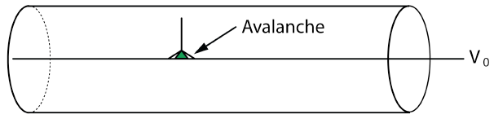
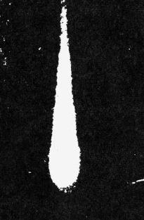
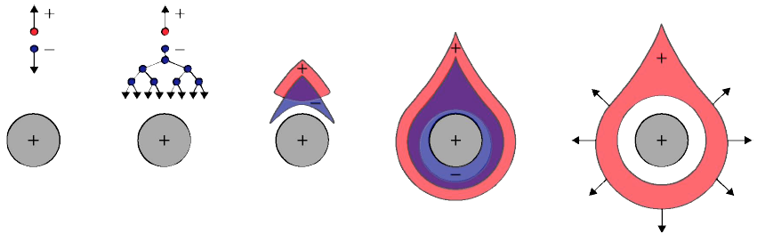
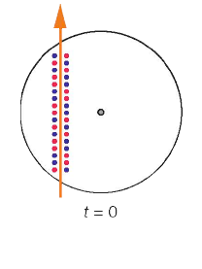
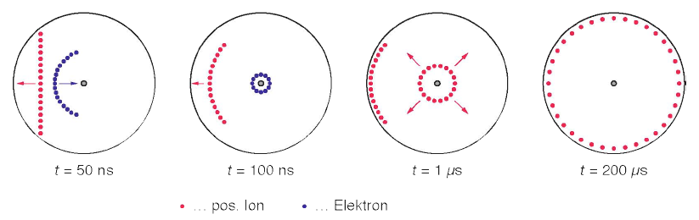
Proportional counter
cloud chamber
The primary produced electrons drift the anode wire and reach the area of high electrical field strength. If a critical field strength is reached, a secondary ionization produces electrons in an avalanche.
time sequence of the signal evolution
primary ionization
secondary ionization
pos. ions drift due to
secondary ionization
pos. ion
electron

Slide 19
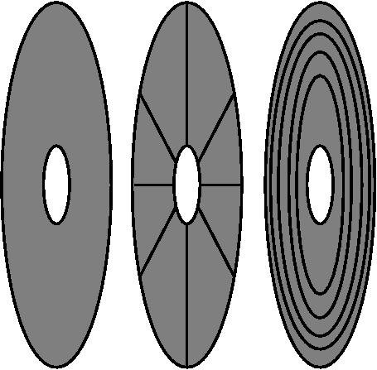
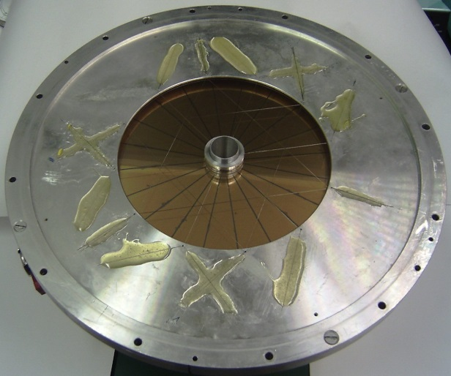
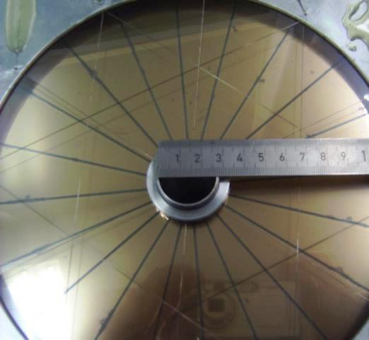
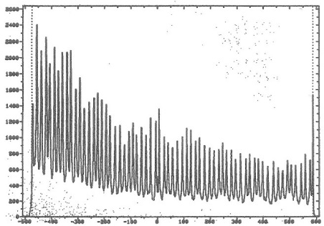
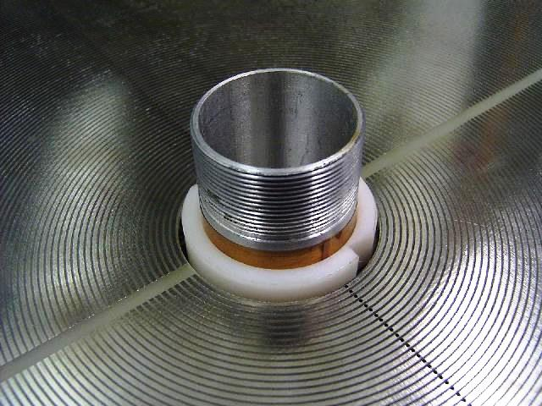
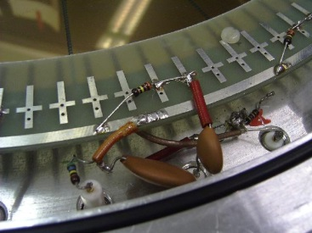
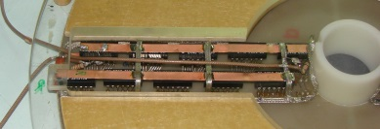
Proportional counter
V₀ ~ 500 V
p = 5-10 Torr
~ 3 mm gap anode-cathode
target
entrance window
~ φ_{lab}
~ tanϑ_{lab}
Δt ~ tanϑ
o
Δtime →
i
i
i
delay line

Slide 20
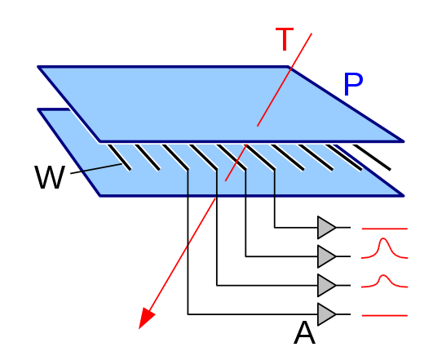

Multi-Wire Proportional Chamber
A multi-wire proportional chamber detects charged particles and gives positional information on their trajectory.
Cathode plate
Wires
d = 2 mm
Georges Charpak
Nobel price 1992
charge signals
Amplifier
time resolution: fast anode signals (t_{rise} ~ 0.1 ns)
position resolution: for d = 2 mm σ_{x} = 50-300 μm
(weighted with charges)

Slide 21

Multi-Wire Proportional Chamber

Slide 22


Time Projection Chamber
Principle: Time Projection Chambers are based on the drift of the charge carriers with constant drift velocity v_{D}
in a homogenous E-field (E = -dU/dz).
typical parameters: E ~ 1 kV/cm, v_{D} ~ 1-4 cm/μs, Δz ~ 200 μm
3-dim. traces: z from the drift time, (x,y) from the segmented anode

Slide 23

Geiger-Müller counter
The discharge is not any more localized
The number of charge carriers is not any more related to the primary ionization
The gas amplification amounts to 10⁸-10¹⁰

