Slide 1
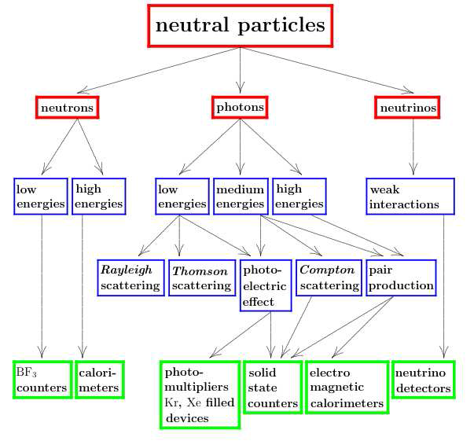
Neutral Particles

Slide 2
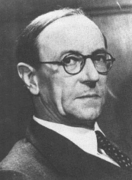
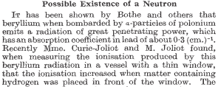
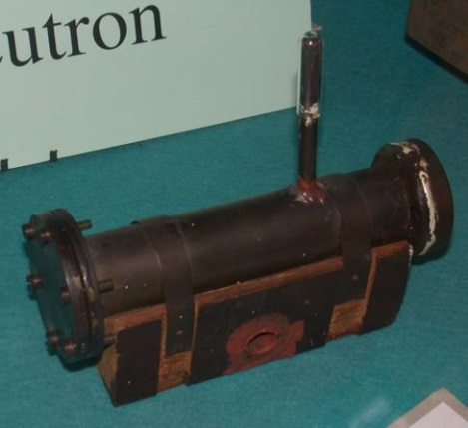
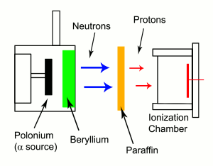
Neutron detectors
Neutron detectors do not detect neutrons but products of neutron interaction!
James Chadwick, Nature 132 (1932) 3252

Slide 3
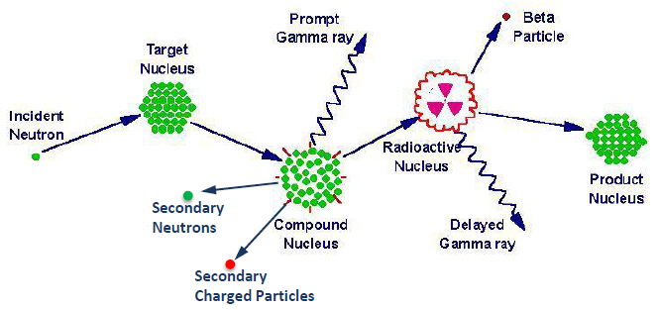
General detection principle
Neutron detectors do not detect neutrons but products of neutron interaction!
Detection of a neutron is a sequential process
1. Interaction of the incident neutron: neutron transport
2. Transport of secondary particles to or within sensing elements
hadron, ion, photon transport
3. Primary ionization by secondary particles
4. Conversion to optical photons, gas amplification:
Transport of electrons and optical photons
5. Conversion to electrical signal
external converter (radiator) converter = detector

Slide 4
Interaction of Neutrons
Indirect detection technique: induce neutrons to interact and produce charged particles.
$n+{}_{}^{6}{Li}→α+{}_{}^{3}{H+4.78 MeV} ⇒ Li\left(Tl\right) scintillator$
$n+{}_{}^{10}B→α+{}_{}^{7}{Li}+2.31 MeV ⇒ BF_{3} gas counter$
$n+{}_{}^{3}{He}→p+{}_{}^{3}{H+0.765 MeV} ⇒ {}_{}^{3}{He}−filled proportional chambers$
$n+p→n+p ⇒ proportional chambers with e.g. CH_{4}$
$n+{}_{}^{235}U→fission products ⇒ coated proportional counters$
$n+nucleus→hadron cascade ⇒ calorimeters$
Neutron detection and identification is important in the field of radiation protection because the relative biological effectiveness (quality factor) is high and depends on the neutron energy.
$$H \left[Sievert\right]=q∙D\left[Gray\right]$$

Slide 5
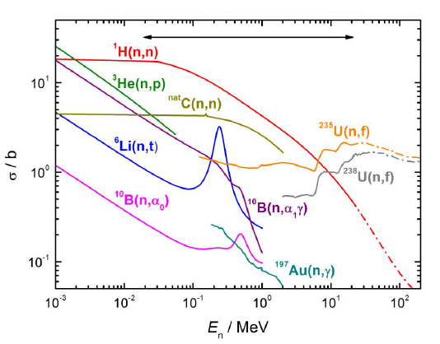
Interaction of neutrons with matter
Neutron detectors can only be detected after conversion to charged particles or photons:
Elastic scattering: ^{A}X(n,n)^{A}X → recoil nucleus ^{A}X^{Z+}
Inelastic scattering: ^{A}X(n,n´γ)^{A}X → recoil nucleus ^{A}X^{Z+} , e⁻
Radiative capture: ^{A}X(n,γ)^{A+1}Y → e⁻
Neutron emission: ^{A}X(n,2n)^{A-1}Y → radioactive daughter
Charged-particle emission: ^{A}X(n,lcp)^{A´}Y → (lcp = p, d, t, α), recoil nucleus ^{A´}Y^{Z+}
Fission: n + ^{A}X → ^{A1}X₁ + ^{A2}X₂ + νn → fission fragments
cross section relevant
for neutron detection

Slide 6
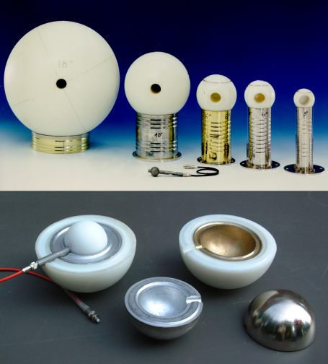
Neutron Detection
$n+{}_{}^{3}{He}→{\left({}_{}^{4}{He}\right)}^{∗}→p+{}_{}^{3}H$, Q=0.765 MeV
Moderate neutrons in spheres of different sizes and then detect the charged particles in a proportional counter in the center.
Bonner sphere

Slide 7
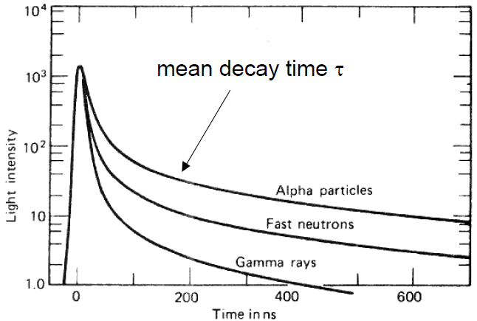
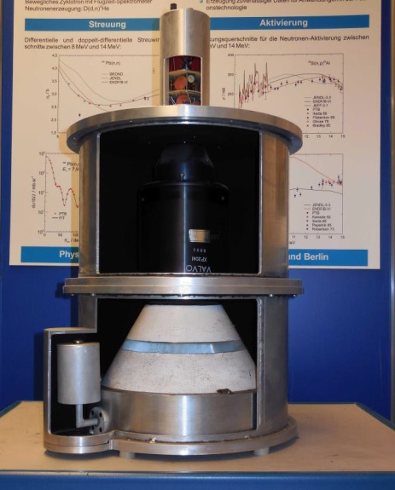
Pulse shape discrimination
Pulse shape discrimination (PSD) in organic scintillators are used in particularly liquid scintillators
(NE213 / BC501A)
PSD is due to long-lived decay of scintillator light caused by high dE/dx particle – neutron scatter interaction events causing proton recoil

Slide 8
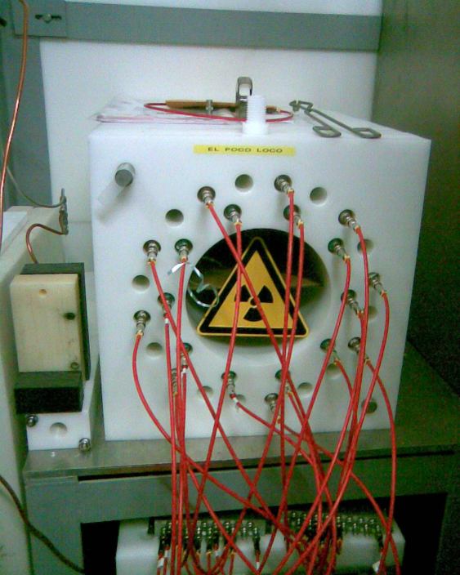
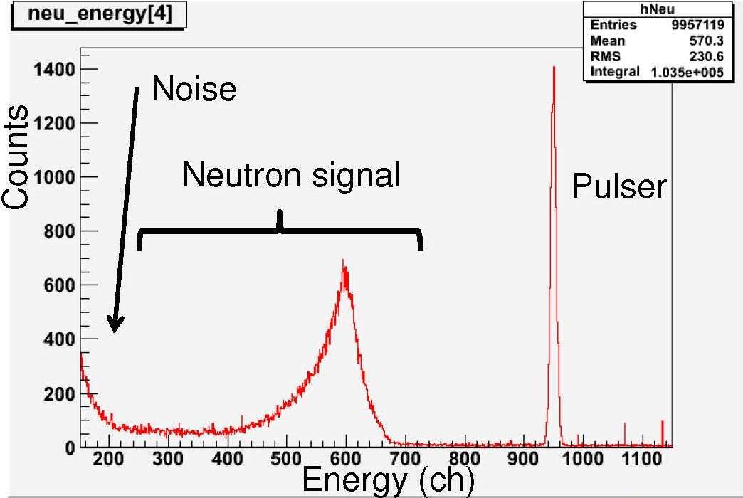
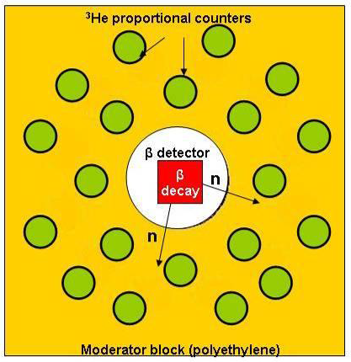
BELEN - Neutron Detection
$$n+{}_{}^{3}{He}→p+{}_{}^{3}H+765 keV σ_{th}=5400 b$$
BELEN-30 (90x90x80 cm³ PE)
20 ³He counters (20 atm) outer ring
10 ³He counters (10 atm) inner ring
efficiency (1 keV – 1MeV) ~ 40%

Slide 9
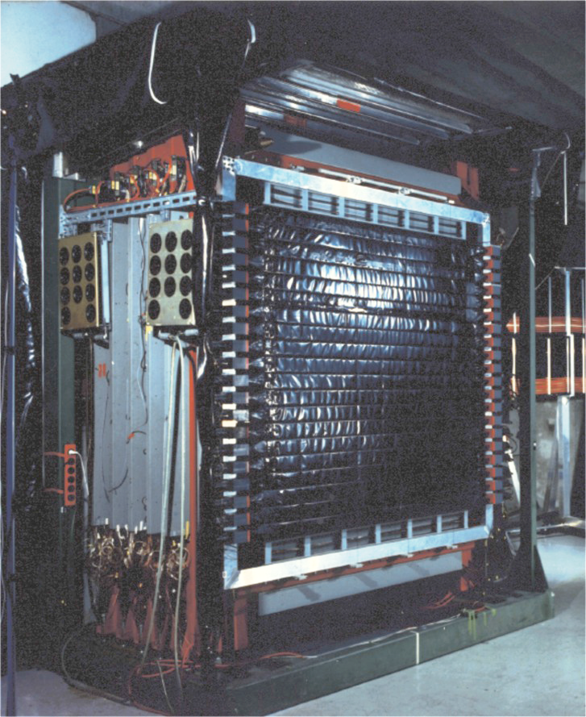
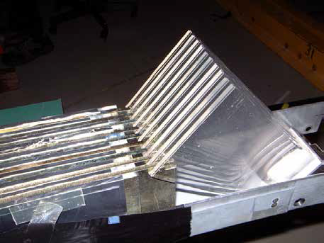
Large Area Neutron Detector
Large Area Neutron Detector (2m x 2m x 1m)
neutron energy T_{n} ≤ 1 GeV
ΔT_{n}/T_{n} = 5.3%
efficiency ~1
passive Fe-converter

Slide 10
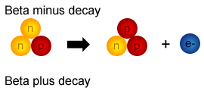
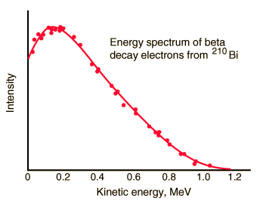
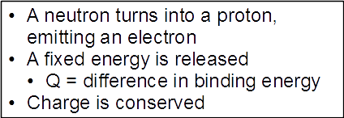
Neutrinos

Slide 11
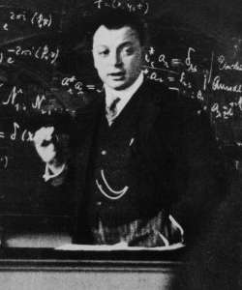
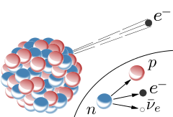
Neutrinos
Wolfgang Pauli

Slide 12
Interaction of Neutrinos
$ν_{e}+n→p+e^{−}$
$\overline{ν_{e}}+p→n+e^{+}$
$ν_{μ}+n→p+μ^{−}$; $ν_{τ}+n→p+τ^{−}$
$\overline{ν_{μ}}+p→n+μ^{+}$; $\overline{ν_{τ}}+p→n+τ^{+}$
(discovery of the neutrino)
Small cross section for MeV neutrinos:
$$σ\left(ν_{e}N\right)=\frac{4}{π}∙{10}^{−10}{\left\{\frac{ℏp}{{\left(m_{p}c\right)}^{2}}\right\}}^{2}=1.6∙{10}^{−44}{cm}^{2} for 0.5 MeV$$
Rate of solar neutrinos interacting in the Earth:
$$N∙σ∙d∙ρ∙flux=6.022∙{10}^{23}∙1.6∙{10}^{−44}{cm}^{2}∙1.2∙{10}^{9}cm∙5.5\frac{g}{{cm}^{3}}∙6.7∙{10}^{10}{cm}^{−2}s^{−1}=4{cm}^{−2}s^{−1}$$
For high energies (GeV-range):
$$σ\left(ν_{μ}N\right)=0.67∙{10}^{−38}∙E_{ν}\left[GeV\right] {{cm}^{2}}/{nucleon}$$

Slide 13
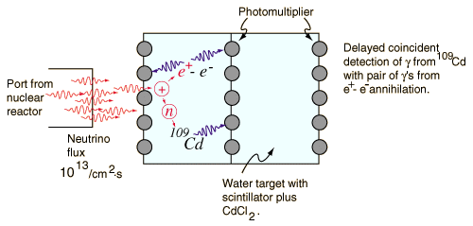
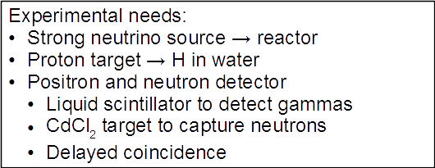
Detecting the Neutrinos
Inverse beta decay:
$$\overline{ν_{e}}+p→e^{+}+n$$

Slide 14
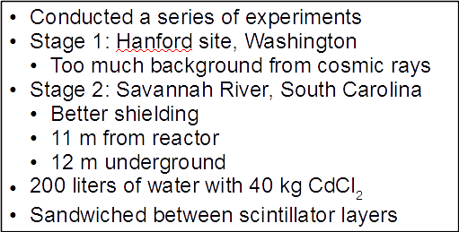
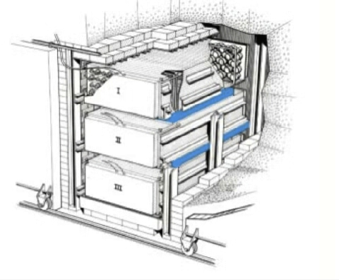
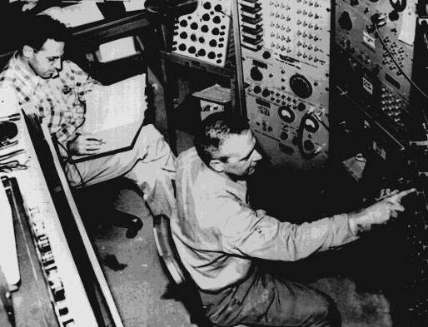
Discovery, Reines & Cowan 1956

Slide 15
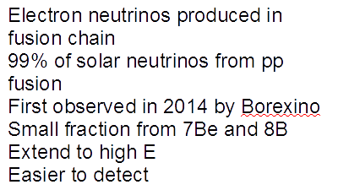
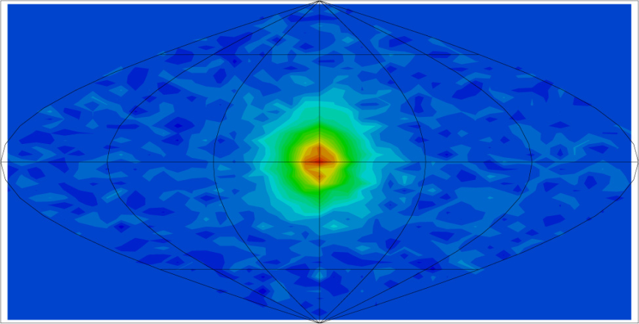
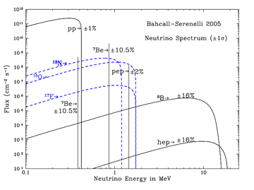
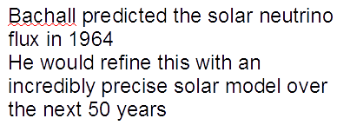
Solar Neutrinos

Slide 16
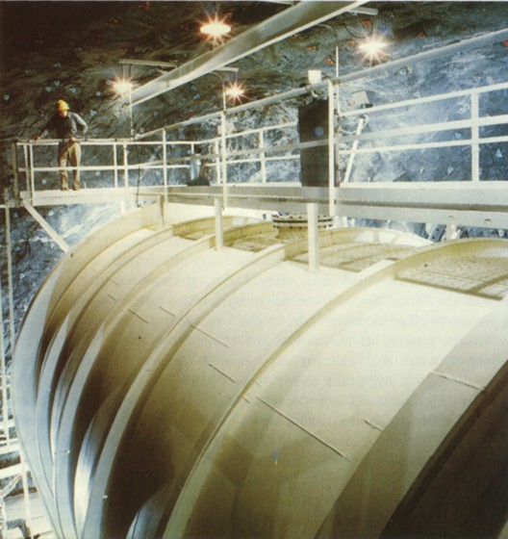
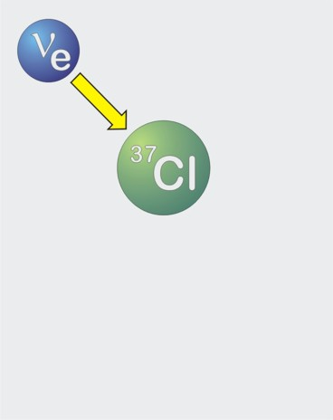
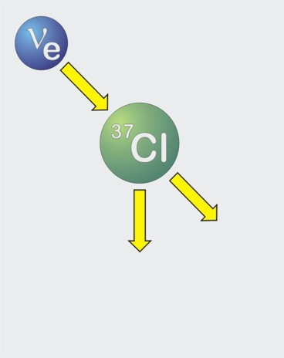
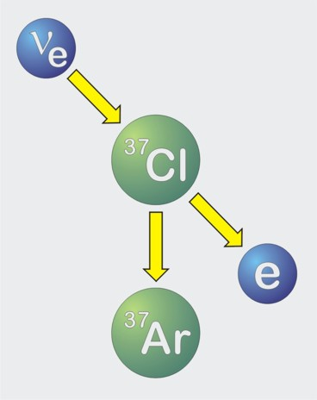
First measurement of the solar neutrinos
Inverse beta-decay
(„neutrino-capture”)
40 days neutrino irradiation …
Expected: 60 atoms ³⁷Ar
600 tons
Carbon tetrachloride
Homestake Sun neutrino-
Observatory (1967−2002)

Slide 17
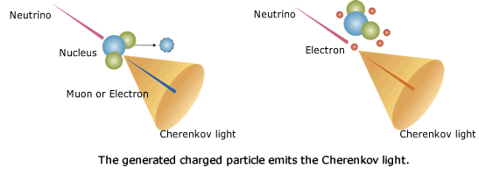
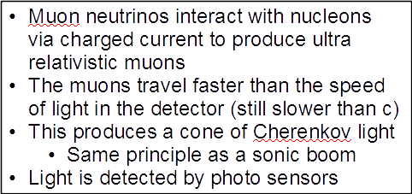
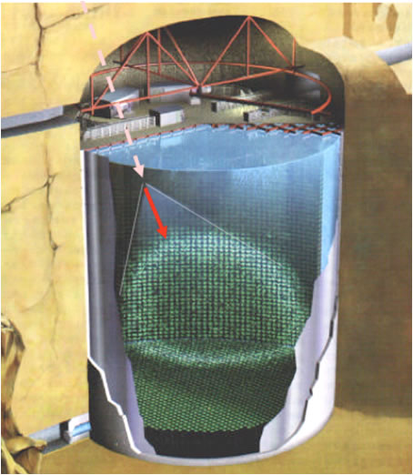
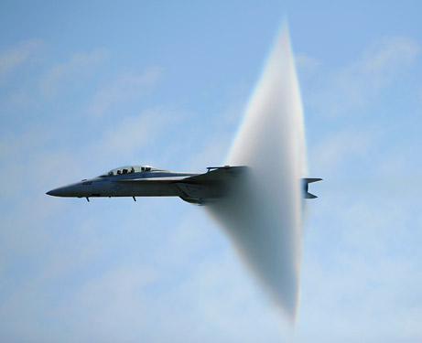
Super Kamiokande – Detection Concept

Slide 18
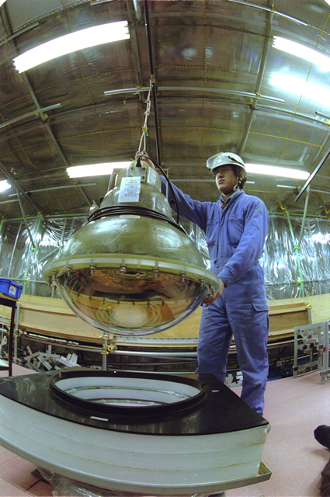
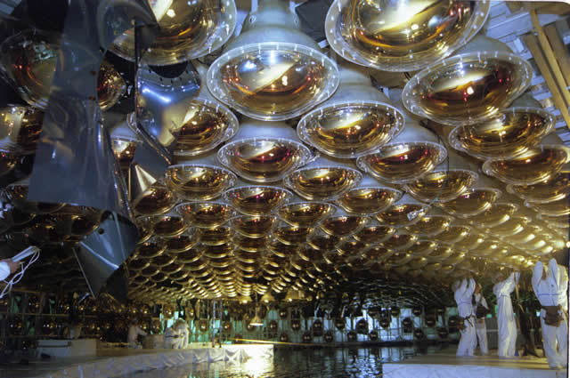
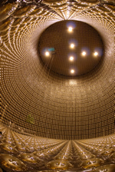
Super Kamiokande – the Detector

Slide 19
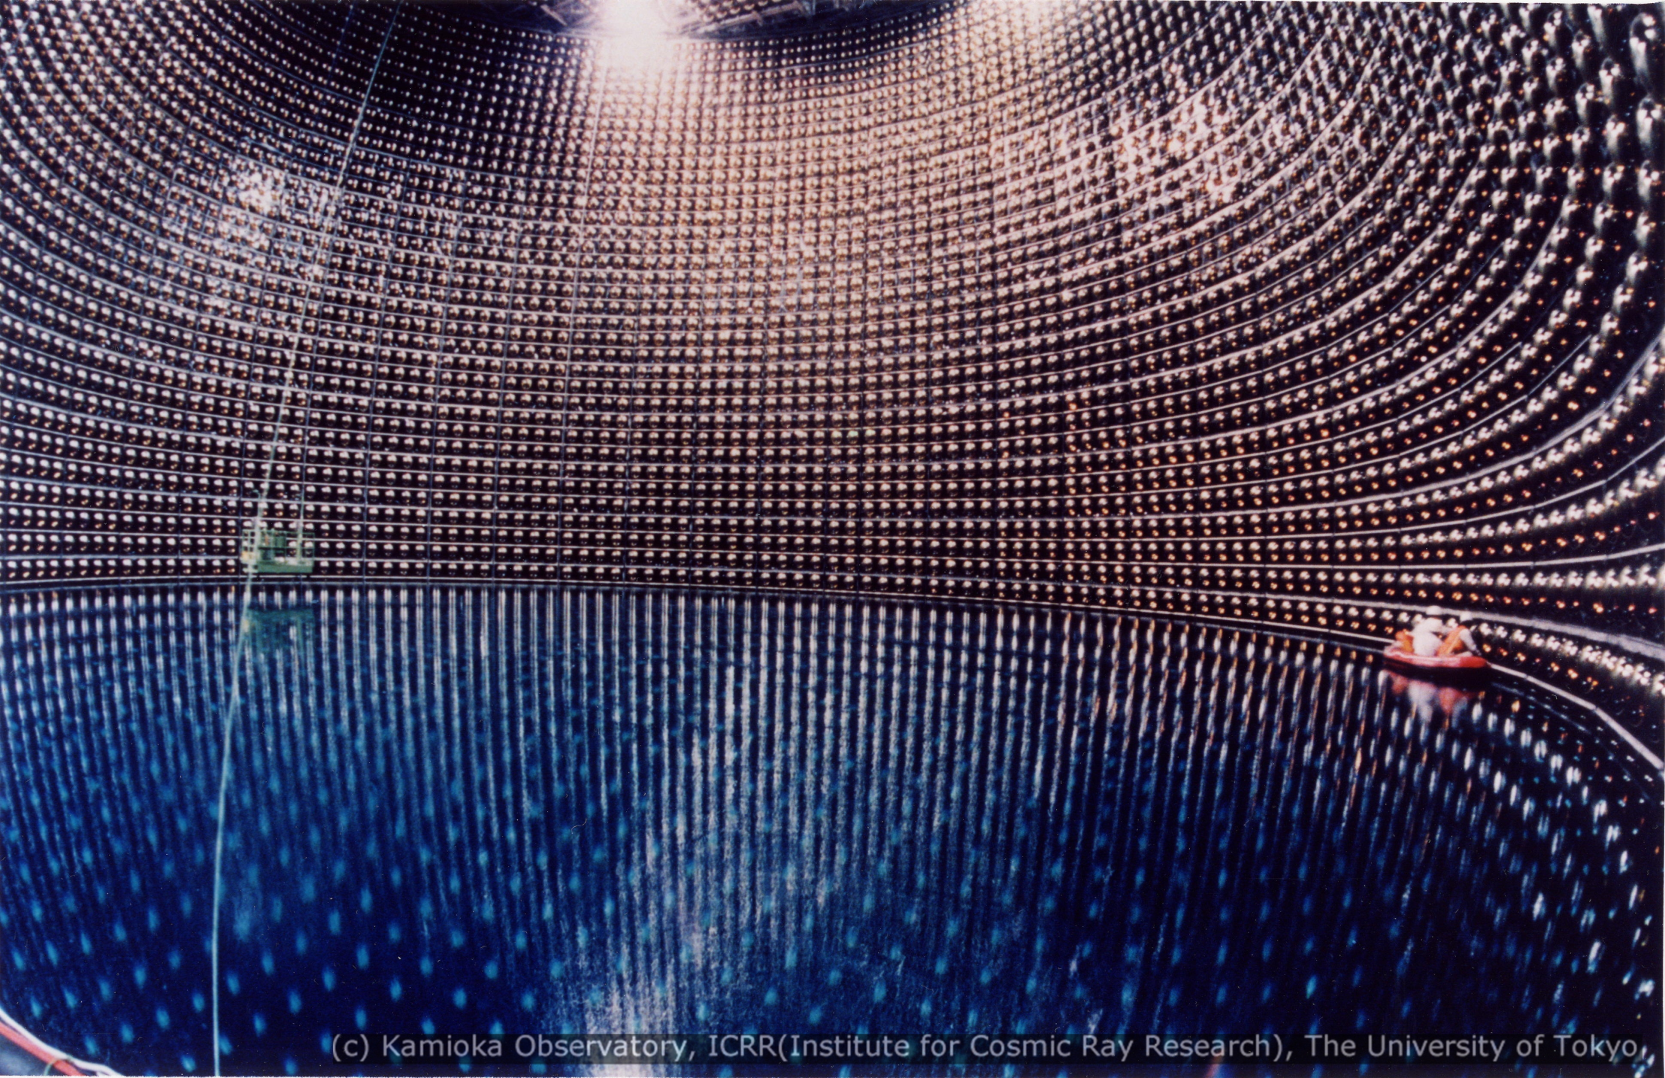
Super Kamiokande – the Detector

