Slide 1
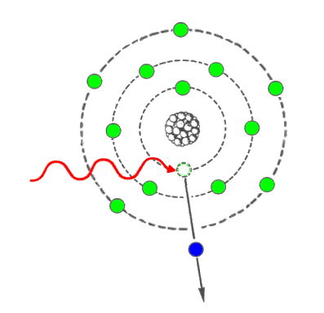
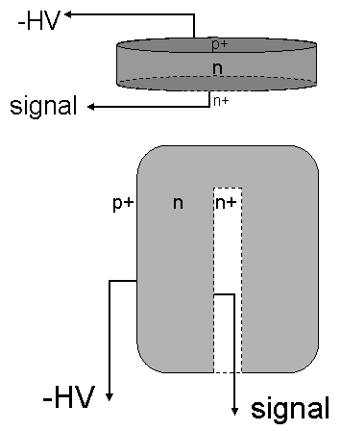
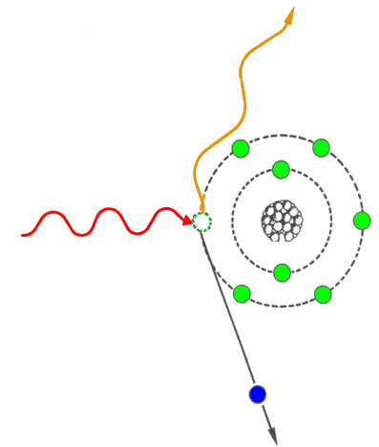
Application of Nuclear Physics
Frontier of gamma-ray spectroscopy
IR visible light UV soft X-ray X-ray hard X-ray gamma-ray →
0.1
1
10
100
1e3
1e4
1e5
1e6
energy [eV]
Photoelectric effect
e⁻
Compton scattering
Germanium
semi-conductor detectors
e⁻

Slide 2
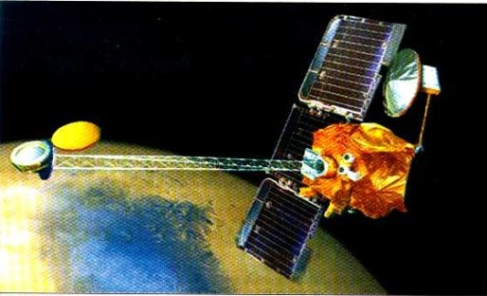
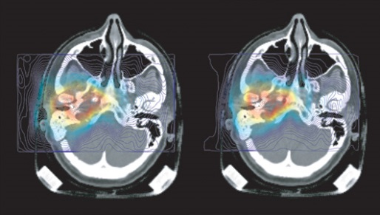
Why imaging gamma-rays?
High energy astrophysics
Correlate the detected photon to source object as known
from more precise observations in other wavelength
Biomedical research
Precise localization of radioactive tracers in the body
Cancer diagnosis
Molecular targeted radiation therapy
Monitor changes in the tracer distribution → dynamic studies
National security
Nuclear non-proliferation / nuclear counter terrorism
Contraband detection
Stockpile stewardship
Nuclear waste monitoring and management
Industrial non-destructive assessments
Determination of the material density distribution
between the source and detector

Slide 3
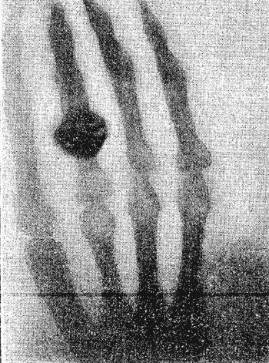
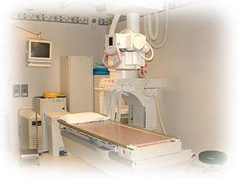
Application of Nuclear Physics
First X-ray image by Wilhelm Conrad Roentgen (1895)
Standard X-ray imaging
Absorption of X-rays by bones and transmission through soft tissue produces image
What if we want a 3D image?
What if we want detailed information on organs, bones and muscles etc?
Nobel Prize 1901

Slide 4
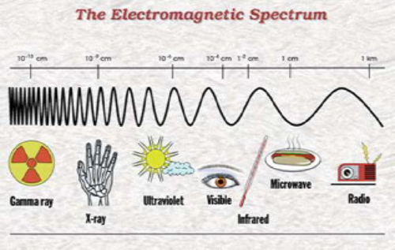
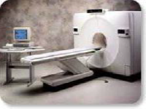
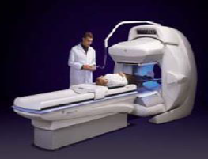
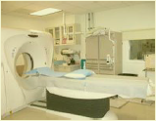
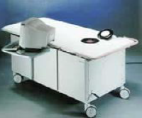
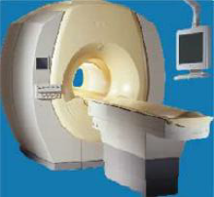
Tomographic Imaging
PET
SPEC
CT
OPTICAL
MRI

Slide 5
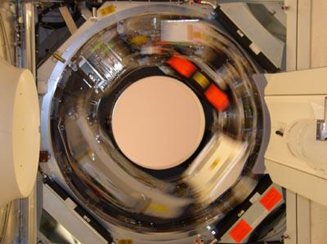
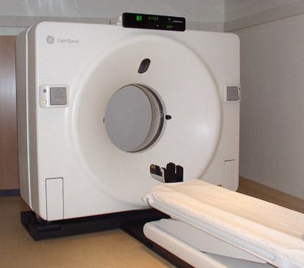
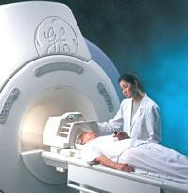
Computed Tomography
CT scanning (originally known as CAT)
X-rays taken at a range of angles around the patient
Generation of 3D images
Radiation detector
X-ray source
Standard CT-system

Slide 6
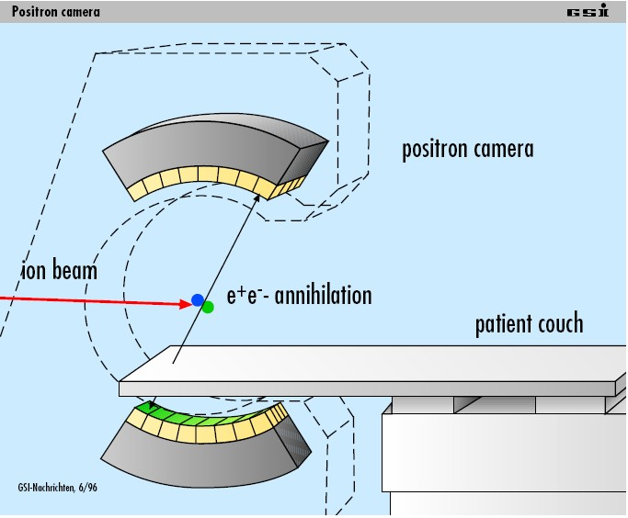
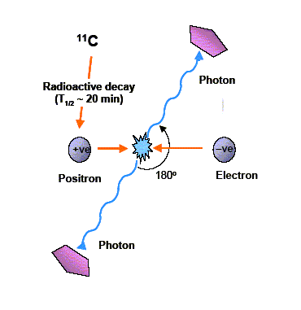
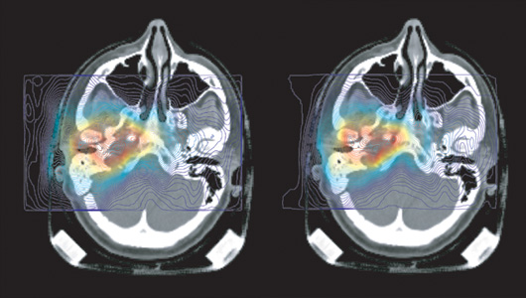
Positron Emission Tomography

Slide 7
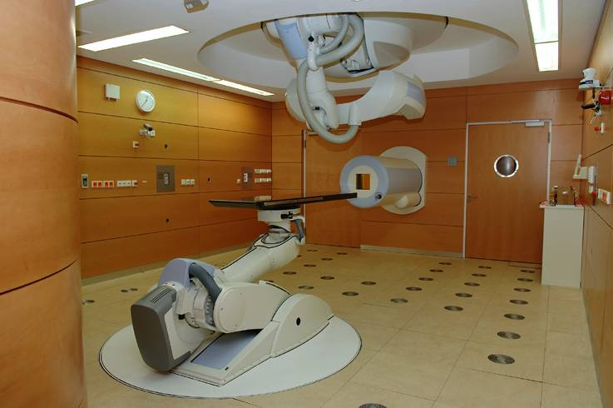
Positron emission tomography

Slide 8
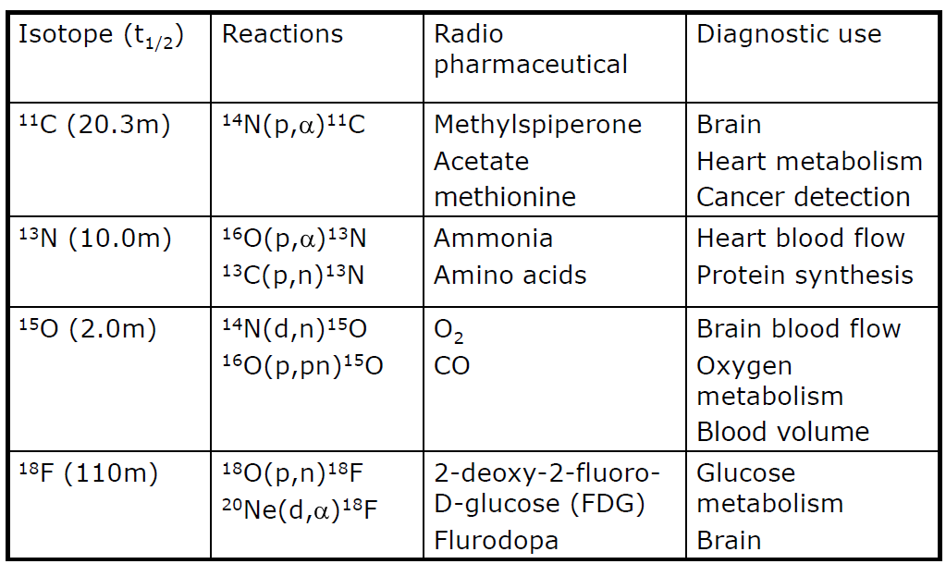
Common PET Isotopes

Slide 9
PET Isotopes: Positron Range

Slide 10
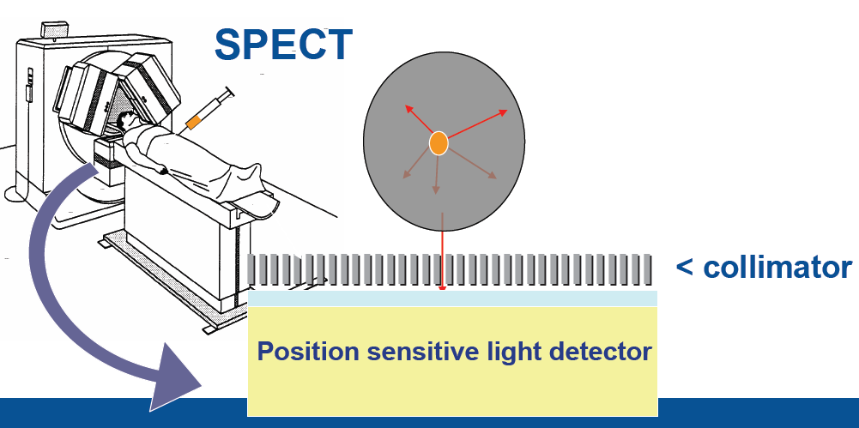
Single Photon Emission Computed Tomography
Most commonly used tracer in SPECT is ⁹⁹Tc^{m}, 140 keV a pure single photon emitter T_{1/2} = 6.02 h.
Utilizes a gamma-ray camera rotated in small ~3⁰ steps around the patient.

Slide 11
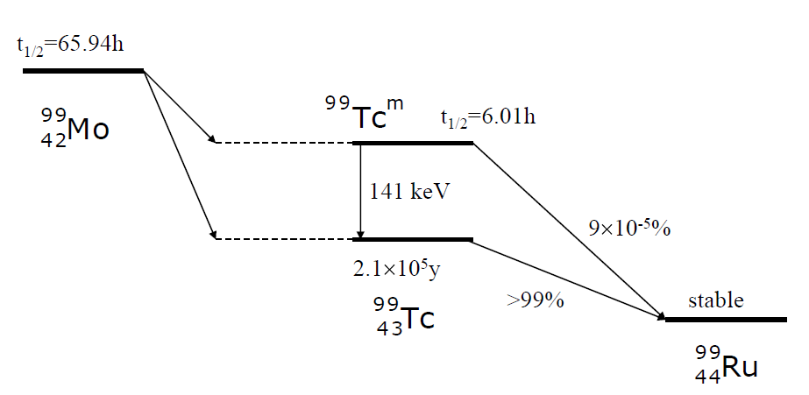
Technetium- 99m
Supplied in a generator consisting of 99Mo absorbed onto alumina.
Container allows liquid introduced at top to be collected at bottom.
Needs replacing weekly

Slide 12
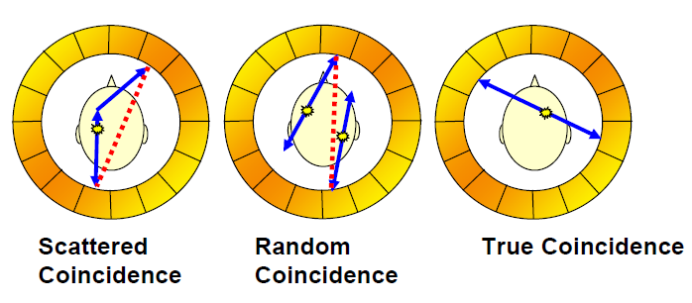
The motivation behind the project
Existing technology relies on BGO scintillator technology
- Limited position resolution
- High patient dose requirement.
- Poor energy resolution only accept photopeak events.
- Will not function in large magnetic field
SPECT applications utilizing Compton Camera techniques.

Slide 13
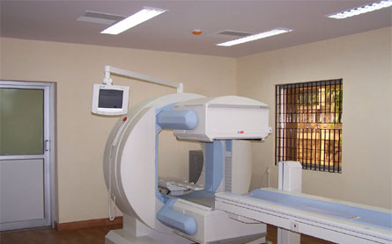
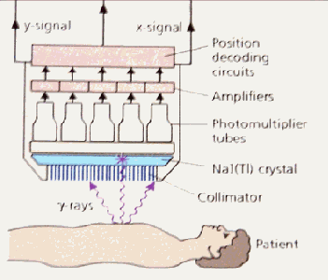
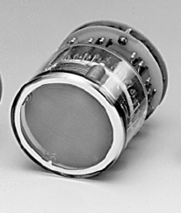
Which γ-ray camera to be used?
Requirements:
Excellent resolution Δx = 2 mm
Large field of view (FOV) = 8x9 cm²
Large FOV of ~20 cm diam.
Low spatial resolution 0.5-1 cm
Small FOV of 3-4 cm diam.
High spatial resolution 2-3 mm
www.siemens.de
Gem-imaging.com

Slide 14
Gamma Camera: Individual multi-anode readout
16 wires in X axis and 16 wires in Y axis
LYSO
scintillator
d = 76 mm
t = 3 mm
ρ = 7.4 g/cm³
Hamamatsu R2486 PSPMT
Photocathode = 56.25 mm
C.Domingo Pardo, N. Goel, et.al., IEEE, Vol.28, Dec. 2009

Slide 15
Which γ-ray camera to be used?
Requirements:
Excellent resolution Δx = 2 mm
Large field of view (FOV) = 8x9 cm²
Small FOV of 3-4 cm diam.
High spatial resolution 2-3 mm
Scintillator
Position Sensitive
PMT
Gem-imaging.com

Slide 16
Which γ-ray camera to be used?
Requirements:
Excellent resolution Δx = 2 mm
Large field of view (FOV) = 8x9 cm²
Small FOV of 3-4 cm diam.
High spatial resolution 2-3 mm
γ-ray
Scintillator
Position Sensitive
PMT
Gem-imaging.com

Slide 17
Which γ-ray camera to be used?
Requirements:
Excellent resolution Δx = 2 mm
Large field of view (FOV) = 8x9 cm²
Small FOV of 3-4 cm diam.
High spatial resolution 2-3 mm
γ-ray
Scintillator
Position Sensitive
PMT
Gem-imaging.com

Slide 18
Which γ-ray camera to be used?
Requirements:
Excellent resolution Δx = 2 mm
Large field of view (FOV) = 8x9 cm²
Small FOV of 3-4 cm diam.
High spatial resolution 2-3 mm
γ-ray
Scintillator
Position Sensitive
PMT
Gem-imaging.com

Slide 19
Which γ-ray camera to be used?
Requirements:
Excellent resolution Δx = 2 mm
Large field of view (FOV) = 8x9 cm²
Small FOV of 3-4 cm diam.
High spatial resolution 2-3 mm
γ-ray 2
γ-ray
Scintillator
Position Sensitive
PMT
Gem-imaging.com

Slide 20
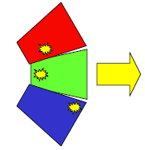
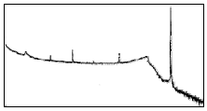
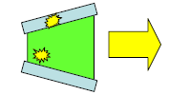
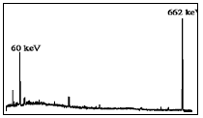
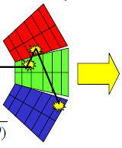
Gamma-ray tracking – the concept
without Compton suppression shield
Compton continuum → small peak to total ratio
Less solid angle coverage → big drop in efficiency
with BGO shielding
with highly segmented detectors
Path of γ-ray reconstructed to form full energy event
→ Compton continuum reduced
→ Excellent efficiency ~50% @ 1 MeV
→ Greatly improved angular resolution (~1%)
to reduce Doppler effect.
$$E_{γ}^{′}=\frac{E_{γ}}{1+\left({E_{γ}}/{mc^{2}}\right)∙\left(1−cosθ\right)}$$

Slide 21
HPGe detector – working principle

Slide 22
HPGe detector – working principle
E = -V V
+ HV = 4000 Volts

Slide 23
HPGe detector – working principle
E = -V V
γ-ray
+ HV = 4000 Volts
electrons
holes

Slide 24
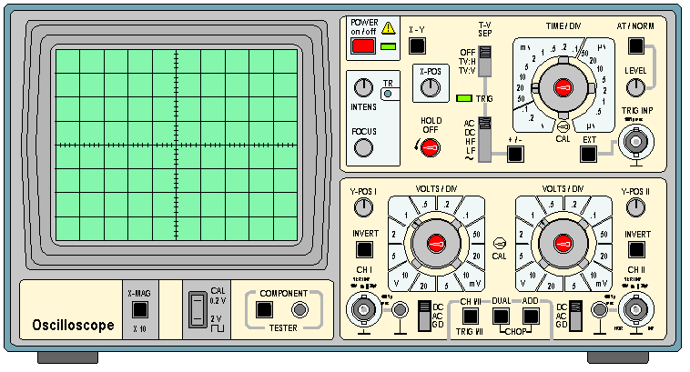
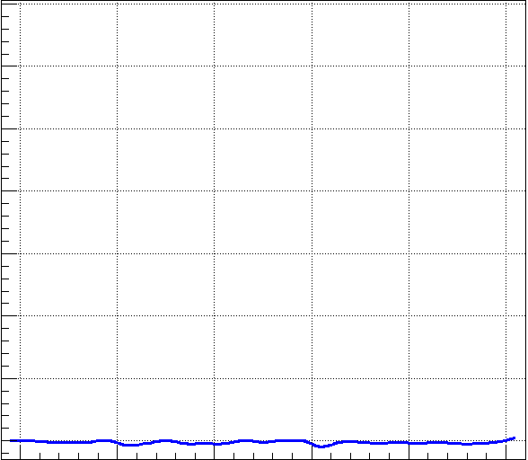
HPGe detector – working principle
E = -V V
γ-ray
+ HV = 4000 Volts
electrons
holes
Electric signal

Slide 25
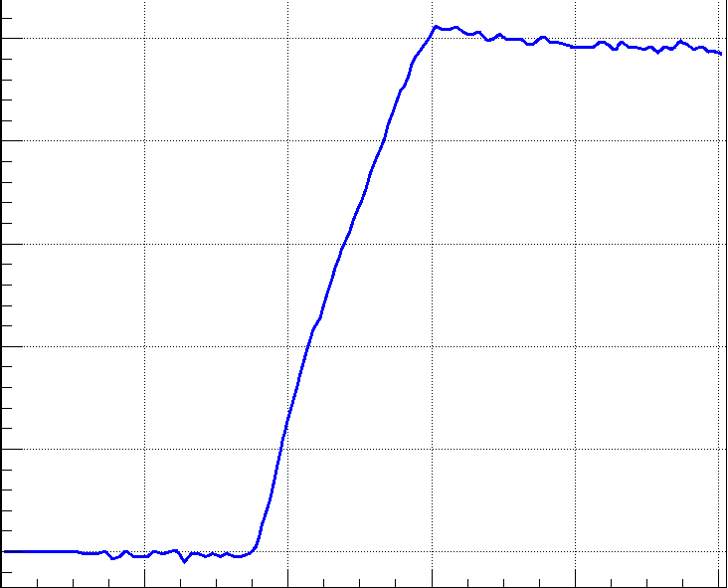
HPGe detector – working principle
E = -V V
γ-ray
+ HV = 4000 Volts
electrons
holes
Electric signal

Slide 26
HPGe detector – working principle
E = -V V
γ-ray
+ HV = 4000 Volts
electrons
holes
Electric signal

Slide 27
HPGe detector – working principle
E = -V V
γ-ray
+ HV = 4000 Volts
γ-ray 2
electrons
holes
Electric signal

Slide 28
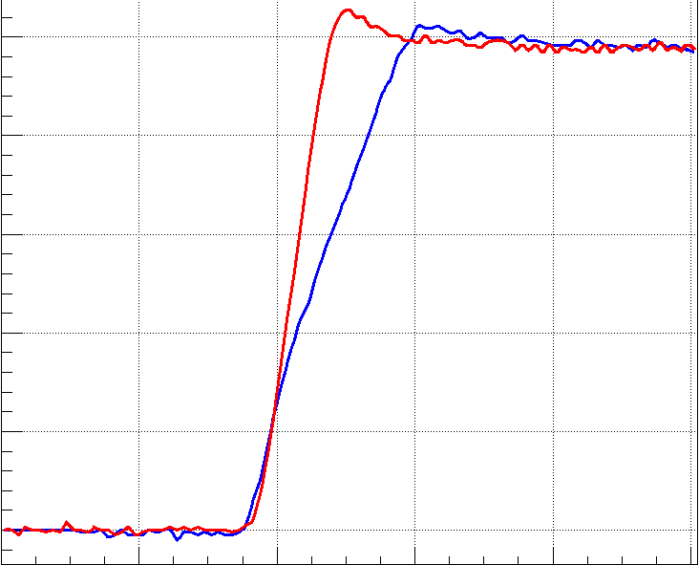
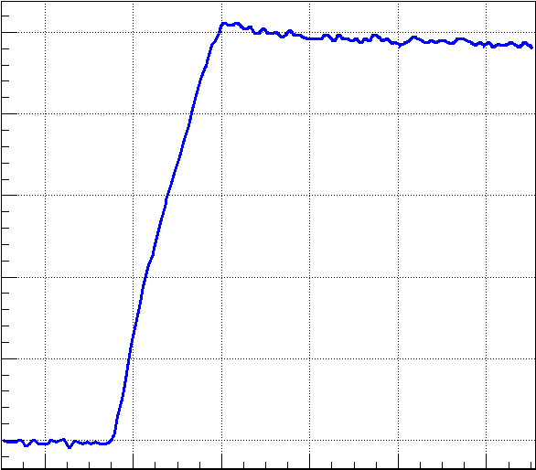
HPGe detector – working principle
E = -V V
γ-ray
+ HV = 4000 Volts
electrons
holes
Electric signal

Slide 29
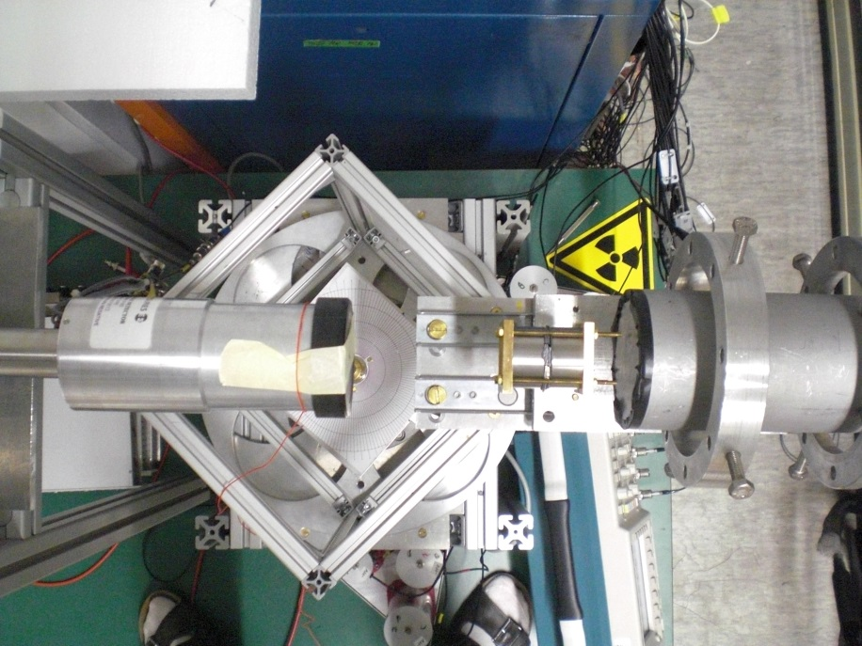
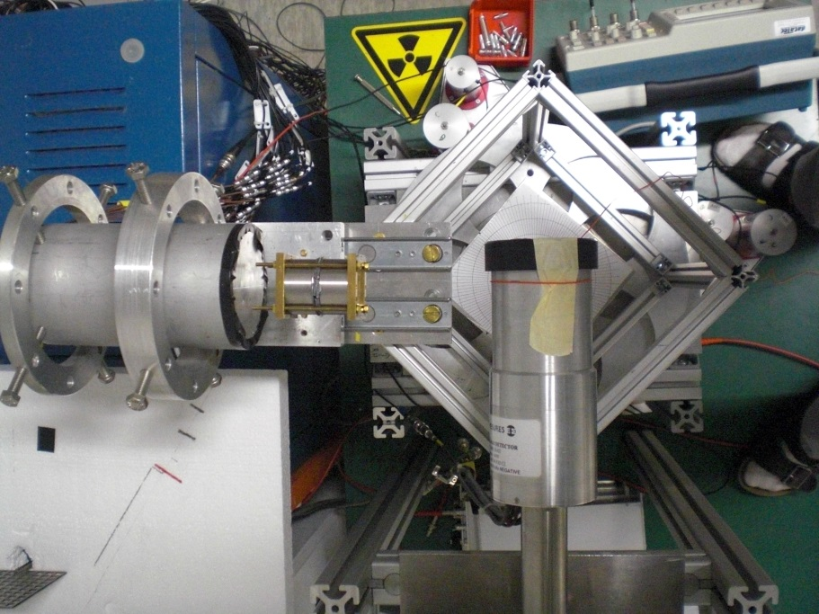
Characterization of planar HPGe detector
Front view
Side view
Planar Ge
d = 4 cm
t = 2 cm
²²Na
Position sensitive detector

Slide 30
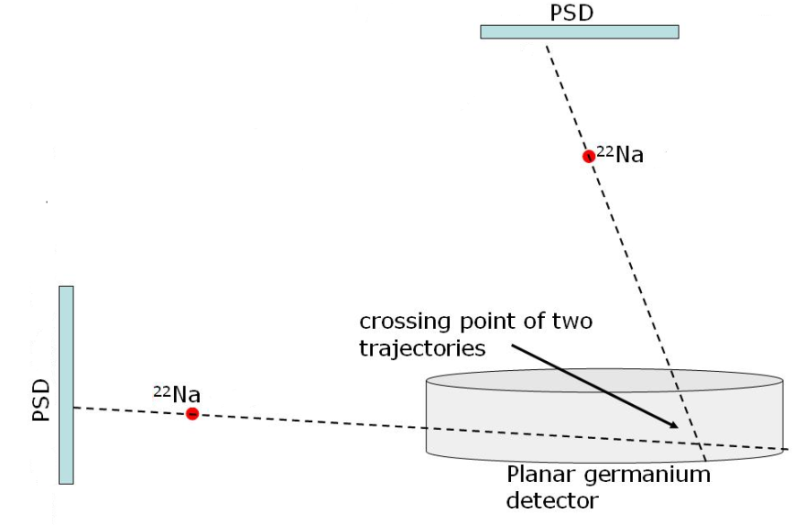
Planar HPGe detector scan
Intensity distribution for photopeak events
(a)
t(ns)
amplitude, Φ
(b)
t(ns)

Slide 31
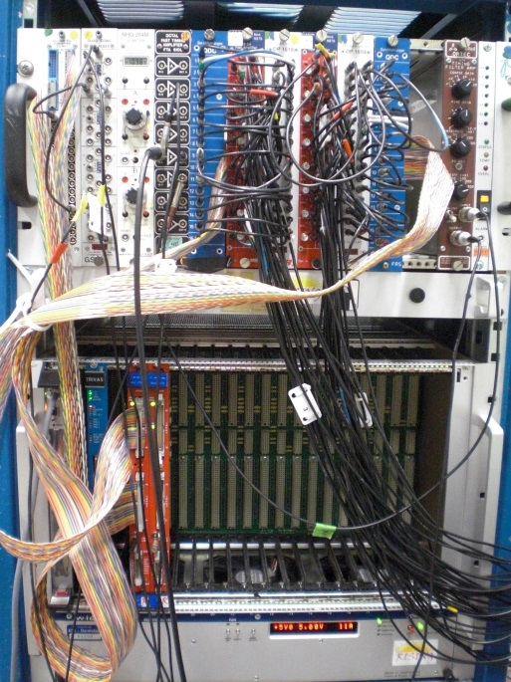
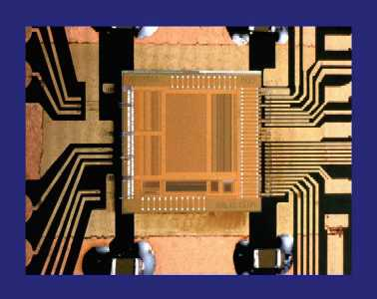
Outlook
The GSI system uses conventional NIM and VME electronics, which makes it not easily portable, not easily scalable and rather expensive if one wants to build many of these devices.
However, this drawback could be overcome thanks to the increasing technology of electronics, e.g. a new acquisition system based on ASIC, FPGA, etc. technologies. This would also make the system more suitable for medical applications.
APV25 chip (from CERN CMS experiment)
?
128-channel analogue pipeline chip
M.J. French et al., NIMA 466 (2001) 359

Slide 32
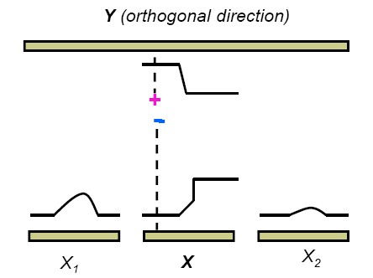
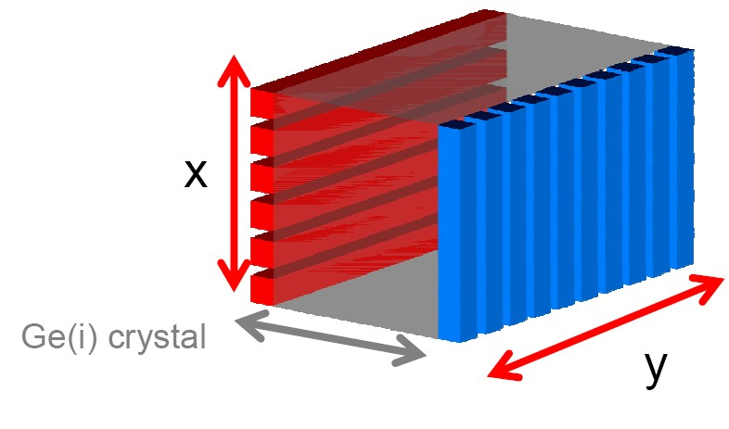
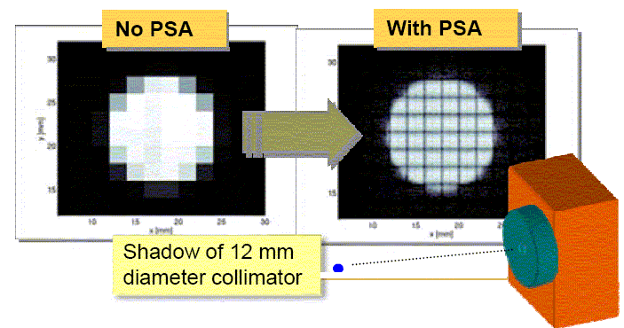
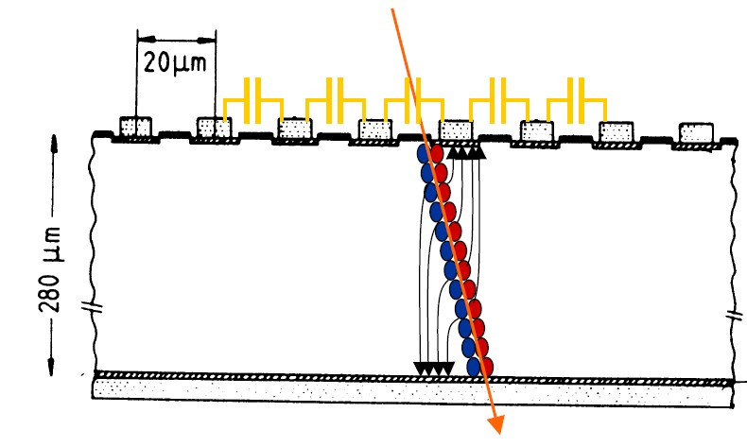
Position Extraction in Planar Detectors

Slide 33
Position Extraction in Planar Detectors

Slide 34
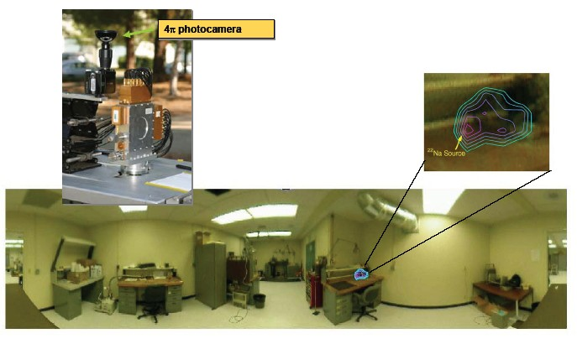
Gamma-Ray Imaging
Gamma-ray imagers are detectors that separate radioactive objects from local background.
Conventional detectors accept gamma-rays from all directions and can be overwhelmed by local backgrounds.

