Slide 1
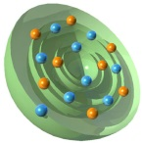
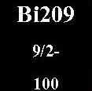
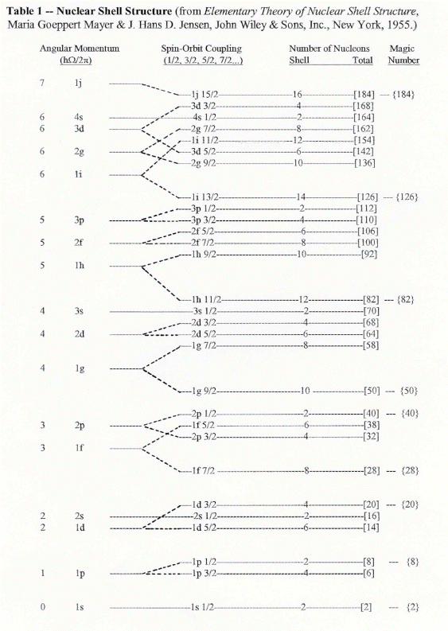
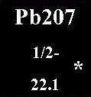
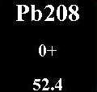
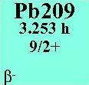
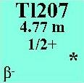
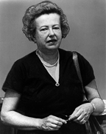
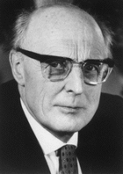
Doubly Magic Nucleus ²⁰⁸Pb
Maria Goeppert-Mayer J. Hans D. Jensen

Slide 2
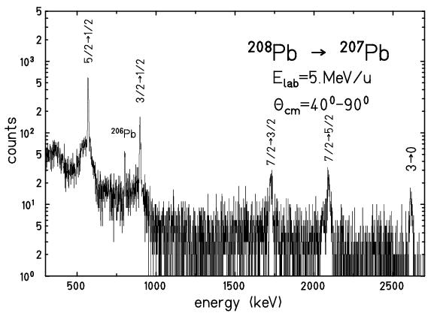
Experimental single-particle energies
γ-spectrum
²⁰⁸Pb → ²⁰⁷Pb
E_{lab} = 5 MeV/u
single-hole energies
3 p_{3/2}
898 keV
2 f_{5/2}
570 keV
3 p_{1/2}
0 keV

Slide 3
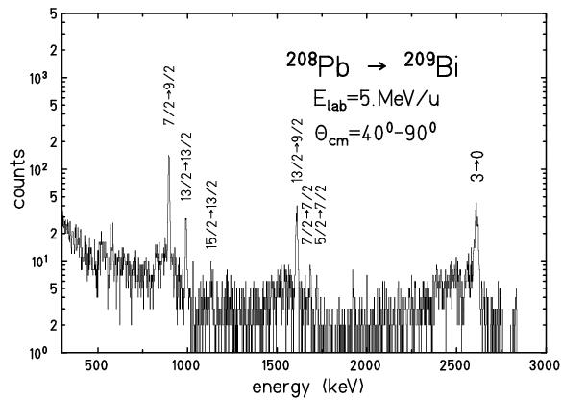
Experimental single-particle energies
γ-spectrum
single-particle energies
1 i_{13/2}
1609 keV
²⁰⁸Pb → ²⁰⁹Bi
E_{lab} = 5 MeV/u
2 f_{7/2}
896 keV
1 h_{9/2}
0 keV

Slide 4
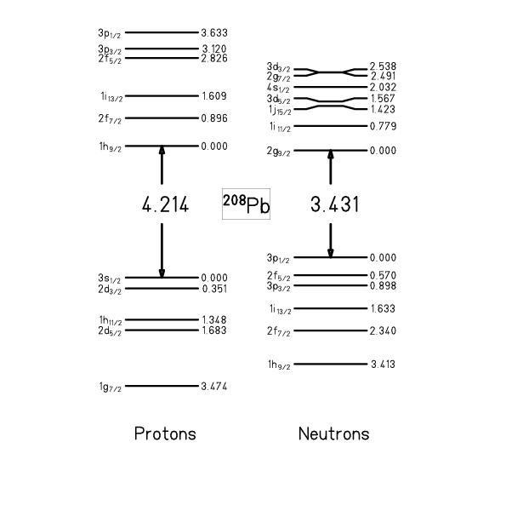
Experimental single-particle energies
particle states
²⁰⁹Bi
1 i_{13/2}
1609 keV
²⁰⁹Pb
2 f_{7/2}
896 keV
1 h_{9/2}
0 keV
energy of shell closure:
²⁰⁷Tl
²⁰⁷Pb
hole states
protons
neutrons

Slide 5
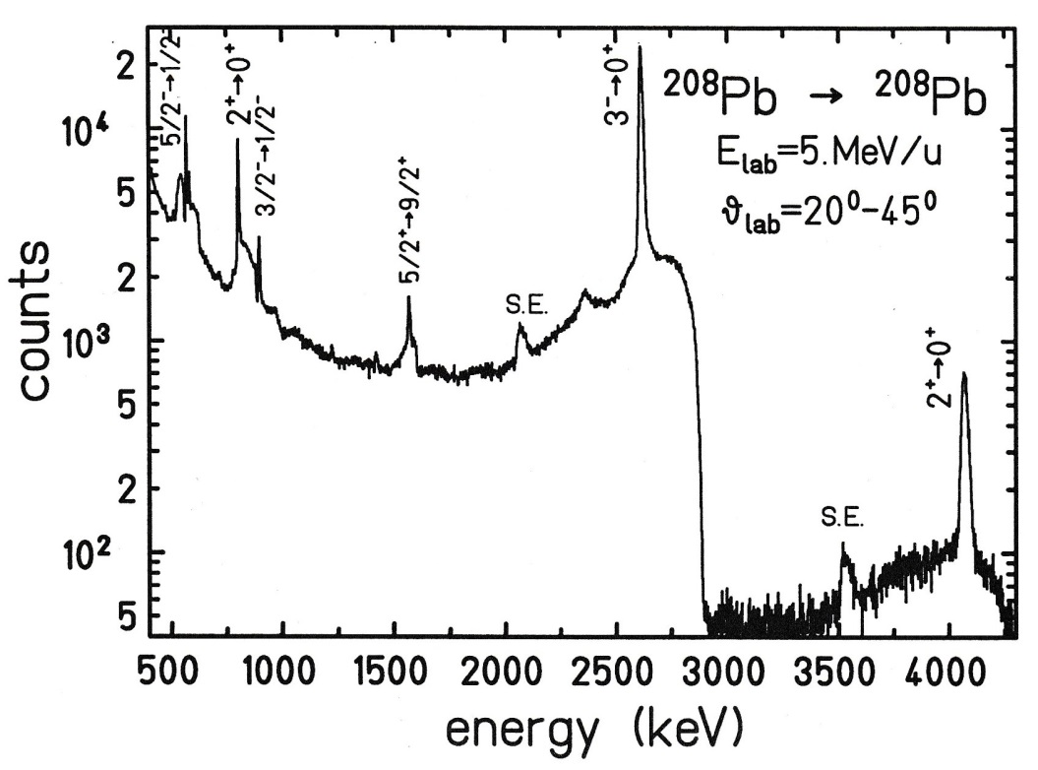
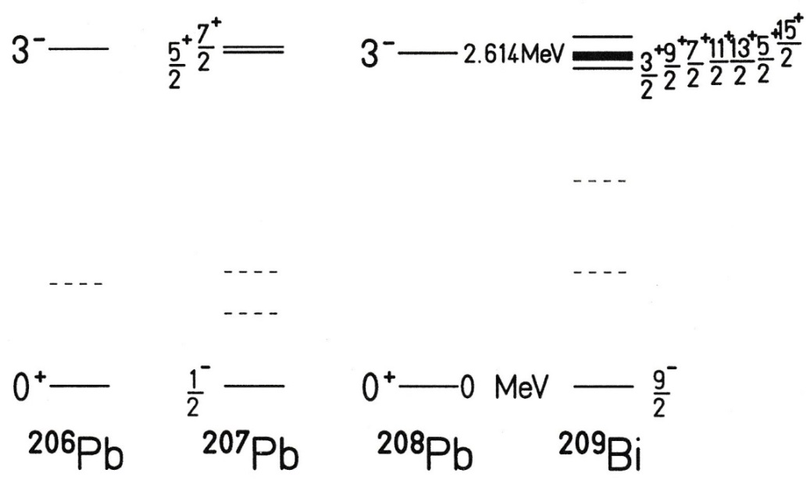
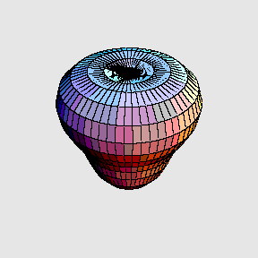
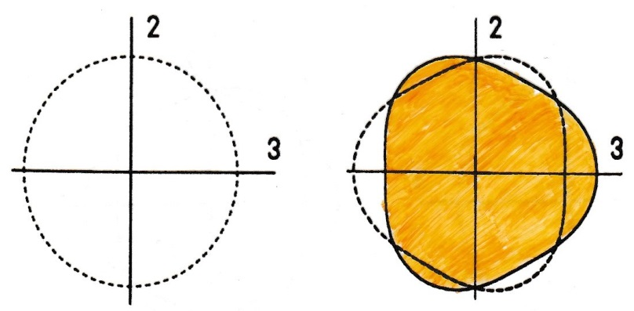
Octupole Vibrational States in the Lead Region
$$ℏω_{3}$$
^{206,207,209}Pb

Slide 6
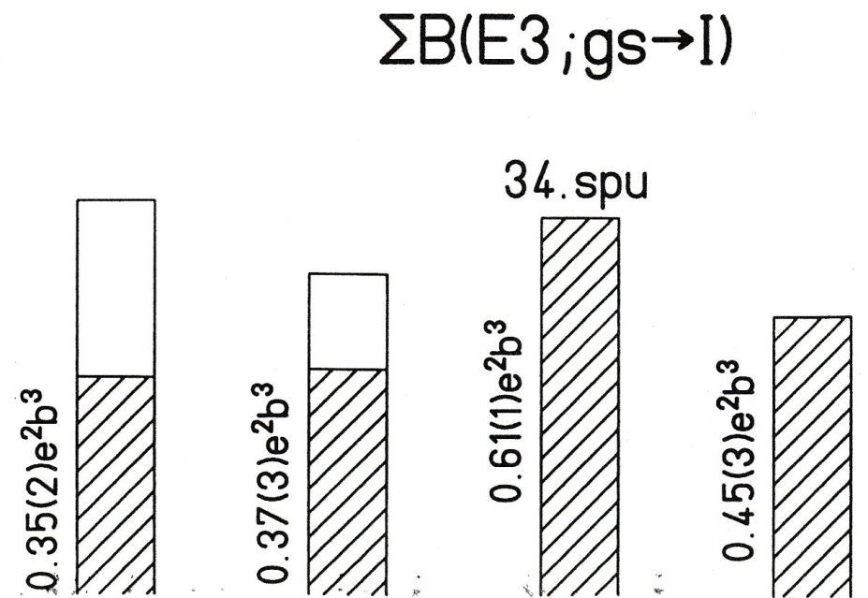
Octupole Vibrational States in the Lead Region
$$ℏω_{3}$$

Slide 7
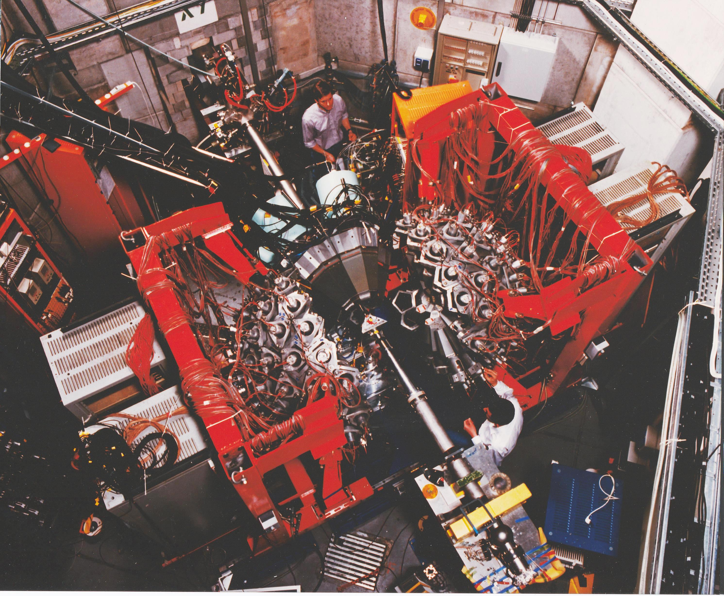
The Darmstadt-Heidelberg Crystal Ball extended by EUROBALL-3 Ge-detectors

Slide 8
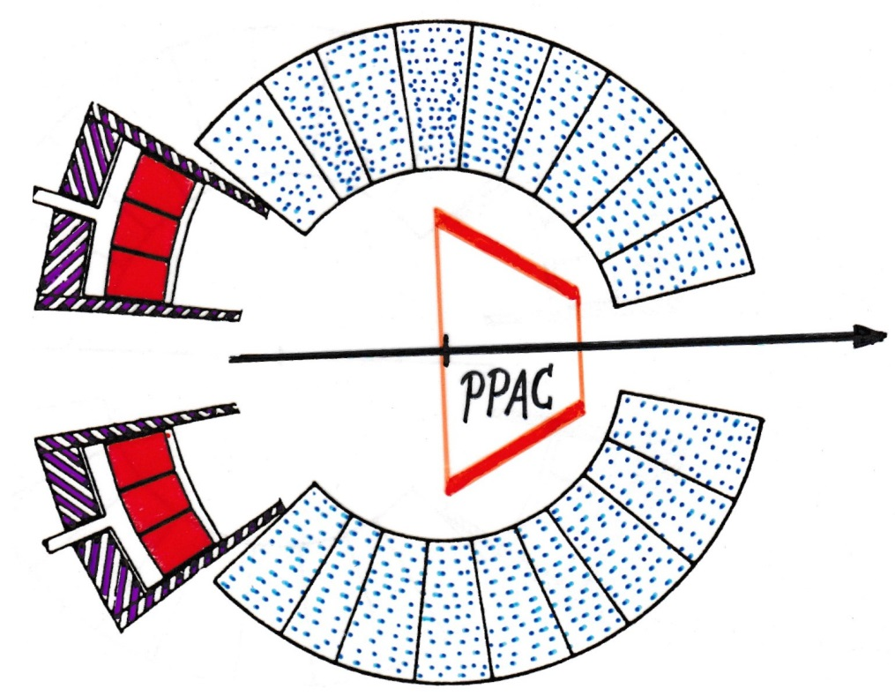
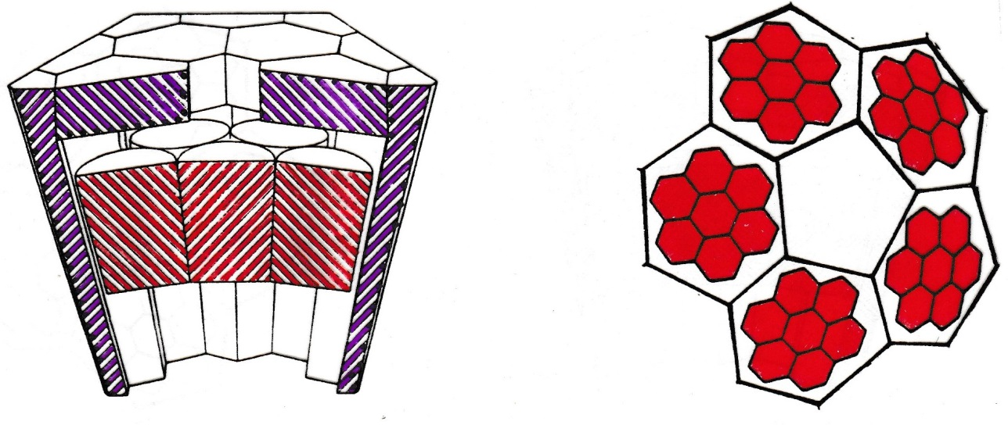
The Darmstadt-Heidelberg Crystal Ball extended by EUROBALL-3 Ge-detectors
$$\left\langle θ_{γ}\right\rangle ={155}^{0}$$
$$R=36 cm$$
Crystal Ball: Ω_{CB} = 83% P_{photopeak} ≈ 53%
Cluster ring: Ω_{EB} = 7% P_{photopeak} ≈ 2.2%
March 27 – September 6, 1996

Slide 9
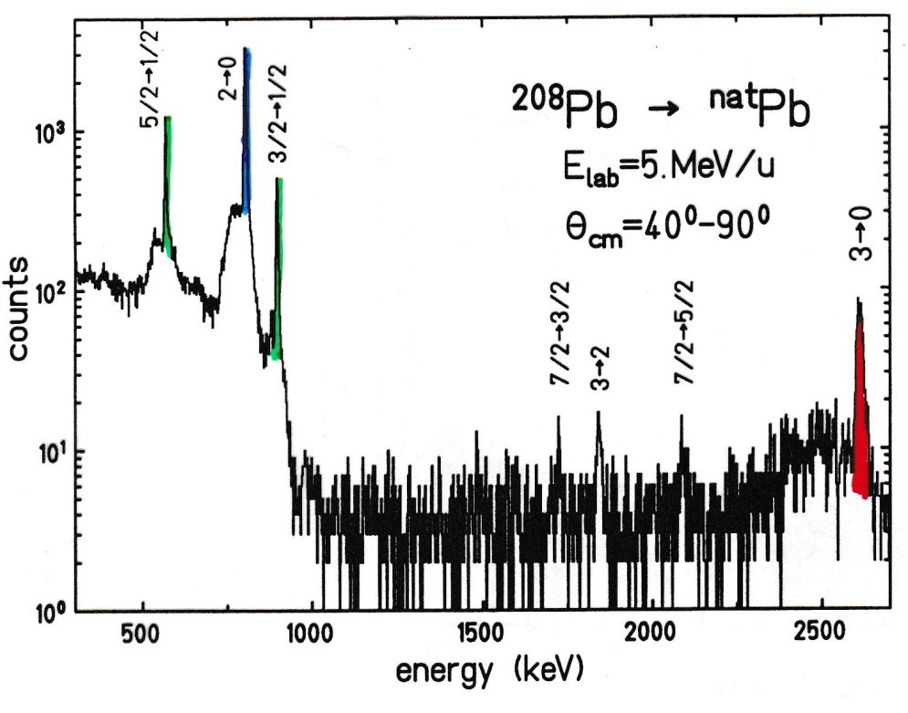
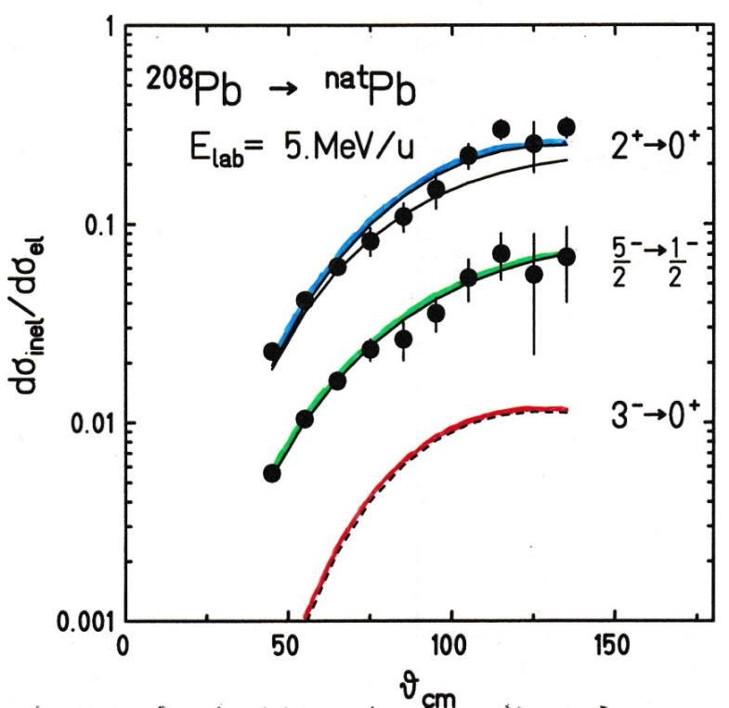
Octupole Vibrational States in the Lead Region
²⁰⁶Pb 24%
²⁰⁷Pb 22%
²⁰⁸Pb 52%
excitation probability for the 1-excited state
E2 excitation
E3 excitation

Slide 10
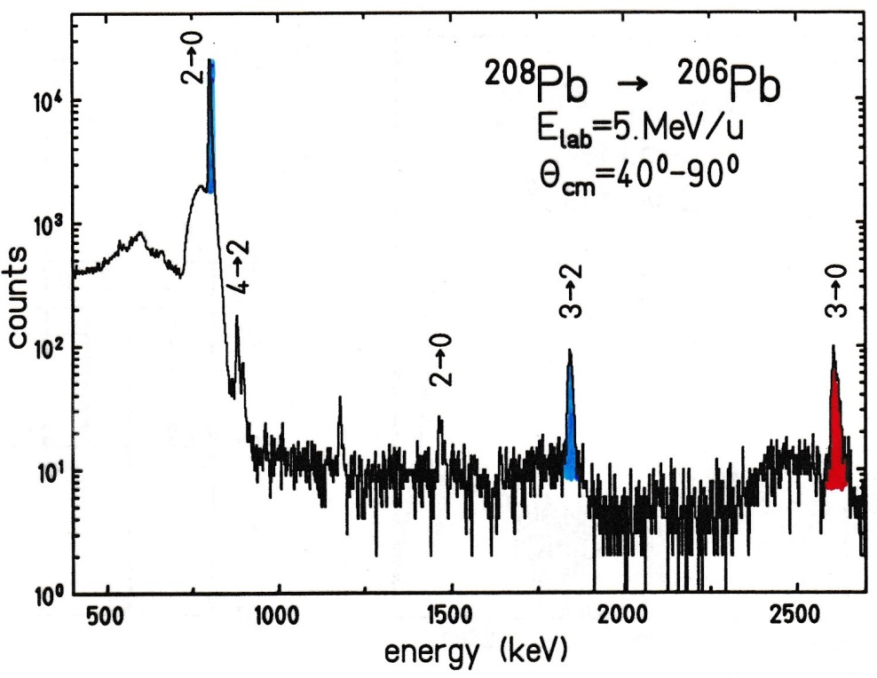
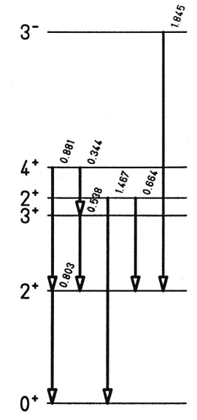
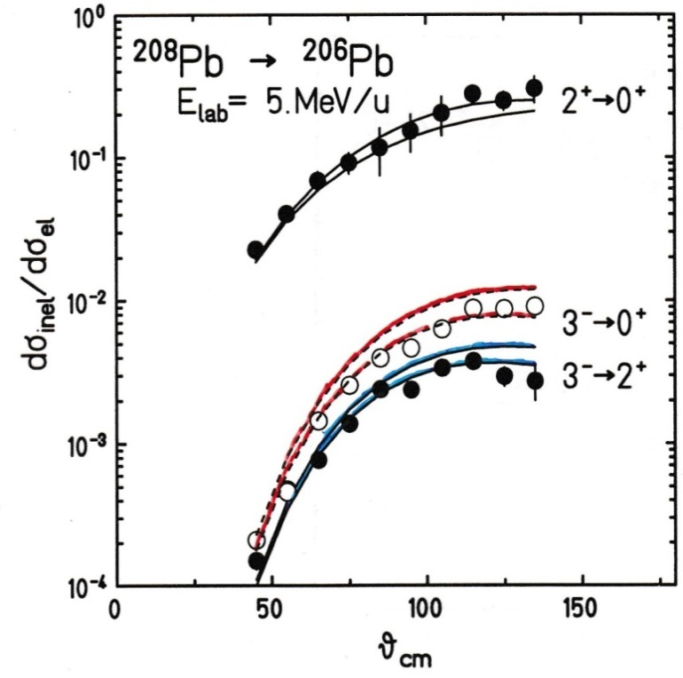
Coulomb Excitation for ²⁰⁸Pb on ²⁰⁶Pb
B(E3)
34 spu
20 spu
Nucl Data: 36 spu

Slide 11
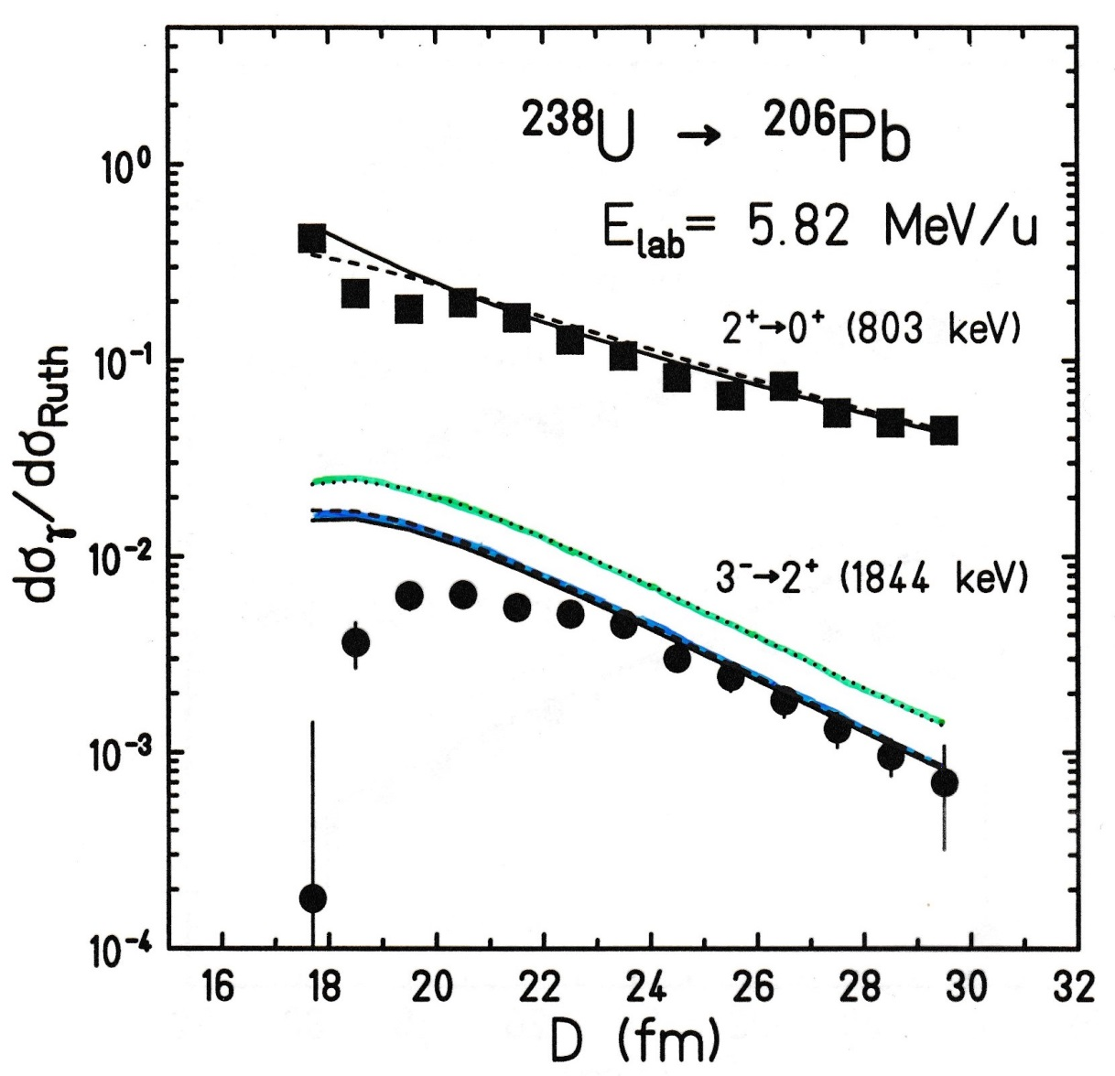
Coulomb Excitation for ²³⁸U on ²⁰⁶Pb
B(E3)
36 spu
20 spu
J. Baumann for EPOS

Slide 12
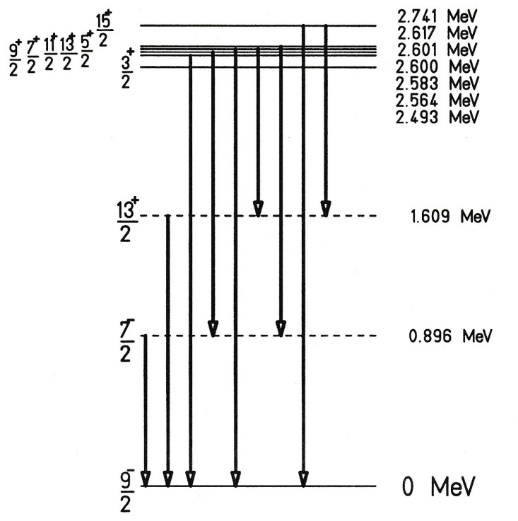
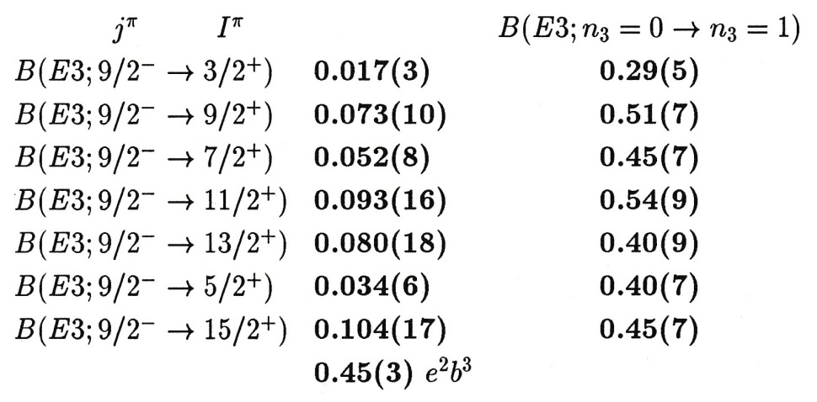
Superposition of Vibrational and Particle Motion
$$3^{−}|\left.h_{9/2}\right\rangle$$
septuplet
²⁰⁹Bi
$$|\left.h_{9/2}\right\rangle$$
weak coupling:
Σ:

Slide 13
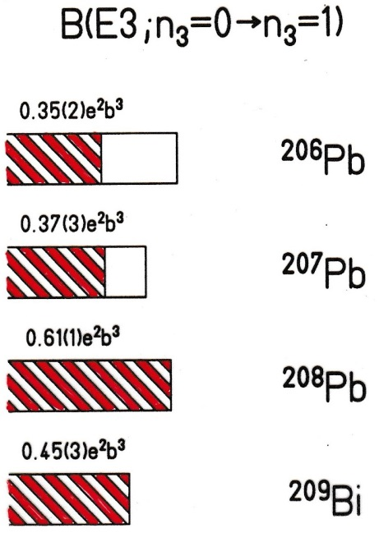
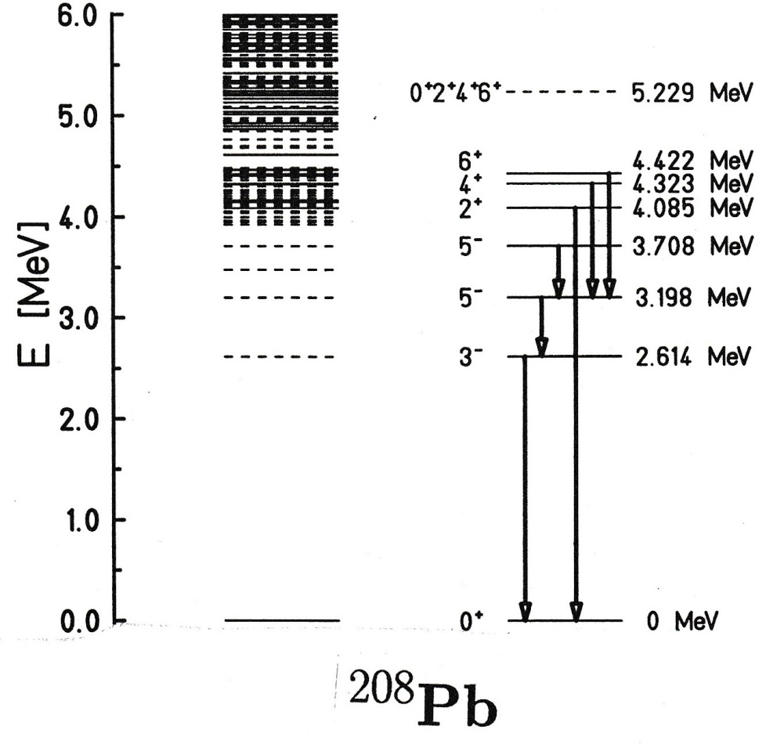
Superposition of Vibrational and Particle Motion
$$ν\left(p_{1/2},−2\right)$$
$$ν\left(p_{1/2},−1\right)$$
particle-hole states
2 - phonon
$$π\left(h_{9/2},+1\right)$$
1 - phonon
octupole vibration

Slide 14
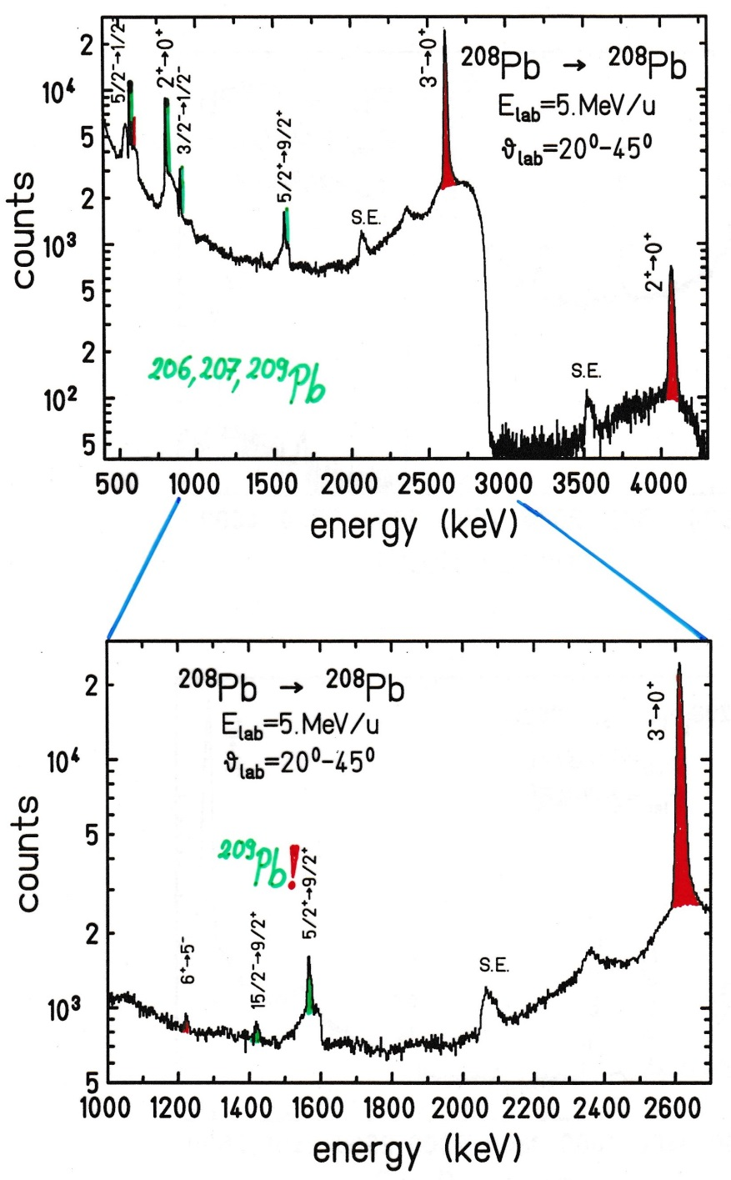
Coulomb Excitation for ²⁰⁸Pb on ²⁰⁸Pb
^{206,207,209}Pb
²⁰⁹Pb !

Slide 15
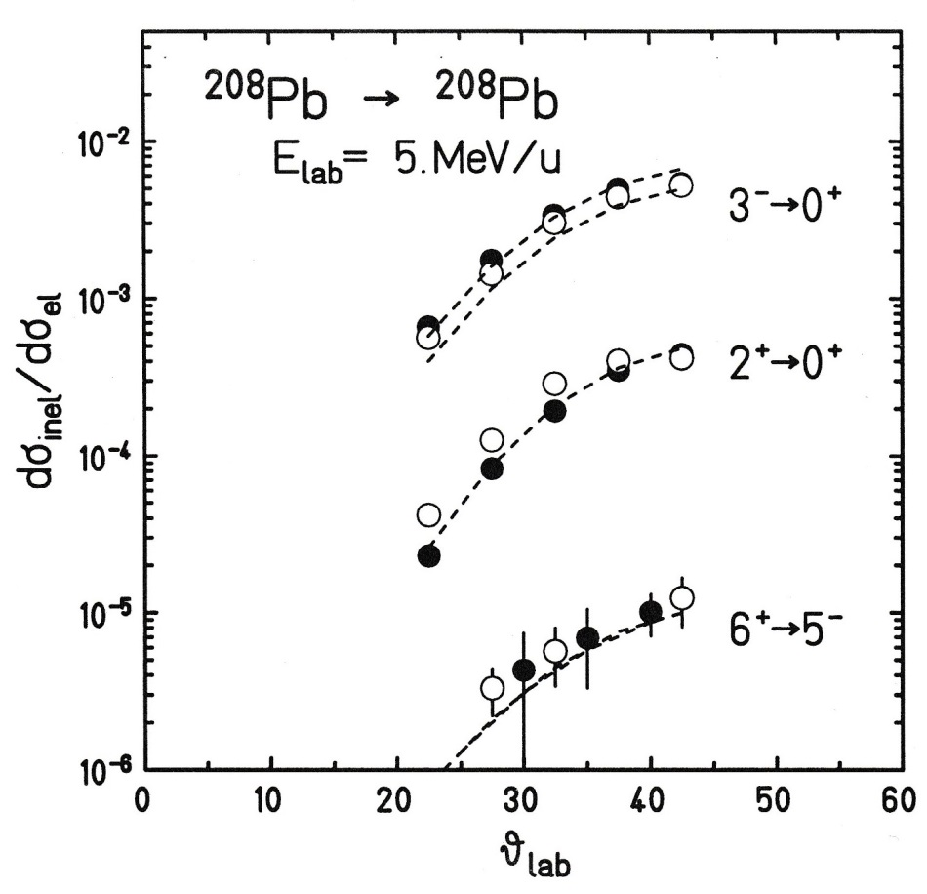
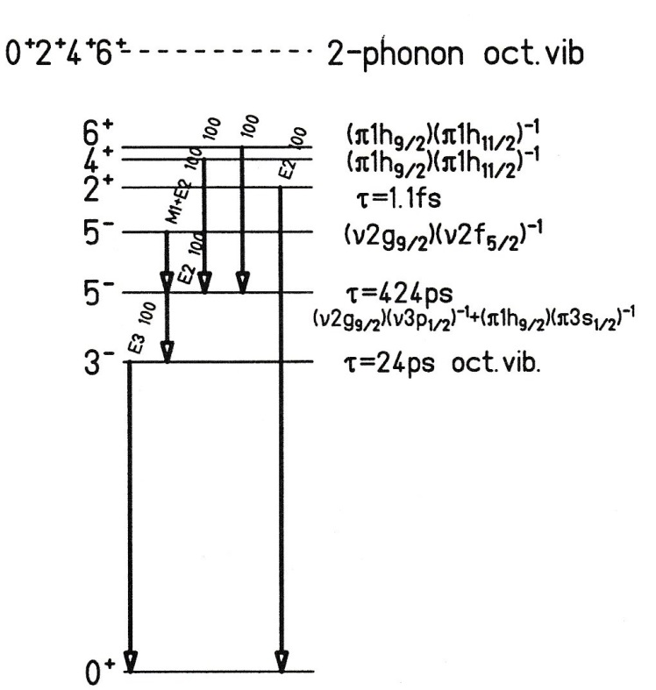
Coulomb Excitation for ²⁰⁸Pb on ²⁰⁸Pb at 5.0 MeV/u
$$\frac{B\left(E3;6^{+}→3^{−}\right)}{B\left(E3;3^{−}→0^{+}\right)}=0.35\left(11\right)$$
2.0_{vibrational}

Slide 16
Octupole Vibrational States in ²⁰⁶Pb, ²⁰⁷Pb, ²⁰⁸Pb and ²⁰⁹Bi
vibrational excitation $ℏω_{3}$ is very similar
B(E3) values are well described in weak coupling model
collective strength depends on particle configuration
2 – phonon octupole vibrational states not observed at 5 MeV/u (insufficient Compton suppression of EUROBALL detectors)
6⁺ particle-hole state contains 18% of the collective vibrational strength
transfer reactions (²⁰⁹Pb) observed at 5 MeV/u
H.J. Wollersheim, E. Lubkiewicz, A. Gadea, J. Gerl, M. Kaspar, I. Kojouharov, Th. Kröll, R. Kulessa, I. Peter, M. Rejmund, J.A. Ros, H. Schaffner, Ch. Schlegel, K. Vetter
GSI-Darmstadt, Jagellonian University Cracow, I.F.I.C.-Valencia

Slide 17
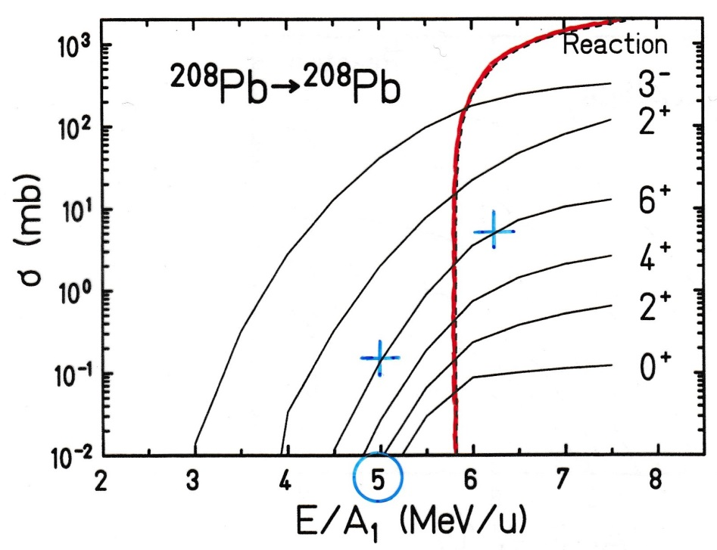
Octupole Vibrational States in the Lead Region
1-phonon
²⁰⁸Pb + ²⁰⁸Pb; E/A₁ = 5 MeV/u
$$σ_{6^{+}}=0.138 mb$$
2-phonon
$$σ_{4^{+}}=0.027 mb$$
$$σ_{2^{+}}=0.009 mb$$
$$σ_{0^{+}}=0.004 mb$$

Slide 18
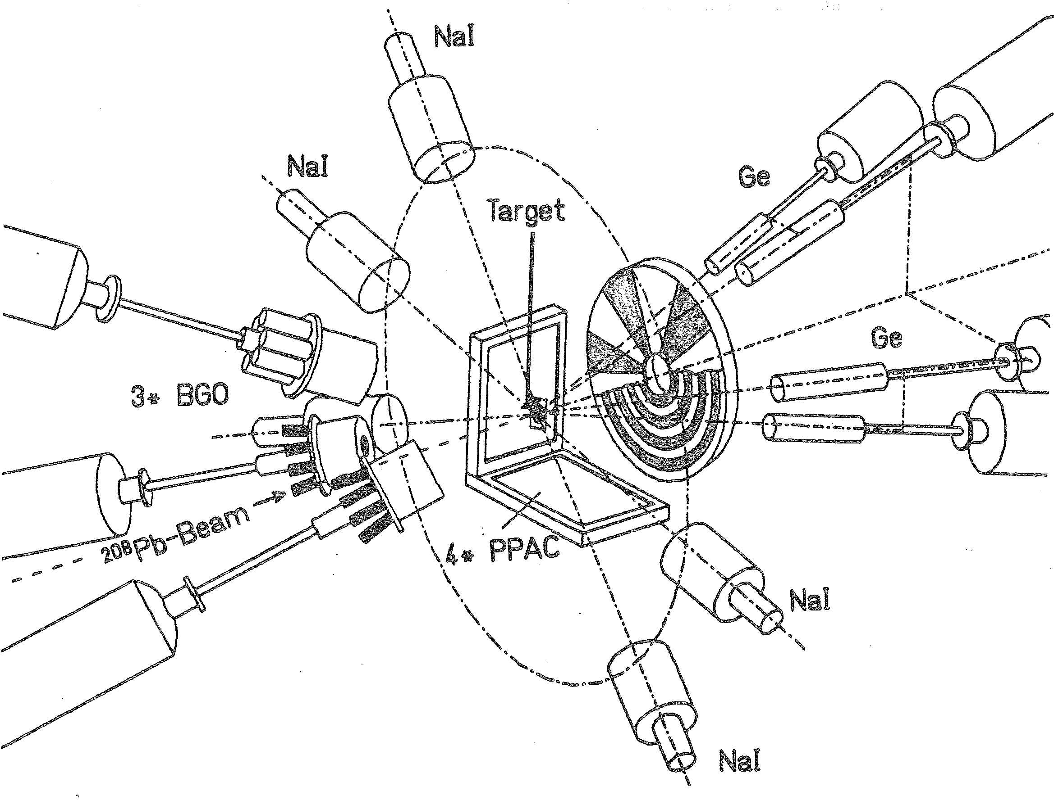
Experimental Setup for ²⁰⁸Pb on ²⁰⁸Pb at 6.2 MeV/u

Slide 19
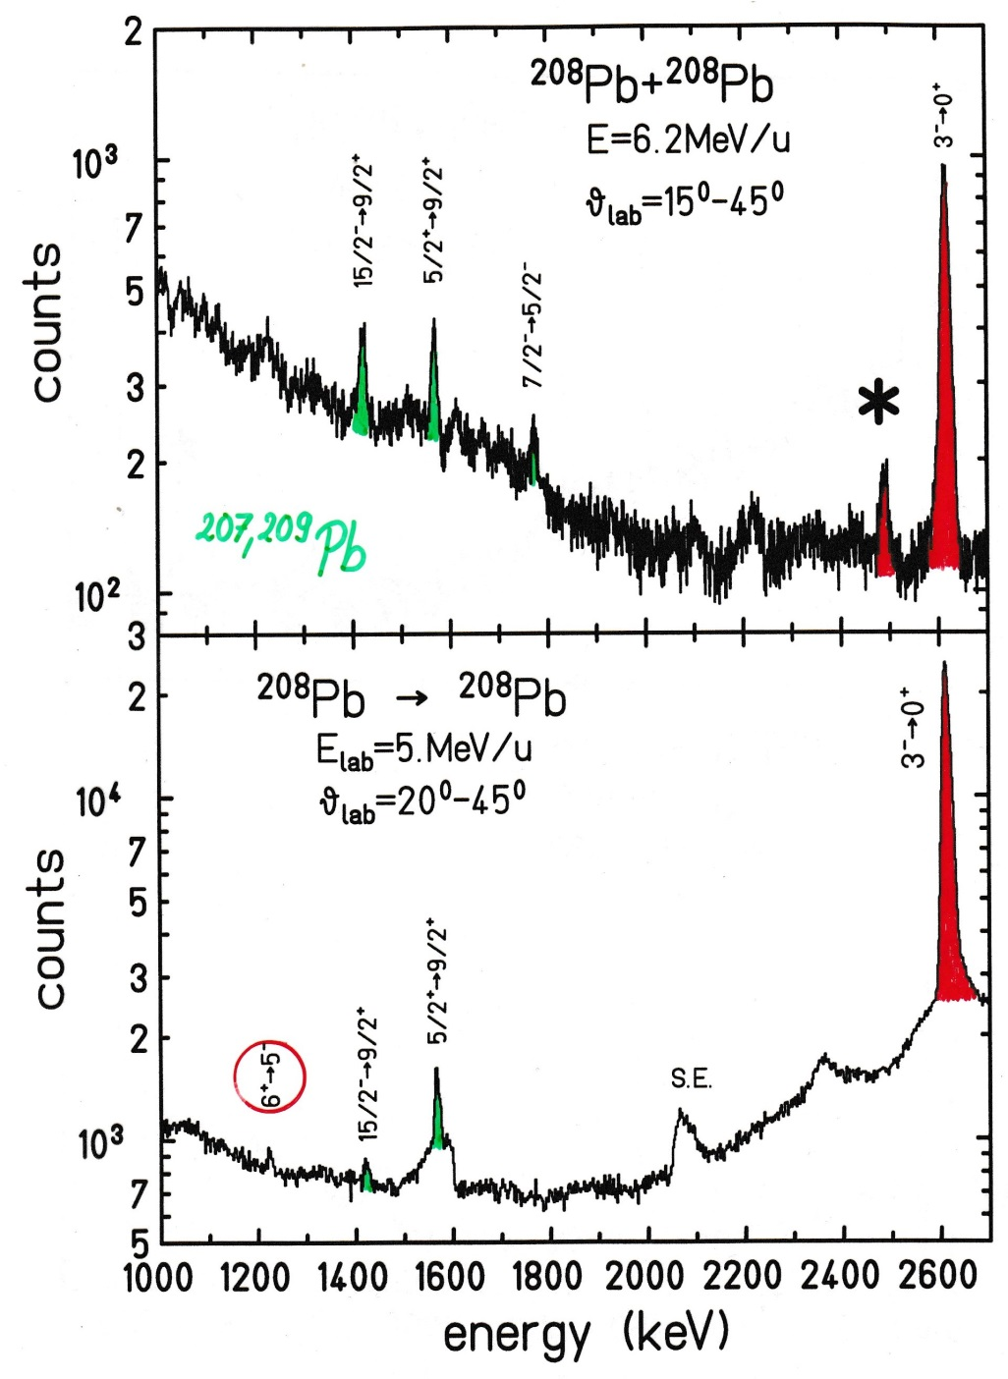
Coulomb Excitation for ²⁰⁸Pb on ²⁰⁸Pb at 6.2 MeV/u
^{207,209}Pb

Slide 20
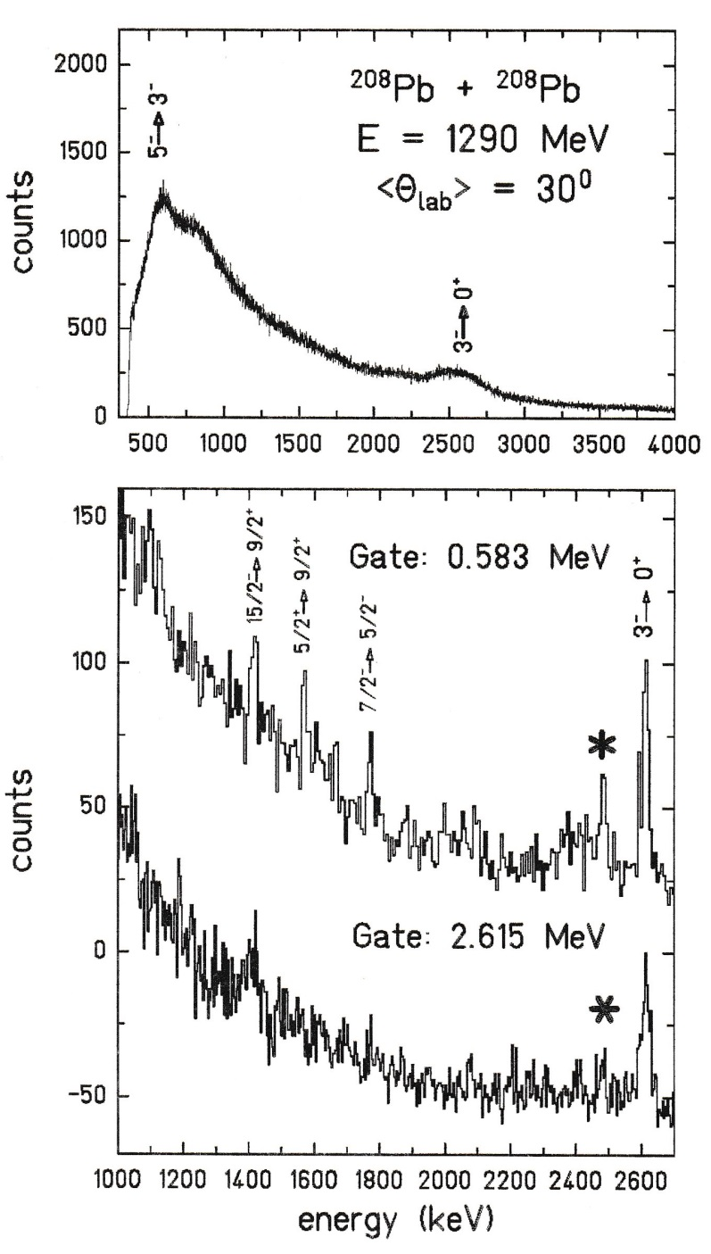
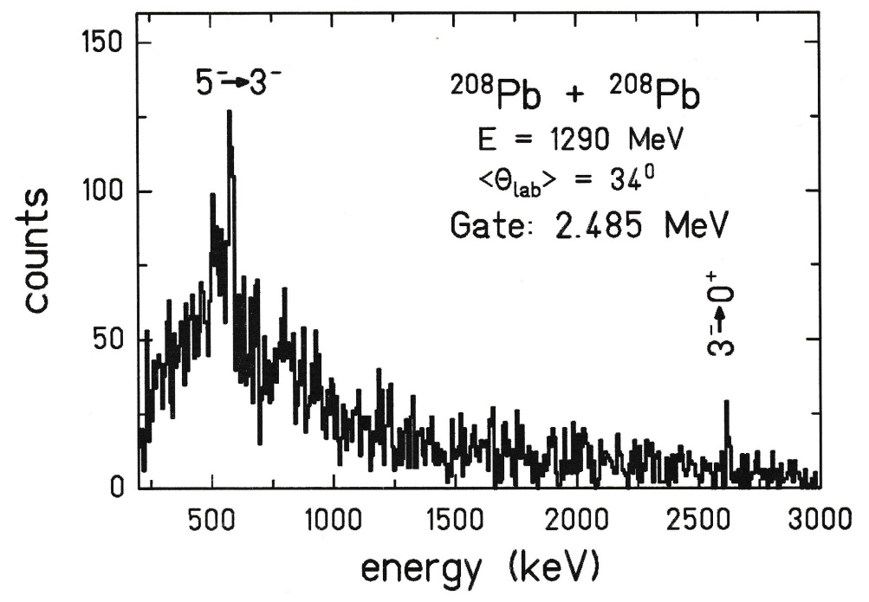
Coulomb Excitation for ²⁰⁸Pb on ²⁰⁸Pb at 6.2 MeV/u

Slide 21
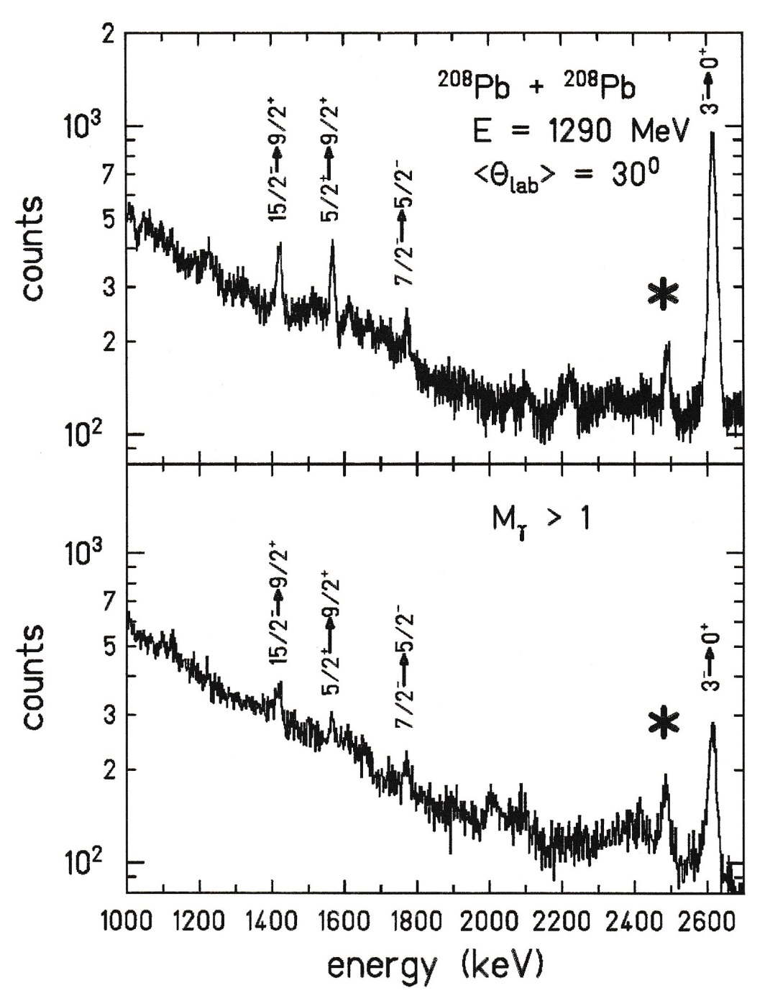
Coulomb Excitation for ²⁰⁸Pb on ²⁰⁸Pb at 6.2 MeV/u

Slide 22
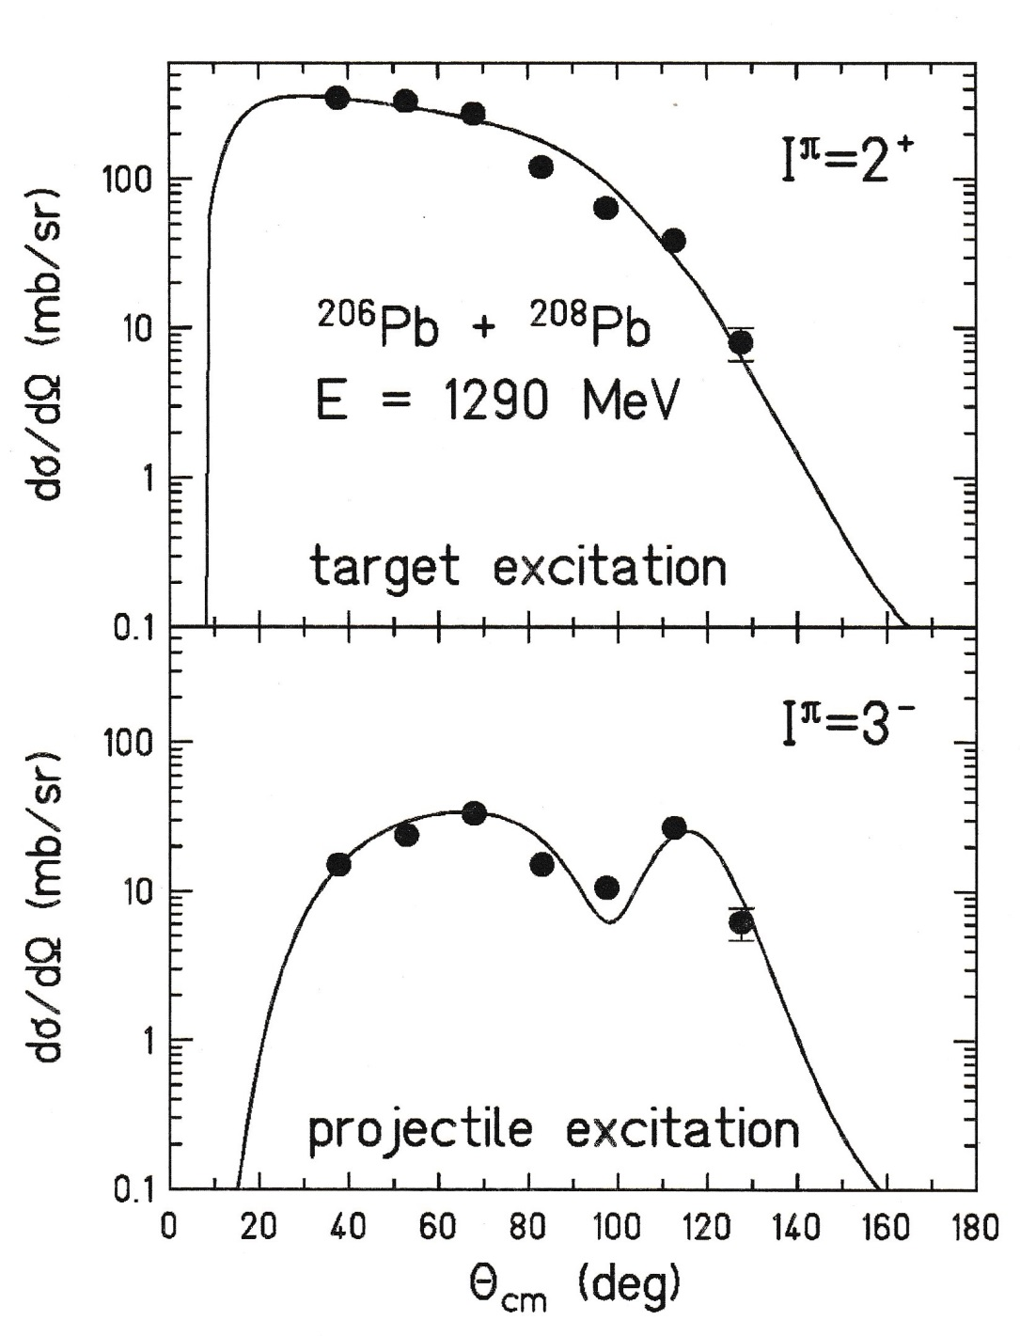
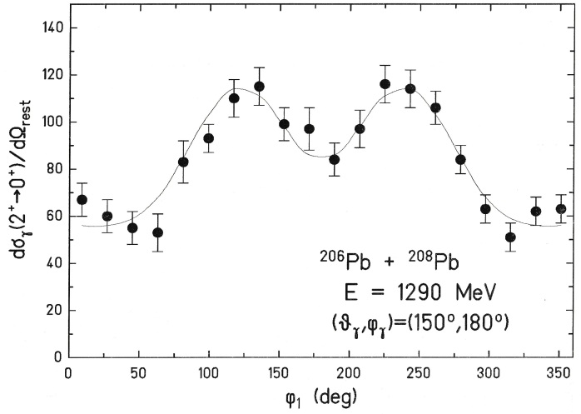
Coulomb and Nuclear Excitation for ²⁰⁸Pb on ²⁰⁶Pb at 6.2 MeV/u
particle-γ angular correlation
electromagnetic excitation
nuclear excitation
g(2⁺) = 0 → unperturbed p-γ angular correlation
$$\frac{σ_{nucl}}{σ_{total}}=63\%$$
analysis with Ptolemy code

Slide 23
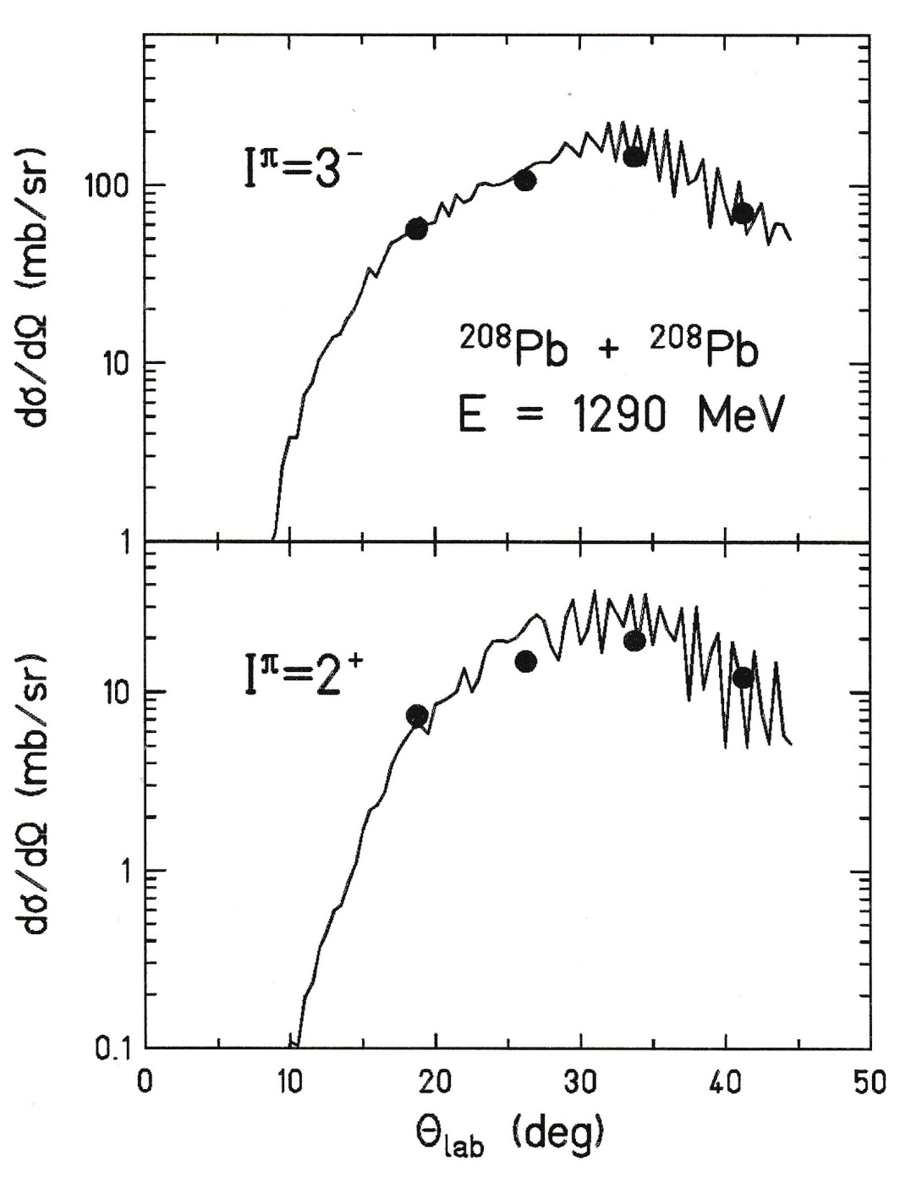
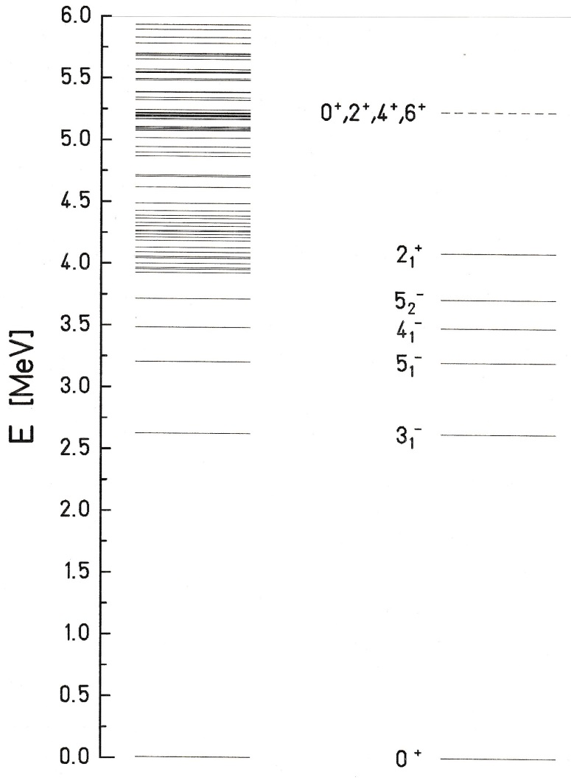
Coulomb and Nuclear Excitation for ²⁰⁸Pb on ²⁰⁸Pb at 6.2 MeV/u
analysis with Ptolemy code

Slide 24
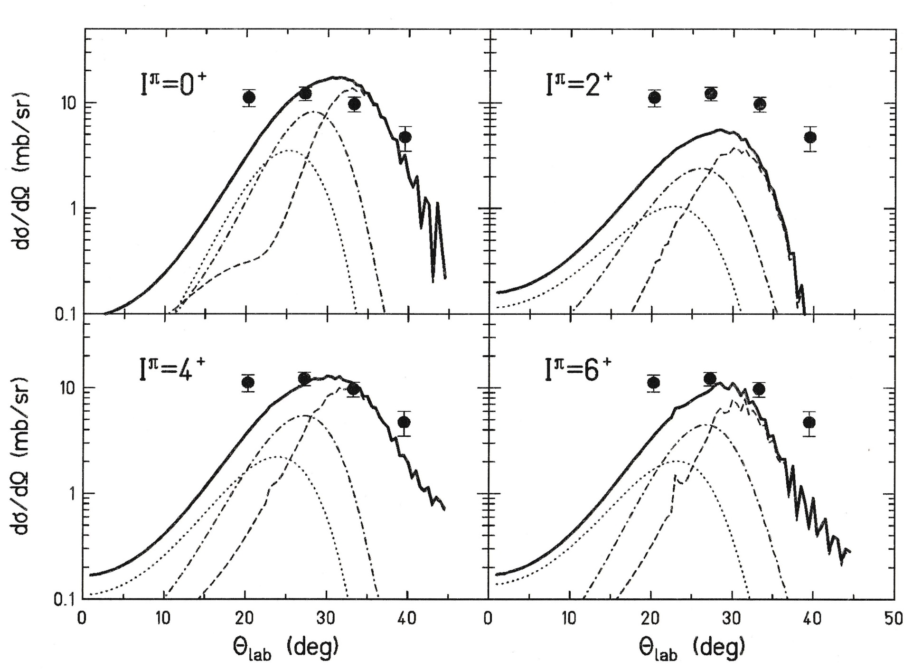
Coulomb and Nuclear Excitation for ²⁰⁸Pb on ²⁰⁸Pb at 6.2 MeV/u
analysis with Ptolemy code

Slide 25
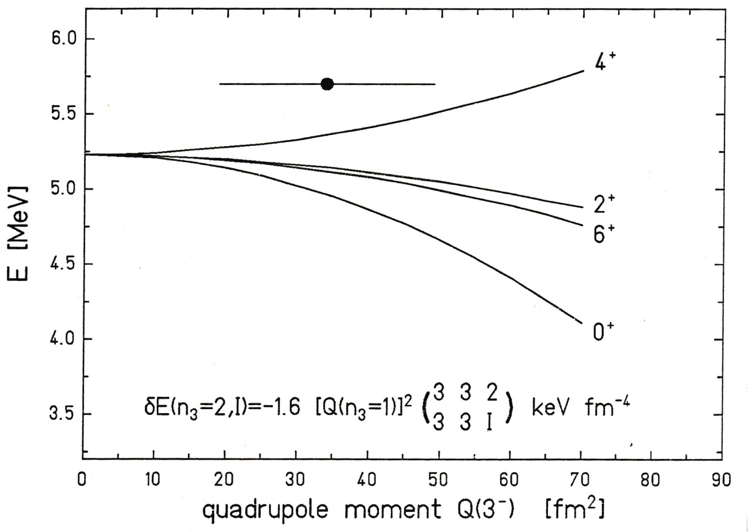
Energy Splitting of the 2-Phonon States

