Slide 1
Doppler-Corrected e⁻ and γ-Ray Spectroscopy
Physical Motivation
  In-beam conversion electron spectroscopy complements the results obtained from γ-spectroscopy
  A method for determining the multipolarity of nuclear transitions
  The only method for detecting E0-transitions
Doppler Correction after Inelastic Heavy Ion Scattering
  ²³⁸U + ¹⁸¹Ta system at the Coulomb barrier
  Electron spectroscopy with mini-orange devices
Doppler Correction after (HI,xn)-Reaction
  ²⁶Mg(¹³⁶Xe,4n)¹⁵⁸Dy reaction
  Electron spectroscopy with high transmission orange-β spectrometer
Summary

Slide 2
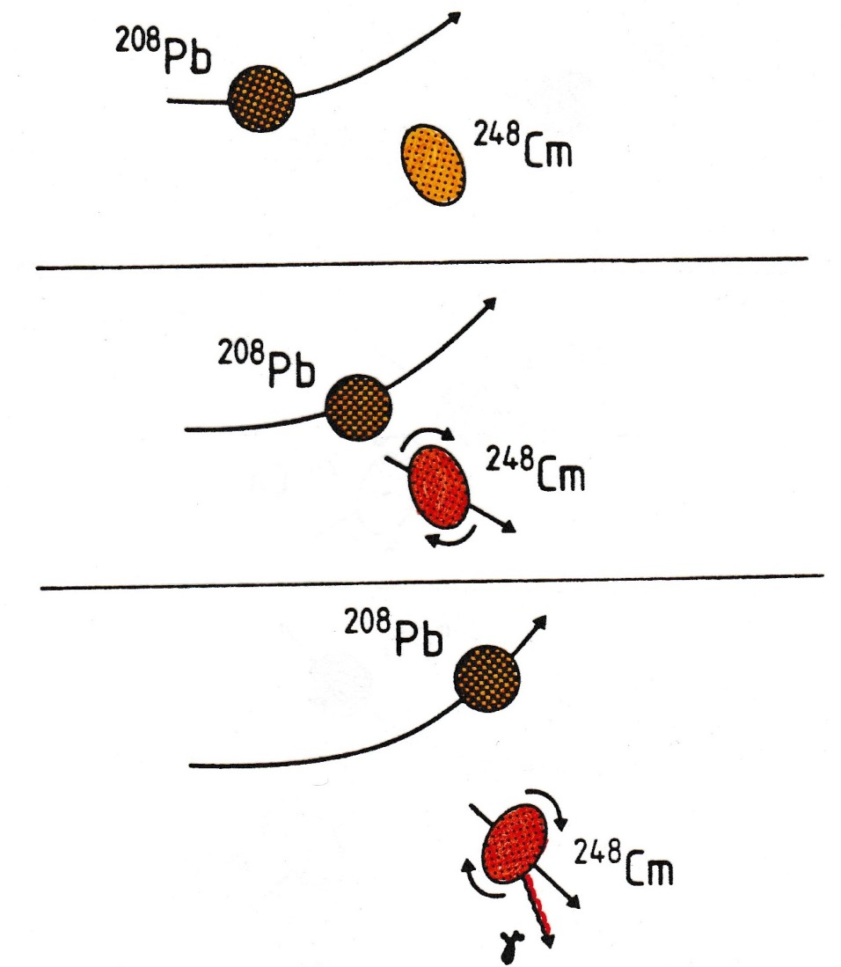
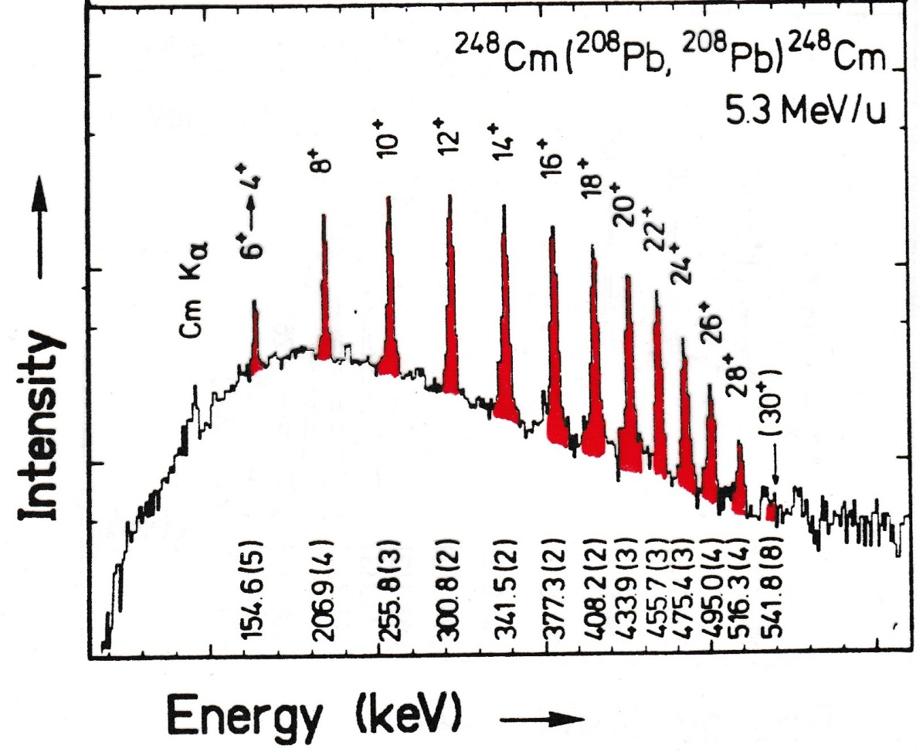
Coulomb Excitation

Slide 3
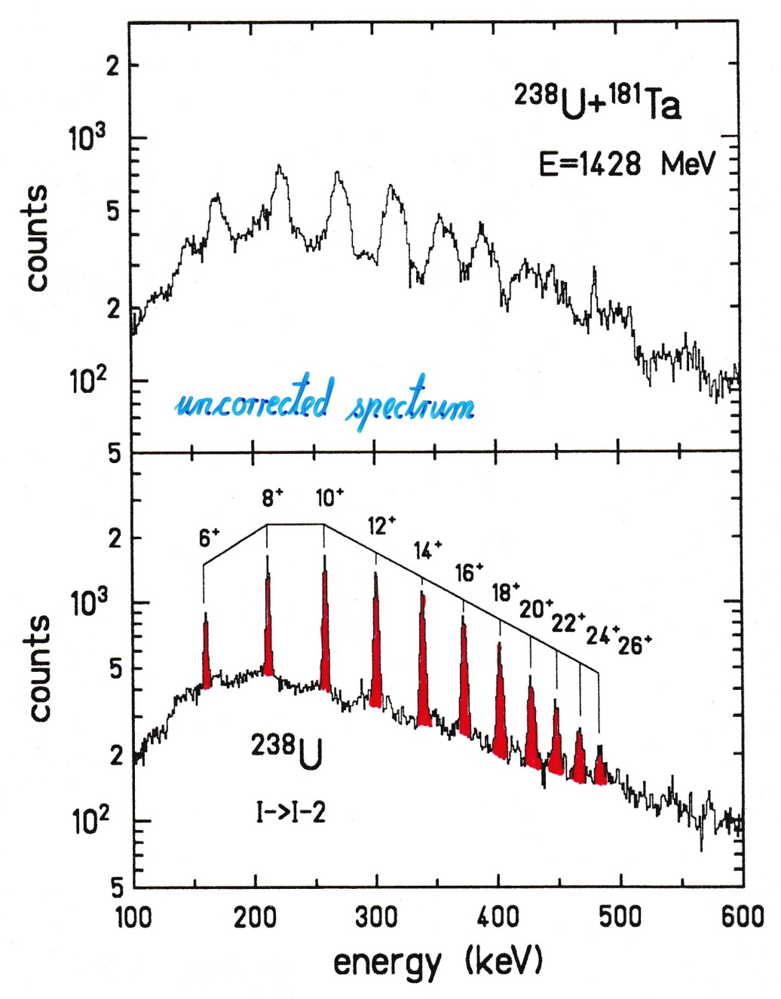
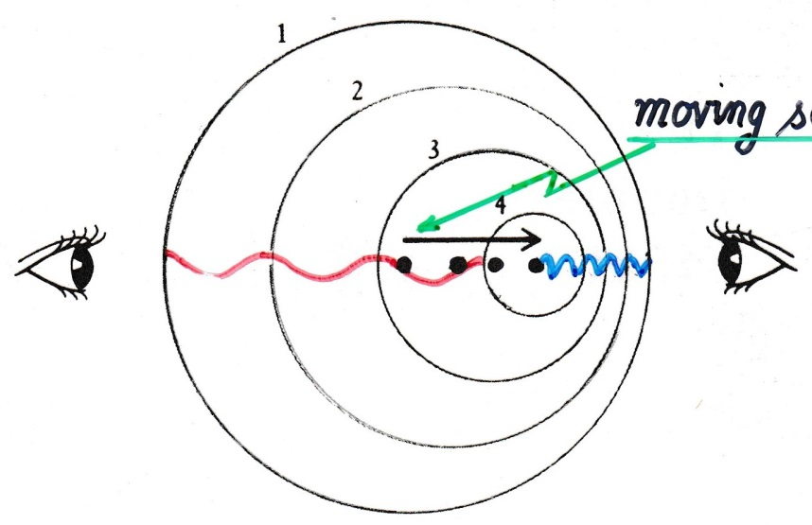
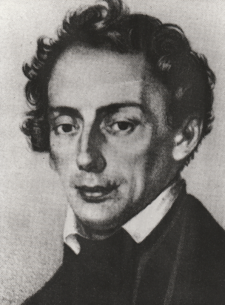
The Doppler Effect
moving source
uncorrected spectrum
Christian Doppler

Slide 4

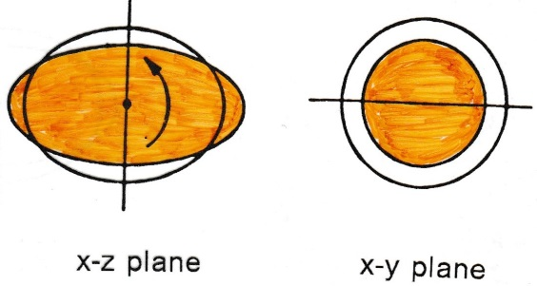
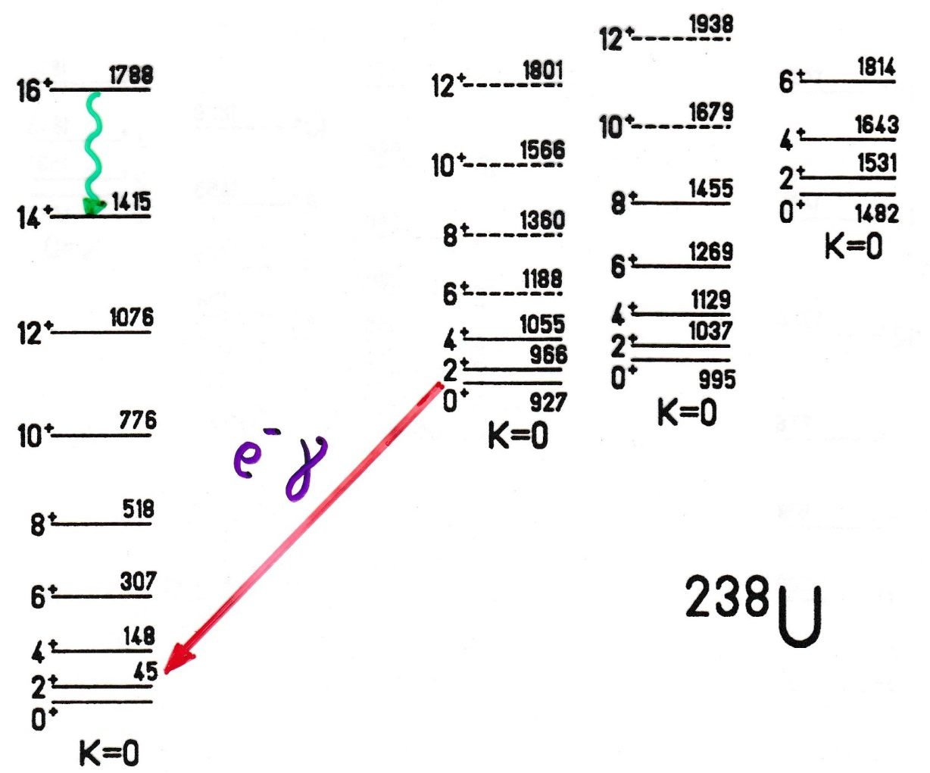
Surface Oscillations in Deformed Nuclei
β - vibration
e⁻ γ
E0 or E2 transition

Slide 5
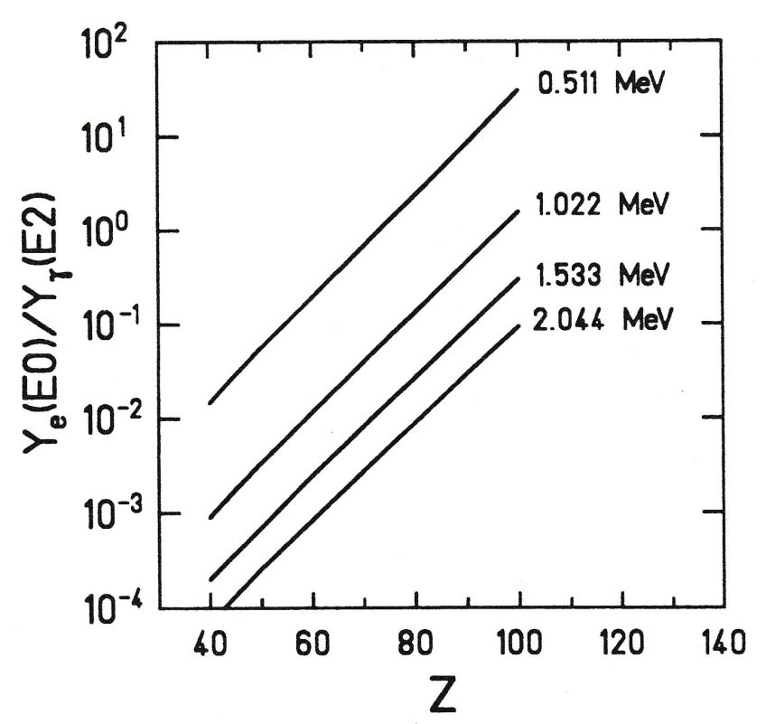
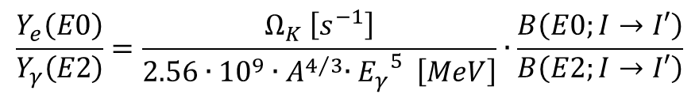
E0/E2 Branching Ratio
$$\frac{Y_{e}\left(E0\right)}{Y_{γ}\left(E2\right)}=\frac{Ω_{K} \left[s^{−1}\right]}{2.56∙{10}^{9}{∙A}^{4/3}{∙E_{γ}}^{5} \left[MeV\right]}∙\frac{B\left(E0;I→I′\right)}{B\left(E2;I→I′\right)}$$
= 14 β² for 2_{β}→2
~Z^{7.5}
Ω_{K}: conversion probability electronic factor
D.A. Bell et al.; Can. J. of Phys. 48 (1970),2542

Slide 6
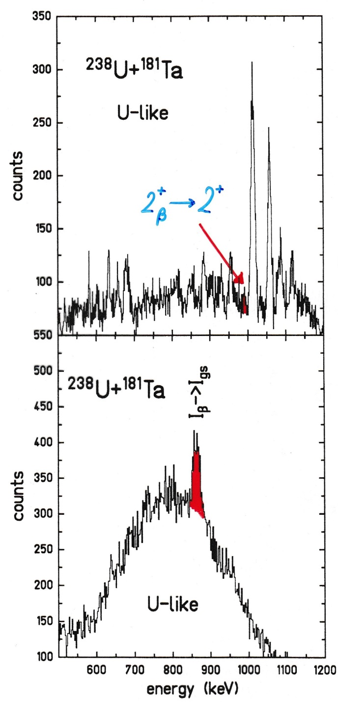

Doppler-Corrected e⁻ and γ-Ray Spectroscopy
$$2_{β}^{+}→2^{+}$$
γ-ray spectrum
e⁻ spectrum

Slide 7
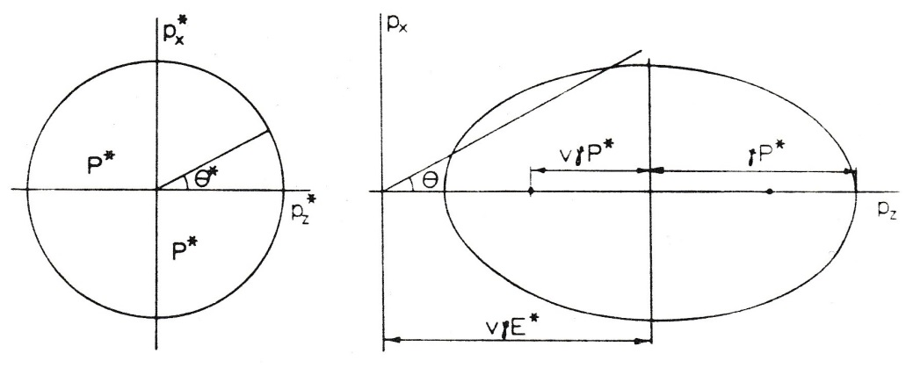
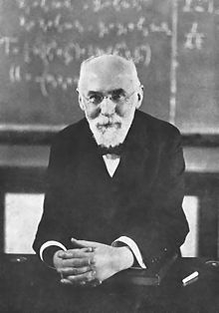




Lorentz Transformation
P* = const.
total energy:
$$E^{∗}=−γ∙v∙P∙cosθ+γ∙E$$
with
$$E=\sqrt{{\left(mc^{2}\right)}^{2}+{\left(Pc\right)}^{2}}$$
rest system
laboratory system
E*, P* total energy and momentum in the rest system
E, P total energy and momentum in the laboratory system
Doppler formula for zero-mass particle (photon): E=Pc
$$E^{∗}=−γ∙β∙E∙cosθ+γ∙E$$
$$E^{∗}=γ∙E\left(1−β∙cosθ\right)$$
Hendrik Lorentz
E. Byckling, K. Kajantie J. Wiley & Sons London

Slide 8
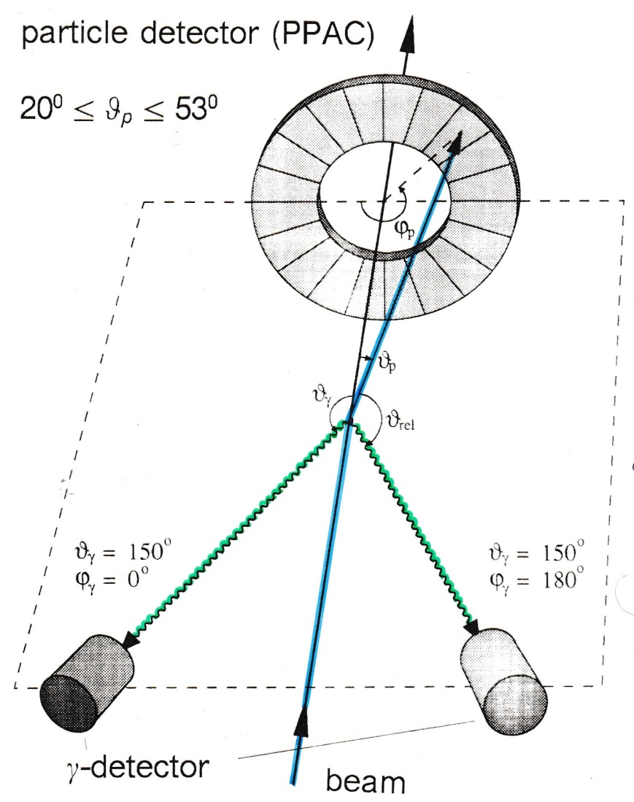




Experimental Arrangement
experimental problem:
Doppler broadening due to finite size of Ge-detector
$$\frac{∆E}{E}\sim 1\%$$
for
$$∆θ_{γ}={20}^{0} β_{1}≅10\%$$
For projectile excitation:
$$E^{∗}=γ∙E∙\left(1−β_{1}∙cosθ_{γ1}\right)$$
Doppler shift
with
$$cosθ_{γ1}=cosθ_{1}cosθ_{γ}+sinθ_{1}sinθ_{γ}cos\left(φ_{γ}−φ_{1}\right)$$
$$ΔE≅E^{∗}∙β_{1}∙sinθ_{γ1}∙∆θ_{γ1}$$
Doppler broadening

Slide 9
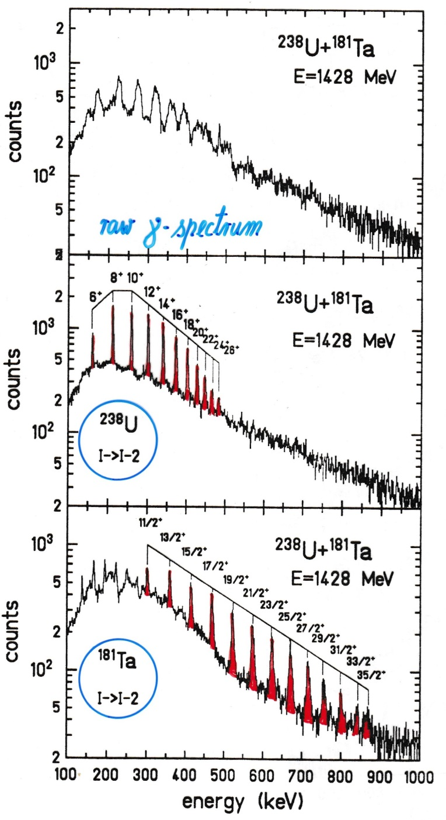
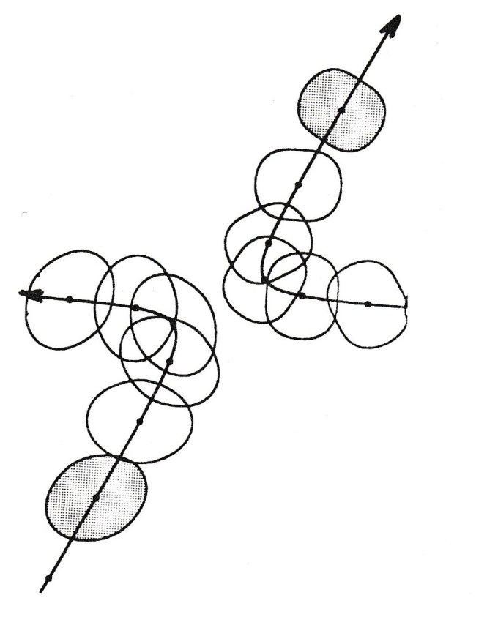
Inelastic Heavy-Ion Scattering
¹⁸¹Ta
raw γ-ray spectrum
²³⁸U

Slide 10
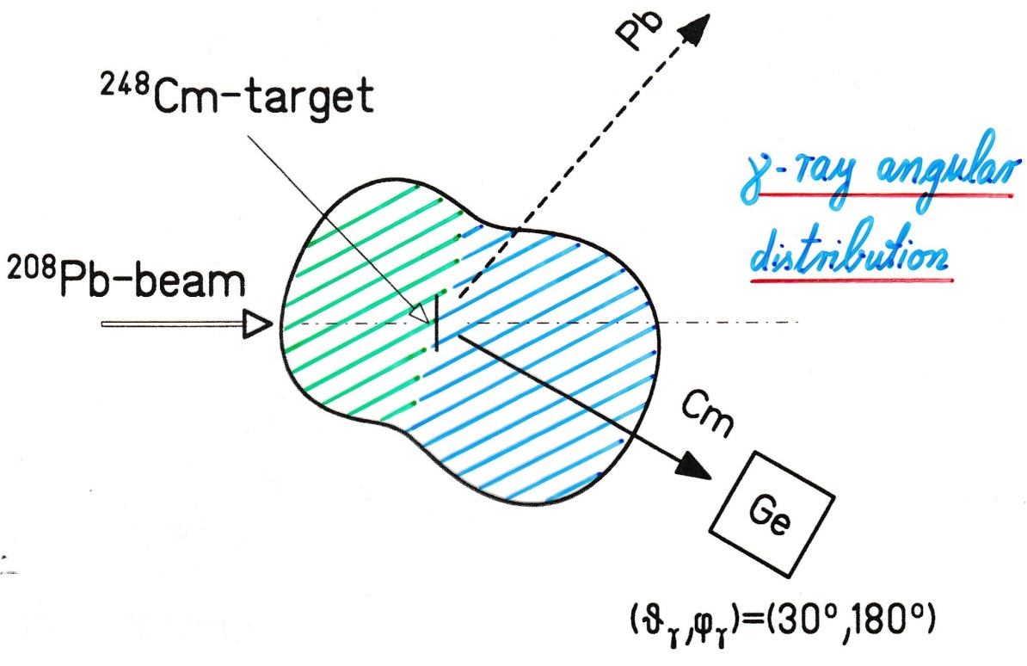

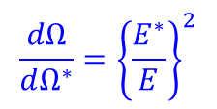
Lorentz Transformation
γ-ray angular distribution
Contraction of the solid angle element in the laboratory system
$$\frac{dΩ}{dΩ^{∗}}={\left\{\frac{E^{∗}}{E}\right\}}^{2}$$
with
$$E^{∗}=γ∙E∙\left(1−β∙cosθ\right)$$
Doppler formula

Slide 11
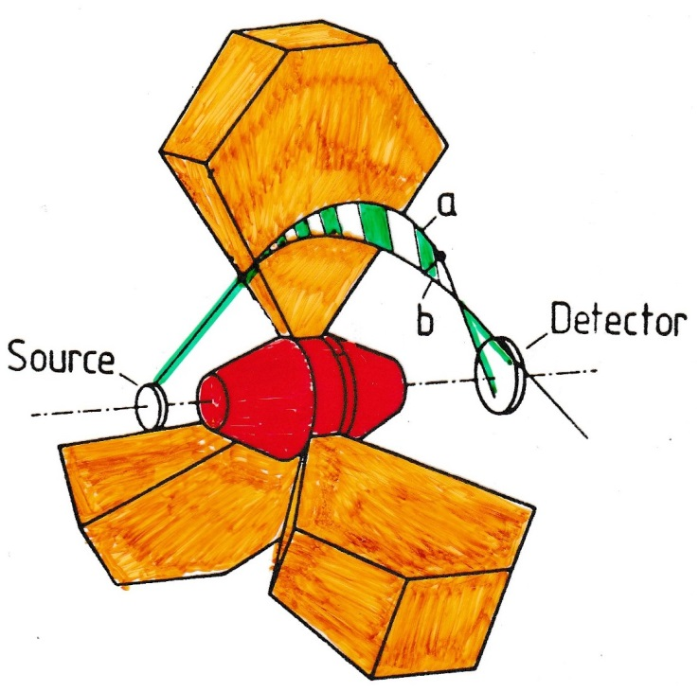
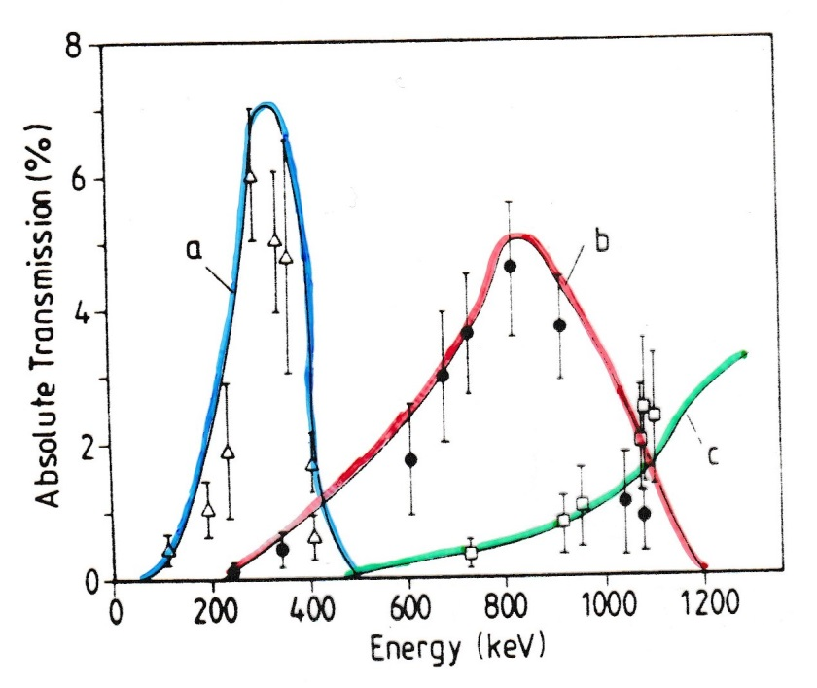
Electron Spectroscopy with Mini-Orange Devices
magnetic filters
SmCo₅ magnets
for symmetric configuration 1 – 5 kG
J. v. Klinken et al.; NIM 151 (1978) 433
T. Dresel et al.; NIM A275 (1989) 301

Slide 12
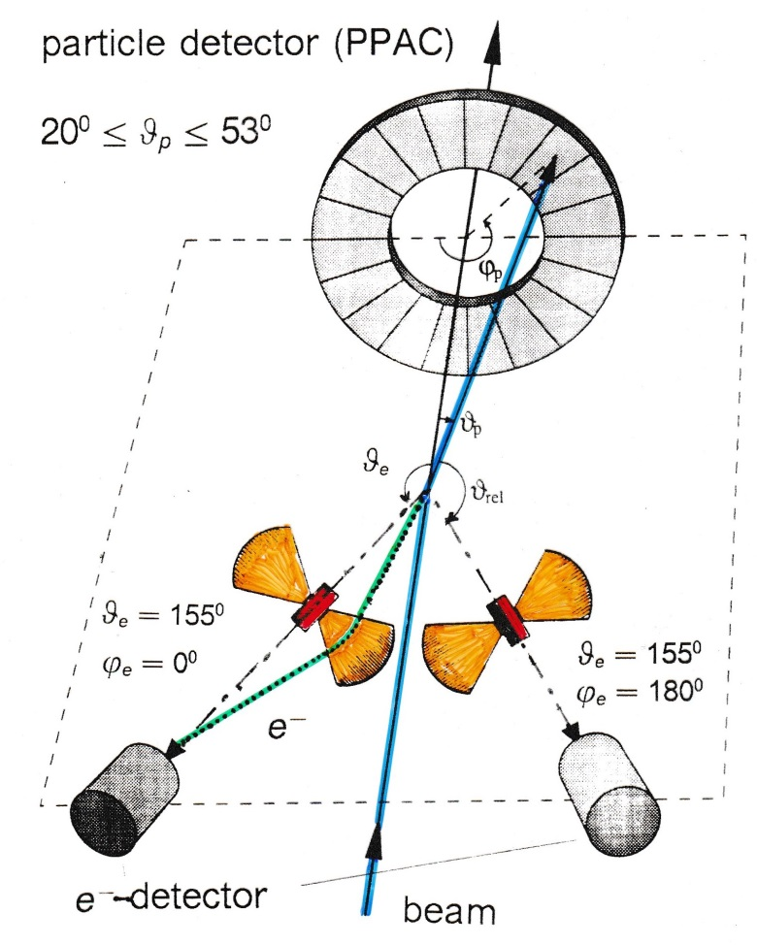
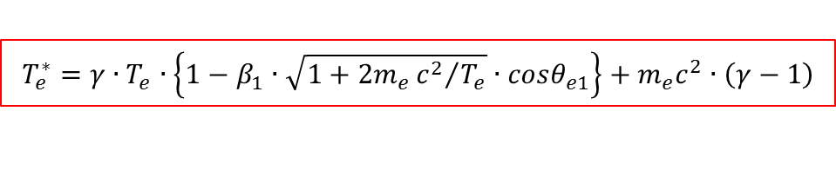
Experimental Arrangement
Doppler broadening
Δϑ_{e} = 20⁰
target – Mini-Orange: 19 cm
Mini-Orange – Si detector: 6 cm
For projectile excitation:
$$T_{e}^{∗}=γ∙T_{e}∙\left\{1−β_{1}∙\sqrt{1+2m_{e}{c^{2}}/{T_{e}}}∙cosθ_{e1}\right\}+m_{e}c^{2}∙\left(γ−1\right)$$
with
$$cosθ_{e1}=cosθ_{1}cosθ_{e}+sinθ_{1}sinθ_{e}cos\left(φ_{e}−φ_{1}\right)$$

Slide 13
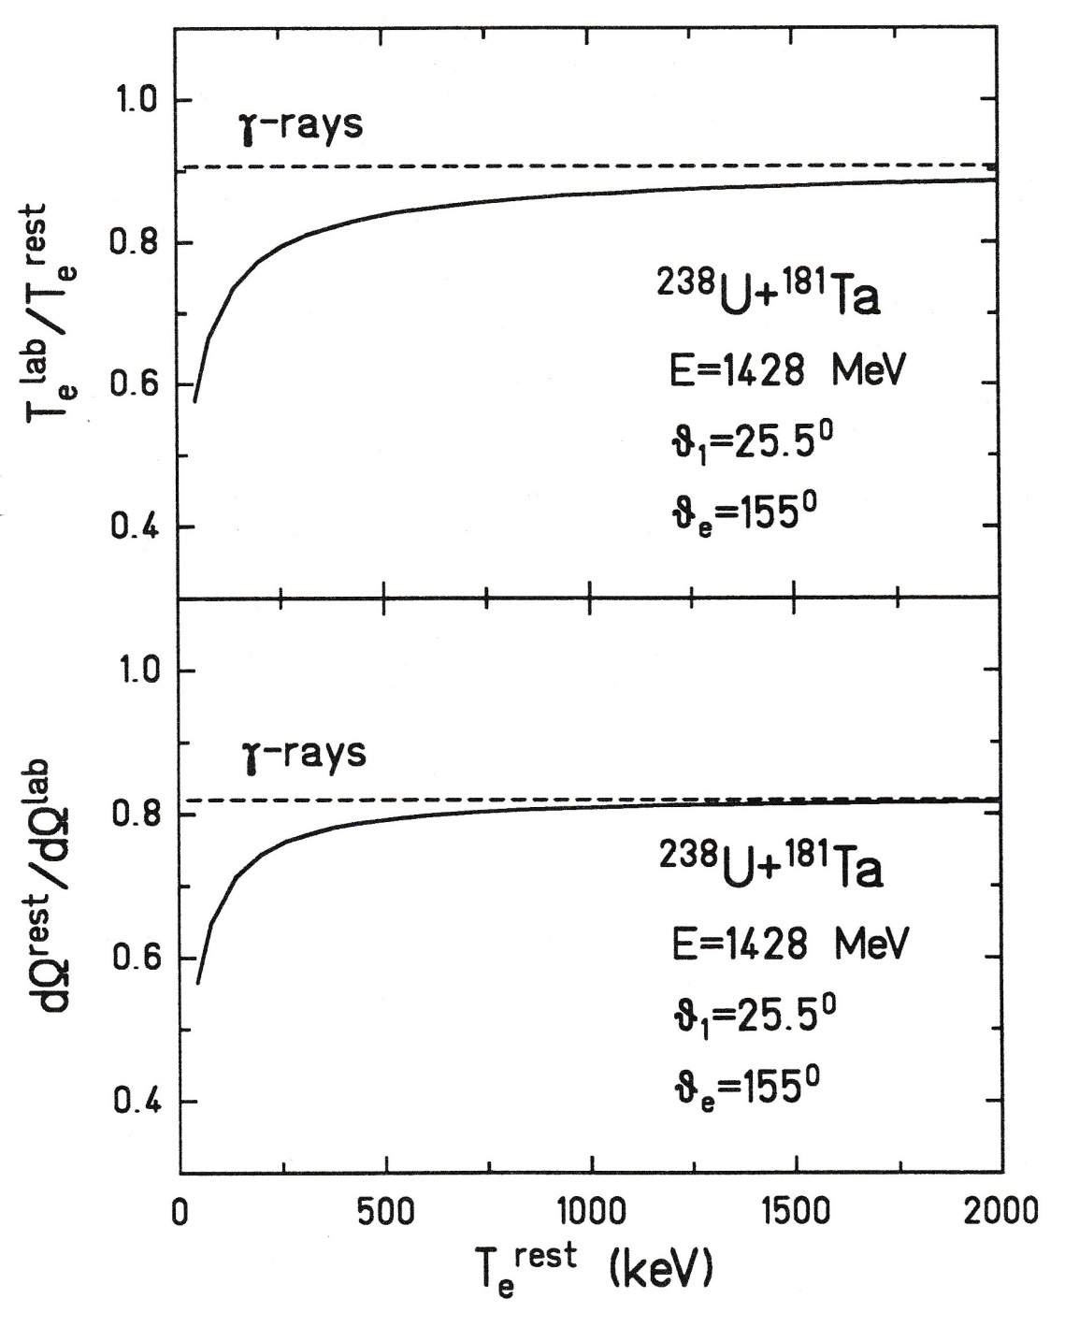
Lorentz Transformation
γ-rays
10%
energy shift
γ-rays
20%
solid angle contraction

Slide 14
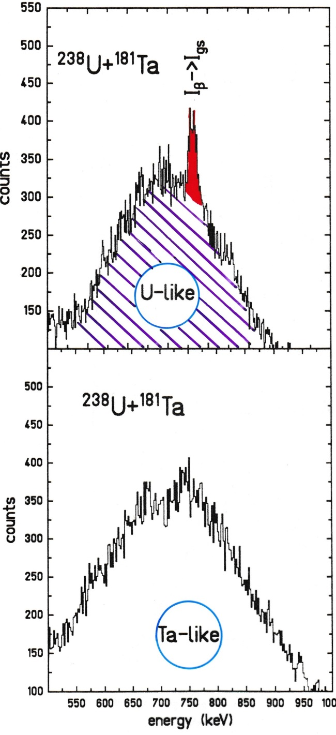
Electron Spectroscopy with Mini-Orange Devices
transmission window

Slide 15
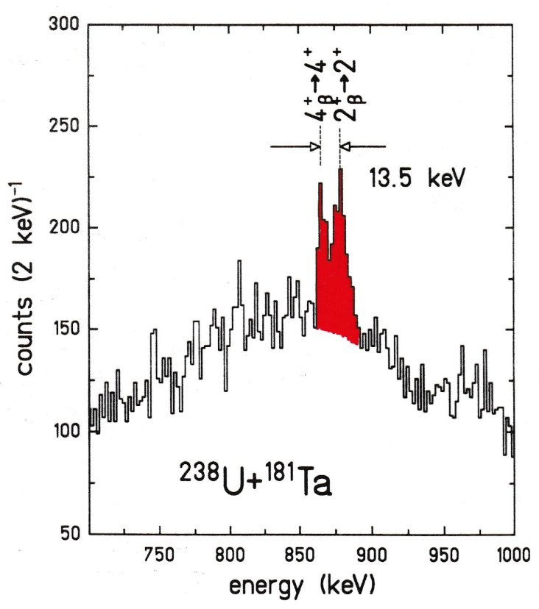
Experimental Arrangement
optimal energy resolution:
cos θ_{e1} = ±1

Slide 16
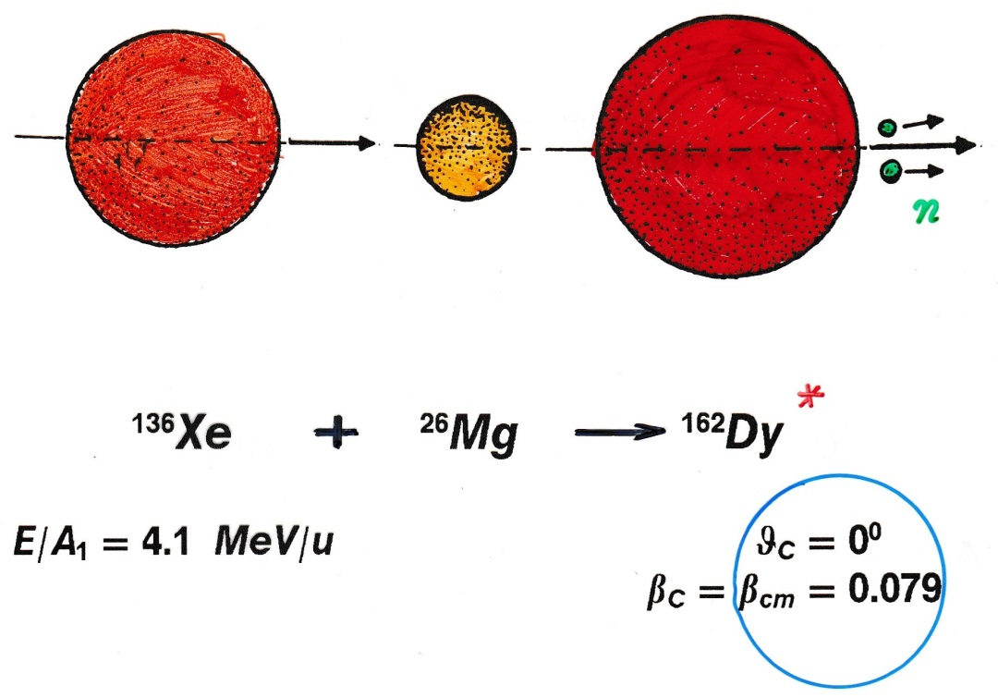
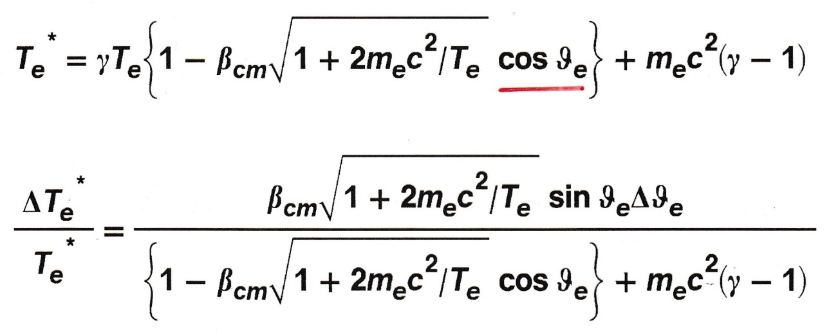
Compound Nucleus Formation
Lorentz transformation:

Slide 17
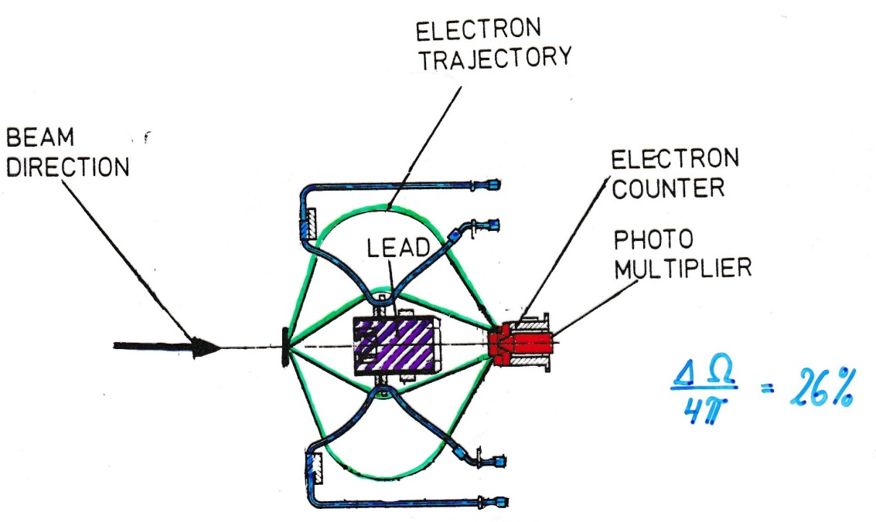
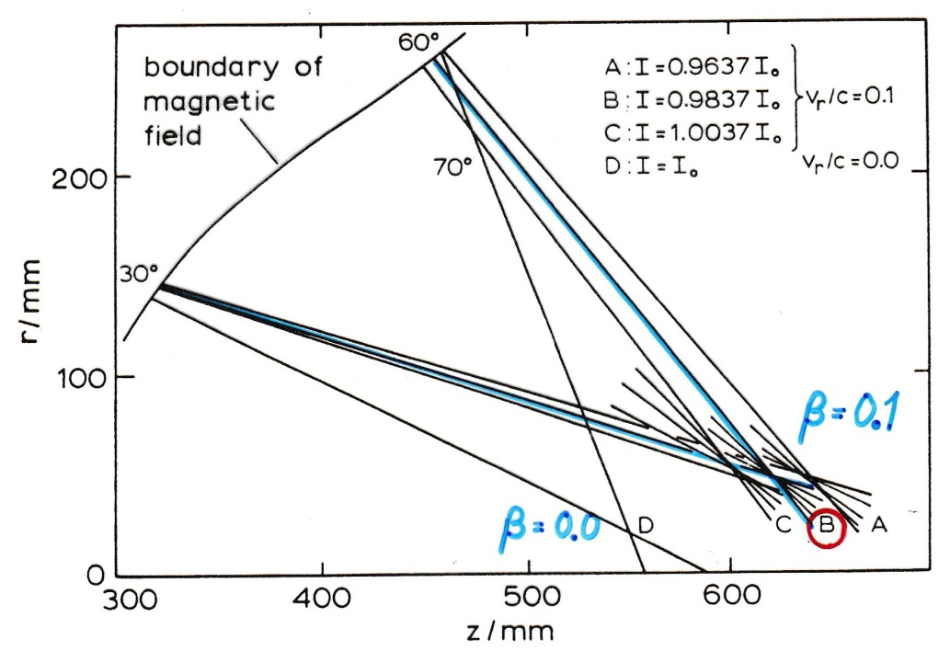


Experimental Arrangement
$$\frac{ΔΩ}{4π}=26\%$$
optimal focusing: β, $T_{e}^{∗}$
β = 0.1
β = 0.0
L. Handschug et al.; NIM 161 (1979) 117

Slide 18
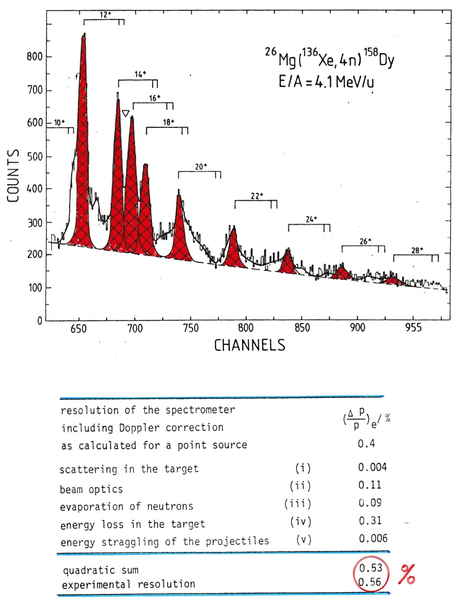
Conversion Electron Spectroscopy after (HI,xn)-Reactions
A. Balanda et al.; GSI 79-11, p.50

Slide 19
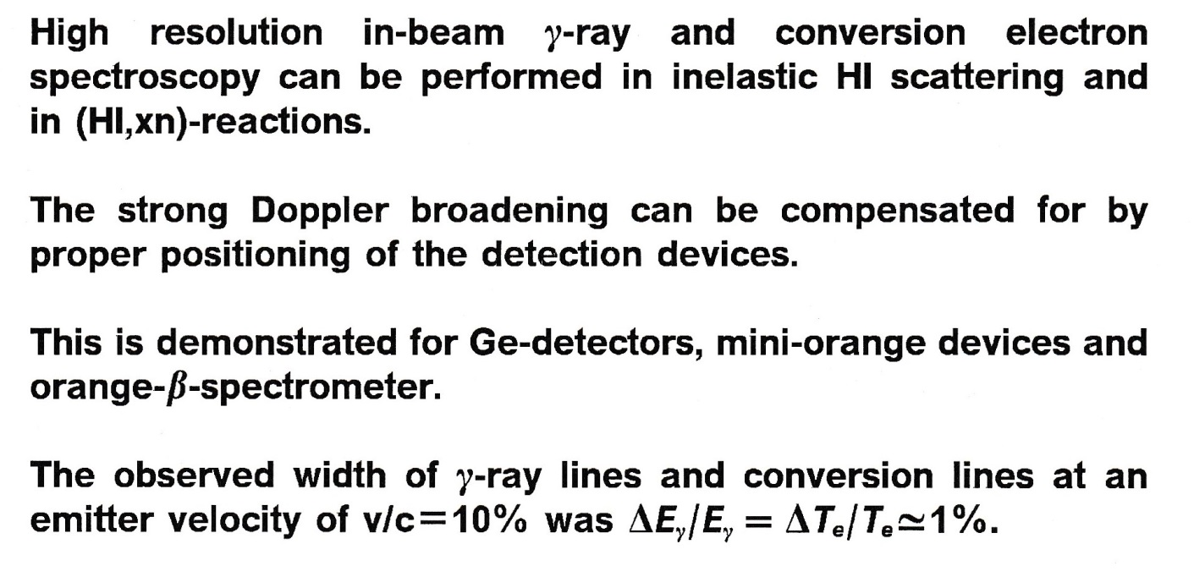
Summary

