Slide 1
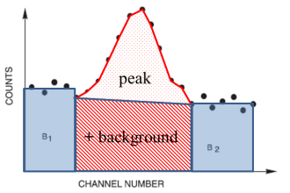
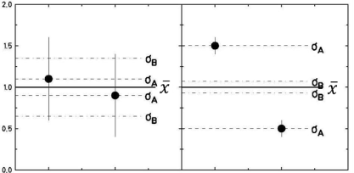
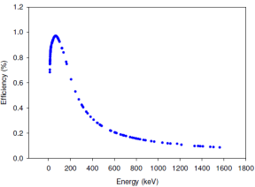
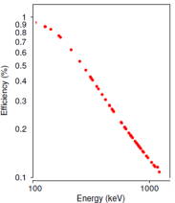
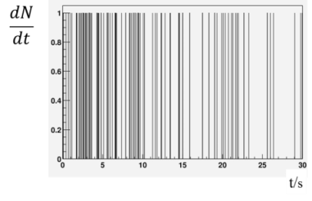
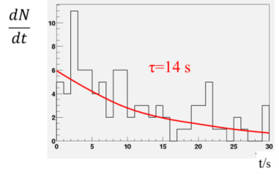
Error Analysis
Quality of measurements (standard deviation, full with at half maximum FWHM)
Statistical error: peak on top of a background
Mean value and standard deviation (without and with errors of individual data points)
Results for a limited number of measurements
Least-squares regression
Decay curve measured with low statistics

Slide 2


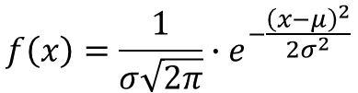
Gaussian Function
$$f\left(x\right)=\frac{1}{σ\sqrt{2π}}∙e^{−\frac{{\left(x−μ\right)}^{2}}{2σ^{2}}}$$
Gaussian function:
Full Width at Half Maximum:
$$FWHM=\sqrt{2∙ln2}∙σ$$

Slide 3
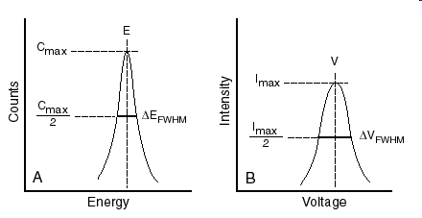

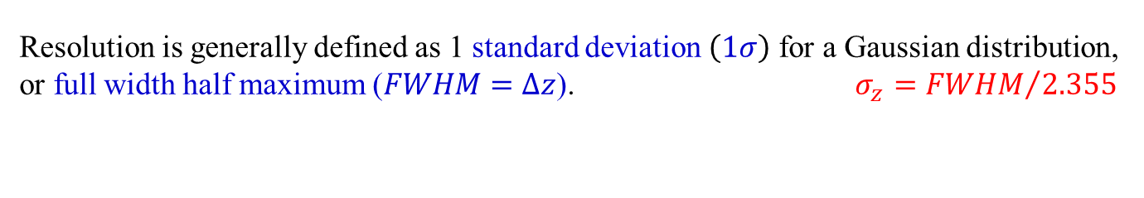


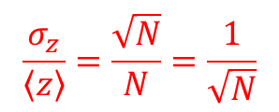
Quality of Measurements: Resolution
$$\left\langle z\right\rangle$$
$$∆z$$
Resolution is generally defined as 1 standard deviation $\left(1σ\right)$ for a Gaussian distribution, or full width half maximum ($FWHM=∆z$). $σ_{z}={FWHM}/{2.355}$
$$\frac{σ_{z}}{\left\langle z\right\rangle }=\frac{\sqrt{N}}{N}=\frac{1}{\sqrt{N}}$$
If the measurement is dominated by Poissonian fluctuations:
Fano factor F: fluctuations on N are reduced by correlation in the production of consecutive e-hole pairs. For Germanium detectors $F\sim 0.1$
$$\frac{σ_{z}}{\left\langle z\right\rangle }=\sqrt{\frac{F}{N}}$$

Slide 4
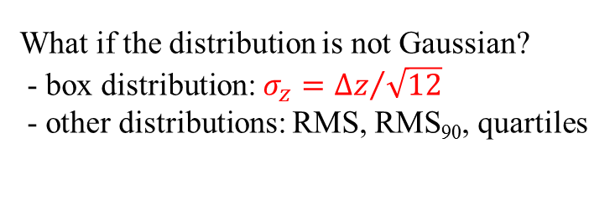
Quality of Measurements: Resolution
$$\left\langle z\right\rangle$$
$$∆z$$
Resolution is generally defined as 1 standard deviation $\left(1σ\right)$ for a Gaussian distribution, or full width half maximum ($FWHM=∆z$). $σ_{z}={FWHM}/{2.355}$
$$\frac{σ_{z}}{\left\langle z\right\rangle }=\frac{\sqrt{N}}{N}=\frac{1}{\sqrt{N}}$$
If the measurement is dominated by Poissonian fluctuations:
What if the distribution is not Gaussian?
- box distribution: $σ_{z}={∆z}/{\sqrt{12}}$
- other distributions: RMS, RMS₉₀, quartiles

Slide 5
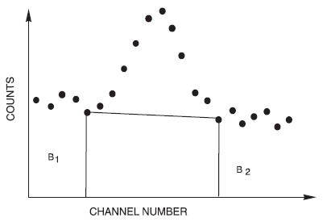


Statistical Error: Peak on top of Background
peak
+ background
The area above the background represents the total counts between the vertical lines P minus the trapezoidal area B (red hatched). If the total counts are (P+B) and the end-points of the horizontal line are B₁ and B₂ (width of B₁ + B₂ = width of B), then the net area is given by:
$$P=\left(P+B\right)−B$$
The standard deviation of ΔP is given by:
$$ΔP=\sqrt{P+2∙B}$$

Slide 6
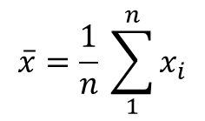
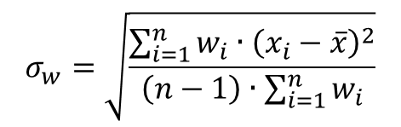

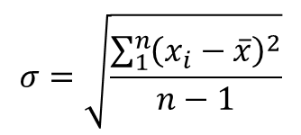
The mean value and the standard deviation
$$\overline{x}=\frac{1}{n} \sum_{1}^{n}{x_{i}}$$
mean value
$$σ=\sqrt{\frac{\sum_{1}^{n}{{\left(x_{i}−\overline{x}\right)}^{2}}}{n−1}}$$
standard normal distribution
standard deviation
68.3% of data in the interval μ ± σ
94.4% of data in the interval μ ± 2σ
99.7% of data in the interval μ ± 3σ
$$\overline{x}=\frac{\sum_{i=1}^{n}{w_{i}∙x_{i}}}{\sum_{i=1}^{n}{w_{i}}}$$
weighted mean value
$$σ_{w}=\sqrt{\frac{\sum_{i=1}^{n}{w_{i}∙{\left(x_{i}−\overline{x}\right)}^{2}}}{\left(n−1\right)∙\sum_{i=1}^{n}{w_{i}}}}$$
weighted standard deviation

Slide 7
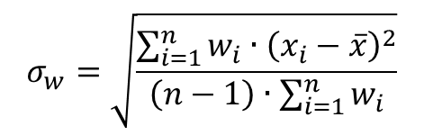
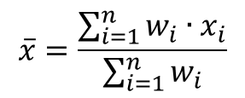
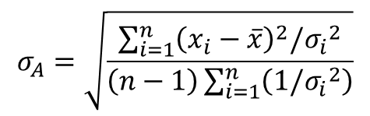
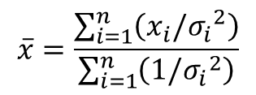
The mean value and the standard deviation
$$\overline{x}=\frac{\sum_{i=1}^{n}{w_{i}∙x_{i}}}{\sum_{i=1}^{n}{w_{i}}}$$
weighted mean value
$$σ_{w}=\sqrt{\frac{\sum_{i=1}^{n}{w_{i}∙{\left(x_{i}−\overline{x}\right)}^{2}}}{\left(n−1\right)∙\sum_{i=1}^{n}{w_{i}}}}$$
weighted standard deviation
The weight w_{i} is given by the errors of the individual data x_{i} ± σ_{i}
$$\overline{x}=\frac{\sum_{i=1}^{n}{\left(x_{i}/{σ_{i}}^{2}\right)}}{\sum_{i=1}^{n}{\left(1/{σ_{i}}^{2}\right)}}$$
weighted mean value
$$σ_{A}=\sqrt{\frac{\sum_{i=1}^{n}{{\left(x_{i}−\overline{x}\right)}^{2}/{σ_{i}}^{2}}}{\left(n−1\right)\sum_{i=1}^{n}{\left(1/{σ_{i}}^{2}\right)}}}$$
weighted standard deviation

Slide 8
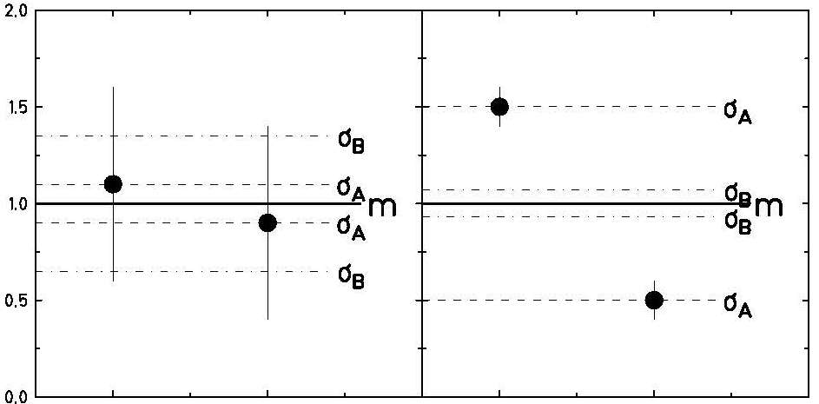

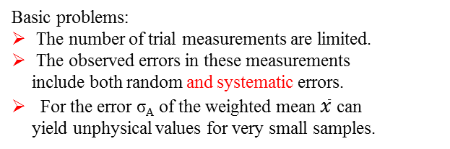
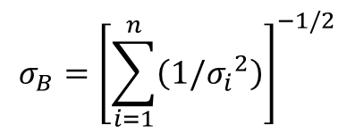


Experimental standard deviation
Basic problems:
The number of trial measurements are limited.
The observed errors in these measurements include both random and systematic errors.
For the error σ_{A} of the weighted mean $\overline{x}$ can yield unphysical values for very small samples.
$$\overline{x}$$
$$\overline{x}$$
$$σ_{A}=\sqrt{\frac{\sum_{i=1}^{n}{{\left(x_{i}−\overline{x}\right)}^{2}/{σ_{i}}^{2}}}{\left(n−1\right)\sum_{i=1}^{n}{\left(1/{σ_{i}}^{2}\right)}}}$$
weighted standard deviation
$$σ_{B}={\left[\sum_{i=1}^{n}{\left(1/{σ_{i}}^{2}\right)}\right]}^{−1/2}$$
$$σ=max\left(σ_{A},σ_{B}\right)$$

Slide 9
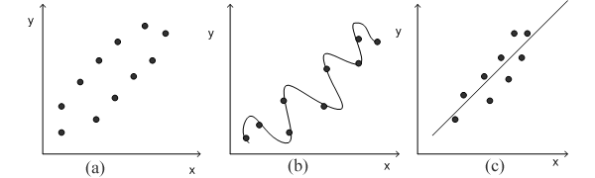
Least-Squares Regression
scattered data
polynomial fit
approximate fit
The principle of least squares is one of the popular methods for finding a curve fitting a given data.
Say (x₁,y₁), (x₂,y₂), ... (x_{n},y_{n}), be n observations from an experiment. We are interested in finding a curve
$$y=f\left(x\right)$$

Slide 10
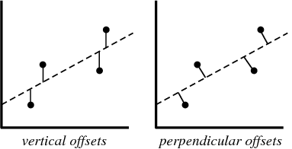

Least-Squares Fit of a Straight Line
We are interested in finding a curve
$$y=a+b∙x$$
$$χ^{2}\left(x_{i},a,b\right)=\sum_{i=1}^{n}{{\left[y_{i}−\left(a+b∙x_{i}\right)\right]}^{2}}$$
We consider the sum of the squares of
We need to find a,b such that χ² is minimum.
$$\frac{dχ^{2}}{da}=\frac{dχ^{2}}{db}=0$$
$$\frac{dχ^{2}}{da}=\sum_{i=1}^{n}{2\left[y_{i}−\left(a+b∙x_{i}\right)\right]=0}$$
$$n∙a+b\sum_{i=1}^{n}{x_{i}}=\sum_{i=1}^{n}{y_{i}}$$
$$\frac{dχ^{2}}{db}=\sum_{i=1}^{n}{2∙x_{i}\left[y_{i}−\left(a+b∙x_{i}\right)\right]=0}$$
$$a\sum_{i=1}^{n}{x_{i}}+b\sum_{i=1}^{n}{{x_{i}}^{2}=\sum_{i=1}^{n}{x_{i}∙y_{i}}}$$

Slide 11
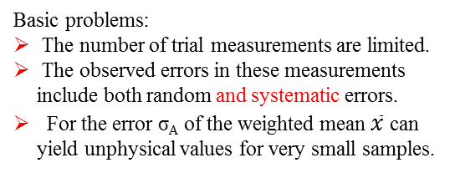
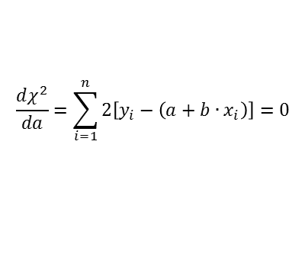
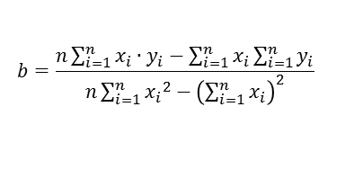
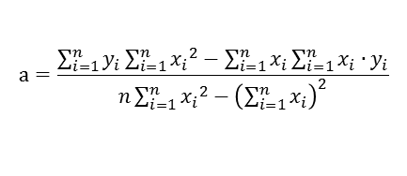
Least-Squares Fit of a Straight Line
$$\frac{dχ^{2}}{da}=\sum_{i=1}^{n}{2\left[y_{i}−\left(a+b∙x_{i}\right)\right]=0}$$
$$n∙a+b\sum_{i=1}^{n}{x_{i}}=\sum_{i=1}^{n}{y_{i}}$$
$$\frac{dχ^{2}}{db}=\sum_{i=1}^{n}{2∙x_{i}\left[y_{i}−\left(a+b∙x_{i}\right)\right]=0}$$
$$a\sum_{i=1}^{n}{x_{i}}+b\sum_{i=1}^{n}{{x_{i}}^{2}=\sum_{i=1}^{n}{x_{i}∙y_{i}}}$$
$$\left|\begin{matrix}n & \sum_{i=1}^{n}{x_{i}} \\ \sum_{i=1}^{n}{x_{i}} & \sum_{i=1}^{n}{{x_{i}}^{2}}\end{matrix}\right|\left|\begin{matrix}a \\ b\end{matrix}\right|=\left|\begin{matrix}\sum_{i=1}^{n}{y_{i}} \\ \sum_{i=1}^{n}{x_{i}∙y_{i}}\end{matrix}\right|$$
In matrix form
$$\left|\begin{matrix}a \\ b\end{matrix}\right|={\left|\begin{matrix}n & \sum_{i=1}^{n}{x_{i}} \\ \sum_{i=1}^{n}{x_{i}} & \sum_{i=1}^{n}{{x_{i}}^{2}}\end{matrix}\right|}^{−1}\left|\begin{matrix}\sum_{i=1}^{n}{y_{i}} \\ \sum_{i=1}^{n}{x_{i}∙y_{i}}\end{matrix}\right|$$
$$\left|\begin{matrix}a \\ b\end{matrix}\right|=\frac{1}{n\sum_{i=1}^{n}{{x_{i}}^{2}}−{\left(\sum_{i=1}^{n}{x_{i}}\right)}^{2}}\left|\begin{matrix}\sum_{i=1}^{n}{y_{i}}\sum_{i=1}^{n}{{x_{i}}^{2}}−\sum_{i=1}^{n}{x_{i}}\sum_{i=1}^{n}{x_{i}∙y_{i}} \\ n\sum_{i=1}^{n}{x_{i}∙y_{i}}−\sum_{i=1}^{n}{x_{i}}\sum_{i=1}^{n}{y_{i}}\end{matrix}\right|$$
The 2x2 matrix inverse is
$$a=\frac{\sum_{i=1}^{n}{y_{i}}\sum_{i=1}^{n}{{x_{i}}^{2}}−\sum_{i=1}^{n}{x_{i}}\sum_{i=1}^{n}{x_{i}∙y_{i}}}{n\sum_{i=1}^{n}{{x_{i}}^{2}}−{\left(\sum_{i=1}^{n}{x_{i}}\right)}^{2}}$$
$$b=\frac{n\sum_{i=1}^{n}{x_{i}∙y_{i}}−\sum_{i=1}^{n}{x_{i}}\sum_{i=1}^{n}{y_{i}}}{n\sum_{i=1}^{n}{{x_{i}}^{2}}−{\left(\sum_{i=1}^{n}{x_{i}}\right)}^{2}}$$

Slide 12

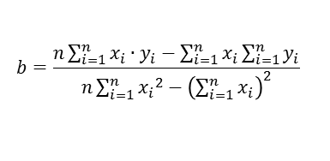


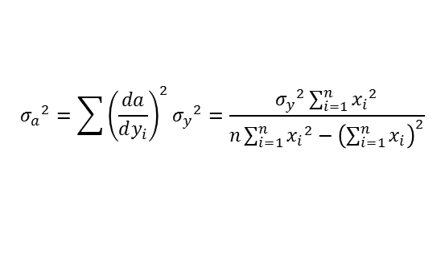
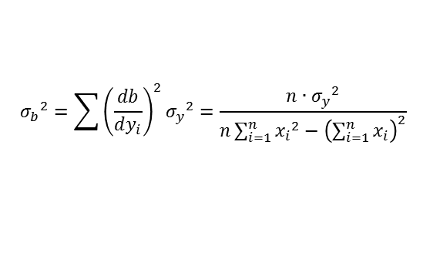

Least-Squares Fit of a Straight Line
standard deviation:
$$a=\frac{\sum_{i=1}^{n}{y_{i}}\sum_{i=1}^{n}{{x_{i}}^{2}}−\sum_{i=1}^{n}{x_{i}}\sum_{i=1}^{n}{x_{i}∙y_{i}}}{n\sum_{i=1}^{n}{{x_{i}}^{2}}−{\left(\sum_{i=1}^{n}{x_{i}}\right)}^{2}}$$
$${σ_{y}}^{2}=\frac{1}{n−2}\sum_{i=1}^{n}{{\left[y_{i}−f\left(x_{i}\right)\right]}^{2}}$$
$$b=\frac{n\sum_{i=1}^{n}{x_{i}∙y_{i}}−\sum_{i=1}^{n}{x_{i}}\sum_{i=1}^{n}{y_{i}}}{n\sum_{i=1}^{n}{{x_{i}}^{2}}−{\left(\sum_{i=1}^{n}{x_{i}}\right)}^{2}}$$
error propagation:
$${σ_{a}}^{2}=\sum{{\left(\frac{da}{dy_{i}}\right)}^{2}}{σ_{y}}^{2}=\frac{{σ_{y}}^{2}\sum_{i=1}^{n}{{x_{i}}^{2}}}{n\sum_{i=1}^{n}{{x_{i}}^{2}}−{\left(\sum_{i=1}^{n}{x_{i}}\right)}^{2}}$$
Example:
$${σ_{b}}^{2}=\sum{{\left(\frac{db}{dy_{i}}\right)}^{2}}{σ_{y}}^{2}=\frac{n∙{σ_{y}}^{2}}{n\sum_{i=1}^{n}{{x_{i}}^{2}}−{\left(\sum_{i=1}^{n}{x_{i}}\right)}^{2}}$$
i | x_{i} | y_{i} | x_{i}∙y_{i} | x_{i}² | f(x) | [y_{i}-f(x_{i})]²
1 | 208 | 21,6 | 4492,8 | 43264 | 24,9 | 10,9
2 | 152 | 15,5 | 2356 | 23104 | 15,9 | 0,2
3 | 113 | 10,4 | 1175,2 | 12769 | 9,6 | 0,6
4 | 227 | 31,0 | 7037 | 51529 | 27,9 | 9,6
5 | 137 | 13,0 | 1781 | 18769 | 13,4 | 0,2
6 | 238 | 32,4 | 7711,2 | 56644 | 29,7 | 7,3
7 | 178 | 19,0 | 3382 | 31684 | 20,0 | 1
8 | 104 | 10,4 | 1081,6 | 10816 | 8,1 | 5,3
9 | 191 | 19,0 | 3629 | 36481 | 22,1 | 9,6
10 | 130 | 11,8 | 1534 | 16900 | 12,3 | 0,3
Σ | 1678 | 184,1 | 34179,8 | 301960 | 183,9 | 45
$$f\left(x\right)=a+b∙x$$
a = -8,65±2,89
b = 0,161±0,017
$${σ_{y}}^{2}=5,625$$

Slide 13
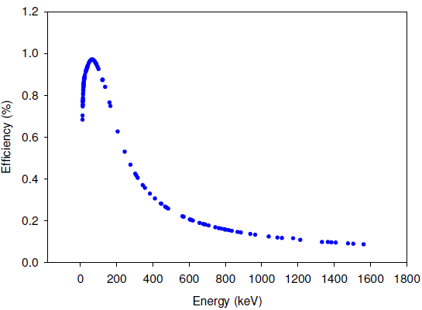






Least-Squares Regression
Linear models are not limited to being straight lines, but include wide range of shapes. For example
$$f\left(x;\vec{a} \right)=a_{0}+a_{1}∙ln\left(x\right)$$
Linearization of non-linear relation:
$$f\left(x\right)=a∙x^{b}$$
$$log\left[f\left(x\right)\right]=log\left(a\right)+b∙log\left(x\right)$$
$$f\left(x\right)=a∙e^{b∙x}$$
$$ln\left[f\left(x\right)\right]=ln\left(a\right)+b∙x$$

Slide 14
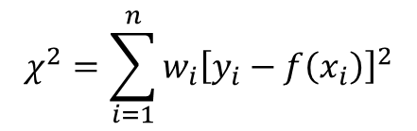
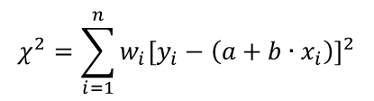

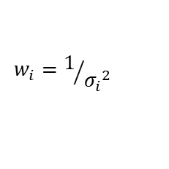
Weighted Least-Squares
$$χ^{2}=\sum_{i=1}^{n}{w_{i}{\left[y_{i}−f\left(x_{i}\right)\right]}^{2}}$$
Example:
$$y=a+b∙x$$
$$χ^{2}=\sum_{i=1}^{n}{w_{i}{\left[y_{i}−\left(a+b∙x_{i}\right)\right]}^{2}}$$
$$w_{i}=1/{{σ_{i}}^{2}}$$
with the weight given by the individual errors

Slide 15
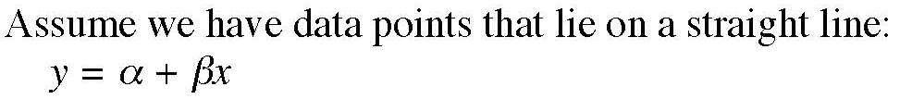
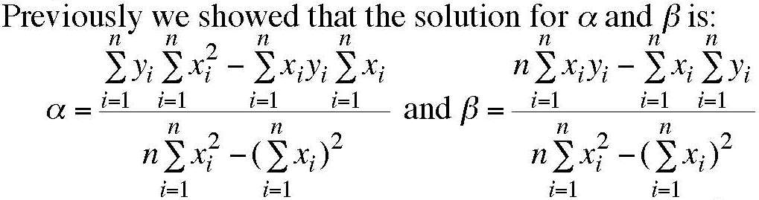
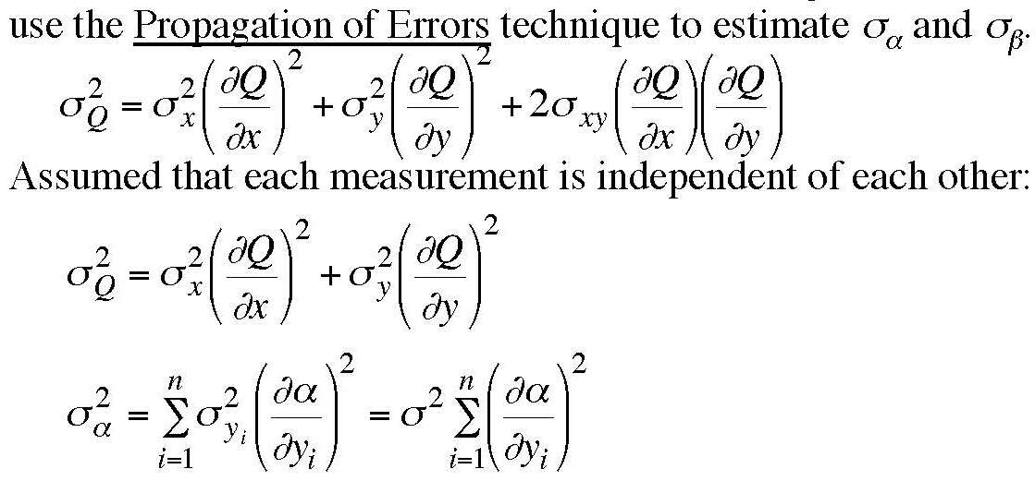
Appendix

Slide 16
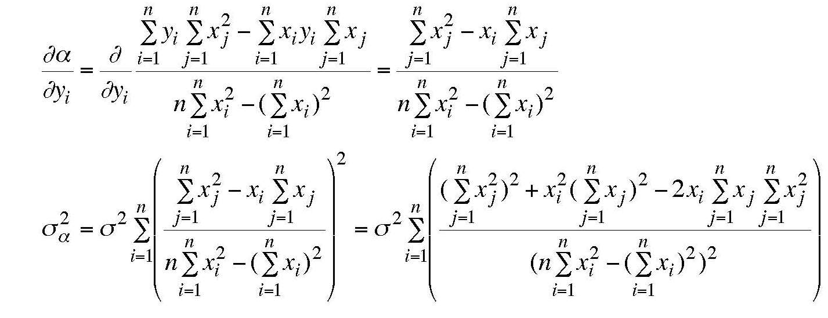
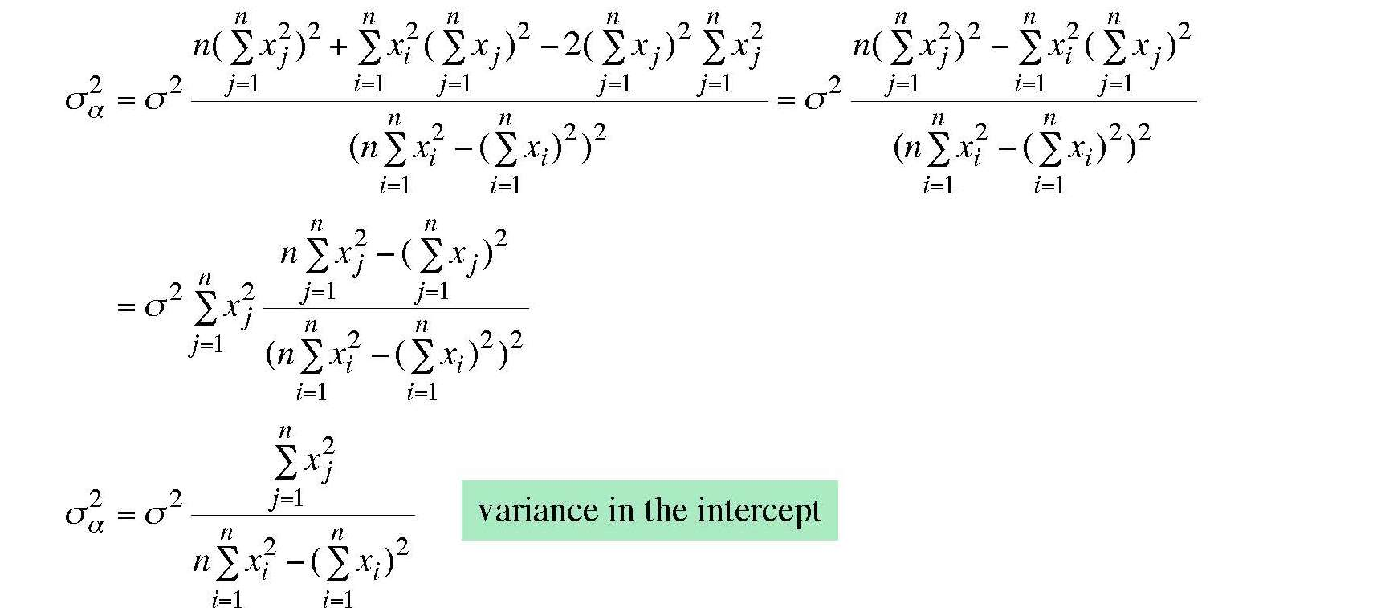

Slide 17
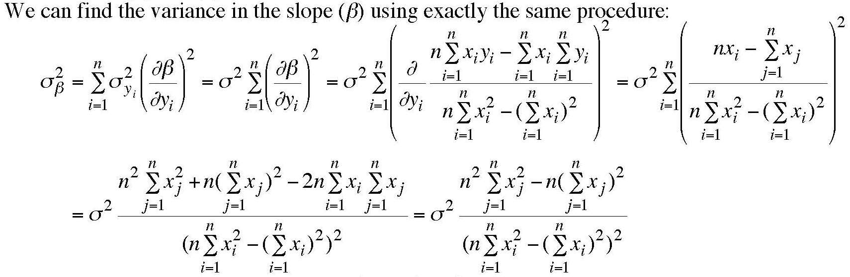
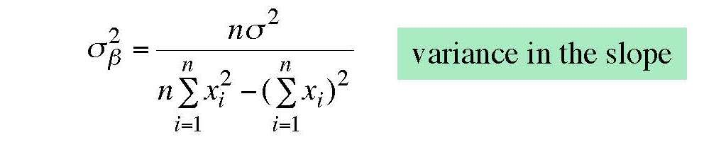

Slide 18
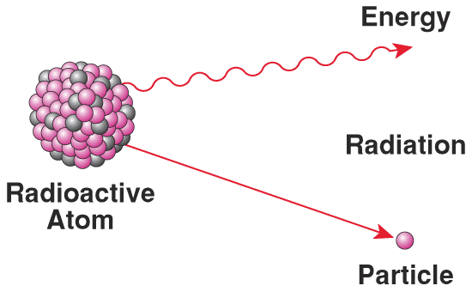
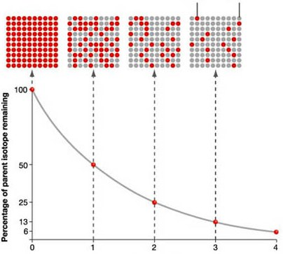
Radioactive Decay Activities
parent
isotope
(red)
daughter
isotope
(grey)
percentage of parent isotope remaining
number of half-lives

Slide 19
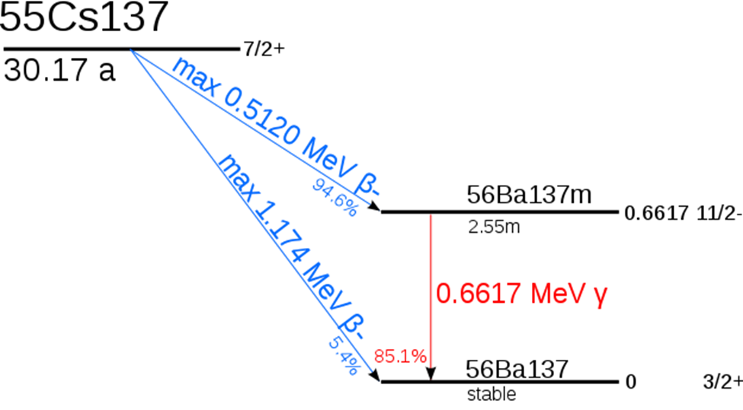
Radioactive Decay Activities
$$N=N_{0}∙e^{−t/τ}$$
$$\ln{N=\ln{N_{0}−t/τ}}$$
$$y=a+bt$$
with y = ln(N), a = ln(N0) and b = -1/τ
uncertainty of decay counts $N$ (Poisson):
$$σ_{N}=\sqrt{N}$$
At time progresses, N, is getting smaller and smaller.
What is the uncertainty of ln(N) ?
$$σ_{lnN}=\left|\frac{dln\left(N\right)}{dN}\right|σ_{N}=\frac{σ_{N}}{N}=\frac{1}{\sqrt{N}}$$

Slide 20
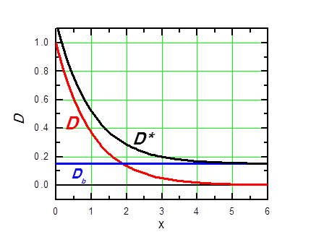
The Background Radiation
Background radiation is the radiation constantly present in the natural environment of the Earth which is emitted by natural and artificial sources (D = N)
D*=D+D_{B} D=D*-D_{B}
Sources in the Earth
Sources from outer space, such as cosmic rays
Sources in the atmosphere, such asthe radon gas released fromthe Earth‘s crust
Attention: Error Propagation !

Slide 21
Least Squares Fitting of Decay Counts
One run of decay counts/interval (D) vs. time (t)
  Must start counting shortly after sample is loaded
  Sampling rate: 10 second/sample (Δt)
  Run time: 600 seconds (# of measurements: n=60).
Measurement of background radiation
  Wait 20-30 minutes
  Repeat the counting experiment in 1.
  Make sure no other radioactive sources near your counter
Analyze data
  Subtract background D=D*-D_{b}, error propagation.
  plot D vs. t and lnD vs. t
  Least square fit and overlap your fitting curves with data plots.

Slide 22
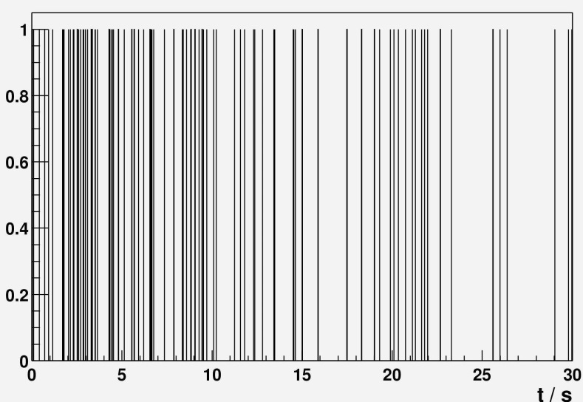
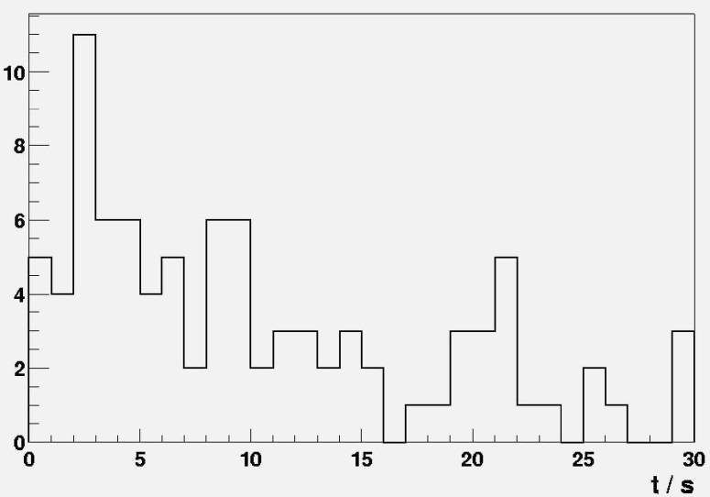





Representation of Decay Curve
$$\frac{dN}{dt}$$
$$N=N_{0}∙e^{−λ∙t}$$
$$\frac{dN}{dt}=−N_{0}∙λ∙e^{−λ∙t}$$
lifetime:
$$τ=1/λ$$
t/s
$$\frac{dN}{dt}$$
Binning of a data set is a pre-processing technique for data smoothing .
The content of 10 original channels is now contained in 1 new channel
τ=14 s
t/s

Slide 23



Representation of Decay Curve
The maximum likelihood estimate of the lifetime τ
$Θ≡ℓn t → \frac{dΘ}{dt}=\frac{1}{t}$ dt=t∙d$Θ$
$$\frac{dN}{dΘ}=−N_{0}∙λ∙t∙e^{−λt}$$
$$\frac{dN}{dΘ}=−N_{0}∙λ∙e^{Θ}∙e^{−λ∙e^{Θ}}$$
K.H.Schmidt, Z.Phys. A316 (1984), 19

Slide 24


Representation of Decay Curve
The maximum likelihood estimate of the lifetime τ
$$\frac{dN}{dt}$$
$$N=N_{0}∙e^{−λ∙t}$$
τ=14 s
$$\frac{dN}{dt}=−N_{0}∙λ∙e^{−λ∙t}$$
lifetime:
$$τ=1/λ$$
t/s
$$\frac{dN}{d ℓn\left(t\right)}$$
Θ_{max} = ℓn (τ) = 2.64 → τ = 14.1 s
$$ℓn\left(t\right)$$
K.H.Schmidt, Z.Phys. A316 (1984), 19

Slide 25

Representation of Decay Curve
The maximum likelihood estimate of the lifetime τ
no. | t (ms)
1 | 0.6
2 | 1.8
3 | 4.4
4 | 0.5
5 | 2.6
average value: 2.0 ms
Logarithmic decay-time distribution of 5 events observed in the α decay of ²⁷¹110 with alpha energies close to 10.74 MeV. Data are taken from S.Hofmann, Rep.Prog.Phys. 61(1998), 639. The curve shows the logarithmic decay-time distribution (τ=2.3 ms). The units on the ordinate are arbitrary.

Slide 26



Solid angle
1 Ci = 3.7·10¹⁰ Bq
d
$$\frac{Ω}{4π}≅\frac{πr^{2}}{4πd^{2}}={\left(\frac{r}{2d}\right)}^{2}$$
Ω = solid angle between source and detector (sr)
For a point source:
d (cm) r = 3cm | $$Ω/{4π} \left[\%\right]$$ | $$Ω/{4π} \left[\%\right]$$
5 | 7.13 | 55
10 | 2.11 | 2.25
15 | 0.97 | 1
$$\frac{Ω}{4π}=\frac{1}{2}∙\left(1−\frac{d}{\sqrt{d^{2}+r^{2}}}\right)$$

Slide 27
Luminosity
$$L=N_{projectiles}∙N_{target nuclei}$$
accelerator current: 1 nA What is the number of projectiles?
1 particle / s ≡ 1.6·10⁻¹⁹ C/s
6.25·10⁹ particles / s ≡ 1 nA
²⁸Si target thickness: 1 mg/cm² How many target nuclei?
28 g/cm² Silicon ≡ 6.02·10²³ atoms/cm²
1 mg/cm² Silicon ≡ 2.15·10¹⁹ atoms/cm²
Luminosity = 6.25·10⁹ · 2.15·10¹⁹ = 1.34·10²⁹ [s⁻¹ cm⁻²]
event rate [s⁻¹] = luminosity [s⁻¹ cm⁻²] · cross section [cm²]
= 1.34∙10²⁹ [s⁻¹ cm²] ∙ cross section [~ mb = 10⁻²⁷ cm²] ≈ 10² [s⁻¹]

