Slide 1
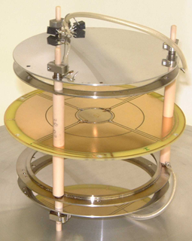
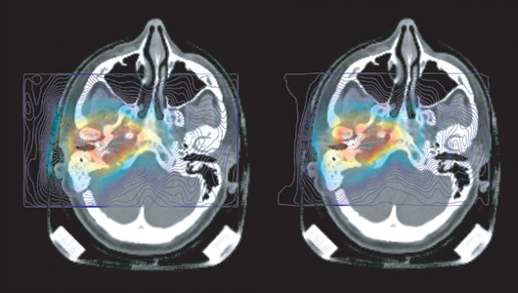
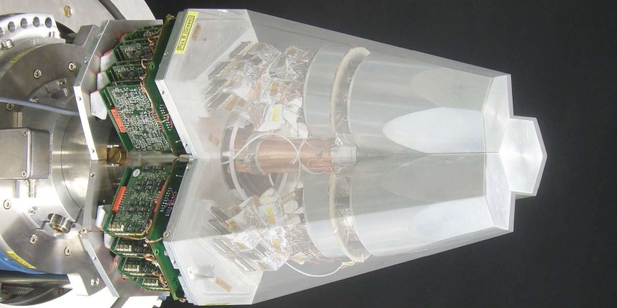
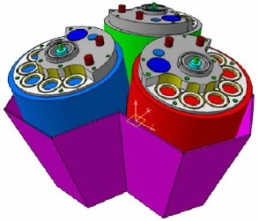
Particle and Radiation Detectors: Advances & Applications
Lecture: Hans-Jürgen Wollersheim
e-mail: h.j.wollersheim@gsi.de

Slide 2

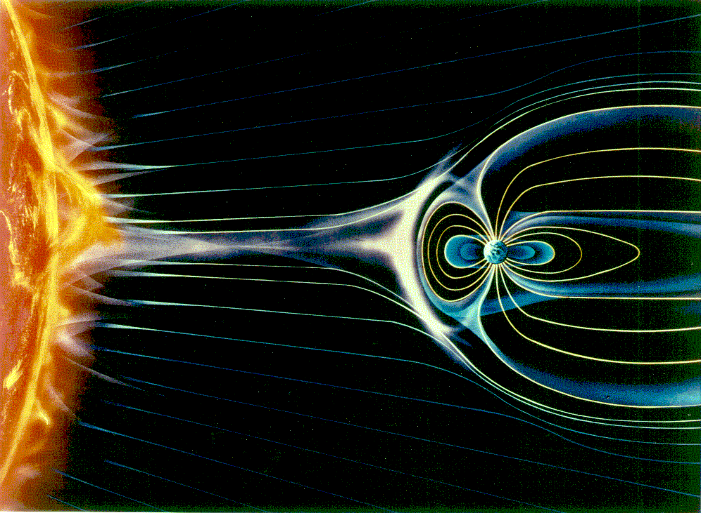
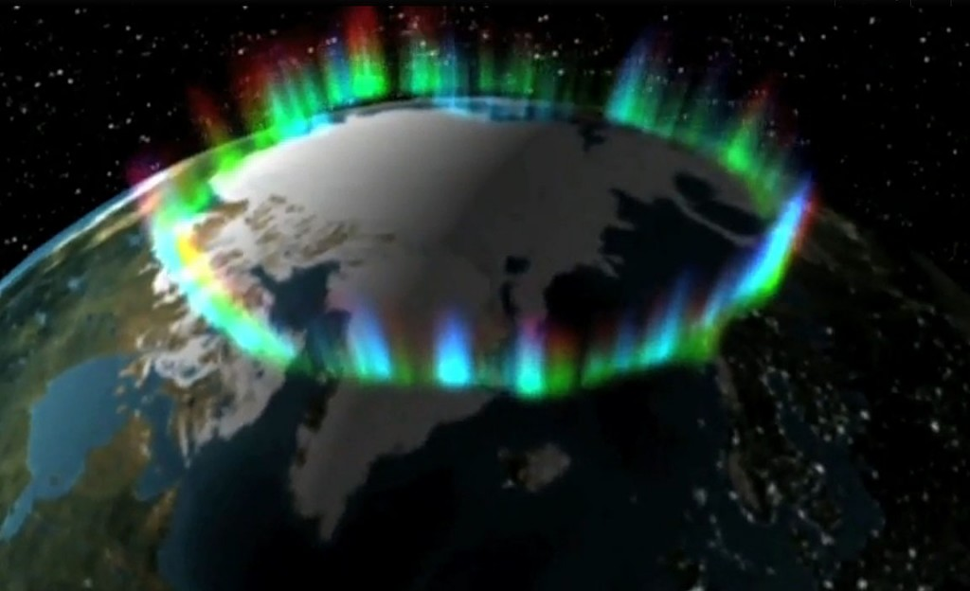
Particle Interaction with Matter
Aurora Borealis
Ionization

Slide 3
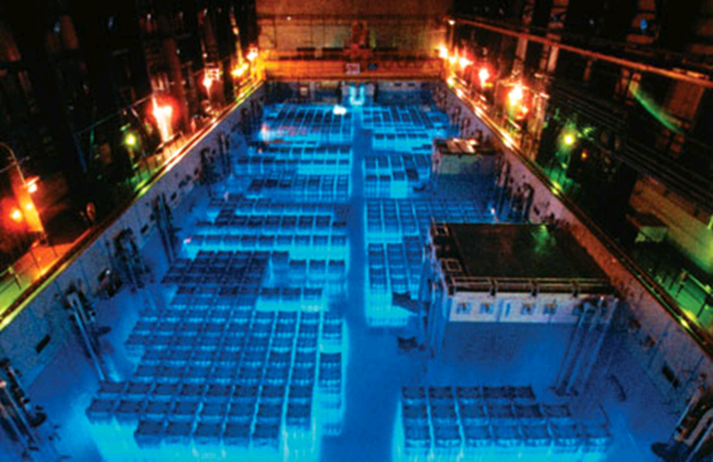
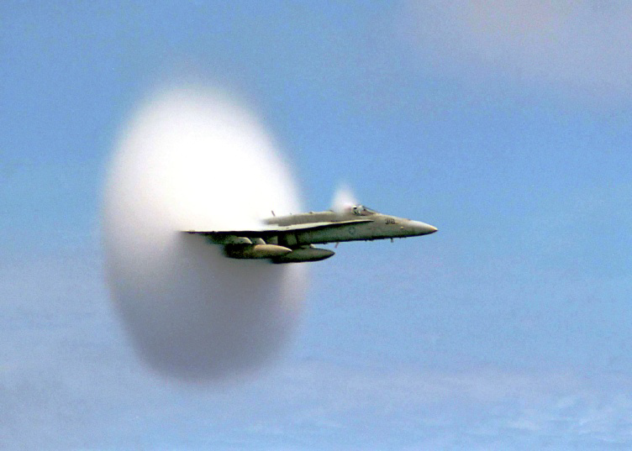
Particle Interaction with Matter
Characteristic glow from a reactor
Cherenkov Light
Cherenkov radiation is an effect similar to sonic booms when the plane exceeds the velocity of sound

Slide 4
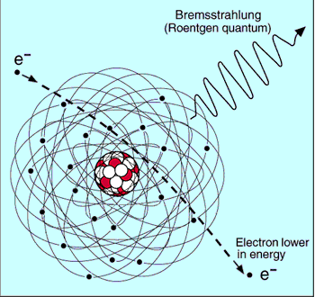
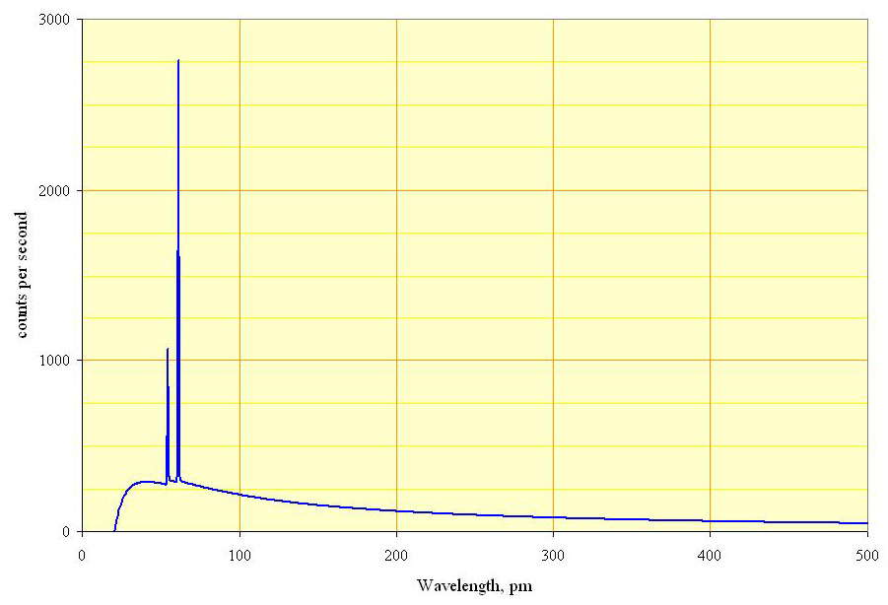
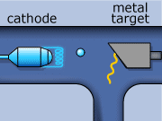
Particle Interaction with Matter
Bremsstrahlung or ‘braking radiation’
Spectrum of the X-rays emitted by an X-ray tube with a rhodium target, operated at 60 kV. The continuous curve is due to bremsstrahlung, and the spikes are characteristic K lines for rhodium.
Bremsstrahlung

Slide 5
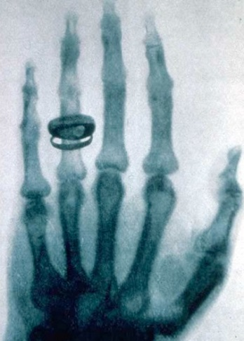
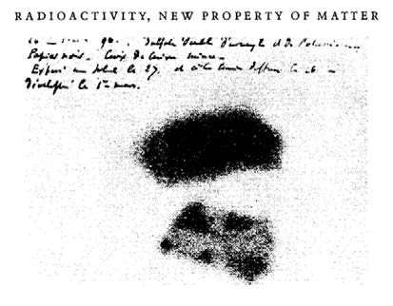
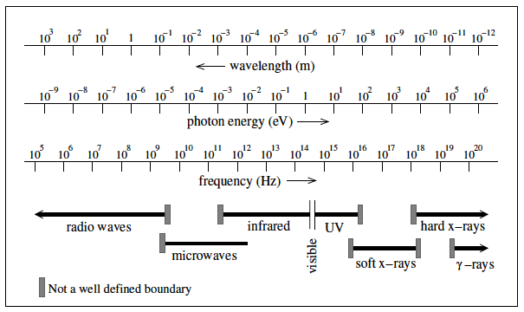


First Detectors – photographic plates
First X-ray image by Wilhelm Conrad Roentgen (1895)
Henri Bequerel’s first “picture” of Uranium (1896)
$$γ−rays$$
$$β−rays$$

Slide 6
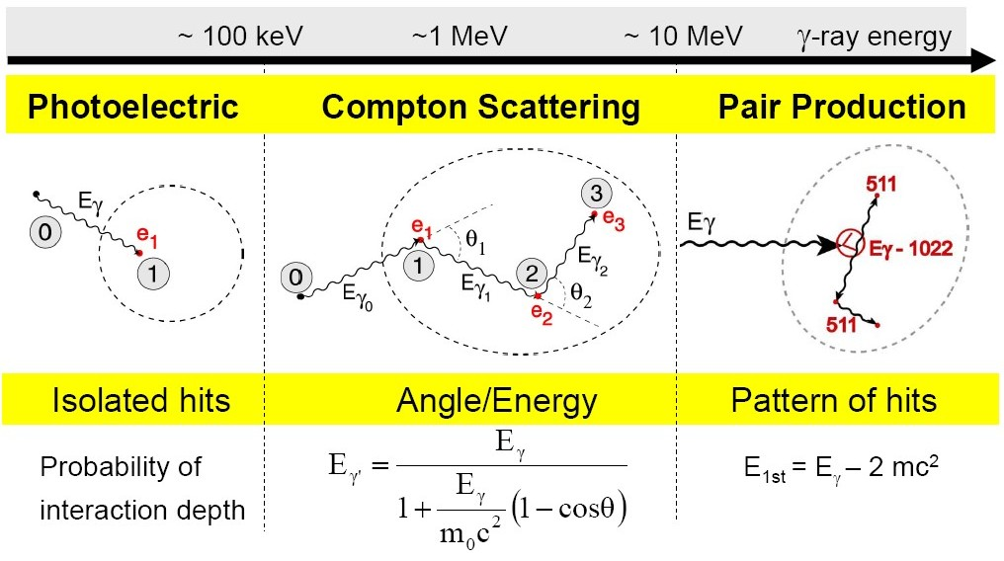
Interaction of gamma rays with matter

Slide 7
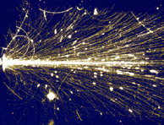
Energy loss – dE/dx
Particles interact differently with matter. Important for detectors is the energy loss per path length. The total energy loss per path length is the sum of all contributions.
$$−{\left(\frac{dE}{dx}\right)}_{tot}=−{\left(\frac{dE}{dx}\right)}_{coll}−{\left(\frac{dE}{dx}\right)}_{rad}−{\left(\frac{dE}{dx}\right)}_{photoeff}−{\left(\frac{dE}{dx}\right)}_{compton}−{\left(\frac{dE}{dx}\right)}_{pair}−{\left(\frac{dE}{dx}\right)}_{hadron}⋯$$
Depending on the particle type, the particle energy and the material some processes dominate, other do not occur. For instance only charged particles will interact with electrons of atoms and produce ionization, etc.

Slide 8
Measurement Principles
A measurement requires an interaction of the particle with the material of the detector. The interaction provokes two effects:
1st Creation of a detectable signal, e.g.
ionization → charges
excitation → scintillation
excitation of phonons → heat
2nd Alternation of the particles properties, e.g.
energy loss
change of trajectory due to scattering
absorption
unwanted side effects. They need to be as small as possible and well understood.

Slide 9
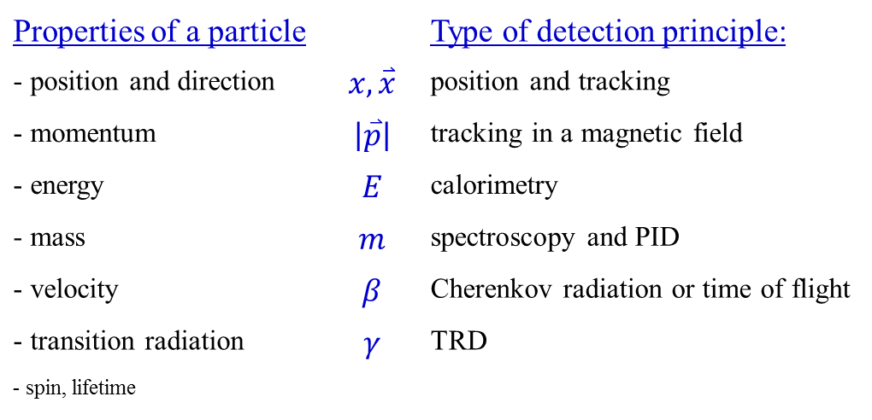
Measurement Principles
A particle detector is an instrument to measure one or more properties of a particle …
Properties of a particle |  | Type of detection principle:
- position and direction | $$x, \overset{⃑}{x}$$ | position and tracking
- momentum | $$\left|\overset{⃑}{p}\right|$$ | tracking in a magnetic field
- energy | $$E$$ | calorimetry
- mass | $$m$$ | spectroscopy and PID
- velocity | $$β$$ | Cherenkov radiation or time of flight
- transition radiation | $$γ$$ | TRD
- spin, lifetime

Slide 10
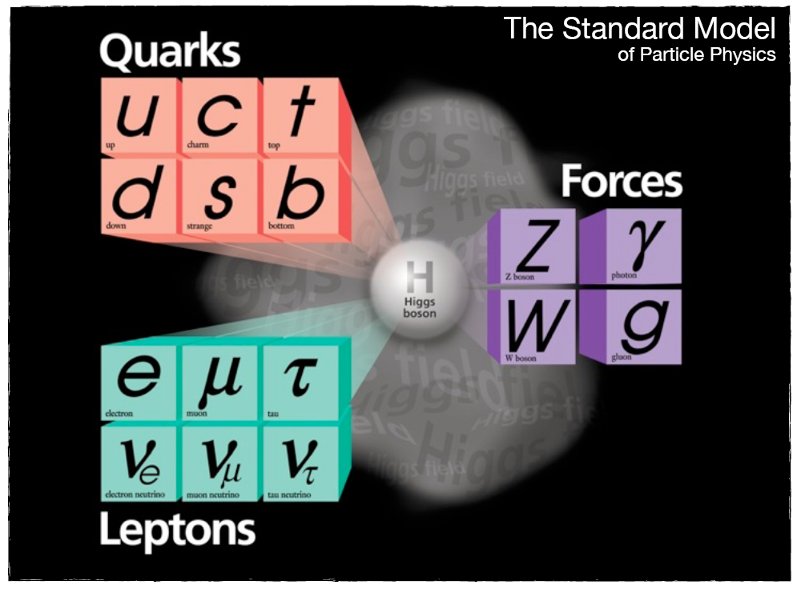
What is a Particle?
Strong force
Electromagnetic force
Weak force

Slide 11
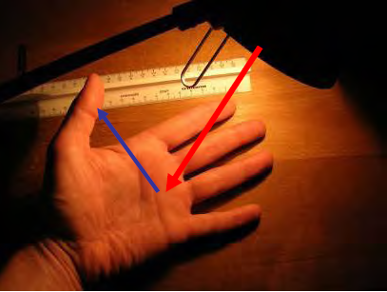

How do we see Particles?
A light bulb shines on a hand and the different reflections make the fine structure visible.
With a magnifying glass or microscope more details can be seen, but there is a fundamental limit:
The wavelength of the light (1/1000 mm) determines the size of the resolvable objects.
available wavelength
→ electromagnetic waves
$$E=\frac{hc}{λ}$$
LW | 3000 m
MW | 300 m
KW | 30 m
UKW | 3 m
GPS | 0.3 m
Infrared | 10⁻⁶ m
light | 5·10⁻⁷ m | 2 eV
UV | 10⁻⁷ m | 10 eV
X-ray | 10⁻¹⁰ m | 10⁴ eV
γ-ray | 10⁻¹² m | 10⁶ eV
light bulb → accelerator
magnifying glass or microscope → detector

Slide 12
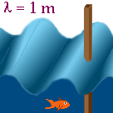
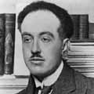
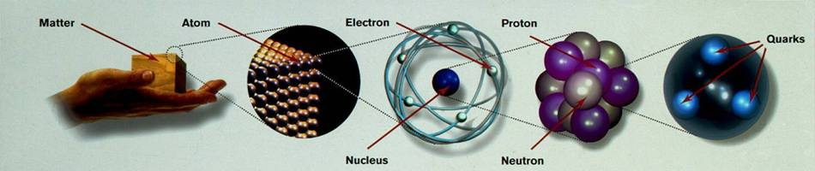

Energy, Wavelength and Resolution
Small objects (smaller than λ) do not disturb the wave → small object is not visible
Large objects disturb the wave → large object is visible
wavelength versus resolution
all particles have wave properties:
$$λ=\frac{h}{p}=\frac{hc}{\sqrt{E_{kin}∙\left(E_{kin}+2m_{0}c^{2}\right)}}$$
de Broglie wavelength
Louis de Broglie
10⁻¹m
10⁻⁹m
10⁻¹⁰m
10⁻¹⁴m
10⁻¹⁵m
h·c = 1239.84 [MeV fm]

Slide 13
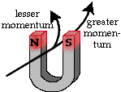
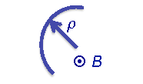
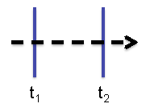
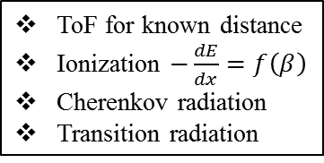
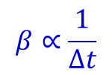
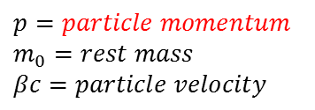
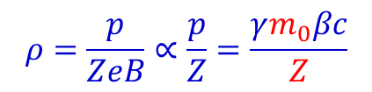
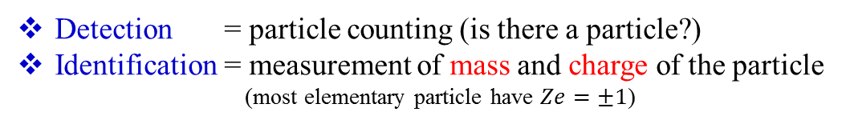
Detection and Identification of Particles
Detection = particle counting (is there a particle?)
Identification = measurement of mass and charge of the particle
(most elementary particle have $Ze=±1$)
How:
- charged particles are deflected by B fields such that:
$$ρ=\frac{p}{ZeB}∝\frac{p}{Z}=\frac{γm_{0}βc}{Z}$$
$$p=particle momentum$$
$$m_{0}=rest mass$$
$$βc=particle velocity$$
- particle velocity measured with time-of-flight (ToF) method
$$β∝\frac{1}{∆t}$$
ToF for known distance
Ionization $−\frac{dE}{dx}=f\left(β\right)$
Cherenkov radiation
Transition radiation

Slide 14

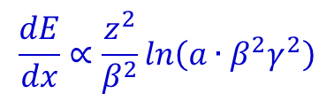
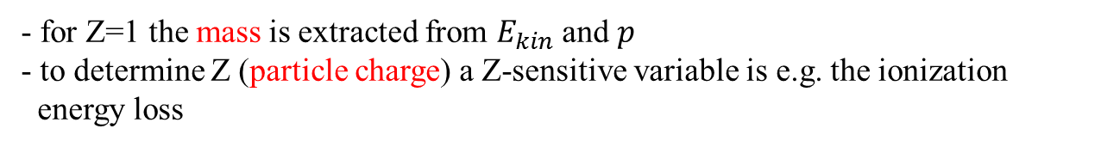
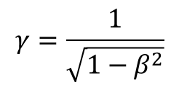
Detection and Identification of Particles
Detection = particle counting (is there a particle?)
Identification = measurement of mass and charge of the particle
(most elementary particle have $Ze=±1$)
How:
- kinetic energy determined via a calorimetric measurement
$$E_{kin}=\left(γ−1\right)m_{0}c^{2}$$
$$γ=\frac{1}{\sqrt{1−β^{2}}}$$
- for Z=1 the mass is extracted from $E_{kin}$ and $p$
- to determine Z (particle charge) a Z-sensitive variable is e.g. the ionization
energy loss
$$\frac{dE}{dx}∝\frac{z^{2}}{β^{2}}ln\left(a∙β^{2}γ^{2}\right)$$
a = material-dependent constant

Slide 15
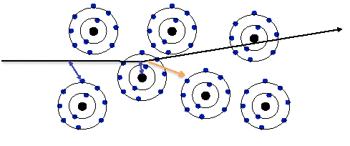
Energetic charged particles in matter
Three types of electromagnetic interactions:
Ionization (of the atoms of the transversed material)
Emission of Cherenkov light
Emission of transition radiation
3) In case the particle’s velocity is larger than the velocity of light in the medium, the resulting EM shockwave manifests itself as Cherenkov Radiation. When the particle crosses the boundary between two media, there is a probability of the order of 1% to produce an X-ray photon, called Transition Radiation.
1) Interaction with the atomic electrons. The incoming particle looses energy and the atoms are excited or ionized.
2) Interaction with the atomic nucleus. The particle is deflected (scattered) causing multiple scattering of the particle in the material. During this scattering a Bremsstrahlung photon can be emitted.

Slide 16
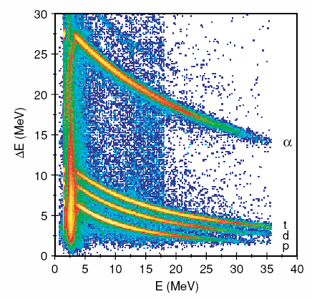
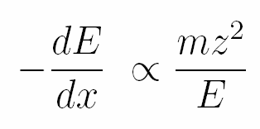
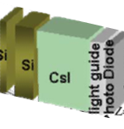
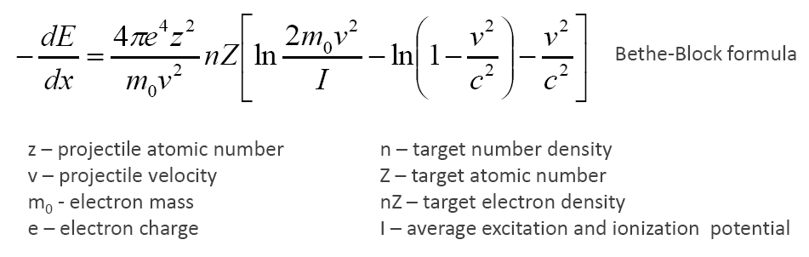
Energetic charged particles in matter
Charged particle identification with
segmented or stacked detectors
Si
Bethe-Bloch formula

Slide 17
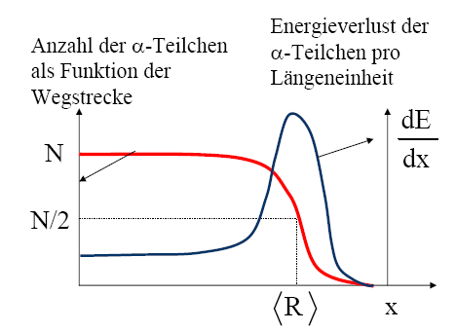
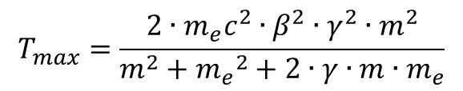
Energetic charged particles in matter
α-particles are highly ionized and lose their energy very fast by ionization and excitation
when passing through matter.
maximum energy transfer T_{max} of a projectile with mass m
and velocity β on an electron m_{e} at rest
$$T_{max}=\frac{2∙m_{e}c^{2}∙β^{2}∙γ^{2}∙m^{2}}{m^{2}+{m_{e}}^{2}+2∙γ∙m∙m_{e}}$$
$$T_{max}=2∙m_{e}c^{2}∙β^{2}∙γ^{2}$$
number of α-particles as a function of distance x
energy loss of α-particles
per distant unit
for all heavy primary particles except electrons and positrons
average range <R> of α-particles with 5 MeV
2,5cm in air, 2,3cm in Al, 4,3cm in tissue

Slide 18
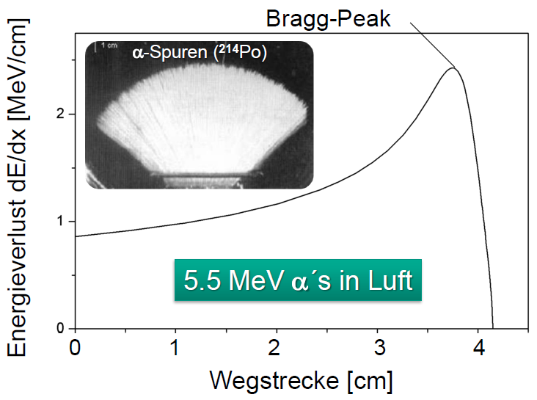
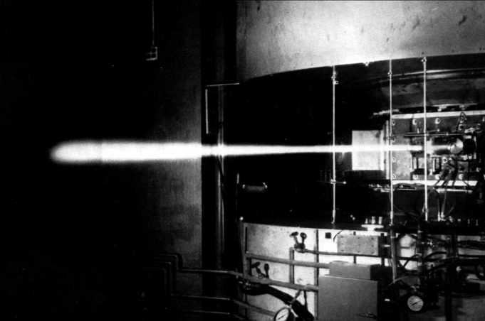
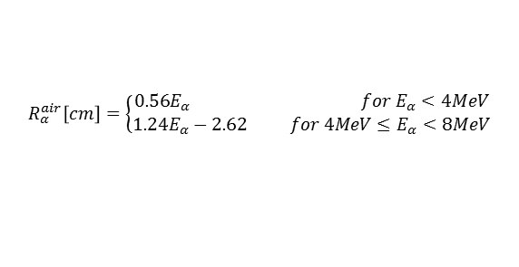

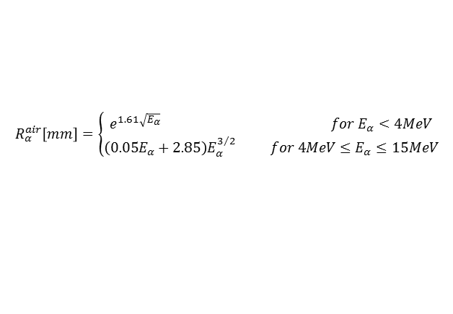



Energy loss and range of charged particles
$$−\frac{dE}{dε}=−\frac{1}{ρ}∙\frac{dE}{dx}=z^{2}∙\frac{Z}{A}∙f\left(β,I\right)$$
-dE/dε is independent of the material for equal particles
the average range for particles with kin. energy T is obtained by integration
7.7 MeV α-particles in air:
range is not exact but there is range straggling,
the number of interactions is a statistical process.
$$\overline{R}=\int_{E_{0}}^{0}{{\left(\frac{dE}{dx}\right)}^{−1}}dE$$
energy loss
5.5 MeV α´s in air
$$\overline{R}/ρ≈7cm$$
distance
Several empirical and semi-empirical formulae have been proposed to compute range of α-particles in air.
$$R_{α}^{air}\left[mm\right]=\left\{\begin{matrix}e^{1.61\sqrt{E_{α}}} for E_{α}<4MeV \\ \left(0.05E_{α}+2.85\right)E_{α}^{3/2} for 4MeV≤E_{α}≤15MeV\end{matrix}\right.$$
$$R_{α}^{air}\left[cm\right]=\left\{\begin{matrix}0.56E_{α} for E_{α}<4MeV \\ 1.24E_{α}−2.62 for 4MeV≤E_{α}<8MeV\end{matrix}\right.$$
deuteron beam scintillating in air
Scaling the range of other materials $R_{α}^{x}=3.37∙{10}^{−4}R_{α}^{air}\frac{\sqrt{A_{x}}}{ρ_{x}}$

Slide 19
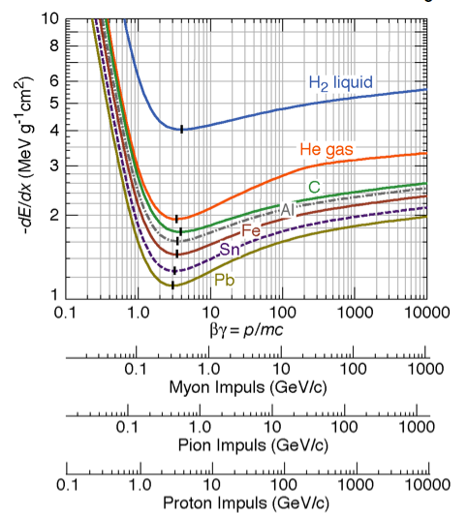
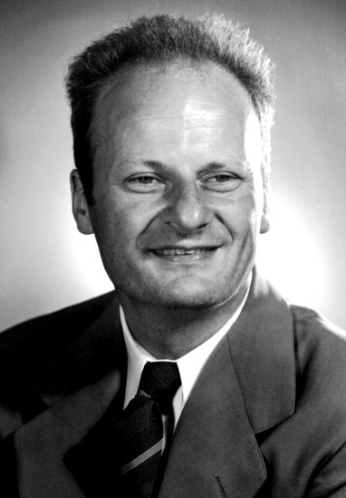
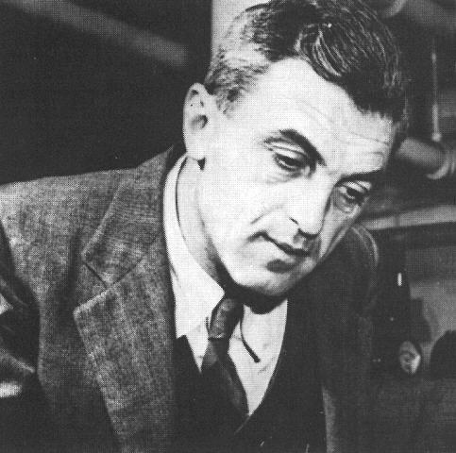
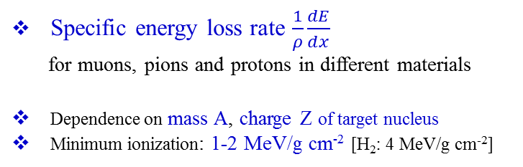

Interaction of charged particles in matter
Bethe-Bloch formula describes the energy loss of heavy particles passing through matter
$$−\frac{dE}{dx}=4∙π∙{r_{e}}^{2}∙N_{a}∙m_{e}c^{2}∙ρ∙\frac{Z}{A}∙\frac{z^{2}}{β^{2}}∙\left[\frac{1}{2}ln\left(\frac{2∙m_{e}c^{2}∙γ^{2}∙β^{2}{∙T}_{max}}{I^{2}}\right)−β^{2}−δ−2∙\frac{C}{Z}\right]$$
$$≈z^{2}∙\frac{Z}{A}∙f\left(β,I\right)$$
= 0.3071 MeV g⁻¹cm²
Specific energy loss rate $\frac{1}{ρ}\frac{dE}{dx}$
for muons, pions and protons in different materials
Dependence on mass A, charge Z of target nucleus
Minimum ionization: 1-2 MeV/g cm⁻² [H₂: 4 MeV/g cm⁻²]
Muon momentum (GeV/c)
Pion momentum (GeV/c)
Proton momentum (GeV/c)

Slide 20
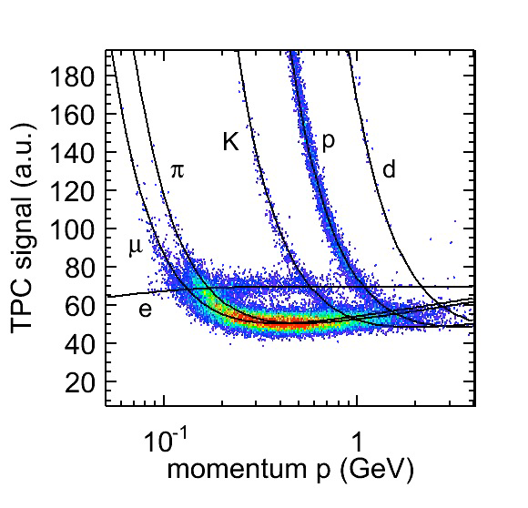

Energy loss of charged particles – dE/dx for different particles
${dE}/{dx}$ for heavy particles in this momentum regime is well described by Bethe-Bloch formula, i.e. the dominant energy loss is collisions with atoms
${dE}/{dx}$ for electrons does not follow Bethe-Bloch formula. The dominant process is Bremsstrahlung
TPC signal (a.u.)
momentum p (GeV/c)
[ALICE TPC, 2009]

Slide 21



Energy loss for electrons and positrons
e± are exceptional cases due to their low mass. They will be deflected significantly in each collision.
In addition to the energy loss due to ionization, the energy loss due to Bremsstrahlung is of importance.
$$−{\left(\frac{dE}{dx}\right)}_{tot}=−{\left(\frac{dE}{dx}\right)}_{coll}−{\left(\frac{dE}{dx}\right)}_{rad}$$
For high energies the energy loss due to Bremsstrahlung is given by
$$−{\left(\frac{dE}{dx}\right)}_{rad}∝E$$
$$−{\left(\frac{dE}{dx}\right)}_{rad}∝\frac{1}{m^{2}}$$
and
Other particles like muons also radiate,
especially at higher energies.

Slide 22




Bremsstrahlung
$$−{\left(\frac{dE}{dx}\right)}_{rad}=\frac{E}{X_{0}}$$
X₀ is the radiation length. It is the mean distance over which a high-energy electron loses all but 1/e of its energy by Bremsstrahlung
fit to data:
$$X_{0}=\frac{716.4∙A}{Z∙\left(Z+1\right)∙ln\left({287}/{\sqrt{Z}}\right)}$$
Usual definition for the critical energy E_{c} (electron)
$${\left(\frac{dE}{dx}\right)}_{ionization}={\left(\frac{dE}{dx}\right)}_{bremsstrahlung}$$
$$E_{c}^{}\left(e^{−}\right)=\left\{\begin{matrix}\frac{610 MeV}{Z+1.24} for solids and liquids \\ \frac{710 MeV}{Z+0.92} for gases \end{matrix}\right.$$
example: Pb (Z=82, ρ = 11.34 [g/cm³] → E_{c} = 7.34 MeV

Slide 23

Comparison between electrons (β⁻) and positrons (β⁺) on their way through matter
electron
positron
β⁺ particles behave similarly as β- particles; they are ionizing and attenuated on their way through matter.
But at the end of the their attenuation one observes a pair annihilation with an electron, which yields high energetic γ-emission. Positrons are hence more dangerous than electrons.
source
source
detector

Slide 24





Cherenkov radiation
$$−\frac{dE}{dx}=4∙π∙{r_{e}}^{2}∙N_{a}∙m_{e}c^{2}∙ρ∙\frac{Z}{A}∙\frac{z^{2}}{β^{2}}∙\left[\frac{1}{2}ln\left(\frac{2∙m_{e}c^{2}∙γ^{2}∙β^{2}{∙T}_{max}}{I^{2}}\right)−β^{2}−δ−2∙\frac{C}{Z}\right]$$
δ ≡ polarization of medium
= 0.3071 MeV g⁻¹cm²
Cherenkov radiation is emitted if the particle velocity $v$ is larger than the velocity of light in the medium.
$$v>\frac{c}{n} \begin{matrix}c⋯speed of light in vacuum \\ n⋯refraction index of medium\end{matrix}$$
$v<c/n$ symmetric orientation
$→$ no resulting dipole field
$v>c/n$ asymmetric orientation
$→$ resulting dipole field
change of dipole field → radiation
atomic dipoles
fast orientation of dipoles

Slide 25







Cherenkov radiation
$$β=0$$
$$β≤\frac{1}{n}$$
$$β≥\frac{1}{n}$$
Pavel Alekseyevich
Cherenkov

Slide 26






Cherenkov radiation
threshold velocity: $β≥\frac{1}{n}$
$$γ={\left(1−β^{2}\right)}^{−1/2}≥\frac{n}{\sqrt{n^{2}−1}}$$
threshold angle: $\cos{θ_{C}=\frac{1}{β∙n}}$
Parameters of typical radiators
medium | n | $$β_{thr}$$ | $$θ_{max}\left(β=1\right)$$ | $$N_{ph}\left(eV^{−1}{cm}^{−1}\right)$$
air | 1.000283 | 0.9997 | 1.36 | 0.208
isobutene | 1.00127 | 0.9987 | 2.89 | 0.941
water | 1.33 | 0.752 | 41.2 | 160.8
quartz | 1.46 | 0.685 | 46.7 | 196.4
Note: Energy loss due to Cherenkov radiation very small compared to ionization (<1%)

Slide 27
Interaction of gamma rays with matter

Slide 28


Interaction of gamma rays with matter
Aluminum
Lead
total absorption coefficient: μ/ρ [cm²/g]
i=1 photoelectric effect
i=2 Compton scattering
i=3 pair production

Slide 29

Interaction of gamma rays with matter
Photo effect:
Absorption of a photon by a bound electron and conversion of the γ-energy in potential and kinetical energy of the ejected electron.
(Nucleus preserves the momentum conservation.)

Slide 30

Interaction of gamma rays with matter
Maximum energy of the
scattered electron:
Energy of the scattered
γ-photon:
Special case for E >> m_{e}c²:
γ-ray energy after 180⁰ scatter
is approximately
Compton scattering:
Elastic scattering of a γ-ray on a free electron. A fraction of the γ-ray energy is transferred to the Compton electron. The wave length of the scattered γ-ray is increased: λ‘ > λ.
Gap between the incoming γ-ray and the maximum electron energy.

Slide 31


Interaction of gamma rays with matter
Pair production:
If γ-ray energy is >> 2m₀c² (electron rest mass 511 keV), a positron-electron pair can be formed in the strong Coulomb field of a nucleus. This pair carries the γ-ray energy minus 2m₀c².
Pair production for E_{γ}>2m_{e}c²=1.022MeV
e⁻
γ-ray > 1 MeV
γ’s
magnetic field
picture of a bubble chamber

Slide 32


Gamma-ray interaction cross section
All three interaction (photo effect, Compton scattering and pair production) lead to an attenuation of the γ-ray or X-ray radiation when passing through matter. The particular contribution depends on the γ-ray energy:
The absorption attenuates the intensity, but the energy and the frequency of the γ-ray and X-ray radiation is preserved!
Photo effect: ~Z⁴⁻⁵, E_{γ}^{-3.5}
Compton: ~Z, E_{γ}⁻¹
Pair: ~Z², increases with E_{γ}

Slide 33


Literature
Recommended Textbook
Recommended Textbook

Slide 34

Some Nuclear Units
Nuclear energies are very high compared to atomic processes, and need larger units. The most commonly used unit is the MeV.
1 electron Volt = 1 eV = 1.6·10⁻¹⁹ Joules
1 MeV = 10⁶ eV; 1 GeV = 10⁹ eV; 1 TeV = 10¹² eV
However, the nuclear size are quite small and need smaller units:
Atomic sizes are on the order of 0.1 nm = 1 Angstrom = 10⁻¹⁰ m. Nuclear sizes are on the order of femtometers which in the nuclear context are usually called fermis:
1 fermi = 1 fm = 10⁻¹⁵ m
Atomic masses are measured in terms of atomic mass units with the carbon-12 atom defined as having a mass of exactly 12 amu. It is also common practice to quote the rest mass energy E=m₀c² as if it were the mass. The conversion to amu is:
1 u = 1.66054·10⁻²⁷ kg = 931.494 MeV/c²
electron mass = 0.511 MeV/c²; proton mass = 938.27 MeV/c²; neutron mass = 939.56 MeV/c²
Mass data: www.nndc.bnl.gov/qcalc/

Slide 35

Some Nuclear Units

Slide 36






Relevant Formulae
The relevant formulae are calculated if A₁, Z₁ and A₂, Z₂ are the mass number (amu) and charge number of the projectile and target nucleus, respectively, and T_{lab} is the laboratory energy (MeV)
$$E=T_{lab}+m_{0}∙c^{2}$$
$$m∙c^{2}=T_{lab}+m_{0}∙c^{2}$$
$$\frac{m_{0}∙c^{2}}{\sqrt{1−β^{2}}}=T_{lab}+m_{0}∙c^{2}$$
$$β=\frac{\sqrt{{T_{lab}}^{2}+1863∙A_{1}∙T_{lab}}}{931.5∙A_{1}+T_{lab}}$$
beam velocity:
Lorentz contraction factor:
$$γ={\left(1−β^{2}\right)}^{{−1}/2}$$
$$γ=\frac{931.5∙A_{1}+T_{lab}}{931.5∙A_{1}}$$
$$β∙γ=\frac{\sqrt{{T_{lab}}^{2}+1863∙A_{1}∙T_{lab}}}{931.5∙A_{1}}$$

Slide 37




Radiation protection
$$absorbed dose=\frac{absorbed energy}{mass}$$
$$1 \frac{Joule}{kg}=1 Gray (Gy)$$
The biological dose, sometimes also known as the dose equivalent is expressed in units of Sieverts [Sv]. This dose reflects the fact that the biological damage caused by a particle depends not only on the total energy deposited but also on the rate of energy loss per unit distance traversed by the particle.
equivalent dose = energy dose · quality factor Q
radiation | quality factor Q
X-ray, γ, β | 1
thermal neutrons | 2.3
fast neutrons | 10
α-particles, heavy ions | 20

Slide 38




Radiation protection
range in air [m]
radioactive
source
Al
Pb
concrete
α´s
β´s
X-rays
γ-rays
neutrons
$$Ω=\frac{a^{2}}{4π∙R^{2}}=\frac{π∙r^{2}}{4π∙R^{2}}$$

Slide 39





Solid angle
1 Ci = 3.7·10¹⁰ Bq
d
$$\frac{Ω}{4π}≅\frac{πr^{2}}{4πd^{2}}={\left(\frac{r}{2d}\right)}^{2}$$
Ω = solid angle between source and detector (sr)
For a point source:
d (cm) r = 3cm | $$Ω/{4π} \left[\%\right]$$ | $$Ω/{4π} \left[\%\right]$$
5 | 7.13 | 55
10 | 2.11 | 2.25
15 | 0.97 | 1
$$\frac{Ω}{4π}=\frac{1}{2}∙\left(1−\frac{d}{\sqrt{d^{2}+r^{2}}}\right)$$

