Slide 1
Signal processing
Lecture: Hans-Jürgen Wollersheim
e-mail: h.j.wollersheim@gsi.de
Working with an oscilloscope
Signal processing

Slide 2
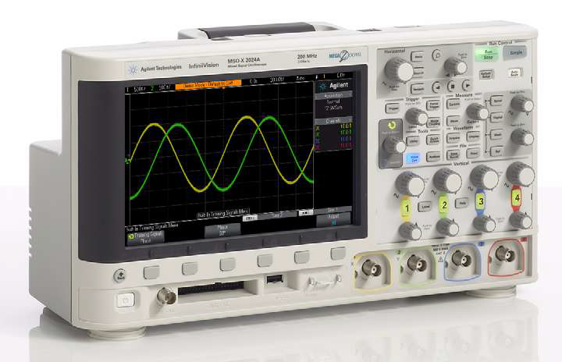
Digital Oscilloscope

Slide 3
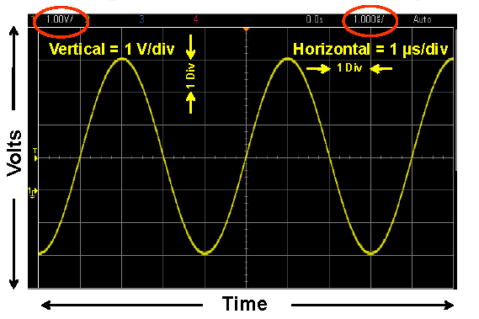
Understanding the Scope’s Display

Slide 4
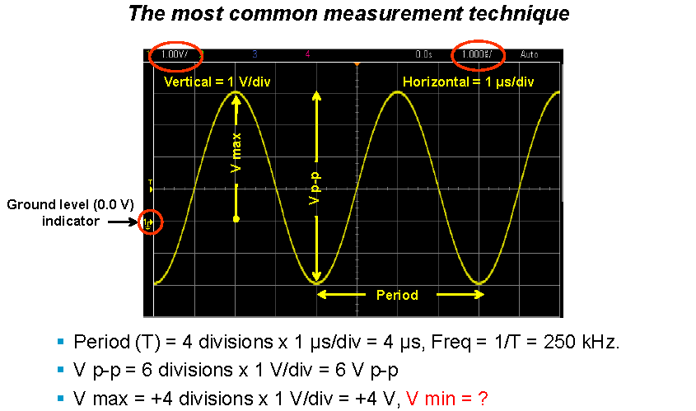
Making Measurements – by visual estimation

Slide 5
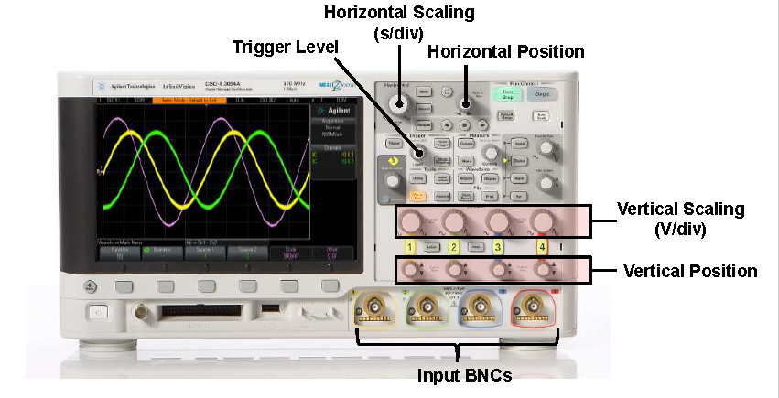
Primary Oscilloscope Setup Controls

Slide 6
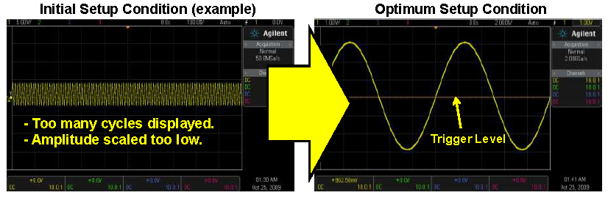
Properly Scaling the Waveform

Slide 7
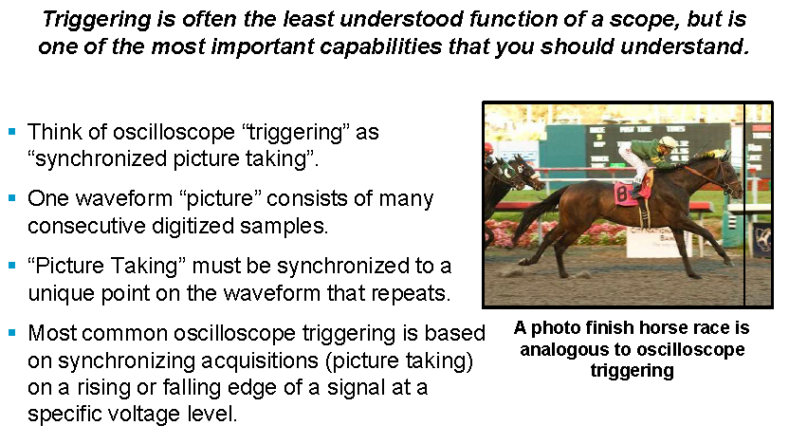
Understanding Oscilloscope Triggering

Slide 8

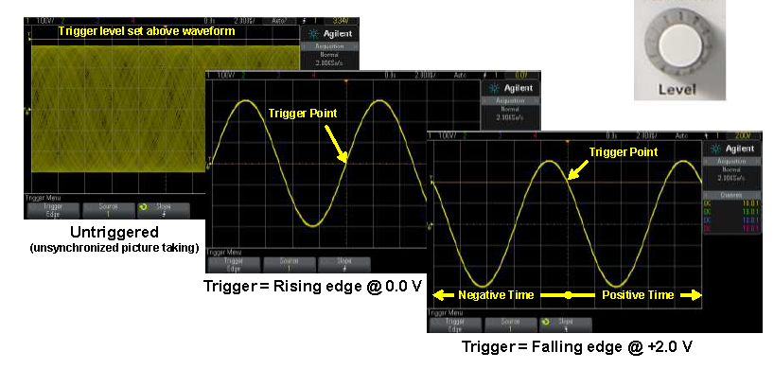
Trigger Examples

Slide 9
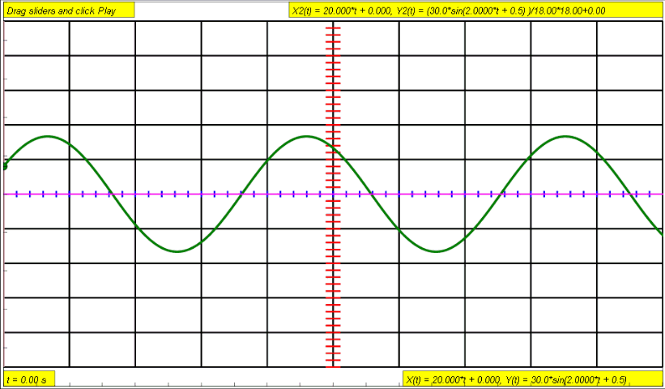

Slide 10
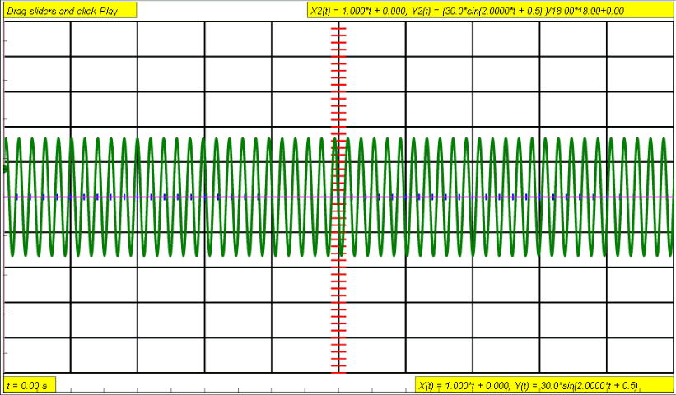

Slide 11
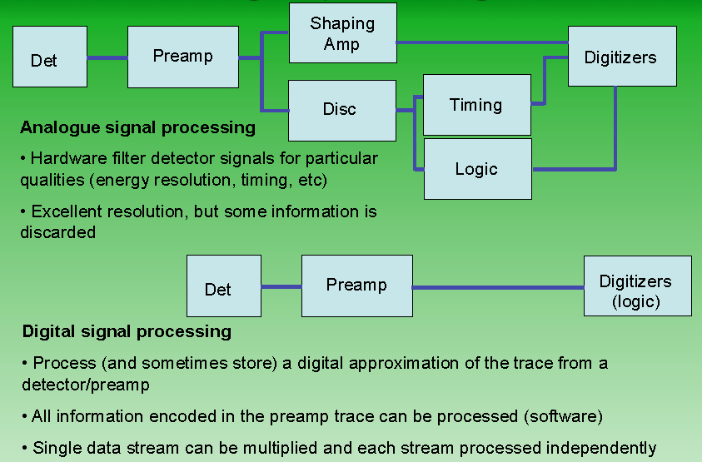
Signal processing

Slide 12
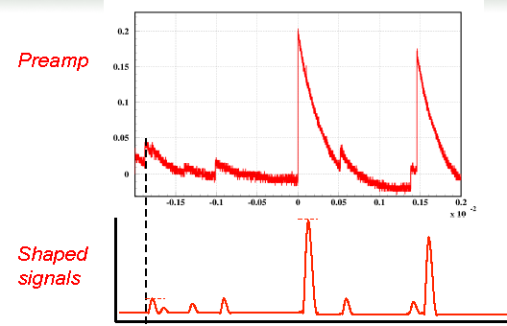
Shaping amplifier
Shape pulses to:
Improve signal to noise
Reduce pileup effects
Keep signal height information
Lose shape information

Slide 13
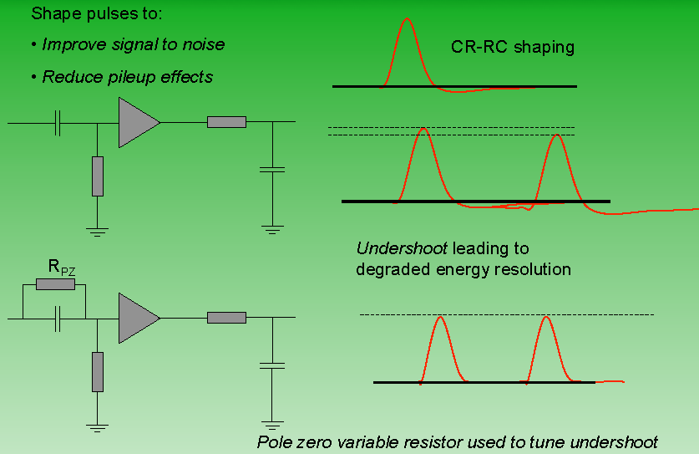
Shaping amplifier

Slide 14
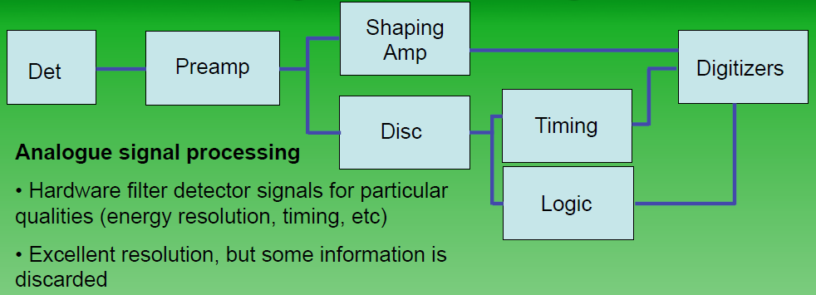
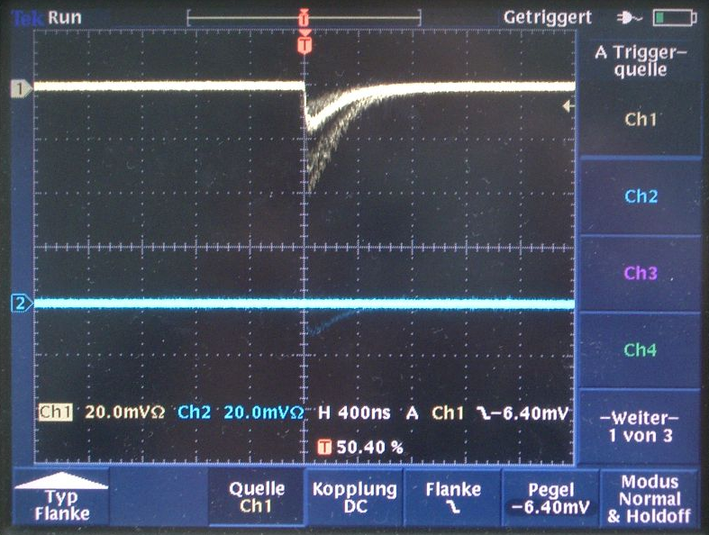
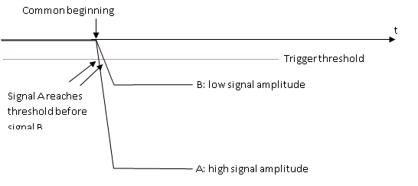
Signal processing

Slide 15
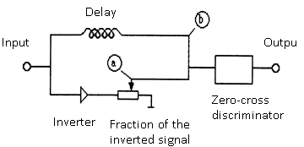
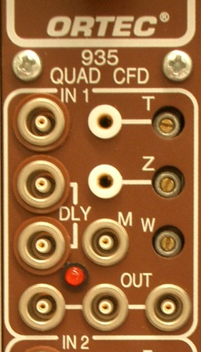
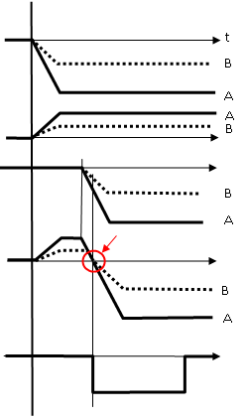
Constant Fraction Discriminator
b
a
Input signals
One signal (a) is in-verted and attenuated
The other signal (b) gets delayed
Adding of the signals (a) and (b)
(The zero crossing is independent of the signal amplitude)
Rectangular output signal

Slide 16

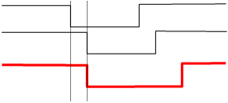
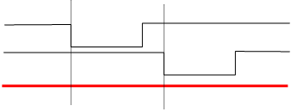
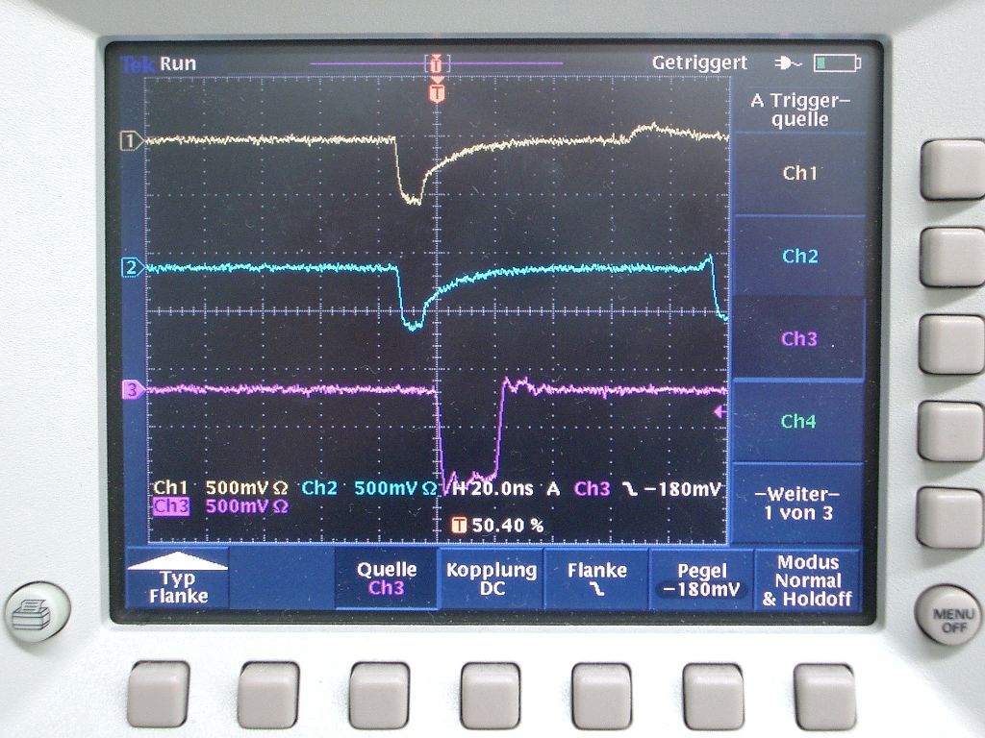
The coincidence unit
detector 1:
detector 2:
(detector 1) AND (detector 2):
detector 1:
detector 2:
(detector 1) AND (detector 2):

Slide 17
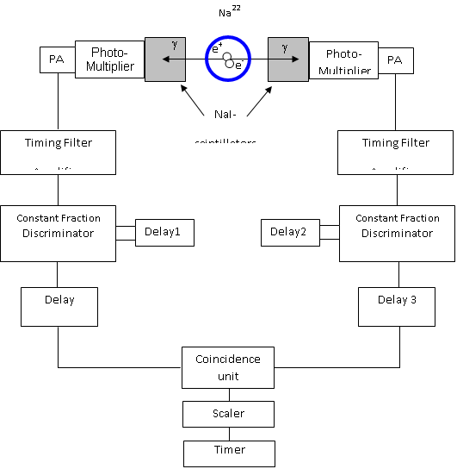
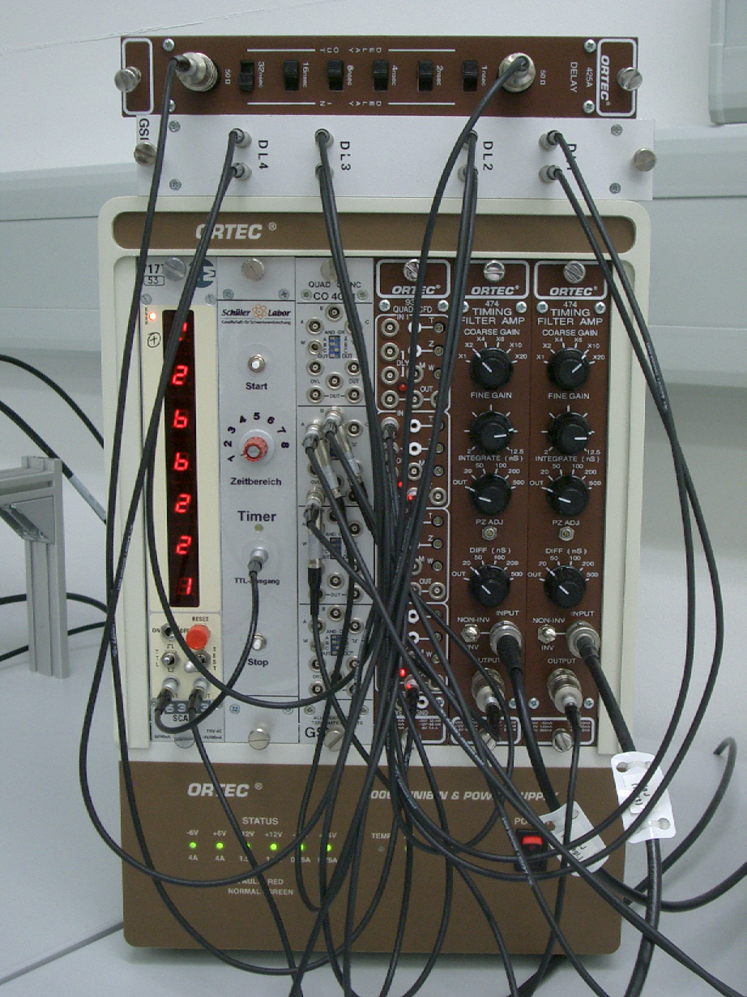
Coincidence electronic

