Slide 1
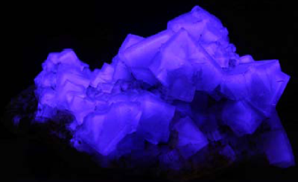
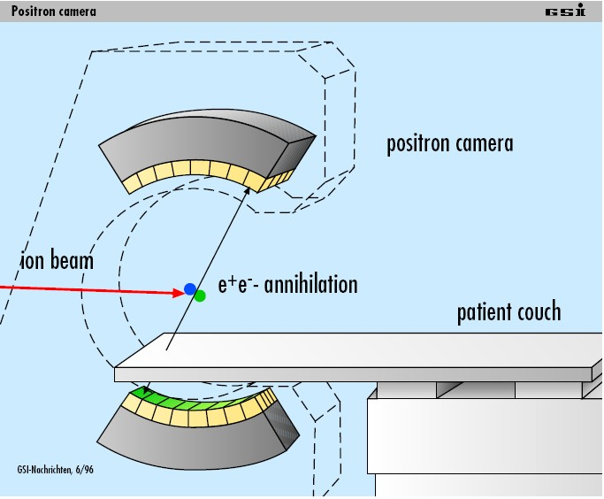
Past / Future in Scintillation
Lecture: Hans-Jürgen Wollersheim
e-mail: h.j.wollersheim@gsi.de

Slide 2
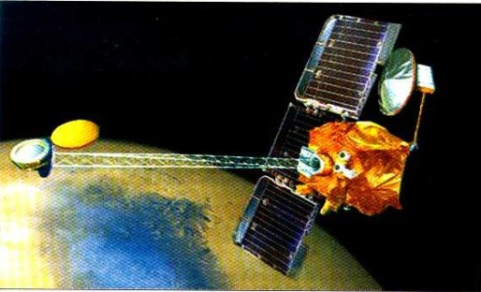
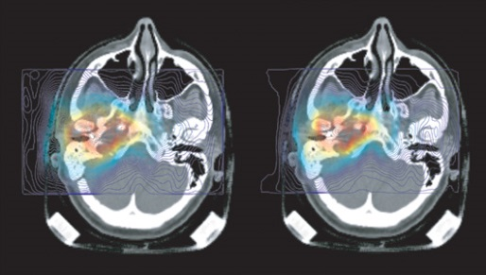
Past / Future in Scintillation
High energy astrophysics
Correlate the detected photon to source object as known
from more precise observations in other wavelength
Biomedical research
Precise localization of radioactive tracers in the body
Cancer diagnosis
Molecular targeted radiation therapy
Monitor changes in the tracer distribution → dynamic studies
National security
Nuclear non-proliferation / nuclear counter terrorism
Contraband detection
Stockpile stewardship
Nuclear waste monitoring and management
Industrial non-destructive assessments
Determination of the material density distribution
between the source and detector

Slide 3
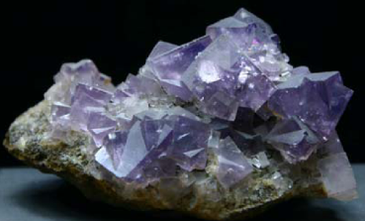
Past / Future in Scintillation
Afterglow = phosphorescence
Phosphorescence is a property of many crystals and organic materials
Light is produced by deexcitation of molecules

Slide 4
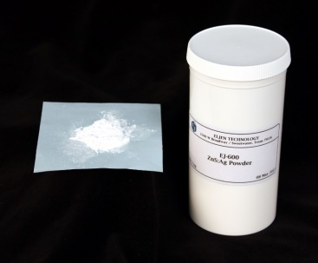
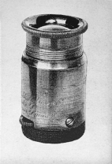
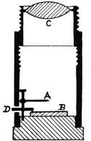
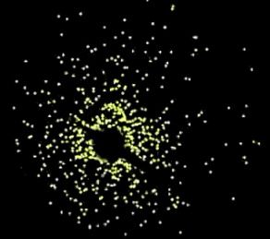
Zinc Sulfide ZnS(Ag) Scintillation Material
1866 – Theodore Sidot reported the phosphorescence of ZnS.
1903 – William Crookes invented a device called a spinthariscope
with a ZnS screen to see scintillations from α-particles.
In 1903 W. Crookes demonstrated in England his
“spinthariscope” for the visual observation of individual
scintillations caused by α-particles impinging upon a ZnS screen. In contrast to the analogue methods of radiation measurements in that time the spinthariscope was a single particle counter, being the precursor of scintillation counters since. In the same period F. Giesel, J. Elster and H. Geitel in Germany also found that scintillations from ZnS represent single particle events. This paper summarizes the historical events relevant to the advent of scintillation counting.
A spinthariscope from 1904. Height about 5 cm, Ra-source (A), ZnS screen (B), magnifying glass

Slide 5
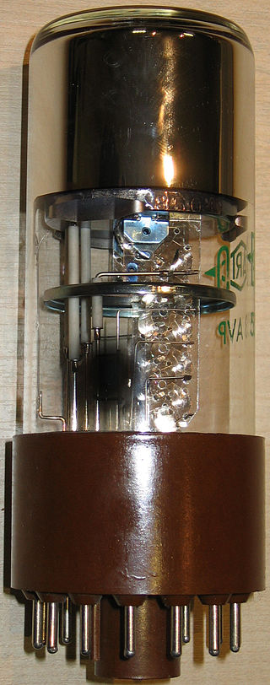
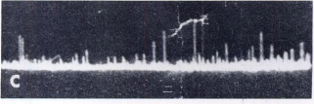
Zinc Sulfide ZnS(Ag) Scintillation Material
1944 – photomultiplier tube was invented
α-particles
background pulses
of naphtalene -20⁰
β-particles
γ-rays
1948 – H. Kallmann

Slide 6
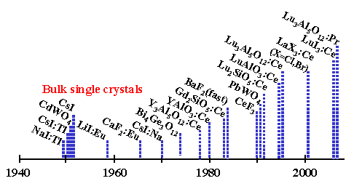
History of Scintillators
History of scintillators starts short after the discovery of X-rays at the end of 19th century
year of introduction of a scintillation material

Slide 7
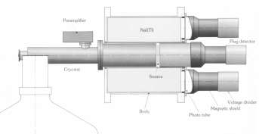
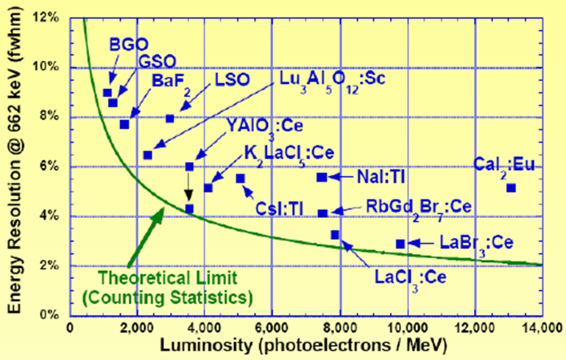
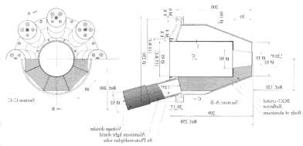
Compton Suppression Shields NaI(Tl) versus BGO
material | NaI(Tl) | BGO
density (g/cm³) | 3,67 | 7.13
50% attenuation for 662 keV in cm | 2.5 | 1.0
Index of refraction n | 1.85 | 2.15
Emission (photons/keV) | 38 | 8
Decay time (ns) | 250 | 300
Maximum size grown (mm) | 700 | 75
Radioactive contamination | ⁴⁰K | ²⁰⁷Bi
NaI(Tl)
BGO

Slide 8
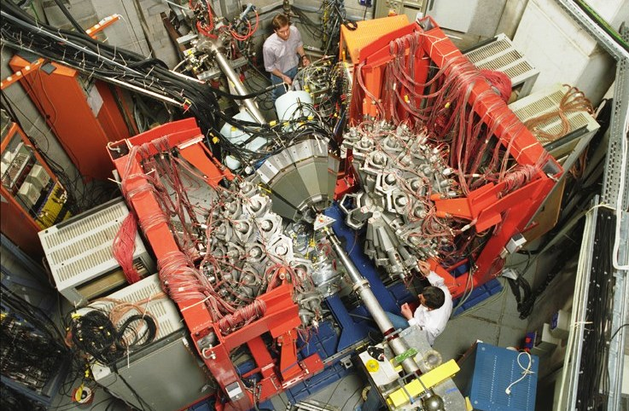
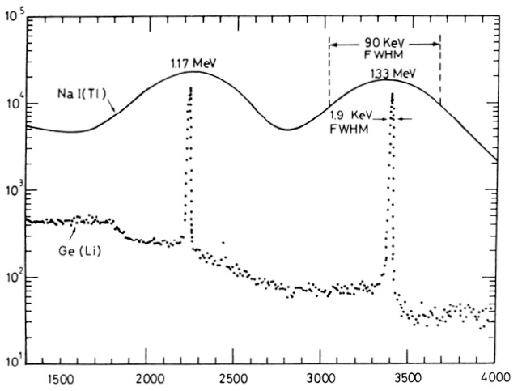
Heidelberg – GSI Crystal Ball
NaI(Tl)
~160 NaI(Tl) and 5 EUROBALL detectors
Ge(Li)

Slide 9
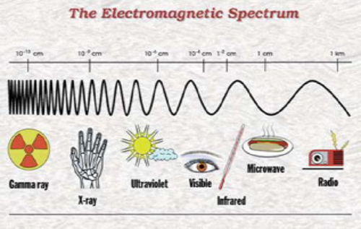
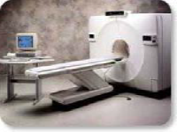
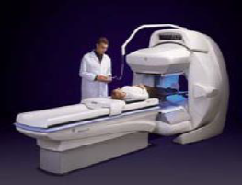
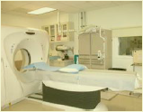
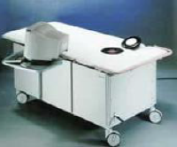
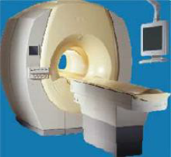
Tomographic Imaging
PET
SPEC
CT
OPTICAL
MRI

Slide 10
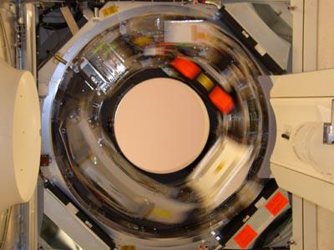
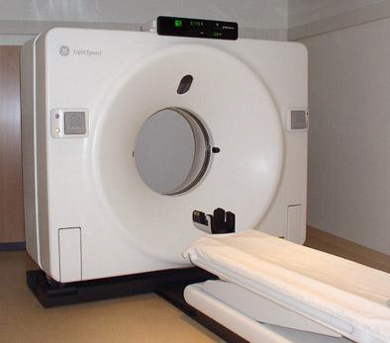
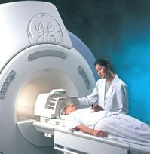
Computed Tomography
CT scanning (originally known as CAT)
X-rays taken at a range of angles around the patient
Generation of 3D images
Radiation detector
X-ray source
Standard CT-system

Slide 11
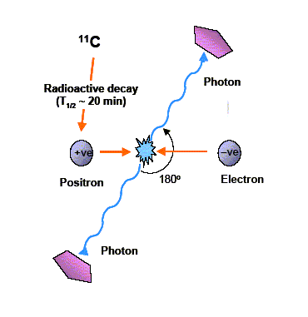
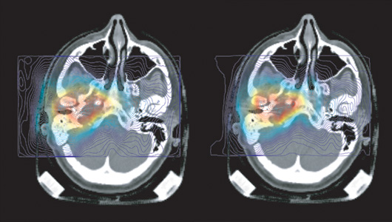
Positron Emission Tomography

Slide 12
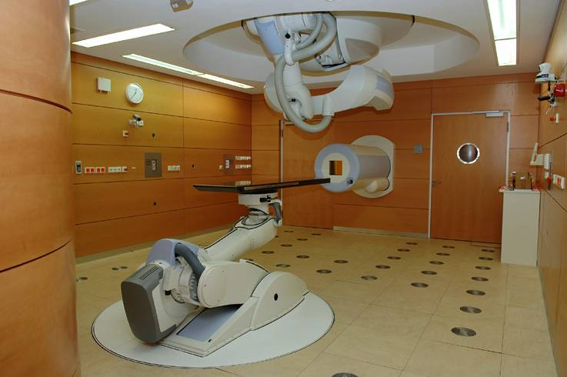
Positron emission tomography

Slide 13
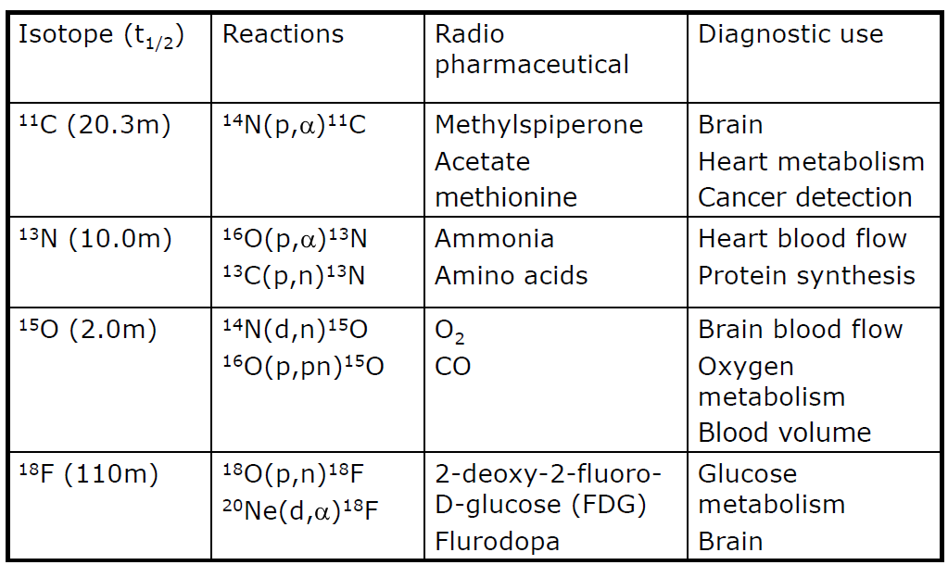
Common PET Isotopes

Slide 14
PET Isotopes: Positron Range

Slide 15
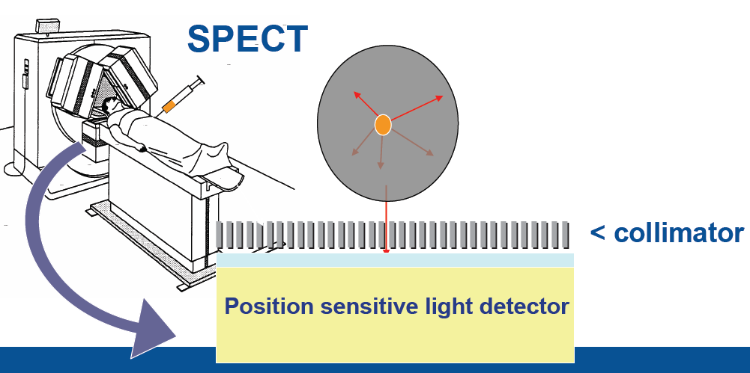
Single Photon Emission Computed Tomography
Most commonly used tracer in SPECT is ⁹⁹Tc^{m}, 140 keV a pure single photon emitter T_{1/2} = 6.02 h.
Utilizes a gamma-ray camera rotated in small ~3⁰ steps around the patient.

Slide 16
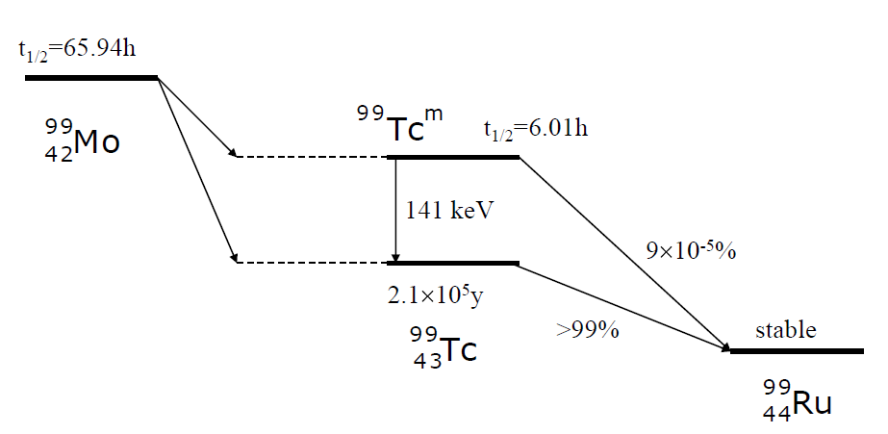
Technetium- 99m
Supplied in a generator consisting of 99Mo absorbed onto alumina.
Container allows liquid introduced at top to be collected at bottom.
Needs replacing weekly

Slide 17
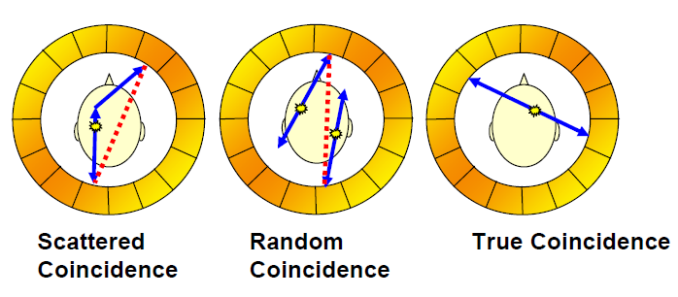
The motivation behind the project
Existing technology relies on BGO scintillator technology
- Limited position resolution
- High patient dose requirement.
- Poor energy resolution only accept photopeak events.
- Will not function in large magnetic field
SPECT applications utilizing Compton Camera techniques.

Slide 18
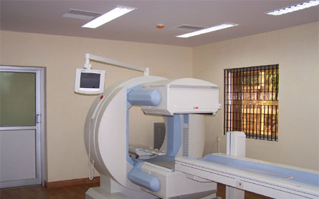
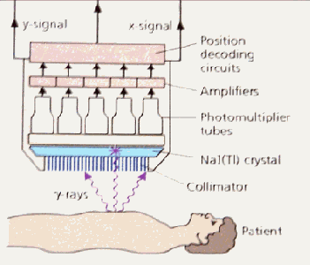
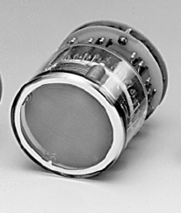
Which γ-ray camera to be used?
Requirements:
Excellent resolution Δx = 2 mm
Large field of view (FOV) = 8x9 cm²
Large FOV of ~20 cm diam.
Low spatial resolution 0.5-1 cm
Small FOV of 3-4 cm diam.
High spatial resolution 2-3 mm
www.siemens.de
Gem-imaging.com

Slide 19
Gamma Camera: Individual multi-anode readout
16 wires in X axis and 16 wires in Y axis
LYSO
scintillator
d = 76 mm
t = 3 mm
ρ = 7.4 g/cm³
Hamamatsu R2486 PSPMT
Photocathode = 56.25 mm
C.Domingo Pardo, N. Goel, et.al., IEEE, Vol.28, Dec. 2009

Slide 20
Which γ-ray camera to be used?
Requirements:
Excellent resolution Δx = 2 mm
Large field of view (FOV) = 8x9 cm²
Small FOV of 3-4 cm diam.
High spatial resolution 2-3 mm
Scintillator
Position Sensitive
PMT
Gem-imaging.com

Slide 21
Which γ-ray camera to be used?
Requirements:
Excellent resolution Δx = 2 mm
Large field of view (FOV) = 8x9 cm²
Small FOV of 3-4 cm diam.
High spatial resolution 2-3 mm
γ-ray
Scintillator
Position Sensitive
PMT
Gem-imaging.com

Slide 22
Which γ-ray camera to be used?
Requirements:
Excellent resolution Δx = 2 mm
Large field of view (FOV) = 8x9 cm²
Small FOV of 3-4 cm diam.
High spatial resolution 2-3 mm
γ-ray
Scintillator
Position Sensitive
PMT
Gem-imaging.com

Slide 23
Which γ-ray camera to be used?
Requirements:
Excellent resolution Δx = 2 mm
Large field of view (FOV) = 8x9 cm²
Small FOV of 3-4 cm diam.
High spatial resolution 2-3 mm
γ-ray
Scintillator
Position Sensitive
PMT
Gem-imaging.com

Slide 24
Which γ-ray camera to be used?
Requirements:
Excellent resolution Δx = 2 mm
Large field of view (FOV) = 8x9 cm²
Small FOV of 3-4 cm diam.
High spatial resolution 2-3 mm
γ-ray 2
γ-ray
Scintillator
Position Sensitive
PMT
Gem-imaging.com

Slide 25
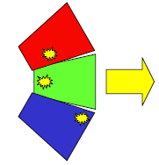
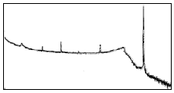
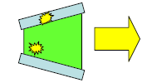
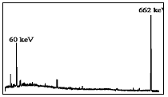
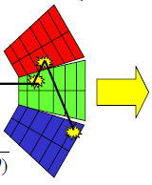
Gamma-ray tracking – the concept
without Compton suppression shield
Compton continuum → small peak to total ratio
Less solid angle coverage → big drop in efficiency
with BGO shielding
with highly segmented detectors
Path of γ-ray reconstructed to form full energy event
→ Compton continuum reduced
→ Excellent efficiency ~50% @ 1 MeV
→ Greatly improved angular resolution (~1%)
to reduce Doppler effect.
$$E_{γ}^{′}=\frac{E_{γ}}{1+\left({E_{γ}}/{mc^{2}}\right)∙\left(1−cosθ\right)}$$

Slide 26
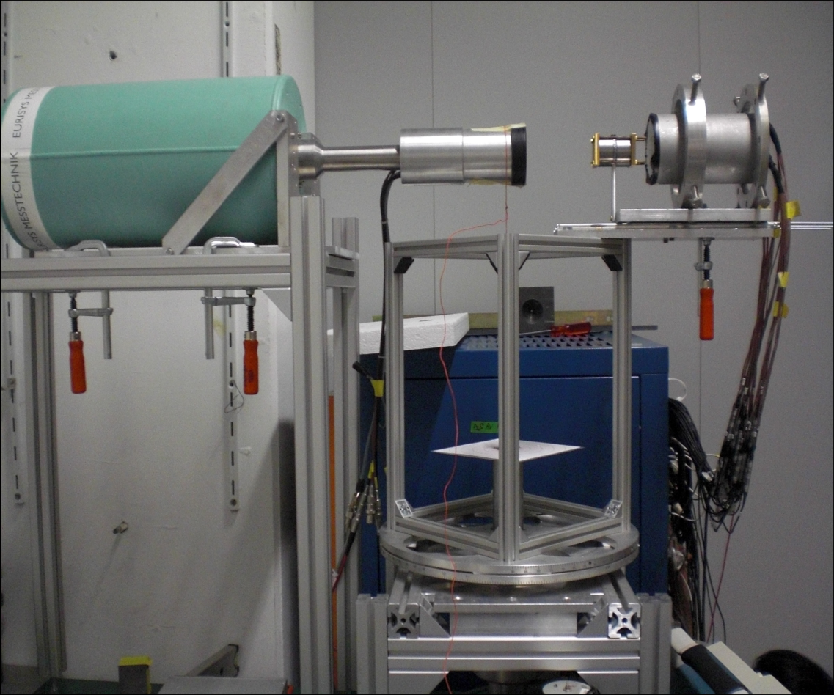
Scanner at GSI
²²Na
Position sensitive detector
Characteristics:
Faster
Precision: 1-2 mm
Imaging capability
Rotating table
Requirements:
1. Position sensitive detector
- Excellent Δx/x
- Large field of view
2. Method to compare the pulses

Slide 27
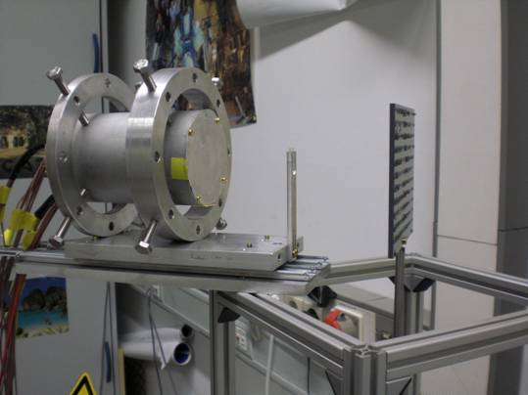
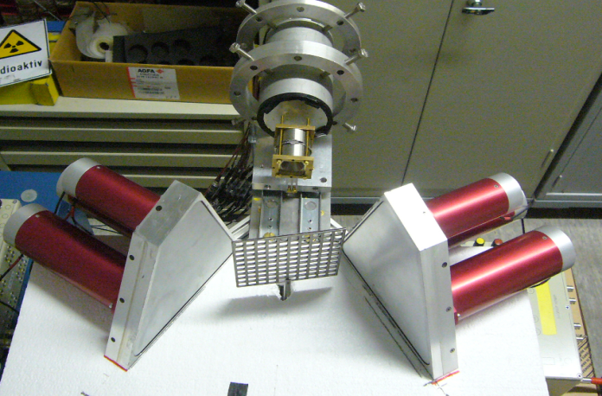
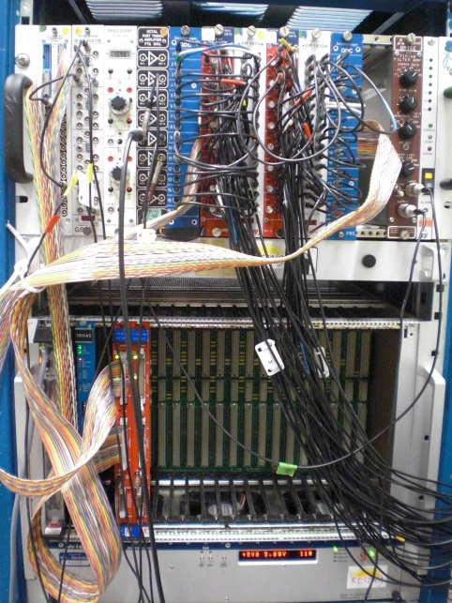
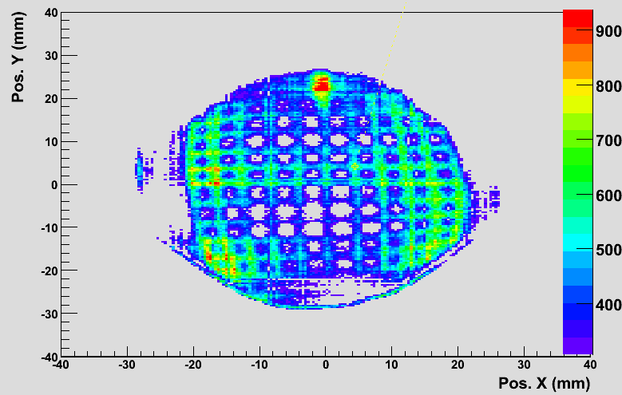
Position calibration
Determine: X_{r}(x_{m},y_{m}), Y_{r}(x_{m},y_{m})
Gamma-ray scattering technique
0⁰ position
Grid raw image when it is parallel to PSD surface (0 deg)

Slide 28
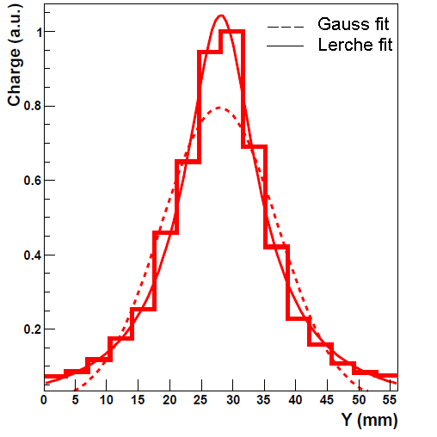
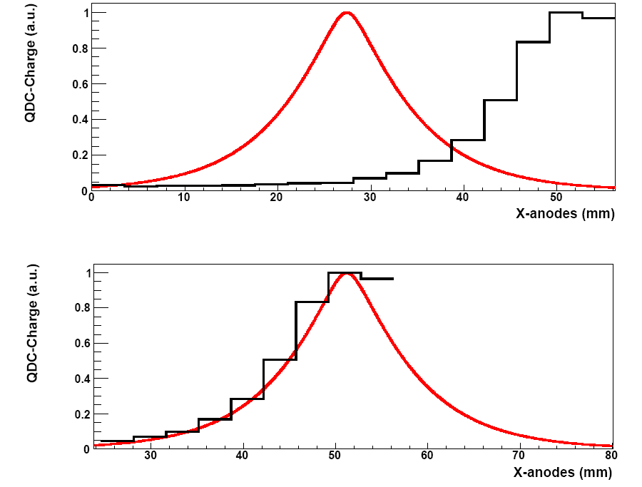
Position reconstruction
Central Interaction
Peripheral Interaction
Photocathode=56.26 mm
LYSO =76 mm
Reference peak fitting
average charge profile at the center
Charge (a.u.)
Y (mm)
Charge (a.u.)
Y (mm)
C. Domingo Pardo, N.Goel, et.al., IEEE, Dec. 2009 Volume: 28 Issue 12
C.W.Lerche, et.al., NIM A, Vol 537, pp. 326-330, Jan. 2005

Slide 29
Position reconstruction
Gaussian fitting
Reference peak fitting
Pos. X (mm)
Pos. X (mm)
Gaussian fitting works relatively well in the central region
Linear for 50 mm
Field of view = 28 cm²
Average spatial resolution in X and Y ~ 1mm

Slide 30
Scanner at GSI
²²Na
Position sensitive detector
Characteristics:
Faster
Precision: 1-2 mm
Imaging capability
Rotating table
Requirements:
1. Position sensitive detector
- Excellent Δx/x
- Large field of view
2. Method to compare the pulses

Slide 31
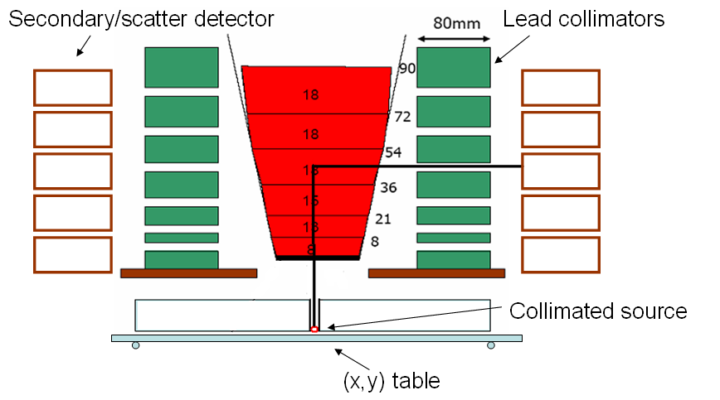
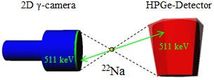
Superiority over conventional scanner
coincidence between the Germanium and BGO detectors for 90 degree Compton scattered events for depth determination
BGO
BGO
¹³⁷Cs
Advantage over conventional scanner: Full detector can be scanned in one measurement 10 times faster than a conventional scanner Accuracy of simulations can be checked for complex regions of electric field

Slide 32
Scanner based on pulse shape comparison scan
a)
a)

Slide 33
Scanner based on pulse shape comparison scan
b)
a)
a)
Collimated source
Geometric crossing point: x,y,z
Common pulse out of data sets (a) & (b)
b)
F.C.L. Crespi, et al. NIM A 593 (2008), 440

Slide 34
Pulse shape comparison scan method based on a position sensitive detector
Position sensitive
detector
511 keV
²²Na
Recording pulse shapes for positions (a) and (b)
Identical signals at the crossing point.
a)
²²Na
Rotated by 90⁰
b)

Slide 35
$χ^{2}$ minimization method
0° measurement
90° measurement
amplitude, Φ
amplitude, Φ
t(ns)
t(ns)
distribution
Average pulse
amplitude, Φ
threshold
t(ns)

Slide 36
Characterization of planar HPGe detector
Front view
Side view
Planar Ge
d = 4 cm
t = 2 cm
²²Na
Position sensitive detector

Slide 37
Detector scan
Front view (0 deg):
Side view (90 deg):

Slide 38
Detector scan
Front view (0 deg):
Side view (90 deg):

Slide 39
Detector scan (data analysis)

Slide 40
Experimental validation of the method

Slide 41
Planar HPGe detector scan
Intensity distribution for photopeak events
(a)
t(ns)
amplitude, Φ
(b)
t(ns)

Slide 42
Outlook
The GSI system uses conventional NIM and VME electronics, which makes it not easily portable, not easily scalable and rather expensive if one wants to build many of these devices.
However, this drawback could be overcome thanks to the increasing technology of electronics, e.g. a new acquisition system based on ASIC, FPGA, etc. technologies. This would also make the system more suitable for medical applications.
APV25 chip (from CERN CMS experiment)
?
128-channel analogue pipeline chip
M.J. French et al., NIMA 466 (2001) 359

Slide 43
Position Extraction in Planar Detectors

Slide 44
Position Extraction in Planar Detectors

Slide 45
Gamma-Ray Imaging
Gamma-ray imagers are detectors that separate radioactive objects from local background.
Conventional detectors accept gamma-rays from all directions and can be overwhelmed by local backgrounds.

