Slide 1
1930: Energy conservation violated in β-decay
alpha-decay
beta-decay
expectation 1930
Th 234
Pa 234
U 238
Th 234
α (He 4)
β (electron)
energy
conservation
J
measurement
L
counts
counts
expectation
α-energy
β-energy

Slide 2
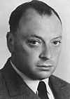
The new particle proposed by Pauli
Beta-decay
Leptonen
Charge −1
Charge 0
e
ν_{e}
Wolfgang Pauli
Electron
e-Neutrino
μ
ν_{μ}
Myon
μ-Neutrino
*
τ
ν_{τ}
Pa 234
Tauon
τ-Neutrino
β (electron)
Th 234
ν
In addition to an electron a light
neutral particle is created which
carries away the missing energy!
„Today I have done something, what one should not do in theoretical physics. I have
explained something, what is not understood, by something, which can not be observed!"

Slide 3
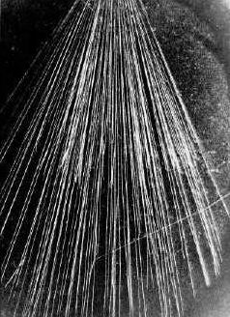
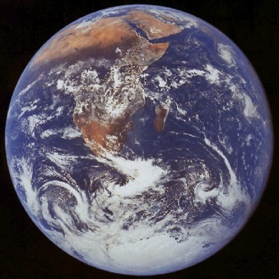
Neutrino detection
Detection of particles:
  Interaction of particles with matter (detector)
Interaction with matter depends strongly on the particle:
  Charge particles: Ionization of matter
  Photons: Energy transfer to charged particles
  Neutrons: Nuclear reactions yield charge particles
cloud chamber
Neutrinos interact very weakly:
  Only one out of 100 billions neutrinos from the
  β-decay will be recognized by the earth.
ν
Calculated 1934: „Hopeless“

Slide 4
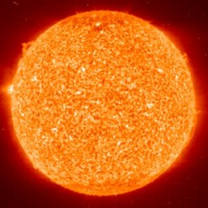
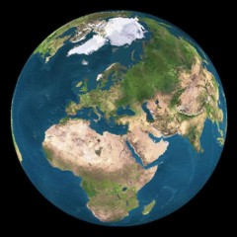
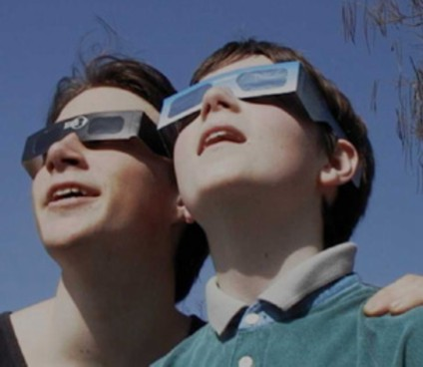
Sun glasses for neutrinos
8.3 light minutes
A lead layer with a thickness
of several light years is needed
Bethe & Peierls 1934
„ … this means, that one obviously will
never be able to observe a neutrino.”

Slide 5
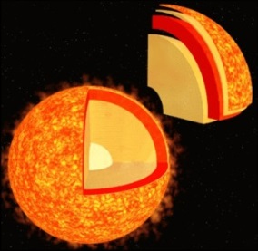
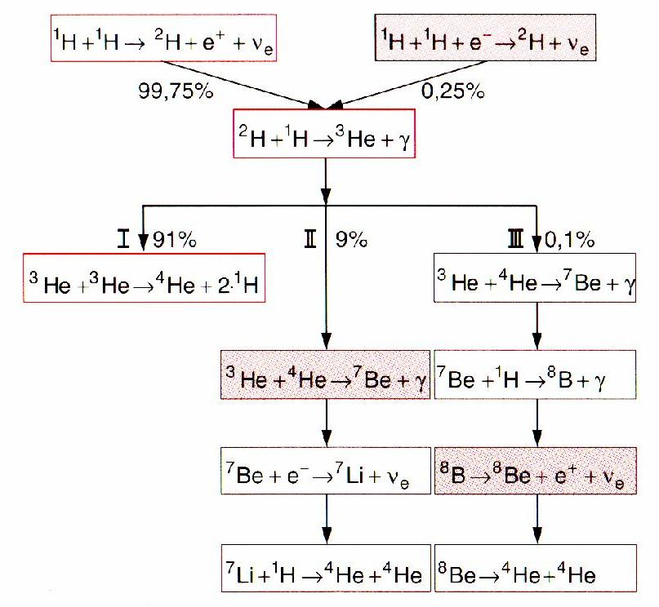
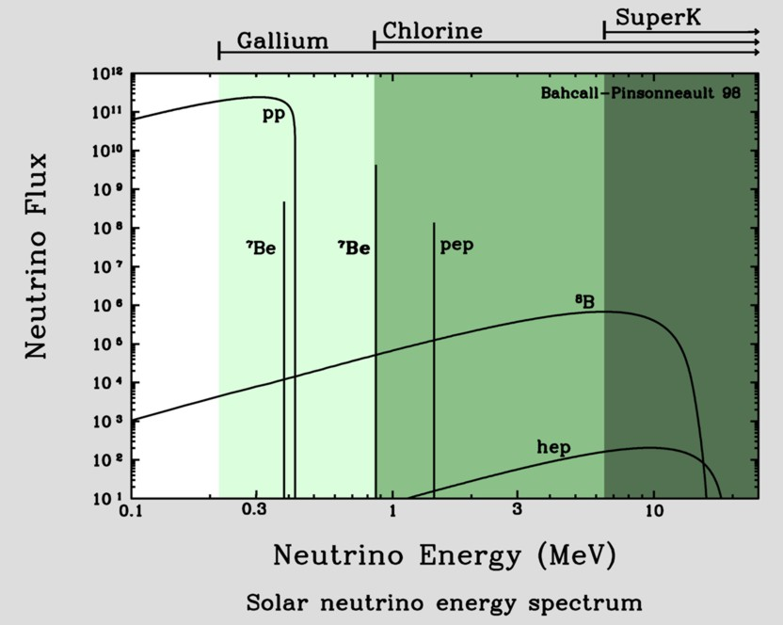
Neutrinos from the sun
Known: total emitted energy
Known: energy per fusion process
number of created neutrinos per sec!
on earth: 66 billions ν per (cm² · s¹)
Standard solar model

Slide 6
Neutrinos from the sun
Known: total emitted energy
Known: energy per fusion process
number of created neutrinos per sec!
on earth: 66 billions ν per (cm² · s¹)
proton-proton-cycle
pp-neutrino
pep-neutrino
p+p => ²H+e⁺+ν_{e} (99%)
p+e⁻+p => ²H+ν_{e} (1%)
2H+p => ³He+γ
hep-neutrino
³He+³He => ⁴He+2p (86%)
³He+p =>⁴He+ν_{e}+e⁺ (<<1%)
³He+⁴He=>⁷Be+γ (14%)
⁷Be-neutrino
⁸B-neutrino
⁷Be + e⁻ =>⁷Li + ν_{e}
⁷Li + p => 2 ⁴He (99%)
⁷Be + p => ⁸B + γ
⁸B => ⁸Be + e⁺+ ν_{e}
⁸Be => 2 ⁴He (1%)

Slide 7
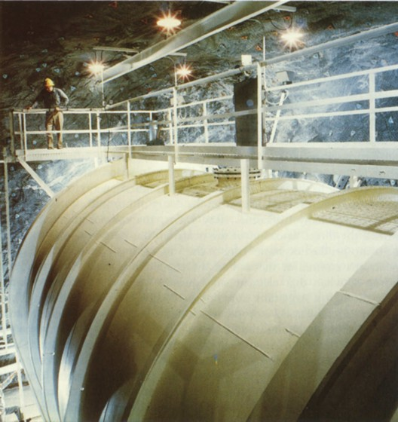
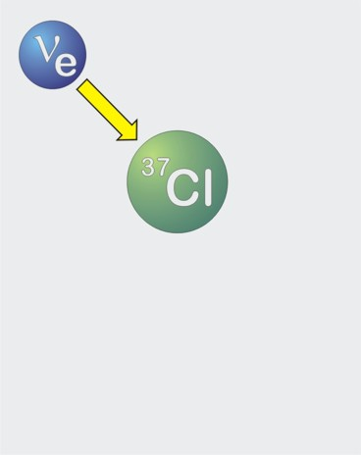
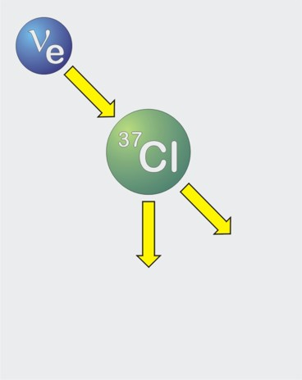
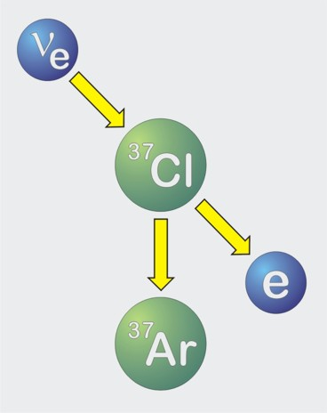
First measurements of the solar neutrinos
Inverse beta-decay
(„neutrino-capture”)
40 days of neutrino exposure …
Expected: 60 atoms ³⁷Ar
600 tons
carbon tetrachloride
Homestake Solar Neutrino
Observatory (1967−2002)

Slide 8
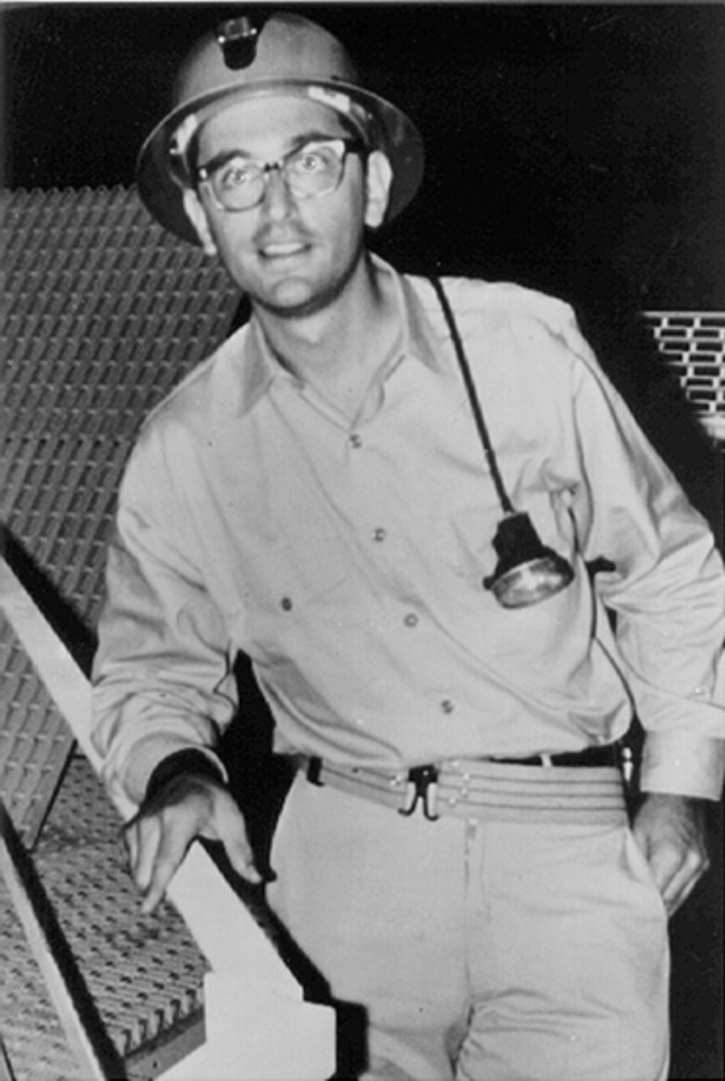
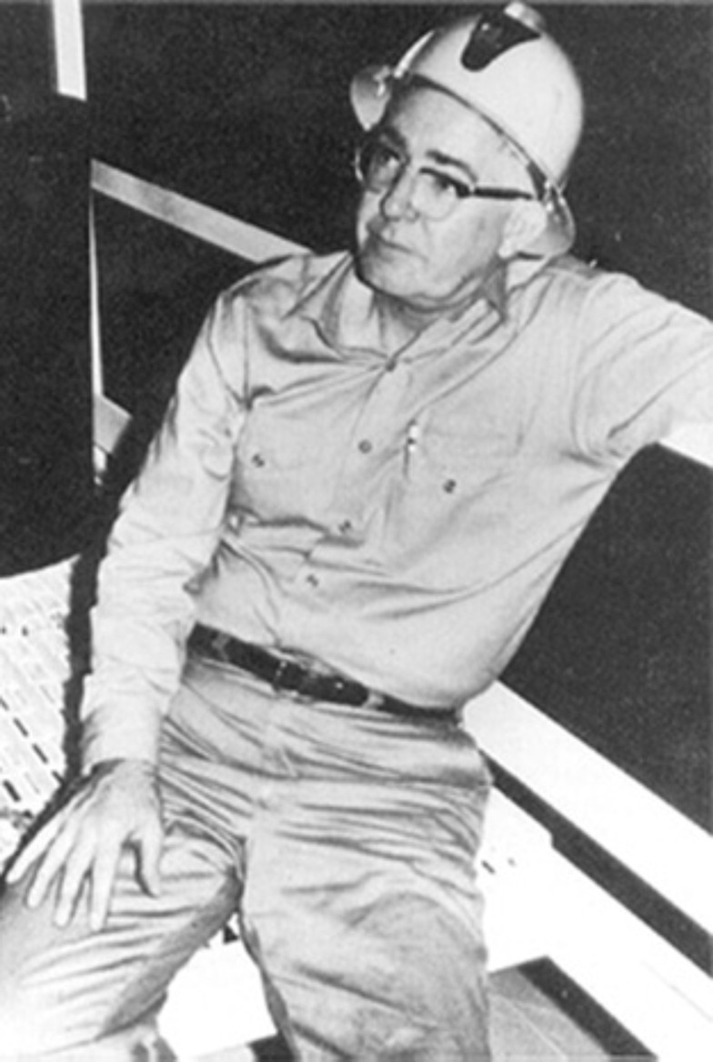
Problem of the “missing” solar neutrinos
Homestake
Chlorine
⁸B
Calculation of the solar
neutrino flux from different
source reactions
CNO
⁷Be
Measurements (1970 – 1995)
John Bahcall
1934 − 2005
Raymond Davis Jr.
1914 − 2006

Slide 9



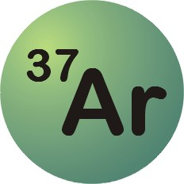





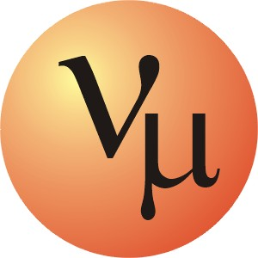
Neutrino conversion is the solution of the problem
detector
Sun
Sun
detector

Slide 10
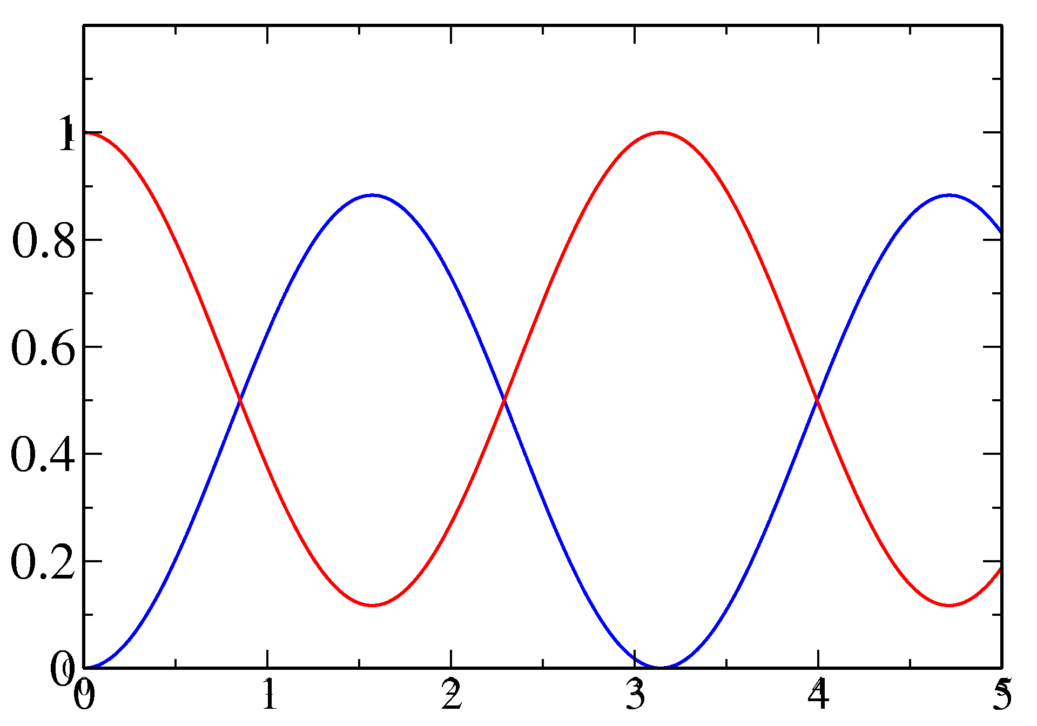
Neutrino oscillations
Electron e
Myon μ
Tau τ
e-Neutrino
μ-Neutrino
τ-Neutrino
Idea: when neutrinos have a mass, they may convert into each other!
Assumption: Mixture of
Conversion of a neutrino
beam with the distance from the neutrino source:
ν_{e}
ν_{μ}
ν_{e} and ν_{μ}
Portion of the beam
distance from the source
1998: Confirmation of the oscillations between Myon- and Tau-neutrinos with methods of Super-Kamiokande (Myon-neutrinos from the atmosphere)

Slide 11
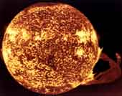
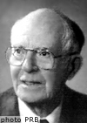
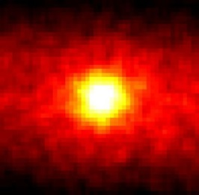
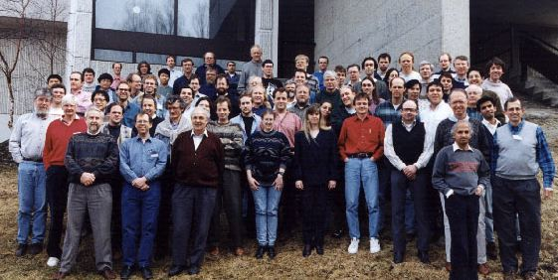
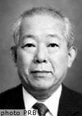
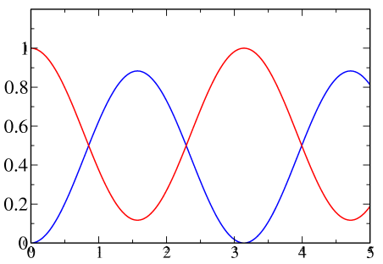
The solar neutrino problem
Sun
since 4.5 billion years
fusion
66 billion neutrinos/s/cm²
since 1964: detection with
Homestake-experiment
expected: 1,5 reactions/d
measured: 0.5 reactions/d
solar
neutrino
problem
prediction
exp
Since 1986 Kamiokande:
confirms Homestake
2002 SNO-experiment:
examines neutrino-oscillation
possible explanation:
neutrino-oscillation
ν₂
solar
neutrino
problem
solved!
all neutrinos
ν₁
prediction
ν_{e}

Slide 12
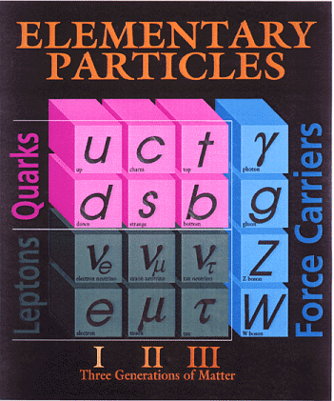
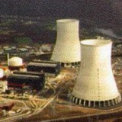
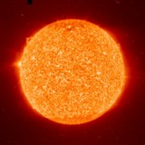

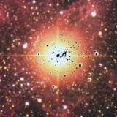

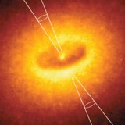


Neutrinos as astrophysical messenger
nuclear reactors
✓
Sun
✓
Supernovae
(collapsing stars)
particle accelerator
✓
SN 1987A ✓
earth atmosphere
(cosmic radiation)
✓
astrophysical
accelerators soon ?
earth crust
(natural radioactivity)
Big Bang of the Universe
(today 330 ν/cm³)
indirect evidence
✓

