Slide 1
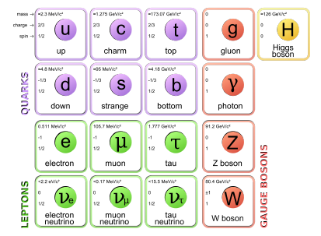
γ-ray spectroscopy
γ-decay is an electromagnetic process where the nucleus decreases in excitation energy, but does not change proton or neutron numbers
This decay process only involves the emission of photons (γ-rays carry spin 1)
Basic γ-ray properties, observables
γ-ray interactions in matter
Detector types
Measurement techniques

Slide 2
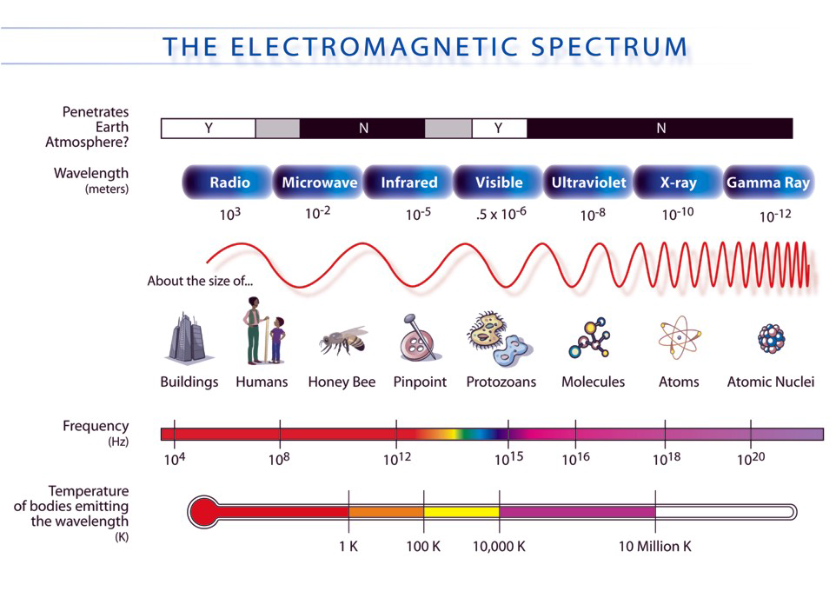
Electromagnetic spectrum

Slide 3
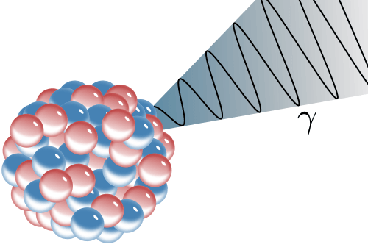
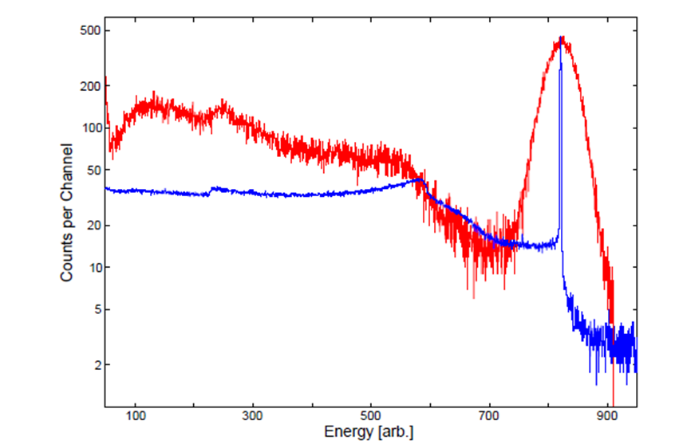
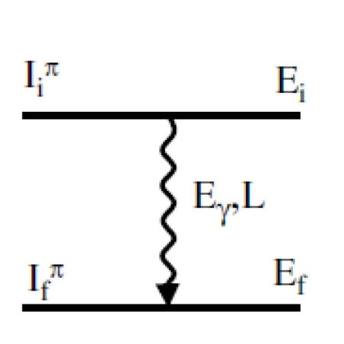

γ-decay
Gamma-ray emission is usually the dominant decay mode
Measurements of γ-rays let us deduce:
Energy, Spin (angular distr. / correl.), Parity (polarization), magnetic moment,
lifetime (recoil distance, Doppler shift), …
of the involved nuclear levels.
¹³⁷Cs detected in red: NaI scintillator
blue: HPGe (high purity Ge semiconductor)
$${}_{Z}^{A}{X_{N}^{∗}}→{}_{Z}^{A}{X_{N}^{\left(∗\right)}}$$

Slide 4
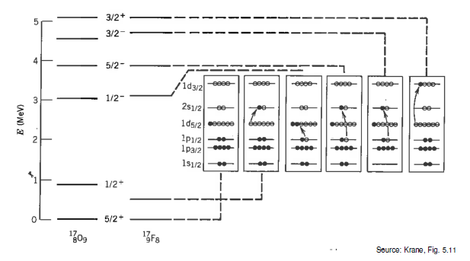
γ-decay in a Nutshell
The photon emission of the nucleus essentially results from a re-ordering of nucleons within the shells.
This re-ordering often follows α or β decay, and moves the system into a more energetically favorable state.

Slide 5
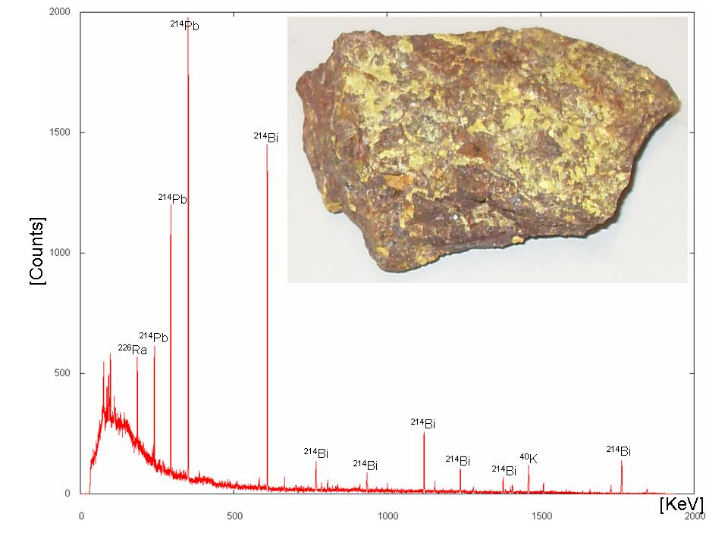
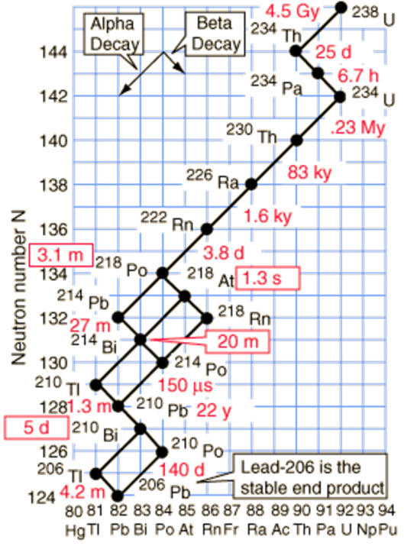
γ-decay
γ-ray spectrum of ^{nat}U

Slide 6
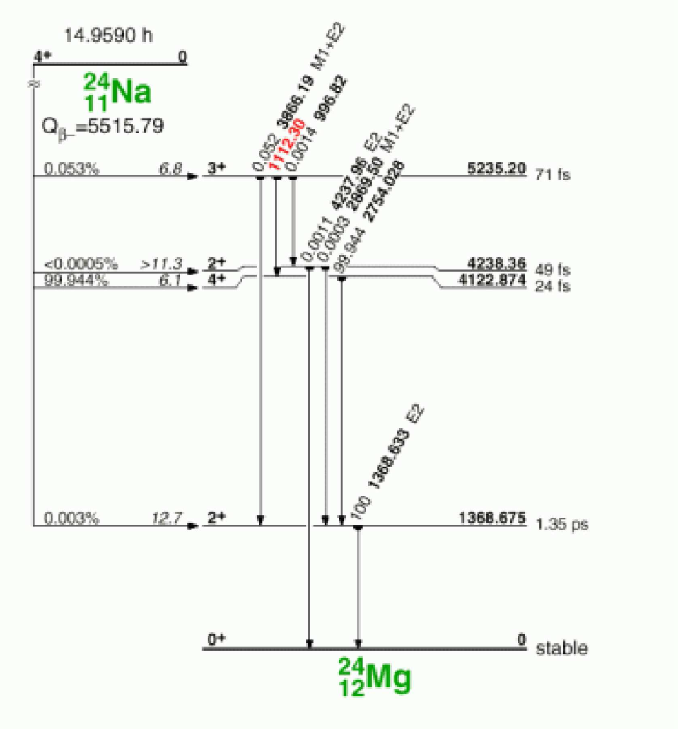
γ-decay
Most β-decay transitions are followed by γ-decay.

Slide 7
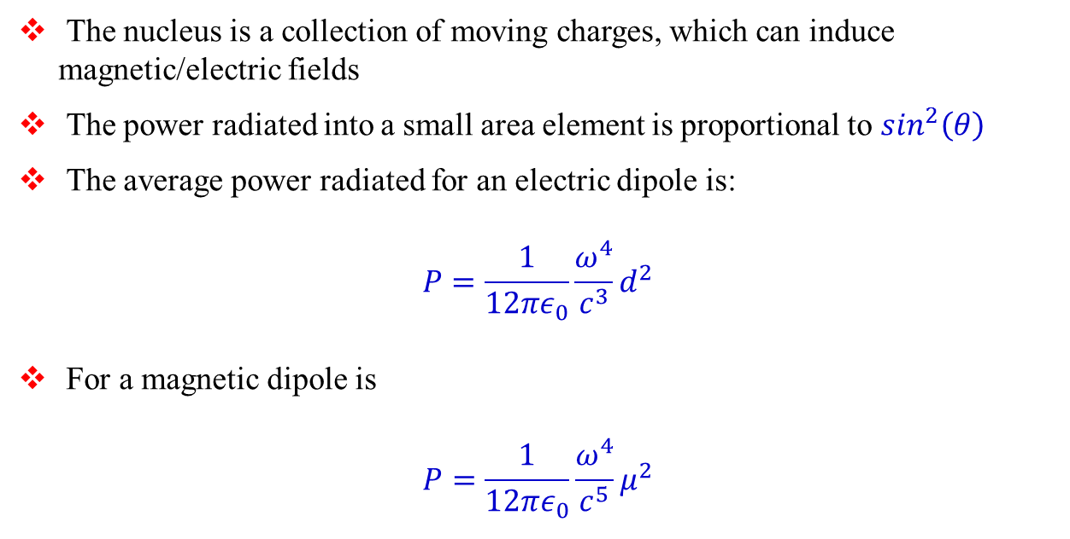
Classical Electrodynamics
The nucleus is a collection of moving charges, which can induce magnetic/electric fields
The power radiated into a small area element is proportional to $\sin^{2}\left(θ\right)$
The average power radiated for an electric dipole is:
$$P=\frac{1}{12πε_{0}}\frac{ω^{4}}{c^{3}}d^{2}$$
For a magnetic dipole is
$$P=\frac{1}{12πε_{0}}\frac{ω^{4}}{c^{5}}μ^{2}$$

Slide 8
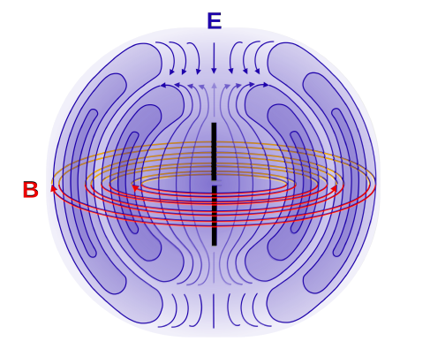
Electric/Magnetic Dipoles
Electric and magnetic dipole fields have opposite parity:
Magnetic dipoles have even parity and electric dipole fields have odd parity.
$$⇒ π\left(Mℓ\right)={\left(−1\right)}^{ℓ+1} and π\left(Eℓ\right)={\left(−1\right)}^{ℓ}$$

Slide 9
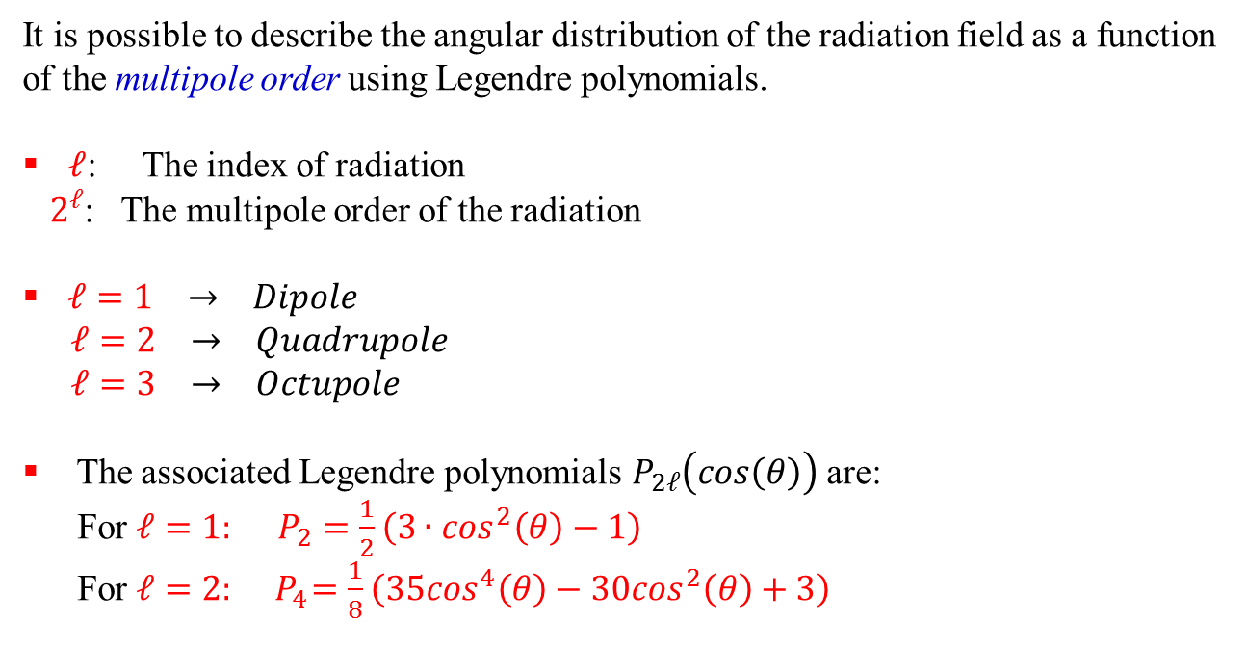
Higher Order Multipoles
It is possible to describe the angular distribution of the radiation field as a function of the multipole order using Legendre polynomials.
$ℓ$: The index of radiation
$2^{ℓ}$: The multipole order of the radiation
$ℓ=1 → Dipole$
$ℓ=2 → Quadrupole$
$ℓ=3 → Octupole$
The associated Legendre polynomials $P_{2ℓ}\left(cos\left(θ\right)\right)$ are:
For $ℓ=1: P_{2}=\frac{1}{2}\left(3∙\cos^{2}\left(θ\right)−1\right)$
For $ℓ=2: { P}_{4}=\frac{1}{8}\left(35\cos^{4}\left(θ\right)−30\cos^{2}\left(θ\right)+3\right)$

Slide 10
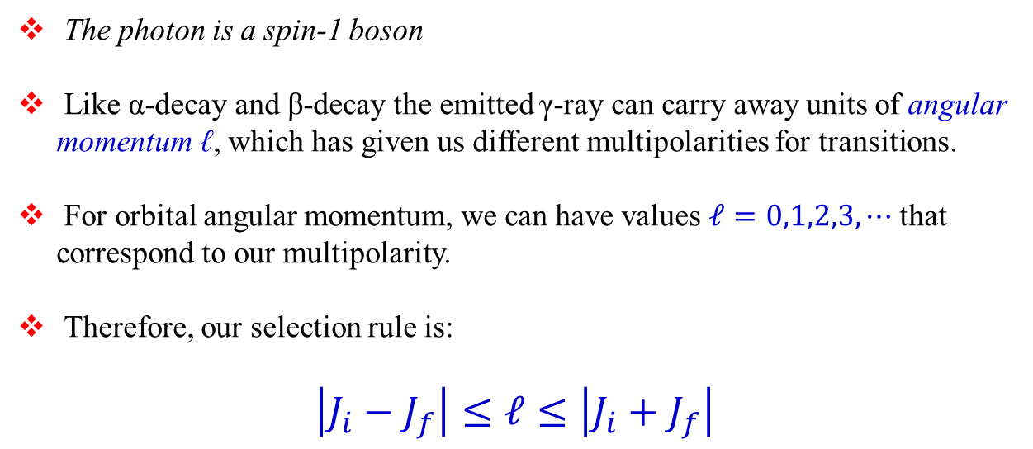
Angular Momentum in γ-Decay
The photon is a spin-1 boson
Like α-decay and β-decay the emitted γ-ray can carry away units of angular momentum ℓ, which has given us different multipolarities for transitions.
For orbital angular momentum, we can have values $ℓ=0,1,2,3,⋯$ that correspond to our multipolarity.
Therefore, our selection rule is:
$$\left|J_{i}−J_{f}\right|≤ℓ≤\left|J_{i}+J_{f}\right|$$

Slide 11
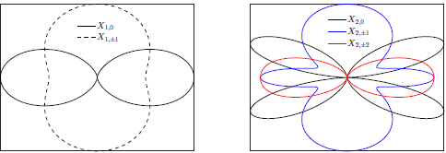




Characteristics of multipolarity
L | multipolarity | π(Eℓ) / π(Mℓ) | angular distribution
1 | dipole | -1 / +1
2 | quadrupole | +1 / -1
3 | octupole | -1 / +1
4 | hexadecapole | +1 / -1
⁞
ℓ = 1
ℓ =2
$$E_{γ}=E_{i}−E_{f}$$
$$\left|I_{i}−I_{f}\right|≤ℓ≤I_{i}+I_{f}$$
$$∆π\left(Eℓ\right)={\left(−1\right)}^{ℓ}$$
$$∆π\left(Mℓ\right)={\left(−1\right)}^{ℓ+1}$$

Slide 12

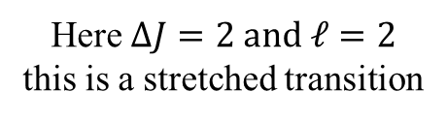
The basics of the situation
2
ℓ
0
$$\left|2−0\right|≤ℓ≤2+0$$
Here $ΔJ=2 and ℓ=2$
this is a stretched transition

Slide 13

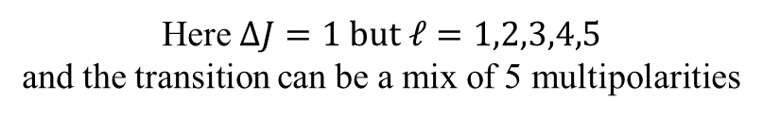
The basics of the situation
3
ℓ
2
$$\left|3−2\right|≤ℓ≤3+2$$
Here $ΔJ=1 but ℓ=1,2,3,4,5$
and the transition can be a mix of 5 multipolarities

Slide 14

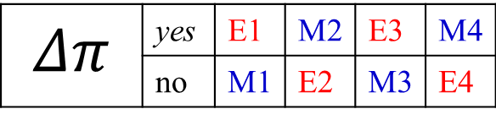


The basics of the situation
$E_{γ}, ℓ, Δπ$
Electromagnetic transitions:
$$Δπ \left(electric\right)= {\left(−1\right)}^{ℓ}$$
$$Δπ \left(magnetic\right)= {\left(−1\right)}^{ℓ+1}$$
$$Δπ$$ | yes | E1 | M2 | E3 | M4
 | no | M1 | E2 | M3 | E4

Slide 15
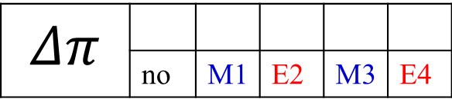

The basics of the situation
2⁺
ℓ
0⁺
$$\left|2−0\right|≤ℓ≤2+0$$
$$ℓ=2 and no change in parity$$
$$Δπ$$ | yes | E1 | M2 | E3 | M4
 | no | M1 | E2 | M3 | E4

Slide 16
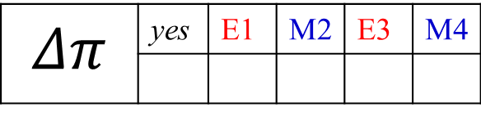

The basics of the situation
3⁺
ℓ
2⁻
$$\left|3−2\right|≤ℓ≤3+2$$
Here $ΔJ=1 but ℓ=1,2,3,4,5$
$$Δπ$$ | yes | E1 | M2 | E3 | M4
 | no | M1 | E2 | M3 | E4
mixed E1,M2,E3,M4,E5

Slide 17
The basics of the situation
3⁺
ℓ
2⁺
$$\left|3−2\right|≤ℓ≤3+2$$
Here $ΔJ=1 but ℓ=1,2,3,4,5$
$$Δπ$$ | yes | E1 | M2 | E3 | M4
 | no | M1 | E2 | M3 | E4
mixed M1,E2,M3,E4,M5

Slide 18



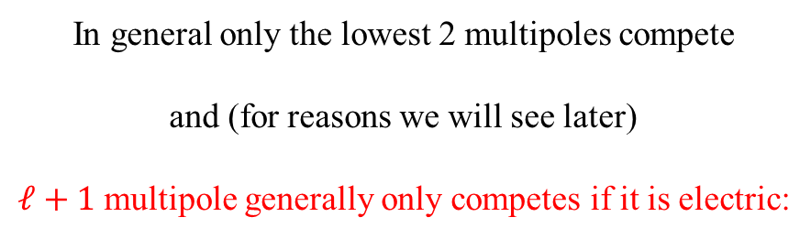
The basics of the situation
$3^{+}→2^{−}:$ mixed M1,E2,M3,E4,M5
$3^{+}→2^{+}:$ mixed E1,M2,E3,M4,E5
In general only the lowest 2 multipoles compete
and (for reasons we will see later)
$ℓ+1$ multipole generally only competes if it is electric:
$3^{+}→2^{+}:$ mixed M1/E2
$3^{+}→2^{−}:$ almost pure E1 (very little M2 admixture)

Slide 19
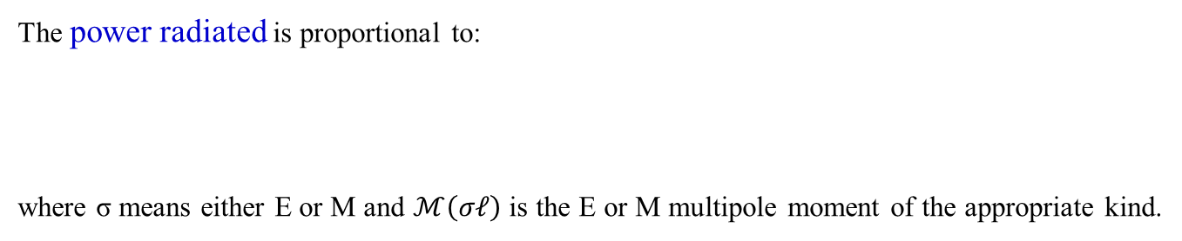
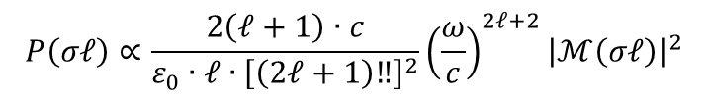
Characteristics of multipolarity
L | multipolarity | π(Eℓ) / π(Mℓ) | angular distribution
1 | dipole | -1 / +1
2 | quadrupole | +1 / -1
3 | octupole | -1 / +1
4 | hexadecapole | +1 / -1
⁞
ℓ = 1
ℓ =2
parity: electric multipoles π(Eℓ) = (-1)^{ℓ}, magnetic multipoles π(Mℓ) = (-1)^{ℓ+1}
The power radiated is proportional to:
where σ means either E or M and $ℳ\left(σℓ\right)$ is the E or M multipole moment of the appropriate kind.
$$P\left(σℓ\right)∝\frac{2\left(ℓ+1\right)∙c}{ε_{0}∙ℓ{∙\left[\left(2ℓ+1\right)‼\right]}^{2}}{\left(\frac{ω}{c}\right)}^{2ℓ+2}{\left|ℳ\left(σℓ\right)\right|}^{2}$$

Slide 20
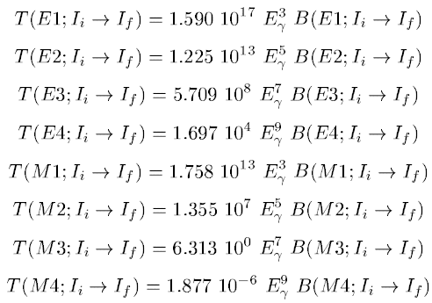
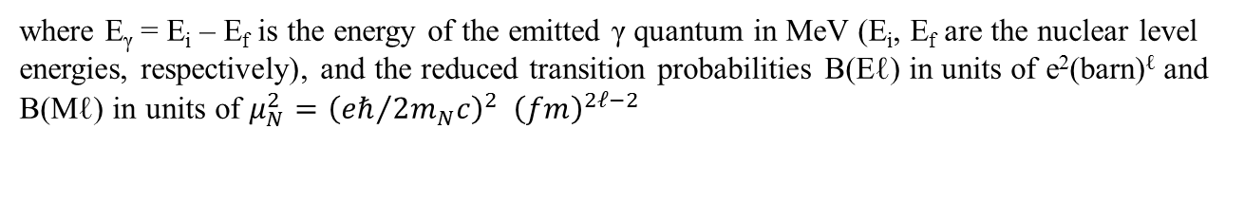
Emission of electromagnetic radiation
where E_{γ} = E_{i} – E_{f} is the energy of the emitted γ quantum in MeV (E_{i}, E_{f} are the nuclear level energies, respectively), and the reduced transition probabilities B(Eℓ) in units of e²(barn)^{ℓ} and B(Mℓ) in units of $μ_{N}^{2}={\left({eℏ}/{2m_{N}c}\right)}^{2} {\left(fm\right)}^{2ℓ−2}$

Slide 21
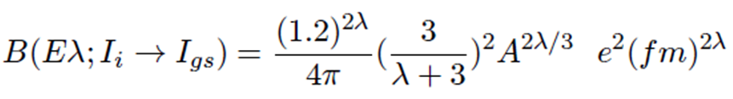
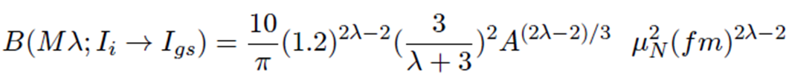
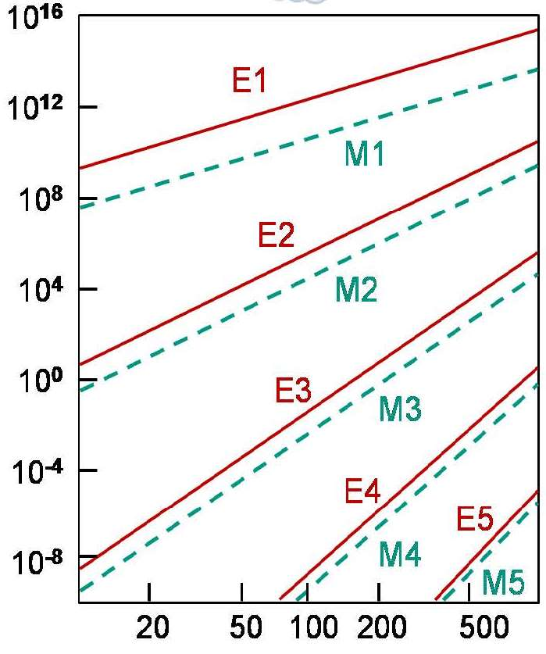
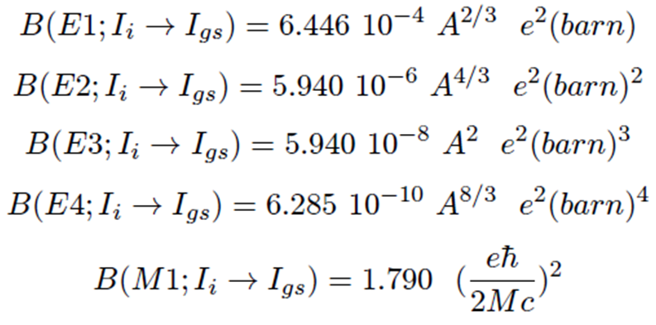
Single particle transition (Weisskopf estimate)
For the first few values of λ, the Weisskopf estimates are
transition probability λ [s⁻¹]
gamma energy E_{γ} [keV]

Slide 22
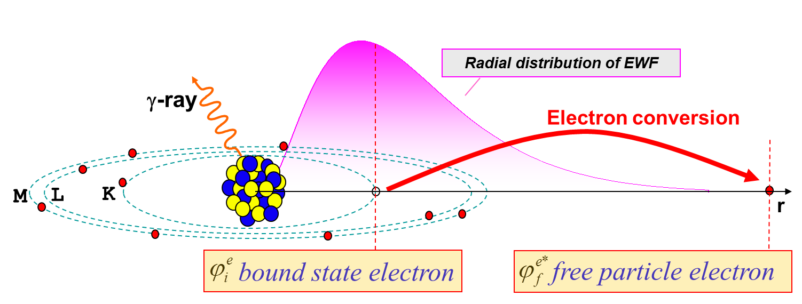
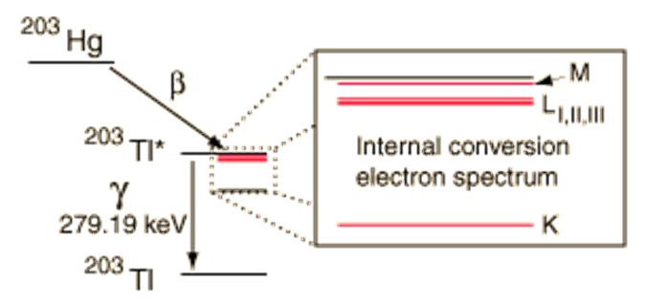
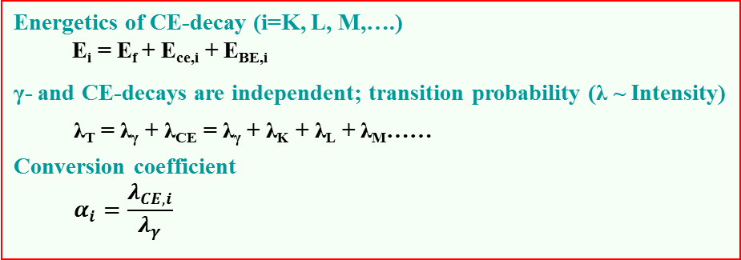
Conversion electrons
Energetics of CE-decay (i=K, L, M,….)
E_{i} = E_{f} + E_{ce,i} + E_{BE,i}
γ- and CE-decays are independent; transition probability (λ ~ Intensity)
  λ_{T} = λ_{γ} + λ_{CE} = λ_{γ} + λ_{K} + λ_{L} + λ_{M}……
Conversion coefficient
  $$α_{i}=\frac{λ_{CE,i}}{λ_{γ}}$$

Slide 23
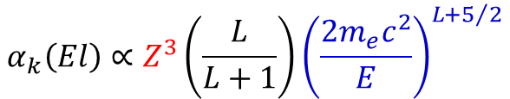
Internal conversion
For an electromagnetic transition internal conversion can occur instead of emission of gamma radiation. In this case the transition energy Q = E_{γ} will be transferred to an electron of the atomic shell.
T_{e} = E_{γ} - B_{e}
T_{e}: kinetic energy of the electron
B_{e}: binding energy of the electron
internal conversion is important for:
heavy nuclei ~ Z³
high multipolarities Eℓ or Mℓ
small transition energies
$$α_{k}\left(El\right)∝Z^{3}\left(\frac{L}{L+1}\right){\left(\frac{2m_{e}c^{2}}{E}\right)}^{L+5/2}$$

Slide 24
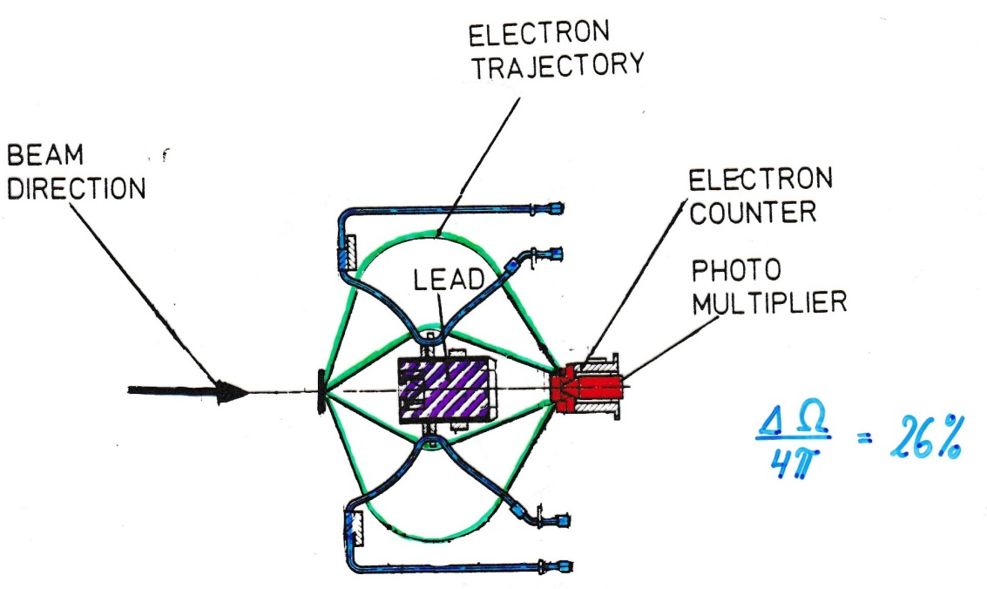
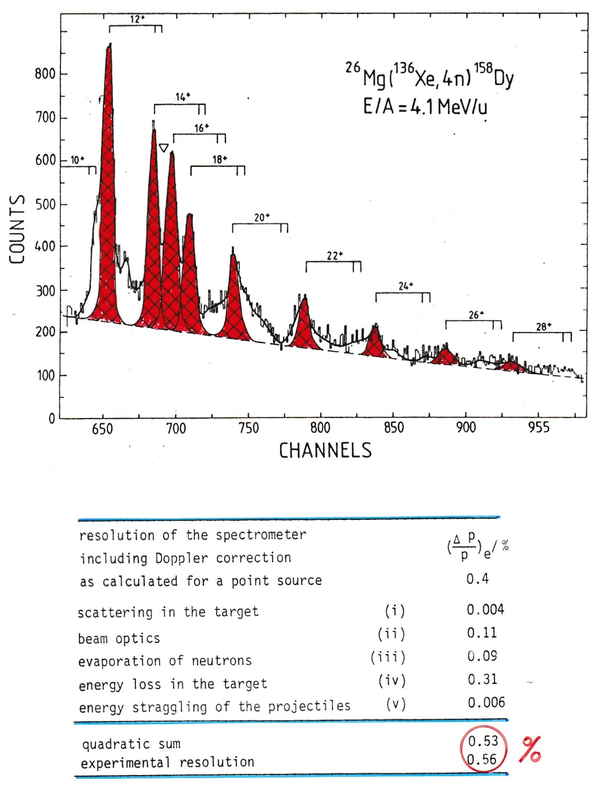

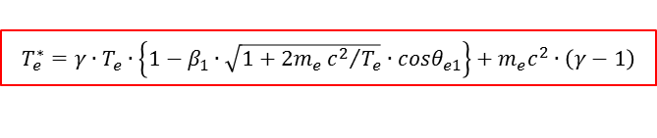
Electron spectroscopy
$$\frac{ΔΩ}{4π}=26\%$$
Doppler shift correction for projectile:
$$T_{e}^{∗}=γ∙T_{e}∙\left\{1−β_{1}∙\sqrt{1+2m_{e}{c^{2}}/{T_{e}}}∙cosθ_{e1}\right\}+m_{e}c^{2}∙\left(γ−1\right)$$
$$cosθ_{e1}=cosθ_{1}cosθ_{e}+sinθ_{1}sinθ_{e}cos\left(φ_{e}−φ_{1}\right)$$

Slide 25
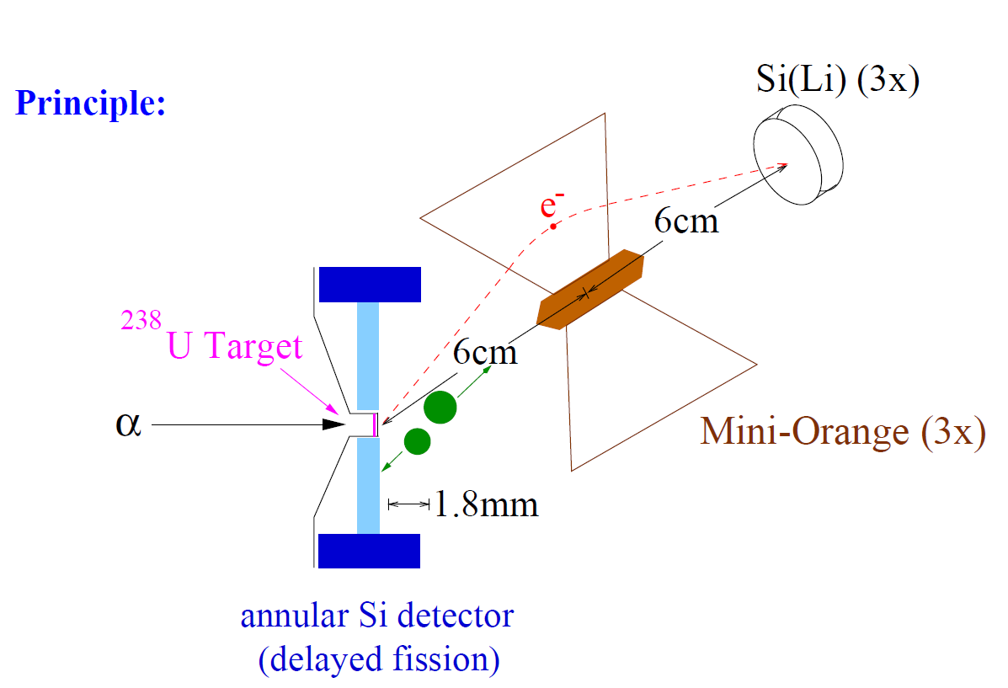
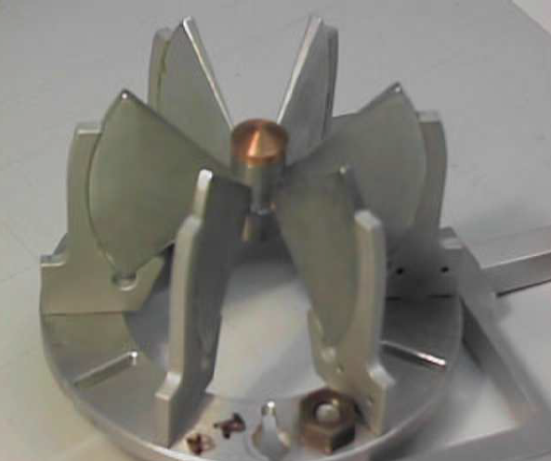
Mini Orange setup for conversion electron spectroscopy

Slide 26
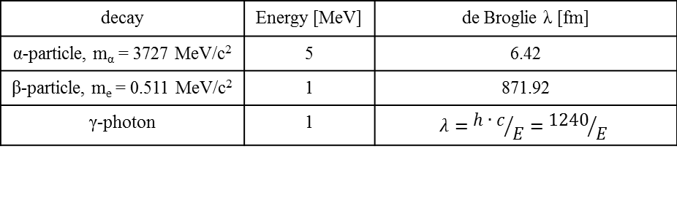

Comparison of α-decay, β-decay and γ-decay
de Broglie wavelength:
$$λ=\frac{h}{p}=\frac{h∙c}{\sqrt{E_{kin}∙\left(E_{kin}+2mc^{2}\right)}}=\frac{1239.84\left[MeV fm\right]}{\sqrt{E_{kin}∙\left(E_{kin}+2mc^{2}\right)}}$$
decay | Energy [MeV] | de Broglie λ [fm]
α-particle, m_{α} = 3727 MeV/c² | 5 | 6.42
β-particle, m_{e} = 0.511 MeV/c² | 1 | 871.92
γ-photon | 1 | $$λ={h∙c}/E={1240}/E$$
For α-particles this dimension is somewhat smaller than the nucleus and this is why a semi-classical treatment of α-decay is successful.
The typical β-particle has a large wavelength λ in comparison to the nuclear size and a quantum mechanical is dictated and wave analysis is called for.
For γ-decay the wavelength λ ranges from 12400 – 1240 fm (0.1 – 1 MeV). Clearly, only a quantum mechanical approach has a chance of success.

Slide 27
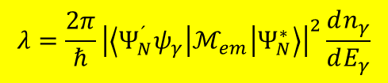
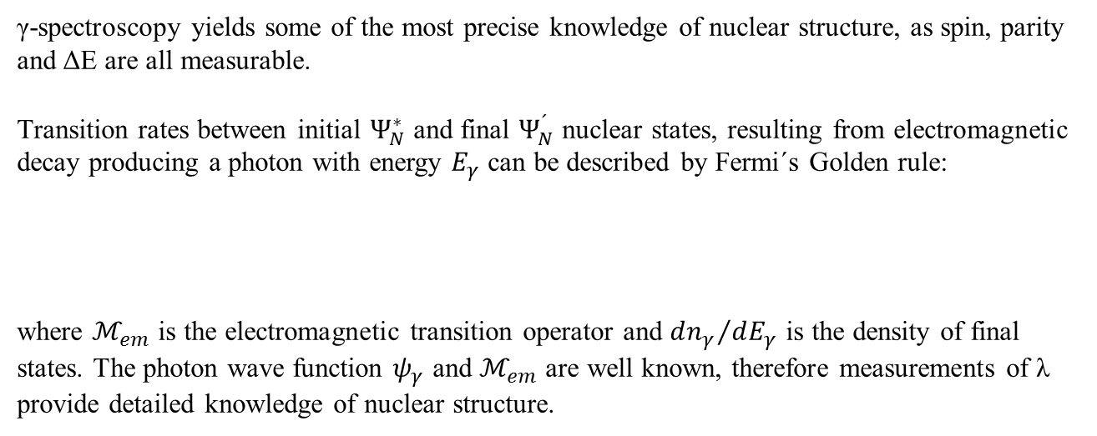
γ-decay
γ-spectroscopy yields some of the most precise knowledge of nuclear structure, as spin, parity and ΔE are all measurable.
Transition rates between initial $Ψ_{N}^{∗}$ and final $Ψ_{N}^{´}$ nuclear states, resulting from electromagnetic decay producing a photon with energy $E_{γ}$ can be described by Fermi´s Golden rule:
where $ℳ_{em}$ is the electromagnetic transition operator and ${dn_{γ}}/{dE_{γ}}$ is the density of final states. The photon wave function $ψ_{γ}$ and $ℳ_{em}$ are well known, therefore measurements of λ provide detailed knowledge of nuclear structure.
$$λ=\frac{2π}{ℏ}{\left|\left\langle Ψ_{N}^{´}ψ_{γ} | ℳ_{em} | Ψ_{N}^{∗}\right\rangle \right|}^{2}\frac{dn_{γ}}{dE_{γ}}$$
A γ-decay lifetime is typically 10⁻¹² [s] and sometimes even as short as 10⁻¹⁹ [s]. However, this time span is an eternity in the life of an excited nucleon. It takes about 4·10⁻²² [s] for a nucleon to cross the nucleus.

Slide 28

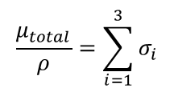
Interaction of gamma rays with matter
Aluminum
Lead
total absorption coefficient: μ/ρ [cm²/g]
i=1 photoelectric effect
i=2 Compton scattering
i=3 pair production

Slide 29
Mass dependence of X-ray absorption
For X-ray radiation the photoelectric effect is the most important interaction.
Lead absorbs more than Beryllium!
₈₂Pb serves as shielding for X-ray and γ-ray radiation; lead vests are used by medical staff people who are exposed to X-ray radiation. Co-sources are transported in thick lead container.
On the contrary:
₄Be is often used as windows in X-ray tubes to allow for almost undisturbed transmission of X-ray radiation.

Slide 30
Mass dependence μ/ρ of X-ray absorption
wave length dependence for Pt as absorber
element number dependence for λ=0.1 nm or 12.4 keV

Slide 31
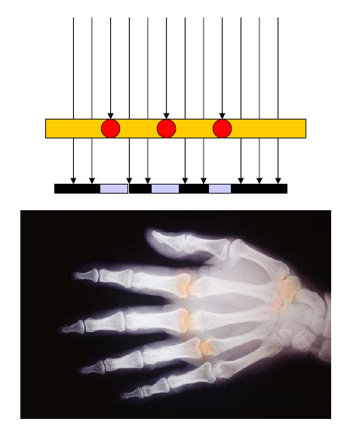
X-ray image shows the effect of different absorptions
Bones absorb more radiation as tissues because of their higher ₂₀Ca content

Slide 32
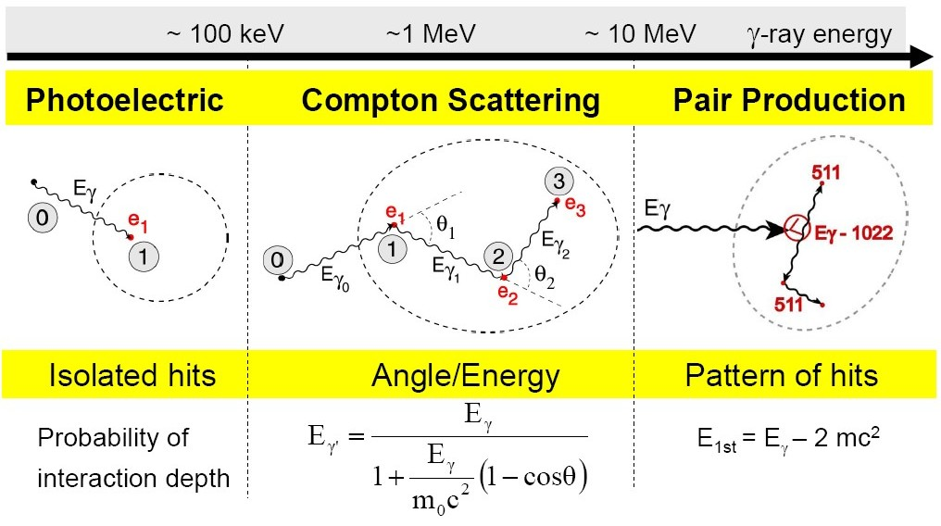
Interaction of gamma rays with matter

Slide 33
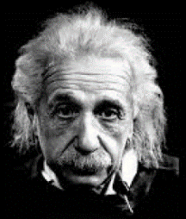
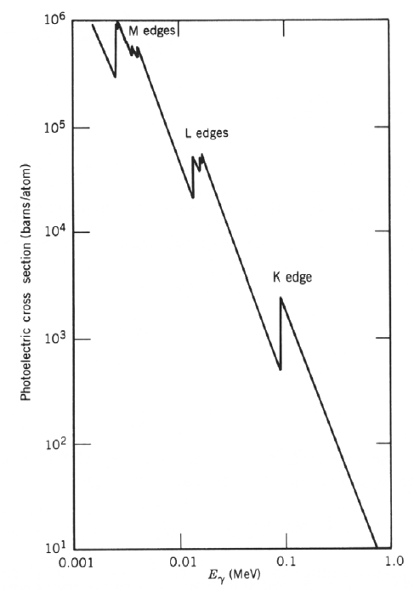
Interaction of gamma rays with matter
Photo effect:
Absorption of a photon by a bound electron and conversion of the γ-energy in potential and kinetical energy of the ejected electron.
(Nucleus preserves the momentum conservation.)

Slide 34
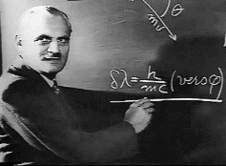




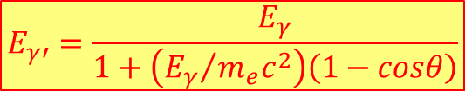


Interaction of gamma rays with matter
relativistic
$$E^{2}={\left(pc\right)}^{2}+{\left(m_{0}c^{2}\right)}^{2}$$
$$photons: m_{0}=m_{γ}=0$$
$$→E_{γ}=p_{γ}c$$
Momentum balance:
$$\vec{p_{e}}=\vec{p_{γ}}−\vec{{p′}_{γ}} → {\left|\vec{p_{e}}c\right|}^{2}={\left|\left(\vec{p_{γ}}−\vec{{p′}_{γ}}\right)c\right|}^{2}$$
$$p_{e}^{2}c^{2}=E_{γ}^{2}+E_{γ′}^{2}−2E_{γ}E_{γ′}∙cosθ$$
Energy balance:
Compton scattering:
Elastic scattering of a γ-ray on a free electron. A fraction of the γ-ray energy is transferred to the Compton electron. The wave length of the scattered γ-ray is increased: λ‘ > λ.
$$E_{γ}+m_{e}c^{2}=E_{γ′}+\sqrt{{\left(p_{e}c\right)}^{2}+{\left(m_{e}c^{2}\right)}^{2}}$$
$$E_{γ′}=\frac{E_{γ}}{1+\left({E_{γ}}/{m_{e}c^{2}}\right)\left(1−cosθ\right)}$$

Slide 35
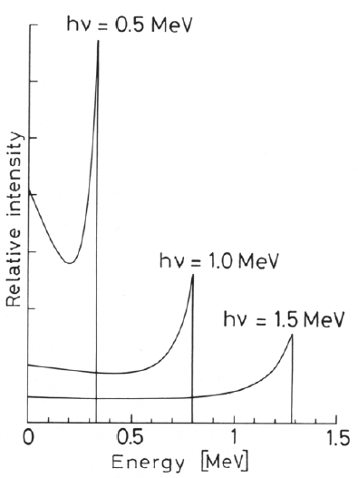
Interaction of gamma rays with matter
Maximum energy of the
scattered electron:
Energy of the scattered
γ-photon:
Special case for E>>m_{e}c²:
γ-ray energy after 180⁰ scatter
is approximately
Compton scattering:
Elastic scattering of a γ-ray on a free electron. A fraction of the γ-ray energy is transferred to the Compton electron. The wave length of the scattered γ-ray is increased: λ‘ > λ.
Gap between the incoming γ-ray and the maximum electron energy.

Slide 36
Interaction of gamma rays with matter
σ_{Compton}
Compton scattering:
Elastic scattering of a γ-ray on a free electron. A fraction of the γ-ray energy is transferred to the Compton electron. The wave length of the scattered γ-ray is increased: λ‘ > λ.

Slide 37
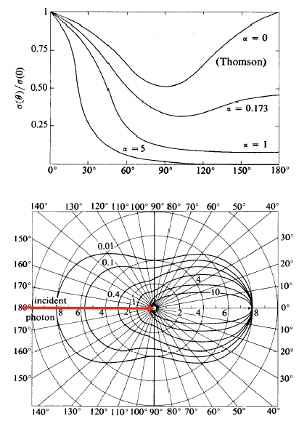


Interaction of gamma rays with matter
Intensity as a function of θ:
$$α={E_{γ}}/{m_{e}c^{2}}$$
Angular distribution:
Compton scattering:
Elastic scattering of a γ-ray on a free electron.
The angle dependence is expressed by the
Klein-Nishina-Formula:
As shown in the plot forward scattering (θ small) is dominant for E_{γ}>100 keV.
MeV
$$\frac{dσ_{c}}{dΩ}=\frac{r_{0}^{2}}{2}{\left(\frac{E_{γ′}}{E_{γ}}\right)}^{2}∙\left\{\frac{E_{γ}}{E_{γ′}}+\frac{E_{γ′}}{E_{γ}}−2\sin^{2}θ∙\cos^{2}φ\right\}$$
r₀=2.818 fm (classical electron radius)

Slide 38



Interaction of gamma rays with matter
$$\frac{dσ_{PP}}{dE_{kin}^{+}}=Z^{2}\frac{1}{137}{\left(\frac{e^{2}}{m_{e}c^{2}}\right)}^{2}\frac{P\left(Z,E_{γ}\right)}{E_{γ}−2m_{e}c^{2}}$$
Pair production:
If γ-ray energy is >> 2m₀c² (electron rest mass 511 keV), a positron-electron pair can be formed in the strong Coulomb field of a nucleus. This pair carries the γ-ray energy minus 2m₀c².
Pair production for E_{γ}>2m_{e}c²=1.022MeV
e⁻
γ-ray > 1 MeV
γ’s
magnetic field
picture of a bubble chamber

Slide 39



Interaction of gamma rays with matter
γ-rays interaction with matter via three main reaction mechanisms:
Photoelectric absorption
Compton scattering
Pair production

Slide 40


Gamma-ray interaction cross section
All three interaction (photo effect, Compton scattering and pair production) lead to an attenuation of the γ-ray or X-ray radiation when passing through matter. The particular contribution depends on the γ-ray energy:
The absorption attenuates the intensity, but the energy and the frequency of the γ-ray and X-ray radiation is preserved!
Photo effect: ~Z⁴⁻⁵, E_{γ}^{-3.5}
Compton: ~Z, E_{γ}⁻¹
Pair: ~Z², increases with E_{γ}

Slide 41

Z dependence of interaction probabilities

Slide 42
Detector types
Solid state semiconductor detectors: Ge
Electron-hole pairs are collected as charge
knock-on effect → an avalanche arrives at the electrode
lots of electrons → good energy resolution
cooled to liquid N₂ temperature (77K) to reduce noise
Advantage: good energy resolution (~0.15% FWHM at 1.3 MeV)
Disadvantage: relative low efficiency, cryogenic operation, limited size of crystal/detector
Scintillation detectors: e.g. NaI, BGO, LaBr₃(Ce)
Recoiling electrons excite atoms, which then de-excite by emitting visible light
Light is collected in photomultiplier tubes (PMT) where it generates a pulse proportional to the light collected
Advantage: good time resolution
detector can be made relative large e.g. NaI detector 14”Ø x 10”
no need for cryogenics
Disadvantage: poor energy resolution (~5% FWHM at 1.3 MeV

Slide 43

Scintillation detectors

Slide 44

Detector characterization

Slide 45


Gamma-ray spectrum of a radioactive decay
Pb-Box
Pb X-ray
γ₁
BSc
γ₂
511 keV
DE γ₂
SE γ₂
CE γ₂
γ₁+γ₂

Slide 46
Spins and parities
Two distinct types of measurements:
Angular correlation : can be done with a non-aligned source but need γ-γ coincidence information.
Angular distribution: need an aligned source but can be done with singles data.
...note that these cannot measure parity but you can usually infer something about the transition

Slide 47


The basics of the situation
Imagine the situation of an M1 decay between two states, the initial one has J^{π} value of 1⁺ and the final one a J^{π} of 0⁺
The initial J^{π}=1⁺ state has 3 degenerate magnetic substates which differ by the magnetic quantum numbers m of $±1$ and 0.
The final J^{π}=0⁺ state has a single magnetic substate with m=0.
When the substates of J^{π}=1⁺ state decay, the γ-rays emitted have different angular patterns.

Slide 48







The basics of the situation
For the M1 case the angular distributions W(θ) are:
$$W_{M1, Δm=1}\left(θ\right)=\frac{3}{16π}\left(1+\cos^{2}θ\right)$$
$$W_{M1,Δm=0}\left(θ\right)=\frac{3}{8π}\sin^{2}θ$$
$$W_{M1,Δm=−1}\left(θ\right)=\frac{3}{16π}\left(1+\cos^{2}θ\right)$$
So the total distribution is $W_{M1}=\frac{1}{3}W_{M1,Δm=1}+\frac{1}{3}W_{M1,Δm=0}+\frac{1}{3}W_{M1,Δm=−1}$
$$=\frac{1}{8π}\left(1+\cos^{2}θ+\sin^{2}θ\right)=\frac{1}{4π}$$
no angular dependence

Slide 49



Angular correlation – non-oriented source
Let’s imagine we have two γ-rays which follow immediately after each other in the level scheme.
$$γ_{1}$$
E1
If we measure γ₁ or γ₂ in singles, then the distribution will be isotropic (same intensity at all angles) ... there is no preferred direction of emission
$$γ_{2}$$
Now imagine that we measure γ₁ and γ₂ in coincidence. We say that measuring γ₁ causes the intermediate state to be aligned. We define the z-direction as the direction of γ₁
The angular distribution of the emission of γ₂ then depends on the spin/parities of the states involved and on the multipolarity of the transition.

Slide 50




A simple example:
0⁺
$$J^{π}=0^{+}, m=0$$
$$γ_{1}$$
E1
1⁺
$$J^{π}=1^{+}, m=0, m=±1$$
$$γ_{2}$$
0⁺
$$J^{π}=0^{+}, m=0$$
Hence, for γ₂ we only see the m=±1 to m=0 part of the distribution i.e. we see that the intensity measured as a function of angle (relative to γ₁) follows a $1+\cos^{2}θ$ distribution.

Slide 51





General formula
J₁
In general, the γ-ray intensity varies as:
$$γ_{1}$$
$$W\left(θ\right)=\sum_{k_{even}}{A_{k}\left(γ_{1}\right)A_{k}\left(γ_{2}\right)Q_{k}\left(γ_{1}\right)Q_{k}\left(γ_{2}\right)P_{k}\left(cosθ\right)}$$
E1
J₂
$$γ_{2}$$
where
θ is the relative angle between the two γ-rays
Q_{k} accounts for the fact that we do not have point detectors
A_{k} depends on the details of the transition and the spins of the level
J₃
$$P_{0}=1 P_{2}=\frac{1}{2}\left(3∙\cos^{2}\left(θ\right)−1\right) P_{4}=\frac{1}{8}\left(35\cos^{4}\left(θ\right)−30\cos^{2}\left(θ\right)+3\right)$$
I₁ (ℓ₁) | I₂ (ℓ₂) | I₃ | a₂ | a₄
0 (1) | 1 (1) | 0 | 1 | 0
1 (1) | 1 (1) | 0 | -1/3 | 0
1 (2) | 1 (1) | 0 | -1/3 | 0
2 (1) | 1 (1) | 0 | 1/13 | 0
3 (2) | 1 (1) | 0 | -3/29 | 0
0 (2) | 2 (2) | 0 | -3 | 4
1 (1) | 2 (2) | 0 | -1/3 | 0
2 (1) | 2 (2) | 0 | 3/7 | 0
2 (2) | 2 (2) | 0 | -15/13 | 16/13
3 (2) | 2 (2) | 0 | -3/29 | 0
4 (2) | 2 (2) | 0 | 1/8 | 1/24
$$W\left(θ\right)=1+a_{2}\cos^{2}θ+a_{4}\cos^{4}θ$$
R.D. Evans, The Atomic Nucleus

Slide 52
General formula
J₁
In general, the γ-ray intensity varies as:
$$γ_{1}$$
$$W\left(θ\right)=\sum_{k_{even}}{A_{k}\left(γ_{1}\right)A_{k}\left(γ_{2}\right)Q_{k}\left(γ_{1}\right)Q_{k}\left(γ_{2}\right)P_{k}\left(cosθ\right)}$$
E1
J₂
$$γ_{2}$$
where
θ is the relative angle between the two γ-rays
Q_{k} accounts for the fact that we do not have point detectors
A_{k} depends on the details of the transition and the spins of the level
J₃
$$P_{0}=1 P_{2}=\frac{1}{2}\left(3∙\cos^{2}\left(θ\right)−1\right) P_{4}=\frac{1}{8}\left(35\cos^{4}\left(θ\right)−30\cos^{2}\left(θ\right)+3\right)$$
$$A_{k}\left(γ_{1}\right)=\frac{F_{k}\left(J_{2}J_{1}ℓ,ℓ\right)−2∙δ{∙F}_{k}\left(J_{2}J_{1}ℓ,ℓ+1\right)+δ^{2}{∙F}_{k}\left(J_{2}J_{1}ℓ+1,ℓ+1\right)}{1+δ^{2}}$$
$$A_{k}\left(γ_{2}\right)=\frac{F_{k}\left(J_{2}J_{3}L,L\right)−2∙δ{∙F}_{k}\left(J_{2}J_{3}L,L+1\right)+δ^{2}{∙F}_{k}\left(J_{2}J_{3}L+1,L+1\right)}{1+δ^{2}}$$
Ferentz-Rosenzweig coefficients
$$F_{k}\left(LL′I_{1}I_{2}\right)={\left(−1\right)}^{I_{1}+I_{2}+1}\sqrt{2k+1}\sqrt{2L+1}\sqrt{2L^{′}+1}\sqrt{2I_{2}+1}\left(\begin{matrix}L & L′ & k \\ 1 & −1 & 0\end{matrix}\right)\left\{\begin{matrix}L & L′ & k \\ I_{1} & I_{1} & I_{2}\end{matrix}\right\}$$
https://griffincollaboration.github.io/AngularCorrelationUtility/

Slide 53



A special case:
$${}_{78}^{195}{Pt}\left(n,γ\right){}_{78}^{196}{Pt}$$

Slide 54

Angular correlations with arrays
Many arrays are designed symmetrically, so the range of possible angles is reduced.
Therefore one measures a Directional Correlation from Oriented Nuclei (DCO ratio)
In the simplest case, if you have an array with detectors at 35⁰ and 90⁰.
Gate on 90⁰ detector, measure coincident intensities in
other 90⁰ detectors
35⁰ detectors
Take the ratio and compare with calculations ... can usually separate quadrupoles from dipoles but cannot measure mixing ratios

Slide 55

Angular correlations with arrays

Slide 56






Angular distribution - fusion
In heavy-ion fusion-evaporation reactions, the compound nuclei have their spin aligned in a plane perpendicular to the beam axis:
$$\vec{ℓ}=\vec{r}×\vec{p}$$
Depending on the number and type of particles ‘boiled off’ before a γ-ray is emitted, transitions are emitted from oriented nuclei and therefore their intensity shows an angular dependence.
$$W\left(θ\right)=A_{0}\left(1+\frac{A_{2}}{A_{0}}∙B_{2}{∙Q_{2}∙P}_{2}\left(cosθ\right)+\frac{A_{4}}{A_{0}}{∙B}_{4}∙Q_{4}∙P_{4}\left(cosθ\right)\right)$$
where A_{k}, Q_{k} and P_{k} are as before and B_{k} contains information about the alignment of the state
$$P\left(m\right)=\frac{exp\left(−\frac{m^{2}}{2σ^{2}}\right)}{\sum_{m^{′}=−I}^{+I}{exp\left(−\frac{{m′}^{2}}{2σ^{2}}\right)}}$$
$$B_{k}\left(I_{i}\right)=\sqrt{2I_{i}+1}\sum_{m=−I}^{+I}{{\left(−1\right)}^{I_{i}−m}\left\langle I_{i}mI_{i}−m | k0\right\rangle P\left(m\right)}$$

Slide 57

Angular distribution
Measure: the γ-ray yield as a function of θ

Slide 58








Angular distribution: Coulomb excitation
$$θ_{2}=\frac{{180}^{0}−θ_{cm}}{2}$$
(30⁰,180⁰)
$$\frac{dW\left(γ_{N→M}\right)}{dΩ_{γ}^{Rest}}=a_{0}∙\left[1+\frac{a_{2}}{a_{0}}{Q_{2}P}_{2}\left(cosθ_{γ2}\right)+\frac{a_{4}}{a_{0}}{Q_{4}P}_{4}\left(cosθ_{γ2}\right)\right]$$
$$cosθ_{γ2}=cosθ_{γ}∙cosθ_{2}+sinθ_{γ}∙sinθ_{2}∙cos\left(φ_{γ}−φ_{2}\right)$$
$$a_{0}=\frac{1}{1+α_{T}\left(I→I−2\right)}\frac{1}{4π}P_{I}$$
$$\frac{a_{2}}{a_{0}}=\frac{5}{7}\frac{I+1}{2I−1}$$
(for m=0 and stretched E2)
$$\frac{a_{4}}{a_{0}}=−\frac{3}{7}\frac{\left(I+1\right)∙\left(I+2\right)}{\left(2I−3\right)∙\left(2I−1\right)}$$
(for m=0 and stretched E2)

Slide 59





Linear polarization
A segmented detector can be used to measure the linear polarization which can be used to distinguish between magnetic (M) and electric (E) character of radiation of the same multipolarity.
The Compton scattering cross section is larger in the direction perpendicular to the electrical field vector of the radiation.
Define experimental asymmetry as: $A=\frac{N_{90}−N_{0}}{N_{90}+N_{0}}$
where N₉₀ and N₀ are the intensities of scattered photons perpendicular and parallel to the reaction plane.
The experimental linear polarization P=A/Q where Q is the polarization sensitivity of the detector
Q~13% at 1 MeV

Slide 60


Linear polarization
Klein-Nishina formula:
$$\frac{dσ_{c}}{dΩ}=\frac{r_{0}^{2}}{2}{\left(\frac{E_{γ′}}{E_{γ}}\right)}^{2}∙\left\{\frac{E_{γ}}{E_{γ′}}+\frac{E_{γ′}}{E_{γ}}−2\sin^{2}θ∙\cos^{2}φ\right\}$$
Maximum polarization at θ=90⁰

Slide 61

Proof of Principle
N. Pietralla, Nucl Instr Meth A483, 556 (2002)

Slide 62

Linear polarization

Slide 63




Laser Compton backscattering
Energy – momentum conservation yields $\sim 4γ^{2}$ Doppler upshift
Thomsons scattering cross section is very small (6·10⁻²⁵ cm²)
High photon and electron density are required

Slide 64


Efficiency versus resolution
With a source at rest, the intrinsic resolution of the detector can be reached;
efficiency decreases with the increasing detector-source distance.
With a moving source also the effective energy resolution depends on the detector-source distance (Doppler effect)
Small d
Large d
Large Ω
Small Ω
High ε
Low ε
Poor FWHM
Good FWHM

Slide 65









Energy resolution
The major factors affecting the final energy resolution (FWHM) at a particular energy are as follows:
$$ΔE_{γ}^{final}={\left(ΔE_{Int}^{2}+Δθ_{det}^{2}+Δθ_{N}^{2}+Δv^{2}\right)}^{1/2}$$
$$v±∆v$$
$ΔE_{Int} −$The intrinsic resolution of the detector system.
It includes contributions from the detector itself and
the electronic components used to process the signal.
$$Δθ_{N}$$
$$Δθ_{det}$$
$Δθ_{det} −$The Doppler broadening arising from the opening angle of
the detectors
$Δθ_{N} −$The Doppler broadening arising from the angular spread of the
recoils in the target
$Δv −$ The Doppler broadening arising from the velocity (energy)
variation of the excited nucleus

Slide 66








Special relativity
Lorentz transformation:

Slide 67






Lorentz transformation
P* = const.
total energy:
$$E^{∗}=γ∙E−γ∙v∙P∙cosθ$$
with
$$E=\sqrt{{\left(mc^{2}\right)}^{2}+{\left(Pc\right)}^{2}}$$
rest system
laboratory system
E*, P* total energy and momentum in the rest system
E, P total energy and momentum in the laboratory system
Doppler formula for zero-mass particle (photon): E=Pc
$$E^{∗}=γ∙E−γ∙β∙E∙cosθ$$
$$E^{∗}=γ∙E\left(1−β∙cosθ\right)$$
Hendrik Lorentz
E. Byckling, K. Kajantie J. Wiley & Sons London

Slide 68

Doppler effect
for

Slide 69

Doppler broadening and position resolution
Position resolution
γ ray
Angular resolution
beam
projectile
Energy resolution

Slide 70

Doppler broadening (opening angle of detector)
for
with

Slide 71

Doppler broadening (velocity variation)
for
with

Slide 72





Experimental arrangement
experimental problem:
Doppler broadening due to finite size of Ge-detector
$$\frac{∆E}{E}\sim 1\%$$
for
$$∆θ_{γ}={20}^{0} β_{1}≅10\%$$
For projectile excitation:
$$E^{∗}=γ∙E∙\left(1−β_{1}∙cosθ_{γ1}\right)$$
Doppler shift
with
$$cosθ_{γ1}=cosθ_{1}cosθ_{γ}+sinθ_{1}sinθ_{γ}cos\left(φ_{γ}−φ_{1}\right)$$
$$ΔE≅E^{∗}∙β_{1}∙sinθ_{γ1}∙∆θ_{γ1}$$
Doppler broadening

Slide 73


Inelastic heavy-ion scattering
¹⁸¹Ta
raw γ-ray spectrum
²³⁸U

Slide 74



Lorentz transformation
γ-ray angular distribution
Contraction of the solid angle element in the laboratory system
$$\frac{dΩ}{dΩ^{∗}}={\left\{\frac{E^{∗}}{E}\right\}}^{2}$$
with
$$E^{∗}=γ∙E∙\left(1−β∙cosθ\right)$$
Doppler formula

Slide 75


Experimental arrangement (electron detection)
Doppler broadening
Δϑ_{e} = 20⁰
target – Mini-Orange: 19 cm
Mini-Orange – Si detector: 6 cm
For projectile excitation:
$$T_{e}^{∗}=γ∙T_{e}∙\left\{1−β_{1}∙\sqrt{1+2m_{e}{c^{2}}/{T_{e}}}∙cosθ_{e1}\right\}+m_{e}c^{2}∙\left(γ−1\right)$$
with
$$cosθ_{e1}=cosθ_{1}cosθ_{e}+sinθ_{1}sinθ_{e}cos\left(φ_{e}−φ_{1}\right)$$

Slide 76

Lorentz transformation
γ-rays
10%
energy shift
γ-rays
20%
solid angle contraction

Slide 77



Segmented detectors
70cm
target
beam
20cm

Slide 78





Recoil distance method
$$I_{degraded}=I∙e^{−d/{vτ}}$$
$$I_{shifted}=\left(1−e^{−d/{vτ}}\right)$$
$$\frac{I_{degraded}}{I_{degraded}+I_{shifted}}=e^{−d/{vτ}}$$

Slide 79



Doppler Shift Attenuation Method
target
stopper
beam
Germanium
detector
$${}_{}^{128}{Xe}→Ge;1.4 MeV/u$$
$$2^{+}→0^{+}, E_{γ}=443 keV$$
$$τ=30 ps$$
$${}_{}^{136}{Xe}→Ge;1.4 MeV/u$$
$$2^{+}→0^{+}, E_{γ}=1313 keV$$
$$τ=0.5 ps$$

Slide 80






Gamma-ray tracking
Gamma Arrays based on Compton
Suppressed Spectrometers
Tracking Arrays based on
Position Sensitive Ge Detectors
EUROBALL
GAMMASPHERE
AGATA
GRETA
ε ~ 10 - 7 %
( M_{γ} = 1 – M_{γ} = 30)
ε ~ 50 - 25 %
( M_{γ} = 1 - M_{γ} = 30)

