Slide 1
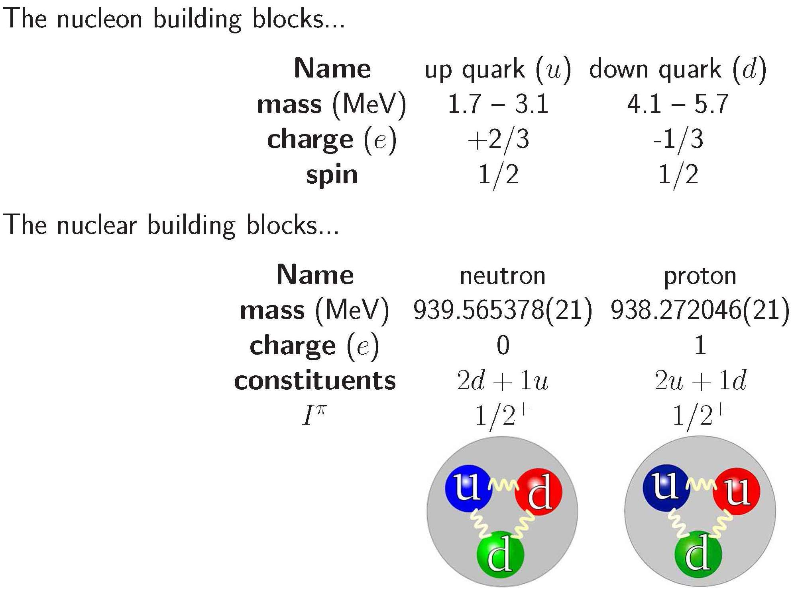
Nuclear Shell Model

Slide 2
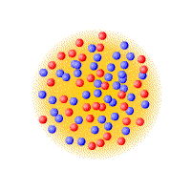
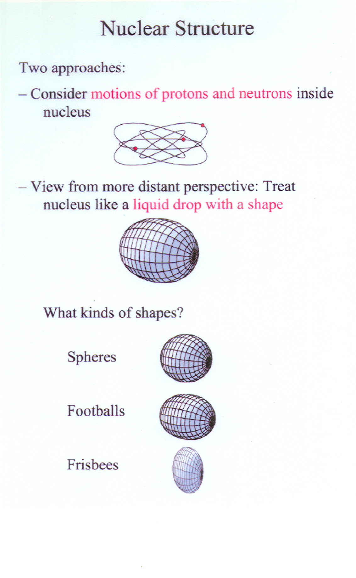
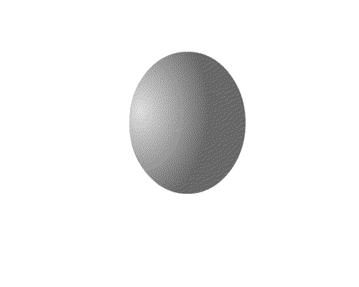
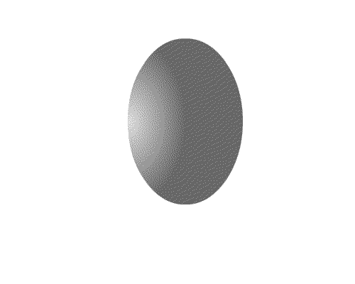
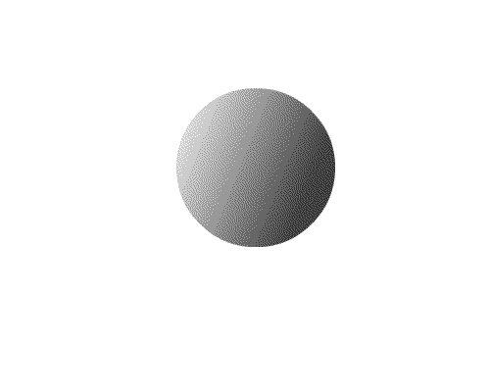
Themes and challenges in modern science
Complexity out of simplicity – Microscopic
  How the world, with all its apparent complexity and diversity can be constructed out of a few elementary building blocks and their interactions
Simplicity out of complexity – Macroscopic
  How the world of complex systems can display such remarkable regularity and simplicity
individual excitations of nucleons
vibration rotation fission

Slide 3
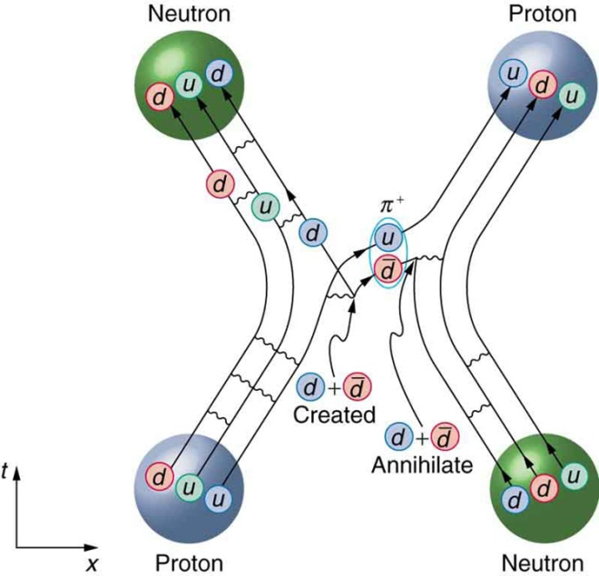
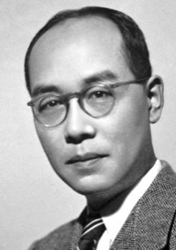
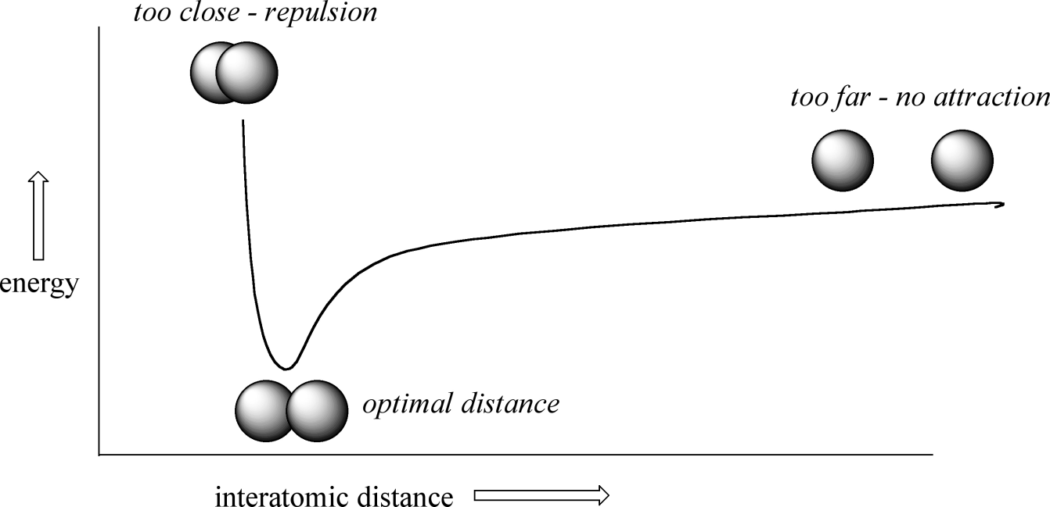
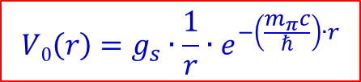
The nuclear force
The nuclear force is short-range, but does not allow for compression of nuclear matter.
Yukawa – potential:
$$V0\left(r\right)=g_{s}∙\frac{1}{r}∙e^{−\left(\frac{m_{π}c}{ℏ}\right)∙r}$$
ω,ρ
π
σ
m(π) ≈ 140 MeV/c²
m(σ) ≈ 500-600 MeV/c²
m(ω) ≈ 784 MeV/c²

Slide 4
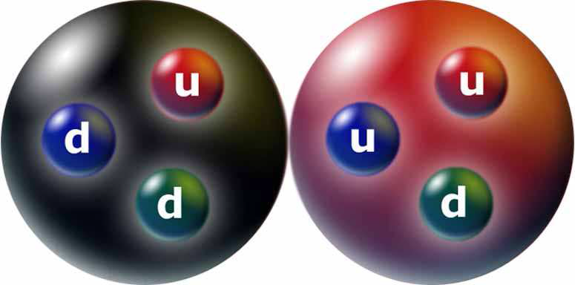
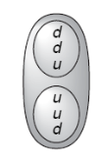
The deuteron
mass (MeV/c²) | 1875.61
charge (e) | 1
I^{π} | 1⁺
binding energy (MeV) | 2.2245
magnetic moment (μ_{N}) | 0.8574
quadrupole moment (b) | 0.0029
n
p
0.8798 μ_{N} = μ_{S} (${}_{1}^{2}H$) → the deuteron can not be a pure s state! ~ 96% s and 4% d.
not spherical consistent with s/d-ratio = 96/4
The deuteron is an ideal candidate for tests of our basic understanding of nuclear physics

Slide 5
Magnetic Moment (classical description)
e⁻-movement ⇒ magnetic moment
A
I
angular momentum:
e⁻
Quantum mechanical description: angular momentum will be quantized, in units of ħ.

Slide 6
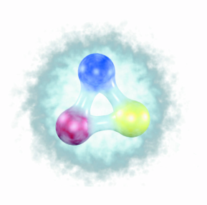
Quark Model
 | Charge | Mass m_{q} | Spin | mag. Moment
u-quark | + 2/3 | ~ 1/3 M_{p} | 1/2
d-quark | - 1/3 | ~ 1/3 M_{p} | 1/2
general coupling rule:
Proton (uud) :
Neutron (ddu) :
g_{Dirac} = 2 prediction of the Dirac-theory for the gyromagnetic factor for spin ½-particles
g_{s}^{proton} = +5.58 ⇒ big deviation from g = 2 ⇔ no fundamental particle
g_{s}^{neutron} = -3.82

Slide 7

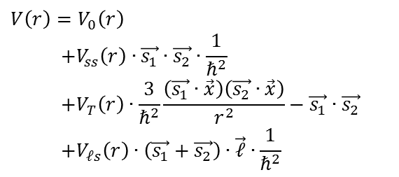

Structure of the nuclear force
Structure of the nuclear force is more complex than e.g. Coulomb force. It results from its structure as residual interaction of the colorless nucleons.
central force V₀(r)
results from deuteron properties (96% ³S₁ state)
$${}_{}^{2S+1}{L_{J}}$$
spin dependent central force
results from neutron-proton scattering (spin-spin interaction)
not central tensor force
results from deuteron properties (4% ³D₁ state)
$${}_{}^{2S+1}{L_{J}}$$
spin-orbit (ℓ·s) term
results from scattering of polarized protons (left/right asymmetry)
$$V\left(r\right)=V_{0}\left(r\right)$$
$$+V_{ss}\left(r\right)∙\vec{s_{1}}∙\vec{s_{2}}∙\frac{1}{ℏ^{2}}$$
$$+V_{T}\left(r\right)∙\frac{3}{ℏ^{2}}\frac{\left(\vec{s_{1}}∙\vec{x}\right)\left(\vec{s_{2}}∙\vec{x}\right)}{r^{2}}−\vec{s_{1}}∙\vec{s_{2}}$$
$$+V_{ℓs}\left(r\right)∙\left(\vec{s_{1}}+\vec{s_{2}}\right)∙\vec{ℓ}∙\frac{1}{ℏ^{2}}$$
central potential
spin-spin interaction
tensor force
spin-orbit interaction

Slide 8
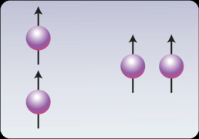
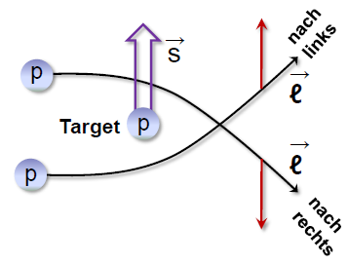



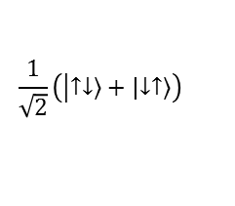
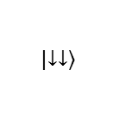

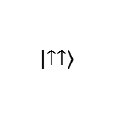


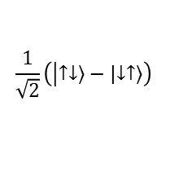
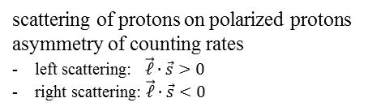
Structure of the nuclear force
$$\frac{1}{\sqrt{2}}\left(\left|\left.↑↓\right\rangle −\left|\left.↓↑\right\rangle \right.\right.\right)$$
s = 0, ℓ = 1
spin-spin force:
$$\sim V_{ss}\left(r\right)∙\vec{s_{1}}∙\vec{s_{2}} /ℏ^{2}$$
different eigenvalues for triplet and singlet states
$$\left|\left.↑↑\right\rangle \right.$$
$$\frac{1}{\sqrt{2}}\left(\left|\left.↑↓\right\rangle +\left|\left.↓↑\right\rangle \right.\right.\right)$$
$$\left|\left.↓↓\right\rangle \right.$$
s = 1, ℓ = 0
tensor force:
$$\vec{x}$$
$$\sim V_{T}\left(r\right)∙\frac{3}{ℏ^{2}}\frac{\left(\vec{s_{1}}∙\vec{x}\right)\left(\vec{s_{2}}∙\vec{x}\right)}{r^{2}}−\vec{s_{1}}∙\vec{s_{2}}$$
small deformation of deuterium maximum magnetic dipole moments
$$\vec{x}$$
attractive repulsive
ℓ·s coupling:
scattering of protons on polarized protons asymmetry of counting rates
left scattering: $\vec{ℓ}∙\vec{s}>0$
right scattering: $\vec{ℓ}∙\vec{s}<0$
to left
$$\sim V_{ℓs}\left(r\right)∙\left(\vec{ℓ}∙\vec{s}\right)$$
to right
ℓ·s coupling:
no net contribution in the center of nucleus
radial dependence at the surface of the nucleus
$$V_{ℓs}\left(r\right)∝\frac{1}{r}∙\frac{dρ}{dr}$$

Slide 9
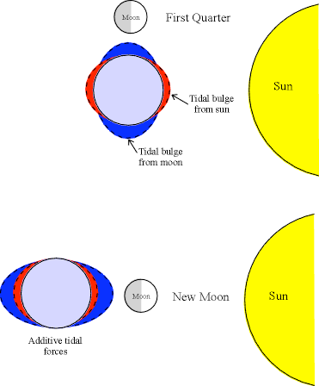
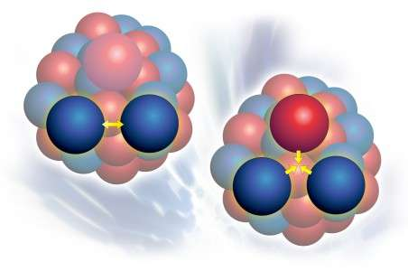
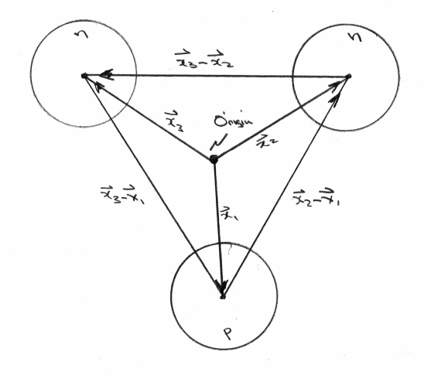
Many-body forces
internal forces governing a ³He nucleus
The force on one nucleon does not only depend on the position of the other nucleons, but also on the distance between the other nucleons! These are called many-body forces.
tidal effects lead to 3-body forces in earth-sun-moon system
Remember: Nucleons are finite-mass composite particles, can be excited to resonances. Dominant contribution Δ(1232 MeV)

Slide 10
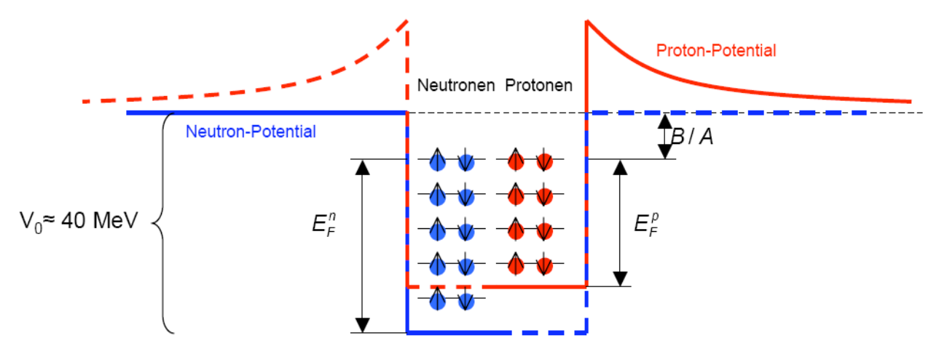
The Fermi gas model
proton potential
neutrons
protons
neutron potential
The Fermi gas model assumes that protons and neutrons are moving freely within the nuclear volume. They are distinguishable fermions (s = ½) filling two separate potential wells obeying the Pauli principle (↑↓-pair).
The model assumes that all fermions occupy the lowest energy states available to them to the highest occupied state (Fermi energy), and that there is no excitation across the Fermi energy (i.e. zero temperature).
The Fermi energy is common for protons and neutrons in stable nuclei.
If the Fermi energy for protons and neutrons are different then the β-decay transforms one type of nucleons into the other until the common Fermi energy (stability) is reached.

Slide 11


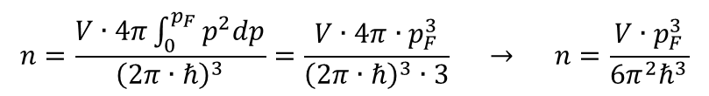
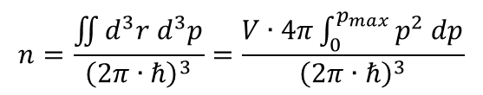

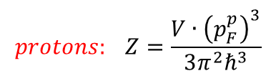
Number of nucleon states
Heisenberg Uncertainty Principle: $∆x∙∆p≥\frac{1}{2}ℏ$
The volume of one particle in phase space: $2π∙ℏ$
The number of nucleon states in a volume V:
$$n=\frac{\iint{d^{3}r d^{3}p}}{{\left(2π∙ℏ\right)}^{3}}=\frac{V∙4π\int_{0}^{p_{max}}{p^{2} dp}}{{\left(2π∙ℏ\right)}^{3}}$$
states in phase space
At temperature T = 0, i.e. for the nucleus in its ground state, the lowest states will be filled up to the maximum momentum, called the Fermi momentum p_{F}. The number of these states follows from integration from 0 to p_{max} = p_{F}.
$$n=\frac{V∙4π\int_{0}^{p_{F}}{p^{2}dp}}{{\left(2π∙ℏ\right)}^{3}}=\frac{V∙4π∙p_{F}^{3}}{{\left(2π∙ℏ\right)}^{3}∙3} → n=\frac{V∙p_{F}^{3}}{6π^{2}ℏ^{3}}$$
Since an energy state can contain two fermions of the same species, we can have
$$neutrons: N=\frac{V∙{\left(p_{F}^{n}\right)}^{3}}{3π^{2}ℏ^{3}}$$
$$protons: Z=\frac{V∙{\left(p_{F}^{p}\right)}^{3}}{3π^{2}ℏ^{3}}$$
$p_{F}^{n}$ is the Fermi momentum for neutrons, $p_{F}^{p}$ for protons

Slide 12
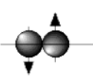
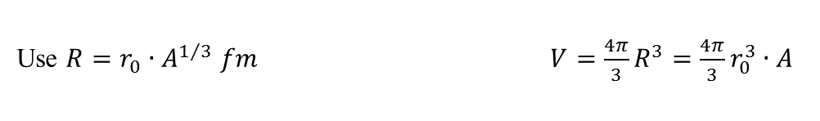

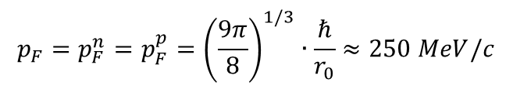
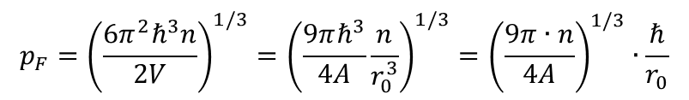

Fermi momentum
Use $R=r_{0}∙A^{1/3} fm$ $V=\frac{4π}{3}R^{3}=\frac{4π}{3}r_{0}^{3}∙A$
The density of nucleons in a nucleus = number of nucleons in a volume V:
$$n=2∙\frac{V∙p_{F}^{3}}{6π^{2}ℏ^{3}}=2∙\frac{4π}{3}r_{0}^{3}∙A∙\frac{p_{F}^{3}}{6π^{2}ℏ^{3}}=\frac{4A}{9π}\frac{r_{0}^{3}∙p_{F}^{3}}{ℏ^{3}}$$
two spin states
Fermi momentum p_{F}:
$$p_{F}={\left(\frac{6π^{2}ℏ^{3}n}{2V}\right)}^{1/3}={\left(\frac{9πℏ^{3}}{4A}\frac{n}{r_{0}^{3}}\right)}^{1/3}={\left(\frac{9π∙n}{4A}\right)}^{1/3}∙\frac{ℏ}{r_{0}}$$
After assuming that the proton and neutron potential wells have the same radius, we find for a nucleus with n = Z = N = A/2 the Fermi momentum p_{F}.
$$p_{F}=p_{F}^{n}=p_{F}^{p}={\left(\frac{9π}{8}\right)}^{1/3}∙\frac{ℏ}{r_{0}}≈250 MeV/c$$
The nucleons move freely inside the nucleus with large momenta
Fermi energy: $E_{F}=\frac{p_{F}^{2}}{2m_{N}}≈33 MeV$
m_{N} = 938 MeV/c² – the nucleon mass

Slide 13
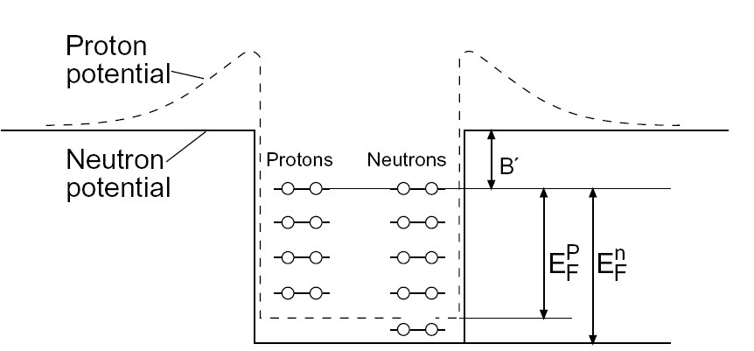


Nucleon potential
The difference B´ between the top of the well and the Fermi level is the average binding energy per nucleon B/A = 7 – 8 MeV.
→ The depth of the potential V₀ and the Fermi energy are independent of the mass number A:
$$V_{0}=E_{F}+B´≈40 MeV$$
Heavy nuclei have a surplus of neutrons. Since the Fermi level of the protons and neutrons in a stable nucleus have to be equal (otherwise the nucleus would enter a more energetically favorable state through β-decay) this implies that the depth of the potential well as it is experienced by the neutron gas has to be larger than of the proton gas.
Protons are therefore on average less strongly bound in nuclei than neutrons. This may be understood as a consequence of the Coulomb repulsion of the charged protons and leads to an extra term in the potential:
$$V_{C}=\left(Z−1\right)\frac{α∙ℏc}{R}$$
Protonen: 33MeV + 7MeV, Neutronen: 43MeV + 7 MeV

Slide 14
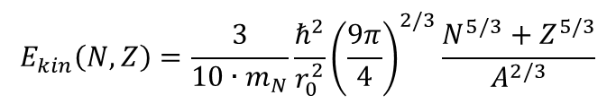
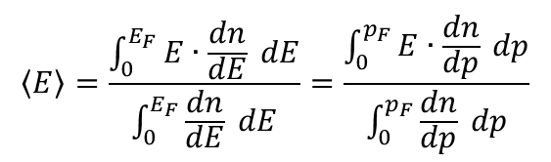
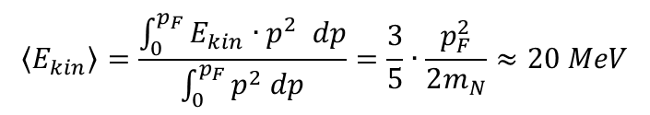


Kinetic energy
The dependence of the binding energy on the surplus of neutrons may be calculated within the Fermi gas model.
First we find the average kinetic energy per nucleon:
$$\left\langle E\right\rangle =\frac{\int_{0}^{E_{F}}{E∙\frac{dn}{dE} dE}}{\int_{0}^{E_{F}}{\frac{dn}{dE} dE}}=\frac{\int_{0}^{p_{F}}{E∙\frac{dn}{dp} dp}}{\int_{0}^{p_{F}}{\frac{dn}{dp} dp}}$$
$$n=\frac{V∙p_{F}^{3}}{6π∙ℏ^{3}}$$
where
$$\frac{dn}{dp}=const∙p^{2}$$
distribution function of the nucleons
$$\left\langle E_{kin}\right\rangle =\frac{\int_{0}^{p_{F}}{E_{kin}{∙p}^{2} dp}}{\int_{0}^{p_{F}}{p^{2} dp}}=\frac{3}{5}∙\frac{p_{F}^{2}}{2m_{N}}≈20 MeV$$
The total kinetic energy of the nucleus is therefore
$$E_{kin}\left(N,Z\right)=N∙\left\langle E_{n}\right\rangle +Z∙\left\langle E_{p}\right\rangle =\frac{3}{10∙m_{N}}∙\left(N∙{\left(p_{F}^{n}\right)}^{2}+Z∙{\left(p_{F}^{p}\right)}^{2}\right)$$
$$E_{kin}\left(N,Z\right)=\frac{3}{10∙m_{N}}\frac{ℏ^{2}}{r_{0}^{2}}{\left(\frac{9π}{4}\right)}^{2/3}\frac{N^{5/3}+Z^{5/3}}{A^{2/3}}$$
where the radii of the proton and neutron potential well have again been taken the same.

Slide 15
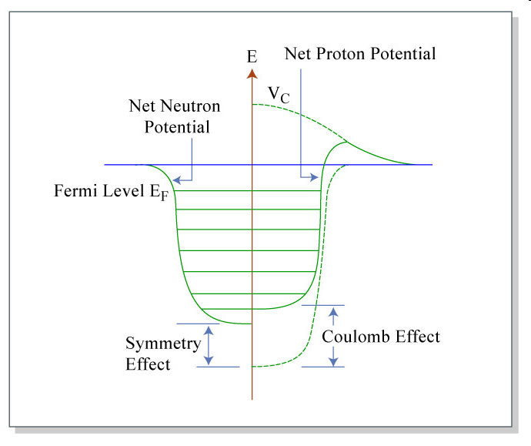
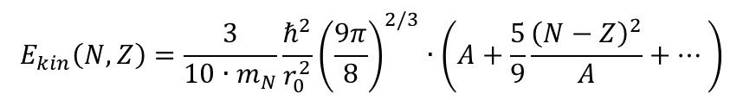
Binding energy
This average kinetic energy has a minimum at N = Z for fixed mass number A (but varying N or, equivalently Z). Hence the binding energy gets maximal for N = Z.
If we expand the equation in the difference N-Z we obtain
$$E_{kin}\left(N,Z\right)=\frac{3}{10∙m_{N}}\frac{ℏ^{2}}{r_{0}^{2}}{\left(\frac{9π}{8}\right)}^{2/3}∙\left(A+\frac{5}{9}\frac{{\left(N−Z\right)}^{2}}{A}+⋯\right)$$
The first term corresponds to the volume energy in the Weizsäcker mass formula, the second one to the asymmetry energy. The asymmetry energy grows with the neutron (or proton) surplus, thereby reducing the binding energy
Note: this consideration neglected the change of the nuclear potential connected to a change of N on cost of Z. This additional correction turns out to be as important as the change in kinetic energy.

Slide 16
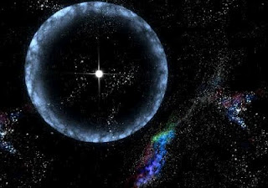

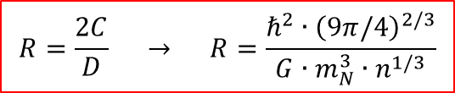


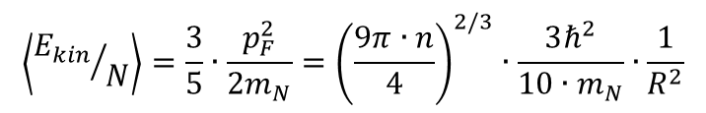

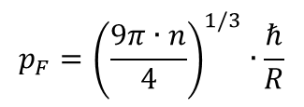


The Fermi gas model and the neutron star
Assumption: neutron star as cold neutron gas with constant density
- 1.5 sun masses: M = 3·10³⁰ kg (m_{N} = 1.67·10⁻²⁷ kg), number of neutrons: n = 1.8·10⁵⁷
Fermi momentum p_{F} for cold neutron gas:
$$p_{F}={\left(\frac{9π∙n}{4}\right)}^{1/3}∙\frac{ℏ}{R}$$
R is the radius of the neutron star
Average kinetic energy per neutron:
$$\left\langle {E_{kin}}/N\right\rangle =\frac{3}{5}∙\frac{p_{F}^{2}}{2m_{N}}={\left(\frac{9π∙n}{4}\right)}^{2/3}∙\frac{3ℏ^{2}}{10∙m_{N}}∙\frac{1}{R^{2}}$$
$$=\frac{C}{R^{2}}$$
Gravitational energy of a star with constant density has an average potential energy per neutron:
$$\left\langle {E_{pot}}/N\right\rangle =−\frac{3}{5}∙\frac{G∙n∙m_{n}^{2}}{R}$$
$$=−\frac{D}{R}$$
$$G=6.67∙{10}^{−11} \frac{m^{3}}{kg∙s^{2}}$$
Minimum total energy per neutron:
$$\frac{d}{dR}\left\langle E/N\right\rangle =\frac{d}{dR}\left[\left\langle E_{kin}/N\right\rangle +\left\langle E_{pot}/N\right\rangle \right]=0$$
$$\frac{d}{dR}\left[\frac{C}{R^{2}}−\frac{D}{R}\right]=−\frac{2C}{R^{3}}+\frac{D}{R^{2}}=0$$
$$R=\frac{2C}{D} → R=\frac{ℏ^{2}∙{\left(9π/4\right)}^{2/3}}{G∙m_{N}^{3}∙n^{1/3}}$$
radius of a neutron star ~ 10.7 km

Slide 17
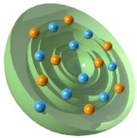
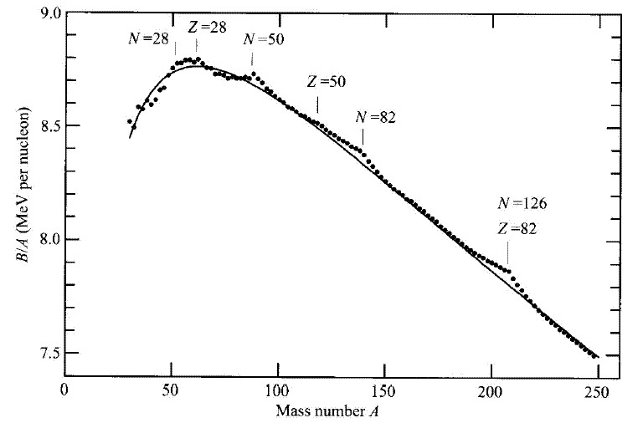
Shell structure in nuclei
Deviations from the Bethe-Weizsäcker mass formula:
Neutron
Proton
28
28
50
50
B/A (MeV per nucleon)
82
especially stable:
126
82
mass number A

Slide 18
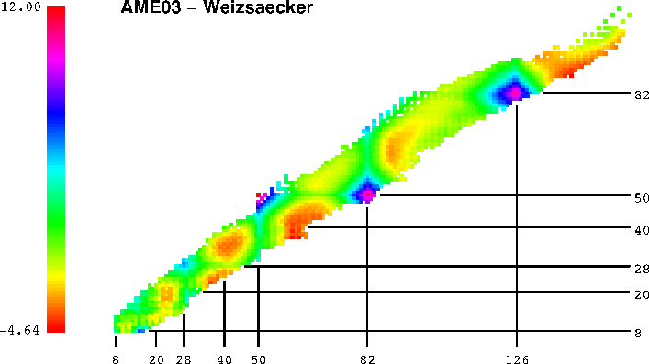
Shell structure in nuclei
deviations from the Bethe-Weizsäcker mass formula: large binding energies
²⁰⁸Pb
¹³²Sn

Slide 19

2-neutron binding energies = 2-neutron ´separation´energies
$$S_{2n}=BE\left(N,Z\right)−BE\left(N−2,Z\right)$$
N = 82
25
23
21
N = 126
19
17
S(2n) MeV
15
13
11
Sm
Hf
9
N = 84
Ba
Pb
7
Sn
5
52
56
60
64
68
72
76
80
84
88
92
96
100
104
108
112
116
120
124
128
132
Neutron Number

Slide 20
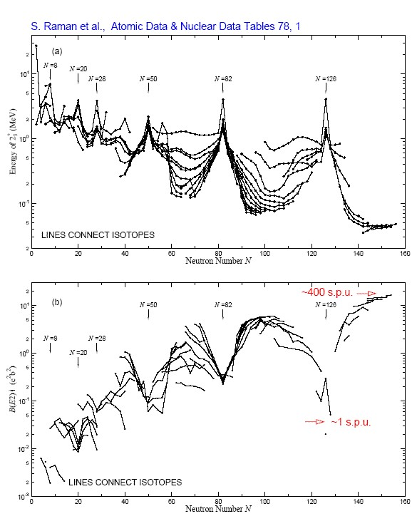


Shell structure in nuclei
Nuclei with magic numbers
of neutrons/protons
high energies of the first excited 2⁺ state
small nuclear deformations
transition probabilities measured in single particle units (spu)
$$E_{2_{1}^{+}}$$
$$B\left(E2;2_{1}^{+}→0^{+}\right)$$

Slide 21
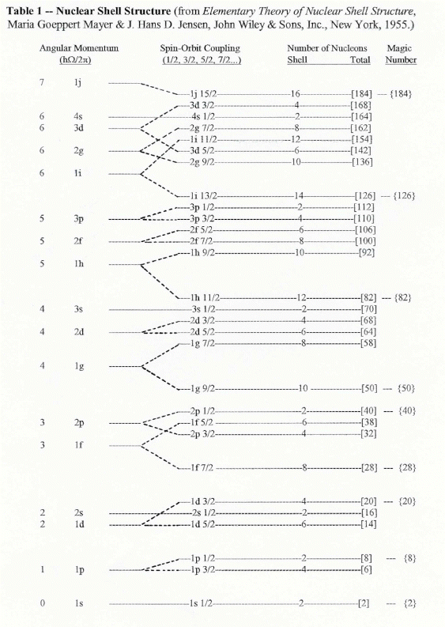
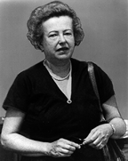
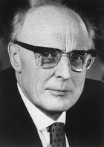
Shell structure in nuclei
$$E_{2_{1}^{+}}$$
$$B\left(E2;2_{1}^{+}→0^{+}\right)$$
Maria Goeppert-Mayer J. Hans D. Jensen

Slide 22
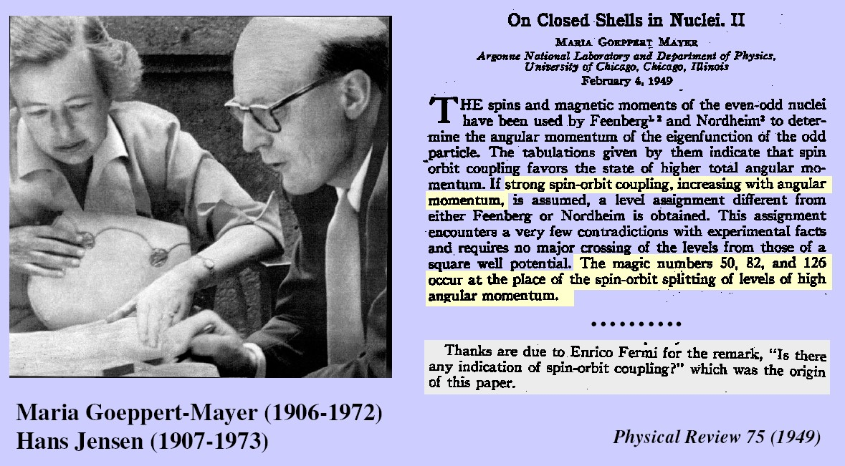
Nuclear Shell Model

Slide 23






Nuclear potential
$$\hat{H}=\sum_{i=1}^{A}{\frac{{\hat{p}}_{i}^{2}}{2m_{i}}+\sum_{i<j}^{A}{\hat{V}\left(r_{i},r_{j}\right)}}$$
$$\hat{H}=\sum_{i=1}^{A}{\left[\frac{{\hat{p}}_{i}^{2}}{2m_{i}}+\hat{V}\left(r_{i}\right)\right]}+\left[\sum_{i<j}^{A}{\hat{V}\left(r_{i},r_{j}\right)}−\sum_{i=1}^{A}{\hat{V}\left(r_{i}\right)}\right]$$
$$V\left(r\right)=\frac{−V_{0}}{1+e^{{\left(r−R_{0}\right)}/a}}$$
$$\left[−\frac{ℏ^{2}}{2m}∇^{2}+V\left(r\right)−ε\right]Ψ\left(r\right)=0$$
$$Ψ\left(r\right)=\frac{u_{ℓ}\left(r\right)}{r}∙Y_{ℓm}\left(θ,φ\right)∙Χ_{m_{s}}$$
In the average nuclear potential V(r):
harmonic oscillator
square well potential
Woods-Saxon potential
the nucleons move freely

Slide 24

Nuclear shell model
$$\hat{H}=\sum_{i=1}^{A}{\left[\frac{{\hat{p}}_{i}^{2}}{2m_{i}}+\hat{V}\left(r_{i}\right)\right]}$$
harmonic
oscillator
square-well
potential
realistic potential
+ spin-orbit coupling
168
V
4s
168
112
3d
4s1/2
2g
3d3/2
2g7/2
3d5/2
3p
126
1i11/2
70
1i
2g9/2
2f
2f5/2
0
3p1/2
1i13/2
r
2p3/2
1h/3s
82
2f7/2
40
1h9/2
2d
3s1/2
1h11/2
1g
2d1/2
50
2d5/2
1g7/2
20
2p
1g9/2
1d
2p1/2
28
3p3/2
1f5/2
2s
20
1f7/2
8
1d
2g1/2
1d3/2
V₀
8
1d5/2
1p
1p1/2
2
1p3/2
1s
2
1s1/2

Slide 25








Woods-Saxon potential
Woods-Saxon does not reproduce the correct magic numbers
(2, 8, 20, 40, 70, 112, 168)_{WS} (2, 8, 20, 28, 50, 82, 126)_{exp}
Meyer und Jensen (1949): strong spin-orbit interaction
$$\left[−\frac{ℏ^{2}}{2m}∇^{2}+V\left(r\right)+V_{ℓs}\left(r\right)∙\vec{ℓ}∙\vec{s}−ε\right]Ψ\left(r\right)=0$$
$$V_{ℓs}\left(r\right)\sim −λ∙\frac{1}{r}∙\frac{dV}{dr} mit λ>0$$
$$\vec{J}$$
$$\vec{s}$$
$$\vec{ℓ}$$
The spin-orbit term has its origin in the relativistic description of the single particle motion inside the nucleus

Slide 26











Woods-Saxon potential (jj-coupling)
$$\vec{j}=\vec{ℓ}+\vec{s}$$
$$⇒ \left\langle ℓ∙s\right\rangle =\frac{1}{2}∙\left[\left\langle j^{2}\right\rangle −\left\langle ℓ^{2}\right\rangle −\left\langle s^{2}\right\rangle \right]∙ℏ^{2}$$
$$=\frac{1}{2}\left[j\left(j+1\right)−ℓ\left(ℓ+1\right)−s\left(s+1\right)\right]∙ℏ^{2}$$
The nuclear potential with spin-orbit term:
spin-orbit interaction leads to a large splitting for large ℓ.
$$V\left(r\right)+\frac{ℓ}{2}∙V_{ℓs} for j=ℓ+1/2$$
$$V\left(r\right)−\frac{ℓ+1}{2}V_{ℓs} for j=ℓ−1/2$$
$$−\left(ℓ+1\right)/2∙\left\langle V_{ℓs}\right\rangle$$
$$j=ℓ−1/2$$
$$j=ℓ±1/2$$
$$ℓ/2∙\left\langle V_{ℓs}\right\rangle$$
$$j=ℓ+1/2$$

Slide 27





Woods-Saxon potential
The spin-orbit term
lowers the j = ℓ+1/2 orbital from the
higher oscillator shell (intruder states)
reproduces the magic numbers
large energy gaps → very stable nuclei
$$ℓ−1/2$$
$$∆E_{ℓs}=\frac{2ℓ+1}{2}∙ℏ^{2}∙\left\langle V_{ℓs}\right\rangle$$
Important consequences:
lowering orbitals from higher lying N+1 shell
having different parity than orbitals from the N shell
strong interaction preserves the parity. The lowered orbitals
with different parity are rather pure states and do not mix
within the shell
$$ℓ+1/2$$

Slide 28





Shell model – mass dependence of single-particle energies
Mass dependence of the neutron
energies:
number of neutrons in each level:
$$E\sim R^{−2}$$
$$2∙\left(2ℓ+1\right)$$

Slide 29


Single-particle energies
$${}_{8}^{17}{O_{9}}$$
Single-particle states observed in odd-A nuclei (in particular, one nucleon + doubly magic nuclei like ⁴He, ¹⁶O, ⁴⁰Ca) characterizes single-particle energies of the shell-model picture.

Slide 30

Success of the extreme single-particle shell model
Ground state spin and parity:
Every orbital has 2j+1 magnetic sub-states,
completely filled orbitals have spin J=0,
they do not contribute to the nuclear spin.
For a nucleus with one nucleon outside a
completely occupied orbital the nuclear spin
is given by the single nucleon.
n ℓ j → J
(-)^{ℓ} = π

Slide 31

Success of the extreme single-particle shell model
$${}_{4}^{7}{Be}$$ | 1p3/2 | 3/2-
$${}_{9}^{17}F$$ | 1d5/2 | 5/2+
$${}_{28}^{63}{Ni}$$ | 1f5/2 | 5/2-
$${}_{29}^{61}{Cu}$$ | 2p3/2 | 3/2-
$${}_{40}^{91}{Zr}$$ | 2d5/2 | 5/2+
$${}_{51}^{123}{Sb}$$ | 1g7/2 | 7/2+
$${}_{65}^{159}{Tb}$$ | 1h11/2 | 11/2-
$${}_{73}^{183}{Ta}$$ | 1h11/2 | 11/2-
$${}_{81}^{199}{Tl}$$ | 3s1/2 | 1/2+
$${}_{82}^{209}{Pb}$$ | 2g9/2 | 9/2+

Slide 32






Success of the extreme single-particle shell model
Magnetic moments:
The g-factor g_{j} is given by:
with
Simple relation for the g-factor
of single-particle states
$$⇒ \vec{μ_{j}}=\left[\left(g_{ℓ}∙\vec{ℓ}+g_{s}∙\vec{s}\right)∙\frac{\vec{j}}{\left|j\right|}\right]∙\frac{\vec{j}}{\left|j\right|}$$
$$\vec{μ_{j}}=g_{ℓ}∙\vec{ℓ}+g_{s}∙\vec{s}=g_{j}∙\vec{j}$$
$${\vec{ℓ}}^{2}={\left(\vec{j}−\vec{s}\right)}^{2}={\vec{j}}^{2}−2∙\vec{j}∙\vec{s}+{\vec{s}}^{2}$$
$${\vec{s}}^{2}={\left(\vec{j}−\vec{ℓ}\right)}^{2}={\vec{j}}^{2}−2∙\vec{j}∙\vec{ℓ}+{\vec{ℓ}}^{2}$$
$${\vec{μ}}_{j}=\frac{g_{ℓ}∙\left\{j\left(j+1\right)+ℓ\left(ℓ+1\right)−3/4\right\}+g_{s}∙\left\{j\left(j+1\right)−ℓ\left(ℓ+1\right)+3/4\right\}}{2∙j\left(j+1\right)}∙\vec{j}$$
$$g_{j}=\frac{1}{2}∙\left(g_{ℓ}+g_{s}\right)+\frac{1}{2}∙\frac{ℓ\left(ℓ+1\right)−s\left(s+1\right)}{2j\left(j+1\right)}∙\left(g_{ℓ}−g_{s}\right)$$
μ/μ_{N}
nucleus state J^{π} model experiment
$$\frac{μ}{μ_{N}}=g_{nucleus}=g_{ℓ}±\frac{\left(g_{s}−g_{ℓ}\right)}{2ℓ+1} for j=ℓ±1$$

Slide 33



Success of the extreme single-particle shell model
$$\left\langle μ_{z}\right\rangle =\left\{\begin{matrix} \left[g_{ℓ}∙\left(j−\frac{1}{2}\right)+\frac{1}{2}∙g_{s}\right]∙μ_{N} for j=ℓ+1/2 \\ \frac{j}{j+1}∙\left[g_{ℓ}∙\left(j+\frac{3}{2}\right)−\frac{1}{2}∙g_{s}\right]∙μ_{N} for j=ℓ−1/2\end{matrix}\right\}$$
magnetic moments:
g-factor of nukleons:
proton: g_{ℓ} = 1; g_{s} = +5.585
neutron: g_{ℓ} = 0; g_{s} = -3.82
proton:
neutron:
$$\left\langle μ_{z}\right\rangle =\left\{\begin{matrix} \left(j+2.293\right)∙μ_{N} for j=ℓ+1/2 \\ \left(j−2.293\right)∙\frac{j}{j+1}∙μ_{N} for j=ℓ−1/2\end{matrix}\right\}$$
$$\left\langle μ_{z}\right\rangle =\left\{\begin{matrix} −1.91∙μ_{N} for j=ℓ+1/2 \\ +1.91∙\frac{j}{j+1}∙μ_{N} for j=ℓ−1/2\end{matrix}\right\}$$

Slide 34

Magnetic moments: Schmidt lines
magnetic moments: proton
magnetic moments: neutron

Slide 35





The three structures of the shell model

Slide 36


Slide 37

Systematics of the Te isotopes (Z=52)
Neutron number 68 70 72 74 76 78 80 82
Val. Neutr. number 14 12 10 8 6 4 2 0

Slide 38


Systematics of the Te isotopes (Z=52)
4⁺
1.63
6⁺
1.69
2⁺
1.59
4⁺
1.58
2⁺
1.16
2⁺
1.28
0⁺
4⁺
1.20
1.10
2⁺
0.84
2⁺
0.56
0⁺
0⁺
0⁺
¹²⁰Te
¹³⁰Te
¹³⁴Te
Case of few valence nucleons: lowering of energies, development of multiplets. R_{4/2} → ~2-2.4

Slide 39
Experimental observables in even-even nuclei
1000
4⁺
400
2⁺
0
0⁺
E ( keV)
J^{π}

