Slide 1
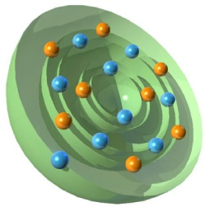
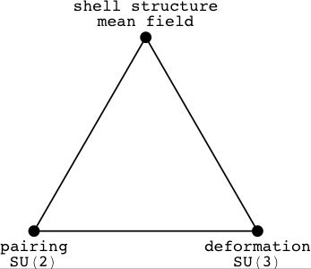
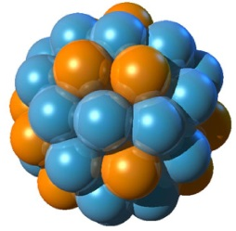
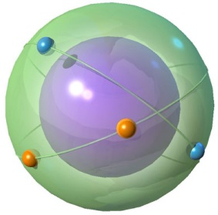
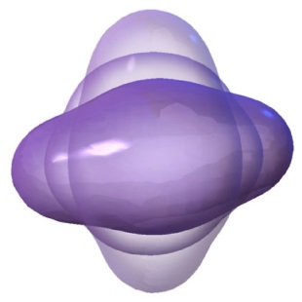
PHL424: Nuclear surface vibration

Slide 2
2⁺ Systematics
Excitation energy (keV)
2⁺
0⁺
Ground state Configuration.
Spin/parity I^{π}=0⁺ ; E_{x} = 0 keV

Slide 3
4⁺/2⁺ Energy ratio: mirrors 2⁺ systematics
Excitation energy (keV)
4⁺
2⁺
0⁺
Ground state Configuration.
Spin/parity I^{π}=0⁺ ; E_{x} = 0 keV

Slide 4
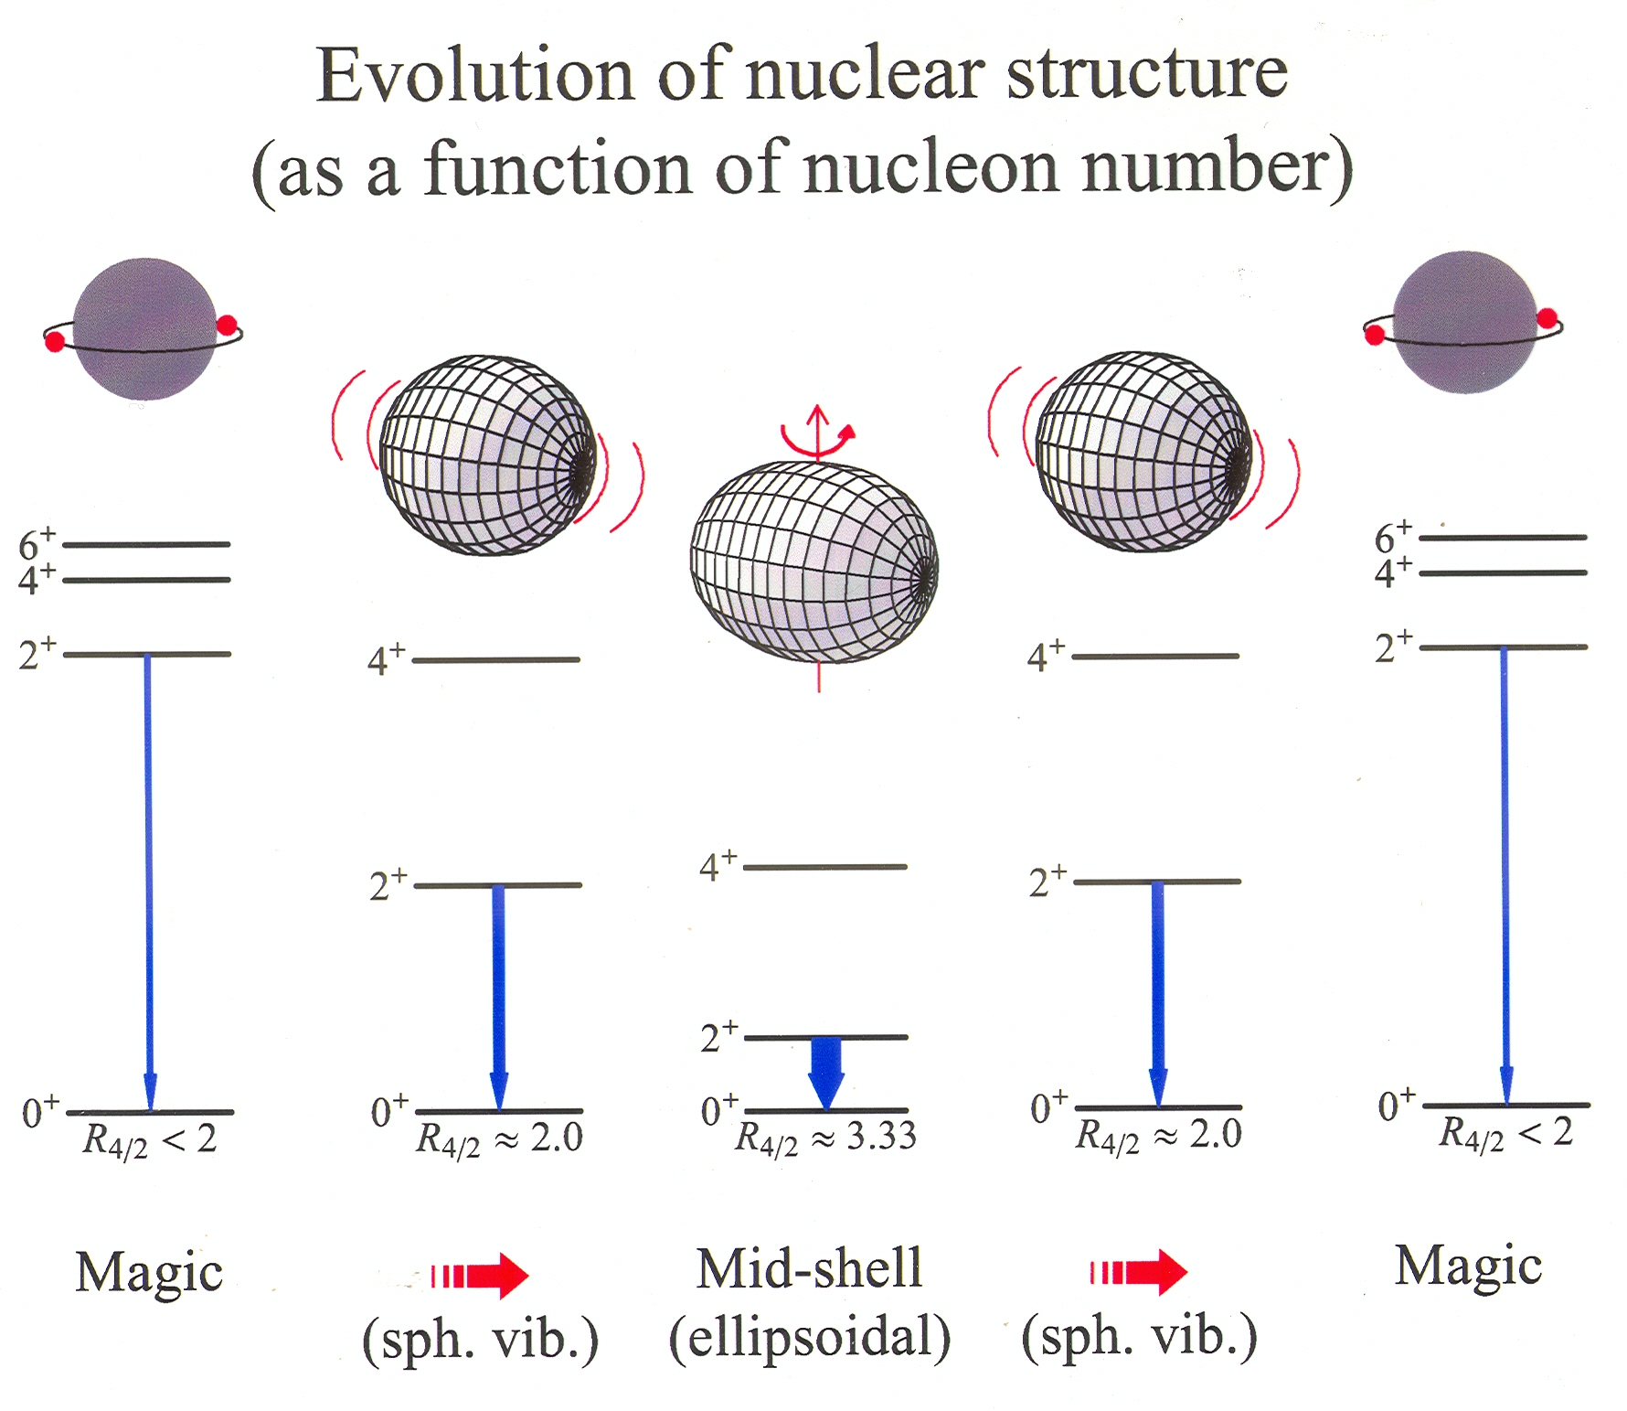
Evolution of nuclear structure as a function of nucleon number

Slide 5
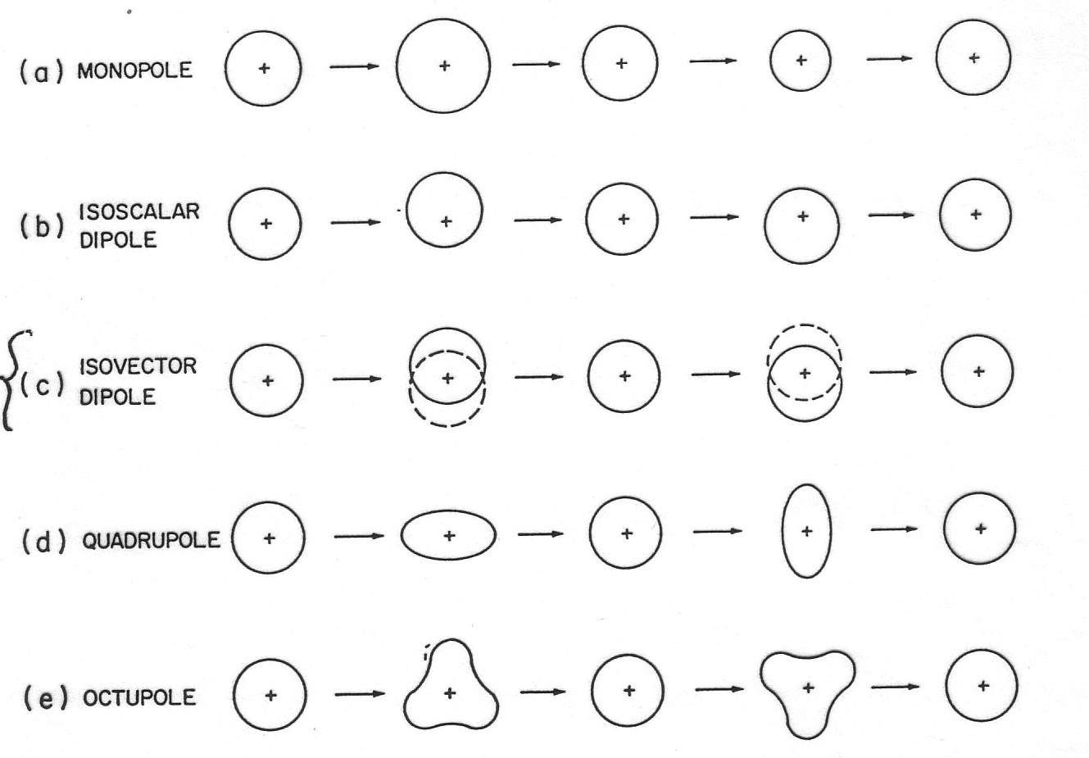
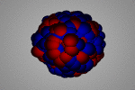
Collective vibration
In general,
forbidden – density change!
λ=0
forbidden – CM moves!
λ=1
time
OK...
λ=2
λ=3

Slide 6
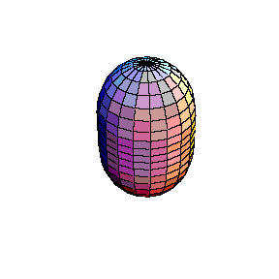
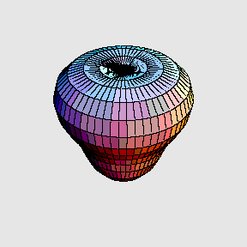
Collective vibration
In general,
harmonic vibration
λ=2: quadrupole vibration
λ=3: octupole vibration

Slide 7

Collective vibration
classical Hamiltonian
constants:
Binding energy of a nucleus:
a_{V} = 15.560 MeV a_{S} = 17.230MeV a_{C} = 0.6970 MeV a_{A} = 23.385 MeV a_{P} = 12.000 MeV

Slide 8
Collective vibration
classical Hamiltonian
quantization
energy eigenvalue
wave function
0
Hermite polynomials

Slide 9
Collective vibration
classical Hamiltonian
differential equation

Slide 10
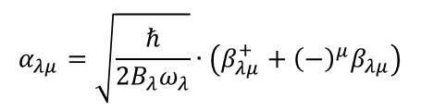
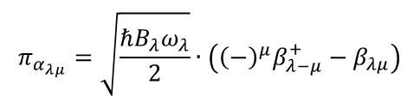
Second quantization
Hamilton operator
$$α_{λμ}=\sqrt{\frac{ℏ}{2B_{λ}ω_{λ}}}∙\left(β_{λμ}^{+}+{\left(−\right)}^{μ}β_{λμ}\right)$$
$$π_{α_{λμ}}=\sqrt{\frac{ℏB_{λ}ω_{λ}}{2}}∙\left({{\left(−\right)}^{μ}β}_{λ−μ}^{+}−β_{λμ}\right)$$
rule for boson operators:

Slide 11
Second quantization
Hamilton operator
rule for boson operators:
creation & annihilation operators
increase or decrease the number of phonons in a wave function
ground state (vacuum)
1-phonon state
2-phonon state

Slide 12
Second quantization
Hamilton operator
rule for boson operators:
1-phonon energy:

Slide 13
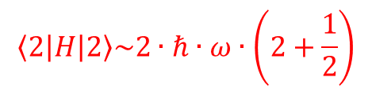
Second quantization
Hamilton operator
rule for boson operators:
2-phonon energy:
etc.
$$\left\langle 2 | H | 2\right\rangle \sim 2∙ℏ∙ω∙\left(2+\frac{1}{2}\right)$$
normalization of wave function !!!

Slide 14
Second quantization
Hamilton operator
rule for boson operators:
2-phonon state:
normalization (approximation):

Slide 15
Second quantization
Hamilton operator
rule for boson operators:
2-phonon state:
normalization:

Slide 16
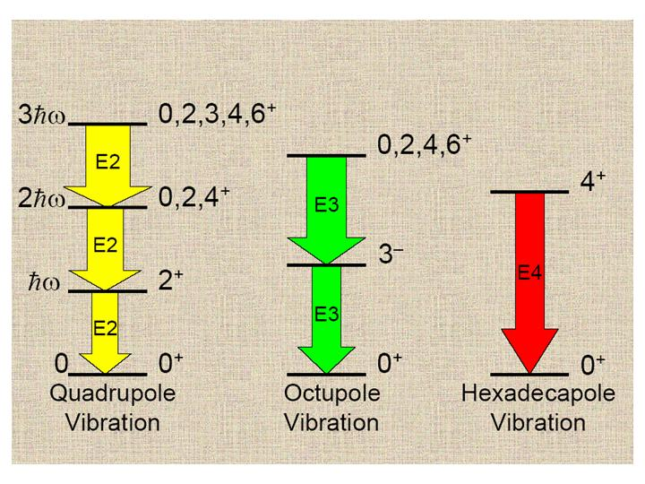
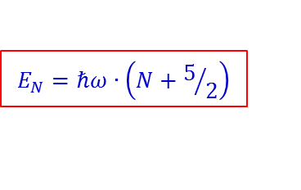
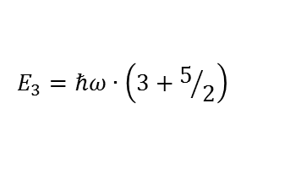
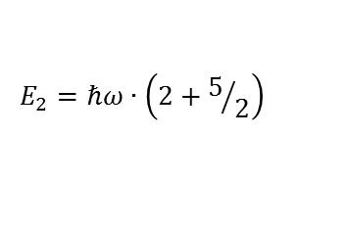
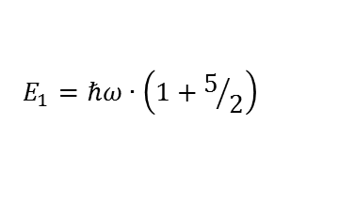
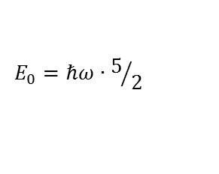
Collective vibration
$$E_{N}=ℏω∙\left(N+5/2\right)$$
$$E_{3}=ℏω∙\left(3+5/2\right)$$
$$E_{2}=ℏω∙\left(2+5/2\right)$$
$$E_{1}=ℏω∙\left(1+5/2\right)$$
$$E_{0}=ℏω∙5/2$$

Slide 17
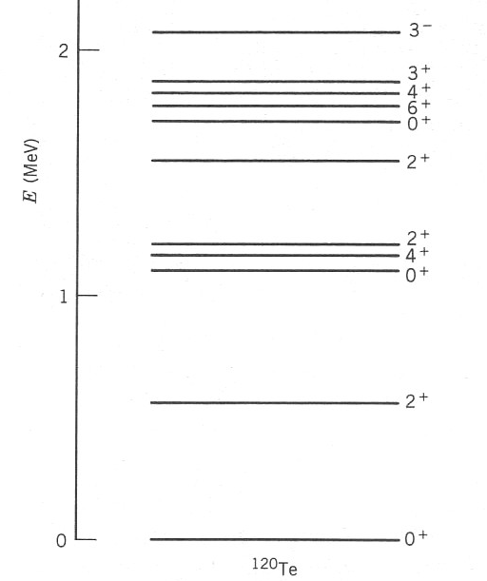
Example of vibrational excitations
3- state?
3ħω₂
multiple λ = 2 phonon
states, ideally degenerate
n = 2, λ = 2, J^{π} = 0+, 2+, 4+
2ħω₂
ħω₂
n=1, λ = 2, 2+ phonon
(E-E ground state)

Slide 18
Second quantization
Hamilton operator
rule for boson operators:
2-phonon state:
reduced transition probability:

Slide 19
Reduced transition probabilities
2-phonon state
3-phonon state

Slide 20
Reduced transition probabilities
1-phonon state
2-phonon state
3-phonon state

Slide 21
Reduced transition probabilities
The figure shows the experimental energy levels for the nucleus ¹⁰⁶Pd. Find the energy of the first excited 2⁺ state.
Level energy (vibrator model):
Ground state level:
First excited 2⁺ level (N=1, J^{π}=2⁺):
Second excited 2⁺ level (N=2, J^{π}=2⁺):
→ Energy of the second exited 2⁺ state
→ Energy of the first exited 2⁺ state

