Slide 1
Shape parameterization
axially symmetric quadrupole
axially symmetric octupole
λ=2
α₂₀≠0, α_{2±1}= α_{2±2}= 0
λ=3
α₃₀≠0, α_{3±1,2,3} = 0
α₂₀≠0, α_{2±1,2} = 0

Slide 2
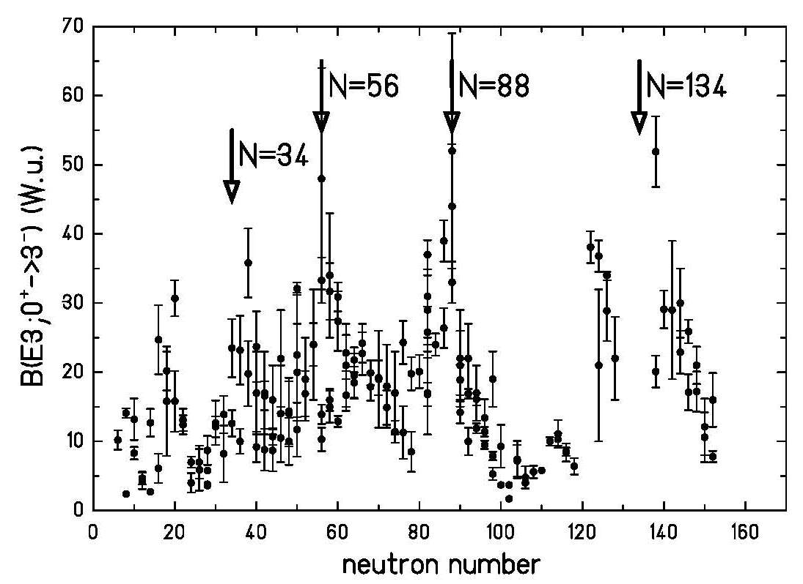
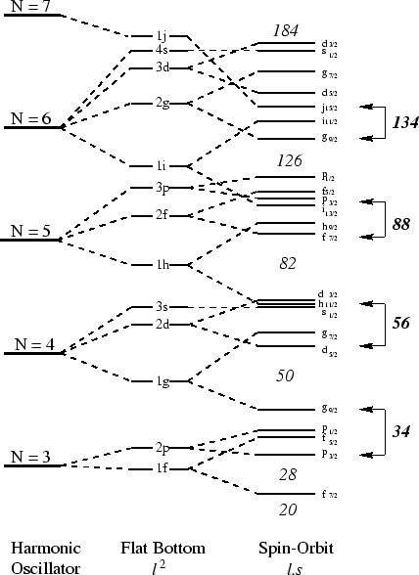
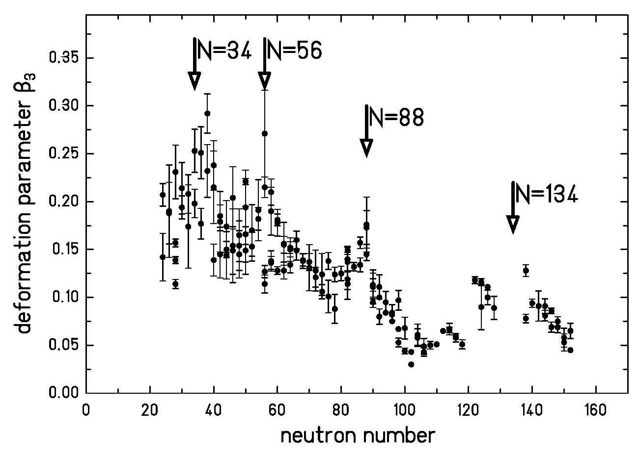
Octupole collectivity
Y₃₀ coupling
Δℓ=3 Δj=3
(W.u.)
some subshells interact via the r³Y₃₀ operator
e.g. in light actinide nuclei one has an interaction between
j_{15/2} and g_{9/2} neutron orbitals
i_{13/2} and f_{7/2} proton orbitals
R.H. Spear At. Data and Nucl. Data Tables 42 (1989), 55

Slide 3
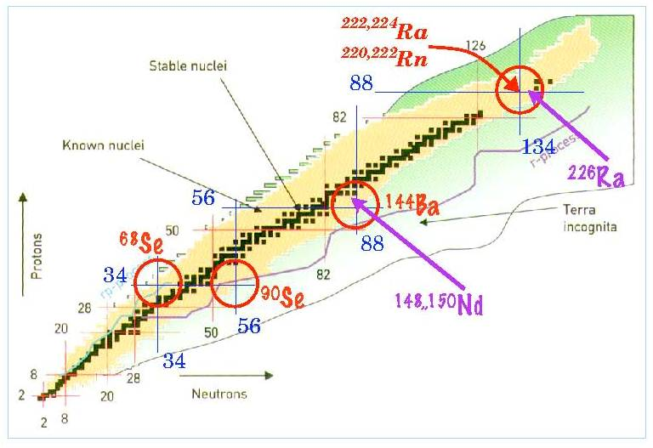
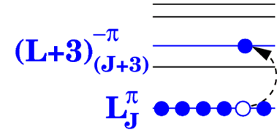
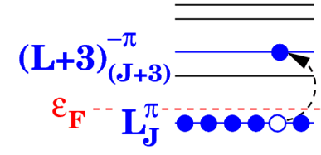
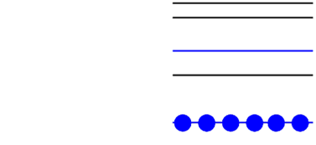
Octupole collectivity
Octupole correlations enhanced at the magic numbers: 34, 56, 88, 134
Microscopically …
Intruder orbitals of opposite parity and ΔJ, ΔL = 3 close to Fermi level
²²⁶Ra close to Z=88 N=134

Slide 4
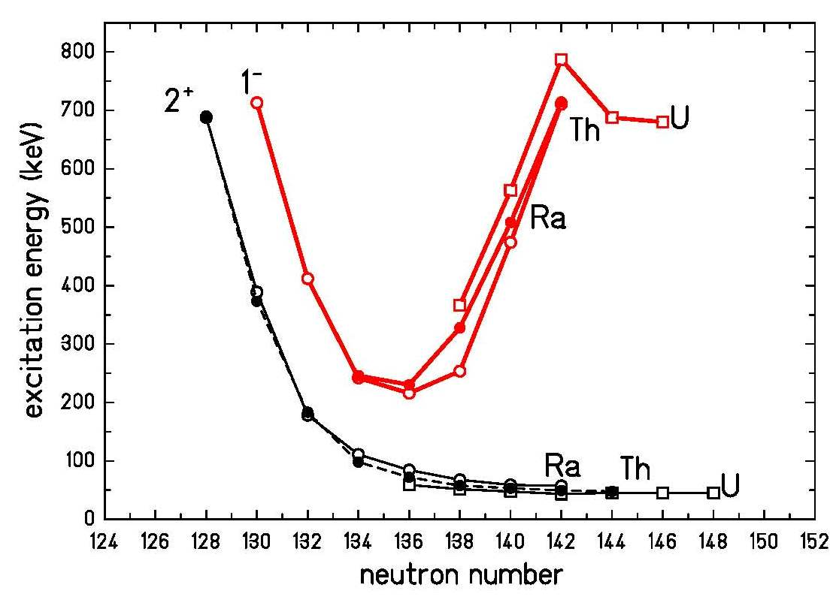
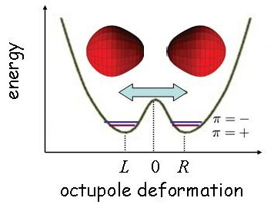
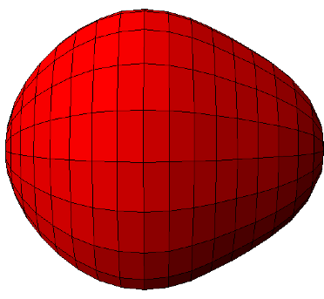
Octupole collectivity
²²⁶Ra
+
-
+
-
+
²²⁶Ra
-
+
-
+
-
In an octupole deformed nucleus the center of mass and center of charge tend to separate,
creating a non-zero electric dipole moment.

Slide 5
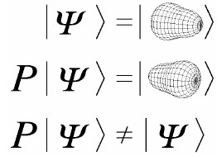
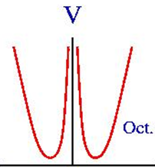
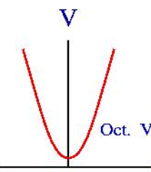
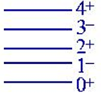
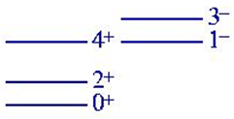
The double oscillator
V
V₀
-a a
β₃
β₃
octupole deformed
octupole vibrational
Merzbacher ‘Quantum Mechanics’

Slide 6
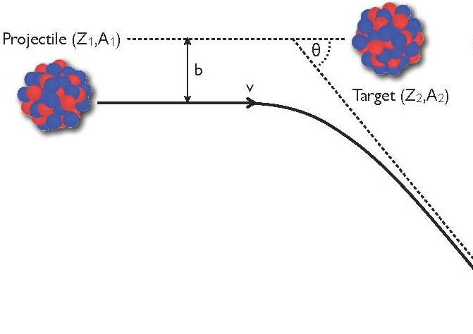
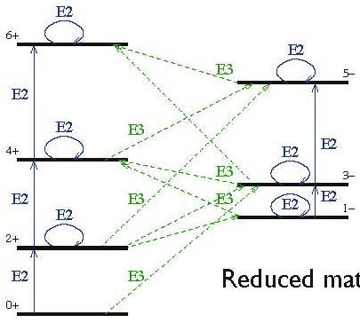
Coulomb excitation
impact parameter
scattering angle

Slide 7
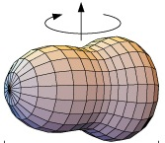
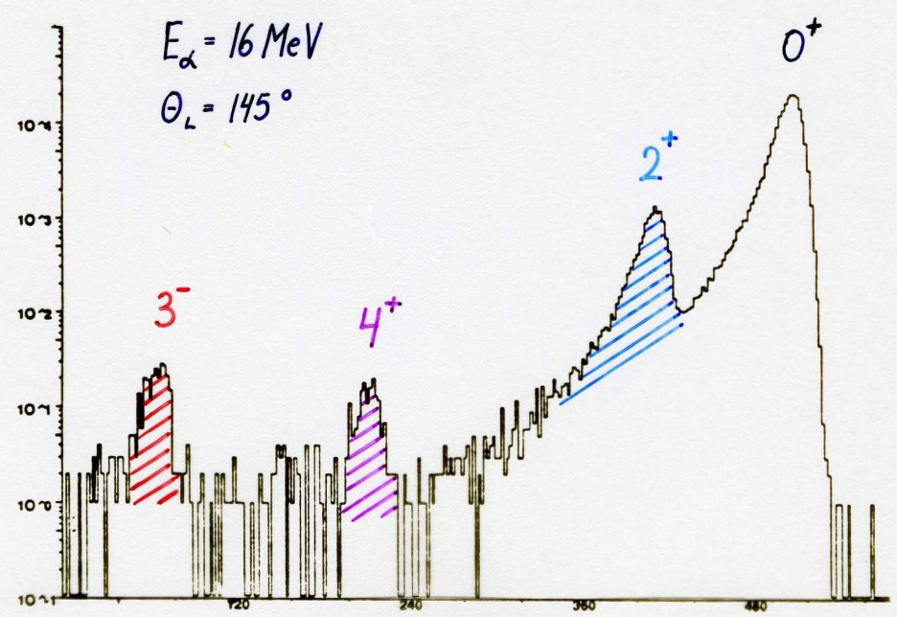
Scattered α-spectrum of ²²⁶Ra
0⁺
⁴He → ²²⁶Ra
E_{α} = 16 MeV
θ_{lab} = 145⁰
2⁺
counts
3⁻
4⁺
²²⁶Ra-target
beam direction
Si-detector
θ
channel number
λ |  | β_{λ} (exp) | β_{λ} (theo)
2 | 2.27 (3) | 0.165 (2) | 0.164
3 | 1.05 (5) | 0.104 (5) | 0.112
4 | 1.04 (7) | 0.123 (8) | 0.096

Slide 8
Scattered α-spectrum of ²²⁶Ra
0⁺
⁴He → ²²⁶Ra
E_{α} = 16 MeV
θ_{lab} = 145⁰
2⁺
counts
3⁻
4⁺
²²⁶Ra-target
beam direction
Si-detector
θ
channel number
λ |  | β_{λ} (exp) | β_{λ} (theo)
2 | 2.27 (3) | 0.165 (2) | 0.164
3 | 1.05 (5) | 0.104 (5) | 0.112
4 | 1.04 (7) | 0.123 (8) | 0.096
I_{f}
4⁺
E2
I_{n}
2⁺
E2
E4
I_{i}
0⁺

Slide 9
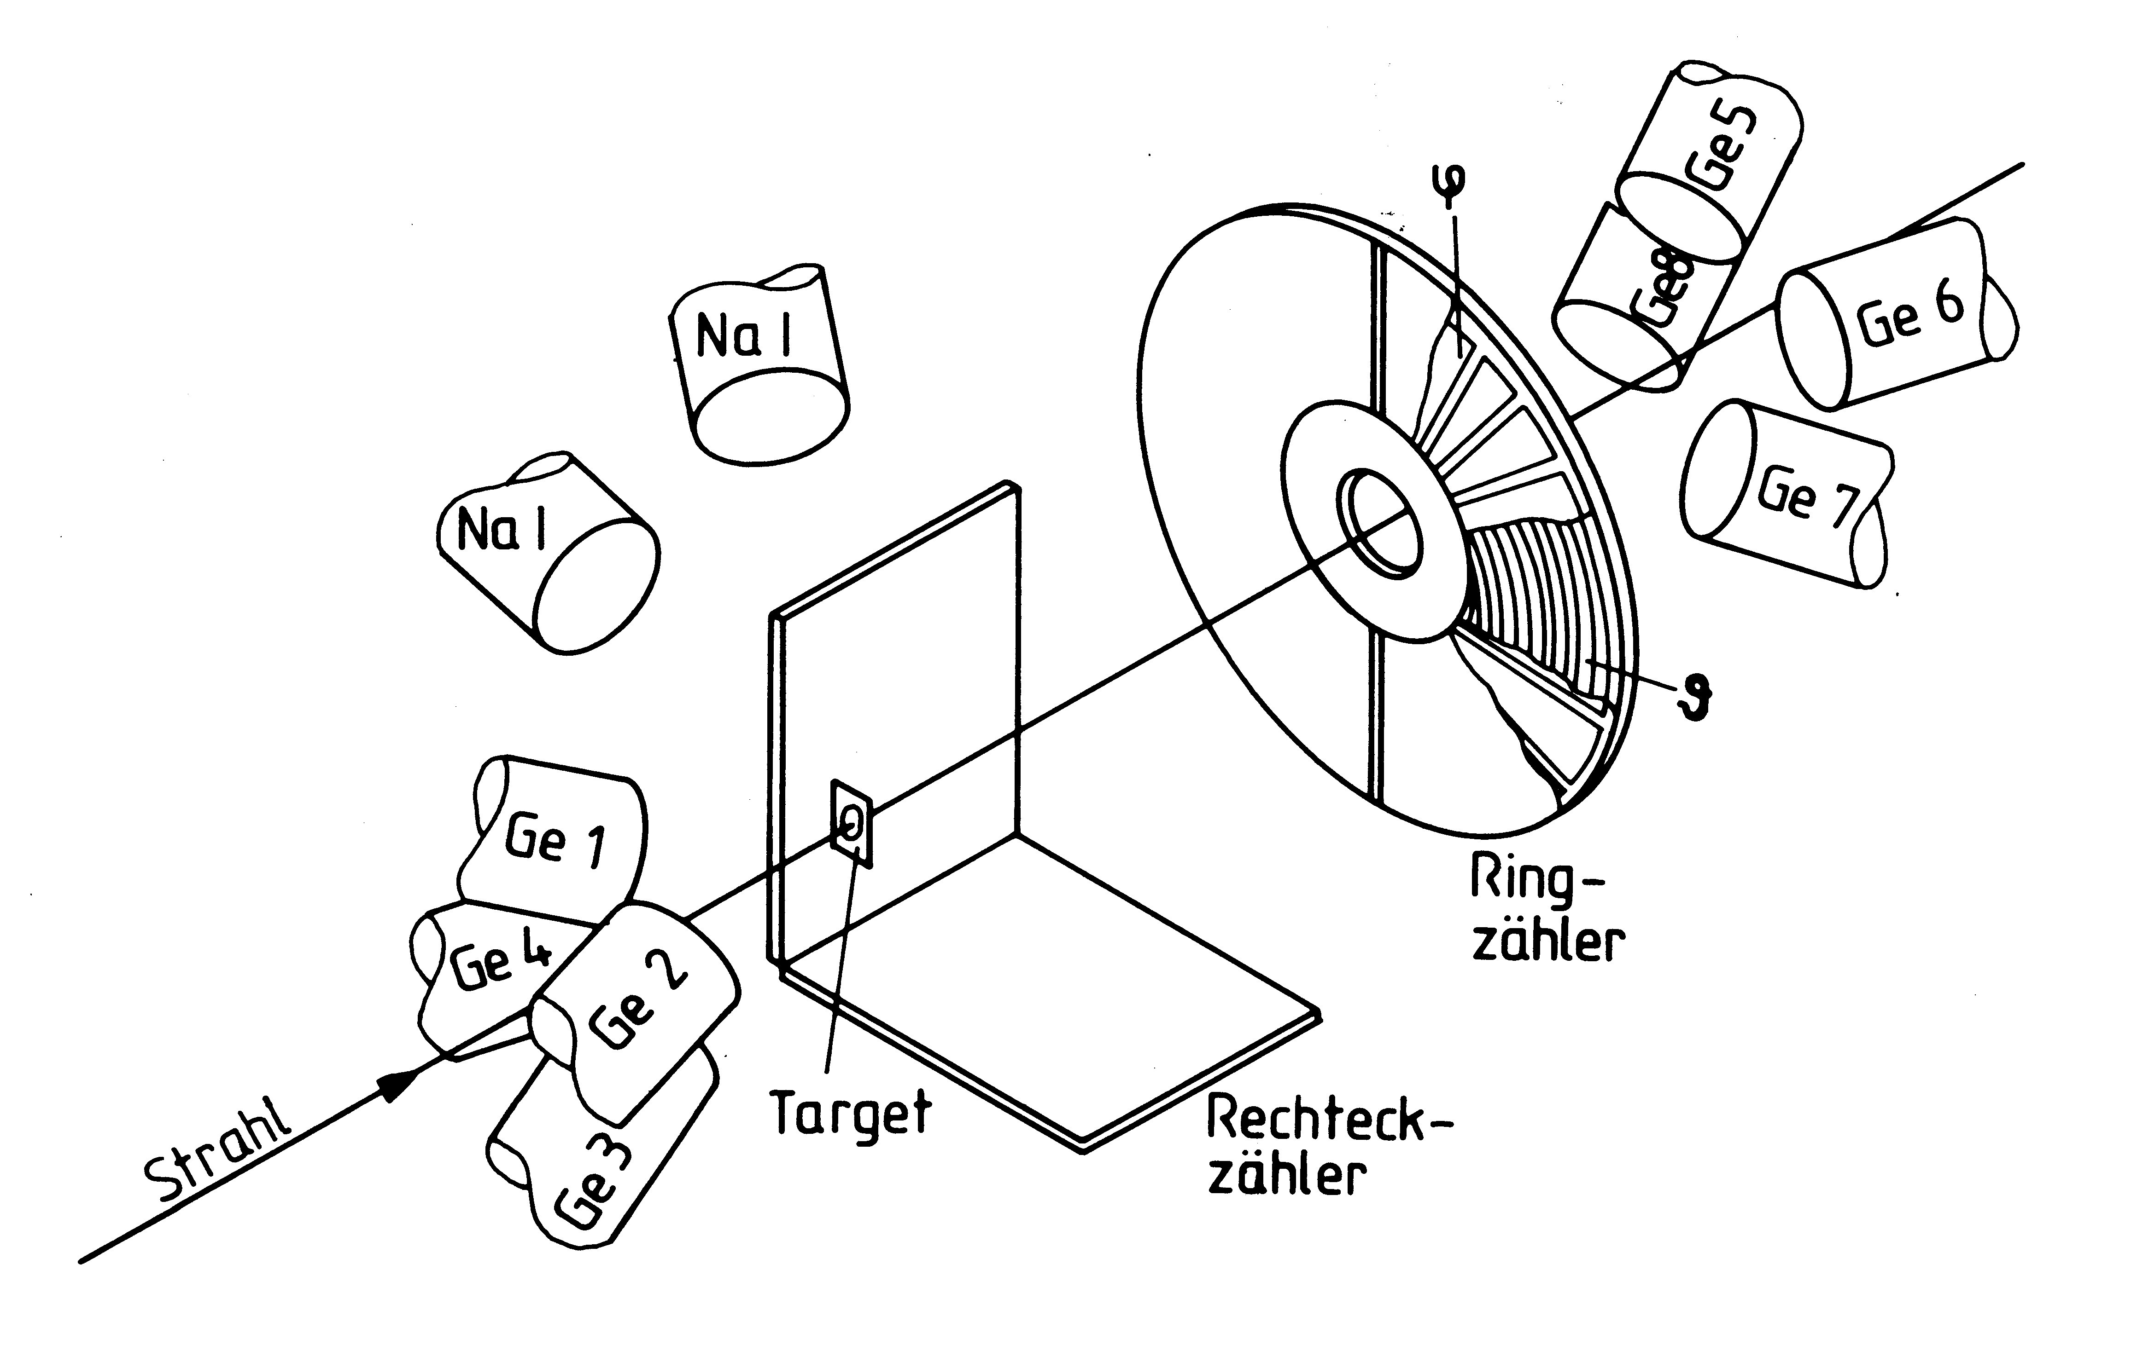
Experimental set-up
Ge 5
Ge8
Ge 6
Ge 7
Ge 1
PPAC ring counter
15⁰≤Θ_{L}≤45⁰, 0⁰≤φ_{L}≤360⁰
Ge 4
Ge 2
²⁰⁸Pb beam
4 PPAC counter
53⁰≤Θ_{L}≤90⁰, 0⁰≤φ_{L}≤84⁰
Ge 3
²²⁶Ra
²²⁶RaBr₂ (400 μg/cm²) on C-backing (50 μg/cm²) and covered by Be (40 μg/cm²)

Slide 10
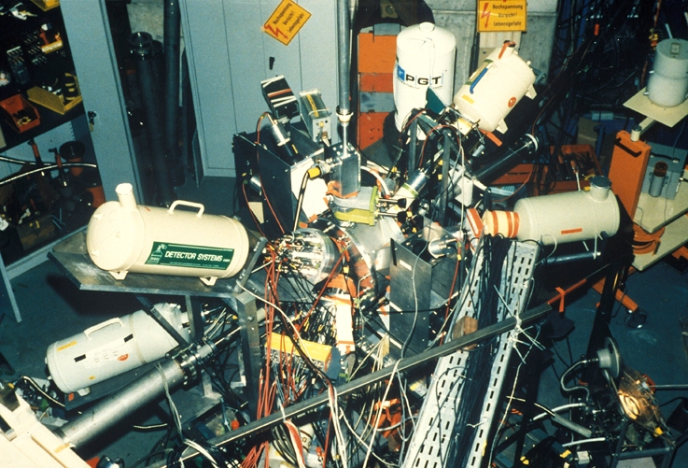
Coulomb excitation of ²²⁶Ra

Slide 11
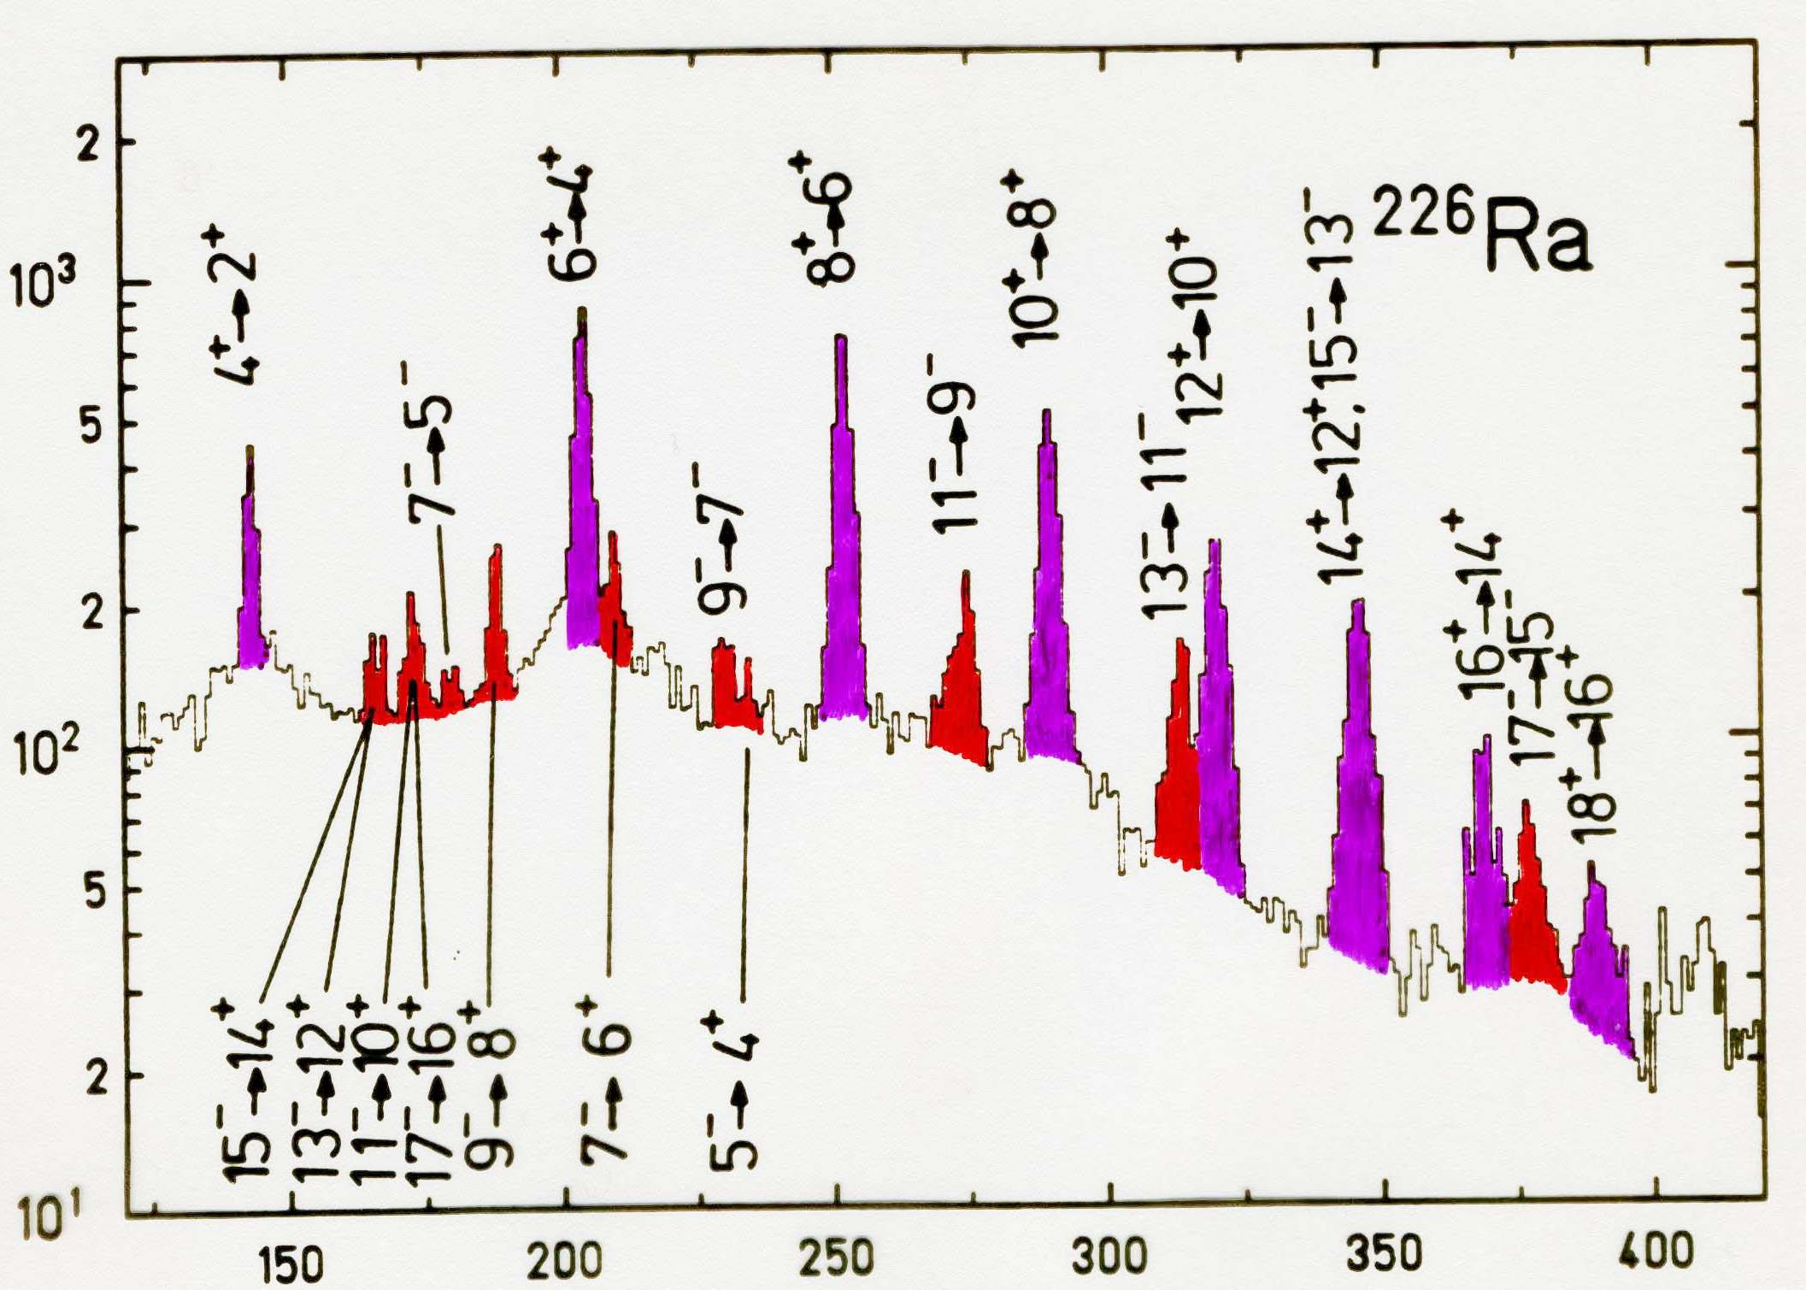
γ-ray spectrum of ²²⁶Ra
²⁰⁸Pb → ²²⁶Ra
E_{lab} = 4.7 AMeV
15⁰ ≤ θ_{lab} ≤ 45⁰
0⁰ ≤ φ_{lab} ≤ 360⁰
counts
energy [keV]

Slide 12
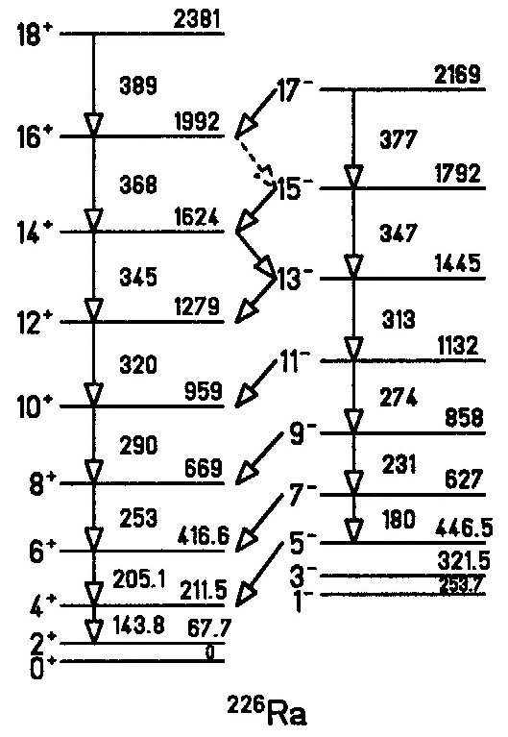
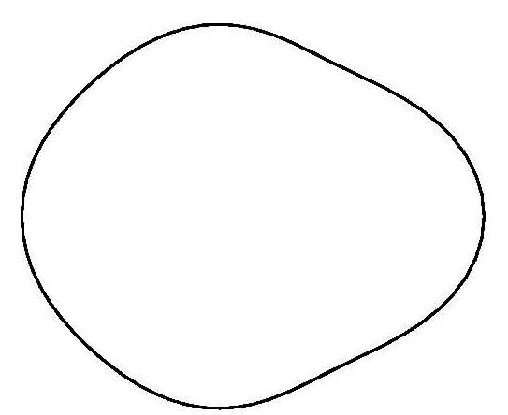
Signature of an octupole deformed nucleus
π: +
π: -
β₂= 0.16
β₃=-0.11
β₄= 0.10
E2
E1
Single rotational band with spin sequence:
I = 0⁺, 1⁻, 2⁺, 3⁻, …
excitation energy E ~ I·(I+1)
competition between intraband E2 and interband E1 transitions
E1 transition strength 10⁻² W.u.

Slide 13
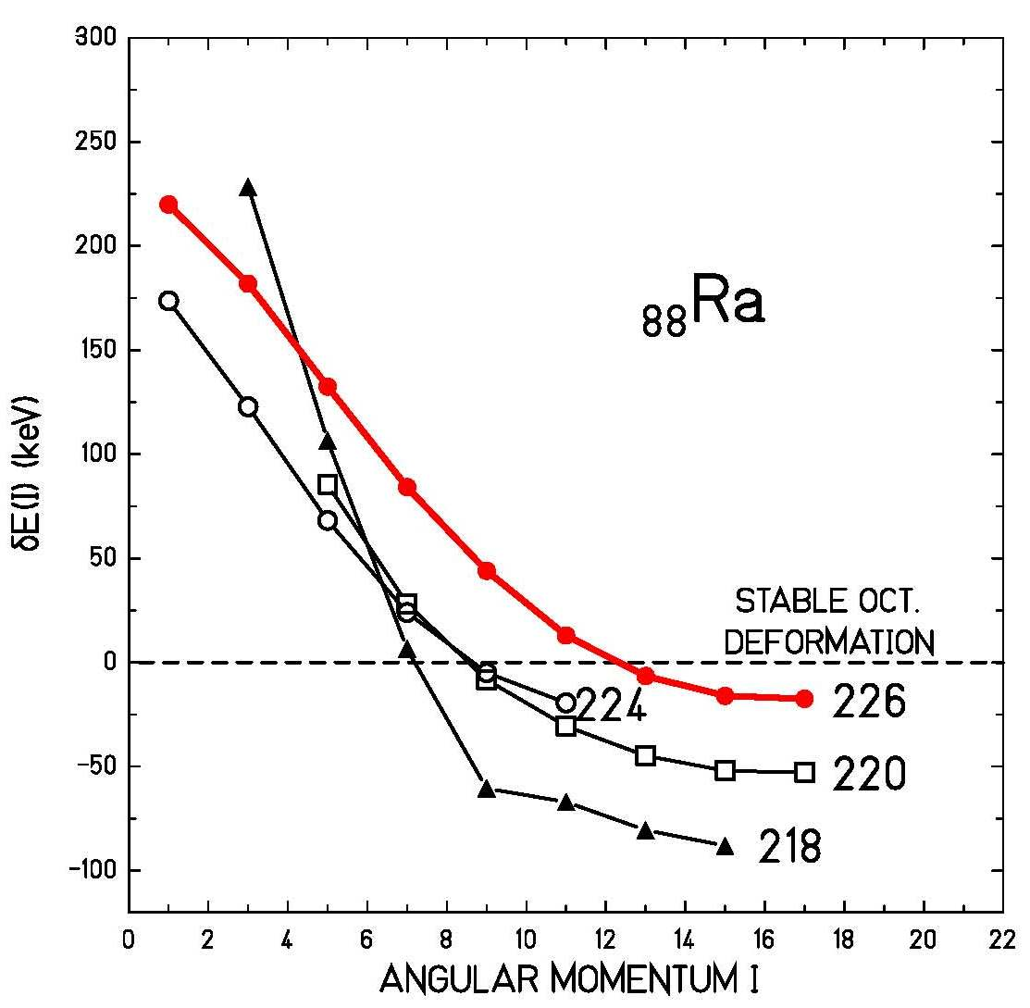
Signature of an octupole deformed nucleus
Energy displacement δE between the positive- and negative-parity states
if they form a single rotational band
W. Nazarewicz et al.; Nucl. Phys. A441 (1985) 420

Slide 14
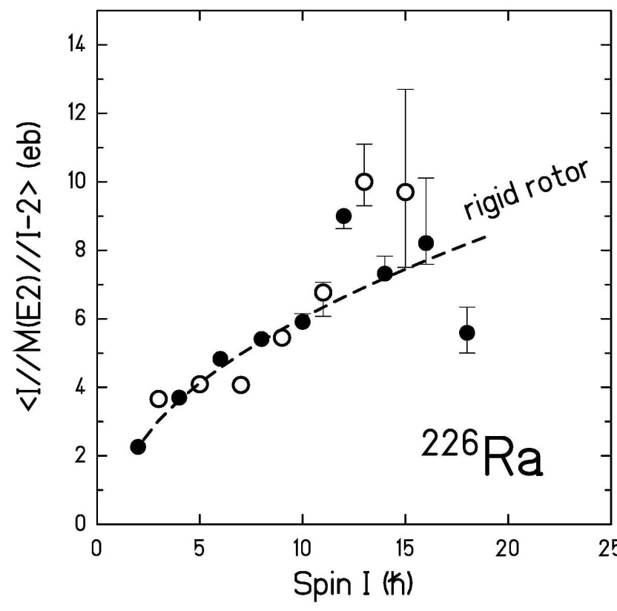
Electric transition quadrupole moments in ²²⁶Ra
negative parity states
positive parity states
rigid rotor model:
liquid drop:
Q₂(exp) = 750 fm²
Q₂(theo) = 680 fm²
β₂ = 0.21
H.J. Wollersheim et al.; Nucl. Phys. A556 (1993) 261
W. Nazarewicz et al.; Nucl. Phys. A467 (1987) 437

Slide 15
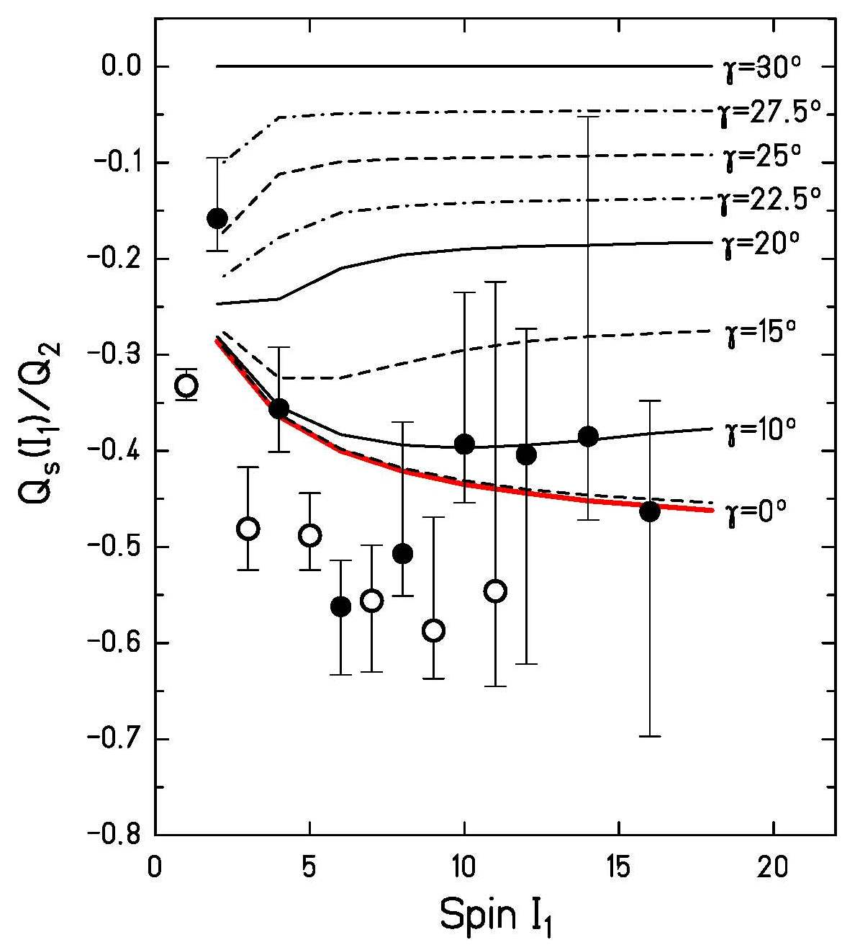
Static quadrupole moments in ²²⁶Ra
negative parity states
positive parity states
rigid rotor model:
rigid triaxial rotor model:
H.J. Wollersheim et al.; Nucl. Phys. A556 (1993) 261
Davydov and Filippov, Nucl. Phys. 8, 237 (1958)

Slide 16
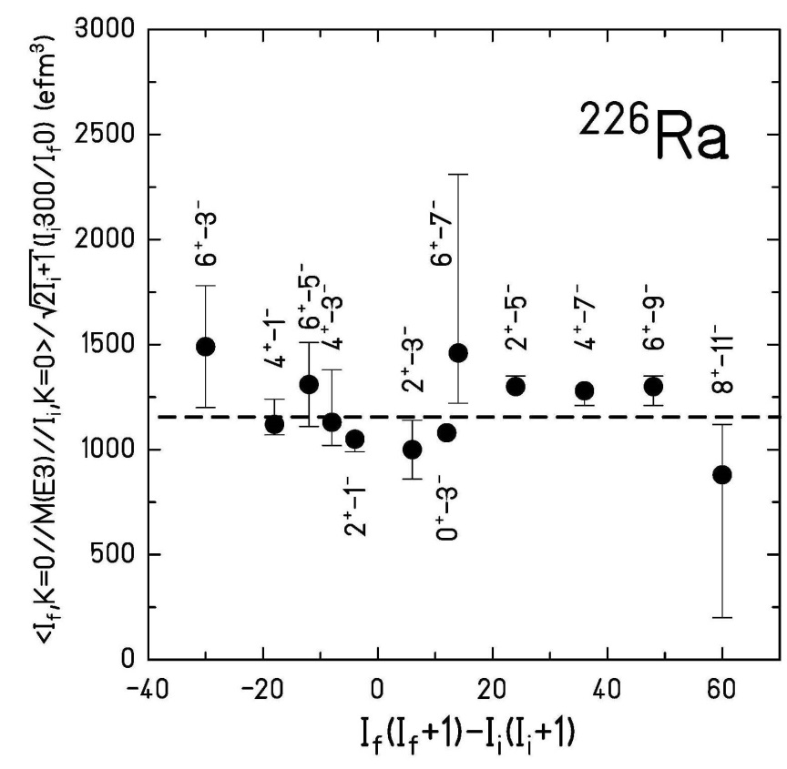
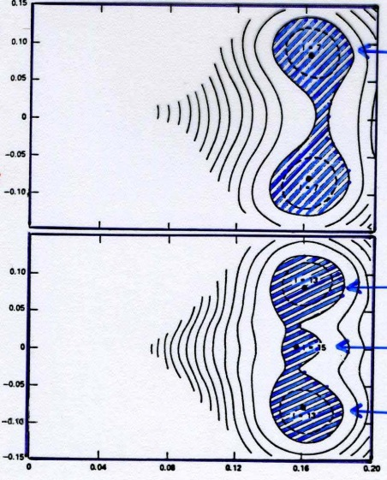
Electric transition octupole moments in ²²⁶Ra
liquid drop:
β₃
0.18
0.12
0.06
0.1
β₃
0
- 0.1
0.1
β₃
0
- 0.1
0.16
β₂
H.J. Wollersheim et al.; Nucl. Phys. A556 (1993) 261
W. Nazarewicz et al.; Nucl. Phys. A467 (1987) 437

Slide 17
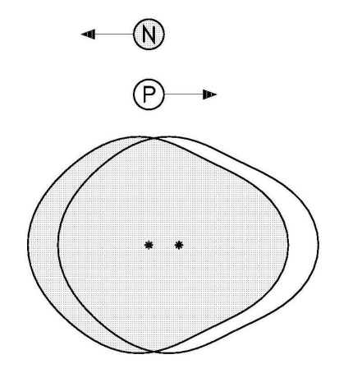
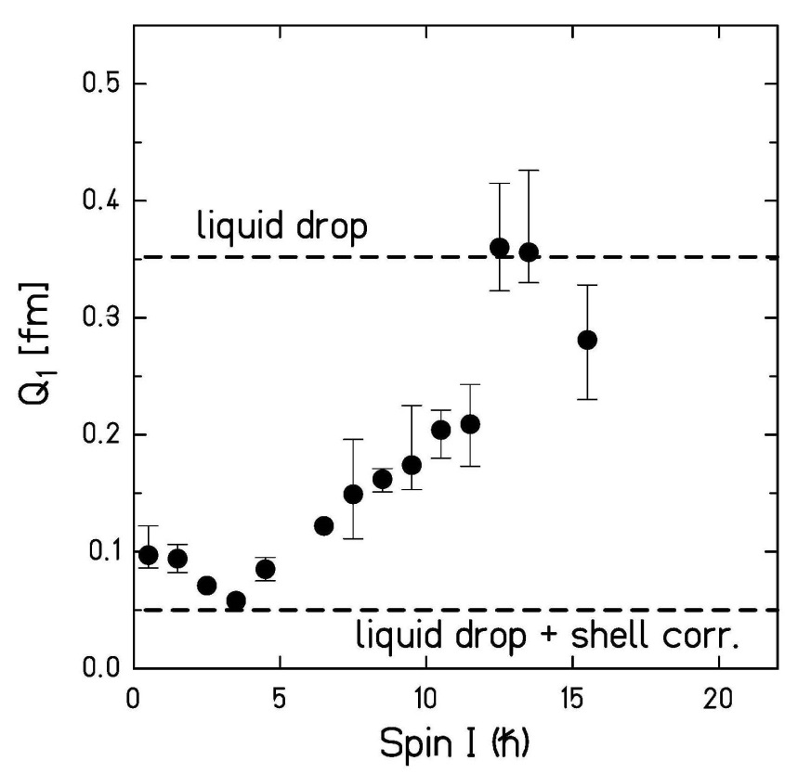
Intrinsic electric dipole moments in ²²⁶Ra
liquid-drop contribution:
rigid rotor model:
H.J. Wollersheim et al.; Nucl. Phys. A556 (1993) 261
G. Leander et al.; Nucl. Phys. A453 (1986) 58

Slide 18
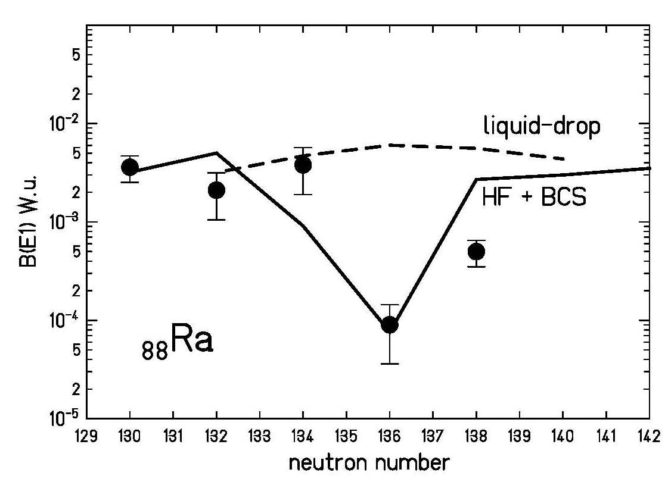
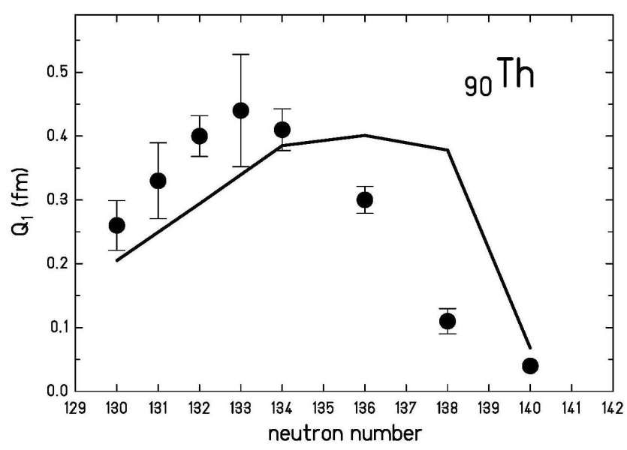
Intrinsic electric dipole moments in Ra / Th
liquid-drop contribution:
G. Leander et al.; Nucl. Phys. A453 (1986) 58

Slide 19
Center of mass conservation
The coordinates (x, y, z) can be expressed by
The dipole coordinate is not an independent quantity. It is non-zero for nuclear shapes with both quadrupole and octupole degrees of freedom.

Slide 20
Intrinsic electric dipole moment
The local volume polarization of electric charge can be derived from the requirement of a minimum in the energy functional. (Myers Ann. of Phys. (1971))
where ρ_{p} and ρ_{n} are the proton and neutron densities, C_{LD} is the volume symmetry energy coefficient of the liquid drop model and V_{C} is the Coulomb potential generated by ρ_{p} inside the nucleus (r < R₀)
Keeping the center of gravity fixed, the integral

Slide 21
Intrinsic electric dipole moment

Slide 22
Intrinsic electric dipole moment
C_{LD} ≈ 20 MeV

Slide 23
Summary
single rotational band for
no backbending observed
β₂, β₃, β₄ deformation parameters are in excellent agreement
with calculated values
octupole deformation is three times larger than in octupole-
vibrational nuclei
equal transition quadrupole moments for positive- and negative-
parity states
static quadrupole moments are in excellent agreement with an
axially symmetric shape
electric dipole moments are close to liquid-drop value ( )
octupole deformation seems to be stabilized with increasing
rotational frequency

Slide 24


Coulomb excitation of ²²⁶Ra
²²⁶Ra target broken after 8 hours
Christoph Fleischmann

