Slide 1
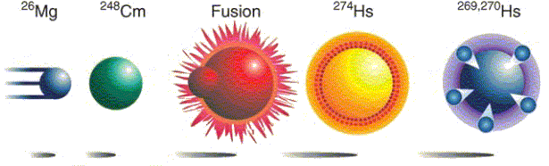
PHL424: Nuclear fusion
“Hot Fusion”
$$5∙{10}^{15} 5∙{10}^{8}$$
projectiles on target compound nuclei 1 atom

Slide 2
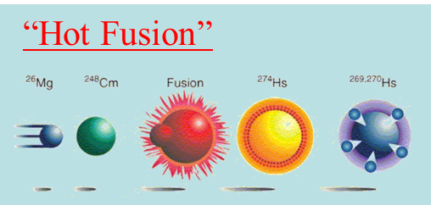
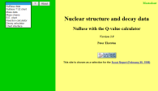


Hot fusion (1961 – 1974) successful up to element 106 (Seaborgium)
Coulomb barrier V_{C} between projectile and target nucleus
has to be exceeded
$$V_{C}=\frac{Z_{p}∙Z_{t}∙e^{2}}{R_{int}}$$
$$=126.2 MeV \left({}_{}^{26}{Mg}+{}_{}^{248}{Cm}\right)$$
reaction: a + A → C* → B + b
Δm = m_{a} + m_{A} - m_{CN}
http://nuclear.lu.se/database/masses/
Δm = (25.983 + 248.072 – 274.143) * 931.478 MeV/c²
= -82.153 MeV/c²
excitation energy of compound nucleus
E* = E_{kin} + Δm·c²
= 126.2 MeV – 82.2 MeV
r
= 44.0 MeV
approximate 4 neutrons will be evaporated to avoid fission

Slide 3
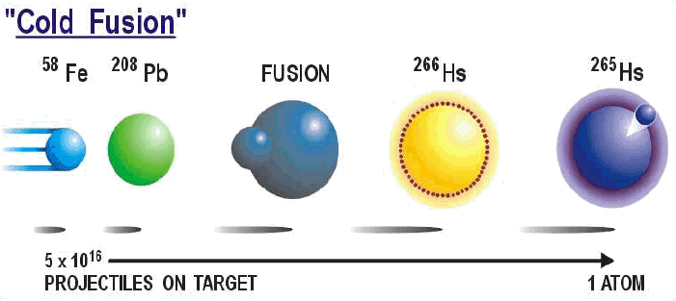


Cold fusion (1981 – 1996)
Coulomb barrier V_{C} between projectile and target nucleus
has to be exceeded
$$V_{C}=\frac{Z_{p}∙Z_{t}∙e^{2}}{R_{int}}$$
$$=223.3 MeV \left({}_{}^{58}{Fe}+{}_{}^{208}{Pb}\right)$$
reaction: a + A → C* → B + b
Δm = m_{a} + m_{A} - m_{CN}
http://nuclear.lu.se/database/masses/
Δm = (57.933 + 207.977 – 266.130) * 931.478 MeV/c²
= -205.092 MeV/c²
excitation energy of compound nucleus
E* = E_{kin} + Δm·c²
= 223.3 MeV – 205.1 MeV
r
= 18.2 MeV
approximate 1-2 neutrons will be evaporated to avoid fission

Slide 4
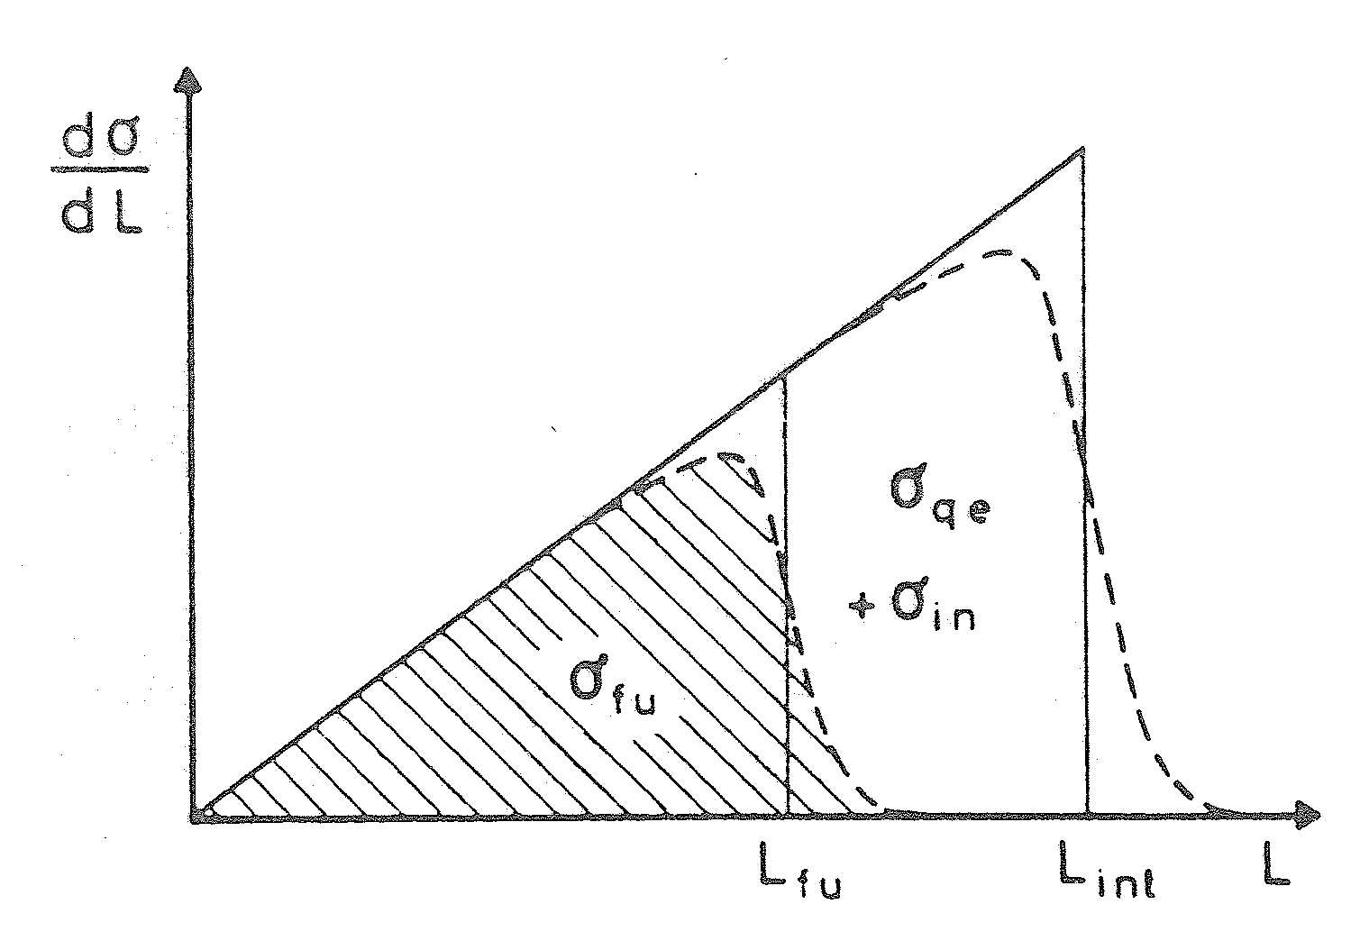

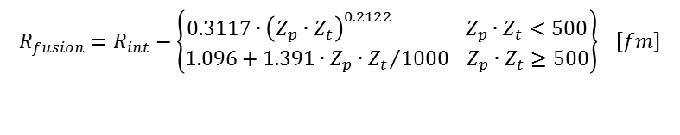




Fusion cross section
Radius for fusion barrier:
$$\frac{dσ}{dℓ}$$
$$R_{fusion}=R_{int}−\left\{\begin{matrix}0.3117∙{\left(Z_{p}∙Z_{t}\right)}^{0.2122} Z_{p}∙Z_{t}<500 \\ 1.096+1.391∙Z_{p}∙{Z_{t}}/{1000} Z_{p}∙Z_{t}≥500\end{matrix}\right\} \left[fm\right]$$
 | R_{i} [fm] | C_{i} [fm] | R_{int} [fm] | V_{C}(R_{int}) [MeV] | R_{fusion} [fm] | V_{C}(R_{fusion}) [MeV]
⁵⁸Fe | 4.40 | 4.17 | 13.75 | 223.3 | 12.36 | 248.4
²⁰⁸Pb | 6.96 | 6.82
ℓ_{fusion} ℓ_{int} ℓ
Total cross section for fusion:
$$σ_{fusion}=πR_{fusion}^{2}∙\left[1−\frac{V_{C}\left(R_{fusion}\right)}{E_{cm}}\right]$$
$$with E_{cm}=\frac{A_{t}}{A_{t}+A_{p}}∙E_{lab}$$
$$σ_{fusion}=\frac{π}{k_{∞}^{2}}∙ℓ_{fusion}∙\left(ℓ_{fusion}+1\right)$$
$$with k_{∞}=0.2187∙\frac{A_{t}}{A_{t}+A_{p}}∙\sqrt{A_{p}∙E_{lab}} \left[{fm}^{−1}\right]$$

Slide 5
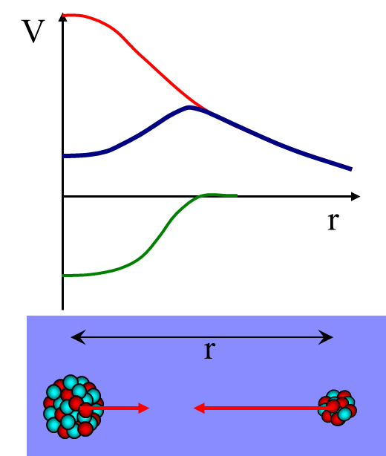

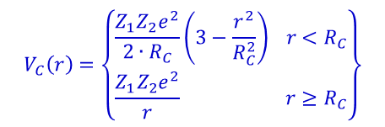


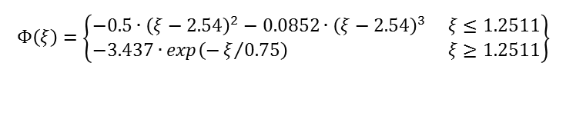




Interaction potential
The potential between projectile and target nucleus is given by a function of the relative distance between them
$$V\left(r\right)=V_{N}\left(r\right)+V_{C}\left(r\right)$$
nuclear potential + Coulomb potential
$$V_{C}\left(r\right)=\left\{\begin{matrix}\frac{Z_{1}Z_{2}e^{2}}{2∙R_{C}}\left(3−\frac{r^{2}}{R_{C}^{2}}\right) r<R_{C} \\ \frac{Z_{1}Z_{2}e^{2}}{r} r≥R_{C}\end{matrix}\right\}$$
$$V_{N}\left(r\right)=4π∙γ∙\frac{C_{p}∙C_{t}}{C_{p}+C_{t}}∙b∙Φ\left(ξ\right)$$
$$Φ\left(ξ\right)=\left\{\begin{matrix}−0.5∙{\left(ξ−2.54\right)}^{2}−0.0852∙{\left(ξ−2.54\right)}^{3} ξ≤1.2511 \\ −3.437∙exp\left(−ξ/{0.75}\right) ξ≥1.2511\end{matrix}\right\}$$
$$ξ=\left(r−C_{p}−C_{t}\right)/b$$
$$b=\frac{π}{\sqrt{3}}∙a≅1 fm with a=0.55 fm$$
$$γ=0.9517∙\left\{1−1.7826∙{\left(\frac{N_{c}−Z_{c}}{A_{c}}\right)}^{2}\right\} \frac{MeV}{{fm}^{2}}$$
$$C_{i}=R_{i}∙\left(1−R_{i}^{−2}\right) \left[fm\right]$$
$$R_{i}=1.28∙A_{i}^{1/3}−0.76+0.8∙A_{i}^{−1/3} \left[fm\right]$$

Slide 6



The Statistical Model de-excitation of the hot compound system
σ_{ℓ}
E*
n
n
Yrast line
n
no states
$$E^{∗}=E_{kin}+∆m∙c^{2}$$
ℓ
$$E_{kin}>V_{C}=\frac{Z_{a}∙Z_{A}∙e^{2}}{R_{int}}$$
$$∆m=m_{a}+m_{A}−m_{CN}$$
http://nuclear.lu.se/database/masses/

Slide 7
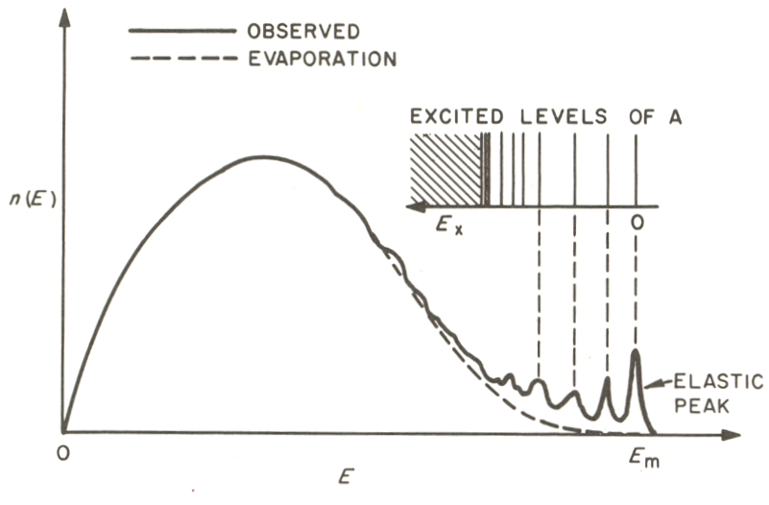
Evaporation particles
cm-spectra of particles statistically emitted from CN (evaporation) are of Maxwell Boltzmann type
neutrons
protons
E_{B} = Coulomb barrier
T = effective nuclear temperature
E_{B}
compound nucleus reactions
direct reactions
Typical energy spectrum of nucleons emitted at a fixed angle
in inelastic nucleon-nucleon reactions.

Slide 8
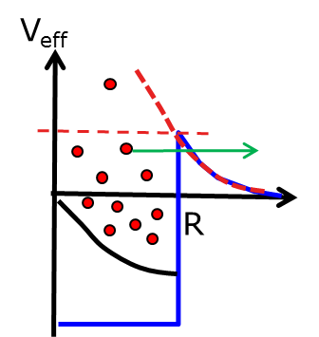
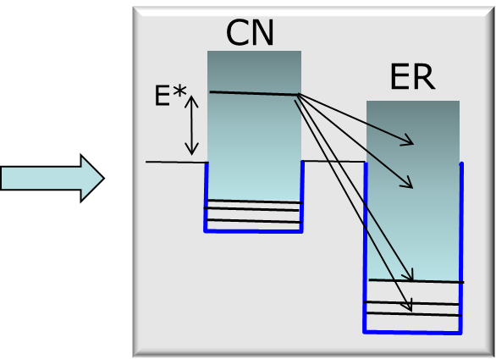
Evaporation particles
cm-spectra of particles statistically emitted from CN (evaporation) are of Maxwell Boltzmann type
neutrons
protons
E_{B} = Coulomb barrier
T = effective nuclear temperature
E_{B}
Even for fixed E* the particle spectrum is continuous (Maxwell Boltzmann), except for transitions to discrete spectrum at low E_{ER}*

Slide 9
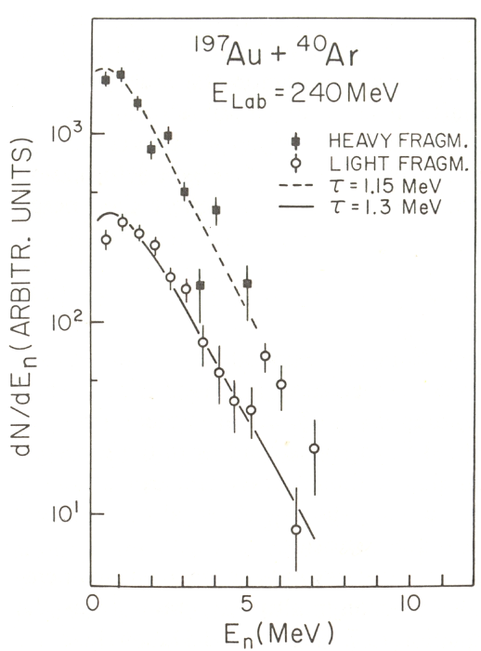
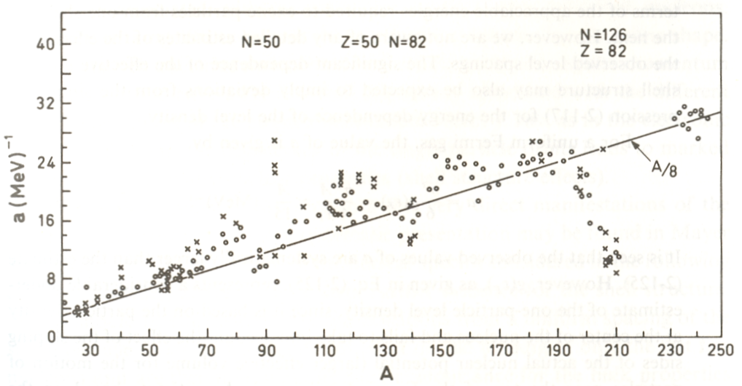
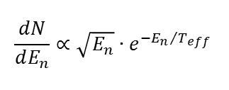

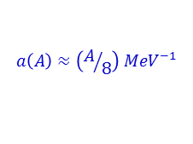
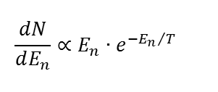
Nuclear temperatures de-excitation of the hot compound system
$$\frac{dN}{dE_{n}}∝E_{n}∙e^{−{E_{n}}/T}$$
spectrum of single neutron
excitation energy
$$\left\langle E_{n}\right\rangle =2T \max{ }\frac{dN}{dE_{n}} @ E_{n}=T$$
$$\frac{dN}{dE_{n}}∝\sqrt{E_{n}}∙e^{−{E_{n}}/{T_{eff}}}$$
spectrum of cascade of neutrons
$$\left\langle E_{n}\right\rangle =1.5T T_{eff}≈0.92∙T \left(1^{st} daughter\right)$$
deviations at shell closures
Fermi gas relations:
collective states
$$a\left(A\right)≈\left(A/8\right) {MeV}^{−1}$$
ground state

Slide 10
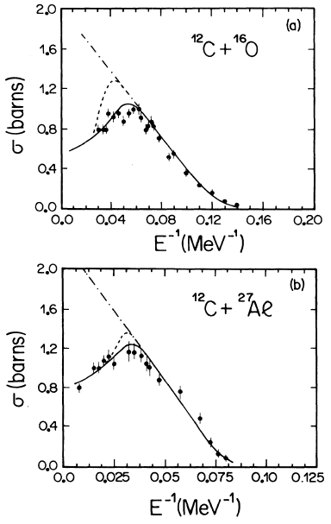
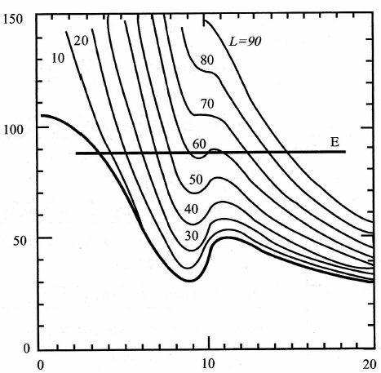
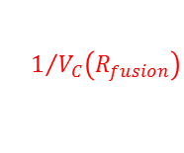

Fusion excitation function
$$πR_{fusion}^{2}$$
maximum ℓ_{fusion} due to nuclear centrifugal stability
V_{nucl} + V_{coul} + V_{L}
$$1/{V_{C}\left(R_{fusion}\right)}$$
r
Elastic/quasi-elastic scattering
multi-
nucleon transfer
FusionFission
Fusion
-ER
0 _{ER} _{F} _{R} 

Slide 11
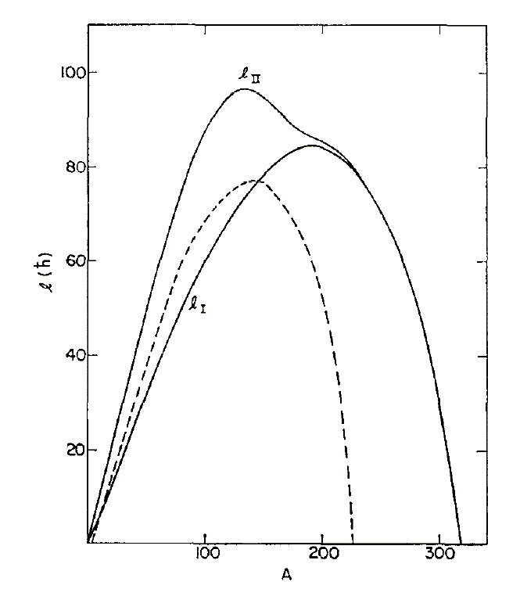
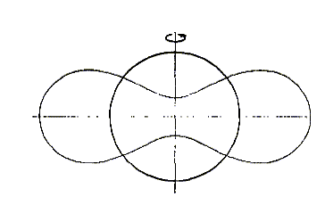
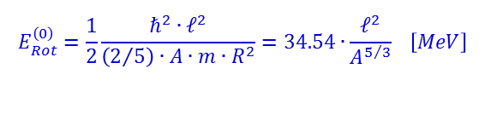

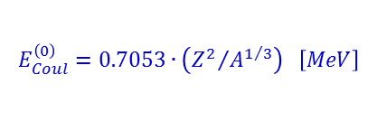
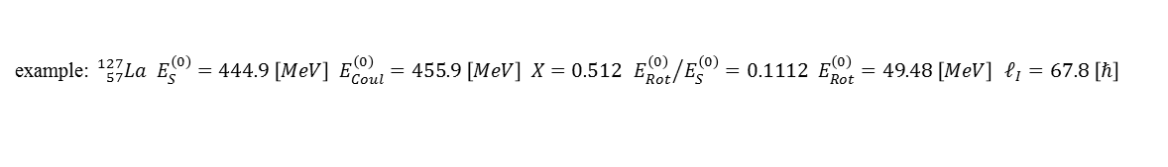
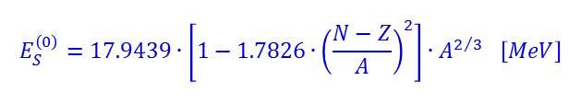


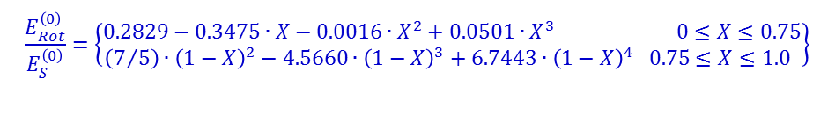

A limiting nuclear angular momentum rotating charged liquid drop
surface energy:
$$E_{S}^{\left(0\right)}=17.9439∙\left[1−1.7826∙{\left(\frac{N−Z}{A}\right)}^{2}\right]∙A^{2/3} \left[MeV\right]$$
$$ℓ_{II}$$
Coulomb energy:
$$E_{Coul}^{\left(0\right)}=0.7053∙\left({Z^{2}}/{A^{1/3}}\right) \left[MeV\right]$$
rotational energy:
ℓ(ħ)
$$E_{Rot}^{\left(0\right)}=\frac{1}{2}\frac{ℏ^{2}∙ℓ^{2}}{\left(2/5\right)∙A∙m∙R^{2}}=34.54∙\frac{ℓ^{2}}{A^{5/3}} \left[MeV\right]$$
$$ℓ_{I}$$
$$Γ_{n}=Γ_{fission}$$
change of the nuclear shape
mass number
$$\frac{E_{Rot}^{\left(0\right)}}{E_{S}^{\left(0\right)}}=\left\{\begin{matrix}0.2829−0.3475∙X−0.0016∙X^{2}+0.0501∙X^{3} 0≤X≤0.75 \\ \left(7/5\right)∙{\left(1−X\right)}^{2}−4.5660∙{\left(1−X\right)}^{3}+6.7443∙{\left(1−X\right)}^{4} 0.75≤X≤1.0 \end{matrix}\right\}$$
$$X=\frac{E_{Coul}^{\left(0\right)}}{2∙E_{S}^{\left(0\right)}}$$
with “fissility parameter”
example: ${}_{57}^{127}{La E_{S}^{\left(0\right)}=444.9 \left[MeV\right] E_{Coul}^{\left(0\right)}=455.9 \left[MeV\right] X=0.512 {E_{Rot}^{\left(0\right)}}/{E_{S}^{\left(0\right)}=0.1112 E_{Rot}^{\left(0\right)}=49.48 \left[MeV\right]} ℓ_{I}=67.8 \left[ℏ\right]}$
Cohen, Plasil, Swiatecki; Ann. Phys. 82, 557 (1974)

Slide 12
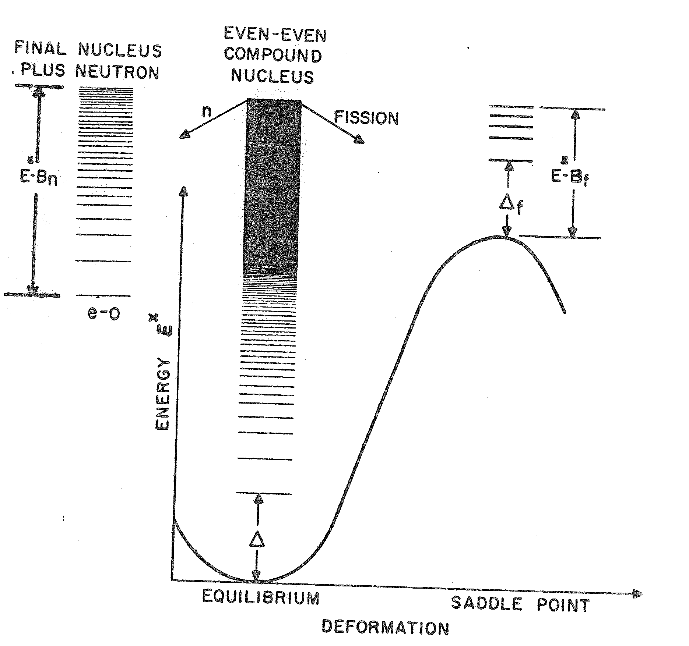
Fusion and evaporation cold fusion
final nucleus
plus neutron
even-even
compound
nucleus
n
fission
⁵⁰Ti + ²⁰⁸Pb ⇒ ²⁵⁸Rf*
(HIVAP calculations)
Fusion
Fission
σ [mbarn]
≈5-7 orders of magnitude
Both decay processes are determined by the level density, either from the residual nucleus or at the saddle point.
level density:
1n
2n
3n
evaporation residues (ER)
E_{lab} [MeV]

Slide 13
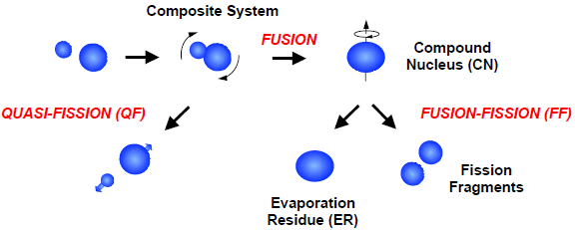
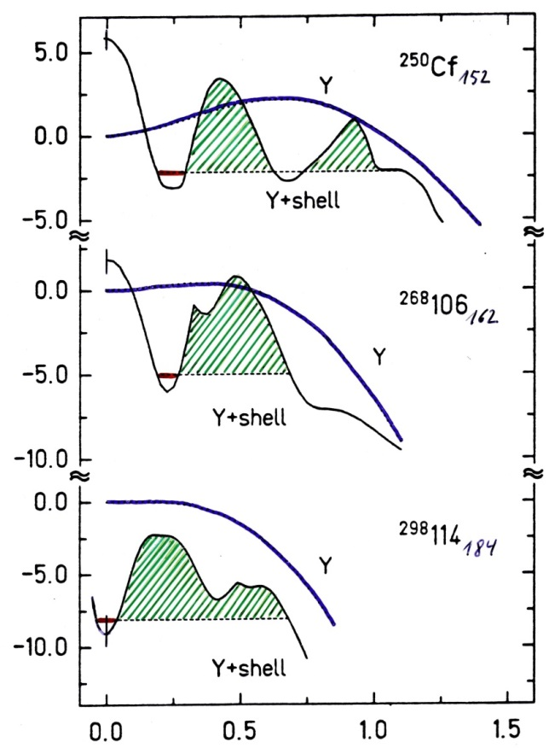
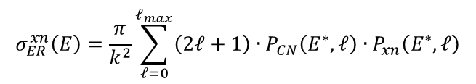


Fusion / Fission competition liquid drop + shell corrections
²⁵⁰98₁₅₂
LD
$$σ_{ER}=σ_{capture}∙P_{CN}∙P_{survival}$$
LD + shell
²⁶⁸106₁₆₂
$$σ_{ER}^{xn}\left(E\right)=\frac{π}{k^{2}}\sum_{ℓ=0}^{ℓ_{max}}{\left(2ℓ+1\right)∙P_{CN}\left(E^{∗},ℓ\right)∙P_{xn}\left(E^{∗},ℓ\right)}$$
Potential energy / MeV
formation survival
²⁹⁸114₁₈₄
Superheavy system: $σ_{ER}≪σ_{capture}$
Deformation β₂
A. Sobiczewski et al.

Slide 14
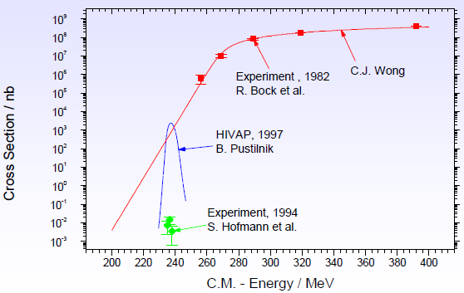

Fusion / Fission competition liquid drop + shell corrections
⁶⁴Ni + ²⁰⁸Pb → ²⁷¹Ds + 1n
$$V_{C}\left(R_{int}\right)=238 MeV$$
$$σ_{ER}=σ_{capture}∙P_{CN}∙P_{survival}$$
fusion-fission

Slide 15
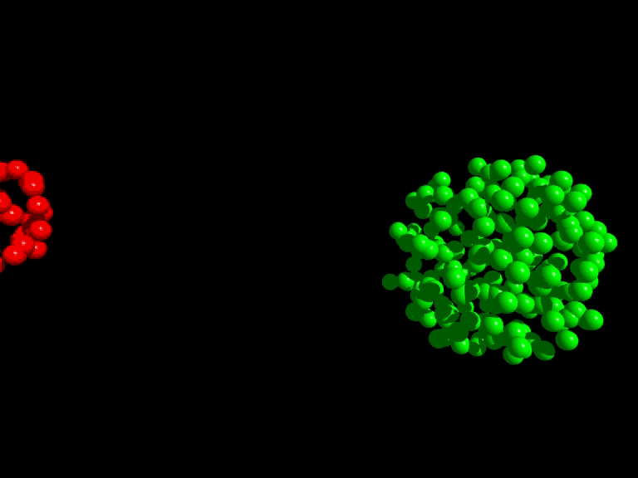
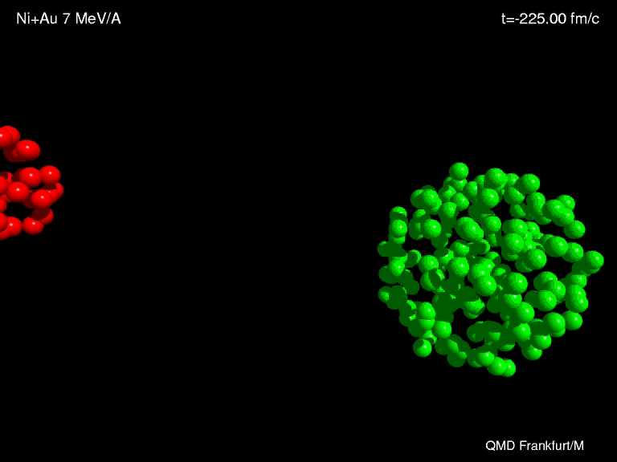
Synthesis of heavy elements
n
⁷⁰Zn
²⁰⁸Pb
²⁷⁷112
Fusion
_1_
10¹²

Slide 16
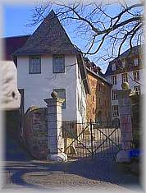
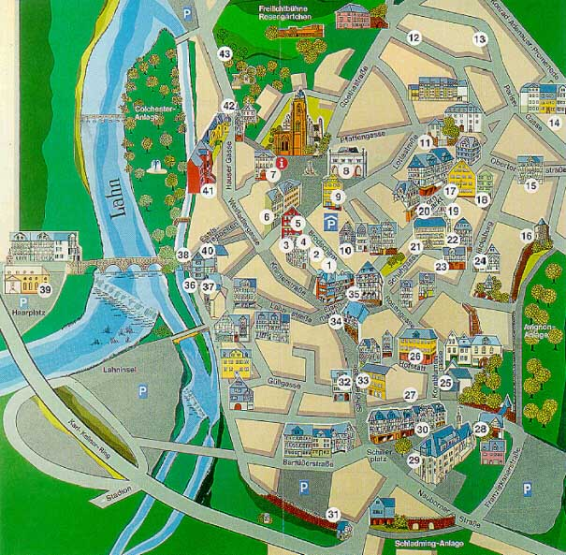
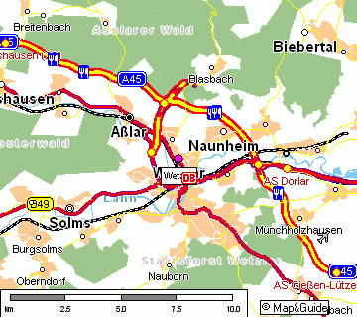

The production cross section fusion cross section and survival probability
Nucleus:
1 barn = 10⁻²⁴ cm² = 10⁻²⁸ m²
fusion cross section:
< 1 barn
Production cross section
²⁷⁷112:
≈ 1 pbarn = 10⁻¹² barn
1:10¹²
Earth:
∅-Area 1.3x10⁸ km²
1.3x10¹⁴ m²
Wetzlar:
Area 75.67 km²
≈1.3x10⁷ m²/2
Charlotte Buff‘s house:
Area x 130 m²
1.3x10² m²
1:10⁷
1:10⁵
1:10¹²

Slide 17
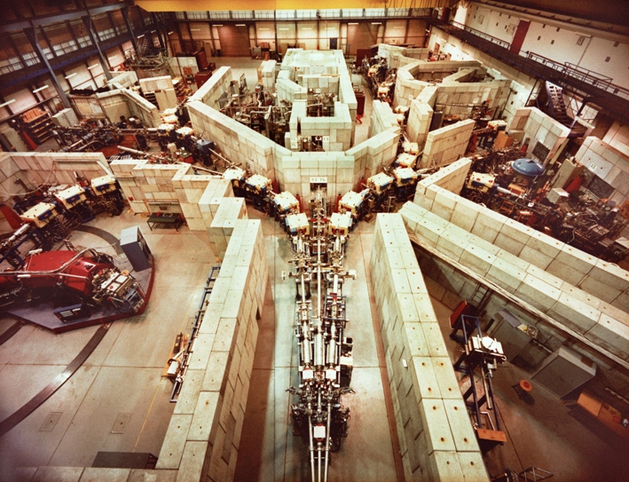
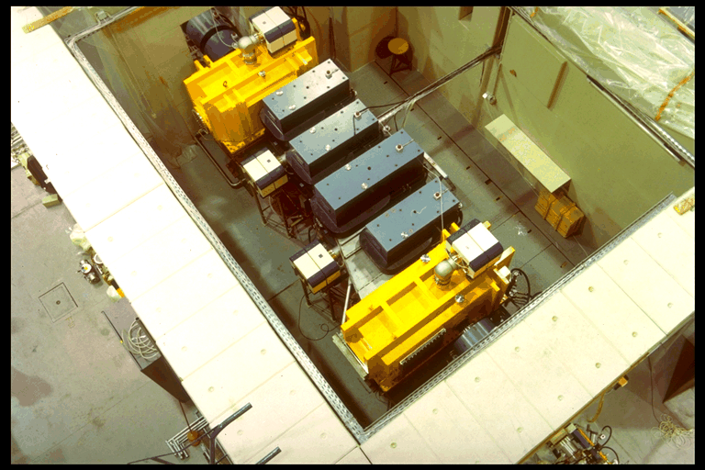
Separator for Heavy Ion Products (SHIP)

Slide 18
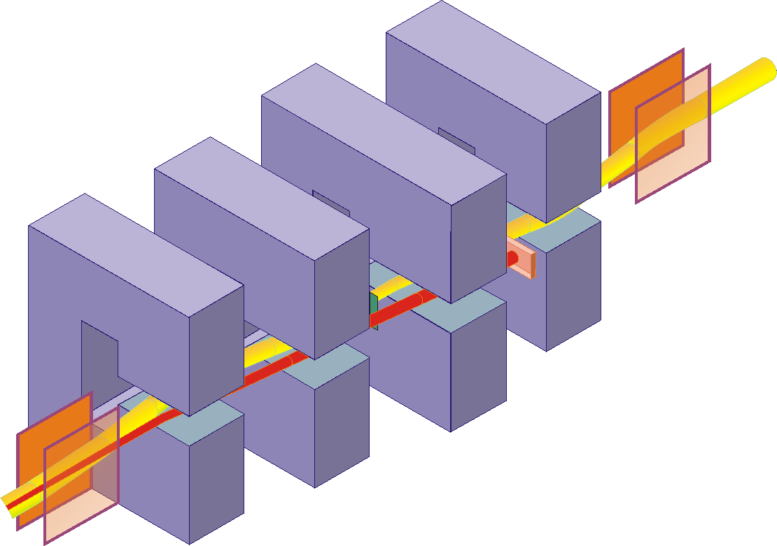
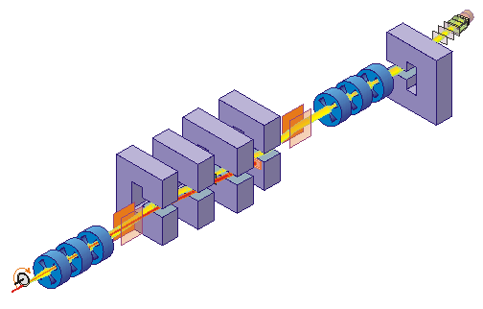




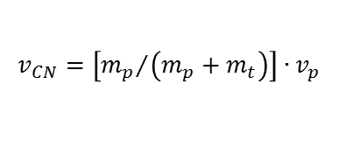
Separator for Heavy Ion Products (SHIP)
Fusion products are slower than scattered or transfer particles
E- and B-field are perpendicular to each other
$$v_{CN}=\left[{m_{p}}/{\left(m_{p}+m_{t}\right)}\right]∙v_{p}$$
$$e.q. v_{p}≈10.3\% → v_{CN}≈2.2\%$$
$$B∙ρ=\frac{m∙v}{e∙q}$$
$$E∙ρ=\frac{m∙v^{2}}{e∙q}$$
$$F_{mag}=F_{el}⇒F_{tot}=0$$
electric deflectors: ±330 kV dipole magnets: 0.7 T max

Slide 19

Separator for Heavy Ion Products (SHIP)
The choice of E and B determines the transmitted velocity
The rejected beam will be stopped on a cooled Cu plate
$$v=\frac{E}{B}$$

Slide 20
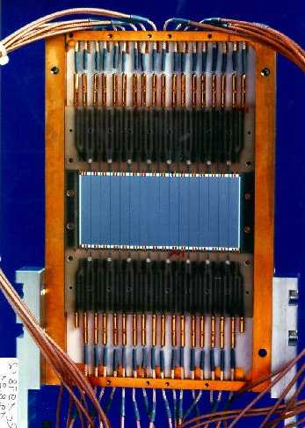
SHIP – stop detector
γ
α (ΔE signal)
SHE will be measured in a pixel
position sensitive Silicon detector determines the position an energy of SHE and α, β, ...
area: 27*87mm², thickness: 0.3mm, 16 strips
energy resolution ΔE=18-20 keV @ E_{α}> 6MeV (cooling 260K)
position resolution Δx=0.3mm (FWHM)
Wait for the emission of an α-particle
(or β-particle)
correlation method: implantation and decay event in the same pixel

Slide 21
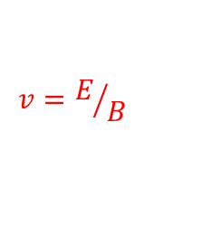
Synthesis and identification of heavy elements with SHIP
n
⁷⁰Zn
²⁰⁸Pb
²⁷⁷112
²⁷⁷112
²⁷⁷112
ER
²⁷³110
11.45 MeV
280 μs
12 m
²⁶⁹Hs
11.08 MeV
110 μ s
²⁶⁵Sg
9.23 MeV
19.7 s
²⁶¹Rf
4.60 MeV (escape)
7.4 s
known
kinematical separation (in flight)
using electric deflectors
and dipole magnets
→ velocity filter
8.52 MeV
4.7 s
²⁵⁷No
²⁵³Fm
8.34 MeV
15.0 s
$$v=E/B$$
Date: 09-Feb-1996
Time: 22:37 h

Slide 22
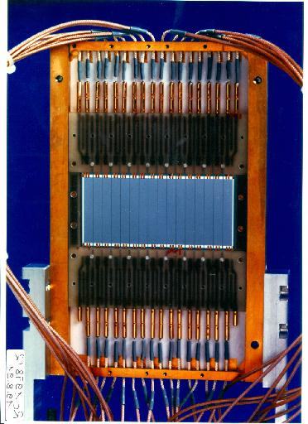
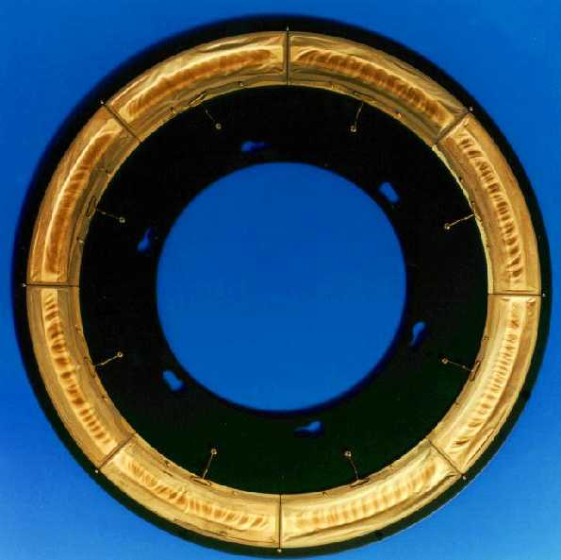
Synthesis and identification of heavy elements with SHIP
n
⁷⁰Zn
²⁰⁸Pb
²⁷⁷112
8 cm
²⁷⁷112
²⁷⁷112
ER
²⁷³110
11.45 MeV
280 μs
12 m
²⁶⁹Hs
11.08 MeV
110 μ s
31 cm
9.23 MeV
19.7 s
²⁶⁵Sg
Identification by
α-α correlations
down to known
isotopes
²⁶¹Rf
4.60 MeV (escape)
7.4 s
known
kinematical separation (in flight)
using electric deflectors
and dipole magnets
→ velocity filter
8.52 MeV
4.7 s
²⁵⁷No
²⁵³Fm
8.34 MeV
15.0 s
$$v=E/B$$
Date: 09-Feb-1996
Time: 22:37 h

Slide 23
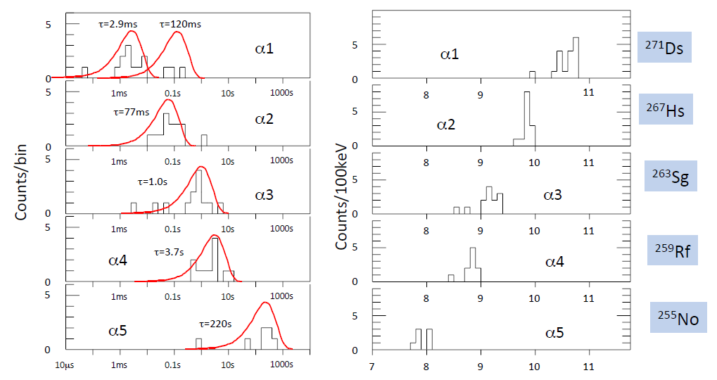
²⁰⁸Pb + ⁶⁴Ni → ²⁷²Ds*
T_{decay}
E_{α} (MeV)

Slide 24


Geiger-Nuttall relationship
The average decay properties of even mass decay chains match the Geiger-Nuttall relationship
Coulomb barrier
nuclear potential
binding energy of α-particle
binding energy per nucleon in nucleus

Slide 25
The JUROGAM array + RITU + GREAT spectrometer

Slide 26




The JUROGAM array + RITU + GREAT spectrometer

Slide 27

The rotational spectrum of ²⁵⁴No
rotational energy:
gamma – energy:
J
3
S. Eeckhaudt et al., Eur. Phys. J. A 26, 227 (2005)

Slide 28

Chemistry of superheavy elements
Are the new elements in the same period?
Does e.g. Lv show the same chemical properties as O, S, Se, Te and Po?

