Slide 1
Nuclear Radii
Gross Properties of Nuclei
Nuclear Sizes

Slide 2
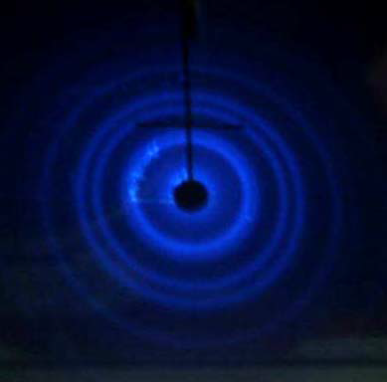
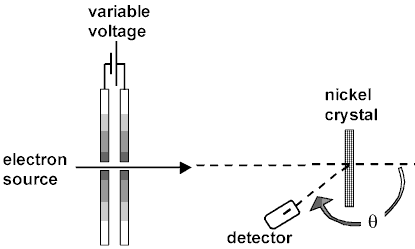
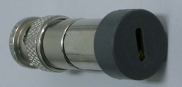



Nuclear Radii
Clinton Davisson & Lester Germer (1925)
Scattered electrons form diffraction pattern characteristic of waves
$$Ψ≈cos\left(k∙x\right)=cos\left(\frac{2π}{λ}∙x\right)$$
Si-detector with slit cover
Wavelength found from Planck’s constant and momentum:
Luis de Broglie (1924): matter particles such as electrons have wave-like properties
$$λ=\frac{h}{m∙v}$$
$$λ=\frac{h}{p}=\frac{h∙c}{\sqrt{E_{kin}∙\left(E_{kin}+2m_{o}c^{2}\right)}}=\frac{1239.84\left[MeV fm\right]}{\sqrt{E_{kin}∙\left(E_{kin}+2m_{0}c^{2}\right)}}$$
Electrons at keV energies:
“interfere” with Angstrom (~10⁻¹⁰ m) scale atomic lattice structure
m₀ = 0.511 [MeV]
ħ = 6.58·10⁻²² [MeV s]

Slide 3
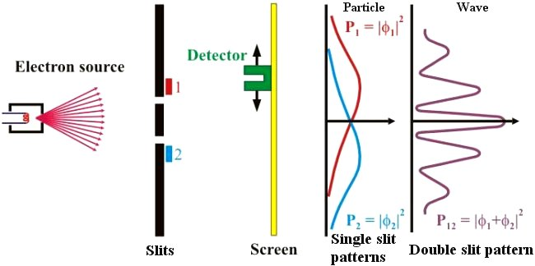
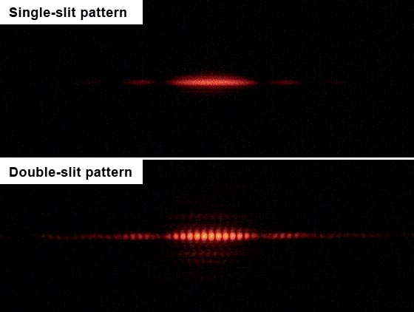
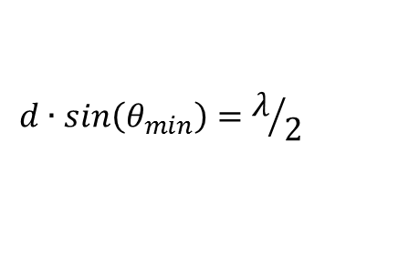
Double slit electron diffraction
d·sinθ
d
Interference minima when path length from holes differs by half wavelength:
$$d∙sin\left(θ_{min}\right)=λ/2$$

Slide 4
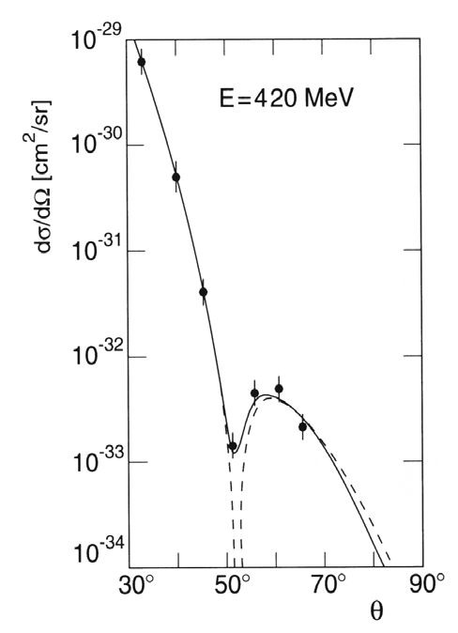
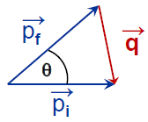

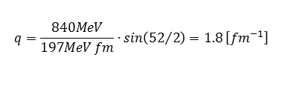
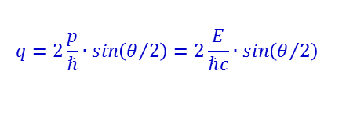
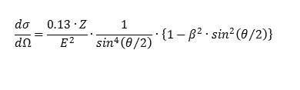
Electron scattering on nuclei
How do we measure nuclear radii?
Use electrons as probe → point like particles, experience only electromagnetic interaction and not strong (nuclear) force, probe the entire nuclear volume.
What energy do we need?
Hint: consider required de Broglie wavelength
$$λ=\frac{h∙c}{\sqrt{E_{kin}∙\left(E_{kin}+2m_{o}c^{2}\right)}}=\frac{1239.84\left[MeV fm\right]}{\sqrt{E_{kin}∙\left(E_{kin}+2m_{0}c^{2}\right)}}$$
λ = 5 [fm] for E_{kin} ~ 250 [MeV]
Study angular distribution of scattered electrons
→ observe diffraction effects
→ analog with optics
e⁻ scattering on ¹²C
The momentum transfer is given by:
$$q=2\frac{p}{ℏ}∙sin\left(θ/2\right)=2\frac{E}{ℏc}∙sin\left(θ/2\right)$$
The cross section describes the scattering on a point-like particle:
$$\frac{dσ}{dΩ}=\frac{0.13∙Z}{E^{2}}∙\frac{1}{\sin^{4}\left(θ/2\right)}∙\left\{1−β^{2}∙\sin^{2}\left(θ/2\right)\right\}$$
$$q=\frac{840MeV}{197MeV fm}∙sin\left({52}/2\right)=1.8 \left[{fm}^{−1}\right]$$

Slide 5
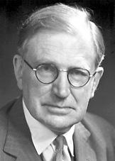
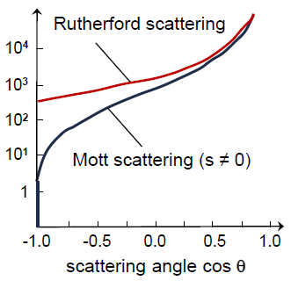
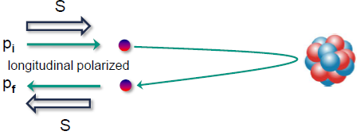
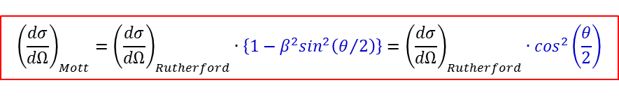
Mott scattering
Mott scattering for relativistic projectiles with spin (no recoil effect)
$${\left(\frac{dσ}{dΩ}\right)}_{Mott}={\left(\frac{dσ}{dΩ}\right)}_{Rutherford}∙\left\{1−β^{2}\sin^{2}\left(θ/2\right)\right\}={\left(\frac{dσ}{dΩ}\right)}_{Rutherford}∙\cos^{2}\left(\frac{θ}{2}\right)$$
for β = v/c → 1
Nevill F. Mott
1905-1996
Central collision (θ = 180⁰, ℓ = 0) of an electron (s = ½)
dσ / d(cosθ)
Electron spin has to perform a spin-flip
→ backward scattering heavily suppressed

Slide 6


Electron scattering on nuclei
Experimental cross section:
$$\left(\frac{dσ}{dΩ}\right)={\left(\frac{dσ}{dΩ}\right)}_{Mott}∙{\left|F\left(q^{2}\right)\right|}^{2}$$
F(q²) is the form factor, which is the Fourier transform of the charge distribution
The form factor of a homogenously charged sphere:
$$F\left(q^{2}\right)=\frac{3}{{\left(qR\right)}^{3}}∙\left\{sin\left(qR\right)−qR∙cos\left(qR\right)\right\}$$
Comparison with experimental cross section on ¹²C
q·R = 4.5 → R = 2.5 [fm] for q = 1.8 [fm⁻¹]

Slide 7
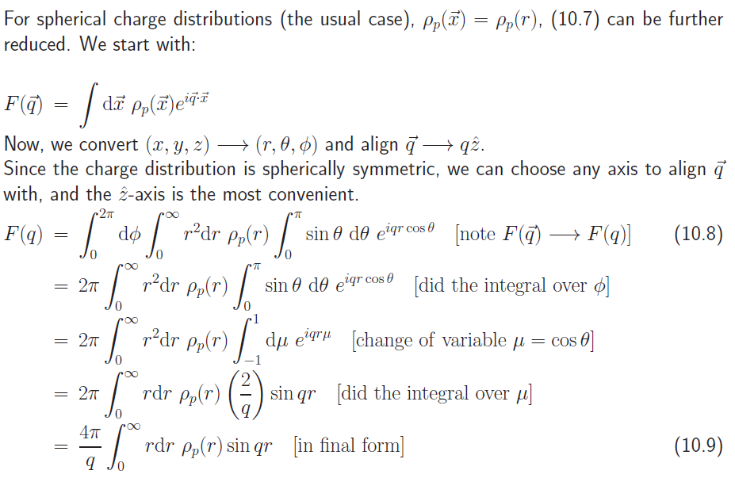
F(q) for spherical charge distribution
Experimental cross section:
$$\left(\frac{dσ}{dΩ}\right)={\left(\frac{dσ}{dΩ}\right)}_{Mott}∙{\left|F\left(q^{2}\right)\right|}^{2}$$
F(q²) is the form factor, which is the Fourier transform of the charge distribution

Slide 8
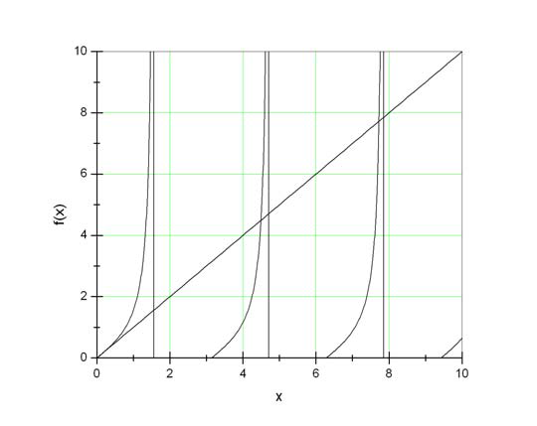
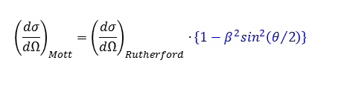
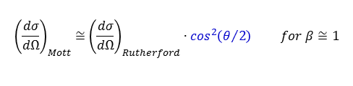
Electron scattering on nuclei
Experimental cross section:
$$\left(\frac{dσ}{dΩ}\right)={\left(\frac{dσ}{dΩ}\right)}_{Mott}∙{\left|F\left(q^{2}\right)\right|}^{2}$$
F(q²) is the form factor, which is the Fourier transform of the charge distribution
The form factor of a homogenously charged sphere:
$$F\left(q^{2}\right)=\frac{3}{{\left(qR\right)}^{3}}∙\left\{sin\left(qR\right)−qR∙cos\left(qR\right)\right\}$$
Comparison with experimental cross section
q·R = 4.5 → R = 2.5 [fm] for q = 1.8 [fm⁻¹]
x = tan(x)
Mott scattering (electron spin s = ½ , velocity v ~ c):
$${\left(\frac{dσ}{dΩ}\right)}_{Mott}={\left(\frac{dσ}{dΩ}\right)}_{Rutherford}∙\left\{1−β^{2}\sin^{2}\left(θ/2\right)\right\}$$
Mott cross section decreases very fast with the scattering angle (relativistic effect)
$${\left(\frac{dσ}{dΩ}\right)}_{Mott}≅{\left(\frac{dσ}{dΩ}\right)}_{Rutherford}∙\cos^{2}\left(θ/2\right) for β≅1$$

Slide 9
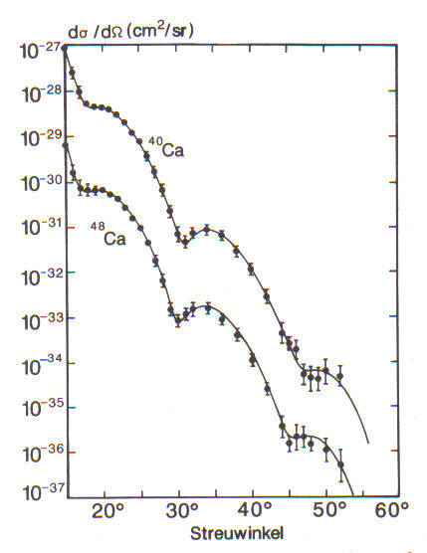
Isotope effect of the nuclear radius
From the position of the cross section minima for ⁴⁸Ca and ⁴⁰Ca it is obvious that the nuclear radius R increases with mass number A.
scattering angle

Slide 10
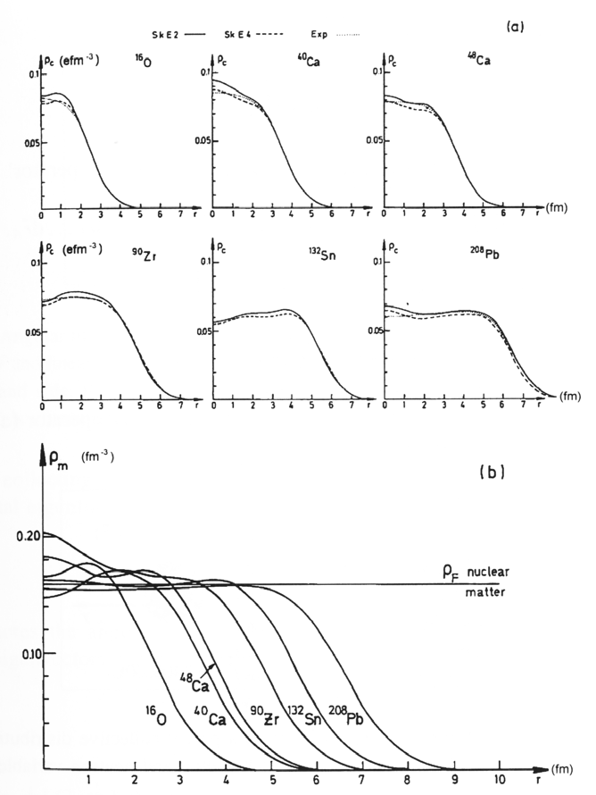
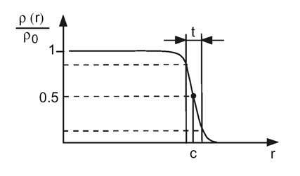
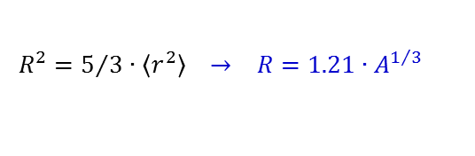
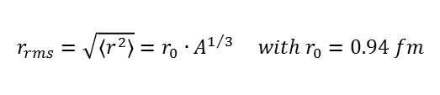
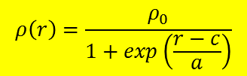
Charge distribution
experimental charge distributions
t = 2.4 fm
¹⁶O
⁴⁰Ca
⁴⁸Ca
Fermi distribution:
$$ρ\left(r\right)=\frac{ρ_{0}}{1+exp\left(\frac{r−c}{a}\right)}$$
⁹⁰Zr
¹³²Sn
²⁰⁸Pb
with c ≈ 1.07·A^{1/3} fm, a ≈ 0.54 fm
Root mean square radius:
$$r_{rms}=\sqrt{\left\langle r^{2}\right\rangle }=r_{0}∙A^{1/3} with r_{0}=0.94 fm$$
ρ₀ ≈ 0.17 nucleons / fm³
Equivalent radius of a sphere:
$$R^{2}=5/3∙\left\langle r^{2}\right\rangle → R=1.21∙A^{1/3}$$

Slide 11
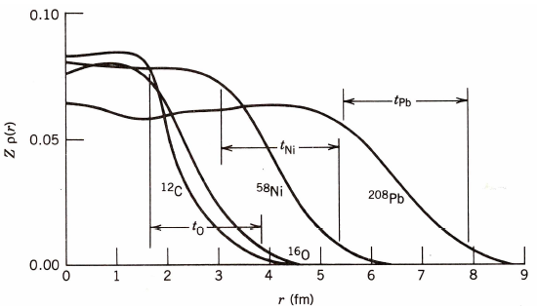
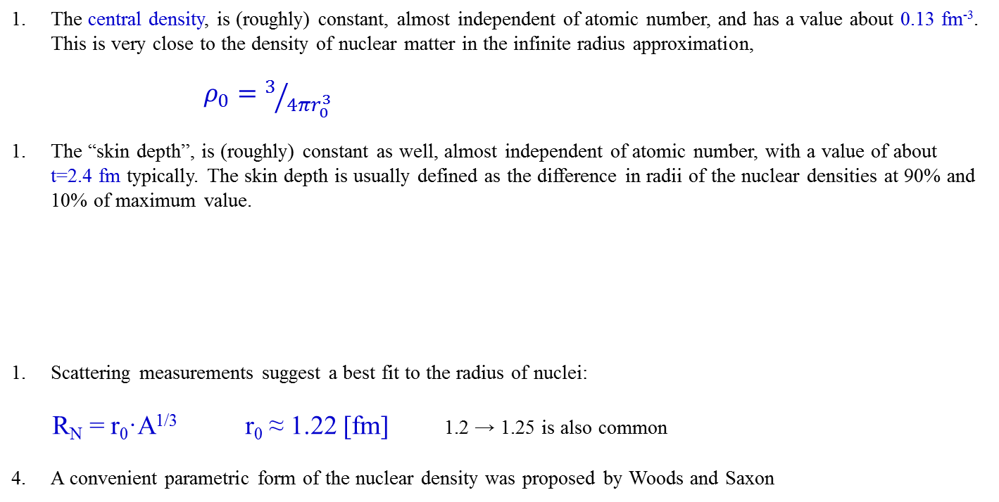
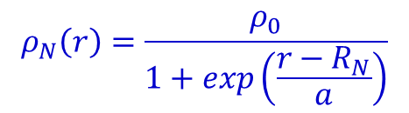
Conclusion of nuclear radius measurements
The central density, is (roughly) constant, almost independent of atomic number, and has a value about 0.13 fm⁻³. This is very close to the density of nuclear matter in the infinite radius approximation,
$ρ_{0}=3/{4πr_{0}^{3}}$
The “skin depth”, is (roughly) constant as well, almost independent of atomic number, with a value of about t=2.4 fm typically. The skin depth is usually defined as the difference in radii of the nuclear densities at 90% and 10% of maximum value.
Scattering measurements suggest a best fit to the radius of nuclei:
R_{N} = r₀·A^{1/3} r₀ ≈ 1.22 [fm] 1.2 → 1.25 is also common
A convenient parametric form of the nuclear density was proposed by Woods and Saxon
$$ρ_{N}\left(r\right)=\frac{ρ_{0}}{1+exp\left(\frac{r−R_{N}}{a}\right)}$$
with t = a·4·ln3

