Slide 1

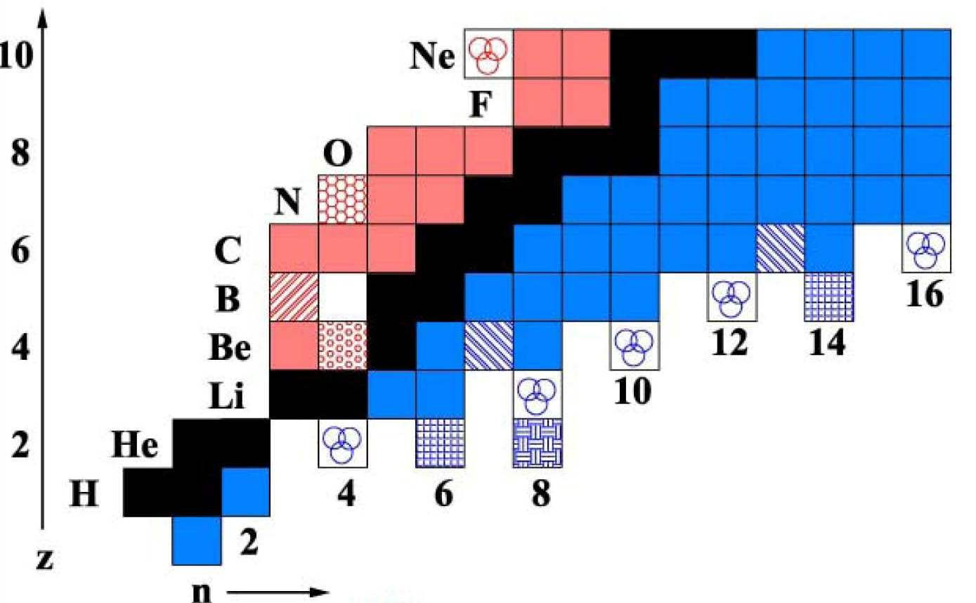
Limits of stability: halo nuclei
stable nuclei
dripline nuclei
continuum
more neutrons
p
n
p
n

Slide 2
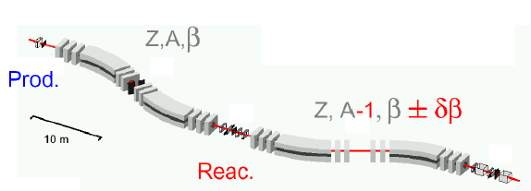
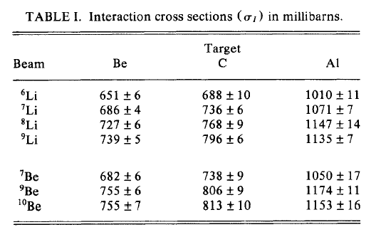
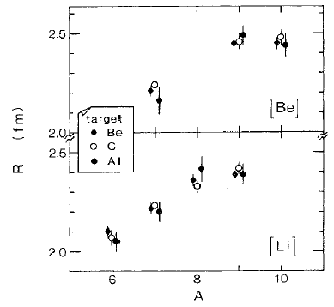
Measurement of the total reaction cross section
800 MeV/u ¹¹B primary beam
Fragmentation
FRagment Separator FRS

Slide 3
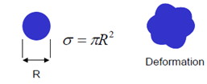
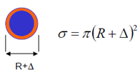
Measurement of the total reaction cross section
¹¹Li is the heaviest bound Li isotope
¹⁰Li not bound
S_{2n}(¹¹Li) = 295(35) keV
only bound in its ground state
reason for larger radius?
deformation
extended wave function

Slide 4
At the limit of the strong force – halo nuclei
reason for larger radius?
deformation
extended wave function
⇒ measurements of magnetic moment and quadrupole moment
¹¹Li consists in its ground state of paired neutrons and a p_{3/2} proton
g-factor of nucleons:
proton: g_{ℓ} = 1; g_{s} = +5.585
neutron: g_{ℓ} = 0; g_{s} = -3.82
proton:
neutron:

Slide 5
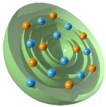
Success of the shell model
Magnetic moments:
g-factor of nucleons:
proton: g_{ℓ} = 1; g_{s} = +5.585
neutron: g_{ℓ} = 0; g_{s} = -3.82
proton:
neutron:

Slide 6
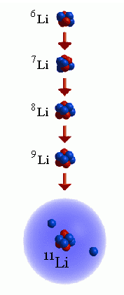

At the limit of the strong force – halo nuclei
reason for larger radius?
deformation
extended wave function
⇒ measurements of magnetic moment and quadrupole moment
¹¹Li consists in its ground state of paired neutrons and a p_{3/2} proton
3 borromean rings
→ spherical and large radius not because of deformation
Exotic nuclei with large neutron excess form nuclei with halo-structure: ¹¹Li nuclei consist of a normal ⁹Li nucleus with a halo of two neutrons. Halo nuclei form borromean states, they are interlocked in such a way that breaking any cycle allows the others to disassociate.
HALO:

Slide 7
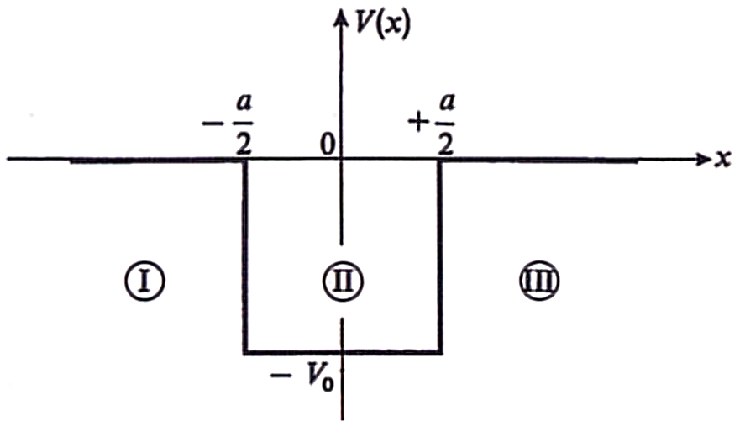
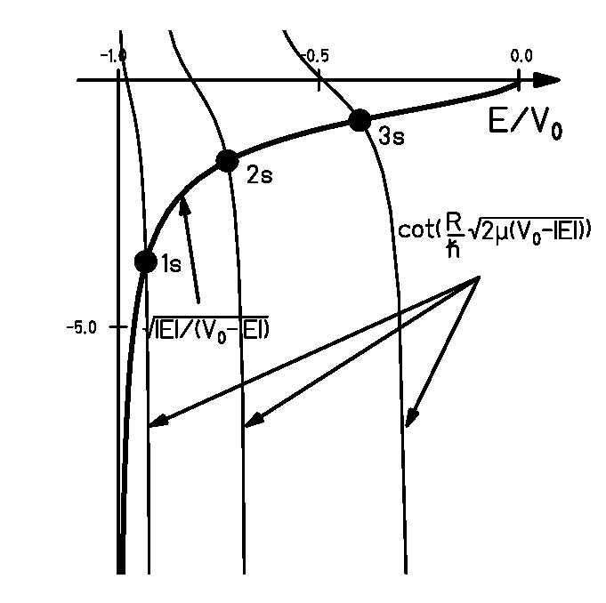
Single particle potential
outside of the square-well potential:
Lösung:
inside of the square-well potential:
Lösung:
continuity of the wave function:
graphical solution of the eigenvalue problem

Slide 8
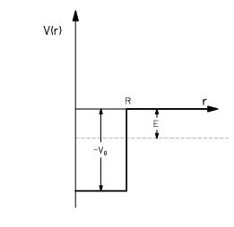
Energy eigenvalues
Schrödinger equation:
ℓ=0 energies:
ℓ=1 energies:
ℓ=2 energies:
Orbital nℓ | E_{nℓ} (MeV) ³⁶Ca R=3.96fm | E_{nℓ} (MeV) ³⁶Ca V₀=54.7MeV | E_{nℓ} (MeV) ³⁶S V₀=47.3MeV
1s | 13.16 | 9.75 | 9.55
1p | 26.90 | 19.77 | 19.31
1d | 44.26 | 32.20 | 31.32
2s | 52.61 | 37.55 | 36.25
1f | 65.08

Slide 9
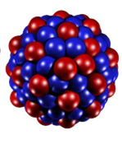
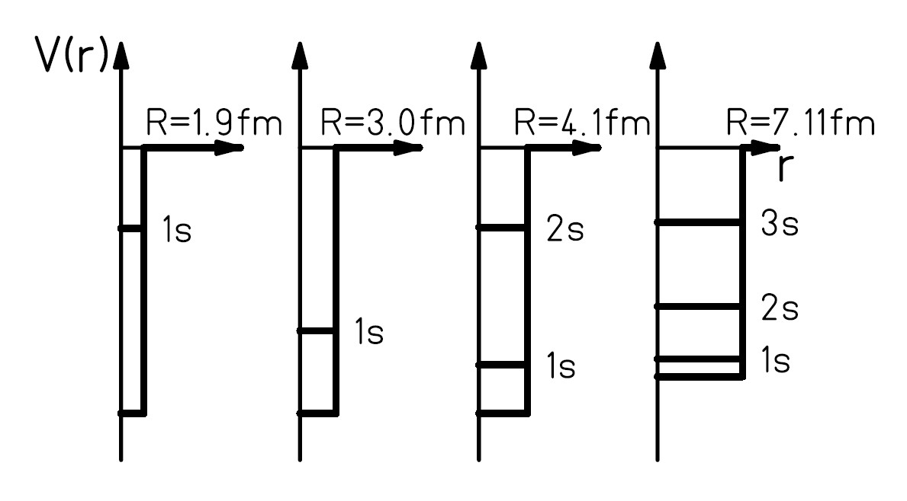
Energy eigenvalues
Energy eigenvalues for ℓ=0 in ⁴He, ¹⁶O, ⁴⁰Ca und ²⁰⁸Pb

Slide 10
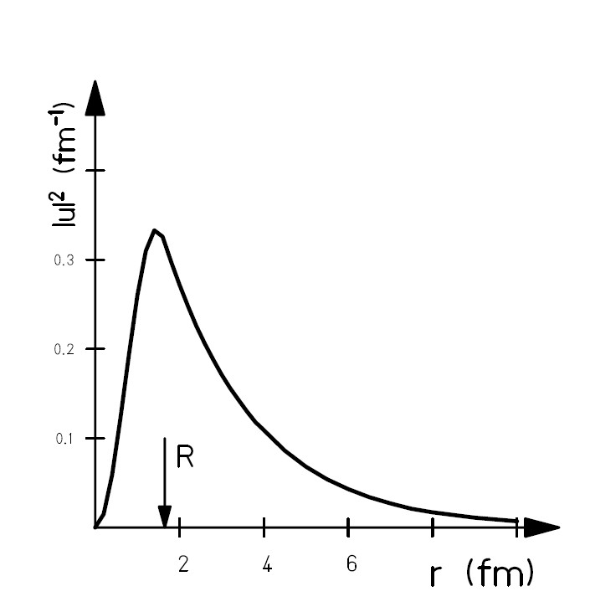
Wave function of the deuteron
Ι
ΙΙ
normalization:

Slide 11
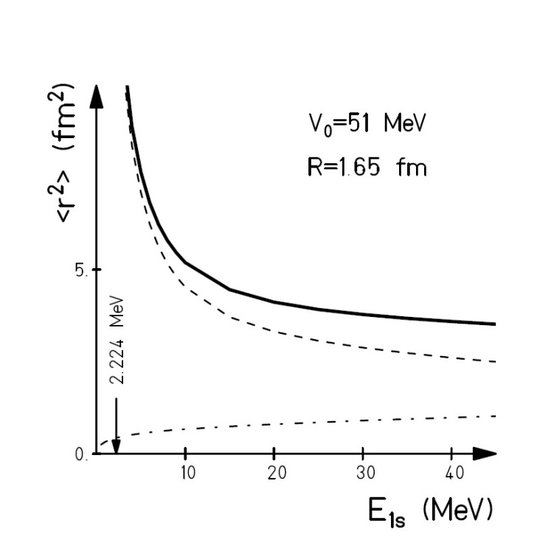
Radius of the deuteron
Ι
ΙΙ
outer region
inner region

Slide 12
Limits of stability: halo nuclei
What can one expect at the neutron-dripline?
wave function outside of the potential
The smaller the binding energy, the more extended the wave function
E | κ² | κ | 1/κ ~ r
7 MeV | 0.35 fm⁻² | 0.6 fm⁻¹ | 1.7 fm
1 MeV | 0.05 fm⁻² | 0.2 fm⁻¹ | 4.5 fm
0.1 MeV | 0.005 fm⁻² | 0.07 fm⁻¹ | 14 fm
Fourier-transform:

Slide 13
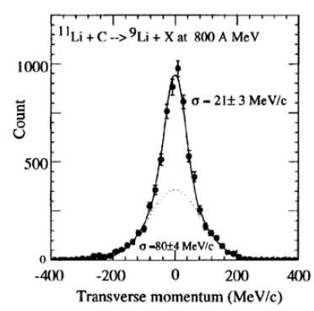
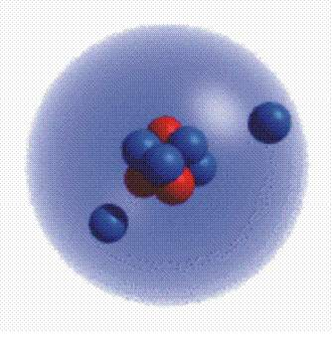
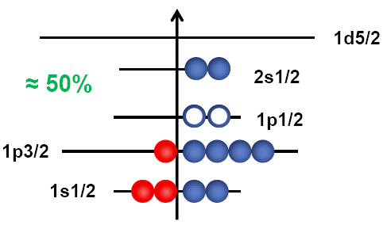
Limits of stability: halo nuclei
test of the extended wave function
momentum distribution:
wider momentum distribution for strongly bound particles
narrow momentum distribution for weakly bound particles
small → large
interpretation:
One can simplify ¹¹Li by describing it as a ⁹Li core plus a di-neutron
One can use the arguments of an extended wave function with an exponential decline:
S_{2n}=250(80) keV
N=8
N=2

Slide 14
Discovery of halo nuclei
2. Momentum distribution of ¹¹Li
⁶He distribution from ⁸He
simlar to Goldhaber model
⁹Li distribution from ¹¹Li (very narrow ! )
uncertainty principle
small → large
wider distribution is similar to Goldhaber model

Slide 15
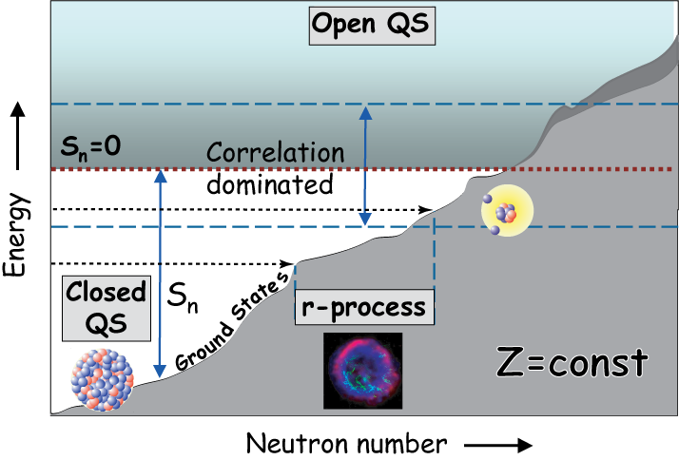
Limits of stability - halo nuclei
radii of lighter nuclei
Prog. Part. Nucl. Phys. 59 (2007), 432

Slide 16
Berechnen sie den Radius der 2-Neutron Wellenfunktion für ¹¹Li
¹⁰Li ist nicht gebunden
Man kann ¹¹Li sehr vereinfacht beschreiben als ⁹Li plus einem Di-Neutron.
S_{2n}(¹¹Li) = 0.295(35) MeV

