Slide 1

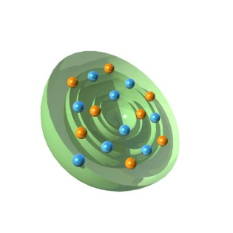
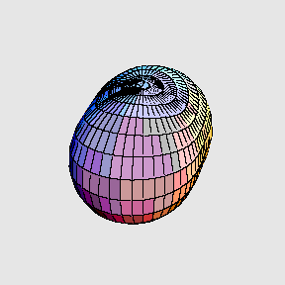
The nucleus and its structure
Presently no complete theory to fully describe structure and behavior of nuclei based solely on knowledge of force between nucleons (although tremendous progress for A < 12 in the past few years!)
use MODELS:
simplifying assumptions
give reasonable account of observed properties
make predictions
Liquid-Drop Model
nucleus regarded as collection of neutrons and protons
forming a droplet of incompressible fluid
→ good description of overall trend of binding energy per nucleon
→ fails to account for magic numbers or give any prediction for J^{π}
SHELL Model
neutrons and protons arranged in stable quantum states
in common potential well
→ accounts for ground state properties (e.g. J^{π}) and magic numbers
→ does not predict many of the observed nuclear excited states
COLLECTIVE Model
neutrons and protons show collective motions
give rise to vibrational and rotational states
→ accounts for properties of non-spherical nuclei
→ fails to reproduce other features

Slide 2
What have we learned about the nucleus so far?
The nuclear density is roughly constant for all nuclei
Nuclei are positively charged, and the nuclear charge density is also roughly constant
The strong force is attractive only at short range...
AND is repulsive at very short range (i.e. nuclear matter is highly incompressible)
These observations are remarkable, and have been performed with very simple concepts so far. We are now at the level of understanding where we can begin to theoretically model the nucleus in an attempt to predict our observations.

Slide 3
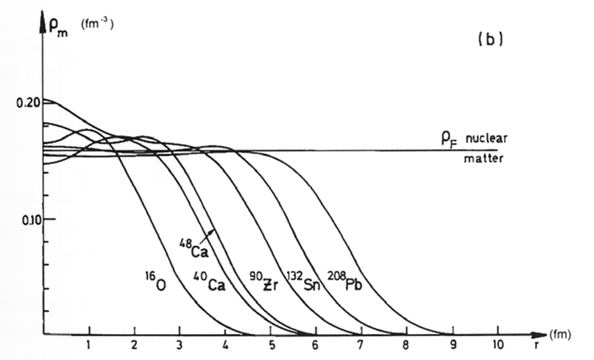
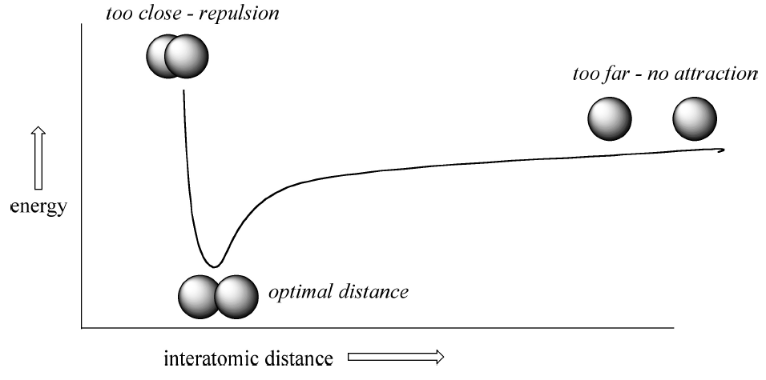
A charged drop of incompressible liquid
The scattering experiments we saw previously suggested that nuclei have approximately constant density. We were then able to calculate the nuclear radius assuming a uniform sphere. A drop of uniform liquid has the same property.
ρ₀ ≈ 0.17 nucleons / fm³
The nuclear force is short-range, but does not allow for compression of nuclear matter. Molecules in a liquid drop have the same basic properties.
Yukawa potential

Slide 4
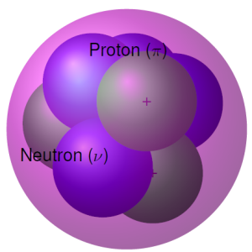
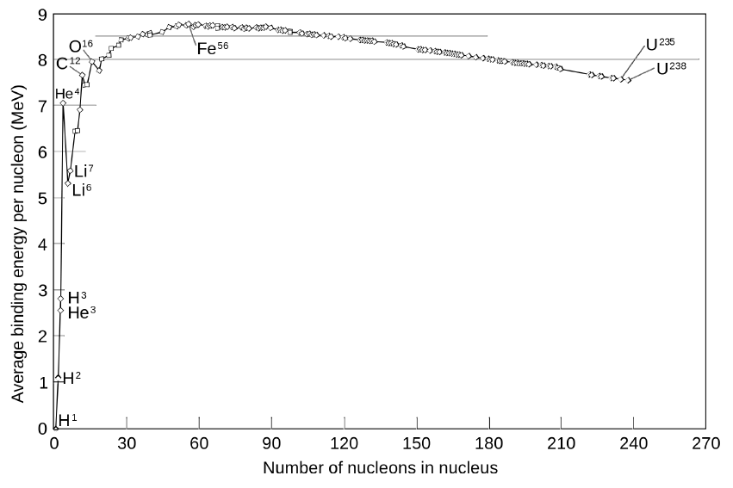

A charged drop of incompressible liquid
For the nucleus we assume a liquid drop with a uniform positive charge.
$$B_{volume}=a_{V}∙A$$

Slide 5
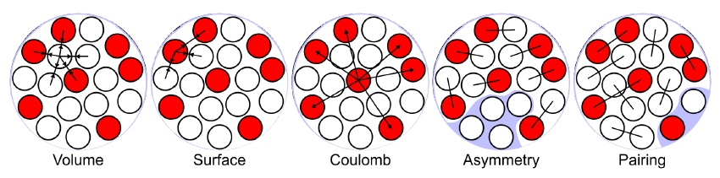

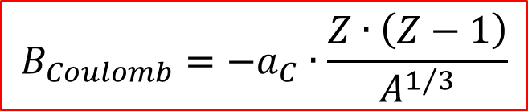
Liquid Drop Model
First, we need to account for the fact that the nucleons on the surface have less neighbours, and do not exhibit the same binding as those in the interior (volume)....
$$B_{surface}={−a}_{S}∙A^{2/3}$$
Protons in the nucleus repel each other due to their mutual positive charge, this reduces the binding energy further....
$$B_{Coulomb}={−a}_{C}∙\frac{Z∙\left(Z−1\right)}{A^{1/3}}$$

Slide 6
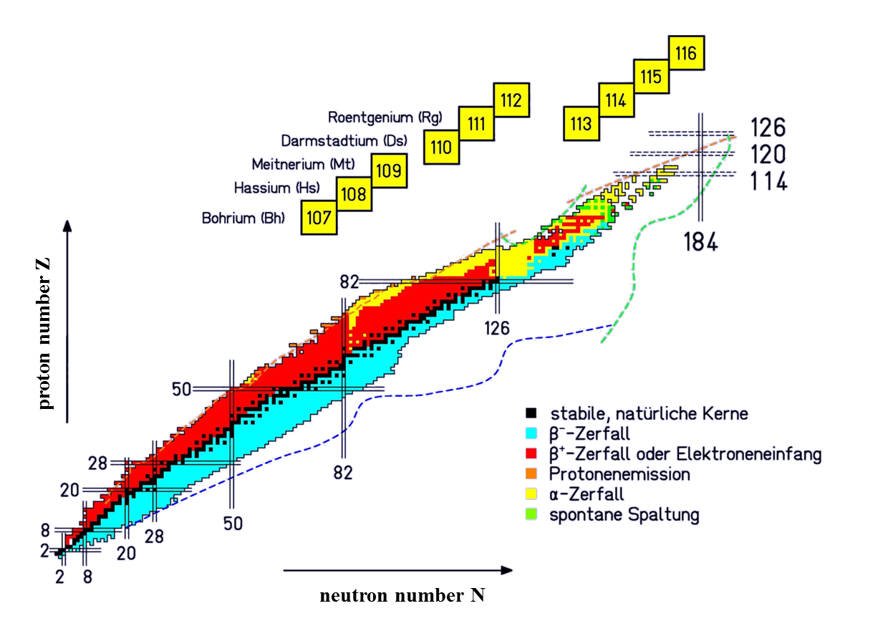
Liquid Drop Model
N = Z

Slide 7
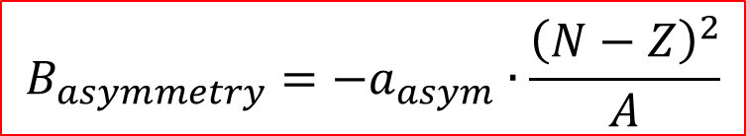
Liquid Drop Model
For light nuclei, N ~ Z (for heavy nuclei N is only slightly larger than Z). Where the Coulomb term would always favour Z = 0 for any A, we must account for the fact that nuclei are quantum objects (specifically that nucleons are fermions), and must obey the Pauli exclusion principle....
$$B_{asymmetry}={−a}_{asym}∙\frac{{\left(N−Z\right)}^{2}}{A}$$

Slide 8
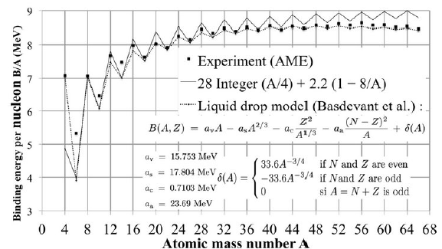
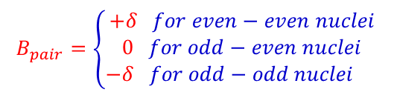
Liquid Drop Model
There is still one observation that can tell us something about the binding energy, and how nucleons interact with one another. How many nuclei with an even or odd number of protons and neutrons are stable?
nuclear pairing
$$B_{pair}=\left\{\begin{aligned}+δ for even−even nuclei \\ 0 for odd−even nuclei \\ −δ for odd−odd nuclei \end{aligned}\right.$$

Slide 9
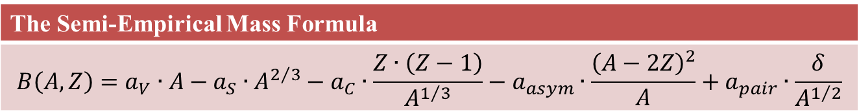
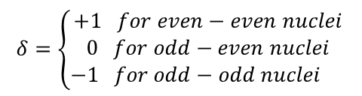
Liquid Drop Model
The Semi-Empirical Mass Formula
$$B\left(A,Z\right)=a_{V}∙A−a_{S}∙A^{2/3}−a_{C}∙\frac{Z∙\left(Z−1\right)}{A^{1/3}}−a_{asym}∙\frac{{\left(A−2Z\right)}^{2}}{A}+a_{pair}∙\frac{δ}{A^{1/2}}$$
with
a_{V} | 15.85 MeV
a_{S} | 18.34 MeV
a_{C} | 0.71 MeV
a_{asym} | 23.21 MeV
a_{pair} | 12 MeV
$$δ=\left\{\begin{aligned}+1 for even−even nuclei \\ 0 for odd−even nuclei \\ −1 for odd−odd nuclei \end{aligned}\right.$$

Slide 10
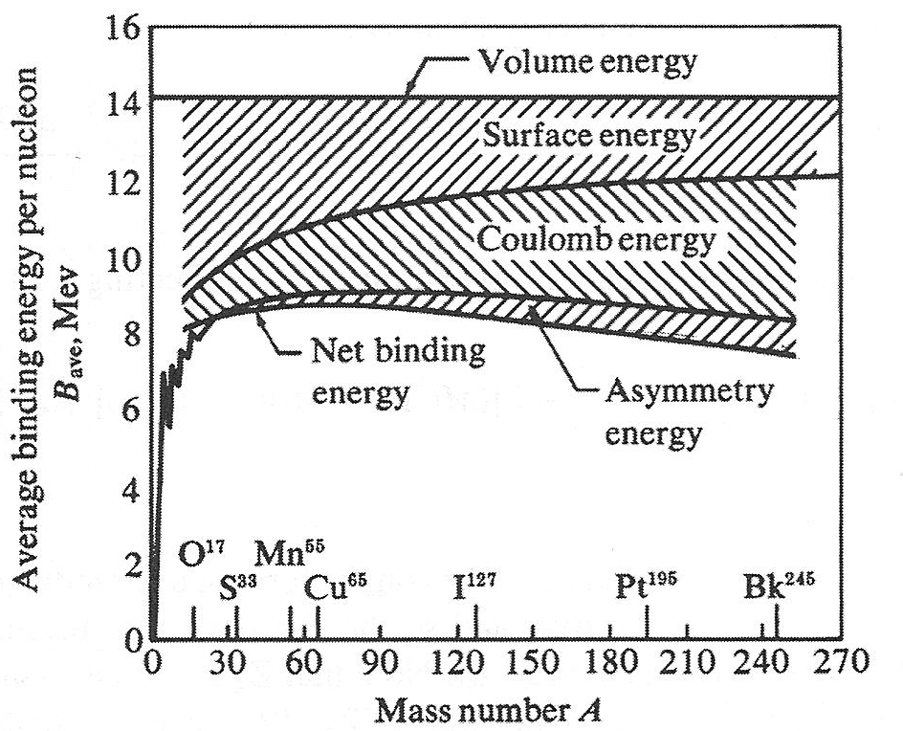
Liquid Drop Model’s contribution

Slide 11
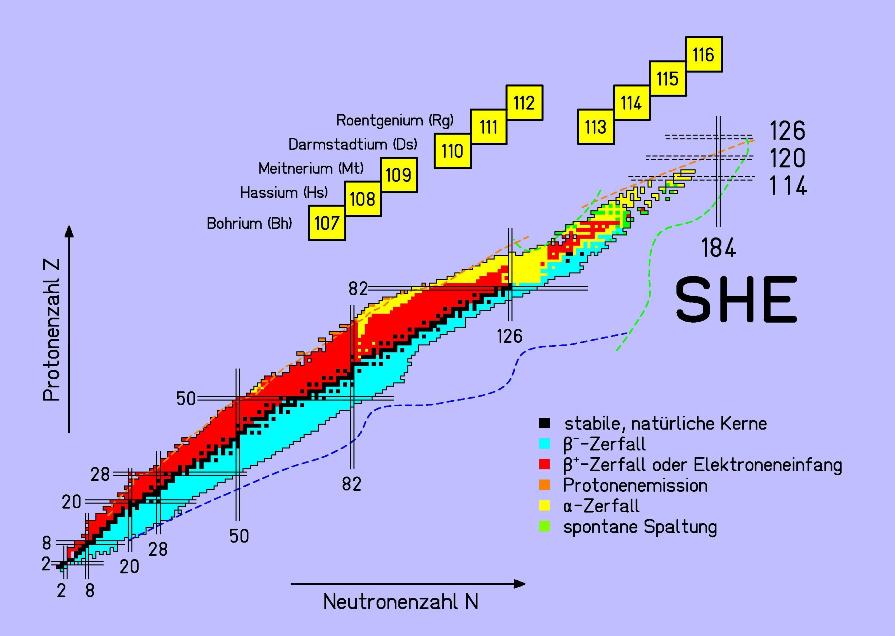
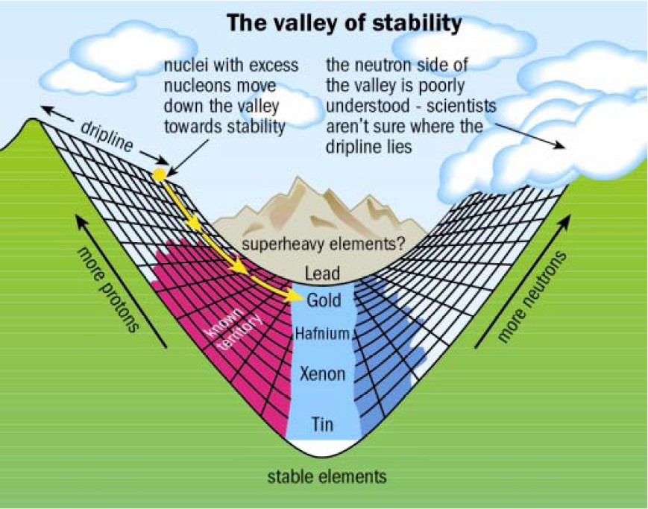
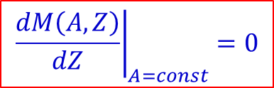
Liquid Drop Model: Line of Stability
$$M\left(A,Z\right)=Z^{2}∙\left[\frac{4∙a_{asym}}{A}+\frac{a_{C}}{A^{\frac{1}{3}}}\right]+Z∙\left[M\left({}_{}^{1}H\right)−M\left(n\right)−4∙a_{asym}\right]+A∙\left[M\left(n\right)−a_{V}+\frac{a_{S}}{A^{\frac{1}{3}}}+a_{A}\right]+δ\left(A,Z\right)$$
$${\left.\frac{dM\left(A,Z\right)}{dZ}\right|}_{A=const}=0$$
proton number Z
neutron number N

Slide 12
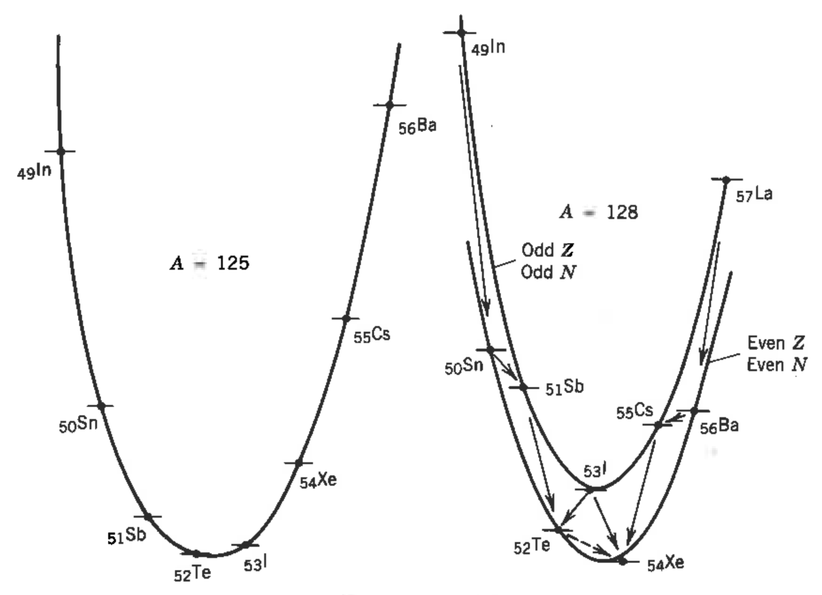














Mass parabola
$$β^{+}$$
$$β^{−}$$
A=128
$$β^{−}$$
A=125
$$β^{+}$$
$$β^{−}$$
$$β^{+}$$
$$β^{+}$$
$$β^{−}$$
$$β^{−}$$
$$β^{+}$$
$$β^{+}$$
$$β^{+}$$
$$β^{−}$$
$$β^{+}$$

Slide 13
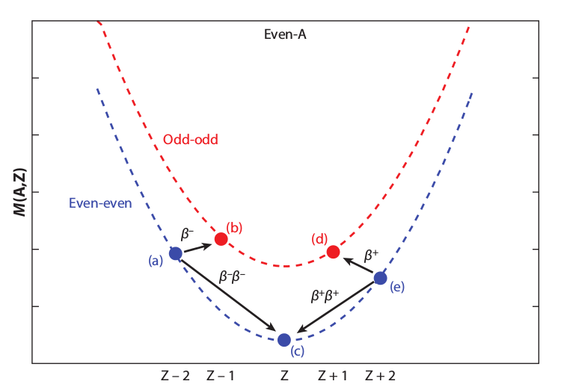
Stable and radioactive nuclei

Slide 14
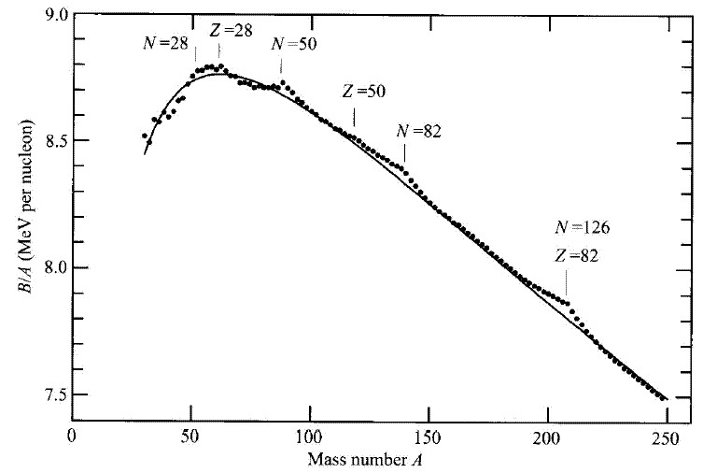
Deviation from Liquid Drop Model
Neutron
Proton
28
28
50
50
B/A (MeV per nucleon)
82
especially stabil:
126
82
mass number A

Slide 15
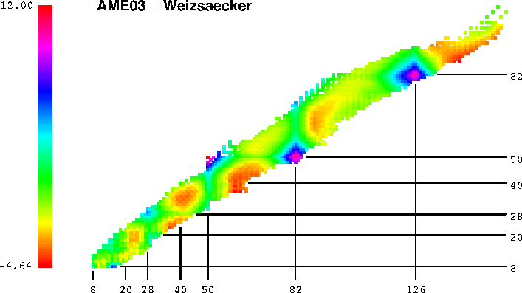
Deviation from Liquid Drop Model

Slide 16
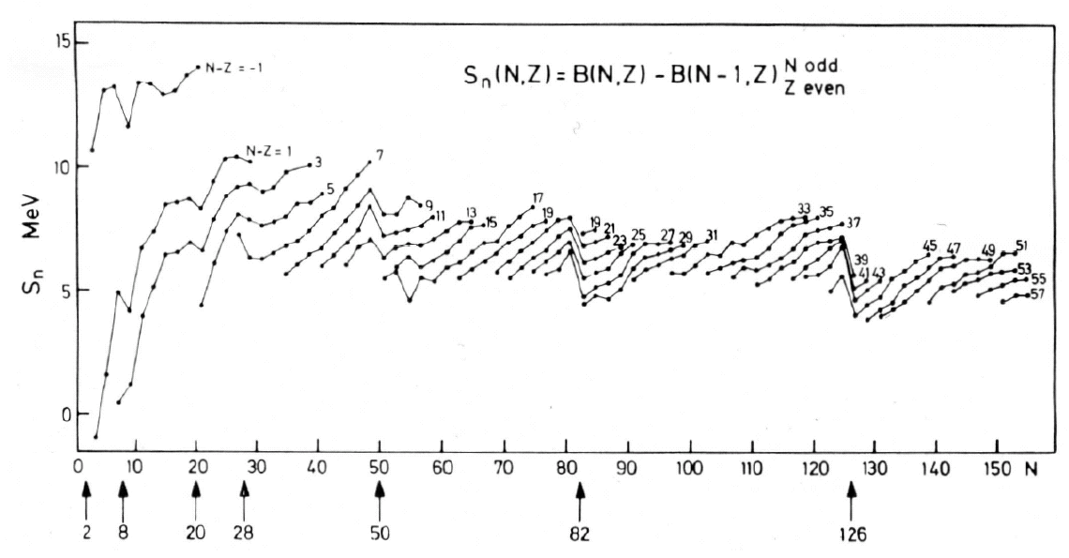
Neutron separation energy

Slide 17
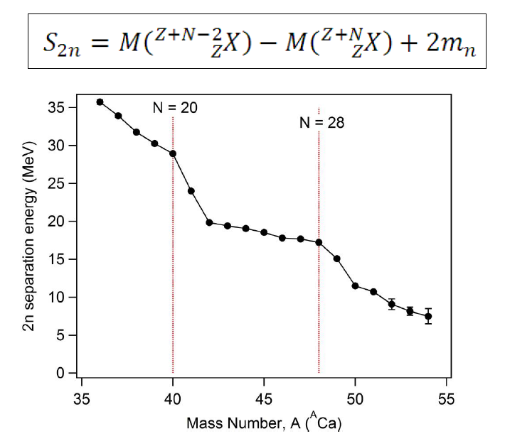
2-neutron separation energy

