Slide 1
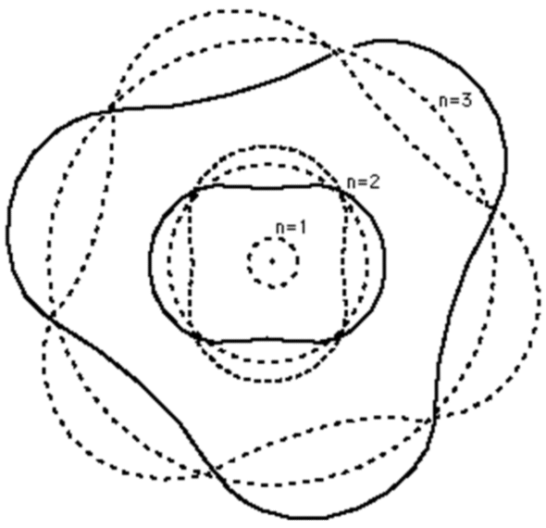
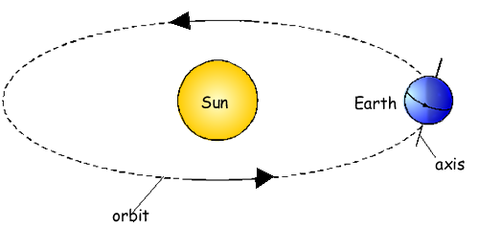
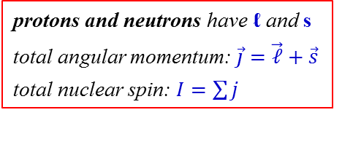
PHL424: Nuclear angular momentum
electron orbitals
electrons in an atom
quantum numbers:
n (principal) 1,2,3,…
ℓ (orbital angular momentum) 0 → n-1
m (magnetic) -ℓ ≤ m ≤ +ℓ
s (spin) ↑↓ or +½ħ -½ħ
n=3
n=2
n=1
classical analogy
spin s
orbital angular momentum ℓ
sun ≡ nucleus
earth ≡ electron
protons and neutrons have ℓ and s
total angular momentum: $\vec{j}=\vec{ℓ}+\vec{s}$
total nuclear spin: $I=\sum{j}$
electron is structure less and hence can not rotate
spin s is a quantum mechanical concept

Slide 2
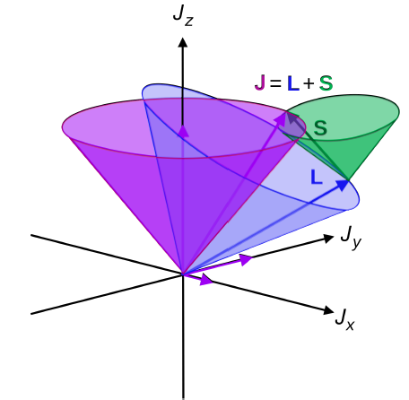
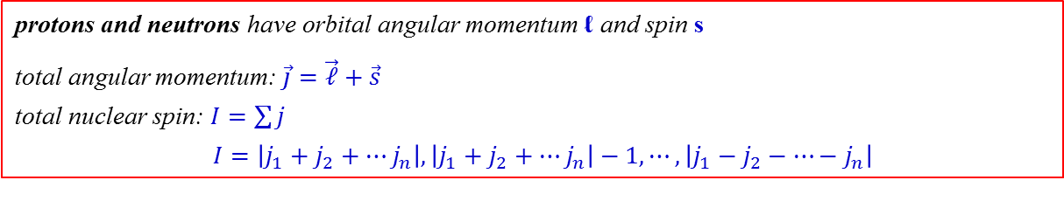
Nuclear spin quantum number
protons and neutrons have orbital angular momentum ℓ and spin s
total angular momentum: $\vec{j}=\vec{ℓ}+\vec{s}$
total nuclear spin: $I=\sum{j}$
$I=\left|j_{1}+j_{2}+⋯j_{n}\right|,\left|j_{1}+j_{2}+⋯j_{n}\right|−1,⋯,\left|j_{1}−j_{2}−⋯−j_{n}\right|$
quantum mechanics

Slide 3
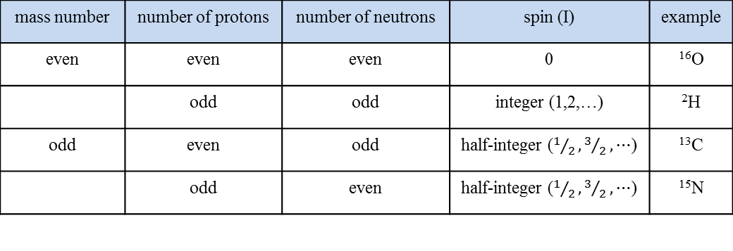
Nuclear spin quantum number
protons and neutrons have orbital angular momentum ℓ and spin s
total angular momentum: $\vec{j}=\vec{ℓ}+\vec{s}$
total nuclear spin: $I=\sum{j}$
$I=\left|j_{1}+j_{2}+⋯j_{n}\right|,\left|j_{1}+j_{2}+⋯j_{n}\right|−1,⋯,\left|j_{1}−j_{2}−⋯−j_{n}\right|$
quantum mechanics
¹H = 1 proton, so I = ½
²H = 1 proton and 1 neutron, so I = 1 or 0
For larger nuclei, it is not immediately evident what the spin should be as there are a multitude of possible values.
mass number | number of protons | number of neutrons | spin (I) | example
even | even | even | 0 | ¹⁶O
 | odd | odd | integer (1,2,…) | ²H
odd | even | odd | half-integer ($1/2,3/2,⋯$) | ¹³C
 | odd | even | half-integer ($1/2,3/2,⋯$) | ¹⁵N

Slide 4
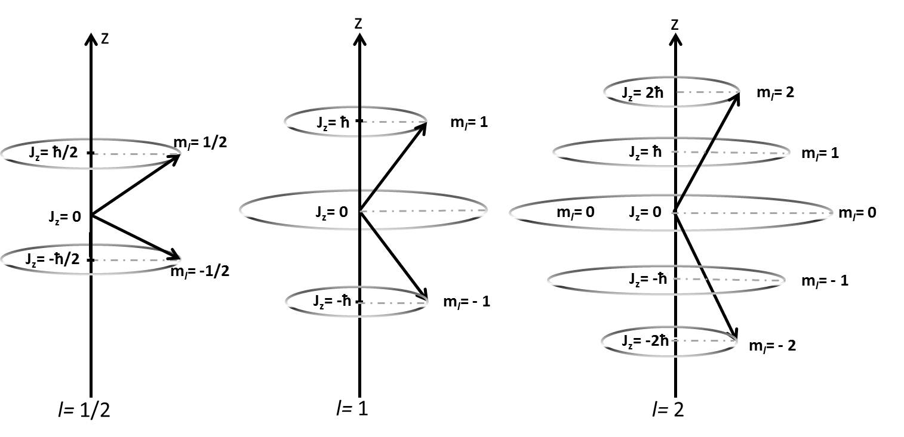
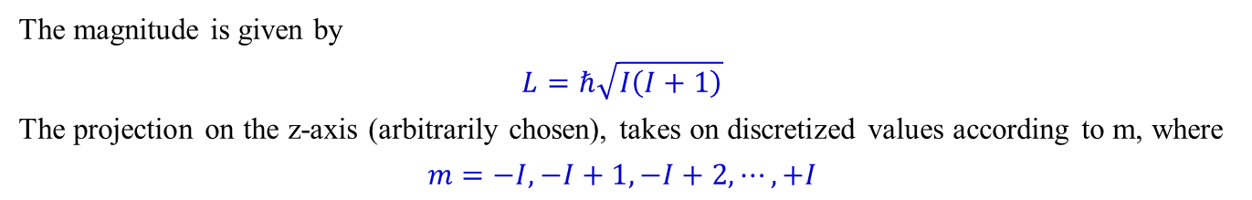
Nuclear spin quantum number
The magnitude is given by
$$L=ℏ\sqrt{I\left(I+1\right)}$$
The projection on the z-axis (arbitrarily chosen), takes on discretized values according to m, where
$$m=−I, −I+1, −I+2, ⋯, +I$$

Slide 5

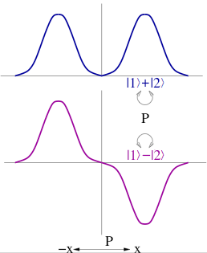
Parity
wave – particle duality:
photoelectric effect
wave function
Ψ(x)
Ψ(x) = Ψ(-x) → parity = even (+)
x
Ψ(x)
ℓ = 0, 2, 4, … even
x
Ψ(x) = -Ψ(-x) → parity = odd (-)
ℓ = 1, 3, 5, … odd

Slide 6
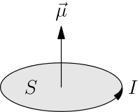
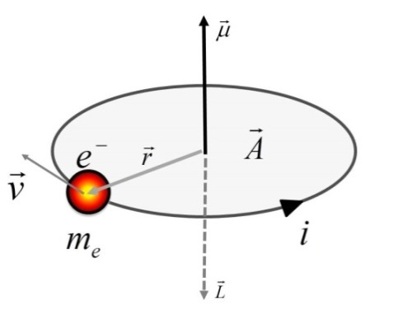


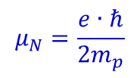










Magnetic moment
$$\vec{μ}=I∙A$$
A
$$ℓ=m_{e}v∙r$$
$$v=\frac{2πr}{t} → t=\frac{2πr}{v}$$
$$I=\frac{e}{t}$$
$$=\frac{e∙v}{2πr}$$
I
$$μ=\frac{e∙v}{2πr}∙πr^{2}=\frac{e∙v∙r}{2}$$
$$\vec{ℓ}$$
$$μ=\frac{e∙v∙r}{2}∙\frac{m_{e}v∙r}{m_{e}v∙r}$$
$$=\frac{e∙ℓ}{2m_{e}}$$
$$μ_{Bohr}=\frac{e∙ℏ}{2m_{e}}$$
$$μ_{ℓ}=μ_{B}∙\frac{ℓ}{ℏ}$$
electron orbital magnetic moment
$$μ_{ℓ}=μ_{N}∙\frac{ℓ}{ℏ}$$
$$μ_{N}=\frac{e∙ℏ}{2m_{p}}$$
proton orbital magnetic moment

Slide 7
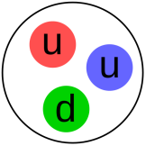






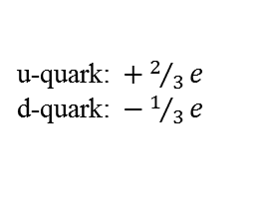

Magnetic moment
$$μ_{ℓ}=μ_{B}∙\frac{ℓ}{ℏ}$$
electron orbital magnetic moment
$$μ_{s}={−2.0023∙μ}_{B}∙\frac{s}{ℏ}$$
electron spin magnetic moment (Dirac equation)
$$μ_{s}={+5.585691∙μ}_{N}∙\frac{s}{ℏ}$$
proton spin magnetic moment
$$μ_{s}={−3.826084∙μ}_{N}∙\frac{s}{ℏ}$$
neutron spin magnetic moment
Why has a neutron a magnetic moment when it is uncharged?
u-quark: $+2/3e$
d-quark: $−1/3e$
neutrons and protons are not elementary particles
internal structure: they have charges.
proton
+1e
neutron
0e
$$μ_{s}\left({}_{1}^{2}H\right)=\left(5.59−3.83\right){∙μ}_{N}∙\frac{1}{2}=0.87980μ_{N}$$
$=0.8574∙μ_{N}$ (experiment)

Slide 8
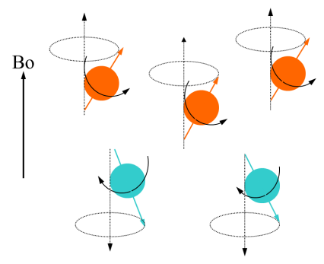
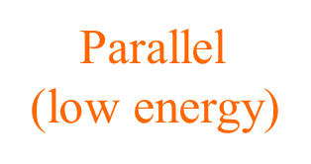
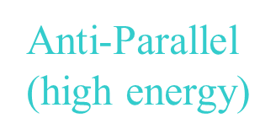
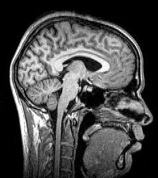
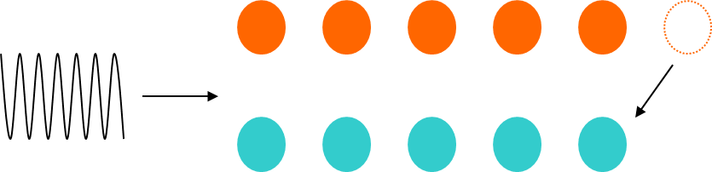
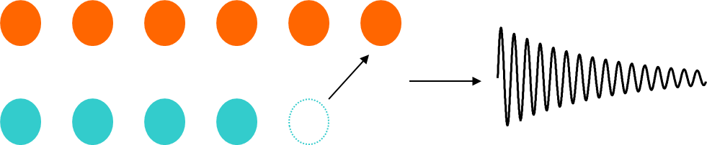

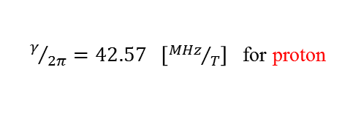

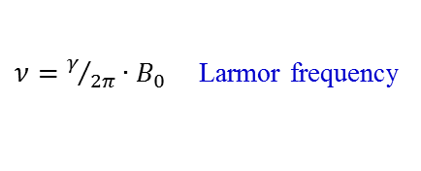



Magnetic resonance imaging (MRI)
$$μ_{s}={+5.585691∙μ}_{N}∙\frac{s}{ℏ}$$
proton spin magnetic moment
$$μ_{I}=γ∙I$$
gyromagnetic ratio $γ=g∙\frac{μ_{N}}{ℏ}=g∙47.89∙{10}^{6} \left[T^{−1}s^{−1}\right]$
proton $g$-factor: +5.585691, spin I: ½ ħ
proton in magnetic field
energy difference between states
$$∆E=h∙ν$$
$$ΔE=2∙μ_{I}∙B_{0}$$
$ν=γ/{2π}∙B_{0}$ Larmor frequency
$γ/{2π}=42.57 \left[{MHz}/T\right]$ for proton
Larmor frequency
low energy
high energy
low energy
high energy

