Slide 1
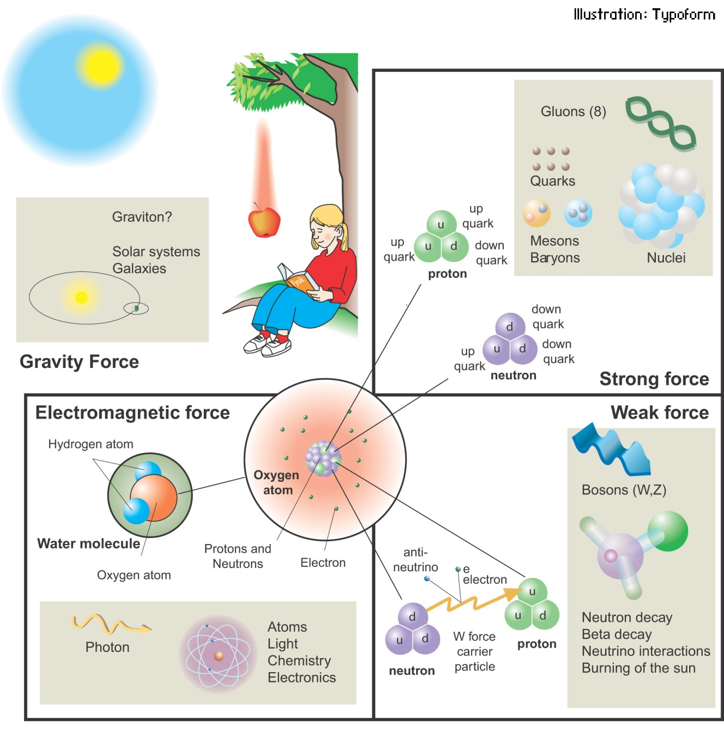
PHL424: 4 fundamental forces in nature
The familiar force of gravity pulls you down into your seat, towa­rd the Earth's center. You feel it as your weight.
Why don't you fall through your seat?
Well, another force, electromagnetism, holds the atoms of your seat together, preventing your atoms from intruding­ on those of your seat.
The remaining two forces work at the atomic level, which we never feel, despite being made of atoms.
The strong force holds the nucleus together.
Lastly, the weak force is responsible for radioactive decay, specifically, β-decay where a neutron within the nucleus changes into a proton and an electron, which is ejected from the nucleus.

Slide 2
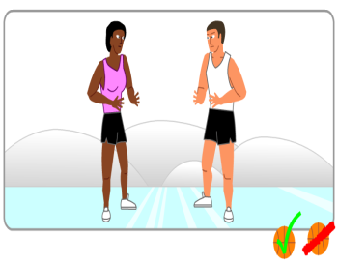
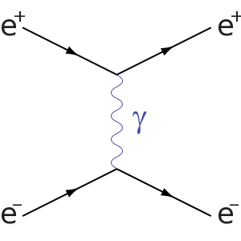
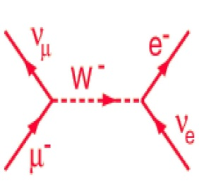
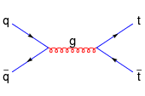
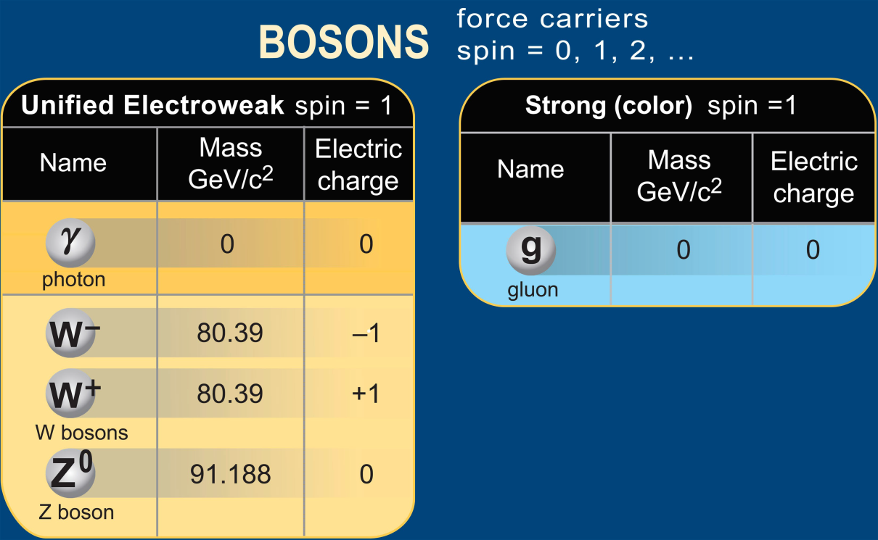
Quantum field theory
Forces are ´carried´ or ´mediated´ by particles: exchange force
Electromagnetic
Weak
Strong

Slide 3
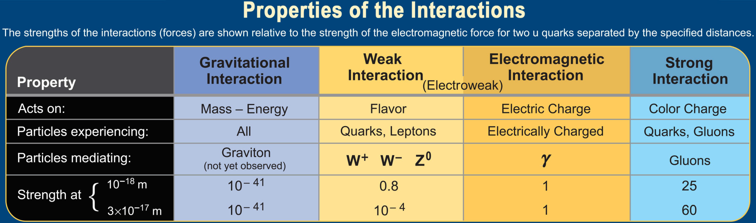
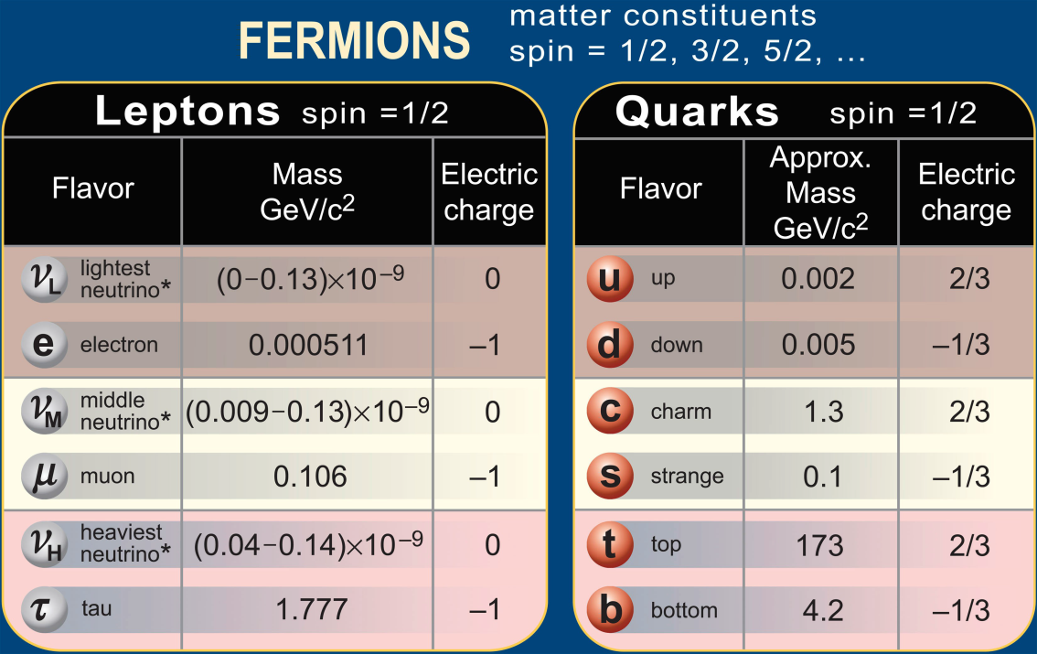
Matter and forces

Slide 4
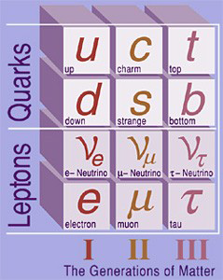
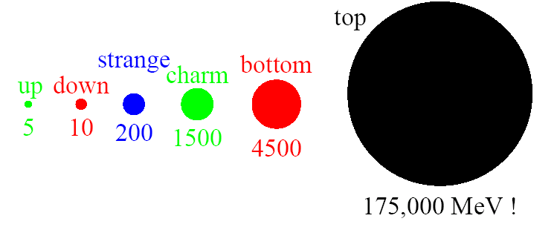
Three families
up and down quarks make protons and neutrons …
They bind with electrons to make atoms …
And neutrinos, partner with electron …
So what´s all the staff to the right?
There just appear to be three copies of all the matter that really matters …
All that distinguishes the ´generations´ is their mass

Slide 5
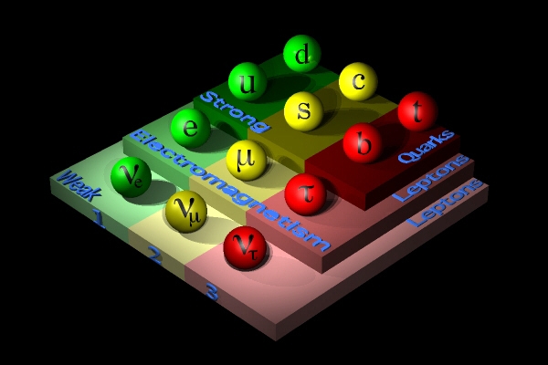
The complete set of particles
The first generation of 4 particles repeats only twice. Nobody knows why!!!

Slide 6
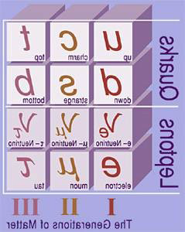
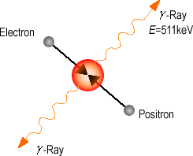
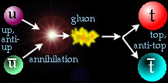
Antimatter
All particles have antiparticles!
Antimatter has the same properties as matter
  Same mass, same spin, same interactions
  But opposite electric charge
Has another weird property…
  It can annihilate with matter to create pure energy!
  Or, conversely, energy can create matter and antimatter pairs. E = mc²
particle – anti-particle annihilation
e⁻
e⁺
The early Universe had a lot of energy … where is the antimatter in the Universe?

Slide 7
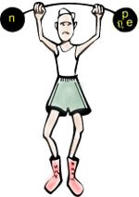
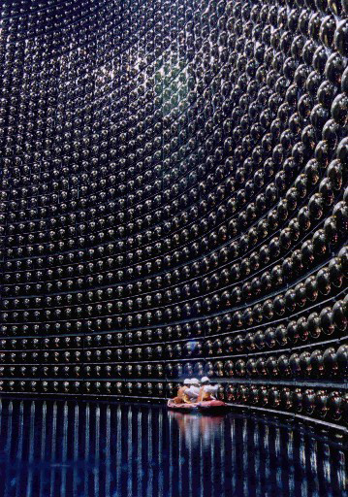
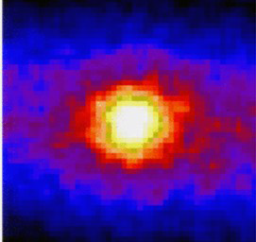
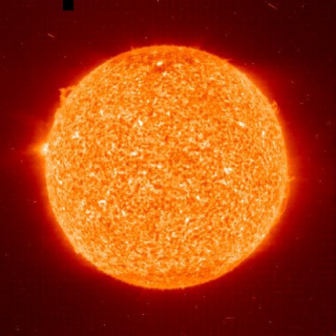
How weak are Weak interactions?
Weak is, in fact, way weak
A 3 MeV neutrino produced in fusion from the sun will travel through water, on average 53 light years, before interacting
  A 3 MeV positron (anti-matter electron) produced in the same fusion process will travel 3 cm on average
Moral: to find neutrinos, one needs a lot of neutrinos and a lot of detectors!
Super-Kamiokande: confirms the existence of the sun in neutrino image!
The sun, imaged in neutrinos, by Super-Kamiokande and optical

Slide 8
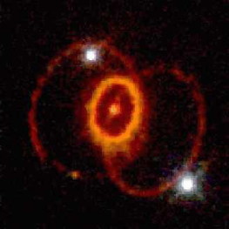

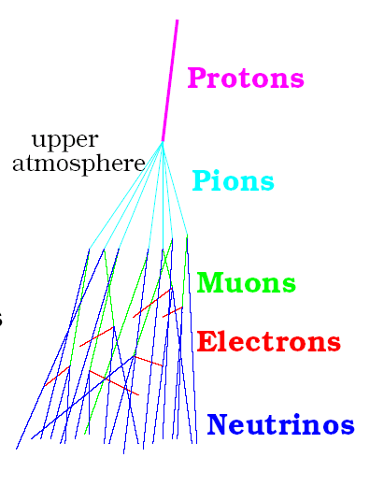
Where are neutrinos found?
In the early Universe
  The heavy things to the right decay (weakly), leaving a waste trail of 100/cm³ of each neutrino species
  Even if they have a very small mass, they make up much of the weight of the Universe
In the sun
  100 billion neutrinos per cm² per second rain on us
Supernova 1987A (150 000 light years away)
  When it exploded, it released 100 times the neutrinos the sun will emit in its whole lifetime
Bananas?
  We each contain about 20 mg of ⁴⁰K which is unstable and undergoes β-decay
  So each of us emits 0.3 billion neutrinos/s
For the same reason, the natural radioactivity of the earth results in 10 million neutrinos per cm² per second
Nuclear reactors (6% of energy is anti-neutrinos)
  Average plant produces 10²⁰ anti-neutrinos/s
Cosmic Rays

Slide 9


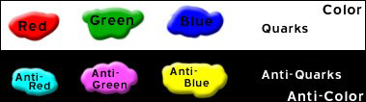
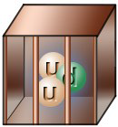
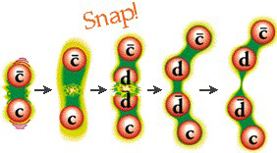
The Strong Force
This force is so strong that it can effectively be thought of as glue
  Force carrier is named the ´gluon´
  Gluons connect to ´color´
  Can think of these colors as combining like light
  ´White´(colorless) things do not feel the strong force
If you think of this as ´glue´ then these colorless combinations stick together
  this is called ´confinement´
  The proton is one such ´confined combination of quarks´
  Red + Green + Blue → Colorless
Two questions follow from this picture
  What happens if you try to pull things apart?
  How do protons stick to each other?

Slide 10
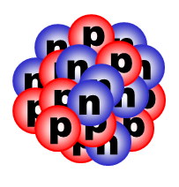
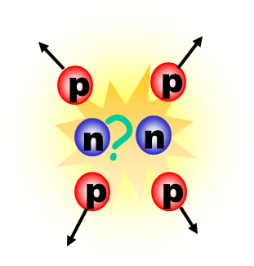

What binds the nucleus together?
neutrons: no charge
protons: positively charged – repel one another.
Why doesn´t the nucleus blow apart?
The strong force holds quarks together to form hadrons, so its carrier particles are whimsically called gluons because they so tightly “glue” quarks together

Slide 11
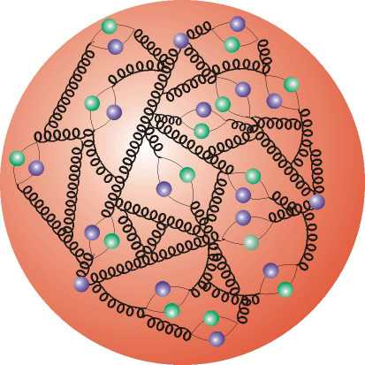
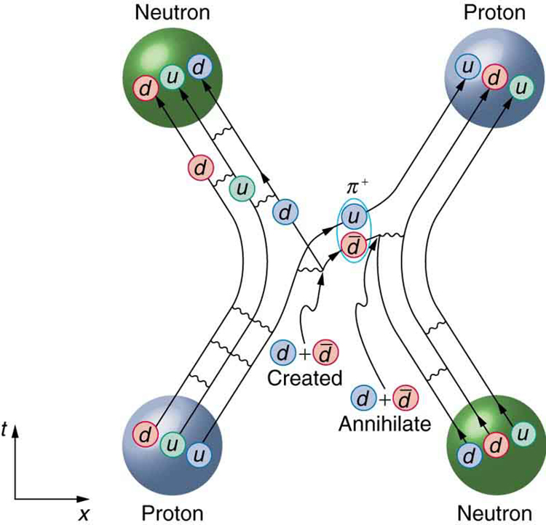
Interaction of nucleons
proton´s internal structure
Only about 1% of the mass of a nucleon is made up of the rest –mass energies of its constituent particles with mass, the quarks. The rest is the kinetic energy of those quarks and the gluons

Slide 12
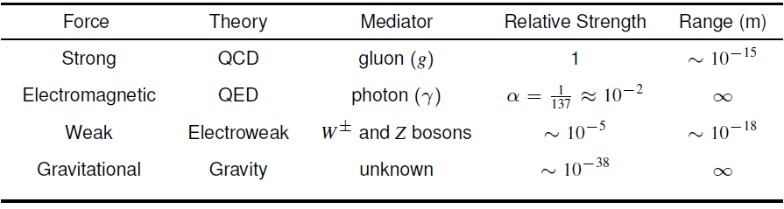
The fundamental forces
http://hyperphysics.phy-astr.gsu.edu/hbase/forces/funfor.html

Slide 13
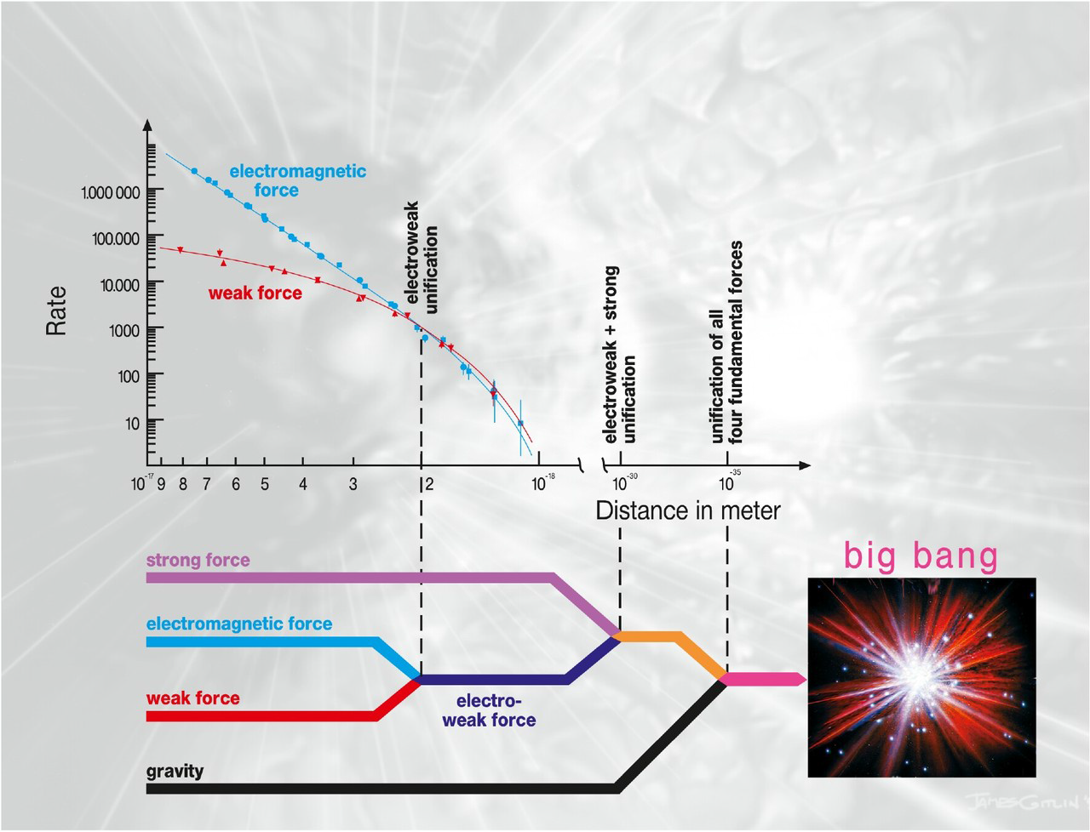
Forces and the history of the universe

Slide 14
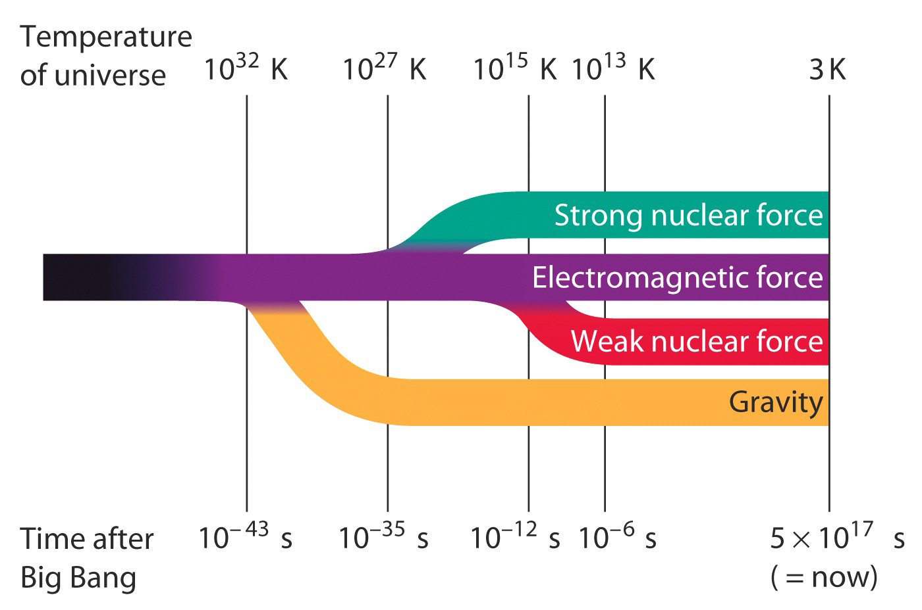
Known fundamental forces
Sheldon Glashow, Abdus Salam, Steven Weinberg

Slide 15
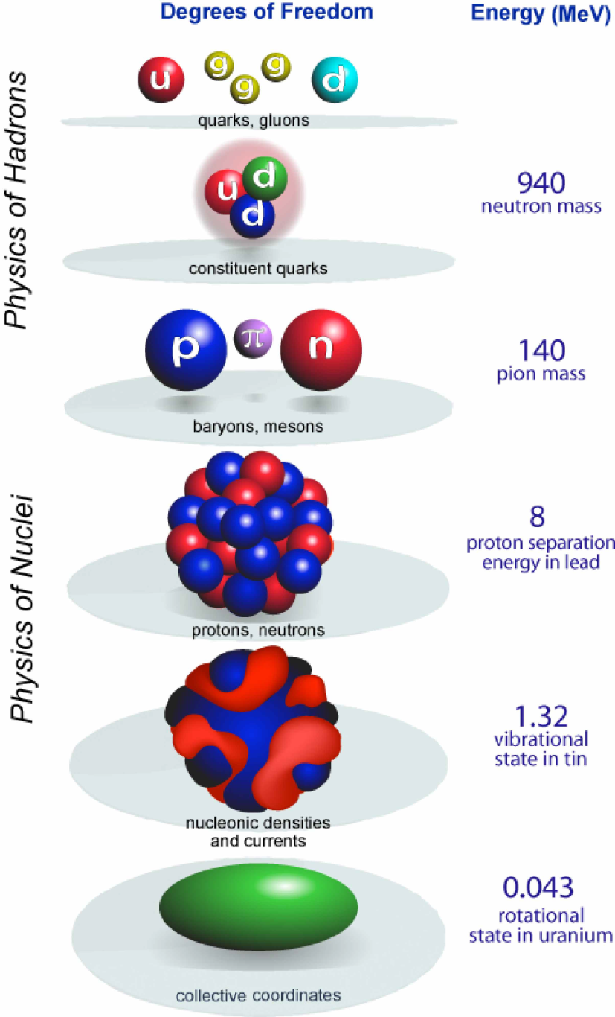
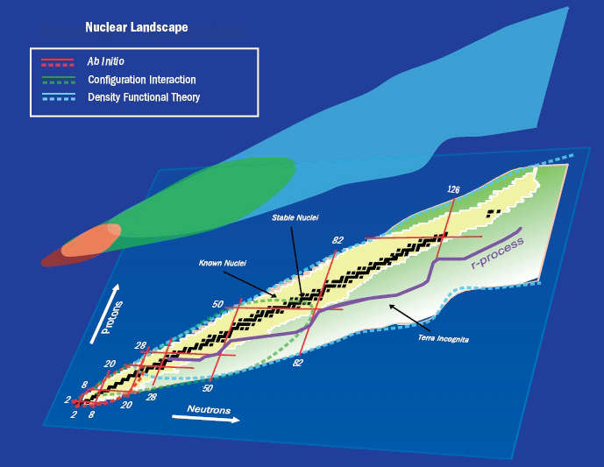
Why can´t we use the fundamental interaction to describe all nuclei?
Many-Body Problem
Conclusion: If we consider only the bare nucleon-nucleon potential,
with so many interactions, we quickly run into the quantum
many-body problem. Although there are some systems today that
can be calculated using the bare nucleon-nucleon interaction, it is
typically limited to very light nuclei (A < 15).

Slide 16
The force between nucleons
Some forms of nuclear theory are able to use the residual interaction between nucleons. We’ll start by comparing what we know about the nucleon-nucleon interaction to atomic physics.
Electrons and atoms | Nucleon-nucleon interaction
Coulomb interaction | Strong interaction
Electrons in classical orbits that have large (relative) energy spacings | Nuclear orbits (shells) have small (relative) energy spacings
Electron distances are large (i.e. small e-e interaction probabilities) | Due to the small nuclear size, a given nucleon will strongly interact with all nearest-neighbor nucleons

