Slide 1
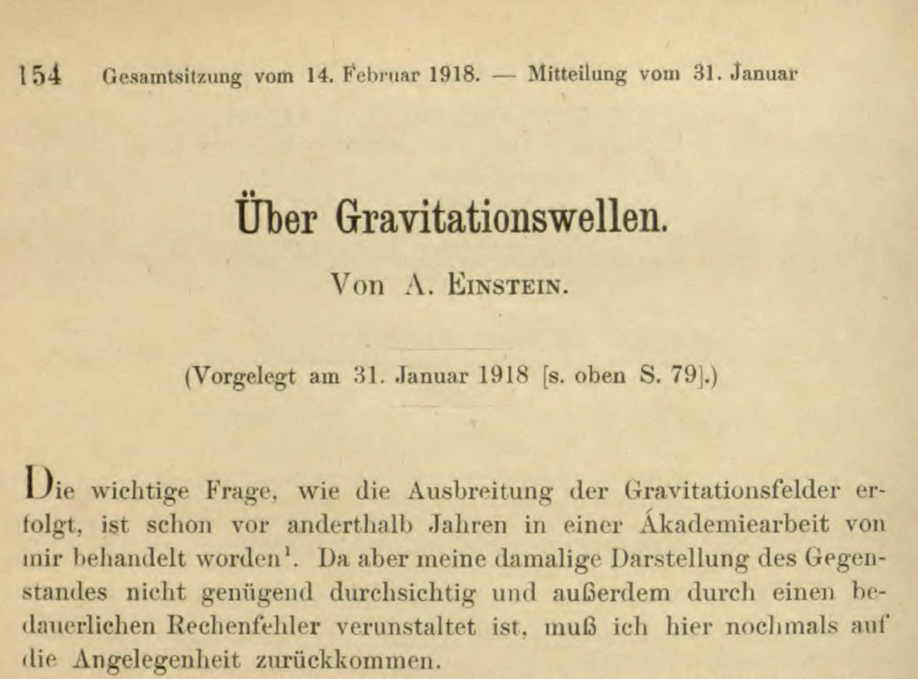
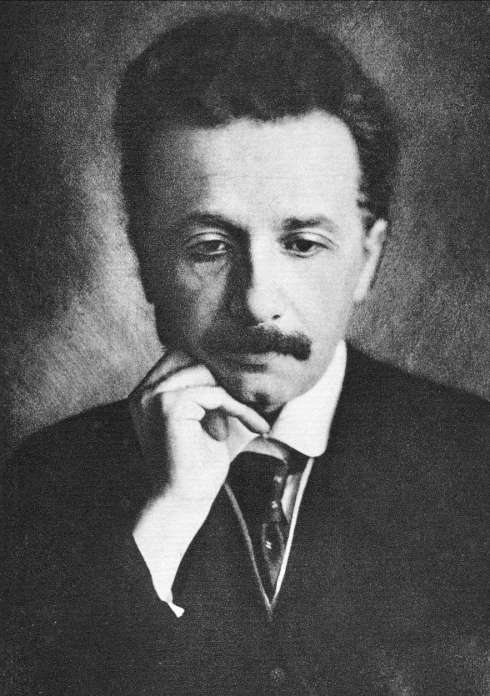
PHL424: Gravitational Waves – Ripples of Spacetime
First publication on gravitational waves in June 1916

Slide 2
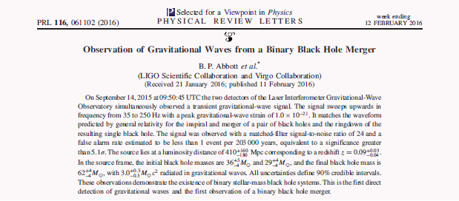
Almost 100 years later
first direct evidence of gravitational waves
signal indicates the merging of two black holes
LIGO: Laser Interferometer Gravitational-Wave Observatory

Slide 3
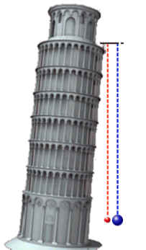
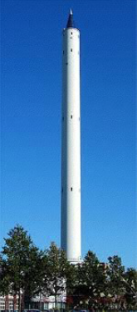
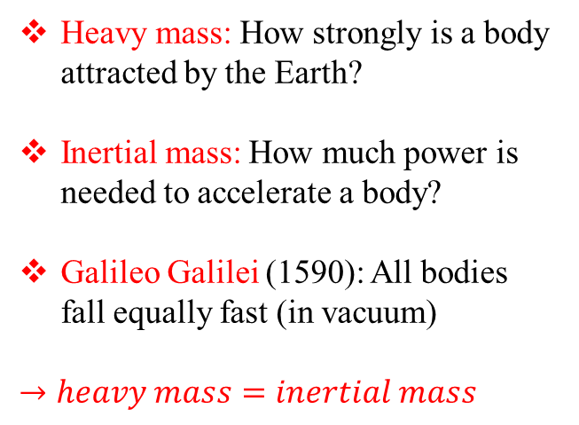
Equivalence Principle
Heavy mass: How strongly is a body attracted by the Earth?
Inertial mass: How much power is needed to accelerate a body?
Galileo Galilei (1590): All bodies fall equally fast (in vacuum)
$$→heavy mass=inertial mass$$
The Bremen drop tower

Slide 4
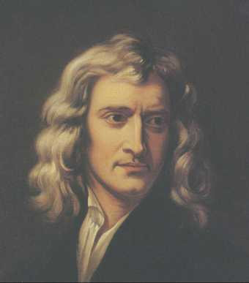
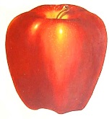
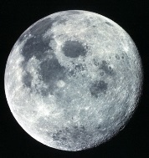
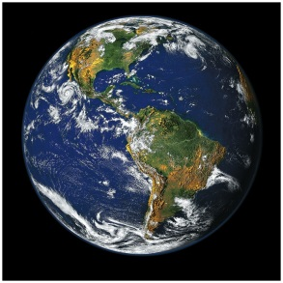
Gravity: The Old School
Sir Isaac Newton (1684)
universal law of gravitation
Unified the gravity
on Earth, the motion of the
Moon, planets and comets
Final confirmation of
Newton´s theory:
  Halley´s Comet returns as predicted in 1758
4

Slide 5
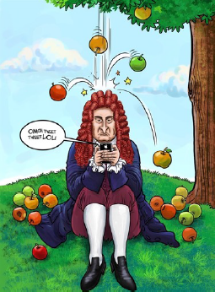
Newton´s Gravitation
Isaac Newton (1684):
universal law of gravitation
Unified the gravity
on Earth, the motion of the
Moon, planets and comets
Final confirmation of
Newton´s theory:
  Halley´s Comet returns as predicted in 1758

Slide 6
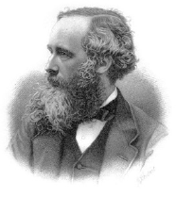
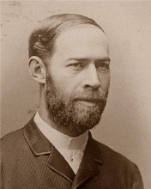
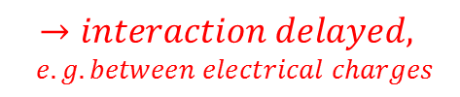

Electromagnetism
James Clerk Maxwell (1864):
Unification of electricity and magnetism
$$→electromagnetism$$
Heinrich Hertz (1888):
Light, radio waves, X-rays
are electromagnetic waves
velocity: 299792 km/s
duration Sun – Earth ~ 8 min
$$→interaction delayed,$$
$e.g. between electrical charges$

Slide 7
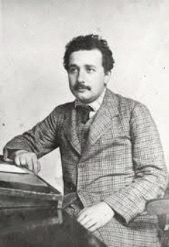
The Special Relativity
Newton´s gravitation:
Foundation for classical mechanics.
  no maximum velocity
  instantaneous interaction
Albert Einstein (1905):
Theory of special relativity:
  velocity of light is the limit
  instantaneous interaction
  is not allowed! contradiction with Newton!
  Space and time (space-time) are curved
  Matter causes this curvature
  Space tells matter how to move
  This looks to us like gravity

Slide 8
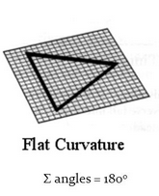
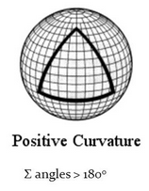
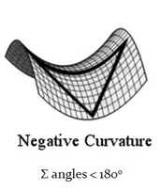
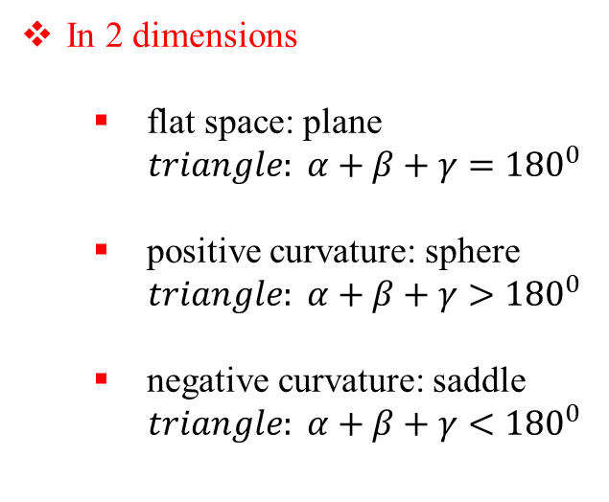
Curved Space
In 2 dimensions
  flat space: plane
  $triangle: α+β+γ={180}^{0}$
  positive curvature: sphere
  $triangle: α+β+γ>{180}^{0}$
  negative curvature: saddle
  $triangle: α+β+γ<{180}^{0}$

Slide 9
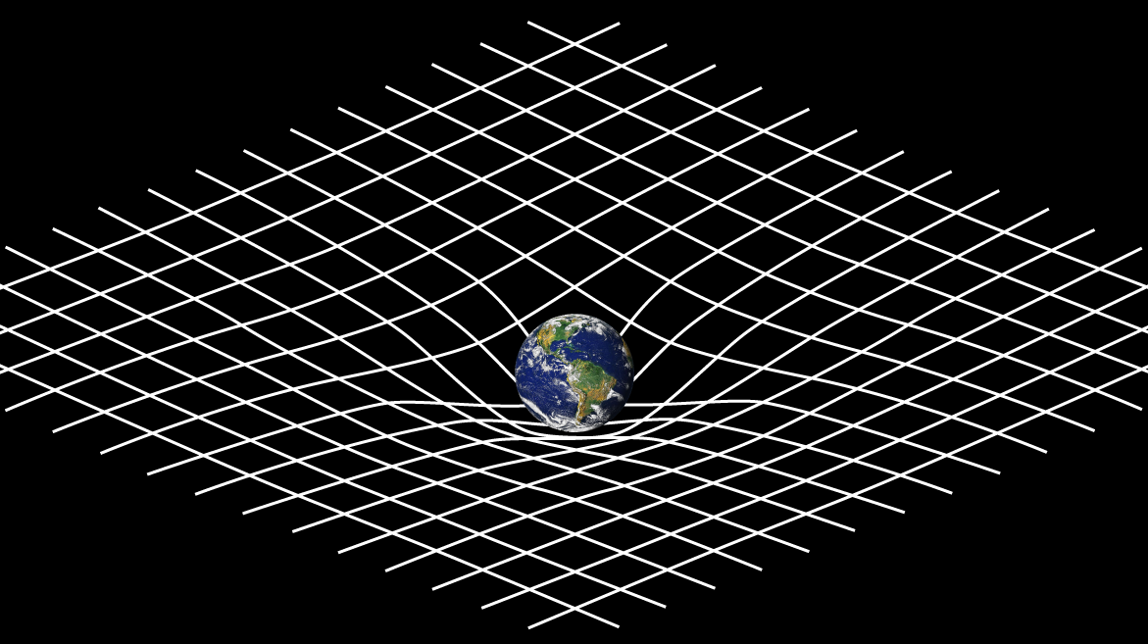
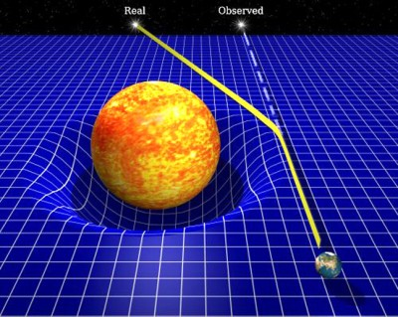
Curved Space-Time
Space-time curved by the Earth mass
Arthur Eddington (1919):
Deflection of light by sun´s gravitational field
First successful test of Einstein´s theory
Geometry bends light

Slide 10
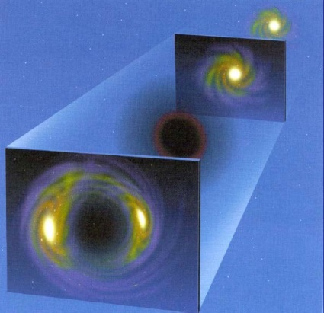
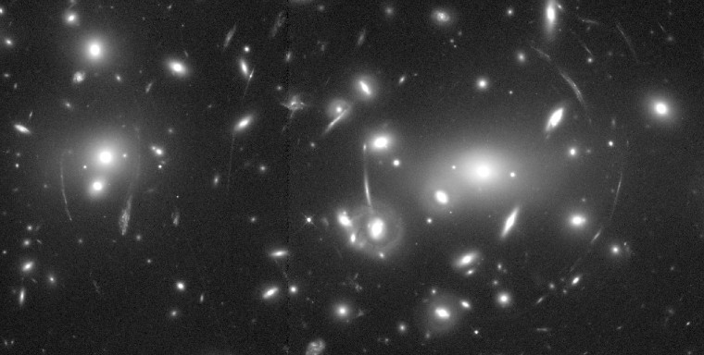
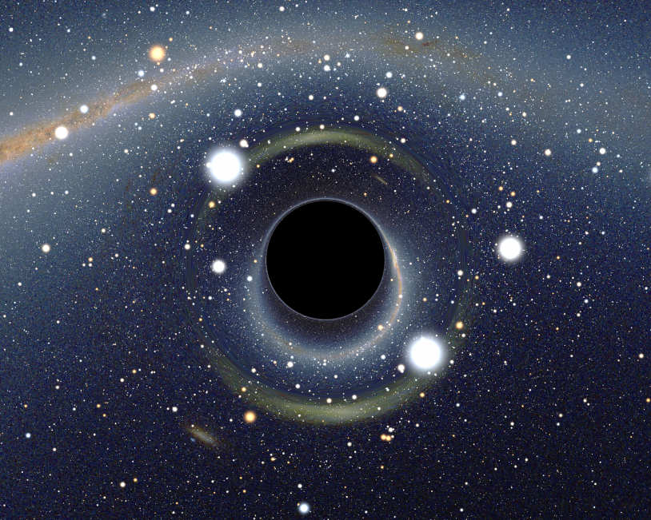
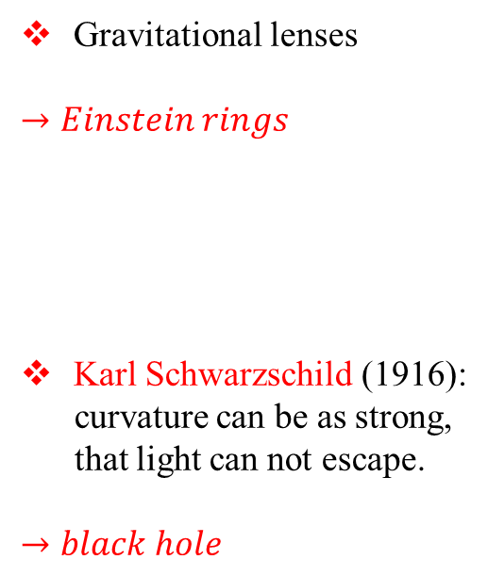
Other Phenomena
Gravitational lenses
$→Einstein rings$
Karl Schwarzschild (1916):
curvature can be as strong,
that light can not escape.
$→black hole$

Slide 11
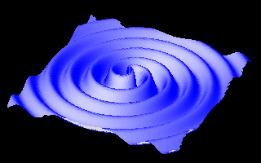
What are Gravitational Waves?
Einstein’s General theory of relativity:
Gravity → Curvature of 4-dimensional
space-time produced by matter
Gravitational waves:
Ripples on space-time
produced by accelerated matter

Slide 12
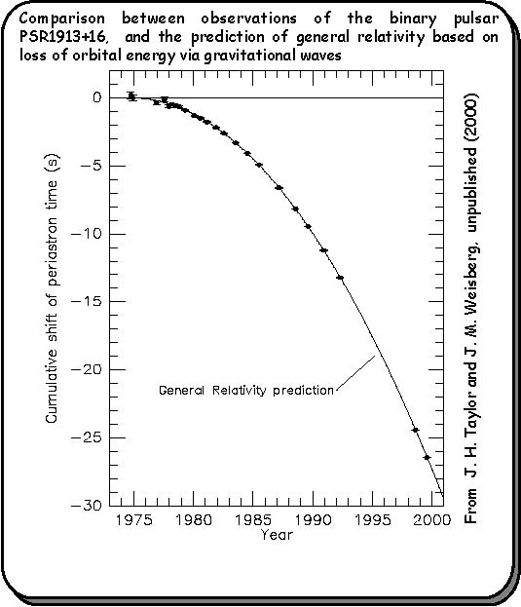
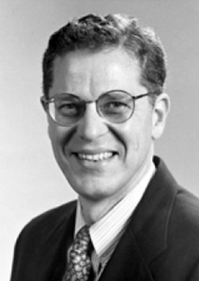
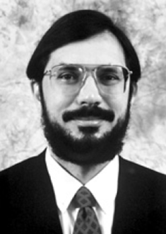
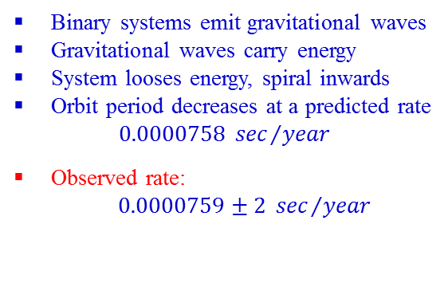
Orbital decay: strong indirect evidence
Emission of gravitational waves
Binary systems emit gravitational waves
Gravitational waves carry energy
System looses energy, spiral inwards
Orbit period decreases at a predicted rate
$$0.0000758 {sec}/{year}$$
Observed rate:
$0.0000759±2 {sec}/{year}$
Joseph Taylor & Russell Hulse, NP 1993

Slide 13
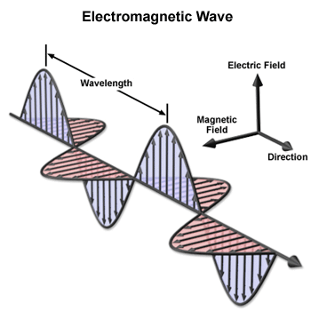
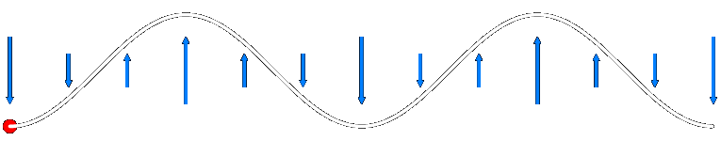
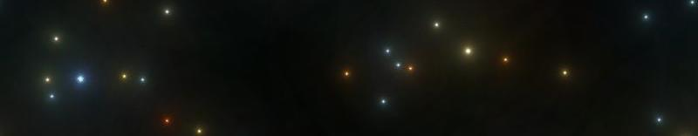
Electromagnetic waves
So far, nearly all our knowledge of the Universe comes from electromagnetic radiation
Time-varying disturbance in electromagnetic field
Arise as a direct consequence of relativity (causality)
  Field of a stationary charge
  Field of a moving charge
  Field of an accelerated charge
Oscillating charges → waves with characteristic lengths

Slide 14
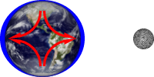
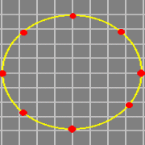
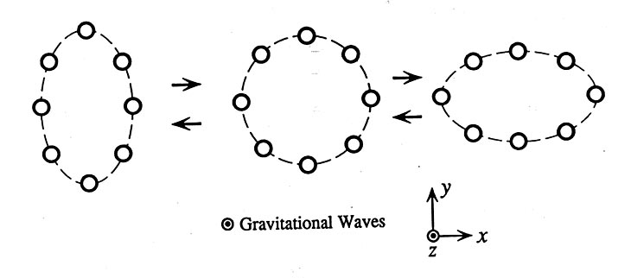
Gravitational waves
The key property of gravity is that it affects all bodies equivalently, with a force that is proportional to the body´s mass.
This means that it is impossible to measure directly an overall gravitational field. The best one can do is to measure the change in the gravitational field.
The effect of gravity from a remote object, such as the Sun or Moon, can be felt by the manner in which it changes from location to location, gravity tidal field.
strain amplitude: 10⁻¹⁸ m

Slide 15
How small is 10⁻¹⁸ meter?
One meter
Human hair, about 100 microns
Wavelength of light, about 1 micron
Atomic diameter, 10⁻¹⁰ meter
Nuclear diameter, 10⁻¹⁵ meter
LIGO sensitivity, 10⁻¹⁸ meter

Slide 16
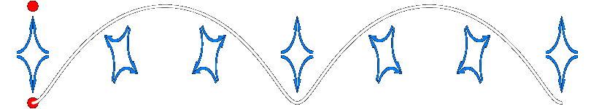
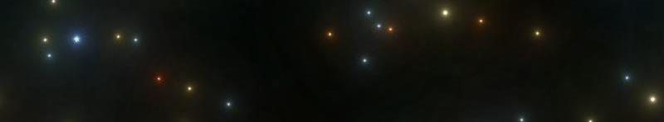
Gravitational waves
The key property of gravity is that it affects all bodies equivalently, with a force that is proportional to the body´s mass.
This means that it is impossible to measure directly an overall gravitational field. The best one can do is to measure the change in the gravitational field.
The effect of gravity from a remote object, such as the Sun or Moon, can be felt by the manner in which it changes from location to location, gravity tidal field.

Slide 17
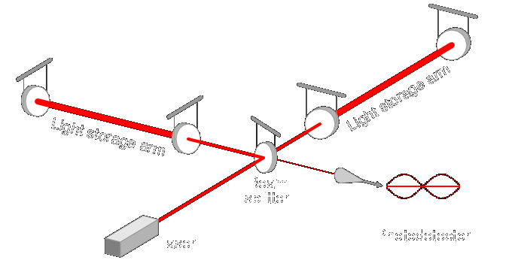
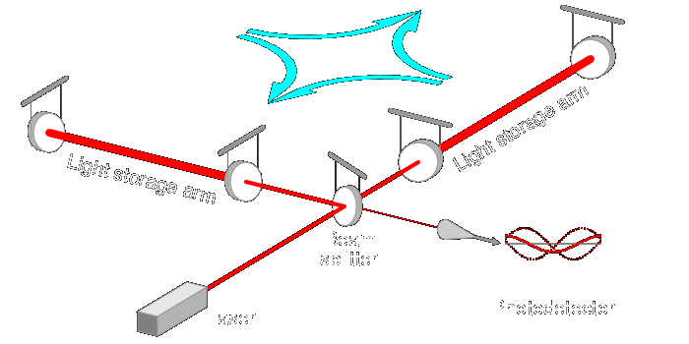
Detecting gravitational waves
Laser interferometers: measure relative motions of separate, freely-hanging masses

Slide 18
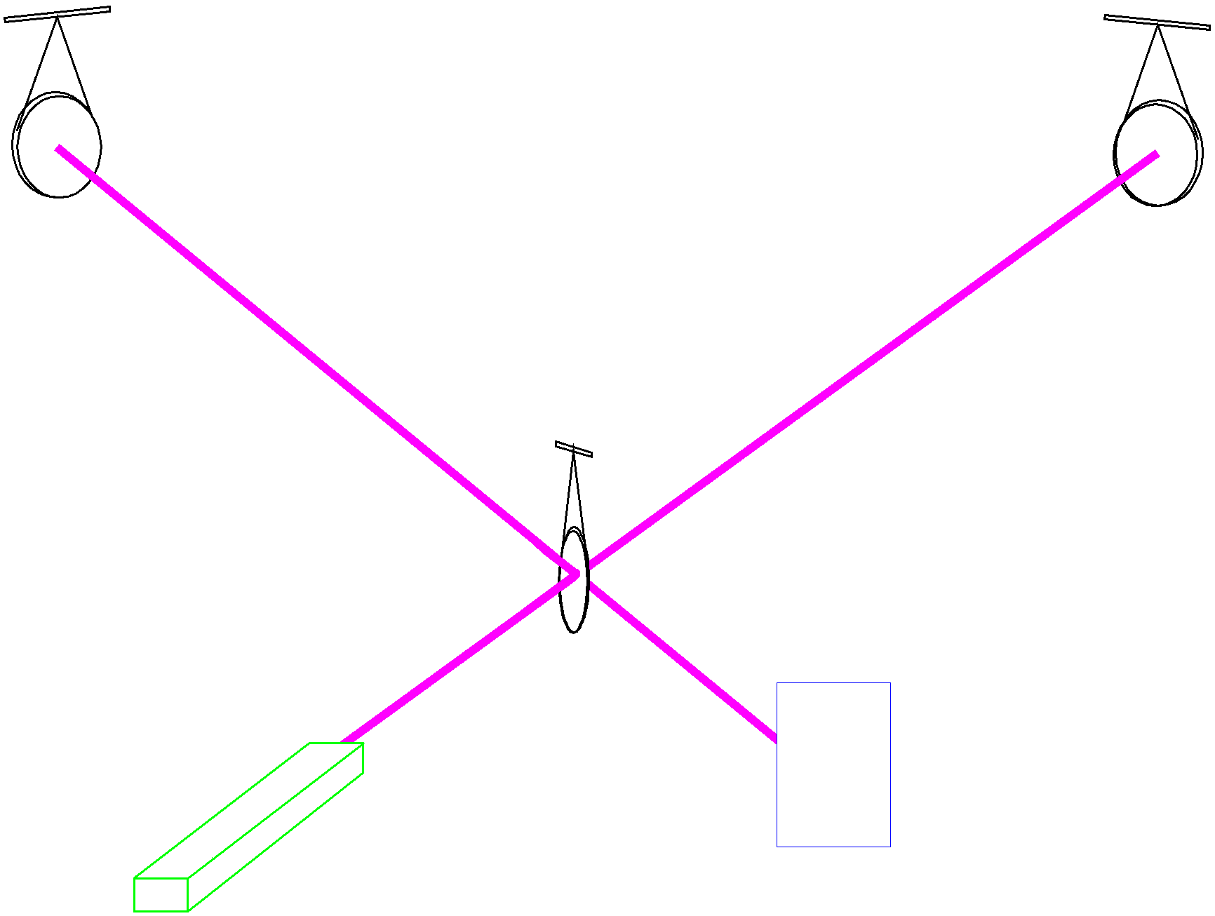
Sketch of a Michelson Interferometer
End Mirror
End Mirror
Beam Splitter
Viewing
Laser
Screen

Slide 19
Sensing the Effect of a Gravitational Wave
Gravitational wave changes arm lengths and amount of light in signal
Change in arm length is
10⁻¹⁸ meters
Laser
signal

Slide 20
How small is 10⁻¹⁸ meter?
One meter
Human hair, about 100 microns
Wavelength of light, about 1 micron
Atomic diameter, 10⁻¹⁰ meter
Nuclear diameter, 10⁻¹⁵ meter
LIGO sensitivity, 10⁻¹⁸ meter

Slide 21
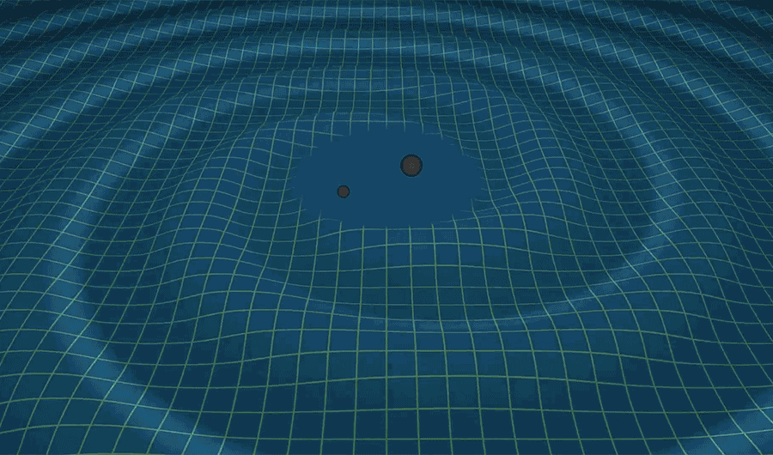
Gravitational waves

Slide 22
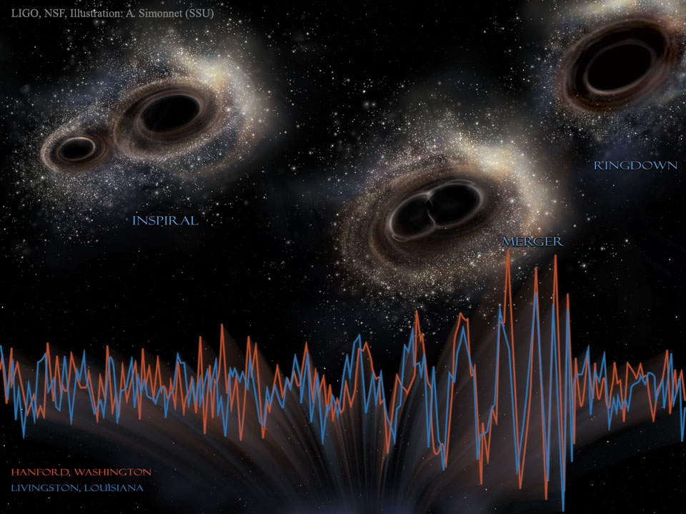
Gravitational waves

Slide 23
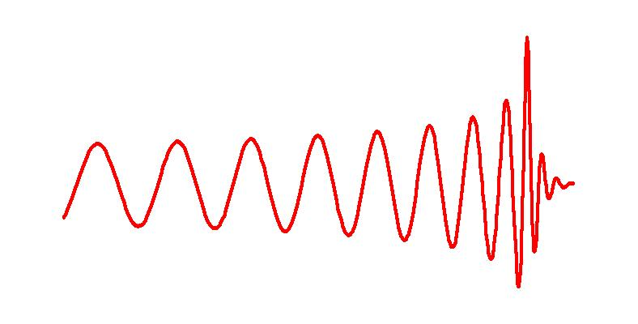
Inspiraling Compact Binaries
Ringdown
Ground-Based (hectahertz)
  Last few minutes (10K
  cycles) for NS-NS
  0.4 - 400 per year by 2018
  BH-BH could be 0.4 - 1000
Space-Based (millihertz)
  MBH pairs (10⁵ - 10⁷ M_{s}) in
  galaxies to large Z
  EMRIs
  Close WD binaries
Pulsar Timing Arrays (nanohertz)
  MBH pairs
Merger waveform
A chirp waveform
Last 4 orbits

Slide 24
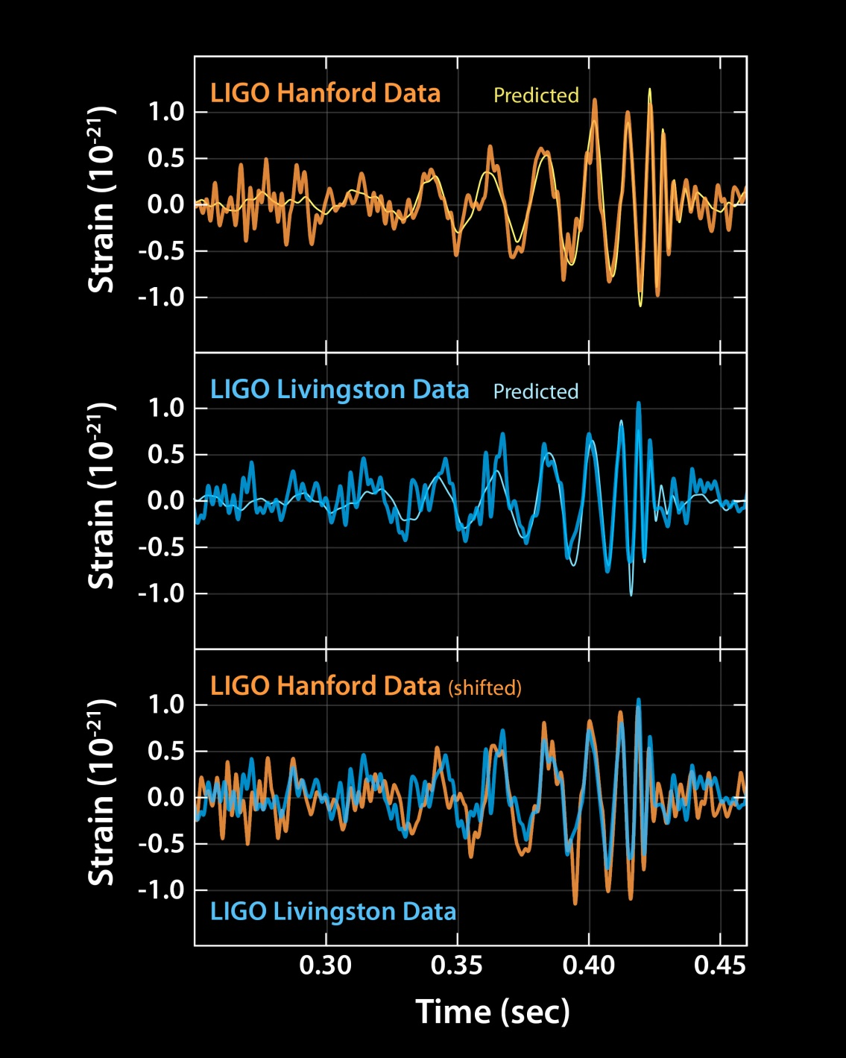
Experimental results

Slide 25
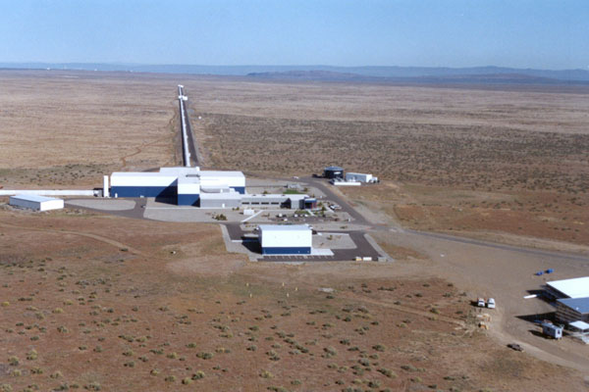
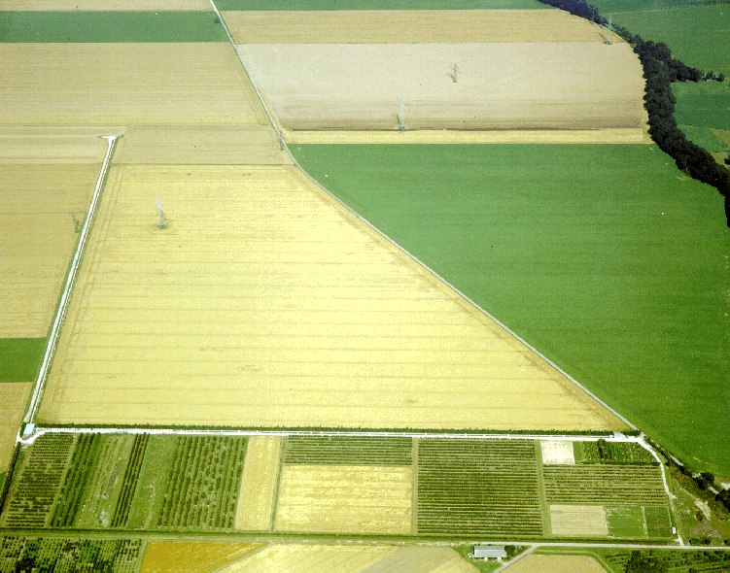
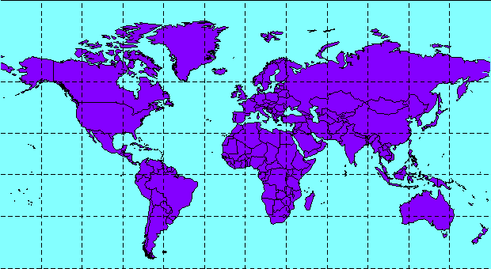
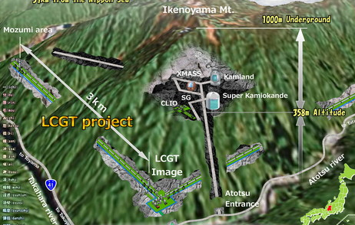
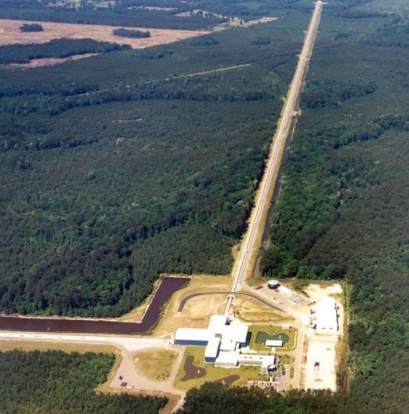

Global Network of Interferometers
LIGO Hanford 4 km (2015)
GEO Hannover 600 m
Kamioka Japan
3 km (2018)
LIGO Livingston 4 km (2015)
Virgo 3 km (2016)

Slide 26




LISA: Laser Interferometer Space Antenna (ESA 2034)
three freely-orbiting spacecraft
$distance between mirrors:5∙{10}^{6} km$
with NASA participation

Slide 27

LISA: Laser Interferometer Space Antenna (ESA 2034)
three freely-orbiting spacecraft
$distance between mirrors:5∙{10}^{6} km$
with NASA participation

Slide 28
Gravitational waves: differences from EM waves
Electromagnetism:
Gravity:
A strong force, but with
opposing charges ( + and - )
A weak force, but with
only one charge (mass)
Fields built up incoherently from
microscopic charge separations
Fields built up coherently from
bulk accumulation of matter
Wavelengths smaller than the source
Wavelengths larger than the source
Waves are easy to detect, but
easily blocked
Waves are hard to detect, but
pass undisturbed through anything
Show the surfaces of energetic bodies
Reveal the bulk motion of dense matter
Used to construct images of
celestial objects
Can be though of as sounds emitted
by those objects
photon massless, J = 1
graviton massless, J = 2
A fundamentally different way of observing the Cosmos!
EM-waves: 10⁷ – 10²⁰ Hz GW: 10⁻⁹ – 10⁴ Hz

