Slide 1
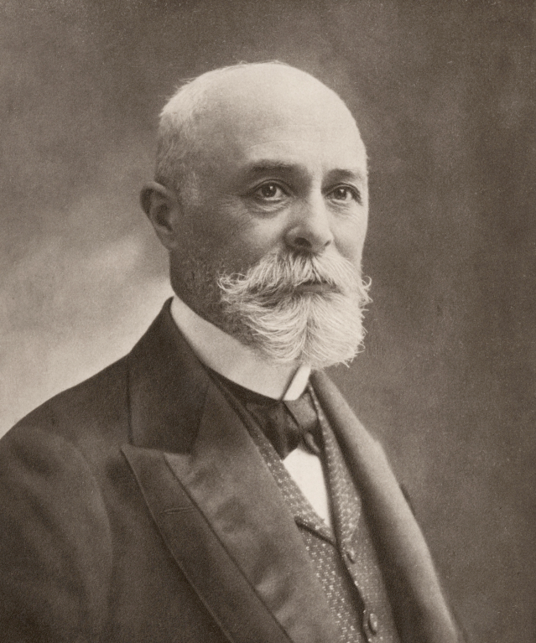
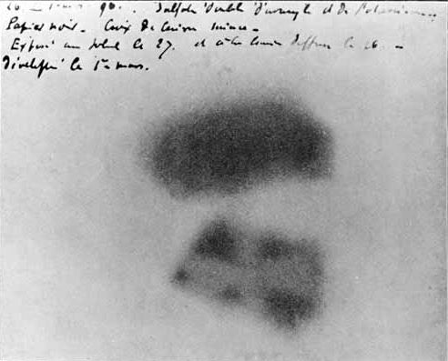
PHL424: Radioactive decay
Radioactive Decay: is the process by which a nucleus of an unstable atom decreases its total energy by spontaneously emitting radiation.
Discovered in 1897 by the French scientist Henri Becquerel.
He place various phosphorescent salts on photographic plates and noticed that only uranium salts exposed the plates.
Henri Becquerel

Slide 2
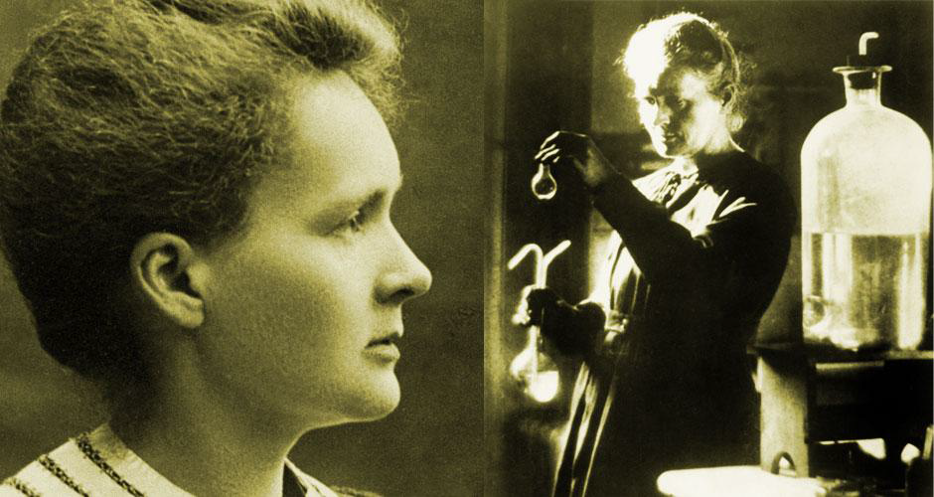
Characterization of radioactive material
Marie Curie
Henri Becquerel’s discovery inspired Marie and Pierre Curie to investigate the phenomena further.
They found that the mineral pitchblende was more active than uranium, and concluded that it must contain different radioactive substances
From this, they discovered polonium and radium, both of them more radioactive than uranium.

Slide 3
Successful investigations of radioactivity

Slide 4
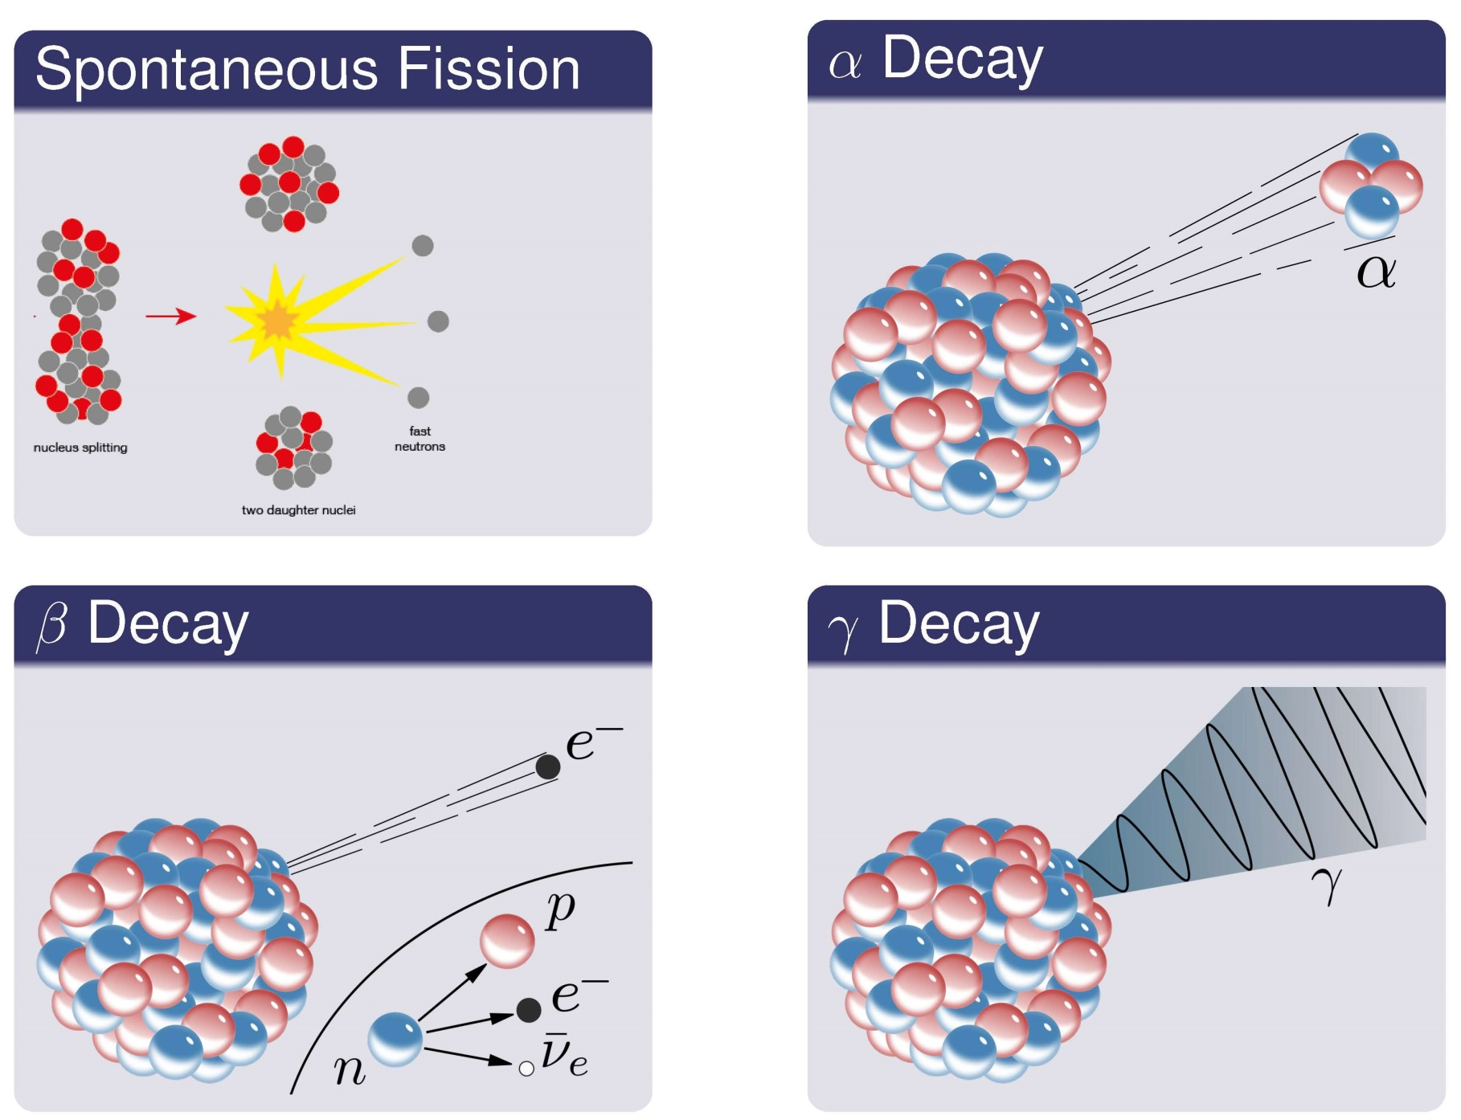
Primary modes of radioactive decay

Slide 5
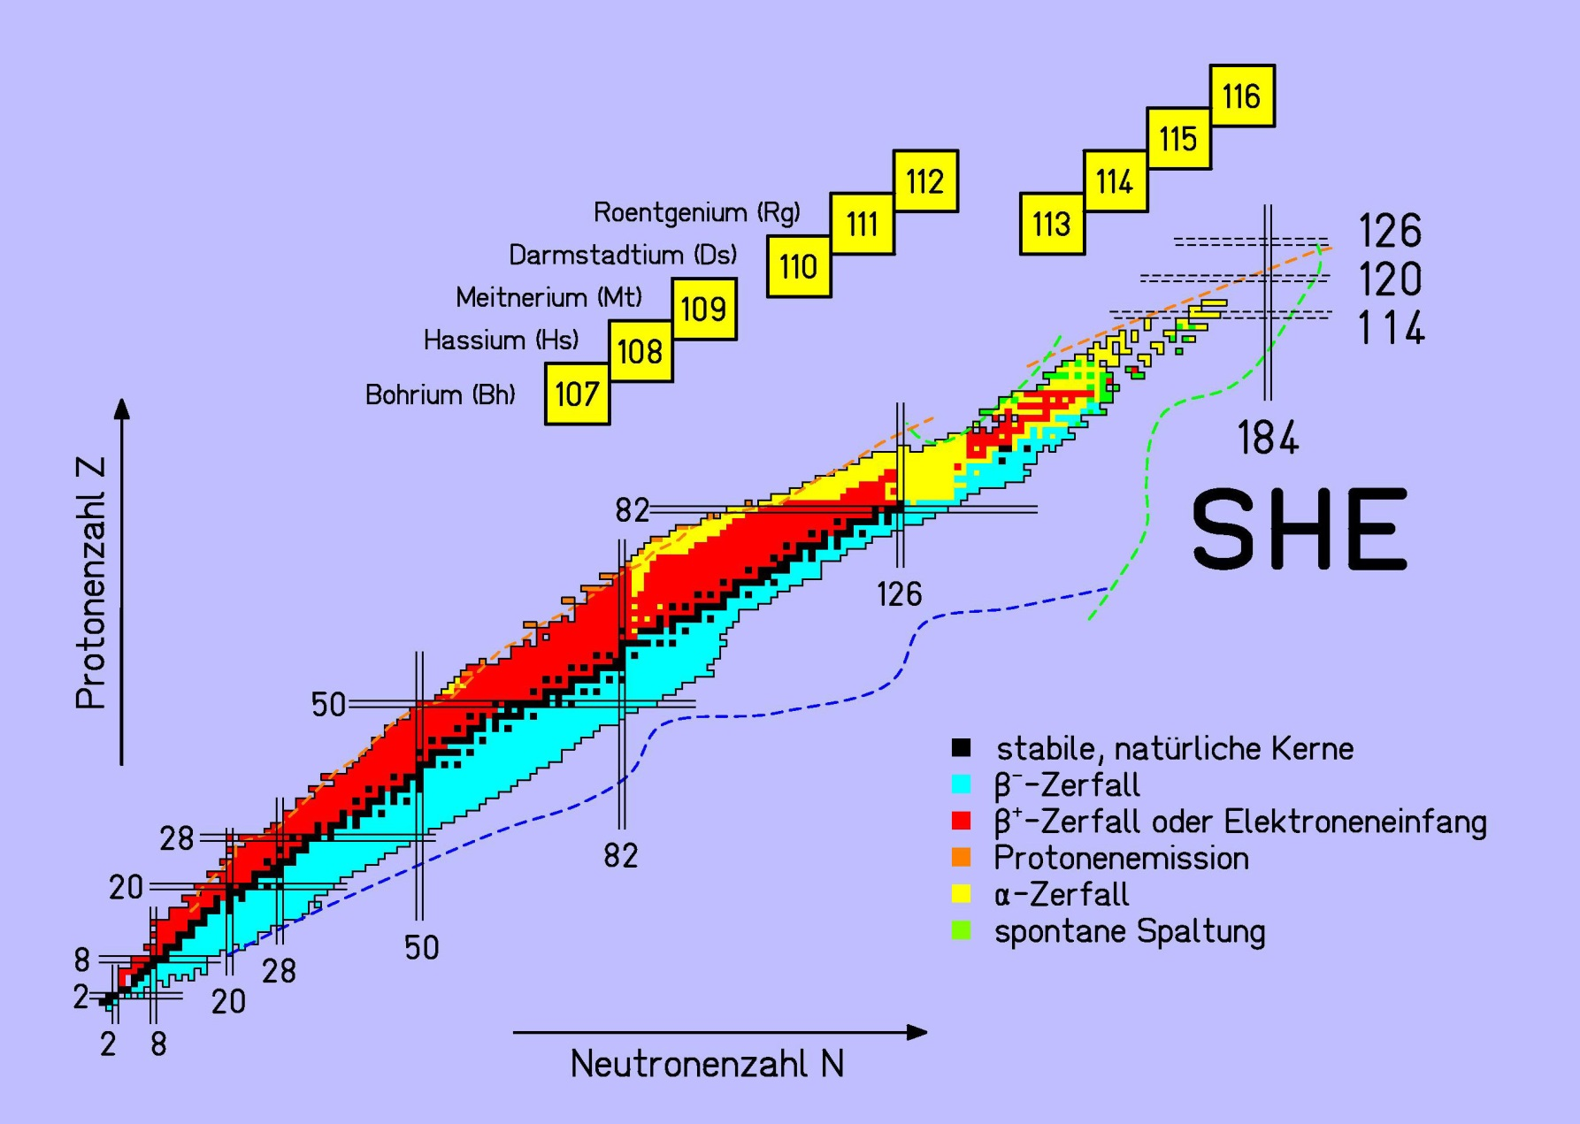
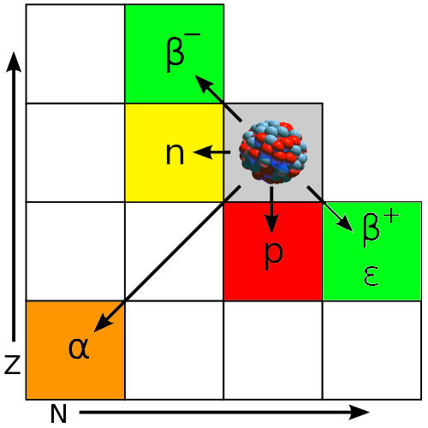
Primary modes of radioactive decay
chart of nuclides:
representation of isotopes in the Z-N plane
isotope: atom (nucleus) of an element with
different number of neutrons
different modes of
radioactive decay
proton number Z
neutron number N

Slide 6
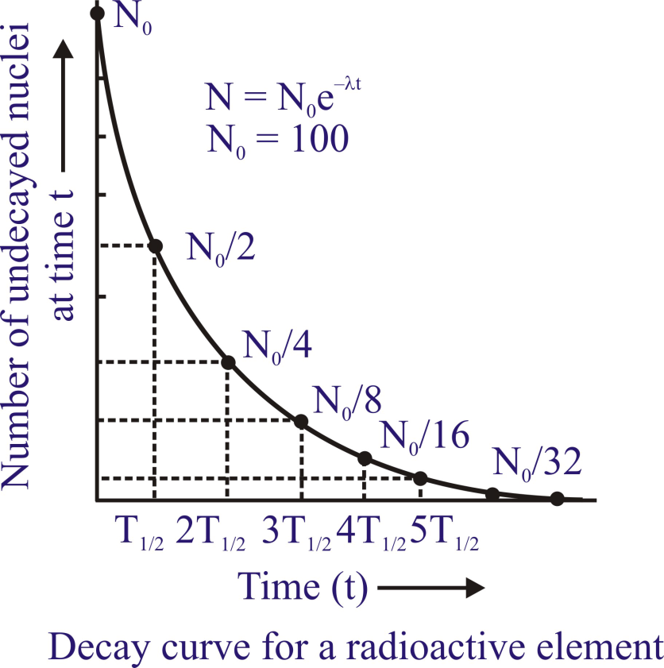
The radioactive decay law
The number of nuclei that decay is proportional to the number of radioactive nuclei N in the sample:
$$−\frac{dN}{dt}=λ∙N$$
λ is the decay constant
Radioactivity is an exponential decay process
$$N\left(t\right)=N_{0}∙e^{−λ∙t}$$
The sample activity or decay rate is given by
$$A=λ∙N$$
The lifetime and the half-life is defined as
$$τ=\frac{1}{λ}$$
$$T_{1/2}=\frac{\ln{2}}{λ}=0.693∙τ$$

Slide 7
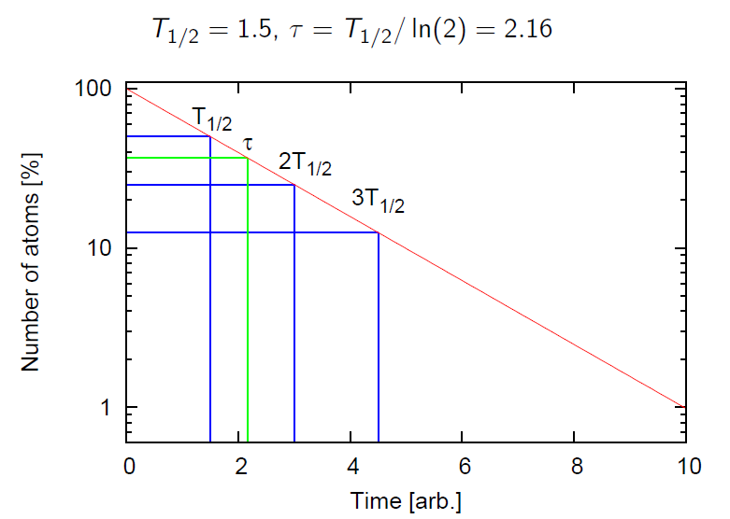
Nuclear decay

Slide 8
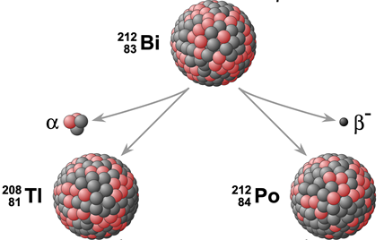
Nuclear decay with branching
The initial nucleus can decay into either of two products, e.g. in a sample of ²¹²Bi, 36% of the nuclei decay to ²⁰⁸Tl and 64% to ²¹²Po.
Consider the case A → B and A → C in parallel.
We have for all time t:
36%
64%
$$N=N_{A}+N_{B}+N_{C}$$
which is constant, since the total number of nuclides remain constant.
Differentiating with respect to time:
$$\frac{dN_{A}}{dt}=−λ_{1}∙N_{A}−λ_{2}∙N_{A}=N_{A}\left(0\right)∙e^{−\left(λ_{1}+λ_{2}\right)∙t}$$
$$λ=λ_{1}+λ_{2}$$
Definition of the branching ratio:
$$f_{1}=\frac{λ_{1}}{λ}$$
$$f_{2}=\frac{λ_{2}}{λ}$$
β-activity: $A_{β}\left(t\right)=N_{A}∙λ∙f_{1}=N_{A}∙λ_{1}$
α-activity: $A_{α}\left(t\right)=N_{A}∙λ∙f_{2}=N_{A}∙λ_{2}$

Slide 9
Activity
For lifetimes comparable or longer than the span of a human life there are no measurable changes in the activity of a sample which prohibits direct decay curve measurements. In these cases the decay rates λ are deduced from the ratio of the observed activity A to the absolute number of radioactive atoms N in a sample.
$$A=λ∙N=λ∙\frac{m}{μ}∙N_{A}=\frac{1}{τ}∙\frac{m}{μ}∙N_{A}$$
with the molar mass μ and the Avogadro number N_{A}
For example 1 MBq of tritium (³H, T_{1/2}=12.33 [y]) corresponds to 5.59·10¹⁴ atoms or 2.78 [ng] of mass.
1 MBq of ¹⁴C (T_{1/2}=5730 [y]) corresponds to 2.6·10¹⁷ atoms or 6 [μg] of mass.
$$A=\frac{ln2}{T_{1/2}}∙N → N=\frac{A∙T_{1/2}}{ln2}=\frac{{10}^{6}∙12.33∙365∙24∙60∙60}{0.693}=5.6∙{10}^{14} atoms$$

Slide 10
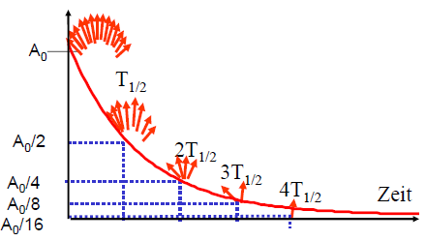
Activity
The number of radioactive nuclei is often unknown. One can only measure the number of decays per second (decay rate). This is the reason why the activity is defined as the number of decays per second:
$$A\left(t\right)=−\frac{∆N\left(t\right)}{∆t}=A_{0}∙e^{−λ∙t}$$
1 Becquerel (Bq) = 1 decay/s
number of decays per second
time
When at the beginning N(t=0) radioactive nuclei were present, then the activity A after the time t is given by
$$A\left(t\right)=−\frac{dN}{dt}=λ∙N_{0}∙e^{−λ∙t}=λ∙N=\frac{N}{τ}=A_{0}∙e^{−λ∙t}$$

Slide 11
Activity
Activity at the beginning:
$$A_{0}$$
Activity at time t:
$$A_{1}=A_{0}∙e^{−λ∙t} → \frac{A_{1}}{A_{0}}=e^{−λ∙t}$$
$$A_{2}=A_{0}∙e^{−λ∙2t}=A_{1}∙e^{−λ∙t}=A_{1}∙\left(\frac{A_{1}}{A_{0}}\right)$$
Activity at time 2t:
$$A_{3}=A_{0}∙e^{−λ∙3t}=A_{2}∙e^{−λ∙t}=A_{2}∙\left(\frac{A_{1}}{A_{0}}\right)=A_{1}∙{\left(\frac{A_{1}}{A_{0}}\right)}^{2}$$
Activity at time 3t:
$$A_{n+1}=A_{n}∙\left(\frac{A_{1}}{A_{0}}\right)=A_{1}∙{\left(\frac{A_{1}}{A_{0}}\right)}^{n}$$
General expression:
Example: The activity of a sample was measured 1000 [Bq] one hour ago. The present activity is 900 [Bq]. What is the activity in one hour?
$$A_{2}=A_{1}∙\left(\frac{A_{1}}{A_{0}}\right)=900∙\left(\frac{900}{1000}\right)=810$$

Slide 12
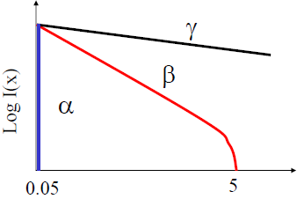
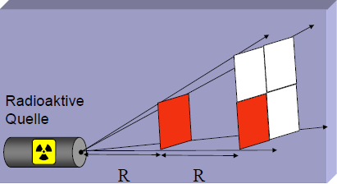
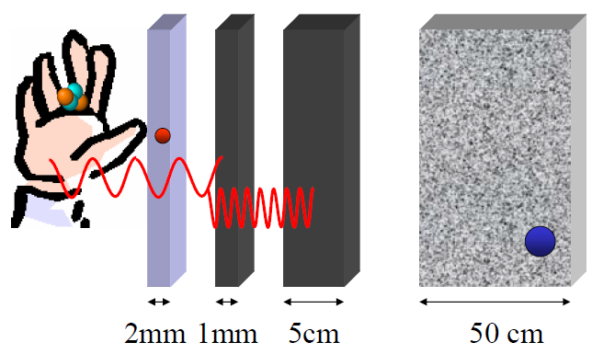
Radiation protection
range in air [m]
radioactive
source
Al
Pb
concrete
α´s
β´s
X-rays
γ-rays
neutrons
$$Ω=\frac{a^{2}}{4π∙R^{2}}=\frac{π∙r^{2}}{4π∙R^{2}}$$

Slide 13
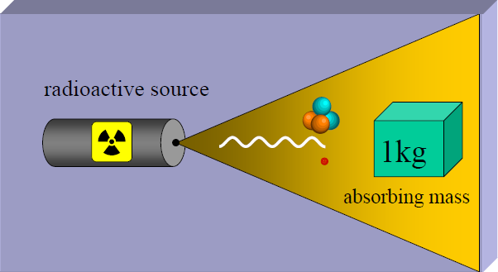
Radiation protection
$$absorbed dose=\frac{absorbed energy}{mass}$$
$$1 \frac{Joule}{kg}=1 Gray (Gy)$$
The biological dose, sometimes also known as the dose equivalent is expressed in units of Sieverts [Sv]. This dose reflects the fact that the biological damage caused by a particle depends not only on the total energy deposited but also on the rate of energy loss per unit distance traversed by the particle.
equivalent dose = energy dose · quality factor Q
radiation | quality factor Q
X-ray, γ, β | 1
thermal neutrons | 2.3
fast neutrons | 10
α-particles, heavy ions | 20

