Slide 1
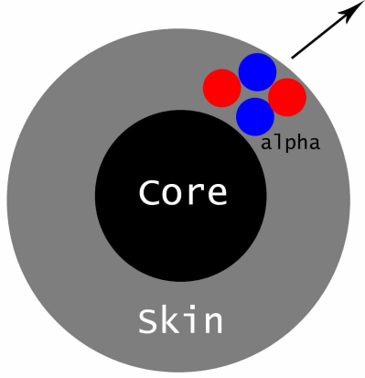
PHL424: α-decay
Why α-decay occurs?
The mass excess (in MeV/c²) of ⁴He and its near neighbors
↓N, Z → | 0 | 1 | 2 | 3 | 4
0 | - | 7.289 | - | - | -
1 | 8.071 | 13.136 | 14.931 | 25.320 | 37.996
2 | - | 14.950 | 2.425 | 11.679 | 18.374
3 | - | 25.928 | 11.386 | 14.086 | 15.769
4 | - | 36.834 | 17.594 | 14.908 | 4.942
Compared to its low-A neighbors in the chart of nuclides, ⁴He is bound very strongly.
Think classically, occasionally 2 protons and 2 neutrons appear together at the edge of a nucleus, with outward pointing momentum, and bang against the Coulomb barrier.

Slide 2
The energetics of α-decay
The α-decay process is determined by the rest mass difference of the initial state and final state.
$$Q=m\left(A,Z\right)−m\left(A−4,Z−2\right)−m\left({}_{2}^{4}{He}\right)$$
$$Q=BE\left(A−4,Z−2\right)+B_{α}\left(28.3 MeV\right)−BE\left(A,Z\right)$$
The Q-value of a reaction or of a decay indicates if it happens spontaneously or if additional energy is needed.
Mass data:
http://nuclear.lu.se/database/masses/
Mass (1u=931.478MeV/c²):
226.0254u → 222.0176u + 4.0026u
energy gain: 4.87 MeV
Binding energy [M(A,Z) - Z·M(¹H) - N·M(¹n)] :
-1731.610 MeV → -1708.184 MeV – 28.296 MeV
energy gain: 4.87 MeV
Mass excess [M(A,Z) - A] :
23.662 MeV → 16.367 MeV + 2.425 MeV
energy gain: 4.87 MeV

Slide 3
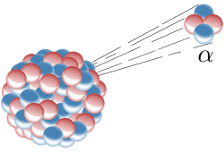
The Q-value and the kinetic energy of α-particles
What is the α-energy for the system
E_{kin}(α)
Mass data: http://nuclear.lu.se/database/masses/
BE(²¹⁴Po) = 1666.0 MeV
BE(²¹⁰Pb) = 1645.6 MeV
BE(⁴He) = 28.3 MeV
Q_{α} = 7.83 MeV
E_{kin}(N)
momentum conservation:
energy conservation:
$$m_{N}∙v_{N}=m_{α}∙v_{α} → v_{N}=\frac{m_{α}}{m_{N}}∙v_{α}$$
$$Q_{α}=E_{kin}^{N}+E_{kin}^{α}$$
$$=\frac{m_{N}}{2}∙v_{N}^{2}+E_{kin}^{α}$$
$$=\frac{m_{N}}{2}∙\frac{m_{α}^{2}}{m_{N}^{2}}∙v_{α}^{2}+E_{kin}^{α}$$
$$=\frac{m_{α}}{m_{N}}∙E_{kin}^{α}+E_{kin}^{α}$$
$$=\frac{m_{α}+m_{N}}{m_{N}}∙E_{kin}^{α}$$
$$→ E_{kin}^{α}=Q_{α}∙\frac{m_{N}}{m_{N}+m_{α}}=7.83MeV∙\frac{210}{214}=7.68 MeV$$
For a typical α-emitter, the recoil energy is ~100-150 keV.

Slide 4
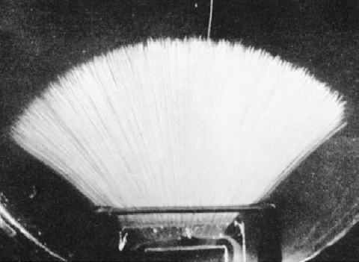
α-decay
Energy differences of atomic masses:
$$Q=m\left(A,Z\right)−m\left(A−4,Z−2\right)−m\left({}_{2}^{4}{He}\right)$$
$$Q=BE\left(A−4,Z−2\right)+B_{α}\left(28.3 MeV\right)−BE\left(A,Z\right)$$
The Q-value of the decay is the available energy which is distributed as kinetical energy between the two participating particles. Since the mother and daughter nucleus have fixed masses, the α-particles are mono-energetic.
Tracks of α-particles (²¹⁴Po → ²¹⁰Pb + α) in a cloud chamber.
The constant length of the tracks shows that the α-particles are mono-energetic (E_{α}=7.7 MeV)

Slide 5
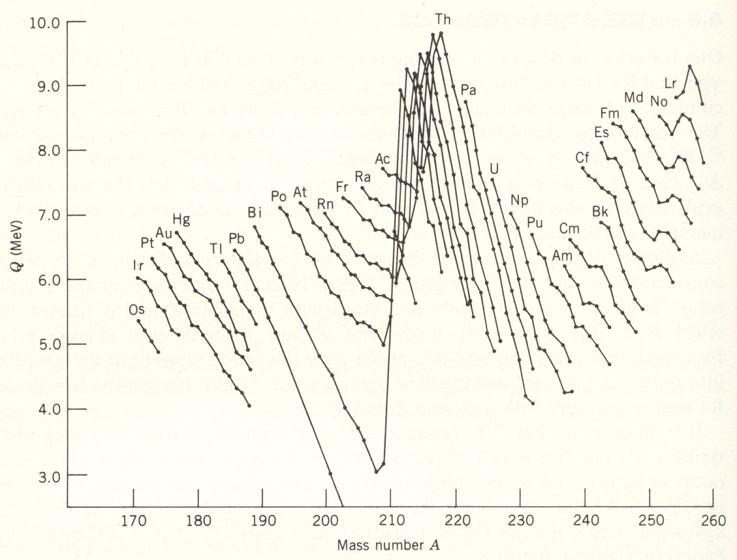
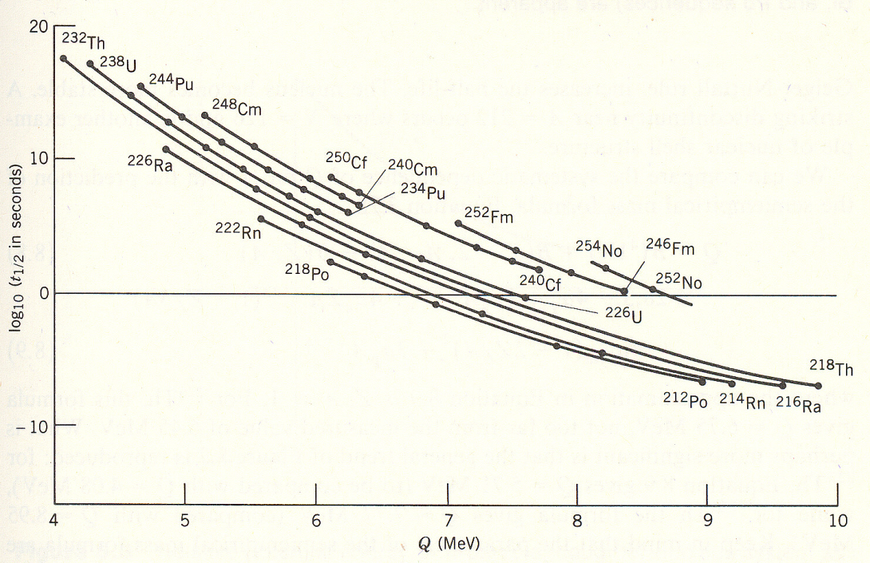
α-decay systematics: Geiger-Nuttall law
Q-value for α-decay:
$$Q=BE\left(A−4,Z−2\right)+B_{α}\left(28.3 MeV\right)−BE\left(A,Z\right)$$
shell effect at N = 126, Z = 82
odd-even staggering
Geiger-Nuttall law:
as the Q-value increases, T_{1/2} decreases

Slide 6
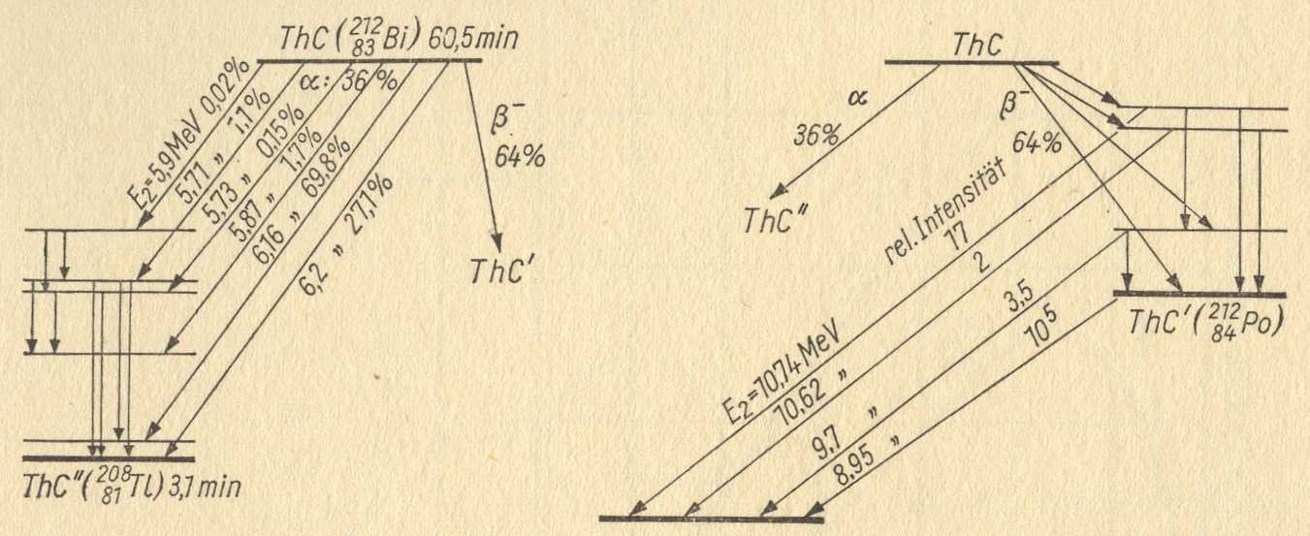
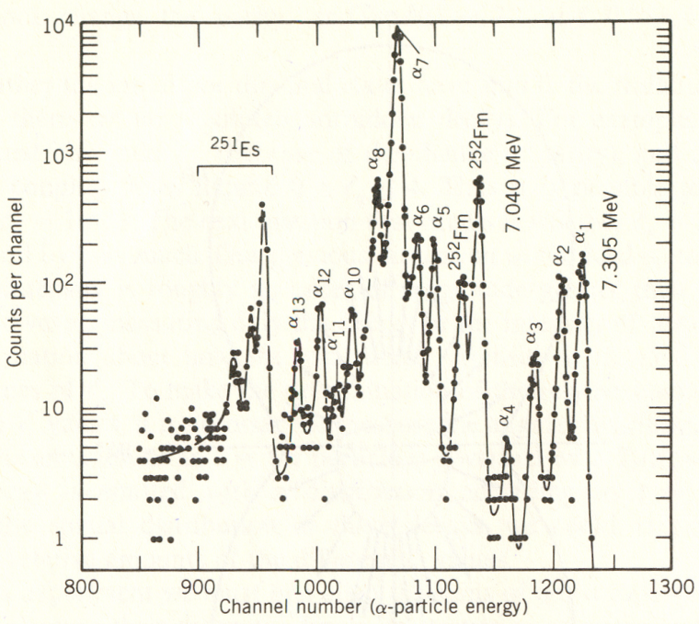
α-decay schemes / spectra
$${}_{100}^{251}{Fm}→{}_{98}^{247}{Cf}$$
α - spectrum

Slide 7
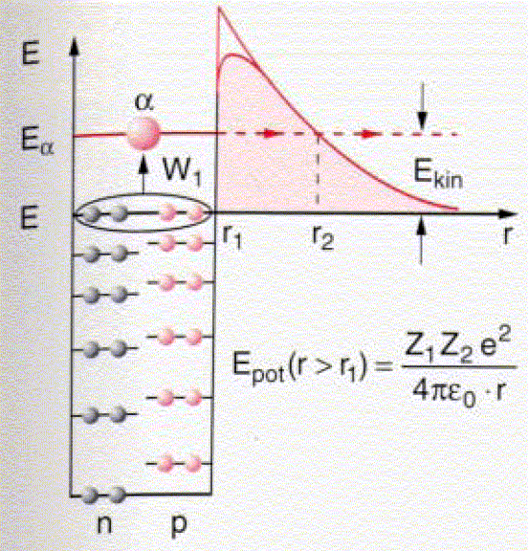
α-decay
Proton and neutrons are bound with up to 7 MeV and can not escape out of the nucleus. The emission of a bound system is more probable because of the additional binding energy E_{α} = 28.3 MeV.
The Coulomb barrier of the nucleus prevents the α-particles from escaping. The energy needed is generally in the range of about 20-25 MeV.
$$V_{C}=\frac{2∙\left(Z−2\right)∙e^{2}}{r}=\frac{2∙82∙1.44 MeV fm}{11.25 fm}=21 MeV$$
Classically, the α-particle is reflected on the Coulomb barrier when E_{α} < V_{C}, but quantum mechanics allows the penetration through the Coulomb potential via the mechanism of tunneling.

Slide 8
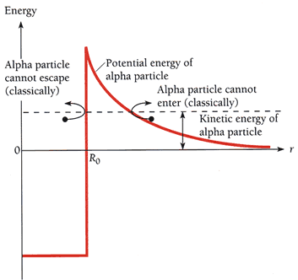
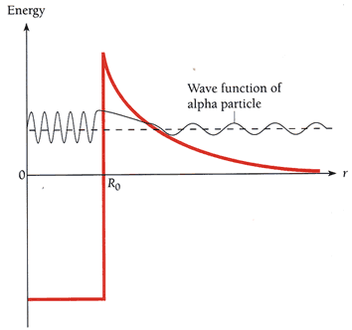
Quantum tunneling and α-decay
classical treatment
quantum treatment

Slide 9
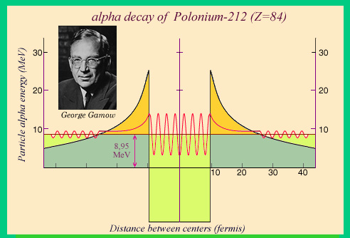
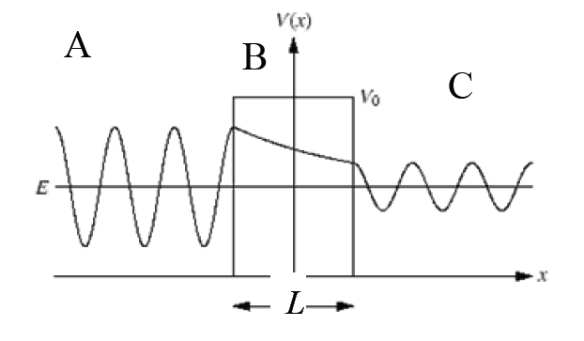
Quantum tunneling
-a
+a
general Ansatz for the solutions in area A, B, C
Intrinsic α-wave function 'leaks' out
A,C:
B:
A:
C:
B:
$$Ψ^{′′}\left(x\right)+k^{2}∙Ψ\left(x\right)=0; k^{2}=2∙m∙E/{ℏ^{2}}$$
time independent Schrödinger equation:
$$Ψ^{′′}\left(x\right)+k^{′2}∙Ψ\left(x\right)=0; k^{′2}=2∙m∙{\left(E−V_{0}\right)}/{ℏ^{2}}$$
$$−\frac{ℏ^{2}}{2m}\frac{∂^{2}}{∂x^{2}}Ψ\left(x\right)+V\left(x\right)∙Ψ\left(x\right)=E∙Ψ\left(x\right)$$
$$Ψ\left(x\right)=A_{1}∙e^{i∙k∙x}+A_{2}∙e^{−i∙k∙x}$$
$$Ψ\left(x\right)=C_{1}∙e^{i∙k∙x}+C_{2}∙e^{−i∙k∙x}$$
$$Ψ\left(x\right)=B_{1}∙e^{κ∙x}+B_{2}∙e^{−κ∙x}; κ^{2}=2∙m∙\left(V_{0}−E\right)/ℏ$$
with $\int{{\left|Ψ\left(x\right)\right|}^{2}}=1$

Slide 10
Quantum tunneling
The α-wave function from left will either be reflected or transmitted through the potential.
In region C the wave is only travelling to the right → C₂ = 0
With 4 equations for the 5 unknowns A₁, A₂, B₁, B₂ and C₁ 4 quantities can be determined with respect to e.g. A₁.
Reflection coefficient:
$$R=\frac{{\left|A_{2}\right|}^{2}}{{\left|A_{1}\right|}^{2}}$$
-a
+a
Transmission coefficient:
$$T=\frac{{\left|C_{1}\right|}^{2}}{{\left|A_{1}\right|}^{2}}$$
$$A_{1}∙e^{−i∙k∙a}+A_{2}∙e^{i∙k∙a}=B_{1}∙e^{−κ∙a}+B_{2}∙e^{κ∙a}$$
x= -a:
x= +a:
$$i∙k∙A_{1}∙e^{−i∙k∙a}−i∙k∙A_{2}∙e^{i∙k∙a}=κ∙B_{1}∙e^{−κ∙a}−κ∙B_{2}∙e^{κ∙a}$$
$$C_{1}∙e^{i∙k∙a}=B_{1}∙e^{κ∙a}+B_{2}∙e^{−κ∙a}$$
$$i∙k∙C_{1}∙e^{i∙k∙a}=κ∙B_{1}∙e^{κ∙a}−κ∙B_{2}∙e^{−κ∙a}$$
$$T={\left[1+\frac{V_{0}^{2}}{4∙E∙\left(V_{0}−E\right)}∙\sinh^{2}\sqrt{2∙m∙\left(V_{0}−E\right)}/ℏ∙L\right]}^{−1}$$
$$T≈\frac{16∙E∙\left(V_{0}−E\right)}{V_{0}^{2}}∙exp\left\{−2∙\sqrt{2∙m∙\left(V_{0}−E\right)}\frac{L}{ℏ}\right\}; E≪V_{0}$$
$$\sinh^{2}x=\frac{1}{4}∙\left(e^{2x}+e^{−2x}\right)−1/2$$

Slide 11
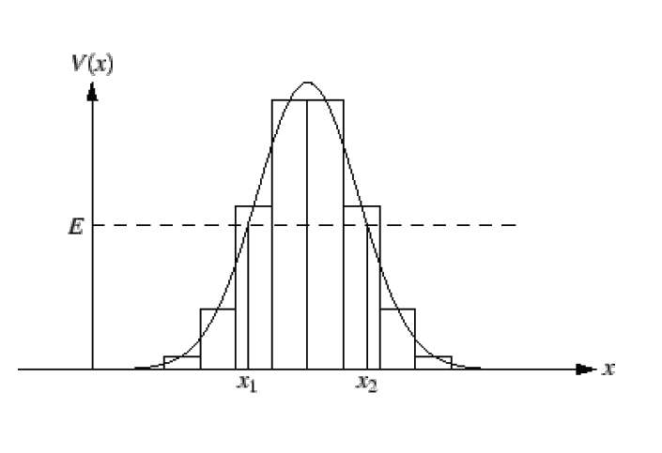
Quantum tunneling
For a simple box potential one obtains the exact solution for transmission coefficient:
$$T\left(E\right)=exp\left\{−\sqrt{2∙m∙\left(V_{0}−E\right) }\frac{2∙L}{ℏ}\right\}$$
-a
+a
In case of a more realistic potential (see below) one has to use step functions (Δx width) as an approximation
$$T\left(E\right)=exp\left\{−2\int_{x_{i}}^{x_{a}}{dx \left(\frac{1}{ℏ}∙\sqrt{2∙m∙\left[V\left(x\right)−E\right]}\right)}\right\}$$

Slide 12
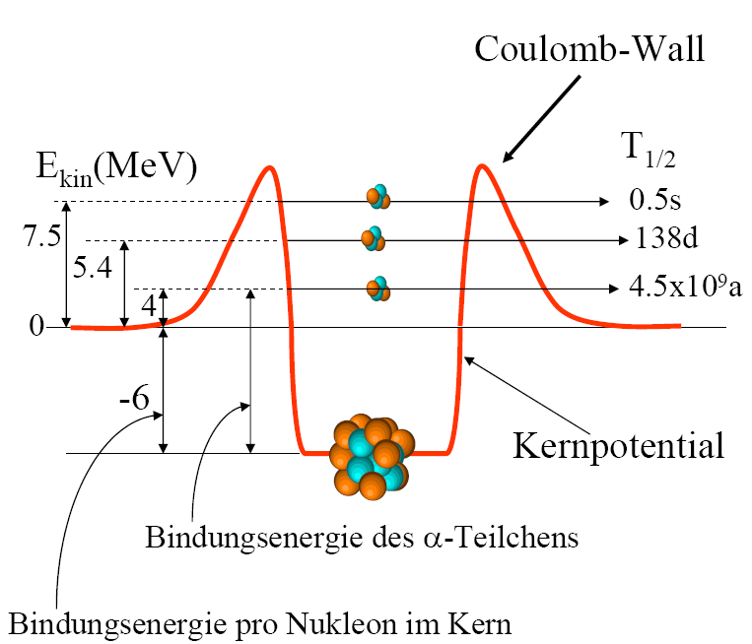
α-decay systematics: Geiger-Nuttall law
Geiger-Nuttall law: Relation between the half-life and the energy of α-particles
Ansatz for α-decay probability λ [s⁻¹]:
$$λ=S∙ω∙P$$
Coulomb barrier
S is the probability that an α-particle has been formed inside of the nucleus
ω is the frequency of the α-particle hitting the Coulomb barrier, where the velocity v is given by the kinetic energy and R is the nuclear radius
P = e^{-2G} is the probability of the tunneling process, where G is the Gamov factor
$$ω=\frac{1}{∆t}=\frac{v}{2R}=\frac{\sqrt{2V_{0}/m_{α}}}{2R}=\frac{\sqrt{2∙\frac{50MeVc^{2}}{3727MeV}}}{2∙10fm}\sim 2∙{10}^{21} s^{−1}$$
nuclear potential
$$lnλ=lnS−lnΔt−2G\left(E_{α}\right)$$
binding energy of α-particle
$$=b\left(Z\right)−a\frac{Z}{\sqrt{E_{α}}}≈−a\frac{Z}{\sqrt{E_{α}}}$$
binding energy per nucleon in nucleus

Slide 13
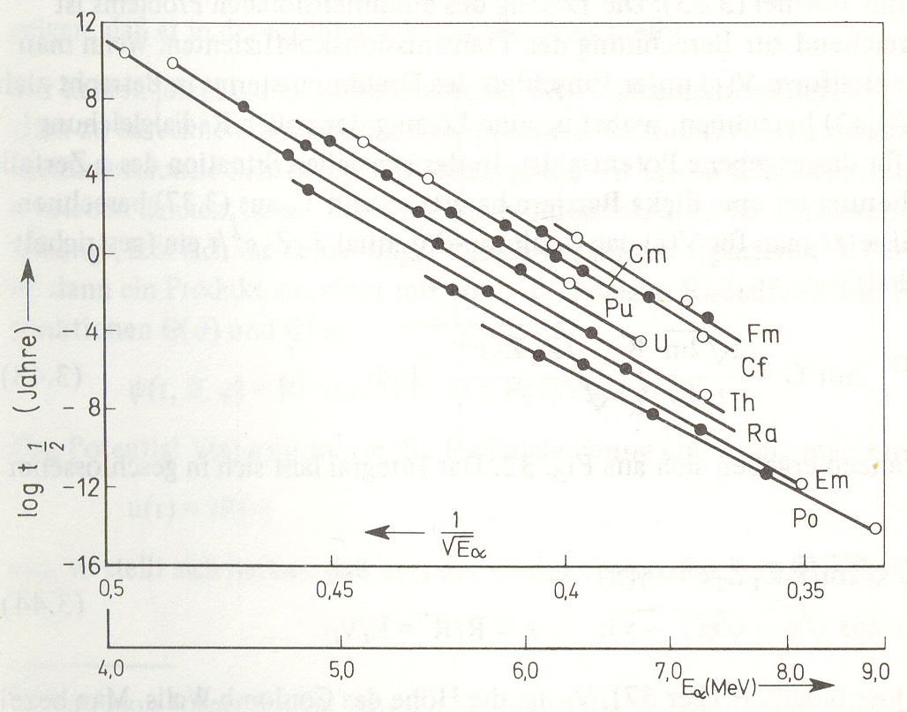
α-decay systematics: Geiger-Nuttall law
(years)

Slide 14
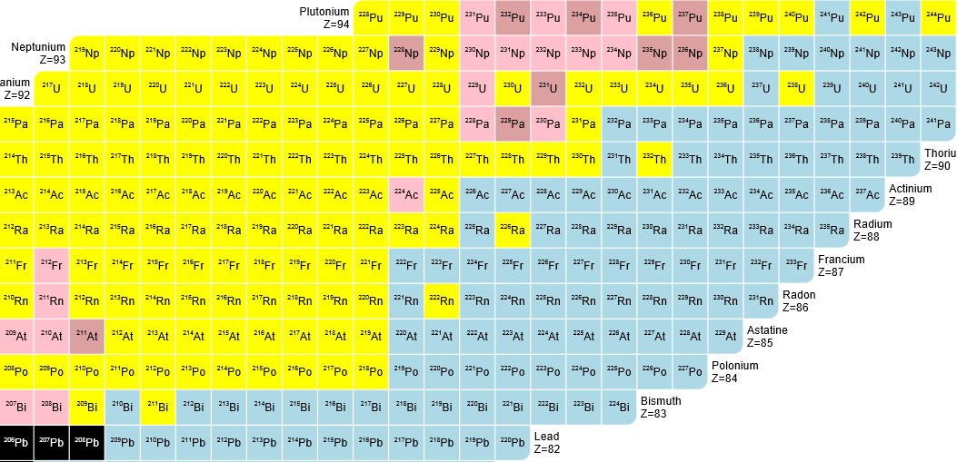
Chart of Nuclides
How are the isotopes of an element arranged on the chart?
Nuclides with the same number of neutrons are called isotones. How are they arranged on the chart?
Nuclides with the same mass number are called isobars. What would be the orientation of a line connecting an isobaric series?
Begin with the following radioactive parent nuclei, ²³⁵U, ²³⁸U, ²⁴⁴Pu, trace their decay processes and depict the mode and direction of each decay process on the chart. What are the final stable nuclei?
http://people.physics.anu.edu.au/~ecs103/chart/index.php

