Slide 1
Spectroscopy of open systems: proton emitters
  Non-adiabatic theory:
  B.Barmore et al., Phys.Rev. C62, 054315 (2000)
  A.T. Kruppa and WN, Phys. Rev. C69, 054311 (2004)

Slide 2
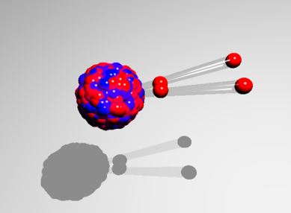
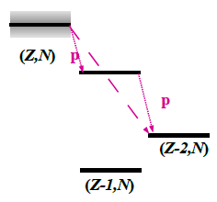
2-proton radioactivity of ⁴⁵Fe
N=Z
1-proton emission:
-120 keV < S_{p} < 70 keV
t_{1/2} > 100s
1-proton emission:
-120 keV < S_{p} < 70 keV
t_{1/2} > 100s
2-proton emission:
-1000 keV < S_{2p} < -1300 keV
t_{1/2}~10⁻⁶s – 1s
sequential
simultanious
proposed by V.I. Goldansky; Nucl.Phys. 19 (1960), 482 Nucl.Phys. 27 (1961), 648 discovered by M.Pfützner et al., EPJA 14 (2002) 279

Slide 3
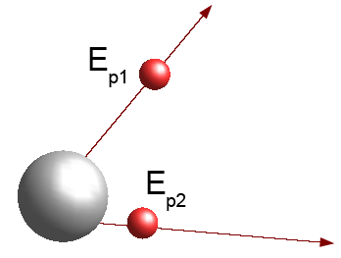
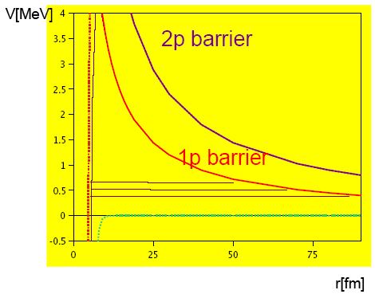
2-proton radioactivity of ⁴⁵Fe
Tunneling through a potential barrier:
S spectroscopic factor for 2-proton creation
ω frequency, with which both protons hit the barrier
P is the penetrability, the probability for a tunneling
process
proposed by V.I. Goldansky; Nucl.Phys. 19 (1960), 482 Nucl.Phys. 27 (1961), 648 discovered by M.Pfützner et al., EPJA 14 (2002) 279

Slide 4
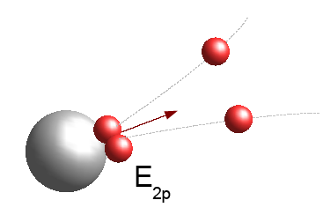
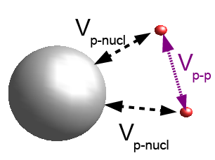
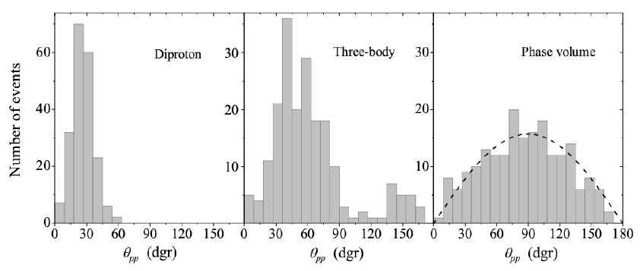
2-proton radioactivity of ⁴⁵Fe
Monte Carlo simulation (200 events) of the opening angles between both protons for the ⁴⁵Fe decay
L. Grigorenko et al. Phys. Rev. Lett. 85 (2000), 22, Nucl.Phys. A714 (2003), 425

Slide 5
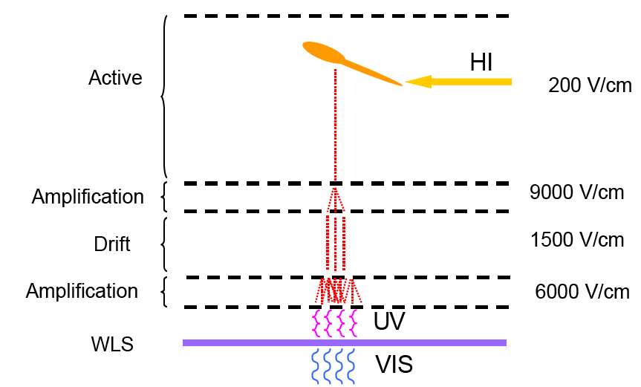
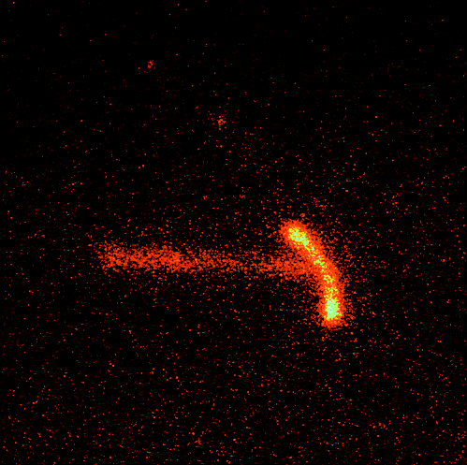
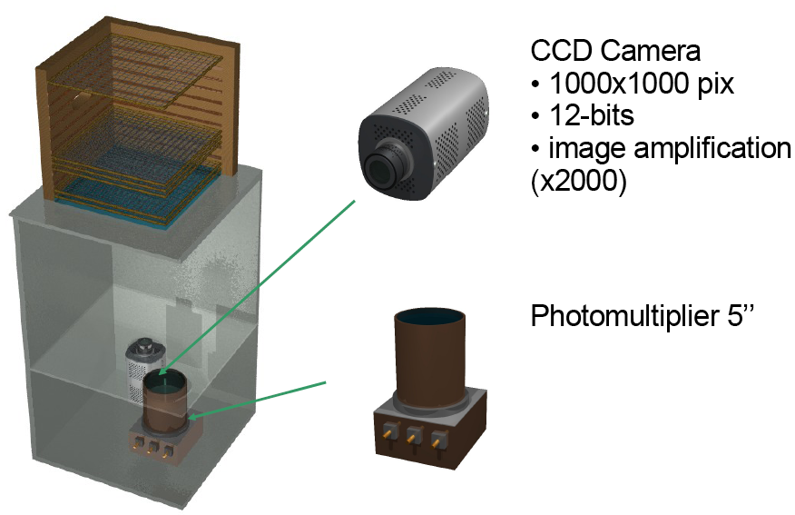
Optical time projection chamber
p
⁴⁵Fe
p
G. Charpak et al., NIM A269 (1988), 142

Slide 6
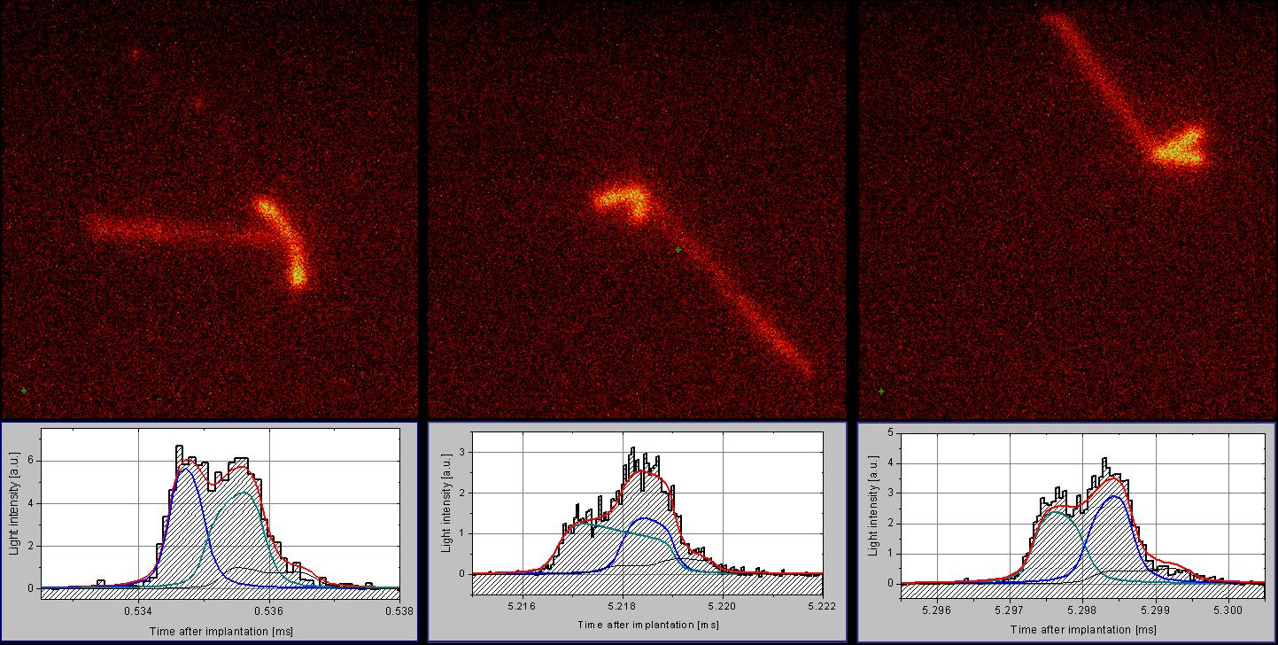
Optical time projection chamber
K. Miernik et al., Phys.Rev.Lett. 99 (2007) 192501

Slide 7
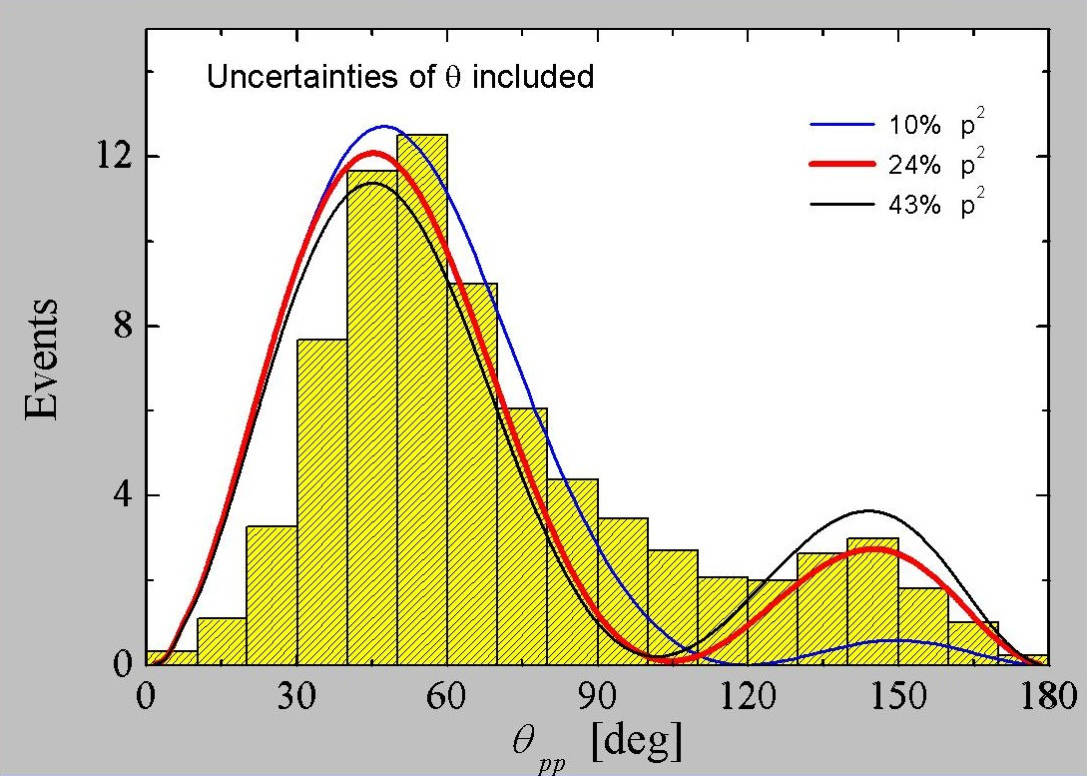
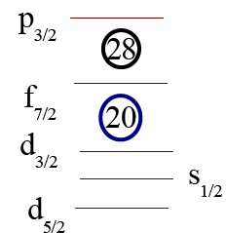
2-proton radioactivity of ⁴⁵Fe
K. Miernik et al., Phys.Rev.Lett. 99 (2007) 192501

Slide 8
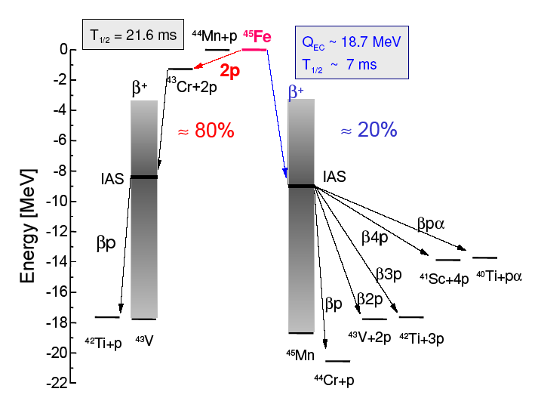
2-proton radioactivity of ⁴⁵Fe
Q_{2p}=1.15±0.09 MeV und T_{1/2} consistent with 2p-emission (sensitive between 1µs and 10 ms)
K. Miernik et al., Phys.Rev.Lett. 99 (2007) 192501

