Slide 1
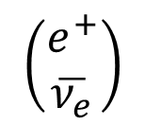
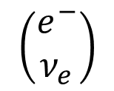
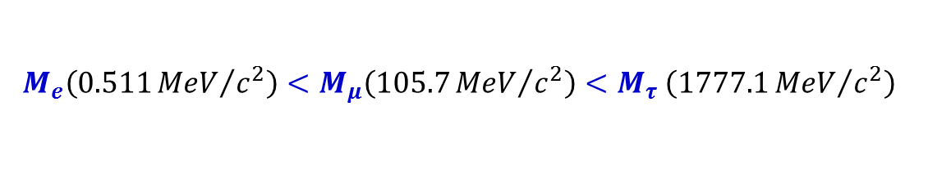
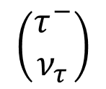
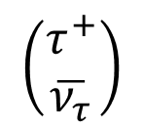
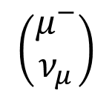
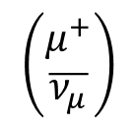
Leptons
Leptons are spin ½ fermions, not subject to strong interaction
$$\left(\begin{matrix}e^{−} \\ ν_{e}\end{matrix}\right)$$
$$\left(\begin{matrix}μ^{−} \\ ν_{μ}\end{matrix}\right)$$
$$\left(\begin{matrix}τ^{−} \\ ν_{τ}\end{matrix}\right)$$
$$M_{e}\left(0.511{MeV}/{c^{2}}\right)<M_{μ}\left(105.7{MeV}/{c^{2}}\right)<M_{τ} \left(1777.1{MeV}/{c^{2}}\right)$$
Electron e⁻, muon μ⁻ and tau τ⁻ have corresponding neutrinos ν_{e}, ν_{μ}, ν_{τ}.
Electron, muon and tau have electric charge of –e. Neutrinos are neutral.
Neutrinos possibly have zero or very small mass.
For neutrinos, only weak interactions have been observed so far.
Antileptons are positron e⁺, positive muon $μ^{+}$ and positive tau $τ^{+}$ and antineutrinos:
$$\left(\begin{matrix}e^{+} \\ \overline{ν_{e}}\end{matrix}\right)$$
$$\left(\begin{matrix}μ^{+} \\ \overline{ν_{μ}}\end{matrix}\right)$$
$$\left(\begin{matrix}τ^{+} \\ \overline{ν_{τ}}\end{matrix}\right)$$
Neutrinos and antineutrinos differ by the lepton number. Leptons posses lepton number L_{α} = 1 (α stands for e, μ, or τ, and antileptons have L_{α} = -1.
Lepton numbers are conserved in any interaction.

Slide 2
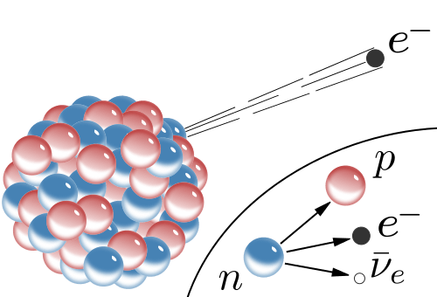
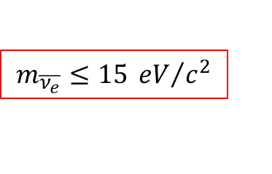



Leptons
Neutrinos can not be registered by any detector, there are only indirect indications of their quantities.
First indication of neutrino existence came from β-decays of a nucleus N:
$$N\left(Z, A\right)→N\left(Z+1, A\right)+e^{−}+\overline{ν_{e}}$$
β-decay is nothing but a neutron decay
$$n\left(udd\right)→p\left(uud\right)+e^{−}+\overline{ν_{e}}$$
Necessity of a neutrino existence comes from the apparent energy and angular momentum non-conservation in observed reactions.
Note that for the sake of the lepton number conservation, electron must be accompanied by an antineutrino and not neutrino!
Mass limit for $\overline{ν_{e}}$ can be estimated from the precise measurements of the β-decay:
$$m_{e}≤E_{e}≤∆M_{N}−m_{\overline{ν_{e}}}$$
The best results are obtained from the tritium decay:
$${}_{}^{3}H→{}_{}^{3}{He}+e^{−}+\overline{ν_{e}}$$
$$m_{\overline{ν_{e}}}≤15 {eV}/{c^{2}}$$

Slide 3
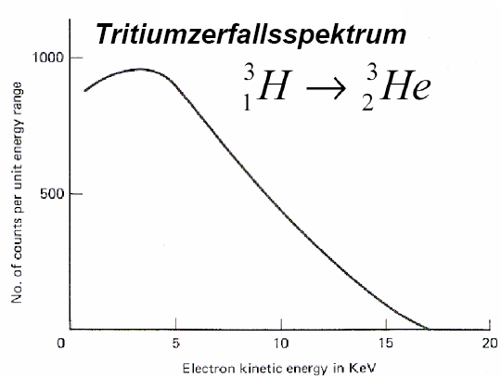
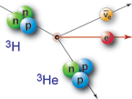
Tritium decay
The β⁻ decay energy is given by the mass difference between mother and daughter nucleus.
This energy will be distributed as kinetic energy
on the emitting particles, the electron and the
anti-neutrino.
Hence, the electron spectrum is continuous.
It starts at zero energy and ends at the maximum
possible energy E_{max} = E₀ - m_{ν}·c² (= Q_{β}).
β decays have a long lifetime and a small decay probability, the related interaction is small compared to other interactions in the nucleus, therefore time dependent perturbation theory is a good approximation.
Tritium decay spectrum
T_{1/2}=12.32a
Q_{β}=18.6 keV

Slide 4
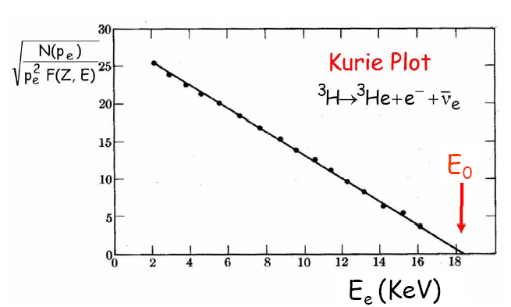
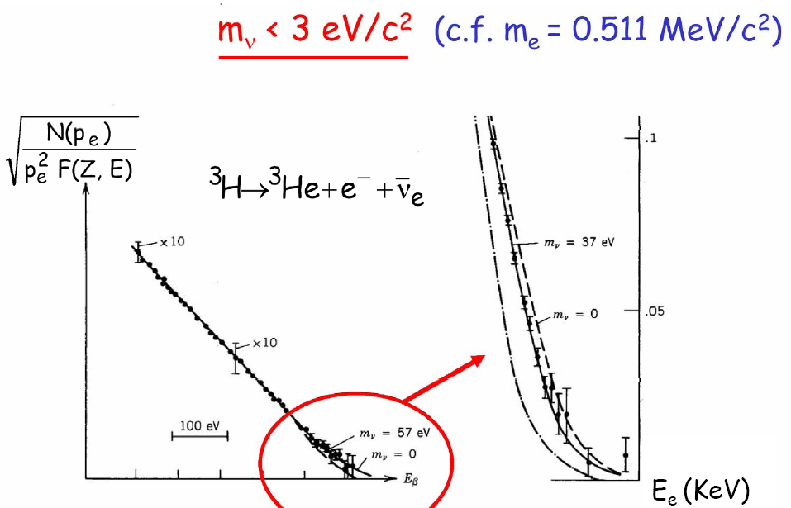
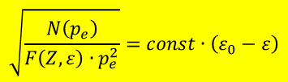
Tritium decay
Kurie plot:
$$\sqrt{\frac{N\left(p_{e}\right)}{F\left(Z,ε\right)∙p_{e}^{2}}}=const∙\left(ε_{0}−ε\right)$$

Slide 5
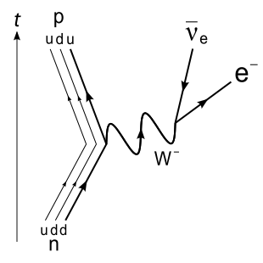


Weak Interaction
Consider a neutron n (udd) β-decay
Although the neutron is heavier than its sister proton p (uud), it cannot decay to proton without changing the flavor of one of its down quarks d.
Neither EM nor strong interactions allow to change the flavor. It must proceed through weak interaction.
$$d→u+W^{−}→u+e^{−}+\overline{ν_{e}}$$
$$n→p+e^{−}+\overline{ν_{e}}$$

Slide 6
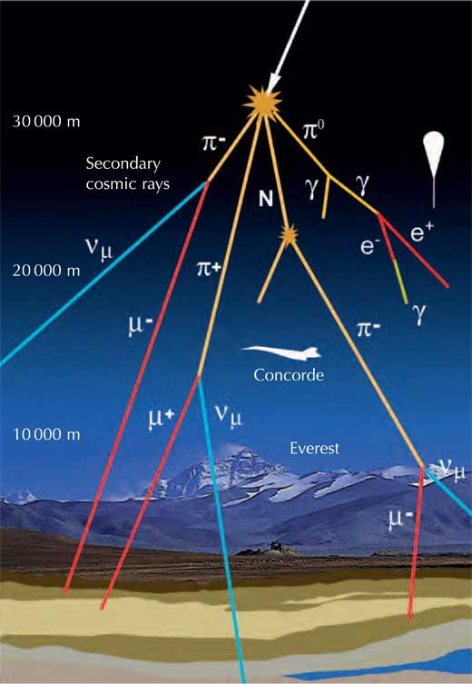
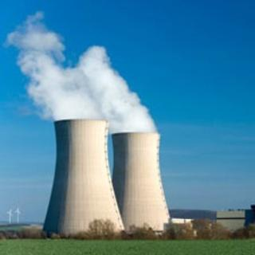
Source of Neutrinos
Nuclear reactions
Fusion in the sun
Fission in reactors
Big bang nucleosynthesis
High energy collisions
Particle colliders
Cosmic ray showers

Slide 7
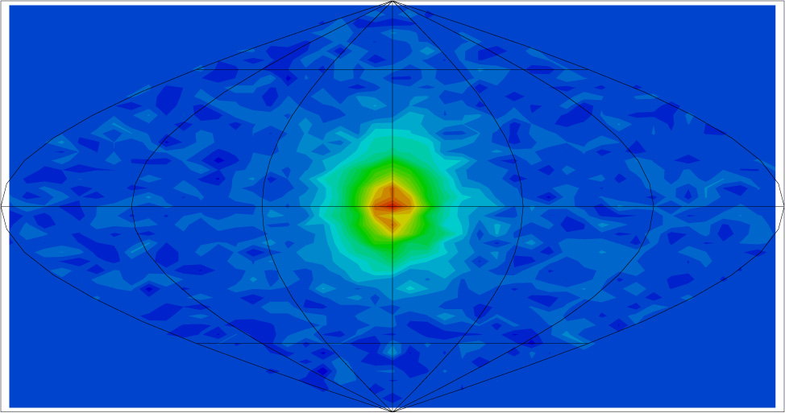
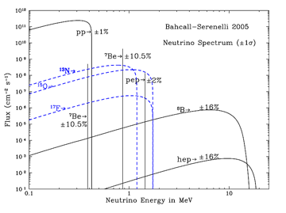
Solar Neutrinos
Electron neutrinos produced in fusion chain
99% of solar neutrinos from pp fusion
First observation in 2014 by Borexino
Small fraction from ⁷Be and ⁸B
Extend to high energy, easier to detect
Bachall predicted the solar neutrino flux in 1964. He refined this with an incredibly precise solar model over the next 50 years.

Slide 8
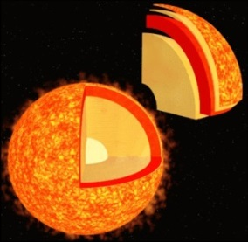
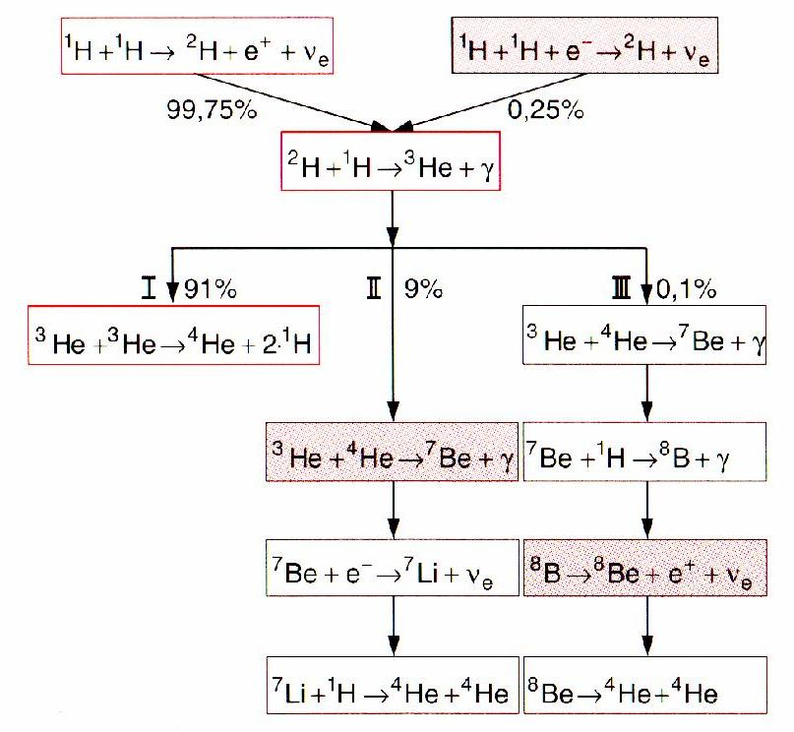
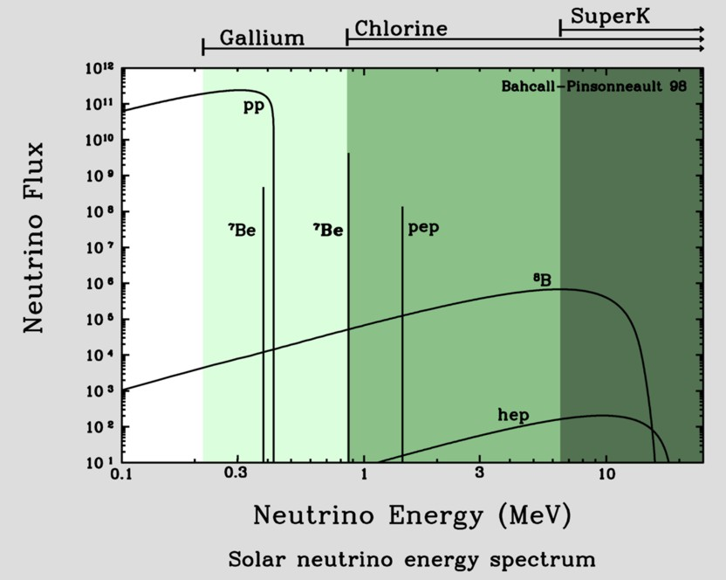
Neutrinos from the Sun
Known: total irradiated energy
Known: Energy per fusion process
Number of neutrinos produced [s⁻¹]!
On Earth: 66 billion ν per (cm² · s¹)
Different fusion pathes

Slide 9
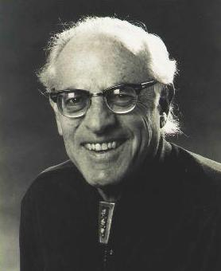
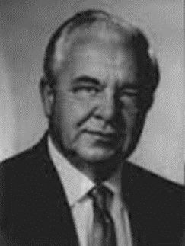


Leptons
An inverse β-decay also takes place:
$$ν_{e}+n→e^{−}+p$$
or
$$\overline{ν_{e}}+p→e^{+}+n$$
However, the probability of these processes is very low, therefore to register it one needs a very intense flux of neutrinos. Reines and Cowan experiment (1956)
Frederick Reines Clyde L. Cowan
Using antineutrinos produced in a nuclear reactor, it is possible to obtain around 2 (10) events per hour.
Aqueous solution of CdCl₂ used as the target (Cd used to capture neutrons).
To separate the signal from the background, the “delayed coincidence” scheme was used: signal from neutron comes later than one from positron.

Slide 10
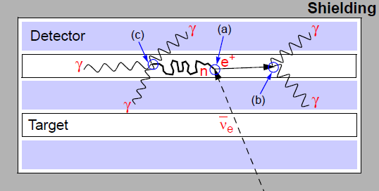
Leptons
Schematic representation of the F. Reines and C. Cowan experiment
Main stages:
Antineutrino interacts with proton, producing neutron and positron
Positron annihilates with an atomic electron, produces fast photon which gives rise to softer photons through the Compton effect.
Neutron captured by a Cd nucleus, releasing more photons

Slide 11
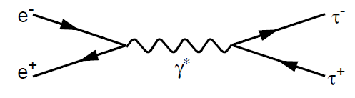
Leptons
Muons were first observed in 1936, in cosmic rays
Cosmic rays have two components:
primaries, which are high-energy particles coming from the outer space, mostly hydrogen nuclei
secondaries, the particles which are produced in collisions of primaries with nuclei in the Earth atmosphere; muons belong to this component
Muons are 200 times heavier than electrons and are very penetrating particles.
Electromagnetic properties of muon are identical to those of electron (upon the proper account of the mass difference)
Tau is the heaviest of leptons, was discovered in e⁺e⁻ annihilation experiments in 1975
τ pair production in e⁺e⁻ annihilation

Slide 12



Lepton Type Conservation
Electron is a stable particle, while muon and tau have a finite lifetime:
$$τ_{μ}=2.2∙{10}^{−6} s$$
and
$$τ_{τ}=2.9∙{10}^{−13} s$$
Muon decays in a purely leptonic mode:
$$μ^{−}→{ν_{μ}+e}^{−}+\overline{ν_{e}}$$
electron number | 0 = 0 + 1 + -1
muon number | 1 = 1 + 0 + 0
tau number | 0 = 0 + 0 + 0
Electrons and their neutrinos have electron number +1
Positrons and their antineutrinos have electron number -1

Slide 13
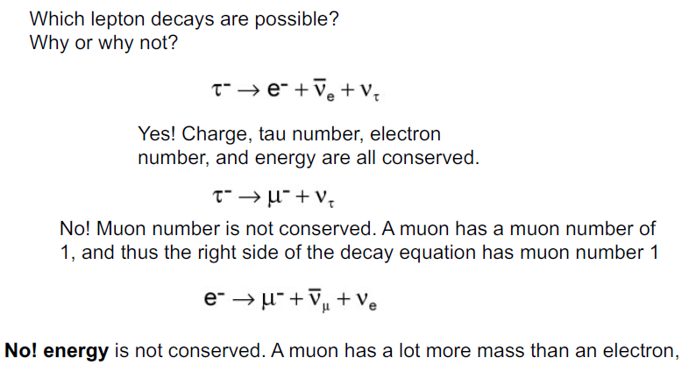
Quiz

Slide 14


Lepton Decay
Electron is a stable particle, while muon and tau have a finite lifetime:
$$τ_{μ}=2.2∙{10}^{−6} s$$
and
$$τ_{τ}=2.9∙{10}^{−13} s$$
Muon decays in a purely leptonic mode:
$$μ^{−}→ν_{μ}+e^{−}+\overline{ν_{e}}$$
Tau has a mass sufficient to produce hadrons, but has leptonic decay modes as well:
$$τ^{−}→{ν_{τ}+e}^{−}+\overline{ν_{e}}$$
$$τ^{−}→{ν_{τ}+μ}^{−}+\overline{ν_{μ}}$$
Fraction of a particular decay mode with respect to all possible decays is called branching ratio.
Branching ratio of both processes are 17.81% and 17.37%, respectively
Note: lepton numbers are conserved in all reactions ever observed

Slide 15
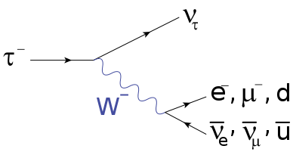
Tau decay
The branching ratio of the dominant hadronic tau decay are:
25.52% for decay into a charged pion, a neutral pion, and a tau neutrino;
10.83% for decay into a charged pion and a tau neutrino;
9.30% for decay into a charged pion, two neutral pions, and a tau neutrino;
8.99% for decay into three charged pions (of which two have the same electrical charge) and a tau neutrino;
2.70% for decay into three charged pions (of which two have the same electrical charge), a neutral pion, and a tau neutrino;
1.05% for decay into three neutral pions, a charged pion, and a tau neutrino.
The branching ratio of the common purely leptonic tau decays are:
17.82% for decay into a tau neutrino, electron and electron antineutrino;
17.39% for decay into a tau neutrino, muon and muon antineutrino.

Slide 16
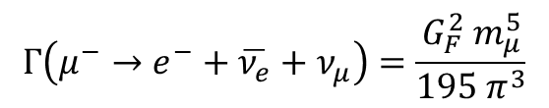
Leptons
Important assumptions:
Weak interactions of leptons are identical, just like electromagnetic ones (“interactions universality”)
One can neglect final state lepton masses for many basic calculations
The decay rate of a muon is given by the expression:
$$Γ\left(μ^{−}→e^{−}+\overline{ν_{e}}+ν_{μ}\right)=\frac{G_{F}^{2} m_{μ}^{5}}{195 π^{3}}$$
Here G_{F} is the Fermi constant ${(G}_{F}^{0}=\frac{G_{F}}{{\left(ℏc\right)}^{3}}=\frac{\sqrt{2}}{8}\frac{g^{2}}{m_{W}^{2}c^{4}}=1.1664∙{10}^{−5} {GeV}^{−2}$)
Substituting m_{μ} with m_{τ} one obtains decay rates of tau leptonic decays, equal for both processes. It explains why branching ratios of these processes have very close values.

Slide 17
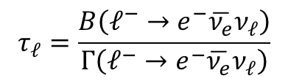
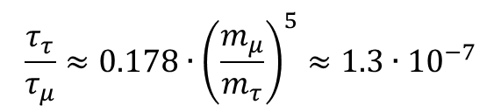
Leptons
Using the decay rate, the lifetime of a lepton is:
$$τ_{ℓ}=\frac{B\left(ℓ^{−}→e^{−}\overline{ν_{e}}ν_{ℓ}\right)}{Γ\left(ℓ^{−}→e^{−}\overline{ν_{e}}ν_{ℓ}\right)}$$
Here ℓ stands for μ or τ. Since muons have basically only one decay mode, B = 1 in their case. Using experimental values of B and formula for Γ, one obtains the ratio of muon and tau lifetimes:
$$\frac{τ_{τ}}{τ_{μ}}≈0.178∙{\left(\frac{m_{μ}}{m_{τ}}\right)}^{5}≈1.3∙{10}^{−7}$$
This again is in very good agreement with independent experimental measurements
Universality of lepton interactions is provided to big extend. That means that there is basically no difference between lepton generations, apart of the mass.

Slide 18
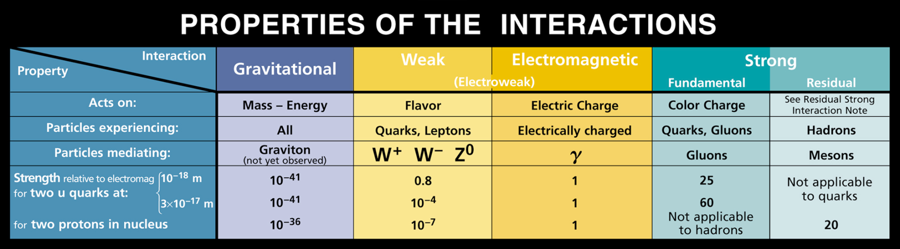
Electroweak
In the Standard Model the weak and the electromagnetic interactions have been combined into a unified electroweak theory.
At very short distances (~ 10⁻¹⁸ m) the strength of the weak interaction is comparable to that of the electromagnetic.
At thirty times that distance (3∙10⁻¹⁷ m) the strength of the weak interaction is 1/10000th than that of the electromagnetic interaction. At distances typical for quarks in a proton or neutron (10⁻¹⁵ m) the force is even tinier.

Slide 19
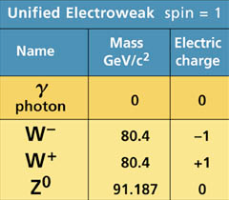
Electroweak
The strength of the interaction depends strongly on both the mass of the force carrier and the distance of the interaction.
The difference between their observed strengths is due to the huge difference in mass between the W± and Z⁰ particles, which are very massive, and the photon, which has no mass.

