Slide 1
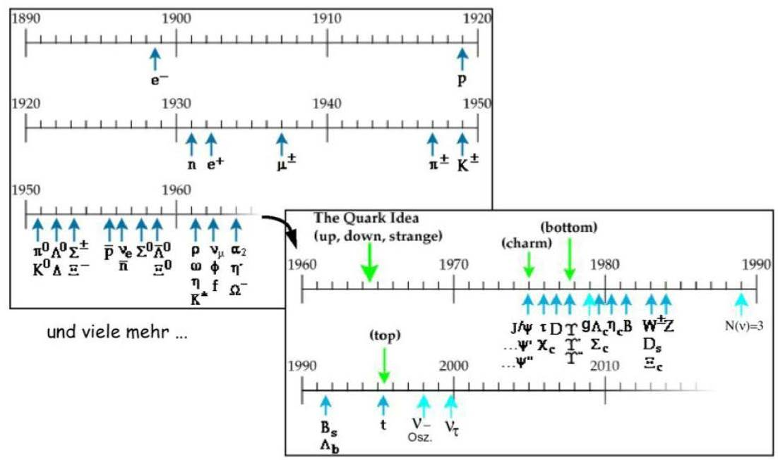
Quarks
Throughout the 1950 – 1960s, a huge variety of additional particles was found in scattering experiments. This was referred to as the “particle zoo”.
today > 200 particles listed in Particle Data Group
already 20 particles discovered

Slide 2
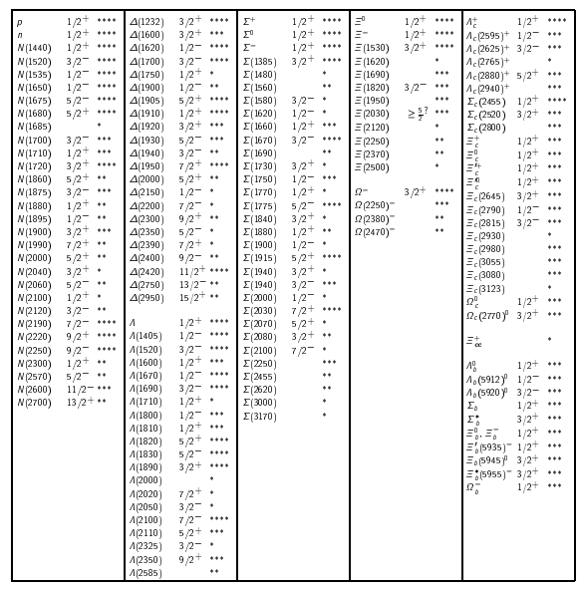
Particle Data Group Baryon Listing

Slide 3
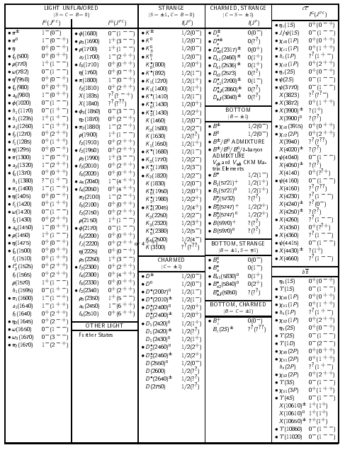
Particle Data Group Meson Listing

Slide 4
Quarks
To escape the “particle zoo”, the next logical step was to investigate whether these patterns could be explained by postulating that all Baryons and Mesons are made of other particles. These particles were named Quarks.
As far as we know, quarks are like points in geometry.
Quarks possess fractional electric charges (-1/3, 2/3).
Quarks are spin ½ fermions, subject to all kind of interactions.
Quarks and their bound states are the only particles which interact strongly.
After extensively testing this theory, scientists now suspect that quarks and electrons are fundamental.
An elementary particle or fundamental particle is a particle not known to have substructure. If an elementary particle truly has no substructure, then it is one of the basic particles of the universe from which all larger particles are made.

Slide 5
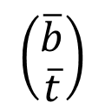

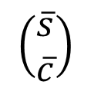
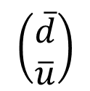


Quarks
The quark model: baryons and antibaryons are bound states of three quarks, and mesons are bound states of a quark and antiquark.
Analogously to leptons, quarks occur in three generations:
Corresponding antiquarks are:
$$\left(\begin{matrix}u \\ d\end{matrix}\right)$$
$$\left(\begin{matrix}c \\ s\end{matrix}\right)$$
$$\left(\begin{matrix}t \\ b\end{matrix}\right)$$
$$\left(\begin{matrix}\overline{d} \\ \overline{u}\end{matrix}\right)$$
$$\left(\begin{matrix}\overline{s} \\ \overline{c}\end{matrix}\right)$$
$$\left(\begin{matrix}\overline{b} \\ \overline{t}\end{matrix}\right)$$
Name (“Flavor”) | Symbol | Charge (in units of e) | Mass (GeV/c²)
Down | d | -1/3 | ~ 0.005
Up | u | +2/3 | ~ 0.002
Strange | s | -1/3 | ~ 0.095
Charmed | c | +2/3 | ~ 1.3
Bottom | b | -1/3 | ~ 4.2
Top | t | +2/3 | ~ 172

Slide 6
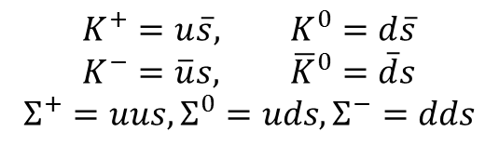
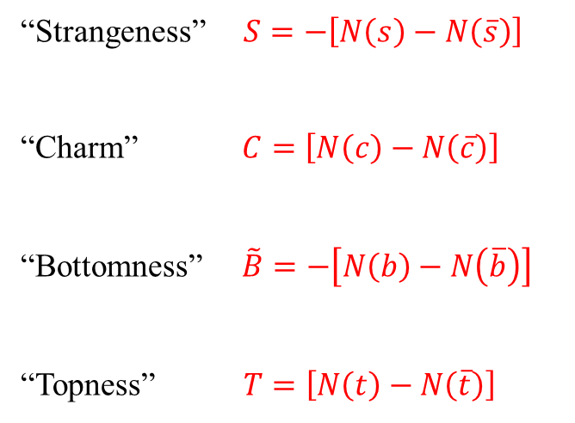
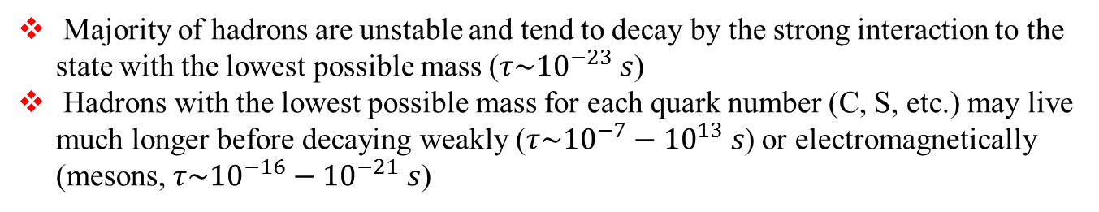
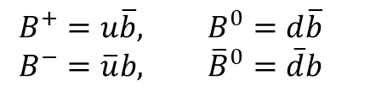
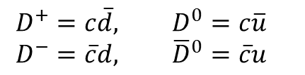
Quantum Numbers and Flavours
$$K^{+}=u\overline{s}, K^{0}=d\overline{s}$$
$$K^{−}=\overline{u}s, {\overline{K}}^{0}=\overline{d}s$$
$$Σ^{+}=uus, Σ^{0}=uds, Σ^{−}=dds$$
“Strangeness” $S=−\left[N\left(s\right)−N\left(\overline{s}\right)\right]$
“Charm” $C=\left[N\left(c\right)−N\left(\overline{c}\right)\right]$
“Bottomness” $\tilde{B}=−\left[N\left(b\right)−N\left(\overline{b}\right)\right]$
“Topness” $T=\left[N\left(t\right)−N\left(\overline{t}\right)\right]$
$$D^{+}=c\overline{d}, D^{0}=c\overline{u}$$
$$D^{−}=\overline{c}d, {\overline{D}}^{0}=\overline{c}u$$
$$B^{+}=u\overline{b}, B^{0}=d\overline{b}$$
$$B^{−}=\overline{u}b, {\overline{B}}^{0}=\overline{d}b$$
No composite hadrons are formed that contain the top (anti) quark
Majority of hadrons are unstable and tend to decay by the strong interaction to the state with the lowest possible mass ($τ\sim {10}^{−23} s$)
Hadrons with the lowest possible mass for each quark number (C, S, etc.) may live much longer before decaying weakly ($τ\sim {10}^{−7}−{10}^{13} s$) or electromagnetically (mesons, $τ\sim {10}^{−16}−{10}^{−21} s$)

Slide 7
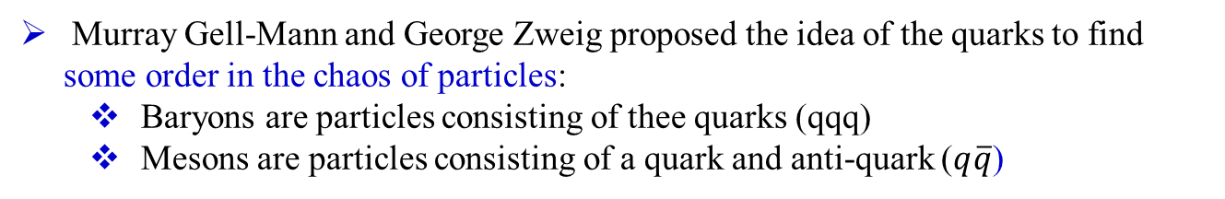
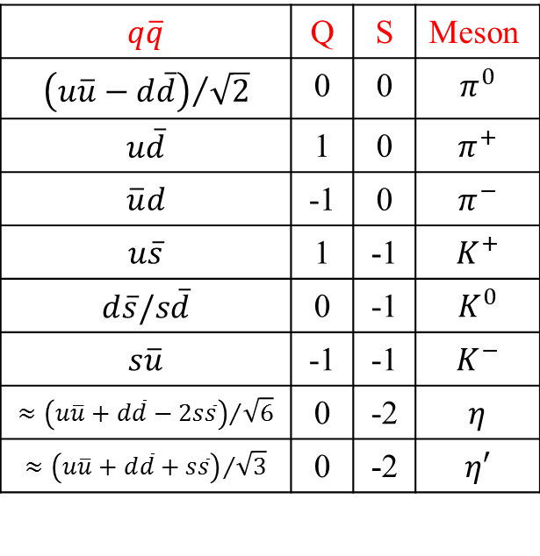
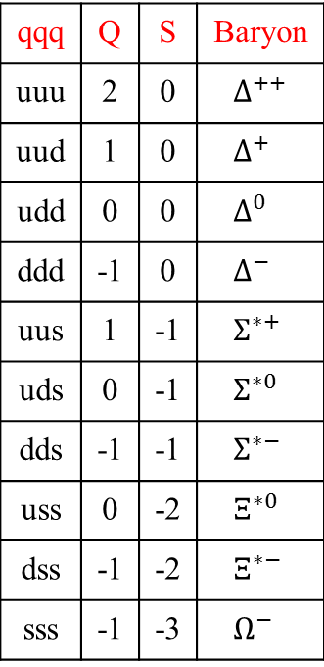
Fractional Charges and Unseen Quarks
Murray Gell-Mann and George Zweig proposed the idea of the quarks to find some order in the chaos of particles:
  Baryons are particles consisting of thee quarks (qqq)
  Mesons are particles consisting of a quark and anti-quark ($q\overline{q}$)
qqq | Q | S | Baryon
uuu | 2 | 0 | $${ ∆}^{++}$$
uud | 1 | 0 | $${ ∆}^{+}$$
udd | 0 | 0 | $${ ∆}^{0}$$
ddd | -1 | 0 | $${ ∆}^{−}$$
uus | 1 | -1 | $${ Σ}^{∗+}$$
uds | 0 | -1 | $${ Σ}^{∗0}$$
dds | -1 | -1 | $${ Σ}^{∗−}$$
uss | 0 | -2 | $${ Ξ}^{∗0}$$
dss | -1 | -2 | $${ Ξ}^{∗−}$$
sss | -1 | -3 | $${ Ω}^{−}$$
$$q\overline{q}$$ | Q | S | Meson
$${\left(u\overline{u}−d\overline{d}\right)}/{\sqrt{2}}$$ | 0 | 0 | $$π^{0}$$
$$u\overline{d}$$ | 1 | 0 | $$π^{+}$$
$$\overline{u}d$$ | -1 | 0 | $$π^{−}$$
$$u\overline{s}$$ | 1 | -1 | $$K^{+}$$
$$d\overline{s}/s\overline{d}$$ | 0 | -1 | $$K^{0}$$
$$s\overline{u}$$ | -1 | -1 | $$K^{−}$$
$${≈\left(u\overline{u}+d\overline{d}−2s\overline{s}\right)}/{\sqrt{6}}$$ | 0 | -2 | $$η$$
$$≈{\left(u\overline{u}+d\overline{d}+s\overline{s}\right)}/{\sqrt{3}}$$ | 0 | -2 | $$η′$$

Slide 8
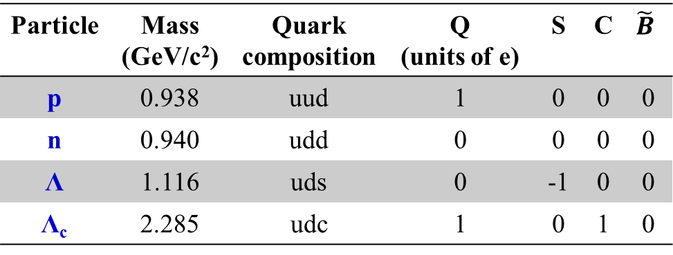
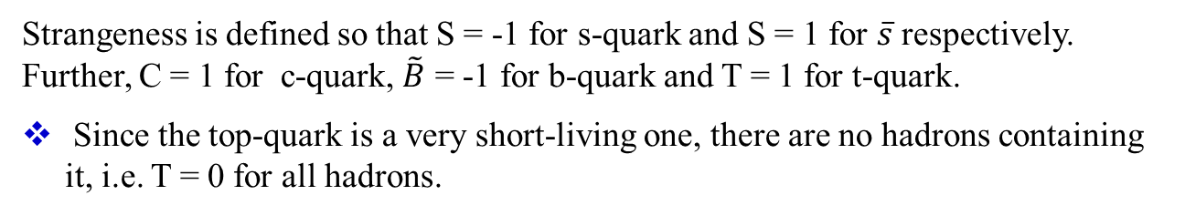
Some Examples of Baryons
Particle | Mass (GeV/c²) | Quark composition | Q (units of e) | S | C | $$\tilde{B}$$
p | 0.938 | uud | 1 | 0 | 0 | 0
n | 0.940 | udd | 0 | 0 | 0 | 0
Λ | 1.116 | uds | 0 | -1 | 0 | 0
Λ_{c} | 2.285 | udc | 1 | 0 | 1 | 0
Strangeness is defined so that S = -1 for s-quark and S = 1 for $\overline{s}$ respectively. Further, C = 1 for c-quark, $\tilde{B}$ = -1 for b-quark and T = 1 for t-quark.
Since the top-quark is a very short-living one, there are no hadrons containing it, i.e. T = 0 for all hadrons.
Quark numbers for up and down quarks have no name, but just like any other flavour, they are conserved in strong and electromagnetic interactions.
Baryons are assigned own quantum number B. B = 1 for baryons, B = -1 for antibaryons and B = 0 for mesons.

Slide 9
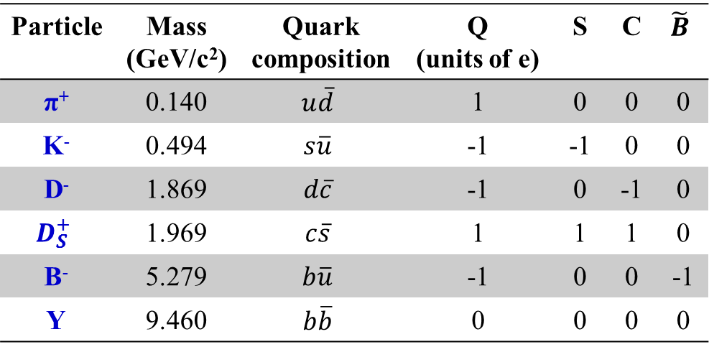
Some Examples of Mesons
Particle | Mass (GeV/c²) | Quark composition | Q (units of e) | S | C | $$\tilde{B}$$
π⁺ | 0.140 | $$u\overline{d}$$ | 1 | 0 | 0 | 0
K⁻ | 0.494 | $$s\overline{u}$$ | -1 | -1 | 0 | 0
D⁻ | 1.869 | $$d\overline{c}$$ | -1 | 0 | -1 | 0
$$D_{S}^{+}$$ | 1.969 | $$c\overline{s}$$ | 1 | 1 | 1 | 0
B⁻ | 5.279 | $$b\overline{u}$$ | -1 | 0 | 0 | -1
Y | 9.460 | $$b\overline{b}$$ | 0 | 0 | 0 | 0
Majority of hadrons are unstable and tend to decay by the strong interaction to the state with the lowest possible mass (lifetime about 10⁻²³ s).
Hadrons with the lowest possible mass for each quark number (S, C, etc.) may live significantly longer before decaying weakly (lifetimes 10⁻⁷ – 10⁻¹³ s). Such hadrons are called stable particles.

Slide 10
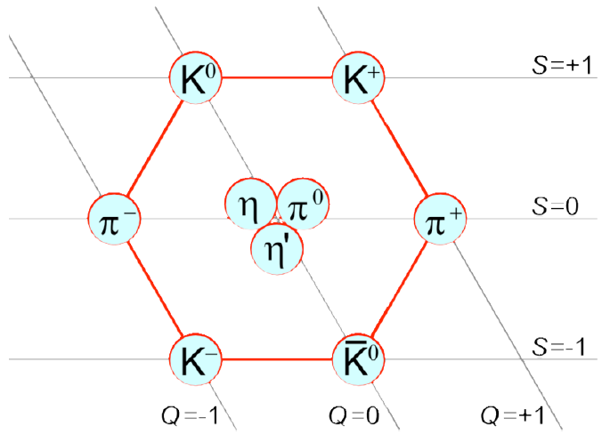
J = 0 Meson Octet

Slide 11
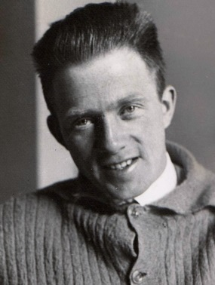
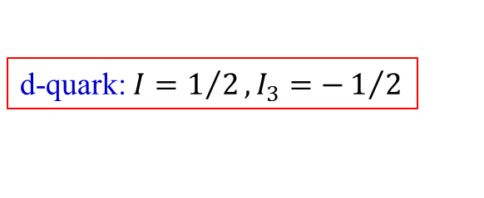
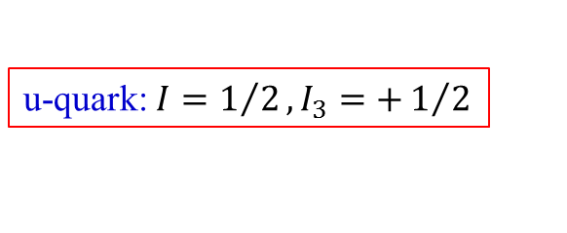
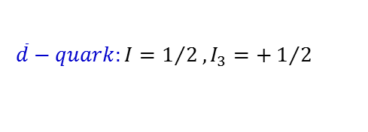
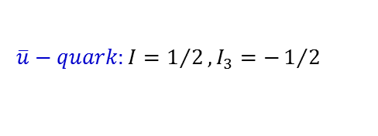
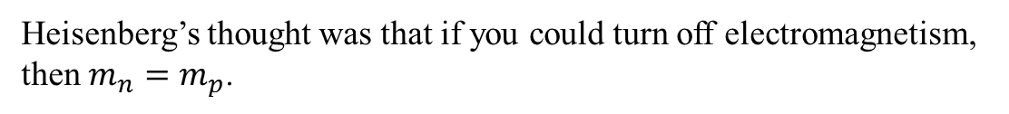
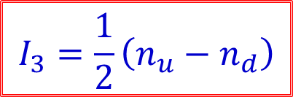
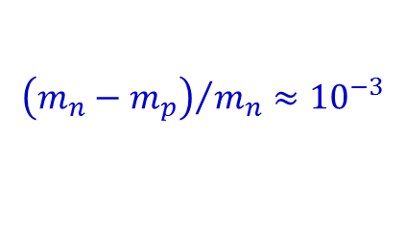

Isospin
Isospin was invented by Heisenberg to explain the apparent fact that the strong interaction does not distinguish between neutron and proton.
$${\left(m_{n}−m_{p}\right)}/{m_{n}}≈{10}^{−3}$$
Heisenberg’s thought was that if you could turn off electromagnetism, then $m_{n}=m_{p}$.
Werner Heisenberg
We now believe that the isospin symmetry is due the near equality of the up and down quarks $\left(m_{u}≈m_{d}\right)$.
We postulate that Isospin is conserved in the strong interaction, but not in the electromagnetic (or weak) interaction.
u-quark: $I=1/2, I_{3}=+1/2$
$$I_{3}=\frac{1}{2}\left(n_{u}−n_{d}\right)$$
d-quark: $I=1/2, I_{3}=−1/2$
all other quarks have $I=0$
$$\overline{u}−quark:I=1/2, I_{3}=−1/2$$
$$\overline{d}−quark:I=1/2, I_{3}=+1/2$$

Slide 12
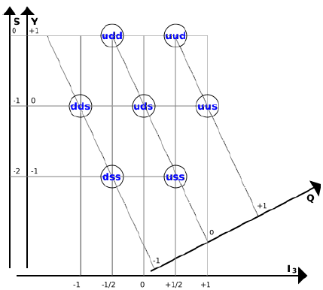
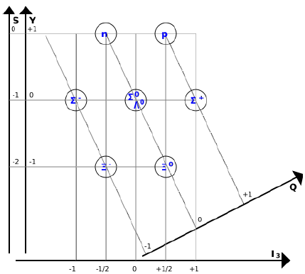



I = ½ Baryon Octet
Strangeness (S): $S=−\left(n_{s}−n_{\overline{s}}\right)$
Hypercharge (Y): $Y=2∙\left(Q−I_{3}\right)$
Electric charge (Q):
Isospin (I₃): $I_{3}=\frac{1}{2}∙\left(n_{u}−n_{d}\right)$

Slide 13
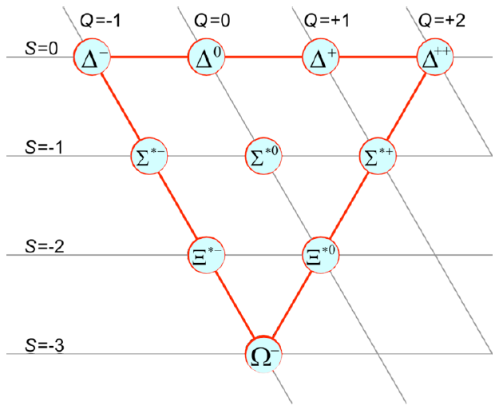
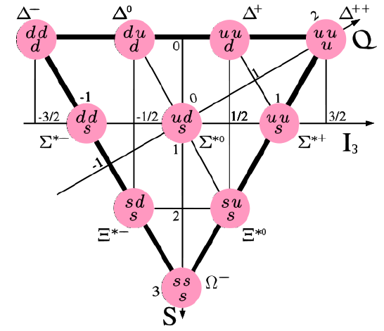
I = 3/2 Baryon Decouplet
Strangeness (S): $S=−\left(n_{s}−n_{\overline{s}}\right)$
Hypercharge (Y): $Y=2∙\left(Q−I_{3}\right)$
Electric charge (Q):
Isospin (I₃): $I_{3}=\frac{1}{2}∙\left(n_{u}−n_{d}\right)$

Slide 14
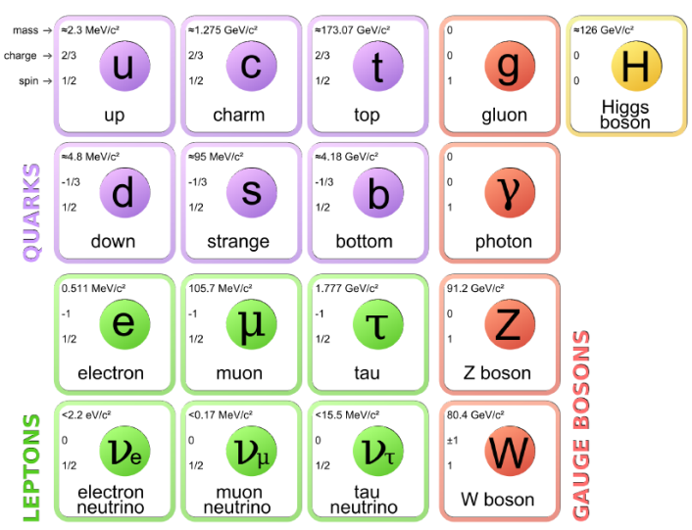
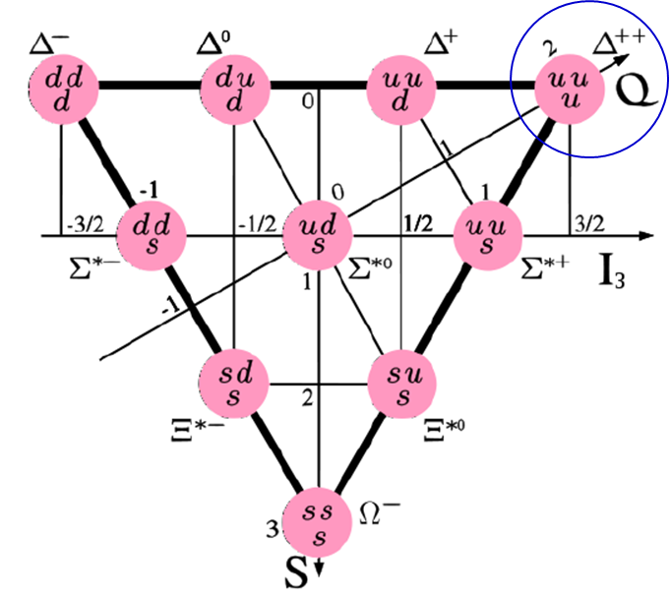
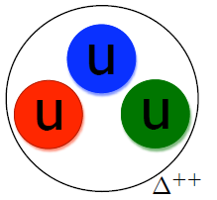
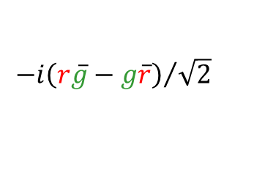
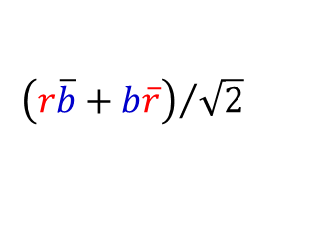
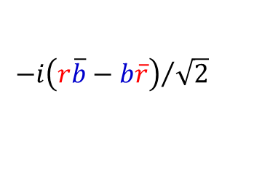
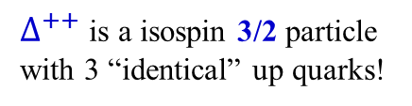
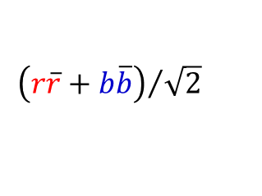
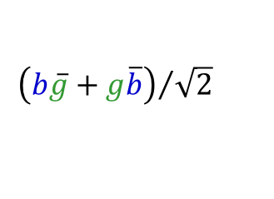
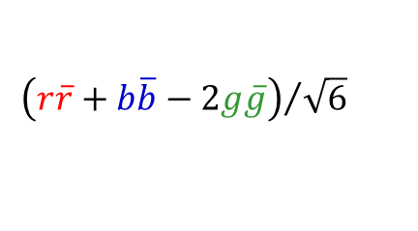
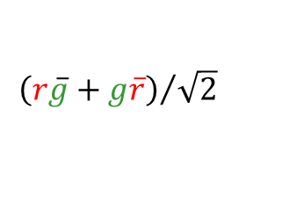
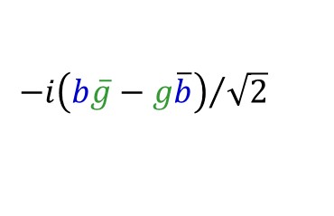
Why colored Quarks?
Three Generations
I II III
Force
Carriers
$∆^{++}$ is a isospin 3/2 particle with 3 “identical” up quarks!
Strong Interactions
Electromagnetism
Weak Interactions
Eight gluon colors
Pauli principle
$${\left(r\overline{b}+b\overline{r}\right)}/{\sqrt{2}}$$
$${−i\left(r\overline{b}−b\overline{r}\right)}/{\sqrt{2}}$$
$${\left(r\overline{g}+g\overline{r}\right)}/{\sqrt{2}}$$
$${−i\left(r\overline{g}−g\overline{r}\right)}/{\sqrt{2}}$$
$${\left(b\overline{g}+g\overline{b}\right)}/{\sqrt{2}}$$
$${−i\left(b\overline{g}−g\overline{b}\right)}/{\sqrt{2}}$$
$${\left(r\overline{r}+b\overline{b}\right)}/{\sqrt{2}}$$
$${\left(r\overline{r}+b\overline{b}−2g\overline{g}\right)}/{\sqrt{6}}$$

Slide 15
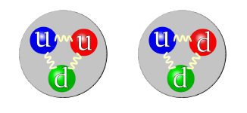
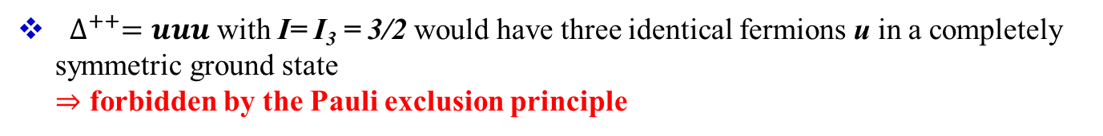
Why Quarks need Color?
Combinations as proton $\left(uud\right)$ and neutron $\left(udd\right)$
$∆^{++}=uuu$ with I= I₃ = 3/2 would have three identical fermions u in a completely symmetric ground state
$⇒$ forbidden by the Pauli exclusion principle
$⇒$ Introduction of a new quantum number for quarks: “Color”
“Color charge” has nothing to do with visible colors, it is just a convenient naming convention for a mathematical system physicists developed to explain their observations about quarks in hadrons.
What about the other possibilities such as $qq, \overline{q}\overline{q}$ or a single quark $q$

Slide 16
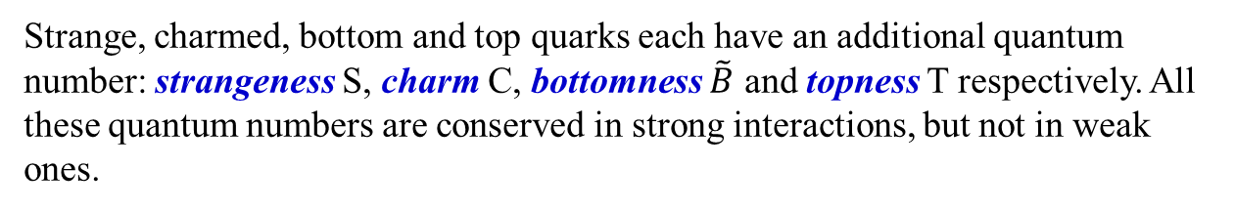
Quarks
Free quarks are not observed
There is an elegant explanation for this:
Every quark possesses a new quantum number: the color. There are three different colors, thus each quark can have three distinct color states.
Colored objects can not be observed.
Therefore quarks must confine into hadrons immediately upon appearance.
Strange, charmed, bottom and top quarks each have an additional quantum number: strangeness S, charm C, bottomness $\tilde{B}$ and topness T respectively. All these quantum numbers are conserved in strong interactions, but not in weak ones.

Slide 17
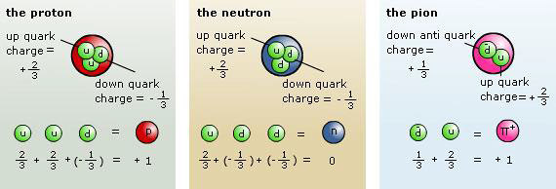
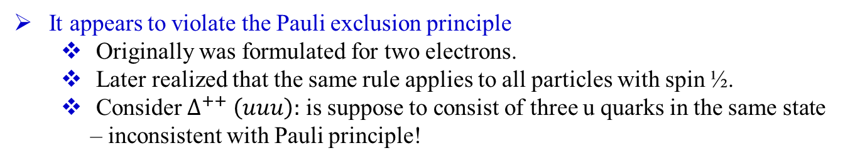
Fractional Charges and Unseen Quarks
Problems arose with introducing quarks:
  Fractional charge – never seen before
  Quarks are not observable
  Not all quark combinations exist in nature
It appears to violate the Pauli exclusion principle
  Originally was formulated for two electrons.
  Later realized that the same rule applies to all particles with spin ½.
  Consider $∆^{++} \left(uuu\right):$ is suppose to consist of three u quarks in the same state – inconsistent with Pauli principle!

Slide 18




Color charge of quarks
So one had to explain why one saw only those combinations of quarks and antiquarks that had integer charge, and why no one ever saw a $q, qq, qq\overline{q}$, or countless other combinations.
Gell-Mann and others thought that the answer had to lie in the nature of forces between quarks. This force is the so-called “strong” force, and the new charges that feel the force are called “color” charges, even though they have nothing to do with ordinary colors.
They proposed that quarks can have three color charges. This type of charge was called “color” because certain combinations of quark colors would be “neutral” in the sense that three ordinary colors can yield white, a neutral color.
Only particles that are neutral can exist, which is why only $qqq$ and $q\overline{q}$ are seen.
This also resolve the problem with Pauli principle
Just like the combination of red and blue gives purple, the combination of certain colors give white. One example is the combination of red, green and blue.

Slide 19




Color of the Quarks – Quantum Chromodynamics
Quarks come in three primary colors: red (R), green (G), blue (B)
all particle states (baryons, mesons) observed in nature are postulated to be colorless/white
this solves problem for the $∆^{++}$
explains also the existence of
  baryons (RGB)
  antibaryons $\left(\overline{R}\overline{G}\overline{B}\right)$
  mesons $\left(R\overline{R}+G\overline{G}+B\overline{B}\right)$
and that the others do not exist
Strange, charmed, bottom and top quarks each have an additional quantum number: strangeness S, charm C, bottomness $\tilde{B}$ and topness T respectively. All these quantum numbers are conserved in strong interactions, but not in weak ones.

Slide 20

Quantum Chromodynamics

Slide 21












Gluon
The force carrier between color-charged quarks is called “Gluon”
The gluon is a vector boson, like the photon, and has a spin of 1.
Gluons are carrying two colors. The eight gluon colors are:
$$\left({r\overline{b}+b\overline{r}}/{\sqrt{2}}\right)$$
$${−i\left(r\overline{b}−b\overline{r}\right)}/{\sqrt{2}}$$
$$\left({r\overline{g}+g\overline{r}}/{\sqrt{2}}\right)$$
$${−i\left(r\overline{g}−g\overline{r}\right)}/{\sqrt{2}}$$
$$\left({b\overline{g}+g\overline{b}}/{\sqrt{2}}\right)$$
$${−i\left(b\overline{g}−g\overline{b}\right)}/{\sqrt{2}}$$
$$\left({r\overline{r}−b\overline{b}}/{\sqrt{2}}\right)$$
$${\left(r\overline{r}+b\overline{b}−2g\overline{g}\right)}/{\sqrt{6}}$$
A hadron with 3 quarks (red, green, blue) before a color change
Blue quark emits a blue-antigreen gluon
Green quark has absorbed the blue-antigreen gluon and is now blue; color remains conserved
Interaction inside a neutron

Slide 22

SU(4) Flavor
4th charm quark:
J = 0
J = 1

Slide 23


Gluons and Quarks
The quarks in a given hadron madly exchange gluons. For this reason, physicists talk about the color-force field which consists of the gluons holding the bunch of quarks together.
Quarks cannot exist individually because the color force increases as they are pulled apart.
What holds the nucleus together?
Since positive protons repel each other with electromagnetic force, and protons and neutrons are color-neutral.
The strong force between the quarks in one proton and the quarks in another proton is strong enough to overwhelm the repulsive electromagnetic force.

