Slide 1
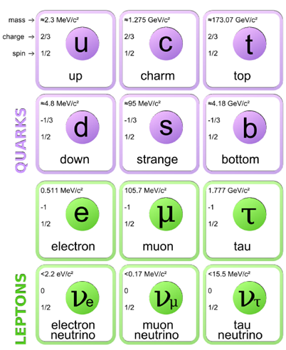
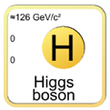
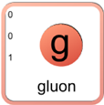
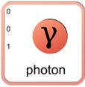
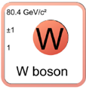
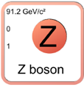

The Standard Model
1st 2nd 3rd
Describes 3 of the 4 known fundamental forces. Separates particle into categories
Bosons (force carriers)
Photon, W, Z, gluon, Higgs
Fermions (matter particles)
3 generations
Quarks (up and down type)
Leptons (charged and uncharged)
strong nuclear force
electromagnetic force
weak nuclear force
Fermions
Gauge bosons

Slide 2
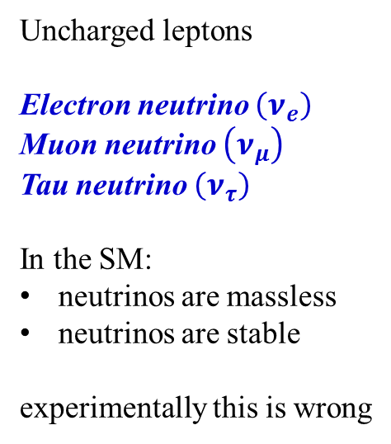
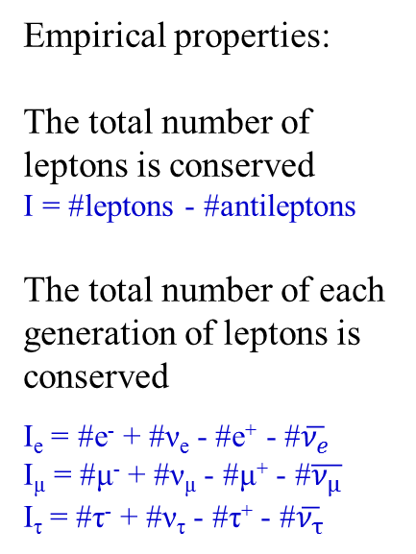
Leptons
Charged leptons
Electrically charged (-1e)
Electron (e)
Mass = 511 keV/c²
Stable
Muon (μ)
Mass = 105.7 MeV/c²
Lifetime = 2.2 μs
Tau (τ)
Mass = 1.777 GeV/c²
Lifetime = 0.29 ps
Uncharged leptons
Electron neutrino $\left(ν_{e}\right)$
Muon neutrino $\left(ν_{μ}\right)$
Tau neutrino $\left(ν_{τ}\right)$
In the SM:
neutrinos are massless
neutrinos are stable
experimentally this is wrong
Empirical properties:
The total number of leptons is conserved
I = #leptons - #antileptons
The total number of each generation of leptons is conserved
I_{e} = #e⁻ + #ν_{e} - #e⁺ - #$\overline{ν_{e}}$
I_{μ} = #μ⁻ + #ν_{μ} - #μ⁺ - #$\overline{ν_{μ}}$
I_{τ} = #τ⁻ + #ν_{τ} - #τ⁺ - #$\overline{ν_{τ}}$

Slide 3
Quarks
Each quark carries a color charge, like electric charge (+, -), but three types
Red, anti-red
Green, anti-green
Blue, anti-blue
Up type
Electric charge +2/3
Up (u)
Mass = 2.3 MeV/c²
Charm (c)
Mass = 1.27 GeV/c²
Top (t)
Mass = 173.1 GeV/c²
Down type
Electrical charge -1/3
Down (d)
Mass = 4.8 MeV/c²
Strange (s)
Mass = 95 MeV/c²
Bottom (b)
Mass = 4.2 GeV/c²
Empirical properties:
No bare color charge has ever been observed
Quarks (and gluons) are contained in composite objects that are color neutral called Hadrons
Mesons: 1 quark + 1 anti-quark
Baryons: 3 quarks

Slide 4
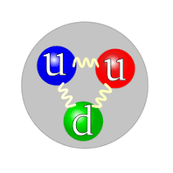
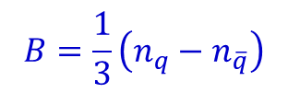
Bound States: Baryons
Baryons are color neutral objects with 3 quarks (anti-baryons have 3 anti-quarks)
Electric charge can be -1, 0, 1, 2
Examples: proton (uud), neutron (udd), Σ⁻ (dds) Σ_{c}⁺⁺ (uuc)
Only the lightest baryon (proton) is stable
Free neutrons, for example, decay to protons.
The total number of baryons is conserved!
This poses constraints on possible decays
$$B=\frac{1}{3}\left(n_{q}−n_{\overline{q}}\right)$$

Slide 5
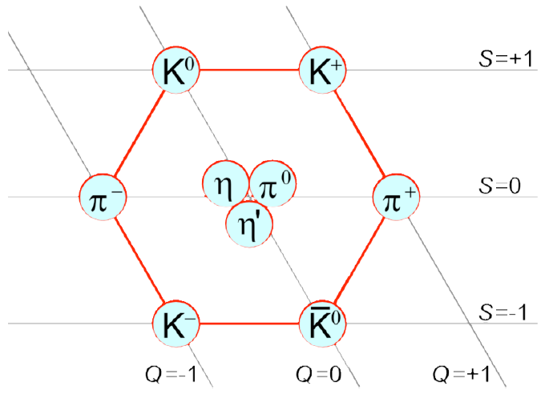
Bound States: Mesons
Mesons are composed of one quark and one anti-quark.
The quark/anti-quark pair contain the same color/anti-color (e.g. red – anti-red) → color neutral.
No conservation law for mesons → all mesons decay
Hadrons (both mesons and baryons) are found in patters, derivable from group theory.
This was used to predict many, many bound states of quarks, what we call the particle zoo.

Slide 6
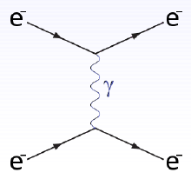
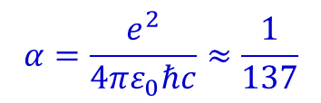
The Photon
Massless boson (γ)
Transmits electromagnetic force
Couples to electric charge but does not carry charge
Spin 1 particle
  Naively, there should be 3 spin projection states
  m_{z} = -1, 0, 1
  It turns out, m_{z} = 0 is not allowed because of special relativity (transverse nature of E&M waves)
  2 spin states → 2 polarizations
Long range force:
Because the photon is massless, it can propagate indefinitely.
Two charged particles can communicate from across the universe
Coupling strength (or strength of force) is electric charge
EM interaction always possible between charged particles, never for neutral particles
$$α=\frac{e^{2}}{4πε_{0}ℏc}≈\frac{1}{137}$$

Slide 7
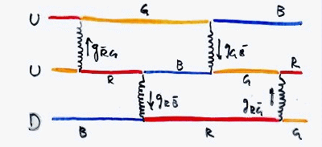
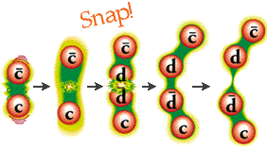
Gluons
The gluon (g) transmit the strong interaction
The spin is 1, but only two polarization states (like the photon)
Unlike the photon, the gluon carries color charge
Quarks carry color, antiquarks carry anti-color
Gluons carry both color and anti-color
8 color – anti-color states
The strong interaction gets stronger as the range increases. If you try to pull a quark free, more energy is pumped into gluons. New quark – anti-quark pair is produced.
The timescale for the strong interaction is very short ~ 10⁻²² s
Thus, lifetimes of strongly interacting particles are short
However, the strong interaction preserves quark generations!
Example: # of t + b quarks is unchanged in strong interactions
We need the weak interaction to break this rule

Slide 8
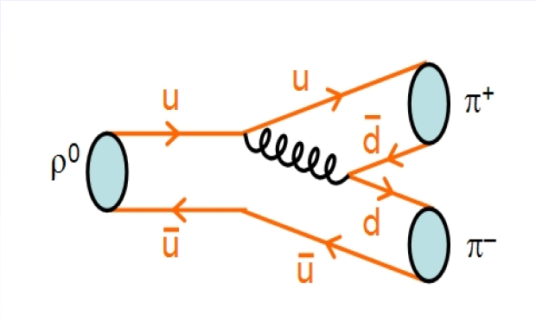
Example: Rho decay

Slide 9
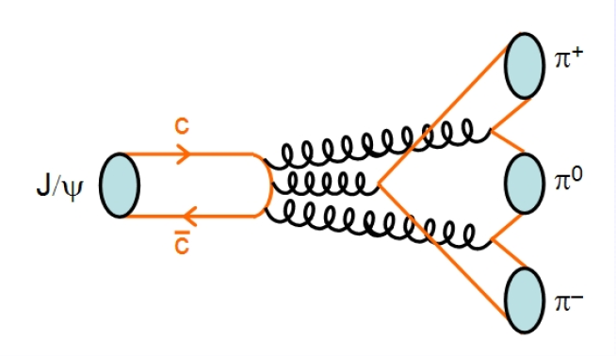
Example: J/Ψ decay
Note this is a higher order diagram, one closed loop

Slide 10
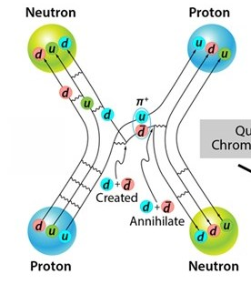
Example: Pion exchange
The force that holds the nucleus together is a special case of strong interactions
Protons and neutrons interact by exchanging π mesons (pions)

Slide 11
Weak Interaction
The W and Z bosons that transmit the weak interaction need careful discussion
They are massive m_{W} = 80.4 GeV/c² m_{Z} = 91.2 GeV/c²
Spin 1 particles, but also each with only 2 spin projection states (same as photon)
Slower interaction than Strong 10⁻⁸ – 10⁻¹³ s
Two important features of the weak interaction:
The W carries electric charge
  W⁺, W⁻
  W interactions change particle type
  Underlying processes like radioactive decay
  Only the W changes quark/lepton flavor
Massive bosons = short range force
These heavy bosons are not long lived
They do not propagate freely
Interactions can only happen over a distance ~ 10⁻¹⁶ m or less
This makes the force effectively very weak
The Z is electrically neutral
  Coupling/timescale the same as W

Slide 12
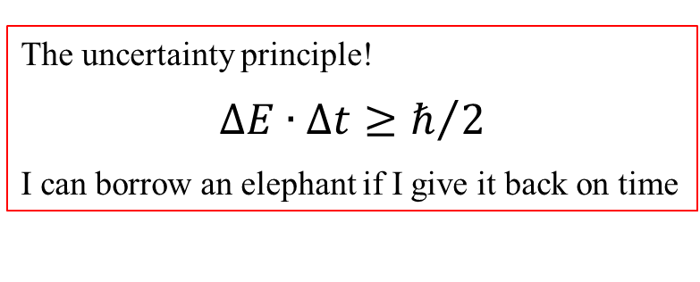
Why is the Weak Force weak?
In E&M, the photon didn’t require any mass energy.
But in weak interactions, the W and Z bosons do require mass energy
How does that happen for low energy particles?
The uncertainty principle!
$$ΔE∙∆t≥ℏ/2$$
I can borrow an elephant if I give it back on time
If two particles are close enough, they can “borrow” energy to create a Z or W boson just long enough to transmit the force

Slide 13
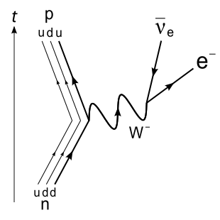
Example: Beta Decay
A neutron (udd) changes to a proton (uud) by emitting a W- boson, which decays into an electron and an anti-neutrino

Slide 14
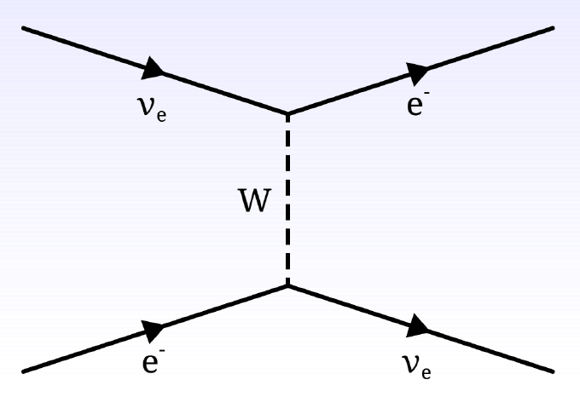
Example: Neutrino – Electron Scattering

Slide 15
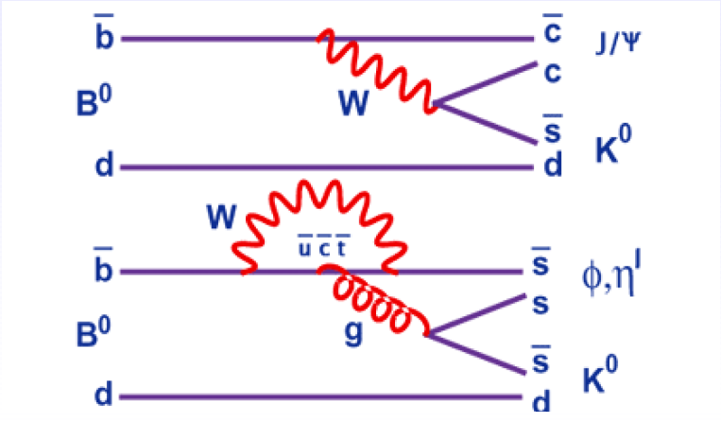
Example: B-Meson Decay

Slide 16
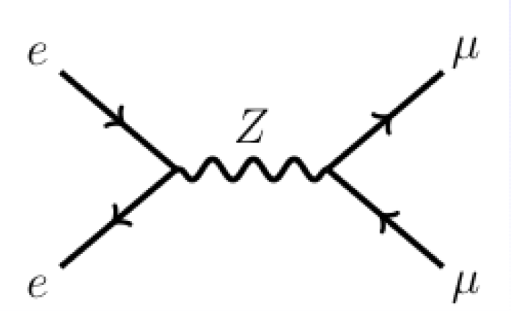
Example: Electron – Positron Scattering

Slide 17
Summary
The three forces described by the standard model:
Include all the known fundamental fermions
Leptons
Quarks
Interactions governed by boson exchange
  Photons
  - Long range, coupled to electric charge
  Gluons
  - Couple to and carry color charge
  - Force gets stronger as quarks are pulled apart
  - Only color neutral composite objects
  W/Z
  - W is electrically charged
Charge flavor (quark and lepton generations)
The Higgs boson
  Related to unification of the electromagnetic and weak interactions
  Responsible for particle masses

Slide 18
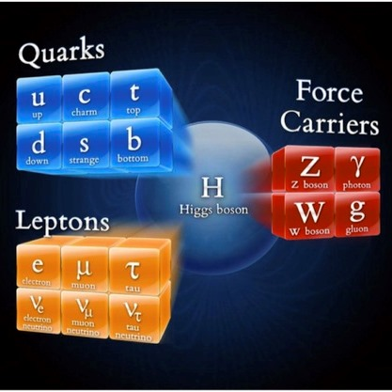
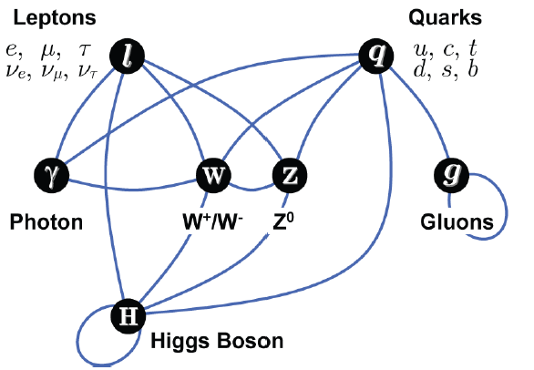
The Standard Model of Elementary Particles

Slide 19
Open Questions
Why are the masses of the particles what they are?
• Why are there 3 generations of fermions?
• Are quarks and leptons truly fundamental?
• Why is the charge of the electron exactly opposite to that of the proton.
Or: why is the total charge of leptons and quarks exactly equal to 0?
• Is a neutrino its own anti-particle?
• Can all forces be described in a single theory (unification)?
• Why is there no anti-matter in the universe?
• What is the source of dark matter?
• What is the source of dark energy?

