Slide 1
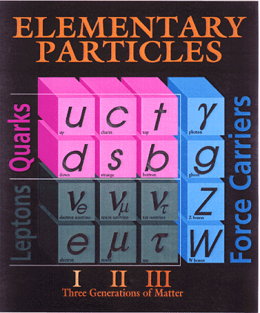
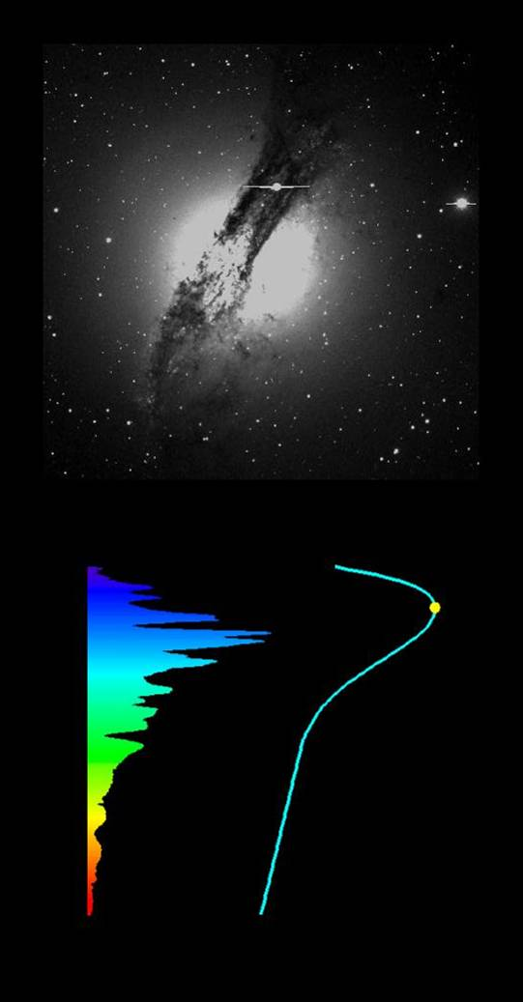
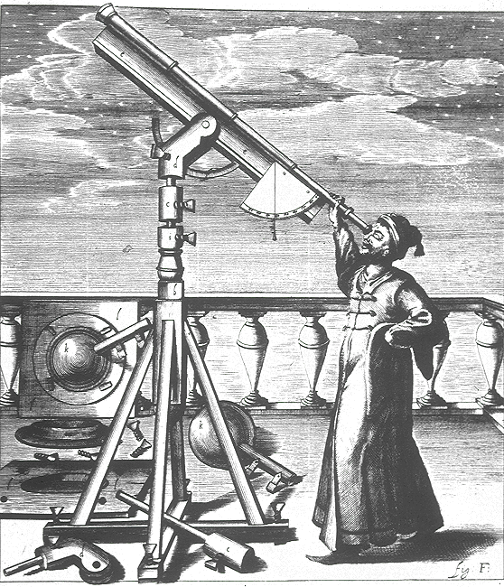
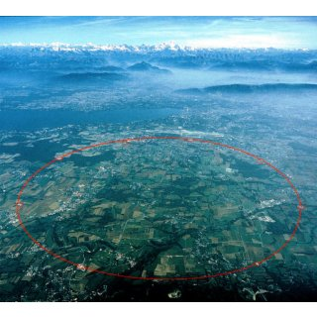
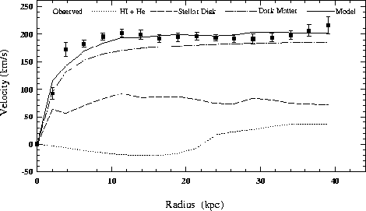
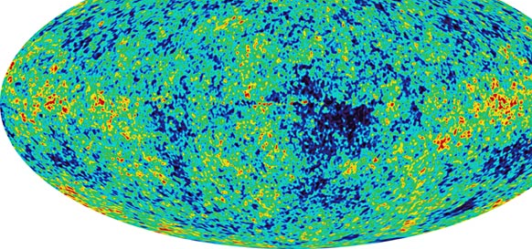
Beyond the Standard Model

Slide 2
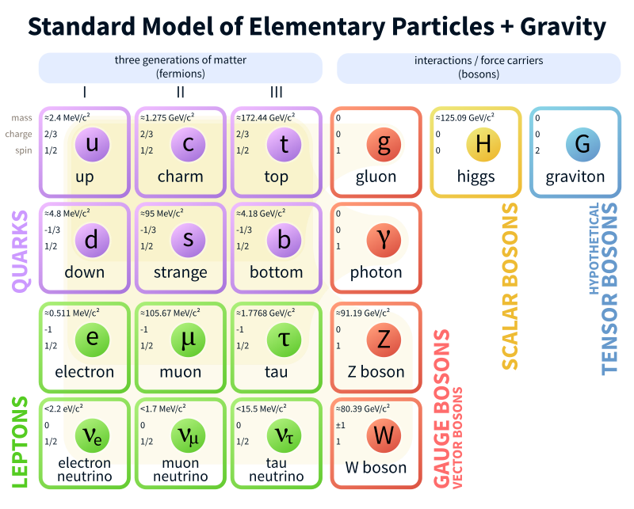
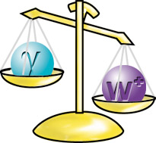
Beyond the Standard Model
The Standard Model is an incomplete theory. It cannot explain why a particle has a certain mass.
Physicists have theorized the existence of the so-called Higgs field, which in theory interacts with other particles to give them mass. The Higgs field requires a particle, the Higgs boson.

Slide 3

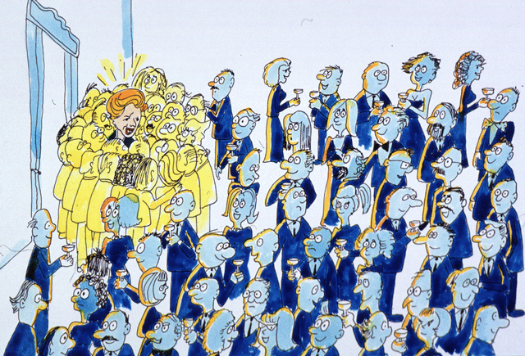
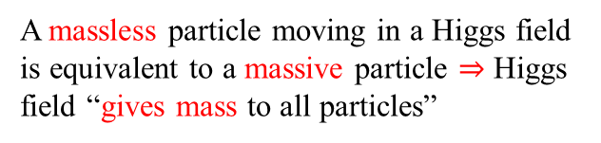
The Higgs Boson
A massless particle moving in a Higgs field is equivalent to a massive particle $⇒$ Higgs field “gives mass to all particles”

Slide 4



Higgs Mechanism
To understand the Higgs mechanism, imagine that a room full of physicists chattering quietly is like space filled with the Higgs field …
… a well-known scientist walks in, creating a disturbance as he moves across the room and attracting a cluster of admirers with each step …
… this increases his resistance to movement, in other words, he acquires mass, just like a particle moving through the Higgs field…

Slide 5


Higgs Mechanism
… if a rumor crosses the room, …
… it creates the same kind of clustering, but this time among the scientists themselves. In the analogy, these clusters are the Higgs particles.

Slide 6
Beyond the Standard Model
The Standard Model is an incomplete theory. It does not adequately explain:
Gravity (graviton simply added)
Dark matter (26%) and dark energy (69%)
Matter – antimatter asymmetry (should be equal)
Mass of neutrinos (what was their role in the formation of the universe?)
Superconductivity (how does high T_{c} work?)
Quantum theory of gravity (is there a QTG that can describe the universe we live in?
Number of dimensions in a fundamental theory of nature.

Slide 7
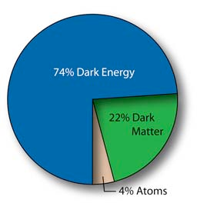
What is the Universe really made of?
Particle physicist’s answer: stable particles – protons, neutrons, electrons, neutrinos
(Why not antiprotons, positrons, etc.? another puzzle – may be next time?)
But astronomical observations indicate that the known particles make only about 4% of the stuff in the Universe!

Slide 8
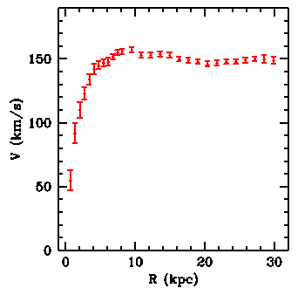

What is Dark Matter?
The first evidence for dark matter was obtained in the 1930s when Zwicky and Smith looked at the velocities of galaxies within clusters and found that they were 10 to 100 times larger than expected from the visible mass. Larger velocities indicate larger gravitational forces ⇒ larger masses than are visible.
This, however, was not strong enough evidence. These observations were particularly susceptible to systematic errors from galaxies that are not truly bound within the cluster, or from galaxies in the foreground.
Not until the 1970s, when Rubin, Freeman, and others looked at the “rotation curves” of galaxies, was strong evidence obtained.
Dark matter can have several types of sources. Dark matter could be composed of
everyday material (protons, neutrons, and electrons) in forms such as planet-sized objects, or as brown dwarf stars. Or it could be composed of other known particles, such as neutrinos. However, as we will discuss next week, results over the past decade indicate the majority of DM is likely to be neither of these two cases. Instead, it strongly appears that dark matter is something exotic and unknown.
Vera Rubin

Slide 9
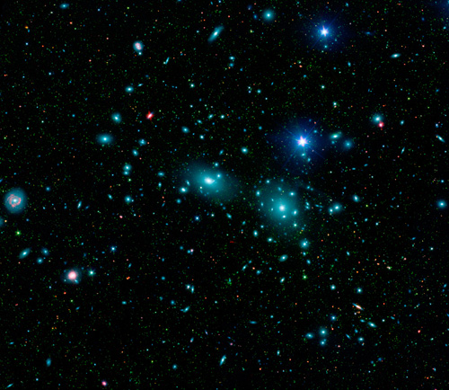
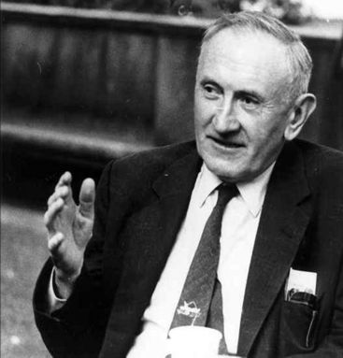
What is Dark Matter?
Coma Cluster: By measuring the velocities of all these galaxies Fritz Zwicky realized that galaxies toward the edge of the cluster were moving far too fast.
Fritz Zwicky: Die Rotverschiebung von Extragalaktischen Nebeln
(The redshift of extragalactic nebulae) Helv. Phys. Acta 6 (1933) 110
In order to obtain, as observed, a medium-sized Doppler effect of 1000 km/s or more, the average density in the Coma system would have to be at least 400 times greater than that derived on the basis of observations of luminous matter. If this should be verified, it would lead to the surprising result that dark matter exists in much greater density than luminous matter.

Slide 10
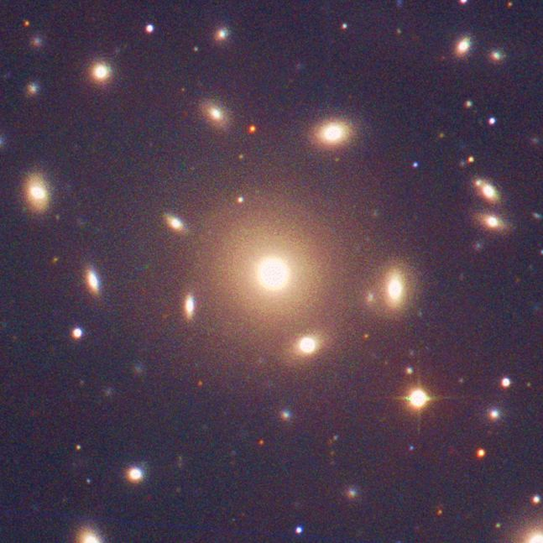
What is Dark Matter?
A gravitational bound
system of many ‘particles’
follows the Virial theorem
Velocity measurement
via Doppler effect of at
least three spectral lines
Coma Cluster
Mass estimate

Slide 11
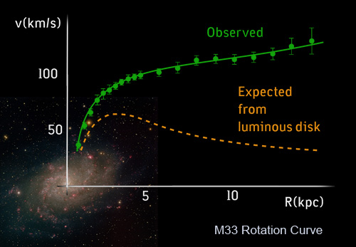
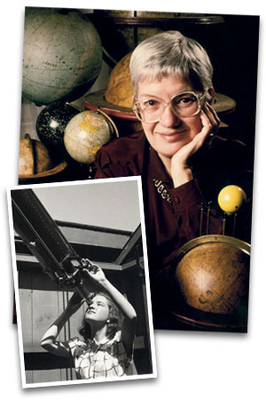

What is Dark Matter?
Keplerian prediction:
Vera Rubin
$$m∙\frac{v^{2}}{r}=f∙\frac{m∙M}{r^{2}} → v^{2}=f∙\frac{M}{r}$$
Fritz Zwicky: Die Rotverschiebung von Extragalaktischen Nebeln
(The redshift of extragalactic nebulae) Helv. Phys. Acta 6 (1933) 110
In order to obtain, as observed, a medium-sized Doppler effect of 1000 km/s or more, the average density in the Coma system would have to be at least 400 times greater than that derived on the basis of observations of luminous matter. If this should be verified, it would lead to the surprising result that dark matter exists in much greater density than luminous matter.

Slide 12
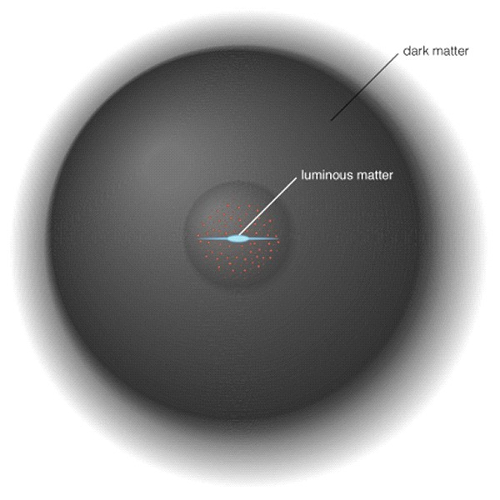
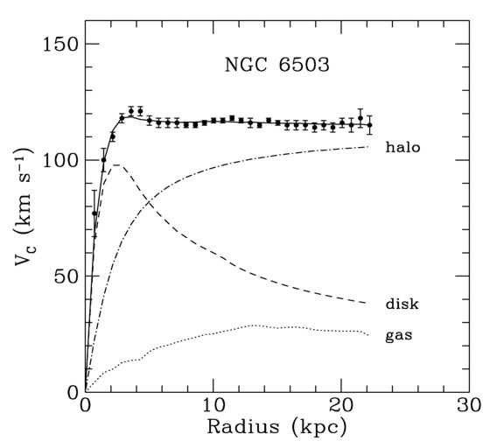
What is Dark Matter?
Dark matter in the Halo around a Galaxy
Dark matter ~ 10x visible mass
Observed flat rotation curve
Expected due to the distribution of the visible matter
Vera Rubin

Slide 13
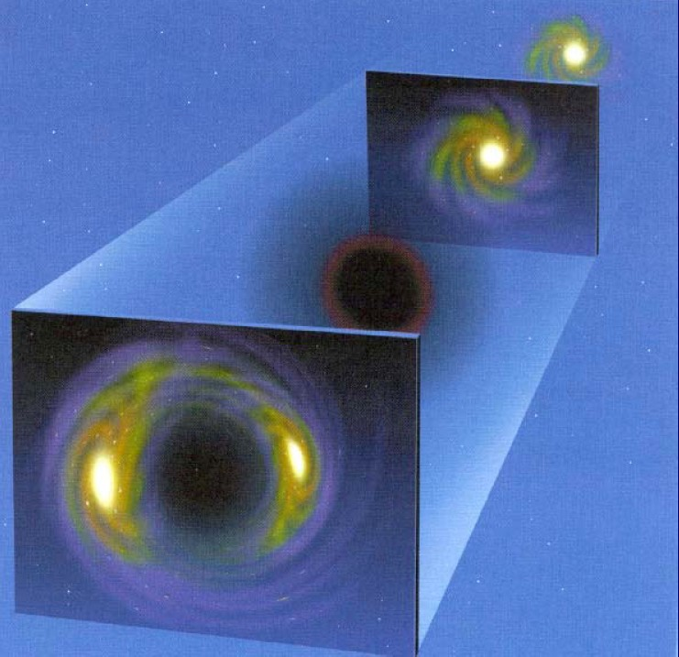
Einstein ring
It is the deformation of light from a source (such as a galaxy or star) into a ring through gravitational lensing of the source’s light by an object with an extremely large mass.

Slide 14
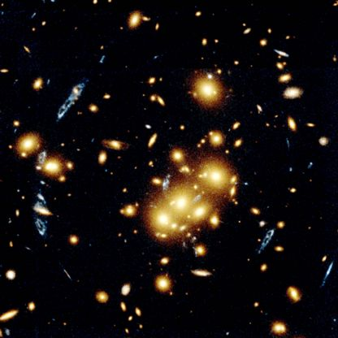
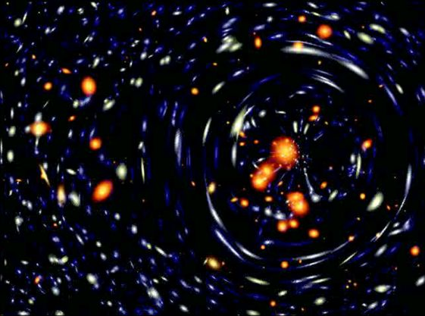

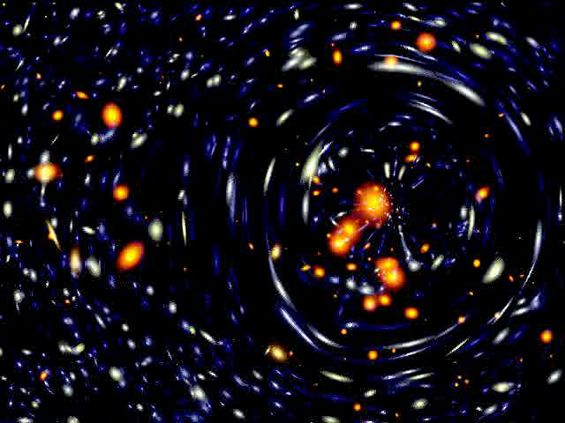
Gravitational lensing effect
Galaxy Cluster Cl 0024+1654
[Hubble Space Telescope]
numerical simulation

Slide 15
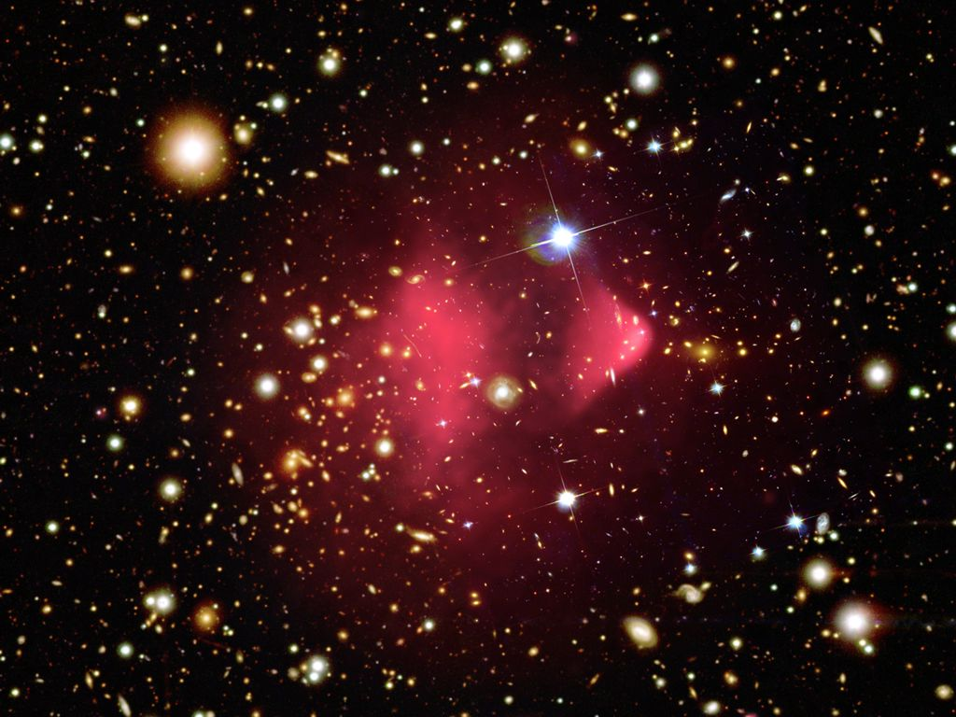
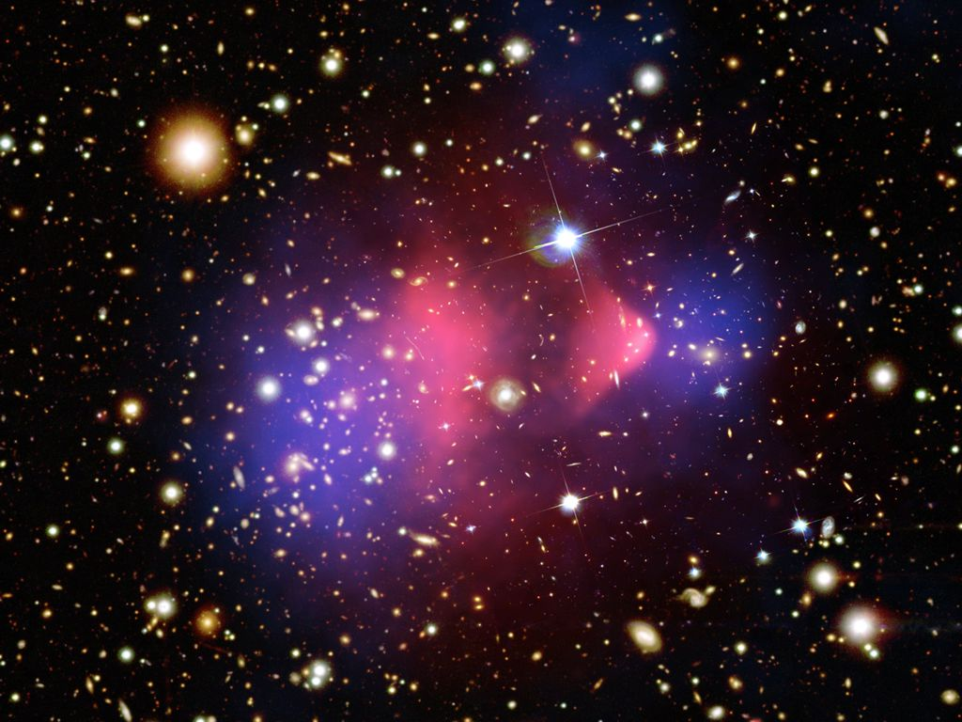
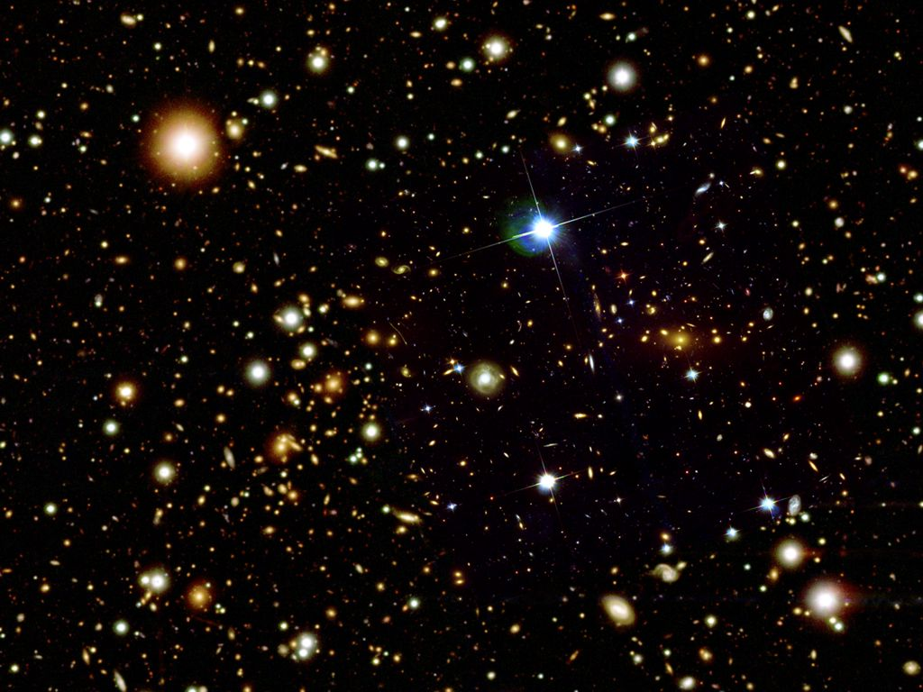
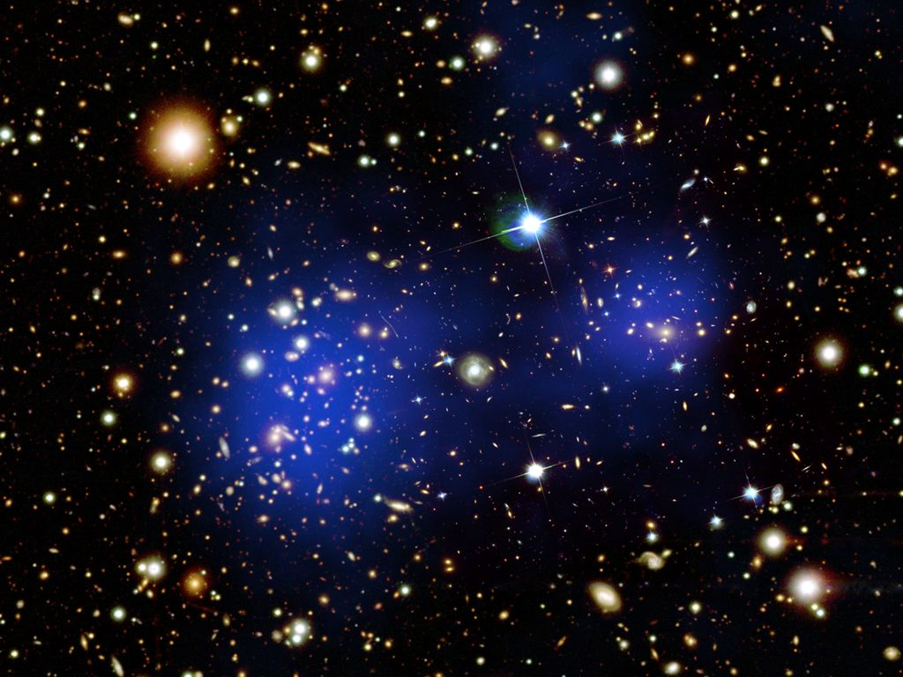
Gravitational lensing effect
Bullet Cluster (1E 0657-56)
Crash of galaxy clusters: Dark matter (blue) creating most of the gravitational potential separated from normal matter (pink).

Slide 16
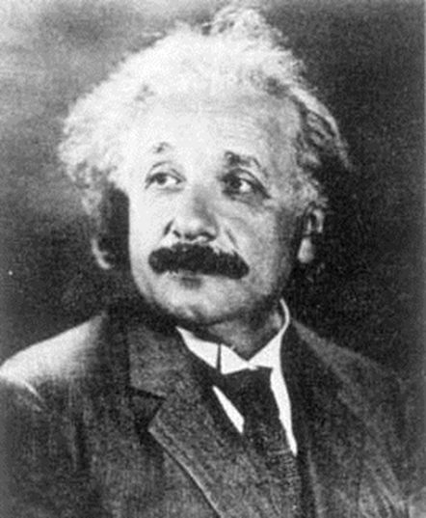
What is Dark Energy?
In Einstein’s General Theory of Relativity, Einstein included a term called the “Cosmological Constant,” which represents the energy density of empty space. If the universe were static (as Einstein thought it was at the time), the cosmological constant must be nonzero in order to counterbalance the attraction of matter in the universe.
In 1929, when Hubble found the universe to be not static, but expanding, Einstein threw away this term.
Later on, in the 60’s and 70’s, when people such as Zel’dovich tried to combine quantum field theory and GR, they noted that this energy of empty space should not be zero, but actually unphysically enormous, due to quantum fluctuations (actually creation and annihilation of particle-antiparticle pairs) that continuously occur within the vacuum. This is the so-called “Cosmological Constant Problem.” It still really has no good answer, however things have changed…
Until the last 5 years, it was thought that there just had to be something – some unknown symmetry of nature – that was offsetting the enormous cosmological constant and causing it to cancel out to zero. After all, the entire body of experimental evidence was consistent with a zero cosmological constant…

Slide 17
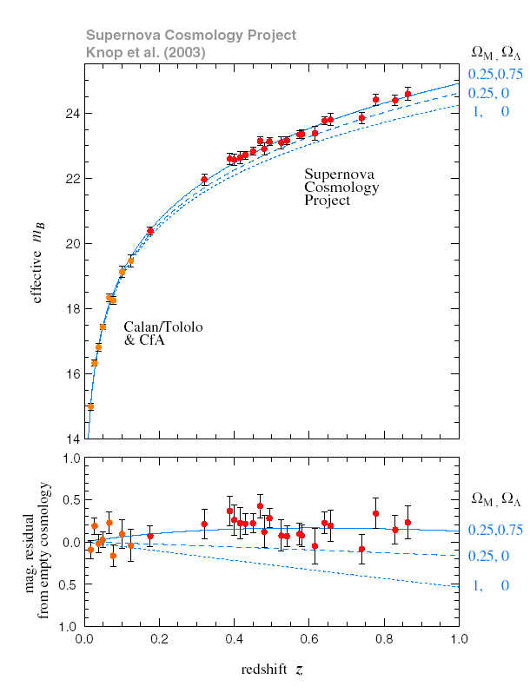
What is Dark Energy?
But in the 1990s evidence began to suggest that there might be a nonzero cosmological constant. Experiments that look at the cosmic microwave background (CMB) were obtaining data that was consistent with there being just enough energy density in the universe so that the universe is “flat” (too much and the universe would be “closed,” too little and it would be “open”). But experiments looking at galactic cluster densities and gravitational lensing were finding only enough matter (dark + light) to account for about 1/3 of this energy density. Where was the extra energy?
In 1999, two experiments looking at distant supernovae reported groundbreaking results. The expansion of the universe that they were measuring appeared to be accelerating. This was consistent with a small, but nonzero, positive cosmological constant that accounted for the difference above.
The fact that this is still completely inconsistent with the quantum mechanical expectation leads people to believe that there could be more to this than just a cosmological constant. Hence the name “Dark Energy.” Nobody knows why the expansion of the universe is accelerating…

Slide 18
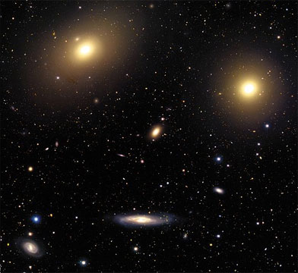
What is Dark Energy?
Big Bang Cosmology: Albert Einstein (1879-1955)
Prediction: The universe is expanding
Observation: Galaxies are moving apart from each other (1929)
Red-shift of the spectral lines in stars (Doppler effect)

Slide 19
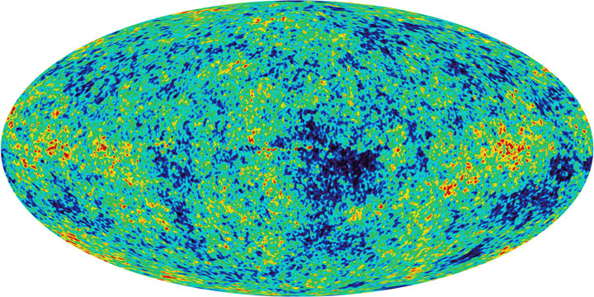
What is Dark Energy?
Testing the Big Bang model
Prediction: If the universe was denser, hotter, in past, we should see evidence of left-over heat from early universe
Observation: Left-over heat from the early universe (Penzias and Wilson, 1965)

Slide 20
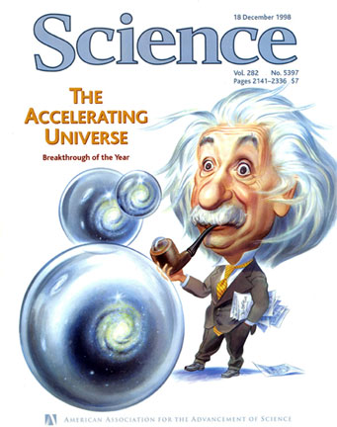
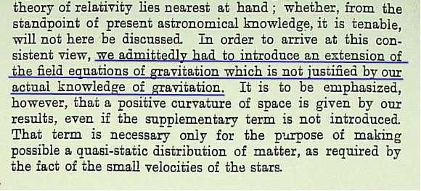
What is Dark Energy?
Testing the Big Bang model
Observation: Expansion is accelerating.
Refine: Extra energy content.
A recent discovery and of unknown origin, the concept of Dark Energy is actually an integral part of Einstein’s theory of gravity.

Slide 21
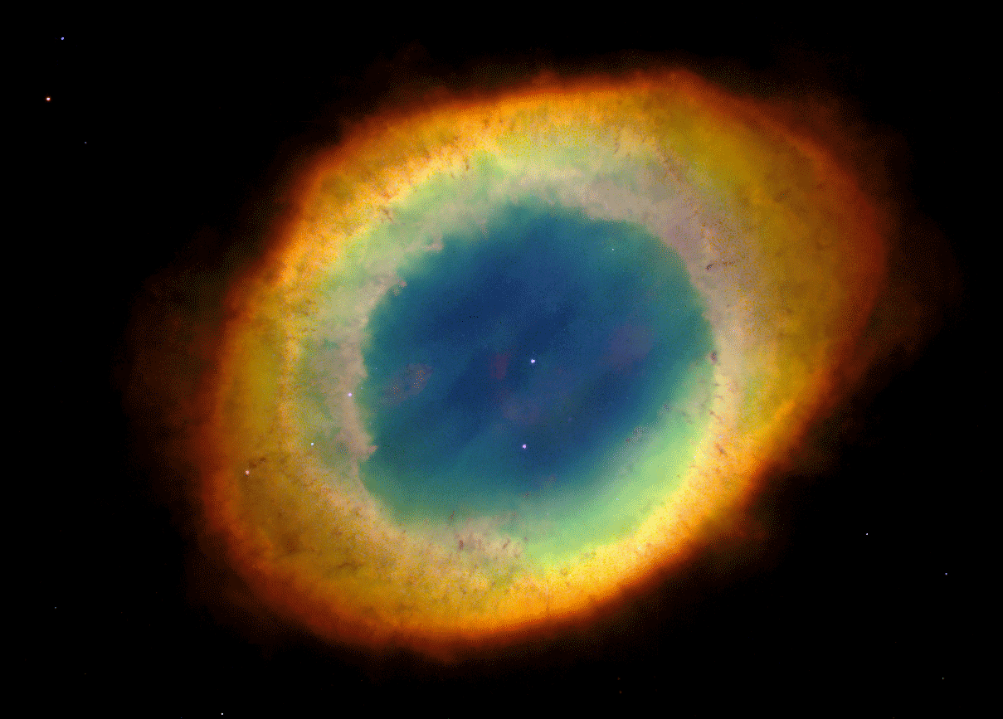
Evidence for Dark Energy
A dying star becomes a white dwarf.

Slide 22
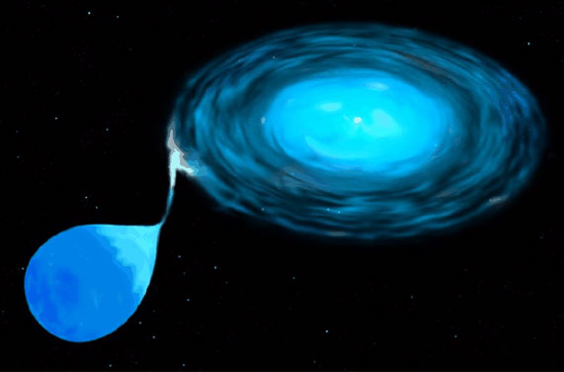
Evidence for Dark Energy
The white dwarf strips gas from its stellar companion …

Slide 23
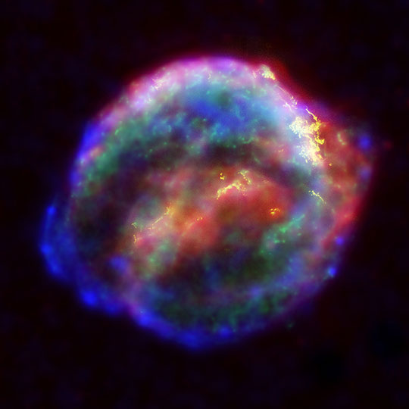
Evidence for Dark Energy
… and uses it to become a hydrogen bomb. Bang!

Slide 24
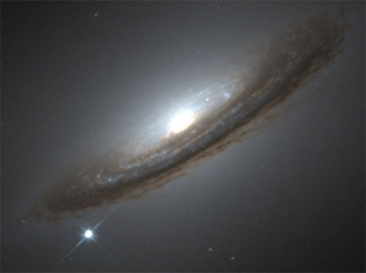
Evidence for Dark Energy
The explosion (Supernova Type Ia) is as bright as an entire galaxy of stars

Slide 25
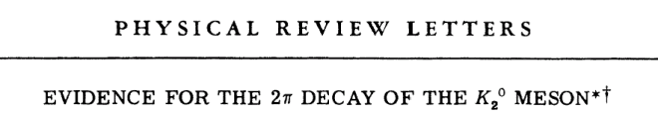
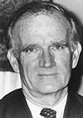
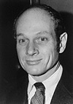
Why is there more matter than antimatter?
The existence of antimatter was predicted by Dirac in 1928 and first discovered by Anderson (positrons in cosmic rays) in 1932. Nowadays we make small amounts of antimatter in laboratories routinely (for use in colliders, PET scans, etc.).
Now note that the Big Bang was purely energy. Energy can divide into matter and antimatter, but it should divide into equal amounts… Where did all the antimatter go?
Maybe there are big clumps of antimatter elsewhere in the universe? Perhaps we are just inside a big clump of matter, and other huge parts of the universe are really made of antimatter? But experiments looking for both the photons that would be produced when particles and antiparticles annihilate at the clump boundaries, and for antiparticles that would drift across into our matter clump, see nothing. CMB data is also inconsistent with matter-antimatter clumping.
Matter-antimatter clumps (known as domains) are still being looked for, they are strongly disfavored.
Back in time. In 1964, Fitch and Cronin discovered a fundamental difference between matter and antimatter. They found that matter and antimatter behave slightly differently with respect to the weak interaction, one of the four fundamental forces of nature…
Val Fitch Jim Cronin

Slide 26
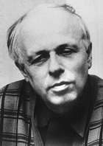
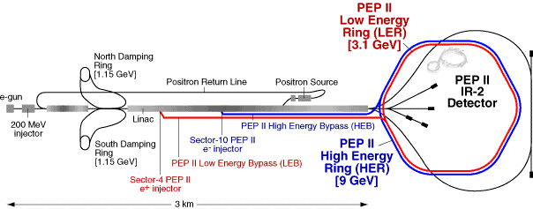
Why is there more matter than antimatter?
Was this small difference between matter and antimatter, known as “CP violation,” (short for charge-parity ) enough to explain a matter-antimatter asymmetry of the universe?
No, more is needed. In 1967, Sakharov detailed exactly what conditions need to be satisfied for a matter-antimatter asymmetry to develop in the universe. CP violation is one of them – it is necessary, but not sufficient:
Sakharov’s conditions for development of matter-antimatter asymmetry
A departure from thermodynamic equilibrium.
Non-conservation of “baryon number.”
C and CP violation.
Andrei Sakharov
The main problem is that the Standard Model of particle physics does not contain enough of these 3 conditions to explain the observed matter-antimatter asymmetry. Thus experiments, for example, BaBar (at the Stanford Linear Accelerator Center, shown at left) look for additional CP violation beyond the Standard Model. Where will it be found…?

Slide 27
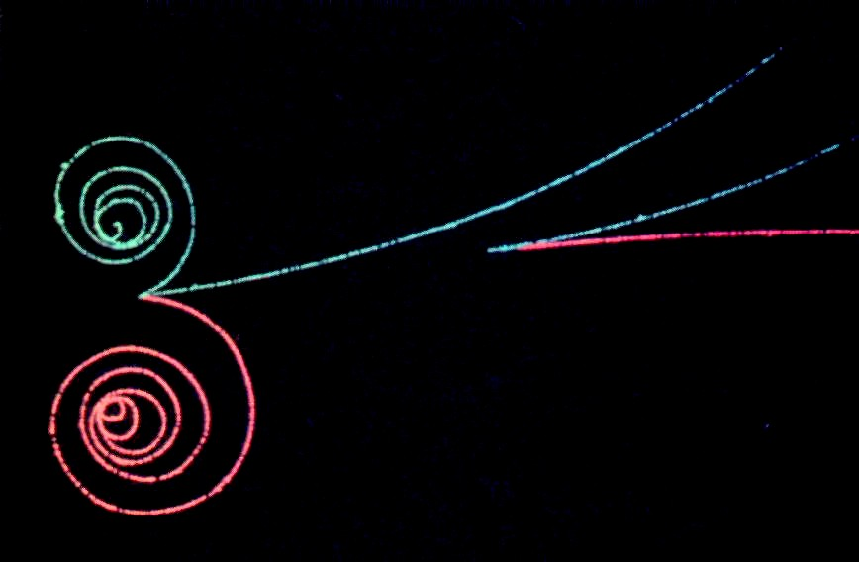

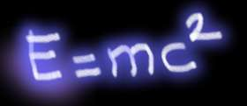

Why is there more matter than antimatter?
Dirac: Key Discovery
Relativity + Quantum Theory
⇒ ‘Antiparticles’
Paul A. M. Dirac
particle
Energy*
* gamma rays
antiparticle

Slide 28
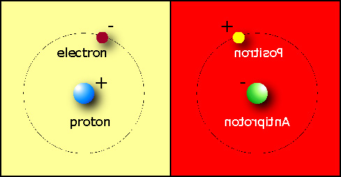
Is the Universe symmetric?
1933 Dirac (from his Nobel lecture)
“If we accept the view of complete symmetry between positive and negative electric charge so far as concerns the fundamental laws of Nature, we must regard it rather as an accident that the Earth (and presumably the whole solar system), contains a preponderance of negative electrons and positive protons.

Slide 29
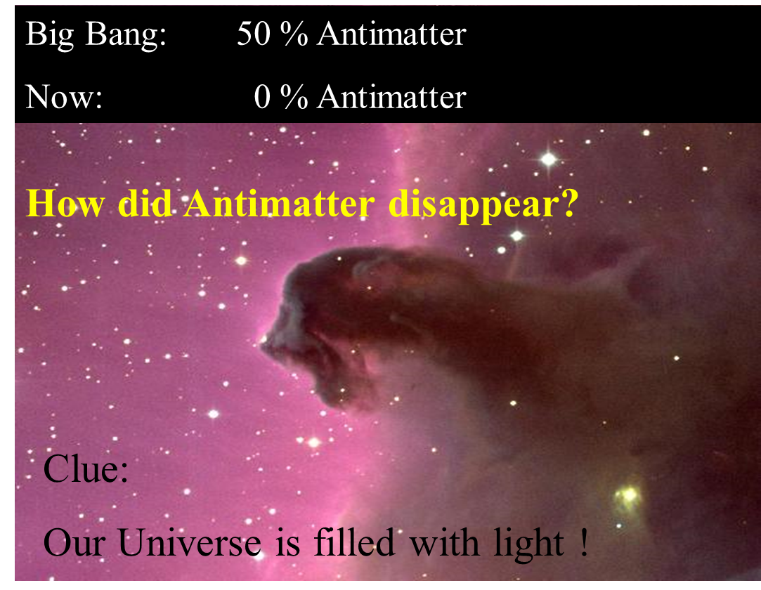
The Antimatter Mystery
Without asymmetry - we would not be here!!
What kind of asymmetry??

Slide 30
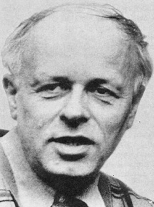
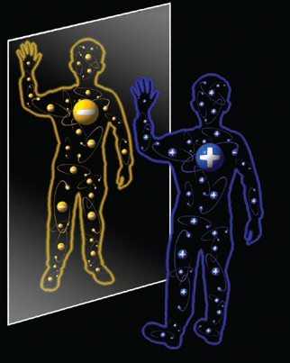
Sakharov’s Idea
Particles decay (a little) faster than antiparticles*
Small imbalance (1,000,000,001:1,000,000,000)
Occurs during cool-down of Universe
Most particle-antiparticle pairs annihilate to radiation
A.D.Sakharov
Galaxies, stars, planets, us = ‘left-over’
*For experts: this is called ‘CP violation’
When we look at our image in a standard mirror, we are looking at the parity transformation of ourselves
Notes:
CP violation is not sufficient. violation of Baryon number needed

Slide 31
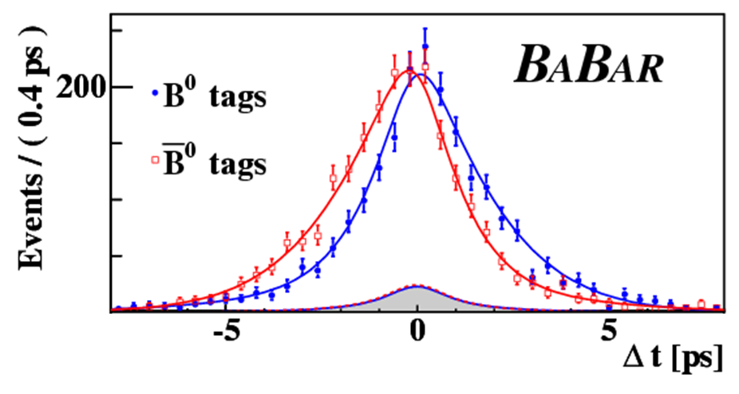
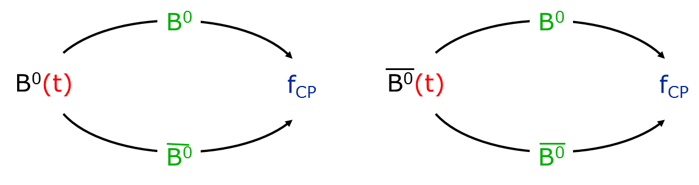


Measuring CP Violation with B⁰s
$$B^{0}=\overline{b}d$$
$$\overline{B^{0}}=b\overline{d}$$
Not equal –
CP Violation!
Stanford Linear Accelerator Center

Slide 32


How heavy are Neutrinos?
For nearly 70 years, neutrinos were thought to be massless particles…
Neutrinos were first postulated in 1930 by Wolfgang Pauli as a solution to the problem of missing energy in nuclear beta decays. A few years later, Fermi named them “neutrinos” and developed the theory of beta decay.
It was not until 1951 that neutrinos were detected directly. This is due to the fact that they tend to just pass through a detector without interacting. In fact (as you’ve undoubtedly heard) the vast majority of neutrinos can simply pass right through the Earth without interacting at all. As we now know, this is because neutrinos are not subject to either the electromagnetic interaction (because they have no electric charge) nor to the strong nuclear interaction, but only to the weak (and presumably gravitational) interactions.
Pauli & Fermi
However, neutrinos are a type of fermion. All the other fermions have mass – why not neutrinos?
  (Fermions are fundamental particles with half-integer spin – they include all 6 types of quark as well as the electron, muon, and tau leptons, and the neutrinos.)
So let’s try to detect the mass of a neutrino. How would one do this? Neutrinos are too light to, for example, look at the missing momentum in a nuclear beta decay and determine the mass through conservation of energy… However, we know that the quarks can occasionally change their flavor – quarks can mix. If (and only if) neutrinos have mass, they should be able to do this too…

Slide 33


How heavy are Neutrinos?
In 1968, Ray Davis set up a detector 4800 ft. underground in the Homestake Gold Mine in Lead, South Dakota. The detector was a 100,000 gallon tank of perchloroethane. Neutrinos from the sun can interact with the Cl atoms and produce Ar. Davis developed techniques for extracting argon atoms. He detected a shortage of solar ν_{e} 2/3 below that predicted by John Bahcall’s Standard Solar Model. Later experiments confirmed this shortage. Were the neutrinos oscillating (mixing)?
A similar deficit was observed for ν_{μ} from cosmic rays in the atmosphere. In 1998, the Super-Kamiokande detector (a 12 million gallon tank of purified water, pictured below) detected a zenith angle dependence of this shortage.
Raymond Davis, Jr.
This was very strong indication that neutrinos were oscillating, and thus had mass. In 2002, the Sudbury Neutrino Observatory detected an excess of solar ν_{τ}, complete confirmation of neutrino oscillations.
How do massive neutrinos fit into the Standard Model of particle physics? The original Standard Model, as developed in the 1970s by Glashow, Weinberg, Salam, and others, had massless neutrinos. It is not too difficult to just modify the Standard Model Lagrangian to add mass terms for the neutrinos. But, as we will discuss a few weeks from now, it’s not so simple…
How do neutrinos get their masses, and why are they so much lighter than the other particles?

Slide 34




Neutrino masses
The Standard Model was built with the assumption of massless neutrinos
No right-handed neutrinos, and then no Dirac mass
Solar neutrino problem:
$$N_{observed}≅\frac{1}{3}N_{expected}$$
Where are the missing neutrinos

Slide 35










Solar Neutrino problem
Detector
Sun
Homestake Sun Neutrino Observatory
Sun
Detector

Slide 36

Neutrino Oscillations
Electron e
Myon μ
Tau τ
e-Neutrino
μ-Neutrino
τ-Neutrino
Idea: if the neutrinos have a non-zero mass, they can interact with each other!
Assumption: Mixture of
changes the composition of the neutrino beam depending on the distance to the neutrino source.
ν_{e}
ν_{μ}
ν_{e} and ν_{μ}
composition of the beam
distance from the source
1998: Detection of oscillation between Myon- und Tau-neutrinos with methods of Super-Kamiokande (Myon-Neutrinos from the atmosphere)

Slide 37






Neutrinoless Double Beta Decay
Paul Dirac
Ettore Majorana
Fermions
particle-antiparticle pair
Neutral Particles
they are their own antiparticles
works for massless neutrinos
$$ν=\overline{ν}$$

Slide 38



How does high T_{c} superconductivity work
Superconductors were discovered in 1911 by Dutch physicist H.K. Onnes. He cooled mercury to liquid helium temperature (4 K) and saw that its resistance disappeared.
In 1933, Meissner and Ochsenfeld discovered that superconductors repel magnetic fields, the “Meissner effect.”
Onnes
An approximate theory of superconductivity was developed by Landau and Ginzburg in the early 1950s. Their work predicts the maximum magnetic field that can be applied to a superconductor before it changes state, the penetration depth of the field, and other observables.
In 1957, a more exact description of supercondutors was developed by Bardeen, Cooper, and Schrieffer. The BCS theory allows one to calculate the superconducting transition temperature
for elements and simple alloys.
With more complicated materials and higher temperatures, however, the BCS theory becomes inadequate to explain the onset of superconductivity.
Bardeen, Cooper, and Schrieffer

Slide 39




How does high T_{c} superconductivity work
In 1986, Müller and Bednorz found a ceramic compound that superconducted at 30 K, 13 degrees above the highest previously known superconductor. What was so odd about this is that the material (a compound of lanthanum, barium, copper, and oxygen) was a ceramic – normally an insulator – so people never expected such materials might be high T_{c} superconductors.
By substituting yttrium for lanthanum, such compounds exceeded 77 K, the temperature of LN2 (a major milestone since
Müller and Bednorz
LN2 is far cheaper than methods of cooling below this temperature). For the first time, concepts such as Maglev trains, superconducting magnets for accelerators, lossless power transmission, etc. became possibilities.
The current record holder is 138 K (for Hg_{0.8}Tl_{0.2}Ba₂Ca₂Cu₃O_{8.33}). How high will transition temperatures reach? Are there yet-undiscovered materials that might exceed room temperature (which
would completely revolutionize the entire electronics and power industries)? Will it ever be possible to understand high T_{c} materials on a quantitative level?

Slide 40



Superconductivity - discovery
Liquid Helium (4K) (1908)
Boiling point 4.22K
Superconductivity in Hg
$T_{C}=4.2K$ (1911)
„Mercury has passed into a new state, which on account of its extraordinary electrical properties may be called the superconducting state“
H. Kamerlingh Onnes 1913 (Nobel price 1913)
Resistivity R=0 below T_{C}; (R<10⁻²³ Ω⋅cm, 10¹⁸ times smaller than for Cu)

Slide 41


Meissner – Ochsenfeld - effect
A superconductor is a perfect diamagnet. Superconducting material expels magnetic flux from the interior.
W. Meissner, R. Ochsenfeld (1933)
On the surface of a superconductor (T < T_{C}) superconducting current will be induced. This creates a magnetic field compensating the outside one.
Magnetic levitation

Slide 42


Classical model of superconductivity
1957 John Bardeen, Leon Neil Cooper and John Robert Schrieffer
An electron on the way through the lattice interacts with lattice sites (cations). The electron produces phonon.
The lattice deformation creates a region of relative positive charge which can attract another electron.
www.superconductors.org
During one phonon oscillation an electron can cover a distance of ~10⁴Å. The second electron will be attracted without experiencing the repulsing electrostatic force .
Size of Cooper pair 100 nm
Lattice spacing 0.1 – 0.4 nm

Slide 43
Classical model of superconductivity
1957 John Bardeen, Leon Neil Cooper and John Robert Schrieffer
An electron on the way through the lattice interacts with lattice sites (cations). The electron produces phonon.
The lattice deformation creates a region of relative positive charge which can attract another electron.
During one phonon oscillation an electron can cover a distance of ~10⁴Å. The second electron will be attracted without experiencing the repulsing electrostatic force .
Size of Cooper pair 100 nm
Lattice spacing 0.1 – 0.4 nm

Slide 44


Further discoveries
1911-1986: “Low temperature superconductors” Highest T_{C}=23K for Nb₃Ge
1986 (January): High Temperature Superconductivity (LaBa)₂ CuO₄ T_{C} = 35K
K.A. Müller und G. Bednorz (IBM Rüschlikon) (Nobel price 1987)
1987 (January): YBa₂Cu₃O_{7-x} T_{C} = 93K
1987 (December): Bi-Sr-Ca-Cu-O T_{C} = 110K,
1988 (January): Tl-Ba-Ca-Cu-O T_{C} = 125K
1993: Hg-Ba-Ca-Cu-O T_{C} = 133K
(A. Schilling, H. Ott, ETH Zürich)

Slide 45
How does high T_{c} superconductivity work
In 1986, Müller and Bednorz found a ceramic compound that superconducted at 30 K, 13 degrees above the highest previously known superconductor. What was so odd about this is that the material (a compound of lanthanum, barium, copper, and oxygen) was a ceramic – normally an insulator – so people never expected such materials might be high T_{c} superconductors.
By substituting yttrium for lanthanum, such compounds exceeded 77 K, the temperature of LN2 (a major milestone since
Müller and Bednorz
LN2 is far cheaper than methods of cooling below this temperature). For the first time, concepts such as Maglev trains, superconducting magnets for accelerators, lossless power transmission, etc. became possibilities.
The current record holder is 138 K (for Hg_{0.8}Tl_{0.2}Ba₂Ca₂Cu₃O_{8.33}). How high will transition temperatures reach? Are there yet-undiscovered materials that might exceed room temperature (which
would completely revolutionize the entire electronics and power industries)?
Will it ever be possible to understand high T_{c} materials on a quantitative level?

Slide 46



Is there a testable quantum theory of gravity?
Since Einstein, theoreticians have been trying to find a quantum theory of the gravitational field – a theory that would answer questions such as what happens at the center of a black hole and in the instant after the Big Bang. Einstein himself died trying to create a unified theory of gravity and electromagnetism…
The early attempts at quantum theories of gravity always had trouble with the gravitational self-interaction at high field strengths, though.
Infinities occurred, and seemed impossible to avoid. In 1972, Deser and Van Nieuwenhuizen used a result from t’Hooft to formally show what had been suspected for a while – that gravity was non-renormalizable, ie. that it was impossible to remove the infinities if gravity is treated as a traditional quantum field theory.
Four years earlier, Veneziano developed a “dual resonance” model of the strong interaction (completely separate from gravity). Nambu, Susskind, and Nielsen soon realized that what Veneziano’s model actually represents is the quantum mechanics of vibrating strings.
In the early 70’s, Ramond, Schwarz, & others expanded this string-based field theory to include the fermions and bosons of particle physics. However, an unidentified massless, spin-2 boson kept popping up and was impossible to get rid of…
In 1974, Scherk and Schwarz realized that the spin-2 boson could represent the graviton, a single quantum of gravity. They proposed string theory as a quantum theory of the gravitational field.
John Schwarz Michael Green

Slide 47
Is there a testable quantum theory of gravity?
The announcement was largely met with silence in the physics community – primarily because a lot of questions remained to be answered. Was a string-based theory of gravity truly free of all the infinities that plagued traditional attempts at quantizing gravity? In 1981, Green and Schwarz formally proved that it was indeed free of such anomalies, and string theory began to be taken much more seriously.
In order to be free of spurious fields, string theory requires supersymmetry, which implies a doubling (at least) of the number of observable particles. All the particles we observe today should, if supersymmetry exists, have partner particles that differ only in their spin (fermions partner with bosons, and vice-versa) and their mass (the supersymmetric partners must be heavier, or we would have observed them already).
Supersymmetry has other nice attributes, in that it provides an ingredient for the unification of the other three forces (electromagnetic, weak, and strong), and the supersymmetric partner
particles provide a potential source of dark matter.
After 20 years of searching, we have not seen indication of it yet. Perhaps the partner particles just live at a higher energy than we’ve been able to measure? In order for them to help in unification, they must be of order 1 TeV or less. The Large Hadron Collider at CERN, which will be completed in 2007, will reach this level, and we will then have more definitive information on whether supersymmetry (and possibly string theory) represent reality or not.
Will string theory ever make firm predictions about particle masses, etc.? How does dark energy fit into the picture?
The LHC ring
10 km

Slide 48





How many dimensions are in a fundamental theory of the universe?
In 1921, Theodor Kaluza and Oscar Klein independently discovered that if there were an extra spacetime dimension that was periodic (ie. “curled up” into a circle), gravity and electromagnetism would automatically be unified in a single theory.
Unfortunately, this simple model predicts an additional scalar field that does not exist. However, the concept of adding additional
“compactified” dimensions to solve fundamental problems still persists…
The original version of string theory required 26 spacetime dimensions. Modern versions of string theory (M-theory) contain 11. All but 4 of these dimensions must be compactified at small scales (in a form called a Calabi-Yau manifold).
But how small are those small scales? They manifestly should be at the scale of quantum gravity, ie. the Planck scale.
But if there are extra compactified dimensions, the Planck scale is no longer necessarily down at 1.6 x 10⁻³⁵ m! Let’s say there is one extra compact dimension, curled up into radius R. We then have the gravitational potential:
$$V\left(r\right)≈\frac{G´m_{1}m_{2}}{r^{2}} \left(r≪R\right)$$
$$V\left(r\right)≈\frac{G´m_{1}m_{2}}{rR} \left(r≫R\right)$$
$$\frac{1}{m_{Planck}}∝G´≠G$$

Slide 49


How many dimensions are in a fundamental theory of the universe?
If the actual Planck scale were close to the electroweak scale, ie 1 TeV, this would have several nice features. One, the problem of why the electroweak and gravitational scales are so different (the “hierarchy problem”) would cease to exist, and two, this can result in extra dimensions that are at the millimeter scale – large enough to be probed by experiment.
Until a few years ago, the smallest scale that anyone ever probed the gravitational force law was ~1 m, in important experiments done in the 19th century by Baron von Eötvös of Hungary. Thus, if there were a different force law at smaller scales than ~1 m, no one would have known…
Recently, a variety of Eötvös-type experiments, primarily at the University of Washington, have lowered this scale to ~100 um. No evidence of extra dimension was seen at this scale.
Experiments at particle accelerators can also look for evidence of extra dimensions. An excess in the number of events with large amounts of “missing energy” – where the energy of all the visible particles does not come close to the total energy of the collision, could be a signal for the production of gravitons into an “invisible” extra dimension. Studies at the Tevatron and elsewhere are ongoing, but have not seen anything yet…

Slide 50
Some other major open questions …
A disadvantage of a course such as this is that the choice of topics to cover is always, to some degree, arbitrary. There are any number of open questions in physics, and one cannot with any certainty predict which questions will turn out to have the largest impact on physics in the future. We are leaving many important things out…
There does, however, exist some degree of general consensus in the physics community about which questions seem most important. We have attempted to choose questions that are on most physicists’ lists of critical questions.
But there are other questions that are also critical. Some extremely important ones that we are unfortunately leaving out due to time constraints are:
  Will we be able to detect gravitational waves? What impact will they have on our understanding of nature?
  Is it possible to build a quantum computer? What materials should best be employed, and how would quantum computers be used in the future?
  We understand the theory of the strong nuclear force, but we have great difficulty using it to calculate particle properties. How can one deal with the strong force and other theories that couple strongly, and use them in calculation?
  (and beyond) …?

