Slide 1

Outline: Accelerators and beam physics
Lecturer: Hans-Jürgen Wollersheim
e-mail: h.j.wollersheim@gsi.de
web-page: https://web-docs.gsi.de/~wolle/ and click on
what are accelerators used for?
relativity and units
how do we see an object
detectors – the eye of a physicist
energy, wavelength and resolution

Slide 2
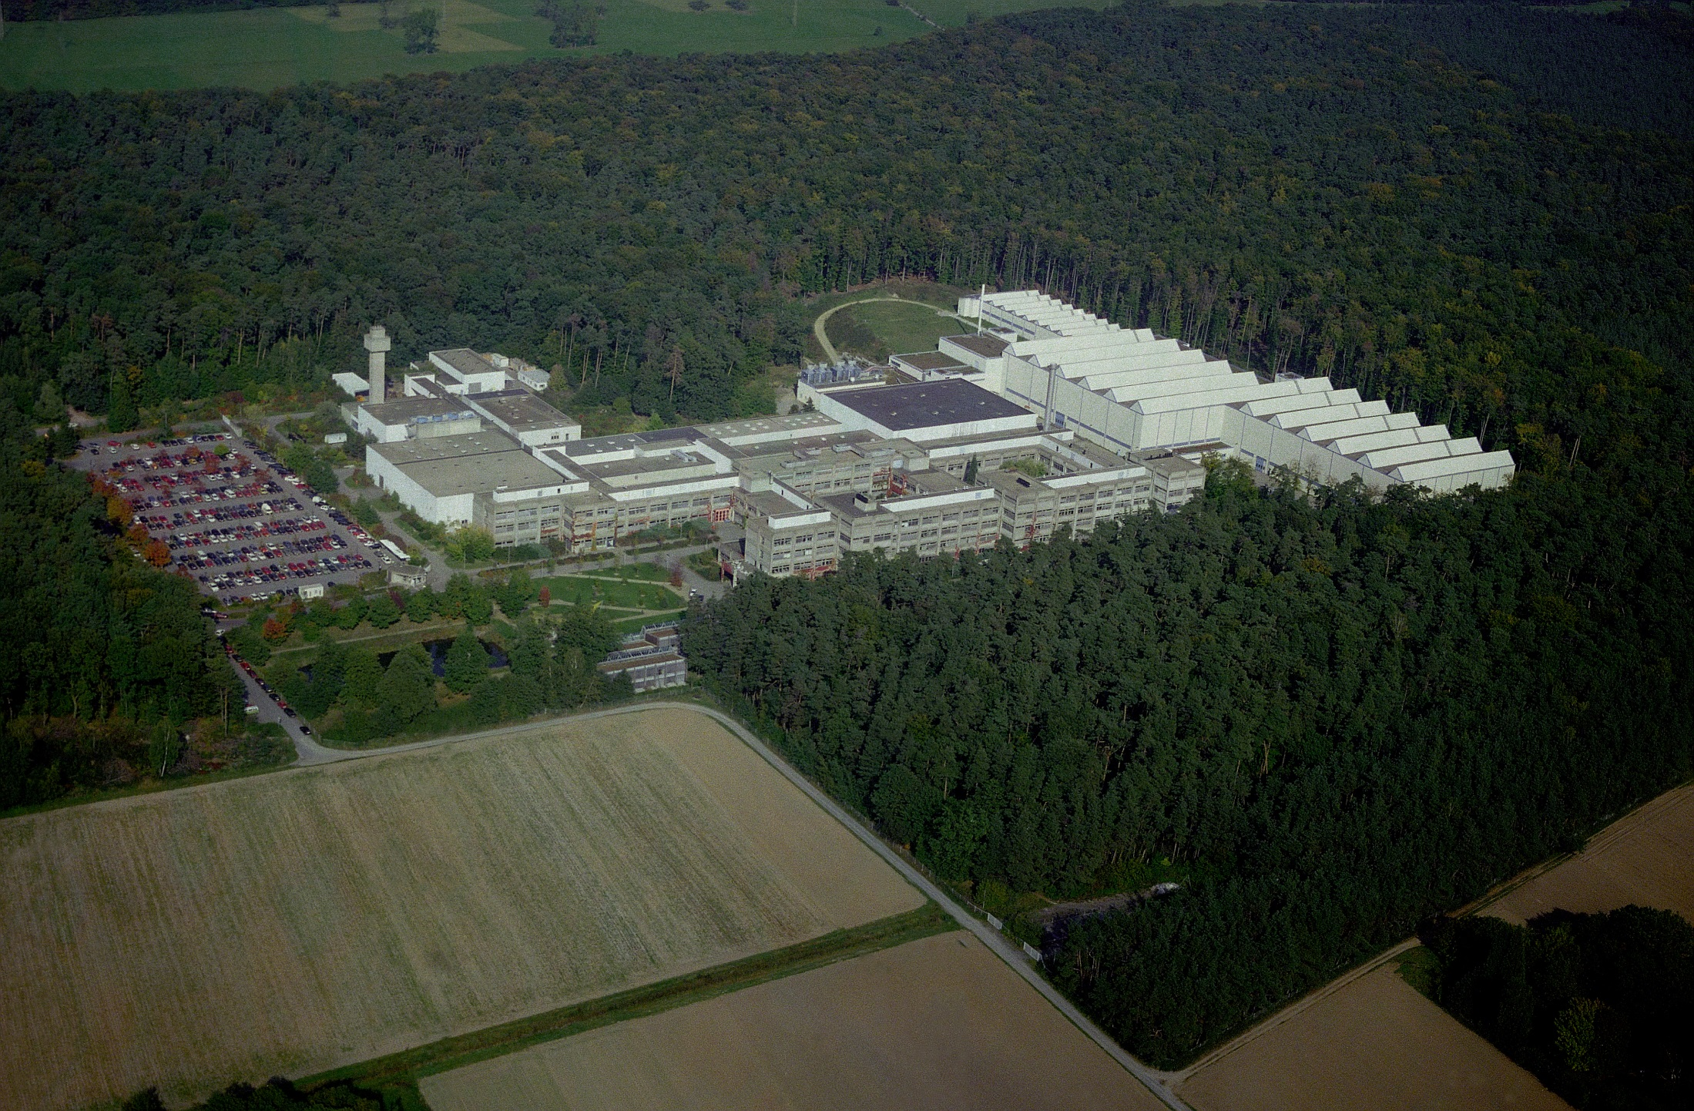

GSI – Helmholtzzentrum für Schwerionenforschung

Slide 3
Tentative outline of accelerator lecture series
A History of Particle Accelerators
cathode rays are particles
Rutherford scattering
natural particle acceleration
electrostatic accelerators:
Cockroft Walton multiplier
Van de Graaff accelerator
Tandem accelerator
Cyclotron
motion in E- and B-fields
cyclotron frequency and K-value
sector focusing cyclotron
Radio-frequency accelerator
Wideroe structure
Alvarez structure
synchrotron
Accelerator facility at GSI
heavy ion source
charge stripper to increase the efficiency
UNILAC, SIS-18
Radioactive Ion Beams
projectile fragmentation
fragment separator at GSI
target fragmentation
isotope separation on line
ISOLDE at CERN
Storage Rings
beam emittance
stochastic cooling
electron cooling
laser cooling
experimental storage ring at GSI
Large Hadron Collider
electron vs. proton machine
fixed target vs. colliding beam experiment
LHC layout and experiments
Magnets
dipole, quadrupole, n-pole magnets
Accelerator light source
Bremsstrahlung
Synchrotron radiation
Inverse Compton scattering
Application
Medical application
Ion implantation
Spallation target
Scanning
Transmutation
Radiocarbon dating
Wakefield Accelerator
Three orders of magnitude higher field gradient

Slide 4
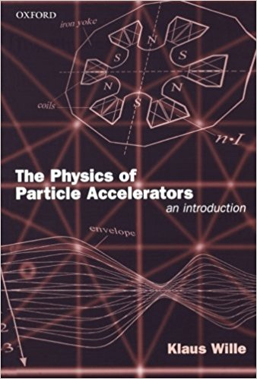
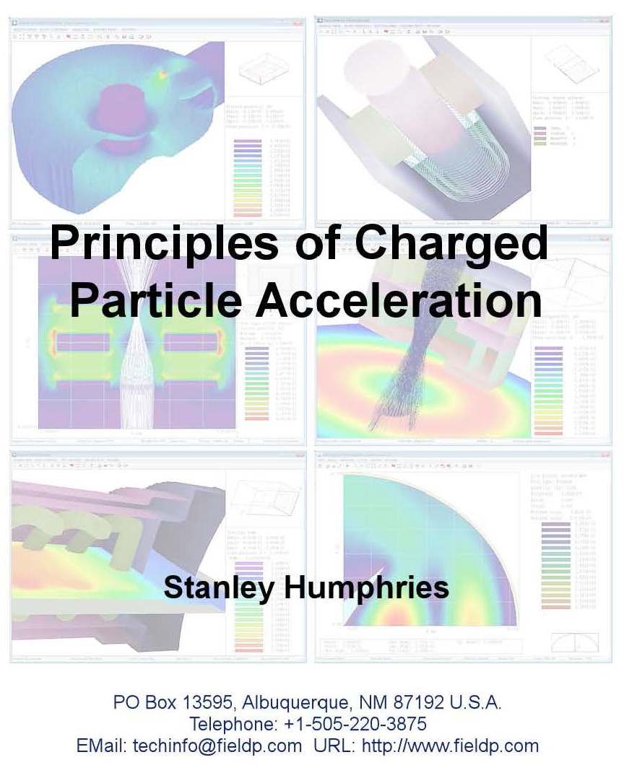
Literature
Recommended Textbook
Recommended e-book
Additional material:
http://uspas.fnal.gov/materials/materials-table.shtml

Slide 5
What are accelerators used for?
High Energy Physics & Nuclear Physics
- Understand the fundamental building blocks of nature and the force that act
upon them
- Understanding the structure and dynamics of nuclear matter
- In short search for answer of the most fundamental questions
Chemistry, Biology, Medicine, Material Sciences
- Find the structure of molecules, proteins, cells … with ultimate goal of
determining structure of a single organic molecule as complex as a protein!
- Determine structure of material and their properties (physics, chemistry,
biology, medicine)
- Resolve structural changes in a natural (femto-sec and atto-sec) time scales
Civil, Industrial and Military Applications
- Medical treatment of tumors and cancers
- Production of medical isotopes
- Ion implantation to modify the surfaces of materials
- National security: cargo inspections, …
This list will never be complete …

Slide 6
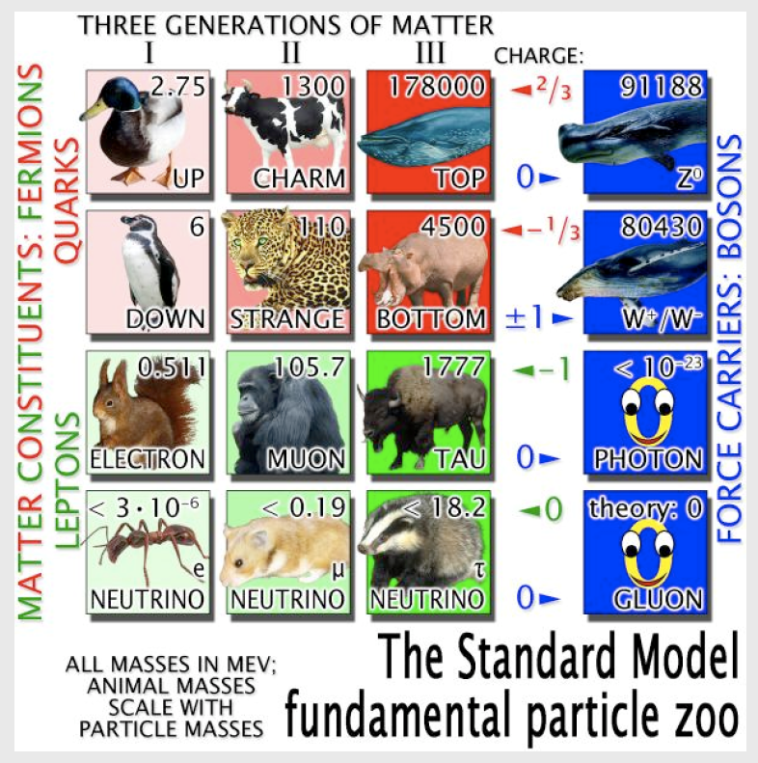
Accelerator allow us to discover the entire zoo of elementary particles and their combinations (states)
Higgs

Slide 7
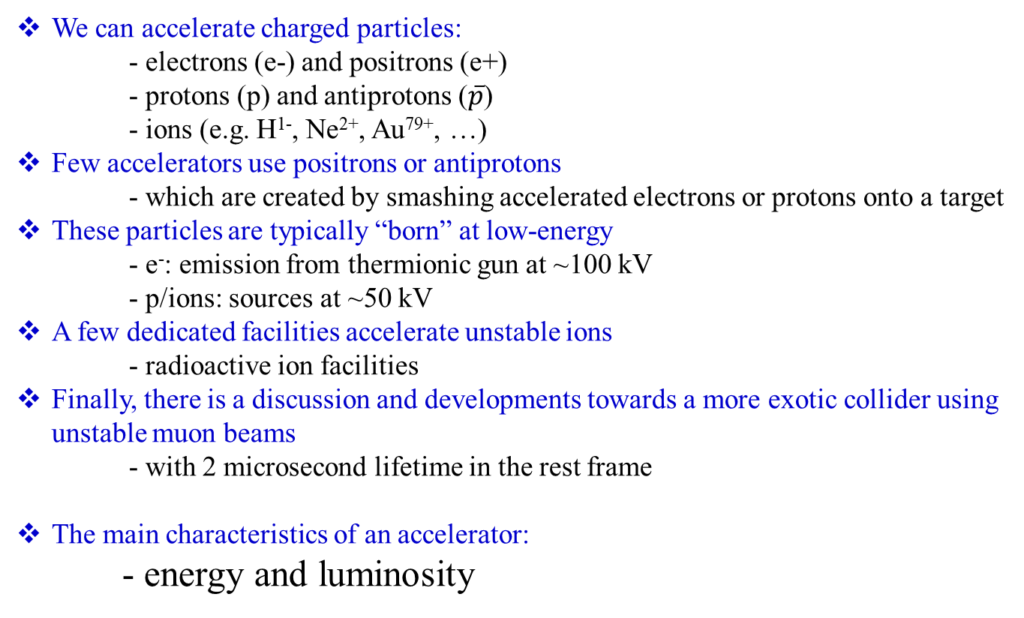
What do we accelerate?
We can accelerate charged particles:
- electrons (e-) and positrons (e+)
- protons (p) and antiprotons ($\overline{p}$)
- ions (e.g. H¹⁻, Ne²⁺, Au⁷⁹⁺, …)
Few accelerators use positrons or antiprotons
- which are created by smashing accelerated electrons or protons onto a target
These particles are typically “born” at low-energy
- e⁻: emission from thermionic gun at ~100 kV
- p/ions: sources at ~50 kV
A few dedicated facilities accelerate unstable ions
- radioactive ion facilities
Finally, there is a discussion and developments towards a more exotic collider using unstable muon beams
- with 2 microsecond lifetime in the rest frame
The main characteristics of an accelerator:
- energy and luminosity

Slide 8
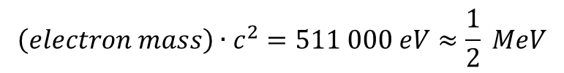
Units of energy: Electron Volts
An “electron-volt” is the energy gained by a particle of unit charge is accelerated over 1V potential
It is really small
  1 eV = 1.6∙10⁻¹⁹ (=0.00000000000000000016) Joules
  – our usual unit of energy.
  A 1 kg weight dropped 1m would have 6∙10¹⁸ eV of energy!
On the other hand, it’s a very useful unit when talking about individual particles
  If we accelerate a proton using an electrical potential, we know exactly what the energy is.
  It’s also useful when thinking about mass/energy equivalence
$$\left(proton mass\right)∙c^{2}=938 000 000 eV≈1 billion eV=1 GeV$$
$$\left(electron mass\right)∙c^{2}=511 000 eV≈\frac{1}{2} MeV$$
speed of light (c): 2.99792∙10⁸ m/s

Slide 9
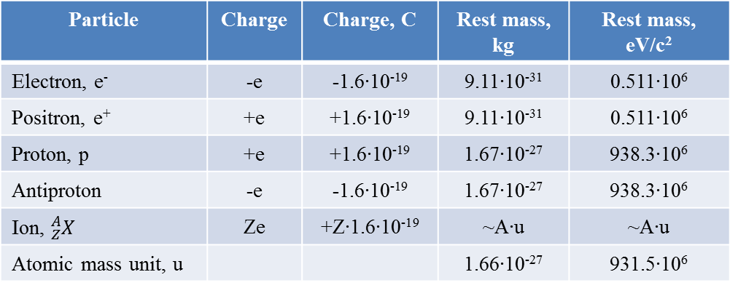
Few numbers and units
Particle | Charge | Charge, C | Rest mass, kg | Rest mass, eV/c²
Electron, e⁻ | -e | -1.6∙10⁻¹⁹ | 9.11∙10⁻³¹ | 0.511∙10⁶
Positron, e⁺ | +e | +1.6∙10⁻¹⁹ | 9.11∙10⁻³¹ | 0.511∙10⁶
Proton, p | +e | +1.6∙10⁻¹⁹ | 1.67∙10⁻²⁷ | 938.3∙10⁶
Antiproton | -e | -1.6∙10⁻¹⁹ | 1.67∙10⁻²⁷ | 938.3∙10⁶
Ion, ${}_{Z}^{A}X$ | Ze | +Z∙1.6∙10⁻¹⁹ | ~A∙u | ~A∙u
Atomic mass unit, u |  |  | 1.66∙10⁻²⁷ | 931.5∙10⁶

Slide 10

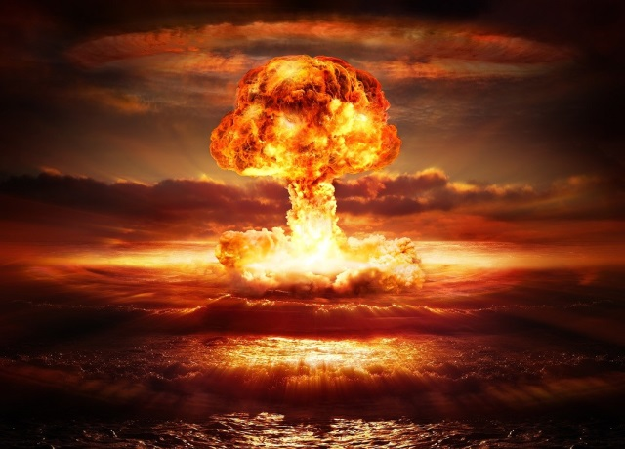
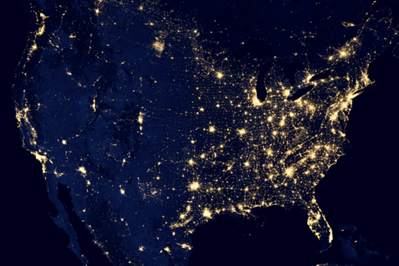

Understanding Energy
High Energy Physics is based on Einstein’s equivalence of mass and energy
$$E=m∙c^{2}$$
All reactions involve some mass changing either to or from energy
0.00000005 % of mass converted to energy
~ 0.1 % (of just Hydrogen!) converted
If we could convert a kilogram of mass entirely to energy, it would supply all the electricity in the United States for almost a day.

Slide 11

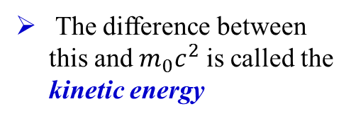
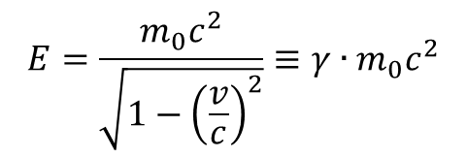

Kinetic Energy
A body in motion will have a total energy given by
$$E=\frac{m_{0}c^{2}}{\sqrt{1−{\left(\frac{v}{c}\right)}^{2}}}≡γ∙m_{0}c^{2}$$
$$γ=\frac{1}{\sqrt{1−{\left(\frac{v}{c}\right)}^{2}}}$$
For v << c (speed of light),
Kinetic energy ~ ½mv²
The difference between this and $m_{0}c^{2}$ is called the kinetic energy
Kinetic Energy
Rest Energy
$$T_{kin}=m_{0}c^{2}∙\left(γ−1\right)$$
Example | Velocity | Velocity v/c | Kinetic Energy/(mc²)
Race car | 240 km/h | .0000002 | .000000000000025
Apollo 12 (fastest men) | 40,000 km/h | .000037 | .00000000068
Proton in the LHC (full energy) | Light minus 2.7 m/s | .999999991 | 7500
Electron in LEP | Light minus 3.6 mm/s | .999999999988 | 203,000

Slide 12
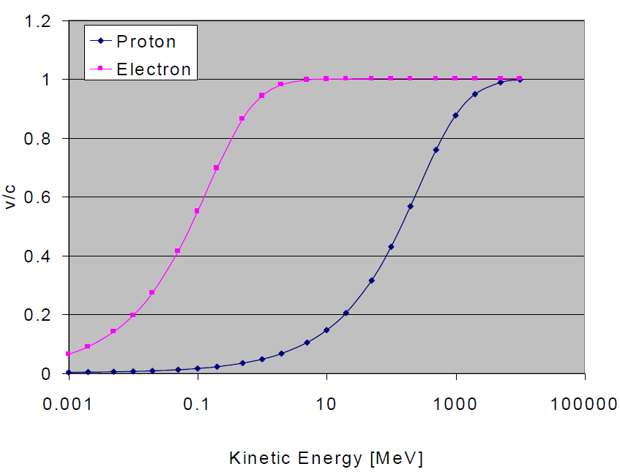
Proton and electron velocities vs. kinetic energy

Slide 13


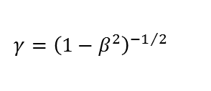
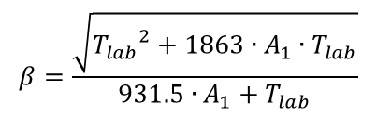
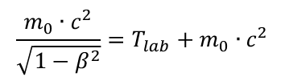

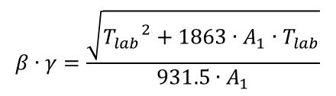
Relevant Formulae
The relevant formulae are calculated if A₁, Z₁ and A₂, Z₂ are the mass number (amu) and charge number of the projectile and target nucleus, respectively, and T_{lab} is the kinetic energy (MeV) in the laboratory system
$$E=T_{lab}+m_{0}∙c^{2}$$
$$m∙c^{2}=T_{lab}+m_{0}∙c^{2}$$
$$\frac{m_{0}∙c^{2}}{\sqrt{1−β^{2}}}=T_{lab}+m_{0}∙c^{2}$$
$$β=\frac{\sqrt{{T_{lab}}^{2}+1863∙A_{1}∙T_{lab}}}{931.5∙A_{1}+T_{lab}}$$
beam velocity:
Lorentz contraction factor:
$$γ={\left(1−β^{2}\right)}^{{−1}/2}$$
$$γ=\frac{931.5∙A_{1}+T_{lab}}{931.5∙A_{1}}$$
$$β∙γ=\frac{\sqrt{{T_{lab}}^{2}+1863∙A_{1}∙T_{lab}}}{931.5∙A_{1}}$$

Slide 14
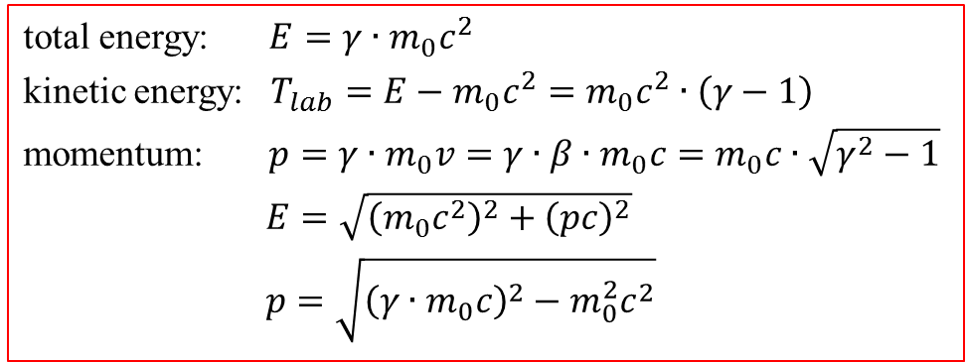
Relativity and Units
Basic Relativity
total energy: $E=γ∙m_{0}c^{2}$
kinetic energy: $T_{lab}=E−m_{0}c^{2}=m_{0}c^{2}∙\left(γ−1\right)$
momentum: $p=γ∙m_{0}v=γ∙β∙m_{0}c=m_{0}c∙\sqrt{γ^{2}−1}$
$E=\sqrt{{\left(m_{0}c^{2}\right)}^{2}+{\left(pc\right)}^{2}}$
$p=\sqrt{{\left(γ∙m_{0}c\right)}^{2}−m_{0}^{2}c^{2}}$
Units
For the most part, we will use SI units, except
  Energy: eV (keV, MeV, etc.) [1 eV = 1.6∙10⁻¹⁹ J]
  Mass: eV/c² [proton = 1.67∙10⁻²⁷ kg = 938.3 MeV/c²]
  Momentum: eV/c [proton @ β = 0.9, → 1.94 GeV/c]

Slide 15
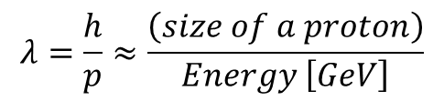
Another way to look at energy
Quantum mechanics tells us all particles have a wavelength
Planck constant
$$λ=\frac{h}{p}≈\frac{\left(size of a proton\right)}{Energy \left[GeV\right]}$$
momentum
as v approaches c
So going to high energy allows us to probe smaller and smaller scales
If we put the high equivalent mass and the small scales together, we have …

Slide 16
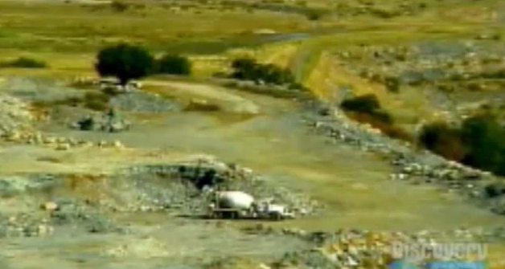
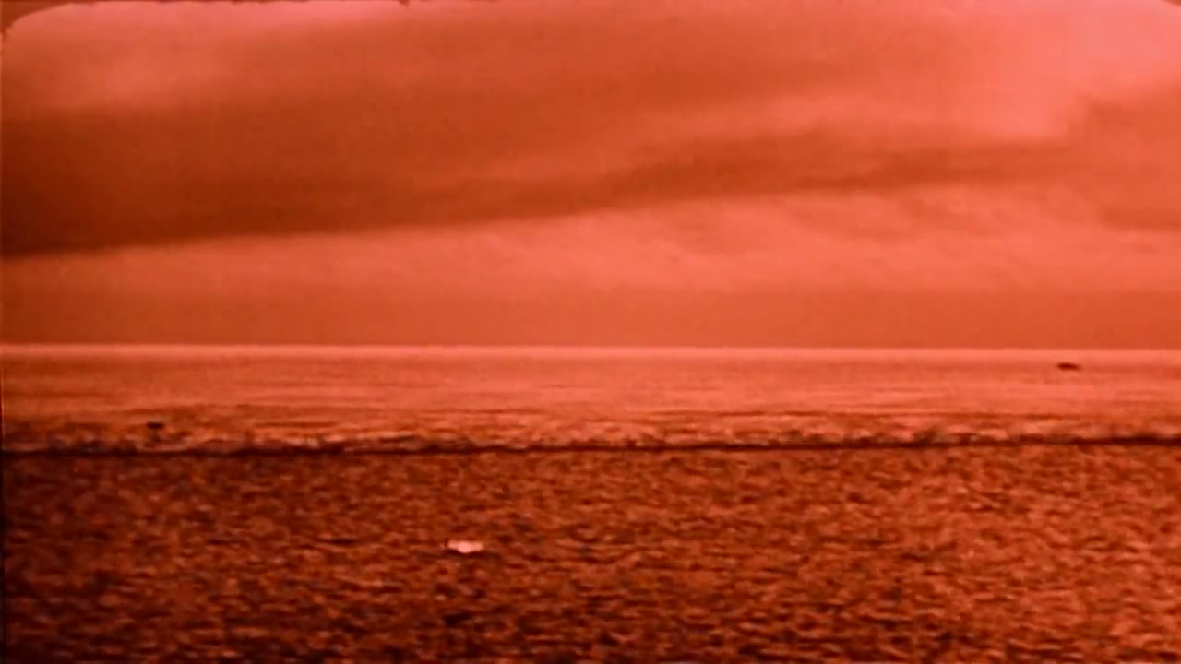
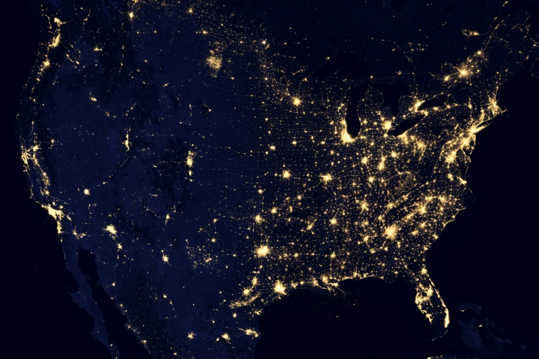

Understanding energy
High Energy Physics is based on Einstein‘s equivalence of mass and energy
$$E=m∙c^{2}$$
All reactions involve some mass changing either to or from energy
Chemical Explosion
Hydrogen Bomb
.00000005% of mass converted to energy
~.1% (of just the Hydrogen!) converted
If we could convert a kilogram of mass entirely to energy, it would supply all the electricity in the United States for almost a day.
Ft. Collins, CO, June 13-24, 2016

Slide 17
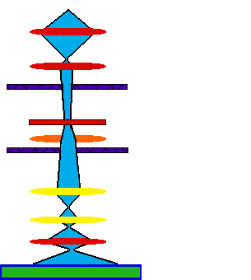
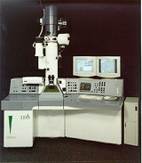
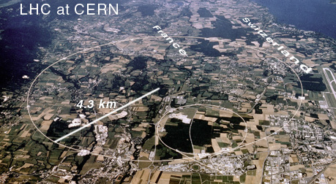
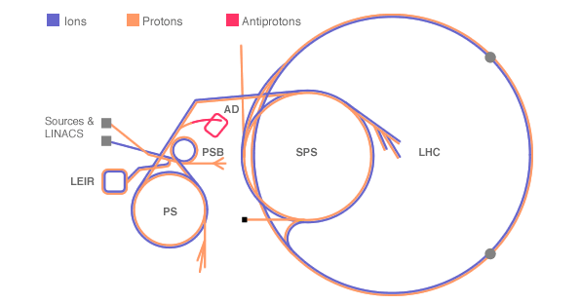
Different accelerators
source
condenser lenses
condenser aperture
sample
objective lens
objective aperture
intermediate lens
projector lens
main screen

Slide 18
GSI – Helmholtzzentrum für Schwerionenforschung

Slide 19
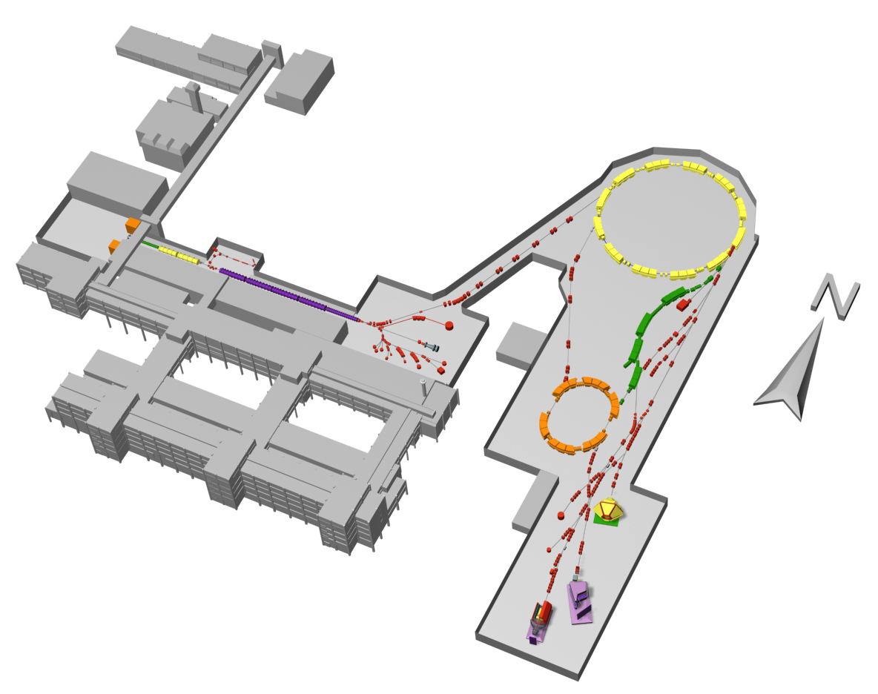

Accelerator facility
Ring-Accelerator
90% speed of light
Ion Sources
Linear-Accelerator
all elements
20% speed of light
SIS
UNILAC
FRS
ESR
Experimental Areas

Slide 20
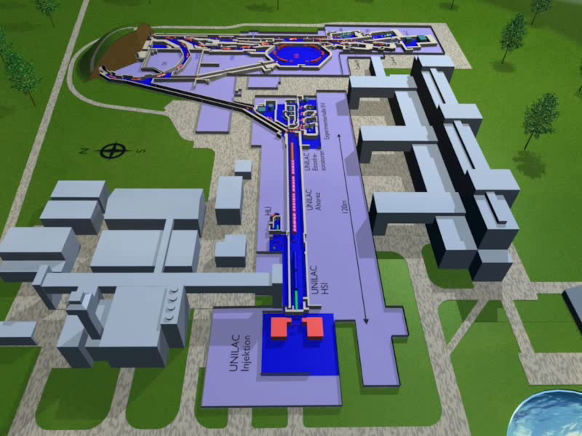
Accelerator facility

Slide 21
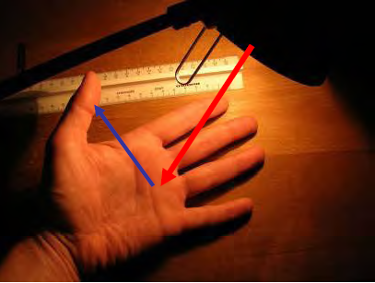

How do we see an object?
A light bulb shines on a hand and the different reflections make the fine structure visible.
With a magnifying glass or microscope more details can be seen, but there is a fundamental limit:
The wavelength of the light (1/1000 mm) determines the size of the resolvable objects.
available wavelength
→ electromagnetic waves
$$E=\frac{hc}{λ}$$
LW | 3000 m
MW | 300 m
KW | 30 m
UKW | 3 m
GPS | 0.3 m
Infrared | 10⁻⁶ m
light | 5·10⁻⁷ m | 2 eV
UV | 10⁻⁷ m | 10 eV
X-ray | 10⁻¹⁰ m | 10⁴ eV
γ-ray | 10⁻¹² m | 10⁶ eV
light bulb → accelerator
magnifying glass or microscope → detector

Slide 22
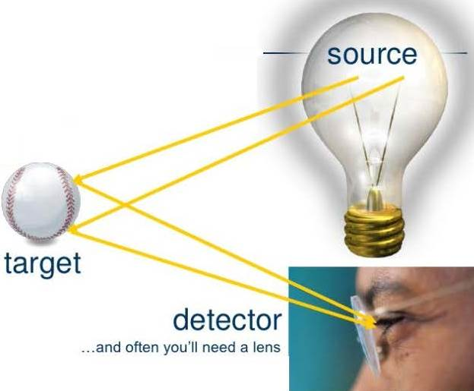
Detectors – the eyes of a particle physicist
What means visibility?
visibility = capability to create an image
Projectiles → Target → Detector
One needs:
1. size of projectile « size of object
2. target accuracy « size of object

Slide 23

How do we detect what´s happening?
Projectile: glow-in-the-dark basketballs

Slide 24

How do we detect what´s happening?
Projectile: glow-in-the-dark tennis balls

Slide 25
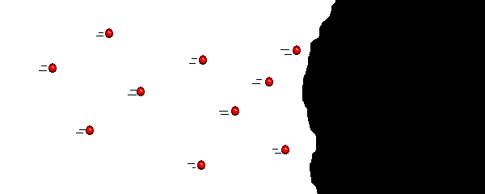
How do we detect what´s happening?
Projectile: glow-in-the-dark marbles
...let`s get out of here!

Slide 26
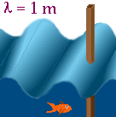
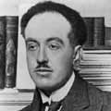
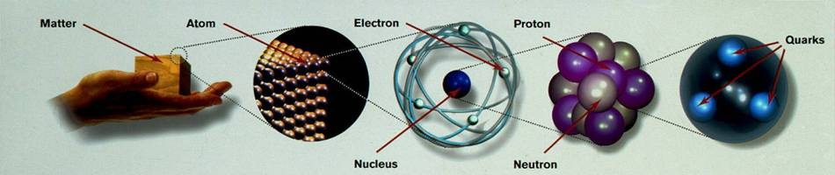

Energy, wavelength and resolution
Small objects (smaller than λ) do not disturb the wave → small object is not visible
Large objects disturb the wave → large object is visible
wavelength versus resolution
all particles have wave properties:
$$λ=\frac{h}{p}=\frac{hc}{\sqrt{E_{kin}∙\left(E_{kin}+2m_{0}c^{2}\right)}}$$
de Broglie wavelength
Louis de Broglie
10⁻¹m
10⁻⁹m
10⁻¹⁰m
10⁻¹⁴m
10⁻¹⁵m
h·c = 1239.84 [MeV fm]

Slide 27
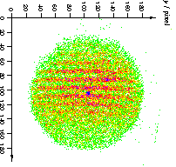
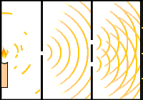
Wave properties of atoms
entry slit
2μm
He*
incoherent
λ_{dB} = 0.47 Å
1μm
8μm
excited Helium is easier to detect
wavelength (i.e. velocity) has a resolution of 5%
slits!!
Carnal&Mlynek, PRL 66,2689)1991
Graphik: Kurtsiefer&Pfau

Slide 28

Importance of high particle energies
For the investigation of small dimensions (10⁻¹⁵ m) high photon energies are needed:
$$E_{γ}=h∙ν=\frac{hc}{λ}=2∙{10}^{−10} \left[J\right]$$
In case of Bremsstrahlung, the electron energy is given by
$$E_{e}>E_{γ} with E_{e}=e∙U$$
An extremely high voltage is needed
$$U=\frac{E_{e}}{e}=1.2∙{10}^{9} \left[V\right]$$
10⁻¹m
10⁻⁹m
10⁻¹⁰m
10⁻¹⁴m
10⁻¹⁵m

Slide 29

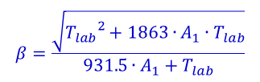




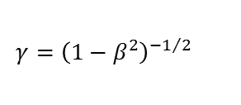

Appendix: Basic concepts
Speed of light: c = 2.99792458×10⁸ [m/s]
Relativistic energy: E = mc² = m₀γc²
Relativistic momentum: p = mv = m₀γβc
E – p relationship:
ultra – relativistic particles β ≈ 1, E ≈ pc
Kinetic energy:
Equation of motion under Lorentz force
Electron charge: e = 1.6021×10⁻¹⁹ [C]
Electron volts: 1 [eV] = 1.6021×10⁻¹⁹ [Joule]
Energy in eV: E [eV] =
Energy and rest mass: 1 eV/c² = 1.78×10⁻³⁶ [kg]
$$β=\frac{\sqrt{{T_{lab}}^{2}+1863∙A_{1}∙T_{lab}}}{931.5∙A_{1}+T_{lab}}$$
$$β=\frac{v}{c}$$
$$γ={\left(1−β^{2}\right)}^{−1/2}$$
$$=\frac{931.5∙A_{1}+T_{lab}}{931.5∙A_{1}}$$
$$\frac{E^{2}}{c^{2}}=p^{2}+{m_{0}}^{2}c^{2}$$
$$T=E−m_{0}c^{2}=m_{0}c^{2}\left(γ−1\right)$$
$$\frac{d\vec{p}}{dt}=\vec{F} → m_{0}\frac{d}{dt}\left(γ\vec{v}\right)=q\left(\vec{E}+\vec{v}×\vec{B}\right)$$
$$\frac{mc^{2}}{e}=\frac{m_{0}γc^{2}}{e}$$
Electron m₀ = 0.511 MeV/c² = 9.109×10⁻³¹ kg
Proton m₀ = 938.3 MeV/c² = 1.673×10⁻²⁷ kg
Neutron m₀ = 939.6 MeV/c² = 1.675×10⁻²⁷ kg

