Slide 1

Outline: Experimental storage ring
Lecturer: Hans-Jürgen Wollersheim
e-mail: h.j.wollersheim@gsi.de
web-page: https://web-docs.gsi.de/~wolle/ and click on
phase space - emittance
beam cooling at the ESR
electron, stochastic and laser cooling
mass spectroscopy
atomic physics experiments

Slide 2
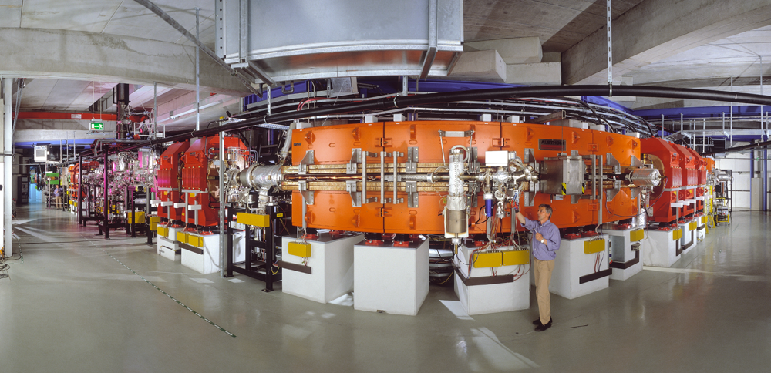
Experimental Storage Ring – ESR E_{max} = 420 MeV/u, 10 Tm

Slide 3
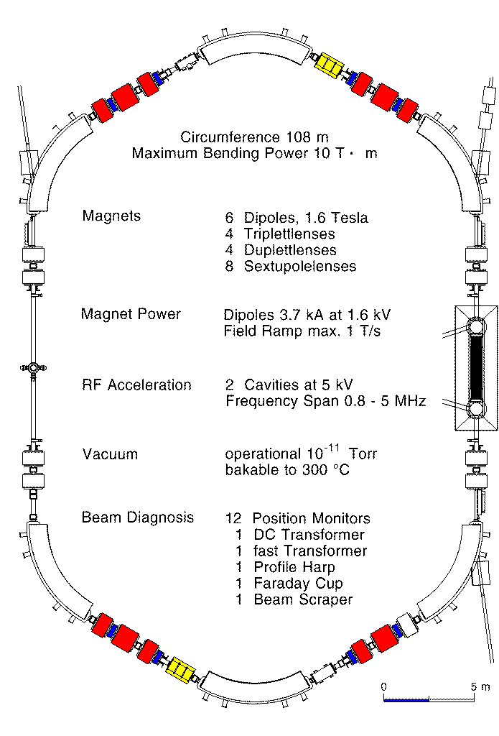
Specification of the ESR
Particle
detectors
Two 5 kV rf-cavities
Re-injection
to SIS
Fast Injection
Schottky
pick-ups
│
Gas jet
e⁻ cooler
I = 10...500 mA
L = 108 m =1/2 L_{SIS}
p = 2· 10⁻¹¹ mbar
E = 3...420 MeV/u
f ≈ 1...2 MHz
β = 0.08...0.73
Q_{h,v} ≈ 2.65
Six 60⁰ dipoles
Bρ ≤ 10 T· m
Extraction

Slide 4
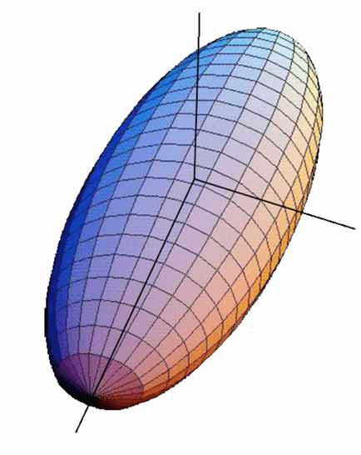
Bunch dimensions
Y
σ_{Y}
For uniform charge distributions
we may use “hard edge values”
For Gaussian charge distributions
use rms values σ_{x}, σ_{y}, σ_{z}
We will discuss measurements of bunch size and charge distribution later
X
σ_{X}
Z
σ_{Z}

Slide 5
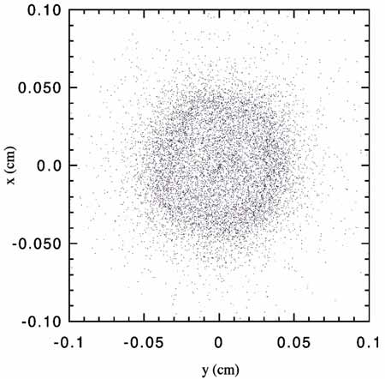
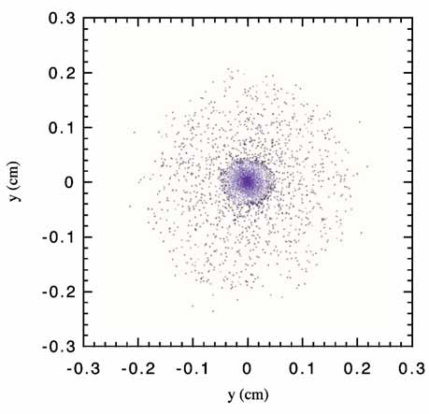
But rms values can be misleading
σ
σ
Gaussian beam
Beam with halo
We need to measure the particle distribution!

Slide 6
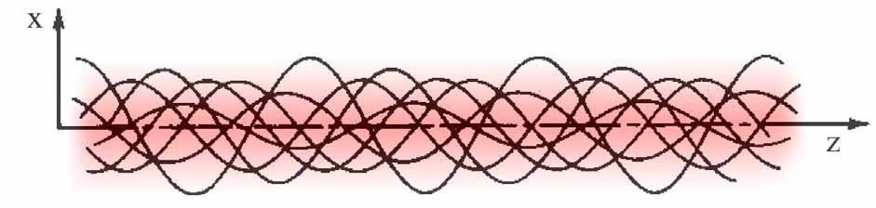
Coordinate space
Each of N_{b} particles is tracked in ordinary 3D-space
orbit traces
Not too helpful!

Slide 7
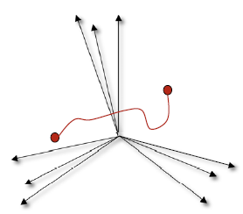
Configuration space
6 N_{b}-dimensional space for N_{b} particles; coordinates (x_{i}, p_{i}), i = 1, …, N_{b}
The bunch is represented by a single point that moves in time
Useful for Hamiltonian dynamics

Slide 8
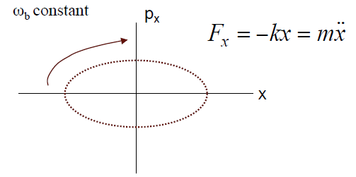
Configuration space example:
1 particle in an harmonic potential
But for many problems this description carries much more information than needed:
We don’t care about each of 10¹⁰ individual particles
But seeing both x & p_{x} looks useful

Slide 9
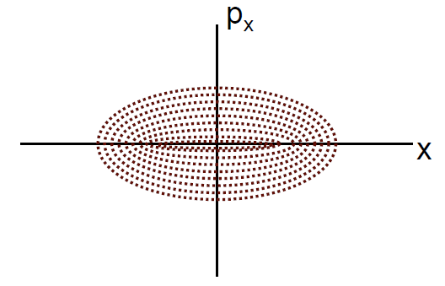
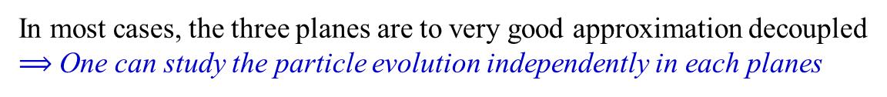
Phase space (gas space in statistical mechanics)
6-dimensional space for N_{b} particles
The i^{th} particle has coordinates (x_{i}, p_{i}), i = x, y, z
The bunch is represented by N_{b} points that move in time
In most cases, the three planes are to very good approximation decoupled
$⟹$ One can study the particle evolution independently in each planes

Slide 10
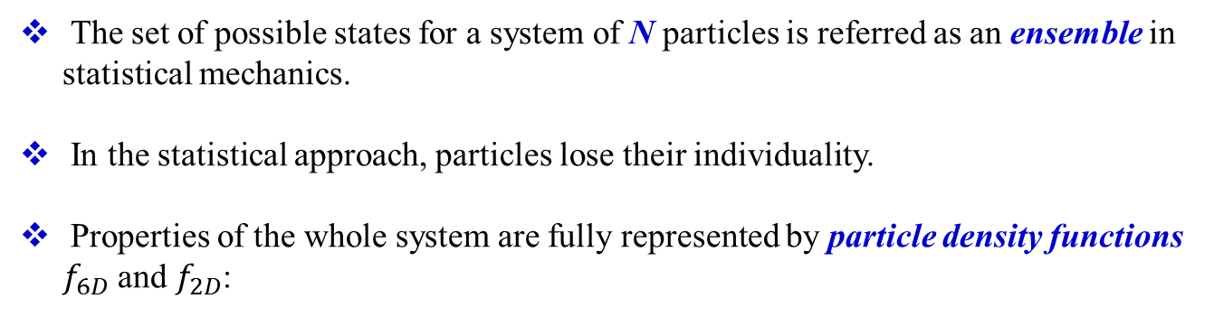
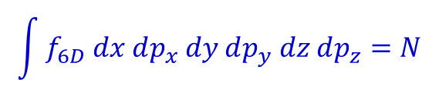

Particle Systems & Ensembles
The set of possible states for a system of N particles is referred as an ensemble in statistical mechanics.
In the statistical approach, particles lose their individuality.
Properties of the whole system are fully represented by particle density functions $f_{6D}$ and $f_{2D}$:
$$f_{6D}\left(x, p_{x}, y, p_{y}, z, p_{z}\right) dx dp_{x} dy dp_{y} dz dp_{z}$$
$$f_{2D}\left(x_{i}, p_{i}\right) dx_{i} dp_{i} i=1,2,3$$
$$\int{f_{6D} dx dp_{x} dy dp_{y} dz dp_{z}=N}$$
where

Slide 11
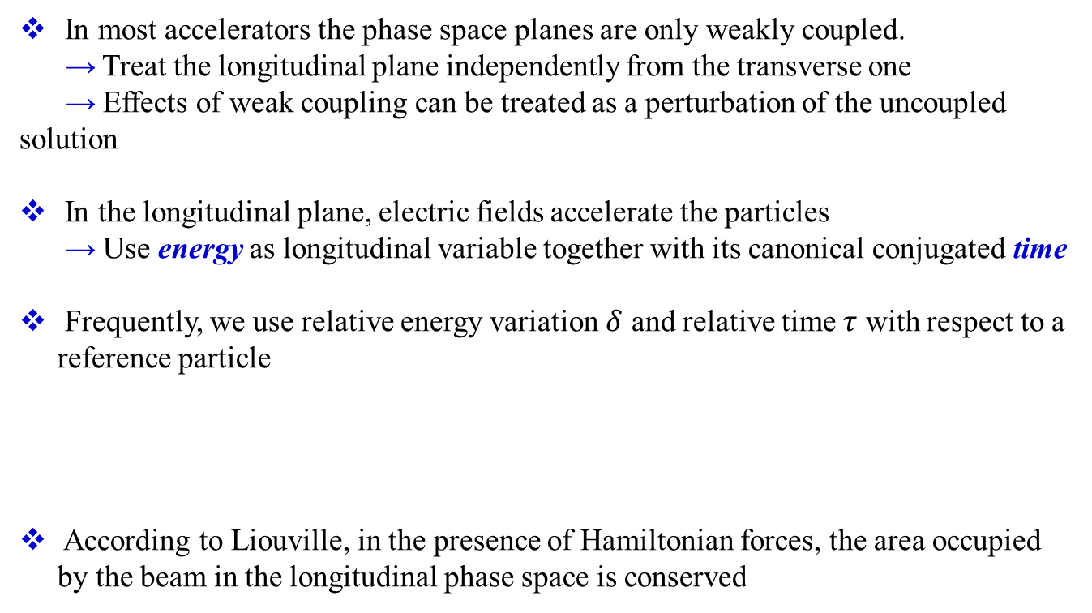


Longitudinal phase space
In most accelerators the phase space planes are only weakly coupled.
→ Treat the longitudinal plane independently from the transverse one
→ Effects of weak coupling can be treated as a perturbation of the uncoupled solution
In the longitudinal plane, electric fields accelerate the particles
→ Use energy as longitudinal variable together with its canonical conjugated time
Frequently, we use relative energy variation $δ$ and relative time $τ$ with respect to a reference particle
According to Liouville, in the presence of Hamiltonian forces, the area occupied by the beam in the longitudinal phase space is conserved
$$δ=\frac{E−E_{0}}{E_{0}}$$
$$τ=t−t_{0}$$

Slide 12
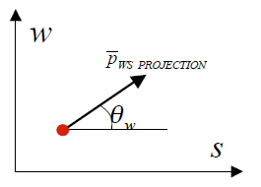
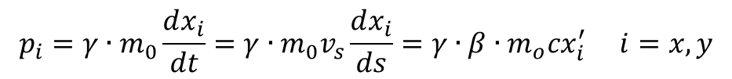
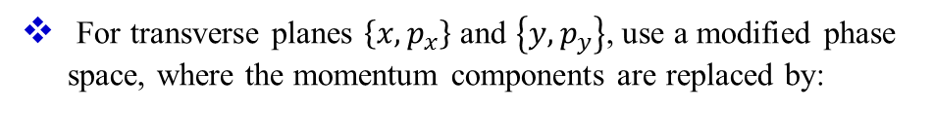
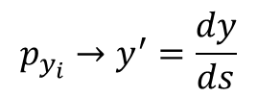
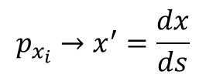

Transverse phase space
For transverse planes $\left\{x, p_{x}\right\}$ and $\left\{y, p_{y}\right\}$, use a modified phase space, where the momentum components are replaced by:
$$p_{x_{i}}→x^{′}=\frac{dx}{ds}$$
$$p_{y_{i}}→y^{′}=\frac{dy}{ds}$$
where s is in the direction of motion
We can relate the old and new variables (for $B_{z}≠0$)
$$p_{i}=γ∙m_{0}\frac{dx_{i}}{dt}=γ∙m_{0}v_{s}\frac{dx_{i}}{ds}=γ∙β∙m_{o}cx_{i}^{′} i=x,y$$
where $β=\frac{v_{s}}{c}$ and $γ={\left(1−β^{2}\right)}^{−1/2}$
Note: x_{i} and p_{i} are canonical conjugate variables while x and x’ are not, unless there is no acceleration ($γ$ and $β$ constant)

Slide 13
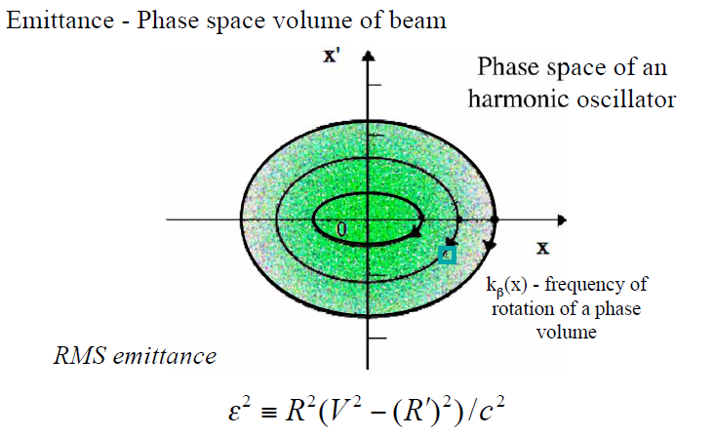
Emittance describes the area in phase space of the ensemble of beam particles

Slide 14
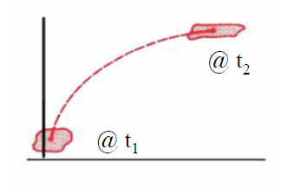
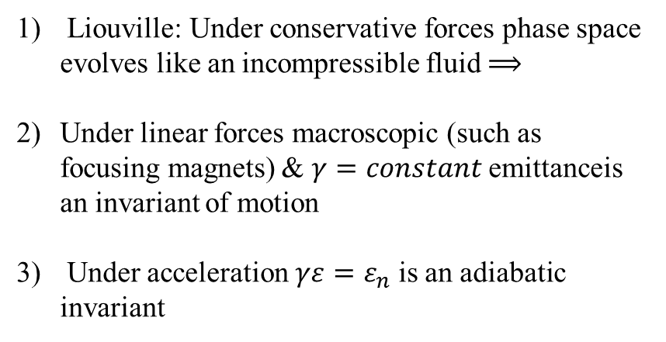
Why is emittance an important concept
Liouville: Under conservative forces phase space evolves like an incompressible fluid $⟹$
Under linear forces macroscopic (such as focusing magnets) & $γ=constant$ emittanceis an invariant of motion
Under acceleration $γε=ε_{n}$ is an adiabatic invariant
Is there any way to decrease the emittance?
This means taking away mean transverse momentum
but
keeping mean longitudinal momentum

Slide 15
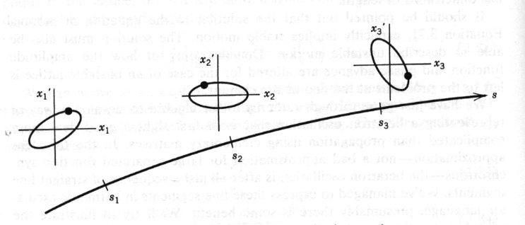
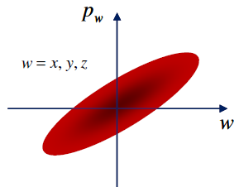
Beam cooling
Beam cooling: By analogy with kinetic theory of gases, where heat is equivalent to disorder, “cooling” here denotes the reduction of disorder in the beam.
Small emittance and momentum spread: reduce phase space volume.
Beam cooling processes are not following the Liouville’s Theorem:
“In a system where the particle motion is controlled by external conservative forces the
phase space density is conserved”
Cooling force: dissipative in nature.
phase space is used for representing particles
As a particle beam propagates along magnets and other beam-manipulating components of an accelerator, the position spread may change, but in a way that does not change the emittance.

Slide 16
Specification of the ESR
Particle
detectors
Two 5 kV rf-cavities
Re-injection
to SIS
Fast Injection
Schottky
pick-ups
│
Gas jet
e⁻ cooler
I = 10...500 mA
L = 108 m =1/2 L_{SIS}
p = 2· 10⁻¹¹ mbar
E = 3...420 MeV/u
f ≈ 1...2 MHz
β = 0.08...0.73
Q_{h,v} ≈ 2.65
Six 60⁰ dipoles
Bρ ≤ 10 T· m
Extraction

Slide 17
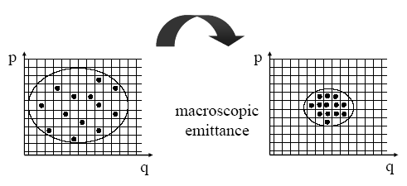
What is beam cooling?
Beam cooling is synonymous for a reduction of beam temperature
Temperature is equivalent to terms as
phase space volume, emittance and momentum spread
Beam cooling processes are not following Liouville’s Theorem:
(which neglects interactions between beam particles)
“In a system where the particle motion is controlled by external
conservative forces the phase density is conserved”
Beam cooling techniques are non-Liouvillean processes
e.g. interaction of beam particles with other particles (electrons, photons)
Benefit of beam cooling:
● Improved beam quality (precision experiments, luminosity increase)

Slide 18
Beam cooling at the ESR
What is cooling? What is temperature?
=
=
v is the velocity relative to a reference particle, which moves with an average ion-velocity.
The temperature is a measure of the random movement.
In an accelerator
=
Why beam cooling?
Improve of the beam quality
smaller beam size and reduction of the emittance
broadening of the energy
better beam intensity, accumulation
lifetime of the beam
Cooling methods:
Electron cooling
Stochastic cooling
Laser cooling
Makroskopische
Emittanz

Slide 19
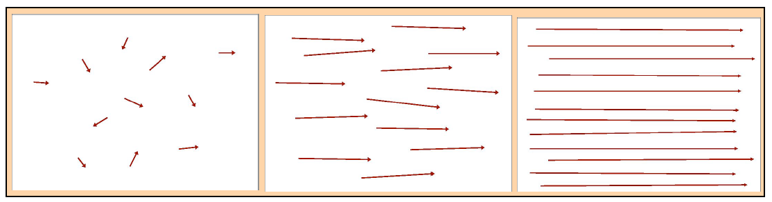
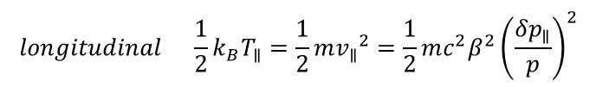

Beam temperature
Where does the beam temperature originate from?
The beam particles are generated in a ‘hot’ source
Thermal particle motion (temperature is conserved)
at rest (source) low energy high energy
$$longitudinal \frac{1}{2}k_{B}T_{∥}=\frac{1}{2}m{v_{∥}}^{2}=\frac{1}{2}mc^{2}β^{2}{\left(\frac{δp_{∥}}{p}\right)}^{2}$$
temperature
$$transverse \frac{1}{2}k_{B}T_{⊥}=\frac{1}{2}m{v_{⊥}}^{2}=\frac{1}{2}mc^{2}β^{2}γ^{2}{θ_{⊥}}^{2}$$

Slide 20
Benefits of beam cooling
Improve beam quality
  Precision experiments
  Luminosity increase
Compensation of heating
  Experiments with internal target
  Colliding beams
Intensity increase by accumulation
  Weak beams from source can be increased
  Secondary beams (antiprotons, rare isotopes)

Slide 21
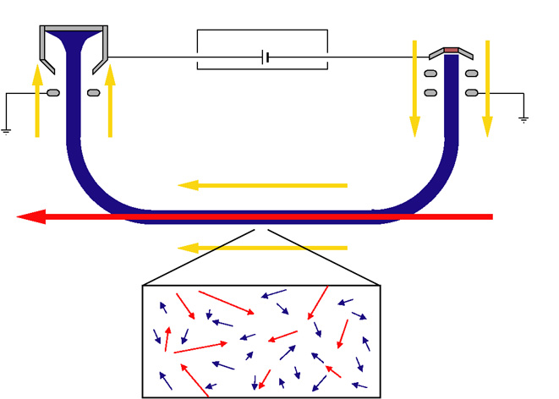
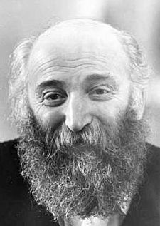
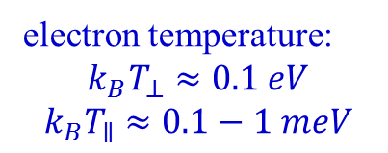
Electron cooling
electron collector
electron gun
I: 5-500 mA
v_{e‖} = v_{ion‖}
E_{e} = m_{e}/M_{ion} ·E_{ion}
high voltage platform
electron beam
e.g.: 200 keV electrons
cool 400 MeV/u ions
magnetic field
ion beam
electron temperature:
$$k_{B}T_{⊥}≈0.1 eV$$
$$k_{B}T_{∥}≈0.1−1 meV$$
in beam frame:
cold electrons interacting with hot ions
superposition of a cold
intense electron beam
with the same velocity
momentum transfer by Coulomb collisions
cooling force results from energy loss
in the co-moving gas of free electrons
G. Budker
G.I. Budker, At. En. 22 (1967) 346
G.I. Budker, A.N. Skrinsky et al., IEEE NS-22 (1975) 2093
Notes:
ions interact 10⁶ s⁻¹ with collinear beam of cold electrons

Slide 22
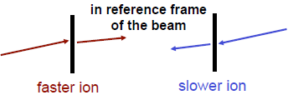
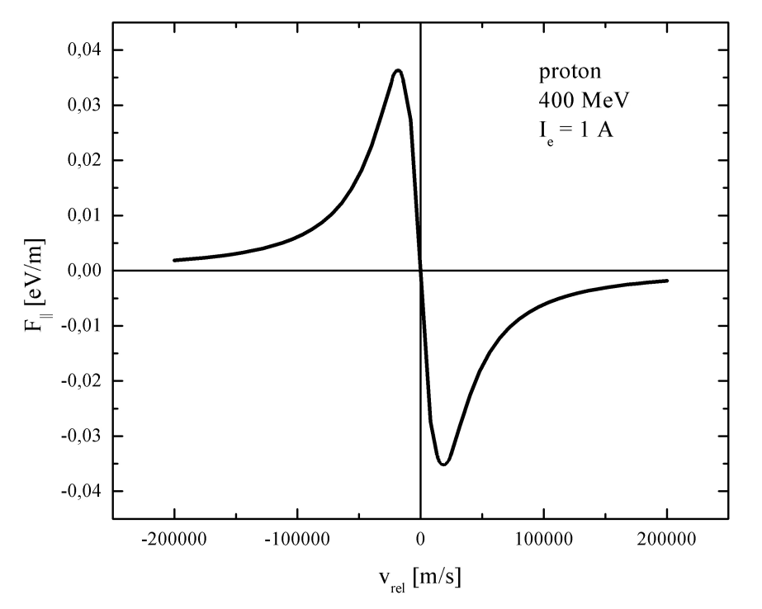
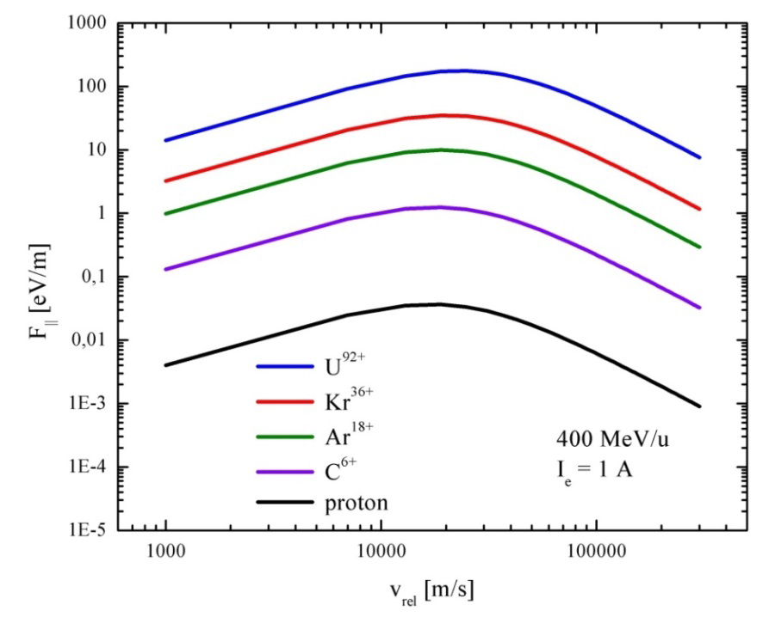

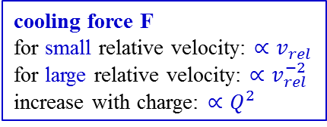
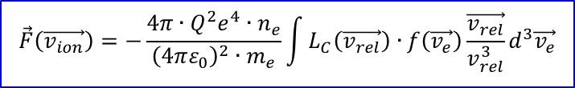


Characteristics of electron cooling force
Analogy: energy loss in matter
(electrons in the shell)
$$\vec{F}\left(\vec{v_{ion}}\right)=−\frac{4π∙Q^{2}e^{4}{∙n}_{e}}{{\left(4πε_{0}\right)}^{2}{∙m}_{e}}\int{L_{C}\left(\vec{v_{rel}}\right)∙f\left(\vec{v_{e}}\right)\frac{\vec{v_{rel}}}{v_{rel}^{3}}d^{3}\vec{v_{e}}}$$
cooling force F
for small relative velocity: $∝v_{rel}$
for large relative velocity: $∝v_{rel}^{−2}$
increase with charge: $∝Q^{2}$
$$\vec{v_{rel}}=\vec{v_{ion}}−\vec{v_{e}}$$
$$F∝v_{rel}$$
$$F∝v_{rel}^{−2}$$
maximum cooling force at effective electron temperature
Notes:
ions interact 10⁶ s⁻¹ with collinear beam of cold electrons

Slide 23
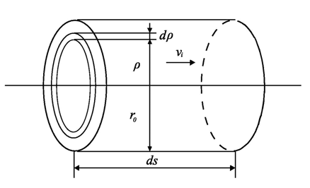
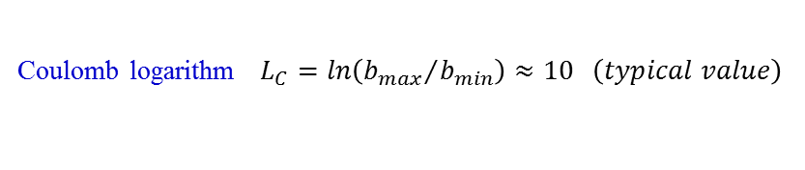
Simple derivation of electron cooling force
Analogy: energy loss in matter
(electrons in the shell)
Rutherford scattering: $2∙tan\left(\frac{θ}{2}\right)=\frac{2Z_{1}Z_{2}e^{2}}{4πε_{0}∆p∙v∙b} Z_{1}=Q \left(ion\right), Z_{2}=−1 \left(electron\right)$
Energy transfer: $∆E\left(b\right)=\frac{{\left(∆p\right)}^{2}}{2m_{e}}≅\frac{2∙Q^{2}e^{4}}{{\left(4πε_{0}\right)}^{2}m_{e}v^{2}}\frac{1}{b^{2}} \left(for b≫b_{min}\right)$
Minimum impact parameter: $b_{min}=\frac{Qe^{2}}{{\left(4πε_{0}\right)}^{2}m_{e}v^{2}} from: ∆E\left(b_{min}\right)=∆E_{max}≅m_{e}v^{2}$
Energy loss: $−\frac{dE}{dx}=2π\int_{b_{min}}^{b_{max}}{b∙n_{e}∙∆E db}=\frac{4πQ^{2}e^{4}}{{\left(4πε_{0}\right)}^{2}m_{e}v^{2}}n_{e}∙ln\frac{b_{max}}{b_{min}}$
Coulomb logarithm $L_{C}=ln\left({b_{max}}/{b_{min}}\right)≈10 \left(typical value\right)$
Notes:
ions interact 10⁶ s⁻¹ with collinear beam of cold electrons

Slide 24
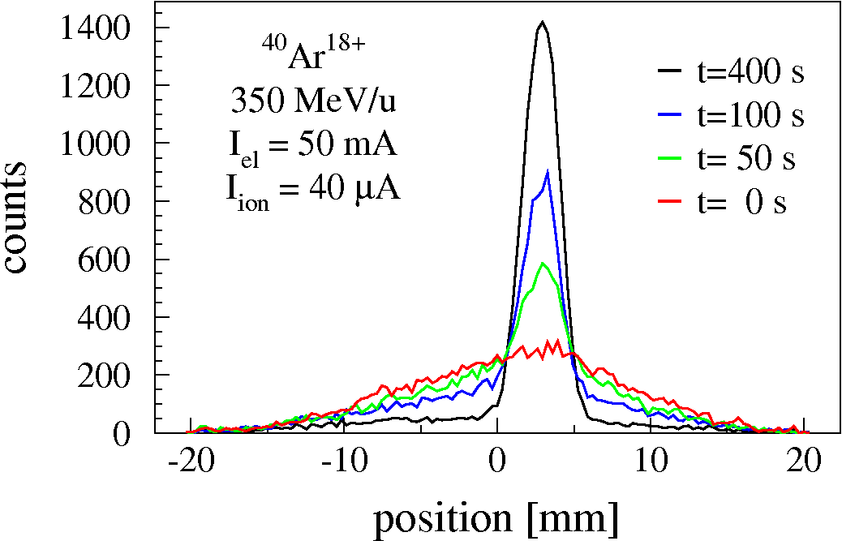
Example of electron cooling
transverse cooling at ESR
measured with residual gas ionization beam profile monitor
cooling of 350 MeV/u Ar¹⁸⁺ ions 0.05 A, 192 keV electron beam n_{e} = 0.8∙10⁶ cm⁻³
Notes:
ions interact 10⁶ s⁻¹ with collinear beam of cold electrons

Slide 25
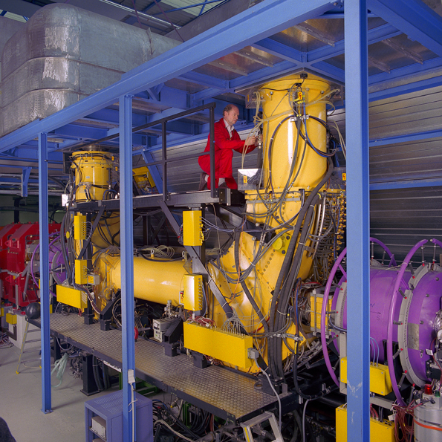
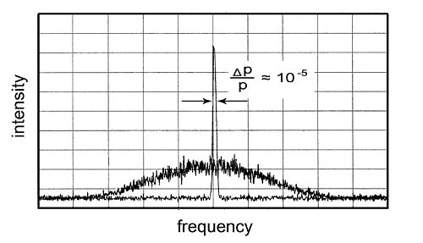
Electron cooling
momentum spread Δp/p = 10⁻⁵
diameter 2 mm
The ions get the sharp velocity of electrons,
small size and divergence
G.I. Budker, At. En. 22 (1967) 346
G.I. Budker, A.N. Skrinsky et al., IEEE NS-22 (1975) 2093

Slide 26
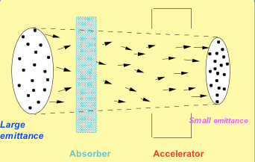
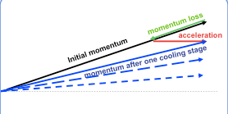
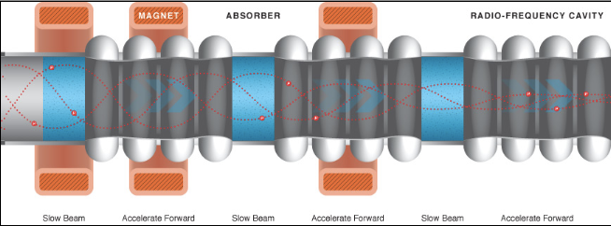
Ionization cooling
Hot muon beam:
- large transverse momentum
- cannot fit in the beam pipe in muon accelerator
Ionization cooling:
Based on use of ionization energy loss of accelerated charged particles
Reduce the transfers motion and accelerate them in forward direction

Slide 27
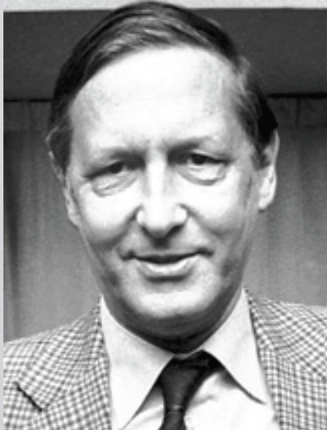
Stochastic cooling: Implementation at the ESR
long. Kicker
Simon van der Meer
transv. Pick-up
Combiner-
Station
transv. Kicker
long. Pick-up
ESR storage ring
Stochastic cooling is in particular efficient for hot ion beams

Slide 28
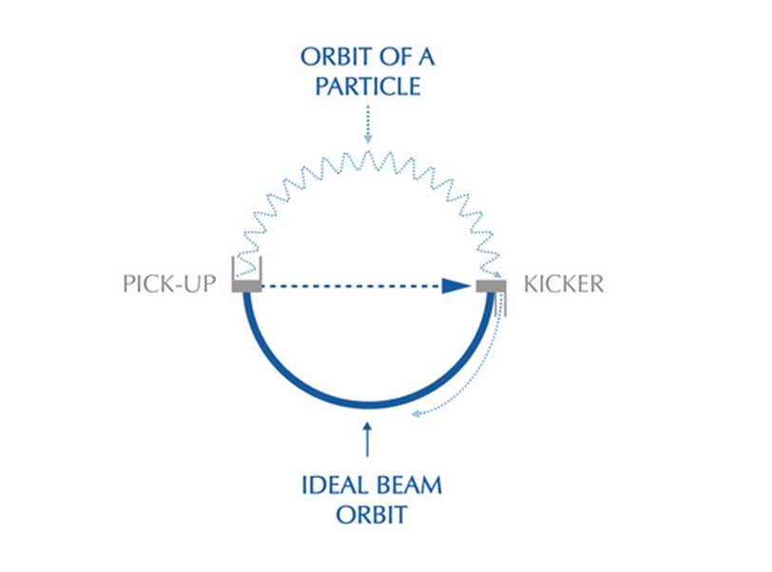
Principle of ‘stochastic’ cooling
A Feedback System: A detector or pick-up which measures the motion of the particle and a corrector, the kicker, which adjusts their angles.
Measures the deviation of the center of gravity of a sample of particles with respect to the requisite orbit and sends an error signal to the kicker.
The kicker applies an electric field to the same sample to correct the deviation measured.

Slide 29
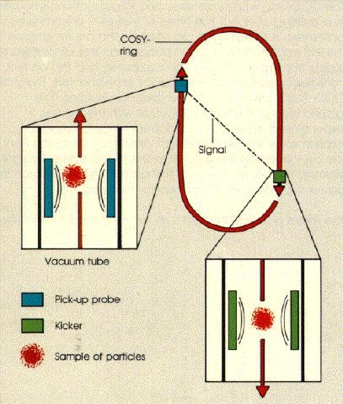
Principle of ‘stochastic’ cooling
Self correction of ion trajectory
Using a pick-up probe, the position of the ion beam is measured at a fixed position via the induced signal. A deviation of the beam from the ideal orbit can be corrected by amplification of this signal.
The amplified signal is now used as a correction signal which acts on the beam at a second position (zero crossing of the betatron function) via a "kicker“.
This method was invented for the cooling of hot p(bar) by van der Meer. He showed that after a cooling time of τ ∝ N/C (N: particle number, C = Bandwidth of the amplifier) a momentum width of the beam of about Δp/p ≈10⁻³ can be achieved by stochastic cooling.
Detection of the W boson from p ↔ p(bar)

Slide 30
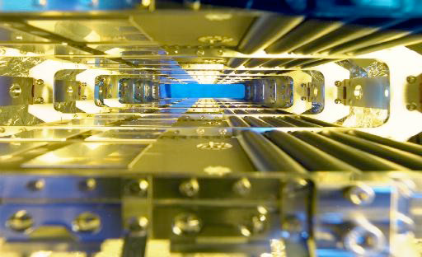
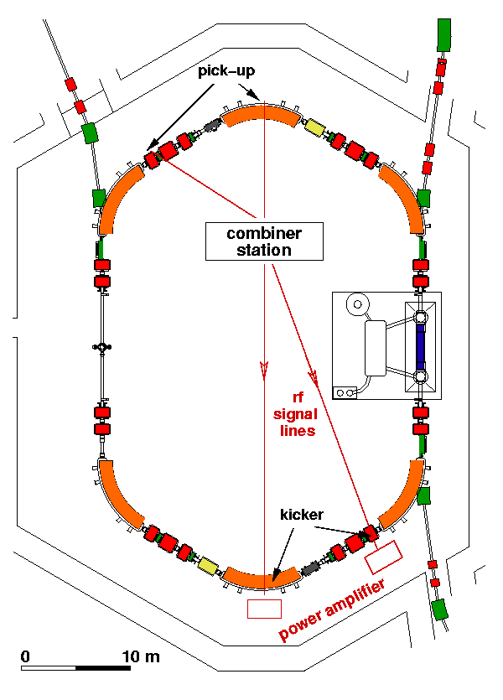
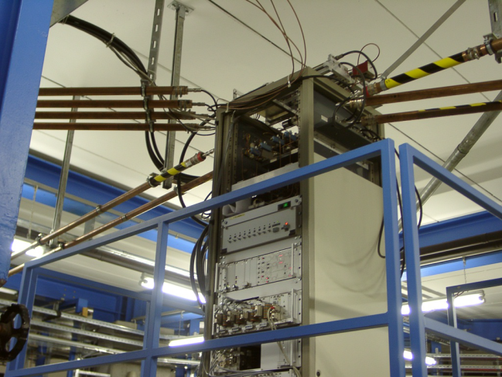
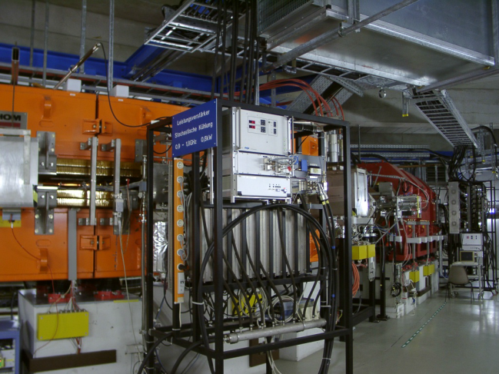


Stochastic cooling at GSI
fast pre-cooling of hot fragment beams
energy 400 (-550) MeV/u
bandwidth 0.8 GHz (range 0.9-1.7 GHz)
electrodes installed inside magnets
$$δp/p=±0.35\% → δp/p=±0.01\%$$
$$ε=10∙{10}^{−6}m → ε=2∙{10}^{−6}m$$
combination of signals from electrodes
power amplifiers for generation of correction kicks

Slide 31
Comparison of Cooling Methods
 | Stochastic Cooling | Electron Cooling
Useful for: | low intensity beams hot (secondary) beams high charge full 3-D control | low energy all intensities warm beams (pre-cooled) high charge bunched beams
Limitations: /problems | high intensity beams beam quality limited bunched beams | space charge effects recombination losses high energy

Slide 32

Principle of laser cooling (snowplow)
only longitudinal cooling
Absorption of photons from a laser beam: Energy and momentum must be conserved.
2. Absorption of photons:
Momentum transfer in a defined direction
(directed momentum transfer).
No defined direction for the spontaneous
emission (isotropic re-emission):
Momentum transfer cancels out over many
absorption-emission-cycles.
typical cooling times ~ 10 μs

Slide 33

Principle of laser cooling
2-step process

Slide 34



Laser cooling at ESR
Fluorescence light detection
Argon ion laser (257.3 nm)
frequency doubled

Slide 35































Cooling
D. Boutin

Slide 36

Cooling with the ESR

Slide 37

Recording the Schottky-noise
Real time analyzer Sony-Tektronix 3066
____________________________ 128 msec
→ FFT
64 msec_____________________
→ FFT

Slide 38







Schottky-Mass-Spectroscopy
4 particles with different m/q
time

Slide 39









Schottky mass spectroscopy
Sin(ω₁)
Sin(ω₂)
Fast Fourier Transform
ω₄
ω₃
ω₂
ω₁
Sin(ω₃)
time
Sin(ω₄)

Slide 40

Schottky mass spectroscopy
Small-band Schottky frequency spectra

Slide 41



Atomic physics in extremely strong Coulomb fields
The interest in highly-charged ions
Simple (few electron) systems: from hydrogen to H-like uranium
Tests of QED in extreme electromagnetic fields. New access to fundamental constants and to nuclear ground state properties
Extremely short and extremely intensive electromagnetic pulses at relativistic energies of highly-charged ions.

Slide 42


Lamb shift in hydrogen-like ions
Strong Coulomb Fields: 1s-Lamb shift in H-like ions
2s_{1/2} (ℓ=0) and 2p_{1/2} (ℓ=1) have not the same energy as predicted by Dirac
self energy (s-electrons are closer to the nucleus than p-electrons → different binding
vacuum polarization (virtual pairs of electrons and positrons are created and annihilated → screening effect
finite nuclear size

Slide 43

Spectroscopy at the ESR

Slide 44


Spectroscopy at the ESR

