Slide 1

Outline: Magnets
Lecturer: Hans-Jürgen Wollersheim
e-mail: h.j.wollersheim@gsi.de
web-page: https://web-docs.gsi.de/~wolle/ and click on
dipole magnets
quadrupole magnets
electromagnetic forces on charged particles
cyclotron frequency and K-value
cyclotron limits

Slide 2
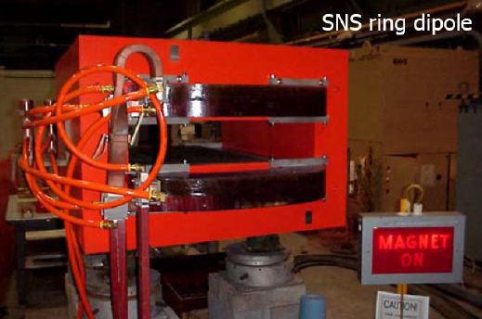
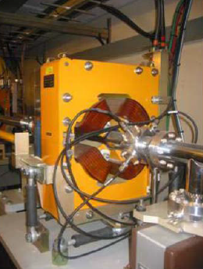
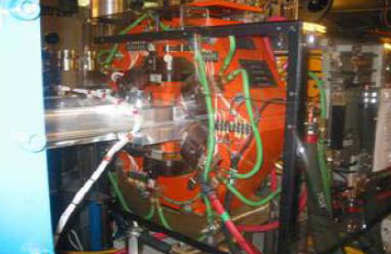
Magnet examples
Quadrupole
Sextupole

Slide 3
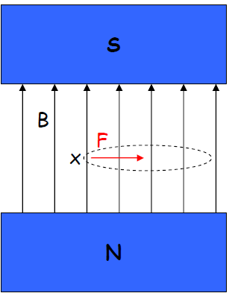
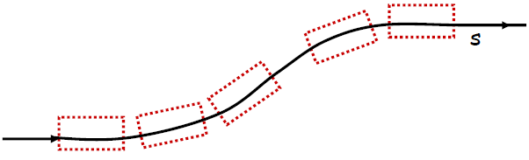
Dipole magnets
A dipole magnet gives a constant B-field.
The field lines in a magnet run from North to South. The field shown at right is positive in the vertical direction.
Symbol convention:
× - traveling into the page
● - traveling out of page
In the field shown, for a positively charged particle traveling into the page, the force is to the right.
In an accelerator lattice, dipoles are used to bend the beam trajectory. The set of dipoles in a lattice defines the reference trajectory:

Slide 4


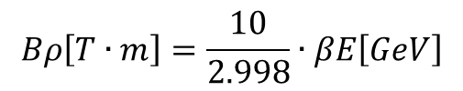
Field equations for a dipole
Let’s consider the dipole field force in more detail. Using the Lorentz Force equation, we can derive the following useful relations:
For a particle of mass m, Energy E and momentum p in a uniform B-field:
The bending radius of the motion of the particle in the dipole field is given by:
Re-arranging (1), we define the “magnetic rigidity” to be the required magnetic bending strength for given radius and energy:
$$\frac{1}{ρ}=\frac{eB}{pc}$$
$$Bρ=\frac{pc}{e}=\frac{βE}{e}$$
$$Bρ\left[T∙m\right]=\frac{10}{2.998}∙βE\left[GeV\right]$$

Slide 5
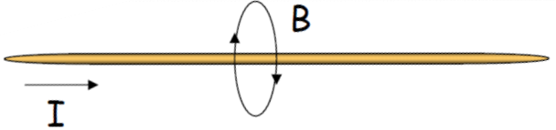
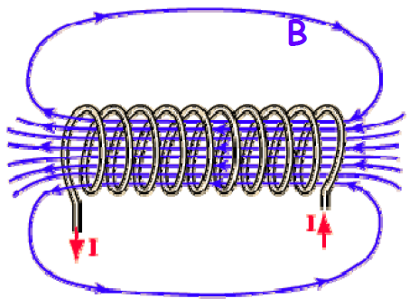
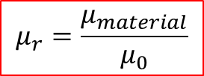
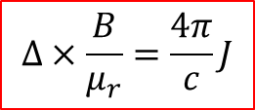
Generating a B-field from a current
Recall that a current in a wire generates a magnetic B-field which curls around the wire
Or, by winding many turns on a coil we can create a strong uniform magnetic field
The field strength is given by one of Maxwell’s equation:
$$∆×\frac{B}{μ_{r}}=\frac{4π}{c}J$$
$$μ_{r}=\frac{μ_{material}}{μ_{0}}$$

Slide 6
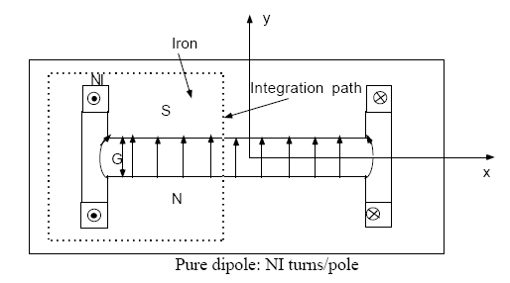
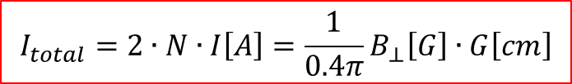
The dipole current-to-field relationship
In an accelerator dipole magnet, we use current-carrying wires and metal cores of high μ to set up a strong dipole field:
N turns of current I generate a small H = B/μ in the metal.
Hence, the B-field across the gap, G, is large.
Using Maxwell’s equation for B, we can derive the relationship between B in the gap, and I in the wires:
$$I_{total}=2∙N∙I\left[A\right]=\frac{1}{0.4π}B_{⊥}\left[G\right]∙G\left[cm\right]$$

Slide 7
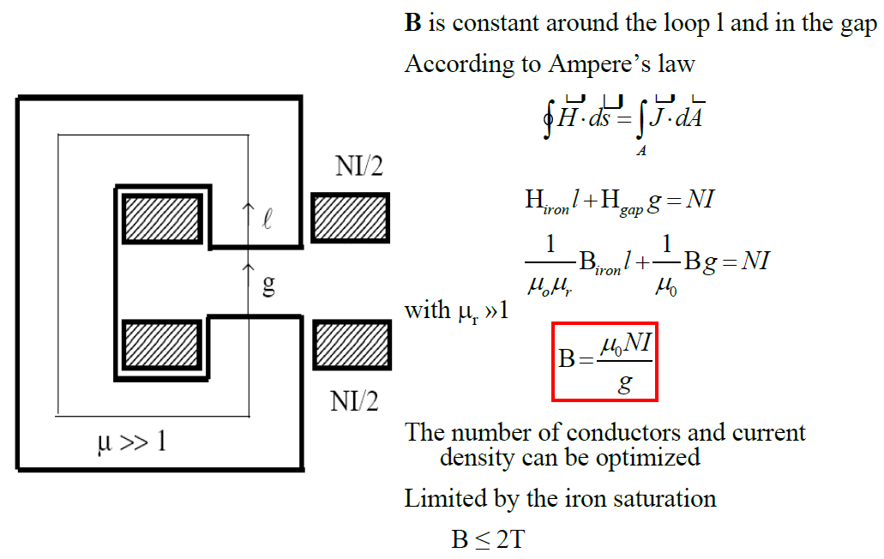
Dipole current

Slide 8
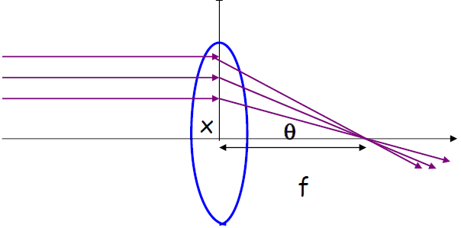

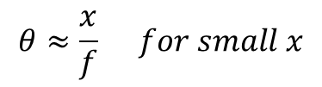
Optical analogy for focusing
We have seen that a dipole produces a constant field that can be used to bend a beam.
Now we need something that can focus a beam. Without focusing, a beam will naturally diverge.
Consider the optical analogy of focusing a ray of light through a lens:
The rays come to a focus at the focal point, f. The focusing angle depends on the distance from center, x.
$$\tan{θ}=\frac{x}{f}$$
$$θ≈\frac{x}{f} for small x$$
The farther off axis, the stronger the focusing effect! The dependence is linear for small x.

Slide 9
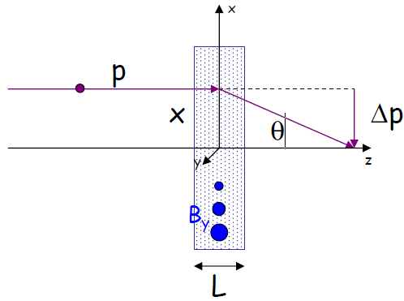
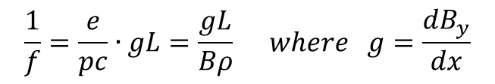
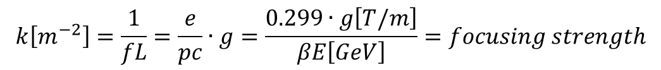
Focusing particles with magnets
Now consider a magnetic lens. This lens imparts a transverse momentum kick, Δp, to the particle beam with momentum p.
For a field which increases linearly with x, the resulting kick, Δp, will also increase linearly with x.
Beginning with the Lorentz force equation, we can solve for the focal length and focusing strength, k:
$$\frac{1}{f}=\frac{e}{pc}∙gL=\frac{gL}{Bρ} where g=\frac{dB_{y}}{dx}$$
$$k\left[m^{−2}\right]=\frac{1}{fL}=\frac{e}{pc}∙g=\frac{0.299∙g\left[T/m\right]}{βE\left[GeV\right]}=focusing strength$$

Slide 10
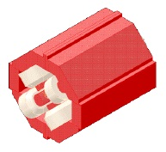
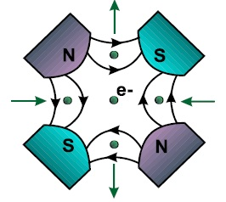
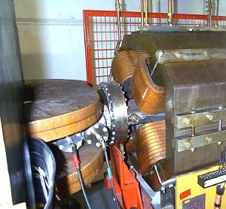
Magnet focusing
Quadrupole magnets are used to focus the beam
B ~ x
FQUADs (shown above) focus the beam horizontally.
DQUADs (as above, rotated 90⁰) focus the beam vertically.

Slide 11
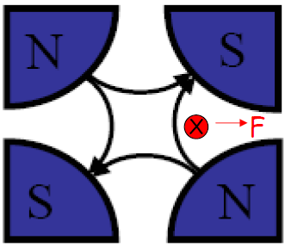
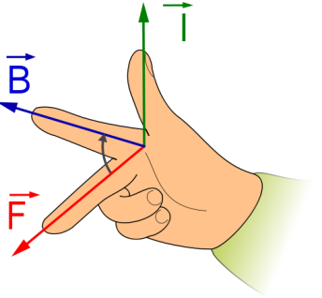
Quadrupole magnet
A quadrupole magnet imparts a force proportional to distance from the center.
This magnet has 4 poles:
Consider a positive particle traveling
into the page (into the magnet field).
According to the right hand rule, the
force on a particle on the right side of
the magnet is to the right, and the
force on a similar particle on left side
is to the left.
This magnet is horizontally defocusing.
A distribution of particles in x would be
defocused!
What about the vertical direction?
→ A quadrupole which defocuses in one plane focuses in the other.
positive charge
right hand rule

Slide 12
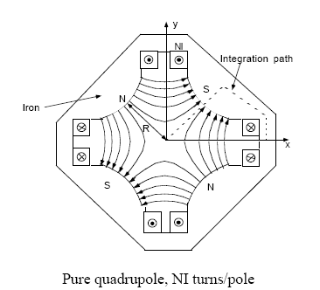

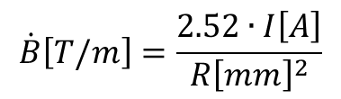
Quadrupole current-to-field equation
As with a dipole, in an accelerator we use current-carrying wires wrapped around metal cores to create a quadrupole magnet:
The field lines are denser near the edges of the magnet, meaning the field is stronger there.
The strength of B_{y} is a function of x, and visa-versa. The field at the center is zero!
Using Maxwell’s equation for B, we can derive the relationship between B in the gap, and I in the wires:
$$\dot{B}=\frac{{dB}_{φ}}{dr}=\frac{8πI}{cR^{2}}$$
$$\dot{B}\left[T/m\right]=\frac{2.52∙I\left[A\right]}{{R\left[mm\right]}^{2}}$$

Slide 13
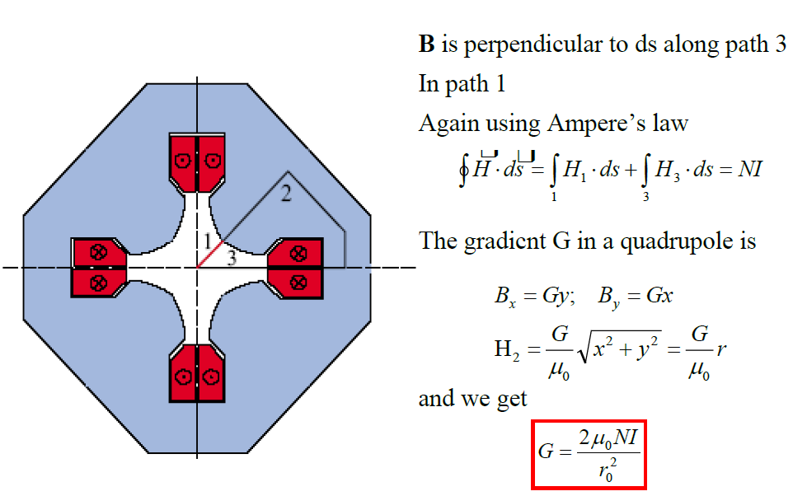
Quadrupole current

Slide 14
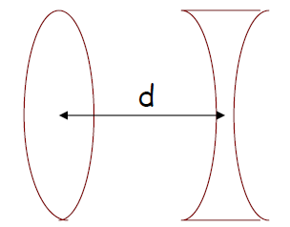

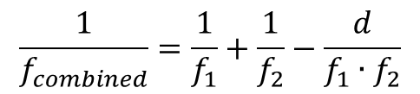




Focusing using arrays of quadrupoles
Quadrupoles focus in one plane while defocusing in the other. So, how can this be used to provide net focusing in an accelerator?
Consider the optical analogy of two lenses, with focal lengths $f_{1}$ and $f_{2}$, separated by a distance d:
The combined $f$ is:
$$\frac{1}{f_{combined}}=\frac{1}{f_{1}}+\frac{1}{f_{2}}−\frac{d}{f_{1}∙f_{2}}$$
What if $f_{1}=−f_{2}$ ?
The net effect is focusing, $\frac{1}{f_{combined}}=\frac{d}{f_{1}∙f_{2}}$
$$f_{1}$$
$$f_{2}$$

Slide 15
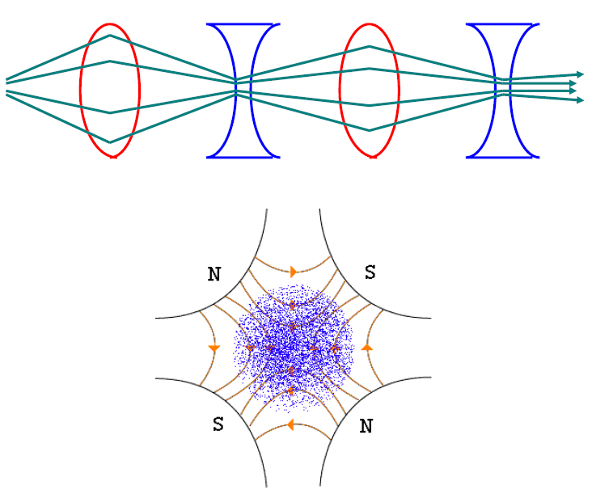
More on focusing particles …
The key is to alternate focusing and defocusing quadrupoles. This is called a FODO lattice (Focus-Drift-Defocus-Drift):

Slide 16
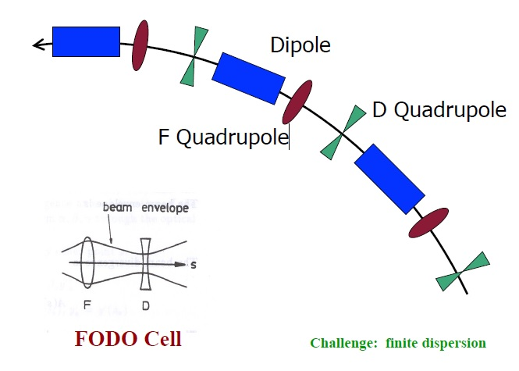
Strong focusing lattice

Slide 17
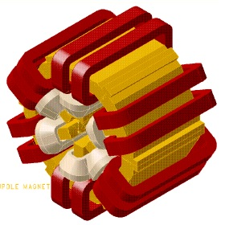
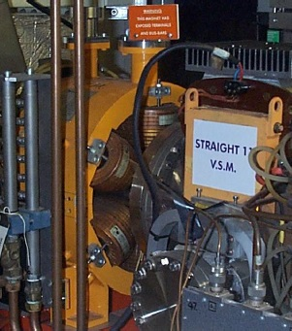
Errors and nonlinearities – chromatic correction
Sextupoles – compensate off-energy particle tune shift
B ~ x²
Located in finite dispersion region: focusing varies with energy offset

Slide 18
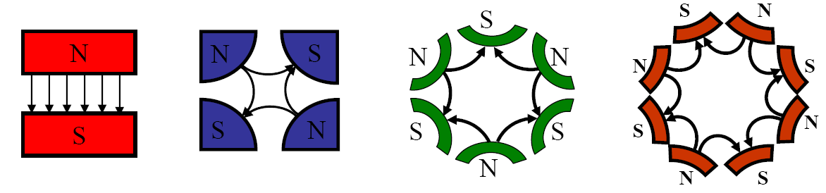
Other n-pole magnets
The general equation for B allows us to write the field for any n-pole magnet.
Examples of upright magnets:
n=1: Dipole n=2: Quadrupole n=3: Sextupole n=4: Octupole
180⁰ between poles 90⁰ between poles 60⁰ between poles 45⁰ between poles
In general, poles are 360°/2n apart.
The skew version of the magnet is obtained by rotating the upright magnet by 180°/2n.

Slide 19
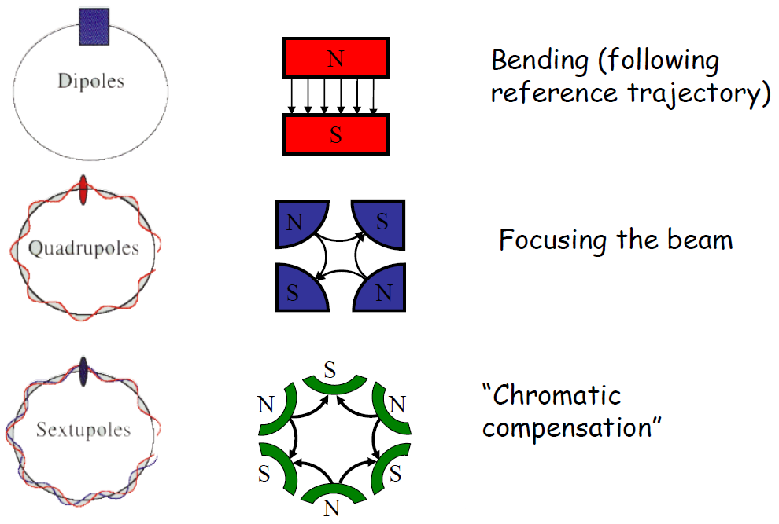
n-pole uses

Slide 20
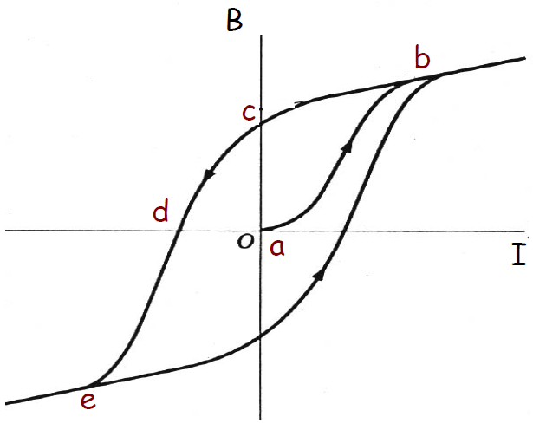
Hysteresis and magnet cycling
An external B-field, created by a current I, creates a B-field in iron by aligning tiny internal dipoles (electron spins) in the material.
However, if the current and external field are dropped to zero, the material remains partially magnetized. This gives rise to “hysteresis” and the need for magnet cycling.
a - start point
b - saturation
c - residual magnetization
d - B=0
e - saturation with -B

Slide 21
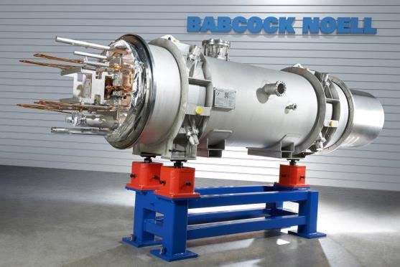
Superconducting magnets

Slide 22
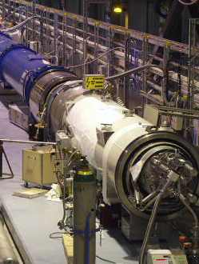
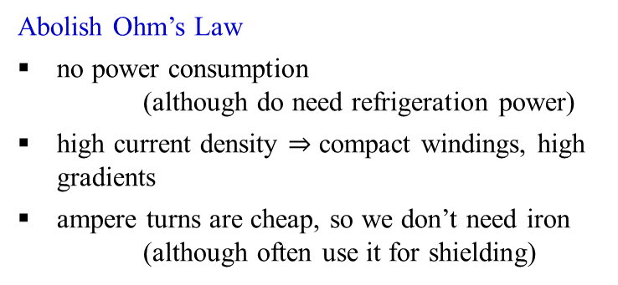
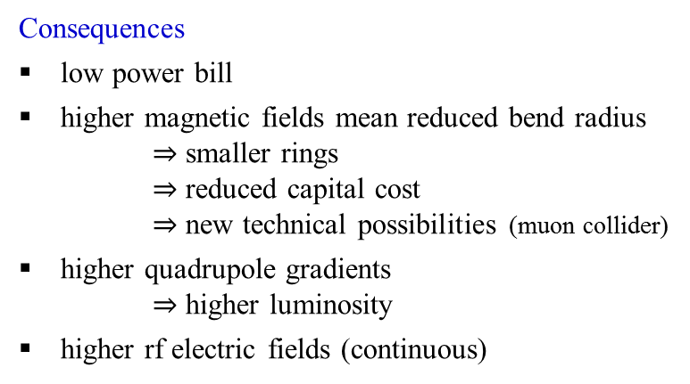
Superconducting Accelerator Magnets
Who needs superconductivity anyway?
Abolish Ohm’s Law
no power consumption
(although do need refrigeration power)
high current density $⇒$ compact windings, high gradients
ampere turns are cheap, so we don’t need iron
(although often use it for shielding)
Consequences
low power bill
higher magnetic fields mean reduced bend radius
$⇒$ smaller rings
$⇒$ reduced capital cost
$⇒$ new technical possibilities (muon collider)
higher quadrupole gradients
$⇒$ higher luminosity
higher rf electric fields (continuous)

Slide 23
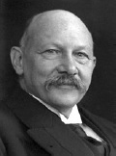
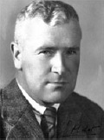
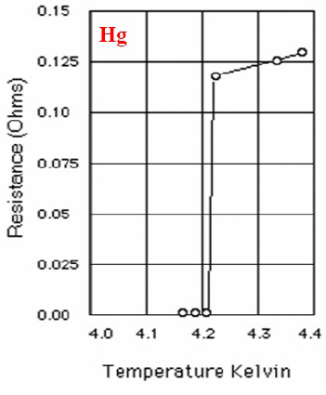
Discovery of superconductivity
Heike Kamerlingh Onnes
Gilles Holst
Superconductivity is a phenomenon occurring in certain materials, when their electrical resistance vanishes below a characteristic critical temperature. It is accompanied by expulsion of the magnetic field from the material.
The superconducting transition is at 4.2K. Within 0.01K, the resistance jumps from unmeasurably small (<10⁻⁶ Ω to 0.1 Ω).
Superconductivity was discovered by Dutch physicist Heike Kamerlingh Onnes and Gilles Holst on April 8, 1911 in Leiden.
This discovery was made possible after Onnes was able to liquefy helium in 1908. He was
awarded a Nobel prize in 1913 “for his investigations on the properties of matter at low
temperatures which led, inter alia, to the production of liquid helium”.

Slide 24
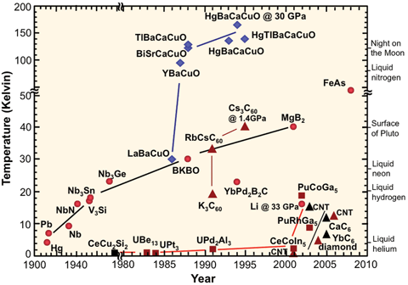
Types of superconductors
There are many ways to classify superconductors. The most common are:
Response to a magnetic field: Type I SC has a single critical field, above which all superconductivity is lost; Type II SC has two critical fields, between which it allows partial penetration of the magnetic field.
By theory of operation: A SC is conventional if it can be explained by the BCS theory or its derivatives, or unconventional, otherwise.
By critical temperature: A SC is generally considered high temperature (HTS) if it reaches a SC state when cooled using liquid nitrogen (T_{c} > 77K), or low temperature otherwise.
By material: SC material classes include chemical elements (e.g. Hg or Pb), alloys (such as NbTi, Nb₃Sn or NbN), ceramics (YBCO and MgB2), or organic superconductors

Slide 25
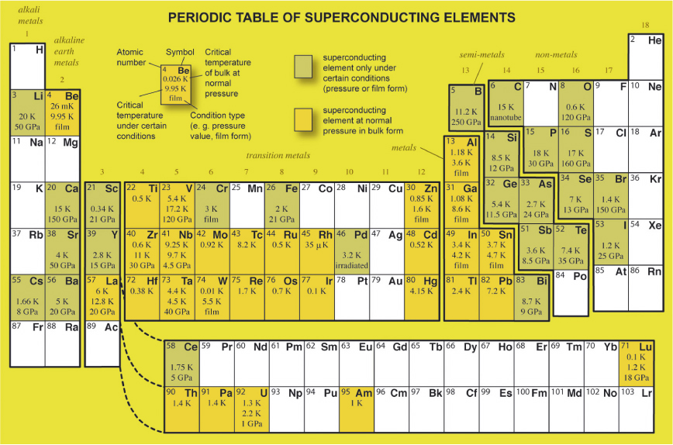
Superconducting elements

Slide 26

Two kinds of superconductor: Type 1
the materials first discovered by Heike Kamerlingh Onnes in 1911 - soft metals like lead, tin mercury
sphere of metal at room temperature
apply magnetic field
reduce the temperature - resistance decreases
reduce the temperature some more - resistance decreases some more
at the critical temperature θ_{c} the field is pushed out - the Meissner effect - superconductivity!
increase the field - field is kept out - by Maxwell there must be surface currents
increase the field some more - superconductivity is extinguished and the field jumps in
thermodynamic critical field B_{c} is trade off between reducing energy via condensation to superconductivity and increasing energy by pushing out field ~ 0.1T
useless for magnets!

Slide 27
Two kinds of superconductor: Type 2
apply magnetic field
reduce the temperature - resistance decreases
at the critical temperature θ_{c} the field is pushed out - surface currents again
increase the field - field jumps back in without quenching superconductivity
it does so in the form of quantized fluxoids
lower critical field B_{c1}
supercurrents encircle the resistive core of the fluxoid thereby screening field from the bulk material
higher field ⇒ closer vortex spacing
superconductivity is extinguished at the (much higher) upper critical field B_{c2}
OK for magnets!

Slide 28
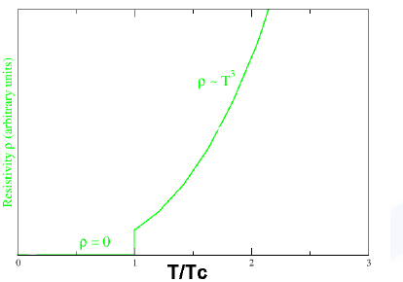
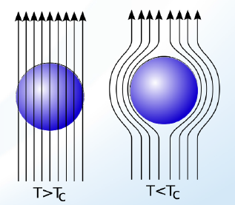


Superconducting state
The superconducting state is characterized by the critical temperature T_{c} and the critical magnetic field H_{c}
The external field is expelled from a superconductor if $H_{ext}<H_{c}$ for Type I superconductors
For Type II superconductors the external field will partially penetrate for $H_{ext}>H_{c1}$ and will completely penetrate at $H_{c2}$.
$$H_{c}\left(T\right)=H_{c}\left(0\right)∙\left[1−{\left(\frac{T}{T_{c}}\right)}^{2}\right]$$

Slide 29



Meissner effect (1933)
Superconductivity is a quantum mechanical phenomenon. It is characterized by the Meissner effect (Meissner and Ochsenfeld, 1933), the complete ejection of magnetic field lines from the interior of the superconductor as it transitions into the superconducting state.
The occurrence of the Meissner effect indicates that superconductivity cannot be understood simply as the idealization of perfect conductivity in classical physics.
Superconductor in Meissner state = ideal diamagnetic
Type I: Meissner state $B=H+M=0 for H<H_{c};$ normal state at $H>H_{c}$
Type II: Meissner state $B=H+M=0 for H<H_{c1};$ partial flux penetration for $H_{c1}<H<H_{c2};$ normal state for $H>H_{c2}$

Slide 30

Meissner effect in Type I superconductors
In 1933 W. Meissner and R. Ochsenfeld discovered what is called the Meissner effect
The magnetic field is expelled from the sample when it becomes superconducting
In strong fields the material goes to normal state.
Meissner effect is not total, the magnetic field actually penetrates a small distance ℓ the London Penetration Depth.
Current is limited to a small surface ~ 20 – 50 mm
typically for NbTi if T = 10 K B_{c} = 0.24 T
The total current is not large enough to create a strong magnetic field.
Type I superconductors are not suitable for magnet coils

Slide 31

Type II superconductors
Type II superconductors have a second critical B_{c2}(T) > B_{c1}(T)
Magnetic field lines penetrate the superconductor in form of flux tubes
When B increases more and more flux tubes penetrate the material
However in the presence of a current, flux tubes move transversely and this motion generates heat
Induce flux-pinning centers (e.g. lattice defects). A very delicate industrial process.
When the external field decreases flux is trapped creating hysteresis (diamagnetic). Needs to warm up the magnet.

Slide 32


Microscopic theory of superconductivity
Bardeen-Cooper-Schrieffer (BCS) theory (1957)
Nobel prize in 1972

Slide 33

BCS Theory
Attraction between electrons with antiparallel momenta k and spins due to exchange of lattice vibration quanta (phonons)
Instability of the normal Fermi surface due to bound states of electron (Cooper) pairs.
Bose condensation of overlapping Cooper pairs in a coherent superconducting state.
Scattering on electrons does not cause the electric resistance because it would break the Cooper pair.
The strong overlap of many Cooper pairs results in the macroscopic phase coherence.

Slide 34

Why Niobium?
High critical temperature (cavities with high-T_{c} sputter coatings on copper have shown much inferior performance in comparison to niobium cavities) → lower RF losses at 4K or 2K → smaller heat load on refrigeration system.
High RF critical field, which of the order of H_{c}. Strong flux pinning associated with high $H_{c2}$ is undesirable as it is coupled with losses due to hysteresis. Hence a ‘soft’ superconductor must be used.
Good formability is desirable for ease of cavity fabrication. Alternative is a thin superconducting film on a copper substrate.
Pure niobium is the best candidate, although its critical temperature T_{c} is only 9.25K, and the thermodynamic critical field about 200 mT.
Pure intermetallic compounds, like Nb₃Sn with a critical temperature of 18.1K, look more favorable at first sight as they are “clean” superconductors. However, the gradients achieved in Nb₃Sn coated niobium cavities were always below 15 MV/m, probably due to grain boundary effects in the Nb3Sn layer.
Alloys are “dirty” superconductors due to their small mean free path and consequently large BCS surface resistivity and poor thermal conductivity. For these reasons, alloys are not suitable for superconducting cavities.

Slide 35


Superconductivity
Superconductivity was discovered in 1911 by H. Kamerlingh Onnes
The temperature at which the transition takes place is called the critical temperature T_{c}
Phase diagram (NbTi). The critical surface.
Under the surface the material has no resistance
Type I and Type II superconductors

Slide 36

Superconducting materials

Slide 37

Persistent currents
Currents are produced to counteract a change in magnetic field
In the copper, eddy currents are minimized by twisting and transposing the stands in the cable
However in the SC they do not decay
This persistent currents produce magnetic effects which can be detected outside the cable
In order to reduce magnetization effects, all magnet conductors are made with the superconductor divided into fine filaments.
For NbTi is ~ 50 μm, for accelerator magnets ~ 6 – 10 μm

Slide 38

Practical superconductors I
NbTi has been developed since many years and can be industrially produced in large quantities.
Nb₃Sn is a promising candidate but it is very brittle what makes winding difficult.
Rutherford cable is the most common used cable in accelerators

Slide 39

Practical superconductors II
Due to their crystalline structure HT superconductors are highly anisotropic and only conduct in a thin surface.
Conductors are made out of superposition of HTS tape
Used in LHC to manufacture current leads
Other high temperature superconductors as MgB2 made the object of intensive research.

Slide 40
The critical surface for niobium titanium
Niobium titanium NbTi is the standard ‘work horse’ of the superconducting magnet business
it is a ductile alloy
picture shows the critical surface, which is the boundary between superconductivity and normal resistivity in 3 dimensional space
superconductivity prevails everywhere below the surface, resistance everywhere above it
we define an upper critical field B_{c2} (at zero temperature and current) and critical temperature θ_{c} (at zero field and current) which are characteristic of the alloy composition
critical current density J_{c}(B,θ) depends on processing
Temperature (K)
Field (Tesla)
J_{c}
θ_{c}
Current density (kA.mm⁻²)
B_{c2}

Slide 41
The critical line at 4.2K
because magnets usually work in boiling liquid helium, the critical surface is often represented by a curve of current versus field at 4.2K
niobium tin Nb₃Sn has a much higher performance in terms of critical current field and temperature than NbTi
but it is brittle intermetallic compound with poor mechanical properties
note that both the field and current density of both superconductors are way above the capability of conventional electromagnets
10⁴
Nb₃Sn
Critical current density A.mm⁻²
10³
NbTi
10²
Conventional iron yoke electromagnets
10
Magnetic field (Tesla)

Slide 42


Practical superconductors for magnets
superconducting materials are always used in combination with a good normal conductor such as copper
to ensure intimate mixing between the two, the superconductor is made in form of fine filaments embedded in a matrix of copper
typical dimensions are:
- wire diameter: 0.3 – 1.0 mm
- filament diameter: 10 – 60 μm
for electromagnetic reasons, the composite wires are twisted so that the filaments look like a rope
for accelerators, many wires are combined in a cable

Slide 43


A typical superconducting cable
Filament in an actual cable
(Filament size in SSC/RHIC magnets: 6 micron

Slide 44


Critical properties
Critical temperature θ_{c}: choose the right material to have a large energy gap or 'depairing energy' property of the material
Upper Critical field B_{c2}: choose a Type 2 superconductor with a high critical temperature and a high normal state resistivity property of the material
Critical current density J_{c}: mess up the microstructure by cold working and precipitation heat treatments hard work by the producer

Slide 45

Critical field & temperature of metallic superconductors
Note: of all the metallic superconductors, only NbTi is ductile.
All the rest are brittle intermetallic compounds

Slide 46
Critical field & temperature of metallic superconductors
To date, all superconducting accelerators have used NbTi.
Of the intermetallics, only Nb₃Sn has found significant use in magnets

Slide 47

Wonderful materials for magnets

Slide 48
Magnetic fields and ways to create them: (1) Iron
Conventional electromagnets
iron yoke reduces magnetic reluctance
⇒ reduces ampere turns required
⇒ reduces power consumption
iron guides and shapes the field
I
I
B
1.6T
B
H
-100A/m
100A/m
Iron electromagnet
– for accelerator, HEP experiment transformer, motor, generator, etc.
-1.6T
BUT iron saturates at ~ 2T

Slide 49
Magnetic fields and ways to create them: (2) Solenoids
B
B
no iron – field shape is set solely by the winding
cylindrical winding
azimuthal current flow
- eg wire wound on bobbin
axial field
can also reduce field curvature by making the winding thicker at the ends
this makes the field more uniform
I
I
field lines curve outwards at the ends
this curvature produces non uniformity of field
very long solenoids have less curvature and more uniform field
I
more complicated winding shapes can be used to make very uniform fields

Slide 50


Magnetic fields and ways to create them: (3) transverse uniform fields
simplest winding uses racetrack coils
some iron - but field shape is set mainly by the winding
used when the long dimension is transverse to the field, eg. accelerator magnets
known as dipole magnets (because the iron version has 2 poles)
' saddle' coils make better
field shapes
special winding cross sections for good uniformity
I
I
I
B
LHC has
'up' & 'down' dipoles side by side

Slide 51



Dipole magnets
made from superconducting cable
winding must have the right cross section
also need to shape the end turns

Slide 52



Fields and ways to create them: (4) transverse gradient fields
gradient fields produce focussing
quadrupole windings
I
I
B_{x} = ky
B_{y} = kx

Slide 53
Engineering current density
In designing a magnet, what really matters is the overall 'engineering' current density J_{eng}
fill factor in the wire
insulation
where mat = matrix : superconductor ratio
typically:
for NbTi mat = 1.5 to 3.0 ie λ_{metal} = 0.4 to 0.25
for Nb₃Sn mat ~ 3.0 ie λ_{metal} ~ 0.25
for B2212 mat = 3.0 to 4.0 ie λ_{metal} = 0.25 to 0.2
λ_{winding} takes account of space occupied by insulation, cooling channels, mechanical reinforcement etc and is typically 0.7 to 0.8
NbTi
Cu
So typically J_{eng} is only 15% to 30% of J_{supercon}

