Slide 1

Outline: Radiation emission
Lecturer: Hans-Jürgen Wollersheim
e-mail: h.j.wollersheim@gsi.de
web-page: https://web-docs.gsi.de/~wolle/ and click on
photons in the universe
nuclear resonance fluorescence
synchrotron radiation
wiggler and undulator
inverse Compton scattering

Slide 2
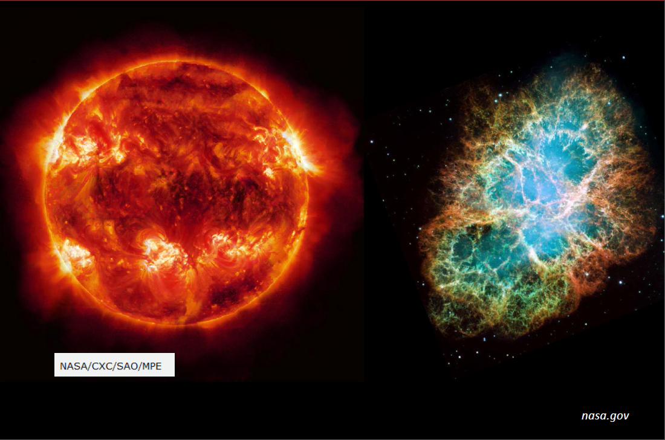
Photons in the universe

Slide 3
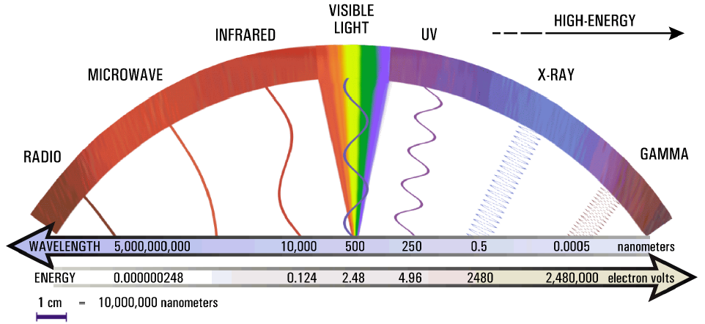
Photons in the universe

Slide 4
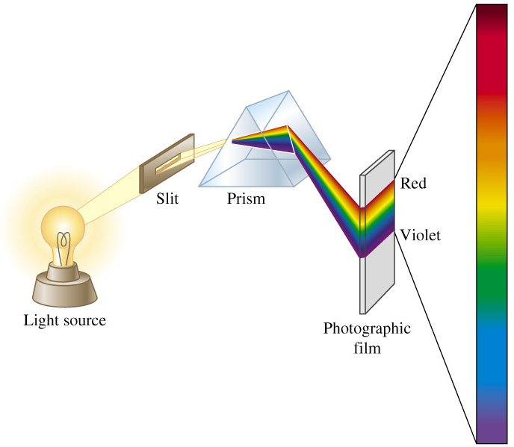
Element production on the sun

Slide 5

Spectral lines of hydrogen
absorption spectrum
absorption
hydrogen gas

Slide 6
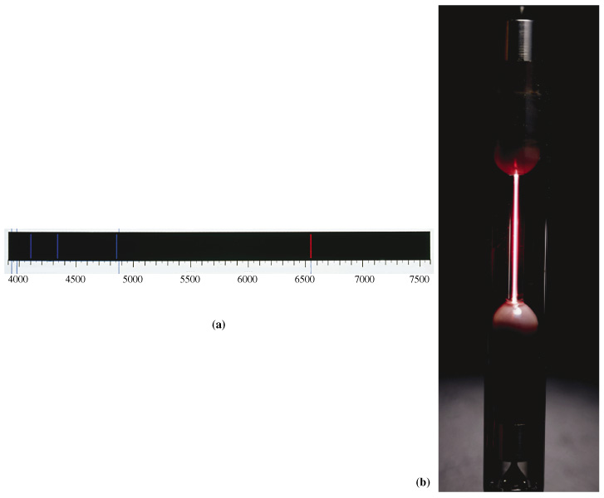
Element production on the sun
Hydrogen emission spectrum
wave length nm
6

Slide 7
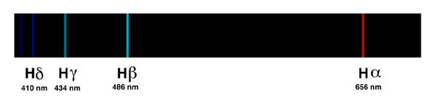
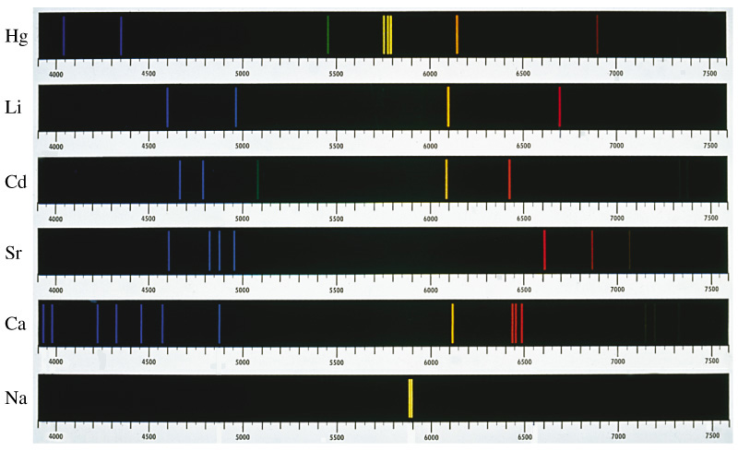
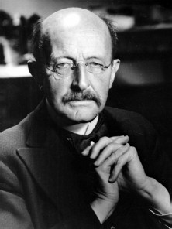
Spectral analysis
H
Spectral analysis
Kirchhoff und Bunsen:
Every element has a characteristic emission band
Max Planck
7

Slide 8
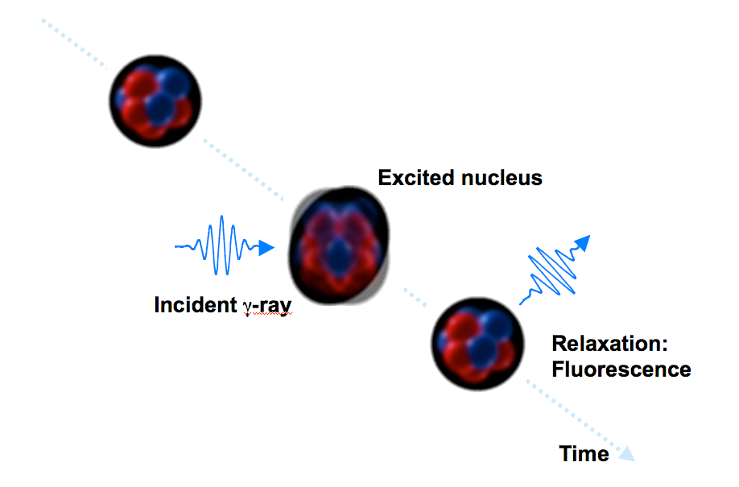
Nuclear Resonance Fluorescence
Nuclear Resonance Fluorescence (NRF) is analogous to atomic resonance fluorescence but depends upon the number of protons AND the number of neutrons in the nucleus

Slide 9
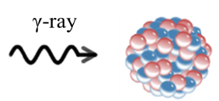
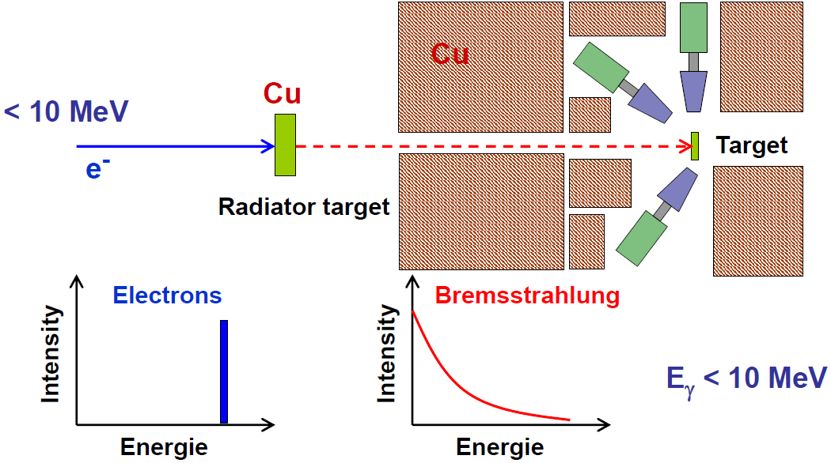
Low energy photon scattering at S-DALINAC
“white“ photon spectrum
wide energy region examined

Slide 10

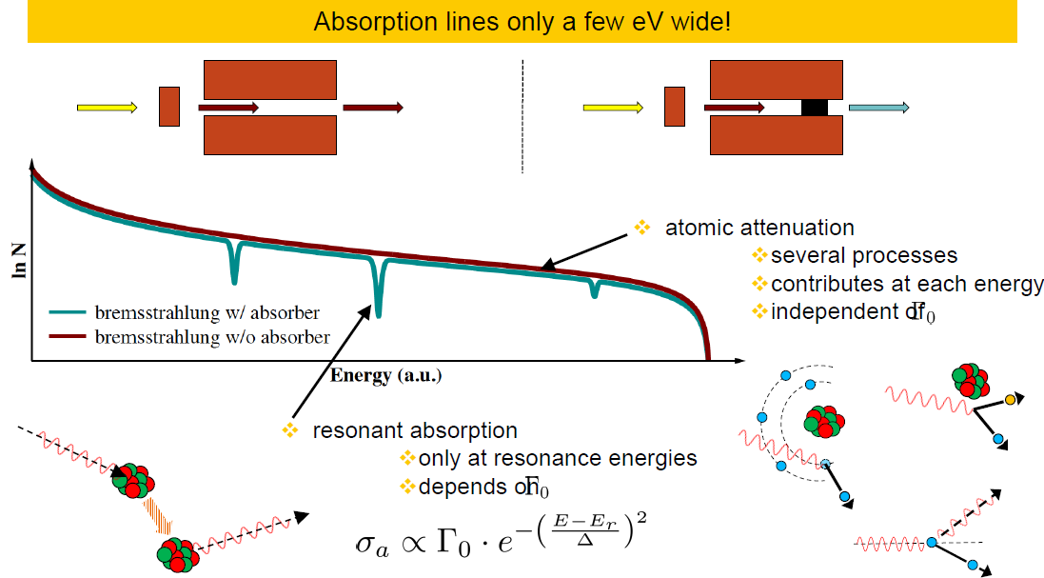
Absorption processes

Slide 11
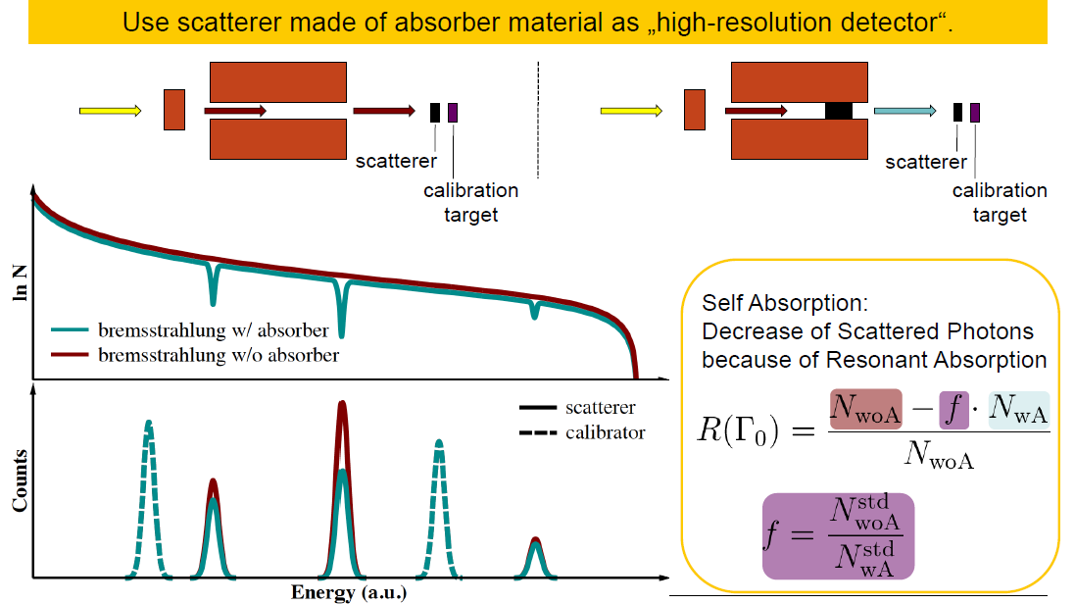
Principle of measurement and self absorption

Slide 12
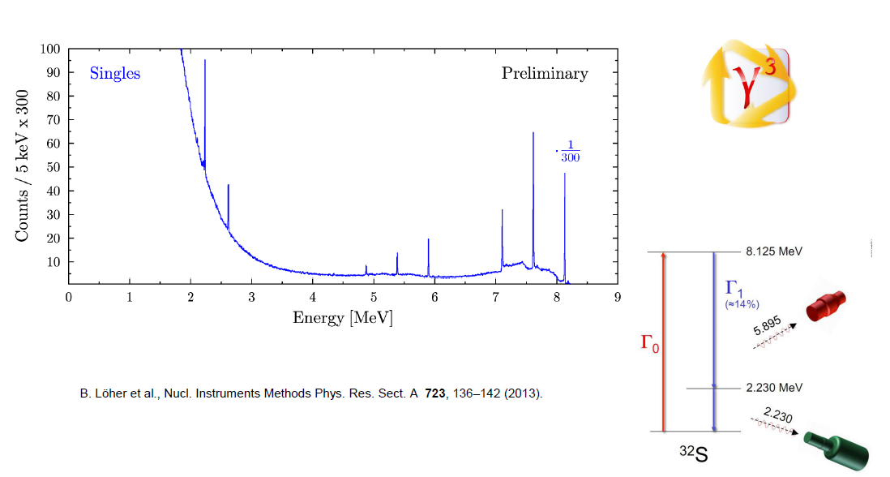
First γγ-coincidences in a γ-beam

Slide 13
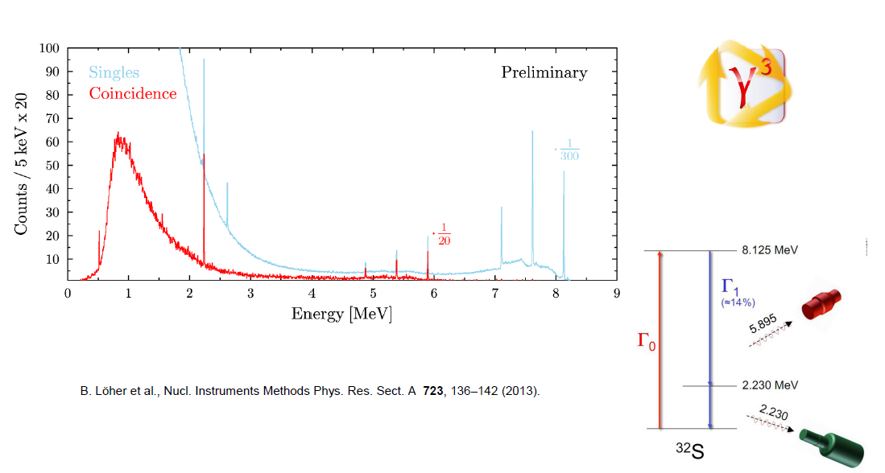
First γγ-coincidences in a γ-beam

Slide 14
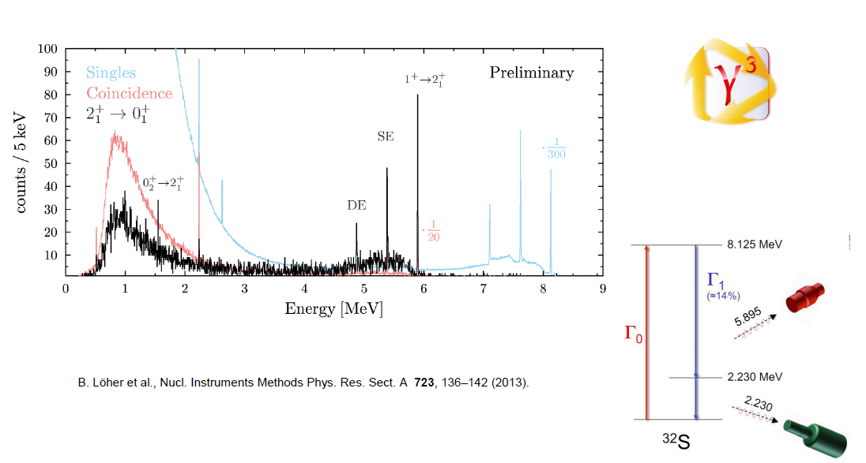
First γγ-coincidences in a γ-beam

Slide 16
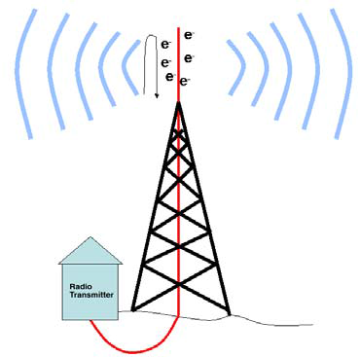
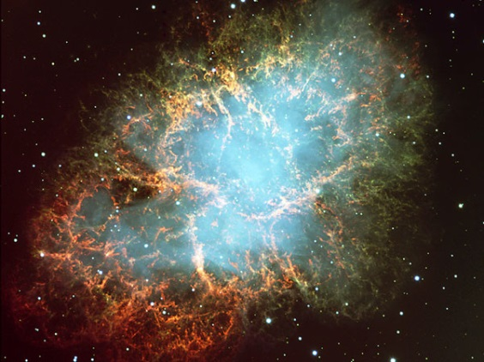
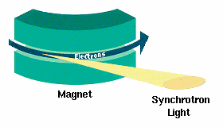
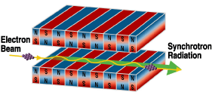
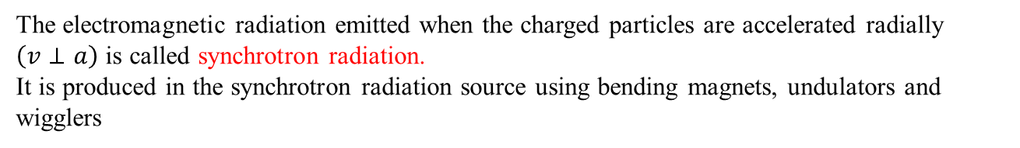
What is synchrotron radiation?
Electromagnetic radiation is emitted by charged particles when accelerated
EM radiated from an antenna:
time-varying current runs up and down the antenna, and in the process emits radio waves
At the heart of the Crab nebula is a rapidly-spinning neutron star, a pulsar, and it powers the strongly polarized bluish ‘synchrotron’ nebula.
The electromagnetic radiation emitted when the charged particles are accelerated radially $\left(v⊥a\right)$ is called synchrotron radiation.
It is produced in the synchrotron radiation source using bending magnets, undulators and wigglers

Slide 17
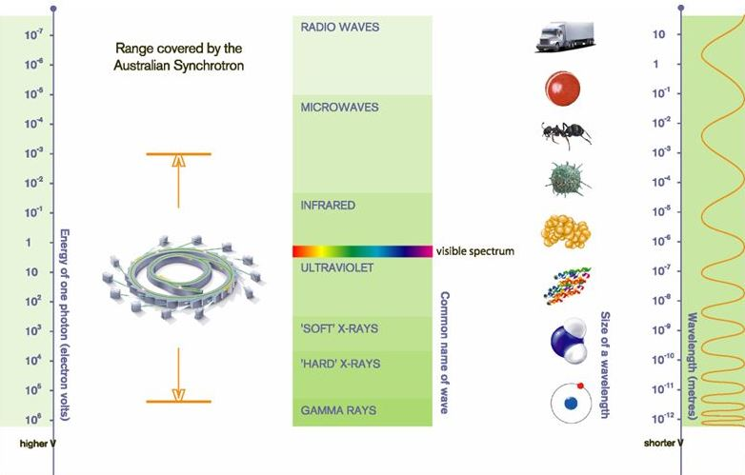
Properties of Synchrotron Radiation: Radiation Spectrum
The Electromagnetic Spectrum

Slide 18
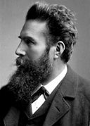
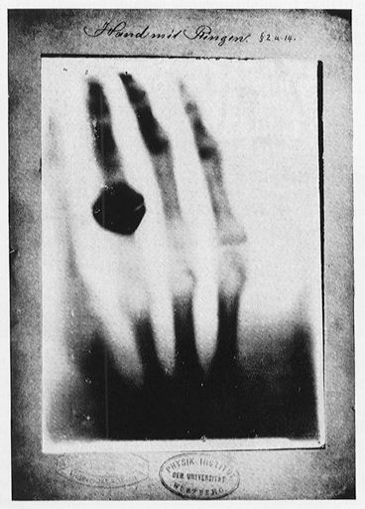
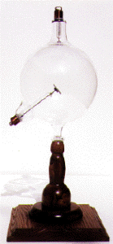
Discovery of X-rays ~100 years ago
X-ray were discovered (accidentally) in 1895 by Wilhelm Konrad Roentgen.
Roentgen won the first Nobel Prize in 1901 “for the discovery with which his name is linked for all time: the … so-called Roentgen rays, as he himself called them, X-rays …”
first commercial X-ray tube

Slide 19
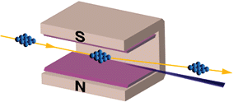

Synchrotron Radiation
Lorentz Force:
$$\vec{F}=q∙\left(\vec{E}+\vec{v}×\vec{B}\right)$$
Synchrotron Radiation
Electromagnetic radiation produced by relativistic charged particles accelerated in circular orbits.

Slide 20
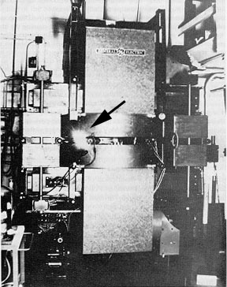
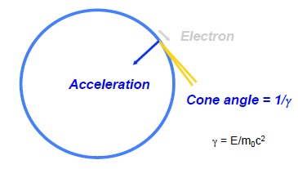
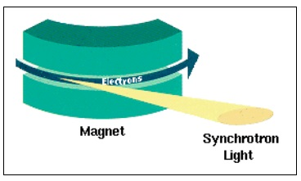
Discovery of Synchrotron Radiation ~50 years ago
Synchrotron radiation was first observed (accidentally) from a 70 MeV synchrotron in 1947
On April 24, 1947 Langmuir and I [Herbert Pollack] were running the machine and as usual were trying to push the electron gun and its associated pulse transformer to the limit. Some intermittent sparking had occurred and we asked the technician to observe with a mirror around the protective concrete wall. He immediately signaled to turn off the synchrotron as “he saw an arc in the tube”. The vacuum was still excellent, so Langmuir and I came to the end of the wall and observed. At first we thought it might be due to Cherenkow radiation, but it soon became clear that we were seeing Ivanenko and Pomeranchuk [i.e. synchrotron] radiation.

Slide 21
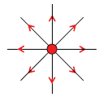

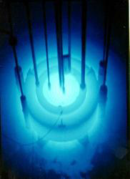
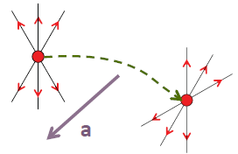
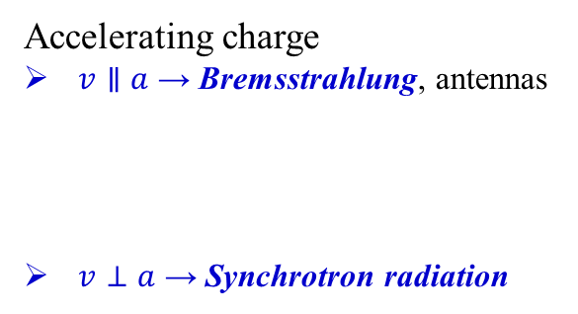
Radiation from moving charges
Charge at rest: Coulomb field, no radiation
Uniformly moving charge, no radiation
(Cherenkov radiation)
v = constant
Accelerating charge
$v∥a$ → Bremsstrahlung, antennas
$v⊥a$ → Synchrotron radiation
v = constant
a

Slide 22
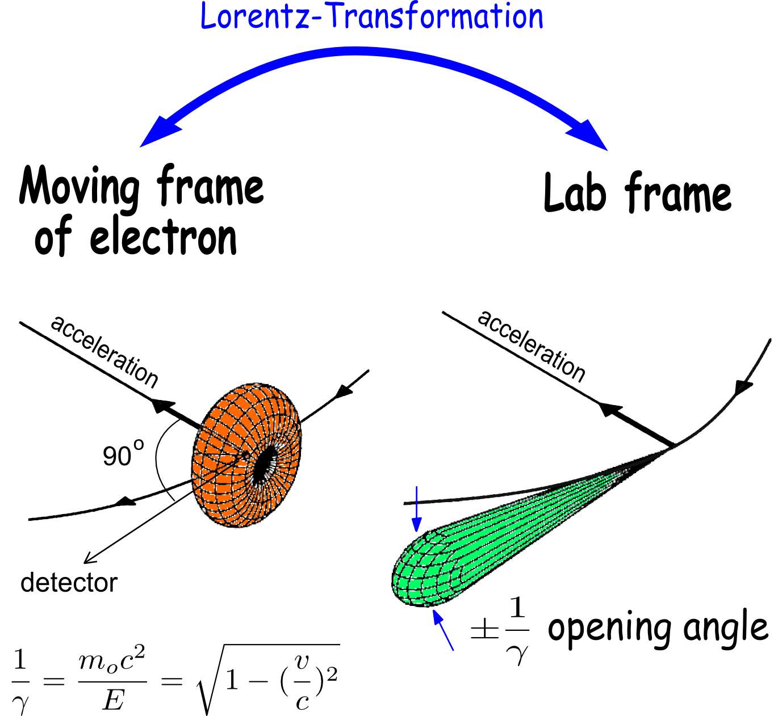
Properties of Synchrotron Radiation: Angular Distribution
Radiation becomes more focused at higher energies

Slide 23
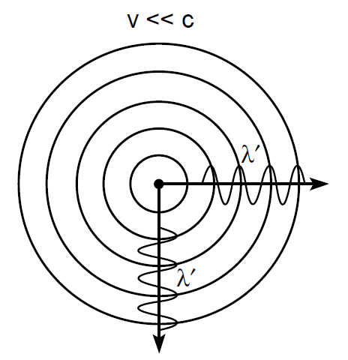
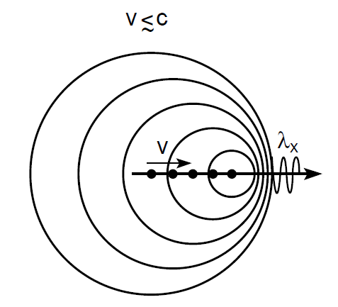

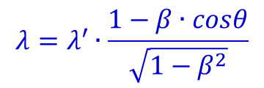
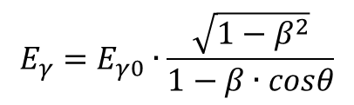
Synchrotron radiation from relativistic electrons
angle dependent Doppler shift
$$λ=λ^{′}∙\frac{1−β∙cosθ}{\sqrt{1−β^{2}}}$$
$$λ≅λ^{′}∙\left(1−β∙cosθ\right)$$
$$E_{γ}=E_{γ0}∙\frac{\sqrt{1−β^{2}}}{1−β∙cosθ}$$

Slide 24
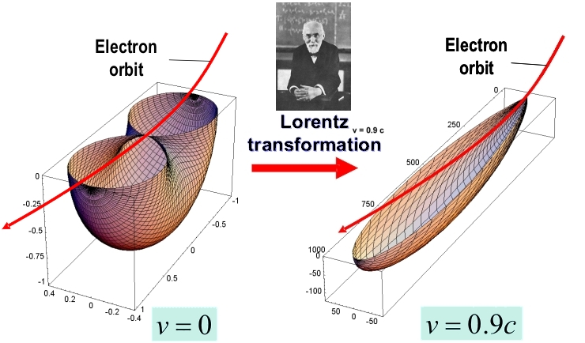
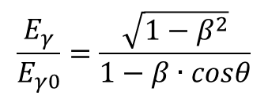
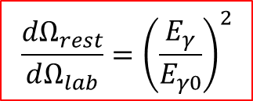
Synchrotron radiation from relativistic electrons
$$\frac{dΩ_{rest}}{dΩ_{lab}}={\left(\frac{E_{γ}}{E_{γ0}}\right)}^{2}$$
$$\frac{E_{γ}}{E_{γ0}}=\frac{\sqrt{1−β^{2}}}{1−β∙cosθ}$$

Slide 25
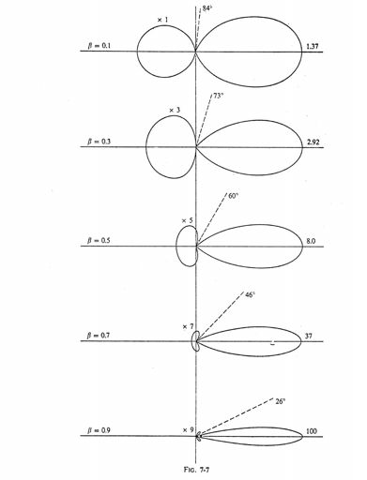
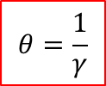
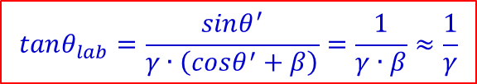
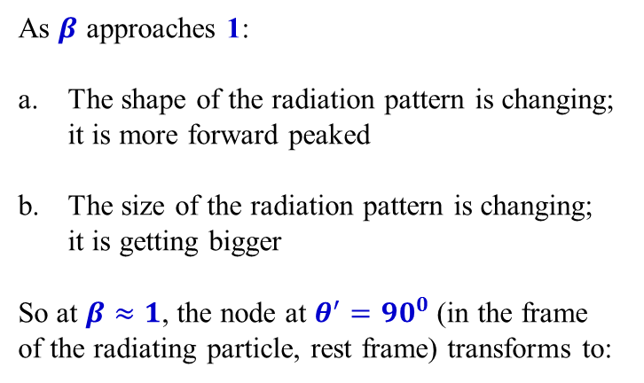
Radiation Patterns when v approaches c
As $β$ approaches 1:
The shape of the radiation pattern is changing; it is more forward peaked
The size of the radiation pattern is changing; it is getting bigger
So at $β≈1$, the node at $θ^{′}={90}^{0}$ (in the frame of the radiating particle, rest frame) transforms to:
$$tanθ_{lab}=\frac{sinθ^{′}}{γ∙\left(cosθ^{′}+β\right)}=\frac{1}{γ∙β}≈\frac{1}{γ}$$
In fact, the opening angle in both the horizontal and vertical directions, is given approximately by:
$$θ=\frac{1}{γ}$$

Slide 26
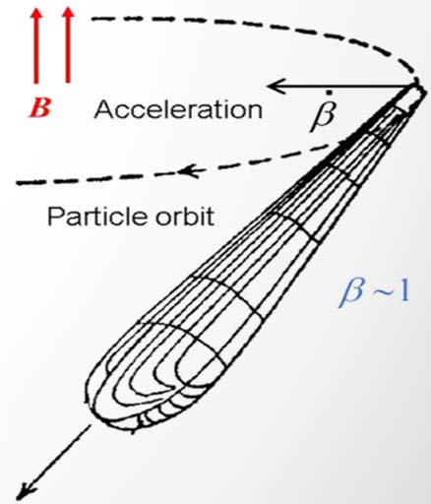
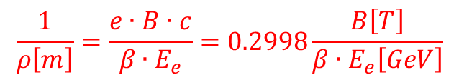

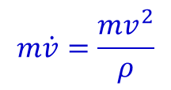

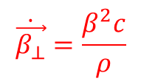
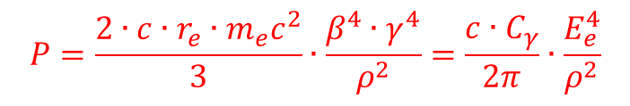

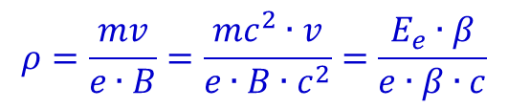
Synchrotron Radiation
Consider a charged particle in homogeneous field B
The acceleration in B is given by
$$ρ$$
$$\dot{\vec{β_{⊥}}}=\frac{β^{2}c}{ρ}$$
$$m\dot{v}=\frac{mv^{2}}{ρ}$$
where the bending radius of charged particle, $ρ$, at energy $E_{e}$ is
$$\frac{1}{ρ\left[m\right]}=\frac{e∙B∙c}{β∙E_{e}}=0.2998\frac{B\left[T\right]}{β∙E_{e}\left[GeV\right]}$$
$$ρ=\frac{mv}{e∙B}=\frac{mc^{2}∙v}{e∙B∙c^{2}}=\frac{E_{e}∙β}{e∙β∙c}$$
Larmor radius
Then the instantaneous radiation power becomes
$$P=\frac{2∙c∙r_{e}∙m_{e}c^{2}}{3}∙\frac{β^{4}∙γ^{4}}{ρ^{2}}=\frac{c∙C_{γ}}{2π}∙\frac{E_{e}^{4}}{ρ^{2}}$$
$$C_{γ}≡\frac{4π}{3}∙\frac{r_{e}}{{\left(m_{e}c^{2}\right)}^{3}}=8.85∙{10}^{−5} \left[\frac{m}{{GeV}^{3}}\right]$$
classical electron radius
$$r_{e}=\frac{e}{4π∙ε_{0}∙m_{e}c^{2}}$$

Slide 27






Synchrotron Radiation Power and Energy Loss for Electrons
Instantaneous Synchrotron Radiation Power for a single electron
$$P_{γ}\left[{GeV}/s\right]=\frac{c∙C_{γ}}{2π}∙\frac{E^{4}\left[{GeV}^{4}\right]}{ρ^{2}\left[m^{2}\right]}$$
$$C_{γ}=8.8575∙{10}^{−5} \frac{m}{{GeV}^{3}}$$
with
Energy loss per turn for a single particle in an isomagnetic lattice with bending radius $ρ$ is given by integrating $P_{γ}$ over the lattice
$$∆E\left[GeV\right]=C_{γ}∙\frac{E^{4}\left[{GeV}^{4}\right]}{ρ\left[m\right]}$$
The average Radiated Power for an entire beam is $\left(P=I/e∙∆E\right)$
$$P_{γ}\left[MW\right]=8.8575∙{10}^{−2}∙\frac{E^{4}\left[{GeV}^{4}\right]}{ρ\left[m\right]}∙I\left[A\right]$$
Radiated Power varies as the inverse fourth power of particle mass. Comparing radiated power from a proton vs. an electron, we have:
$$\frac{P_{e}}{P_{p}}={\left(\frac{m_{p}}{m_{e}}\right)}^{4}={1836}^{4}=1.1367∙{10}^{13}$$
$$P_{γ}\left[MW\right]=2.65∙{10}^{−2}∙E^{3} {\left[GeV\right]}^{3}∙B \left[T\right]∙I \left[A\right]$$

Slide 28

Synchrotron Radiation Photon Numbers
Total photon numbers

Slide 29







Some useful formulas for synchrotron radiation
$$γ=\frac{1}{\sqrt{1−\frac{v^{2}}{c^{2}}}}=\frac{1}{\sqrt{1−β^{2}}}; β=\frac{v}{c}; \left(1−β\right)≅\frac{1}{2γ^{2}}$$
$$E_{e}=γ∙mc^{2}; p=γ∙mv$$
$$γ=\frac{E_{e}}{mc^{2}}=1957∙E_{e} \left[GeV\right]$$
$$ℏω∙λ=1239.842 \left[eV∙nm\right]$$
$$1 Watt⇒5.034∙{10}^{15}∙λ \left[nm\right]∙\frac{photons}{s}$$
$$Bending Magnet: E_{c}=\frac{3e∙ℏ∙B∙γ^{2}}{2m}; E_{c}\left(keV\right)=0.6650E_{e}^{2} \left[GeV\right]∙B\left[T\right]$$
$$Undulator: λ=\frac{λ_{u}}{2γ^{2}}∙\left(1+\frac{K^{2}}{2}+γ^{2}∙θ^{2}\right); E\left(keV\right)=\frac{0.9496∙E_{e}^{2} \left(GeV\right)}{λ_{u}\left(cm\right)∙\left(1+\frac{K^{2}}{2}+γ^{2}∙θ^{2}\right)}$$
where $K≡\frac{e∙B_{0}∙λ_{u}}{2π∙mc}=0.9337∙B_{0}\left(T\right)∙λ_{u}\left(cm\right)$

Slide 30


Accelerator Synchrotron Sources
Synchrotron radiation is generated in normal accelerator bending magnets
There are also special magnets called wigglers and undulators which are designed for this purpose.

Slide 31

Bright and powerful X-rays from relativistic electrons
___Synchrotron radiation___ | ___Undulator radiation___
10¹⁰ brighter than the most powerful (compact) laboratory source An X-ray “light bulb” in that it radiates all “colors” (wavelengths, photons energies) | Lasers exist for the IR, visible, UV, VUV and EUV Undulator radiation is quasi-monochromatic and highly directional, approximating many of the desired properties of an X-ray laser

Slide 32


Layout of a synchrotron radiation source
Electrons are generated and accelerated in a LINAC, further accelerated to the required energy in a booster and injected and stored in a storage ring.
The circulating electrons emit an intense beam of synchrotron radiation which is sent down the beamlines.
6 GeV
200 MeV

Slide 33

Synchrotron Light Sources

Slide 34






Synchrotron Radiation Spectrum
Bending Magnet Radiation covers a broad region of the spectrum, including the primary absorption edges of most elements.
$$E_{c}=ℏω_{c}=\frac{3e∙ℏ∙B∙γ^{2}}{2m}$$
$$=2.218∙\frac{E_{e}^{3}{\left[GeV\right]}^{3}}{ρ\left[m\right]}$$
$$E_{c}\left(keV\right)=0.6650∙E_{e}^{2}\left(GeV\right)∙B\left(T\right)$$
$$\frac{d^{2}F_{B}}{dθ {dω}/ω}=2.46∙{10}^{13}E_{e}\left(GeV\right)∙I\left(A\right)∙G_{1}\left(E/{E_{c}}\right)∙\frac{photons/s}{mrad∙\left(0.1\%BW\right)}$$
Advantages: cover broad spectral range
least expensive
most accessible
Disadvantages: limited coverage of hard X-rays
not as bright as undulator

Slide 35




Synchrotron Radiation Spectrum
For a wiggler or single bend magnet, the radiation spectrum depends on a single parameter, the critical energy
$$ε_{c}=ℏω_{c}=\frac{3∙h∙c∙γ^{3}}{4π∙ρ}$$
photon energy:
wavelength:
$$λ_{c}={2π∙c}/{ω_{c}}$$
$$1.333∙{\left(\frac{ε}{ε_{c}}\right)}^{1/3}$$
The distribution for longer wavelengths does not depend on energy

Slide 36


Insertion Devices
Undulator: Electron beam is periodically deflected by a weak magnetic field. Particle emits radiation at wavelength of the periodic motion, divided by $γ^{2}$. So period of cm for magnets results in radiation in VUV to X-ray regime.
Wiggler: Electron beam is periodically deflected by strong bending magnets. Motion is no longer pure sinusoid and radiation spectrum is continuous up to a critical cut off photon energy $\left(ε_{crit}\sim B∙γ^{2}\right)$. Spectrum is infrared to hard X-rays.

Slide 37

Three Forms of Synchrotron Radiation

Slide 38

An Undulator up close
ALS U5 undulator, beamline 7.0, N = 89, $λ_{u}=50 mm$

Slide 39

Undulator Radiation

Slide 40






How to characterize the properties of a synchrotron radiation source?
T$otal flux≡\frac{Photons}{s}$
100%
70.7%
$$Spectral flux≡\frac{{Photons}/s}{0.1\% bandwidth}$$
$$Brightness≡\frac{{Photons}/s}{{mrad}^{2}∙0.1\% bandwidth}$$
$$Brilliance≡\frac{{Photons}/s}{{mrad}^{2}∙{mm}^{2}∙0.1\% bandwidth}$$
Brilliance is the figure of merit for the design of a new synchrotron source

Slide 41

Brilliance
Brilliance takes into account:
  Number of photons produced per second
  The angular divergence of the photons, or how fast the beam spreads out
  The cross-section area of the beam
  the photons falling within a bandwidth of 0.1% of the central wavelength or frequency
Oxfordshire, UK
SRS = Synchrotron Radiation Source

Slide 42

Layout of a synchrotron radiation source
Electrons are generated and accelerated in a LINAC, further accelerated to the required energy in a booster and injected and stored in a storage ring.
The circulating electrons emit an intense beam of synchrotron radiation which is sent down the beamlines.
Soleil, France

Slide 43



Applications
Medicine, Biology, Chemistry, Material Science, Environmental Science and more
Biology
Reconstruction of the 3D structure of a nucleosome with a resolution of 0.2 nm
Archeology
A synchrotron X-ray beam at the SSRL facility illuminated an obscured work erased, written over and even painted over of the ancient mathematical genius Archimedes 287 B.C.
The collection of precise information on the molecular structure of chromosomes and their components can improve the knowledge of how the genetic code of DNA is maintained and reproduced
X-ray fluorescence imaging revealed the hidden text by revealing the iron contained in the ink used by a 10th century scribe. This X-ray image shows the lower left corner of the page.

Slide 44




Protein Crystallography
Diffraction pattern
X-rays
Protein crystal

Slide 45



Bragg Scattering in Crystals
Regular structure (crystal)
Monochromatic light
$⇒$ Diffractive Pattern

Slide 46



Imaging of magnetic domains
Circularly polarized SR,
E = 778 eV
Co/Pt
multilayer

Slide 47


Slide 48
Future experiments with Synchrotron Radiation
Improvement of:
Spatial resolution
Energy resolution
Time resolution
Most of present-day experiments are dealing with equilibrium properties of condensed matter. In the future, non-equilibrium properties will be of great interest:
Dynamics of phase transitions, magnetic switching phenomena, chemical reactions etc.
Reveal the underlying mechanisms by taking snapshots on ultrashort time scales!

Slide 49

Future experiments with Synchrotron Radiation

Slide 50
New radiation sources
Limits of Storage – Ring Based Sources
Beam properties reflect the equilibrium
Dynamics of particle in the ring, resulting from averaging over all revolutions
Particles are re-cycled
Development of New Radiation Sources
Radiation is generated by single bunches passing through an undulator
Energy – Recovery Linear Accelerator (ERL)
Sub-Picosecond Pulsed Sources (SPPS)
X-ray Free Electron Laser (XFEL)

Slide 51
New radiation sources
Limits of Storage – Ring Based Sources
Beam properties reflect the equilibrium
Dynamics of particle in the ring, resulting from averaging over all revolutions
Particles are re-cycled
Development of New Radiation Sources
Radiation is generated by single bunches passing through an undulator
Energy – Recovery Linear Accelerator (ERL)
Sub-Picosecond Pulsed Sources (SPPS)
X-ray Free Electron Laser (XFEL)

Slide 52



X-ray free electron laser
self-amplified spontaneous emission
Explosion of a biomolecule (T4 lysozyme) after exposure to a 2-fs XFEL pulse (E=12 keV)
Desy XFEL

Slide 53



Free Electron Laser (FEL) Principle
Fourth Generation light sources generally utilize free electron lasers (FELs) to increase brightness by at least an order of magnitude over Third Generation light source by using coherent production.
$$λ_{n}=\frac{λ_{u}}{2n∙γ^{2}}∙\left[1+\frac{K^{2}}{2}+γ^{2}∙θ^{2}\right]$$
where:
$n=1,2,3,⋯$
$γ=\frac{E}{m_{0}c^{2}}, K=0.934∙B_{0}∙λ_{u}$
$λ_{u}$ is the undulator period
$B_{0}$ is in Tesla and $λ_{u}$ is in cm
relativistic electron beam passes through periodic magnetic field – radiates
mirror feeds spontaneous emission back into beam
spontaneous emission enhanced by stimulated emission

Slide 55



Total power received by Earth from the Sun
174 Peta (10¹⁵) Watt
@
extreme light infrastructure, Europe

Slide 56





Compton scattering and inverse Compton scattering
Compton scattering:
Elastic scattering of a high-energy γ-ray on a free electron.
A fraction of the γ-ray energy is transferred to the electron.
The wave length of the scattered γ-ray is increased: λ‘ > λ.
$$hν≥m_{e}c^{2}$$
$$λ^{′}−λ=\frac{h}{m_{e}c}∙\left(1−cosθ_{γ}\right)$$
$$E_{γ}^{′}=\frac{E_{γ}}{1+\frac{E_{γ}}{m_{e}c^{2}}∙\left(1−cosθ\right)}$$
Inverse Compton scattering:
Scattering of low energy photons on ultra-relativistic electrons.
Kinetic energy is transferred from the electron to the photon.
The wave length of the scattered γ-ray is decreased: λ‘ < λ.
$$λ′≈λ∙\frac{1−β∙cosθ_{γ}}{1+β∙cosθ_{L}}$$

Slide 57












Inverse Compton scattering
Electron is moving at relativistic velocity
Transformation from laboratory frame to reference frame of e⁻ (rest frame): in order to repeat the derivation for Compton scattering
$$E_{γ}=γ∙E_{γ}∙\left(1−\frac{v}{c}cosθ_{e^{−}γ}\right)$$
Lorentz factor: $γ={\left(1−β^{2}\right)}^{−1/2}=1+\frac{T_{e}^{MeV}}{931.5∙0.00055}$
Doppler shift
differential cross section (Klein-Nishina)
$$E_{γ}^{′}=\frac{E_{γ}}{1+\frac{E_{γ}}{m_{e}c^{2}}∙\left(1−cosφ\right)}$$
Compton scattering in rest frame of e⁻
$$E_{γ}^{′}=γ∙E_{γ}^{′}\left(1+\frac{v}{c}cosθ_{e^{−}γ^{′}}\right)$$
transformation into the laboratory frame
Limit $E_{γ}≪m_{e}c^{2}$
$$E_{γ}^{′}≈γ^{2}∙E_{γ}\left(1−\frac{v}{c}cosθ_{e^{−}γ}\right)\left(1+\frac{v}{c}cosθ_{e^{−}γ^{′}}\right)$$
$$E_{γ}^{′}≈{4γ}^{2}∙E_{γ}$$
electron and γ interaction $θ_{e^{−}γ}\sim {180}^{0}$
γ‘ emission relative to electron $θ_{e^{−}γ^{′}}\sim 0^{0}$

Slide 58



Laser Compton backscattering
Energy – momentum conservation yields $\sim 4γ^{2}$ Doppler upshift
Thomsons scattering cross section is very small (6·10⁻²⁵ cm²)
High photon and electron density are required

Slide 59








Gamma rays resulting after inverse Compton scattering
photon scattering on relativistic electrons (γ >> 1)
$$hν=2.3 eV \left(≡515 nm\right)$$
$$T_{e}^{lab}=720 MeV → γ_{e}=1+\frac{T_{e}^{lab}\left[MeV\right]}{931.5∙A_{e}\left[u\right]}=1410$$
$$E_{γ}=2γ_{e}^{2}\frac{1+cosθ_{L}}{1+{\left(γ_{e}θ_{γ}\right)}^{2}+a_{0}^{2}+\frac{4γ_{e}E_{L}}{mc^{2}}}∙E_{L}$$
$\frac{4γ_{e}E_{L}}{mc^{2}}=$ recoil parameter
$a_{L}=\frac{eE}{mω_{L}c}=$ normalized potential vector of the laser field
E = laser electric field strength $E_{L}=ℏω_{L}$
$γ_{e}=\frac{E_{e}}{mc^{2}}=\frac{1}{\sqrt{1−β^{2}}}=$ Lorentz factor
maximum frequency amplification:
head-on collision (θ_{L} = 0⁰) & backscattering (θ_{γ} = 0⁰)
A. H. Compton
Nobel Prize 1927
$$E_{γ}\sim 4γ_{e}^{2}∙E_{L}$$
$$≅18.3 MeV$$

Slide 60


Scattered photons in collision
Yb: Yag J-class laser
10 Peta (10¹⁵) Watt
$$Q=1\left[nC\right]$$
$$U_{L}=0.5\left[J\right] hν_{L}=2.4\left[eV\right]=3.86∙{10}^{−19}\left[J\right]≡515\left[nm\right]$$
$${→ N}_{e}={6.25∙10}^{9}$$
$${→ N}_{L}={1.3∙10}^{18}$$
Luminosity: $L=\frac{N_{L}∙N_{e}}{4π∙σ_{R}^{2}}$
$$∙f$$
$$≅{2.9∙10}^{32}∙f \left[{cm}^{−2}s^{−1}\right]$$
$$σ_{R}=15\left[μm\right]$$
γ-ray rate: $N_{γ}=L∙σ_{Thomson}$
$$≅2∙{10}^{8}∙f \left[s^{−1}\right]$$
$$σ_{T}=0.67∙{10}^{−24}\left[{cm}^{2}\right]$$
(full spectrum)
repetition rate:
$f=3.2 kHz$

Slide 61


Thomson Scattering
J. J. Thomson
Nobel prize 1906
Thomson scattering = elastic scattering of electromagnetic radiation by an electron at rest
the electric and magnetic components of the incident wave act on the electron
the electron acceleration is mainly due to the electric field
→ the electron will move in the direction of the oscillating electric field
→ the moving electron will radiate electromagnetic dipole radiation
→ the radiation is emitted mostly in a direction perpendicular to the motion of
the electron
→ the radiation will be polarized in a direction along the electron motion

Slide 62

Thomson Scattering
J. J. Thomson
Nobel prize 1906
$$\frac{dσ_{T}\left(θ\right)}{dΩ}=\frac{1}{2}r_{0}^{2}∙\left(1+\cos^{2}θ\right)$$
differential cross section
$$r_{0}=\frac{e^{2}}{4πε_{0}m_{e}c^{2}}=2.818∙{10}^{−15} \left[m\right]$$
classical electron radius
$$σ_{T}=\int{\frac{dσ_{T}\left(θ\right)}{dΩ}dΩ}=\frac{2πr_{0}^{2}}{2}\int_{0}^{π}{\left(1+\cos^{2}θ\right)dθ}=\frac{8π}{3}r_{0}^{2}=6.65∙{10}^{−29} \left[m^{2}\right]=0.665 \left[b\right]$$

Slide 63



Scattered photons in collision
$$E_{γ}=2γ_{e}^{2}\frac{1+cosθ_{L}}{1+{\left(γ_{e}θ_{γ}\right)}^{2}+a_{0}^{2}+\frac{4γ_{e}E_{L}}{mc^{2}}}∙E_{L}$$
θ = π
θ = 0
Compton edge
$$sinθ=1/γ$$

Slide 64



Laser Compton backscattering

Slide 65


Inverse Compton scattering of laser light

Slide 66



Gamma rays resulting after inverse Compton scattering

Slide 67

Extreme Light Infrastructure – Nuclear Physics

Slide 68



Nuclear Resonance Fluorescence
Widths of particle-bound states: $Γ≤10eV$
Breit-Wigner absorption resonance curve for isolated resonance:
$$σ_{a}\left(E\right)=π{\overline{λ}}^{2}\frac{2J+1}{2}\frac{Γ_{0}Γ}{{\left(E−E_{r}\right)}^{2}+{\left(Γ/2\right)}^{2}}\sim {Γ_{0}}/Γ$$
Resonance cross section can be very large: $σ_{0}≅200 \left[b\right]$ (for Γ₀ = Γ, 5 MeV)
Example: 10 mg, A~200 → N_{target} = 3·10¹⁹, N_{γ} = 100, event rate = 0.6 [s⁻¹]

Slide 69


Nuclear Resonance Fluorescence
Count rate estimate
10⁴ γ/(s eV) in 100 macro pulses
100 γ/(s eV) per macro pulse
example: 10 mg, A ~ 200 target
resonance width Γ = 1 eV
2 excitations per macro pulse
0.6 photons per macro pulse in detector
pp-count rate 6 Hz
1000 counts per 3 min
narrow band width 0.5%
8 HPGe detectors
2 rings at 90⁰ and 127⁰
ε_{rel}(HPGe) = 100%
solid angle ~ 1%
photopeak ε_{pp} ~ 3%

Slide 70

Nuclear Resonance Fluorescence
narrow bandwidth allows selective excitation and detection of decay channels

Slide 71

Deformation and Scissors Mode
Decay to intrinsic excitations

