Slide 1
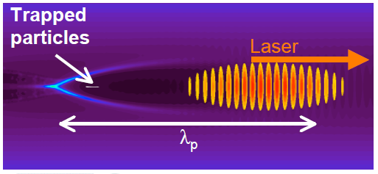
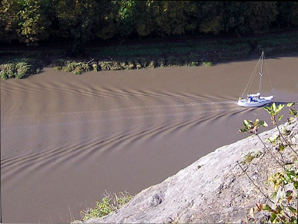
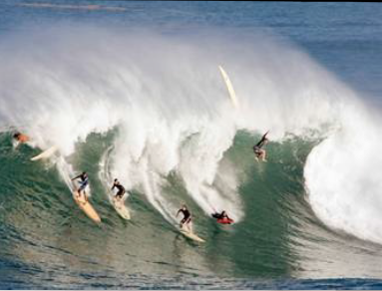
Wakefield Accelerator
Process: Laser radiation pressure displaces electrons
Space charge causes oscillating density ‘wake’ moving with the laser
Wake electric fields of ~GV/cm accelerate particles
Analogy: boat displacing water
Particle injection

Slide 2
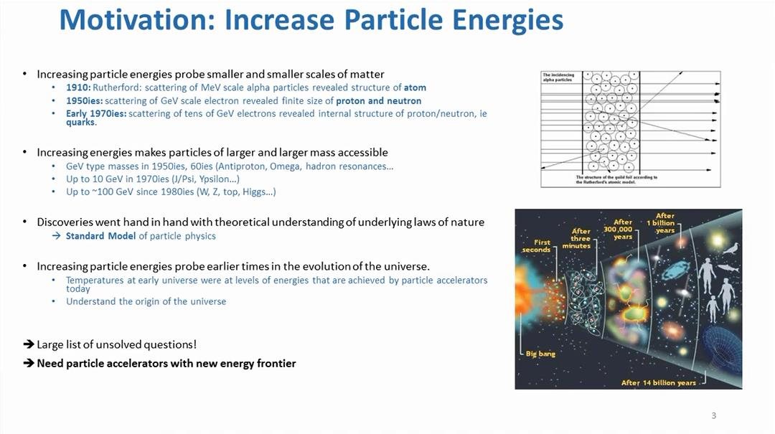
The Advanced Proton Driven Plasma Wakefield Experiment

Slide 3
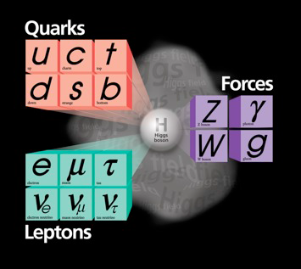
Big questions in particle physics
The Standard Model is amazingly successful, but there are unanswered questions:
What are the consequences of the “Higgs” particle discovery?
Why is there so much matter (vs. anti-matter) ?
Why is there so little matter (5%) in the Universe?
Can we unify the forces?

Slide 4
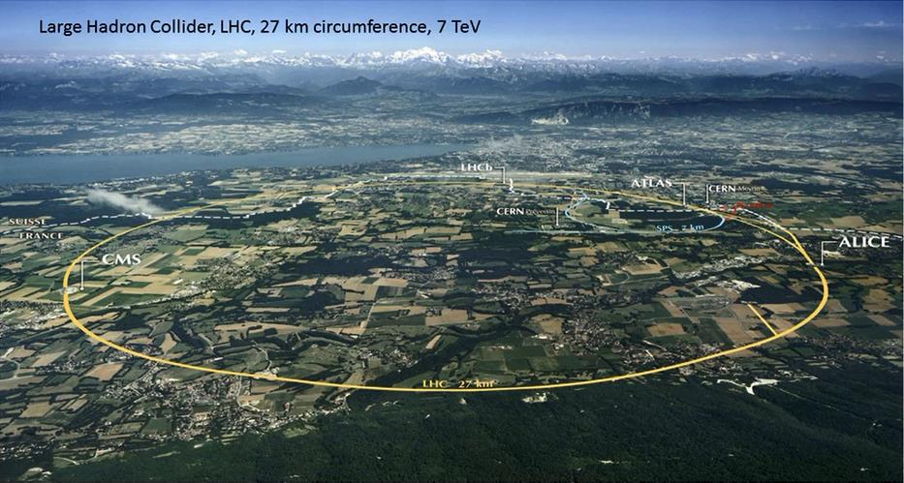

Slide 5
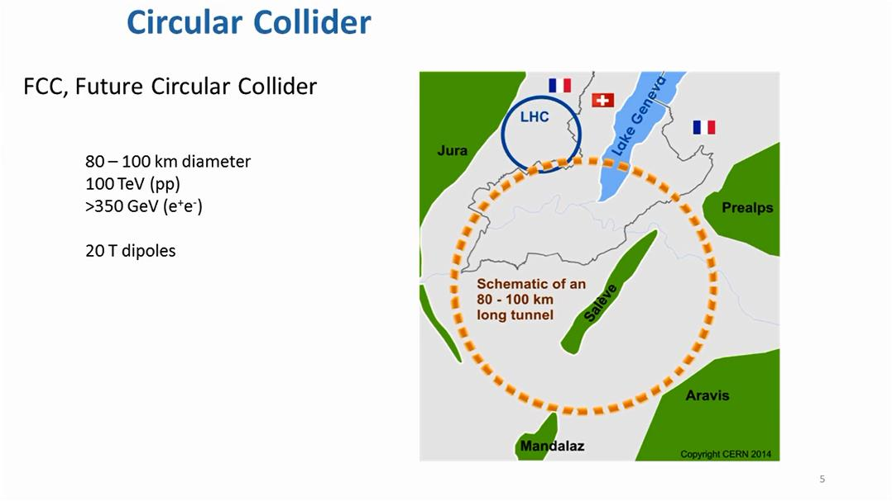

Slide 6
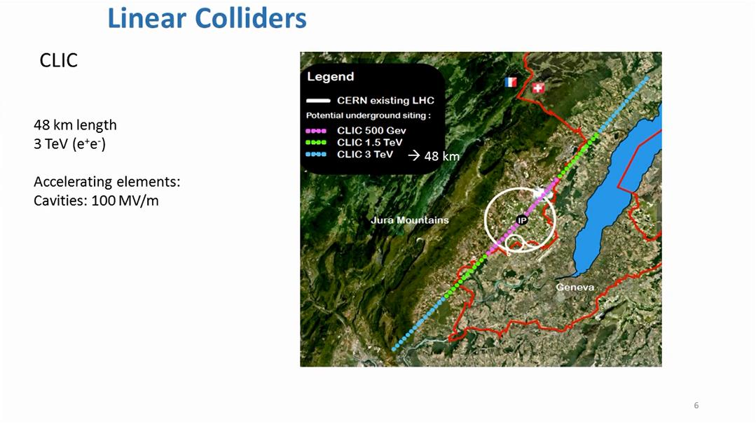

Slide 7
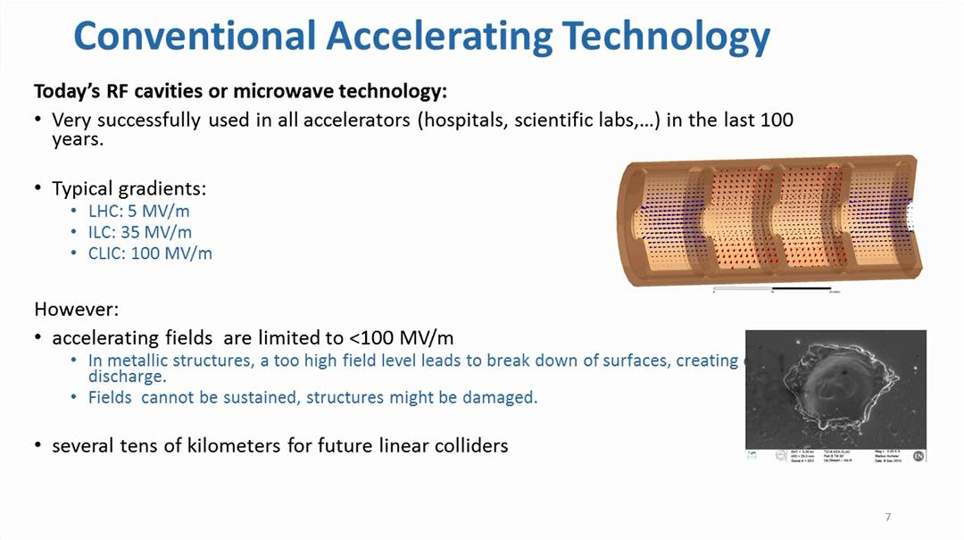

Slide 8
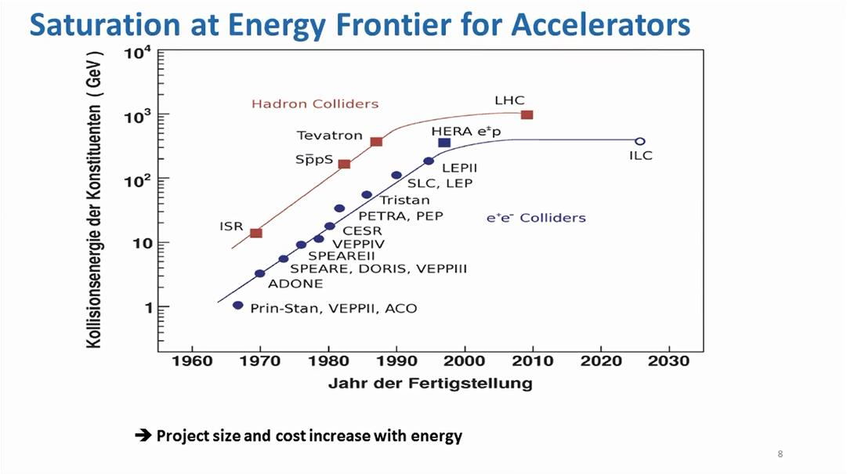

Slide 9
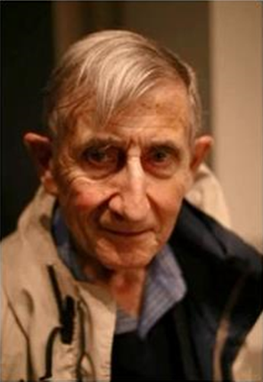
Motivation
New directions in science are launched by new tools much more often than by new concepts.
The effect of a concept-driven revolution is to explain old things in new ways.
The effect of a tool-driven revolution is to discover new things that have to be explained.
from Freeman Dysen ‘Imagined Worlds’

Slide 10
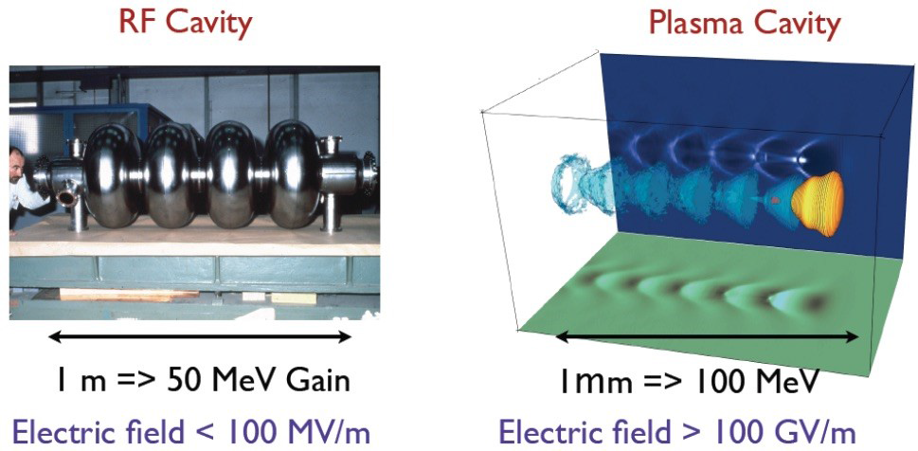

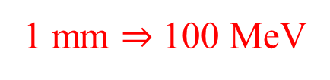
1 m $⇒$ 50 MeV Gain
1 mm $⇒$ 100 MeV
Compactness of plasma ‘cavity’. Left: Radiofrequency cavity. Right: Non-linear laser plasma wakefield. The laser pulse in yellow propagates from left to right, the iso-electronic density is shown in blue and the electron bunch in red.

Slide 11
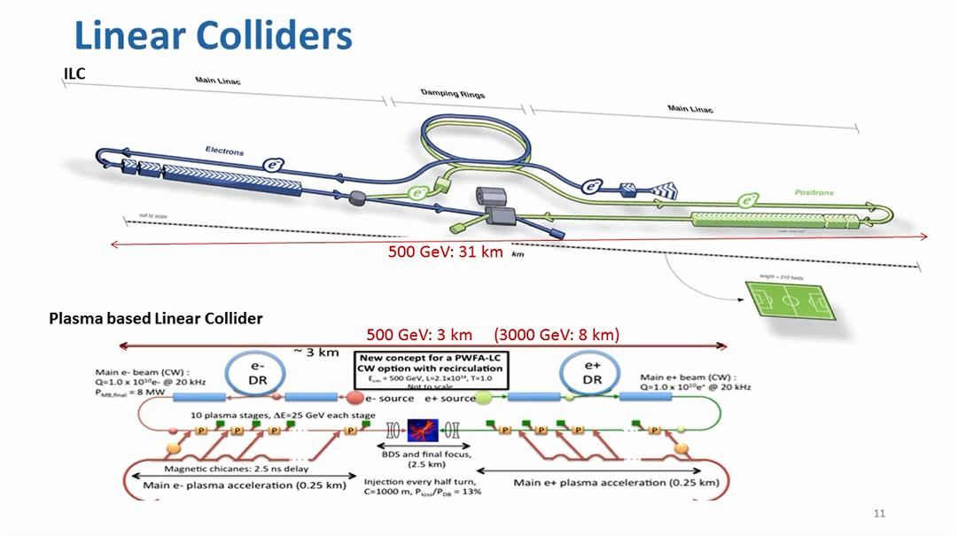
Notes:
International Linear Collider (Japan)

Slide 12
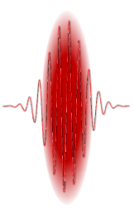
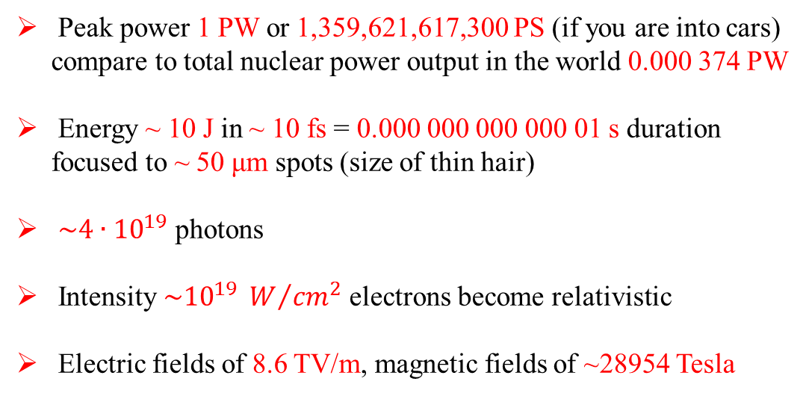
Let’s look at the driver first: a relativistically intense laser pulse
Peak power 1 PW or 1,359,621,617,300 PS (if you are into cars) compare to total nuclear power output in the world 0.000 374 PW
Energy ~ 10 J in ~ 10 fs = 0.000 000 000 000 01 s duration focused to ~ 50 μm spots (size of thin hair)
$\sim 4∙{10}^{19}$ photons
Intensity $\sim {10}^{19} W/{{cm}^{2}}$ electrons become relativistic
Electric fields of 8.6 TV/m, magnetic fields of ~28954 Tesla
Burning question: can these fields be used for particle acceleration?

Slide 13
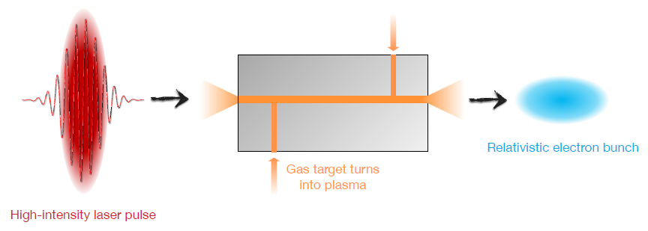
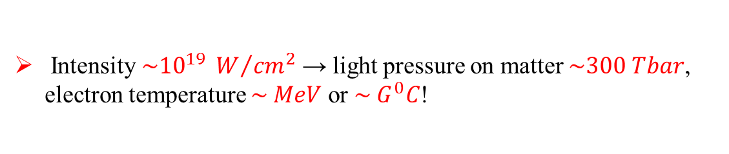
But interacting the laser with matter works!
Intensity $\sim {10}^{19} W/{{cm}^{2}}$ → light pressure on matter $\sim 300 Tbar$, electron temperature $\sim MeV$ or $\sim G^{0}C$!

Slide 14
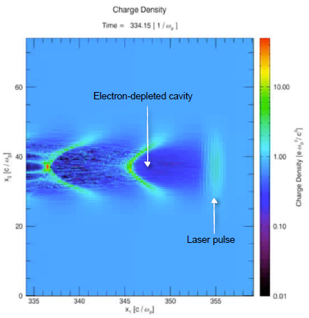
Laser excitation of strong plasma waves
Intense laser-pulse from left to right
Pushes away electrons by its light pressure or ponderomotive force (ions are too heavy, hardly move)
Creates electron-depleted cavity and sets up charge separation
Strong electrostatic fields pull back electrons on axis
Electrons oscillate and create copropagating wakefield

Slide 15
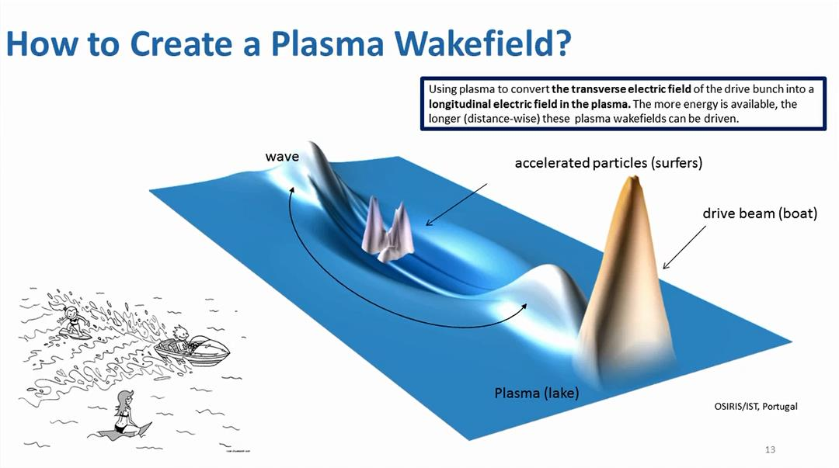

Slide 16
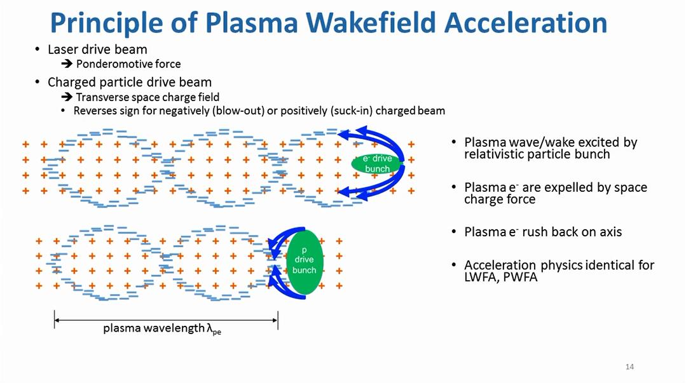
use transverse field to create a longitudinal field for acceleration

Slide 17
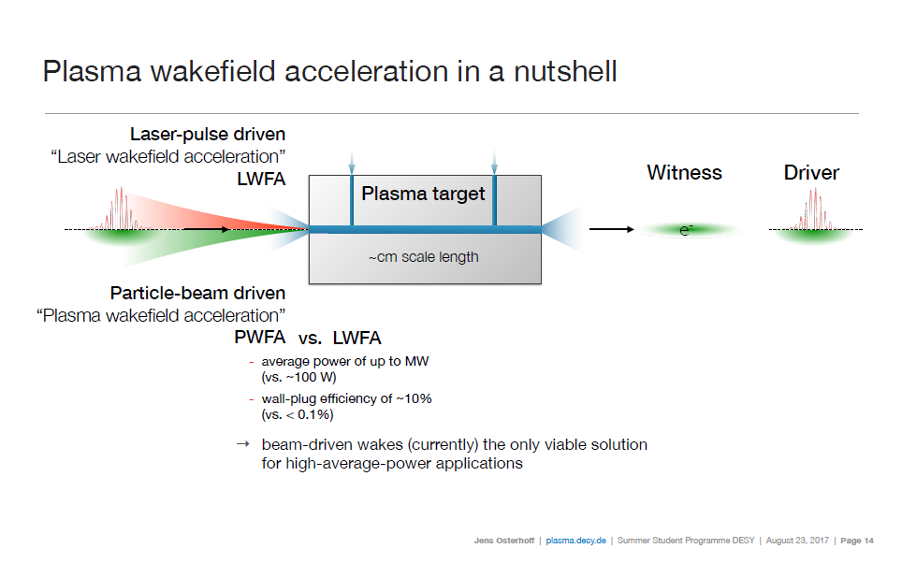

Slide 18
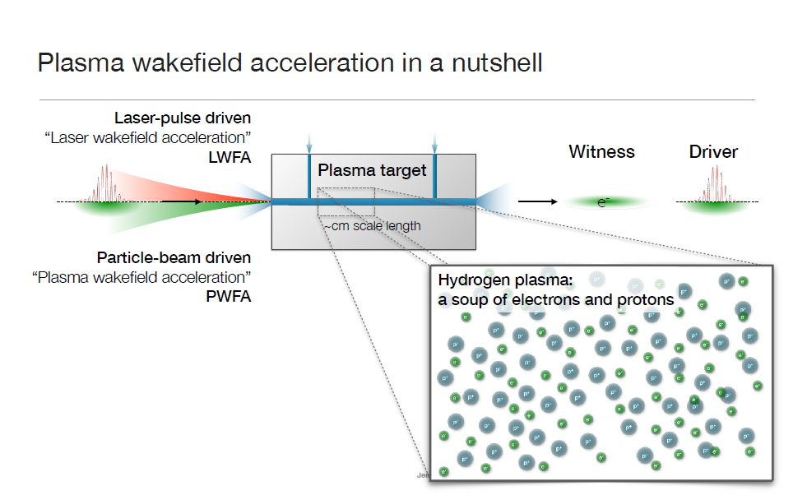

Slide 19
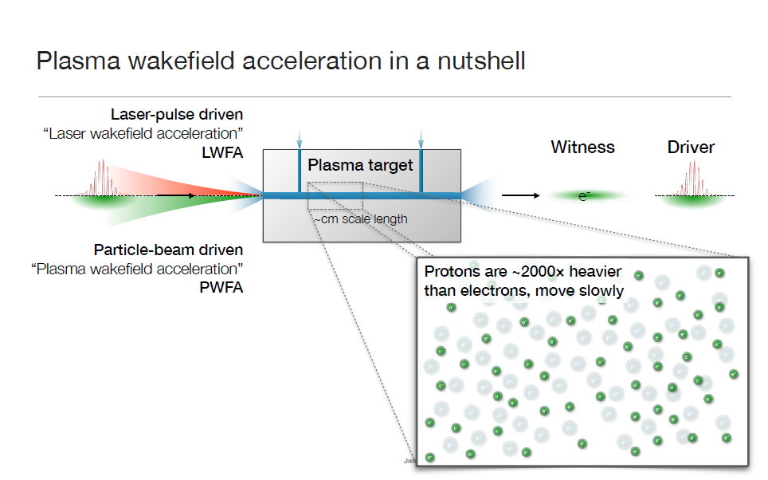

Slide 20
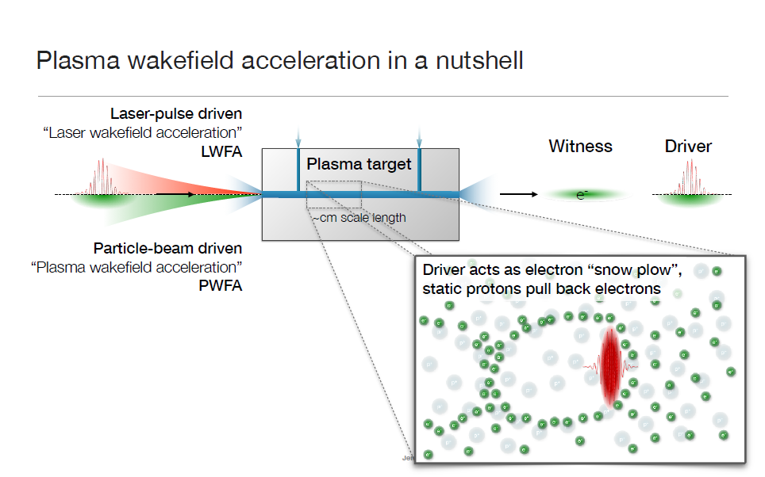

Slide 21
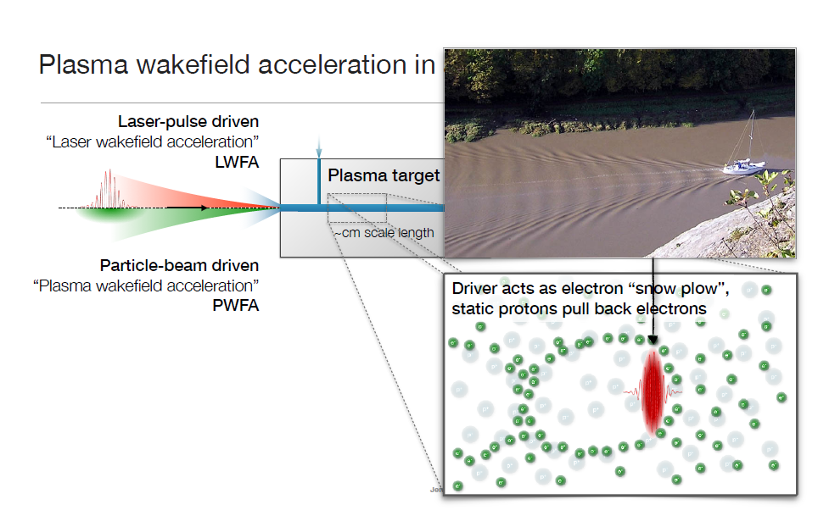

Slide 22
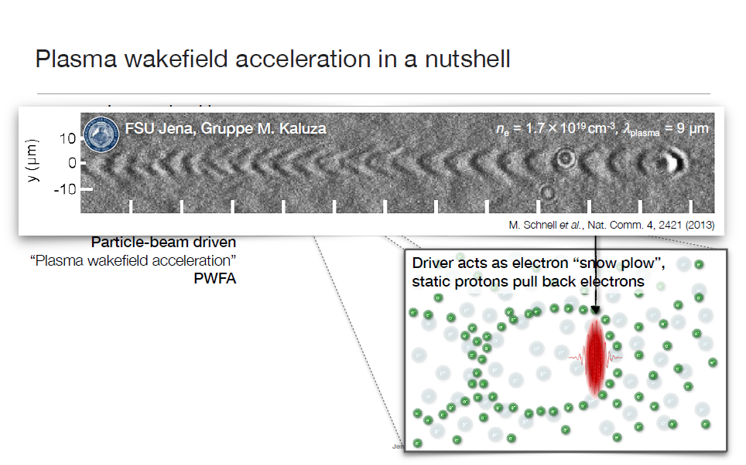

Slide 23
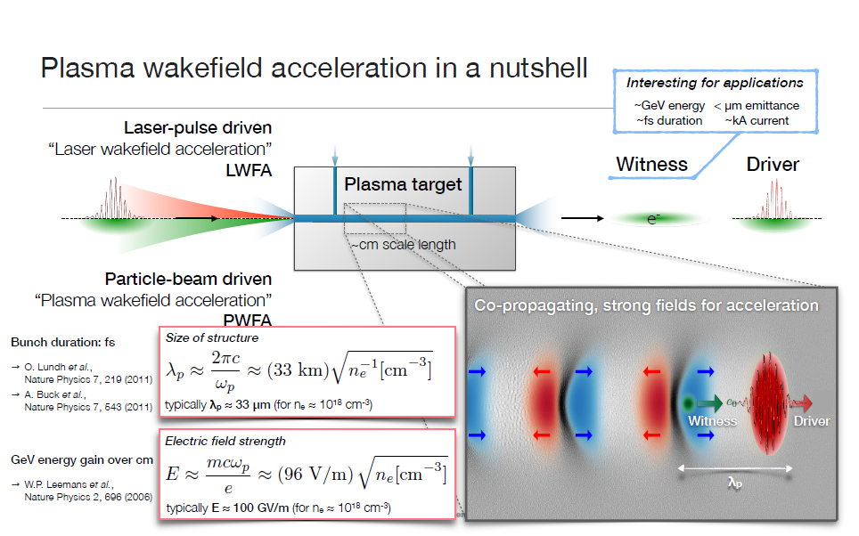

Slide 24
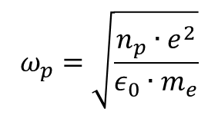
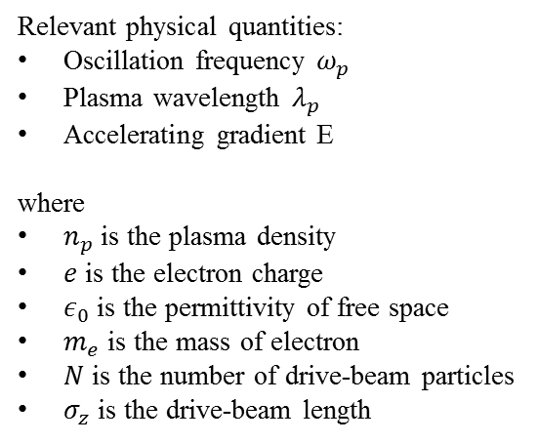
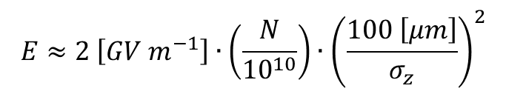
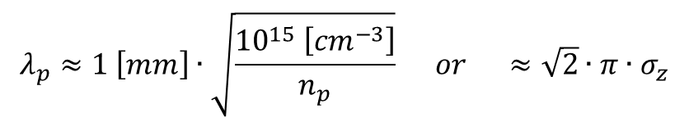
Plasma considerations
Based on linear fluid dynamics:
Relevant physical quantities:
Oscillation frequency $ω_{p}$
Plasma wavelength $λ_{p}$
Accelerating gradient E
where
$n_{p}$ is the plasma density
$e$ is the electron charge
$ε_{0}$ is the permittivity of free space
$m_{e}$ is the mass of electron
$N$ is the number of drive-beam particles
$σ_{z}$ is the drive-beam length
$$ω_{p}=\sqrt{\frac{n_{p}∙e^{2}}{ε_{0}∙m_{e}}}$$
$$λ_{p}≈1 \left[mm\right]∙\sqrt{\frac{{10}^{15} \left[{cm}^{−3}\right]}{n_{p}}} or ≈\sqrt{2}∙π∙σ_{z}$$
$$E≈2 \left[GV m^{−1}\right]∙\left(\frac{N}{{10}^{10}}\right)∙{\left(\frac{100 \left[μm\right]}{σ_{z}}\right)}^{2}$$
High gradients with:
Short drive beams (and short plasma wavelength)
Pulses with large number of particles (and high plasma density)
T. Tajima & J.W. Dawson; Phys. Rev. Lett. 43 (1979) 267
P. Chen et al.; Phys. Rev. Lett. 54 (1985) 693

Slide 25
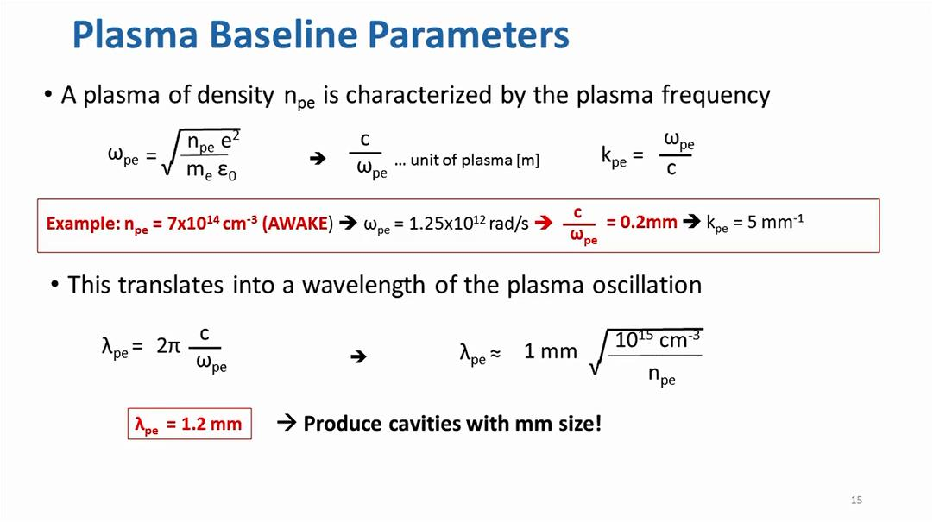

Slide 26
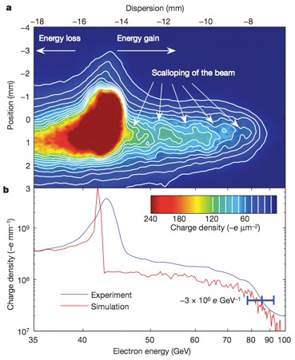
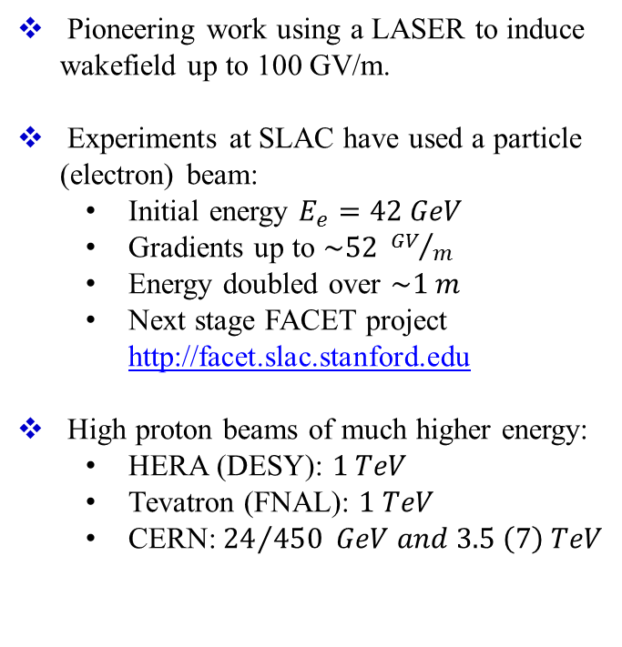
Plasma wakefield experiments
Pioneering work using a LASER to induce wakefield up to 100 GV/m.
Experiments at SLAC have used a particle (electron) beam:
  Initial energy $E_{e}=42 GeV$
  Gradients up to $\sim 52 {GV}/m$
  Energy doubled over $\sim 1 m$
  Next stage FACET project http://facet.slac.stanford.edu
High proton beams of much higher energy:
  HERA (DESY): $1 TeV$
  Tevatron (FNAL): $1 TeV$
  CERN:${ 24}/{450} GeV and 3.5 \left(7\right) TeV$

Slide 27
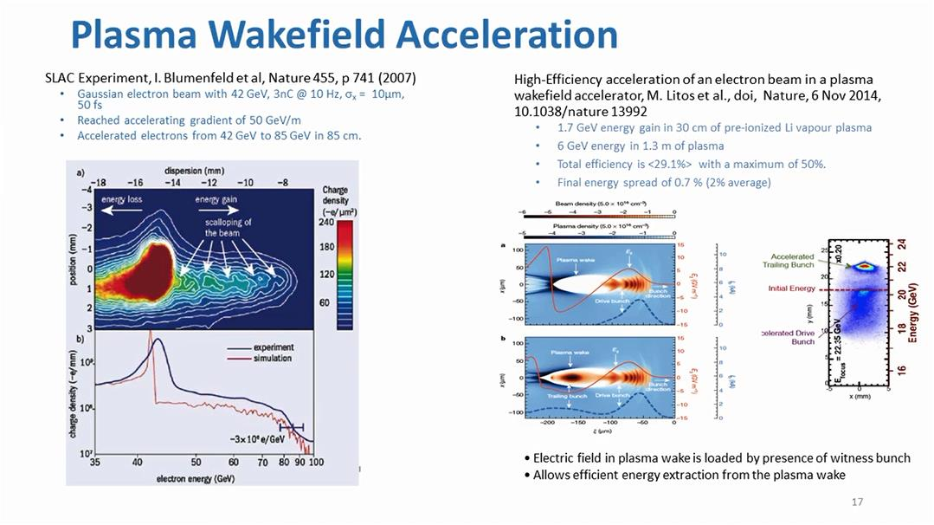

Slide 28
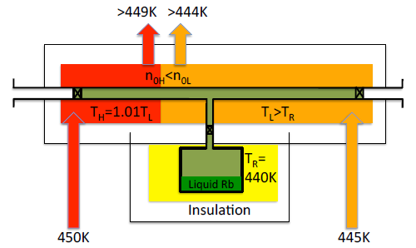
Rubidium plasma source
Laser
p⁺ e⁻
Synthetic oil surrounding Rb for temperature stability and hence density uniformity
Vacuum tube surrounding oil suppressing heat loss
Rubidium vapor sources available commercially; development of fast valves started in collaboration with industry
Need 1 – 2 TW laser with 30 – 100 fs pulse

Slide 29
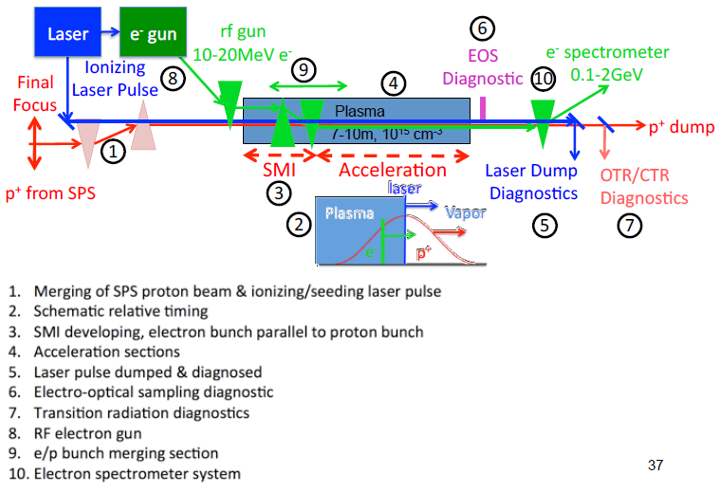
Experimental setup

Slide 30
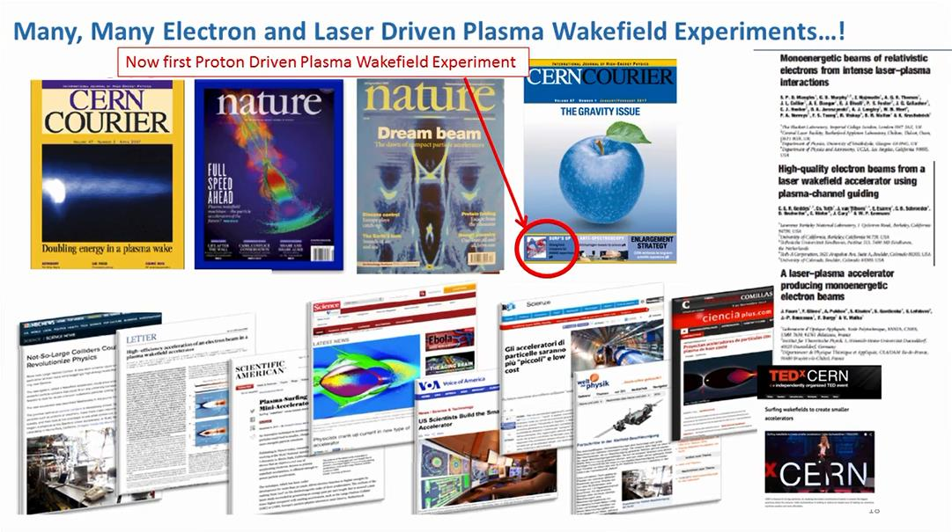

Slide 31
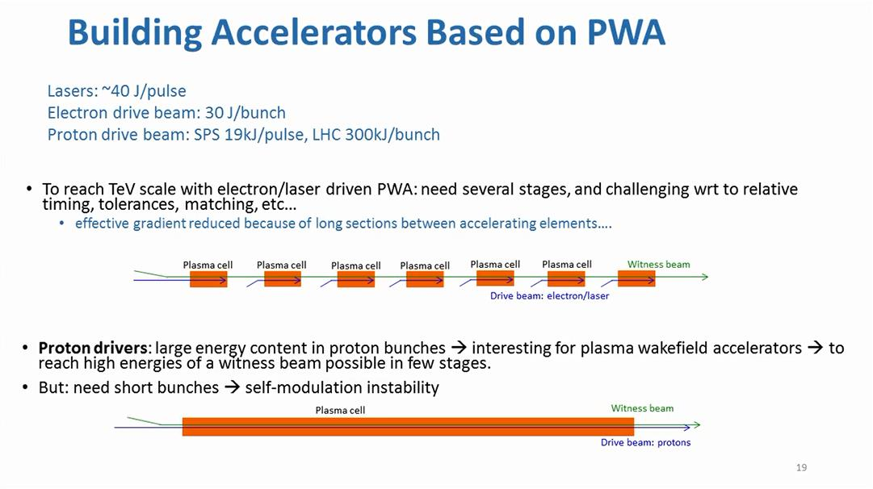
Why protons?
Lasers do not have enough energy:
Can not propagate long distances in plasma
Can not accelerate electrons to high energy
For high energy, need multiple stages

Slide 32
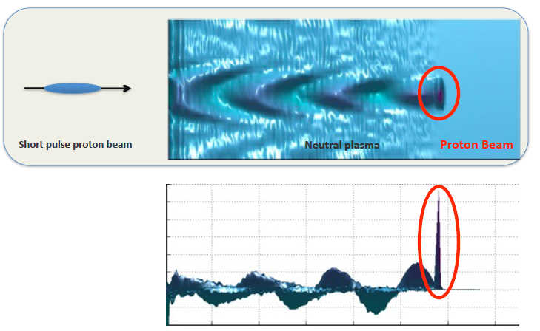
Plasma wakefield accelerator

Slide 33
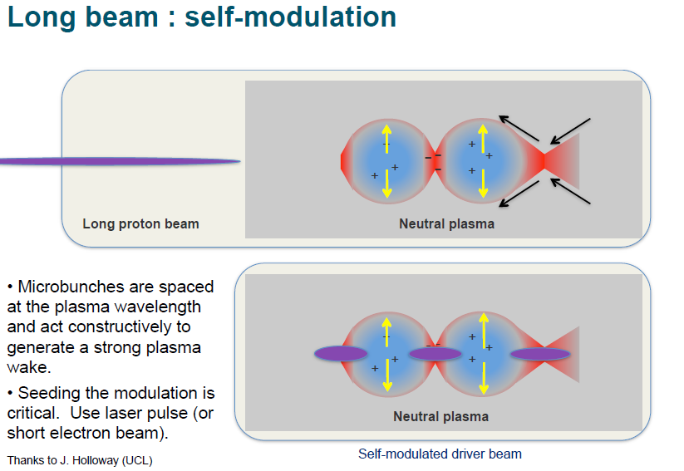
The AWAKE experiment at CERN

Slide 34
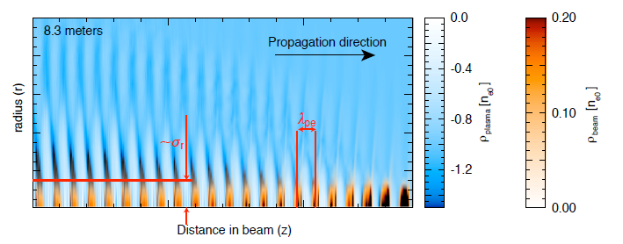
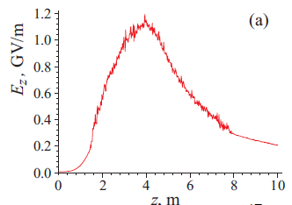
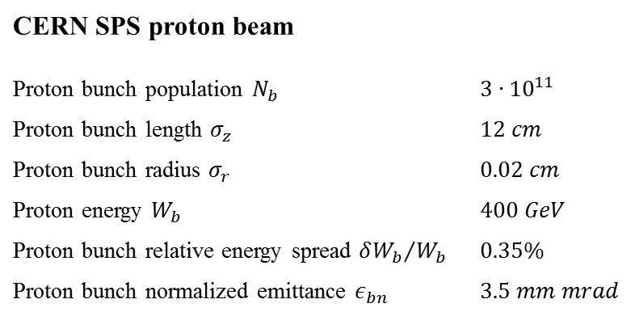
Self-modulation of the proton beam
CERN SPS proton beam
Proton bunch population $N_{b}$ | $3∙{10}^{11}$
Proton bunch length $σ_{z}$ | $12 cm$
Proton bunch radius $σ_{r}$ | $0.02 cm$
Proton energy $W_{b}$ | $400 GeV$
Proton bunch relative energy spread ${δW_{b}}/{W_{b}}$ | $0.35\%$
Proton bunch normalized emittance $ε_{bn}$ | $3.5 mm mrad$

Slide 35
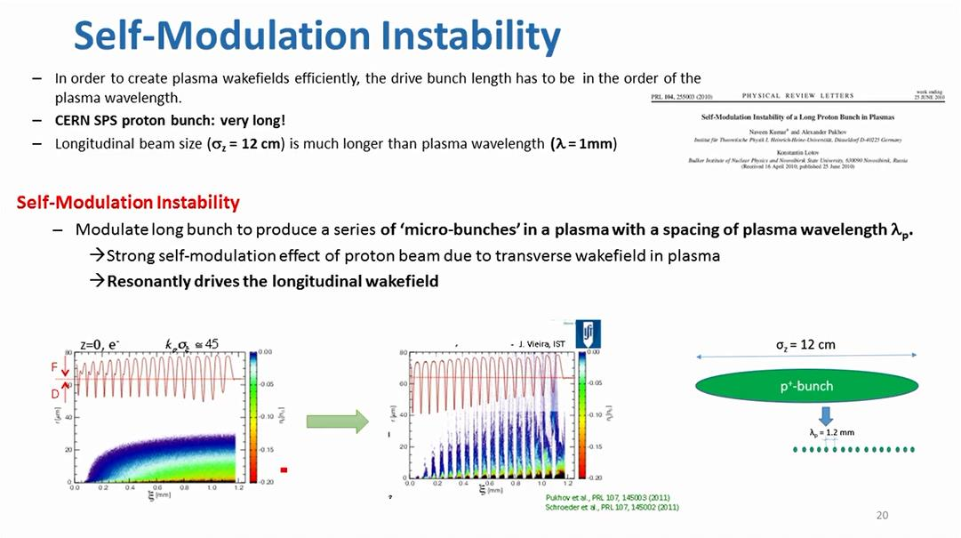

Slide 36
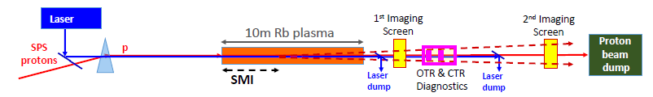
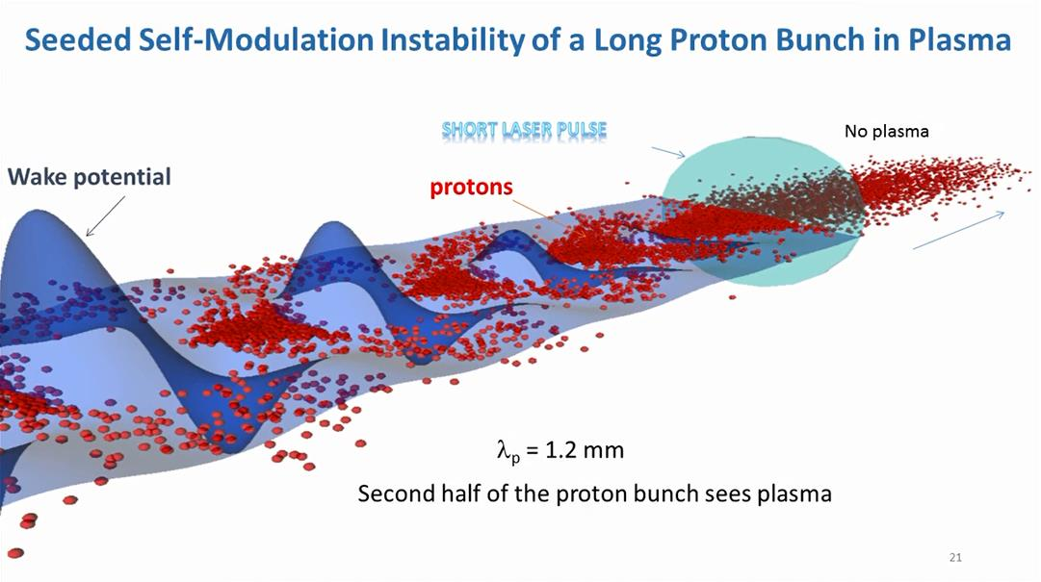
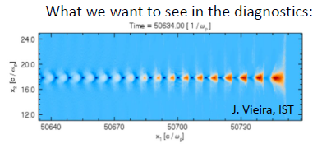
First experiment: Seeded Self-Modulation

Slide 37
