Slide 1
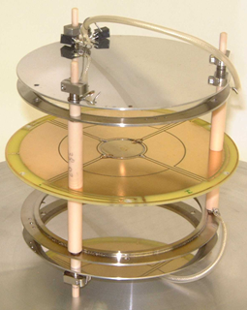
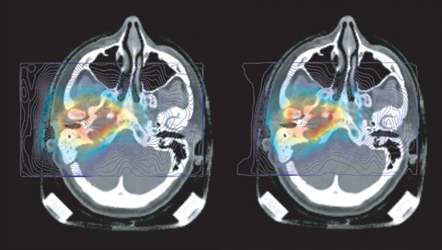
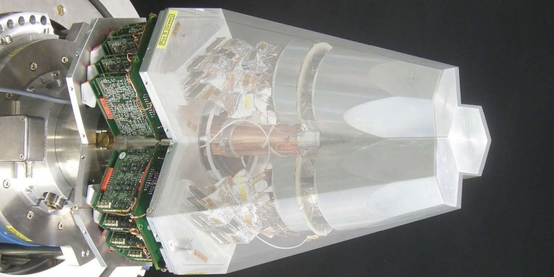
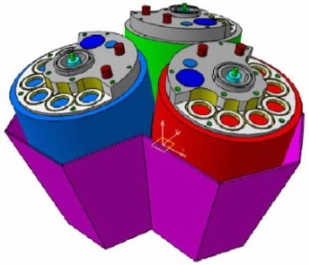
Particle and Radiation Detectors: Advances & Applications
Lecture: Hans-Jürgen Wollersheim
e-mail: h.j.wollersheim@gsi.de

Slide 2

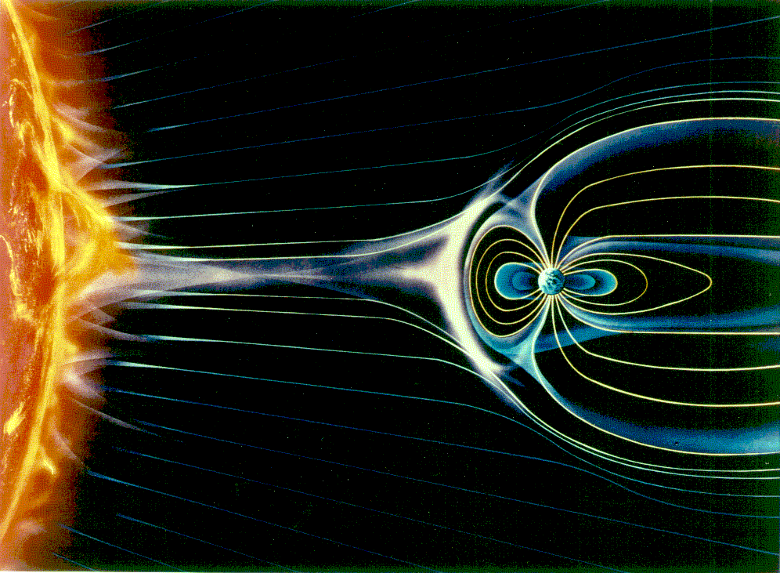
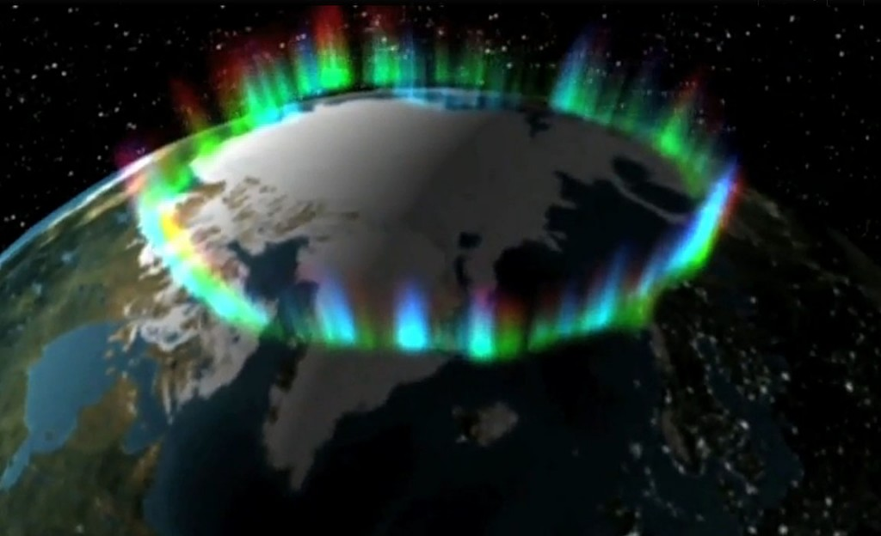
Particle Interaction with Matter
Aurora Borealis
Ionization

Slide 3
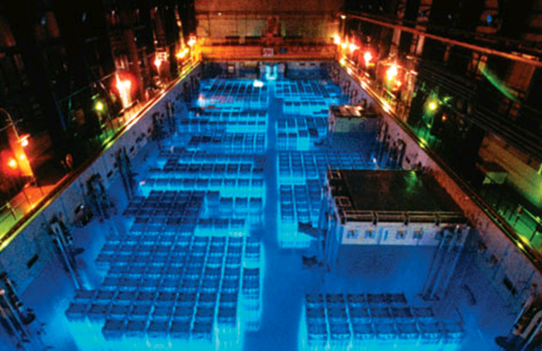
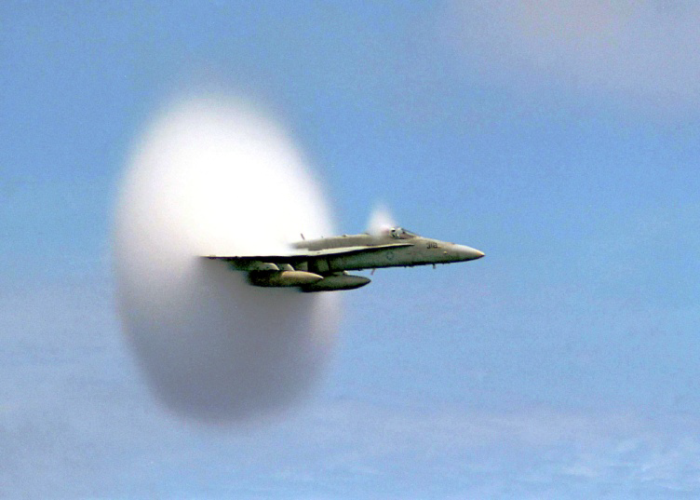
Particle Interaction with Matter
Characteristic glow from a reactor
Cherenkov Light
Cherenkov radiation is an effect similar to sonic booms when the plane exceeds the velocity of sound

Slide 4
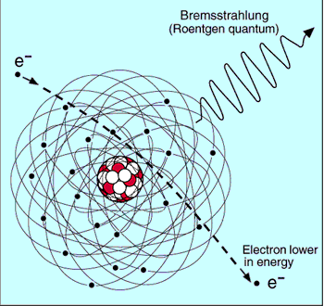
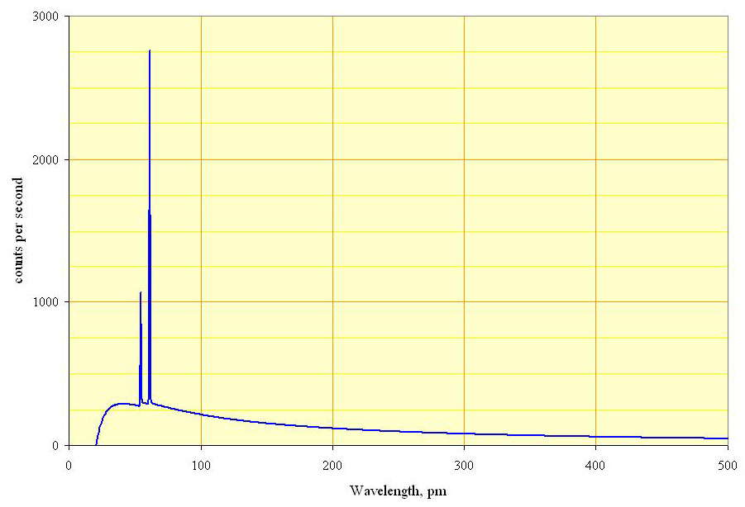
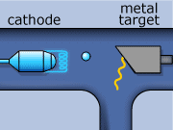
Particle Interaction with Matter
Bremsstrahlung or ‘braking radiation’
Spectrum of the X-rays emitted by an X-ray tube with a rhodium target, operated at 60 kV. The continuous curve is due to bremsstrahlung, and the spikes are characteristic K lines for rhodium.
Bremsstrahlung

Slide 5
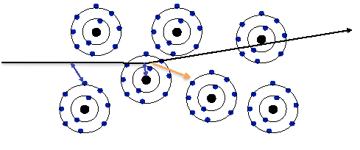
Energetic charged particles in matter
Three types of electromagnetic interactions:
Ionization (of the atoms of the transversed material)
Emission of Cherenkov light
Emission of transition radiation
3) In case the particle’s velocity is larger than the velocity of light in the medium, the resulting EM shockwave manifests itself as Cherenkov Radiation. When the particle crosses the boundary between two media, there is a probability of the order of 1% to produce an X-ray photon, called Transition Radiation.
1) Interaction with the atomic electrons. The incoming particle looses energy and the atoms are excited or ionized.
2) Interaction with the atomic nucleus. The particle is deflected (scattered) causing multiple scattering of the particle in the material. During this scattering a Bremsstrahlung photon can be emitted.

Slide 6
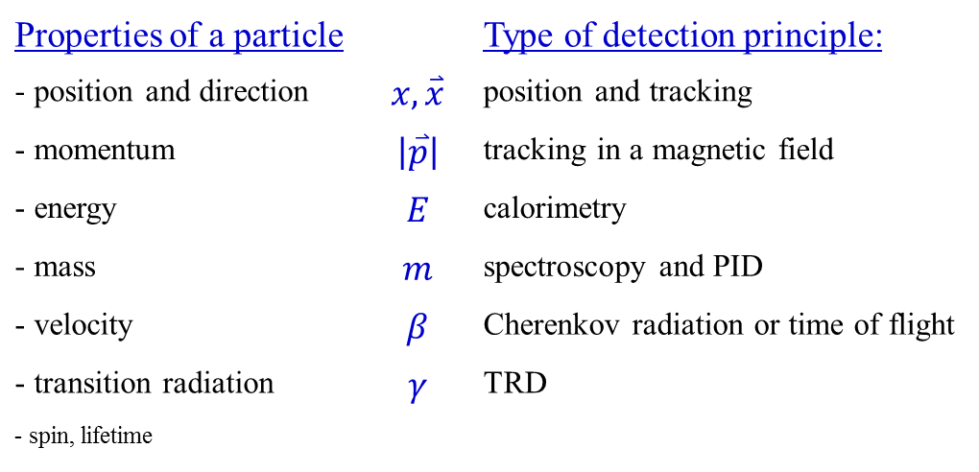
Measurement Principles
A particle detector is an instrument to measure one or more properties of a particle …
Properties of a particle |  | Type of detection principle:
- position and direction | $$x, \overset{⃑}{x}$$ | position and tracking
- momentum | $$\left|\overset{⃑}{p}\right|$$ | tracking in a magnetic field
- energy | $$E$$ | calorimetry
- mass | $$m$$ | spectroscopy and PID
- velocity | $$β$$ | Cherenkov radiation or time of flight
- transition radiation | $$γ$$ | TRD
- spin, lifetime

Slide 7
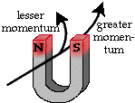
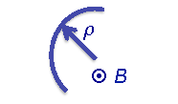
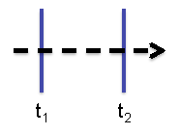
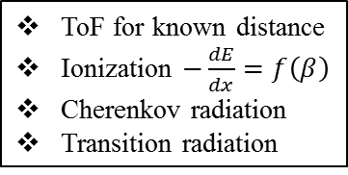
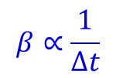
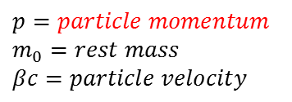
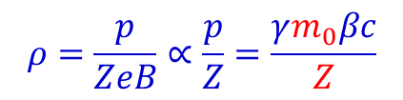
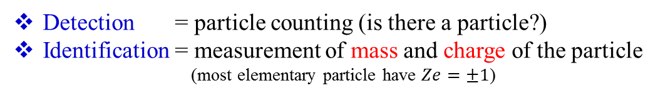
Detection and Identification of Particles
Detection = particle counting (is there a particle?)
Identification = measurement of mass and charge of the particle
(most elementary particle have $Ze=±1$)
How:
- charged particles are deflected by B fields such that:
$$ρ=\frac{p}{ZeB}∝\frac{p}{Z}=\frac{γm_{0}βc}{Z}$$
$$p=particle momentum$$
$$m_{0}=rest mass$$
$$βc=particle velocity$$
- particle velocity measured with time-of-flight (ToF) method
$$β∝\frac{1}{∆t}$$
ToF for known distance
Ionization $−\frac{dE}{dx}=f\left(β\right)$
Cherenkov radiation
Transition radiation

Slide 8

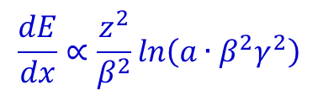
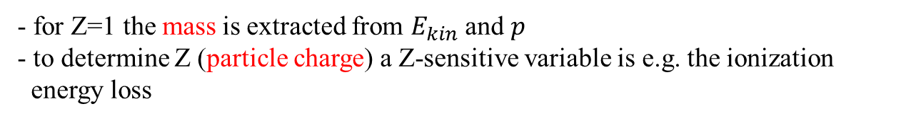
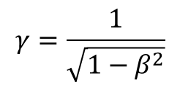
Detection and Identification of Particles
Detection = particle counting (is there a particle?)
Identification = measurement of mass and charge of the particle
(most elementary particle have $Ze=±1$)
How:
- kinetic energy determined via a calorimetric measurement
$$E_{kin}=\left(γ−1\right)m_{0}c^{2}$$
$$γ=\frac{1}{\sqrt{1−β^{2}}}$$
- for Z=1 the mass is extracted from $E_{kin}$ and $p$
- to determine Z (particle charge) a Z-sensitive variable is e.g. the ionization
energy loss
$$\frac{dE}{dx}∝\frac{z^{2}}{β^{2}}ln\left(a∙β^{2}γ^{2}\right)$$
a = material-dependent constant

Slide 9
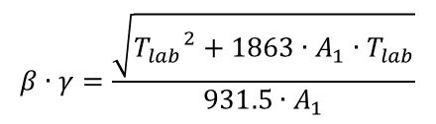



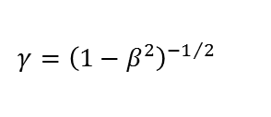
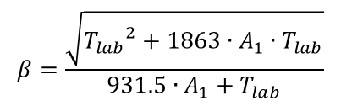
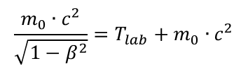
Relevant Formulae
The relevant formulae are calculated if A₁, Z₁ and A₂, Z₂ are the mass number (amu) and charge number of the projectile and target nucleus, respectively, and T_{lab} is the laboratory energy (MeV)
$$E=T_{lab}+m_{0}∙c^{2}$$
$$m∙c^{2}=T_{lab}+m_{0}∙c^{2}$$
$$\frac{m_{0}∙c^{2}}{\sqrt{1−β^{2}}}=T_{lab}+m_{0}∙c^{2}$$
$$β=\frac{\sqrt{{T_{lab}}^{2}+1863∙A_{1}∙T_{lab}}}{931.5∙A_{1}+T_{lab}}$$
beam velocity:
Lorentz contraction factor:
$$γ={\left(1−β^{2}\right)}^{{−1}/2}$$
$$γ=\frac{931.5∙A_{1}+T_{lab}}{931.5∙A_{1}}$$
$$β∙γ=\frac{\sqrt{{T_{lab}}^{2}+1863∙A_{1}∙T_{lab}}}{931.5∙A_{1}}$$

Slide 10

Some Nuclear Units
Nuclear energies are very high compared to atomic processes, and need larger units. The most commonly used unit is the MeV.
1 electron Volt = 1 eV = 1.6·10⁻¹⁹ Joules
1 MeV = 10⁶ eV; 1 GeV = 10⁹ eV; 1 TeV = 10¹² eV
However, the nuclear size are quite small and need smaller units:
Atomic sizes are on the order of 0.1 nm = 1 Angstrom = 10⁻¹⁰ m. Nuclear sizes are on the order of femtometers which in the nuclear context are usually called fermis:
1 fermi = 1 fm = 10⁻¹⁵ m
Atomic masses are measured in terms of atomic mass units with the carbon-12 atom defined as having a mass of exactly 12 amu. It is also common practice to quote the rest mass energy E=m₀c² as if it were the mass. The conversion to amu is:
1 u = 1.66054·10⁻²⁷ kg = 931.494 MeV/c²
electron mass = 0.511 MeV/c²; proton mass = 938.27 MeV/c²; neutron mass = 939.56 MeV/c²
Mass data: www-nds.iaea.org/amdc/ (mass16.txt)

Slide 11
Measurement Principles
A measurement requires an interaction of the particle with the material of the detector. The interaction provokes two effects:
1st Creation of a detectable signal, e.g.
ionization → charges
excitation → scintillation
excitation of phonons → heat
2nd Alternation of the particles properties, e.g.
energy loss
change of trajectory due to scattering
absorption
unwanted side effects. They need to be as small as possible and well understood.

Slide 12
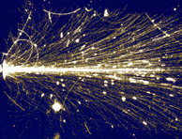
Energy loss – dE/dx
Particles interact differently with matter. Important for detectors is the energy loss per path length. The total energy loss per path length is the sum of all contributions.
$$−{\left(\frac{dE}{dx}\right)}_{tot}=−{\left(\frac{dE}{dx}\right)}_{coll}−{\left(\frac{dE}{dx}\right)}_{rad}−{\left(\frac{dE}{dx}\right)}_{photoeff}−{\left(\frac{dE}{dx}\right)}_{compton}−{\left(\frac{dE}{dx}\right)}_{pair}−{\left(\frac{dE}{dx}\right)}_{hadron}⋯$$
Depending on the particle type, the particle energy and the material some processes dominate, other do not occur. For instance only charged particles will interact with electrons of atoms and produce ionization, etc.

Slide 13
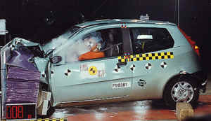
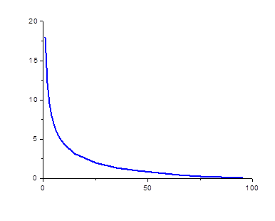

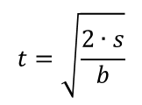



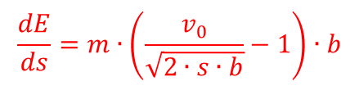



Interaction with matter
accelerated motion:
$$t=\sqrt{\frac{2∙s}{b}}$$
$$s=\frac{b}{2}t^{2}$$
$$v=v_{0}−b∙t=v_{0}−\sqrt{2∙s∙b}$$
$$\frac{energy loss}{braking distance}\left(\frac{Joule}{m}\right)$$
$$E=\frac{1}{2}mv^{2}$$
$$\frac{dE}{ds}=m∙\left(\frac{v_{0}}{\sqrt{2∙s∙b}}−1\right)∙b$$
$$v_{0}=100\frac{km}{h}=27.78\frac{m}{s}$$
$$b=3.86\frac{m}{s^{2}}$$
$$braking distance \left(m\right)$$

Slide 14
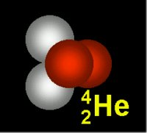
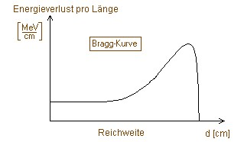
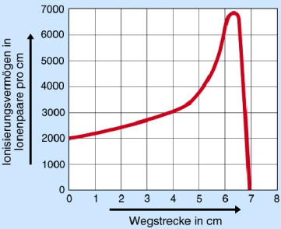
Interaction with matter
$$\frac{energy loss}{braking distance}\left(\frac{Joule}{m}\right)$$
energy loss
Bragg-curve
range
d [cm]
$$braking distance \left(m\right)$$

Slide 15
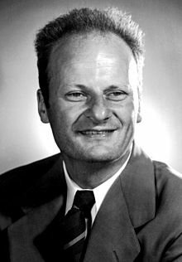
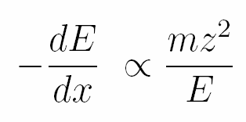
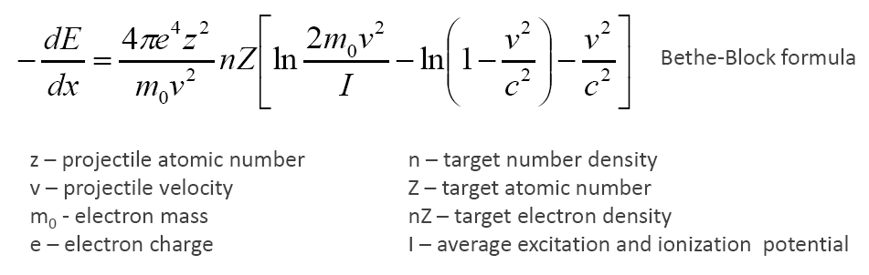
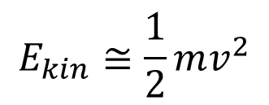
Energetic charged particles in matter
$$E_{kin}≅\frac{1}{2}mv^{2}$$
Hans Bethe
(1906-2005)
dominant in the classical limit [40 MeV/A (0.3c) - <1% deviation

Slide 16
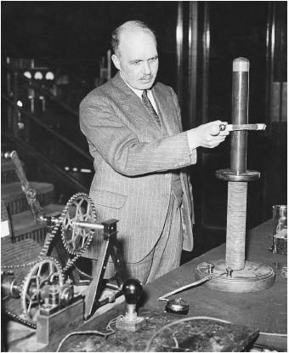
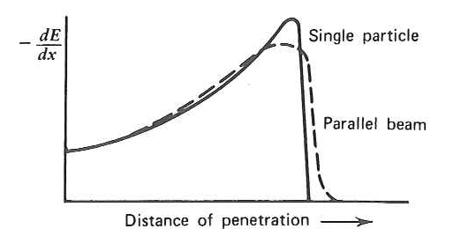
Energetic charged particles in matter
Bragg curve
William Henry Bragg
(1890-1971)

Slide 17
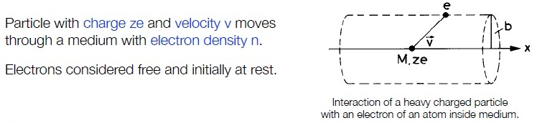
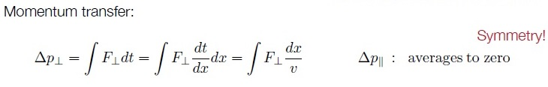
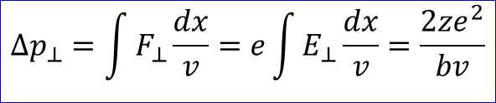
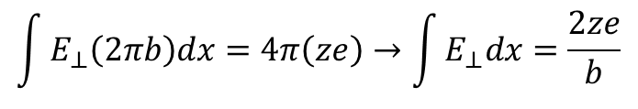
Bethe-Bloch – Classical Derivation (Bohr 1913)
Gauss law (infinite cylinder, electron in center):
$$\int{E_{⊥}\left(2πb\right)dx}=4π\left(ze\right)→\int{E_{⊥}dx}=\frac{2ze}{b}$$
$$∆p_{⊥}=\int{F_{⊥}\frac{dx}{v}}=e\int{E_{⊥}\frac{dx}{v}=\frac{2ze^{2}}{bv}}$$

Slide 18
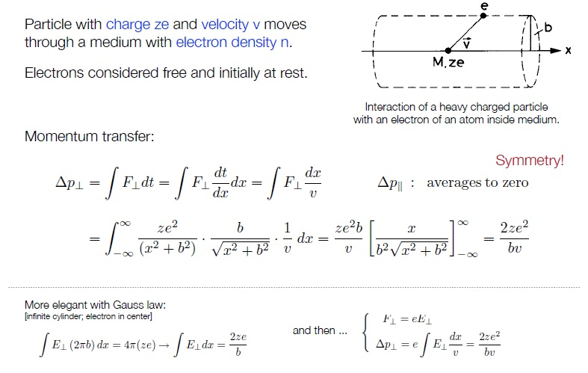
Bethe-Bloch – Classical Derivation (Bohr 1913)

Slide 19
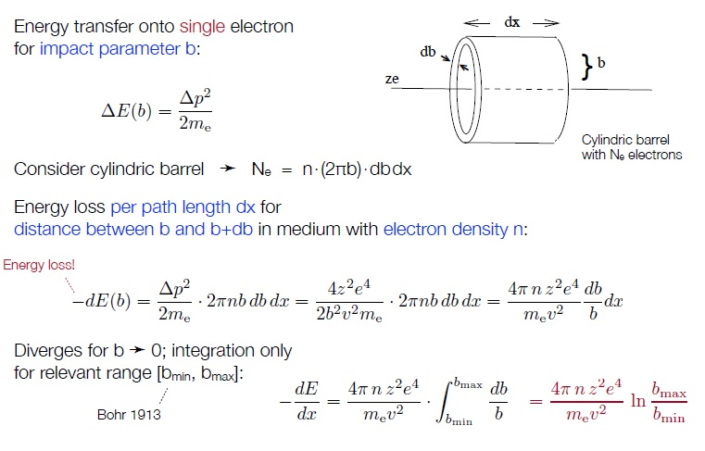
Bethe-Bloch – Classical Derivation (Bohr 1913)

Slide 20
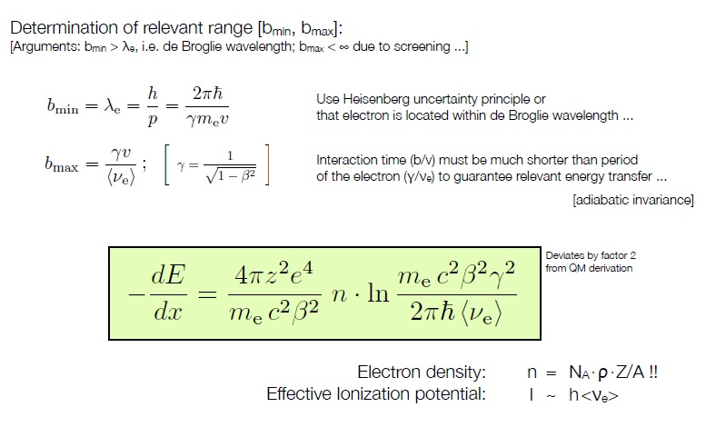
Bethe-Bloch – Classical Derivation (Bohr 1913)

Slide 21
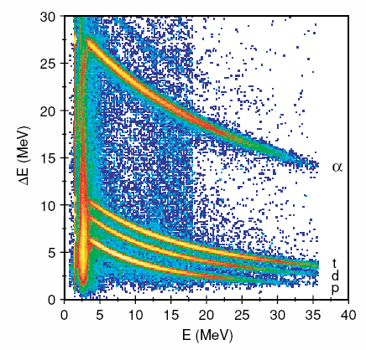

Energetic charged particles in matter
Charged particle identification with
segmented or stacked detectors
Si

Slide 22



Interaction of α-particles in matter
α-particles are highly ionized and lose their energy very fast by ionization and excitation
when passing through matter.
maximum energy transfer T_{max} of a projectile with mass m
and velocity β on an electron m_{e} at rest
$$T_{max}=\frac{2∙m_{e}c^{2}∙β^{2}∙γ^{2}∙m^{2}}{m^{2}+{m_{e}}^{2}+2∙γ∙m∙m_{e}}$$
$$T_{max}=2∙m_{e}c^{2}∙β^{2}∙γ^{2}$$
number of α-particles
as a function of distance x
energy loss of
α-particles
per distant unit
for all heavy primary particles except electrons and positrons
average range <R> of α-particles with 5 MeV
2,5cm in air, 2,3cm in Al, 4,3cm in tissue

Slide 23








Energy loss and range of charged particles
$$−\frac{dE}{dε}=−\frac{1}{ρ}∙\frac{dE}{dx}=z^{2}∙\frac{Z}{A}∙f\left(β,I\right)$$
-dE/dε is independent of the material for equal particles
the average range for particles with kin. energy T is obtained by integration
7.7 MeV α-particles in air:
range is not exact but there is range straggling,
the number of interactions is a statistical process.
$$\overline{R}=\int_{E_{0}}^{0}{{\left(\frac{dE}{dx}\right)}^{−1}}dE$$
energy loss
5.5 MeV α´s in air
$$\overline{R}/ρ≈7cm$$
distance
Several empirical and semi-empirical formulae have been proposed to compute range of α-particles in air.
$$R_{α}^{air}\left[mm\right]=\left\{\begin{matrix}e^{1.61\sqrt{E_{α}}} for E_{α}<4MeV \\ \left(0.05E_{α}+2.85\right)E_{α}^{3/2} for 4MeV≤E_{α}≤15MeV\end{matrix}\right.$$
$$R_{α}^{air}\left[cm\right]=\left\{\begin{matrix}0.56E_{α} for E_{α}<4MeV \\ 1.24E_{α}−2.62 for 4MeV≤E_{α}<8MeV\end{matrix}\right.$$
deuteron beam scintillating in air
Scaling the range of other materials $R_{α}^{x}=3.37∙{10}^{−4}R_{α}^{air}\frac{\sqrt{A_{x}}}{ρ_{x}}$

Slide 24




Interaction of charged particles in matter
Bethe-Bloch formula describes the energy loss of heavy particles passing through matter
N_{a} : Avogadro number 6.02·10²³ mol⁻¹
r_{e} : class. electron radius 2.81·10⁻¹³ cm
m_{e} : electron mass
ρ : density of abs. matter
Z : element number of abs. matter
A : mass of abs. matter
z : charge number of incoming particle
W_{max} : max. energy transfer in a single collision
I : average ionization potential
$$−\frac{dE}{dx}=4∙π∙{r_{e}}^{2}∙N_{a}∙m_{e}c^{2}∙ρ∙\frac{Z}{A}∙\frac{z^{2}}{β^{2}}∙\left[\frac{1}{2}ln\left(\frac{2∙m_{e}c^{2}∙γ^{2}∙β^{2}{∙T}_{max}}{I^{2}}\right)−β^{2}−δ−2∙\frac{C}{Z}\right]$$
$$≈z^{2}∙\frac{Z}{A}∙f\left(β,I\right)$$
= 0.3071 MeV g⁻¹cm²
for small β the term 1/β² is dominant
dE/dx has a minimum at βγ~3-4 (minimum ionizing particle)
for high momenta dE/dx reaches a saturation

Slide 25

Interaction of charged particles in matter
Bethe-Bloch formula describes the energy loss of heavy particles passing through matter
$$−\frac{dE}{dx}=4∙π∙{r_{e}}^{2}∙N_{a}∙m_{e}c^{2}∙ρ∙\frac{Z}{A}∙\frac{z^{2}}{β^{2}}∙\left[\frac{1}{2}ln\left(\frac{2∙m_{e}c^{2}∙γ^{2}∙β^{2}{∙T}_{max}}{I^{2}}\right)−β^{2}−δ−2∙\frac{C}{Z}\right]$$
$$≈z^{2}∙\frac{Z}{A}∙f\left(β,I\right)$$
= 0.3071 MeV g⁻¹cm²
liquid-H₂
Specific energy loss rate $\frac{1}{ρ}\frac{dE}{dx}$
for muons, pions and protons in different materials
Dependence on mass A, charge Z of target nucleus
Minimum ionization: 1-2 MeV/g cm⁻² [H₂: 4 MeV/g cm⁻²]
He-gas
for small β the term 1/β² is dominant
dE/dx has a minimum at βγ~3-4 (minimum ionizing particle)
for high momenta dE/dx reaches a saturation

Slide 26


Energy loss of charged particles – dE/dx for different particles
${dE}/{dx}$ for heavy particles in this momentum regime is well described by Bethe-Bloch formula, i.e. the dominant energy loss is collisions with atoms
${dE}/{dx}$ for electrons does not follow Bethe-Bloch formula. The dominant process is Bremsstrahlung
TPC signal (a.u.)
momentum p (GeV/c)
[ALICE TPC, 2009]

Slide 27


Example: Proton in Silicon
Bethe-Bloch formula describes the energy loss of heavy particles passing through matter
$$−\frac{dE}{dx}=4∙π∙{r_{e}}^{2}∙N_{a}∙m_{e}c^{2}∙ρ∙\frac{Z}{A}∙\frac{z^{2}}{β^{2}}∙\left[\frac{1}{2}ln\left(\frac{2∙m_{e}c^{2}∙γ^{2}∙β^{2}{∙T}_{max}}{I^{2}}\right)−β^{2}−δ−2∙\frac{C}{Z}\right]$$
$$≈z^{2}∙\frac{Z}{A}∙f\left(β,I\right)$$
= 0.3071 MeV g⁻¹cm²
$$T_{max}=2∙m_{e}c^{2}∙β^{2}∙γ^{2}$$
dE/dx vs. E of protons in silicon

Slide 28

Interaction of β-particles with matter
β-particles are also ionizing, similar to α-particles. Since the mass of the electrons and positrons are very small, the energy transfer per collision is small and the range large. Similar to the X-rays there is first only an attenuation, which finally leads to a maximum range for larger layer thicknesses.
max. range
layer thickness

Slide 29

Interaction of β-particles with matter
β⁺ particles behave similarly as β⁻ particles; they are ionizing and attenuated on their way through matter.
But at the end of the their attenuation one observes a pair annihilation with an electron, which yields high energetic γ-emission. Positrons are hence more dangerous than electrons.

Slide 30

Bremsstrahlung
Bremsstrahlung (‘braking radiation’) is electromagnetic radiation produced by the deceleration of a charged particle when deflected by another charged particle, typically an electron by an atomic nucleus.
The moving particle loses kinetic energy, which is converted into a photon, thus satisfying the law of conservation of energy.
Bremsstrahlung has a continuous spectrum.

Slide 31




Bremsstrahlung
$$E_{photon}=h∙ν=E_{kin}=e∙U$$
$$λ_{min}=\frac{h∙c}{e∙U}$$
$$λ_{min}=\frac{1.24∙{10}^{−6}Vm}{U}$$
spectral distribution:
$$J\left(λ\right)=K∙I∙Z∙\left(\frac{λ}{λ_{min}}−1\right)∙\frac{1}{λ^{2}}$$
K = Kramer constant
I = electron current
Z = element number of material
Spectrum of the X-rays emitted by an X-ray tube with a rhodium target, operated at 60 kV. The continuous curve is due to bremsstrahlung, and the spikes are characteristic K lines for rhodium.

Slide 32




Bremsstrahlung
$$−{\left(\frac{dE}{dx}\right)}_{rad}=\frac{E}{X_{0}}$$
X₀ is the radiation length. It is the mean distance over which a high-energy electron loses all but 1/e of its energy by Bremsstrahlung
fit to data:
$$X_{0}=\frac{716.4∙A}{Z∙\left(Z+1\right)∙ln\left({287}/{\sqrt{Z}}\right)}$$
Usual definition for the critical energy E_{c} (electron)
$${\left(\frac{dE}{dx}\right)}_{ionization}={\left(\frac{dE}{dx}\right)}_{bremsstrahlung}$$
$$E_{c}^{}\left(e^{−}\right)=\left\{\begin{matrix}\frac{610 MeV}{Z+1.24} for solids and liquids \\ \frac{710 MeV}{Z+0.92} for gases \end{matrix}\right.$$
example: Pb (Z=82, ρ = 11.34 [g/cm³] → E_{c} = 7.34 MeV

Slide 33





Synchrotron radiation
The electromagnetic radiation emitted when charged particles are accelerated radially (a ⊥ v) is called synchrotron radiation. It is produced, for example, in synchrotrons using bending magnets.
The energy loss of a charged particle (Z·e) due to radiation (during one cycle) is given by
with Z = element number, ε₀ = electric field constant, R = radius of the storage ring, β=v/c and the Lorentz factor
For relativistic velocities β ≈ 1
It is apparent that one uses light particles to create synchrotron radiation.
$$ΔE=\frac{{\left(Ze\right)}^{2}∙β^{3}∙γ^{4}}{ε_{0}∙3R}$$
$$γ=\frac{1}{\sqrt{1−β^{2}}}≡\frac{E}{m_{0}c^{2}}$$
$$ΔE=\frac{{\left(Ze\right)}^{2}∙E^{4}}{ε_{0}∙3R∙{\left(m_{0}c^{2}\right)}^{4}}$$

Slide 34


Synchrotron radiation
Raja Ramanna Centre for Advanced Technology
Indore

Slide 35




Raja Ramanna Centre for Advanced Technology - Synchrotron radiation
Applications: condensed matter physics, material science, biology and medicine.
Structure of a ribosome (components of a cell)

Slide 36


Typical range of radioactive radiation in air
range of 5.5 MeV α-particles in air is ~ 4.2 cm
range of 1 MeV β-particles in air is ~ 4 m
range of X-rays, γ-rays and neutrons is very large.
shielding or large distances (1/r² law) are the solution

Slide 37



Energy loss for electrons and positrons
e± are exceptional cases due to their low mass. They will be deflected significantly in each collision.
In addition to the energy loss due to ionization, the energy loss due to Bremsstrahlung is of importance.
$$−{\left(\frac{dE}{dx}\right)}_{tot}=−{\left(\frac{dE}{dx}\right)}_{coll}−{\left(\frac{dE}{dx}\right)}_{rad}$$
For high energies the energy loss due to Bremsstrahlung is given by
$$−{\left(\frac{dE}{dx}\right)}_{rad}∝E$$
$$−{\left(\frac{dE}{dx}\right)}_{rad}∝\frac{1}{m^{2}}$$
and
Other particles like muons also radiate,
especially at higher energies.

Slide 38
Bremsstrahlung
$$−{\left(\frac{dE}{dx}\right)}_{rad}=\frac{E}{X_{0}}$$
X₀ is the radiation length. It is the mean distance over which a high-energy electron loses all but 1/e of its energy by Bremsstrahlung
fit to data:
$$X_{0}=\frac{716.4∙A}{Z∙\left(Z+1\right)∙ln\left({287}/{\sqrt{Z}}\right)}$$
Usual definition for the critical energy E_{c} (electron)
$${\left(\frac{dE}{dx}\right)}_{ionization}={\left(\frac{dE}{dx}\right)}_{bremsstrahlung}$$
$$E_{c}^{}\left(e^{−}\right)=\left\{\begin{matrix}\frac{610 MeV}{Z+1.24} for solids and liquids \\ \frac{710 MeV}{Z+0.92} for gases \end{matrix}\right.$$
example: Pb (Z=82, ρ = 11.34 [g/cm³] → E_{c} = 7.34 MeV

Slide 39

Comparison between electrons (β⁻) and positrons (β⁺) on their way through matter
electron
positron
β⁺ particles behave similarly as β- particles; they are ionizing and attenuated on their way through matter.
But at the end of the their attenuation one observes a pair annihilation with an electron, which yields high energetic γ-emission. Positrons are hence more dangerous than electrons.
source
source
detector

Slide 40





Cherenkov radiation
$$−\frac{dE}{dx}=4∙π∙{r_{e}}^{2}∙N_{a}∙m_{e}c^{2}∙ρ∙\frac{Z}{A}∙\frac{z^{2}}{β^{2}}∙\left[\frac{1}{2}ln\left(\frac{2∙m_{e}c^{2}∙γ^{2}∙β^{2}{∙T}_{max}}{I^{2}}\right)−β^{2}−δ−2∙\frac{C}{Z}\right]$$
δ ≡ polarization of medium
= 0.3071 MeV g⁻¹cm²
Cherenkov radiation is emitted if the particle velocity $v$ is larger than the velocity of light in the medium.
$$v>\frac{c}{n} \begin{matrix}c⋯speed of light in vacuum \\ n⋯refraction index of medium\end{matrix}$$
$v<c/n$ symmetric orientation
$→$ no resulting dipole field
$v>c/n$ asymmetric orientation
$→$ resulting dipole field
change of dipole field → radiation
atomic dipoles
fast orientation of dipoles

Slide 41







Cherenkov radiation
$$β=0$$
$$β≤\frac{1}{n}$$
$$β≥\frac{1}{n}$$
Pavel Alekseyevich
Cherenkov

Slide 42






Cherenkov radiation
threshold velocity: $β≥\frac{1}{n}$
$$γ={\left(1−β^{2}\right)}^{−1/2}≥\frac{n}{\sqrt{n^{2}−1}}$$
threshold angle: $\cos{θ_{C}=\frac{1}{β∙n}}$
Parameters of typical radiators
medium | n | $$β_{thr}$$ | $$θ_{max}\left(β=1\right)$$ | $$N_{ph}\left(eV^{−1}{cm}^{−1}\right)$$
air | 1.000283 | 0.9997 | 1.36 | 0.208
isobutene | 1.00127 | 0.9987 | 2.89 | 0.941
water | 1.33 | 0.752 | 41.2 | 160.8
quartz | 1.46 | 0.685 | 46.7 | 196.4
Note: Energy loss due to Cherenkov radiation very small compared to ionization (<1%)

