Slide 1
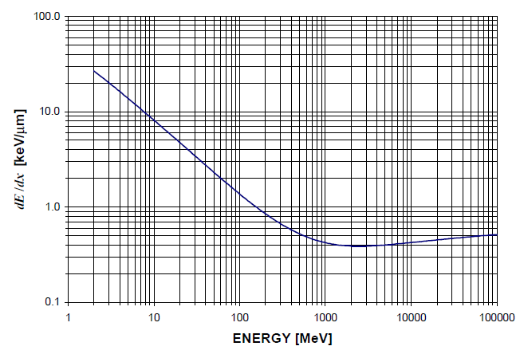


Interaction of charged particles in matter
Bethe-Bloch formula describes the energy loss of heavy particles passing through matter
$$−\frac{dE}{dx}=4∙π∙{r_{e}}^{2}∙N_{a}∙m_{e}c^{2}∙ρ∙\frac{Z}{A}∙\frac{z^{2}}{β^{2}}∙\left[\frac{1}{2}ln\left(\frac{2∙m_{e}c^{2}∙γ^{2}∙β^{2}{∙T}_{max}}{I^{2}}\right)−β^{2}−δ−2∙\frac{C}{Z}\right]$$
$$≈z^{2}∙\frac{Z}{A}∙f\left(β,I\right)$$
= 0.3071 MeV g⁻¹cm²
$$T_{max}=2∙m_{e}c^{2}∙β^{2}∙γ^{2}$$
dE/dx vs. E of protons in silicon

Slide 2
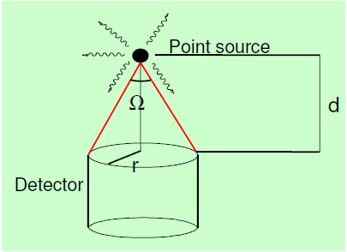
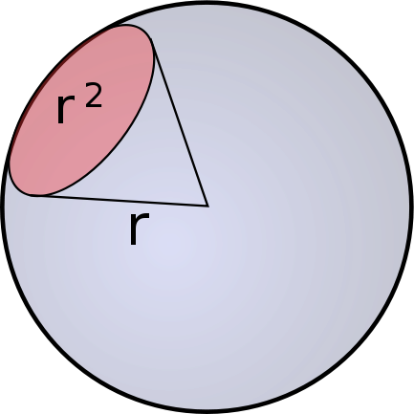
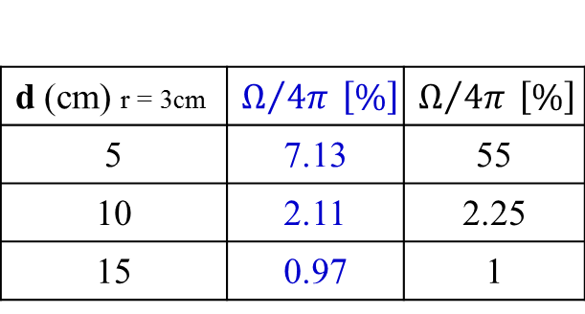
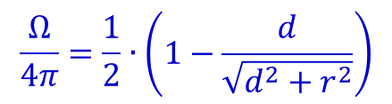
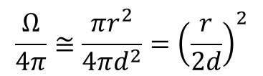
Solid angle
1 Ci = 3.7·10¹⁰ Bq
d
$$\frac{Ω}{4π}≅\frac{πr^{2}}{4πd^{2}}={\left(\frac{r}{2d}\right)}^{2}$$
Ω = solid angle between source and detector (sr)
For a point source:
d (cm) r = 3cm | $$Ω/{4π} \left[\%\right]$$ | $$Ω/{4π} \left[\%\right]$$
5 | 7.13 | 55
10 | 2.11 | 2.25
15 | 0.97 | 1
$$\frac{Ω}{4π}=\frac{1}{2}∙\left(1−\frac{d}{\sqrt{d^{2}+r^{2}}}\right)$$

Slide 3
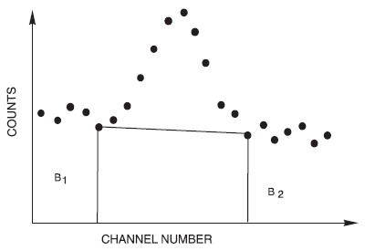


Statistical Error: Peak on top of Background
peak
+ background
The area above the background represents the total counts between the vertical lines P minus the trapezoidal area B (red hatched). If the total counts are (P+B) and the end-points of the horizontal line are B₁ and B₂ (width of B₁ + B₂ = width of B), then the net area is given by:
$$P=\left(P+B\right)−B$$
The standard deviation of ΔP is given by:
$$ΔP=\sqrt{P+2∙B}$$

Slide 4
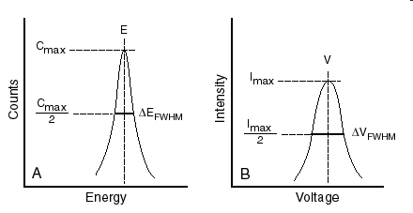
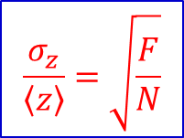
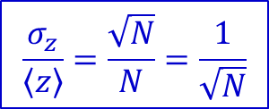
Quality of Measurements: Resolution
Resolution generally defined as 1 standard deviation $\left(1σ\right)$ for a Gaussian distribution, or the FWHM $\left(∆z=2.355∙σ_{z}\right)$
If the measurement is dominated by Poissonian fluctuations:
z
Δz
$$\frac{σ_{z}}{\left\langle z\right\rangle }=\frac{\sqrt{N}}{N}=\frac{1}{\sqrt{N}}$$
lowest limit for the resolution apart from Fano factor correction
Fano factor F: fluctuations on N are reduced by correlation in the production of consecutive e-hole pairs. For Germanium detectors F ~ 0.1
$$\frac{σ_{z}}{\left\langle z\right\rangle }=\sqrt{\frac{F}{N}}$$

Slide 5

Luminosity
$$L=N_{projectiles}∙N_{target nuclei}$$
accelerator current: 1 nA What is the number of projectiles?
1 particle / s ≡ 1.6·10⁻¹⁹ C/s
6.25·10⁹ particles / s ≡ 1 nA
²⁸Si target thickness: 1 mg/cm² How many target nuclei?
28 g/cm² Silicon ≡ 6.02·10²³ atoms/cm²
1 mg/cm² Silicon ≡ 2.15·10¹⁹ atoms/cm²
Luminosity = 6.25·10⁹ · 2.15·10¹⁹ = 1.34·10²⁹ [s⁻¹ cm⁻²]
event rate [s⁻¹] = luminosity [s⁻¹ cm⁻²] · cross section [cm²]
= 1.34∙10²⁹ [s⁻¹ cm²] ∙ cross section [~ mb = 10⁻²⁷ cm²] ≈ 10² [s⁻¹]

