Slide 1
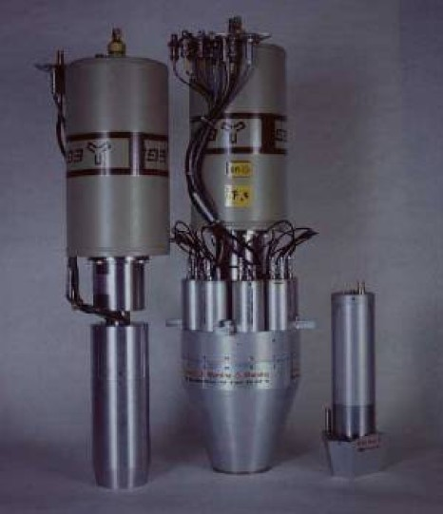
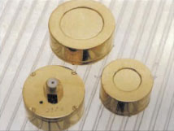
Semiconductor Detectors
Lecture: Hans-Jürgen Wollersheim
e-mail: h.j.wollersheim@gsi.de

Slide 2
Advantages / Disadvantages of semiconductor detectors
Semiconductor detectors have a high density
● large energy loss in a short distance
● diffusion effect is smaller than in gas detectors resulting in achievable position resolution of less then 10 μm
Low ionization energy (few eV per e – hole pair) compared to
● gas detectors (20 – 40 eV per e – ion pair) or
● scintillators (400 – 1000 eV to create a photon)
No internal amplification, i.e. small signal
● with a few exceptions
High cost per surface unit
● not only Silicon itself
● high number of readout channels
● large power consumption, cooling

Slide 3
Elemental Semiconductor
Germanium:
● used in nuclear physics
● needs cooling due to small band gap of 0.66 eV (usually done with liquid nitrogen att 77 K)
Silicon:
● can be operated at room temperature
● synergies with micro electronics industry
Diamond (CVD or single crystal):
● allotrope of carbon
● large band gap (requires no depletion zone)
● very radiation hard
● disadvanture: low signal and high cost

Slide 4
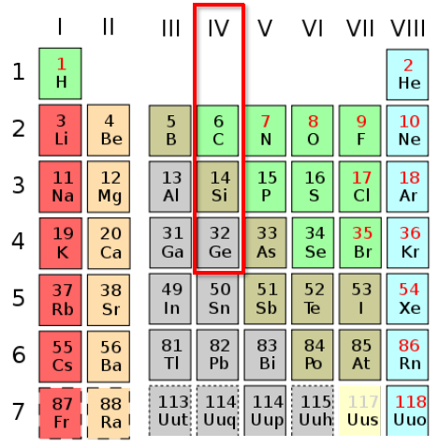
Compound semiconductors
Compound semiconductors consist of
● two (binary semiconductors) or
● more than two
Depending on the column in the periodic system of elements one differentiates between
● IV – IV – (e.g. SiGe, SiC),
● III – V – (e.g. GaAs)
● II – VI compounds (CdTe, ZnSe)
important III – V compounds:
● GaAs: faster and probably more radiation resistant than Si.
Drawback is less experience in industry and higher costs.
● GaP, GaSb, InP, InAs, InSb, InAIP
important II – VI compounds:
● CdTe: high atomic number (48 + 52) hence very efficient to
detect photons.
● ZnS, ZnSe, ZnTe, CdS, Cd_{1-x}Zn_{x}Te, Cd_{1-x}Zn_{x}Se

Slide 5
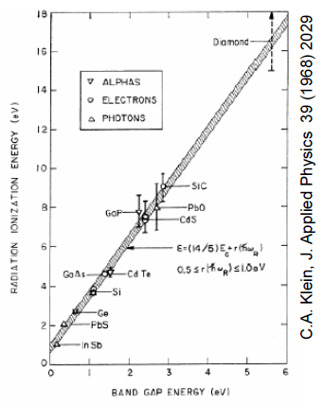
Why Silicon
Semiconductor with moderate bandgap (1.12 eV)
Energy to create electron/hole pair (signal quanta) = 3.6 eV
● (c.f. Argon gas = 15 eV)
● high carrier yield
● better energy resolution and high signal
→ no gain stage required
High density and atomic number
● higher specific energy loss
→ thinner detectors
→ reduced range of secondary particles
→ better spatial resolution
High carrier mobility → Fast!
● less than 30 ns to collect entire signal
Large experience in industry with micro-chip
technology
High intrinsic radiation hardness
plus phonon excitation

Slide 6
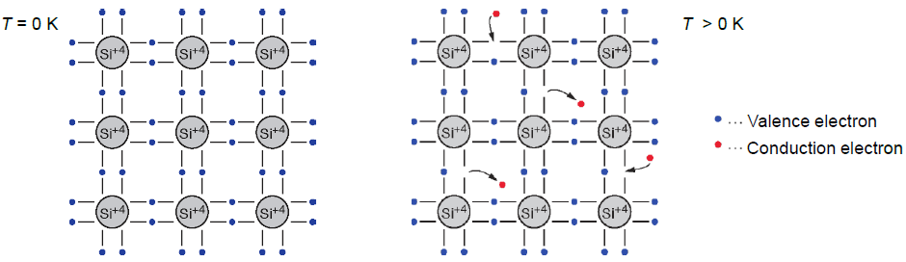
Bond model of semiconductors
Example of column IV elemental semiconductor (2-dimensional projection):
Each atom has 4 closest neighbors, the 4 electrons in the outer shell are shared and form covalent bonds.
At low temperature all electrons are bound
At higher temperature thermal vibrations break some of the bonds →
free e⁻ cause conductivity (electron conduction)
The remaining open bonds attract other e⁻ → the “holes” change position (hole conduction)

Slide 7
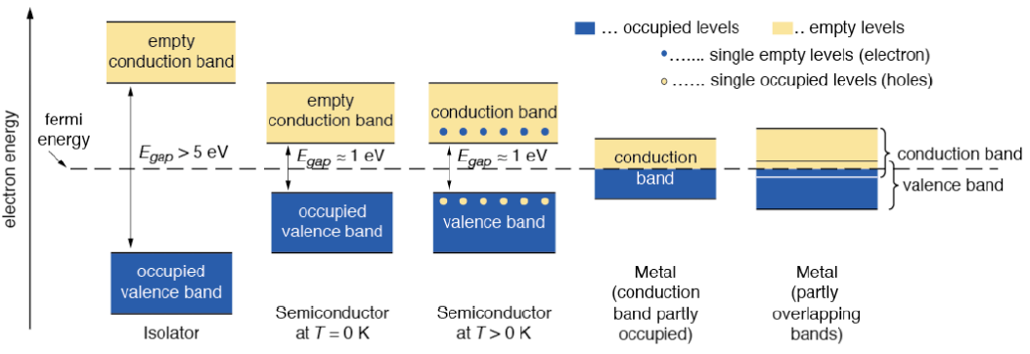
Energy bands: isolator – semiconductor - metal
In an isolated atom the electrons have only discrete energy levels. In solid state material the atomic levels merge to energy bands. In metals the conduction and the valence band overlap, whereas in isolators and semiconductors these levels are separated by an energy gap (band gap). In isolators this gap is large.

Slide 8
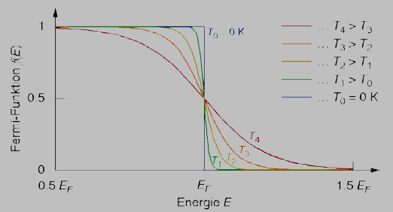
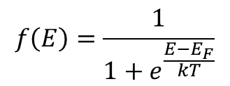
Fermi distribution, Fermi levels
Fermi distribution $f\left(E\right)$ describes the probability that an electronic state with energy E is occupied by an electron
$$f\left(E\right)=\frac{1}{1+e^{\frac{E−E_{F}}{kT}}}$$
The Fermi level E_{F} is the energy at which the probability of occupation is 50%. For metals E_{F} is in the conduction band, for semiconductors and isolators E_{F} is in the band gap
Fermi distribution function for different temperatures
T₄ > T₃ > T₂ > T₁ > T₀ = 0 K
T₀ = 0 K: saltus function

Slide 9
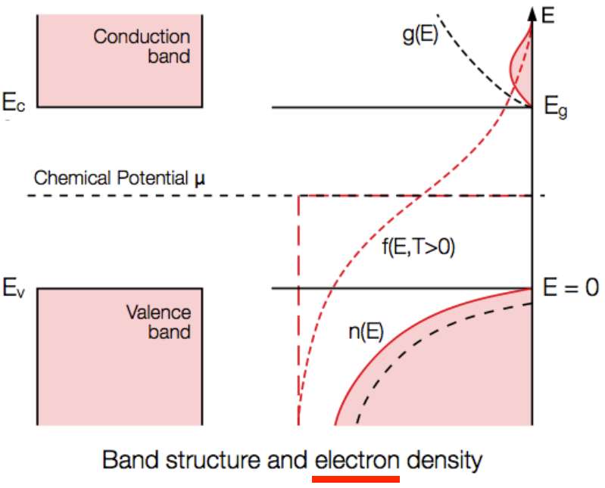
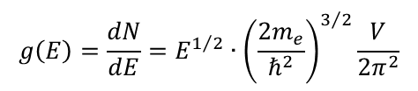


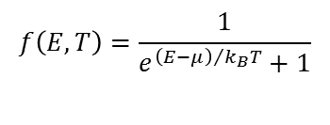
Intrinsic semi-conductor properties
Dispersion relation
Density of states
Fermi-Dirac distribution
Electron density
$$E\left(\vec{k}\right)=\frac{ℏ^{2}k^{2}}{2m_{e}}=\frac{ℏ^{2}}{2m_{e}}\left({k_{x}}^{2}+{k_{y}}^{2}+{k_{z}}^{2}\right)$$
$$g\left(E\right)=\frac{dN}{dE}=E^{1/2}∙{\left(\frac{2m_{e}}{ℏ^{2}}\right)}^{3/2}\frac{V}{2π^{2}}$$
$$f\left(E,T\right)=\frac{1}{e^{{\left(E−μ\right)}/{k_{B}T}}+1}$$
$$n=\frac{1}{V}\int_{0}^{E_{max}}{g\left(E\right)f\left(E\right)dE}$$

Slide 10
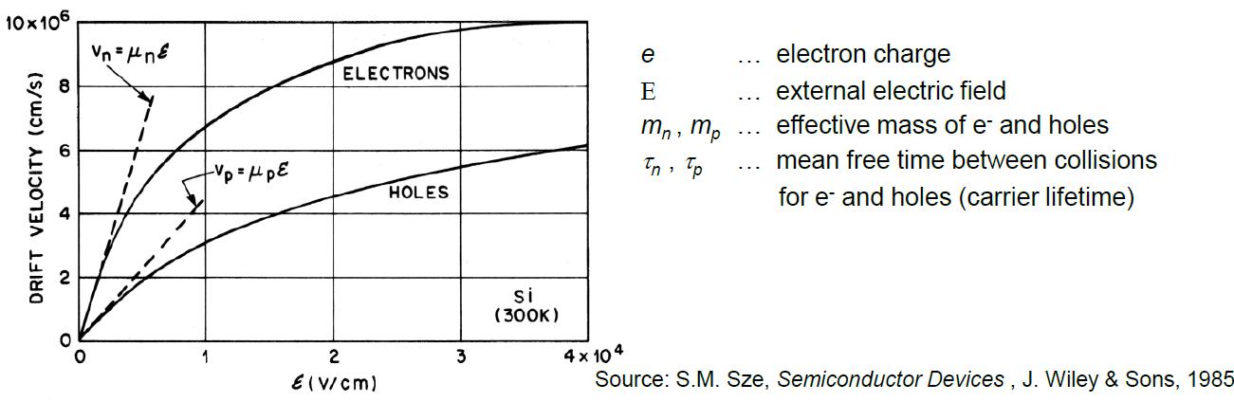
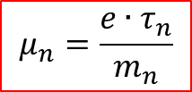

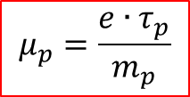

Drift velocity and mobility
Drift velocity
for electrones:
$$\vec{v_{n}}=−μ_{n}\vec{E}$$
and for holes:
$$\vec{v_{p}}=−μ_{p}\vec{E}$$
Mobility
for electrones:
$$μ_{n}=\frac{e{∙τ}_{n}}{m_{n}}$$
and for holes:
$$μ_{p}=\frac{e{∙τ}_{p}}{m_{p}}$$

Slide 11
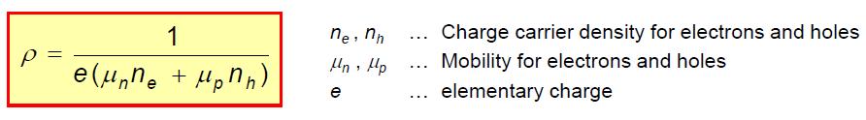
Resistivity
Specific resistivity is a measure of silicon purity
Carrier mobilities: μ_{p}(Si, 300K) ≈ 450 cm²/Vs
μ_{n}(Si, 300K) ≈ 1450 cm²/Vs
The charge carrier concentration in pure silicon (i.e. intrinsic Si) for T = 300 K is:
n_{e} = n_{h} ≈ 1.45·10¹⁰ cm⁻³
This yields an intrinsic resistivity of:
ρ ≈ 230 kΩcm

Slide 12
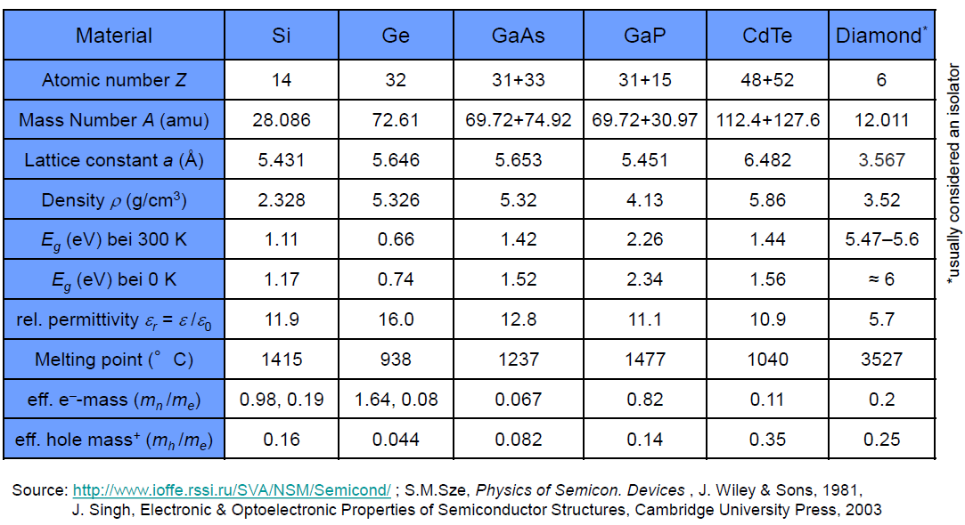
Comparison of different semiconductor materials

Slide 13
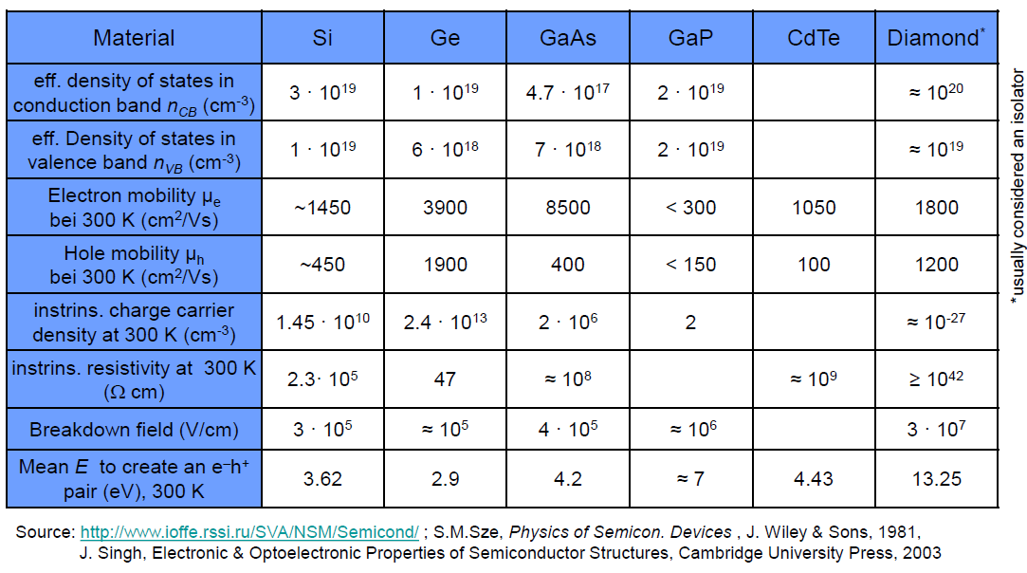
Comparison of different semiconductor materials

Slide 14
Constructing a detector
One of the most important parameter of a detector is the signal-to-noise-ratio (SNR). A good detector should have a large SNR.
However this leads to two contradictory requirements:
Large signal
  low ionization energy → small band gap
Low noise
  very few intrinsic charge carriers → large band gap
An optimal material should have E_{g} ≈ 6 eV
In this case the conduction band is almost empty at room temperature and the band gap is small enough to create a large number of e⁻h⁺ pairs through ionization.
Such a material exist, it is Diamond. However even even artificial diamonds (e.g. CVD diamonds) are too expensive for large area detectors.

Slide 15

Constructing a detector
Let’s make a simple calculation for silicon:
mean ionization energy I₀ = 3.62 eV.
mean energy loss per flight path of a mip dE/dx = 3.87 MeV/cm
Assuming a detector with a thickness of d = 300 μm and an area of A = 1 cm²
Signal of a mip in such a detector:
Intrinsic charge carrier in the same volume (T = 300 K)
$$\frac{{dE}/{dx}∙d}{I_{0}}=\frac{3.87∙{10}^{6}{eV}/{cm}∙0.03cm}{3.62eV}≈3.2∙{10}^{4}e^{−}h^{+}−pairs$$
$$n_{i}∙d∙A=1.45∙{10}^{10}{cm}^{−3}∙0.03cm∙1{cm}^{2}≈4.35∙{10}^{8}e^{−}h^{+}−pairs$$
Result: the number of thermal created e⁻h⁺-pairs (noise is four orders of magnitude larger than the signal.
We have to remove the charge carriers
→ depletion zone in inverse biased pn junctions

Slide 16
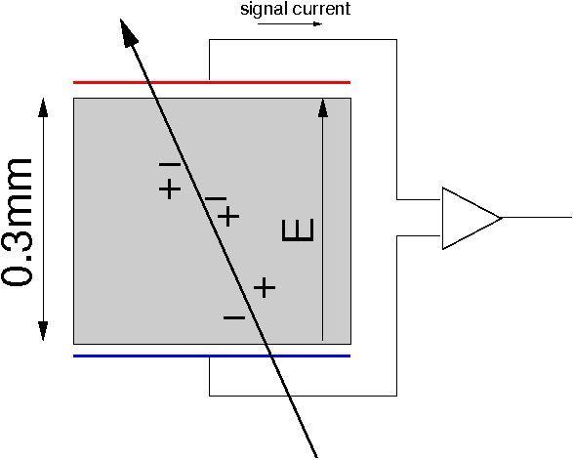
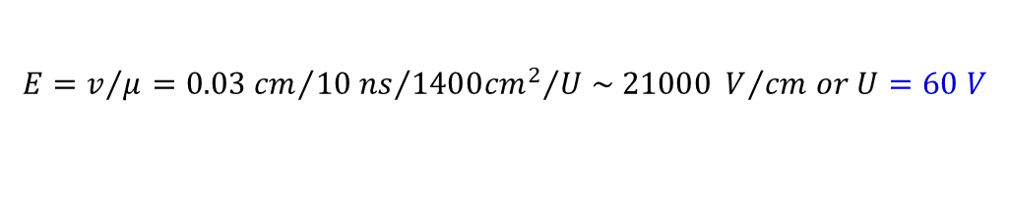
Constructing a detector
Thickness: 0.3 mm
Area: 1 cm²
Resistivity: 10 kΩcm
Mobility (electrons): ~1400 cm²/Vs
Collection time: ~10 ns
Charge released: ~25000 e~4fC
Need an average field of
$$E=v/μ={0.03 cm}/{{10 ns}/{{1400{cm}^{2}}/{U \sim 21000 V/{cm or U=60 V}}}}$$

Slide 17
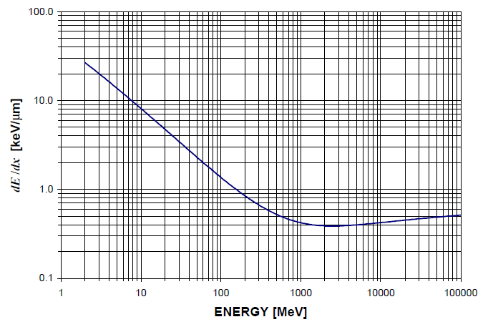

Constructing a detector
Proton in Silicon
Let’s make a simple calculation for silicon:
mean ionization energy I₀ = 3.62 eV.
mean energy loss per flight path of a mip dE/dx = 3.87 MeV/cm
Assuming a detector with a thickness of d = 300 μm and an area of A = 1 cm²
Signal of a mip in such a detector:
Intrinsic charge carrier in the same volume (T = 300 K)
$$\frac{{dE}/{dx}∙d}{I_{0}}=\frac{3.87∙{10}^{6}{eV}/{cm}∙0.03cm}{3.62eV}≈3.2∙{10}^{4}e^{−}h^{+}−pairs$$
$$n_{i}∙d∙A=1.45∙{10}^{10}{cm}^{−3}∙0.03cm∙1{cm}^{2}≈4.35∙{10}^{8}e^{−}h^{+}−pairs$$
Result: the number of thermal created e⁻h⁺-pairs (noise is four orders of magnitude larger than the signal.
We have to remove the charge carriers
→ depletion zone in inverse biased pn junctions

Slide 18
Doping
A pn junction consists of n and p doped substrates:
Doping is the replacement of a small number of atoms in the lattice by atoms of neighboring columns from the periodic table
These doping atoms create energy levels within the band gap and therefore alter the conductivity.
Definitions:
An un-doped semiconductor is called an intrinsic semiconductor
  For each conduction electron exists the corresponding hole.
A doped semiconductor is called an extrinsic semiconductor.
  Extrinsic semiconductors have a abundance of electrons or holes.

Slide 19
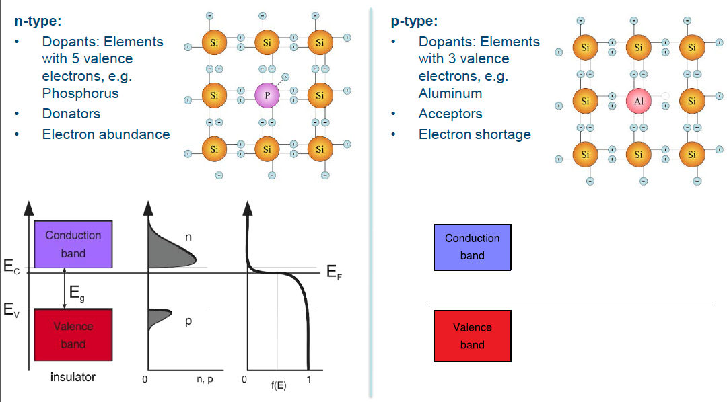
Doping: n- and p-type silicon

Slide 20
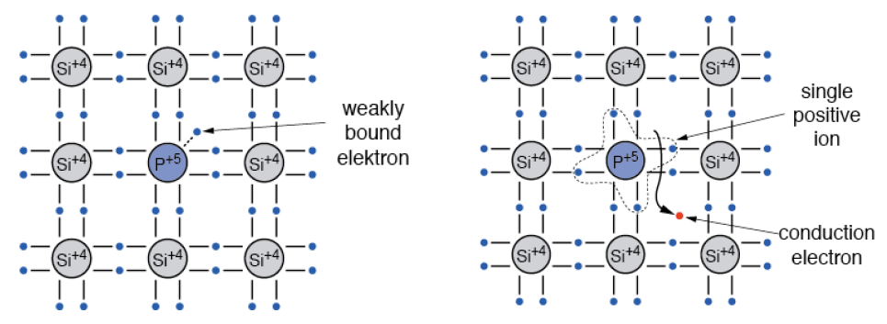
Bond model: n-doping in silicon
Doping with an element 5 atom (e.g. P, As, Sb). The 5th valence electrons is weakly bound.
The doping atom is called donor The released conduction electron
leaves a positively charged ion

Slide 21
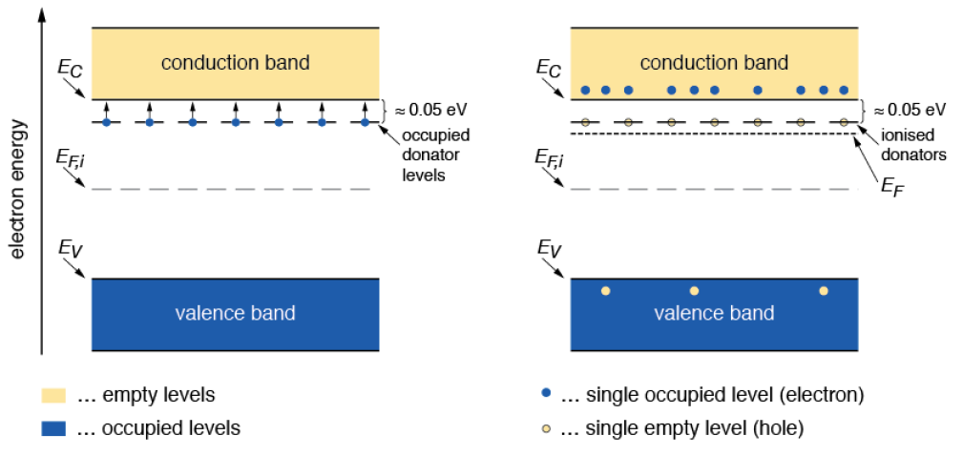
Band model: n-doping in silicon
The energy level of the donor is just below the edge of the conduction band. At room temperature most electrons are raised to the conduction band. The Fermi level E_{F} moves up.

Slide 22
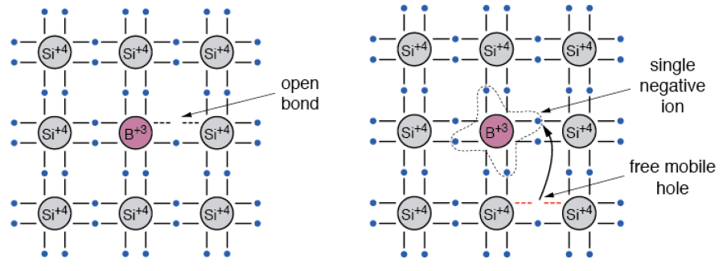
Bond model: p-doping in silicon
Doping with an element 3 atom (e.g. B, Al, Ga, In). One valence bond remains open. This open bond attracts electrons from the neighbor atoms.
The doping atom is called acceptor. The acceptor atom in the lattice is
negatively charged.

Slide 23
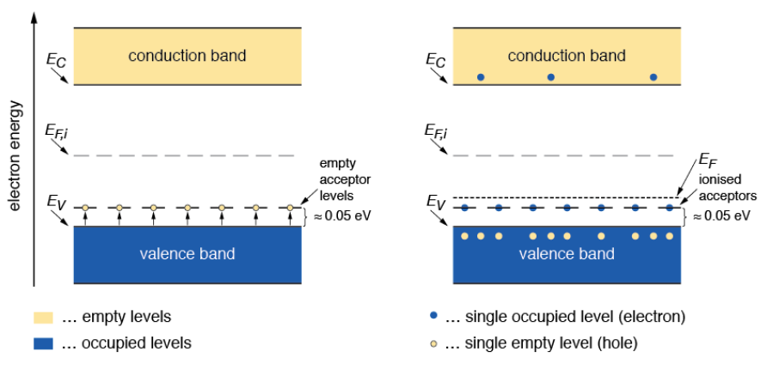
Band model: p-doping in silicon
The energy level of the acceptor is just above the edge of the valence band. At room temperature most levels are occupied by electrons leaving holes in the valence band.
The Fermi level E_{F} moves down.

Slide 24
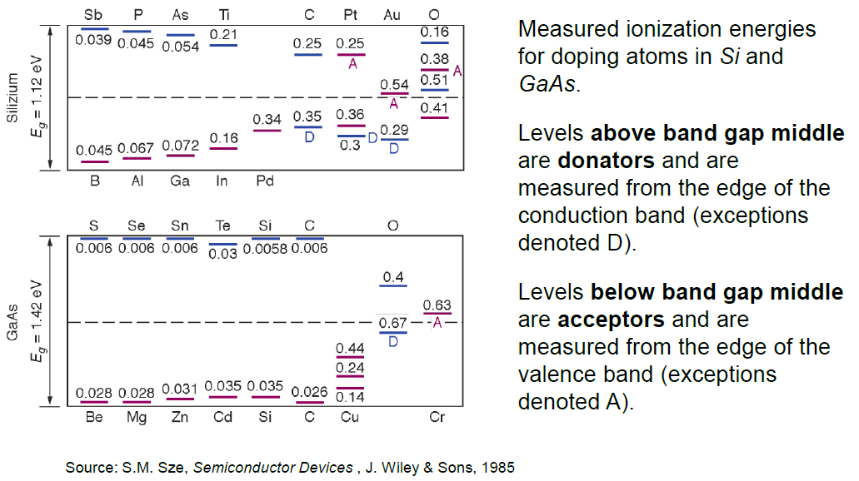
Donor and acceptor levels in Si and GaAs

Slide 25
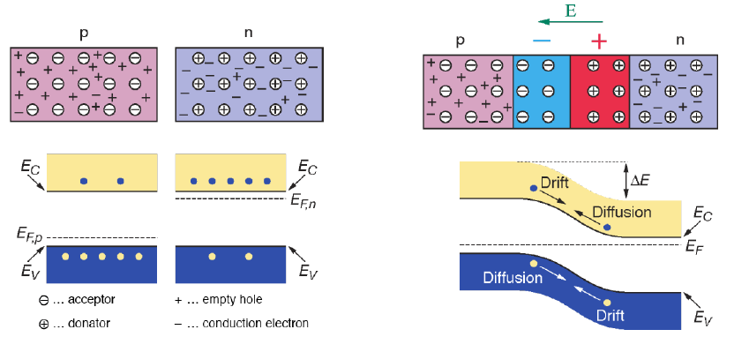
Creating a pn junction
At the interface of an n-type and p-type semiconductor the difference in the Fermi levels cause diffusion of excessive carries to the other material until thermal equilibrium is reached. At this point the Fermi level is equal. The remaining ions create a space charge region and an electric field stopping further diffusion.
The stable space charge region is free of charge carries and is called the depletion zone.

Slide 26
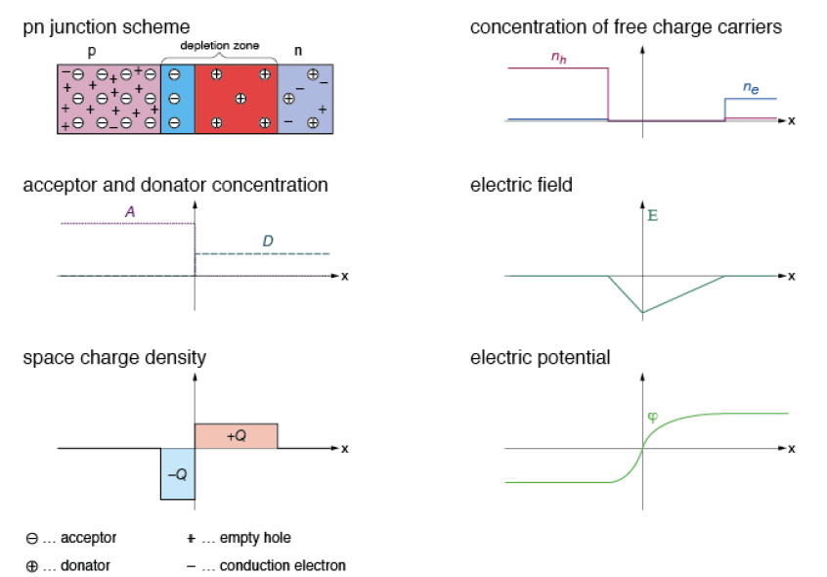
Electrical characteristics of pn junctions

Slide 27
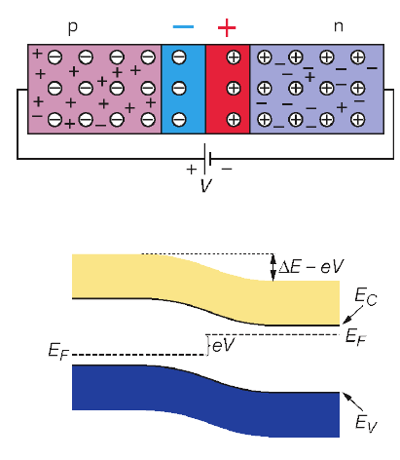
Operation of a pn-junction with forward bias
pn-junction with forward bias
Applying an external voltage V with the anode to p and the cathode to n e- and holes are refilled to the depletion zone. The depletion zone becomes narrower (forward biasing)
Consequences:
The potential barrier becomes smaller by eV
Diffusion across the junction becomes easier
The current across the junction increases significantly.

Slide 28
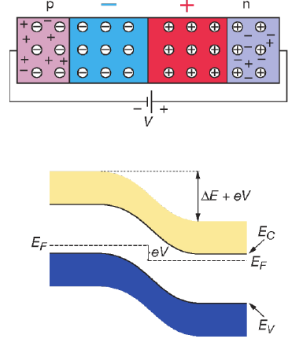
Operation a pn-junction with reverse bias
pn-junction with reverse bias
Applying an external voltage V with the cathode to p and the anode to n e⁻ and holes are pulled out of the depletion zone. The depletion zone becomes larger (reverse biasing).
Consequences:
The potential barrier becomes higher by eV
Diffusion across the junction is suppressed.
The current across the junction is very small (“leakage current”)
This is the way we operate our semiconductor detector!

Slide 29
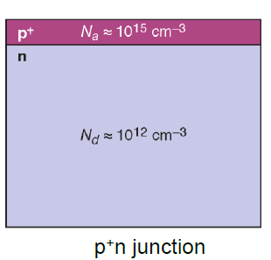
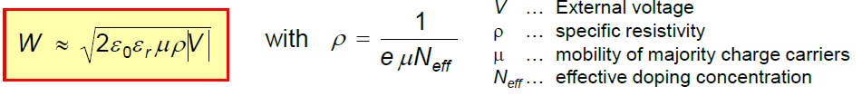
Width of the depletion zone
Effective doping concentration in typical silicon detector with p⁺-n junction
N_{a} = 10¹⁵ cm⁻³ in p⁺ region
N_{d} = 10¹² cm⁻³ in n bulk
without external voltage:
W_{p} = 0.02 μm
W_{n} = 23 μm
Applying a reverse bias voltage of 100 V:
W_{p} = 0.4 μm
W_{n} = 363 μm
Width of depletion zone in n bulk:

Slide 30
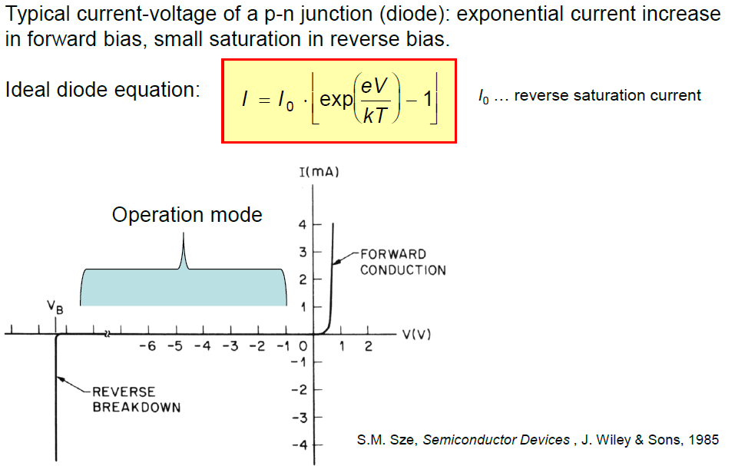
Current-voltage characteristics

Slide 31
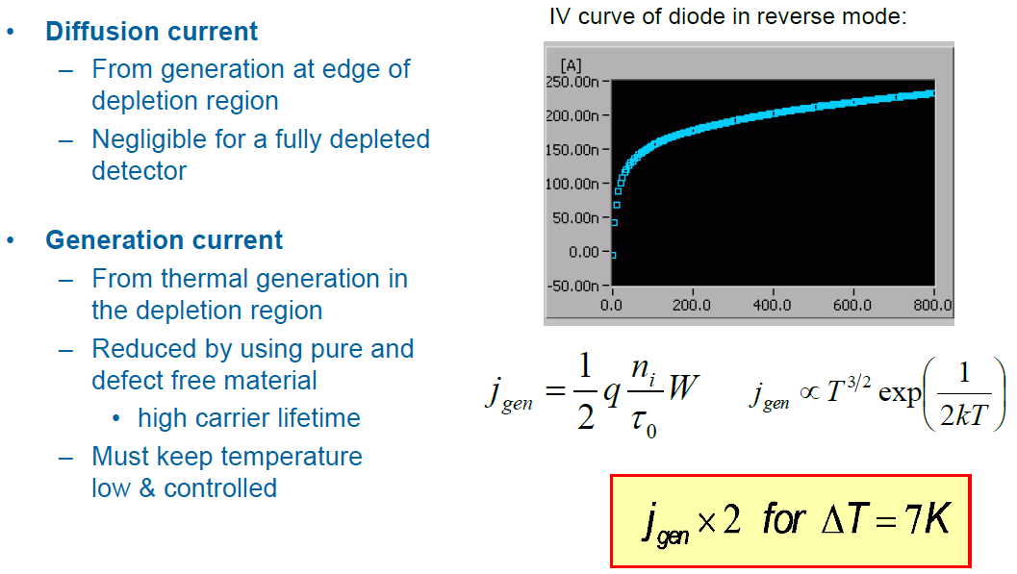
Reverse current

Slide 32
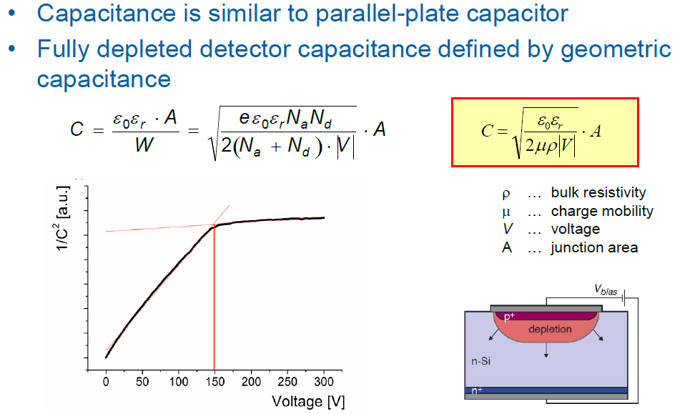
Detector capacitance and full depletion

Slide 33
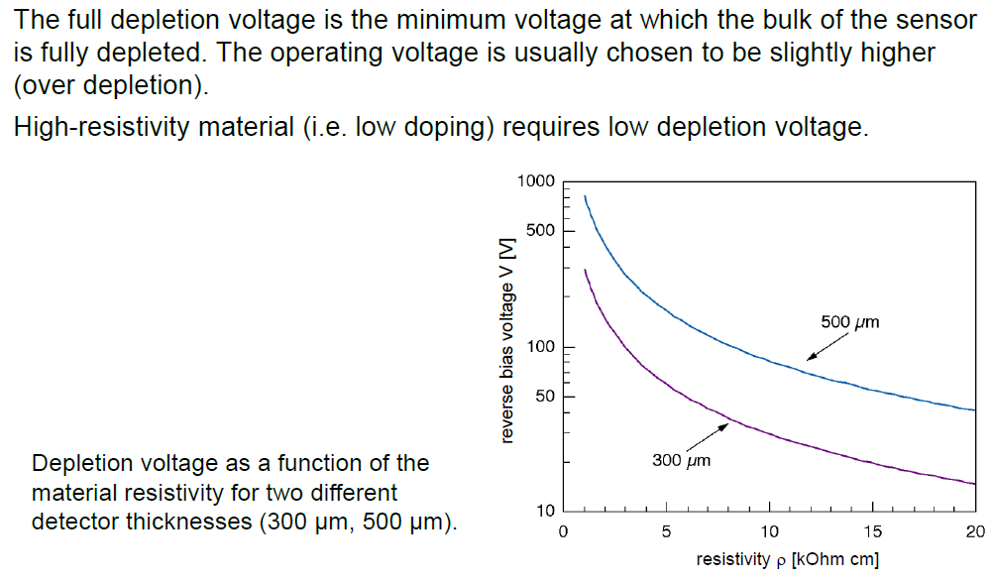
Full depletion voltage

Slide 34
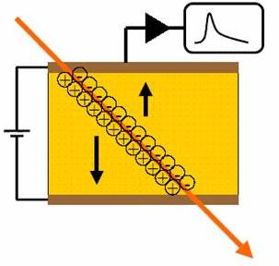
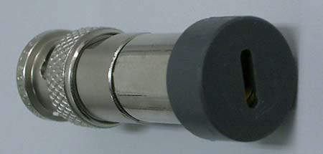
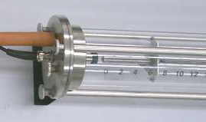
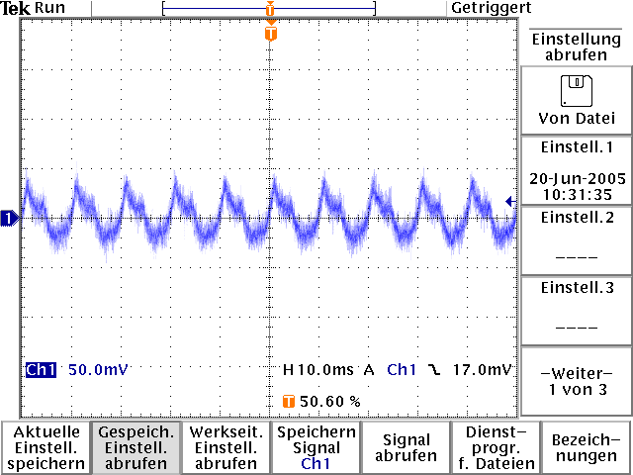
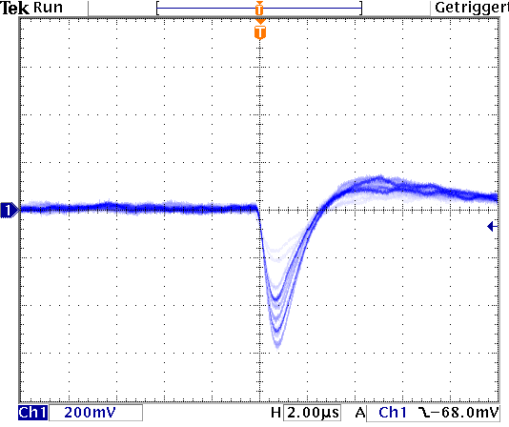
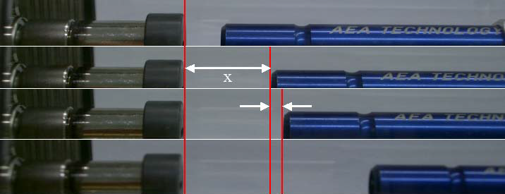
Measurements with Si-detectors
Si-detector
Si-detector with slit cover
detector principle
Energy loss measurement of α-particles in air
Δx

Slide 35
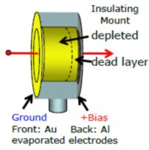
Surface Barrier Detectors
Different Fermi energies adjust to on contact.
Thin metal film on Si surface produces space
charge, an effective barrier (contact potential)
and depleted zone free of carriers. Apply reverse
bias to increase depletion depth.
Possible:
depletion depth ~ 300μm
dead layer d_{d} ≤ 1μ
V ~ 0.5 V/μ
Over-bias reduces d_{d}

Slide 36
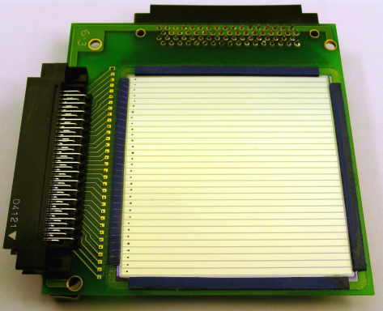
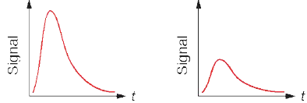
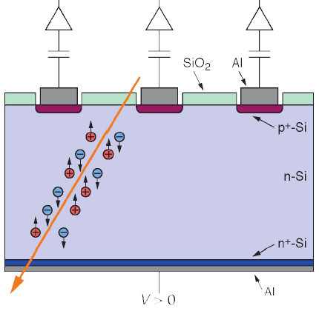
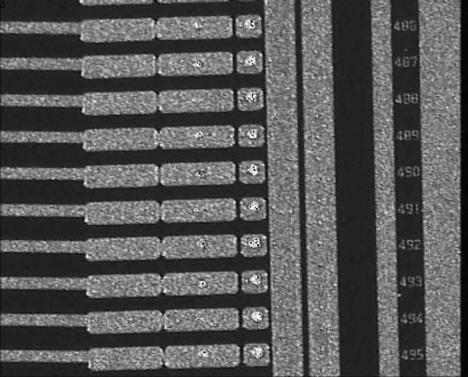
Principle of microstrip detector
surface of a Microstrip detector
bonding pads

Slide 37
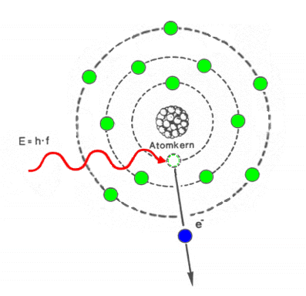
Germanium detector
Interaction in a Ge crystal:
Photo effect (low γ-ray energy)
Compton scattering (medium γ-ray energy)
Pair production e⁺e⁻ (high γ-ray energy)
conduction band
0.7 eV
3 eV
valence band
Number of electron-hole pairs for 1 MeV, N = 10⁶ / 3 = 3 ×10⁵
energy resolution

Slide 38
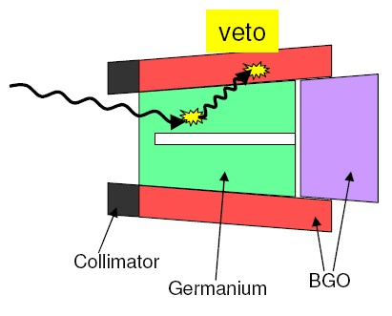
Germanium detector
Interaction in a Ge crystal:
Photo effect (low γ-ray energy)
Compton scattering (medium γ-ray energy)
Pair production e⁺e⁻ (high γ-ray energy)

Slide 39
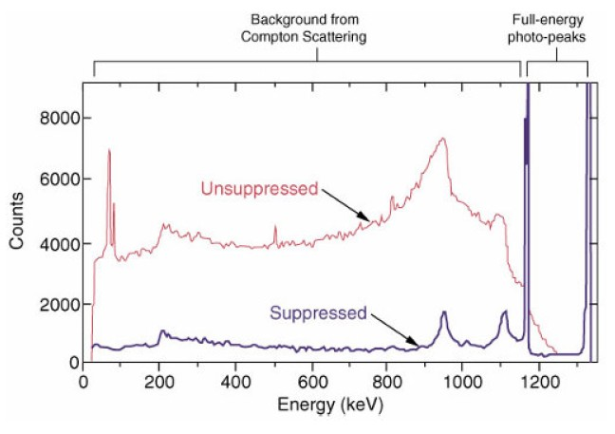

Compton suppressed Germanium detektor
Interaction in a Ge crystal:
Photo effect (low γ-ray energy)
Compton scattering (medium γ-ray energy)
Pair production e⁺e⁻ (high γ-ray energy)
peak-to-total ratio
unsuppressed
P/T~0.15
Compton suppressed
P/T~0.6

Slide 40


Gamma-ray spectrum of a radioactive decay
Pb-Box
Pb X-ray
γ₁
BSc
γ₂
511 keV
DE γ₂
SE γ₂
CE γ₂
γ₁+γ₂

Slide 41




EUROBALL (Legnaro / Strasbourg)
15 seven-fold
Cluster detectors
30 coaxial
detectors
26 four-fold
Clover detectors

Slide 42



Making a High Purity Germanium detector
Coaxial Ge detectors
The hard part: Don´t spoil purity of the Ge crystal
(HPGe 10¹⁰ imp./cm³; e.g. 1ng Cu = 10¹³ atoms and
10⁹ Cu atoms per cm³ already deteriorates FWHM
[L. Van Goethem et al., NIM A240 (1985) 365])

