Slide 1
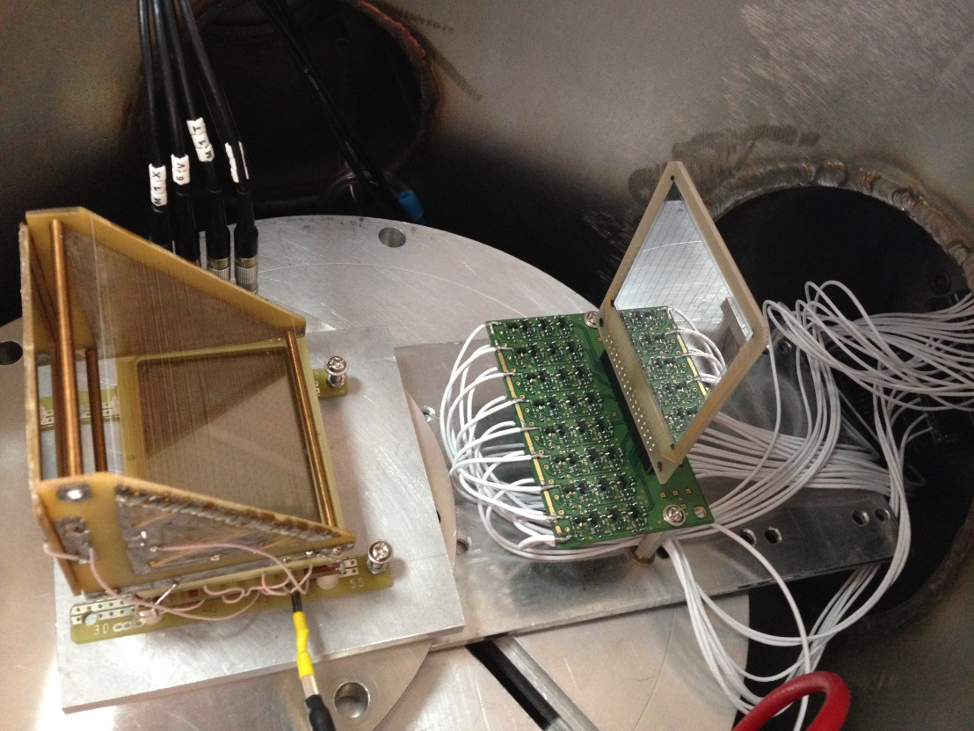
Fast timing of double sided Si strip detector
Lecture: Hans-Jürgen Wollersheim
e-mail: h.j.wollersheim@gsi.de
Akhil Jhingan, Inter University Accelerator Centre, Delhi

Slide 2
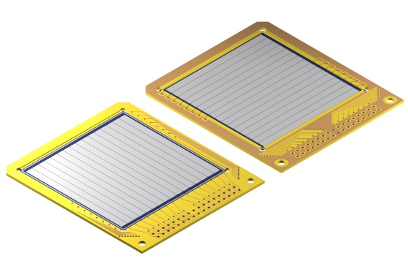

Fast timing of double sided Si strip detector
RIB-experiments after slowing down to Coulomb barrier
Ideal beam tracking detector:
large area tracking system
Energy resolution ΔE/E < 1%
Position resolution ~ 1 mm
Time resolution ≤ 100 ps
MCP DSSSD
double-sided silicon-strip detectors
- active area 50x50 mm²
- thickness 40 μm
- 16 x 16 strips (3.125 mm)
- manufactured by MICRON

Slide 3
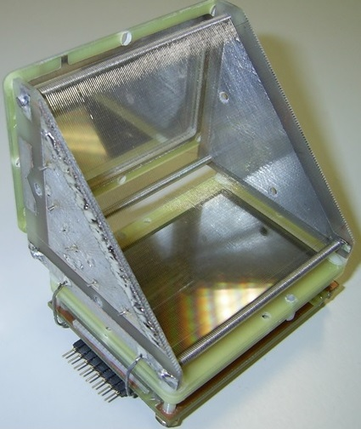
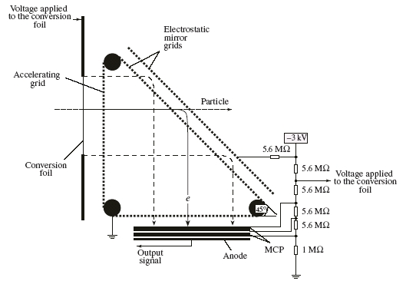
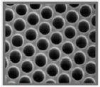
Micro Channel Plates - MCP
time resolution – 150 ps
position resolution
for alpha particles – 3 mm
for fission fragments – 1.7 mm
N. Kondratiev (FLNR JINRDubna), M. Pfeiffer (IKP Köln)

Slide 4
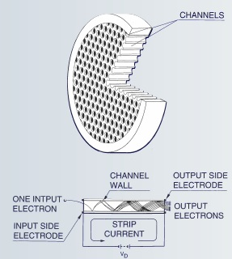
Micro Channel Plates - MCP
time resolution – 150 ps
position resolution
for alpha particles – 3 mm
for fission fragments – 1.7 mm
N. Kondratiev (FLNR JINRDubna), M. Pfeiffer (IKP Köln)

Slide 5
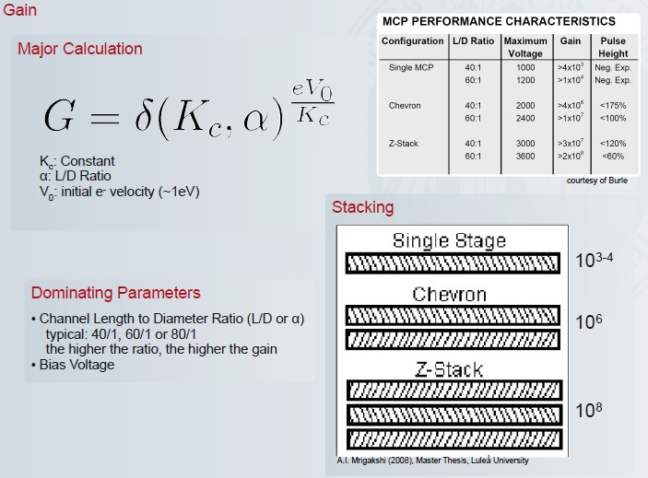
Micro Channel Plates - MCP

Slide 6
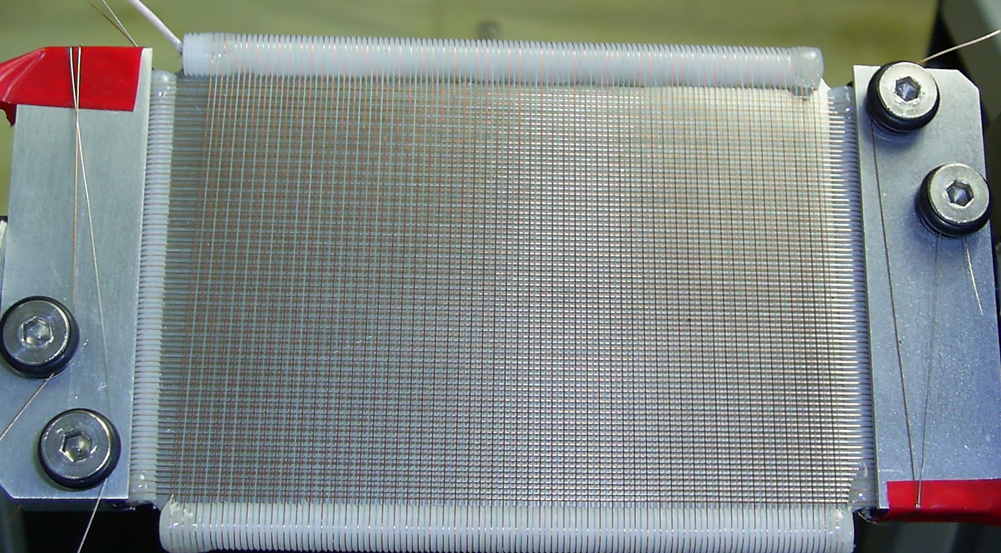
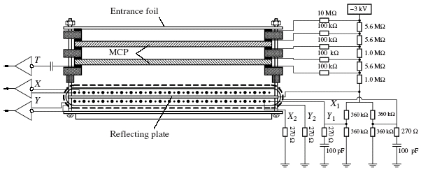
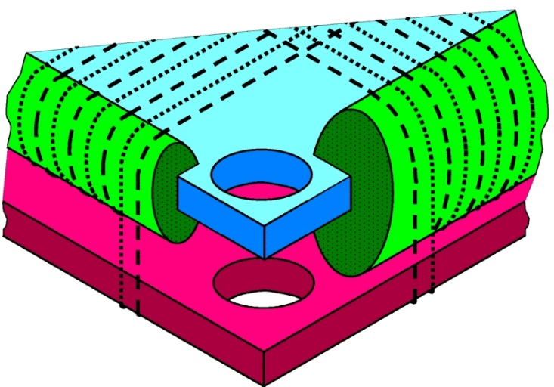
Schematic diagram of the MCP-based position-sensitive detector

Slide 7
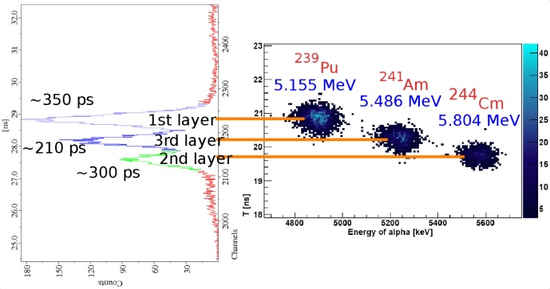
Tagging of triple alpha source

Slide 8
Fast timing of double sided Si strip detector
Experimental ToF setup with MCP and DSSSD

Slide 9
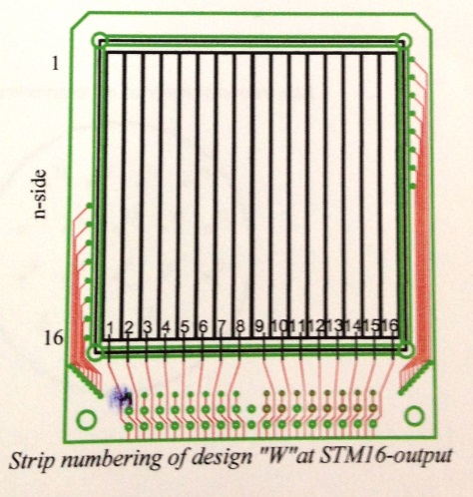
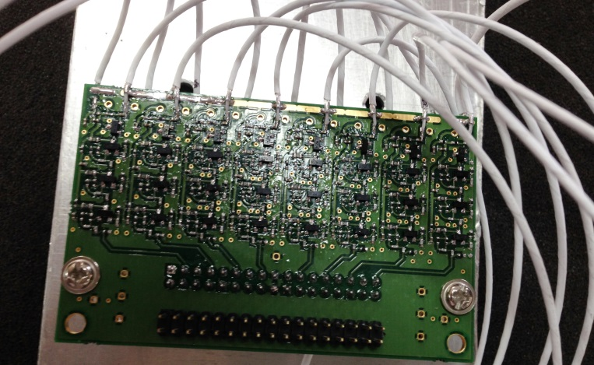
Fast timing of double sided Si strip detector
front strips
timing preamplifiers

Slide 10
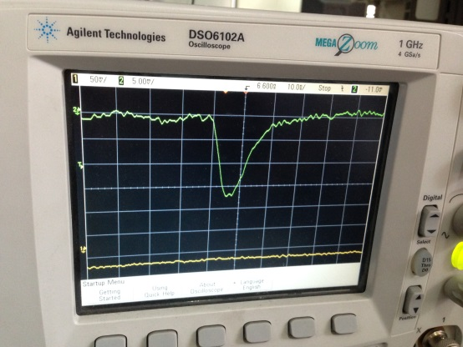
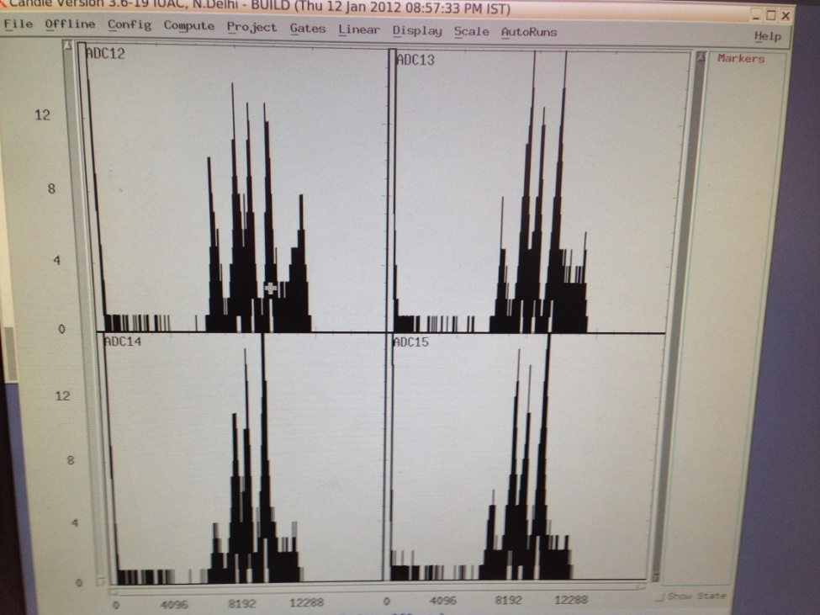
Fast timing of double sided Si strip detector
 | ²²⁹Th α-source | Cf fission source
rise time | 5 ns | 9 ns
pulse hight | 15 mV | 300 mV
noise | 5 mV
Energy resolution ~300 keV for different strips

Slide 11
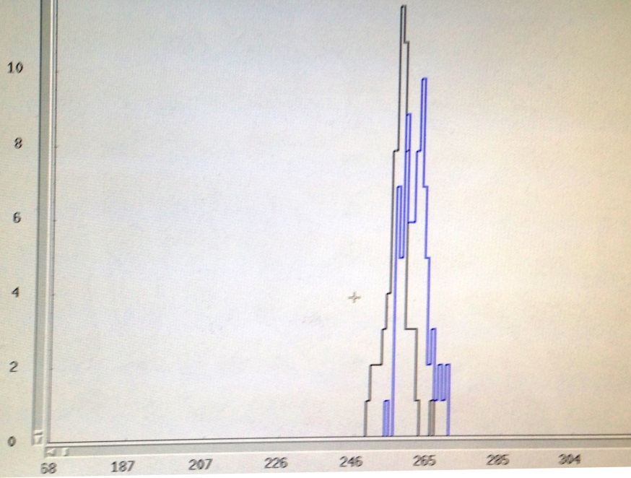
Fast timing of double sided Si strip detector
Energy measurement with Mesytec:
Energy resolution ΔE = 300 keV
²²⁹Th
Time measurement with 16-ch. fast timing preamplifier (IUAC):
pulse height 15 mV
noise 5 mV
rise time 5 ns
MCP DSSSD
Δt ≈ 1 ns
E_{α}=6.34 MeV
E_{α}=7.07 MeV
energy gated TOF spectra:

Slide 12
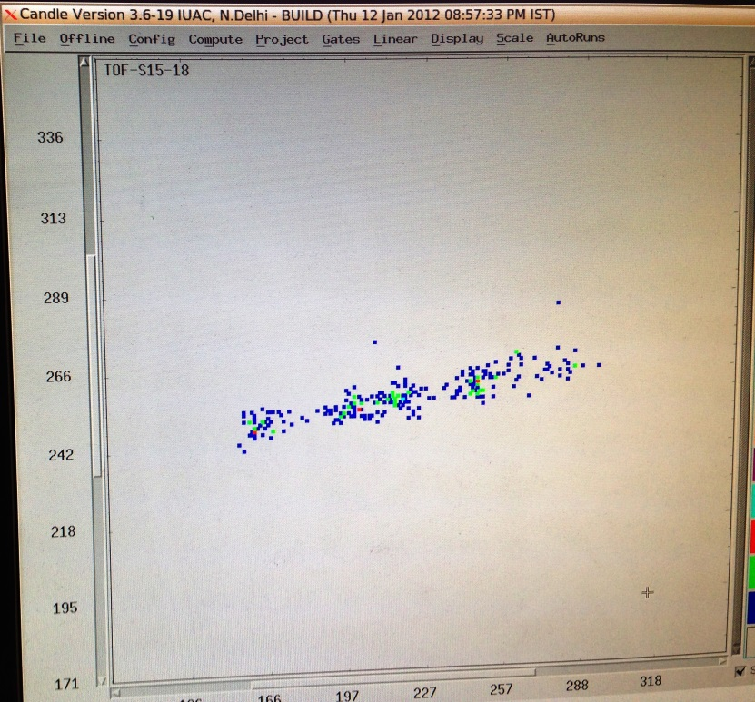
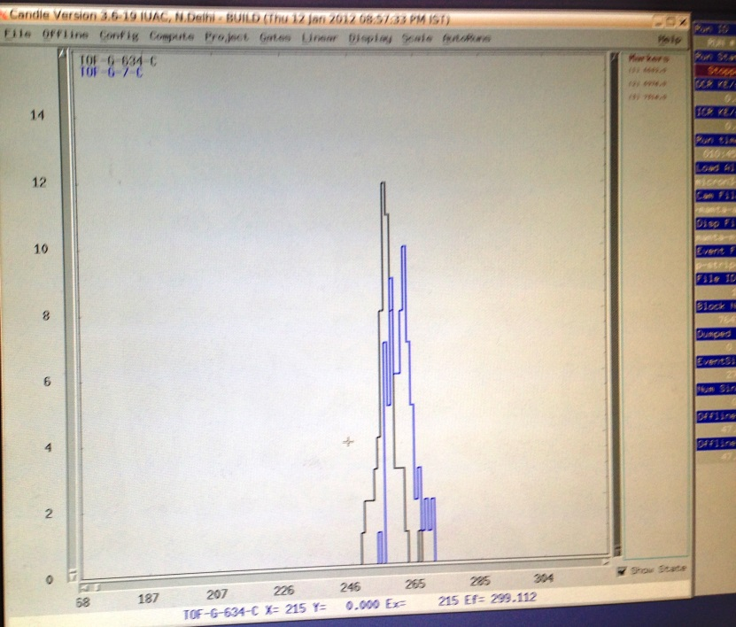
Fast timing of double sided Si strip detector
Details of the ²²⁹Th alpha source:
E_{α} = 4.84 MeV, v = 1.527 10⁷ m/s, TOF = 9.824 ns
E_{α} = 5.83 MeV, v = 1.676 10⁷ m/s, TOF = 8.950 ns
E_{α} = 6.34 MeV, v = 1.747 10⁷ m/s, TOF = 8.586 ns
E_{α} = 7.07 MeV, v = 1.845 10⁷ m/s, TOF = 8.130 ns
E_{α} = 8.38 MeV, v = 2.009 10⁷ m/s, TOF = 7.466 ns
ToF versus alpha energy measured for four strips
Energy gated ToF spectra

Slide 13
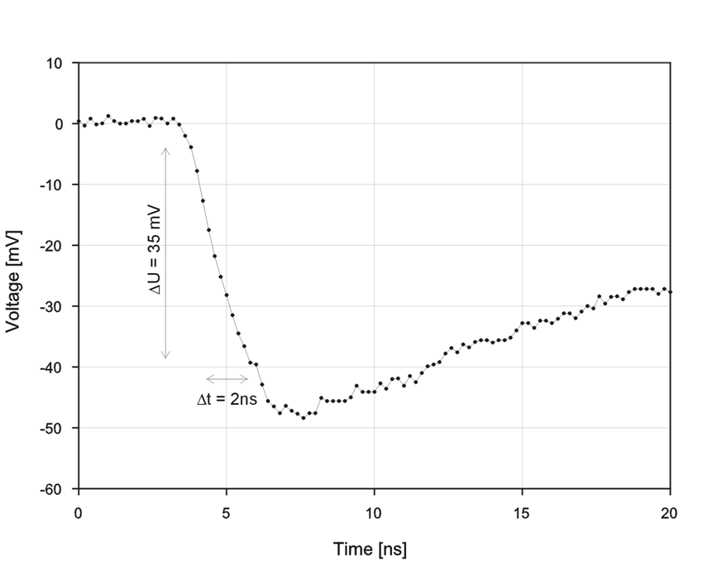
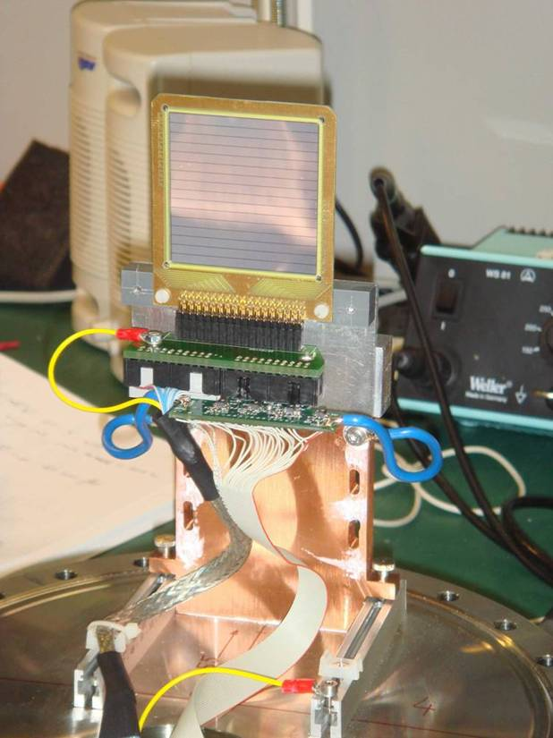
DSSSD – fast timing
Coulomb scattering of ⁴⁸Ca beam, 12.6 MeV/u at 20⁰
Estimated time resolution:
ΔT (FWHM) ~ 100 ps

Slide 14
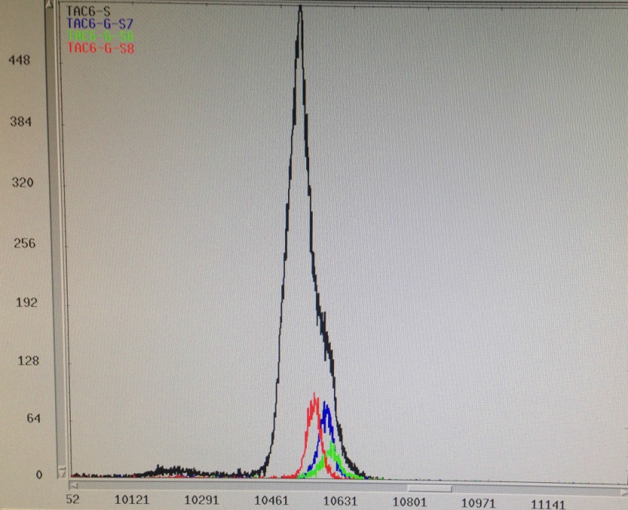
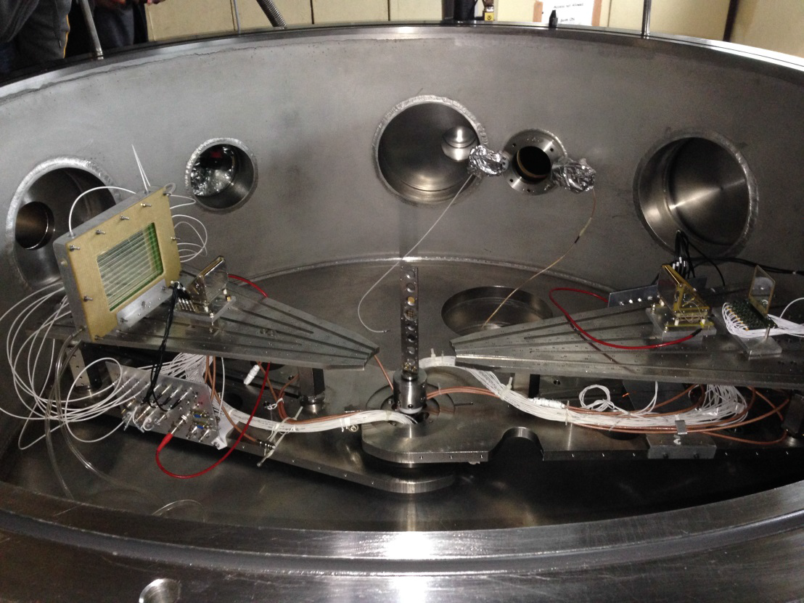
Fast timing of double sided Si strip detector
Energy measurement with Mesytec:
Energy resolution ΔE/E = 1.5%
IUAC experiment :
²⁸Si → ¹⁹⁷Au (0.2mg/cm²) at 122 MeV
Time measurement with 16-ch. fast timing preamplifier (IUAC):
pulse height 300 mV
rise time 6.3 ns
Time resolution 200 ps for one of the 256 detector pixels
Δt ≈ 1 ns
total detector
one detector pixel
MWPC + MCP MCP + DSSSD
TOF between MCP and DSSSD

