Slide 1
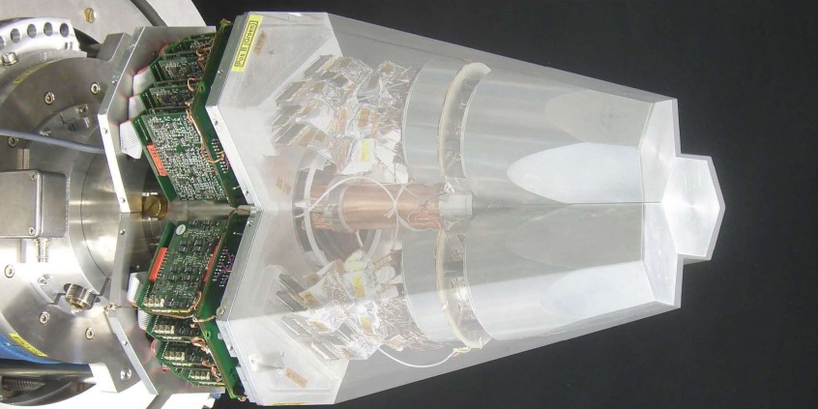
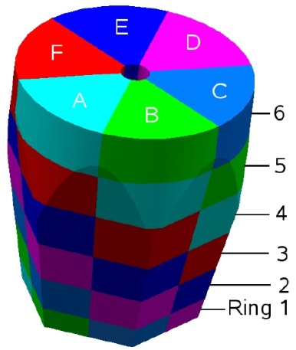
Segmented Detectors
Lecture: Hans-Jürgen Wollersheim
e-mail: h.j.wollersheim@gsi.de

Slide 2
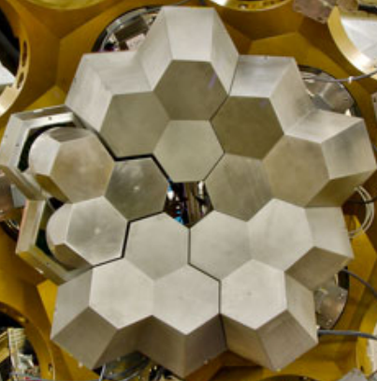
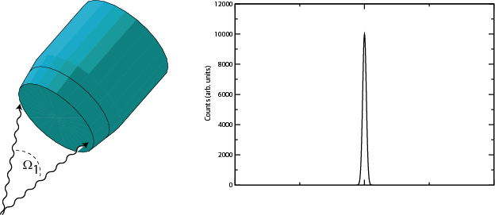
Challenges of γ-ray spectroscopy efficiency vs resolution
Emission at rest
ΔE=2keV
Counts(arb. units)
γ ray
Channel No.
Composite HPGe detectors
in ADD BACK mode

Slide 3
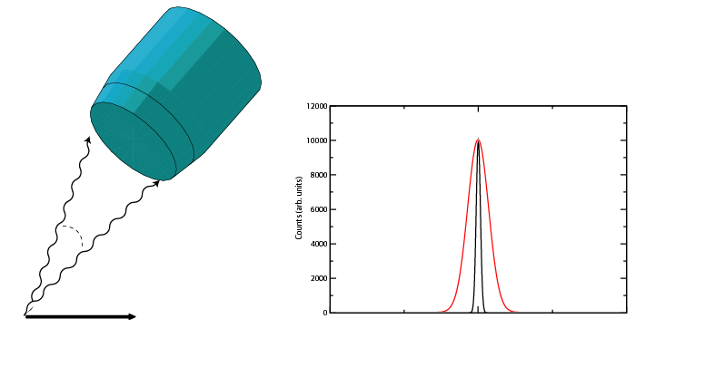
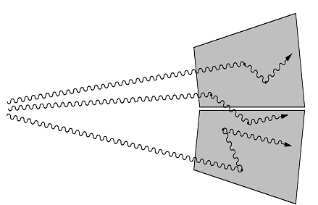
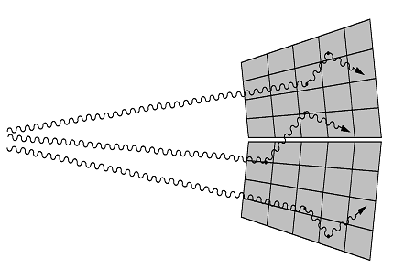
Challenges of γ-ray spectroscopy efficiency vs resolution
Doppler broadening
High M_{γ}
Emission in flight
Δө
Counts(arb. units)
ө
v
Channel No.
Solution
- Segmentation
- Gamma-ray tracking
- Pulse shape analysis
- Doppler correction

Slide 4
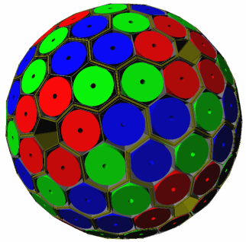
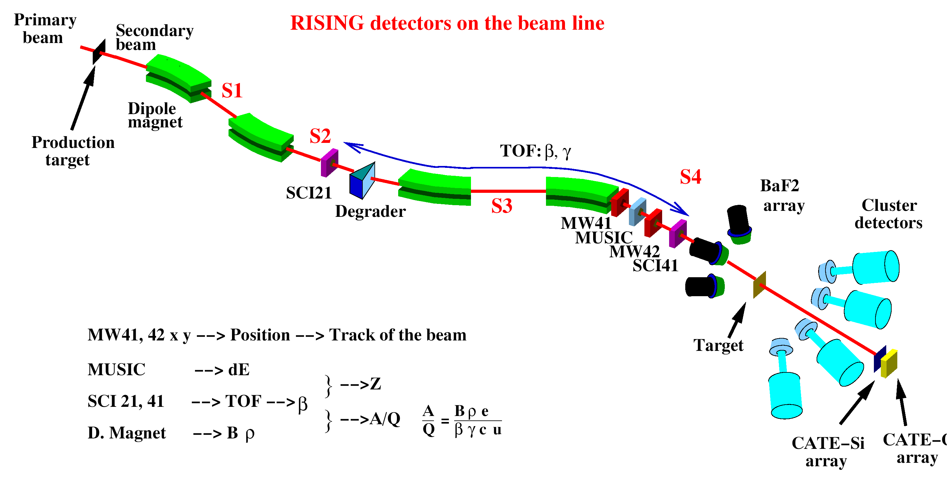
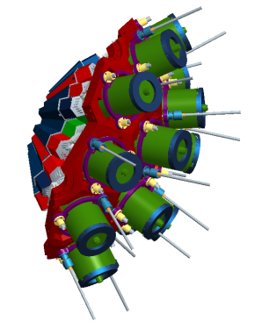
γ-ray spectroscopy with 3D position sensitive HPGe detectors
In flight γ-ray spectroscopy
HISPEC
Advanced GAmma Tracking Array
Efficiency: 43% (M_{γ} =1) 28% (M_{γ} =30)
P/T: 58% (M_{γ}=1) 49% (M_{γ}=30)
Angular resolution: ~1º
FWHM (1 MeV, v/c=50%) ~ 6 keV
Decay γ−ray spectroscopy after implantation
DESPEC

Slide 5
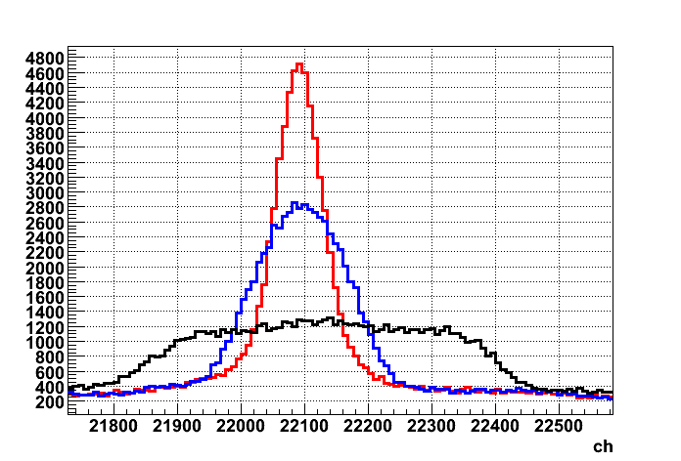
γ-ray spectroscopy with 3D position sensitive HPGe detectors
In flight γ-ray spectroscopy
Δθ
β = 0.5
Via tracking it becomes possible to determine the incident angle and preserve the good energy resolution.
θ
Decay γ−ray spectroscopy after implantation
E_{γ} = 1.3 MeV
Counts
PSA = 5 keV
Segment = 12 keV
Detector = 35 keV
Energy

Slide 6
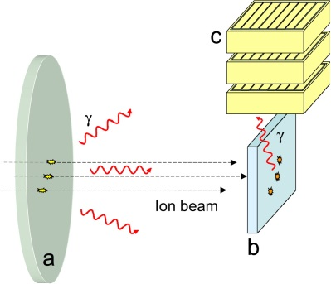
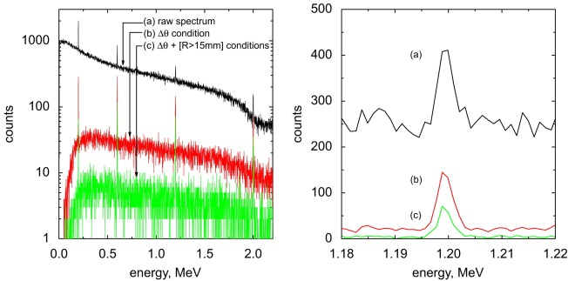
γ-ray spectroscopy with 3D position sensitive HPGe detectors
In flight γ-ray spectroscopy
θ
Background suppression and P/T can be improved by applying imaging techniques.
Decay γ−ray spectroscopy after implantation
S. Tashenov, et al. NIMA 586 (2008) 224-228

Slide 7

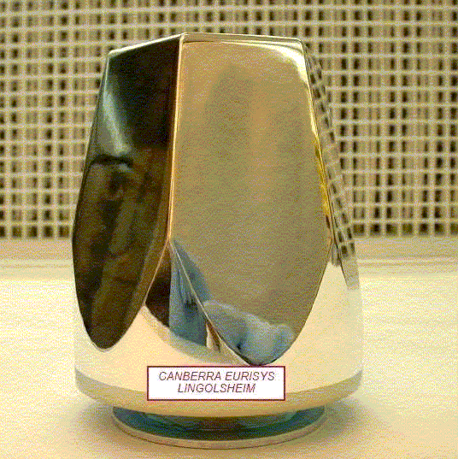
HPGe detector
7 cm
9 cm

Slide 8
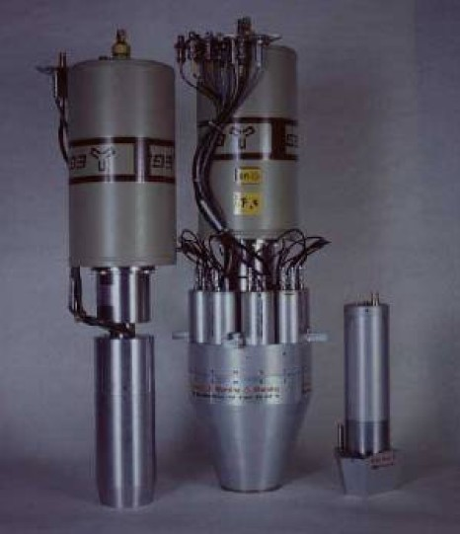
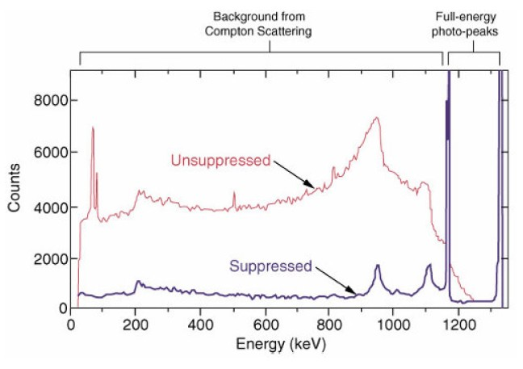
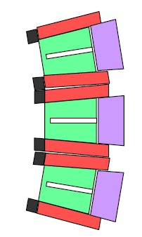
Compton suppressed Germanium detektor
Interaction in a Ge crystal:
Photo effect (low γ-ray energy)
Compton scattering (medium γ-ray energy)
Pair production e⁺e⁻ (high γ-ray energy)
peak-to-total ratio
unsuppressed
P/T~0.15
Compton suppressed
P/T~0.6

Slide 9
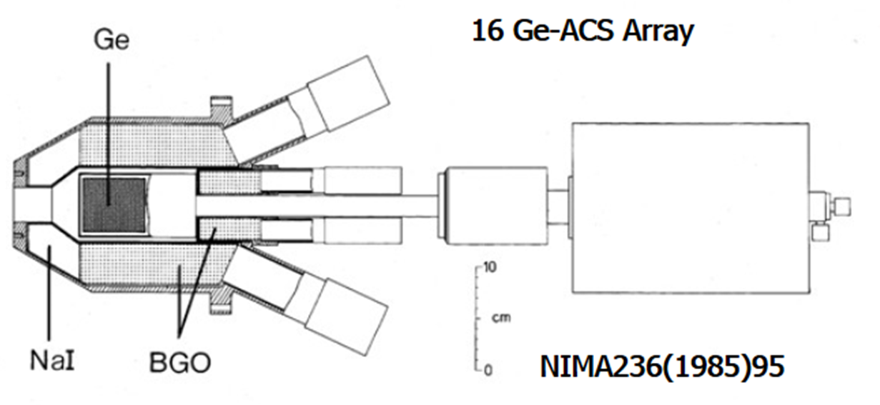
Compton suppressed Germanium detektor

Slide 10
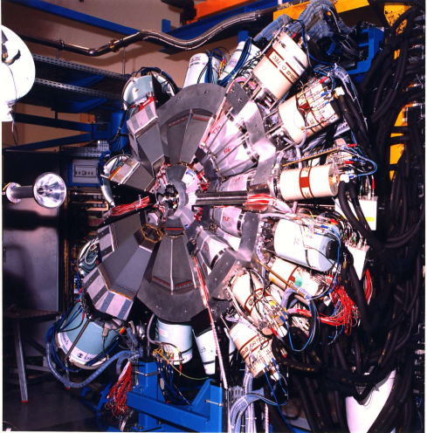
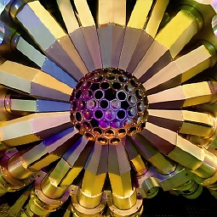
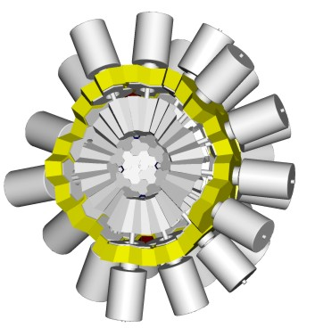
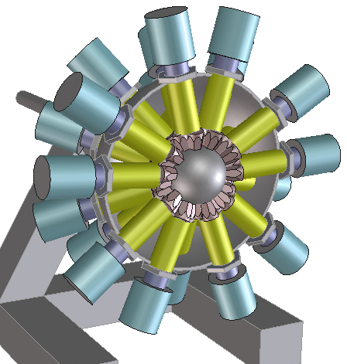
Gamma Arrays based on Compton
Suppressed Spectrometers
Tracking Arrays based on
Position Sensitive Ge Detectors
EUROBALL
GAMMASPHERE
AGATA
GRETA
ε ~ 10 - 7 %
( M_{γ} = 1 – M_{γ} = 30)
ε ~ 50 - 25 %
( M_{γ} = 1 - M_{γ} = 30)

Slide 11
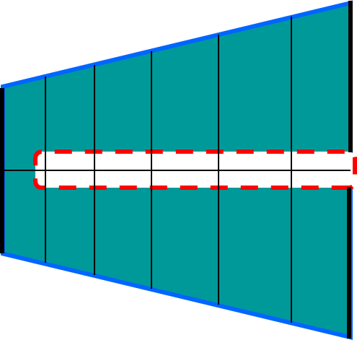
HPGe detector – working principle

Slide 12
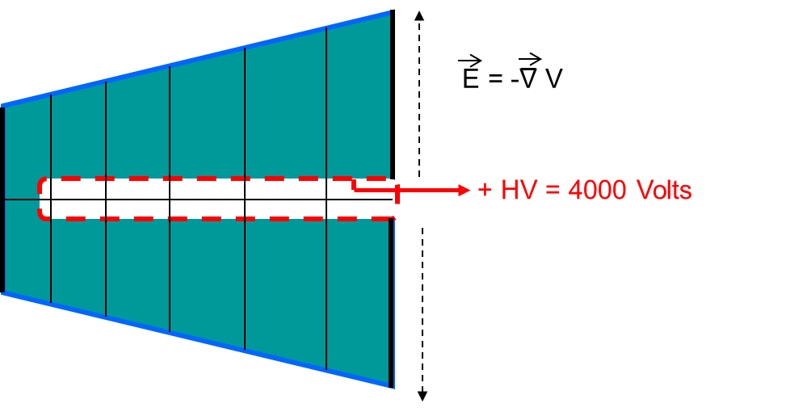
HPGe detector – working principle

Slide 13
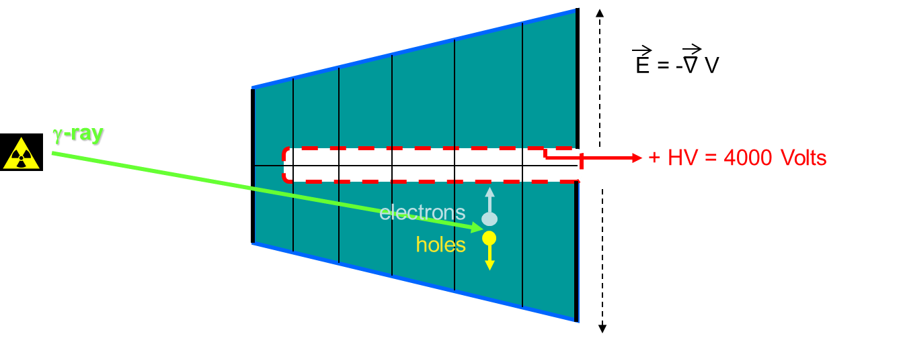
HPGe detector – working principle

Slide 14
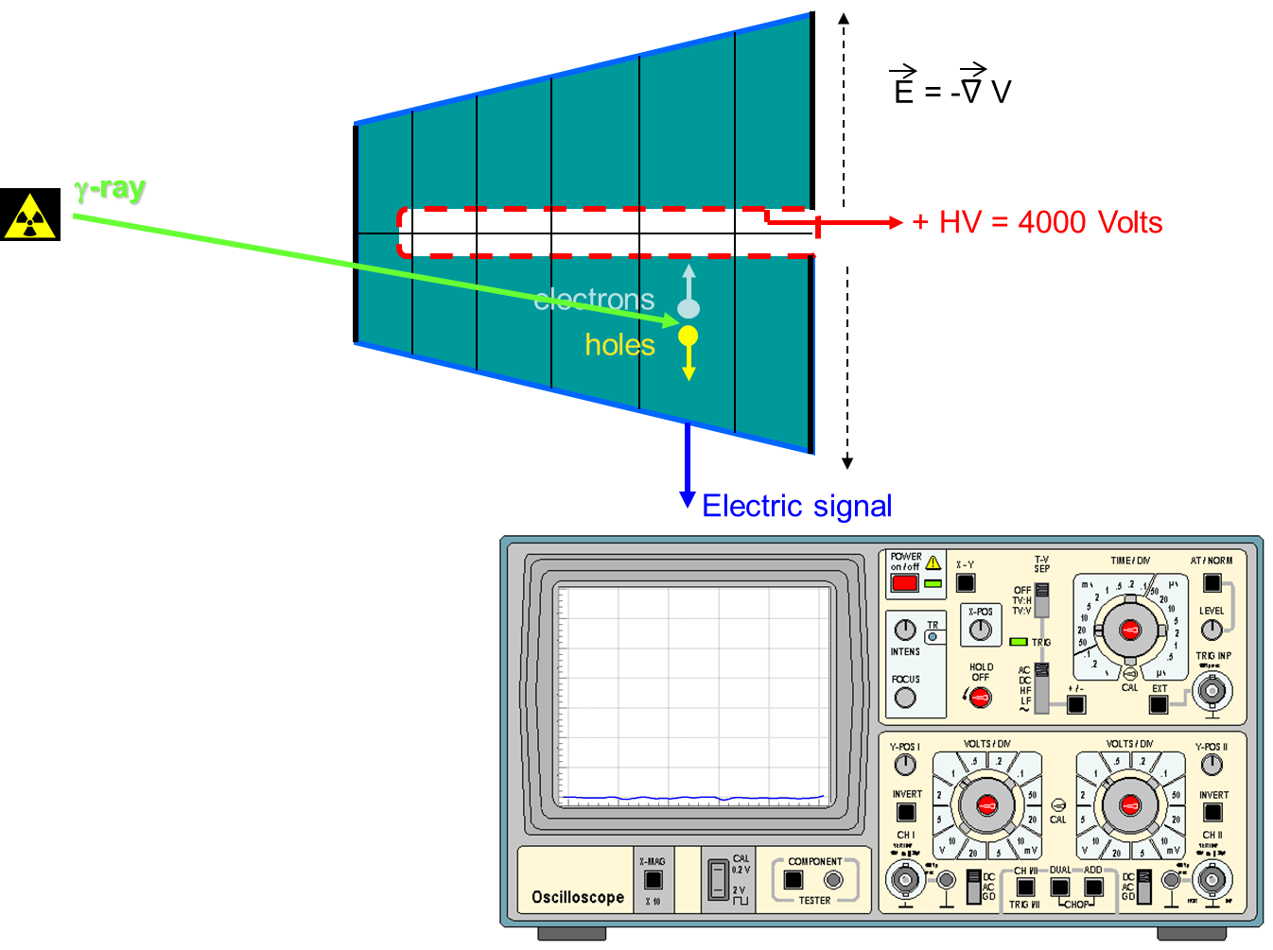
HPGe detector – working principle

Slide 15
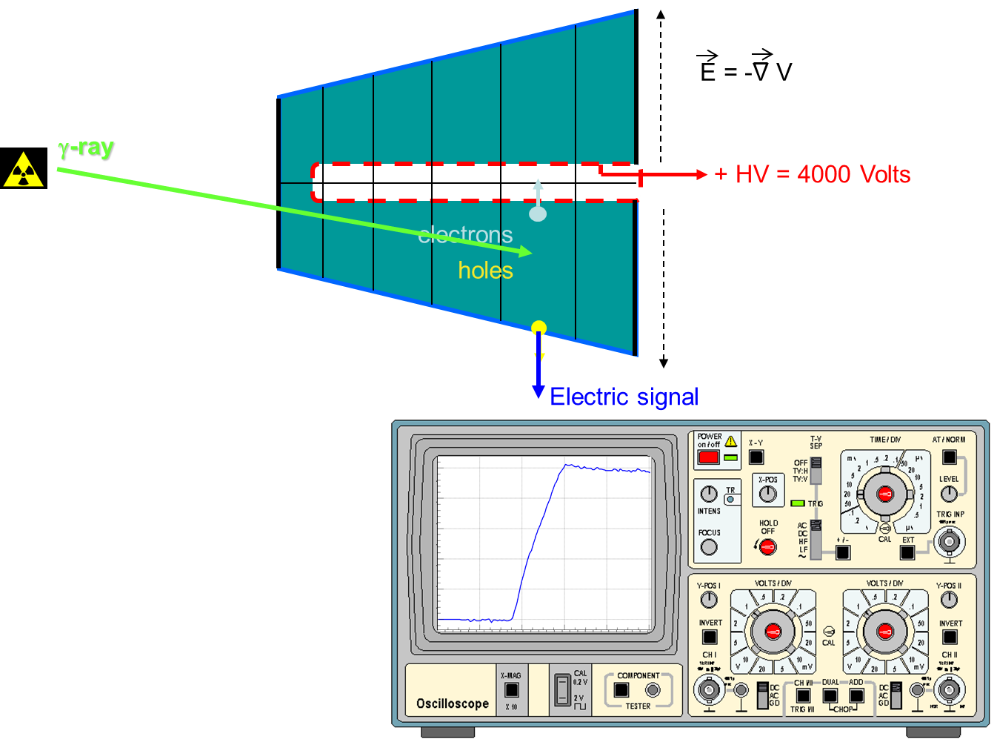
HPGe detector – working principle

Slide 16
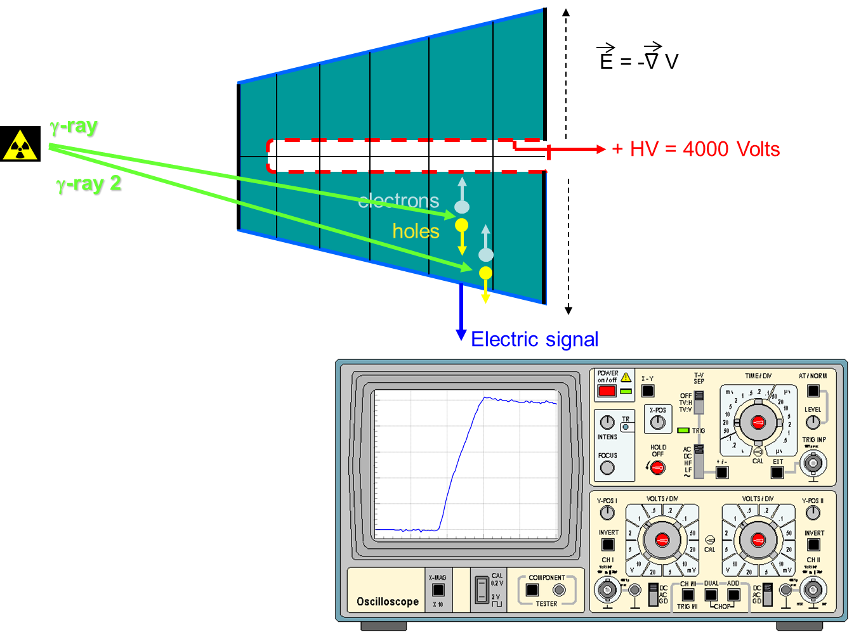
HPGe detector – position sensitivity

Slide 17
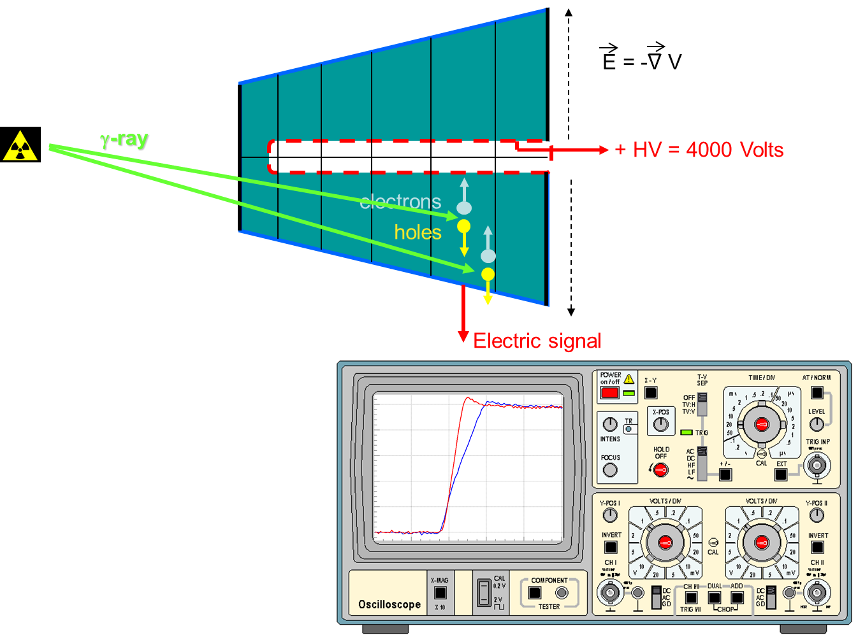
HPGe detector – position sensitivity

Slide 18
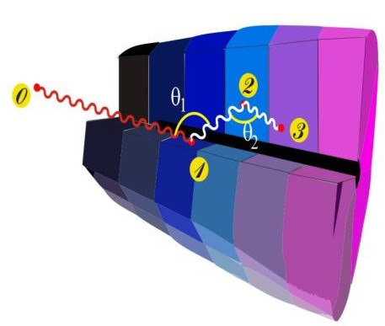
Ingredients of γ-ray tracking
Highly segmented
HPGe detectors
AGATA:
Advanced Gamma Tracking Array
Pulse Shape Analysis to identify the interaction position coordinates
Digital electronics
to record and
process segment signals
(x,y,z,E)_{i}
Reconstruction of tracks
e.g. by evaluation of permutations
of interaction points
reconstructed γ-rays

Slide 19
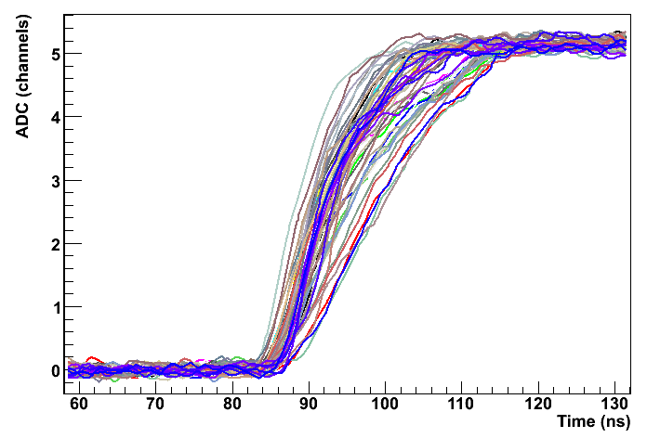
Method to characterize the pulse shape of HPGe detectors
Determine a data-base of pulse shapes S(x,y,z) which allows one to correlate an arbitrarily measured pulse, with an interaction position inside the detector.
?
How to do this?
Using PET principle in combination with γ-ray imaging techniques !

Slide 20
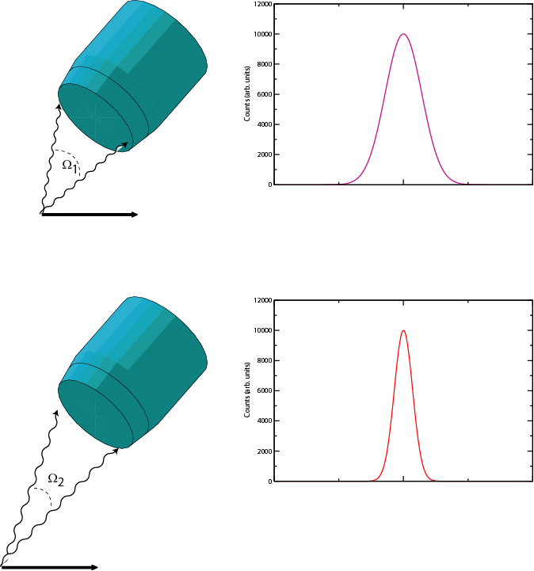
Doppler effect - Efficiency versus energy resolution
With a source at rest, the intrinsic resolution of the detector can be reached.
Efficiency decreases with the increasing detector-source distance.
With a moving source also the effective energy resolution depends on the detector-source distance (Doppler effect)
Small d
Large d
Large Ω
Small Ω
High ε
Low ε
Poor FWHM
Good FWHM

Slide 21
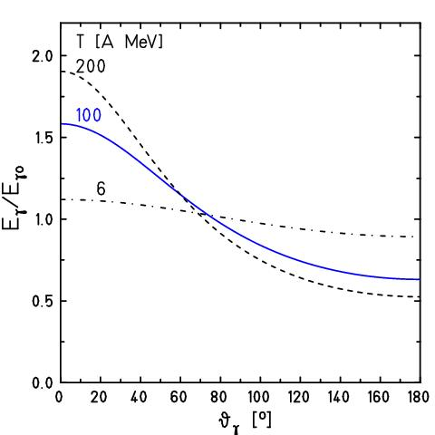
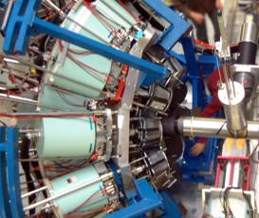
Doppler effect at relativistic energies
for
beam
Lorentz boost:

Slide 22

Doppler broadening and position resolution
Position resolution
γ ray
Angular resolution
beam
projectile
Energy resolution

Slide 23
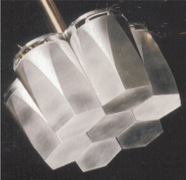
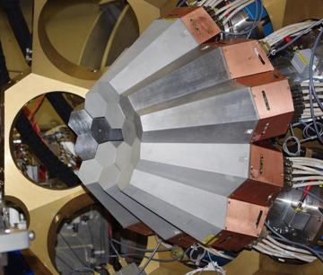
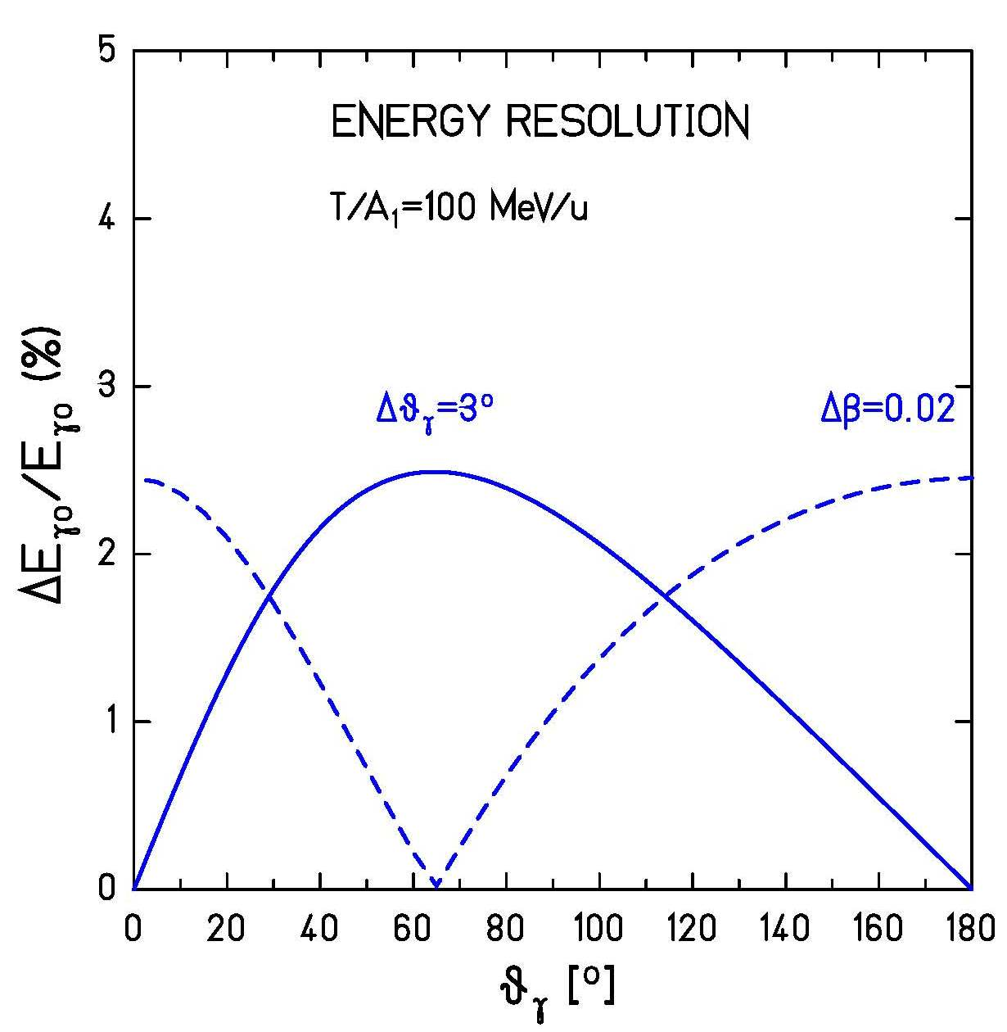
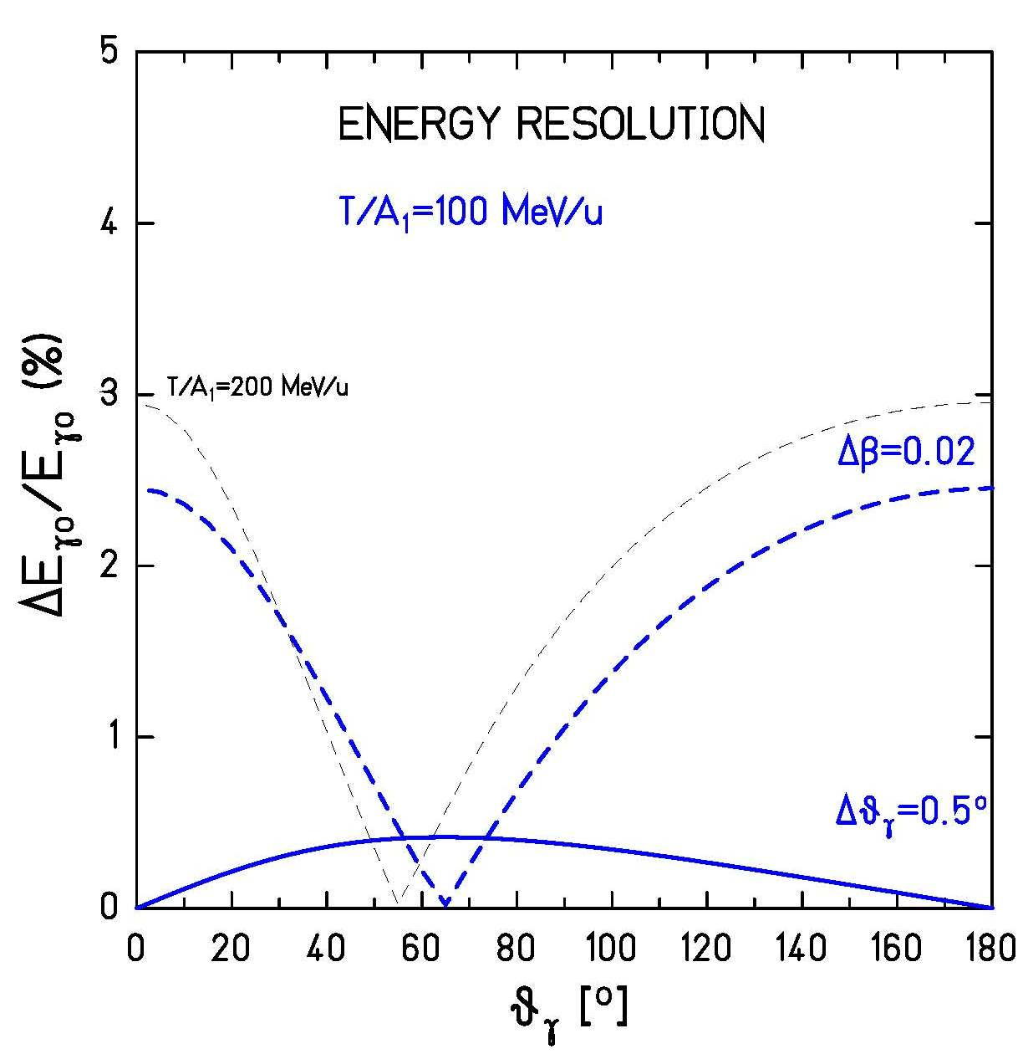



Doppler broadening

Slide 24
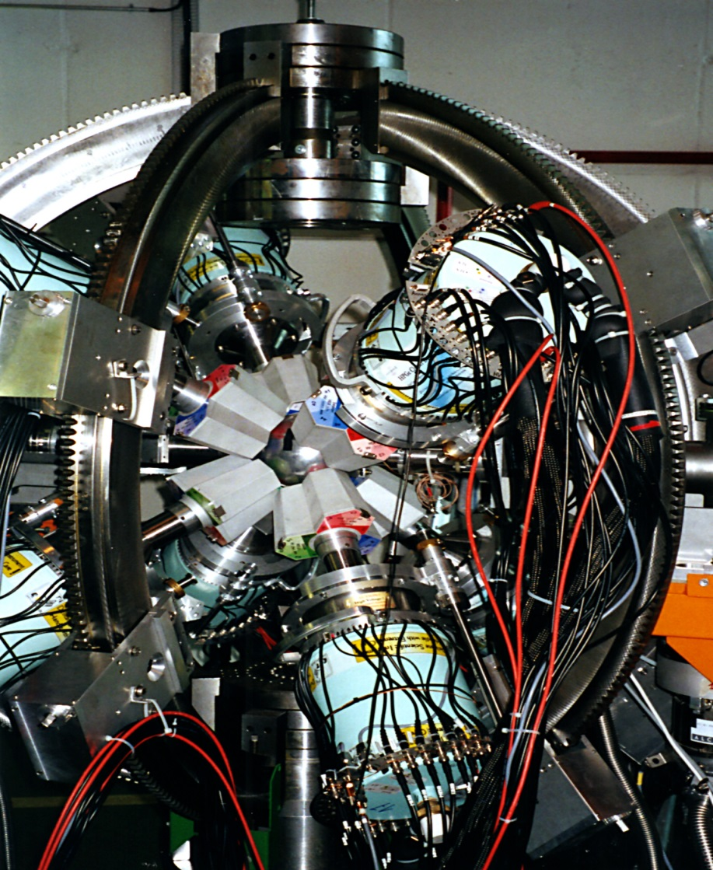
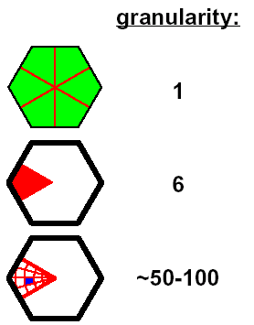

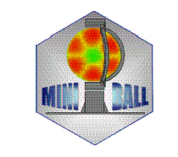
Miniball
- 8 clusters à 3 6-fold segmented crystals
total MINIBALL efficiency ~8% at 1.3 MeV
digital electronics, on-board online pulse shape analysis (PSA) for better position resolution

Slide 25
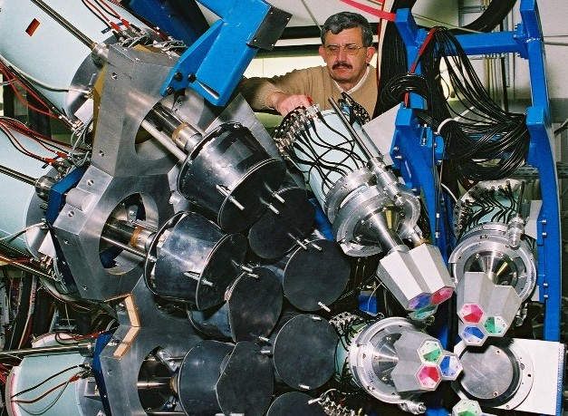

EUROBALL versus MINIBALL detectors
70cm
target
beam
20cm

Slide 26

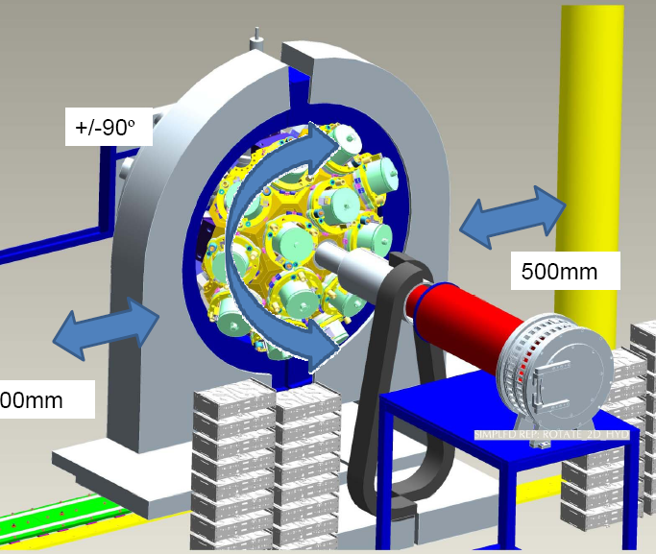

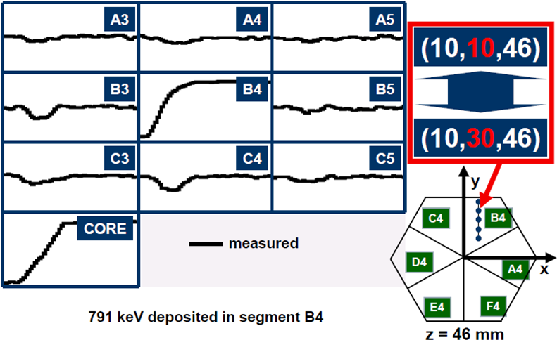
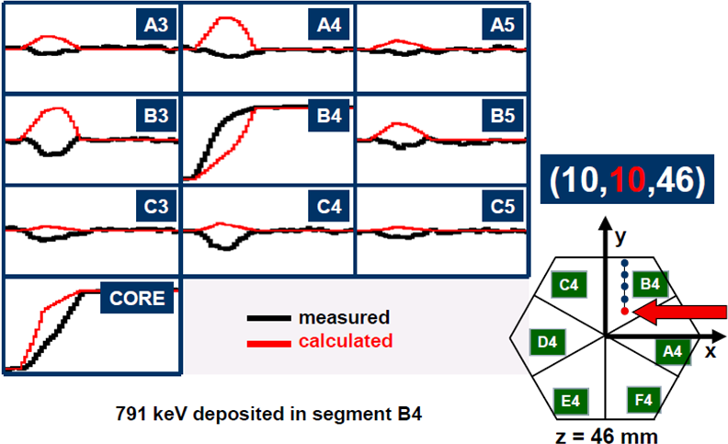

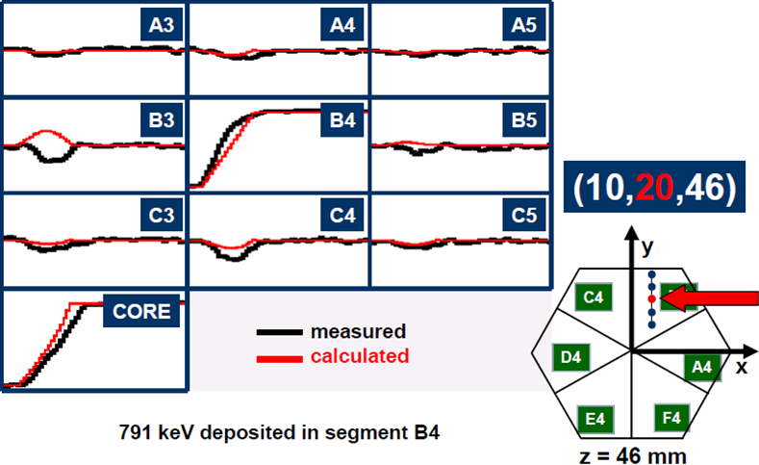

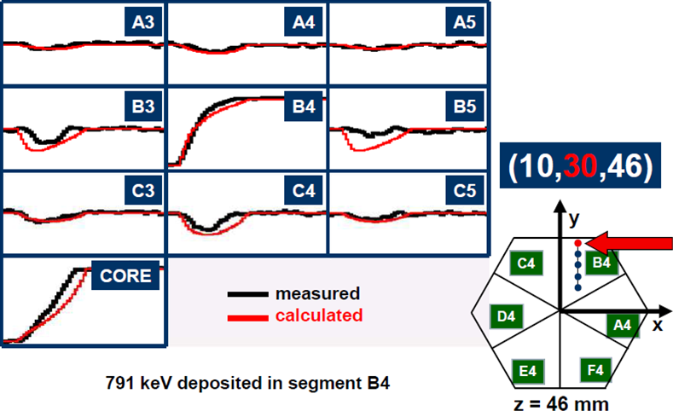
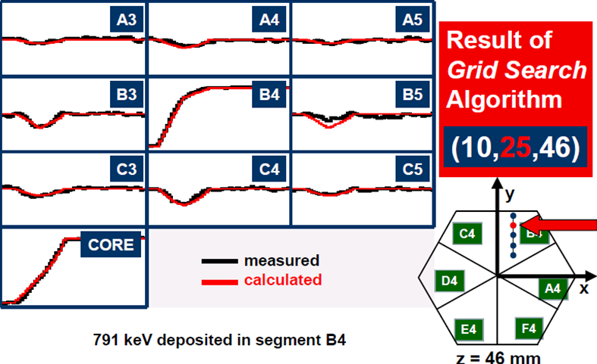
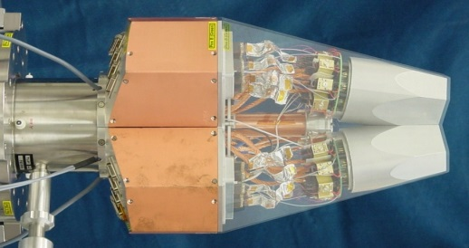
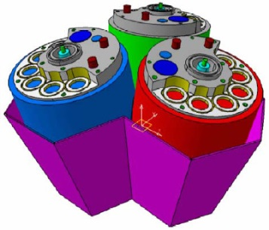
Advanced GAmma Tracking Array
Signals from 36 segments + core
are measured as a function of time
(γ-ray interaction point)
John Strachan

Slide 27




AGATA at PreSPEC
preprocessor
computer farm
AGATA
digitiser
Damian Ralet,
Stephane Pietri

Slide 28

Doppler-shift correction ²³⁸U on ¹⁹⁷Au at 183 AMeV
cos θ_{γ}
66.372 | 79 Au | K_{α3} | 0.033
66.991 | 79 Au | K_{α2} | 27.5
68.806 | 79 Au | K_{α1} | 46.4
77.577 | 79 Au | K_{β3} | 5.57
77.982 | 79 Au | K_{β1} | 10.70
80.130 | 79 Au | K_{β2} | 3.84

Slide 29

Doppler-shift correction ²³⁸U on ¹⁹⁷Au at 183 AMeV
cos θ_{γ}
93.844 | 92 U | K_{α3} | 0.099
94.654 | 92 U | K_{α2} | 28.2
98.434 | 92 U | K_{α1} | 45.1
110.421 | 92 U | K_{β3} | 5.65
111.298 | 92 U | K_{β1} | 10.70
114.445 | 92 U | K_{β2} | 4.15

Slide 30


Scattering experiment at relativistic energies
⁸⁰Kr → ¹⁹⁷Au, 150 AMeV
Doppler effect

Slide 31



Coulomb excitation experiment at IUAC
⁵⁸Ni → Sn at 175MeV
γ-efficiency = 0.005
accelerator duty factor=100%
beam intensity = 0.5pnA
target thickness = 0.2mg/cm²
pγ-rate (Sn) = 1/s
^{112,116}Sn target
⁵⁸Ni beam
γ-ray spectrum

Slide 32







Position sensitive proportional counter
V₀ ~ 500 V
p = 5-10 Torr
~ 3 mm gap anode-cathode
target
entrance window
~ φ_{lab}
~ tanϑ_{lab}
Δt ~ tanϑ
o
Δtime →
i
i
i
delay line

Slide 33


Position sensitive proportional counter
~ tan ϑ_{lab}
raw γ-ray spectrum

Slide 34

Position sensitive proportional counter
raw γ-ray spectrum
~ tan ϑ_{lab}
2⁺
Doppler-shift corrected
γ-ray spectrum

Slide 35




Position resolution – Double Sided Silicon Strip Detector (DSSSD)
surface of a Microstrip detector
bonding pads

Slide 36

Simulation result – electrical field configuration
Thomas.Eichhorn@kit.edu

Slide 37













Current density
Ionizing particle with 45⁰ angle t = 0 ns
Ionizing particle with 45⁰ angle t = 1 ns
Ionizing particle with 45⁰ angle t = 1.1 ns
Ionizing particle with 45⁰ angle t = 1.3 ns
Ionizing particle with 45⁰ angle t = 1.5 ns
Ionizing particle with 45⁰ angle t = 1.7 ns
Ionizing particle with 45⁰ angle t = 1.9 ns
Ionizing particle with 45⁰ angle t = 2.0 ns
Ionizing particle with 45⁰ angle t = 3.0 ns
Ionizing particle with 45⁰ angle t = 4.0 ns
Ionizing particle with 45⁰ angle t = 5.0 ns
Ionizing particle with 45⁰ angle t = 6.0 ns
Ionizing particle with 45⁰ angle t = 7.0 ns
all electrons are collected
Thomas.Eichhorn@kit.edu

Slide 38


Time resolution – Double Sided Silicon Strip Detector (DSSSD)
TOF between MCP and DSSSD
MCP DSSSD
Time resolution 200 ps for one of the 256 detector pixels
Akhil Jhingan (IUAC)
degrader
target
slowed down experiment
TPC-1 TPC-2 SC41
(x₁ y₁ t₁) (x₂ y₂ t₂)
(x₃ y₃ t₃)

