Slide 1
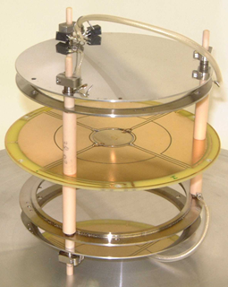
Gaseous Detectors – Ionization Measurement
Lecture: Hans-Jürgen Wollersheim
e-mail: h.j.wollersheim@gsi.de

Slide 2
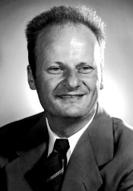
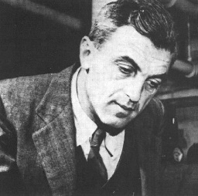

Interaction of charged particles in matter
Bethe-Bloch formula describes the energy loss of heavy particles passing through matter
energy loss of a particle is
independent of its mass!
energy loss is an important
tool for particle identification
for minimum ionizing particles m.i.p.
dE/dx ~ 1-2 MeV g⁻¹ cm²
i.e. for a target density ρ = 1 g/cm³
dE/dx ~ 2 MeV/cm
$$−\frac{dE}{dx}=4∙π∙{r_{e}}^{2}∙N_{a}∙m_{e}c^{2}∙ρ∙\frac{Z}{A}∙\frac{z^{2}}{β^{2}}∙\left[\frac{1}{2}ln\left(\frac{2∙m_{e}c^{2}∙γ^{2}∙β^{2}{∙T}_{max}}{I^{2}}\right)−β^{2}−δ−2∙\frac{C}{Z}\right]$$
$$≈z^{2}∙\frac{Z}{A}∙f\left(β,I\right)$$
= 0.3071 MeV g⁻¹cm²
liquid-H₂
He-gas
for small β the term 1/β² is dominant
dE/dx has a minimum at βγ~3-4 (minimum ionizing particle)
for high momenta dE/dx reaches a saturation

Slide 3
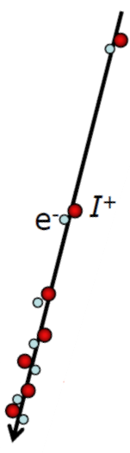
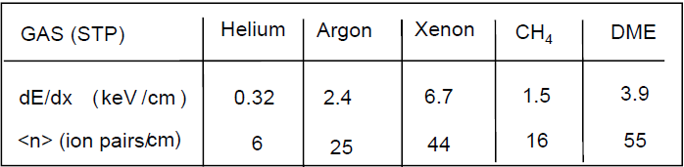
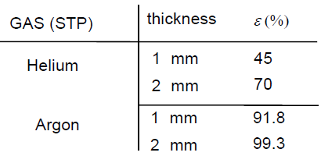



Ionization detectors
incoming particle
ionization track
ion/e⁻ pairs
Minimum-ionizing particles (Sauli. IEEE+NSS 2002)
different counting gases:
ionization process: Poisson statistics
detection efficiency ε depends on average number <n> of ion pairs
$$ε≤1−e^{−\left\langle n\right\rangle }$$
$$∆E∝\left\langle n\right\rangle$$
$$≈linear for ∆E≪E$$

Slide 4
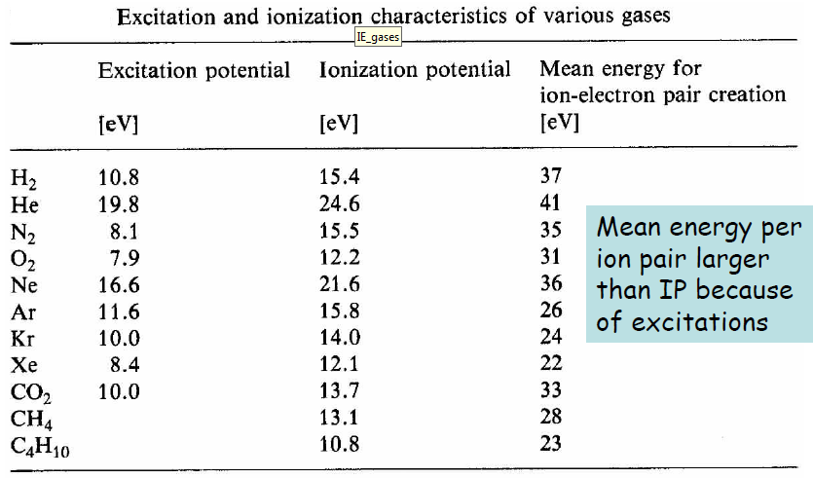
Effective ionization energies
Large organic molecules have low-lying excited rotational states
→ excitation without ionization through collisions

Slide 5
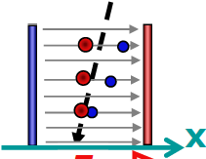
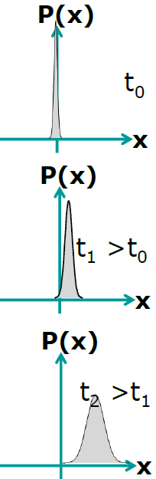


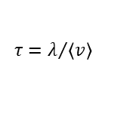
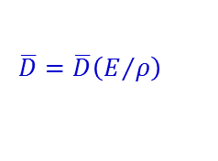

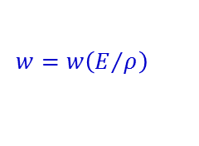
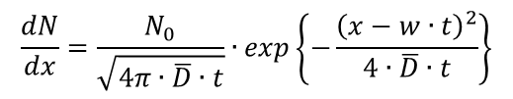

Charge transport in gas
Electric field E = ΔU / Δx separates positive and negative charges
E
charge diffusion in electric field
$$\frac{dN}{dx}=\frac{N_{0}}{\sqrt{4π∙\overline{D}∙t}}∙exp\left\{−\frac{{\left(x−w∙t\right)}^{2}}{4∙\overline{D}∙t}\right\}$$
$$w=\frac{e}{2m}∙E∙τ$$
drift velocity
$$τ=λ/{\left\langle v\right\rangle }$$
mean time between collisions
$$\overline{D}=μ∙\frac{k∙T}{e}$$
$$μ=\frac{w}{E}$$
mobility
There is a cycle of acceleration and scattering/ionization etc.
drift(w) and diffusion (D) depend on field strength E and gas pressure ρ
charge diffusion
$$w=w\left(E/ρ\right)$$
$$\overline{D}=\overline{D}\left(E/ρ\right)$$
Notes:
Gauss distribution

Slide 6
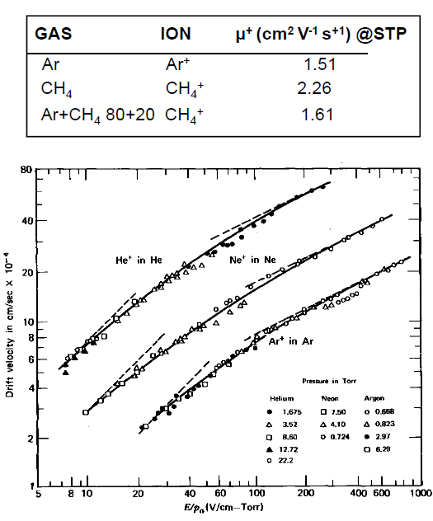
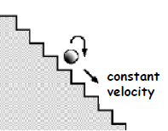
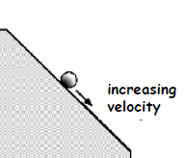
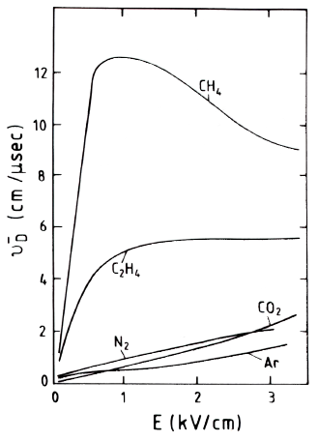
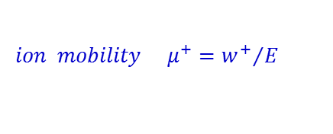
Ion mobility
$$ion mobility { μ}^{+}={w^{+}}/E$$
For ions there is an interplay between acceleration and
collisions. Ion mobility is independent of field for a given gas at ρ, T = const.
ions
electrons
He
Ne
Ar
E/ρ (V/cm/torr)
w⁺ ~ 10⁻² cm/μs
w⁻ ~ 10¹ cm/μs
E. McDaniel and E. Mason; The mobility and diffusion of ions in gases (Wiley 1973)

Slide 7
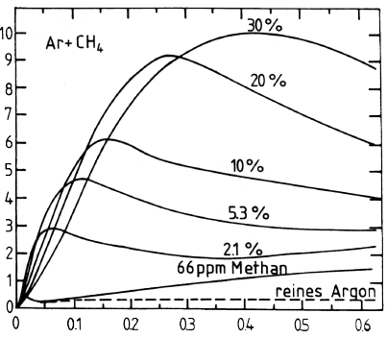
Electron mobility
In general, the mobility of electrons is not constant, but depend on their kinetic energy and varies with the electric field strength.
drift velocities of electrons in Argon-Methan mixture
drift velocities of electrons in different gases
pure
reduced electric field strength [V/cm mm Hg]

Slide 8
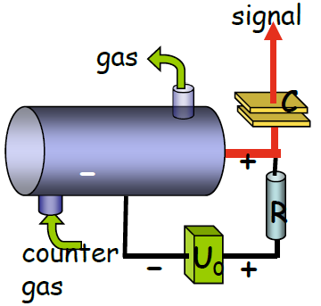
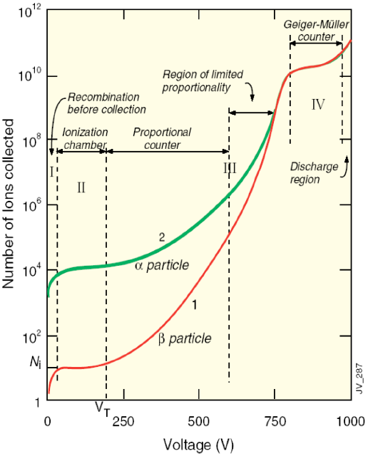
Amplification counters
single-wire gas counter
gas counters may be operated in different operation modes depending on the applied high voltage.

Slide 9
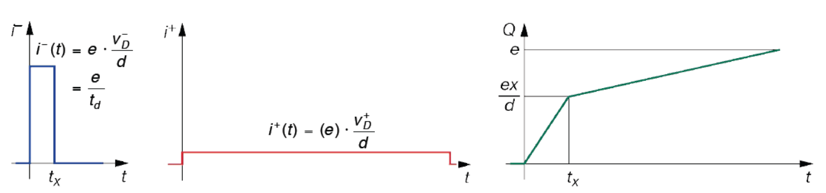
Ionization chamber
An ionization chamber is operated at a
voltage which allows full collection of
charges, however below the threshold of
secondary ionization (no amplification).
planar ionization chamber
For a typical field strength 500 V/cm and typical
drift velocities the collection time for 10 cm drift is
about 2 μs for e– and 2 ms for the ions.
Time evolution of the signals for one e⁻ ion pair:
electrons
ions
total charge

Slide 10
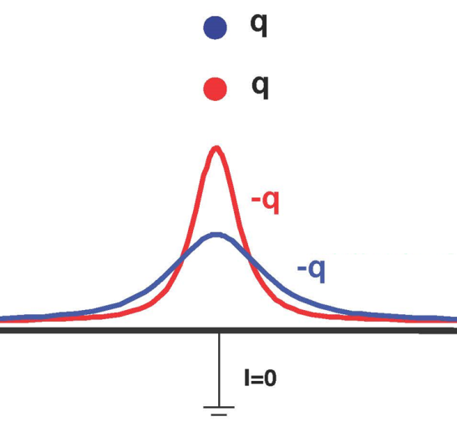
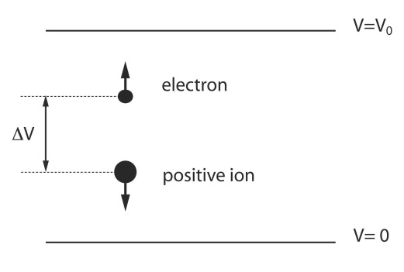
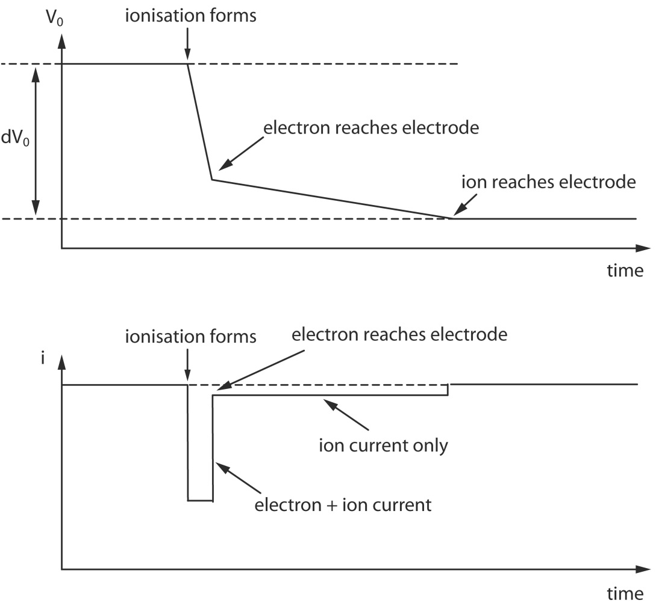

Signal collection
The motion of charges induces an apparent current in the electrodes.
Ion causes the same signal as the electron = same sign, same amplitude, but much slower
$$i=\frac{q}{V_{0}}\frac{dV}{ds}\frac{ds}{dt}$$

Slide 11
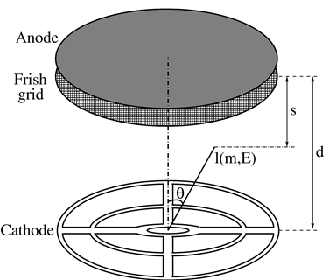
Ionization chamber
no gas gain
charges move in electric field
induced signal is generated during drift of charges
induced current ends when charges reach electrodes
²⁵²Cf source (25k f/s)
T_{1/2}=2.645 y
E_{α} = 6.118 and 6.076 MeV
binary fission/α-decay = 1/31
additional ´Frisch grid´:
electrons drift towards Frisch grid and induce a signal but not on the anode.
when electrons pass the Frisch grid, a signal is induced on anode.
the angular dependence of the electrons is removed from anode signal

Slide 12
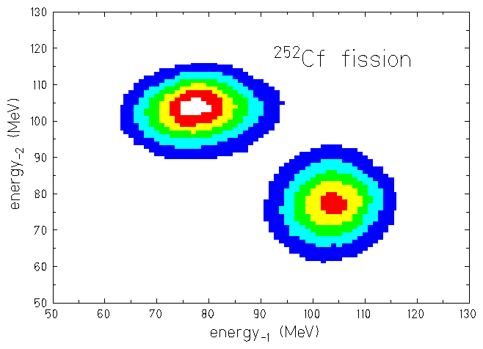
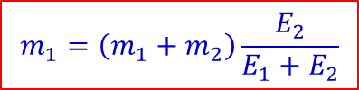
4π twin ionization chamber for fission fragments
measured quantities:
E_{H}
A_{H}
E_{L}
A_{L}
e⁻ drift time
ϑ
segmented cathode
φ
$$m_{1}v_{1}+m_{2}v_{2}=0 → m_{1}E_{1}=m_{2}E_{2}$$
$$m_{1}=\left(m_{1}+m_{2}\right)\frac{E_{2}}{E_{1}+E_{2}}$$
$$\left\langle E_{L}\right\rangle =103.5±0.5 MeV → \left\langle A_{L}\right\rangle =108.9±0.5$$
$$\left\langle E_{H}\right\rangle =78.3±0.5 MeV → \left\langle A_{H}\right\rangle =143.1±0.5$$

Slide 13
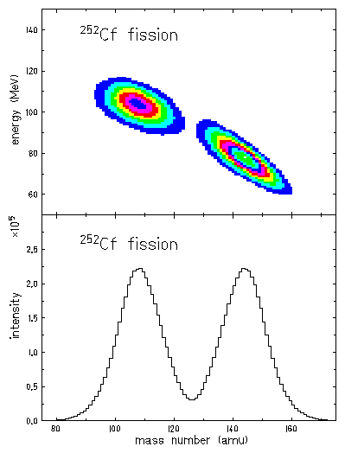
Fission fragment mass measurement
<108.9 amu>
<143.1 amu>
mass resolution σ = 3 amu
P. Adrich, diploma thesis (2000)

Slide 14
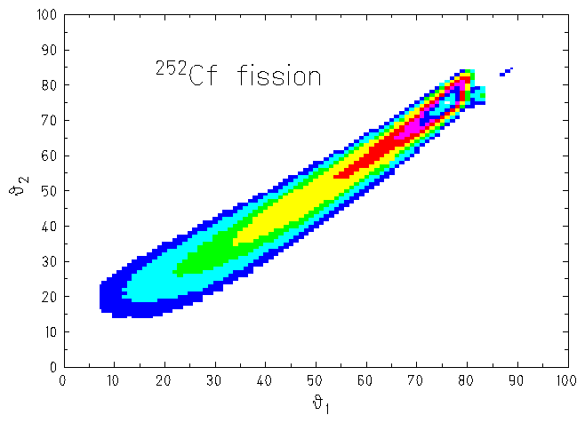

Determination of the polar angles
$$cos\left(θ\right)=\frac{d−t∙v_{drift}}{ℓ\left(E,A\right)}$$
angular resolution
ϑ | φ
30⁰ | 4.2⁰
50⁰ | 2.5⁰
70⁰ | 2.3⁰
drift velocity: v_{drift} = 10 (cm/μs)
range of fragments in methan gas: ℓ(E,A)
distance cathode-anode: d = 3.8cm
P. Adrich, diploma thesis (2000)

Slide 15
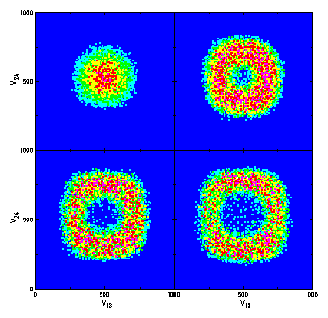
Determination of the azimuthal angles
energy ratios for different emission angles ϑ
P. Adrich, diploma thesis (2000)

Slide 16
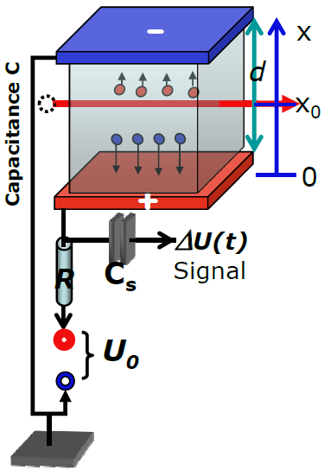



Signal generation in ionization counters
primary ionization in gases: I ≈ 20-30 eV/IP
energy loss Δε: n = n_{I} = n_{e} = Δε / I of primary ion pairs n at x₀, t₀
force: F_{e} = -eU₀/d = -F_{I}
energy content of capacity C
1)
2)
1) + 2)
$$W\left(t\right)=\frac{C}{2}\left[{U_{0}}^{2}−U^{2}\left(t\right)\right]≈C∙U_{0}∙∆U\left(t\right)$$
$$W\left(t\right)=n_{e}F_{e}\left[x_{e}\left(t\right)−x_{0}\right]+n_{I}F_{I}\left[x_{I}\left(t\right)−x_{0}\right]$$
$$=+\frac{n∙eU_{0}}{d}\left[x_{I}\left(t\right)−x_{e}\left(t\right)\right]$$
w⁺(t)∙(t-t₀)
$$∆U\left(t\right)=\frac{W\left(t\right)}{C∙U_{0}}=\frac{n∙e}{C∙d}\left[w^{+}\left(t\right)−w^{−}\left(t\right)\right]\left(t−t_{0}\right)$$
total signal: electron & ion components

Slide 17
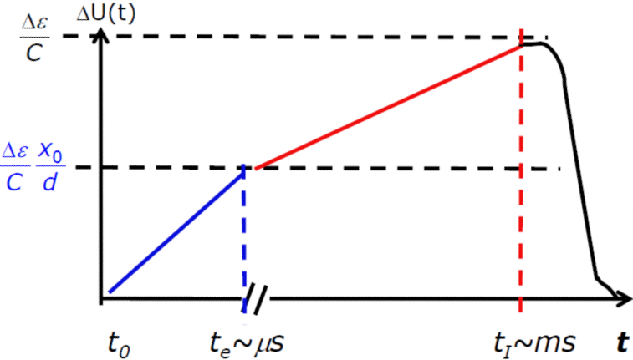


Time-dependent signal shape
total signal: electron & ion components
$$∆U\left(t\right)=\frac{∆ε}{C∙d}\left[w^{+}\left(t\right)−w^{−}\left(t\right)\right]\left(t−t_{0}\right)$$
drift velocities (w⁺ > 0, w⁻ < 0)
$$\left|w^{+}\left(t\right)\right|\sim {10}^{−3}∙\left|w^{−}\left(t\right)\right|$$
Both components measure Δε and
depend on position of primary ion pair
x₀ = w⁻∙(t_{e}-t₀)
for fast counting use only electron component!

Slide 18
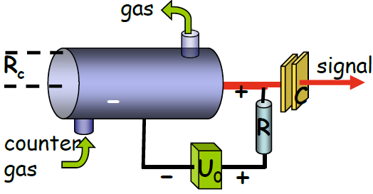
Proportional counter
wire

Slide 19
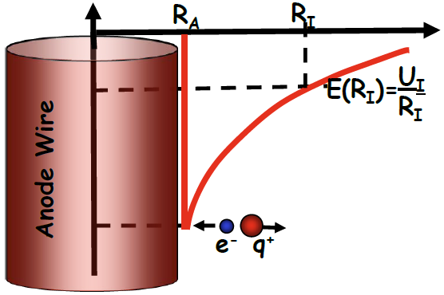
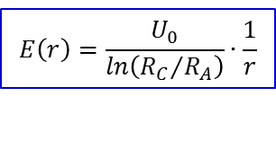
Proportional counter
gas amplification factor (typical 10⁴–10⁶) is constant
wire
anode wire: small radius R_{A} ≈ 50 μm or less
voltage U₀ ≈ (300-500) V
field at r from the wire
$$E\left(r\right)=\frac{U_{0}}{ln\left({R_{C}}/{R_{A}}\right)}∙\frac{1}{r}$$
avalanche R_{I} → R_{A} (wire radius), several mean free paths needed pulse height mainly due to positive ions (q⁺)

Slide 20
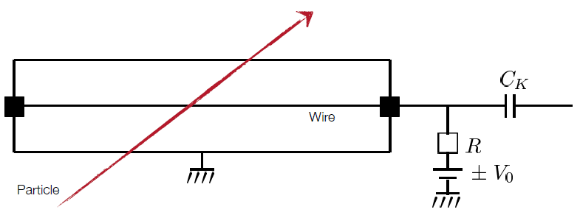
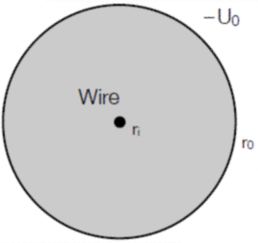
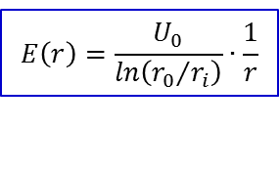
Proportional counter
gas amplification factor (typical 10⁴–10⁶) is constant
anode wire: small radius r_{i} ≈ 50 μm or less
voltage U₀ ≈ (300-500) V
-U₀
field at r from the wire
$$E\left(r\right)=\frac{U_{0}}{ln\left({r_{0}}/{r_{i}}\right)}∙\frac{1}{r}$$
r_{i}
r₀
avalanche R_{I} → R_{A}, several mean free paths needed
pulse height mainly due to positive ions (q⁺)

Slide 21
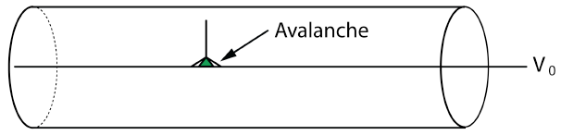
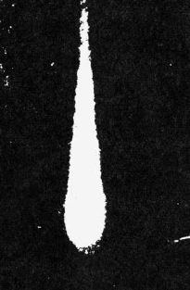
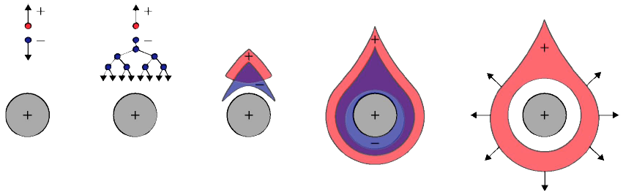
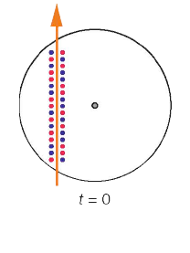
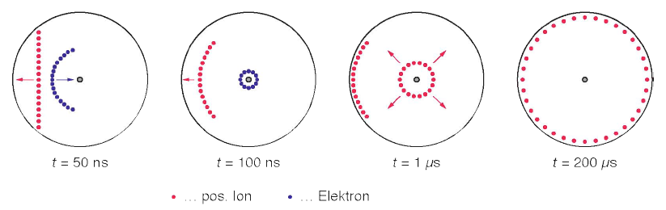
Proportional counter
cloud chamber
The primary produced electrons drift the anode wire and reach the area of high electrical field strength. If a critical field strength is reached, a secondary ionization produces electrons in an avalanche.
time sequence of the signal evolution
primary ionization
secondary ionization
pos. ions drift due to
secondary ionization
pos. ion
electron

Slide 22
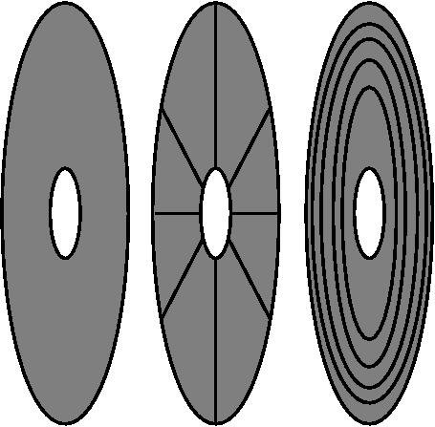
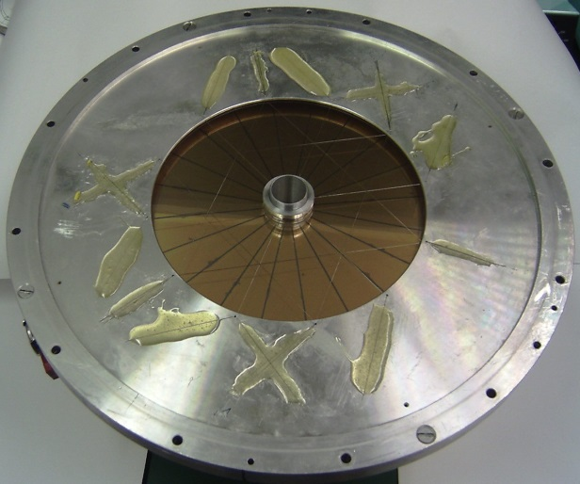
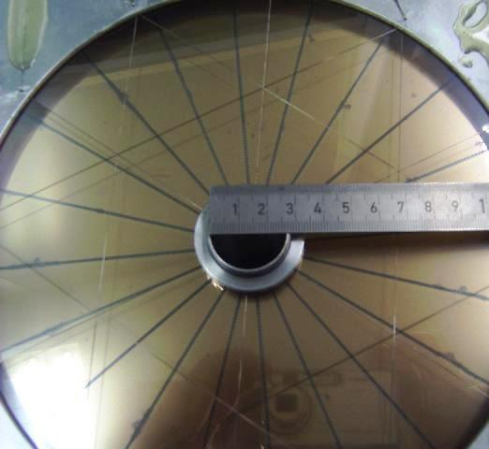
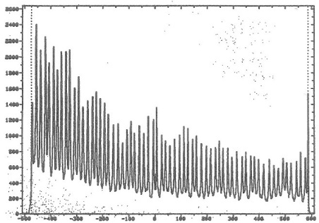
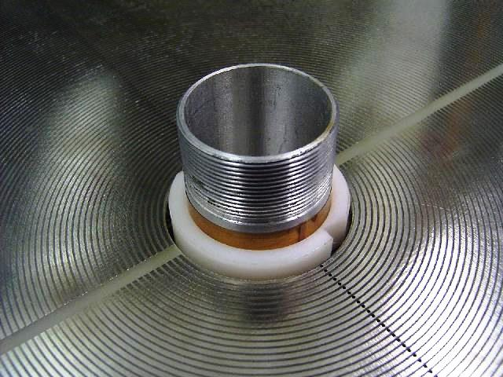
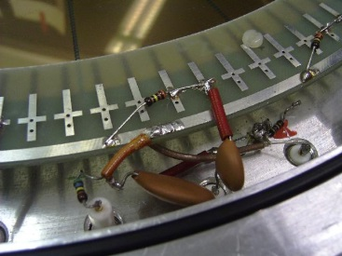

Proportional counter
V₀ ~ 500 V
p = 5-10 Torr
~ 3 mm gap anode-cathode
target
entrance window
~ φ_{lab}
~ tanϑ_{lab}
Δt ~ tanϑ
o
Δtime →
i
i
i
delay line

Slide 23


Multi-Wire Proportional Chamber
A multi-wire proportional chamber detects charged particles and gives positional information on their trajectory.
Cathode plate
Wires
d = 2 mm
Georges Charpak
Nobel price 1992
charge signals
Amplifier
time resolution: fast anode signals (t_{rise} ~ 0.1 ns)
position resolution: for d = 2 mm σ_{x} = 50-300 μm
(weighted with charges)

Slide 24

Multi-Wire Proportional Chamber

Slide 25


Time Projection Chamber
Principle: Time Projection Chambers are based on the drift of the charge carriers with constant drift velocity v_{D}
in a homogenous E-field (E = -dU/dz).
typical parameters: E ~ 1 kV/cm, v_{D} ~ 1-4 cm/μs, Δz ~ 200 μm
3-dim. traces: z from the drift time, (x,y) from the segmented anode

Slide 26

Time Projection Chamber
for position measurement (x + y)

Slide 27

Time Projection Chamber
for position measurement (x + y)

Slide 28






Time Projection Chamber

Slide 29

Gas Electron Multipliers Technology
GEM-foil
²³⁸U at 1 GeV/u
50 μm Kapton, 5 μm Cu on both sides, 500 V
TPC with C-pads: 100 kHz
GEM-TPCs: 10 MHz

Slide 30

Geiger-Müller counter
The discharge is not any more localized
The number of charge carriers is not any more related to the primary ionization
The gas amplification amounts to 10⁸-10¹⁰

