Slide 1
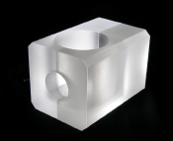
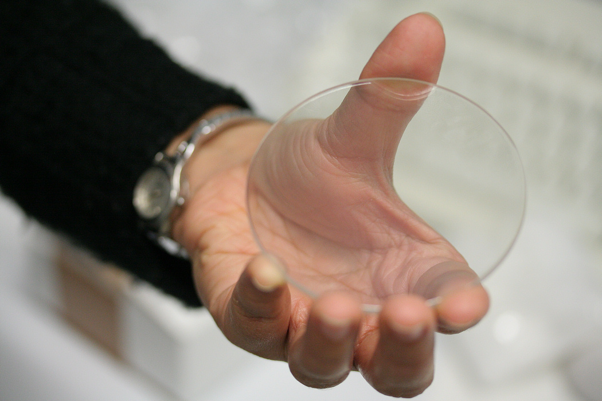
Scintillation Detector
Lecture: Hans-Jürgen Wollersheim
e-mail: h.j.wollersheim@gsi.de

Slide 2
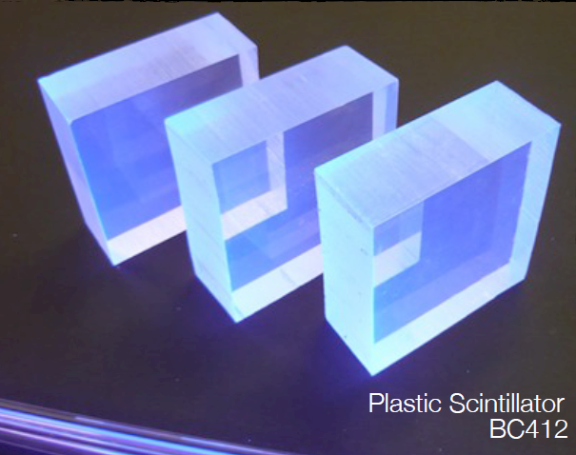
Scintillators – General Characteristics
Principle:
dE/dx converted into visible light
Detection via photosensor
[e.g. photomultiplier, human eye …]
Main Features:
Sensitivity to energy
Fast time response
Pulse shape discrimination
Requirements
High efficiency for conversion of excitation energy to fluorescent radiation
Transparency to its fluorescent radiation to allow transmission of light
Emission of light in a spectral range detectable for photosensors
Short decay time to allow fast response

Slide 3
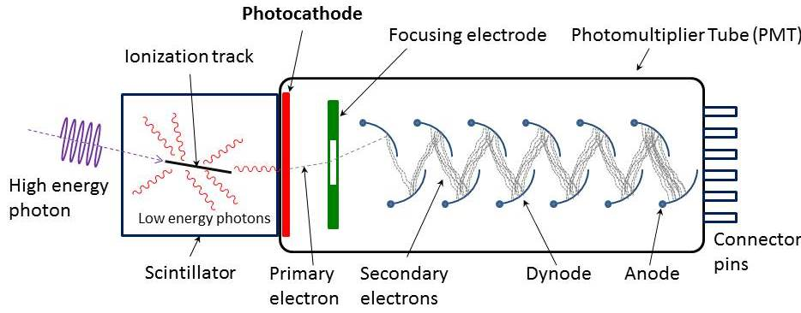
Scintillators – basic counter setup
An incident photon or particle ionizes the medium.
Ionized electrons slow down causing excitation.
Excited states immediately emit light.
Emitted photons strike a light-sensitive surface.
Electrons from the surface are amplified.
A pulse of electric current is measured.
Scintillation materials:
Inorganic crystals
Organic scintillators
Polymeres (plastic scintillators)
Photosensors:
Photomultipliers
Micro-Channel Plates
Hybrid Photo Diodes
Visible Light Photo Counter
Silicon Photomultipliers

Slide 4
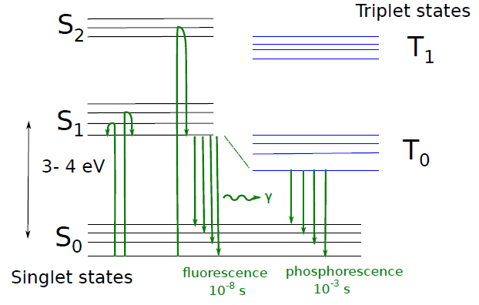
Scintillation counters
loss of energy through change in vibrational states
Luminescence: Emission of photons (visible light, UV, X-ray) after absorption of energy.
Scintillation: Emission of photons following the excitation of atoms and molecules by radiation.
Fluorescence: Emission of light by a substance that has absorbed light or another electromagnetic radiation of a different wave length. In most cases the emitted light has a longer wavelength. The emission follows shortly after ~ 10 ns.
Phosphorescence: Similar to Fluorescence, however the re-emission is not immediate. The transition between energy levels and the photon emission is delayed (ms up to hours)

Slide 5
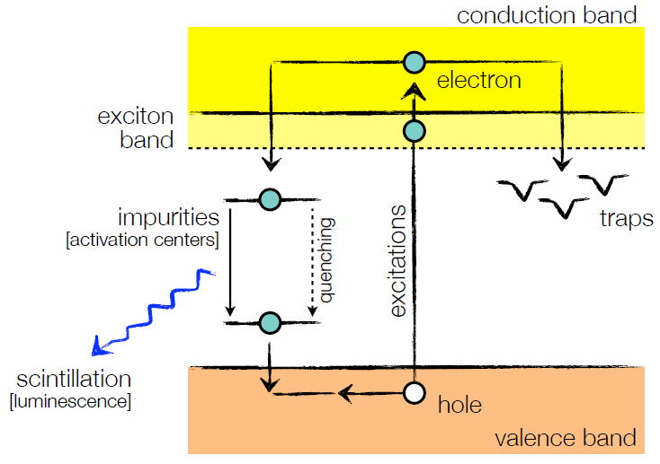
Inorganic crystals
Materials:
Sodium iodide (NaI)
Cesium iodide (CsI)
Barium fluoride (BaF₂)
…
Mechanism:
Energy deposition by ionization
Energy transfer to impurities
Radiation of scintillation photons
Time constants:
Fast: recombination from activation centers [ns … μs]
Slow: recombination due to trapping [ms … s]
Energy bands
in impurity activated crystals
showing excitation, luminescence,
quenching and trapping

Slide 6
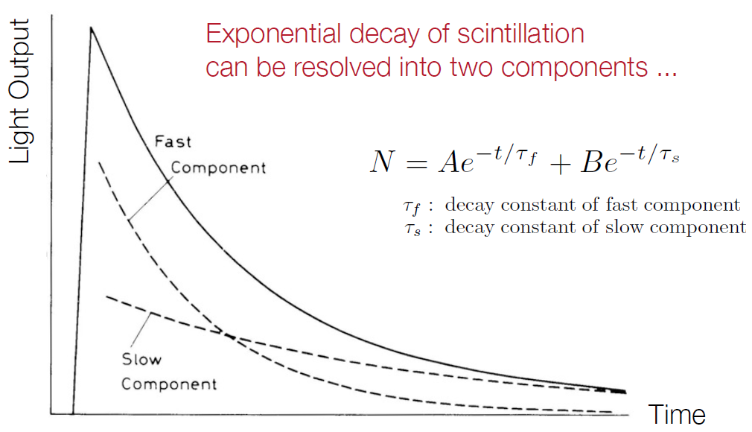
Inorganic crystals – time constants

Slide 7
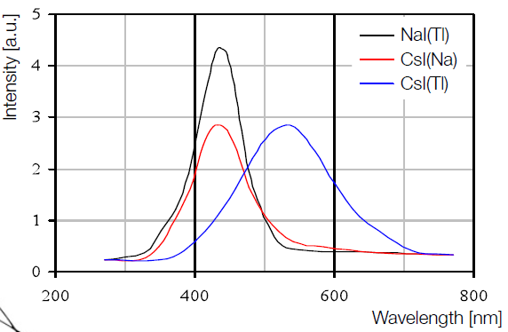
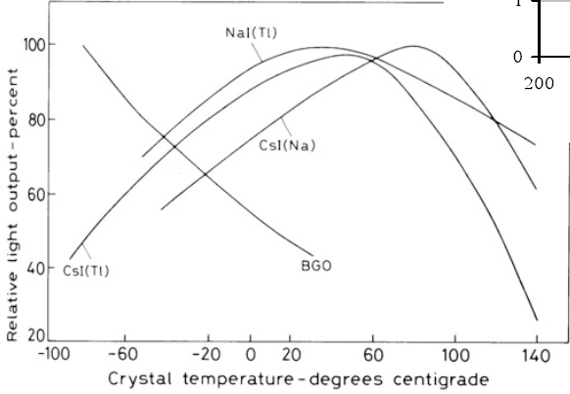
Inorganic crystals – light output
scintillation spectrum
for NaI and CsI
strong temperature dependence
[in contrast to organic scintillators]

Slide 8
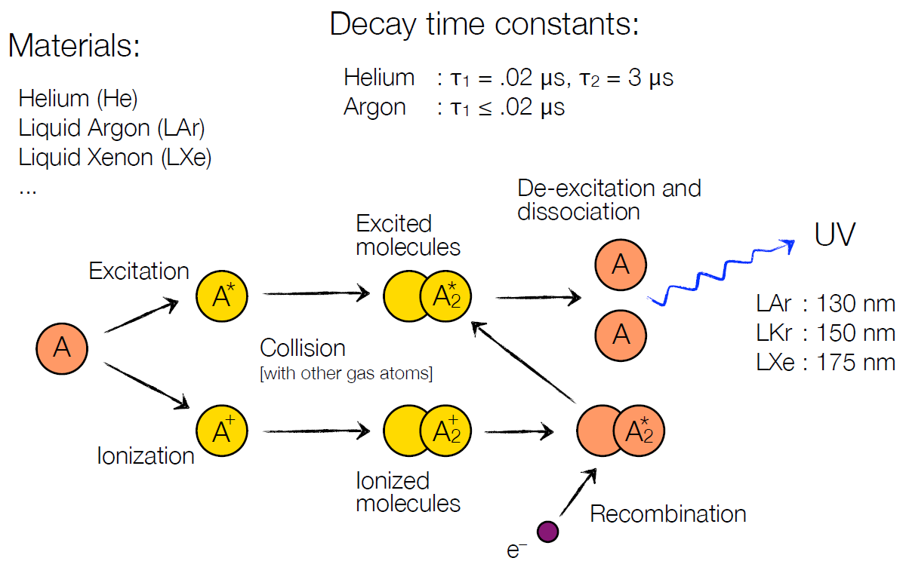
Scintillation in liquid noble gases

Slide 9
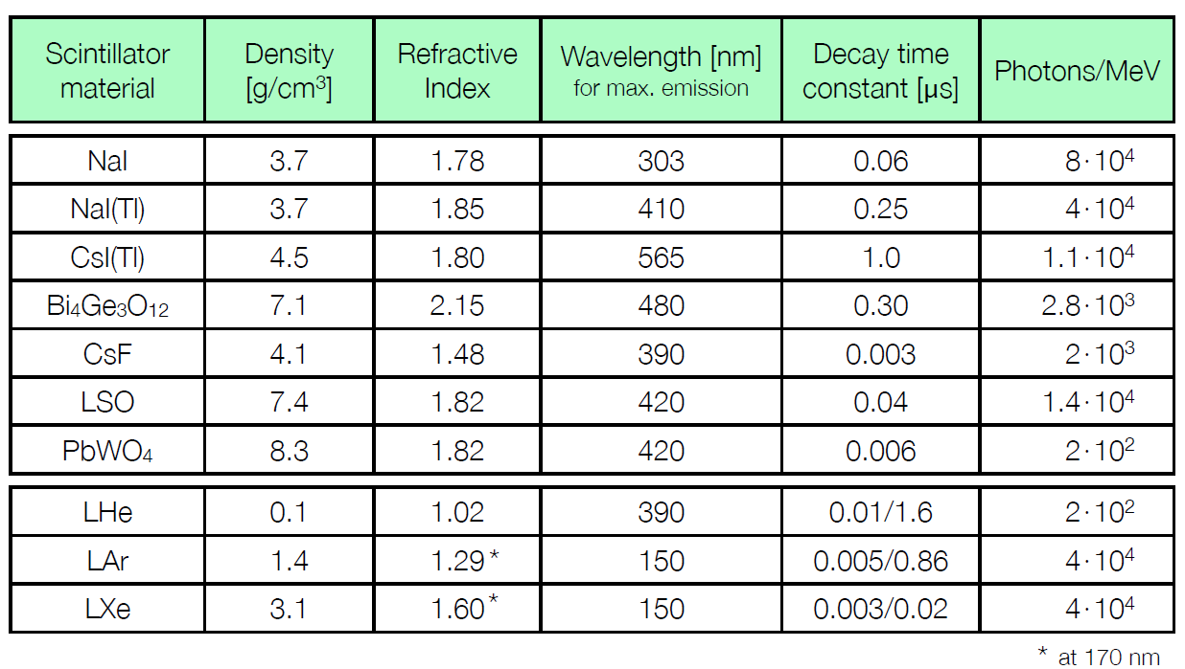
Inorganic scintillators - properties
The time for 1/e of the atoms to remain excited is the characteristic decay time τ

Slide 10
Inorganic scintillators - properties
Numerical examples:
NaI(Tl) λ_{max} = 410 nm; → h∙ν = 3 eV
photons/MeV = 40000
τ = 250 ns
PbWO₄ λ_{max} = 420 nm; → h∙ν = 3 eV
photons/MeV = 200
τ = 6 ns
Scintillator quality:
Light yield ε_{SC} ≡ fraction of energy loss going into photons
NaI(Tl): 40000 photons; 3 eV/photon → ε_{SC} = 4∙10⁴∙3 eV/10⁶ eV = 12%
PbWO₄: 200 photons; 3 eV/photon → ε_{SC} = 2∙10²∙3 eV/10⁶ eV = 0.06%
[for 1 MeV particle]
Only a few percent of the deposited energy is transferred into light. The remaining energy is used up be ionization, etc.
h = 0.41∙10⁻¹⁴ [eV/Hz]

Slide 11
Photon statistics
Typical problem
Gamma rays of 450 keV are absorbed with 12% efficiency. Scintillator photons with average 2.8 eV produce photoelectrons 15% of the time.
What is the energy to produce a measurable photoelectron?
How does this compare to a gas detector?
Answer
The total energy of scintillation is 450 ∙ 0.12 = 54 keV
- 5.4∙10⁴ / 2.8 = 1.93∙10⁴
photons produced
- 1.93∙10⁴ ∙ 0.15 = 2900
photoelectrons produced
The equivalent value for the scintillator is:
- 450 keV/2900 = 155 eV/pe
mean value in gas = 30 eV/ip

Slide 12
Band structure
Impurities in the crystal provide energy levels in the band gap.
Charged particles excites electrons to states below the conduction band.
Deexcitation causes photon emission.
  Crystal is transparent at photon frequency.
conduction band
impurity excited states
hν
impurity ground state
valence band
Impurities improve visible light emission

Slide 13
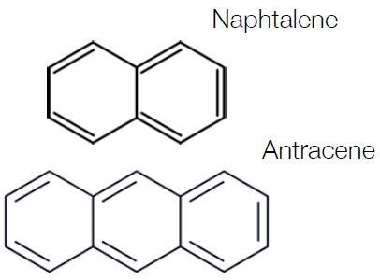
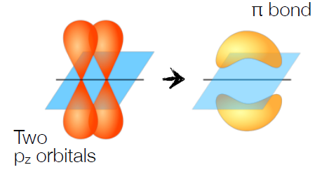
Organic scintillators
Aromatic hydrocarbon compounds:
e.g. Naphtalene [C₁₀H₈]
Antracene [C₁₄H₁₀]
Stilbene [C₁₄H₁₂]
…
Very fast!
[decay times of 0 ns]
Scintillation is based on electrons of the C=C bond …
Scintillation light arises from
delocalized electrons in π-orbitals
Transition of ´free´ electrons …

Slide 14
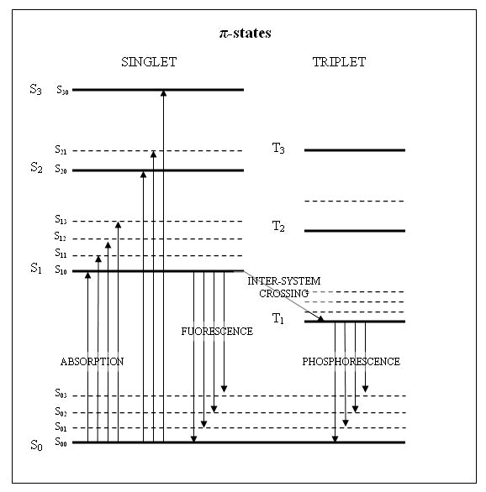
Organic scintillators – excited rings
π-bonds are most common in aromatic carbon rings.
Excited states radiate photons in the visible and UV spectra.
  Fluorescence is the fast component (S₁→S₀ <10⁻⁸ s)
  Phosphorescence is the slow component (T₀→S₀ >10⁻⁴ s)
singlet states
triplet states
π-electronic energy levels of an organic molecule.
S₀ is the ground state. S₁, S₂, S₃ are excited singlet states. T₁, T₂, T₃ are excited triplet states. S₀₀, S₀₁, S₁₀, S₁₁ etc. are vibrational sublevels.

Slide 15
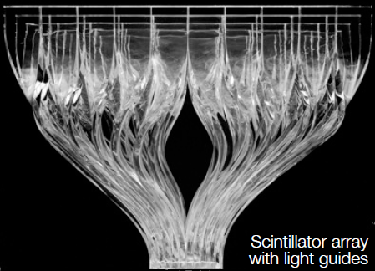
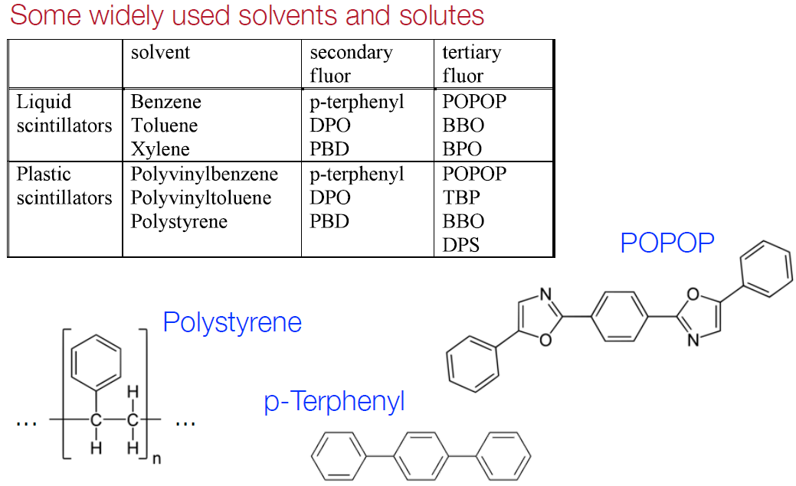
Plastic scintillators
Organic scintillators can be mixed with polystyrene to form a rigid plastic

Slide 16
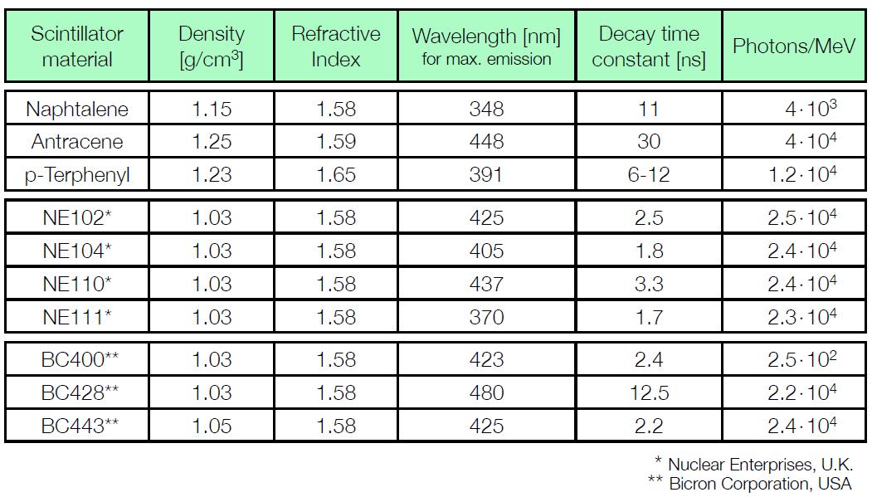
Organic scintillators - properties

Slide 17
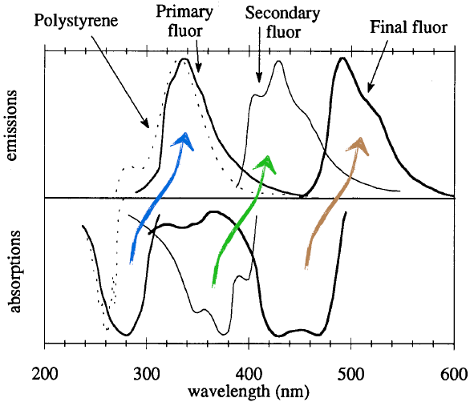
Wavelength shifting
Principle:
Absorption of primary scintillation light
Re-emission at longer wavelength
Adapts light to spectral sensitivity of photosensor
Requirements:
Good transparency for emitted light
Schematics of wavelength shifting principle

Slide 18
Scintillators - comparison
Inorganic Scintillators
Advantages high light yield [typical ε_{SC} ≈ 0.13]
high density [e.g. PbWO₄: 8.3 g/cm³]
good energy resolution
Disadvantages complicated crystal growth
large temperature dependence
Organic Scintillators
Advantages very fast
easily shaped
small temperature dependence
pulse shape discrimination possible
Disadvantages lower light yield [typical ε_{SC} ≈ 0.03]
radiation damage

Slide 19
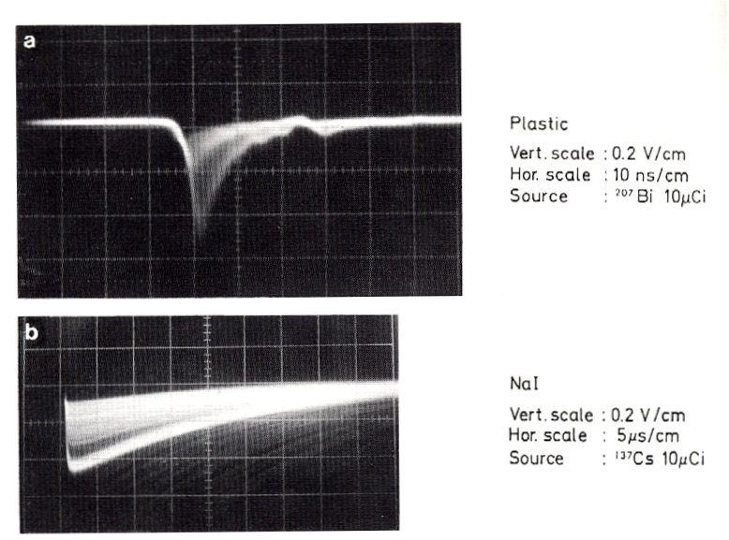
Oscilloscope traces from scintillation counters
Plastic scintillator
10 nsec / division
Inorganic crystal, NaI
5000 nsec / division
Longer time scale for
fluorescence to occur

Slide 20
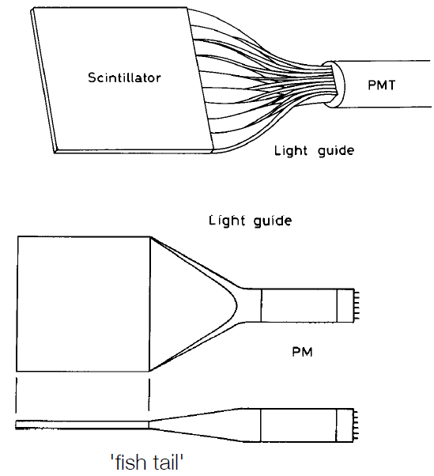
Scintillation counters - setup
Scintillator light to be guided to photosensor
→ light guide [plexiglas, optical fibers]
light transfer by total internal reflection
[ may be combined with wavelength shifter]
Liouville´s Theorem:
Complete light transfer
impossible as Δx∙Δθ = const.
[limits acceptance angle]
Use adiabatic light guide like ´fish tail´;
→ appreciable energy loss

Slide 21
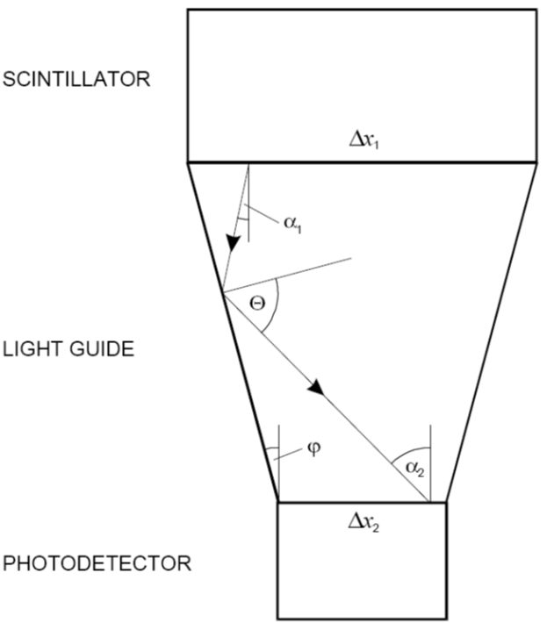
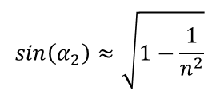




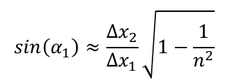
Liouville´s Theorem
Consider a phase space element for a photon in a light guide
x = transverse coordinate
p = n sin α = angular divergence
Liouville´s theorem says Δx₁Δp₁ = Δx₂Δp₂
2 Δx₁∙n∙sin α₁ = 2 Δx₂∙n∙sin α₂
isotropic light emission
$$sin\left(α_{1}\right)=\frac{∆x_{2}}{∆x_{1}}sin\left(α_{2}\right)$$
$$sin\left(α_{2}\right)=sin\left(φ+{90}^{0}−θ_{c}\right)$$
$$sin\left(α_{2}\right)=cos\left(φ−θ_{c}\right)=\sqrt{1−\sin^{2}\left(φ−θ_{c}\right)}$$
$$sin\left(α_{2}\right)≈\sqrt{1−\sin^{2}\left(θ_{c}\right)}$$
for small taper angles
$$sin\left(α_{2}\right)≈\sqrt{1−\frac{1}{n^{2}}}$$
$$sin\left(α_{1}\right)≈\frac{∆x_{2}}{∆x_{1}}\sqrt{1−\frac{1}{n^{2}}}$$
then
for Δx₁ = Δx₂ and n=1.5
$$sin\left(α_{1}\right)=0.75$$
There will be some light losses even in the case of equal dimensions

Slide 22
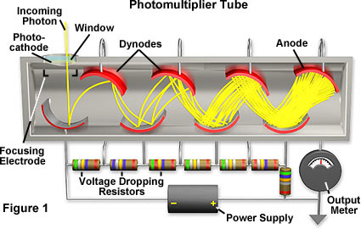
Photomultiplier tube
A photomultiplier tube (phototube, PMT) combines a photocathode and series of dynodes.
Photocathode: UV detection (alkali compound, Cs-I, Cs-Te), visible light (bialkali compound,
Sb-Rb-Cs, Sb-K-Cs), visible light to IR (semiconductors, GaAsP, InGaAs)
Dynodes: Electrons can be multiplied by interaction with surface (emitter: BeO, GaP or
metal substrate: Ni, Fe, Cu)
The high voltage is divided between the dynodes. Dynodes typically operate at around 100 V.
Output current is measured at the anode.
  Sometimes at the last dynode

Slide 23
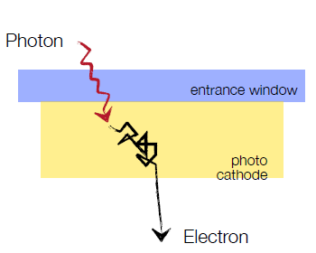
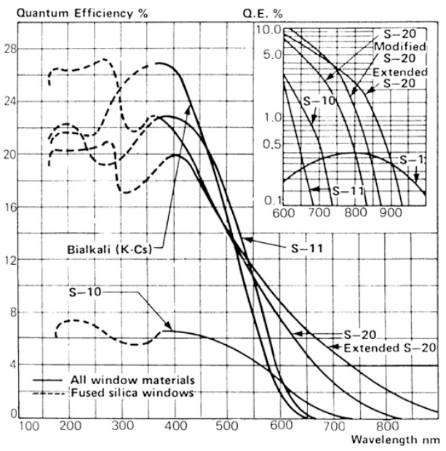
Photomultiplier - Photocathode
γ-conversion via photoeffect …
3-step process:
Electron generation via ionization
Propagation through cathode
Escape of electron into vacuum
Quantum Efficiency Q.E. ≈ 10-30%
vacuum energy
e⁻
E_{A}
Percent of light which passes
conduction band
ψ
Fermi energy
hν
E_{G}
valence band
Wavelength of light

Slide 24
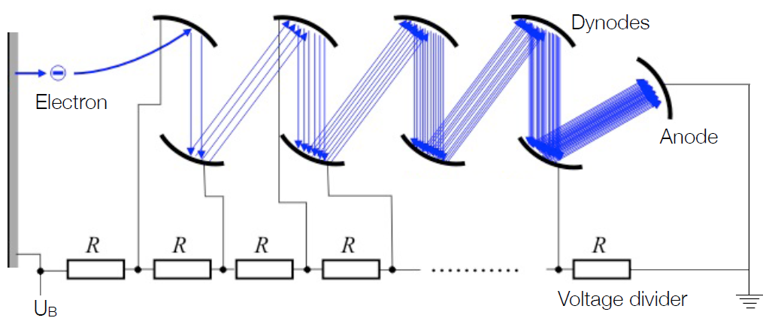
Photomultiplier – Dynode Chain
Multiplication process:
Electrons accelerated towards dynode
Further electrons produced → avalanche
Secondary emission coefficient: δ = #(e⁻ produced) / #(e⁻ incoming) = 2 – 10
#dynodes n = 8 – 15
Gain factor: G = δ^{n} = 10⁶ - 10⁸

Slide 25

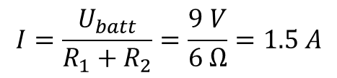
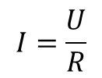
Voltage divider
Current, I
(amperes)
4 Ω = R₁
Battery
U_{batt} = 9 Volts
+
a
-
2 Ω = R ₂
Voltmeter
here
b
Ohm´s law:
or
$$I=\frac{U}{R}$$
$$U=R∙I$$
current in circuit:
$$I=\frac{U_{batt}}{R_{1}+R_{2}}=\frac{9 V}{6 Ω}=1.5 A$$
$$U_{across R_{2}}=I∙R_{2}=1.5 A∙2 Ω=3 V$$
The 9 V battery is “divided” in 3 V and 6 V, now accessible with this circuit.

Slide 26
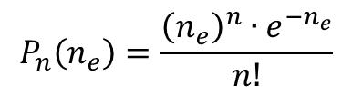

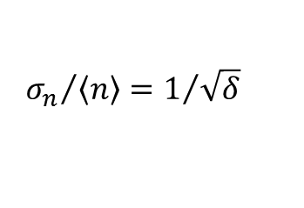
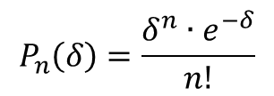
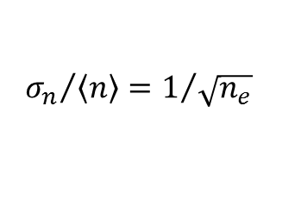
Photomultiplier – Energy Resolution
Energy resolution influenced by:
Linearity of PMT: at high dynode current possible saturation by space charge effects;
I_{A} ≈ nγ for 3 orders of magnitude possible …
Photoelectron statistics: given by Poisson statistics.
Secondary electron fluctuations:
n_{e} is given by dE/dx …
$$P_{n}\left(n_{e}\right)=\frac{{\left(n_{e}\right)}^{n}{∙e}^{−n_{e}}}{n!}$$
$$n_{e}=\frac{dE}{dx}×\frac{photons}{MeV}×η×Q.E.$$
For NaI(Tl) and 10 MeV photon
photons/MeV = 40000
light collection efficiency η = 0.2
quantum efficiency Q.E. = 0.25
n_{e} = 20000
σ_{n}/<n> = 0.7%
$${σ_{n}}/{\left\langle n\right\rangle }=1/{\sqrt{n_{e}}}$$
$$P_{n}\left(δ\right)=\frac{δ^{n}∙e^{−δ}}{n!}$$
$${σ_{n}}/{\left\langle n\right\rangle }=1/{\sqrt{δ}}$$

Slide 27
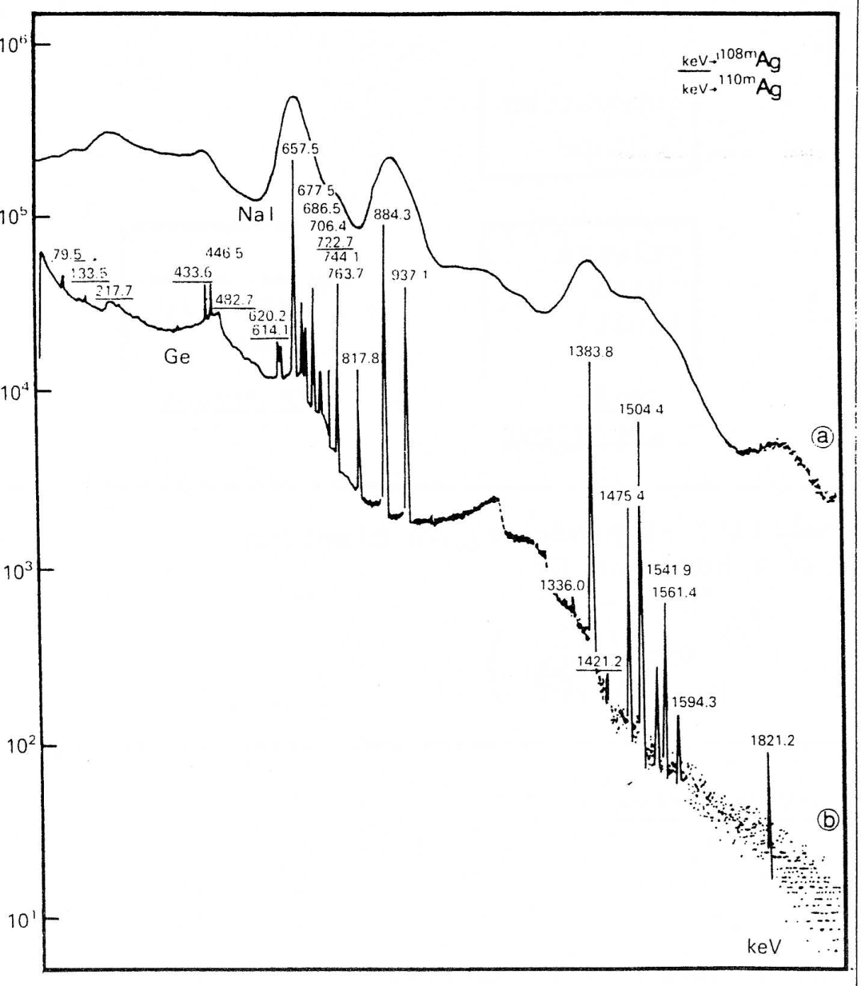
Scintillation detector – energy resolution
NaI
Ge
comparison of NaI and Ge detectors

Slide 28
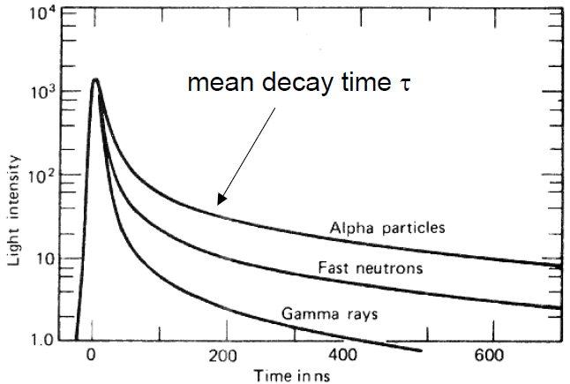
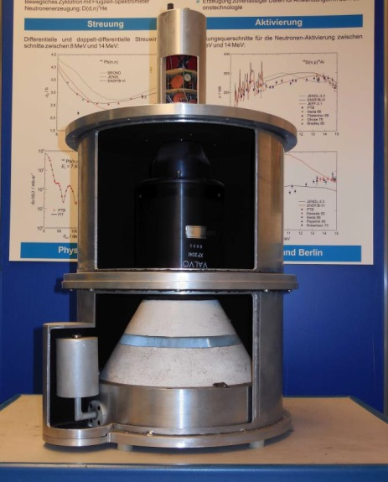
Pulse shape discrimination
Pulse shape discrimination (PSD) in organic scintillators are used in particularly liquid scintillators
(NE213 / BC501A)
PSD is due to long-lived decay of scintillator light caused by high dE/dx particle – neutron scatter interaction events causing proton recoil

