Slide 1
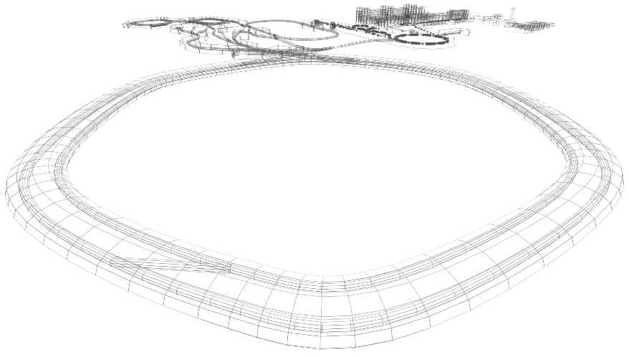
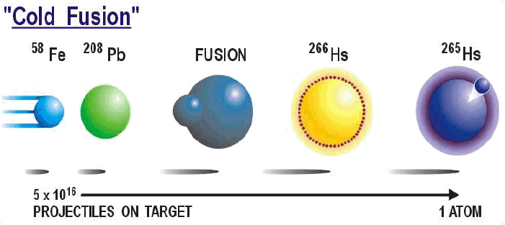

Spectrometer – particle identification
Lecture: Hans-Jürgen Wollersheim
e-mail: h.j.wollersheim@gsi.de

Slide 2
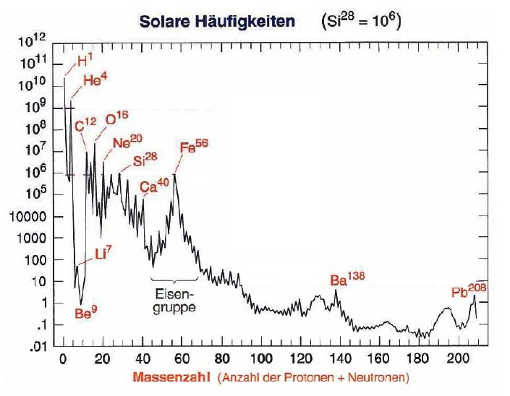
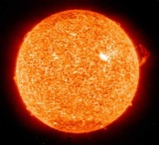
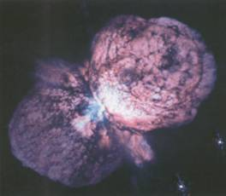
Solar abundances of elements
Solar abundance (Si²⁸ = 10⁶)
Big Bang
fusion reactions
neutron reactions
open questions:
Why is Fe more common
than Au ?
Why do the heavy elements
exist and how are they
produced?
Can we explain the solar
abundances of the elements?
Mass number

Slide 3
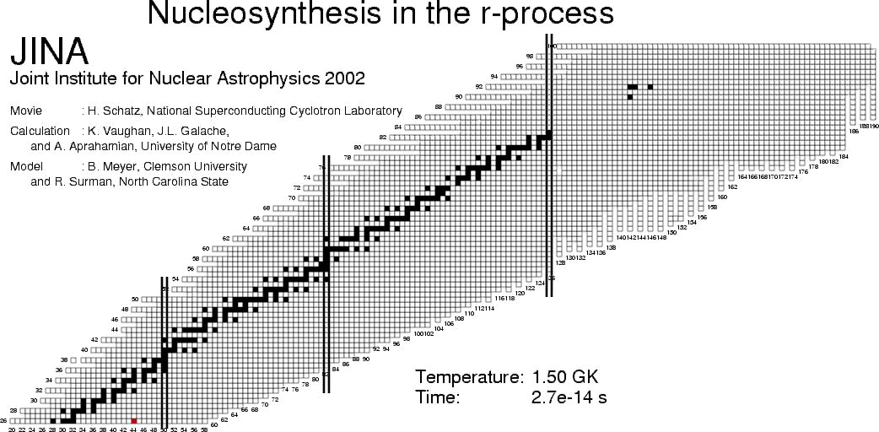
The chart of nuclides

Slide 4
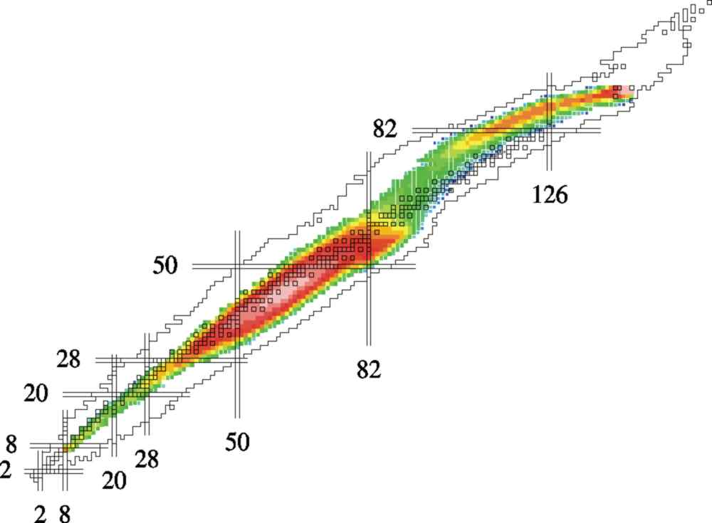
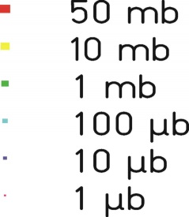
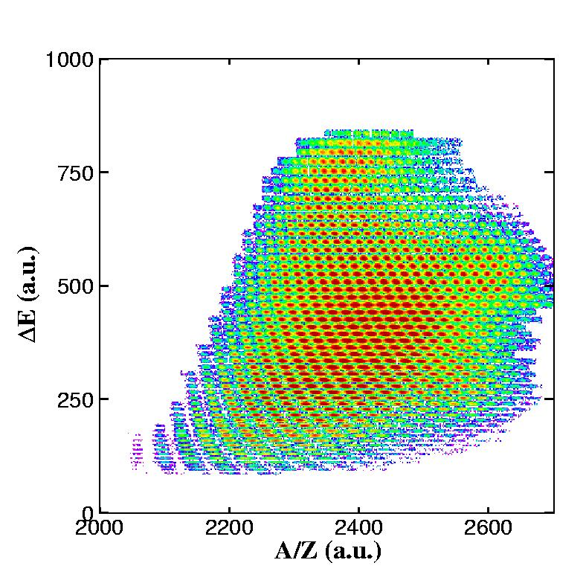
Radioactive Ion Beams at GSI
projectile
projectile fragment
target nucleus
1GeV/u U + H
abrasion
ablation
About 1000 nuclear residues identified
A/Z-resolution ~10⁻³

Slide 5
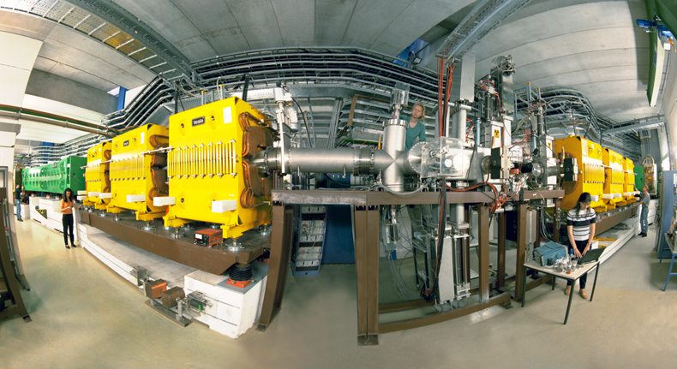
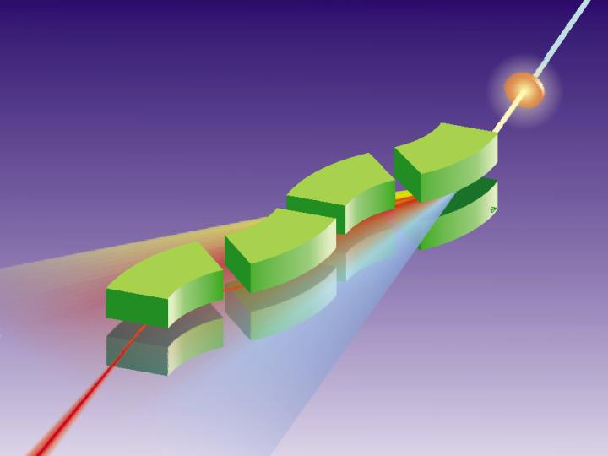
FRagment Separator at GSI
¹³¹Sn
¹³²Sn
in-flight A and Z selection
energy resolution: ~ 1 GeV

Slide 6
Rare Isotope Selection at FRS: $Bρ−∆E−Bρ selection$
primary beam
⁸⁶Kr ~700 AMeV
20m
secondary beam
⁷⁸Ni ~ 100 AMeV
production target
⁹Be
magnetic dipoles
degrader
magnetic dipoles
Βρ ∝ βγ Α/Ζ
ΔΕ ∝ Ζ²f(β)
Βρ ∝ βγ Α/Ζ

Slide 7
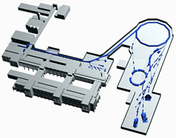
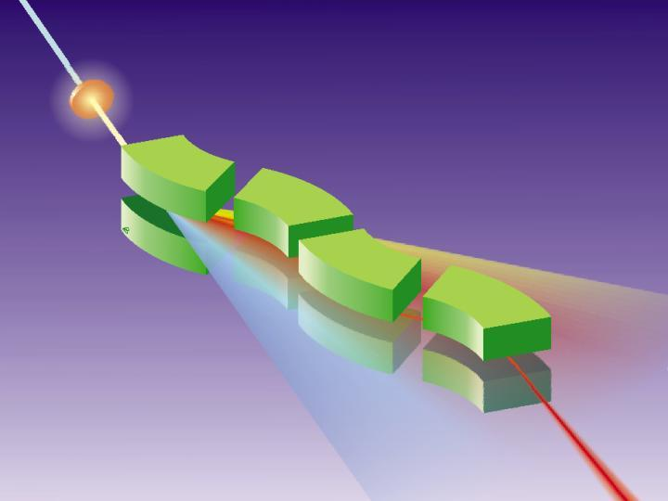
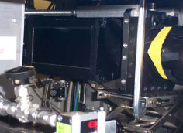
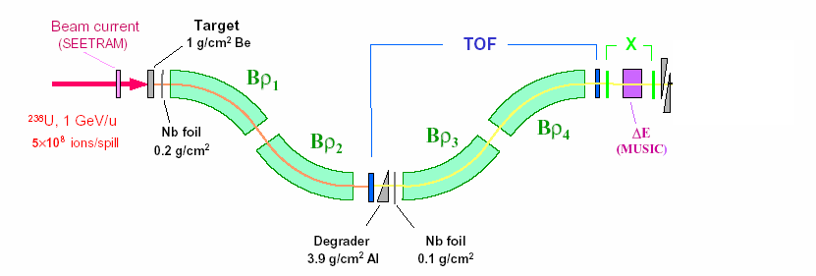
Production, Separation, Identification
projectile
projectile fragment
target nucleus
SIS
abrasion
ablation
UNILAC
FRS
FRagment Separator
⁵⁶Cr, 100MeV/u
⁸⁶Kr, 480MeV/u
Standard FRS detectors
TPC-x,y position @ S2,S4
Plastic scintillator (TOF)
@ S4
MUSIC (ΔE)
@ S4

Slide 8
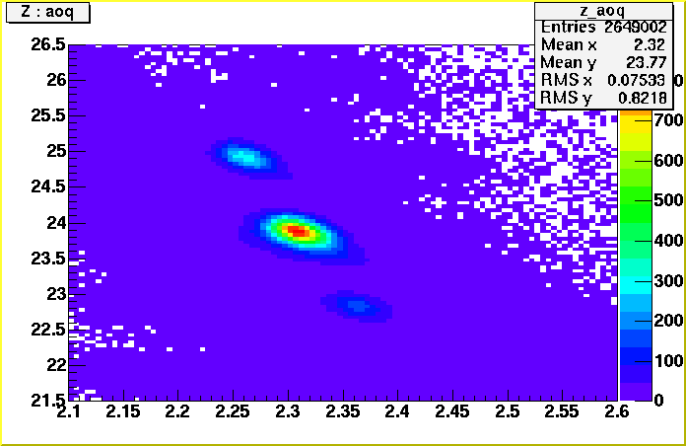
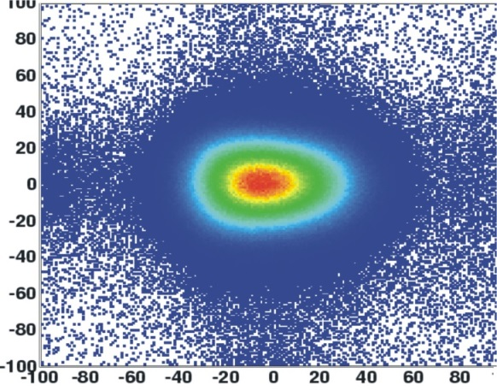
Production, Separation, Identification
multiwire chamber or TPC;
beam position
⁵⁶Cr, 100MeV/u
⁸⁶Kr, 480MeV/u
MUSIC
ionization chamber;
Z
scintillator
scintillator
β
⁵⁶Cr
Y
Z
X
A/Q

Slide 9
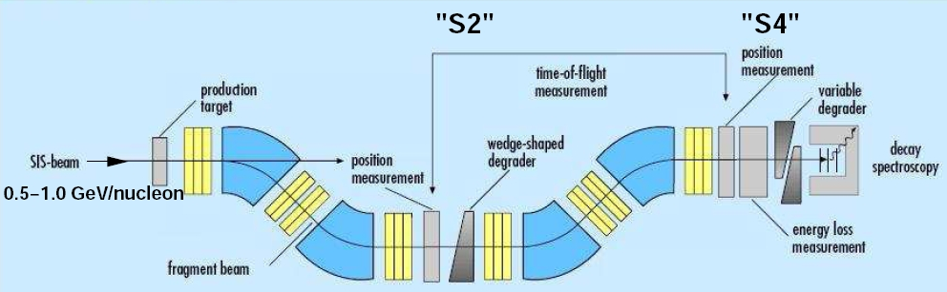
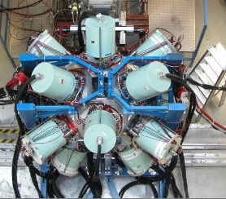
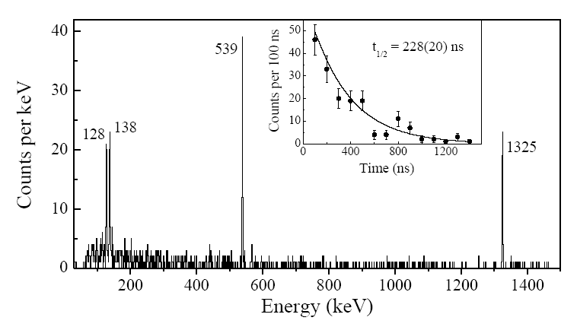
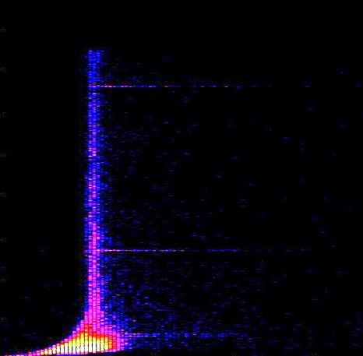
Experimental set-up for γ-ray spectroscopy
σ_{exp}(¹³⁰Cd)~150 pb
variable
degrader
4 g/cm² Be
¹³⁶Xe
750 MeV/u
ΔE
Prompt γ-flash
¹³⁰Cd
0
1.5
1.0
0.5
0.0
Energy ( MeV )
DGF time ( arbt. units )
R. Grzywacz et al., Phys. Rev C55 ,1126 (1997)
Decay time range: 20 ns ... 20 μs

Slide 10
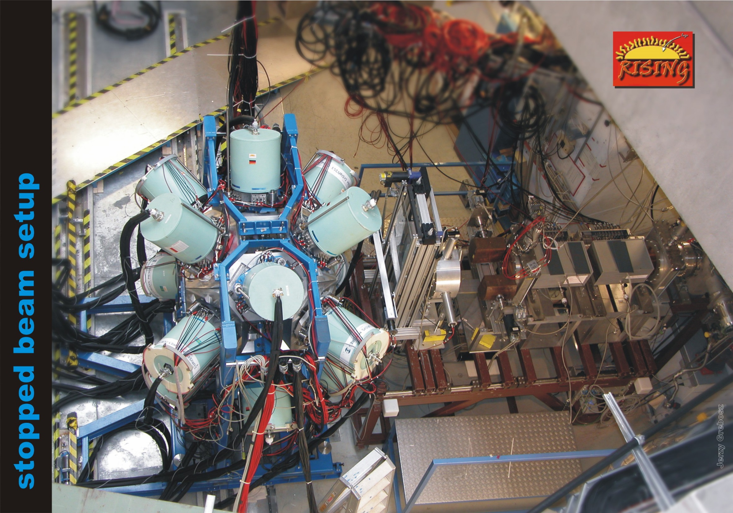
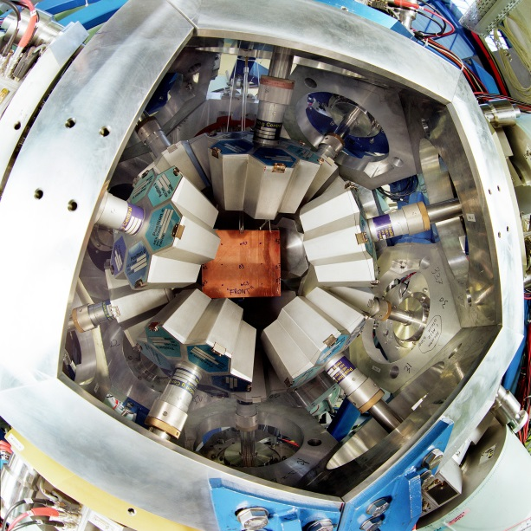
ionization
chambers
(MUSIC41,42)
scintillator
(SC41)
beam
multiwire
chambers
(MW41,MW42)
degrader

Slide 11
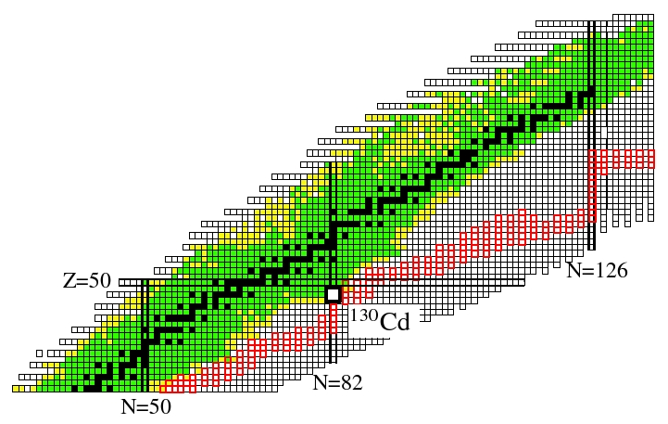
The astrophysical r-process ´path´
r-process abundances
exp.
pronounced shell gap
shell structure quenched
mass number A
r-process waiting point
Assumption of a N=82 shell quenching leads to a considerable
improvement in the global abundance fit in r-process calculations !

Slide 12
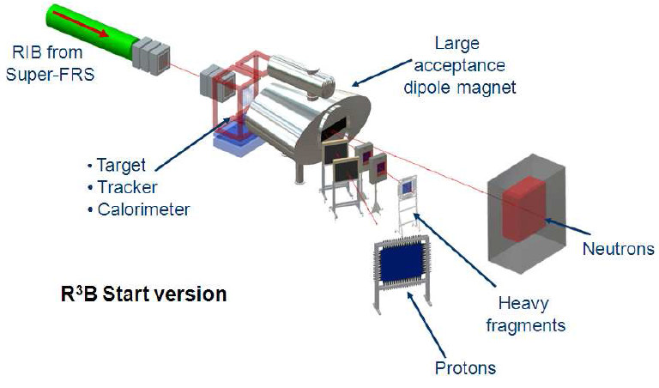
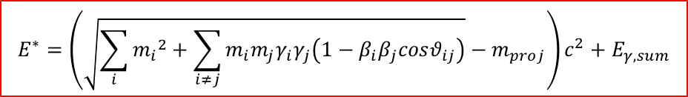
Reaction with Relativistic Radioactive Beams – R³B
Excitation energy E* from kinematically complete measurement of all outgoing particles
$$E^{∗}=\left(\sqrt{\sum_{i}{{m_{i}}^{2}}+\sum_{i≠j}{m_{i}m_{j}γ_{i}γ_{j}\left(1−β_{i}β_{j}cosθ_{ij}\right)}}−m_{proj}\right)c^{2}+E_{γ,sum}$$

Slide 13
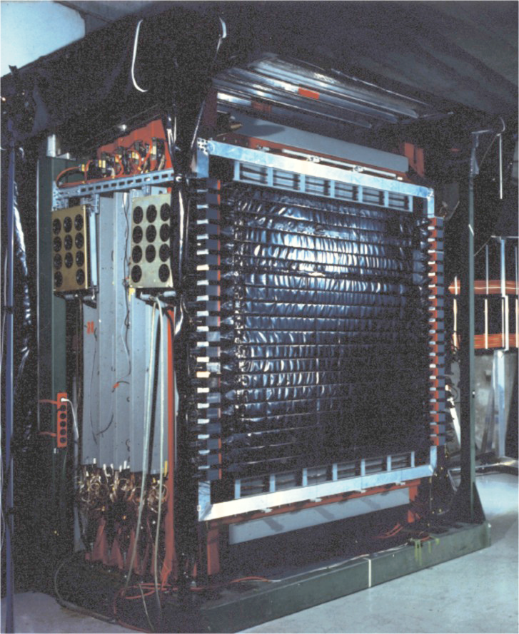
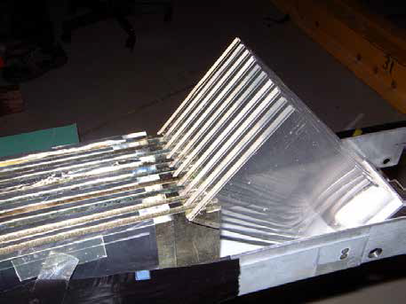
Large Area Neutron Detector
Large Area Neutron Detector (2m x 2m x 1m)
neutron energy T_{n} ≤ 1 GeV
ΔT_{n}/T_{n} = 5.3%
efficiency ~1
passive Fe-converter

Slide 14
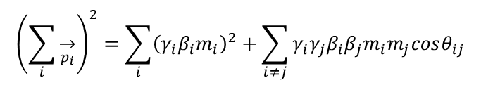
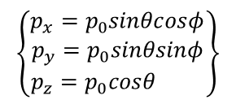
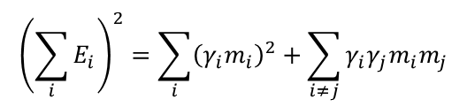

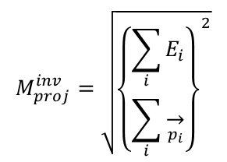


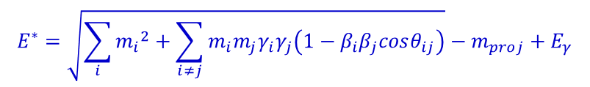

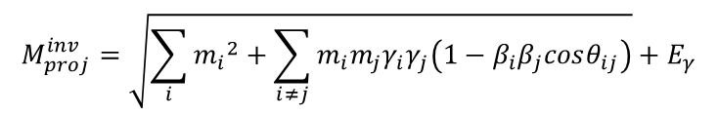
Invariant mass analysis
$$M_{proj}^{inv}=m_{proj}+E^{∗}$$
$$M_{proj}^{inv}=\sqrt{{\left\{\begin{matrix}\sum_{i}{E_{i}} \\ \sum_{i}{\overset{→}{p_{i}}}\end{matrix}\right\}}^{2}}$$
$${\left(\sum_{i}{E_{i}}\right)}^{2}=\sum_{i}{{\left(γ_{i}m_{i}\right)}^{2}}+\sum_{i≠j}{γ_{i}γ_{j}m_{i}m_{j}}$$
$${\left(\sum_{i}{\overset{→}{p_{i}}}\right)}^{2}=\sum_{i}{{\left(γ_{i}β_{i}m_{i}\right)}^{2}}+\sum_{i≠j}{γ_{i}γ_{j}β_{i}β_{j}m_{i}m_{j}cosθ_{ij}}$$
$$M_{proj}^{inv}=\sqrt{\sum_{i}{{m_{i}}^{2}}+\sum_{i≠j}{m_{i}m_{j}γ_{i}γ_{j}\left(1−β_{i}β_{j}cosθ_{ij}\right)}}+E_{γ}$$
Momentum reconstruction: (ħ=c=1)
four-momenta:
$$\hat{P}=\left(E,\vec{p}\right)$$
$$E^{∗}=\sqrt{\sum_{i}{{m_{i}}^{2}}+\sum_{i≠j}{m_{i}m_{j}γ_{i}γ_{j}\left(1−β_{i}β_{j}cosθ_{ij}\right)}}−m_{proj}+E_{γ}$$
$$\left\{\begin{matrix}p_{x}=p_{0}sinθcosφ \\ p_{y}=p_{0}sinθsinφ \\ p_{z}=p_{0}cosθ \end{matrix}\right\}$$
$$p_{0}=m_{0}βγ$$
$$γ^{2}\left(1−β^{2}\right)=1$$

Slide 15
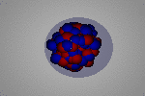
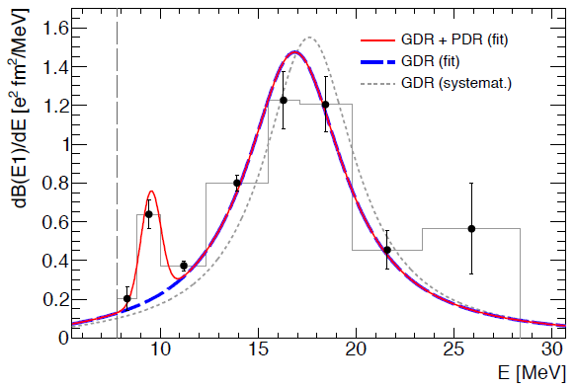
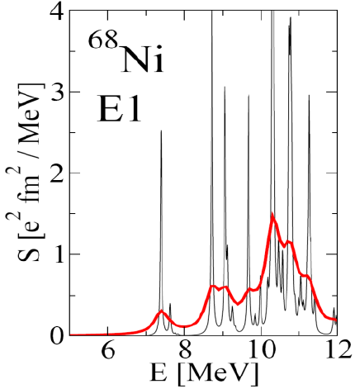
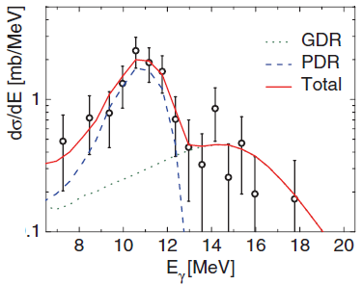
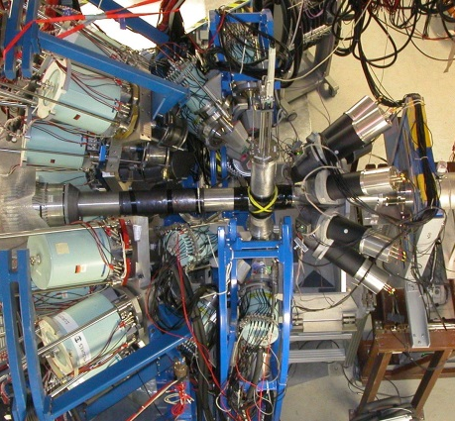
Dipole strength distribution of ⁶⁸Ni
mean field calculation
Pygmy resonance
neutron decay data
direct γ-decay
branching ratio:
Γ₀/Γ = 7(2)%
E.Litvinova et al.; PRC 79, (2009) 054312
γ-ray decay data
O. Wieland et al.; Phys. Rev. Lett 102, 092502 (2009)
D. Rossi et al.; Phys. Rev. Lett 111, 242503 (2013)

Slide 16
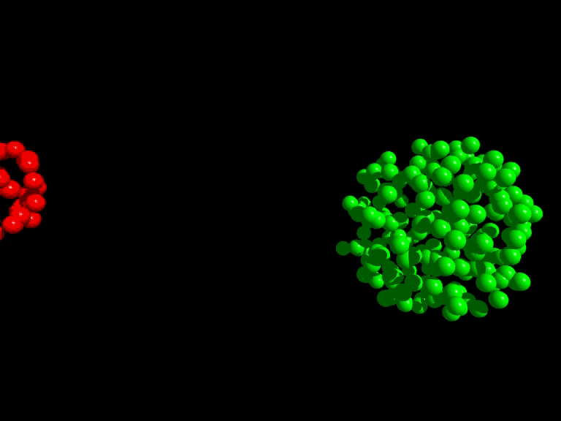
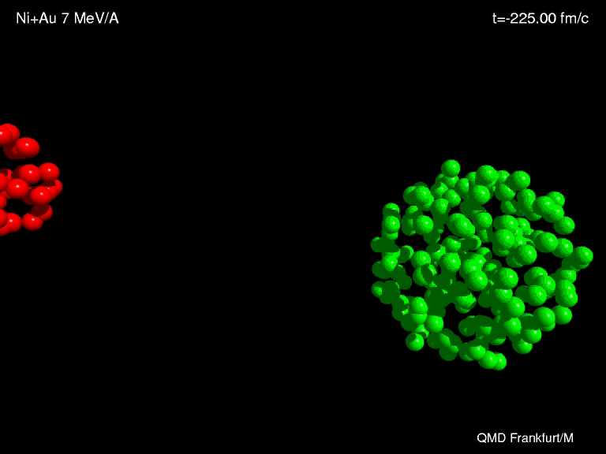
Synthesis of heavy elements
n
⁷⁰Zn
²⁰⁸Pb
²⁷⁷112
Fusion
_1_
10¹²

Slide 17
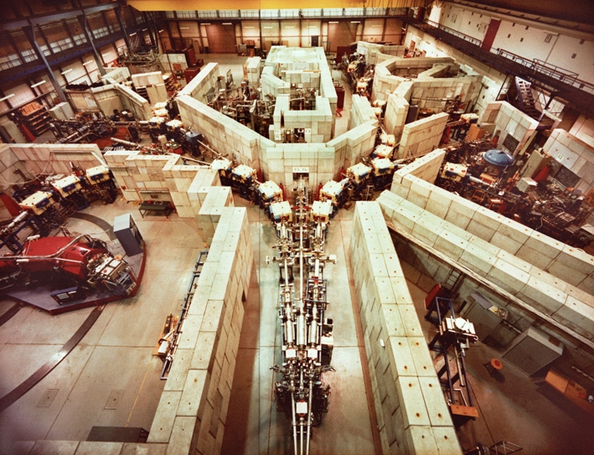
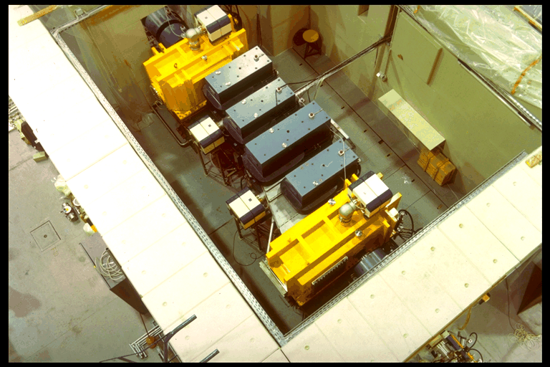
Separator for Heavy Ion Products (SHIP)

Slide 18
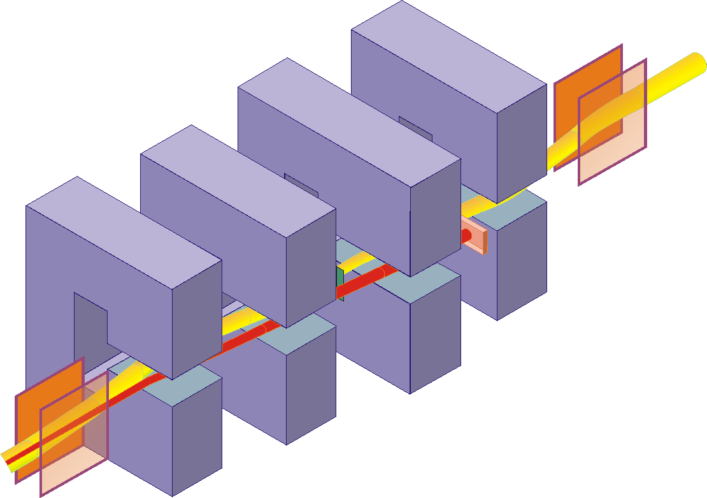
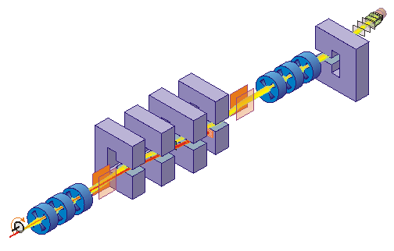




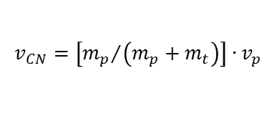
Separator for Heavy Ion Products (SHIP)
Fusion products are slower than scattered or transfer particles
E- and B-field are perpendicular to each other
$$v_{CN}=\left[{m_{p}}/{\left(m_{p}+m_{t}\right)}\right]∙v_{p}$$
$$e.q. v_{p}≈10.3\% → v_{CN}≈2.2\%$$
$$B∙ρ=\frac{m∙v}{e∙q}$$
$$E∙ρ=\frac{m∙v^{2}}{e∙q}$$
$$F_{mag}=F_{el}⇒F_{tot}=0$$
electric deflectors: ±330 kV dipole magnets: 0.7 T max

Slide 19

Separator for Heavy Ion Products (SHIP)
The choice of E and B determines the transmitted velocity
The rejected beam will be stopped on a cooled Cu plate
$$v=\frac{E}{B}$$

Slide 20
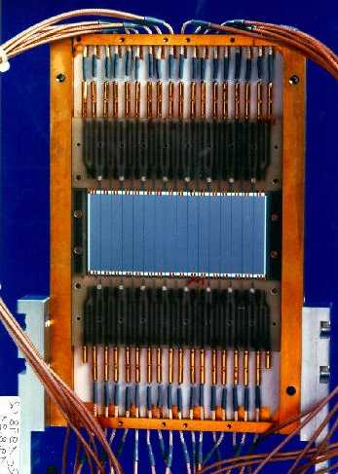
SHIP – stop detector
γ
α (ΔE signal)
SHE will be measured in a pixel
position sensitive Silicon detector determines the position an energy of SHE and α, β, ...
area: 27*87mm², thickness: 0.3mm, 16 strips
energy resolution ΔE=18-20 keV @ E_{α}> 6MeV (cooling 260K)
position resolution Δx=0.3mm (FWHM)
Wait for the emission of an α-particle
(or β-particle)
correlation method: implantation and decay event in the same pixel

Slide 21

Synthesis and identification of heavy elements with SHIP
n
⁷⁰Zn
²⁰⁸Pb
²⁷⁷112
²⁷⁷112
²⁷⁷112
ER
²⁷³110
11.45 MeV
280 μs
12 m
²⁶⁹Hs
11.08 MeV
110 μ s
²⁶⁵Sg
9.23 MeV
19.7 s
²⁶¹Rf
4.60 MeV (escape)
7.4 s
known
kinematical separation (in flight)
using electric deflectors
and dipole magnets
→ velocity filter
8.52 MeV
4.7 s
²⁵⁷No
²⁵³Fm
8.34 MeV
15.0 s
$$v=E/B$$
Date: 09-Feb-1996
Time: 22:37 h

Slide 22


Synthesis and identification of heavy elements with SHIP
n
⁷⁰Zn
²⁰⁸Pb
²⁷⁷112
8 cm
²⁷⁷112
²⁷⁷112
ER
²⁷³110
11.45 MeV
280 μs
12 m
²⁶⁹Hs
11.08 MeV
110 μ s
31 cm
9.23 MeV
19.7 s
²⁶⁵Sg
Identification by
α-α correlations
down to known
isotopes
²⁶¹Rf
4.60 MeV (escape)
7.4 s
known
kinematical separation (in flight)
using electric deflectors
and dipole magnets
→ velocity filter
8.52 MeV
4.7 s
²⁵⁷No
²⁵³Fm
8.34 MeV
15.0 s
$$v=E/B$$
Date: 09-Feb-1996
Time: 22:37 h

Slide 23




Cherenkov Radiation Threshold Detection - The Kaon Spectrometer
Experimental task is to identify the kaons in a large background of protons and pions.
$$p^{+}, π^{+},K^{+} rate: {\sim 10000}/{{1000}/1}$$
Time-of-flight (ToF) measurement

Slide 24

Cherenkov Radiation Threshold Detection - The Kaon Spectrometer
Experimental task is to identify the kaons in a large background of protons and pions.
$$p^{+}, π^{+},K^{+} rate: {\sim 10000}/{{1000}/1}$$
Time-of-flight (ToF) measurement
Cherenkov detectors
  lucite ($n=1.49, β≥0.67$) and water ($n=1.34, β≥0.75$) i.e. above the velocity of protons for $p<0.8 GeV/c$ and $p<1 GeV/c$ respectively
  silica aerogel ($n=1.05, β≥0.95$) allows separation of pions and kaons

Slide 25


Cherenkov Radiation Threshold Detection - The Kaon Spectrometer
Experimental task is to identify the kaons in a large background of protons and pions.
$$p^{+}, π^{+},K^{+} rate: {\sim 10000}/{{1000}/1}$$
Time-of-flight (ToF) measurement
Cherenkov detectors
  lucite ($n=1.49, β≥0.67$) and water ($n=1.34, β≥0.75$) i.e. above the velocity of protons for $p<0.8 GeV/c$ and $p<1 GeV/c$ respectively
  silica aerogel ($n=1.05, β≥0.95$) allows separation of pions and kaons
The signal from the plastic ToF-wall in coincidence with the first Cherenkov row and in anti-coincidence with the second one can thus be used as a kaon trigger for momenta above $500 MeV/c$.
The green spectrum is measured with a trigger on charged particles without ToF.
The red one is measured with the ToF trigger.
The black spectrum is measured with the kaon trigger.

